Slide 1


LSMC Meets GPU Acceleration: High Quality Multi-Row Detailed Placement
Andrew Kahng, Jason Liang, Zhiang Wang
May 26, 2026
Notes:
Hi everyone, thanks for joining. I will be presenting our work today on our work "LSMC Meets GPU Acceleration: High Quality Multi-Row Detailed Placement"

Slide 2


Outline
Introduction
Our Approach
Experimental Results
Conclusion
Notes:
The outline of today's talk is as follows.

Slide 3
Motivation
Millions of standard cells placed in an extremely packed area
Numerous legality constraints at advanced nodes
Increasing use of multi-row height cells, which are fixed in existing GPU placers
Notes:
2 min
I will first be going over the motivation of our paper by going over some challenges faced in detailed placement. To briefly describe detailed placement, it is usually the step in the VLSI physical design flow that happens after global placement and legalization, where cell locations are refined to improve power/performance/area metrics. It is typically invoked to recoverbecause it is invoked many times during the design cycle, it is critical for detailed placement to be fast and effective.
However, detailed placement is a hard problem: modern designs are large and complex, which bring about a number of challenges for designing an effective and efficient detailed placement engine. Some of these challenges include:
[FLASH BULLET 1] A number of standard cells tightly packed in a constrained area, which makes it harder for the placer to find legal cell locations to improve the placement quality. Classical placers such as OpenROAD's detailed placer (DPO) and ABCDPlace tend to get stuck in local minima in high utilization floorplan
[FLASH BULLET 2] Numerous legality constraints (which grow at advanced nodes). Becomes hard to scale when you have more cells to place.
[FLASH BULLET 3] Increasing use of multi-row height cells (such as complex logic gates and MBFFs) which are often fixed in existing GPU placers; this leaves some PPA gain on the table. This also further complicates the placement procedure.

Slide 4
Our Contributions
GPU-DPO: efficient GPU-accelerated detailed placement framework that handles mixed-height cell designs and high utilization designs using LSMC heuristic
First placer featuring GPU-accelerated kernels that handle fully movable
multi-row height cells
Large-step Markov chain (LSMC) booster to escape local minima
Built on OpenROAD, fully open-sourced
HPWL metric: 1.71% improvement vs. DPO, 3.5% improvement vs. ABCDPlace post-detailed placement
Routed WL: 3.1% improvement vs. DPO, 8.5% improvement vs. ABCDPlace post-route optimization
Notes:
1 min
We therefore present GPU-DPO, a GPU accelerated detailed placer with the following key contributions:
[FLASH BULLET 1] To the best of our knowledge, it is the first open sourced GPU-accelerated placer that is able to handle fully reorderable and movable cells (including multi-height cells). It features GPU-accelerated transforms like Independent set matching, global swap, and local reordering
[FLASH BULLET 2] A large-step Markov chain (or LSMC) heuristic that perturbs the local optimum, breaking out of stuck states at high utilization
[FLASH BULLET 3] Fully open sourced
[FLASH BULLET 4] Consistent HPWL and rWL improvements compared to OpenROAD DPO and state of the art GPU-accelerated detailed placer ABCDPlace

Slide 5
Outline
Introduction
Our Approach
Experimental Results
Conclusion
Notes:
Next I will introduce our approach.

Slide 6
Framework
2
LSMC Booster
If new_hpwl
< curr_hpwl
Perform kick move (random swaps) and descend to obtain new placement
Calculate curr_hpwl
Yes
No
Accept new placement, update curr_hpwl
Reject new placement
If LSMC move fails n times in a row
Yes
No
1
No
LEF/DEF files
Calculate curr_hpwlr
Descent (GPU accelerated detailed placement)
Max LSMC iter?
Final DEF
Yes
Descent: GPU-accelerated detailed placement kernels
LSMC Booster: Large-Step Markov Chain iterative search metaheuristic which allows iterative placement optimization to escape local minima
Notes:
1 min
This slide shows the overall framework of our approach. Our two main contributions are highlighted as components 1 and 2.
First, the placer reads in the design, evaluates the current HPWL, and performs a single descent phase. During this phase, we run our GPU-accelerated detailed placement operators to improve HPWL.
If LSMC is enabled, the placer then enters an iterative optimization stage. In each iteration, we perturb the current solution and run the descent phase again to further improve placement quality. A new solution is accepted only if it achieves a lower HPWL than the previous one. We’ll explain this process in more detail on a later slide.
If LSMC repeatedly fails to find a better solution, the algorithm terminates and outputs the final placement.

Slide 7
GPU-Accelerated Detailed Placement Operators
Maximum independent set matching: extract independent cell sets and solve linear assignment problems (LAPs) to minimize HPWL in parallel
Global swap: exchange each cell with its lowest-cost neighbor within an optimal median net bounding box region
Local reordering: find the optimal cell permutation within a sliding window via parallel site-assignment cost evaluation
Notes:
1 min
We now introduce the core algorithms behind our GPU-accelerated detailed placement operators, all of which are designed to directly optimize HPWL. We first introduce a few definitions.
[FLASH BULLET 1] MIS operates by extracting independent sets of cells and solving a parallel linear assignment problem to assign cells to placement sites to minimize HPWL.
[FLASH BULLET 2] Global swap improves placement quality by exchanging a cell with a nearby candidate cell located within its optimal median net bounding-box region, but only when the swap reduces HPWL.
[FLASH BULLET 3] Local reordering optimizes placement by evaluating permutations of cells within a small local window and selecting the arrangement with the lowest HPWL cost.

Slide 8
Operator 1: Independent Set Matching
1
2
Extract a maximal independent set by selecting cells that share no nets with other members. All cells are checked in parallel, with one thread per cell.
Apply k-means clustering to partition set into subsets with cells of the same size to make LAP solving more manageable. Assign thread per cell to compute distance to nearest cluster centroid in parallel.
3
Solve LAP problem by finding maximum weight bipartite matching of cells to sites for each cluster. Edge only exists if move is legal; edge weight is the HPWL improvement for that move.
Notes:
2 min
We now talk about the first operator, maximum independent set matching. In this context, a maximum independent set is a group of cells where no two cells share a net. Since these cells do not directly interact, they can be optimized at the same time without conflict, which makes parallel GPU execution a reasonable strategy.
[FLASH STEP 1] In the first step as shown, the algorithm first selects a maximal set of non-interacting cells, highlighted in red. Each cell is checked in parallel on the GPU using one thread per cell to see whether their neighbors fall within this set, allowing many cells to be evaluated in parallel.
[FLASH STEP 2] Next, we use k-means clustering to group the selected cells into smaller subsets of similar size. This makes the later optimization step easier to solve efficiently. Again, the work is parallelized: each thread computes the distance from its cell to the nearest cluster centroid independently.
[FLASH STEP 3] Then for each cluster, the algorithm solves a linear assignment problem by matching cells to legal placement sites. A connection between a cell and a site exists only if the move is allowed. The weight of each possible move is based on the expected improvement in half-perimeter wirelength. The algorithm then chooses the set of moves that gives the greatest overall wirelength improvement.

Slide 9
Operator 1: Independent Set Matching (cont'd)
site
ε-based Auction Algorithm for Solving Cluster LAP
4
 | s₁ | s₂ | … | s_{l}
c₁ | 8 | 2 | - | -
c₂ | 3 | - | - | -
... | - | - | - | -
c_{k} | - | - | - | -
5
cell
site
site
 | s₁ | s₂ | … | s_{l}
c₁ | 8 | 2 | - | -
c₂ | 3 | - | - | -
... | - | - | - | -
c_{k} | - | - | - | -
 | s₁ | s₂ | … | s_{l}
c₁ | 8 | 2 | - | -
c₂ | 3 | - | - | -
... | - | - | - | -
c_{k} | - | - | - | -
cell
cell
Build a cost matrix of the HPWL delta of placing a cell at a site for each cluster. Each GPU thread computes a delta entry in parallel
Bid: Each thread per cell submits a bid (best value site-2nd best value) + ε (cell's marginal value over next best site)
Assign: Each thread per site picks the highest-bid cell, raises its price, and frees losers to re-bid in next round. Price rise steers losing cells away from contested sites in subsequent rounds.
6
Sequentially commit cell locations to new sites for each cluster
Notes:
1 min
We now introduce the core steps in solving this linear assignment problem, which is a parallel auction-based matching approach.
[FLASH STEP 4] For each cluster, the algorithm constructs a cost matrix that captures the HPWL change for placing a particular cell at a particular site. Each matrix entry represents the estimated wirelength improvement of that move. This step is parallelized with one GPU thread assigned to compute each matrix entry.
[FLASH STEP 5] Within the auction algorithm, each cell thread evaluates the available sites and submits a bid for its preferred site. The bid is based on how much better the best site is compared to the second-best option, plus a small ε term to encourage convergence. Then, each site thread selects the highest bidder, increases the site’s price, and rejects the losing cells. Rejected cells then bid again in the next round. As site prices rise, heavily contested sites become less attractive, naturally spreading cells toward other legal placements. This process repeats until the matching converges.
[FLASH STEP 6] Finally, once the matching is complete, the new cell locations are committed sequentially for each cluster, updating the placement with the optimized assignments.

Slide 10
Operator 2: Global Swap
1
1
4
5
2
3
GPU Block
2
6
GPU thread
7
1
2
3
4
5
6
7
Collect a batch of cells and an optimal region based on the median net bounding box of the cell containing candidates to swap with.
Assign some number of GPU blocks containing GPU threads for each cell; each thread calculates the HPWL cost of swapping a candidate in the optimal region in parallel. Cost is infinite if the swap results in overlap.
3
1
4
3
2
5
6
Use parallel reduction to get the lowest swap cost and commit the swap sequentially.
7
Notes:
1-2 min
Now let’s take a closer look at global swap. The main idea here is pretty straightforward: we want to swap cells in ways that improve HPWL.
[FLASH STEP 1] For each cell, we first build a list of candidate cells that it could potentially swap with. Instead of searching globally across the entire design, we only look within the cell’s median net bounding box. This is a useful heuristic because cells in that region are much more likely to lead to a beneficial HPWL improvement.
[FLASH STEP 2] From there, the GPU evaluates these candidate swaps in parallel. We assign GPU blocks to each cell, and then individual threads within the block each evaluate one possible swap candidate. Every thread computes what the HPWL would look like if the two cells were exchanged. Illegal swaps are assigned an infinite cost to maintain legality during optimization.
[FLASH STEP 3] Once all of the candidate costs have been computed, we leverage a standard GPU primitive called parallel reduction to quickly find the minimum-cost swap for each cell. This operation quickly aggregates many values down to a single minimum-cost result.
Even though the evaluation step is fully parallel, we commit swaps sequentially. The reason for this is to avoid conflicts where multiple cells might try to swap with the same target cell at the same time.

Slide 11
Operator 3: Local Reordering
site
row
window
DP table: dp[cell][site]
1
1
2
4
6
2
site
GPU threads
 | s₁ | s₂ | s₃ | ... | s_{l}
c₁ | 1 | 2 | 4 | ∞ | 12
c₂ | - | - | - | - | -
… | - | - | - | - | -
c_{k} | - | - | - | - | -
cell
3
8
c₁
c₂
c₃
...
c_{k}
5
7
s_{j}
s₁
s₂
s₃
...
s_{l}
Gather all cells in window and extract site locations
Fill out dynamic programming (DP) matrix to find best cost of placing cell i at site j (dummy values used above)
3
site
4
 | s₁ | s₂ | s₃ | ... | s_{l}
c₁ | 1 | 2 | 4 | ∞ | 12
c₂ | - | - | - | - | -
… | - | - | - | - | -
c_{k} | - | - | - | - | -
cell
1
4
2
6
3
8
5
7
Parallel reduction to find the best cost permutation
Backtrack through the DP matrix to commit the cell-to-site assignment
Notes:
2 min
Now let’s look at local reordering. The goal here is to find the optimal ordering, or permutation, of cells within a small placement window in order to minimize HPWL.
[FLASH STEP 1] We start by extracting all of the movable cells within a window, which can span multiple rows, along with all of the legal placement sites available in that region. One important challenge is that multiple windows may be processed in parallel, and cells in different windows can sometimes share nets. If we ignored those dependencies, optimizing windows independently could lead to suboptimal assignments. To avoid this, we only consider cells whose nets are fully contained within the current window, which removes cross-window conflicts during parallel execution.
[FLASH STEP 2] Once the window is constructed, we build a dynamic programming table that incrementally determines the best permutation of cells. Each entry in the table represents the minimum HPWL cost of placing cell i at site j within the window.
To accelerate this process on the GPU, we parallelize the cost computation step. Multiple GPU threads simultaneously evaluate the cost of assigning different cells to different sites, and then parallel reduction is used to efficiently identify the minimum-cost assignment for each stage of the DP construction.
[FLASH STEP 3] As the dynamic programming table fills in, the final row represents all possible ways of placing the last cell, meaning it captures the total cost of complete permutations for the window. We again use parallel reduction to quickly identify the minimum-cost final placement.
[FLASH STEP 4] Finally, we backtrack through the DP table to recover the sequence of predecessor assignments that produced the optimal solution. This gives us the best cell ordering for the window, and we then commit those cell locations back onto the placement grid.

Slide 12
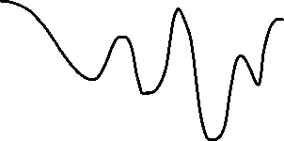
LSMC Booster
Classical greedy techniques (descent) can get trapped in local min solution
Large-step Markov chain (LSMC) applies kick move (n_{k} random swaps) to perturb current local min solution → allows placer to explore more of the solution landscape
Greedy descent only
LSMC (kick + descend)
start
start
“kick move”
HPWL (cost)
local min
local min
Notes:
2 min
Now I'll talk about the LSMC booster.
Classical detailed placement techniques are greedy local search methods that iteratively apply operations such as independent set matching, global swap, and local reordering to reduce HPWL. In high-utilization designs with limited whitespace and multi-row cells, these methods often become trapped in local minima where additional local moves provide little improvement.
To resolve this, the large-Step Markov Chain (LSMC) heuristic escapes these local minima by applying “kick moves” consisting of random legal cell swaps to perturb the current solution. After perturbation, the GPU-accelerated descent flow is rerun to converge to a new local optimum. If the new placement improves HPWL, it is accepted; otherwise, the previous solution is retained. This iterative workflow enables exploration of a much larger solution space and improves placement quality, especially at high utilization.

Slide 13
Outline
Introduction
Our Approach
Experimental Results
Conclusion
Notes:
I'll now talk about some results.

Slide 14
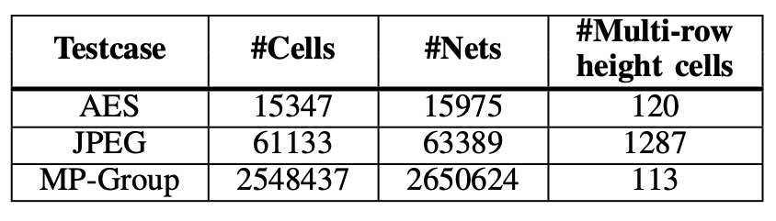
Experiment Setup
Table: Statistics of Benchmarks
Benchmarks
  TILOS macro placement designs on ASAP7 PDK
Metrics
  Half-perimeter wirelength (HPWL)
  Routed wirelength (rWL) from commercial router
  Runtime of detailed placement flow
Platform
  1 NVIDIA A100-SXM4-80GB GPU
  1 AMD Epyc 7742 64-core CPU (128 threads) with 503 GB RAM
Placers compared with
  DPO: default sequential detailed placer in OpenROAD
  ABCDPlace: default GPU-accelerated detailed placer in DREAMPlace
Notes:
45 sec
First I'll describe our setup. We evaluate our approach on 3 testcases taken from the Tilos macro placement benchmarks on ASAP7 technology, as shown. We benchmark on HPWL, routed wirelength after post route optimization, and runtime of the detailed placement flow
Our platform consists of these machines, including one NVIDIA GPU for running CUDA code
We compare our approach against DPO, the detailed placer in OpenROAD, and ABCDPlace, a well-known GPU-accelerated detailed placer

Slide 15
Experiment Workflow
Main Workflow
Utilization Study Workflow
Synthesis + global placement of testcases using Genus/Innovus
Synthesis + global placement of testcases using Genus/Innovus at different utilizations
Detailed placement using each placer to be evaluated (no LSMC for GPU-DPO)
Detailed placement using each placer to be evaluated (LSMC applied for GPU-DPO)
Measure post-detailed placement HPWL using OpenROAD
Measure post-detailed placement HPWL using OpenROAD
Take detailed placement solution thru post-route optimization with Innovus
Take detailed placement solution thru post-route optimization with Innovus
Notes:
30 sec
Our experiments consist of two main workflows, a main workflow and a utilization study workflow (where we evaluate the quality and runtime of our placer in higher utilization designs by seeing how our GPU-accelerated detailed placement kernels work in tandem with our LSMC framework).
Our test cases are synthesized and globally placed using commercial tools before running through the detailed placement flows to be evaluated.
We measure detailed placement HPWL using OpenROAD and then take the designs through post route optimization and evaluate the routed wirelength using commercial tools.

Slide 16
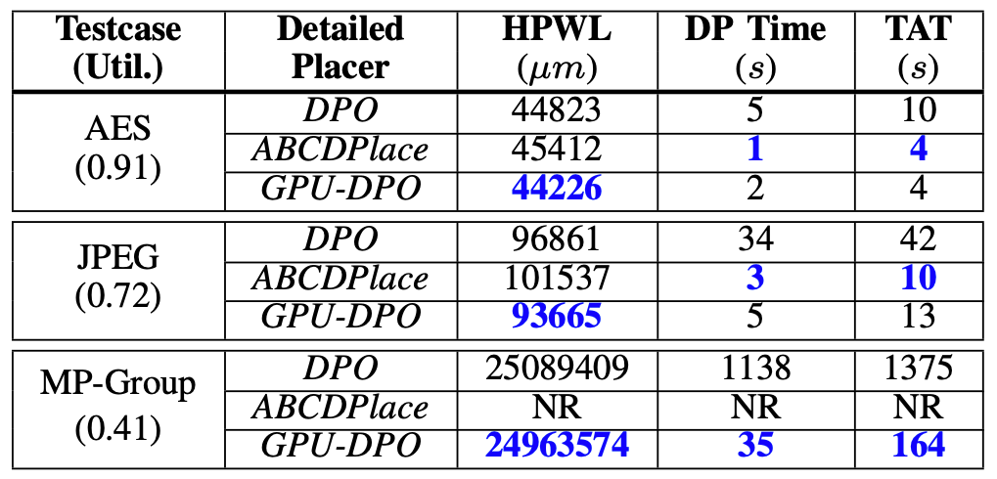
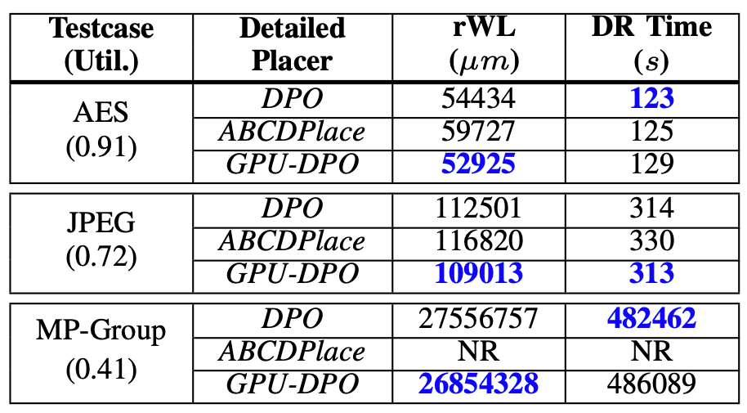
Main Results
Table: QoR Metrics Post-Detailed Placement
After detailed placement:
1.71% better HPWL vs. DPO,
3.5% better HPWL vs. ABCDPlace, all with better or comparable runtime
After post-route optimization: 3.1% better rWL vs. DPO,
8.5% better rWL vs. ABCDPlace
Table: QoR Metrics After Post-Route Opt
Notes:
1 min
Here we present the main results of our experiments. We can see that in most cases, we achieve better HPWL than both DPO and ABCDPlace with similar or better runtime.
After post-route optimization, we also achieve better routed wirelength than DPO and ABCDPlace, where the NR indicates that ABCDPlace crashed due to a segmentation fault during the detailed placement flow.

Slide 17
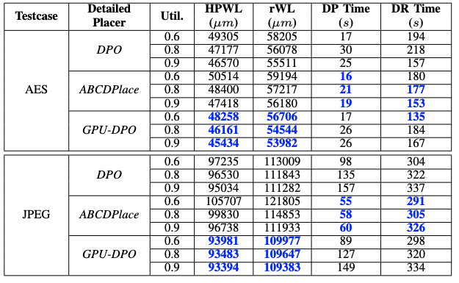
Utilization Study Results
Consistently dominates in HPWL and rWL as we scale up utilization
Achieves 4% lower post-detailed placement HPWL compared to ABCDPlace at 90% utilization
Notes:
1 min
We now present the utilization study workflow results, where we adjust the utilization of our testcases to study the performance of our workflow as utilization increases. As a reminder, we have enabled the LSMC heuristic in these experiments, which incurs some expected runtime due to the additional optimization iterations that are performed after the first descent phase.
As we can see, our GPU-DPO consistently achieves better HPWL and rWL at higher utilizations, with up to 4% lower post detailed placement HPWL compared to ABCDPlace in 90% utilization. So, we can see that these results underscore the effectiveness of our LSMC heuristic in allowing the placer to explore meaningful opportunities for HPWL improvement.

Slide 18
Outline
Introduction
Our Approach
Experimental Results
Conclusion
Notes:
Now I will talk about conclusion and future work.

Slide 19
Conclusion and Future Work
GPU-DPO, an efficient and high-quality mixed-height detailed placer featuring GPU-parallelized operators and LSMC booster
Key elements of GPU-DPO
  Fast GPU-accelerated kernels that handle relocation of multi-row height cells
  LSMC framework to escape local minima in dense, high-utilization designs
Future work
  Support complex objectives beyond just HPWL (pin access-awareness, incremental timing-driven optimization)
  Support complex constraints (drain-to-drain separation, minimum implant area, jog length)
Notes:
30 sec – 1 min
[FLASH BULLET 1] So in conclusion, we have presented GPU-DPO,
[FLASH BULLET 2] a fast and effective GPU accelerated detailed placement workflow with GPU-accelerated transforms and an LSMC booster.
[FLASH BULLET 3] Some future work includes adding additional objectives to our workflow besides having a purely HPWL driven cost function, and supporting additional design constraints during optimization.
Thank you for listening.

