Slide 1
Agentic AI for EDA R&D: Status and Prospects
Amur Ghose, Andrew B. Kahng, Sayak Kundu and Bodhisatta Pramanik
University of California, San Diego
Notes:
Hi, everyone. While our paper will not be formally presented at ISPD, we along with our advisor Professor Kahng would like to invite you to watch this video and learn more from our paper. I'm Amur Ghose, and joining me are Sayak Kundu and Bodhi Pramanik, all from UC San Diego.

Slide 2
Outline
The Need
The New Lever: LLMs → Agents → R&D Acceleration
Semiconductor Design = Optimization
Modern Agentic Stack for Production EDA
Case Studies
Vision: OpenROAD as a Continuous Learning Platform
Notes:
Here is our outline. We start with why IC designers need a new approach, then cover the agentic stack, case studies, and our vision.

Slide 3
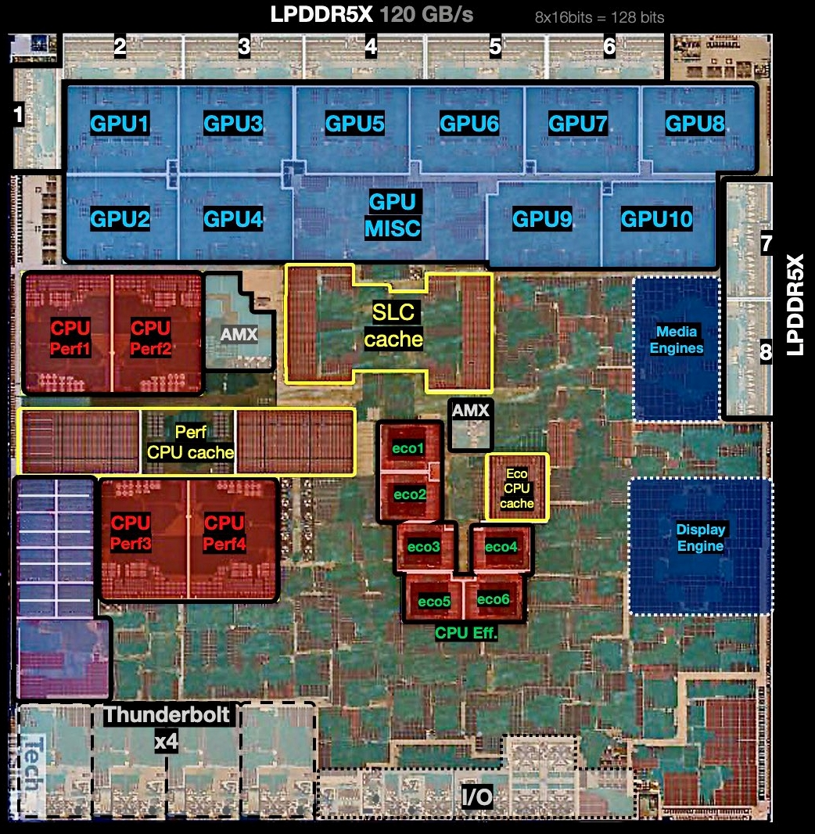
The need
IC designers need better design automation tools
Core challenge of IC design: OPTIMIZATION
Optimization
IC design
AI/ML/LLMs
Automation (EDA)
Notes:
IC design is a large-scale optimization problem where timing, power, area and routability must all be satisfied simultaneously. This challenge is compounded by design-technology co-optimization. At advanced nodes below seven nanometers, DTCO contributes over twenty-five percent of area improvement. At three nanometers, that number exceeds fifty percent. Consolidation in the EDA industry further stymies the innovation needed to address these challenges.

Slide 4
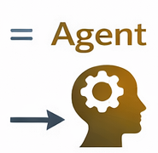
The new lever (LLMs → Agents → R&D Acceleration )
Scaling is design-based
Tools are bespoke
Ecosystem is consolidated
Optimization remains
What changed from 2025?
LLMs can sustain multi-hour / multi-days reasoning
They can read and write code
They can call tools
They can iterate with feedback
→ This enables autonomous R&D loops, not just chat assistance
IC design goals (PPA, schedule, cost)
LLM + tool use
Spec → Edit code → Build → Run → Parse reports → Parse images → Propose next steps
EDA Tools (synthesis, P&R, STA, etc.)
Human R&D loop (read logs + tweak params + edit code + rerun + sanity checks)
From “EDA tools” → to “EDA R&D collaborators”
Notes:
So what has changed? Scaling is design-based, tools are bespoke, and the ecosystem is consolidated. But starting around 2025, LLMs gained critical capabilities: sustained reasoning, code generation, tool calling, and iterative feedback. This enables autonomous R&D loops, not just chat assistance. On the left you see the traditional stack: design goals to LLM, then EDA tools, then human loop. The key shift is from EDA tools to EDA R&D collaborators. An agent follows the cycle of spec, edit, build, run, parse and propose.

Slide 5
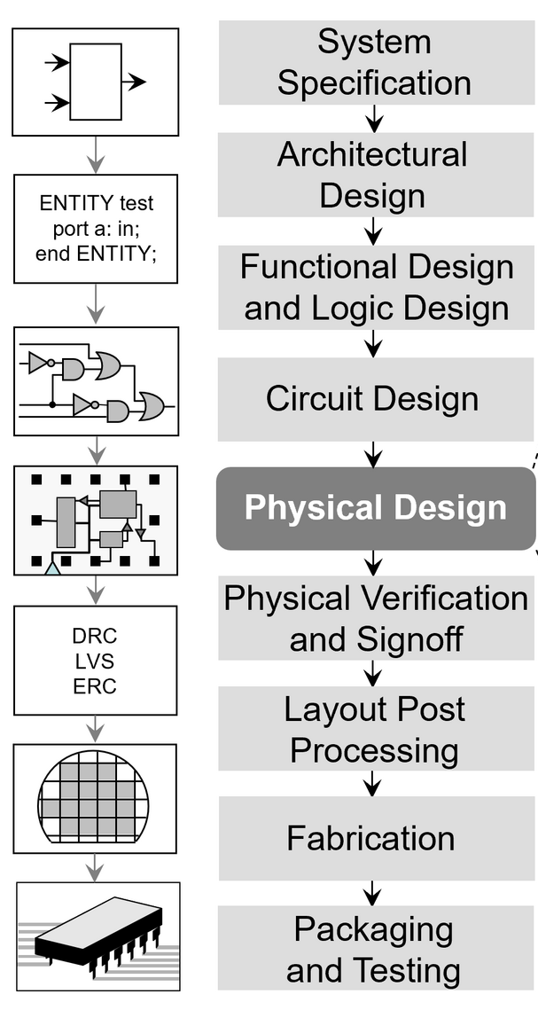
Semiconductor design = Optimization
Exploration
The tall, wide, deep, scaled AI agent-empowered engineer:
“Rank these 20 floorplans by likelihood of producing the lowest power and area when implemented.”
“I need to show a design rule-clean result by 9am on Friday. Generate the best 10 tool runscripts to launch when licenses free up at midnight.”
“Generate a layout for this circuit that satisfies all the manufacturability, reliability and floorplan constraints, while meeting the performance spec.”
“Given this activity trace, tell me which timing-critical transistor will suffer the worst IR drop, at which clock cycle.”
Diagnosis
Execution
This is a multi-step decision making – not “autocomplete”
Yes, LLMs (agents) can do these!
Notes:
Think about what a tall, wide, deep, scaled, agent-empowered engineer could do. Rank twenty floorplans by likelihood of best PPA. Generate the best tool scripts when licenses free up at midnight. Diagnose which transistor suffers worst IR drop at which clock cycle. These span exploration, execution and diagnosis. This is multi-step decision making, not autocomplete. Earlier ML approaches were task-specific subroutines within fixed flows. Agents learn about and across the tools themselves. Now I'll hand it over to Bodhi.

Slide 6
Outline
The Need
Modern Agentic Stack for Production EDA
Agentic EDA: Momentum and Uptake
From Assistance to Autonomy: Two Levels
Case Studies
Vision: OpenROAD as a Continuous Learning Platform
Notes:
Thanks, Amur. I’ll now discuss the modern agentic stack: production architecture, momentum in the field, and two levels of agent autonomy.

Slide 7







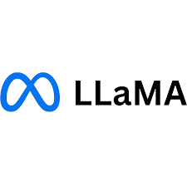

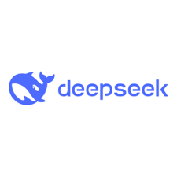
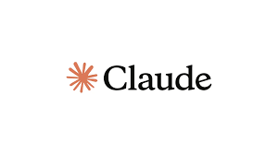

Modern agentic stack for production EDA
Data + feedback Infrastructure Regression history | Logs | Metrics | Benchmark corpora
Production-ready
Human oversight
Objective definition
Trade-off arbitration
Safety approval
4. Evaluation and governance layer Regression | QoR gates | CI/CD | Audit
3. Knowledge and constraint layer Design rules | Cost models | Invariants
Increasing production maturity
Competitive differences in EDA will emerge from the upper layers – not from model capabilities alone
2. Structured tool interface Typed APIs | Determinism | State control
1. Foundational model layer Reasoning | Code | Multimodal
Experimental
Notes:
This is a four-layer architecture. Foundation models like LLaMA, Claude or DeepSeek provide reasoning and code capabilities. Layer two provides structured tool interfaces with typed APIs. Layer three encodes design rules, cost models and invariants. Layer four handles evaluation and governance with regression gates and CI/CD. A data and feedback infrastructure ties everything together. The key insight is that competitive differences in EDA will emerge from these upper layers, not from model capabilities alone.

Slide 8
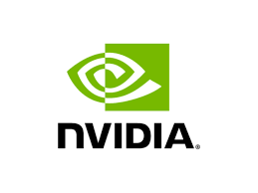





Agentic EDA: momentum and uptake
SATLUTION
EDA CORPUS
AUDOPEDA
ORFS-AGENT
CHIPNEMO
CHATEDA
MCP4EDA
EVO-PLACE
OPENROAD-ASSISTANT
MULTI-AGENTS FOR EDA
2023
2024
2025
2026
2027++
Notes:
And we have seen remarkable acceleration. ChipNeMo from NVIDIA in 2023 used domain-adapted LLMs. In 2024, ChatEDA from CUHK and OpenROAD-Assistant from NYU and ASU emerged. EDA Corpus from ASU provided open prompt-script pairs. By 2025, we see SATLUTION, ORFS-agent, MCP4EDA, and multi-agent systems from CUHK. In 2026, AuDoPEDA and EVO-Place are pushing further.

Slide 9
From assistance to autonomy: two levels
LLMs thrive on data
Premise: Not all LLM agents (in EDA) operate at the same level of abstraction → This matters because abstraction determines the search space, feedback signal, and risk profile
Two recurring patterns
Code-level agents modify algorithmic structure (source code)
Example: “Improve the global swap operator in the dpl module of OpenROAD”
Flow-level agents modify control variables (tool flow, parameters, objectives)
Example: “Minimize ECP with < 2% area/power/PDP degradation by tuning ORFS configurations”
We distinguish two classes: Code-level agents ↔ Flow-level agents
Core question: Is the agent reasoning about heuristics (code and operators), or policies (parameters and sequencing) in a tool flow?
GitHub = structured development history
Preference and temporal data: PRs merged, issues opened/closed, commits
Implicit supervision signals
EDA is data rich
70+ years of heuristics and literature
Massive open-source codebases – e.g., OpenROAD
Rich logs: timing, congestion, DRCs, PPA
Docs can be a great basis
Research testbeds and reproducible experimentation
Notes:
This is a key slide. On the left, we show why EDA is perfect for LLM agents. GitHub provides a structured development history. EDA is data rich with seventy-plus years of heuristics, massive open-source codebases like OpenROAD, and rich logs. These can only benefit LLMs. So.. on the right is our main taxonomy of agents. Code-level agents modify algorithmic structure, for example, improving the global swap operator in dpl. Flow-level agents modify control variables like tool parameters. The core question: is the agent reasoning about heuristics or policies?

Slide 10






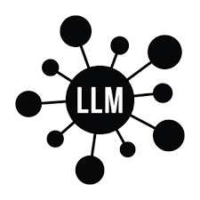

Flow-level agents – architecture
ChipNeMo (NVIDIA) (2023)
Pretraining on expert-engineer scripts
Combines ICL with document retrieval
Generates high-quality Tcl scripts for timing analysis, etc.
ChatEDA (CUHK) (2024)
Translates flow automation to an agentic task
Rich training corpora, CoT prompting, usage of multi-agents
ORAssistant (Precision Innovation) (2024)
Automated script generation and chatbot for OpenROAD ecosystem
ORFS-agent (UCSD) (2025)
LLM-driven iterative optimization agent for parameter tuning in the OpenROAD-flow-scripts repo.
High-level objective “Minimize ECP with < 2% PDP degradation”
LLM planner
Query
Knowledge corpus
Parse documents
Parse codebase / scripts
Parse misc. corpus
Decompose objective
Generate flow script
Propose parameters
Response
Query
Feedback
LLM
Response
Execution layer
Invoke tools
Monitor logs
Capture metrics
Invoke
EDA tools
PPA
Treat EDA tools as black-boxes; LLM decomposes objective into subtasks; each subtask is translated to scripts
Notes:
Flow-level agents treat EDA tools as black boxes. The architecture starts with a high-level objective, for example, "minimize ECP with less than two percent PDP degradation." The LLM planner parses documents and codebases, decomposes the objective, generates flow scripts, and proposes parameters. It queries a knowledge corpus and the LLM. The execution layer invokes tools, monitors logs, and captures PPA metrics. Human feedback closes the loop. Four example realizations of flow-level agents are on the right. ChipNeMo is pretrained on expert scripts with in-context learning. Then, ChatEDA uses chain-of-thought prompting. ORAssistant generates scripts for the OpenROAD flow. And, ORFS-agent is an LLM-driven iterative optimization agent that tunes flow parameters.

Slide 11
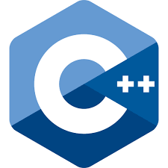
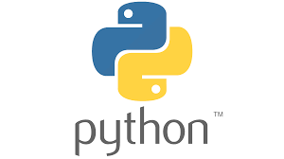

Code-level agents – architecture
High-level objective “Reduce HPWL by improving global swap operator in OpenROAD’s dpl”
EvoPlace (CUHK) (2025)
Python code edits inside DREAMPlace framework
SATLUTION (NVIDIA) (2025)
C++ code diffs targeting Boolean Satisfiability problems
Directly evolves solver repositories
AuDoPEDA (UCSD) (2026)
Proposes research directions + expands them into executable code diffs
Code parser
Response
Parse source code
Parse relevant modules
Parse misc. corpus
Understand dependencies
Query
Feedback
LLM
LLM reasoner
Response
Query
Propose code edits
Introduce new cost terms
Tune hyperparameters
Refactor control logic
QoR metrics
Feedback
Compiler + regression tests
Build tool
Run benchmark suite
Sanity checks
Linters
EDA tools
Modify internal heuristics and algorithms; LLM reads, proposes and edits code diffs
Notes:
Code-level agents go one level deeper than flow-level agents. They modify internal heuristics and algorithms directly – and generate code diffs. The given objective can be something like "reduce HPWL by improving the global swap operator in OpenROAD's dpl." The architecture of a code-level agent shown here has three layers. At the top, the code parser reads source code of a target repository, parses relevant modules, and understands module dependencies. In the middle, the LLM reasoner can propose code edits, introduce new cost functions, tune hyperparameters, and refactor control logic. At the bottom, the compiler and regression test layer builds the modified tool, runs benchmarks, performs sanity checks, and runs linters. EDA tools produce QoR metrics that feed back to the LLM, closing the loop. As examples, EvoPlace makes Python edits inside DREAMPlace. SATLUTION generates C++ diffs for SAT problems and directly evolves a target solver repository. And AuDoPEDA is built on OpenROAD – it proposes research directions and expands them into executable code diffs.

Slide 12
Outline
The Need
Modern Agentic Stack for Production EDA
Case Studies
Evolving OpenROAD’s DPL
ORFS-Agent
Improving Logic Synthesis: Yosys + ABC
Improving Functional Simulation: Verilator
Improving a SOTA Hypergraph Partitioner: TritonPart
Vision: OpenROAD as a Continuous Learning Platform
Notes:
Now let us look at some case studies.

Slide 13


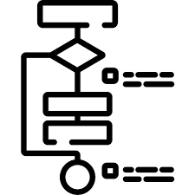

Evolving OpenROAD’s DPL
Placement-EVO leverages LLMs + multi-agents
Automatically discovers + improves placement algorithms in the OpenROAD tool
Natural language request → automatic target discovery → code evolution of target → improved algorithms
Rich corpus + agents + end-to-end automation
Fitness score
I want to improve OpenROAD’s dpl
$$w_{1} ×\frac{HPWL_{baseline }}{HPWL_{candidate}}−w_{2} ×\max\left(0,\frac{Runtime_{candidate}}{Runtime_{baseline}}\right)$$
Higher fitness score is better w1, w2 are hyperparameters
Evolution of dpl’s codebase
Evolved dpl codebase
Notes:
Placement-EVO leverages LLMs and multi-agents to automatically discover and improve placement algorithms in OpenROAD. Given a request like "improve OpenROAD's dpl," the system identifies the target, evolves the codebase, and produces an improved detailed placer. The fitness score balances HPWL improvement against runtime penalty. A key result: the agent autonomously implemented a particle swarm optimization reordering heuristic, generating over six hundred lines of new C++ code. This is rich corpus plus agents plus end-to-end automation.

Slide 14
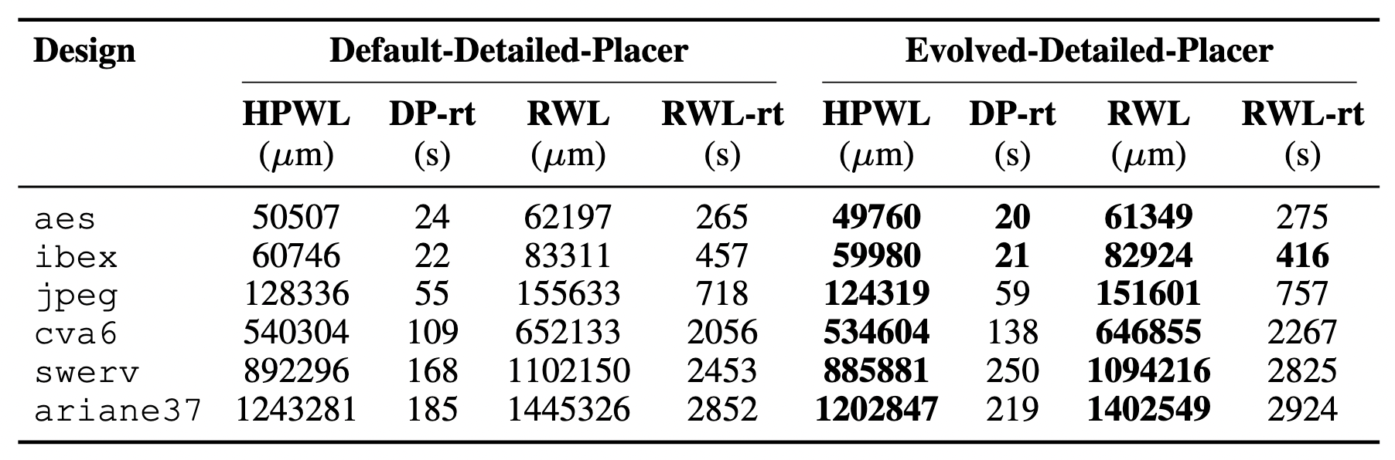
Results with dpl’s improvePlacement
Baseline: default OpenROAD’s dpl
Designs: aes, jpeg, ibex, swerv, cva6, ariane37 w. ASAP7
User query: “Improve OpenROAD’s improvePlacement for better HPWL”
Up to 3% reduction in HPWL and RWL compared to baseline
Notes:
The baseline is OpenROAD's default detailed placer. We test on six ASAP7 designs: aes, jpeg, ibex, swerv, cva6 and ariane37. The query is simply "improve improvePlacement for better HPWL." The evolved placer achieves up to three percent reduction in both HPWL and routed wirelength. As Table 2 in our paper details, both move sequence evolution and reordering algorithm evolution contribute to these gains. Next, Sayak will take you through the remaining case studies.

Slide 15
What is ORFS-agent?
Design flow tuning is high-dimensional
1000s (actually 10000s) of knobs in RTL-to-GDS
Plain BO struggles – weak domain priors; poor high-D scaling
Key idea: ORFS-agent ← LLM-driven flow autotuner
Read logs; reason in context, interpret bottlenecks, propose structured parameter updates, iterate with tool feedback
Architecture pattern: INSPECT → MODEL → ACT → REFINE
Key properties:
Support natural language objectives
Multi-objective aware
Parallelizable trials
Model agnostic – extensible to commercial flows
Notes:
Thanks, Bodhi. Design flow tuning is high-dimensional. RTL-to-GDS flows expose tens of thousands of tunable parameters. Traditional Bayesian optimization struggles with weak domain priors and poor high-dimensional scaling. ORFS-agent is an LLM-driven flow autotuner. It reads logs, interprets bottlenecks, and proposes structured parameter updates. The architecture follows an INSPECT, MODEL, ACT, REFINE pattern. Key properties are natural language objectives, multi-objective awareness, parallelizable trials, and model-agnostic design.

Slide 16
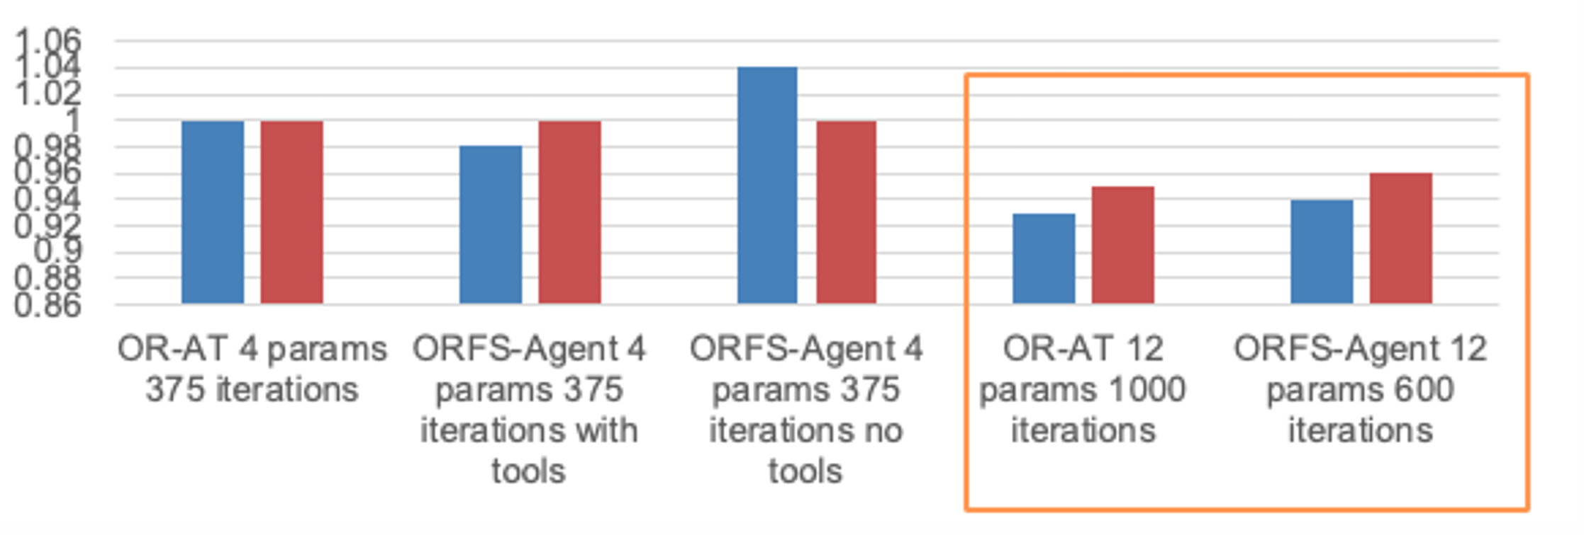
ORFS-Agent: Key outcomes
Baseline: OR-AT (4 vars, 375 iters) ≡ 1.0
ORFS-agent can achieve ≈ 40% fewer iters iso-QOR ≈ 13% gains in WL or ECP (single-objective) (details in the paper)
Comparison of ORFS-agent and OR-AutoTuner w.r.t. wirelength and ECP
Normalization: Results with OR-AT4 params and 375 iterations set as 1.0
Notes:
The chart compares ORFS-agent against OR-AutoTuner for wirelength and effective clock period. Using OR-AutoTuner with four parameters and 375 iterations as baseline, ORFS-agent achieves roughly forty percent fewer iterations at the same quality. For single-objective optimization, we see approximately thirteen percent gains in wirelength or ECP. In the high-dimensional setting with twelve parameters, ORFS-agent at 600 iterations matches OR-AutoTuner at 1000. Experiments use SKY130 and ASAP7.

Slide 17
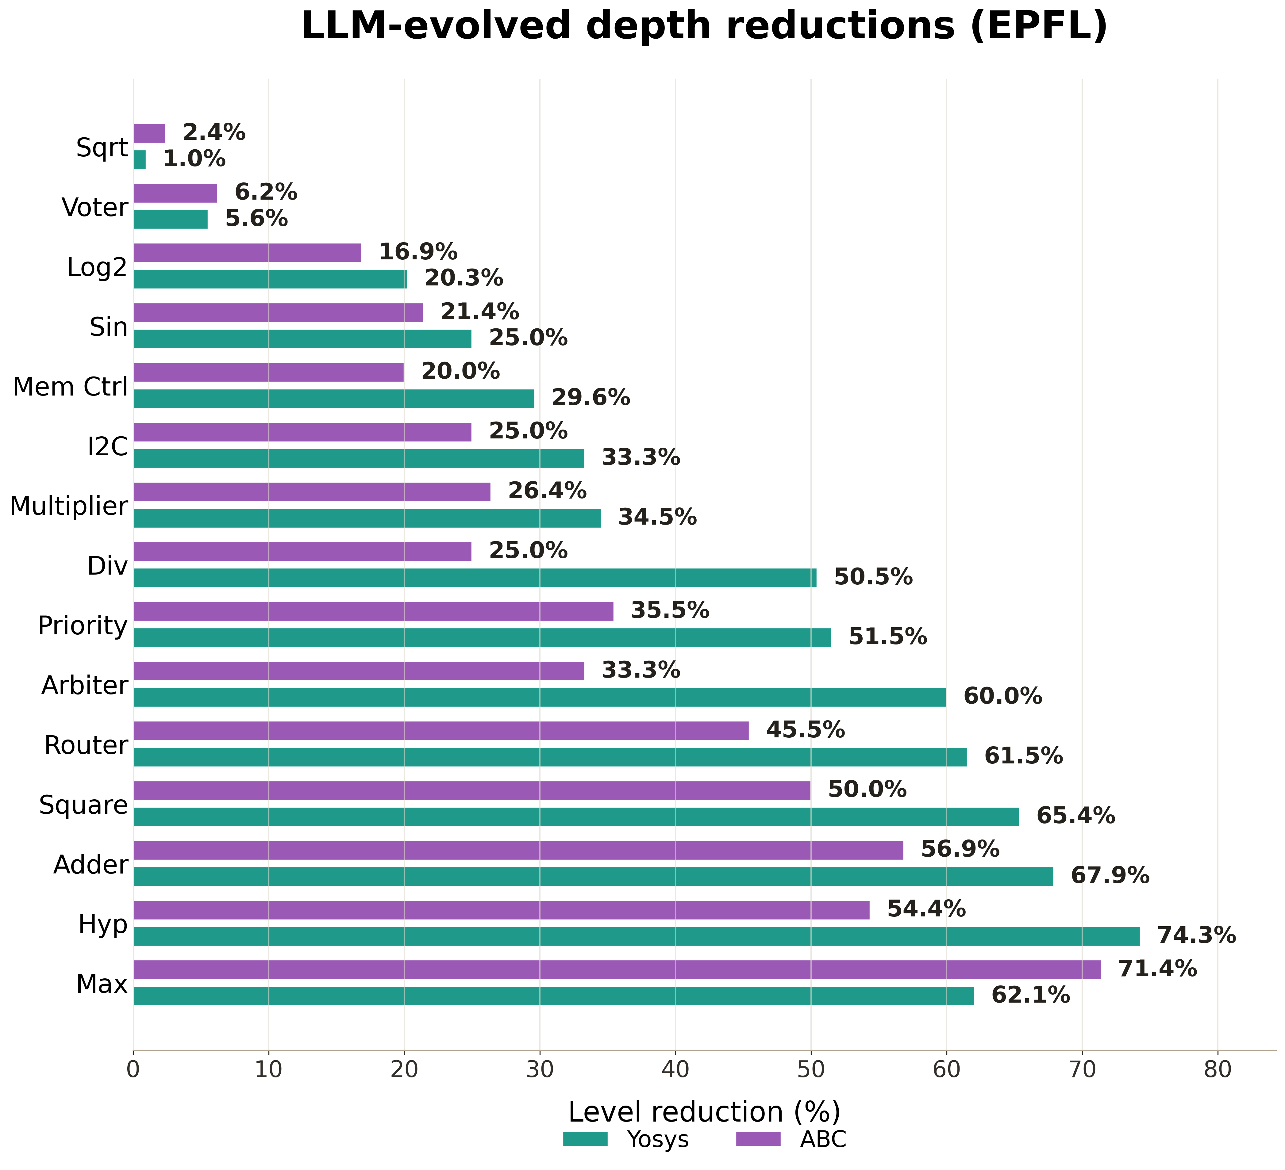
Improving logic synthesis: Yosys + ABC
Goal: For FPGA benchmarks, reduce LUT metrics (depth, area/count) without significantly changing LUT-level histograms
Measurement: EPFL, Koios, LogikBench benchmark suites
Setup: Only change ABC
Measure changes on ABC
Measure changes with Yosys that calls ABC as a backend
Notes:
We applied code-level agents to logic synthesis. The goal is reducing LUT depth and area for FPGA benchmarks without significantly changing LUT-level histograms. We measure on EPFL, Koios and LogikBench suites. The setup only changes ABC, measured both directly and through Yosys as a frontend. The chart shows LLM-evolved depth reductions on EPFL benchmarks, ranging from one percent for Sqrt up to over seventy percent for Max and Hypotenus.

Slide 18
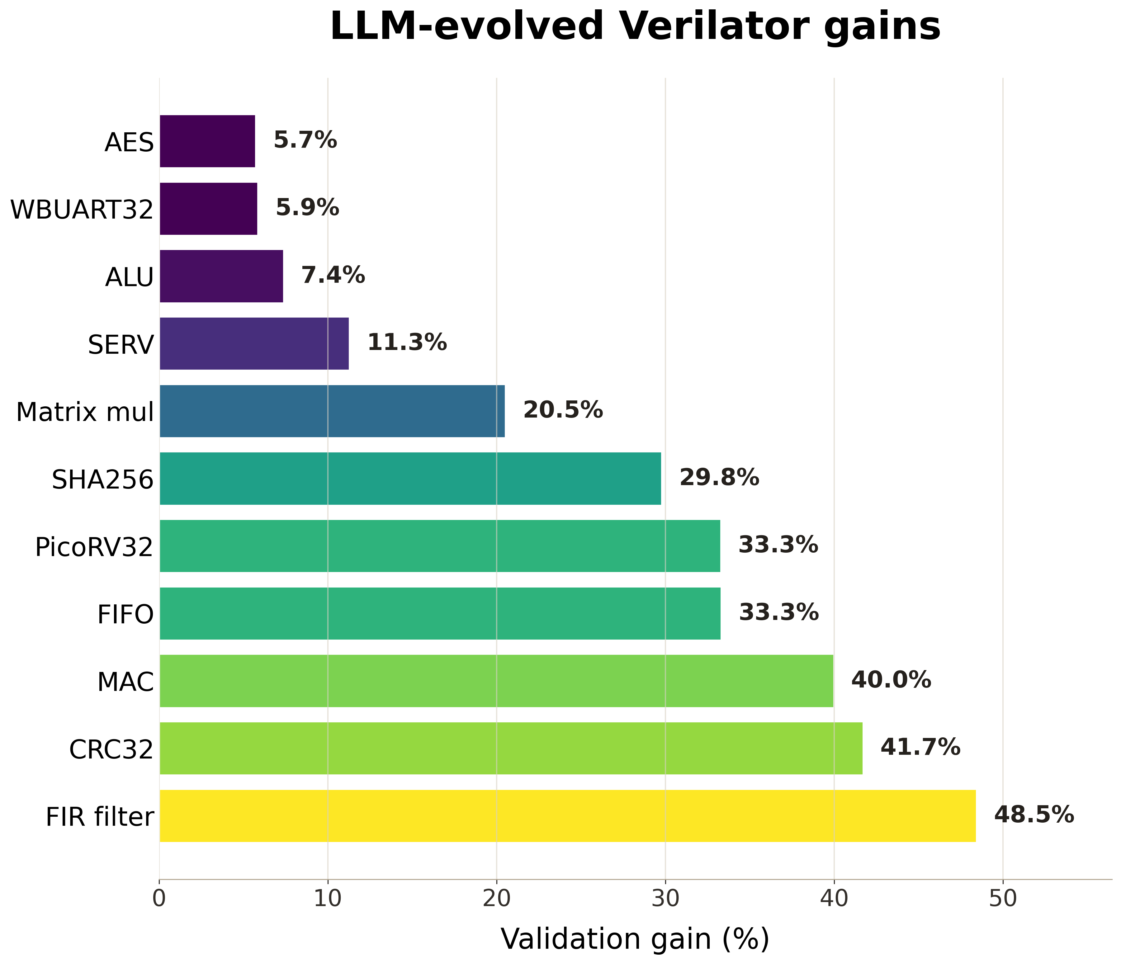
Improving functional simulation: Verilator
Simulation converts RTL to CPP, then to executable
Optimization: find best sets of RTL-level and GCC-level flags
RTL-level: larger search space and gains
Given <flag set, runtime> tuples, the LLM agent finds a better flag set
For an existing RTL or an entirely new RTL
No full fine-tuning (use GEPA)
Notes:
Verilator converts RTL to C++ then compiles to an executable. We frame flag selection as a performance optimization problem. RTL-level flags represent a much larger design space compared to GCC flags alone. The LLM agent proposes improved flag combinations using guided evolutionary prompting, without fine-tuning. It works for both existing and new RTL designs. Speedups range from six percent for AES up to forty-eight percent for FIR filter.

Slide 19
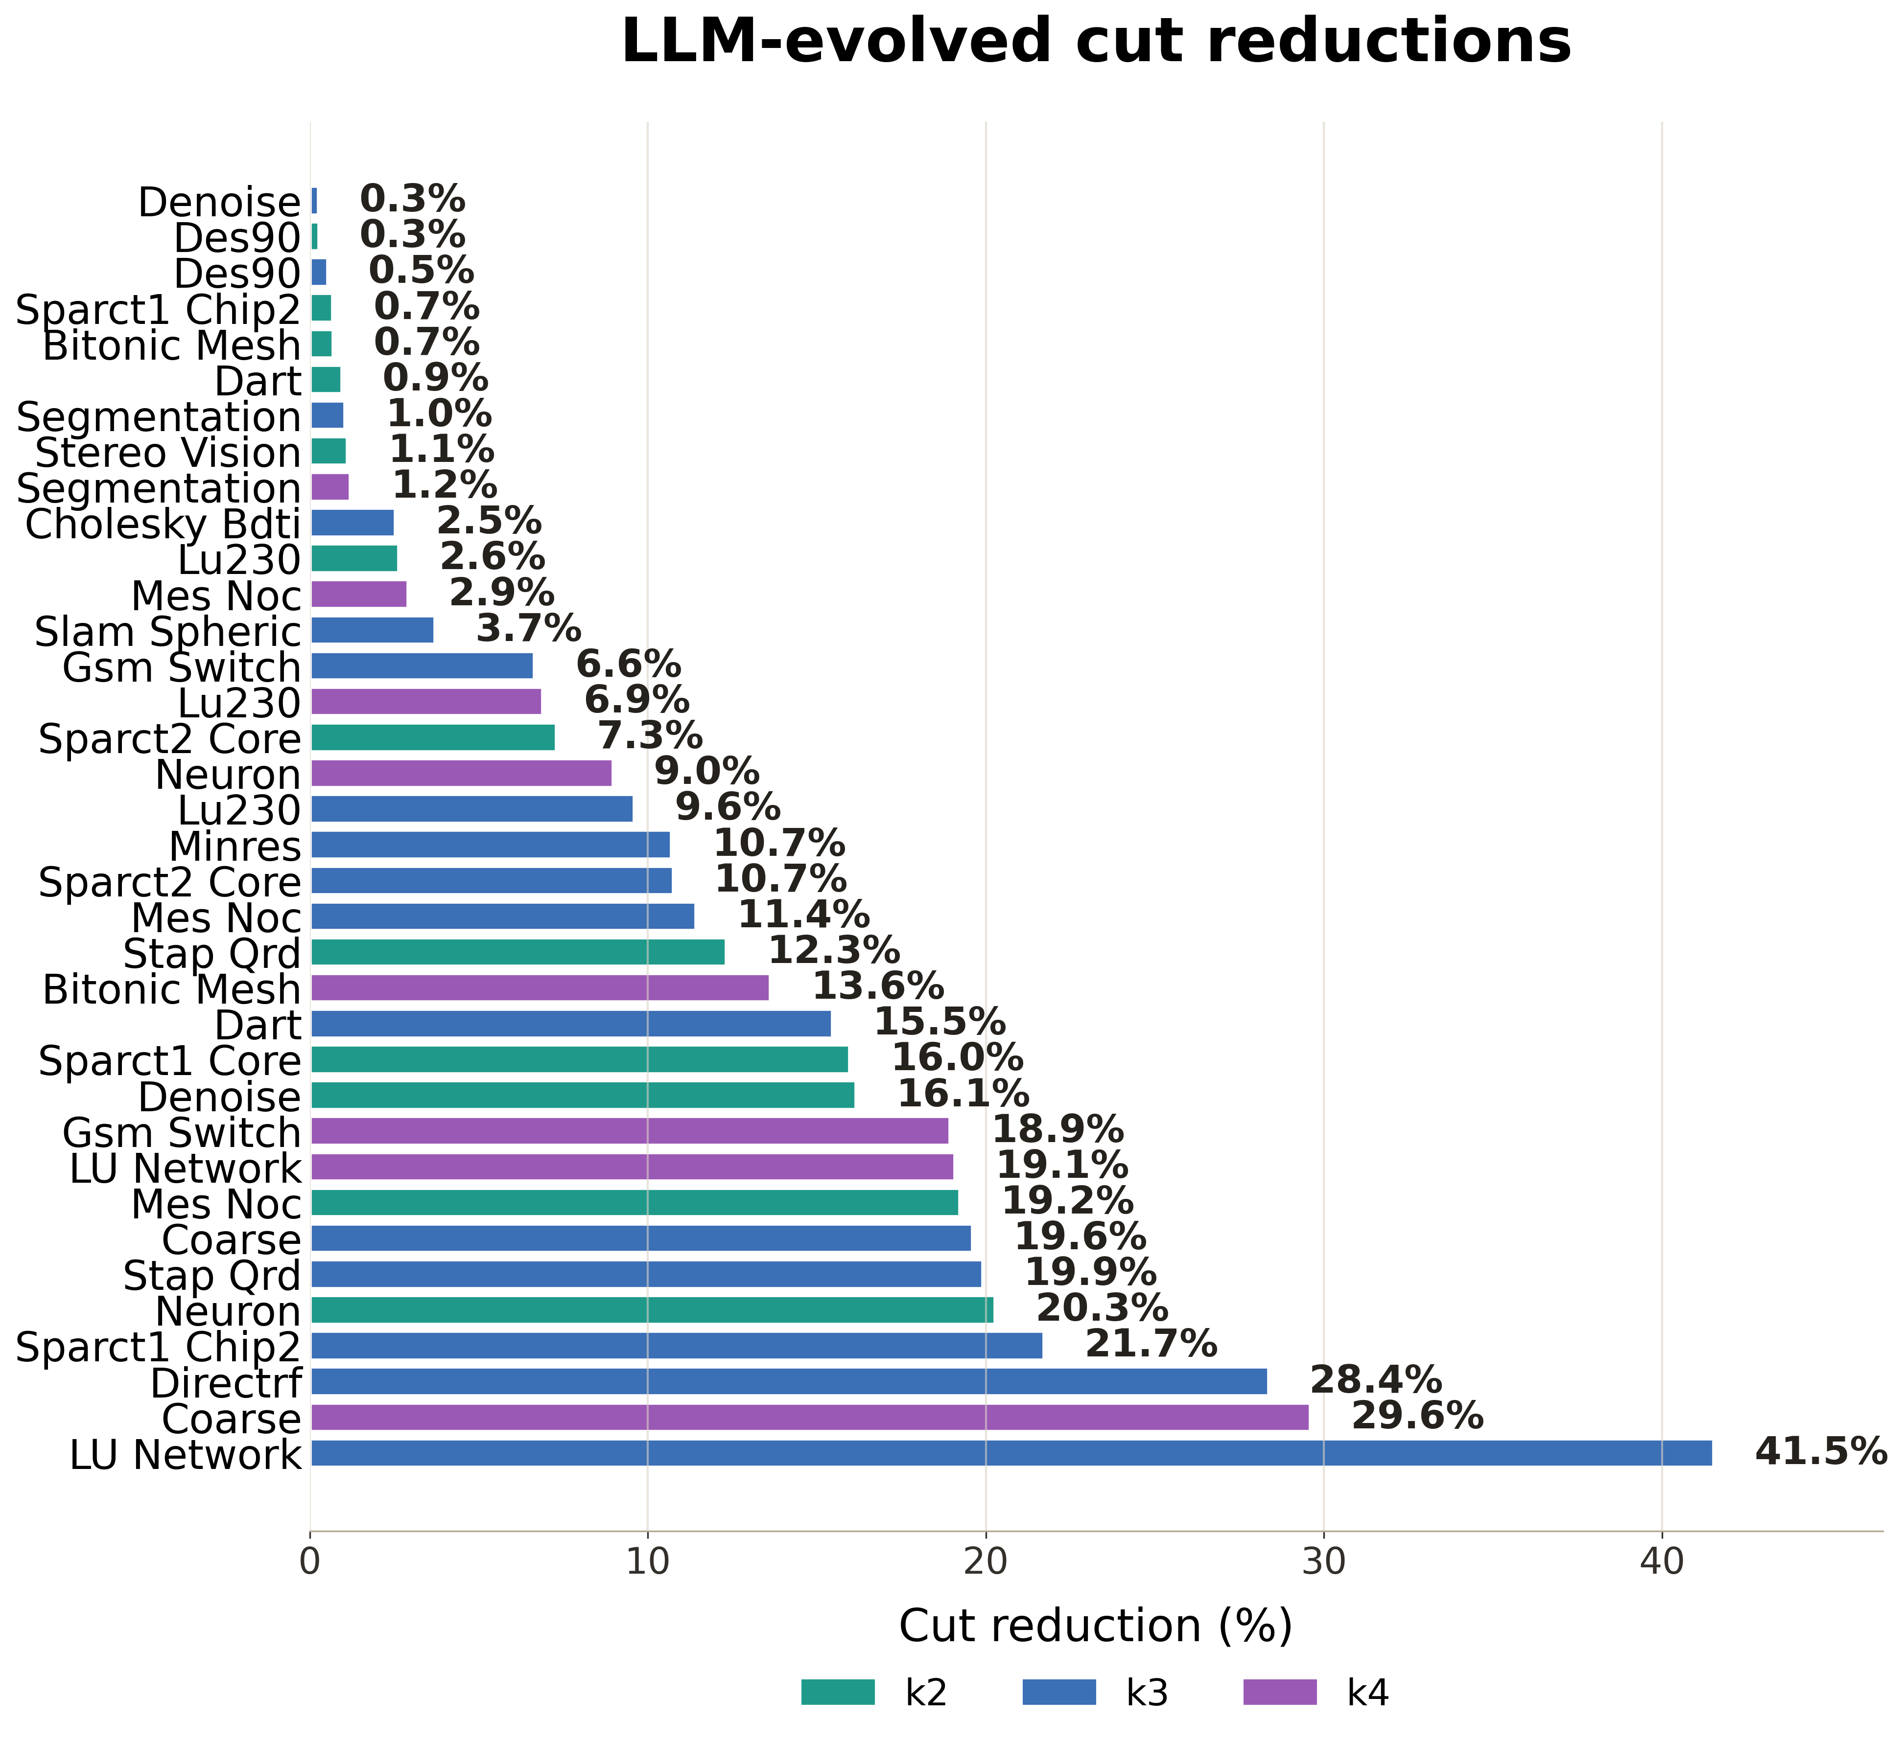
Improving a SOTA Hypergraph Partitioner (TritonPart)
TritonPart = SOTA hypergraph partitioner (> hMETIS, KaHyPar)
Has ILP “boundary optimization” step (with CPLEX or OR-Tools)
Autonomous AI diff “lowers the variance” of solver step
Substantial wins over TritonPart
Even with the weaker OR-Tools solver, finds world’s best-ever solutions!
Titan23 suite, LLM-evolved diff
Cut reduction (%) vs. TritonPart
K = 2
K = 3
K = 4
Notes:
TritonPart is the state-of-the-art hypergraph partitioner, outperforming hMETIS and KaHyPar. It includes an ILP-based boundary optimization step using CPLEX or OR-Tools. We deploy an agent that targets variance reduction in this solver step through localized code modifications. The agent preserves TritonPart's core structure while modifying solver formulations. We evaluate on the Titan23 suite. The autonomous AI diff lowers solver variance, yielding substantial wins and best-ever results for cases highlighted in yellow.

Slide 20
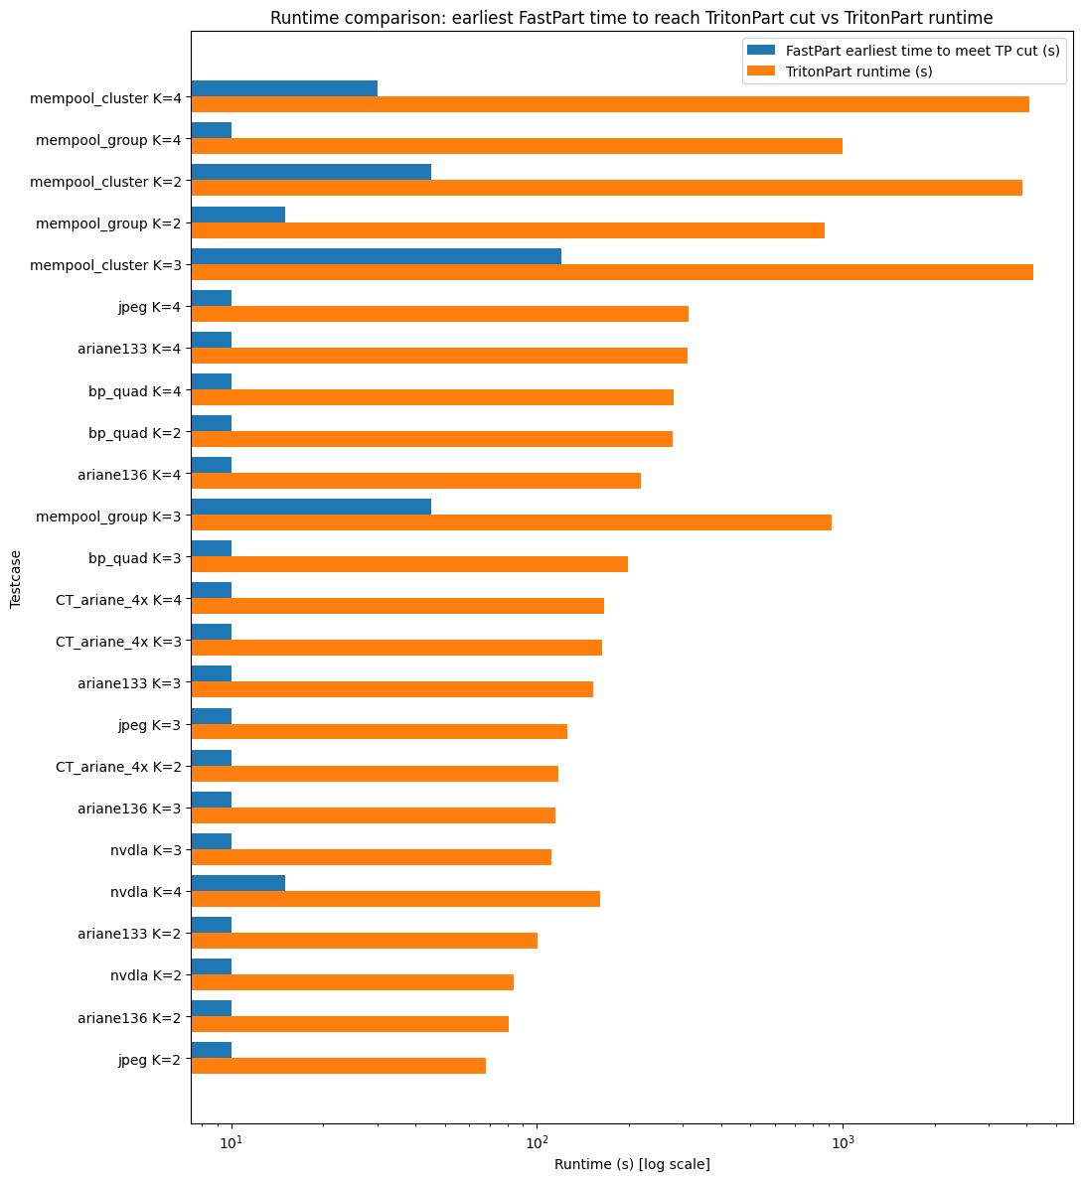
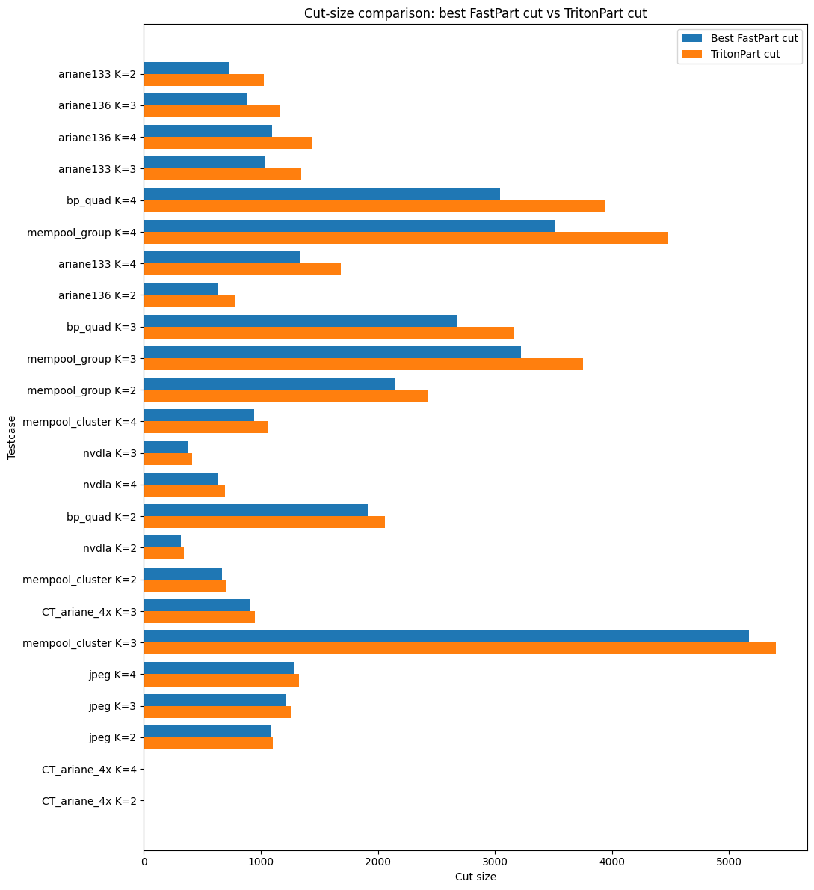
Beyond accuracy - speed
Better cutsize than TritonPart
Same cutsize with significantly faster runtime!
Notes:
Two stories here. On the left, FastPart achieves the same cutsize as TritonPart with significantly less runtime, often one to two orders of magnitude faster. On the right, FastPart produces strictly better cutsizes on medium to large designs. Even using the open-source OR-Tools solver instead of CPLEX, the agent finds world's best-ever solutions on several benchmarks. I'll hand it back to Bodhi for our vision and closing.

Slide 21
Outline
The Need
Modern Agentic Stack for Production EDA
Case Studies
Vision: OpenROAD as a Continuous Learning Platform
Notes:
Thanks, Sayak. Finally, our vision for the future is given in Section 5 of our paper. Some aspects closely connected to ISPD are in the next slide:

Slide 22
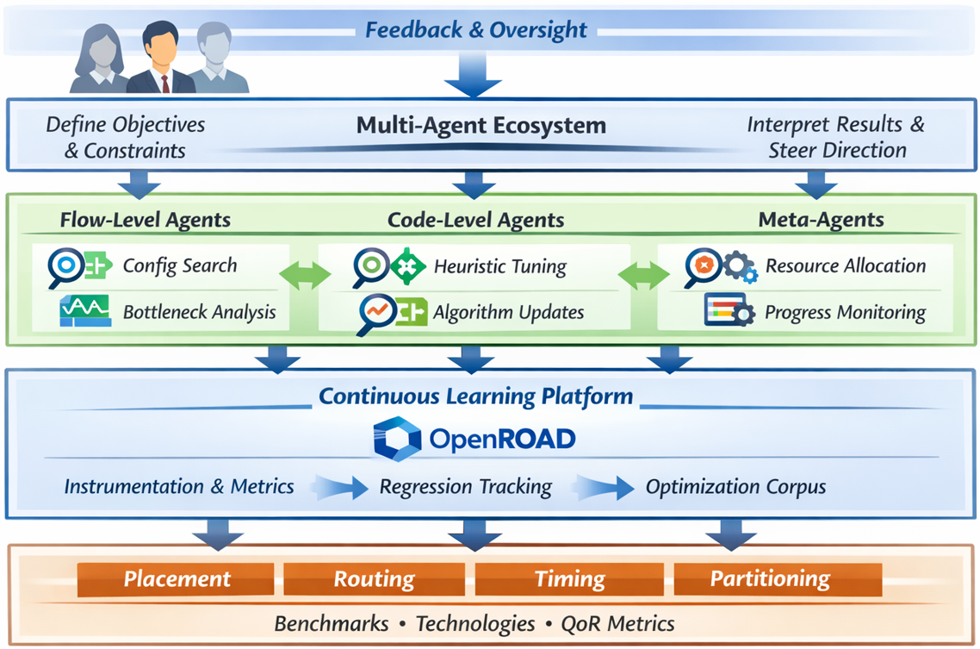
Vision: OpenROAD as a Continuous Learning Platform
Near-term: Agent-assisted algorithm development
Rapid prototyping of cost functions, heuristics, control logic
Automated benchmarking enables iteration at machine speed
Medium-term: Data-driven heuristic discovery
Growing corpus of agent-discovered optimizations grounded in measured QoR
Design patterns + algorithmic variants across diverse benchmarks & tech nodes
Long-term: Multi-agent OpenROAD ecosystem
Specialized agents collaboratively evolve tools and workflows
Human researchers gain new insights from agent-discovered tradeoffs
Notes:
We see OpenROAD not as a static tool but as a continuous learning platform. Near term, agents assist algorithm development through rapid prototyping of cost functions and heuristics, with automated benchmarking at machine speed. Medium term, data-driven heuristic discovery, where agent-discovered optimizations are grounded in measured QoR across diverse benchmarks and technology nodes. Long term, a multi-agent ecosystem with specialized flow-level, code-level and meta-agents collaborating. Importantly, this is human-agent co-evolution. Human researchers gain new insights from agent-discovered tradeoffs.

Slide 23

Thank You!
Link to our paper
Notes:
We hope you found this overview useful, and your feedback is very welcome. Please check out our proceedings paper, and thank you for watching!

