Slide 1
The Many PD Faces of Jens Lienig
Andrew B. Kahng
University of California, San Diego
abk@ucsd.edu
Notes:
It is an honor to be able to add some personal thoughts to this session.
So many of us are here to celebrate the ISPD lifetime achievement award for Jens Lienig – a colleague and coauthor and friend.

Slide 2
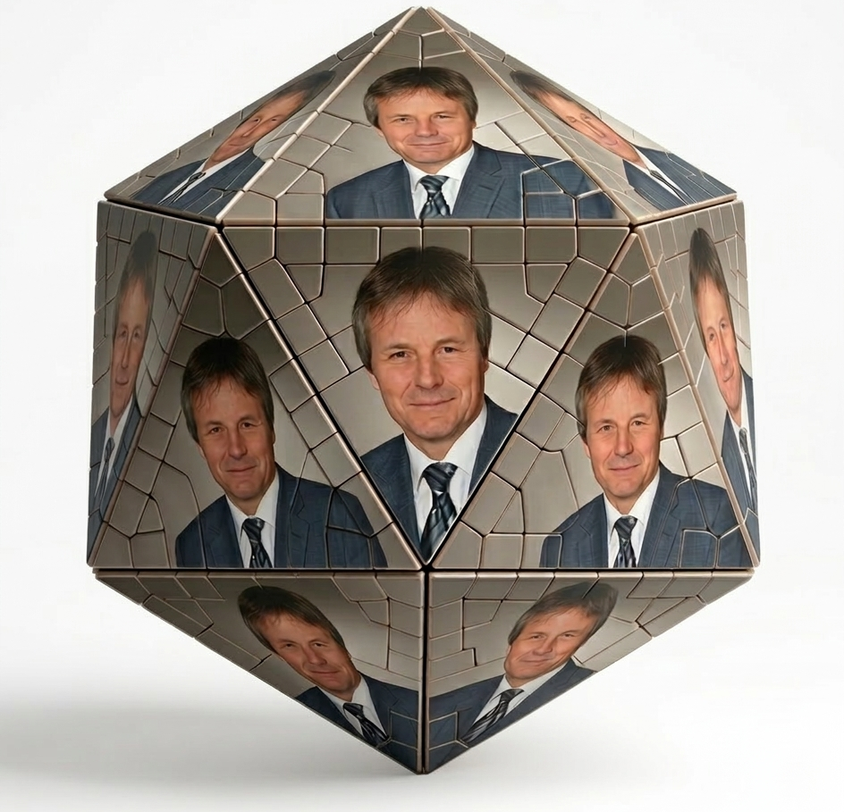
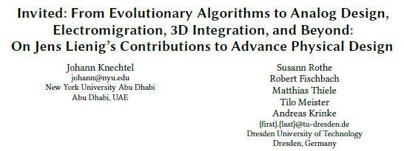
Many PD Faces
Analog Layout
3D Integration
Today: a few thoughts “from a coauthor and fan” (see the accompanying paper …)
Evolutionary Metaheuristics
Codification and Pedagogy
ISPD Impact
NEXT TALK !
EM Stress Reliability
Notes:
Credit to Gemini for this image …
[CLICK] Many of the PD faces of Jens are well-covered in the previous and especially in the next talk – and this afternoon’s sessions as well -- and Patrick asked me to keep this on the short side.
[CLICK] So I am a coauthor and a fan of Jens – today I’ll just touch on [CLICK] these three faces, and you can read a bit more in the paper.

Slide 3
Jens Lienig: A Timeline
1988
M.Sc. TU Dresden
1991
Ph.D. TU Dresden
1996
Habilitation TU Dresden
2002–present
Professor + Director, IFTE, TU Dresden
1991–1994
Postdoc Concordia
1994–1996
Visiting Asst. Prof. U. Virginia
1996–1999
Tanner Research Pasadena
1999–2002
Tool Manager Robert Bosch
2021
ISPD General Chair
2026
ISPD Lifetime Achievement
Academic years → evolutionary/metaheuristic optimization
Industrial product delivery → bringing the physical to physical design
Institute-building at TU Dresden → tools, pedagogy, scaling
OPT = SEARCH
PHYSICS
CODIFICATION
Notes:
The timeline naturally provides these faces.
[CLICK] Jens’s postdoc and visiting faculty positions at Concordia and UVA gave rise to seminal works on evolutionary optimization and metaheuristics – notably for VLSI routing.
[CLICK] Then, industrial roles – delivering CAD tools at Tanner, and using CAD tools to deliver IC products at Bosch – shaped how Jens has brought physics and the physical to physical design.
[CLICK] He built an institute and has left a one-of-a-kind stamp of mentoring, codification and pedagogy that reaches around the world.
[CLICK] So: optimization as search; physics; and codification are words to keep in mind.

Slide 4
Jens Lienig: A Timeline
1988
M.Sc. TU Dresden
1991
Ph.D. TU Dresden
1996
Habilitation TU Dresden
2002–present
Professor + Director, IFTE, TU Dresden
1991–1994
Postdoc Concordia
1994–1996
Visiting Asst. Prof. U. Virginia
1996–1999
Tanner Research Pasadena
1999–2002
Tool Manager Robert Bosch
2021
ISPD General Chair
2026
ISPD Lifetime Achievement
Academic years → evolutionary/metaheuristic optimization
OPT = SEARCH
Notes:
I start with evolutionary and metaheuristic optimization.

Slide 5
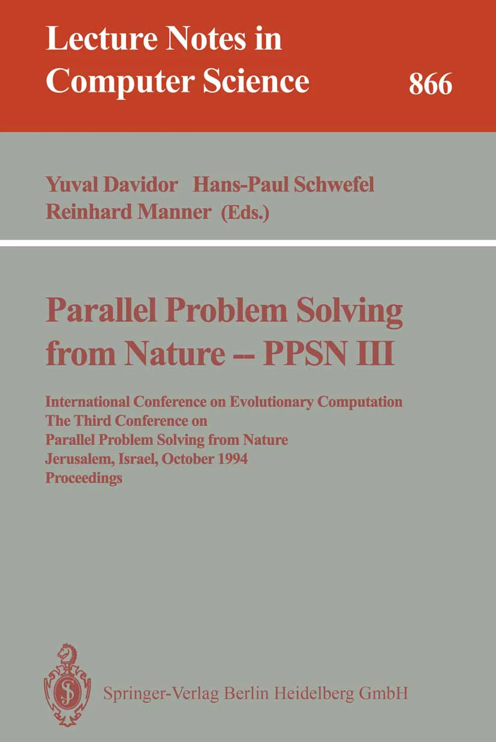
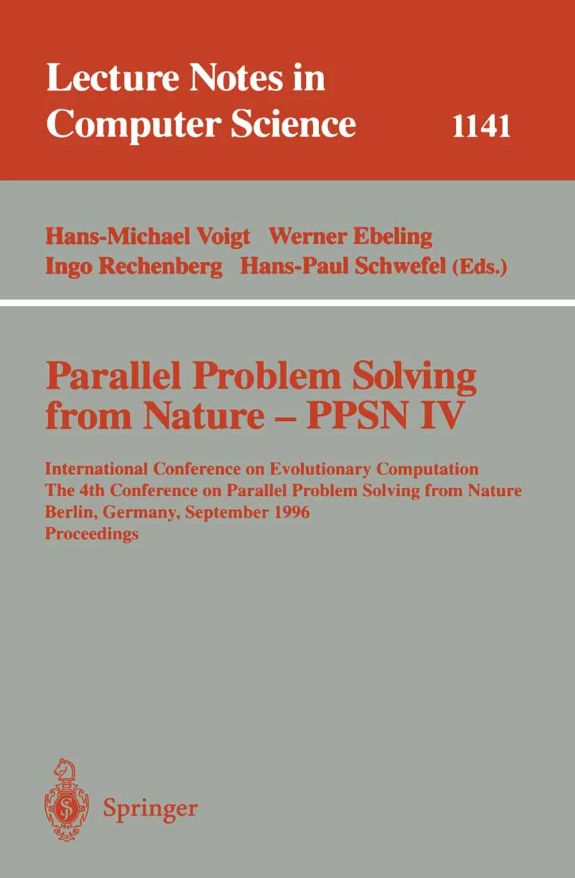
Evolutionary Optimization / Metaheuristics for Routing
1992
Routing Algorithms for Multi-Chip Modules, Proc. EURO-DAC
A Genetic Algorithm for Channel Routing in VLSI Circuits, Evolutionary Computation
1994
An Evolutionary Algorithm for the Routing of Multi-Chip Modules, Intl. Conf. on Parallel Problem Solving
1996
A Parallel Genetic Algorithm For Two Detailed Routing Problems, Proc. ISCAS
GASBOR: A Genetic Algorithm Approach for Solving the Switchbox Routing Problem, J. Circuits, Systems and Computers
1997
Channel and Switchbox Routing with Minimized Crosstalk - A Parallel Genetic Algorithm Approach, Proc. VLSID
A Parallel Genetic Algorithm for Performance-Driven VLSI Routing, IEEE Trans. Evolutionary Computing
Notes:
As many know quite well, Jens wrote a remarkable series of papers from 1992 to 1997, at Concordia and Virginia, pioneering the use of GA and evolutionary metaheuristics for VLSI routing. Reading these papers brings memories of the mentors – Professor Thulasiraman and Professors Cohoon and Martin.
[CLICK] And they made important overtures to the Parallel Problem-Solving from Nature (PPSN) and metaheuristics community that still haven’t been as fruitful as they should have been – or, should be, going forward.

Slide 6
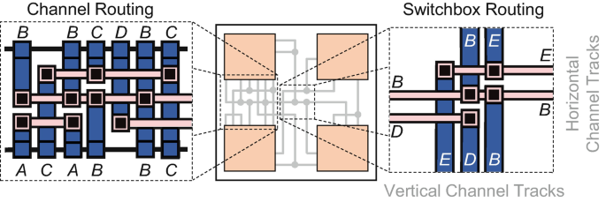
Reimagining Routing in the 1990s
Increase in complexity of the routing problem
Wirelength
Crosstalk
Via count
Sequential implementation
Jens saw routing as discrete, combinatorial, rugged search
Explored evolutionary algorithms for routing and related PD problems
1997: parallel genetic algorithm for detailed routing
“These results showed … the power of evolutionary algorithms, but even this brute-force, massive parallel approach could not overcome their drawbacks: slow, stochastic, tricky to set up... , hence, not applicable to commercial design automation”
Today, PD is rediscovering evolutionary optimization!
Multi-chip modules
Notes:
To set the stage: in the early-to-mid 1990s, routing was getting harder along multiple axes simultaneously. Wirelength, crosstalk, via count, sequential implementation constraints - all compounding, especially in multi-chip modules where the problem structure is inherently different from single-die problems. The solution methods were mostly sequential and greedy - left-edge, dogleg, Yoshimura-Kuh style approaches, and reduce to channels and switchboxes.
[CLICK] What Jens recognized is that routing is fundamentally a discrete, combinatorial, rugged-landscape search problem. Not something you should attack with a single trajectory through a solution space. He was the first to seriously explore evolutionary algorithms for detailed routing, culminating in the first parallel genetic algorithm for this domain in 1997.
[CLICK] As Jens noted, here in blue font – the world wasn’t ready at the time. But TODAY, GAs are absolutely alive and well in physical design – and one might say that they are mandatory going forward.

Slide 7
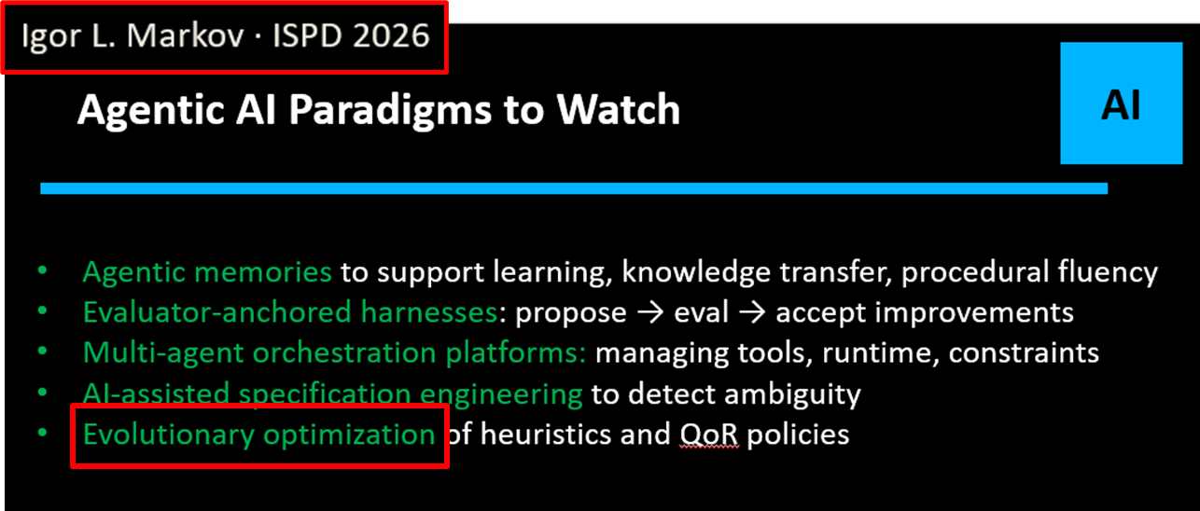
Reimagining Routing in the 1990s
Increase in complexity of the routing problem
Wirelength
Crosstalk
Via count
Sequential implementation
Jens saw routing as discrete, combinatorial, rugged search
Explored evolutionary algorithms for routing and related PD problems
1997: parallel genetic algorithm for detailed routing
“These results showed … the power of evolutionary algorithms, but even this brute-force, massive parallel approach could not overcome their drawbacks: slow, stochastic, tricky to set up... , hence, not applicable to commercial design automation”
Today, PD is rediscovering evolutionary optimization!
Multi-chip modules
Notes:
Or actually, Igor Markov DID say that yesterday.

Slide 8


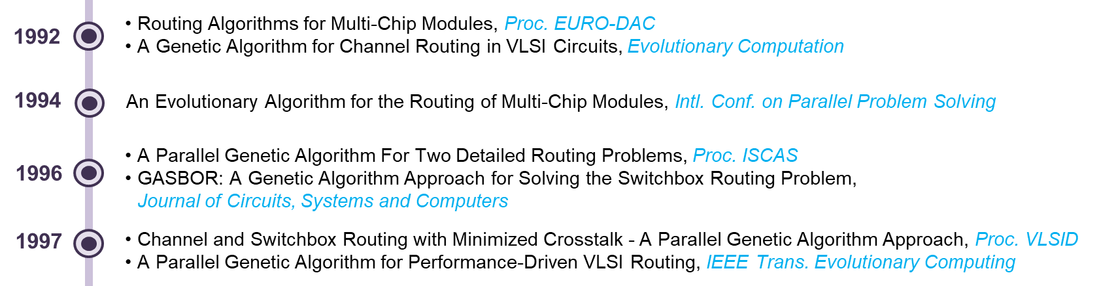
Genetic Algorithms for Routing
Jens introduced genetic algorithms (GAs) for MCM routing and related PD problems
Evolutionary search offered an alternative to
Single-solution methods
Purely greedy heuristics
And achieved competitive benchmark results
Initial population
Tournament selection
Crossover/mutation
X
Evolved solutions
Notes:
Jens’s earliest GA papers -- EURO-DAC 1992, Evolutionary Computation journal 1994 – targeted MCM routing. The encoding represented routing solutions as chromosomes, and Jens applied tournament selection, order-based crossover, and mutation operators tailored to channel and switchbox geometries.
Before this form of SEARCH, the dominant paradigm was “single-solution methods” – start from one configuration and improve greedily, or build a solution left-to-right with a constructive heuristic. By contrast, evolutionary search maintains a population and recombines solutions, sampling from multiple regions of solution space in parallel. The results were competitive with the best known methods – and the trajectory went on to add parallelism, and crosstalk and timing objectives.
Frederica Darema, Jimmy Lam, Bill Swartz

Slide 9
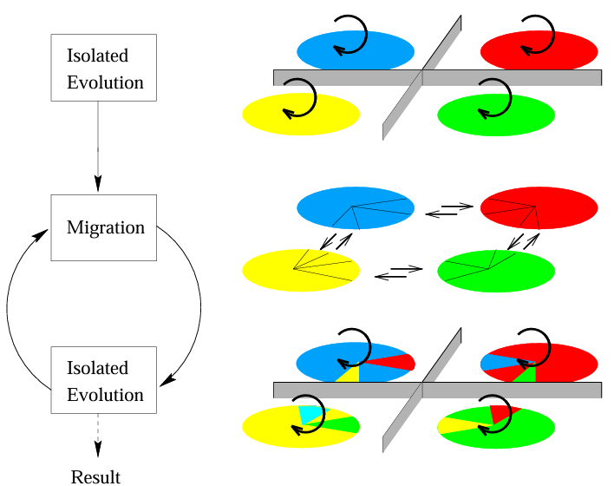
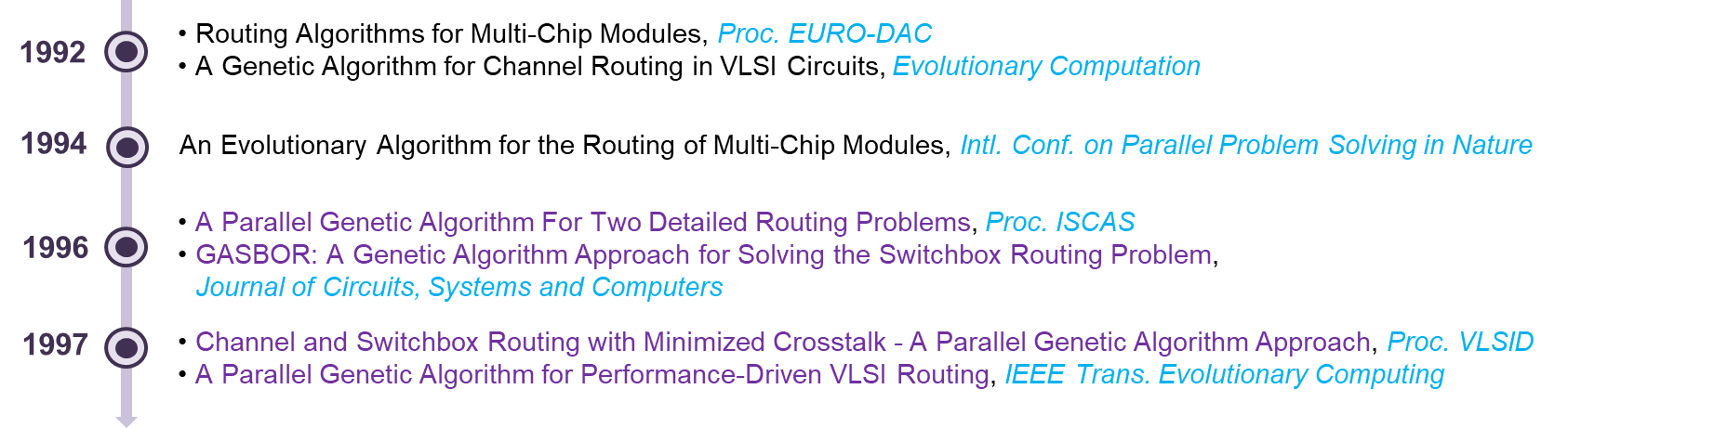
Parallel Search Changed Search !
At UVA, Jens leveraged campus-wide distributed computing resources → could run multiple routing populations in parallel
Broader search over the routing landscape than a single evolutionary run
Sparse exchange of solutions maintained diversity without collapsing exploration
Less stagnation, better exploration, stronger results
Punctuated equilibria model in parallel GA (Lienig ‘97) (link)
Notes:
And there was serendipity: At the University of Virginia, Jens had access to campus-wide distributed computing – networked workstations, essentially an early cluster. So he didn't use parallelism to speed up a single GA. He ran multiple independent populations in parallel across different machines.
This enabled a realization of evolution with punctuated equilibria – this figure, from top to bottom, shows the alternation between isolated evolution and brief migration events. During isolation, each subpopulation converges toward its own local optimum. Migration injects genetic material from other subpopulations, creating sudden bursts of improvement – punctuated equilibria, borrowing the term from evolutionary biology.
The result? – less stagnation, better coverage, stronger final solutions. So this was use of parallelism beyond just speedup – it changed the quality of the search.

Slide 10
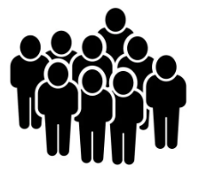
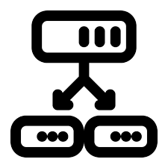



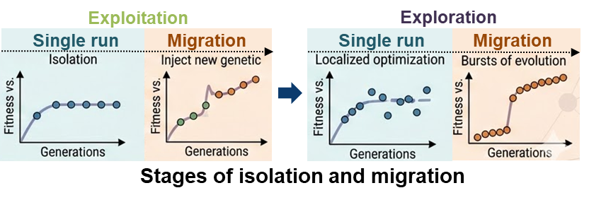


Island Models Changed Parallel Search !
Not just “many searches at once” → a structured evolution architecture
Subpopulations evolve largely independently with occasional migration between them
Explicit design choices
How many subpopulations?
How often to migrate?
How many migrants?
How to select migrants?
Tie-breaking strategies?
Diversity becomes a controllable algorithmic resource
Population partitioning
Selection
Selection
Crossover
Crossover
Mutation
Mutation
Migration
Notes:
Jens formalized this into the island model: partition your population into subpopulations that evolve independently, with controlled migration between them. The pipeline on the right shows partitioning, then selection, crossover, mutation on each island, then periodic migration.
[CLICK] The systematic exploration of we now call hyperparameters is noteworthy: How many islands? Jens experimented with 4 to 16. How often to migrate? How many migrants – and do you send your best, top 50%, or random? Each choice trades off exploration versus exploitation. Too much migration and your islands converge prematurely; too little and you're running independent searches that never benefit from each other.
[CLICK] In the bottom picture: isolation gives localized optimization (exploitation), while migration triggers bursts of exploration.
So in our field, Jens was one of the first to study diversity as a controllable algorithmic resource.

Slide 11
Lasting Insights
PD should not simplify away hard objectives and constraints
Evolutionary-based exploration is a principled response to hardness and scale in (PD) optimizations
Metaheuristics can directly handle complex cost functions
Treat PD as large-scale search and optimization !
Embrace combinatorial hardness
Optimize rich objectives directly
Use populations, not one trajectory
Notes:
Stepping back, we see what are now time-tested insights.
Don’t simplify away the hard parts. Don’t fall into the trap of relaxation, for convenience – the “assume a spherical horse” trap.
Optimizers should address the real objectives and constraints -- crosstalk, via count, timing, and reliability.
Metaheuristics including annealing give us this – which we often forget.
And, in rugged combinatorial landscapes, population-based search that maintains diversity is a principled response.
[CLICK] Jens’s island models, parallel search, and structured diversity are very much the forebears of parallel portfolio solvers, LLM-guided search, evolution of heuristics and more.
He saw PD as large-scale search and optimization long before that perspective was common.

Slide 12
What A Difference 30 Years Makes !
1990s verdict: “Not suitable for EDA”
2020s perspective: “A Must for EDA”
Parallel evolutionary search showed clear promise in physical design
But practical barriers were severe
Stochastic behavior
High computational cost
Difficult to tune
→ Not applicable to commercial EDA
Much stronger compute: multi-core CPUs, GPUs, clusters, VMs, cloud
Better search control: stabler heuristics and tuning
Better optimization frameworks: parallel portfolios, Bayesian Optimization
New AI-guided search: ML and LLM-based orchestration
→ A must-have in commercial EDA
Ideas that were ahead of their time: today’s ecosystem makes them newly practical Today’s trajectory: heavyweight parallel metaheuristics and solver-based search!
Notes:
So, what a difference 30 years makes !
In the 1990s, the verdict on evolutionary methods in EDA was: interesting but not practical.
Stochasticity was lemons, no one saw the lemonade. Overnight was still the largest time constant in the heads of users. Tuning GA parameters was a highly manual art.
[CLICK] Fast forward to the 2020s, with multi-core CPUs, GPUs, cloud-scale compute. Bayesian optimization for autotuning, parallel portfolio methods – and now we have Agentic AI-based orchestration of search.
[CLICK] So Jens’s ideas were considerably ahead of their time: the ecosystem just needed a quarter century to catch up.

Slide 13
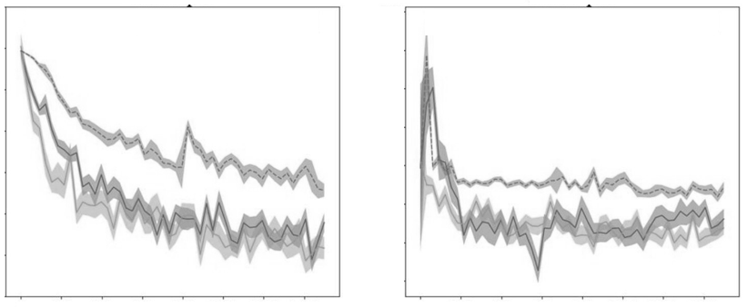
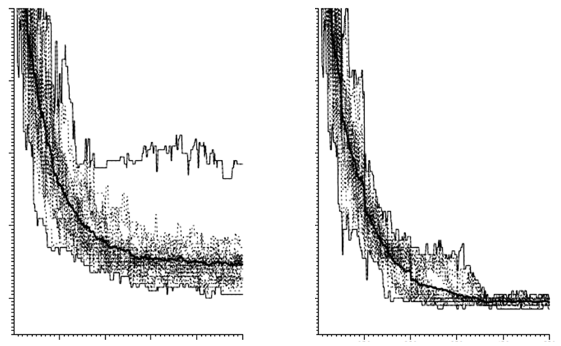
Stochastic Optimization Hasn’t Changed …
1997, Handbook of Evolutionary Computing
2022, ICLR
2022, ICLR
1997, Handbook of Evolutionary Computing
Notes:
These pictures were made a quarter century apart. The point is: stochastic optimization still looks the same. You still pay geometrically more for that next increment of improvement. Jens’s picture appeared in the 1997 Handbook of Evolutionary Computing.
[CLICK] Actually, Jens’s picture is the LEFT one.
Langevin diffusions, stochastic gradient Markov chain Monte Carlo …
Figure 6.3.4 MartinCL97
So did it actually work? The plot is from Jens's 1997 paper. It shows the effect of different migrant selection strategies – random, top 50%, and best –

Slide 14
Jens Lienig: A Timeline
1988
M.Sc. TU Dresden
1991
Ph.D. TU Dresden
1996
Habilitation TU Dresden
2002–present
Professor + Director, IFTE, TU Dresden
1991–1994
Postdoc Concordia
1994–1996
Visiting Asst. Prof. U. Virginia
1996–1999
Tanner Research Pasadena
1999–2002
Tool Manager Robert Bosch
2021
ISPD General Chair
2026
ISPD Lifetime Achievement
Academic years → evolutionary/metaheuristic optimization
Industrial product delivery → bringing the physical to physical design
OPT = SEARCH
PHYSICS
Notes:
From a timeline standpoint, the industrial years reinforced “bringing physics and the physical, to physical design”. So, don’t lose sight of the acceptance criterion. And, no spherical horses (please).

Slide 15
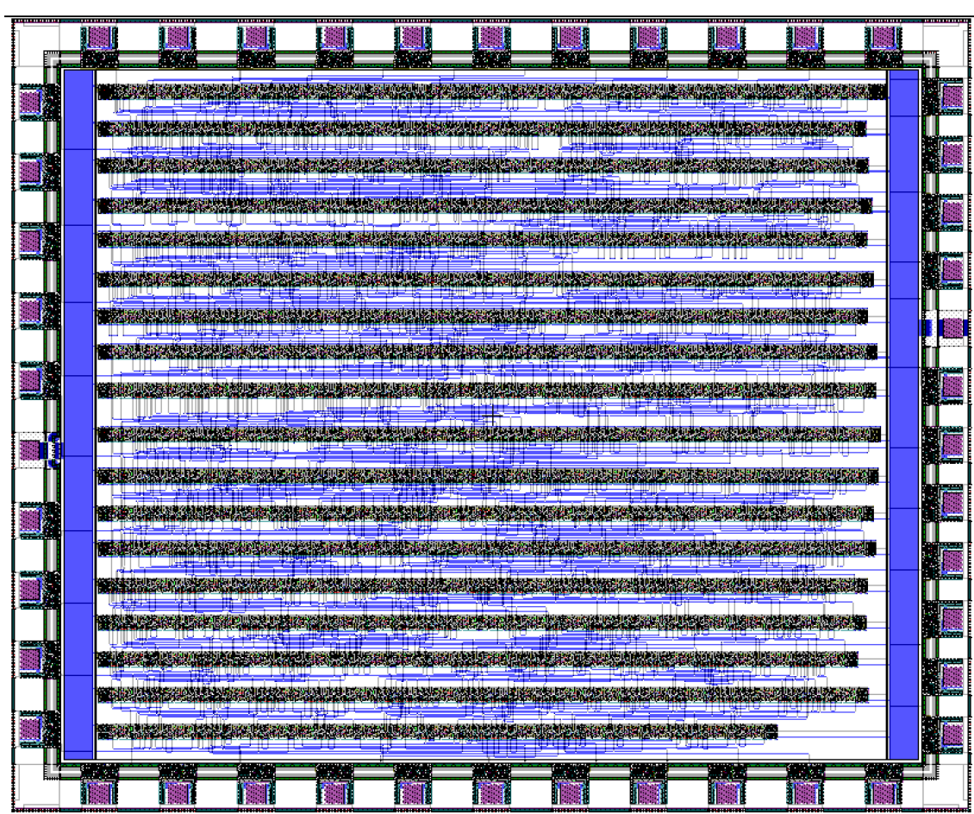
From Tanner Research to Robert Bosch GmbH
Tanner Research
Tool flows, analog/mixed-signal users, and the discipline of building tools that simply had to be correct
Judy Bergstresser recalls “… [Jens’s] attention to the precision and accuracy of the explication of his work, his intensive review, and reliable adherence to requested deadlines”
Robert Bosch
Manufacturing, automotive and power devices brought physics of reliability into PD foreground
Jens recalls: “… those moments when JPL called in the afternoon because they encountered a routing bug and needed a fix the same day … The Martian rovers that roam(ed) on the red planet have those Tanner-tool-designed chips in them!”
Result
Jens’s research remained close to the artifacts, tool chains, and constraints faced by practitioners
L-Edit v16 place-and-route image [J. Bergstresser]
10
Notes:
So again: the years in industry provided the discipline of business (in both small and large organizations) – and reinforced the physical grounding that we see in Jens’s research.
A former Tanner colleague, Judy Bergstresser, recalled much about Jens 30 years later. (And, many thanks to Susann for helping me obtain Judy’s thoughts – along with this L-Edit image that she sent.) [CLICK] Her description of Jens’s attention to precision and accuracy of explication, his intensive review, and his reliable adherence to deadlines were apparent even back then – it rings a bell, doesn’t it ?
And [CLICK] Jens also provides vivid recollections: “The Martian rovers that roamed on the red planet have those Tanner-tool-designed chips in them!” – Wow!
From his years at Robert Bosch, Jens was driven to deep study of reliability mechanisms. And he developed methods for prediction of local problems, and critical wire-based filtering for tool scalability, well into this century. So he was also doing AI and ML more than two decades ago.

Slide 16
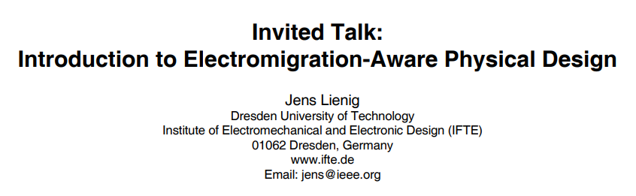

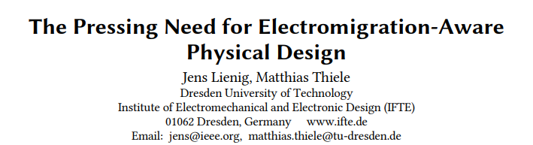
From Awareness to Agenda to Codification: An ISPD Story
ISPD-2006
Introduced EM-aware PD
2025
Codified in the EM textbook 2nd edition
ISPD-2018
Pressing need for EM-aware PD
Notes:
I first realized Jens’s amazing gifts as a communicator and teacher when I saw his talk on electromigration at ISPD-2006. And like many others, I still use his slides on this topic today.
Electromigration (along with this afternoon’s sessions) exemplifies how Jens has shaped the trajectory of ISPD and our community. Here is a clear three-stage progression. First, make the field aware of the issue. [CLICK] Second, explain why the issue belongs on the agenda going forward. Third, [CLICK] codify as a stable body of knowledge.
The 2006 invited paper, the 2018 “pressing need” paper, and the 2025 second-edition EM book trace exactly this progression. What is quite special is to see one person executing all stages of this “life cycle” (as Leon might call it).

Slide 17
Jens Lienig: A Timeline
1988
M.Sc. TU Dresden
1991
Ph.D. TU Dresden
1996
Habilitation TU Dresden
2002–present
Professor + Director, IFTE, TU Dresden
1991–1994
Postdoc Concordia
1994–1996
Visiting Asst. Prof. U. Virginia
1996–1999
Tanner Research Pasadena
1999–2002
Tool Manager Robert Bosch
2021
ISPD General Chair
2026
ISPD Lifetime Achievement
Academic years → evolutionary/metaheuristic optimization
Industrial product delivery → bringing the physical to physical design
Institute-building at TU Dresden → tools, pedagogy, scaling
OPT = SEARCH
PHYSICS
CODIFICATION
Notes:
And this brings me to CODIFICATION – which Jens has achieved through tools and pedagogy – and through his books, which scale out to all who are within reach of Springer.

Slide 18








“Books for all Design Levels” https://www.layoutentwurf.de/index.html
Unified pedagogical arc spans
Electronic systems design
Layout design of IC, MCMs, PCBs
Algorithms for physical design
Books that are both references and textbooks for instruction
As a corpus:
Solid conceptual framing
Clear explanations and distillations, with meticulous illustrations
Electronic systems design
Layout design
Algorithms for PD
Notes:
Jens’s eight books are indeed “Books for all Design Levels” – they span the entire design stack – electronic systems design, layout design of ICs, MCMs, and PCBs, down to VLSI physical design algorithms.
The textbooks are really optimized for instruction and learning – exercises, worked examples, pedagogical structure – with consistent notation, conceptual framing, and excellent illustrations. Jens is absolutely unique in our field for creating a unified pedagogical framework at this scale.

Slide 19
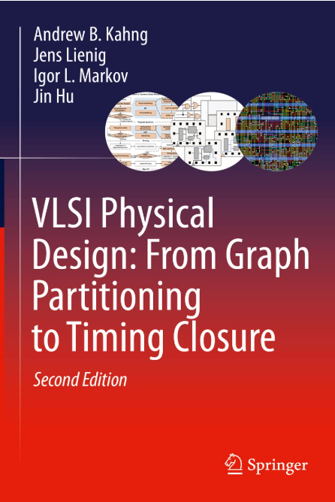
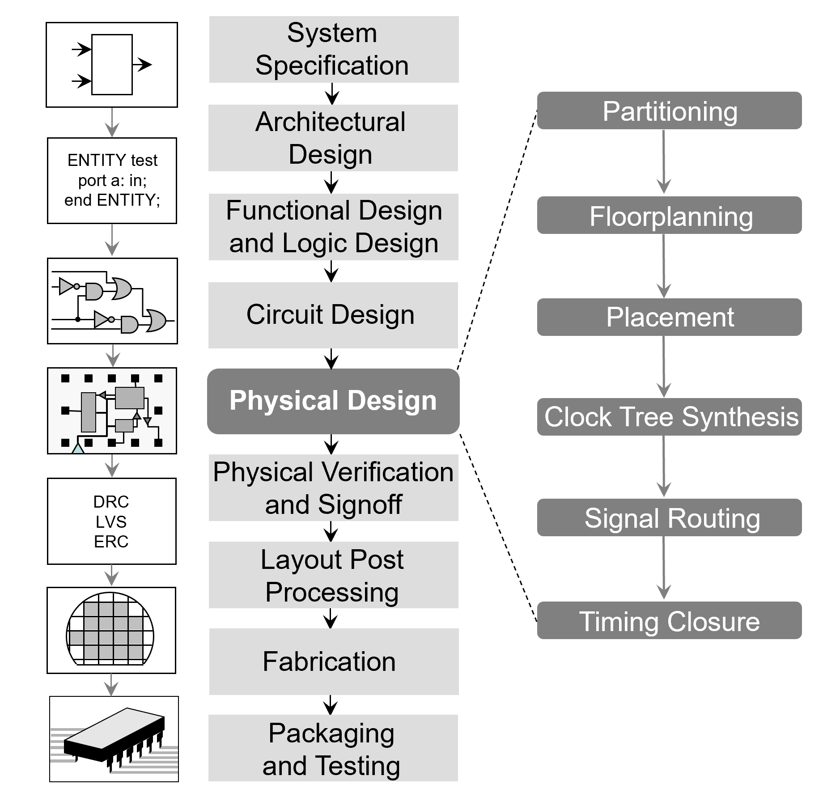
A Personal Highlight – contributing to this arc
Two editions over 14 years (2008-2022)
1st edition: analytic placement, CTS, timing closure
2nd edition: color figures, machine learning appendix
Jens made this happen !!!
Hundreds of emails
Thousands of fixes
Figures and lecture slides
Copies in university libraries
Translation (Mandarin)
CC-by-4.0
Notes:
This PD book is of course a personal highlight. It included topics such as timing closure and analytic placement that had been absent from previous books.
And when preparing this talk, I realized that the PD book brought us together for 14 years !
[CLICK] And he really made this happen. Aside from the tremendous thought and effort, everything was optimized by Jens, including placement of the book in key university libraries, creating free lecture materials, and [CLICK] making sure that this figure could freely propagate via a permissive Creative Commons license.

Slide 20
Acknowledgments
Many thanks to Yiting Liu and Bodhisatta Pramanik for their tremendous help with the figures and text in this paper.
Correspondences with Susann Rothe, Johann Knechtel, and Jens Lienig himself provided unique background elements that are reflected here.
Thanks are also due to the ISPD 2026 organizers for their warm invitation to write down this perspective, and to authors of [47] for graciously sharing early views of their paper.
Notes:
Huge thanks to many folks who helped me a lot, including Bodhi and Yiting at UCSD, and Susann, Johann, and Jens himself.

Slide 21
Thank You to Jens …
For helping physical design become truer to physics, systems, and people
As a scientist, educator, and community builder
With gratitude as a coauthor and colleague — thank you for your friendship and for being the example.
Notes:
So, Jens, thank you—for making our field truer to physics, systems and people – for the science, the books, the institutional leadership and collaborations, and for the example.
I am really grateful for being able to say that you are a colleague and coauthor and friend.
Congratulations !

