Slide 1


ISPD 2026 Contest: Post-Placement Buffering and Sizing
Andrew Kahng†, Seokhyeong Kang‡, Sayak Kundu†*, Yiting Liu†*, Davit Markarian†*, Seonghyeon Park‡, Zhiang Wang§
† University of California, San Diego
‡ Pohang University of Science and Technology
§ Fudan University
Notes:
Hello everyone. I am Yiting Liu from UC San Diego.
Today, Sayak, Davit, and I will present the ISPD 2026 contest post-placement buffering and sizing together.
This contest was jointly organized by UCSD, POSTECH, and Fudan University. These are the organizers involved in this contest.

Slide 2
Outline
Introduction and Motivation
Problem Formulation
Benchmarks
Evaluation
Participation Statistics
Acknowledgments
Next Year’s Roadmap
Notes:
Here is the outline of today’s presentation.
I will start by introducing the contest and its motivation, followed by the problem formulation.
Sayak will then walk through the benchmarks and contest evaluation flow.
Davit will present the evaluation methodology and participation statistics.
Finally, I will close with acknowledgments and the roadmap for next year.

Slide 3
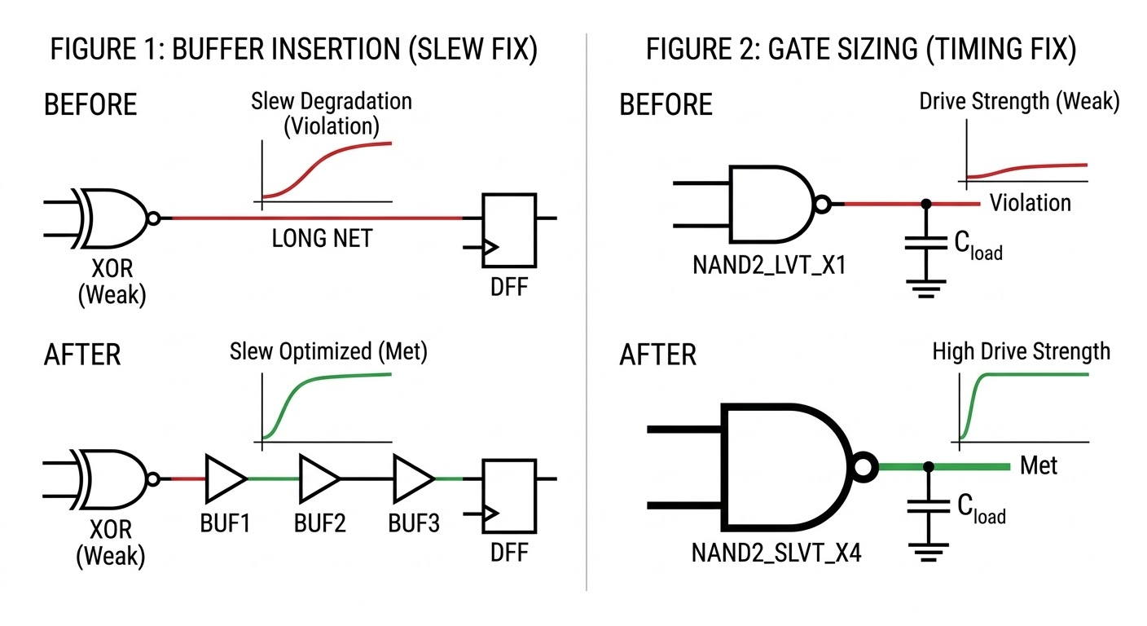
Introduction and Motivation
Post-placement timing closure is increasingly difficult
Key levers
Repeater insertions
Gate sizing
Goal
Develop a post-detailed placement buffering and sizing tool
Improve power, performance and area (PPA)
Fix ERC violations
(Under a set of real-world physical constraints)
Real-World Motivation
Fixed macros and I/Os
Power delivery network
Soft placement blockages
Fixed routing resource
Notes:
This slide explains the motivation for the contest. In today’s advanced technology nodes, post-placement timing closure is becoming more and more difficult.
[CLICK] Two key techniques for addressing this challenge are repeater insertion
[CLICK] and gate sizing.
[CLICK] Based on this, the goal of the contest is to develop a post-detailed-placement buffering and sizing tool. This tool should improve power, performance, and area, while also fixing ERC violations.
[CLICK] Importantly, the contest is designed to reflect real industry conditions. Our benchmarks include practical physical constraints
[CLICK] such as fixed macros and I/Os, the power delivery network, soft placement blockages, and fixed routing resources.
Together, these constraints reduce available whitespace, increase congestion, and make legal and effective post-placement optimization much more challenging.

Slide 4
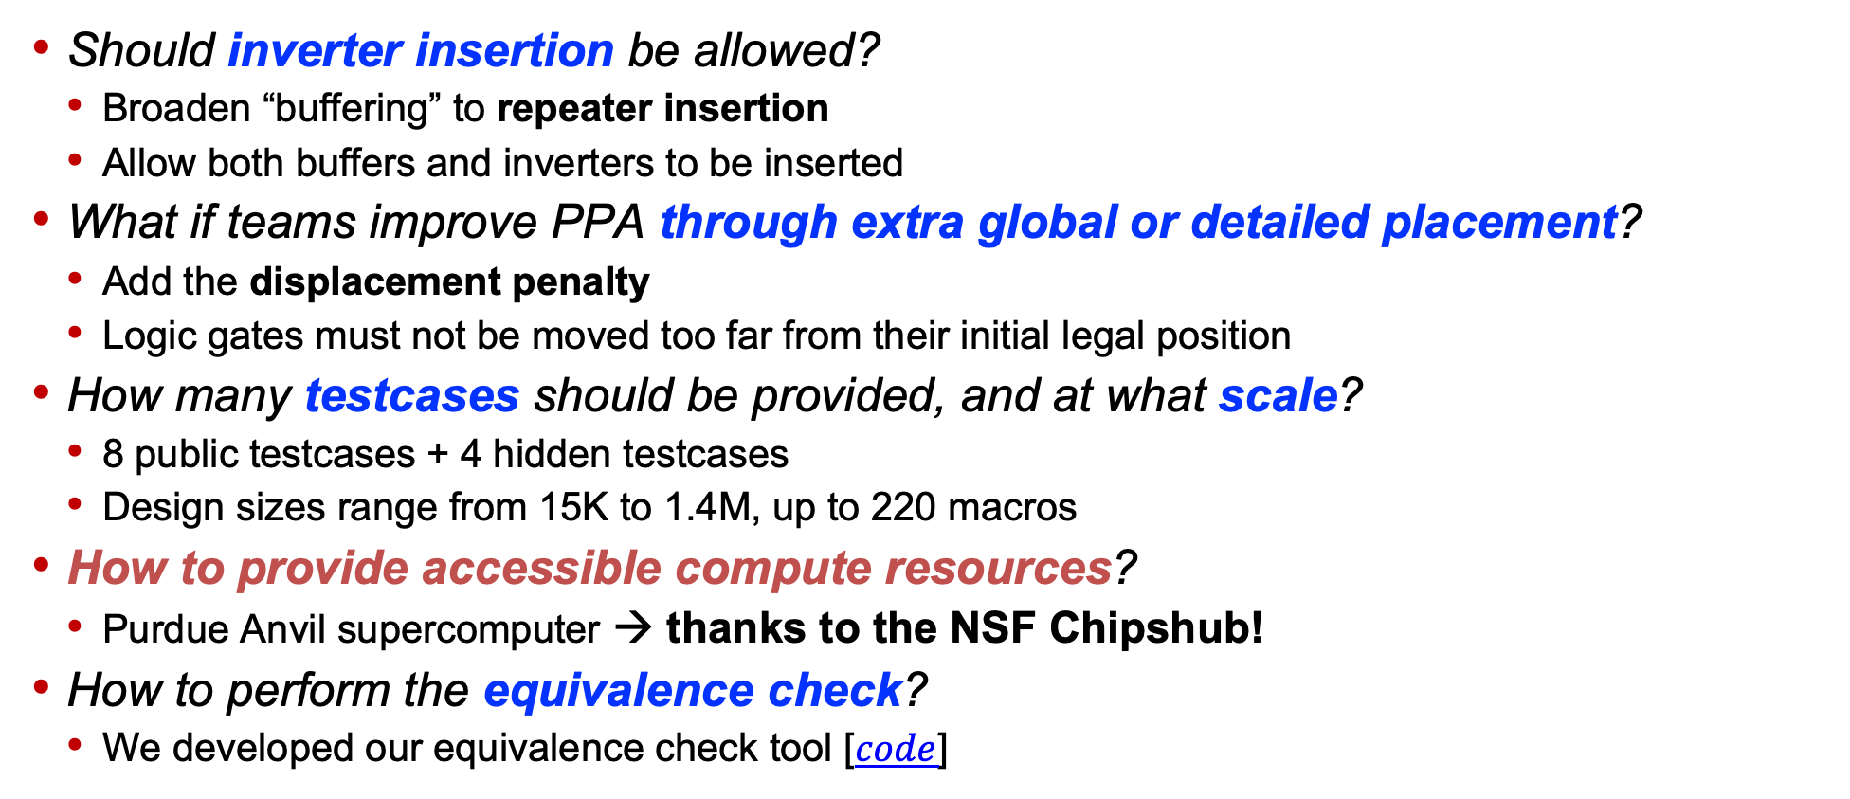
Key Discussions and Decisions
Should inverter insertion be allowed?
Broaden “buffering” to repeater insertion
Allow both buffers and inverters to be inserted
What if teams improve PPA through extra global or detailed placement?
Add the displacement penalty
Logic gates must not be moved too far from their initial legal position
How many testcases should be provided, and at what scale?
8 public testcases + 4 hidden testcases
Design sizes range from 15K to 1.4M, up to 220 macros
How to provide accessible compute resources?
Purdue Anvil supercomputer → thanks to the NSF Chipshub!
How to perform the equivalence check?
We developed our equivalence check tool [$code$]
Special thanks to:
Stephan Held, Davit Chinnery, Vidya Chhabria, Matt Liberty, Tom Spyrou, Wen-Hao Liu, Yi-Chen Lu, and Mark Ren!
Notes:
During the preparation stage, we had many discussions with experts in the field and received a lot of helpful feedback. Their input helped us shape several key design choices for the contest.
This slide highlights some of those discussions and decisions.
For buffering, we allow inserting both buffers and inverters, since both are commonly used in practice and can expand the optimization space.
[CLICK] We introduce a displacement penalty. This is to discourage contestants from improving PPA simply by moving cells excessively. That is not the main focus of this contest.
[CLICK] In total, we provide 12 testcases, with design sizes ranging from about 15 thousand to 1.4 million instances, and with up to two hundred and twenty macros.
[CLICK] For computing resources, we aim to make the evaluation process transparent and accessible to all contestants. In particular, we thank NSF ChipsHub and Purdue University for providing access to the Anvil supercomputer.
[CLICK] We also developed an equivalence checking tool to ensure the logical equivalence of submissions.
[CLICK] We sincerely thank everyone who contributed suggestions during the proposal and contest design stages.

Slide 5
Differentiation from Previous Contests
ISPD 2012-2013 Discrete Gate Sizing Contests
Discrete gate sizing only
Logic-level optimization; no placement awareness
No congestion, PDN, legalization, or blockage constraints
ICCAD 2024 Contest Problem C: Scalable Logic Gate Sizing
Focused on scalable gate sizing
No buffer insertion, netlist edits, or cell relocation
ICCAD 2025 Contest Problem C: Incremental Placement Optimization Beyond Detailed Placement
Similar setting to ISPD 2026 contest
But simplified testcases, without blockage constraints and post-route evaluation
MLCAD 2025 Contest: ReSynthAI: Physical-Aware Logic Re-synthesis for Timing Optimization Using AI
AI-driven logic resynthesis for timing optimization
Still abstracted from actual implementation flow; no physical blockages or routing considerations
Notes:
There have been several closely related contests in the past. However, many of them simplified important aspects of real-world physical design flows.
For example, the ISPD 2012 and 2013 contests focused only on gate sizing. They operated purely at the logic level, without considering placement or other physical design constraints.
[CLICK] Similarly, the ICCAD 2024 contest also focused only on gate sizing. It did not allow buffer insertion, netlist edits, or cell relocation.
[CLICK] The ICCAD 2025 contest had a setting similar to our ISPD 2026 contest. However, its testcases were simplified and mainly focused on post-placement PPA metrics, without considering routing quality.
[CLICK] The MLCAD 2025 contest encouraged AI-driven logic resynthesis for timing optimization. But the problem formulation remained relatively abstract and did not include physical blockages or routing considerations.

Slide 6
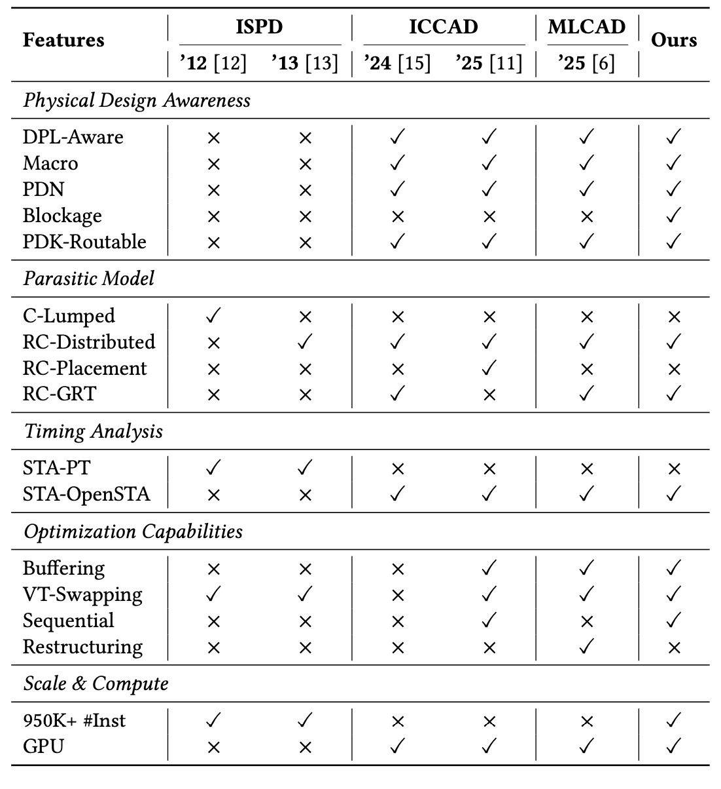
Differentiation from Previous Contests
ISPD
‘26
ISPD 2012-2013 Discrete Gate Sizing Contests
Discrete gate sizing only
Logic-level optimization; no placement awareness
No congestion, PDN, legalization, or blockage constraints
ICCAD 2024 Contest Problem C: Scalable Logic Gate Sizing
Focused on scalable gate sizing
No buffer insertion, netlist edits, or cell relocation
ICCAD 2025 Contest Problem C: Incremental Placement Optimization Beyond Detailed Placement
Similar setting to ISPD 2026 contest
But simplified testcases, without blockage constraints and post-route evaluation
MLCAD 2025 Contest: ReSynthAI: Physical-Aware Logic Re-synthesis for Timing Optimization Using AI
AI-driven logic resynthesis for timing optimization
Still abstracted from actual implementation flow; no physical blockages or routing considerations
Notes:
Here is a table from our invited paper that summarizes the key differences between these contests.

Slide 7
Outline
Introduction and Motivation
Problem Formulation
Benchmarks
Evaluation
Participation Statistics
Acknowledgments
Next Year’s Roadmap
Notes:
Next is the contest problem formulation.

Slide 8
Problem Formulation
Given
A gate-level netlist
A legalized placement with cell locations
A standard cell library
Design constraints (clock period, input/output delays, and ERC limits)
Find
For each gate: a library cell with appropriate drive strength and threshold voltage
A set of buffers and inverters to insert
Focus
Conduct gate sizing, VT-swapping, and repeater (buffer and inverter) insertion
Optimize timing and power while fixing ERC violations
Minimize: A weighted combination of
TNS, power. ERC violations, runtime, cell displacement, and global routing overflow
Subject to
Placement legality, logical equivalence, and fixed elements
Notes:
Given the gate-level netlist, legalized placement, standard cell library, and various design constraints, the goal is to find buffering and gate sizing solutions that improve timing and power while also fixing ERC violations.
[CLICK] We evaluate the solution quality using a weighted combination of several metrics, including TNS, power, ERC violations, runtime, cell displacement, and global routing overflow.
[CLICK] The solution must maintain placement legality, preserve logical equivalence, and ensure that fixed elements remain unmoved.

Slide 9
Outline
Introduction and Motivation
Problem Formulation
Benchmarks
Evaluation
Participation Statistics
Acknowledgments
Next Year’s Roadmap
Notes:
Next, Sayak will present the benchmarks and evaluation flow

Slide 10
Testcases and Enablement
Four designs: AES, JPEG, Ariane and BSG_CHIP
Commercial and Yosys synthesis; commercial netlist anonymized
Macro-containing designs: Ariane (1 unique macro type) and BSG_CHIP (6 unique macro types)
Varied TCP and utilization → easy-to-hard difficulty range per design
ASAP7 enablement
Three VT variants: RVT, LVT and SLVT (slowest to fastest)
~90 logical cells per VT, each with different drive strength
Benchmark generations
OpenROAD-flow-scripts: floorplan init, macro placement, tapcells, PDN and soft blockage insertion, global and detailed placement
Human macro placement from TILOS/MacroPlacement repo
All buffers are removed
Soft blockage: only buffers, inverters and physical cells no other logic gates or macros
Synthesis (TCP)
Floorplan (Util)
Macro Placement
Tapcell, PDN and soft blockage insertion
Global and Detailed Placement
Write out debuffered *.def and *.v
Notes:
We use four base designs — AES, JPEG, Ariane, and BSG_CHIP — synthesized using both commercial tools and Yosys. Commercial netlists are anonymized. Each design has two variants differing in TCP and utilization, spanning an easy-to-hard difficulty range.
All benchmarks use the ASAP7 7nm predictive PDK with three threshold voltage variants — RVT, LVT, and SLVT — each containing approximately 90 logical cell types with multiple drive strengths, enabling contestants to explore timing-power tradeoffs.
As shown on the right, benchmark generation follows a fixed ORFS-based pipeline: synthesis, floorplanning, macro placement, tapcell and PDN insertion with soft blockages, and global and detailed placement. Human macro placement solutions come from the TILOS MacroPlacement repository. Finally, all buffers are removed and the debuffered DEF and Verilog netlist are written out as contest inputs.

Slide 11
Benchmark Suite
8 public + 4 hidden benchmarks; 15K–1.4M instances; macro-free to macro-rich
Hidden benchmarks: Ariane and BSG_CHIP variants (most difficult testcases)
Design | TCP | Utilization | # Stdcells | # Macros | # Nets | # Pins | # Blocks
AES | 250 | 0.40 | 15K | 0 | 14K | 389 | 0
AES (v2) | 200 | 0.40 | 15K | 0 | 15K | 390 | 8
Ariane | 900 | 0.30 | 0.13M | 37 | 0.15M | 496 | 9
Ariane (v2) | 950 | 0.45 | 0.20M | 37 | 0.18M | 497 | 41
BSG_CHIP | 1200 | 0.30 | 0.90M | 220 | 1.14M | 136 | 83
BSG_CHIP (v2) | 1300 | 0.50 | 1.38M | 220 | 1.26M | 137 | 90
JPEG | 350 | 0.70 | 44K | 0 | 45K | 48 | 0
JPEG (v2) | 450 | 0.65 | 55K | 0 | 61K | 49 | 26
Ariane (h1) | 850 | 0.5 | 0.14M | 37 | 0.16M | 496 | 9
Ariane (h2) | 800 | 0.6 | 0.13M | 37 | 0.14M | 496 | 9
BSG_CHIP (h1) | 1250 | 0.5 | 0.84M | 220 | 1.16M | 136 | 90
BSG_CHIP (h2) | 1150 | 0.5 | 0.89M | 220 | 1.16M | 136 | 83
TCP: target clock period
# Stdcells includes physical cell count in the design → in a few cases # Nets is less than # Stdcells
# Blocks denotes number of soft blockages in the design
A floating scan enable pin is added in a few cases → different pin count for the same design
Notes:
The benchmark suite spans 15K to 1.4M instances across eight public and four hidden benchmarks. Varied TCP and utilization provide an easy-to-hard difficulty range per design. Standard cell count includes physical cells, so in some cases net count is less than standard cell count. The four hidden benchmarks — two Ariane and two BSG_CHIP variants — are the most challenging test cases and are not revealed to contestants.

Slide 12
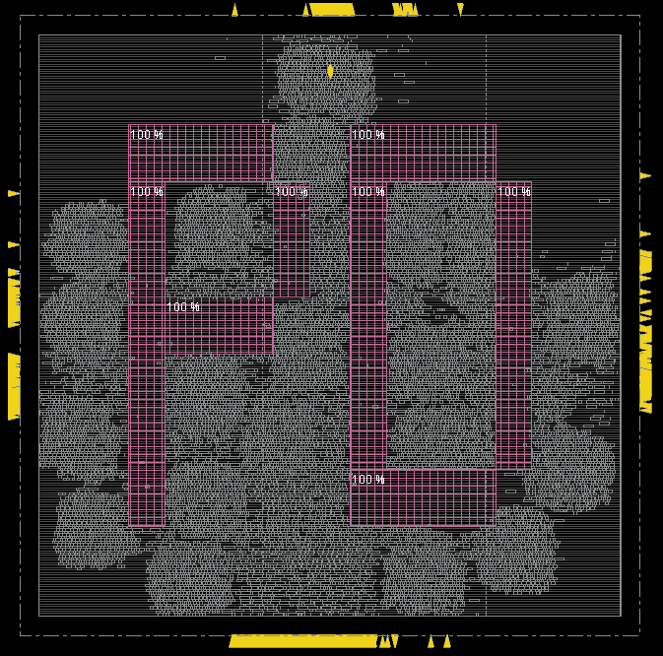
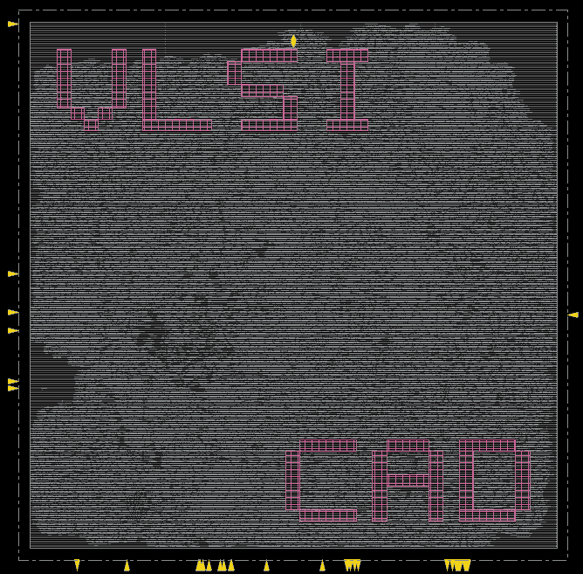
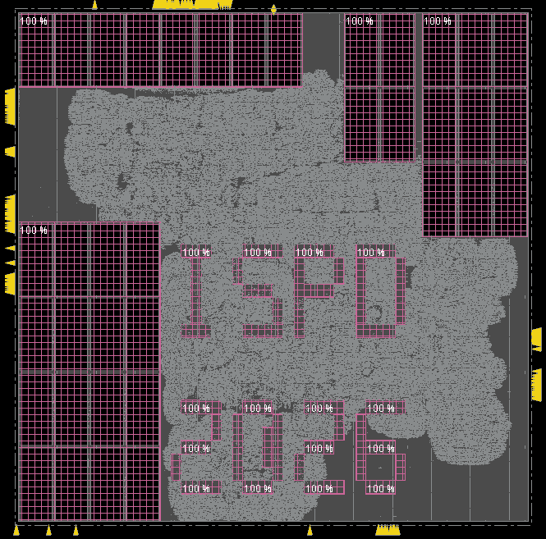
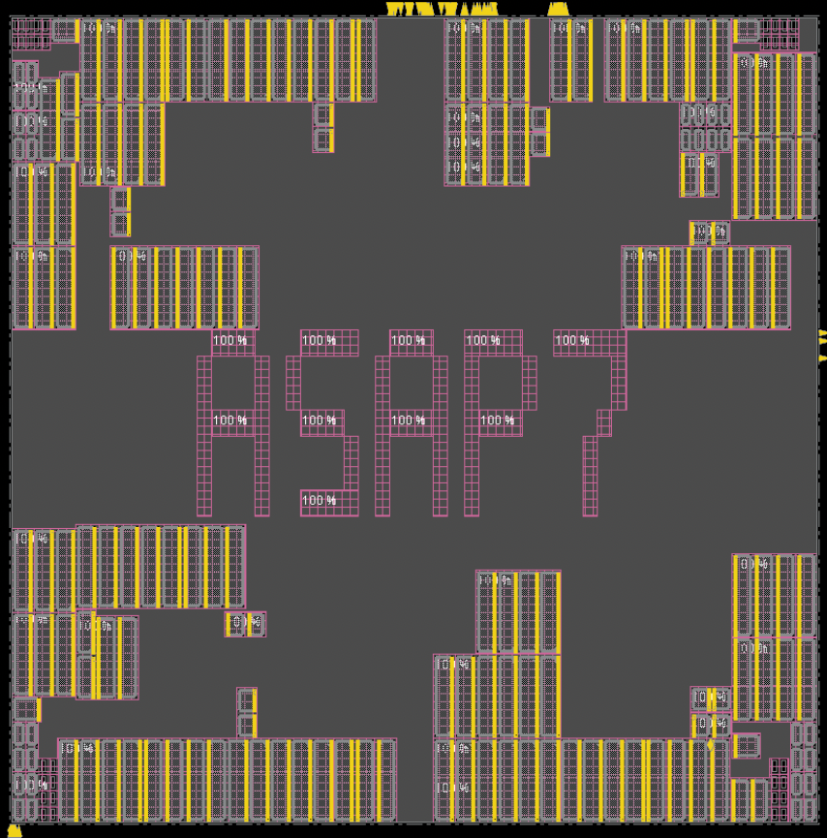
Public Benchmarks
Eight public benchmarks
AES, JPEG, Ariane, BSG_CHIP — each with base and v2 variant
Base variant: commercial synthesis + manual macro placement
v2 variant: Yosys synthesis + OpenROAD macro placement + soft blockages
TCP: 200 Util: 40%
TCP: 450 Util: 65%
TCP: 950 Util: 45%
TCP: 1300 Util: 50%
AES
JPEG
Ariane
BSG_CHIP
Visualization for the v2 variant of the public benchmarks
Notes:
Here are the public benchmarks. Each design has two variants. The base variant uses commercial synthesis with manual macro placement. The v2 variant uses Yosys synthesis with OpenROAD macro placement and includes soft blockages, further constraining available whitespace for buffer insertion. Images show the v2 placement layouts.

Slide 13
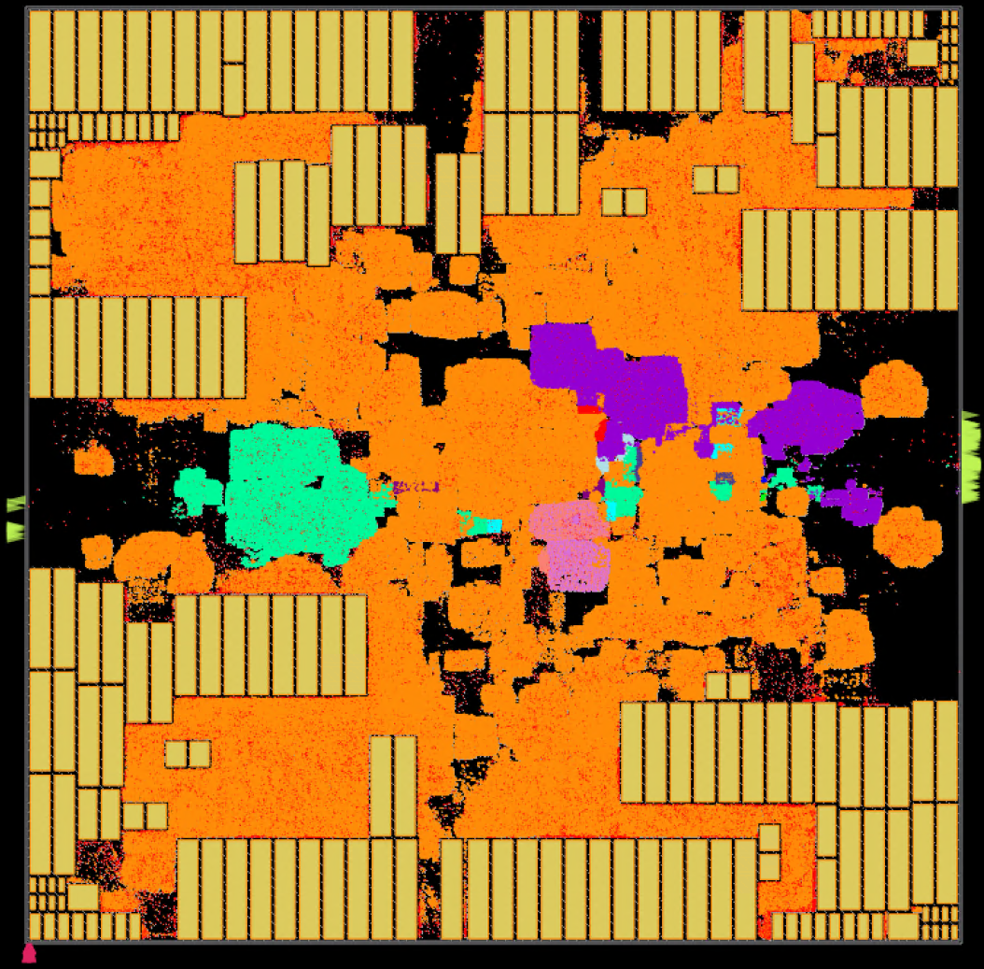
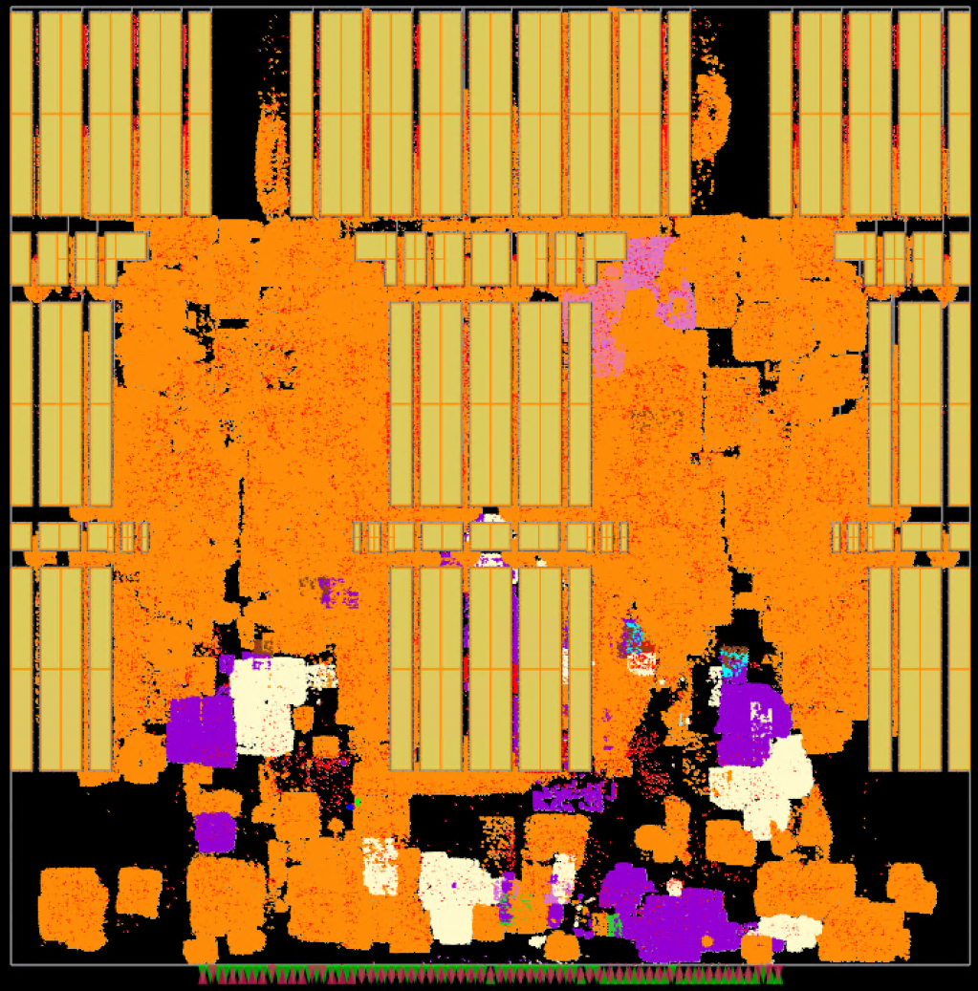
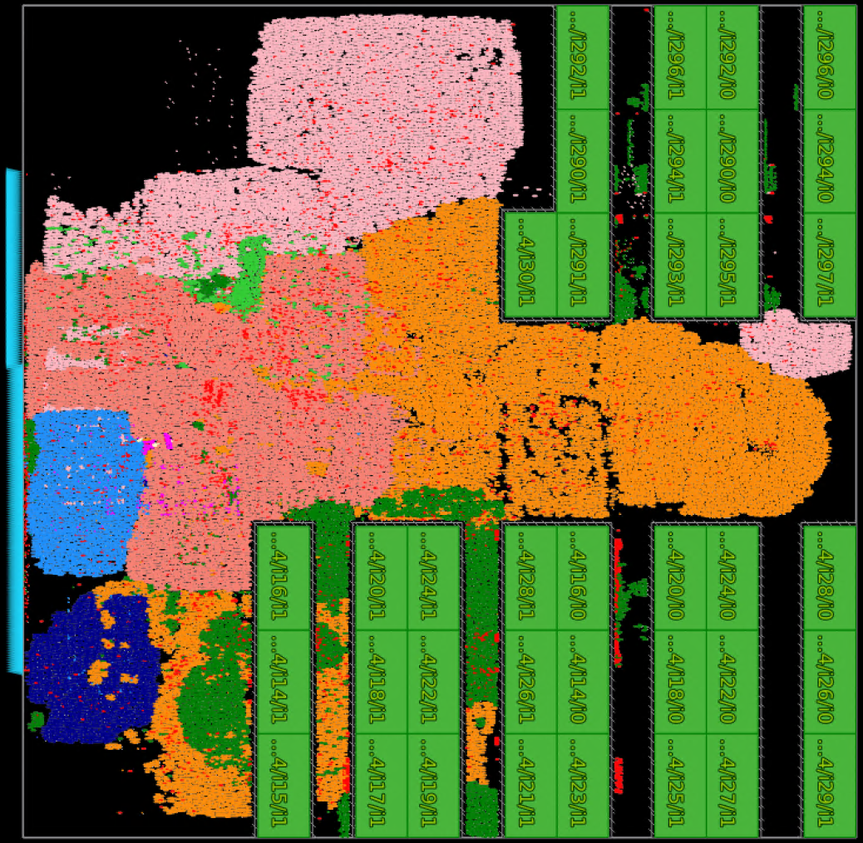
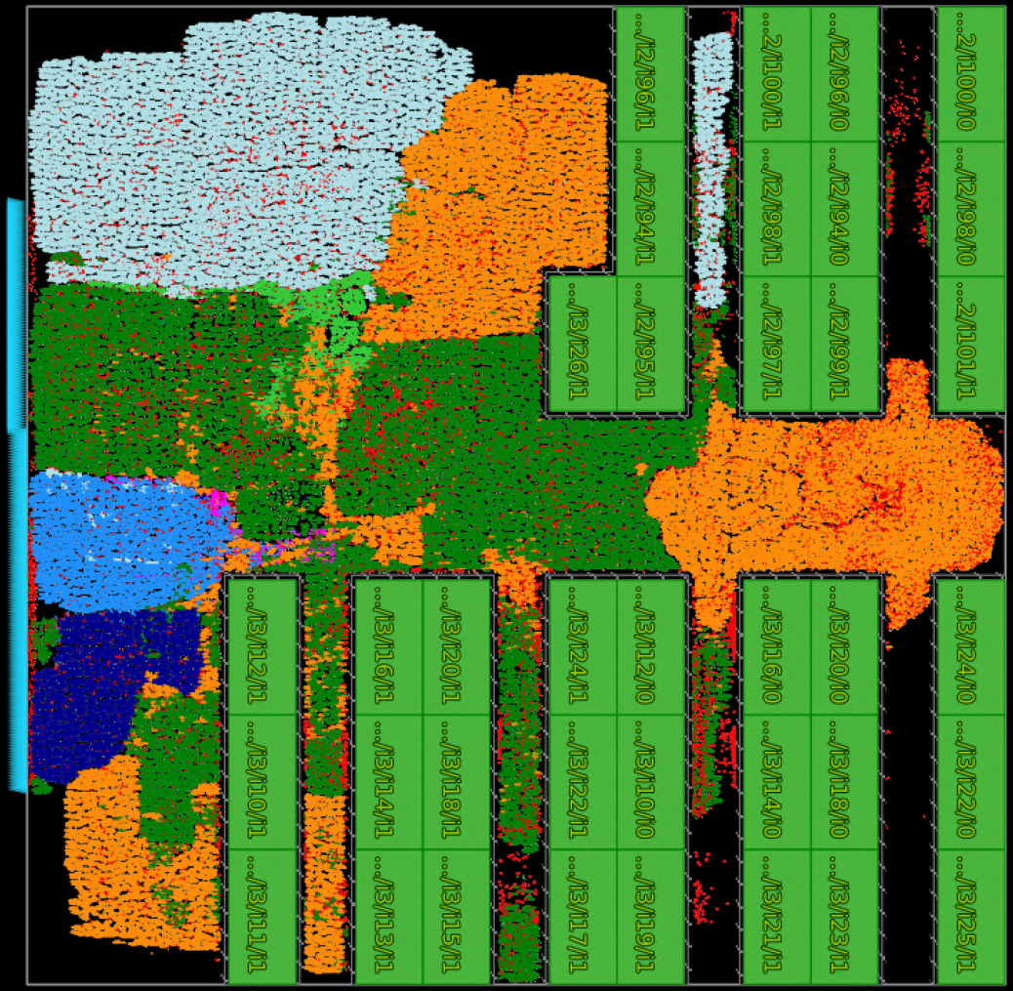
Hidden Benchmarks
Four hidden benchmarks
Two variants (in terms of TCP and Util) for each of Ariane and BSG_CHIP
Added soft guides around the macros
The placed design is generated using ORFS flow
Macro placement: BSG_CHIP – human and Hier-RTLMP; Ariane – human only
Different variants of public benchmarks are used
No unfamiliar design structure – contestants’ tools already handle these designs
TCP: 1150 Util: 50%
TCP: 1250 Util: 50%
TCP: 850 Util: 50%
TCP: 800 Util: 60%
BSG_CHIP
BSG_CHIP
Ariane
Ariane
Notes:
Now we present the four hidden benchmarks — variants of the public Ariane and BSG_CHIP designs, ensuring no unfamiliar design structures for contestants' tools. Soft guides are added around macros. For BSG_CHIP, one variant uses human macro placement and the other Hier-RTLMP; both Ariane variants use human placement.

Slide 14
Outline
Introduction and Motivation
Problem Formulation
Benchmarks
Evaluation
Participation Statistics
Acknowledgments
Next Year’s Roadmap
Notes:
Now we will present contest evaluation details.

Slide 15
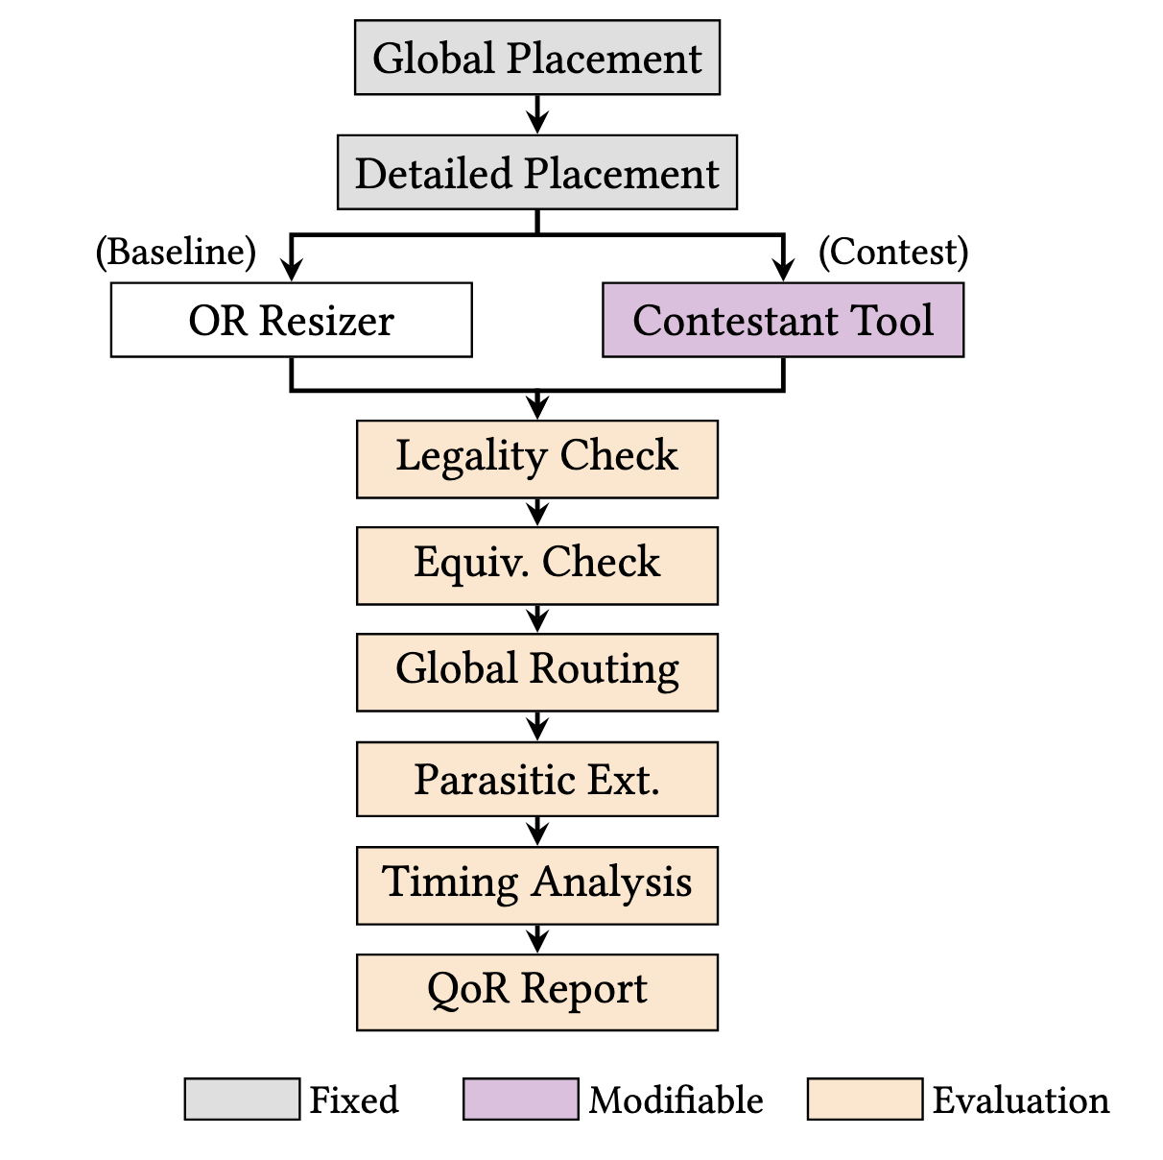
Evaluation Flow
Inputs to contestants:
Post-placement DEF
Debuffered Verilog netlist
.sdc constraints
ASAP7 .lef + .lib
Output: modified netlist + DEF
Evaluation: OpenROAD infrastructure
Custom equivalence check verifies:
Functional equivalence between original and resized cells
Instance insertions limited to buffers and inverters
Equivalent pin-to-pin connectivity
Buffer tree parity: even inverter count per source-to-sink path
Notes:
The figure on the right shows our evaluation flow.
Contestants receive four input files: a post-detailed placement DEF with fixed macros, I/Os, PDN, and soft blockages; a debuffered Verilog netlist; an SDC file specifying clock period and I/O delays; and ASAP7 LEF and multi-VT library files.
The output must include a modified Verilog netlist and a legalized DEF.
Evaluation runs entirely within OpenROAD infrastructure: GR-based parasitic extraction, then timing and power analysis.
A custom equivalence check verifies four properties: functional equivalence of resized cells, buffer and inverter-only insertions, preserved pin-to-pin connectivity, and buffer tree parity — meaning each source-to-sink path must contain an even number of inverters to preserve signal polarity. Next, here is Davit.

Slide 16
Evaluation Infrastructure
Provided a hybrid Docker/Apptainer evaluation environment
Containing fixed OpenROAD + Linux environment
Contestants upload a ZIP file with
setup.sh: install packages and build submissions
run.sh: called on each benchmark design
Evaluations used Apptainer on Purdue Anvil with:
16x AMD Epyc 7763 CPU cores
64 GB memory
200 GB disk
1x NVIDIA A100 GPU (if submission requests it)
Notes:
For evaluation, we provided a container to both organizers and contestants. So, contestants could evaluate solutions on their local machines before gaining access to the contest resources provided by Purdue’s Chipshub.
[CLICK] Contestants upload a ZIP file with a setup script to install and build packages into the fixed container environment, plus a run script that we execute for each benchmark testcase.
[CLICK] For each submission cycle, we create fresh resource-limited Apptainer instances on Anvil for each team.
Ultimately, we saw some resource and access bottlenecks to solve in next year’s contest.

Slide 17

Evaluation Scoring
$$S_{PPA}=w_{TNS}Δ_{TNS}+w_{dpower}Δ_{dpower}+w_{lpower}Δ_{lpower}$$
using weighted normalized differences vs. pre-opt baseline
Minus penalties for:
Runtime
Resizer runtime
Total tool + evaluation flow runtime
Displacement
Average Manhattan displacement of movable cells
ERC Violations
Total slew violation
Total capacitance violation
# of fanout violations
Global Routing Overflow
# of over-capacity edges in the 3D Gcell grid graph
Placement must be legal, logically equivalent, and must not perturb floorplan
Notes:
Our scoring function is a weighted sum of relative improvements over the pre-optimization, post-placement baseline.
[CLICK] We apply several penalties, for
[CLICK] Excess runtime for both the submitted tool and the evaluator,
[CLICK] Displacement of movable cells,
[CLICK] Electrical rules violations, and
[CLICK] Global routing overflow, as computed by OpenROAD’s GRT, summed over all layers and Gcells.
[CLICK] Finally, violating any of the constraints in the red text results in zero score. For example, nothing in the floorplan, including PDN and the placement of I/Os and physical cells, can be changed.
A team’s score is given by a weighted sum over all test cases which prioritizes larger designs.

Slide 18
Outline
Introduction and Motivation
Problem Formulation
Benchmarks
Evaluation
Participation Statistics
Acknowledgments
Next Year’s Roadmap
Notes:
Next come the results. For this video, we just give participation statistics.

Slide 19
Participation Statistics
36 teams registered
Beta Submission February 2, 2026 14 submissions
Results Announced March 18, 2026
Alpha Submission January 12, 2026 17 submissions
Final Submission March 6, 2026 13 submissions
Registration Open October 1, 2025
Notes:
We opened registration in October and published an initial evaluation toolkit. [CLICK] 36 teams registered. The full set of benchmarks was released in December, and [CLICK] 17 teams made Alpha submissions by January 12th. [CLICK] Beta submissions were due on February 2nd, and
[CLICK] 13 teams made final submissions. Throughout, the feedback to teams included scores and anonymized rankings. [CLICK] And, we will announce the results at ISPD.

Slide 20
Outline
Introduction and Motivation
Problem Formulation
Benchmarks
Evaluation
Participation Statistics
Acknowledgments
Next Year’s Roadmap
Notes:
We would like to acknowledge those who made the contest possible.

Slide 21
Acknowledgments
Sponsors
Purdue University and NSF Chipshub: provided compute resources for teams and submission evaluation
NVIDIA: provided prizes for the winning teams
Community Support
OpenROAD Initiative for their support
ISPD committee, especially Stephan Held and David Chinnery, for their interaction and guidance
Proposal and Contest Feedback
Vidya Chhabria, Matt Liberty, Tom Spyrou, Wen-Hao Liu, Yi-Chen Lu, and Mark Ren for valuable feedback on the contest proposal and contest description
Notes:
[CLICK] We would like to thank our sponsors: Purdue University and the NSF Chipshub for providing compute resources for teams and submission evaluation, and NVIDIA for providing the prizes.
[CLICK] We also appreciate support from the OpenROAD Initiative and its open-source ecosystem.
We thank the ISPD committee for featuring this contest, especially Stephan Held and David Chinnery for their interaction and guidance.
[CLICK] Finally, we would like to thank all the experts who provided valuable feedback on the contest proposal and description.

Slide 22
Outline
Introduction and Motivation
Problem Formulation
Benchmarks
Evaluation
Participation Statistics
Acknowledgments
Next Year’s Roadmap
Notes:
Finally, we will look at our potential roadmap for next year

Slide 23
Next Year’s Roadmap
Stress the robustness and scalability of buffering and sizing
Introduce more challenging and realistic conditions
Multi-Corner Multi-Mode (MCMM) timing constraints
Incremental infrastructure improvements
Post-CTS sizing and buffering
Hold timing constraints
Iterative ECO-style optimization
Multi-stage evaluation
We welcome suggestions on problem formulations, evaluation metrics, and new challenges!
Thank you for watching!
Notes:
[CLICK] Building on this year’s contest, we plan to place greater emphasis next year on the robustness and scalability of buffering and sizing strategies.
We also hope to introduce more challenging and realistic conditions.
[CLICK] For example, we are considering directions such as multi-corner multi-mode timing constraints, incremental infrastructure improvements, post-CTS sizing and buffering, hold timing constraints, iterative ECO-style optimization, and multi-stage evaluation.
[CLICK] These ideas are still under discussion, and we very much welcome suggestions from the community on problem formulations, evaluation metrics, and possible new challenges.
[CLICK] Thank you for watching our video!

