Slide 1

Au-MEDAL: Adaptable Grid Router with Metal Edge Detection And Layer Integration
Andrew B. Kahng¹, Seokhyeong Kang², Sehyeon Kim², Jakang Lee¹, Dooseok Yoon¹
¹ University of California, San Diego
² Pohang University of Science and Technology
Notes:
Hello everyone. Thank you for attending.
I’m Jakang Lee, a first-year Ph.D. student at UC San Diego.
Today, I’ll present Au-MEDAL, a collaborative project between UCSD and POSTECH.
Au-MEDAL is an automatic router for standard cell.

Slide 2
Contents
Introduction
  Standard Cell Layout Automation
  Key Limitations of Prior Cell Routers
Preliminaries
  Standard Cell Design Rules
  SMT Formulations of Design Rules
  Key Factors for Standard Cell Routing
Proposed Methods
  Extended Design Rules
  Pin Accessibility–aware Routing
Experimental Results
  Standard Cell-level Metrics
  Block-level Metrics
Conclusions
Notes:
Today’s talk is organized as follows.
First, in the Introduction, I will explain the motivation, and discuss the limitations of existing standard-cell router.
Then, in Preliminaries, I will briefly introduce standard cell design rules and how to formulate them as SMT constraints.
Next, in Proposed Methods, I will explain how our method addresses those limitations.
Finally, I will present the experimental results and conclusions.

Slide 3
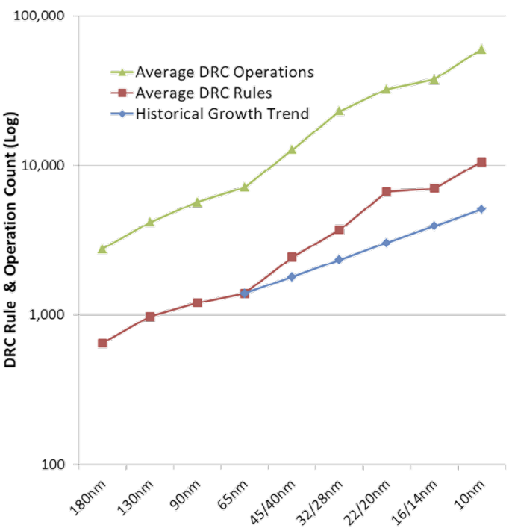
Standard Cell Layout Automation
DTCO-Driven Library Expansion
  DTCO requires an explosive variety of standard cell variants
  Manual design cannot scale to meet this demand
Exponential Design Rule Complexity
  Advanced nodes introduce many design rules
  Complexity exceeds human cognitive limits for DRC-clean
Logic | Inverter
Cell Layout
Synthesis Options | # of fins: 2 Gate length: 8 Single-pattern | # of fins: 3 Gate length: 8 Single-pattern | # of fins: 2 Gate length: 10 Single-pattern
Target | Standard | High perf. | Low leakage
Source: Siemens Business
Notes:
This slide explains why standard cell layout automation is important right now.
(Click)
First, due to the DTCO flow, the size of standard-cell libraries is growing very fast.
Because we need multiple versions of the same function cell—such as multi-Vt, multiple cell heights, and various driving strengths—libraries expand dramatically.
In this situation, purely manual design cannot keep up in terms of scalability.
(Click)
Second, design rules become complex in advanced nodes.
It is practically very difficult for humans to handle every condition perfectly and consistently produce DRC-clean routing solutions.
For these reasons, standard-cell layout automation has been studied.

Slide 4
Key Limitations of Prior Cell Routers
Limited Design-Rule Coverage
  Prior routers struggle with bidirectional routing and inter-layer design rules
  This leads to many DRC violations
Poor Block-level Routing
  Internal DRC-cleanliness does not guarantee pin accessibility
  Pins are often blocked during the P&R stage, causing routing failures in the block-level design
A
B
Y
Tip-to-Side
Tip-to-Side
Tip-to-Tip
Corner-to-Corner
Limited Design-Rule Coverage
Pool Block-level Routing
Notes:
However, conventional approaches have two major limitations.
First, the supported rule coverage is limited.
In particular, many methods do not properly handle bi-directional routing and inter-layer rules, which makes it hard to guarantee DRC-clean results.
Second, they do not guarantee block-level routing.
Even if routing is DRC-clean inside the cell, DRVs can occur during block-level routing.
This happens because cell design often does not sufficiently consider block-routing scenarios.
Therefore, standard-cell routing should consider not only in-cell constraints, but also block-level routing behavior.

Slide 5
Contents
Introduction
  Standard Cell Layout Automation
  Key Limitations of Prior Cell Routers
Preliminaries
  Standard Cell Design Rules
  SMT Formulations of Design Rules
  Key Factors for Standard Cell Routing
Proposed Methods
  Extended Design Rules
  Pin Accessibility–aware Routing
Experimental Results
  Standard Cell-level Metrics
  Block-level Metrics
Conclusions
Notes:
Before introducing our method, I will briefly review the background information.
First, I will summarize what types of rules we need to handle and how to express them in SMT formula.
Then, I will show what kinds of issues arise in practical routing.

Slide 6
Standard Cell Design Rules
Intra-layer Rules
  Minimum spacing rules defined by metal edge types (e.g., side, tip)
Inter-layer Rules
  Constraints defined between layers like LIG and LISD
Via Rules
  Specific constraints for via positioning relative to adjacent metals
M1
V0
LIG
LISD
GATE
M1.S.1
M1.S.2
M1.S.4
M1.S.6
Side-to-Side
Tip-to-Side
Tip-to-Tip
Corner-to-Corner
Intra-layer Design Rules
LIG.GATE.S.9B
LIG.LISD.S.7
LIG.LISD.S.6
Tip-to-Side
Tip-to-Tip
Corner-to-Corner
Inter-layer Design Rules
V0.S.2 - 4
V0.M1.EN.1
V0.S.1
V0.M1.AUX.3
Via Enclosure
Via Auxiliary
Via Spacing
Via Design Rules
Notes:
In standard-cell routing, design rules can be categorized into three types.
(Click)
First, intra-layer rules.
These are rules defined within the same metal layer, and the example is the minimum spacing rule.
An important point is that the minimum spacing design rules can depend on the edge type.
For example, spacing constraints may differ for Side-to-Side, Tip-to-Side, Tip-to-Tip, and Corner-to-Corner cases.
Therefore, a standard-cell router must identify metal edge types and apply the corresponding rules correctly.
(Click)
Second, inter-layer rules.
These are rules defined between different layers, and they appear frequently in standard cells.
The figure shows an example of rules between two different layers, such as LIG and LISD.
(Click)
Third, via rules.
These include constraints such as via-to-via spacing and via enclosure rule.
The standard-cell routers should be able to handle all three rule categories simultaneously.

Slide 7
























SMT Formulations of Design Rules
$$v_{FR}$$
$${tip}_{v,Right}∧{tip}_{v_{FR},Left}==False$$
$$v_{FR}$$
$$v_{L}$$
$$v$$
$$v_{R}$$
$$v_{RR}$$
$${tip}_{v,Right}∧{tip}_{v_{BR},Left}==False$$
$$v_{R}$$
$$v_{RR}$$
$$v_{L}$$
$$v$$
$$v_{BR}$$
$$v_{BR}$$
Corner-to-Corner Spacing Rule
Violated
Satisfied
$$v_{FR}$$
$${tip}_{v,Right}∧{tip}_{v_{R},Left}==False$$
$$v_{FR}$$
$${tip}_{v,Right}∧{tip}_{v_{RR},Left}==False$$
$$v_{L}$$
$$v$$
$$v_{R}$$
$$v_{RR}$$
$$v_{L}$$
$$v$$
$$v_{R}$$
$$v_{RR}$$
$$v_{BR}$$
$$v_{BR}$$
Tip-to-Tip Spacing Rule
Violated
Satisfied
If edge types are identified correctly, design rules are easy to encode
Notes:
This slide shows how we can produce DRC-clean routing using SMT constraints.
(Click)
The top-left figure shows a corner-to-corner spacing violation scenario—that is to say, two corners become too close.
To prevent this DRV, we can add these SMT constraints.
(Click)
Here, the right tip of vertex v corresponds to this part of the figure,
(Click)
the left tip of v’s front-right vertex corresponds to this part,
(Click)
and the left tip of v’s back-right vertex corresponds to this part.
In short, these constraint prevents those tip variables from being simultaneously true,
so design-rule violations do not occur during standard cell routing.
(Click)
The next figure shows a tip-to-tip spacing violation case.
The concept is the similar, so here you can just focus on the concept.
These examples highlight the key idea:
if we can correctly identify edge types, we can accurately encode spacing rules as SMT constraints.

Slide 8
Key Factors for Standard Cell Routing
Bi-directional Routing
  No layer-specific preferred direction, so edge types (side/tip) vary with route shape
  The example on the right shows that the metal edge type can vary with the routing shape
Block-level Routing
  A standard-cell layout can be DRC-clean, yet violate DRC after block-level routing
  Poor pin accessibility often leads to numerous DRVs at the block level
Tip
Side
Inner Corner
Outer Corner
Uni-direction
Bi-direction
Side → Tip
Bend
Routing
Consistent Metal Edge Type
Variable Metal Edge Type
Tip → Side
Cell-level Routing
Cell-level Routing
Block-level Routing
A
A
B
Y
A
B
Y
Cell-level Routing Metal (M2)
Block-level Routing Metal (M2)
Case 1
Case 2
Notes:
This slide introduces the main factors to consider in standard cell routing.
The first is bidirectional routing.
(Click)
In this figure, uni-directional routing assumes a fixed routing direction.
In that case, edge types are consistent. For example, in this case, a vertical routing layer, left/right are always sides and front/back are always tips.
So edge types can be determined from the layer direction.
In contrast, bi-directional routing allows multiple directions and often introduces bend routing.
The important point is that when the shape changes due to a bend, a side edge can become a tip, and vice versa.
(Click)
Like this.
So in bi-directional routing, edge types are not fixed—they depend on the routing shape.
But since spacing rules depend on whether an edge is a side or a tip, rule handling becomes much more complex.
(Click)
Now, let’s look at the block-level routing issue.
The key point is: even if standard cell layout is DRC-clean, DRVs can still appear at block level routing.
As shown in the figure, a cell can be DRC-clean on its own, yet its pins may be blocked by surrounding routing metals, causing block-level routing to fail
(Click)
In the first case, the standard cell layout is DRC-clean.
But because of one M2 metal, pin A is not reachable at all.
No matter what order we try, routing will fail.
In the second case, there is no way to route pin A, B, and Y together.
For example, we route A first (click x 2), then route Y. (click x 2)
After that, pin B has nowhere left to route.
And that also causes routing failure.
Therefore, standard-cell routing must consider block-level routing.

Slide 9
Contents
Introduction
  Standard Cell Layout Automation
  Key Limitations of Prior Cell Routers
Preliminaries
  Standard Cell Design Rules
  SMT Formulations of Design Rules
  Key Factors for Standard Cell Routing
Proposed Methods
  Extended Design Rules
  Pin Accessibility–aware Routing
Experimental Results
  Standard Cell-level Metrics
  Block-level Metrics
Conclusions
Notes:
Now I will introduce our method. It has two main components.
First, extended design-rule support.
Second, pin-accessibility-aware routing.

Slide 10
Extended Design Rules – Main Targets
SMT-Based Edge-Type Detection
  We use SMT to distinguish side / tip / corner edges, so spacing rules can be applied even when shapes change
Inter-Layer Rule Modeling
  We encode design rules across different layers, capturing layer-to-layer dependencies
Via-Enclosure-Aware Spacing
  We incorporate via enclosure–induced metal extension into spacing constraints to prevent violations
M1
V0
LIG
LISD
GATE
M1.S.1
M1.S.2
M1.S.4
M1.S.6
Side-to-Side
Tip-to-Side
Tip-to-Tip
Corner-to-Corner
Intra-layer Design Rules
LIG.GATE.S.9B
LIG.LISD.S.7
LIG.LISD.S.6
Tip-to-Side
Tip-to-Tip
Corner-to-Corner
Inter-layer Design Rules
V0.S.2 - 4
V0.M1.EN.1
V0.S.1
V0.M1.AUX.3
Via Enclosure
Via Auxiliary
Via Spacing
Via Design Rules
Notes:
This slide is a quick reminder of the various design rules I introduced in the Preliminaries section.
The three bullets below summarize the key challenges we must address.
Among them, the main focus of my talk today is the first one: SMT-based edge-type detection.
To do this properly, we first need a clear way to distinguish metal edge types using SMT constraints.
Starting from the next slide, I will explain that step by step.

Slide 11


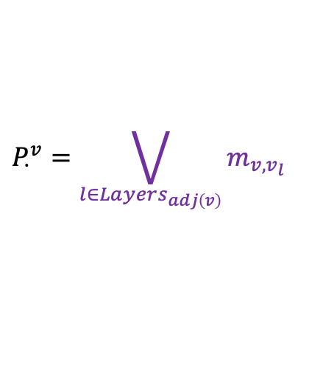

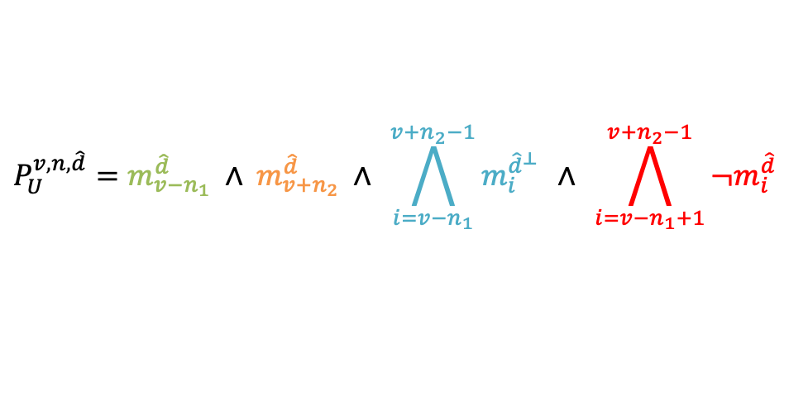

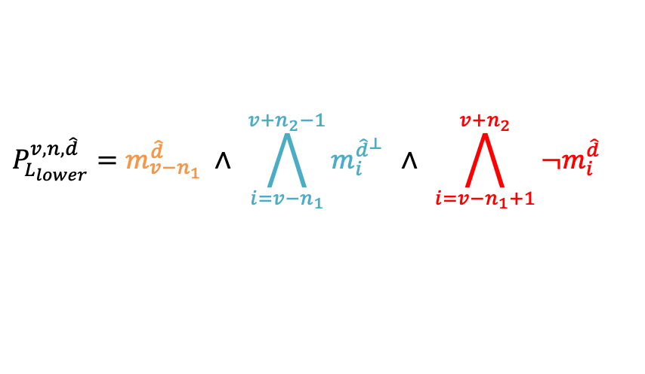

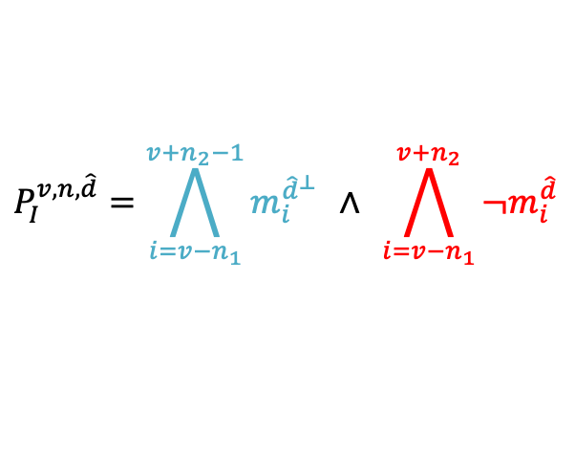

Extended Design Rules – Metal Patterns
Metal Patterns
  Dot pattern
  I Pattern
  L Pattern
  U Pattern
$$P_{∙}^{v}=\bigvee_{l∈Layers_{adj\left(v\right)}}{m_{v,v_{l} }}$$
$${\hat{d}}^{⊥}$$
$$P_{I}^{v,n,\hat{d}}=\bigwedge_{i=v−n_{1}}^{v+n_{2}−1}{m_{i}^{{\hat{d}}^{⊥}}} ∧ \bigwedge_{i=v−n_{1}}^{v+n_{2}}{¬m_{i}^{\hat{d}}}$$
$$\hat{d}$$
$$P_{L_{lower}}^{v,n,\hat{d}}=m_{v−n_{1}}^{\hat{d}} ∧ \bigwedge_{i=v−n_{1}}^{v+n_{2}−1}{m_{i}^{{\hat{d}}^{⊥}}} ∧ \bigwedge_{i=v−n_{1}+1}^{v+n_{2}}{¬m_{i}^{\hat{d}}}$$
$${\hat{d}}^{⊥}$$
$$\hat{d}$$
$$P_{U}^{v,n,\hat{d}}=m_{v−n_{1}}^{\hat{d}} ∧ m_{v+n_{2}}^{\hat{d}} ∧ \bigwedge_{i=v−n_{1}}^{v+n_{2}−1}{m_{i}^{{\hat{d}}^{⊥}}} ∧ \bigwedge_{i=v−n_{1}+1}^{v+n_{2}−1}{¬m_{i}^{\hat{d}}}$$
$$\hat{d}$$
$${\hat{d}}^{⊥}$$
$$\text{where} n_{1}+n_{2}=n, n_{1},n_{2}≥0, n,n_{1},n_{2}∈Z$$
Notes:
This slide shows how we model the four metal patterns we defined—Dot, I, L, and U—into SMT constraints.
The Dot pattern is the simplest.
It’s just a tiny block of metal like a dot, and it usually comes from a via.
(click) This formula is for the Z-direction routing in the figure.
The I pattern is a straight metal line that goes in one direction.
(click) This part of the formula matches this part of the figure,
(click) and this part matches this part.
I marked each part with colors, so it should be easy to see.
The main thing here is just to check the metal direction d hat.
Next, the L pattern is an I pattern with one more segment, so it makes a bend.
(click) The orange part of the formula matches this segment in the figure.
The U pattern is an L pattern with one more segment added.
(click) The added light-green part in the formula matches this part of the figure.
Once we define these patterns in SMT, we can use them to identify edge types, which I’ll cover in the next slide.

Slide 12
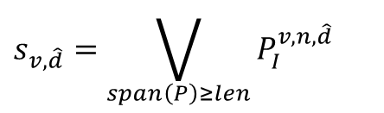


Extended Design Rules – Metal Edge Detection
Metal Edge Detection
  Side Edge
  Tip Edge
  Corner Edge
$$s_{v,\hat{d}}=\bigvee_{span\left(P\right)≥len}{P_{I}^{v,n,\hat{d}}}$$
For the detailed equations, please refer to the paper and the code
$$t_{v,\hat{d}}=¬\left(m_{v}^{\hat{d}}∨m_{v}^{−{\hat{d}}^{⊥}}∨m_{v}^{{\hat{d}}^{⊥}}\right)∧\left(m_{v}^{−\hat{d}}∨P_{∙}^{v}\right)$$
$$c_{v,\hat{d},{\hat{d}}^{⊥}}=\left(m_{v}^{{\hat{d}}^{⊥}}∧m_{v}^{\hat{d}}\right)∨\left(m_{v}^{−\hat{d}}∨m_{v}^{−{\hat{d}}^{⊥}}∨P_{∙}^{v}\right)$$
e.g., When $\hat{d}$ is the right, $c_{v,Right,Front }=\left(m_{v}^{Front}∧m_{v}^{Right}\right)∨\left(m_{v}^{Left}∨m_{v}^{Back}∨P_{∙}^{v}\right)$
$$v$$
$$v$$
$$v$$
$$v$$
Notes:
(Click)
This slide explains the SMT logic for detecting metal edges.
(Click)
A all-metal edge types are defined in SMT as follows.
(Click)
Since side and tip has similarities with corners,
(Click)
So, I will use the Corner edge type as an example.
The formula itself is not very intuitive, so let’s look at an example.
(Click)
Suppose we detect the top-right corner at vertex v.
Once d-hat is set to the right, the directions in the formula are determined accordingly.
Looking at each term:
Mv_front corresponds to this metal (Click),
and Mv_right corresponds to this metal (Click).
If both metals exist, we have an inner corner.
On the other hand,
Mv_left (Click), Mv_back (Click), and the Dot pattern of v (Click)
each can create an outer corner.
In summary, we identify side/tip/corner at each vertex via SMT,
and directly use those detected edge types in spacing rules.
More detailed formulas are included in our paper and code, if you would like to refer to them.

Slide 13






Extended Design Rules – Multiple Spacing Rules
Multiple Spacing Rules
  Using an SMT formulation, we enforce the min distance between the corresponding metal edge types
  Au-MEDAL can also account for metal extensions caused by via enclosure
  The example below encodes the min C2C spacing with metal enclosure as SMT constraints
➔
$$MS_{c2c}\left(v,u\right)=¬\left(enc_{v,Hor}∨enc_{u,Hor}\right)∨¬\left(c_{v, Back,Right} ∧c_{u,Front,Left}\right)==True$$
V1
M1
M1 Enclosure for V1
$$v$$
$$v$$
$$v$$
$$v$$
$$u$$
$$u$$
$$u$$
$$u$$
Notes:
This slide shows how we implement minimum spacing rules in our approach.
As discussed in Preliminaries, we enforce minimum spacing rules based on edge types using SMT constraints.
This formula is a representative example.
(Click)
For reference, this horizontal enclosure of vertex v means this.
The key point is that when we apply spacing rules, we also account for via enclosure effects.
When a via exists, surrounding metal must enclose it, which can cause spacing violations.
We model this effect as well, structurally preventing spacing-rule violations.

Slide 14
Pin Accessibility-aware Routing – Pin-Length Max
Objective Function for Maximizing Pin Length
  To extend vertical external pin lengths, we reordered optimization priority on the external-pin layer
  Center tracks in a standard cell are assigned higher cost than peripheral tracks
  By optimizing sequentially, we reduce runtime and reserve slack space to increase pin length
Lower Metal Cost
Pin-length Maximization Objective Function
Higher Metal Cost
Lower Metal Cost
External Pin
Notes:
Now let’s move on to pin accessibility.
Even if we achieve DRC-clean routing inside the cell, routing can fail if pins are difficult to access at block level.
So we aim to make pins easier to connect.
(click)
Our first idea is to make external pins longer.
Since M2 is the horizontal routing layer, extending M1 external pins in the vertical direction increases the number of connection options for the block-level router.
To do this, we define a cost.
On the external-pin layer, we assign higher cost to the center track and lower cost to outer tracks. Like this. (Click)
Then the optimization avoids the center, leaving more space and making it easier to extend pins.
Also, because this is optimized sequentially, it helps reduce runtime.

Slide 15
Pin Accessibility-aware Routing – Block-aware
Ensuring Pin Accessibility at Block-Level Routing
  We route standard cells with block-level routing in mind to guarantee at least one accessible pin
  Constraint: each external pin must have ≥1 connection to an upper metal layer
  After removing the upper-metal segments, the cell supports ≥1 valid block-level routing scenario
A
This metal segment is not part of the standard cell, so it is removed
A
Upper metal segment for intended
block-level routing
Notes:
However, extending pins is not always sufficient.
There are cases where pins are longer but accessibility is still not guaranteed.
So we add a stronger constraint in the SMT solver.
The rule is simple: each external pin must have at least one point connecting to an upper metal layer.
This guarantees at least one connection option during block-level routing.
(click)
we assume that a metal segment connecting from the external pin to the upper layer must exist during standard cell routing,
and then remove that segment in the final layout.
The key is that this process ensures at least one feasible block-level connection scenario.

Slide 16
Contents
Introduction
  Standard Cell Layout Automation
  Key Limitations of Prior Cell Routers
Preliminaries
  Standard Cell Design Rules
  SMT Formulations of Design Rules
  Key Factors for Standard Cell Routing
Proposed Methods
  Extended Design Rules
  Pin Accessibility–aware Routing
Experimental Results
  Standard Cell-level Metrics
  Block-level Metrics
Conclusions
Notes:
Now I will present the experimental results.
First, the standard cell-level results.
Then, the block-level results.

Slide 17
Experimental Results – Overview
Extended Design Rules
Cell-level Metrics
Inter-layer Rules
Various Spacing Rules
Via Rules
# DRV
Runtime
Pin Accessibility–aware Routing
Block-level Metrics
# DRV
Power
Maximizing Pin Length
Ensuring Pin Accessibility
Area
TNS
Notes:
This slide summarizes which components of our method influence each set of experimental results.
First, the extended design rules mainly have a direct impact on the cell-level metrics
such as the number of DRVs.
Additionally, this technique satisfies a wider range of design rules, which ultimately has a positive impact on block-level routing.
In addition, our pin-accessibility-aware routing increases pin connectivity at the block level,
reducing routing failures.
As a result, it contributes to improving block-level performance, both directly and indirectly.

Slide 18
Standard-Cell-Level Metrics
DRC Results
Runtime
Place | Route | # Cells
 |  | Clean | Total | Ratio
ASAP7 (Manual) | ASAP7 (Manual) | 172 | 172 | 100 %
 | Au-MEDAL | 172 | 172 | 100 %
Csyn-fp | Csyn-fp | 92 | 169 | 54.4 %
 | Au-MEDAL | 169 | 169 | 100 %
NCTUcell | NCTUcell | 70 | 75 | 93.3%
 | Au-MEDAL | 75 | 75 | 100 %
10 ~ 60 min
(1.9 %)
1 ~ 3 hours
(0.5 %)
5 ~ 10 min
(3.9 %)
46.7 %
47.0 %
1 ~ 5 min
(46.7 %)
~ 1 min
(47.0 %)
All cells used in the experiments are generated within 3 hours, and 93.7% of the cells are generated within 5 minutes
All routed cells are DRC-clean !
Notes:
This slide shows two key results.
(click)
First, all routed cells using our method are DRC-clean, verified using Calibre DRC.
As you can see, we use same placement compared to previous works, and compare only each routers' performance.
Among conventional standard cell routing frameworks, our method is the only one that achieves DRC-clean results.
This indicates that our constraints and modeling reflect real design rules very well.
(click)
Please note that only our router can generate all DRC-clean cells.
(click)
Second, the runtime is practical.
All cells in our experiments finished within 3 hours, and 93.7% completed within 5 minutes.
So we achieve both correctness and practical speed.

Slide 19
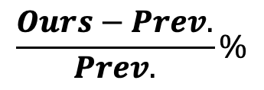
Block-level Metrics
Place | Design | # Cell | Block-level Metrics (Improvement %)
 |  |  | Area | Power | Eff. Clock | TNS | # DRVs
ASAP7 (Manual) | AES | 17k | -0.17 % | -1.00 % | -0.70 % | -6.15 % | 0 %
 | LDPC | 52k | -0.05 % | -0.52 % | -0.13 % | -16.00 % | +33.97 %
 | JPEG | 65k | -1.70 % | -3.98 % | -2.12 % | -80.86 % | +1.14 %
Csyn-fp | AES | 17k | +2.04 % | +1.55 % | +3.81 % | +15.13 % | -92.67 %
 | LDPC | 52k | +0.24 % | -0.16 % | -1.05 % | -23.35 % | -75.94 %
 | JPEG | 65k | -4.14 % | -4.48 % | -17.22 % | -81.61 % | -95.09 %
NCTUcell | AES | 17k | -2.68 % | -2.02 % | -2.67 % | -12.72 % | -97.86 %
 | LDPC | 52k | +0.17 % | -2.99 % | +0.26 % | +36.71 % | -94.59 %
 | JPEG | 65k | -1.56 % | +2.86 % | -1.25 % | -56.64 % | -97.06 %
Average Reduction |  |  | -0.87 % | -1.19 % | -2.34 % | -25.05 % | -57.57 %
We fixed the placement and compared only the routing results using the metrics below
$$\frac{Ours−Prev.}{Prev.}\%$$
Compared to prior standard-cell layout automation methods, Au-MEDAL reduces block-level DRVs by 92% on average
Notes:
This slide shows the block-level results.
Compared to prior methods, we almost improve block-level PPA,
and in particular, we reduce block-level DRVs by 92% on average compared to other automated routers.
This large reduction is because we do not only focus on in-cell routing,
but also increase pin accessibility, improving the likelihood of successful block routing.

Slide 20
Conclusion
Advanced-node, DRC-clean in-cell routing
  We ensure DRC-clean routing under advanced-node rules via metal-edge detection and extended spacing/via constraints (Calibre-verified)
Pin-accessible standard cells for block-level routing
  We maximize pin stretchability while guaranteeing at least one valid access point per pin, cutting block-level DRVs by ~92% versus prior in-cell routers
Overall PPA and runtime improvements
  Across AES/LDPC/JPEG, we achieve average gains of 0.87% (area), 1.19% (power), 2.34% (effective clock), and 25.05% (TNS)
  93.7% of cells finish within 5 minutes (all within 3 hours)
Notes:
Let me summarize the keys of our methods.
First, we achieve DRC-clean in-cell routing in advanced nodes.
We do this using metal-edge detection and extended spacing/via constraints, and we verified it with Calibre.
Second, we generate cells with block-level pin accessibility.
We extend external pins and guarantee at least one connection option per pin.
As a result, block-level DRVs are reduced by about 92% compared to conventional routers.
Third, we also achieve strong results in PPA and runtime, most cells are generated within 5 minutes.

Slide 21

Thank you !
https://github.com/ABKGroup/Au-MEDAL
Notes:
That’s all for my presentation.
Thank you for your attention.
You can find the code and more details at the following link:

Slide 22
Back Up Slides
Notes:
Au-MEDAL addresses these issues with several key methods.
It improves design-rule coverage for bi-directional routing using metal edge type detection.
It supports off-grid rule checking and variable grid spacing.
It also routes MOL and BEOL layers together to properly handle inter-layer constraints.
Finally, it adds constraints to improve pin accessibility for block-level routing.

Slide 23
Extended Design Rules – Inter-layer Design Rules
Inter-layer Design Rules
  Enhanced DRC capabilities to support checks between two different routing layers
Shorts between diff. nets between LISD and LIG are prohibited
M0
LISD
LIG
Physical Metal Stack
Must satisfy the design rules between the two layers as well
LIG
Gate
LIG.LISD.S.6
LIG.LISD.S.7
LISD
LIG
Tip-to-Tip
Corner-to-Corner
Expand the scope of design rules to enable DRC checks across diff. layers
Notes:
This slide explains inter-layer rules.
The ASAP7 PDK uses MOL layers.
LIG stands for local interconnect gate, and LISD stands for local interconnect source/drain.
These layers provide additional routing resources, but the problem is that they are not fully independent.
(Click)
As shown in the figure, LIG and LISD have overlapping regions in the stack.
Therefore, the two layers become physically dependent.
(Click)
This can cause shorts between the two layers (Click),
which leads to new minimum spacing rules between them (Click).
Our method extends beyond intra-layer-only rule handling,
and can also check rules across different metal layers.

Slide 24
Standard-Cell-Level Metrics
DRC Results
Runtime
Place | Route | # Cells
 |  | Clean | Total | Ratio
ASAP7 (Manual) | ASAP7 (Manual) | 172 | 172 | 100 %
 | Au-MEDAL | 172 | 172 | 100 %
Csyn-fp | Csyn-fp | 92 | 169 | 54.4 %
 | Au-MEDAL | 169 | 169 | 100 %
NCTUcell | NCTUcell | 70 | 75 | 93.3%
 | Au-MEDAL | 75 | 75 | 100 %
10 ~ 60 min
(1.9 %)
1 ~ 3 hours
(0.5 %)
5 ~ 10 min
(3.9 %)
46.7 %
47.0 %
1 ~ 5 min
(46.7 %)
~ 1 min
(47.0 %)
All cells used in the experiments are generated within 3 hours, and 93.7% of the cells are generated within 5 minutes
All routed cells are DRC-clean !
Notes:
This slide shows two key results.
(click)
First, all routed cells using our method are DRC-clean, verified using Calibre DRC.
As you can see, we use same placement compared to previous works, and compare only each routers' performance.
Among existing standard cell routing frameworks, our method is the only one that achieves DRC-clean results.
This indicates that our constraints and modeling reflect real design rules very well.
(click)
Second, the runtime is practical.
All cells in our experiments finished within 3 hours, and 93.7% completed within 5 minutes.
So we achieve both correctness and practical speed.

Slide 25
Standard-Cell-Level Metrics – Cell-Flex Metrics
Pin Access Flexibility (PAF)
  Average number of block-level routing scenarios that can connect all pins while remaining DRC-clean
Hor. Passing Track Availability (HPTA)
  Availability of horizontal passing tracks (M2 tracks) for block-level routing
Hor.-to-Ver. Via Availability (H2VVA)
  Availability of vias (V2) that enable horizontal-to-vertical transitions for block-level routing
Place | Route | Norm. Metrics
 |  | PAF | HPTA | H2VVA
ASAP7 | ASAP7 | 1.000 | 1.000 | 1.000
 | Au-MEDAL | 0.984 | 1.023 | 1.013
Csyn-fp | Csyn-fp | 1.000 | 1.000 | 1.000
 | Au-MEDAL | 1.653 | 1.045 | 1.019
NCTUcell | NCTUcell | 1.000 | 1.000 | 1.000
 | Au-MEDAL | 2.500 | 1.060 | 1.022
Higher is better !
Notes:
We aim to generate cells that connect well at block level.
So we use three metrics from cell-flex.
First, PAF (Pin Access Flexibility).
It represents the number of routing scenarios where all pins can be connected without DRVs under various block-routing conditions.
Higher PAF means easier pin access.
Second, HPTA (Horizontal Passing Track Availability).
It measures how many horizontal tracks (e.g., on M2) remain available.
A higher value means the block router can more easily route wires across the cell.
Third, H2VVA (Horizontal-to-Vertical Via Availability).
It measures how many via opportunities exist to transition from horizontal to vertical routing.
More via options reduce conflicts and make routing easier.
Except for the PAF of manual layouts, our method generally outperforms other automated approaches across these metrics.

Slide 26
Key Limitations of Prior In-cell Routers
Limited Design-Rule Coverage
  Prior routers struggle with bidirectional routing and inter-layer design rules
  This leads to many DRC violations
Uniform Grid Constraints
  Heavy reliance on a uniform routing grid strategy restricts adaptability
  It limits the search for optimized solutions under complex design rule specifications
Sequential Routing Optimization Flow
  MOL routing is performed followed by BEOL routing in a sequential manner
  This flow neglects inter-layer design rules and lacks concurrent layer optimization
Poor Block-level Routability
  Internal DRC-cleanliness does not guarantee pin accessibility
  Pins are often blocked during the P&R stage, causing routing failures in the block-level design
Notes:
Prior in-cell routers often have limited design-rule coverage.
They may not fully enforce bi-directional spacing rules, and they also struggle with off-grid and inter-layer rules.
This can cause DRC violations, or it can force overly conservative routing.
Some routers also route layers one by one, which can miss important inter-layer constraints.
Even if a cell is DRC-clean, poor pin access can still cause routing failures at the block level.

Slide 27











Flexible Routing Grid Spacing – Narrower Case
Narrower-Than-Default Metal Pitch
  Set a metal pitch narrower than the default metal pitch (e.g., M1 pitch, half contacted poly pitch)
  We checks DRC using physical distances (not grid counts), enabling flexible track insertion
$$λ_{2}$$
$$λ_{2}$$
$$λ_{2}$$
$$λ_{2}$$
$$λ_{3}$$
$$λ_{2}$$
$$λ_{3}$$
$$λ_{2}$$
$$λ_{3}$$
$$λ_{2}$$
$$λ_{3}$$
$$λ_{2}$$
$$λ_{2}$$
$$λ_{2}$$
$$λ_{1}$$
$$λ_{1}$$
$$λ_{1}$$
Grid Spacing Option 1
Grid Spacing Option 2
Grid Spacing Option 3
Vertical Track ($λ_{1}$)
Horizontal Track ($λ_{2}$)
Horizontal Track ($λ_{3}$)
Notes:
This slide focuses on extended design rules for bi-directional routing.
Au-MEDAL detects metal edge types so it can apply the correct spacing rule for each case.
This helps avoid minimum-spacing violations and improves DRC-clean routing in realistic layouts.

Slide 28

Flexible Routing Grid Spacing – Wider Case
Wider-Than-Default Metal Pitch
  Routing tracks at locations with no net connection points can be removed to improve runtime
  It can be applied to cells like BUFx24, which are large but have simple routing
Removable !
$${2∗λ}_{1}$$
$${2∗λ}_{1}$$
Y
Y
Y
Y
Y
Y
Track Pruning
Y
Y
Y
Y
Y
Y
A
A
A
A
A
A
A
A
Y
Y
Y
Y
Y
Y
Y
Y
Y
Y
Y
Y
Original Grid Setting
Pruned Grid Spacing Setting
Notes:
This slide focuses on extended design rules for bi-directional routing.
Au-MEDAL detects metal edge types so it can apply the correct spacing rule for each case.
This helps avoid minimum-spacing violations and improves DRC-clean routing in realistic layouts.

Slide 29
Integrated MOL/BEOL Routing
Per-layer routing direction is configurable
  Metal-edge detection enables design-rule-aware bidirectional routing, making it easy to set routing directions per layer (e.g., M1: bidirectional, LIG: horizontal)
Inter-layer design rules can be enforced
  We can route multiple layers in an integrated flow while enforcing inter-layer DRC constraints
Sequential Routing
Simultaneous Routing
LIG-LISD
Routing
M1-M2
Routing
LIG-LISD & M1-M2
Routing
Previous Works
Au-MEDAL
Notes:
This slide focuses on extended design rules for bi-directional routing.
Au-MEDAL detects metal edge types so it can apply the correct spacing rule for each case.
This helps avoid minimum-spacing violations and improves DRC-clean routing in realistic layouts.

Slide 30
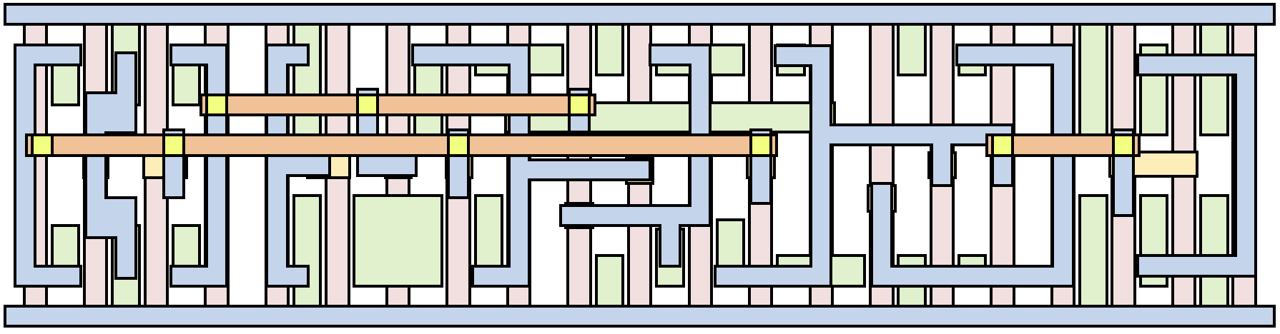
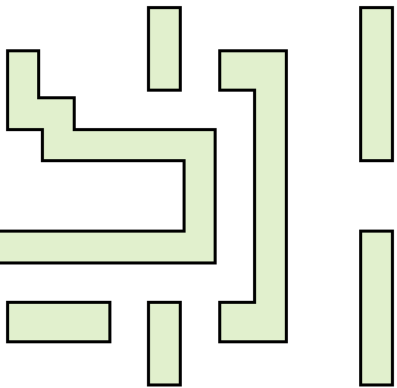
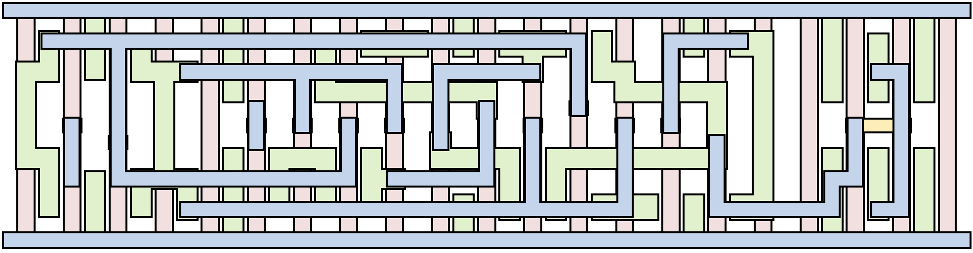
Standard-Cell-Level Metrics – Example
LIG
Gate
LISD
V1
M1
M2
Aggressive MOL Routing
Place (ASAP7) – Route (ASAP7)
Place (ASAP7) – Route (Au-MEDAL)
Same placement, but not using M2
Notes:
This slide focuses on extended design rules for bi-directional routing.
Au-MEDAL detects metal edge types so it can apply the correct spacing rule for each case.
This helps avoid minimum-spacing violations and improves DRC-clean routing in realistic layouts.

Slide 31
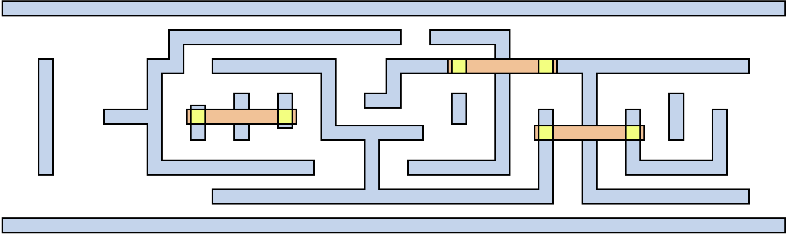
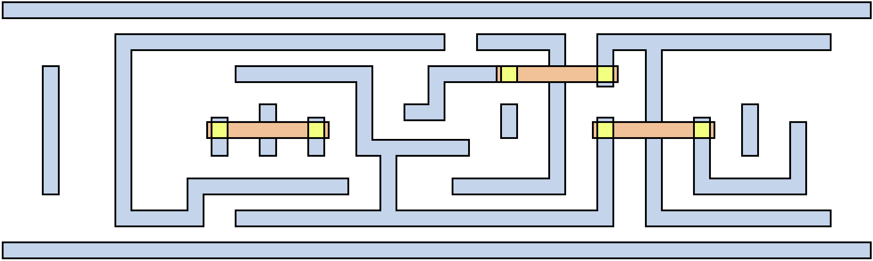
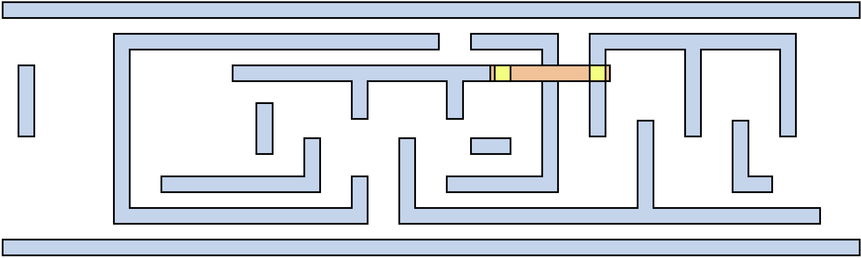
Standard-Cell-Level Metrics – Example
Pin accessible
Pin inaccessible
M1
M1 Pin
V1
M2
No pin-aware routing applied
Only (1) Pin stretchability objective function applied
(1) Pin stretchability objective function and
(2) Block-level routing-aware routing applied
Notes:
This slide focuses on extended design rules for bi-directional routing.
Au-MEDAL detects metal edge types so it can apply the correct spacing rule for each case.
This helps avoid minimum-spacing violations and improves DRC-clean routing in realistic layouts.

Slide 32

Realistic In-cell Routing
Bi-directional Routing
  Realistic routing is often bi-directional, so edge types (tip/side) are not fixed
  As routing changes, the metal edge type can change, making rule enforcement non-trivial
Off-Grid Routing Metal
  Realistic layouts include off-grid metal, so on-grid DRC cannot be applied directly
  Simple snapping can be optimistic (DRC violations) or pessimistic (over-constrained)
Tip
Side
Inner Corner
Outer Corner
Uni-directional Routing
Bi-directional Routing
Side → Tip
Bend
Routing
Tip → Side
Consistent Metal Edge Type
Variable Metal Edge Type
Off-Grid Metal
On-Grid Metal
Optimistic
Satisfied
Pessimistic
Satisfied
Min Tip-to-Tip Spacing
Violated
Notes:
In bi-directional routing, edge types can change along the route, so spacing rules must be edge-aware.
Also, real layouts can include off-grid shapes, so a pure on-grid rule model is not enough.
These factors are a major reason why prior routers have limited design-rule coverage in practice.

Slide 33







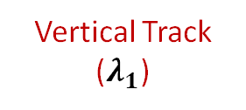


Realistic In-cell Routing
3. Non-uniform Routing Grid Spacing
Realistic routing uses non-uniform track spacing
A single grid spacing no longer represents a fixed physical distance
So, uniform on-grid rule encoding cannot be applied as-is
Vertical Track ($λ_{1}$)
Horizontal Track ($λ_{2}$)
Horizontal Track ($λ_{3}$)
$$λ_{2}$$
$$λ_{2}$$
$$λ_{2}$$
$$λ_{3}$$
$$λ_{2}$$
$$λ_{3}$$
$$λ_{2}$$
Add Horizontal Track Spacing $λ_{3}$ !
$$λ_{2}$$
$$λ_{1}$$
$$λ_{1}$$
Uniform Routing Grid Spacing
Non-uniform Routing Grid Spacing
Notes:
Real designs can use non-uniform track spacing, so one grid step is not always the same physical distance.
If a router assumes a uniform grid, it can encode spacing rules incorrectly.
This motivates using variable grid spacing to match real track patterns.

Slide 34
Potential Issues
Block-level Routing
A standard-cell layout can be DRC-clean, yet violate DRC after block-level routing
Poor pin accessibility often leads to numerous DRVs at the block level
Cell-level DRC
Block-level DRC
Standard Cell 1
Standard Cell 1
…
…
Block-level
Routing
Standard Cell 2
Standard Cell 2
➔ Standard-cell routing must consider all possible block-level scenarios
Spacing Rule Satisfied
Spacing Rule Violated
Notes:
A cell can be DRC-clean by itself but still cause violations after placement and routing at the block level.
This often happens because the pin access points are blocked in real routing scenarios.
So cell routing should also consider pin accessibility for downstream routing.

Slide 35




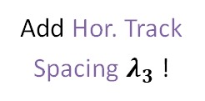




Key Factors for Standard Cell Routing
Bi-directional Routing
  Realistic routing is often bi-directional, so edge types (tip/side) are not fixed
  Metal edge type can change, making rule enforcement non-trivial
Non-uniform Routing Grid Spacing
  Routing uses non-uniform track spacing
  A single grid spacing no longer represents a fixed physical distance
  Uniform on-grid rule encoding cannot be applied as-is
Tip
Side
Inner Corner
Outer Corner
Uni-direction
Bi-direction
Side → Tip
Bend
Routing
Consistent Metal Edge Type
Variable Metal Edge Type
Tip → Side
Ver. Track ($λ_{1}$)
Hor. Track ($λ_{2}$)
Hor. Track ($λ_{3}$)
$$λ_{2}$$
$$λ_{2}$$
$$λ_{2}$$
$$λ_{3}$$
$$λ_{2}$$
$$λ_{3}$$
$$λ_{2}$$
Add Hor. Track Spacing $λ_{3}$ !
$$λ_{2}$$
$$λ_{1}$$
$$λ_{1}$$
Uniform Grid Spacing
Non-uniform Grid Spacing
Notes:
In bi-directional routing, edge types can change along the route, so spacing rules must be edge-aware.
Also, real layouts can include off-grid shapes, so a pure on-grid rule model is not enough.
These factors are a major reason why prior routers have limited design-rule coverage in practice.

Slide 36
Key Factors for Standard Cell Routing (Cont.)
Block-level Routing
  A standard-cell layout can be DRC-clean, yet violate DRC after block-level routing
  Poor pin accessibility often leads to numerous DRVs at the block level
Cell-level Routing
Cell-level Routing
Block-level Routing
A
A
B
Y
A
B
Y
Cell-level Routing Metal (M2)
Block-level Routing Metal (M2)
Case 1
Case 2
➔ Standard-cell routing must consider all possible block-level routing scenarios
Notes:
A cell can be DRC-clean by itself but still cause violations after placement and routing at the block level.
This often happens because the pin access points are blocked in real routing scenarios.
So cell routing should also consider pin accessibility for downstream routing.

Slide 37
Standard-Cell-Level Metrics – DRC Violations
Place | Route | DRV Types |  |  |  |  | # Cells
 |  | S2S | S2T | T2T | C2C | etc | Clean | Total | Ratio
ASAP7 (Manual) | ASAP7 (Manual) | 0 | 0 | 0 | 0 | 0 | 172 | 172 | 100 %
 | Au-MEDAL | 0 | 0 | 0 | 0 | 0 | 172 | 172 | 100 %
Csyn-fp | Csyn-fp | 0 | 22 | 28 | 60 | 10 | 92 | 169 | 54.4 %
 | Au-MEDAL | 0 | 0 | 0 | 0 | 0 | 169 | 169 | 100 %
NCTUcell | NCTUcell | 0 | 1 | 1 | 3 | 3 | 70 | 75 | 93.3%
 | Au-MEDAL | 0 | 0 | 0 | 0 | 0 | 75 | 75 | 100 %
Notes:
This slide focuses on extended design rules for bi-directional routing.
Au-MEDAL detects metal edge types so it can apply the correct spacing rule for each case.
This helps avoid minimum-spacing violations and improves DRC-clean routing in realistic layouts.

Slide 38
Standard-Cell-Level Metrics – Runtime
10 ~ 60 min
(1.9 %)
1 ~ 3 hours
(0.5 %)
5 ~ 10 min
(3.9 %)
46.7 %
47.0 %
~ 1 min
(47.0 %)
1 ~ 5 min
(46.7 %)
All cells used in the experiments are generated within 3 hours, and 93.7% of the cells are generated within 5 minutes
Notes:
This slide focuses on extended design rules for bi-directional routing.
Au-MEDAL detects metal edge types so it can apply the correct spacing rule for each case.
This helps avoid minimum-spacing violations and improves DRC-clean routing in realistic layouts.

Slide 39
Conclusion
Advanced-node, DRC-clean in-cell routing
  We ensure DRC-clean routing under advanced-node rules via metal-edge detection and extended spacing/via constraints (Calibre-verified)
Flexible MOL/BEOL multi-layer routing
  We jointly route MOL/BEOL with per-layer grid tuning, reducing M2 usage by 61% on average and speeding up large-cell routing by up to 77%
Pin-accessible standard cells for block-level routing
  We maximize pin stretchability while guaranteeing at least one valid access point per pin, cutting block-level DRVs by ~92% versus prior in-cell routers
Overall PPA and runtime improvements
  Across AES/LDPC/JPEG, we achieve average gains of 0.87% (area), 1.19% (power), 2.34% (effective clock), and 25.05% (TNS). 93.7% of cells finish within 5 minutes (all within 3 hours)
Notes:
This slide focuses on extended design rules for bi-directional routing.
Au-MEDAL detects metal edge types so it can apply the correct spacing rule for each case.
This helps avoid minimum-spacing violations and improves DRC-clean routing in realistic layouts.

Slide 40
Standard Cell Layout Automation
DTCO-Driven Library Expansion
  DTCO requires an explosive variety of standard cell variants (multi-VT, multi-height)
  Manual design cannot scale to meet this demand
Exponential Design Rule Complexity
  Advanced nodes introduce many design rules
  Complexity exceeds human cognitive limits for DRC-clean
Logic | Inverter
Cell Layout
Synthesis Options | # of fins: 2 Gate length: 8 Single-pattern | # of fins: 3 Gate length: 8 Single-pattern | # of fins: 2 Gate length: 10 Single-pattern
Target | Standard | High perf. | Low leakage
Notes:
Modern DTCO needs many cell variants, so manual layout does not scale.
Advanced nodes also have many complex design rules, so it is hard to keep layouts DRC-clean by hand.
This is why we need a router that can handle complex rules automatically.

Slide 41
Key Limitations of Prior In-cell Routers
Limited Design-Rule Coverage
  Prior routers struggle with bidirectional routing and inter-layer design rules
  This leads to many DRC violations
Sequential Routing Optimization Flow
  MOL routing is performed followed by BEOL routing in a sequential manner
  This flow neglects inter-layer design rules and lacks concurrent layer optimization
Poor Block-level Routability
  Internal DRC-cleanliness does not guarantee pin accessibility
  Pins are often blocked during the P&R stage, causing routing failures in the block-level design
Notes:
Prior in-cell routers often have limited design-rule coverage.
They may not fully enforce bi-directional spacing rules, and they also struggle with off-grid and inter-layer rules.
This can cause DRC violations, or it can force overly conservative routing.
Some routers also route layers one by one, which can miss important inter-layer constraints.
Even if a cell is DRC-clean, poor pin access can still cause routing failures at the block level.

