Slide 1
IEEE DATC RDF-2025: Enabling an EDA Research Ecosystem
Vidya A. Chhabria¹, Amur Ghose², Vikram Gopalakrishnan¹, Andrew B. Kahng², Sayak Kundu², Yiting Liu, Zhiang Wang², and Bing-Yue Wu¹
¹Arizona State University
²University of California, San Diego
October 29, 2025
Notes:
Thank you for the kind introduction.
Today, I am going to present our invited paper, “IEEE DATC RDF-2025: Enabling an EDA Research Ecosystem ”
The paper was written with my coauthors at UCSD and ASU

Slide 2

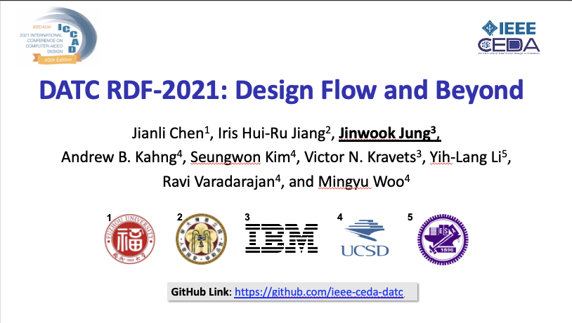

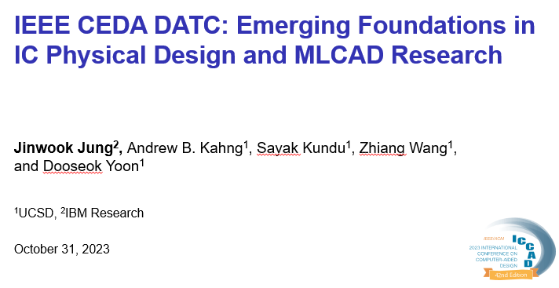
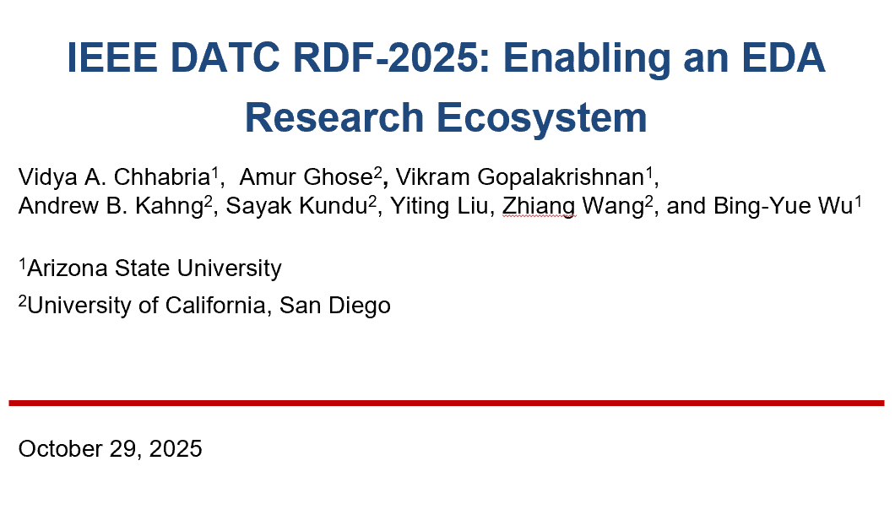
Design Automation Technical Committee (DATC)
A member technical committee of IEEE Council on EDA (CEDA)
Provide a forum for discussing current issues and future strategies in design automation field
Current rosters: Vidya A. Chhabria (ASU), Andrew Kahng (UCSD), Rhett Davis (NCSU), Rongjian Liang (NVIDIA), Zhiang Wang (Fudan Univ. )
Web page: https://ieee-ceda.org/technical-committee/datc
Since 2016, DATC has maintained Robust Design Flow (RDF)
An academic reference RTL-to-GDS flow incorporating contest-winning point tools and the OpenROAD tool chain, to preserve and integrate leading research codes
Invited papers at previous ICCAD Contest special sessions have provided updates on RDF and DATC’s strategic directions and activities
Updates this year include:
Support for IHP130-sg13g2 open-source PDK
Improved design enablements for NG45 and ASAP7
New academic engines
Notes:
First, in case you haven’t heard about DATC and its work before,
The Design Automation Technical Committee, DATC, is a member technical committee under IEEE CEDA, which is one of the main sponsors of this ICCAD contest.
We work to provide a forum for discussing current issues and future strategies in the design automation field.
And the current DATC members are myself Vidya Chhabrua, Prof. Andrew Kahng at UCSD, and Prof. Rhett Davis at NCSU and Rongjian Liang at NVIDIA.
[C1]
Since 2016, we have maintained an academic reference design flow, named Robust Design Flow, and we have been working to incorporate numerous contest-winning tools and the OpenROAD tool chain,
We have been doing this in order to preserve and integrate leading research codes to encourage cross stage, cross point tools research, and benchmarking
Our work has been presented in the previous ICCAD Contest special sessions, and we have provided updates on RDF and DATC’s activities.
[C2] Updates this year include support for a new PDK IHP130, improved design enablements for older PDKs NG45 and ASAP7, and updates to existing academic PD engines.

Slide 3
DATC Efforts Thus Far..
Goal: Building a reproducible, standards-based, and community-driven ecosystem for physical design
Reproducibility
Calibrations for ML-EDA (timing, RC, IR-drop) 2020–2021
Public release of commercial EDA TCL scripts 2022
Best-ever open baselines (WNS/TNS, wirelength, power) 2023–2024
Standards-based
METRICS 2.1 / JSON outputs for unified PPA and ML evaluation 2021
CircuitOps + Python APIs for standardized data representation 2024
Research artifact evaluation criteria and standards 2024
Community-driven
Contest-winning and academic point tools preserved 2016
Open GitHub flow with CI tests 2020
Benchmarks and datasets for ML-EDA research 2022
Notes:
This slide shows what DATC has been building toward — a reproducible, standards-based, and community-driven ecosystem for ML-EDA and physical design.
You see the three pillars of this effort that are highlighted in different colors.
Under Reproducibility, DATC has had— starting with calibration datasets for ML-EDA in 2020–2021, releasing commercial EDA TCL scripts in 2022, and publishing best-ever open baselines through 2023–2024.
Under Standards, DATC efforts — introducing METRICS 2.1 for unified PPA reporting and the CircuitOps schema enablement via OpenROAD are few efforts.
And under Community — DATC efforts preserve contest-winning academic tools since 2016, maintaining GitHub CI flows since 2020, and releasing open benchmarks and datasets for ML-EDA research from 2022 onward..

Slide 4
Current Landscape
Goal: Building a reproducible, standards-based, and community-driven ecosystem for physical design
Open-source chip design ecosystem:
NSF POSE: OpenROAD Initiative and OSE https://openroadinitiative.org/
ZeroASIC: Dashboard of designs SiliconCompiler (runs OpenROAD under the hood) https://www.zeroasic.com/dashboard
Workforce development:
NSF Chip Design Hub: Purdue Chipshub
https://nanohub.org/groups/chipshub/
ML EDA Research Infrastructure:
SLICE: Infrastructure for ML EDA https://slice-ml-eda.github.io/
Si2 LLM benchmarking coalition (LBC) https://si2.org/llm-benchmarking-coalition/
Notes:
Toward achieving this broader goal — it’s not just DATC, but several complementary, parallel efforts that are making key advances
[click] In the open-source ecosystem, I want to highlight a specific NSF POSE effort building on growing the open-source ecosystem around OpenrOAD Another exciting direction is ZeroASIC’s silicon compiler, which runs OpenROAD under the hood. They recently released a dashboard of designs compiled through i.
[click] On the workforce development side, Purdue’s Chipshub is a shared cyber-infrastructure for chip design, providing compute, data, and teaching support for academic and community training.
[click] And finally, on the ML-EDA research infrastructure front, efforts like SLICE and Si2’s LBC has brought together critical mass for benchmarking and helping shape the foundations of reproducible and standardized ML-EDA research.

Slide 5
Recent DATC Efforts
Enabling an EDA Research Ecosystem
An EDA benchmarking first
Benchmarking results from Siemens Aprisa v2025.2
OpenROAD-Research and ORFS-Research
GPU-accelerated physical design engine
Physical design engines for advanced packaging
Pseudo-3D flow for face-to-face 3D integration
ORFS-agent
Serving an ML EDA Commons
Datasets and benchmarks
Standards for data formats and data flows
Agentic physical design flow
Contests and hackathons
DATC and RDF roadmap updates (3 slides)
Continuous integration
Calibrations and best-ever baselines
Long-term challenges
Notes:
In the context of that landscape, my presentation today is about DATC’s latest activities from last year.
[C1] we for the first time ever, show benchmarking results for a leading-edge commercial EDA tools, Siemens EDA’s Aprisa v2025.2 with results for open-source testcases and open-source research enablements.
[C2] we introduce an open and collaborative sandbox environment as a part of RDF 2025 OpenROAD-Research and ORFS-Research.
[C3] and we also highlight different efforts to support the creation of an ML EDA Commons
[C4] and we have outlined updates to the roadmap and long-term challenges

Slide 6
Agenda
Introduction
An EDA benchmarking first
OpenROAD-Research and ORFS-Research
Serving an ML EDA Commons
DATC RDF roadmap updates
Notes:
In the context of that landscape, my presentation today is about DATC’s latest activities from last year.
[C1] we for the first time ever, show benchmarking results for a leading-edge commercial EDA tools, Siemens EDA’s Aprisa v2025.2 with results for open-source testcases and open-source research enablements.
[C2] we introduce an open and collaborative sandbox environment as a part of RDF 2025 OpenROAD-Research and ORFS-Research.
[C3] and we also highlight different efforts to support the creation of an ML EDA Commons
[C4] and we have outlined updates to the roadmap and long-term challenges
So lets look at these one at a time.

Slide 7
First-ever public benchmarking of Comm EDA!
How can we make research reproducible?
2022: sharing of tool scripts for fundamental research purposes
How can we make the leading edge visible?
ICCAD25: first-ever public benchmarking of commercial P&R tool with vendor permission: Aprisa from Siemens EDA
Kudos and thanks to Siemens EDA for this breakthrough!
ASAP7
NanGate45
Design | Power | WNS | TNS | #DRV | Power | WNS | TNS | #DRV
AES | 8 | 0 | 0 | 0 | 37 | -172 | -25 | 0
JPEG | 58 | -55 | -19 | 0 | 115 | -32 | -3 | 0
Ariane | 555 | -306 | -2116 | 50 | 745 | -37 | -1 | 0
BlackParrot | 1923 | -348 | -14145 | 60 | 3831 | -31 | -11 | 0
Aprisa
Aprisa P&R results: post-route power (mW), WNS (ps), TNS (ns) and DRV count
https://github.com/ieee-ceda-datc/First-Commercial-Benchmarking-SiemensEDA
All Aprisa scripts and post-route databases public in GitHub
Notes:
Our EDA community faces two big challenges when working with commercial tools — how do we make research reproducible, and how do we make the leading edge visible?
[CLICK]
The first one was solved back in 2022, as reported in RDF 2022. We can now share commercial tool scripts for research — so results can be reproduced and verified by others.
[CLICK]
The second one — making the leading edge visible — is where we have finally achieved a huge breakthrough.
We are really excited to share that Siemens EDA has permitted us to publicly benchmark and share results from their place-and-route tool, Aprisa. This is a major step forward for open benchmarking in our field.
Kudos and thanks to Siemens EDA for this breakthrough! [CLICK] The table here shows Aprisa’s post-route power and performance from a widely-used signoff flow. And everything — benchmarks, scripts, and post-route databases — is available on GitHub.

Slide 8
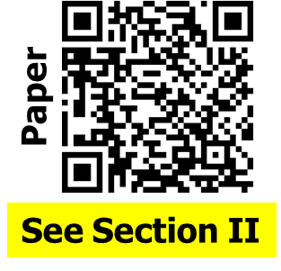
Benchmarks and evaluation
Designs: AES, JPEG, Ariane and BlackParrot (quad-core)
Enablements: ASAP7 and NanGate45
Gate-level netlists: anonymized, from Comm tool
#DRVs: from Aprisa v2025.2 for Aprisa from Comm P&R tool for OpenROAD
Timing and power reports: from widely-used commercial signoff tools
ASAP7
NanGate45
Design | Power | WNS | TNS | #DRV | Power | WNS | TNS | #DRV
AES | 8 | 0 | 0 | 0 | 37 | -172 | -25 | 0
JPEG | 58 | -55 | -19 | 0 | 115 | -32 | -3 | 0
AES | 7 | -128 | -20 | 0 | 30 | -208 | -52 | 0
JPEG | 43 | -123 | -83 | 0 | 104 | -327 | -260 | 0
Aprisa
OR*
Aprisa and OpenROAD (OR) P&R results: Power (mW), WNS (ps), TNS (ns)
*Note: OpenROAD could not complete routing for Ariane and BlackParrot
Notes:
This slide describes the benchmarks and our evaluation.
We used four testcases — AES, JPEG, Ariane, and BlackParrot — in two enablements, ASAP7 and NanGate45, for a total of eight benchmarks.
Netlists are anonymized, and were produced by an unnamed commercial synthesis tool.
[CLICK] For design rule violation reporting, we used Aprisa v2025.2 for Aprisa results, and a commercial P&R tool for OpenROAD results.
All timing and power reports are from widely used commercial signoff tools — ensuring consistent measurement across all results.
This table shows some benchmarking results, directly comparing Aprisa and OpenROAD.
[CLICK] And we note that OpenROAD could NOT complete routing for Ariane and BlackParrot.

Slide 9

IEEE-CEDA-DATC Benchmarking GitHub
Additional PDKs enabled: SKY130HD, IHP130
Scripts to bring up new designs
Enablement of Aprisa RTL synthesis tool
Reference scripts for logical and physical synthesis Note: Aprisa RTL currently in controlled release from Siemens EDA
The published Aprisa results may be freely cited, attributed and compared !!!
Process to publish new benchmarks using Aprisa: see GitHub
Ongoing efforts
Scan chain insertion and compression with Tessent
RC extraction with Calibre xACT
Thanks again to Siemens EDA !
GitHub
https://github.com/ieee-ceda-datc/First-Commercial-Benchmarking-SiemensEDA
Notes:
In our IEEE-CEDA-DATC Benchmarking GitHub, we have gone beyond the benchmarks I showed earlier. We have Aprisa support for two additional PDKs — SKY130HD and IHP130 — with complete scripts and tech files to bring up new designs easily. We also provide enablement for the Aprisa RTL synthesis tool, with reference scripts. Please note that right now, Aprisa RTL is in controlled release from Siemens EDA.
[CLICK] All published Aprisa results may be freely cited, attributed, and compared. And if you would like to contribute new benchmarks or results using Aprisa, you can find the process detailed on our GitHub page.
[CLICK] This effort is expanding: to add scan chain insertion and compression with Tessent, and RC extraction using Calibre xACT.
[CLICK] Once again, huge thanks to Siemens EDA for making this breakthrough milestone for the field possible !!!

Slide 10
Agenda
Introduction
An EDA benchmarking first
OpenROAD-Research and ORFS-Research
Serving an ML EDA Commons
DATC RDF roadmap updates
Notes:
Next I am going to talk about two newly established repositories on OpenROAD Research and ORFS Research and their purpose.

Slide 11


Accelerating the Open-Source Ecosystem
New Inflection Point (2025)
ML, LLMs, and GPU acceleration have opened opportunities in physical design.
Research that is not yet production-ready.
OpenROAD-Research and ORFS-Research
Platform for research, developing, and sharing for advanced P&R engines
Serve as open library of baselines and algorithms
Accelerate innovation (GPU-accelerated, LLM-based, 3D ICs …)
Support education and workforce development
Fost global collaboration (from US, China, ….)
Fully open-source and free to use (BSD 3-Clause License)
Copyrights are preserved through DCO authentication
Scan me for more information of OR-Research
Scan me for more information of ORFS-Research
Notes:
In 2025, we’ve reached an inflection point. Machine learning, large language models, and GPU acceleration are opening new frontiers for optimization — yet most of these techniques are not production-mature. We need p[lace to to innvoate reserarch and share early protypes.
we’re launching OpenROAD-Research and ORFS-Research under the RDF umbrella. Think of them as “innovation sandboxes” — open contrib repositories where experimental algorithms, ML agents, and educational flows can coexist with stable mainline tools.
CLICK
OpenROAD-Research is a platform for developing and sharing for advanced physical design engines and ORFS-Researcch includes scripts and research that work with flows developed around OpenROAD.
The missions of OpenROAD-Research are to:
(i) serve as an open library of baselines and algorithms
(ii) preserve diverse research contributions (e.g., multiple detailed placers with different heuristics), even if they are not yet production-ready.
(iii) support education and workforce development**: provide students and researchers with reproducible implementations and a broad collection of physical design algorithms.
and (iv) foster global collaboration.
You can scan these QR codes for more information of OR-Research and ORFS-Research.
The paper presents four example tools in OpenROAD-Research and ORFS-Research. However, in the interest of time I will present two here one example in OpenROAD-Research and another on ORFS-Research and you can look at the third on GPU accelerated detailed placement and the 3D flow on the GH repository
[CLICK]

Slide 12
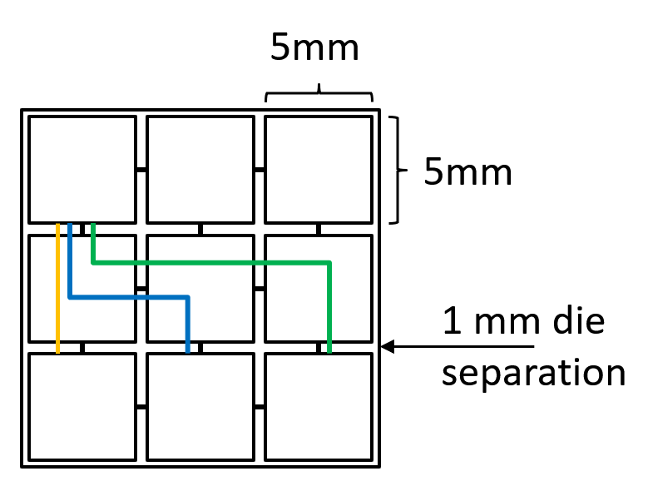
Example 1: Chiplet Partitioning
2.5D system partitioner (src)
Cost-aware (integration with CATCH chiplet cost model from UCLA)
Floorplan-aware (annealing-based chiplet floorplanning)
Technology-aware (chiplet technology assignments via genetic algorithm)
Up to 23% improvement in chiplet cost with heterogeneous technology compared to homogeneous integration
Floorplan awareness
Technology awareness
Reach constraints → max. wirelength that can be driven by IO cells
Different chiplets implemented in different technology
7mm reach
7nm
10nm
10nm
10nm
13 mm reach
19 mm reach
7nm
14nm
14nm
7nm
Which partitioning solution is better?
Notes:
The first example is ChipletPart that has been integrated into OpenROAD-Research.
This research develops a tool to determine which parts of the system should be implemented together in which chiplet, in which technology node?
ChipletPart leverages a chiplet cost model from UCLA, plus multiple pieces of OpenROAD – the partitioner, the annealing code used in the floorplanner, and more – to achieve this design space exploration capability. It finds over 23% improvement in chiplet cost via heterogenous integration.

Slide 13
Example 2: GPU-Accelerated DPO
GPU-accelerated Detailed Placement Optimizer (src)
First known implementation of GPU-accelerated detailed placement operators that move multi-height cells cf., e.g., ABCDPlace
Considers constraints that help maintain routability
LSMC (large-step Markov chain) metaheuristic enables better exploration of solution space efficiently on GPU, especially in high-density placements
Detailed Placer | Move Type | #Moves | HPWL Before (um) | HPWL After (um) | TAT (ms) | Routability
DPO | Descent | 5 | 46529.1 | 44301.2 | 90282 | Yes
ABCDPlace | Descent | 5 | 46529.1 | 44232.7 | 25293 | Yes
GPU-DPO | Kick + Descent | 5 | 46529.1 | 40736.1 | 27091 | Yes
Testcase: AES (Routability Evaluator: OpenROAD)
15347 cells, 120 multi-height cells, 152 rows 95% utilization in ASAP7
Notes:
The second example is GPU-accelerated detailed placement optimizer.
Classical EDA heuristics can be broken down into GPU-accelerated kernels to gain speed.
Here, we took OpenROAD’s Detailed Placement Optimizer and developed CUDA kernels that can handle multi-height cells.
This testcase has 15K cells with 95% utilization, and GPU acceleration gives speedup while preserving routability.
This allows metaheuristics – here, the Large-Step Markov Chain approach -- to be applied on top of traditional greedy methods.
To get better wirelength.

Slide 14


Example 2: LLM for Parameter Optimization
ORFS-agent (src)
Autotunes OpenROAD flow using batch-based LLM exploration, built atop Claude-3.7 (Anthropic)
Batch exploration: runs 25 OpenROAD jobs in parallel, each with different parameters
Training data: generates <parameter set, quality metrics> tuples (e.g., rWL, ECP)
Learning loop: LLM observes results and proposes better configurations over time
Goal: discover “optimal” flow (tool) parameters
Modify
Config, SDC file for ORFS
PDK
Logic synthesis
Floorplan & placement
CTS
Routing
Verilog
ORFS flow
Ingredients for ORFS
METRICS 2.1
Prompts for agent
Inputs
Iterations
ORFS-agent
Output
Optimized config, SDC file
Notes:
The second example is ORFS-agent: an LLM-based autotuning framework in OpenROAD. This has been integrated into our ORFS-Research repository.
It uses batch-based LLM exploration: proposing parameters, running jobs in parallel, then learning from the results. The goal is to discover optimal tool parameters for each design.
This figure shows how ORFS-agent works:
We start with Verilog, a PDK, and initial config/SDC files. These go into the OpenROAD flow – 25 parallel runs with different parameters. Each run produces <input, output> data – parameters in, and metrics like ECP and wirelength out. METRICS 2.1 standardizes this loop, making it reusable across agents. The agent learns from this data, adjusts strategies, and proposes better configs. Even partial or failed runs contribute useful information. Over time, the agent refines settings across iterations.
[CLICK]

Slide 15
Example 4: Pin3D Flow Based on OpenROAD
Pseudo 3D Flow Based on OpenROAD (src)
Open-source end-to-end physical design flow for face-to-face 3D ICs
2D PDK
3D PDK
OpenROAD built-in tool
Develop based on existing tool
Yosys
Logical Synthesis
Employ existing tool
OpenROAD
Floorplan
TritonPart
3D Partition
TritonPart + RePlace
3D Placement
RePlace
Top Die Placement
TritonCTS
CTS and Optimization
RePlace
Bottom Die Placement
OpenDP
Re-Legalization
FastRoute
Global Routing
TritonRoute
Detail Routing
OpenSTA
3D Timing Analysis
OpenRCX
RC Extraction
HotSpot
Thermal Analysis
Notes:
The last example is the Pin3D flow based on OpenROAD.
In ORFS-Research, we integrate an open-source end-to-end physical design flow for face-to-face 3D ICs.
Based on existing tools in OpenROAD-Research, we could implement a 3D ICs through PDK augmentation.
You can find the detailed scripts in our ORFS-Research repo.
[CLICK]

Slide 16
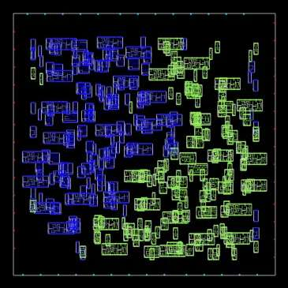
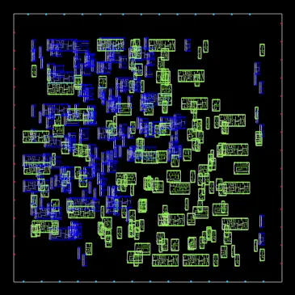
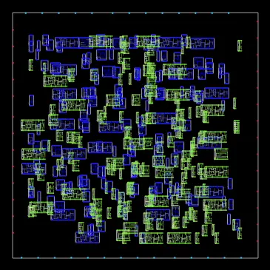
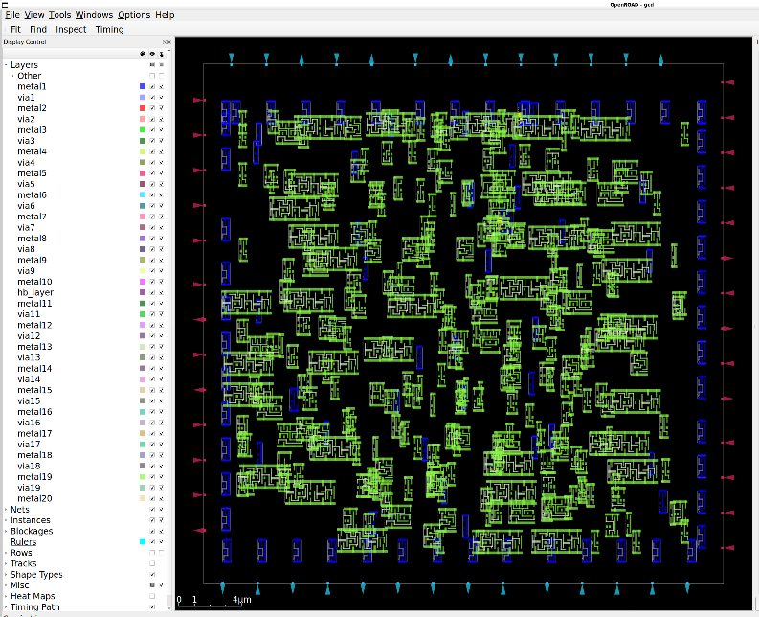
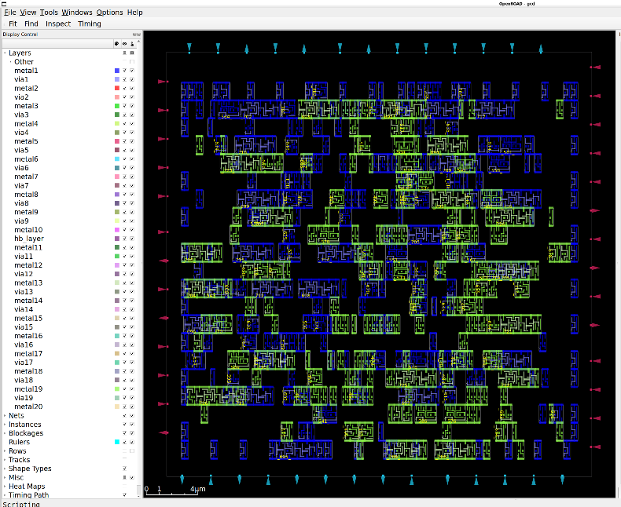
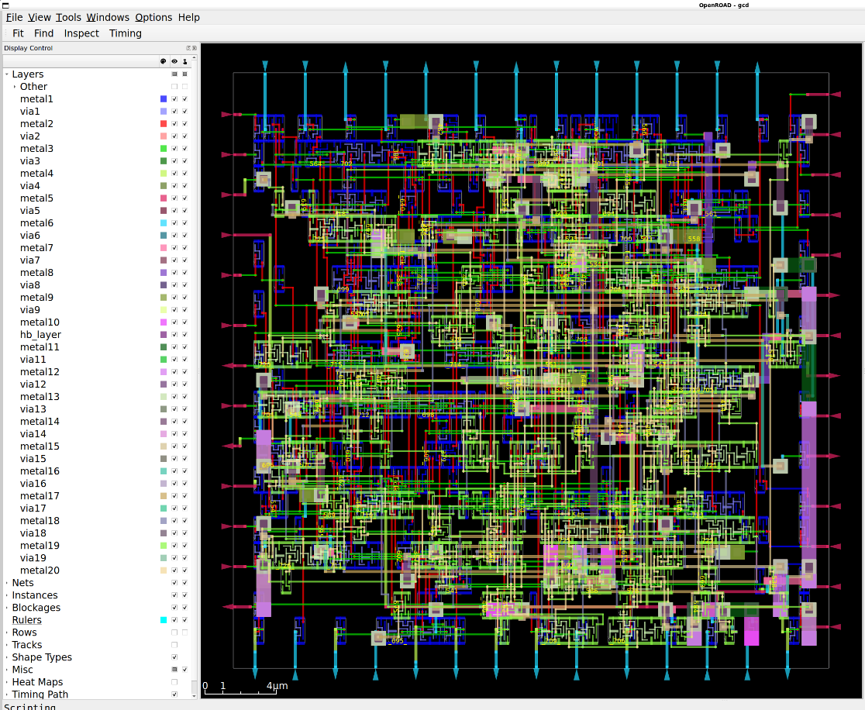
Example 4: Pin3D Flow Based on OpenROAD
3D Placement
2D Global Placement
Top Die Global Placement
Bottom Die Global Placement
Clock Tree Synthesis, Re-Legalization and Routing
Clock Tree Synthesis
Re-Legalization
Routing
Notes:
This slide gives a demonstration of Pin3D flow using AES testcase and NanGate45 technology node.
This demo is also available in our ORFS-Research repo.
[CLICK]

Slide 17
Agenda
Introduction
An EDA benchmarking first
OpenROAD-Research and ORFS-Research
Serving an ML EDA Commons
DATC RDF roadmap updates
Notes:
Next I will highlight efforts that serve towards this broader vision of an ML EDA Commons.

Slide 18
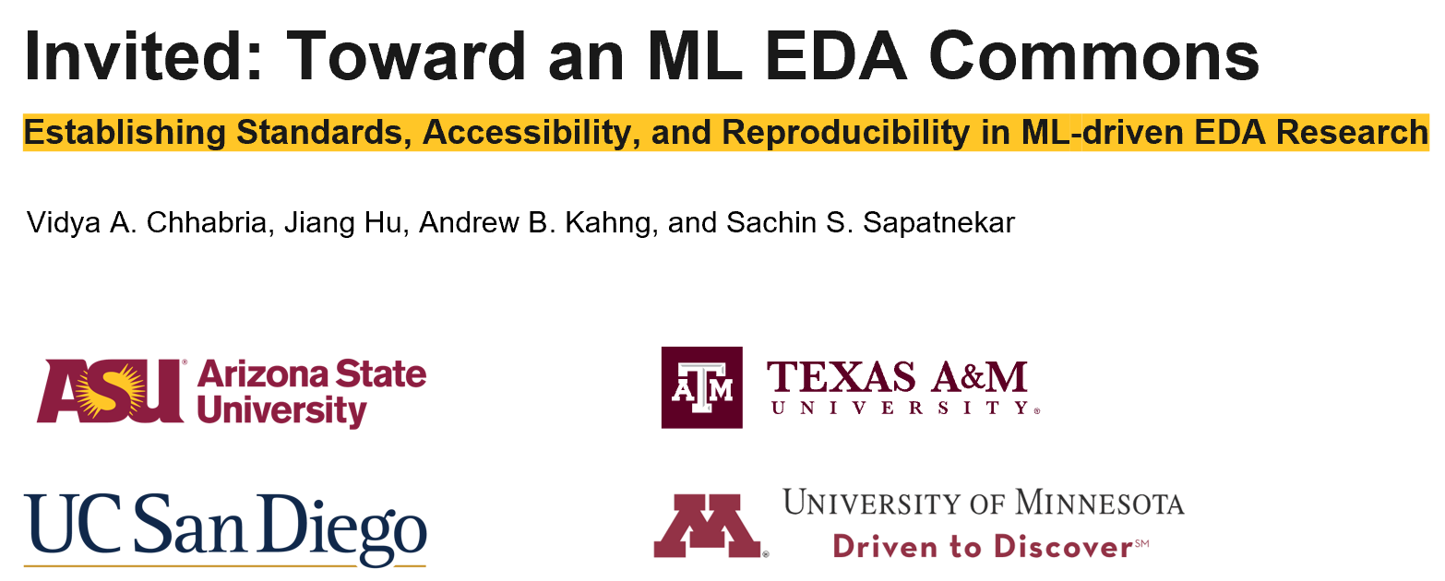
ML EDA Commons: Vision and Roadmap
Nascent Mature
ISPD 2025 Invited Paper
A vision for an ML EDA Commons
Standards, accessibility, and reproducibility
Components of a ML EDA Commons
Ongoing individual-driven infrastructure development efforts:
Components of an ML EDA Commons:
Governance & standards
Accessibility & reproducibility
Benchmarks and metrics
Datasets
Datasets
Datasets
Consortium of stakeholders
Cloud infrastructure
Contests
Tools & flows
Tools & flows
Tools & flows
Tools & flows
Contests
Formats & quality
Contests
Open-source
Research artifacts
Sustenance
Proxies
ML EDA infrastructure
Notes:
A vision for an ML EDA Commons, along with a roadmap, was presented at ISPD 2025 in March as an invited paper.
This vision is built on three key pillars — reproducibility, accessibility, and standards — which together define what a sustainable ML-EDA ecosystem should look like.
CLICK
Today, the field is still in a nascent stage, where most infrastructure development — datasets, benchmarks, contests, and tools — happens through individual, fragmented efforts.
The roadmap outlines how we can transition from these independent activities into a cohesive ML EDA Commons governed by shared standards and community infrastructure.
I will highlight some of DATC efforts that contribut towards the ML EDA Commons vision on datasets, standards, and LLM-aided research.

Slide 19
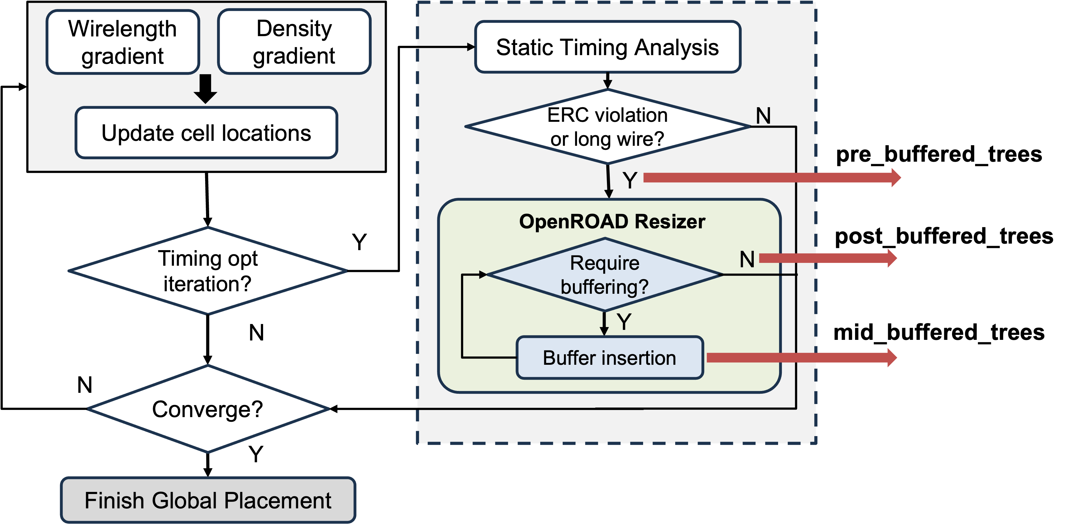
ML Buffering Benchmarks and Scripts
Overview
Support innovations in ML-based buffering approaches
Include detailed cell- and buffer-level attributes across the OpenROAD Resizer’s buffering process
Benchmarks
Designs: IBEX, JPEG, Ariane and BlackParrot (Quad-core)
Enablements: NanGate45 and ASAP7
Download full set of benchmarks: Link
Scripts for collecting more benchmarks: GitHub repository
Contents
Pre_buffered_trees
Original netlists and cell features before any buffer insertion
Mid_buffered_tress
Trajectory of OpenROAD Resizer’s buffer insertion process
Post_buffered_trees
Final Resizer-buffered netlist and feature
Notes:
The first effort here is on benchamarks.
Buffering is a key strategy for timing closure in modern technology nodes.
To support ML-based innovations, we publicly release ML buffering benchmarks collected from OpenROAD Resizer.
[CLICK]
As shown in the figure, our data collection workflow captures the buffering process in three stages:
[CLICK]
pre_buffered_trees: Original netlists and cell features before any buffer insertion
[CLICK]
mid_buffered_trees: The trajectory of OpenROAD Resizer's buffer insertion process
[CLICK]
post_buffered_trees: The final Resizer-buffered netlist and features.
[CLICK]
The full benchmark set and scripts for generating additional data are available through the links provided in the slides.
These benchmarks establish an extensible foundation for evaluating, training, and validating ML-based buffering strategies.

Slide 20
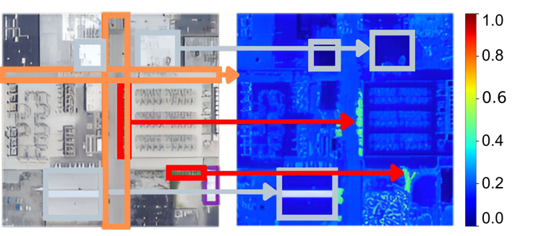
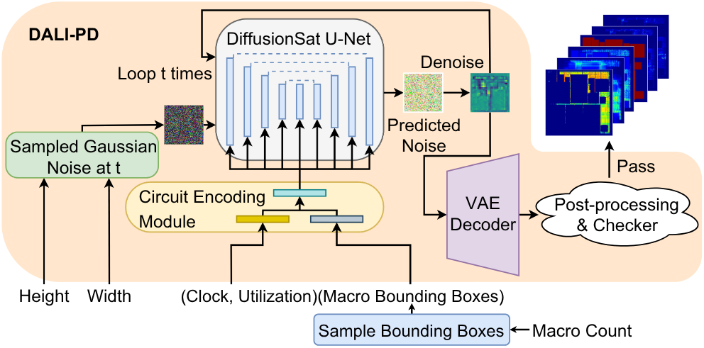
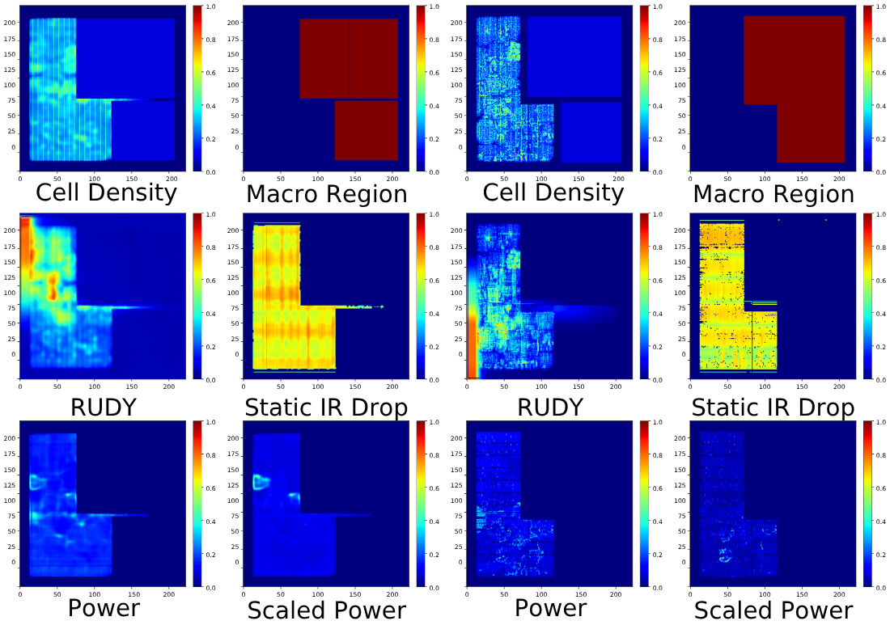
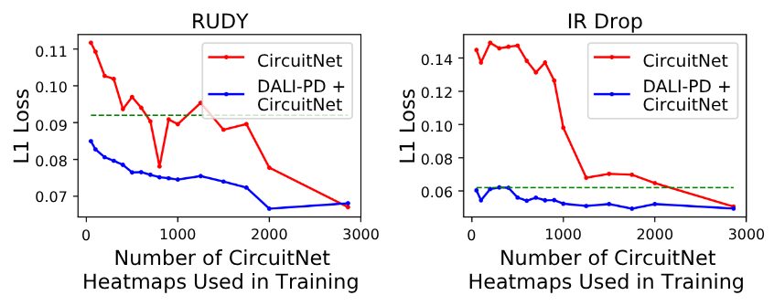
Synthetic Data for ML EDA: DALI-PD
Challenges with PD datasets
Scale: high quality data is expensive to generate.
Diversity: restricted by IP and EUA.
DALI-PD for rapid synthetic data generation
Satellite diffusion model is fine-tuned with CircuitNet
Evaluation of synthetic data as a proxy
Rapid ML EDA training with limited real circuit data
DALI-PD takes seconds to generate a set of heatmaps
Accuracy improvement on downstream ML task when combined with real data
DALI-PD
CircuitNet
N28 technology node data is available. NEW: PDN benchmarks for N28
[Z. Chai et al., CircuitNet, TCAD, 2023.]
[B.-Y. Wu et al., DALI-PD, ASP-DAC, 2026.]
[S. Khanna et al., DiffusionSat, ICLR, 2024.]
https://github.com/ASU-VDA-Lab/DALI-PD
Notes:
The second effort is on synthetic data.
Data scarcity is the main bottleneck for ML EDA research. Although open-source datasets do exist, they often have several limitations.
One limitation is scale, since generating each data point requires running multiple physical design tools. This process is time-consuming and extremely computationally expensive.
Another limitation is diversity, since open-source datasets are restricted by IP and EUA policies. With only a few open-source designs available, the resulting datasets often lack diversity.
CLICK
To address these challenges, we propose DALI-PD, a synthetic data generation framework that creates proxy data for ML EDA research.
This framework is transfer-learned from a satellite image diffusion model, since satellite images share similar visual traits with circuit heatmaps.
The generated synthetic dataset is available at the GitHub link shown on this slide.
CLICK
The bottom right figure shows an example synthetic heatmap compared to a real circuit heatmap from CircuitNet.
When synthetic and real data are combined, the ML tasks performance significantly improves compared to training only with a limited amount of real data as it models the diversity from synthetic data and the realism from the few real circuit data.
Our GH repository contains over 20,00 layout cconfigurations . It also contains PDN benchamrks.

Slide 21
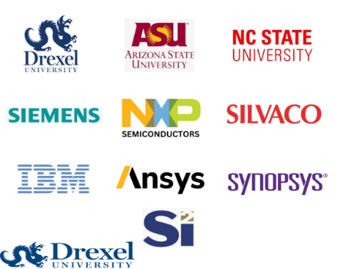
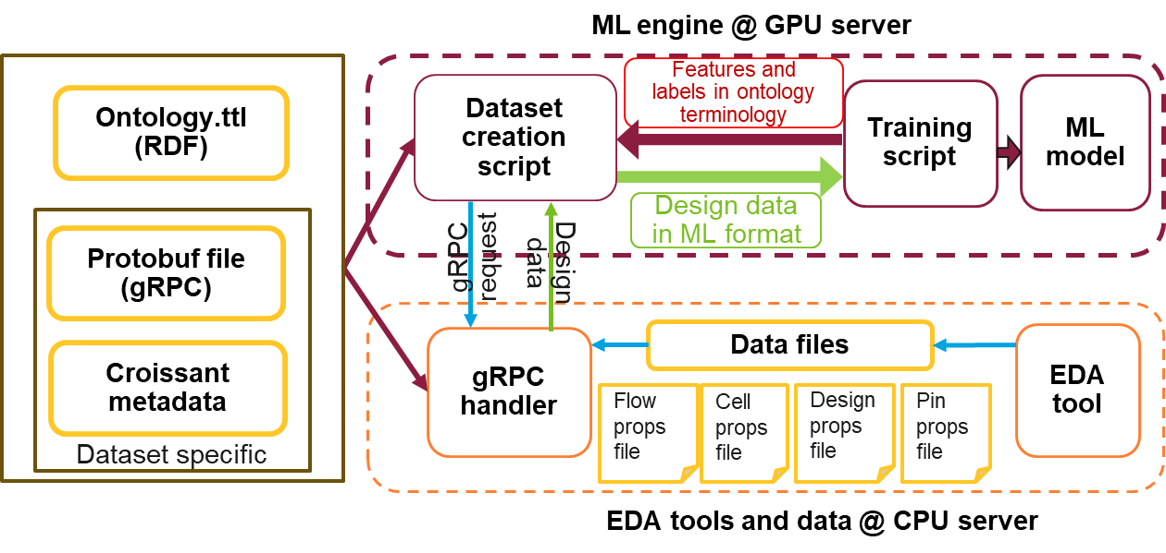
Standards for ML EDA Data Pipeline
Enable AI-based EDA via:
Standardized data flows
Ontology-based EDA data relationships
Tool-agnostic and dataset-agnostic data pipelines
Seamless integration with EDA tools on CPU servers and ML on GPUs (training and inference)
Si2 Open Standards Working Group
A common standard is essential for enabling consistent data exchange, interpretation, and ontology-driven applications for LLM-based EDA reasoning and automation.
Notes:
The second is on standardization.
As an effort toward establishing standards for ML-EDA data flow and improving interoperability between tools and data sources, the Si2 Open Standards Working Group has been building an ontology for ML-EDA data that formally defines entity relationships across the design flow.
CLICK
Here, I want to highlight ASU’s contribution as part of this working group — which focuses on building a data pipeline that leverages these standards.
This pipeline includes all the components shown on the left — an ontology file in Turtle format, Croissant metadata that maps the ontology to actual data sources or EDA tool outputs, and gRPC protocols that establish communication between EDA tool servers and GPU servers used for ML applications.
CLICK
Overall, this is one step toward establishing a common standard for the emerging ML-EDA era — where consistent data exchange and interoperatbility will be key

Slide 22
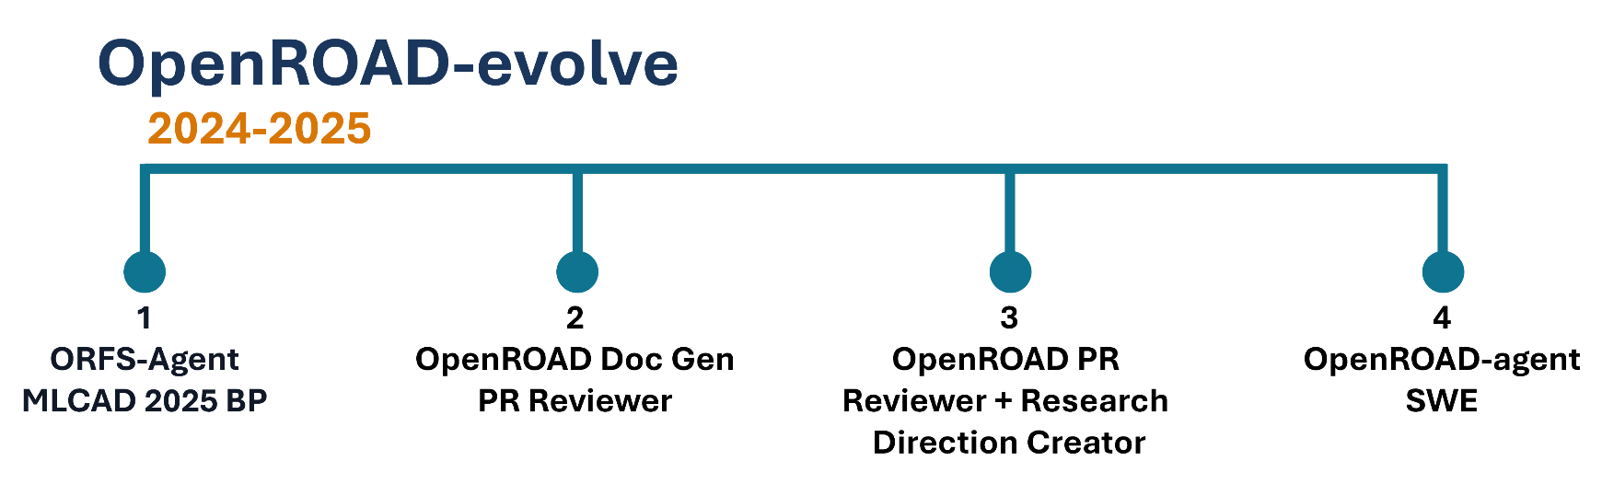
Agentic EDA – Roadmap and Progress
Beyond ORFS-agent, what’s the roadmap ?
OpenROAD-evolve sees the following timeline :
Create docs, generate high-level ideas from code+papers
Use these to make implementation plans and diffs
Review said diffs and audit them to full PRs
The overall loop is a full agentic SWE, and can improve Verilator and Synthesis tools – today !
Notes:
The third is on LLM research.
We’d like to consider the roadmap beyond ORFS-agent, towards a fully agentic end-to-end self-improving loop for OpenROAD code.
CLICK
This roadmap is shown in the picture here. We believe moving towards this relies on three lynchpins.
CLICK
First, documentation is key. EDA is so high-context that integrating the code and papers into one coherent markdown bloc is worth the immense work. Context quality matters and having the requisite ideas in 1 concise markdown file really does help.
Second, we consider using these docs for high-level idealization plans to help with granular implementation and actual code diffs.
Third, to make it a closed-loop process and complete the ouroboros, we make a specialized PR reviewing process determining their suitability as EDA code.
The final output is an agentic SWE that can make improvements to Verilator and Synthesis tools today !

Slide 23
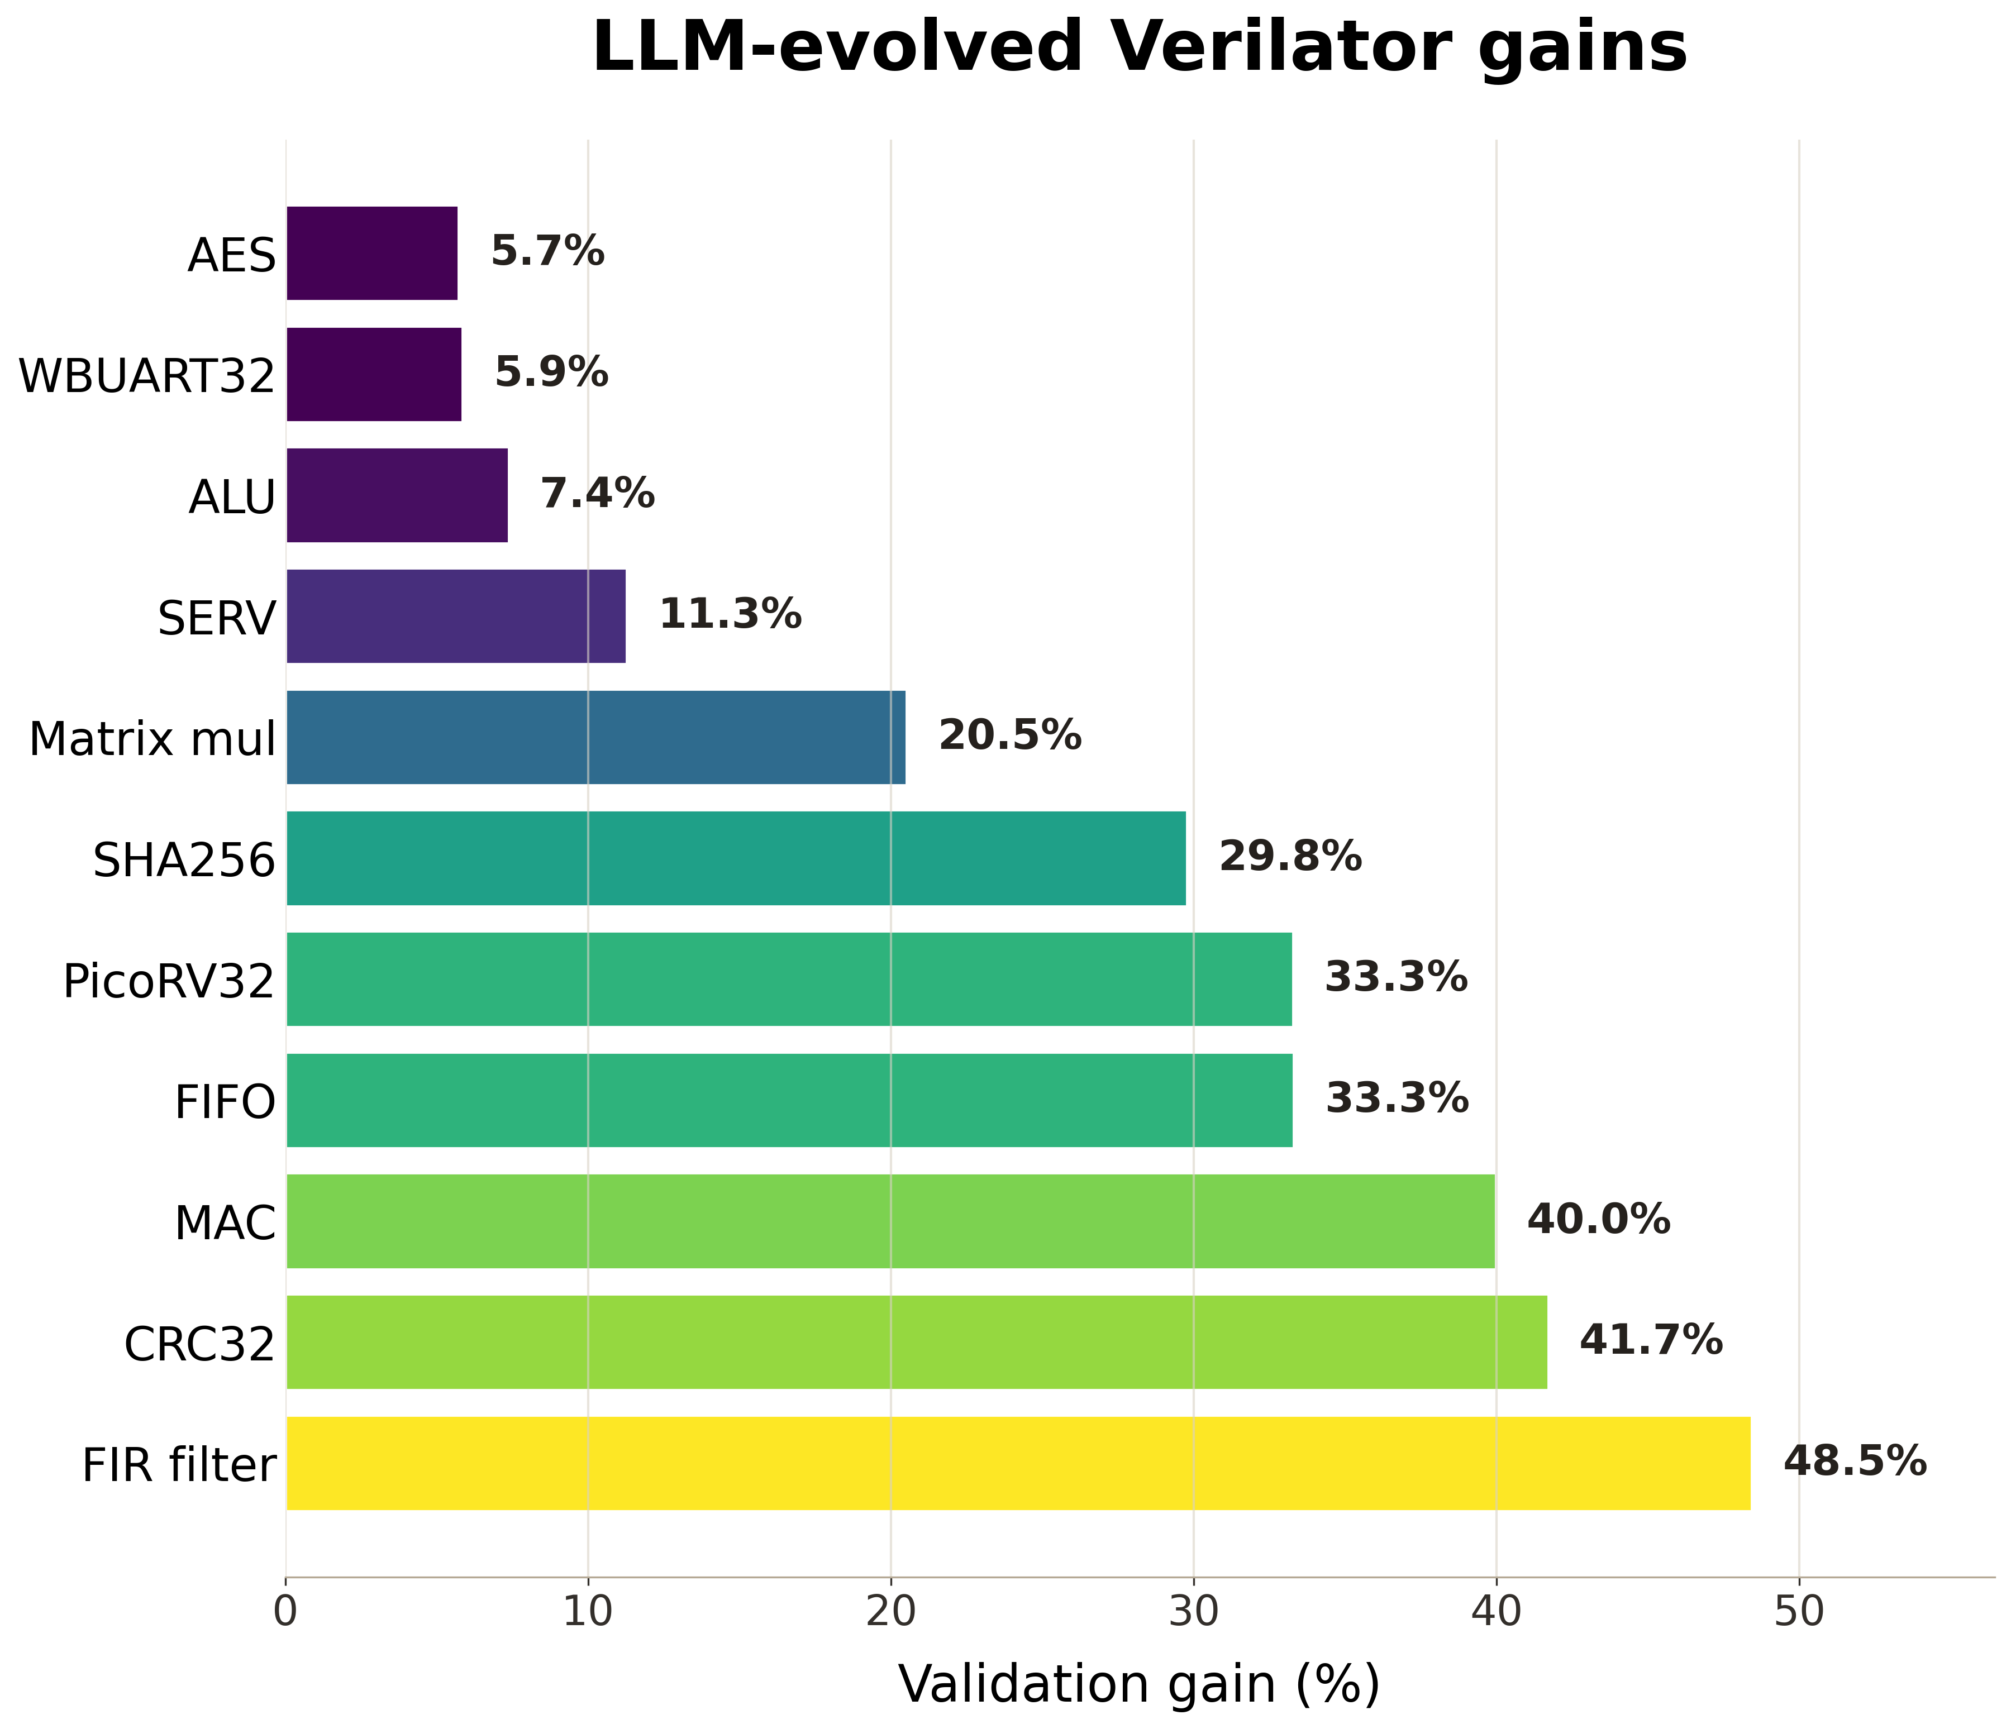
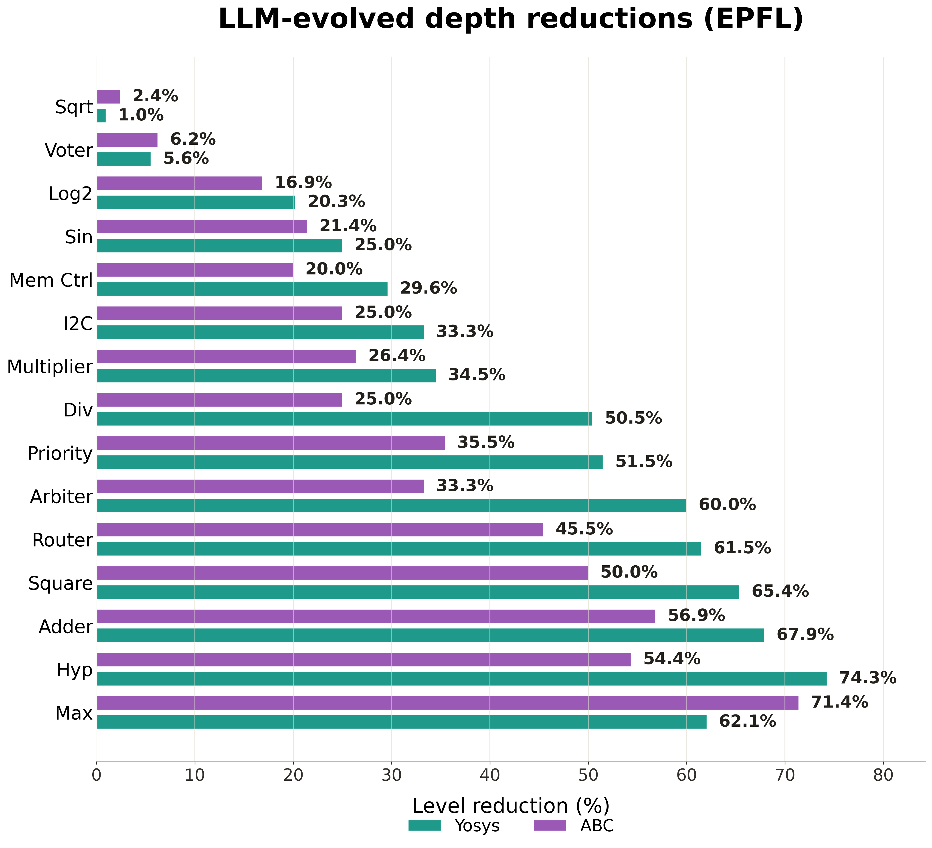
Results Overview
Notes:
We see here two charts capturing results of goal-oriented EDA codebase evolution with a coding agent. Let’s address these charts one by one.
First, we consider the flag-level optimization in Verilator, i.e. changing RTL to CPP. The bars show improvements relative to random sampling, which takes significant time. Relative to a true baseline of not choosing flags at all, improvements can result in ~40% reduced runtime on average.
CLICK
Second, we see synthesis-level gains relative to Yosys/ABC on the EPFL logic synthesis suite. These results are relative to the baseline versions of both tools, without special fine-tuning for the EPFL suite. The results, very broadly, improve the baseline, but do not approach best-ever numbers obtained experts. However, AI could provide half that kind of quality, on-demand, to novice designers for neither cost nor time.

Slide 24
Agenda
Introduction
An EDA benchmarking first
OpenROAD-Research and ORFS-Research
Serving an ML EDA Commons
DATC RDF roadmap updates

Slide 25
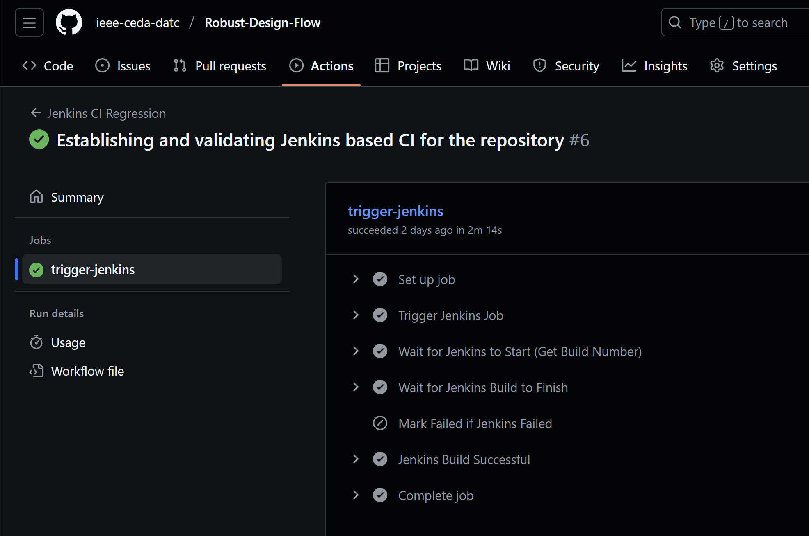
DATC Roadmap Updates
Regression tests have been setup for RDF GitHub Repository using Jenkins:
Tests use Metrics2.1
DCO checks for PRs
How to contribute new tools guidelines with CI/CD checks and guidance
Future Efforts:
CI/CD for OpenROAD-Research and ORFS-Research
Baselines and calibrations based on OpenROAD-Research and ORFS-Research to find best-ever baselines
Notes:
Some updates on the roadmap.
We now have regression tests set up using Jenkins for the RDF GitHub repository. These tests automatically validate every pull request using the Metrics2.1 framework, ensuring consistent QoR evaluation across flow with DCO checks so that every contributor’s code commits are properly signed off, maintaining traceability and compliance.
In parallel, we’re drafting contribution guidelines for new tools and scripts — detailing how contributors can integrate with the continuous integration and delivery (CI/CD) setup. This helps ensure that every addition is regression-tested before merging.’
Our future efforts focus on extending this CI/CD framework to OpenROAD-Research and ORFS-Research — the new innovation sandboxes under the RDF umbrella.
We’re also working on building new baselines and calibration tests using these research repositories — to identify “best-ever” flows and parameter configurations, helping the community continually improve and benchmark progress.

Slide 26
DATC Roadmap: Long-term Challenges
Support for Advanced Packaging
Need open algorithms, databases, and PDKs for 2.5D/3D ICs, chiplets, hybrid bonding, and backside PDNs.
Open and native P&R engines for advanced packaging are critical next steps.
Open PDKs for Advanced Nodes
Lack of open enablement at advanced nodes hinders reproducibility.
“Proxy Design Enablement” offers a foundation, but sustained collateral IP and community use are needed.
Scarcity of Industry-Grade Designs
Academic testcases often too small or unrealistic.
Need large-scale, community-maintained, parameterized designs bridging academic and industrial gaps.
Integration with Broader Ecosystem
Must align RDF with Chipshub, OpenROAD Initiative, and MLCommons-style benchmarking.
Interoperability ensures long-term sustainability and shared innovation.
Metadata & Metrics Standardization
Lack of structured metadata limits reproducibility.
Need unified schema (inspired by MLCommons Croissant, METRICS2.1) for flow configs, QoR metrics, and versions.
Notes:
Several long-standing challenges still need attention.
First, as the industry transitions to chiplets and 3D ICs, our open design flows must evolve to handle advanced packaging — with open databases, accurate PDKs, and native tools that support hybrid bonding and backside power delivery.
CLICK
Second, the scarcity of open PDKs at advanced nodes continues to be a major roadblock. Proxy Design Enablement has helped, but we need sustained investment in collateral IPs and broader community adoption.
CLCIK
Third, academic research often relies on small testcases. To make results more realistic, we need large, industry-grade benchmarks that reflect true design complexity.
CLICK
Fourth, integration is key — aligning RDF with initiatives like Chipshub, the OpenROAD ecosystem, and MLCommons-inspired benchmarking will ensure interoperability and sustainability.
CLICK
Finally, reproducibility depends on standardizing metadata and metrics reporting — much like MLCommons Croissant — so that every design, flow configuration, and QoR metric is machine-readable and reusable.

Slide 27
Summary
Enabling an EDA Research Ecosystem
An EDA benchmarking first
Benchmarking results from Siemens Aprisa v2025.2
OpenROAD-Research and ORFS-Research
GPU-accelerated physical design engine
Physical design engines for advanced packaging
Pseudo-3D flow for face-to-face 3D integration
ORFS-agent
Serving an ML EDA Commons
Datasets and benchmarks
Standards for data formats and data flows
Agentic physical design flow
Contests and hackathons
DATC and RDF roadmap updates
Continuous integrations
Calibrations and best-ever baselines
Long-term challenges
Notes:
I conclude here by highlighting a summary of our efforst this year on this slide.

Slide 28
Acknowledgments
We would like to thank Andrew Johnson, Henry Chang, Sahrima Jannat Oishwee and Simon Chang from Siemens EDA for their collaboration and contribution to this publication.
We thank Jiang Hu, Sachin Sapatnekar, Siddharth Garg, Callie Hao and others for discussions of “SLICE” and the framing of an ML EDA Commons.
This work is supported in part by the IEEE Council on Electronic Design Automation (CEDA)
Notes:
Thank you.

