Slide 1
SO3-Cell : Standard Cell Layout Automation Framework for Simultaneous Optimization of Topology, Placement, and Routing
Chung-Kuan Cheng, Andrew B. Kahng, Byeonggon Kang, Seokhyeong Kang, Jakang Lee, Bill Lin
{ckcheng, abk, b8kang, billlin}@ucsd.edu, {shkang, wkrkd95}@postech.ac.kr
Notes:
Hello everyone. My name is Byeonggon Kang,
I’m a Ph.D. student in Computer Science and Engineering at UC San Diego,
and also an engineer at Samsung Foundry.
My research focuses on standard cell design and automation.
Today, I’m gonna present “SO3-Cell: A Standard Cell Layout Automation Framework for Simultaneous Optimization of Topology, Placement, and Routing.”

Slide 2
Outline
Introduction (3)
Motivation (4)
SO3-Cell (5-6)
Circuit Topology Optimization (7-8)
Design Space Pruning Technique (9-10)
Incorporating Cell-Flex (11-12)
Experiments (13-16)
Github (17)
Notes:
The outline of my presentation is shown here.

Slide 3
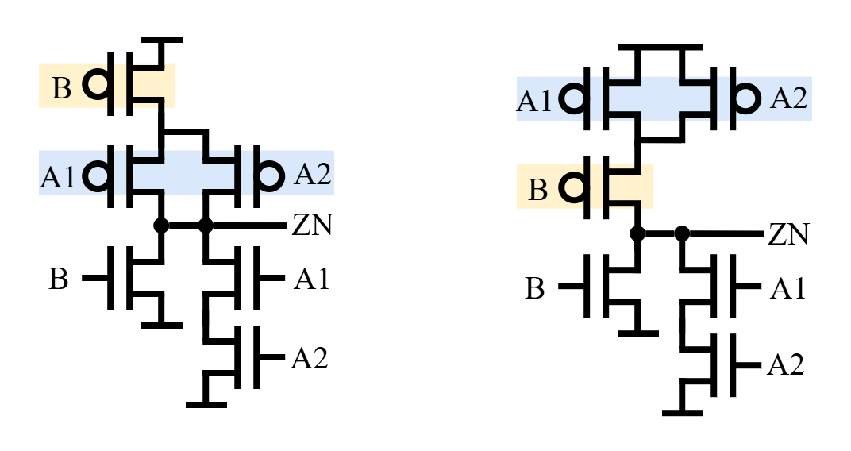
Introduction
Many cell layout generation engines are emerging, yet we’re not considering the circuit.
“Can the circuit itself constrain the optimality of the cell layout?”
<Logically Equivalent AOI21_X1>
Notes:
Let’s start with the introduction.
In this work, we integrate the circuit — in particular, series stack order — into the cell layout generation process.
This idea originates from a simple but important question:
“Can the circuit itself constrain the optimality of the cell layout?”
The figure shows two logically equivalent circuits of AOI21 (, illustrating that different topologies can lead to different layout outcomes.)

Slide 4
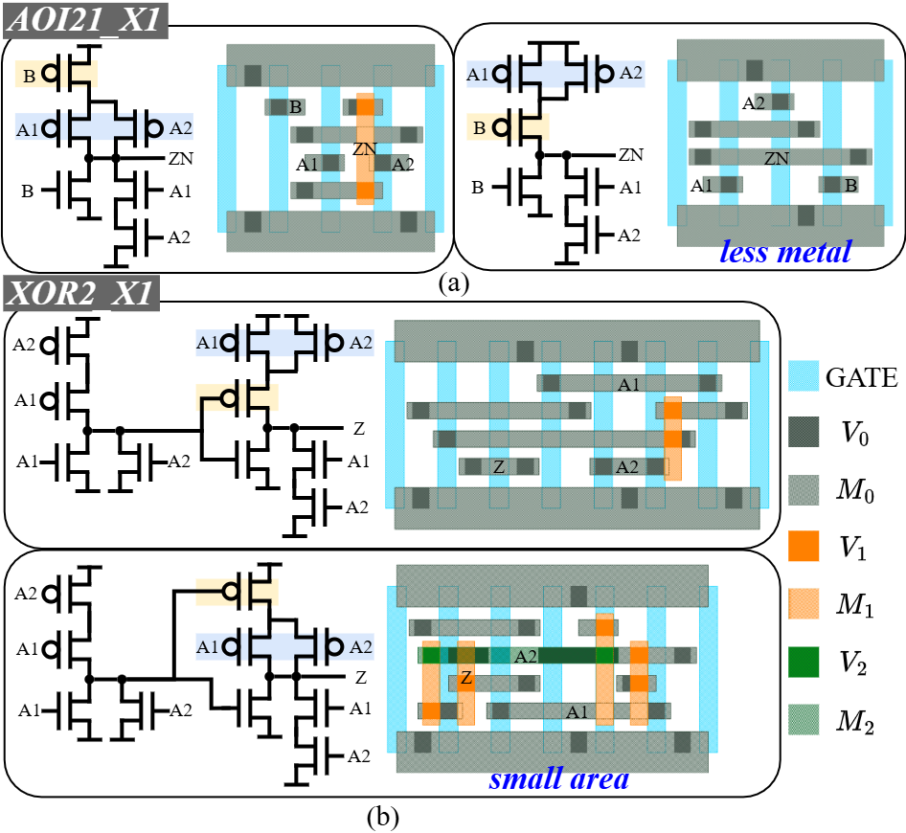
Motivation
Circuit topology influences layout quality!
No euler path
Notes:
The figure shows how the layout differs depending on the circuit topology.
For example, in the case of AOI21, the metal usage can vary (significantly) depending on its topology.
Similarly, for XOR2, the layout area can also change as the circuit topology changes.
These examples clearly demonstrate that circuit topology directly affects layout quality.

Slide 5
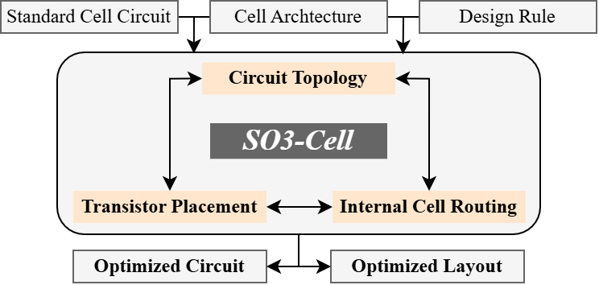
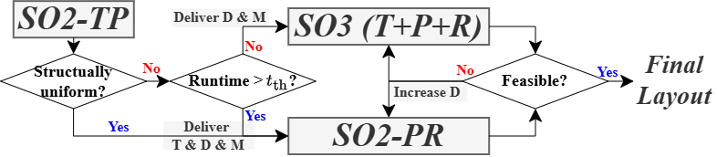
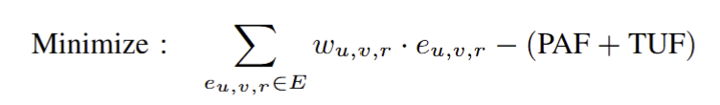
SO3-Cell (Simultaneous Optimization of Three Steps–Cell)
We propose SO3-Cell! (ILP by Gurobi Optimizer v12.0.1)
  a framework that simultaneously optimizes three key steps —
  Circuit Topology & Transistor Placement & Internal Cell Routing
T
P
R
<Complexity Aware Optimization Strategy>
Metal Usage
Penalty
Cell-Flex
Rewards
<Overall Flow>
Controlled by the weighting coefficient.
<Objective Function>
Notes:
So, we propose SO3-Cell,
a framework that simultaneously optimizes three key steps —
circuit topology, transistor placement, and internal cell routing.
The figure on the left illustrates the overall flow of our framework,
while the figure on the right shows our optimization strategy and objective function.

Slide 6
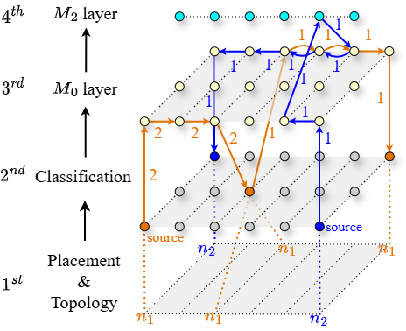
SO3-Cell (Simultaneous Optimization of Three Steps–Cell)
3D Routing Grid – enumerating all possible combinations
Simultaneously determine..
Source / Drain of transistor
Placement location of the transistor
Net-to-net routing
Notes:
This figure shows the 3D routing graph used in our framework,
which is capable of enumerating all possible combinations across the three optimization steps.
Using this graph, we can simultaneously determine
the source and drain assignment of each transistor,
the placement location,
and the net-to-net routing connections within the cell.

Slide 7
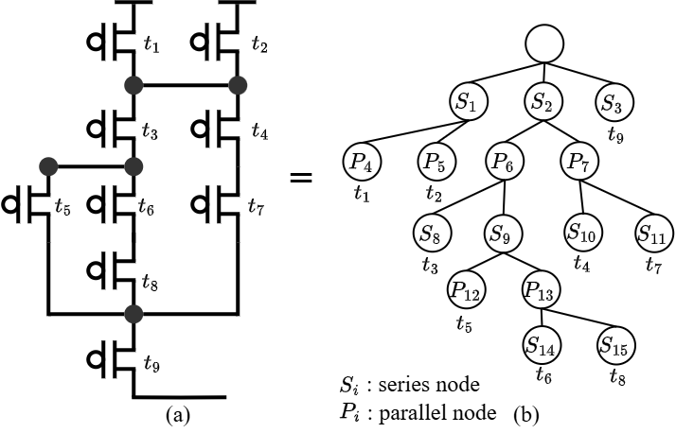
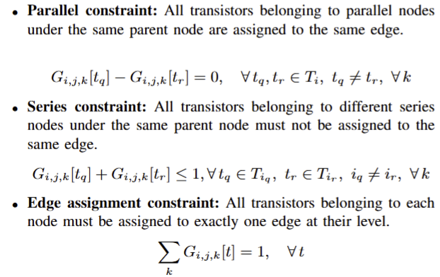
Circuit Topology Optimization
Hierarchical Series-Parallel Tree Structure
  systematically enumerate all logically equivalent circuit topologies.
Convert
Notes:
Let’s take a closer look at the circuit topology optimization.
We first convert the transistor network into a hierarchical series–parallel tree structure.
Then, we formulate a set of constraints — including series constraints, parallel constraints, and edge-assignment constraints —
to systematically enumerate all logically equivalent circuit topologies.
This formulation allows our framework to explore multiple topology variations that implement the same Boolean function.

Slide 8
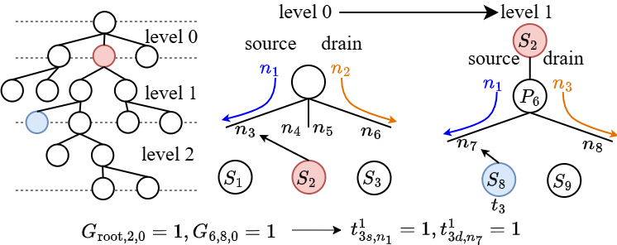
Circuit Topology Optimization
Hierarchical Net Remapping
tr3’s source/drain : n4,n7 -> n1,n7
Notes:
We also introduce variables and constraints for hierarchical net remapping,
which allow us to track the source and drain net names of each transistor throughout the optimization process.
This ensures that the logical connectivity of the circuit is fully preserved even when the topology changes.

Slide 9
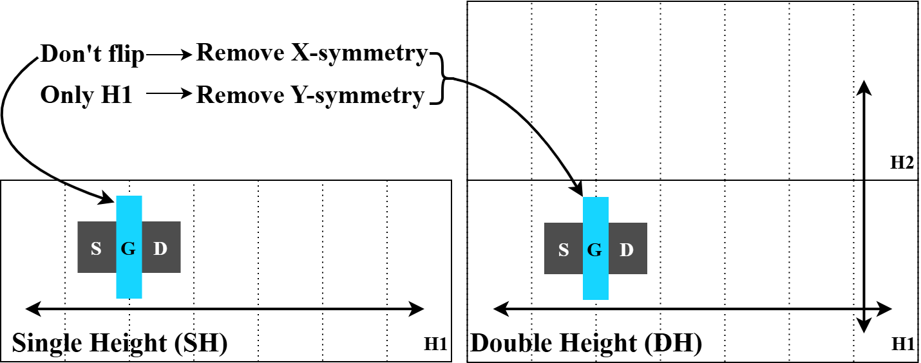
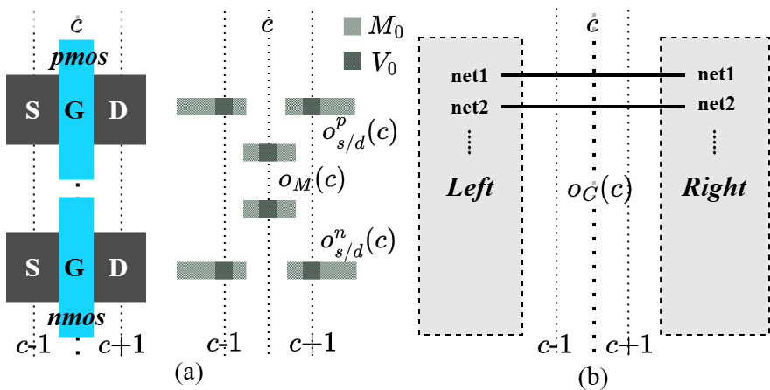
Design Space Pruning Technique
Symmetry Breaking (SB)
  Just controlling one transistor is enough.
Maximum Occupying Track (MOT)
Notes:
Now, let’s talk about design space pruning.
First, we introduce symmetry breaking for both single-height and double-height cells.
By applying a constraint to only one transistor,
we can eliminate redundant symmetric cases and significantly reduce the search space.
Next, we define a maximum occupying track constraint.
By estimating the expected track usage for each column,
this constraint helps us exclude unroutable placement configurations (early in the optimization process.)

Slide 10
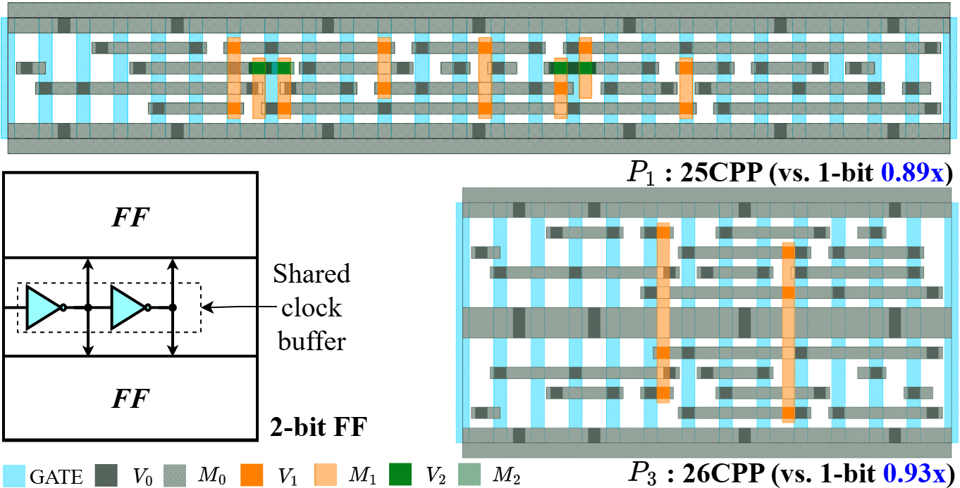
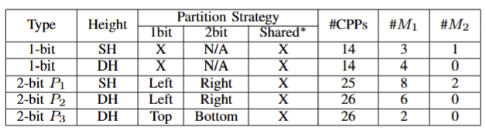
Design Space Pruning Technique
Misaligned Gate Specification (MGS)
  Only applied when a misaligned gate is detected by SO2-TP.
Structure-Driven Partitioning (SDP)
  Only two-group (left/right or top/bottom) partitioning.
Notes:
Next is the misaligned gate specification.
This constraint is applied when a misaligned gate is detected during the preprocessing step.
The final one is the structure-driven partitioning,
which partitions transistor groups into left and right, or top and bottom,
based on the circuit structure.
These two constraints are specifically designed for flip-flops,
which are among the most complex types of standard cells.

Slide 11
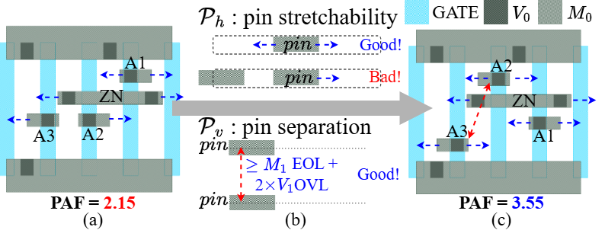
Incorporation Cell-Flex
Cell-Flex: Cell Layout Flexibility
  How well can a cell be placed and routed at the block level?
PAF : Pin Access Flexibility
Notes:
We also integrate Cell-Flex into our cell layout generation framework.
Cell-Flex represents how well a cell can be placed and routed at block level.
First, we consider Pin Access Flexibility.
By defining a reward function that evaluates pin stretchability and pin separation,
our framework can adapt the layout from left to right, improving the overall routing accessibility.

Slide 12
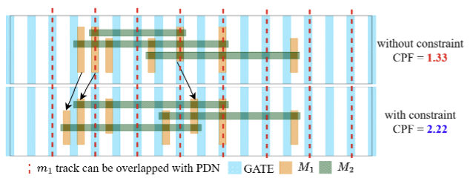
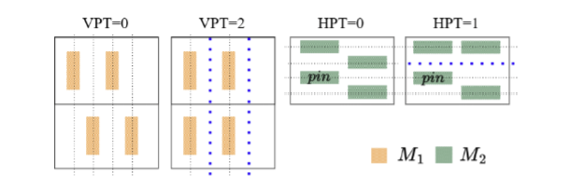
Incorporation Cell-Flex
CPF: Cell Placement Flexibility
TUF: Track Utilization Flexibility
PDN aware Guidance!
avoiding the specified track
OBS alignment!
Remain empty -> Facilitate routing
Notes:
Second, we make a constraint for Cell Placement Flexibility.
This metric helps avoid placing internal metals on tracks that could be occupied by the Power Delivery Network (PDN),
allowing the cell to be placed more freely at block level.
The last component is Track Utilization Flexibility.
This considers the alignment of obstruction (OBS) metals within cell,
ensuring that certain tracks remain empty to facilitate routing for neighboring cells.

Slide 13
Experiments
Settings
  Solver: Gurobi Optimizer v12.0.1
  LVS and PEX: Cadence Pegasus v21.3, Cadence Quantus v21.2
  Characterization: Cadence Liberate v23.1
  Synthesis and P&R: Synopsys Fusion Compiler v22.12
Notes:
Next, I’ll move on to the experimental results.
This slide shows the environmental setup used in our work,
including the tools and versions applied in each step of the framework.

Slide 14
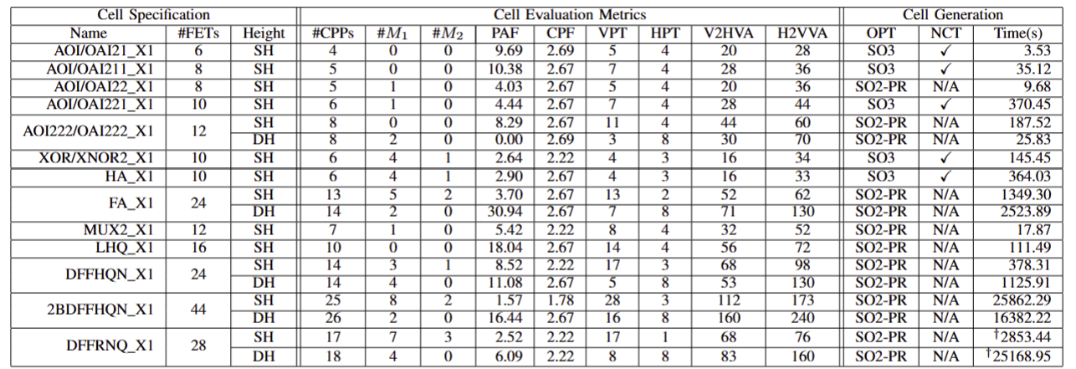
Experiments
Cell Generation Statistics
  Combinational cells, Full Adder, Mbit-FF…
Notes:
This slide presents the cell generation statistics of our framework.

Slide 15
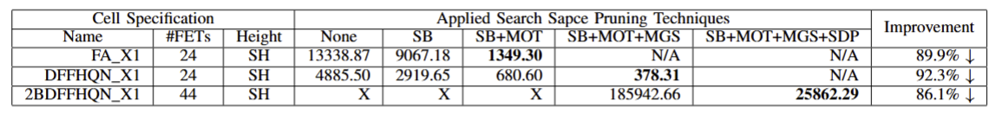
Experiments
Effectiveness of Design Space Pruning 86~90%
Notes:
This slide shows the impact of design space pruning,
which can reduce the runtime by up to 90%.

Slide 16
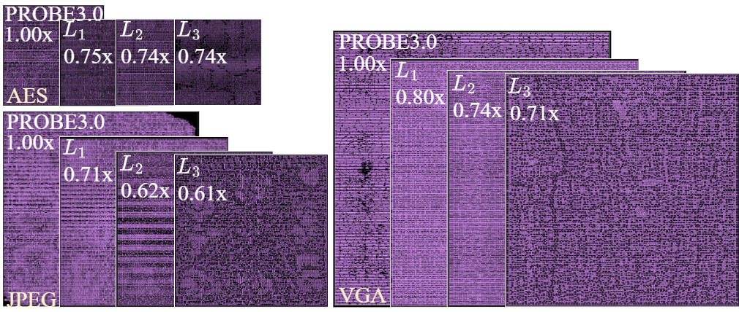
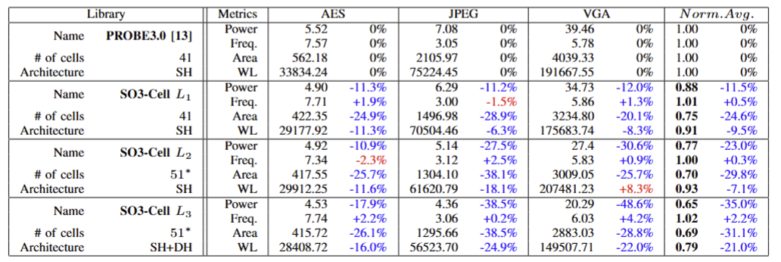
Experiments
Block Level Implementation
  Block PPA improved! L1->L2->L3
Notes:
This slide shows the block-level implementation results of our framework.
L1 illustrates the overall improvement of our framework compared to the previous approach.
L2 demonstrates the impact of adding more cell types within the library.
And L3 shows the impact of introducing double-height cells on design quality and routability.

Slide 17
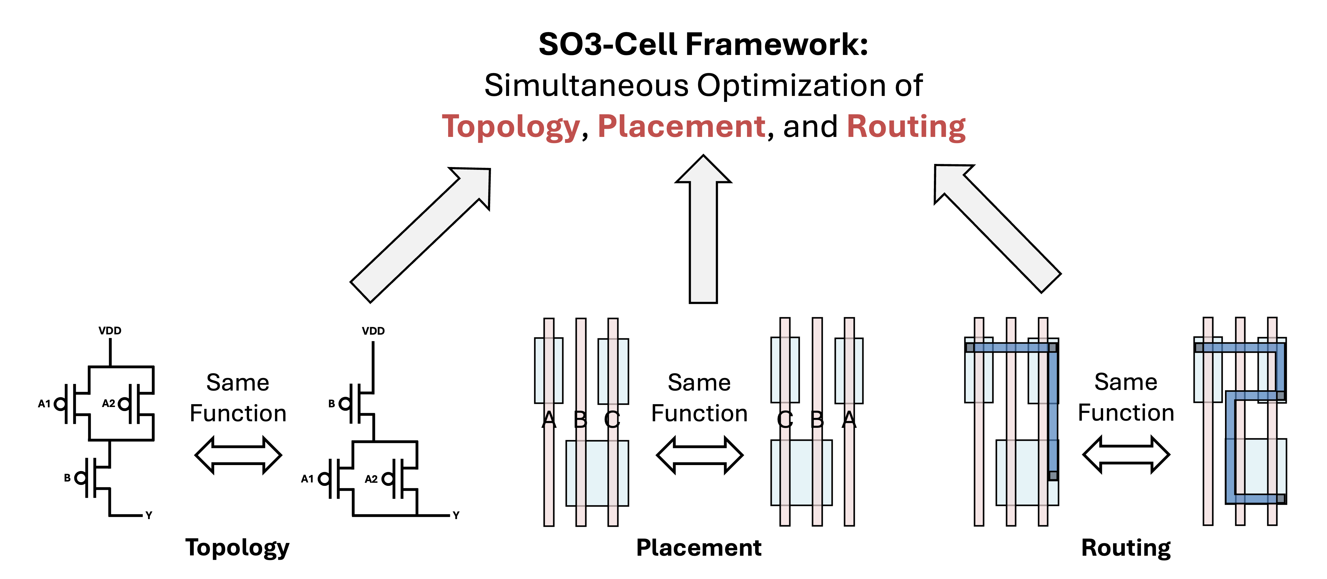
GitHub is ready!
http://github.com/ckchengucsd/SO3-Cell
Script for Cell Generation to Block Experiment
  Cell Layout Generation: *.cdl -> Gurobi ILP Python API -> *.gds
  Cell Library Construction: Cadence Pegasus, Quantus, Liberate
  Block Experiments: Synopsys Fusion Compiler
Notes:
Our framework is open-sourced on GitHub.
It includes cell layout generation, cell library construction,
and block-level experimental settings for reproducibility and further research.

Slide 18
Thank you!

