Slide 1
Recursive Learning-Based Virtual Buffering for Analytical Global Placement MLCAD 2025
Andrew B. Kahng, abk@ucsd.edu
Yiting Liu, yil375@ucsd.edu
Zhiang Wang, zhw033@ucsd.edu
University of California, San Diego
Notes:
Hi everyone. I am Yiting Liu, a postdoc at UCSD.
This is joint work with Zhiang Wang and professor Andrew Kahng.

Slide 2
Agenda
Introduction
Motivation
Key contributions
Our approach
Reformulation of buffer insertion
MLBuf model structure
MLBuf-RePlAce
Experimental results
Conclusion
Notes:
I’ll start with motivations and our key contributions. Then, I will introduce details of our proposed approach. Finally, I will show the experimental results and conclude the presentation.

Slide 3
Motivation
Challenges
Timing closure requires extensive buffer insertion
Solution: Buffer-porosity-aware placement
Actual buffer insertion slows down the GPU-accelerated placer because the topology changes!
Solution: Lightweight virtual buffering strategy
Limitations of existing methods
Traditional van Ginneken-Lillis-style methods
Computationally expensive
Modern ML-based approaches
Omit Electrical Rule Check (ERC) considerations
Fail to “close the loop” back into the physical design flow
Notes:
Let’s start with motivations.
[CLICK]
With scaling of interconnect versus gate delays in advanced technology nodes, timing closure requires extensive buffer insertion.
[CLICK]
But buffer insertion only works well if the placement stage already left room for them. That’s where buffer porosity comes in.
Placement with buffer porosity awareness can pre-allocate enough space for buffer insertion at later optimization stages. It helps reduce routing congestion while improving post-route power and timing. Achieving this requires invoking a buffering engine multiple times during global placement.
[CLICK]
Modern GPU-accelerated placers have achieved significant speedups. But in a GPU-accelerated placer, if we try to do actual buffer insertion, it will change the netlist topology. Updating that netlist stored in GPU memory requires frequent memory accesses, which will significantly slow down the GPU-accelerated placer.
[CLICK]
Therefore, instead of actual buffer insertion, we need a virtual buffering strategy. Something lightweight that gives the placer a sense of where buffers will go, without all the expensive memory updates.
[CLICK]
Now, let’s look at the existing buffering approaches.
Traditionally, buffering relied on van Ginneken-Lillis-style dynamic programming. But these methods are too computationally expensive inside placement loops.
[CLICK]
Recently, Machine learning (ML)-based buffering approaches have attracted significant attention, but many existing works share two limitations:
First, they don’t fully consider Electrical Rule Check (ERC) constraints;
Second, they do not “close the loop” back to evaluate in the full physical design flow.

Slide 4
Key Contributions
MLBuf
A recursive learning-based generative buffering model
Predicts buffer locations
Predicts buffer types
Predicts buffered tree structures
MLBuf-RePlAce
An open-source learning-driven virtual buffering-aware analytical global placement framework
Operates within a complete placement and optimization flow (closing the loop)
Achieve better post-route PPA results in both OpenROAD flow and commercial flow
Notes:
[CLICK]
In this work, we present MLBuf, a recursive learning-based generative buffering model that efficiently predicts buffer types, locations and buffered tree structures to address ERC violations.
[CLICK]
We further integrate MLBuf into RePlAce to develop MLBuf-RePlAce, a learning-driven virtual buffering aware analytical global placement framework. It combines ML-guided buffering with a “full placement and optimization flow”.
We have built this on the OpenROAD infrastructure.
When evaluated with a post-placement flow, both with OpenROAD and with a commercial tool, MLBuf-RePlAce consistently achieves better post-route PPA results than other approaches.

Slide 5
Agenda
Introduction
Motivation
Key contributions
Our approach
Reformulation of buffer insertion
MLBuf model structure
MLBuf-RePlAce
Experimental results
Conclusion
Notes:
Now, I will describe our approach.

Slide 6
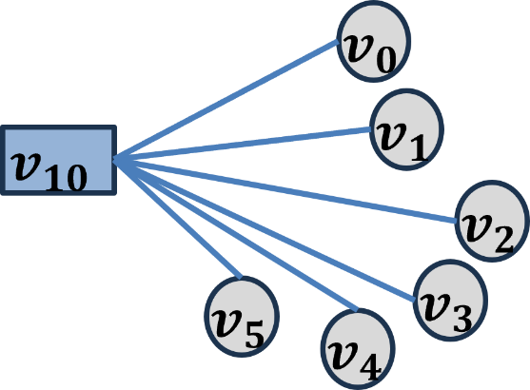
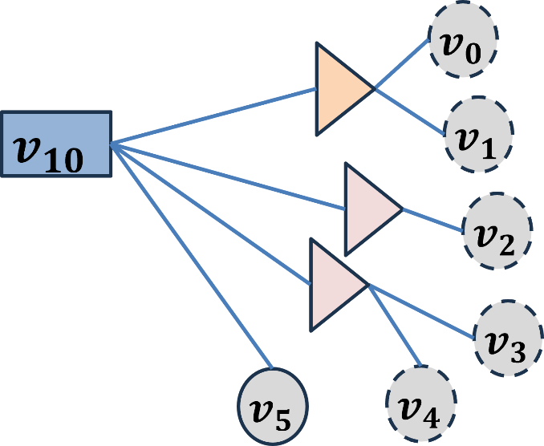

















Reformulation of Buffer Insertion
Model buffer insertion as sequence transformation
Consider each net independently
Represent cells within the same net as a sequence
Input: A sequence of a driver and its sinks
$${ v}_{0}$$
$${ v}_{1}$$
$${ v}_{2}$$
$${ v}_{3}$$
$${ v}_{4}$$
$${ v}_{5}$$
$${ v}_{10}$$
Output: A transformed sequence containing the driver, predicted buffers, and unbuffered sinks
$${ v}_{6}$$
$${ v}_{6}$$
$${ v}_{6}$$
$${ v}_{7}$$
$${ v}_{8}$$
$${ v}_{8}$$
$${ v}_{5}$$
$${ v}_{10}$$
$${ v}_{7}$$
$${ v}_{8}$$
driver
buffer
sink
BufFormer [link]
Notes:
[CLICK]
We formulate the buffer insertion process as a sequence transformation problem. This is motivated by Nvidia’s work BufFormer. If you don’t know this work, we put a link in this slide.
Each net is considered independently. Cells within the same net are regarded as a sequence with their spatial and electrical information.
[CLICK]
The input is a sequence of the original net with the driver and all sinks. For example, in this figure, the input is the driver labeled v10, and six sinks v0 through v5.
MLBuf determines which sinks need to be merged and driven by the same buffer,
[CLICK] The output is their corresponding “parent” buffers with buffer types and locations.
[CLICK]
In this example, sinks v0 and v1 are merged and driven by the buffer v6;
[CLICK] sink v2 is driven by the buffer v7;
[CLICK] sinks v3 and v4 are merged and driven by the buffer v8;
[CLICK] and sink v5 is not buffered.
The driver serves as the root of the tree.

Slide 7
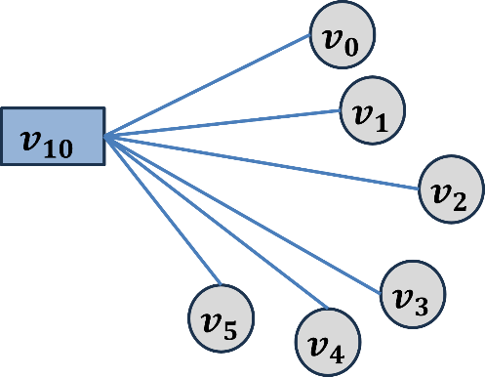
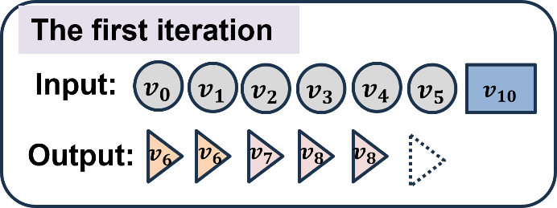
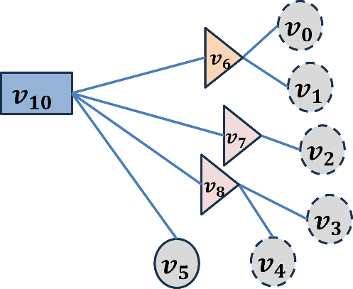
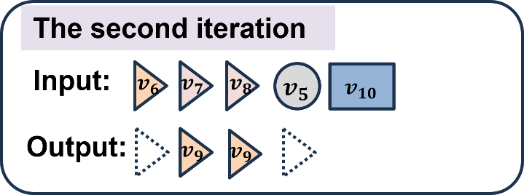
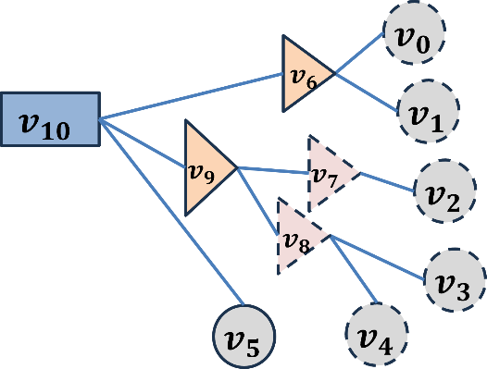
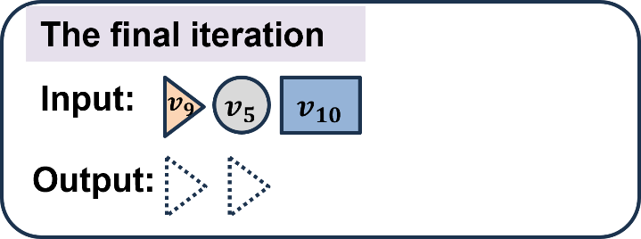
Reformulation of Buffer Insertion
MLBuf mimics the bottom-up dynamic programming
No Steiner tree construction
Notes:
MLBuf mimics the bottom-up dynamic programming process.
[CLICK]
The output of each iteration is fed into the next iteration,
[CLICK]enabling a hierarchical construction of the buffer-embedded tree.
[CLICK]
The iterations end when there is no further buffering needed. Then, the entire buffer-embedded tree is constructed.
[CLICK]
So no Steiner tree construction is needed when applying MLBuf.

Slide 8
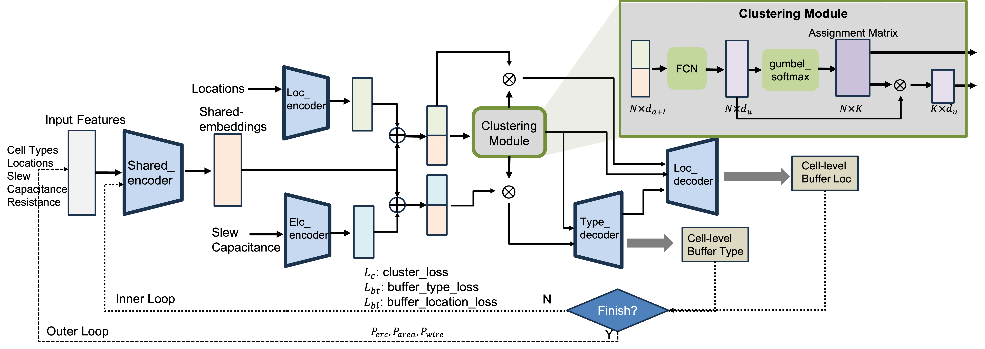
ML-based Virtual Buffering (MLBuf)
Feature encoders: extract spatial and electrical features
Differentiable clustering module: end-to-end training
Task-specific decoders: output buffer types and locations
Dual-level optimization flow: inner-loop loss functions and outer-loop global penalties
Feature encoders
Inner Loop
Outer Loop
Notes:
This is the model structure of MLBuf, from Figure 3 in the paper.
Here, I want to point out three key components:
[CLICK] First, we have the feature encoders: they extract meaningful representations of cells for downstream modules;
[CLICK] Second, there is the differentiable clustering module: it determines which sinks need to be merged;
[CLICK] Then, we have two task-specific decoders: they predict the buffer types and locations.
Predicted buffers are treated as dummy sinks, so the model can keep building the tree recursively.
[CLICK]
MLBuf’s training is guided by both inner-loop loss functions and outer-loop global penalties. This way, MLBuf learns not just to mimic the given labels, but to search for better buffering solutions.
In the next three slides, I will give some more details for these components.

Slide 9
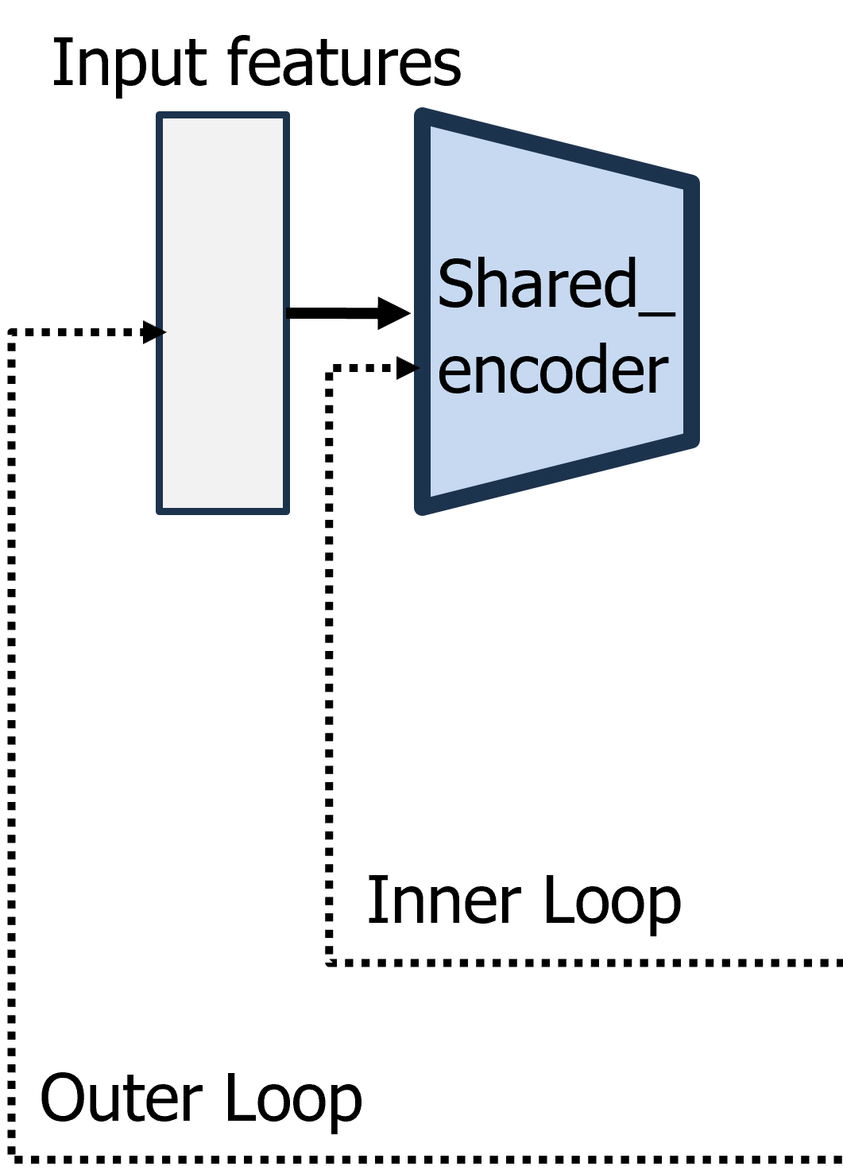
MLBuf: Input Features
Cell type (driver, sink, or buffer)
Relative coordinates of sinks
Driver fixed at (0, 0)
Manhattan distance to the driver
Input slew (ps) of sinks
-1 for the driver
Output slew (ps) of the driver
-1 for sinks
Input capacitance (fF) of sinks
-1 for the driver
Output load capacitance (fF) of the driver
-1 for sinks
Maximum capacitance of the driver
-1 for sinks
Resistance of the driver
-1 for sinks
Cell types
Locations
Slew
Capacitance
Resistance
Notes:
First, input features. To make smart buffering decisions, MLBuf needs rich input features that capture both spatial and electrical properties of the net. They include
[CLICK] cell type,
[CLICK] cell locations. [[It includes relative coordinates of sinks and their Manhattan distances to the driver]]
[CLICK] Slews, that is input slew of sinks, output slew of the driver,
[CLICK] Capacitances, that is input capacitance of sinks, output load capacitance of the driver, maximum capacitance of the driver
[CLICK] and driver resistance.
Together, these features give the model a detailed picture of each net.

Slide 10
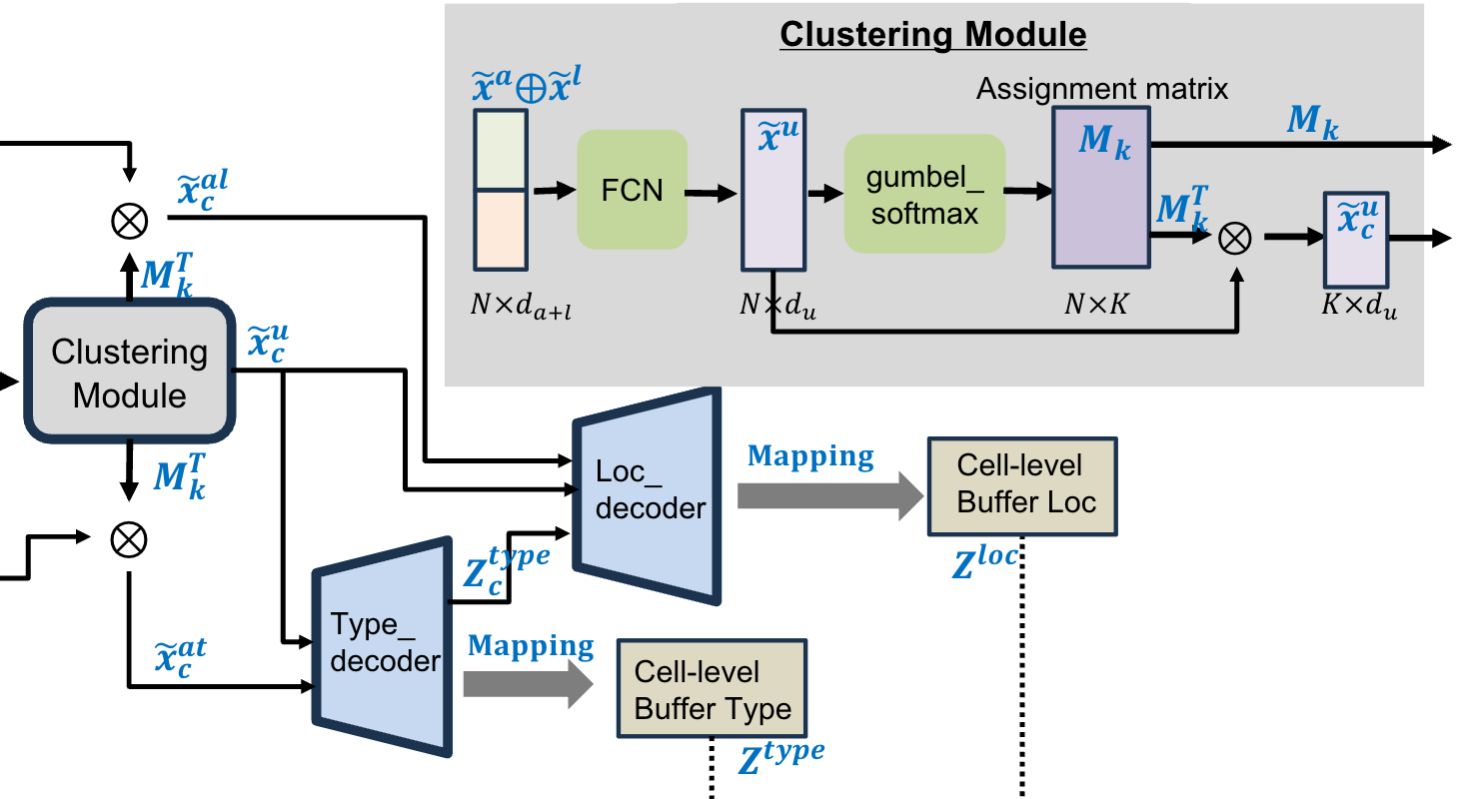
MLBuf: Differentiable Clustering
Determines which sinks should be merged and driven by the same buffer
Steiner tree → too expensive
Learn a probability distribution over cluster assignments
End-to-end training
Notes:
Then, clustering determines which sinks should be merged and driven by the same buffer.
How do we do this?
[CLICK]
A naive approach would require computing Steiner trees, which is too expensive.
[CLICK]
Instead, MLBuf uses a differentiable clustering module. It learns a probability distribution over cluster assignments, which makes the clustering process smooth and trainable.
[CLICK] This lets us train the whole model end-to-end, bridging the gap between discrete clustering and continuous neural training

Slide 11
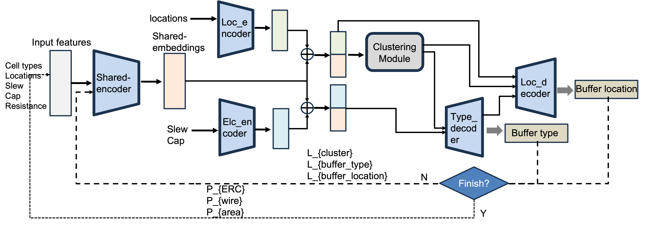
MLBuf: Loss Function
Inner-loop loss functions guide hierarchical btree construction
Cluster prediction loss
Buffer type classification loss
Buffer location regression loss
Inner Loop
Notes:
Recall that, to train MLBuf, we have a dual-level optimization flow. It includes inner-loop loss functions and outer-loop global penalties.
[CLICK]
In the inner-loop, the model predicts
[CLICK]cluster assignment,
[CLICK]buffer types and
[CLICK]locations, and it hierarchically constructs the buffer-embedded tree.
Three loss functions guide this process:
[CLICK]cluster prediction loss, buffer type classification loss, and buffer location regression loss.
Once all buffers are predicted, MLBuf produces a complete buffer-embedded tree.

Slide 12
MLBuf: Loss Function
Outer-loop global penalties encourage exploration to find better btrees
ERC penalty
Wirelength penalty
Buffer area penalty
Outer Loop
Notes:
[CLICK] Then we add three global penalty terms in outer loop to encourage MLBuf explore better buffering solution,
that is
[CLICK]ERC penalty, wirelength penalty, and buffer area penalty.
For ERC penalty and wirelength penalty, they penalize ERC violations and long wires in the predicted buffer-embedded tree.
For buffer area penalty, it serves as a regularization term, and encourages the model to minimize the total buffer area. That is how we train MLBuf to find better buffering solutions.

Slide 13
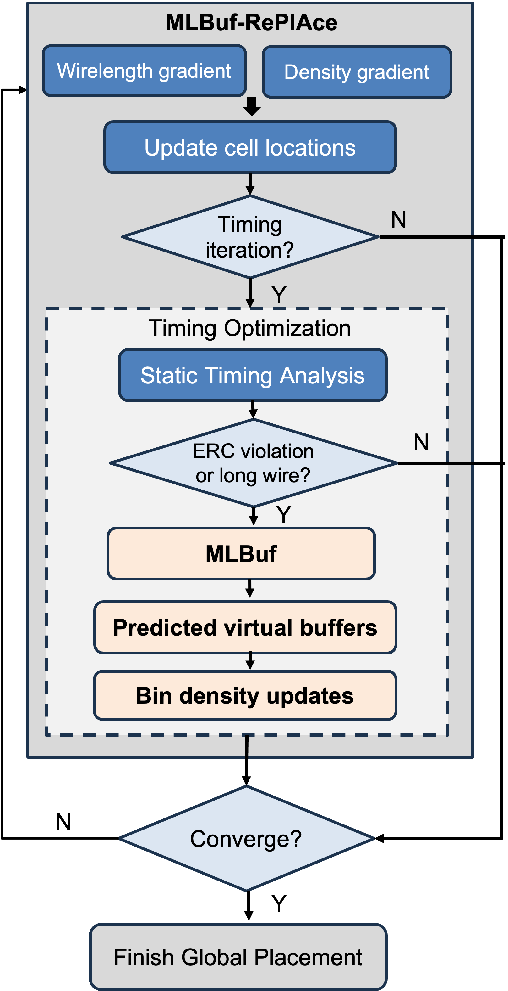
MLBuf-RePlAce: Buffer Porosity-Awareness
Trigger: Overflow > threshold
Timing analysis: OpenSTA finds problem nets
MLBuf: Feed the problem nets to pre-trained MLBuf model
repair_design focus on ERC fixing
Virtual buffering: → virtual area occupancy in placement bins
The placer reserves space, reducing routing congestion and improving post-route PPA
Notes:
Now let’s see how MLBuf integrates into the full placement flow.
We integrate MLBuf into RePlAce to construct MLBuf-RePlAce, a virtual buffering aware analytical global placement framework.
This workflow is shown in this figure.
[CLICK] During placement, when the placement overflow reaches a predefined threshold,
[CLICK] OpenSTA is invoked to identify problematic nets with ERC violations.
[CLICK] Those nets are then passed into the pre-trained MLBuf model, which is designed to repair ERC violations.
In other words, MLBuf is not a timing optimizer. It behaves more like the repair_design command in OpenROAD, rather than repair_timing. So it focuses on ERC fixing.
For each problematic net, MLBuf generates the buffer-embedded tree.
[CLICK] Then virtual buffering is performed. We pre-allocate virtual occupancy within placement bins according to the predicted buffer-embedded trees.
[CLICK] This guides the placer to reserve space for real buffers later. It reduces routing congestion while improving post-route power and timing.

Slide 14
Agenda
Introduction
Motivation
Key contributions
Our approach
Reformulation of buffer insertion
MLBuf model structure
MLBuf-RePlAce
Experimental results
Conclusion
Notes:
Now I will present our experimental results.

Slide 15
Experiment Setup
Framework built on OpenROAD infrastructure
Designs from the MacroPlacement and OpenROAD repositories
All designs use the NanGate45 open enablement
Evaluations of MLBuf-RePlAce solutions are conducted using both OpenROAD and a Commercial tool
Design | #Insts | #Nets | *TCP_{OR} | *TCP_{Com}
ibex | 16907 | 17728 | 2.20 | -
jpeg | 53042 | 58898 | 1.40 | -
ariane | 119256 | 142226 | 4.00 | -
BlackParrot (BP) | 768851 | 998716 | NA | -
MegaBoom (MB) | 1086920 | 1443755 | NA | -
* TCP_{𝑂𝑅} and TCP_{Com} denote the target clock periods used in the OpenROAD and commercial flows, respectively.
Notes:
We have developed our framework on the OpenROAD infrastructure. We use open designs from the MacroPlacement and OpenROAD repositories.
We evaluate our MLBuf-RePlAce solutions using both OpenROAD and a commercial tool to measure post-routing PPA.
[CLICK] The table here shows the characteristics of the designs we have used for our evaluation.
The target clock periods are masked to avoid any unintentional benchmarking of tools. The instance count in our test cases varies from 16K to 1.1M.

Slide 16
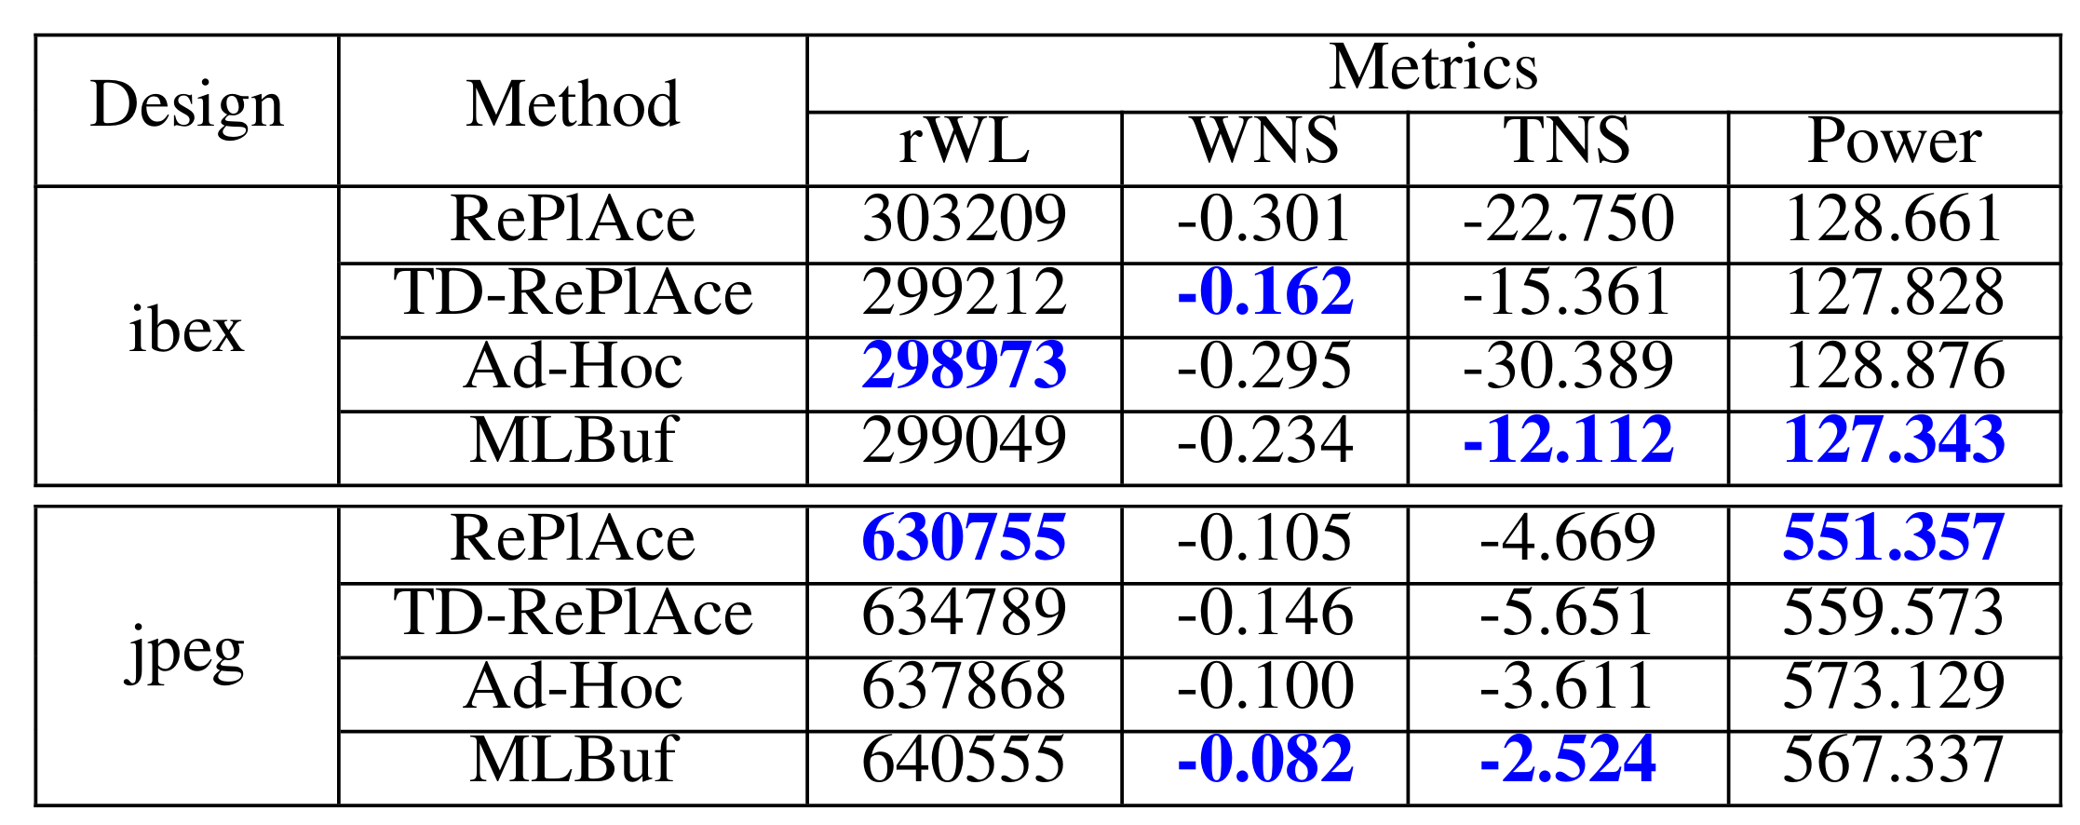
PPA Validation with OpenROAD
Three baselines:
RePlAce: normal RePlAce without timing-driven mode
TD-RePlAce: default virtual buffering-based timing-driven RePlAce in OR
Ad-Hoc: a baseline for comparison
MLBuf-RePlAce achieves (maximum, average) improvements of (56%, 31%) in TNS, compared with TD-RePlAce
Notes:
We compare MLBuf against three baselines:
The normal RePlAce without timing-driven mode,
TD-RePlAce, which is the default virtual buffering-based timing-driven placement in OpenROAD,
and an ad-hoc baseline. It is a rule-based analytical approximation approach.
[CLICK] In this table of results, we highlight the best results among the four approaches in blue.
[CLICK] Compared with TD-RePlAce, the MLBuf-RePlAce achieves up to 56% improvement in total negative slack (TNS), and on average, around 31%. And we get these timing benefits without degradation of post-route power.

Slide 17
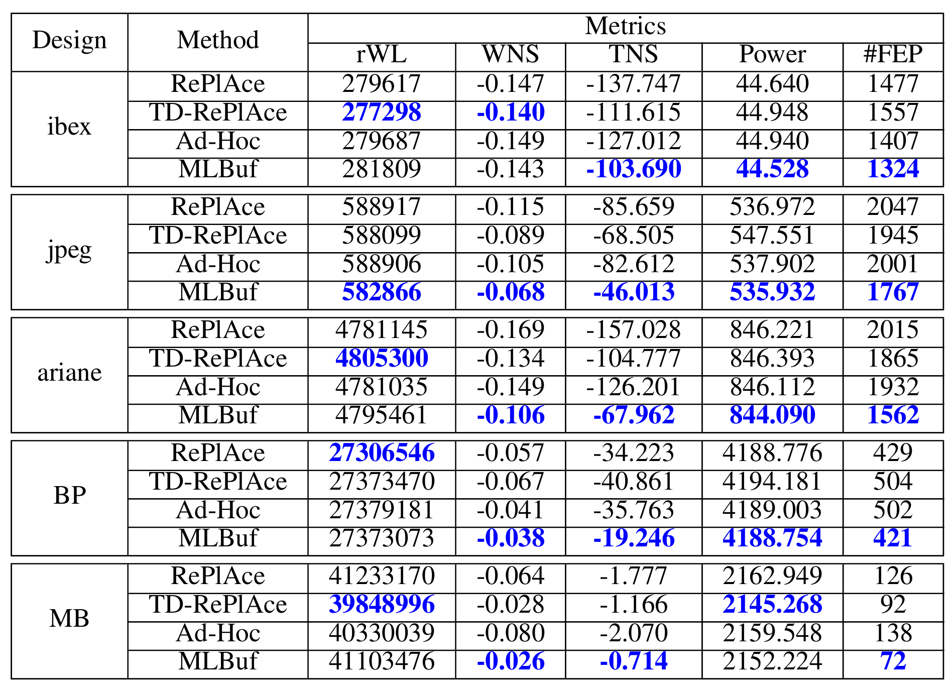
PPA Validation with Commercial Tool*
MLBuf-RePlAce achieves (maximum, average) improvements of (53%, 28%) in TNS, compared with TD-RePlAce
*Note: We perform only evaluation, and no benchmarking, with the commercial tool
Notes:
We also feed the generated global placement results into a commercial tool and compare post-route PPA results. So the commercial tool is only used for post-placement evaluation. What you see here is Table V in the paper.
[CLICK]
We can see that, MLBuf-RePlAce achieves up to 53% improvement in TNS, and on average, around 28%, And here, we see a slight improvement in post-route power, compared with TD-RePlAce.
In general, MLBuf-RePlAce consistently produces high quality placement solutions, yielding better PPA outcomes compared to other methods.

Slide 18
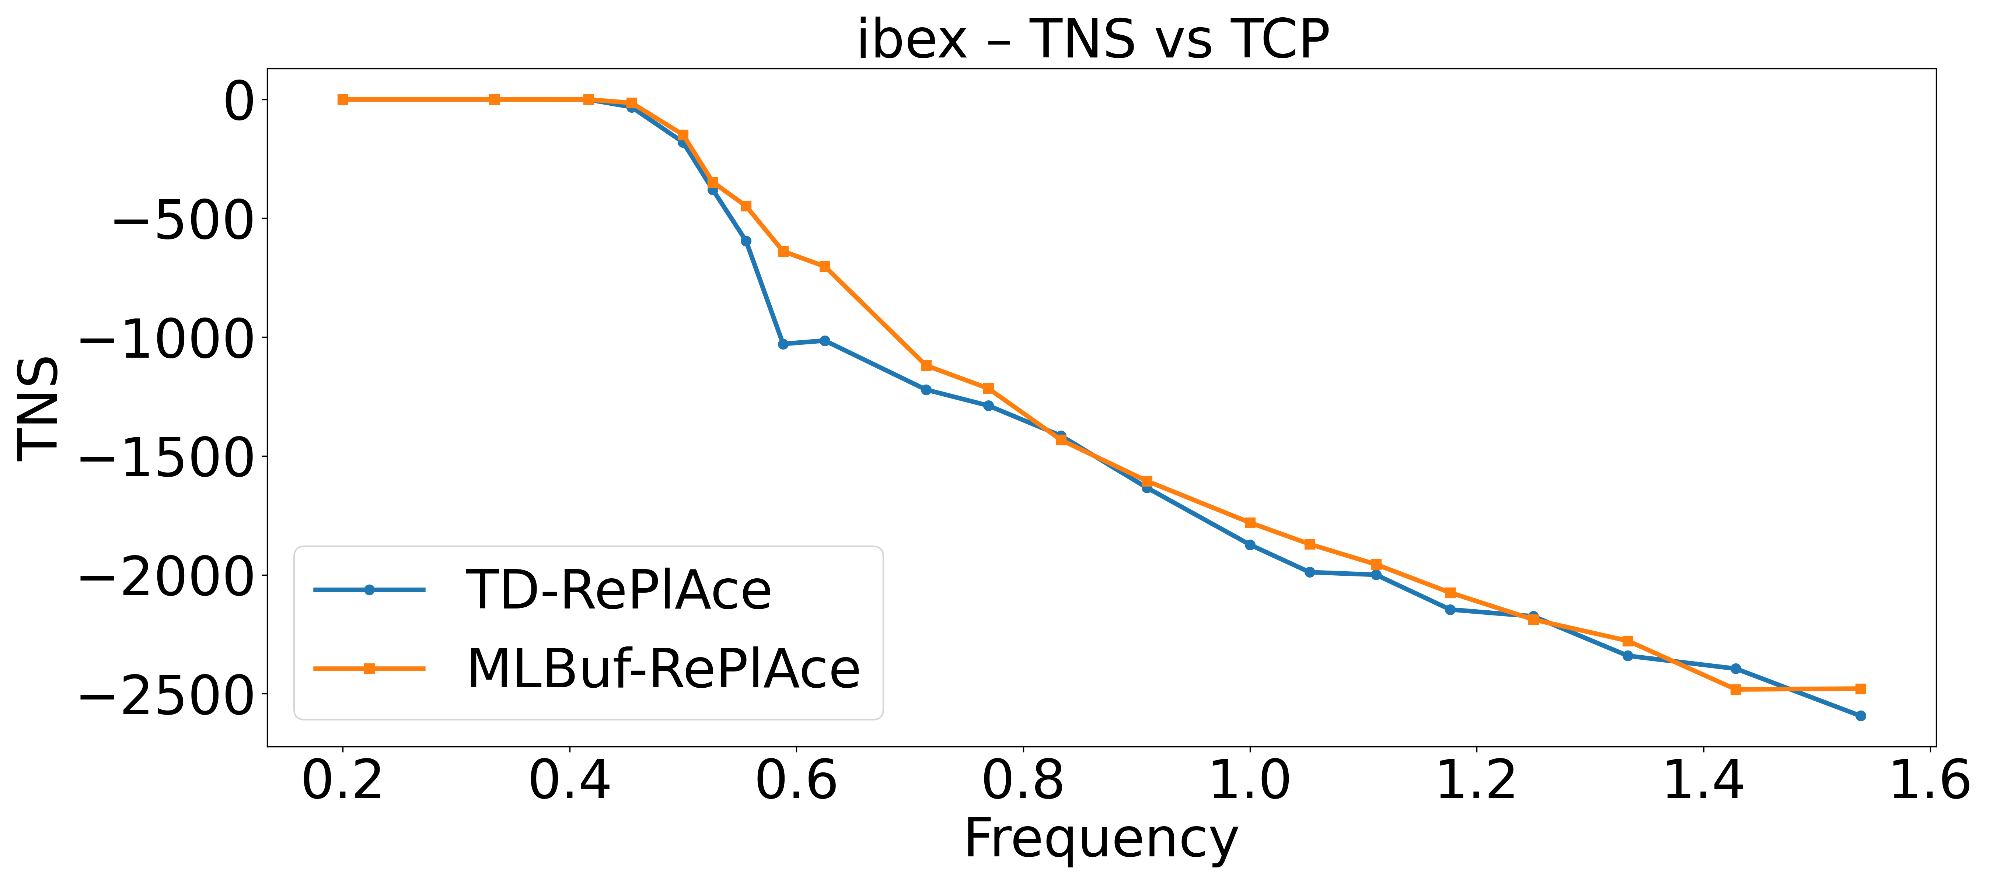
Benefits of Buffer-porosity-aware Placement
Timing clock period (TCP) sweep
Type 2
Tighten TCP
Type 1
Tighter timing constraints
Type 3
More buffers
Type 1: No buffering, no benefit
Type 2: Consistent MLBuf benefits → the sweet spot
Type 3: Heavy buffering, no benefit
MLBuf is designed for fixing ERC violations
Insensitive to timing constraints
Notes:
To further investigate the impact of buffer-porosity-aware placement on the full optimization flow, we performed a systematic sweep of the target clock period (TCP).
[CLICK]Tightening the clock period means tighter timing constraints. And that, in turn, forces more buffers to be inserted during optimization.
This figure shows the post-route TNS of MLBuf-RePlAce and TD-RePlAce across different clock frequencies under the OpenROAD infrastructure.
We observe three Types of outcomes:
[CLICK] First, Type 1, where there is no buffering required;
[CLICK] Second, Type 2, where MLBuf consistently outperforms TD-RePlAce. This is the sweet spot we care most about;
[CLICK] And Type 3, where benefits plateau with heavy buffering.
In general, MLBuf-RePlAce delivers greater benefits with greater buffering needs, as in Type 1 and Type 2. MLBuf guides the placer to pre-allocate buffer space for downstream optimization, thereby reducing routing detours and achieving better PPA results.
[CLICK]
However, MLBuf is designed for resolving ERC violations. It is insensitive to timing constraints. So under extremely tight timing, as in Type 3, MLBuf doesn’t show benefits – which is as expected.
We are currently adding timing-related features and constraints, to achieve timing-aware virtual buffering prediction.

Slide 19
Agenda
Introduction
Motivation
Key contributions
Our approach
Reformulation of buffer insertion
MLBuf model structure
MLBuf-RePlAce
Experimental results
Conclusion
Notes:
Now, let me conclude my presentation.

Slide 20
Conclusion
This work presents MLBuf and MLBuf-RePlAce
Learning-driven, virtual buffering-aware global placement built on the OpenROAD infrastructure
“Close the loop” back into the physical design flow
Outperforms OpenROAD’s default virtual buffering-based global placement (commit hash: df581be)
Open-source (all 3 artifact badges) [GitHub repo]
Please let us know if you find any issues!
Ongoing extensions
Inverter-based repeater insertion and sink polarity
Use delay information for timing-driven placement
Integration with GPU-accelerated global placer
Notes:
[CLICK]
This work presents MLBuf and MLBuf-RePlAce, a learning-driven virtual buffering-aware analytical global placement framework built upon the OpenROAD infrastructure.
[CLICK]
It “closes the loop” back into the physical design flow.
Experimental results demonstrate that MLBuf-RePlAce outperforms the default virtual buffering based global placer in OpenROAD.
[CLICK]
All data, codes and scripts are open-sourced. Please let us know if you find any issues!
[CLICK]
Our ongoing extensions to MLBuf-RePlAce include:
[CLICK] enabling inverter-based repeater insertion and handling sink polarity,
[CLICK] incorporating delay information into the virtual buffering model to enable net weighted timing-driven global placement,
[CLICK] and integrating the virtual buffering model with state-of-the-art GPU-accelerated global placers to support virtual buffering-aware timing-driven GPU-accelerated global placement.

Slide 21
Thank You
Notes:
This concludes my presentation – thank you for your attention !

Slide 22
BACKUP

Slide 23
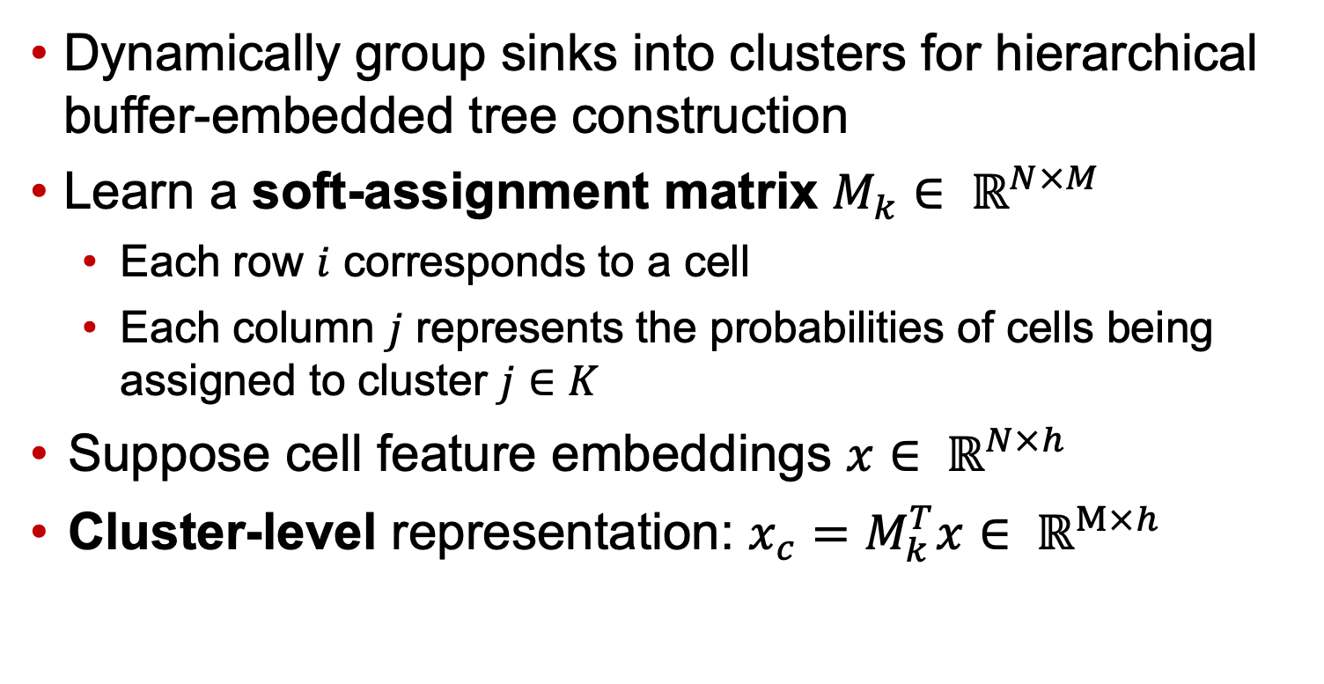
MLBuf: Differentiable Clustering
Dynamically group sinks into clusters for hierarchical buffer-embedded tree construction
Learn a soft-assignment matrix $M_{k}∈ ℝ^{N×M}$
Each row $i$ corresponds to a cell
Each column $j$ represents the probabilities of cells being assigned to cluster $j∈K$
Suppose cell feature embeddings $x∈ ℝ^{N×h}$
Cluster-level representation: $x_{c}=M_{k}^{T}x∈ ℝ^{M×h}$

Slide 24
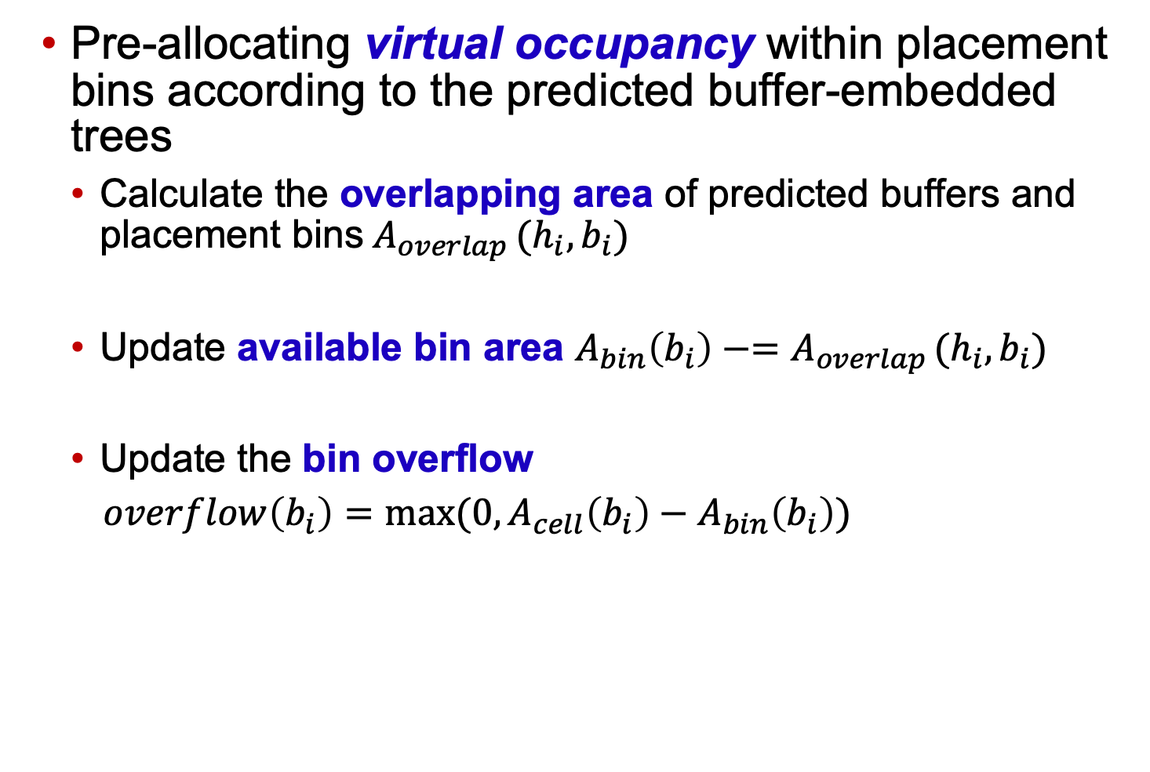
Virtual Buffering
Pre-allocating virtual occupancy within placement bins according to the predicted buffer-embedded trees
Calculate the overlapping area of predicted buffers and placement bins$A_{overlap }(h_{i}, b_{i})$
Update available bin area $A_{bin}\left(b_{i}\right)−=A_{overlap }(h_{i}, b_{i})$
Update the bin overflow
$overflow\left(b_{i}\right)=max⁡(0, A_{cell}\left(b_{i}\right)−A_{bin}\left(b_{i}\right))$
Notes:
The available bin area needs to be reduced by the buffer area.

Slide 25
Baselines
Ad-Hoc Baseline
Estimating the net wirelength using a wireload model
Applying a pessimism margin of 25% to the estimated wirelength
→ account for placement dynamics and congestion effects
Estimating the buffer count
Dividing the total load capacitance (wire + sinks) in one net by the max capacitance limit of the buffer
Adding an additional overhead factor of 20%
→ routing detours and inefficiencies
Allocating the estimated buffer area “non-uniformly” within the bounding box of the net
All hyperparameters are tuned
Improve the competitiveness of this baseline
Notes:
All hyperparameters are tuned to enhance the accuracy of estimated buffer counts by benchmarking against OR rsz
, thereby improving the competitiveness of this baseline.

Slide 26
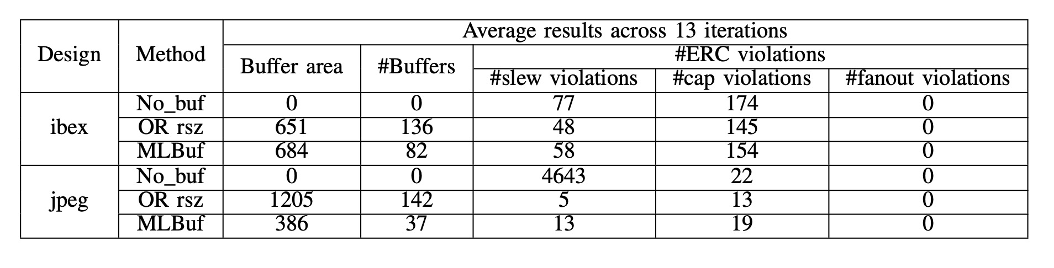
ERC Evaluation Results
Insert the predicted buffers back into netlists
Compare buffer areas and #ERC violations
MLBuf achieves comparable ERC violation resolution to OR rsz
OR rsz: OpenROAD Resizer [link]
Notes:
During each timing optimization, we insert the predicted buffers back into netlists according to the topology of the buffer-embedded trees on ibex and jpeg.
Then we compare the buffer area, and the number of ERC violations reported by OpenSTA.
Note that timing optimization is performed a total of 13 times during the global placement process;

Slide 27
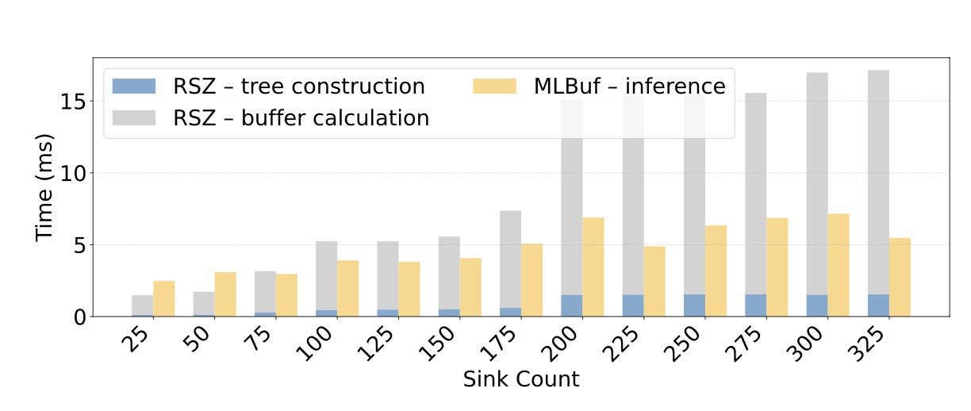
Runtime Comparison: OR rsz and MLBuf
OR rsz: Stenier tree generation + buffer calculation
MLBuf: Inference time (i.e., buffer-embedded tree generation)
Notes:
OR rsz runs on a single CPU thread.
The runtime contains the Steiner tree generation and buffer calculation (i.e., buffer type selection and buffer location calculation).
For MLBuf, we assume that the features of the driver and sinks are already extracted, and we measure the runtime of generating an entire buffer-embedded tree (i.e., inference time).
As net sizes increase, the runtime of OR rsz increases significantly. On the other hand, MLBuf consistently predicts buffer types and location with high efficiency, achieving over a 3× speedup on large nets compared to OR rsz.
These results demonstrate the efficiency and scalability of MLBuf.
Since each net can be considered independently during virtual buffering, our ongoing work further enhances the efficiency of MLBuf-RePlAce by parallelizing net processing.

