Slide 1
A Partitioning-Based CAD Flow For Interposer-Based Multi-Die FPGAs
Mahesh A. Iyer¹, Andrew B. Kahng², Jason Luu³, Bodhisatta Pramanik², Kristofer Vorwerk¹ and Grace Zgheib¹
[1] Altera [2] University of California, San Diego [3] Intel Corporation
FCCM 2025
Notes:
Good morning, everyone.
Today, I’ll be presenting our work titled A Partitioning-Based CAD Flow for Interposer-Based Multi-Die FPGAs.
This is a collaborative effort between UC San Diego, Intel, and Altera.

Slide 2
A partitioning-based flow for multi-die FPGAs
FPGAPart: first open-source netlist partitioner that can handle FPGA-based designs
Pre-packing guidance: provide clustering guidance
FP-Growth: improve timing-driven clustering (partitioning)
Neighborhood influences: accelerate ILP convergence
Partitioning-based CAD flow for interposer-based multi-die FPGAs
Integration with the open-source VTR 7 interposer branch
Key results: Up to 14% improvement in rWL and 23% in Fmax compared to default VTR 7 flow
Lower sensitivity to seed noise compared to default VTR 7 flow
Produce more routable designs compared to default VTR 7 flow
Notes:
Here’s a high-level overview of our work. We propose FPGAPart, the first open-source netlist partitioner designed specifically for FPGA-based designs.
FPGAPart introduces several key features:
Improved clustering, guided by VTR’s pre-packing solution.
Timing-driven clustering, enhanced using a frequent pattern mining approach based on the FP-Growth algorithm.
And faster ILP solving, accelerated by introducing neighborhood-based cutting planes.
We then integrate FPGAPart into a full CAD flow for interposer-based multi-die FPGAs, building on the VTR 7 interposer branch.
Our results show up to a 14% improvement in routed wirelength and up to a 23% improvement in FMax compared to the default VTR flow.
We also observe reduced sensitivity to seed noise and more routable designs overall.

Slide 3
Outline
Background and motivation
Why partitioning?
The partitioning problem
Modeling 2.5D multi-die architectures
FPGAPart
Overall framework
Clustering (pre-packing + FP-growth)
Initial partitioning (neighborhood influences)
Multilevel refinement
Experimental results
Baseline flows
Validation of partitioning
Routability study
Conclusion and future directions
Notes:
Here’s the outline of my talk. I’ll begin with the background and motivation, then walk through the FPGAPart framework.
After that, I’ll present our experimental results, and finally, I’ll wrap up with conclusions and future directions.

Slide 4
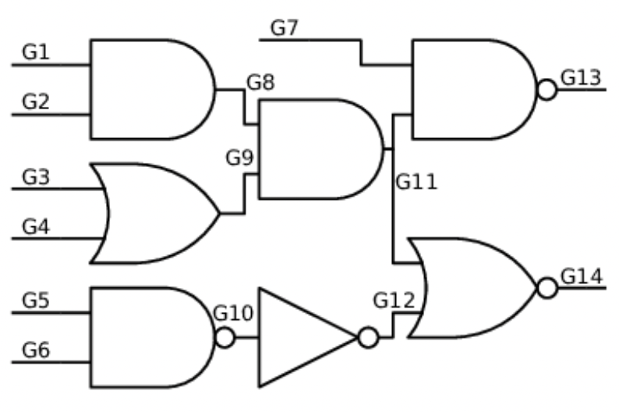
Why partitioning?
Overall goal: improve performance metrics (Fmax, routed WL) for multi-die FPGA designs
Why partitioning? → aligns with the nature of the problem
Min-cut objective (limited cross-die interconnects)
Discreteness of partitions (mapped to separate dies)
Die 0
Die 1
Partition 1
Partition 0
Partition 0
Partition 1
Partition 2
Die 3
Die 2
Partition 3
Partition 3
Partition 2
Notes:
Why partitioning? Our goal is to improve routed wirelength and FMax for multi-die FPGA designs.
Partitioning naturally fits this setting. A min-cut partitioner optimizes cutsize, which aligns with the presence of limited connectivity across dies on the FPGA.
And since partitions are discrete, each partition can be mapped to a separate die.
[CLICK] The cartoon below shows this process: the circuit on the left is split [CLICK] and mapped to separate dies on the right, just like a standard multi-die design flow.

Slide 5
The partitioning problem
Netlist partitioning: given a netlist (hypergraph) divide the vertices into disjoint sets
Optimize a cost function (typically cutsize)
Satisfy constraints (typically balance)
Properties | Classical hypergraph partitioning | Multi-die FPGA partitioning
Multi-resource types (FF, DSP, etc.) | ❌ | ✅
Logic groups (carry chains, RAMS, etc.) | ❌ | ✅
Min cut objective | ✅ | ✅
Timing optimization | ❌ | ✅
Partitioners | hMETIS, GenPart, SpecPart, MedPart, etc. | FPGAPart ← this work (!)
Notes:
Here’s a quick overview of the partitioning problem.
We model the netlist as a hypergraph and aim to split it into disjoint vertex sets while minimizing a cost, under the presence of some constraints.
The table compares classical hypergraph partitioning to our FPGA-specific case.
Multi-die FPGA partitioning must handle:
Multiple resource types (e.g., flip-flops, DSPs, RAMs),
Grouping constraints, like carry chains and hard macros,
And timing optimization, which classical partitioners don’t consider.
Tools like hMETIS or SpecPart were not built for these challenges. That’s where FPGAPart comes in.

Slide 6
Handling multi-die FPGA architectures
Lack of open-source multi-die architectures
VTR 7 (interposer branch) to the rescue ☺
Translates a monolithic die into multi-die architecture
Adapts internal P&R algorithms to account for interposer
Model interposer bandwidth
Model interposer delay
Increase delay of wires across die boundaries
Placer optimization
Modify placer timing cost
Remove wires across die boundaries
Modify placer wiring cost
Router optimization
Modify delay estimation cost
Cutline
Notes:
To solve the partitioning problem, we also need a multi-die architecture—something that’s missing from open-source tools.
The VTR 7 interposer branch fills this gap by converting a monolithic architecture into a multi-die one, and adapting its internal place and route algorithms to account for interposers.
Here’s how it works:
It first [CLCK] splits the monolithic fabric into dies.
It then [CLICK] models limited interposer bandwidth by removing some inter-die wires.
Adds delay penalties to wires crossing dies to model high interposer delay.
And finally modifies necessary cost functions in the place-and-route algorithms to account for the interposer.
For more details, you can check the TVLSI 2016 paper or the interposer branch implementation.

Slide 7
Our contributions
Packing
Partitioning
...
Placement
Routing
A partitioning-based CAD flow for multi-die FPGAs
An open-sourced FPGA-targeted partitioner
FPGAPart
0
1
3
2
Notes:
So, these are our contributions:
A partition-based CAD flow for multi-die FPGAs and an open-source FPGA-targeted partitioner that can handle designs to be implemented on multi-die FPGAs.

Slide 8
Outline
Background and motivation
Why partitioning?
The partitioning problem
Modeling 2.5D multi-die architectures
FPGAPart
Overall framework
Clustering (pre-packing + FP-growth)
Initial partitioning (neighborhood influences)
Multilevel refinement
Experimental results
Baseline flows
Validation of partitioning
Routability study
Conclusion and future directions
Notes:
Now I’ll dive into the core of our work – FPGAPart.

Slide 9
FPGAPart: overall framework
Input netlist
Timing information
FP-Growth
VTR pre-packing
1
Multilevel clustering
Timing-driven multilevel First-Choice
2
Initial partitioning
Greedy
Random
ILP
3
Multilevel refinement
K-way pairwise FM
K-way FM
FPGAPart
Output partition
Notes:
This is the overall framework of FPGAPart, which follows the multilevel partitioning paradigm with three main stages.
The inputs are a netlist and some timing information which is typically a list of of say top 100 or 1000 critical paths.
First [CLICK] , we run multilevel clustering to build a hierarchy of coarser hypergraphs.
This uses three clustering strategies: FP-Growth for timing-driven clustering, Pre-packing from VTR for guidance, and First Choice clustering mainly for connectivity and timing.
Next, [CLICK] we perform initial partitioning on the coarsest hypergraph. FPGAPart supports three types: random, greedy, and ILP-based partitioners.
Finally, [CLICK] we apply multilevel refinement using two FM-based methods: K-way FM and K-way pairwise FM. I’ll touch on these shortly in a later slide.

Slide 10
Multilevel clustering
Clustering
Partitioning
Refinement
Multilevel clustering paradigm (similar to hMETIS) + enhancements
H₀
1
Pre-packing guidance
Hypergraph
VTR pre-packing
Clusters
H₁
2
FP-Growth clustering
Timing paths
H₂
Pattern mining with FP-Growth
Clusters
3
H₃
Hypergraph
Timing-driven multilevel FC
Connectivity
First-Choice
Clusters
Timing
Notes:
Our multilevel clustering builds progressively coarser hypergraphs in three steps.
We start [CLICK] with VTR’s pre-packer, which gives us an initial coarse hypergraph based on pre-packing information.
Next, [CLICK] we apply FP-Growth to identify vertex sets that frequently appear together across timing paths and then cluster them to prevent cutting through these paths.
Finally, [CLICK] we use a First Choice clustering method, guided by both connectivity and timing scores, to complete the hierarchy.
Together, these steps form the foundation of our clustering strategy in FPGAPart. More details are available in Section V of our paper.

Slide 11
Initial partitioning
Clustering
Partitioning
Refinement
Partitioning of the coarsest hypergraph in the multilevel hierarchy
VILE: Generate imbalanced partitions (from [7])
Random: Randomly assign vertices to partitions
ILP: Solve ILP instance of the partitioning problem
Does not scale with problem size ☹ ← introduce cutting planes
Introducing (cutting planes) neighborhood influences
Core idea: add constraints (“cutting planes”) to prune solution space
Determine the assignment of an undetermined vertex based on its neighbors’ assignment (see Section V-B in paper)
Leverage UserCallback API of CPLEX
Accelerates ILP solver by ~38X with < 1% cutsize degradation (see Section VI-B in paper)
Notes:
Once clustering is done, we perform initial partitioning on the coarsest hypergraph.
We implement:
Random partitioning,
VILE, a greedy method that generates imbalanced partitions, and
A native ILP solver, which offers high solution quality but struggles to scale.
To address scalability [CLICK], we introduce cutting planes, which we call neighborhood influences.
These encourage a vertex to join the partition where most of its neighbors are, reducing the ILP’s search space and accelerating convergence.
Our cutting planes end up improving the ILP runtime by 38X, with less than 1% QoR degradation.

Slide 12
Multilevel refinement
Clustering
Partitioning
Refinement
Optimize cutsize and timing
Uncoarsen and refine the partition along the multilevel hierarchy
K-way pairwise FM: pairwise restricted K-way FM (from [9])
Direct K-way FM: standard K-way FM
FPGAPart implements slack propagation paradigm [5]
Prevent timing-noncritical paths from turning timing-critical
Introduce delay for a cut hyperedge + update slacks of all paths (+ hyperedges) affected by the delay
Notes:
The final step is multilevel refinement, where we improve cutsize and timing as we uncoarsen the hypergraph.
We use two FM-based strategies:
Direct K-way FM, which allows moves across all partitions, and
Pairwise K-way FM, which restricts moves to selected partition pairs for better locality and faster solve.
To optimize timing paths, we also implement a slack propagation mechanism.
For each cut hyperedge, we insert a constant delay and update the slacks of affected timing paths, helping prevent non-critical paths from becoming critical.
More details on these are available in the paper reference shown in this slide or you can refer to Section 5 in our paper.

Slide 13
Outline
Background and motivation
Why partitioning?
The partitioning problem
Modeling 2.5D multi-die architectures
FPGAPart
Overall framework
Clustering (pre-packing + FP-growth)
Initial partitioning (neighborhood influences)
Multilevel refinement
Experimental results
Baseline flows
Validation of partitioning
Routability study
Conclusion and future directions
Notes:
Now, I’ll move on to some experimental results to evaluate the effectiveness of FPGAPart.

Slide 14
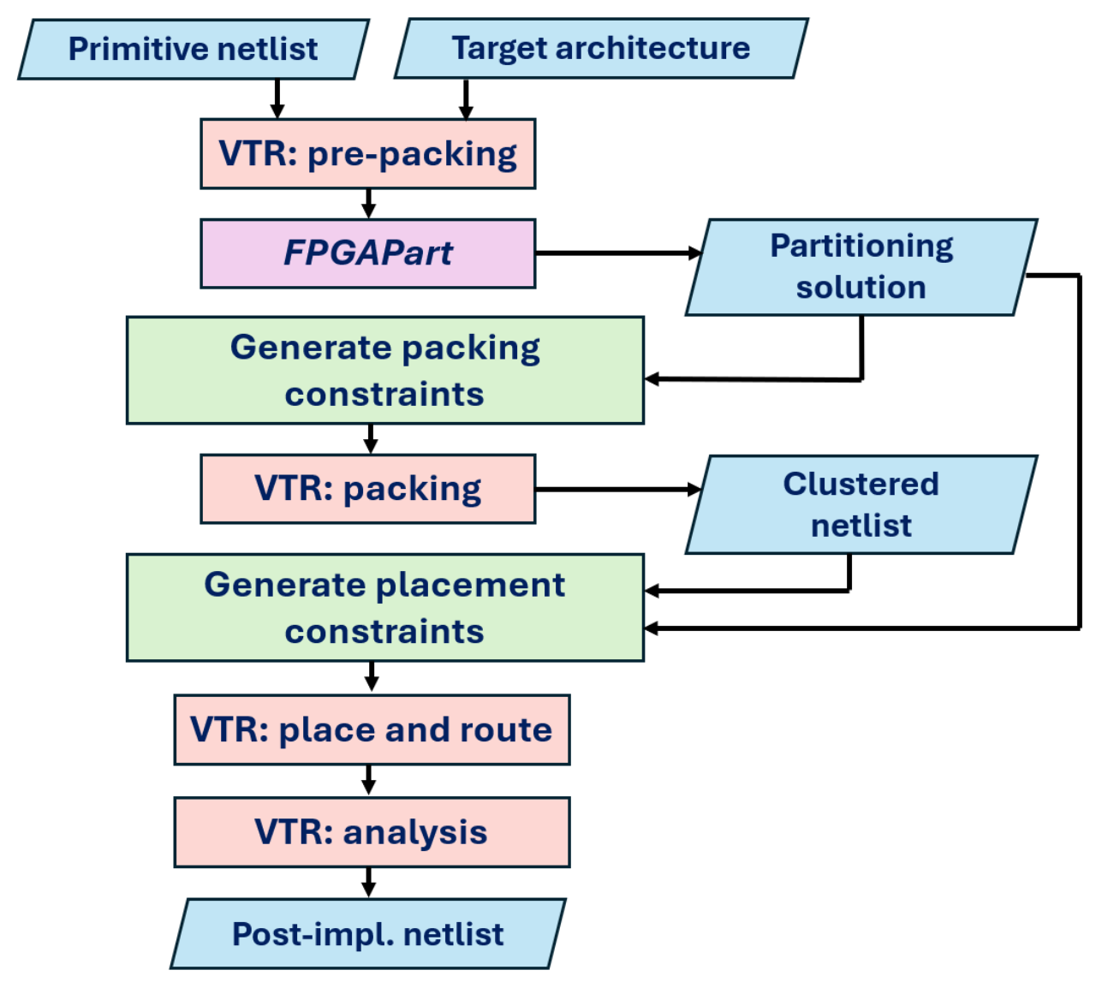
FPGAPart-based implementation flow
We integrate FPGAPart with the VTR 7 (interposer) branch
1
Partitioning with FPGAPart
2
Constrained packing
3
Constrained placement
Notes:
Before we get to the numbers, here’s an overview of our FPGAPart-based flow built on VTR 7.
The input is a primitive netlist. We [CLICK] first run VTR’s pre-packer, and the result is passed to our partitioner to guide clustering.
From the partitioning solution, we generate [CLICK] packing constraints i.e., primitives assigned to different partitions (dies) are not allowed to be packed together.
This feature is supported in the VTR 7 interposer branch. We perform packing and then generate placement constraints [CLICK] where the placement region of each logic block is the intersection of the regions of its primitives.
After running VTR’s placement, we finally, run the router to generate the post-implementation netlist and extract metrics like routed wirelength (rWL) and FMax.

Slide 15
Experimental setup
FPGAPart implemented in C++ on OpenROAD infrastructure (https://github.com/ABKGroup/FPGAPart)
FPGAPart-based flow implemented using VTR 7 (interposer) branch
Benchmarks: VTR 7 designs + Koios designs (33 designs) Architecture: k6_frac_N10_mem32K_40nm.xml
Baselines: 4 flows
Default
hMETIS-based
METIS-based
TritonPart-based
Experiments: results on (two, three, four)-dies, ablation of cutting planes, seed noise study, routability study (for details check Section VI of our paper)
Input netlist
Constrained placement
Partitioning
Constrained packing
Routing
PPA
Notes:
This slide outlines our experimental setup.
We implement FPGAPart in C++ using the OpenROAD infrastructure and integrate it into the VTR 7 interposer branch. All of our code and scripts are open-sourced and available at the link shown here.
For benchmarks, we use designs from VTR 7 and Koios, targeting the k6_frac10 device – VTR 7’s flagship architecture.
We compare FPGAPart against four baseline flows:
The default VTR 7 flow, and [CLICK]
Three partitioning-based flows where we integrate hMETIS, METIS, and TritonPart into the same VTR 7 flow structure. This is illustrated on the right.
[CLICK]
We conducted a variety of experiments. For time limitations I shall present a subset of these results. The ones I’ll show today are bolded and underlined. For full details, please refer to Section 6 in our paper.

Slide 16
Comparison with default VTR 7 flow
Architecture configurations: (three)-dies, interposer delay 1ns, 70% wires removed at die-boundaries ← results reported are averaged over 10 seeds
FPGAPart geo-mean improvements: rWL 6%, Fmax 4%
Routed Wirelength
Fmax (Mhz)
Koios designs | Default | FPGAPart | Default | FPGAPart
bnn | 2458889 | 2223186 | 84.09 | 86.27
lstm | 2055257 | 2035348 | 82.68 | 92.89
robot_rl | 218674 | 206651 | 98.49 | 99.03
softmax | 174350 | 167756 | 156.39 | 157.97
tpu.small.os | 444053 | 339903 | 141.22 | 145.74
Notes:
Let’s start by comparing FPGAPart with the default VTR 7 flow.
This chart shows results for a three-die configuration, using a 1ns interposer delay and with 70% of inter-die wires removed – a fairly aggressive setup.
FPGAPart shows consistent improvement: a 6% reduction in routed wirelength and a 4% increase in FMax, on geometric mean.
The table below shows a subset of results. For brevity, we’ve only included selected results here, but the full results, across multiple designs and different die configurations – are available in the paper, and they follow similar trends with FPGAPart showing improvements over the default flow.

Slide 17
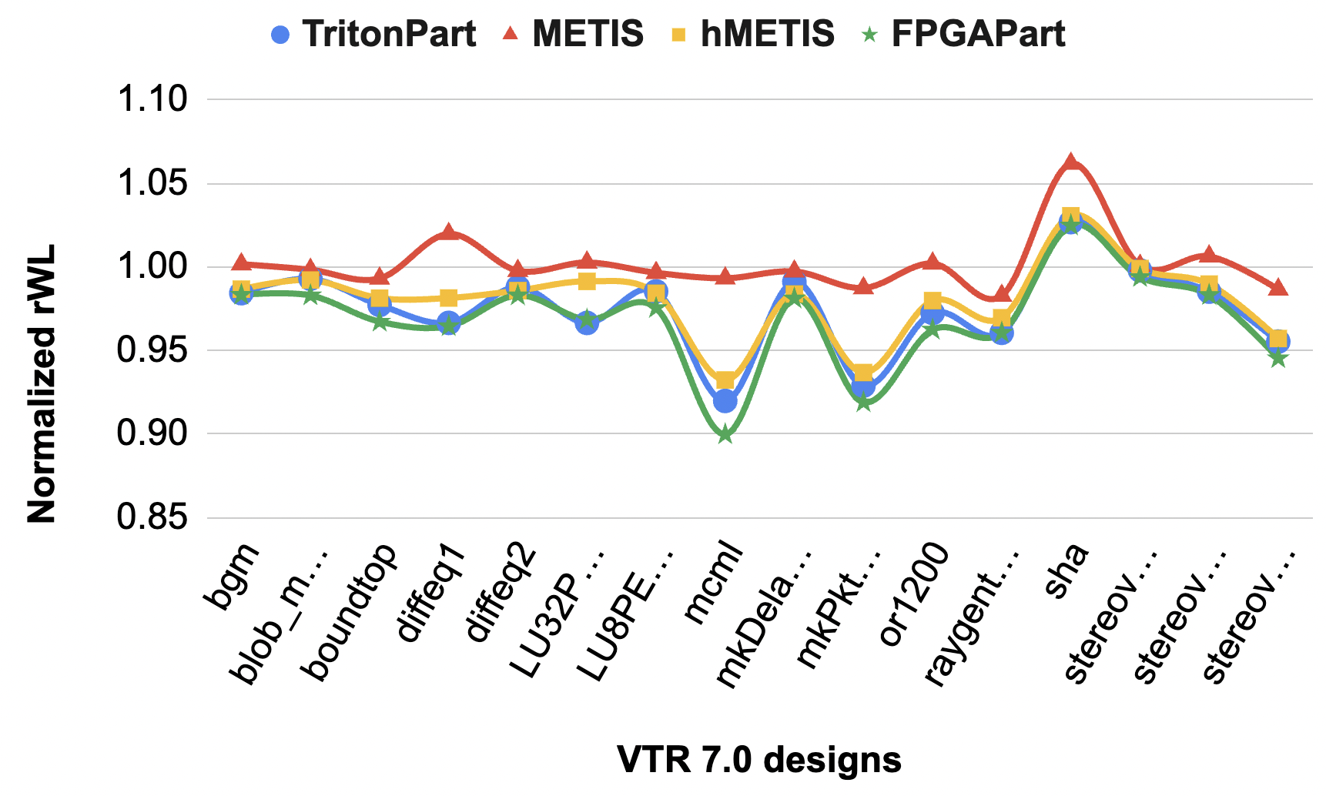
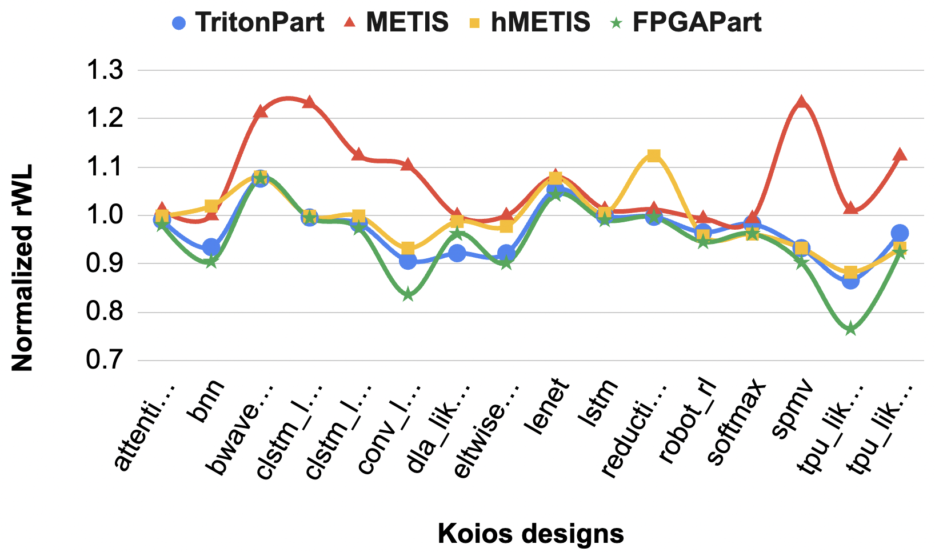
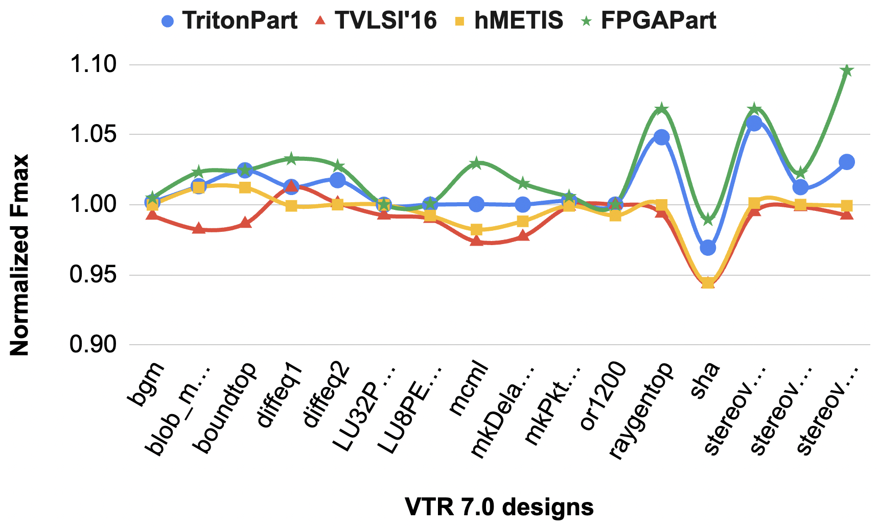
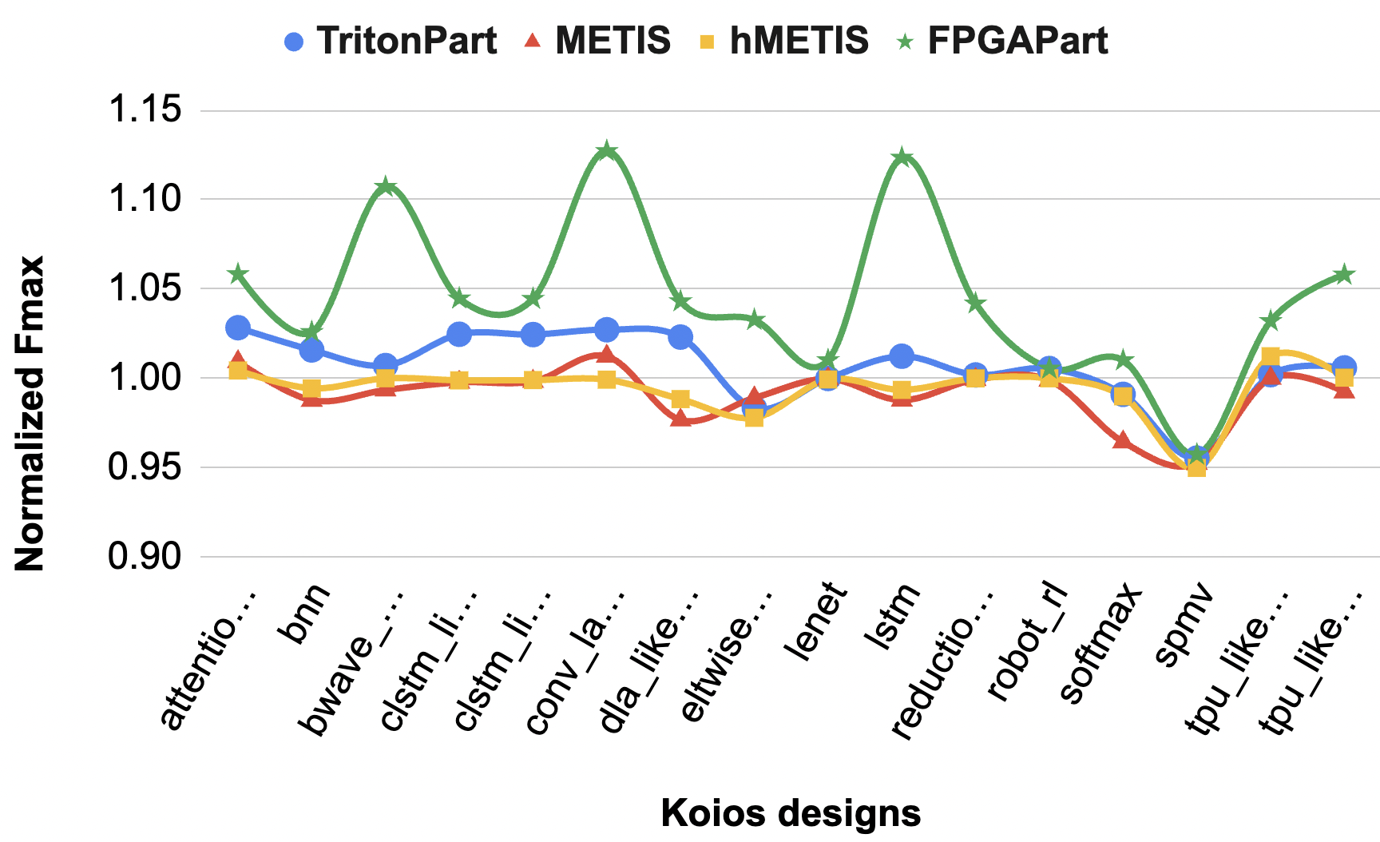
Comparison with baseline partitioners
Two-dies
Three-dies
rWL comparison
rWL comparison
Two-dies
Three-dies
Fmax comparison
Fmax comparison
FPGAPart-based flow achieves improvements up to 10% in rWL and 9% in Fmax
Notes:
This slide compares our FPGAPart-based flow against three other partitioning-based baselines: hMETIS, METIS, and TritonPart.
We evaluate all benchmark designs under both two-die and three-die configurations, using the same setup as before: 1ns interposer delay and 70% inter-die wire removal.
The key takeaway here is that [CLICK] FPGAPart consistently outperforms the baselines, achieving up to 10% improvement in routed wirelength and up to 9% improvement in FMax across configurations.
You can see this trend by observing the green line in all these 4 plots.
These gains highlight the benefits of using our partitioner in a multi-die FPGA flow.

Slide 18
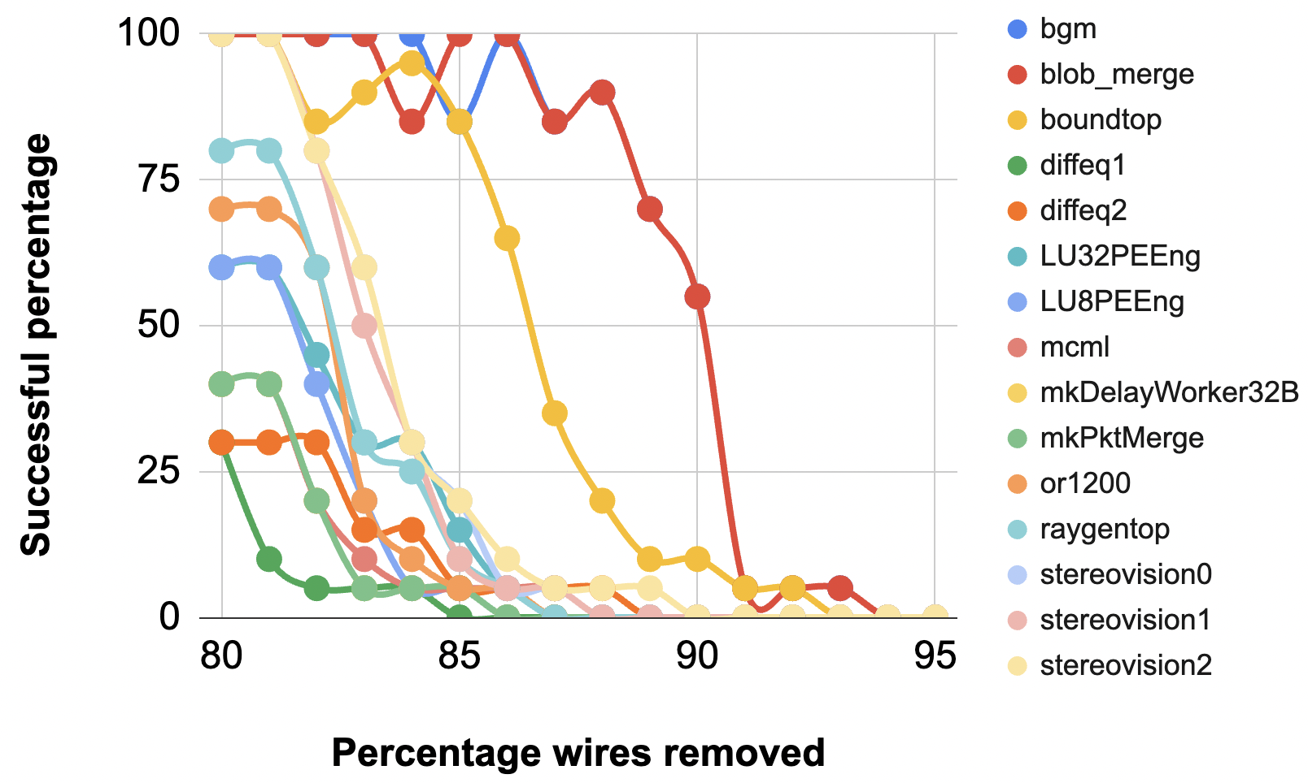
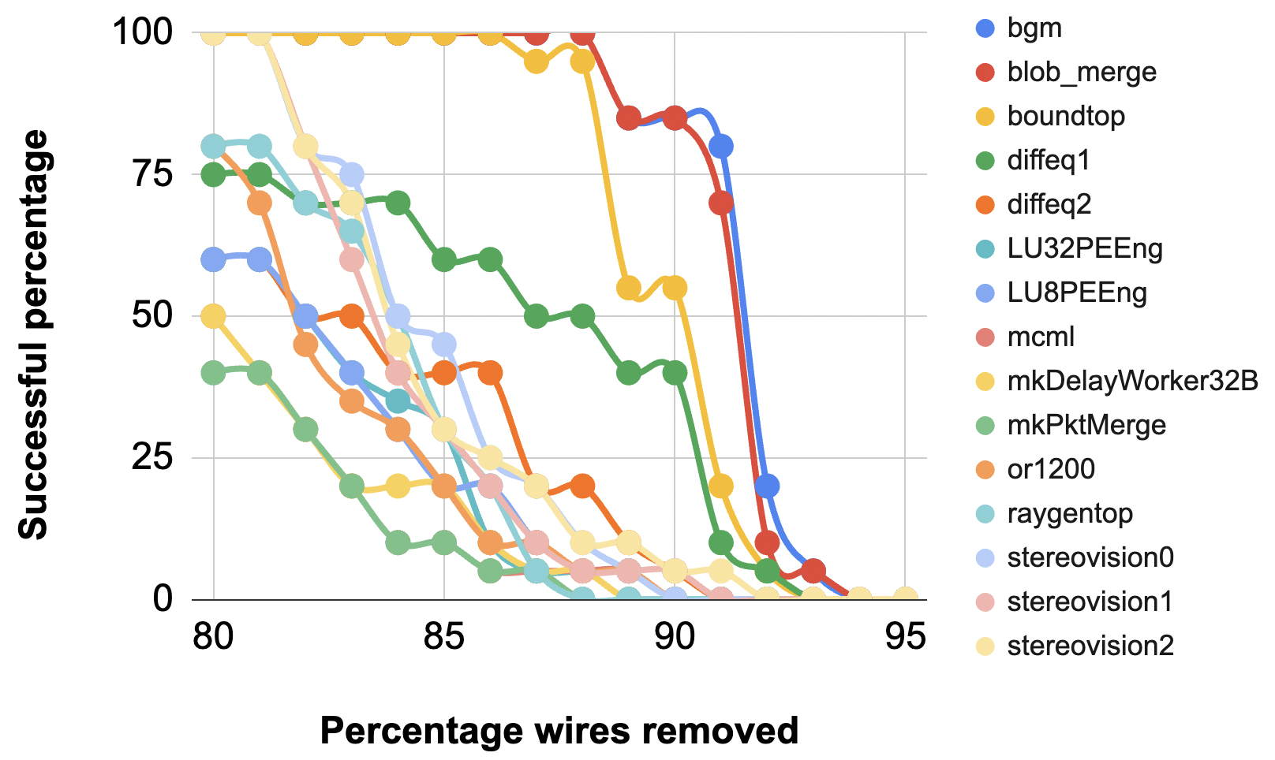
Routability study (four-dies)
Gradually reduce interconnects at die boundaries → sweep percentage wire reduction from 80% to 95%
Report percentage of successfully routed runs out of 20 seeds
Cliffing effect
Cliffing effect
Default VTR 7 flow
FPGAPart-based VTR 7 flow
FPGAPart-based flow produces more routable designs
Notes:
In my opinion, partitioning-based flows really shine when inter-die resources are tight. This slide illustrates that point.
We progressively reduce the number of cross-die interconnects from 80% to 95%, and for each case, report the percentage of successfully routed designs over 20 runs.
On the left, you see results using the default VTR 7 flow. There's a clear cliffing effect [CLICK] – a sharp drop in routability as wire constraints tighten.
On the right, with the FPGAPart flow, we still see a cliff [CLICK], but it's shifted to the right.
This means the FPGAPart-based flow [CLICK] preserves routability even under tighter constraints, enabling successful implementation where default flows fail.
This shows the value of efficient partitioning in multi-die flows under severe resource limitations.

Slide 19
Outline
Background and motivation
Why partitioning?
The partitioning problem
Modeling 2.5D multi-die architectures
FPGAPart
Overall framework
Clustering (pre-packing + FP-growth)
Initial partitioning (neighborhood influences)
Multilevel refinement
Experimental results
Baseline flows
Validation of partitioning
Routability study
Conclusion and future directions
Notes:
To wrap up, let me quickly summarize our contributions and future directions.

Slide 20
Conclusion and future directions
Conclusions:
FPGAPart: the first open-sourced FPGA-targeted partitioner – built on OpenROAD infrastructure (https://github.com/ABKGroup/FPGAPart)
FPGAPart-based VTR 7 flow for implementing multi-die FPGA designs
Pre-packing + FP-Growth clustering for better clustering
Neighborhood-based cutting planes for faster ILP convergence
Future directions:
Adapting FPGAPart to the latest VTR 9 framework
Incorporating spatial awareness into FPGAPart
Heuristic advances – better timing-driven partitioning / clustering
Notes:
We introduced FPGAPart, the first open-source, FPGA-targeted partitioner built on the OpenROAD infrastructure.
We also demonstrated a FPGAPart-based flow within VTR 7 for partitioning and implementing designs on multi-die FPGA architectures.
Three key innovations in FPGAPart are:
Using pre-packing for clustering guidance,
Applying FP-Growth for timing-driven clustering,
And incorporating neighborhood-based cutting planes to accelerate ILP convergence.
Looking ahead, we plan to:
Port FPGAPart to the VTR 9 framework,Although this requires significant engineering effort since VTR 9 does not have interposer support
Add spatial awareness to the partitioner, where the partitioner is aware of different die configurations
And we plan to explore new and better heuristics for improved timing-driven partitioning and clustering.
And That concludes my presentation. Thank you for your time.

Slide 21
Backup
FCCM 2025

Slide 22
Our contributions
Packing
Partitioning
...
Placement
Routing
A partitioning-based CAD flow for multi-die FPGAs
An open-sourced FPGA-based partitioner
FPGAPart
0
1
3
2

Slide 23
Neighborhood influences
Leverage UserCallback API of CPLEX
For each partition $i$ and vertex $v$ → binary variable $x\left[v\right][i]$
Cutting planes:
$x\left[v\right]\left[i_{strongest}\right]>Λ$ for the strongest partition
$x\left[v\right]\left[i\right]≤Λ$ for all other partitions
Find vertices with undetermined assignments
CPLEX
Find all neighbors of each undetermined vertex
Based on the current assignment of all neighbors, find the strongest partition (influence)
Encourage the undetermined vertex to be assigned to the strongest partition (cutting plane)

Slide 24
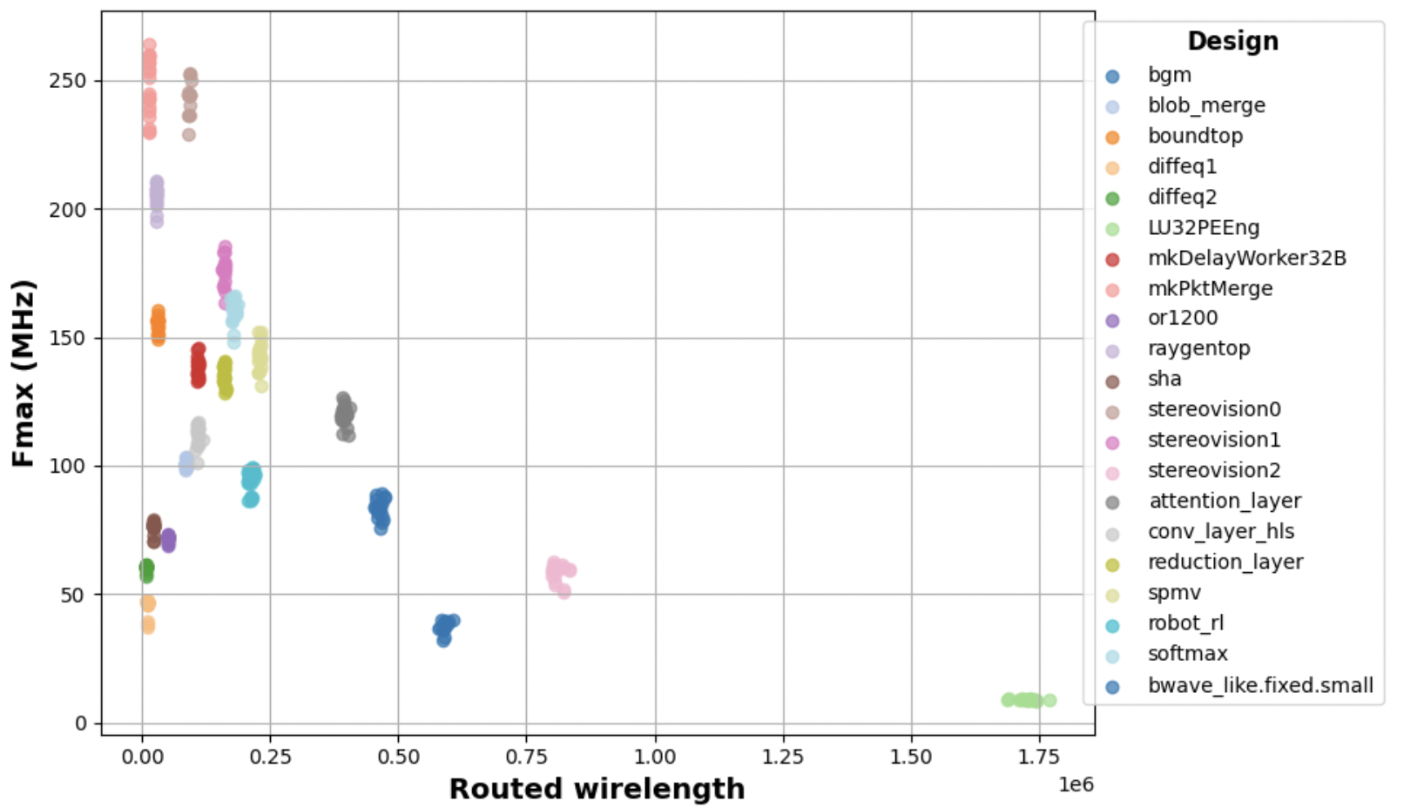
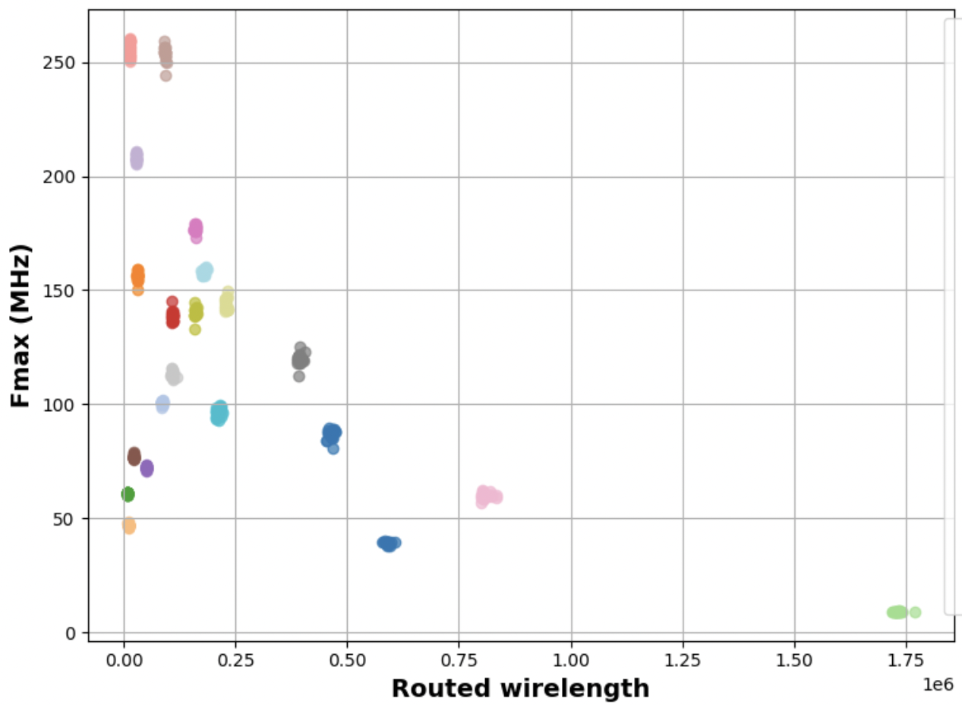
Miscellaneous studies: seed noise
100 runs – each with a unique seed on VTR 7 and Koios designs
Architecture configurations: three-dies, interposer delay 1ns, 70% wires removed at die-boundaries
CV for Fmax: 3.44
CV for rWL: 1.49
CV for Fmax: 1.35
CV for rWL: 1.44
FPGAPart-based flow shows better robustness to seed noise
Default VTR 7 flow
FPGAPart-based VTR 7 flow

Slide 25
Eval. of partitioning – VTR 7 designs (two-dies)
Architecture configurations: (three)-dies, interposer delay 1ns, 70% wires removed at die-boundaries
FPGAPart geo-mean improvements: rWL 3%, Fmax 3%
Routed Wirelength
Fmax (Mhz)
Designs | Default | FPGAPart | Default | FPGAPart
bgm | 596332 | 586373 | 39.02 | 39.21
blob_merge | 87668 | 86173 | 101.61 | 103.98
boundtop | 29678 | 28705 | 152.60 | 156.36
raygentop | 28778 | 27643 | 194.69 | 207.98
stereovision2 | 855932 | 809111 | 56.08 | 61.45

Slide 26
Eval. of partitioning – VTR 7 designs (three-dies)
Architecture configurations: (two, three)-dies, interposer delay 1ns, 70% wires removed at die-boundaries
FPGAPart geo-mean improvements: rWL 3%, Fmax 2%
Routed Wirelength
Fmax (Mhz)
Designs | Default | FPGAPart | Default | FPGAPart
bgm | 586332 | 568438 | 39.22 | 39.55
blob_merge | 85561 | 85272 | 99.42 | 101.98
boundtop | 30490 | 28518 | 154.29 | 156.36
raygentop | 27969 | 25641 | 210.15 | 211.34
stereovision2 | 798888 | 734728 | 56.98 | 61.51

Slide 27
Eval. of partitioning – Koios designs (two-dies)
Architecture configurations: (two, three)-dies, interposer delay 1ns, 70% wires removed at die-boundaries
FPGAPart geo-mean improvements: rWL 3%, Fmax 3%
Routed Wirelength
Fmax (Mhz)
Designs | Default | FPGAPart | Default | FPGAPart
bnn | 2317469 | 2223826 | 85.02 | 85.37
lstm | 2105091 | 1815726 | 96.88 | 105.01
robot_rl | 210775 | 204080 | 98.59 | 99.50
softmax | 171535 | 170419 | 150.78 | 153.98
tpu.small.os | 466148 | 446796 | 137.64 | 137.95

