Slide 1




Invited: Toward an ML EDA Commons
Establishing Standards, Accessibility, and Reproducibility in ML-driven EDA Research
Vidya A. Chhabria, Jiang Hu, Andrew B. Kahng, and Sachin S. Sapatnekar
Notes:
Thank you for the introduction and thank you to the ISPD organization committee who invited me to present this talk.
The talk today is about an ML EDA Commons to drive the establishment of standards, and prioritize accessibility and reproducibility of ML EDA Research.
This paper is a collaborative effort between the authors listed on the slide here.

Slide 2







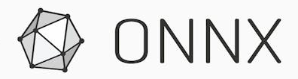



What can we learn from the success of AI?
Open ecosystem and shared infrastructure
AI Open Ecosystem and Shared Infrastructure
Collaborative Frameworks
Pre-trained models
Community platforms
Frameworks
Datasets
Notes:
To start with I want to ask what we can learn from the success of AI.
We know that advances in AI have been propelled by the availability of data and the availability of compute resource to support. This is well established.
But I also want to point out that success and acceleration of research has been possible because of an open ecosystem and shared infrastructure. Some examples of this infrastructure include:
If you have used ML frameowkr you will be familiar with some of these items listed on the screen here and how useful they have been.

Slide 3

What can we learn from the success of AI?
Beyond the infrastructure
AI Open Ecosystem and Shared Infrastructure
Collaborative Frameworks
Pre-trained models
Benchmarks
MLPerf
AlgoPerf
….
Medical
Automotive
…
Data
Datasets
Croissant metadata
MLCube
MLCard
…
Community platforms
Frameworks
AI Risk & Reliability
Datasets
Research
Schema
Algorithms
Data-centric
Science
Notes:
However, ML is not just supported by infrastructure such as this on the left it also has efforts such as MLCommons that establish standards, and benchmarks that have all indirectly if not directly driven ML research.

Slide 4
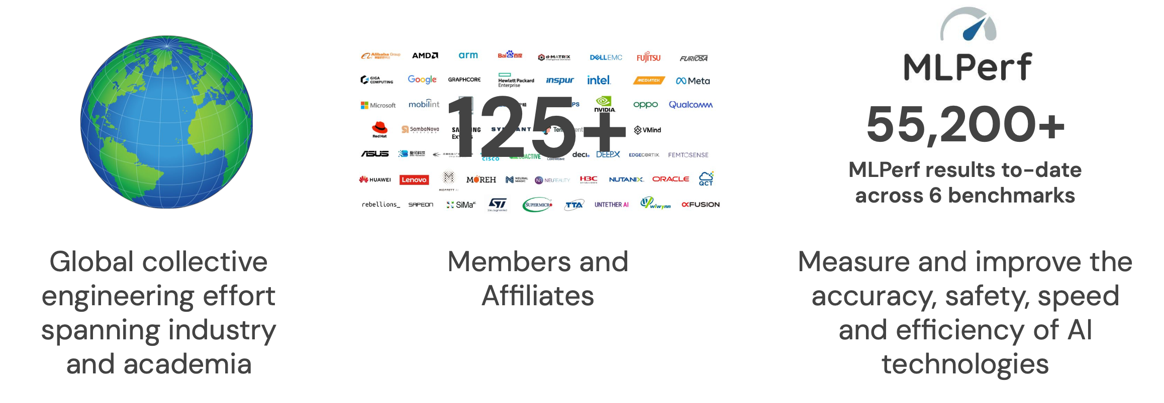
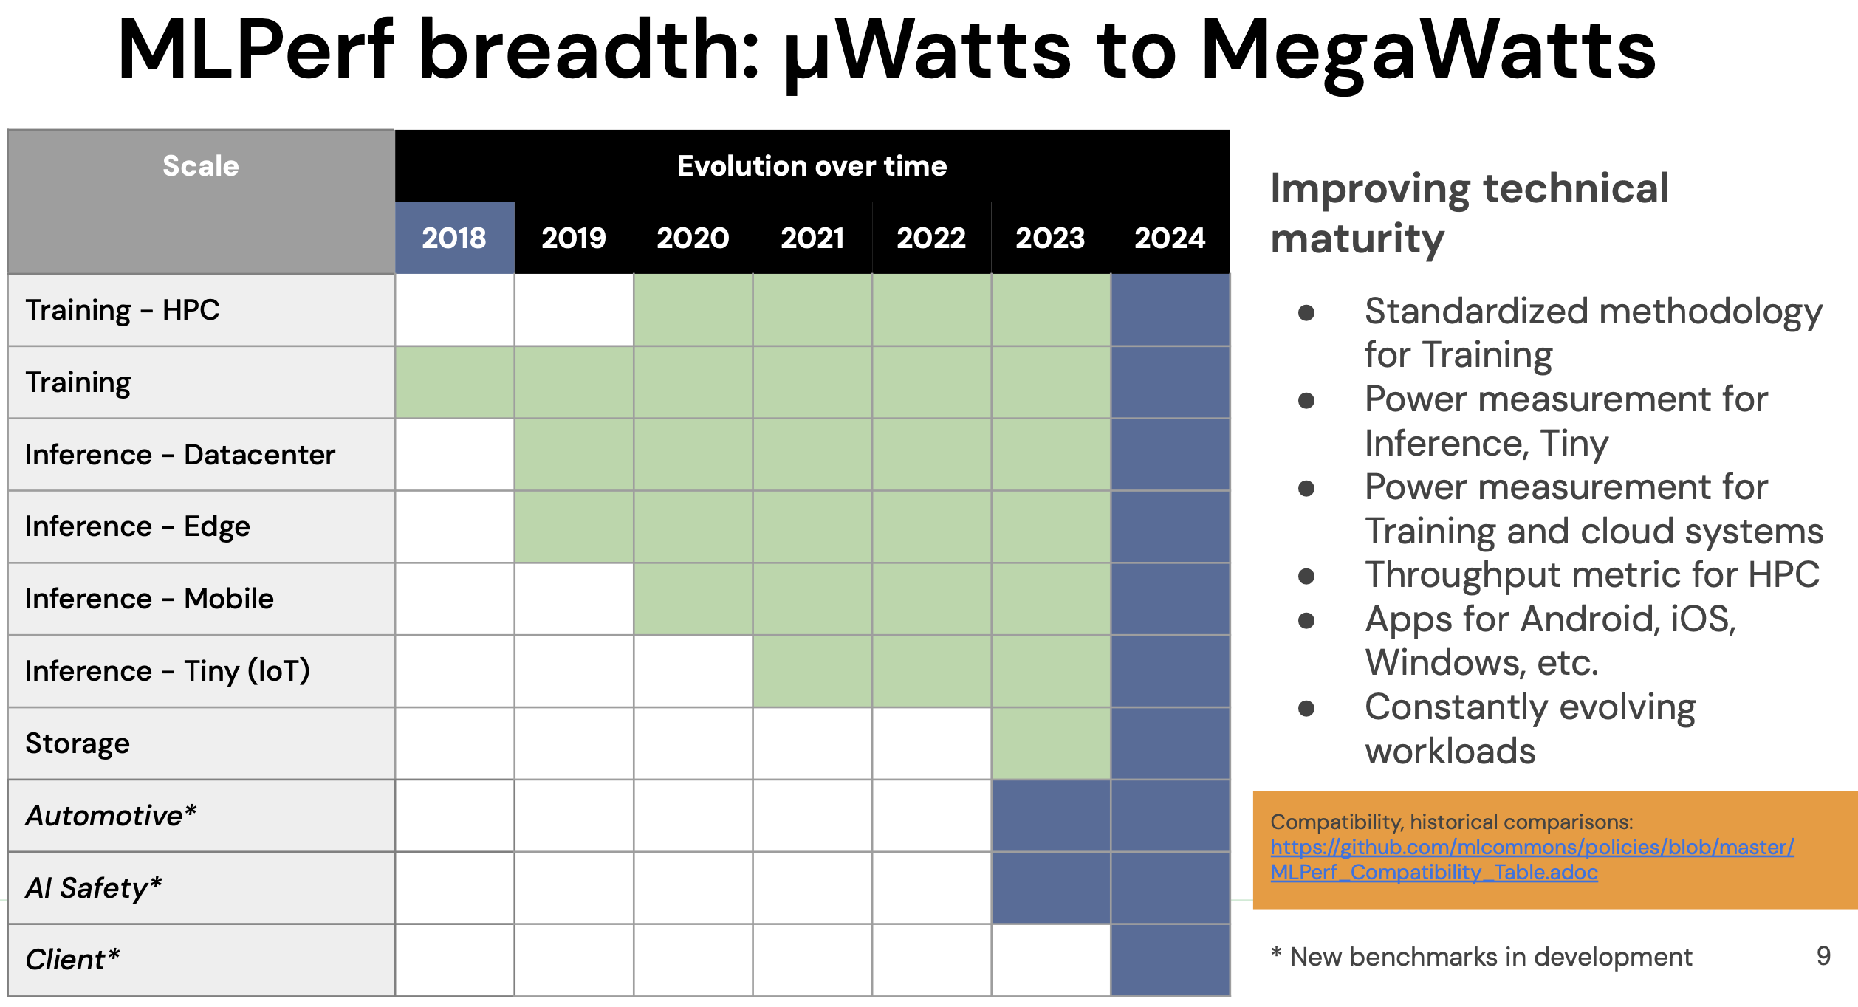
A case study in success
https://mlcommons.org/
ML Commons
Key principles:
Grow AI markets and make the world a better place
Get everyone involved
Act through collaborative engineering
Make fast but consensus-supported decisions
Build a community that people want to be part of
Targeting a diverse set of workloads that was built over time.
Notes:
The MLCommons is a successful case study of the impact a Common can make.
[CLICK] ML Commons is a global collective engineering effort that spans academia and industry. With over 125 members and affiliates, the ML Comms has had immense impact and has key stakeholder buy in.
[CLICK] Taken off their website their key driving principles are simply to grow AI markers get key stakeholders buy in, and work via collaboration.
[CLICK] The classical success story of the MLCommons in the the ML hardware research area with its MLPerf benchmarks that have been wide used and maintained over the past several years for a diverse set of workloads

Slide 5

What about ML EDA for physical design?
AI Open Ecosystem and Shared Infrastructure
Collaborative Frameworks
Pre-trained models
Benchmarks
MLPerf
AlgoPerf
….
Medical
Automotive
…
Data
Datasets
Croissant metadata
MLCube
…
Community platforms
Frameworks
AI Risk & Reliability
Datasets
Research
Schema
Algorithms
Data-centric
Science
Notes:
However, the question here is what about for ML EDA in particular what about physical design? Is there such an infrastructure let alone a Commons?
In the past decade ML EDA research has been of interest to our physical design community. However, the challenge of the gap between the open nature of the ML and the closed nature of the EDA community has been a challenge for ML EDA research that is yet to be fully addressed.

Slide 6
This talk
Calls for the establishment of an ML EDA Commons to build ML EDA infrastructure and propel ML EDA research for the RTL-to-GDSII flow
Highlights existing initiatives towards development of an infrastructure and identifies critical gaps in establishing an ML EDA Commons
Outlines the scope and vision of an ML EDA Commons
  Maturing and unifying ML EDA infrastructure
  Establishing standards and governance
  Prioritizing accessibility and reproducibility
Notes:
This talk provides perspectives on three things.
[Click] First, it’s a call to action for the establishment of an ML EDA Commons to not only build an infrastructure for ML EDA but also propel ML EDA research for the RTL to GDS ii flow.
[Click] Second, it highlights existing efforts towards the development of an infrastructure and identifies gaps that need to be addressed for the establishment of a Commons
[Click] Third, it also outlines a vision and scope of work for such a Commons its role in the community, who must be involved, and what we should do to make it happen.

Slide 7
Agenda
Vision of an ML EDA Commons
Efforts toward ML EDA Commons
  Infrastructure development efforts
  Benchmarks and standardization efforts
  Accessibility and reproducibility efforts
Governance and roadmap
Conclusion
Notes:
This is an agenda for the rest of my talk. I will start with the vision for an ML EDA Commons

Slide 8
A vision for an ML EDA Commons
The pillars of an ML EDA commons
Foundations: ML EDA infrastructure
  Datasets, models, proxies, contests, etc.
  Python APIs with open-source tools, libraries
Pillar: Standardization
  Benchmarks and metrics
  Data formats standardization and taxonomy
Pillar: Accessibility
  Open datasets and models
  Open-source tools and flows
Pillar: Reproducibility
  Contests and leaderboards
  Artifact and community evaluations
ML EDA Research
Standardization
Accessibility
Reproducibility
ML EDA Infrastructure
ML EDA Commons
Notes:
The goal is to drive ML EDA Research, so we have that at the top here.
[Click] The foundation must be built on infrastructure which includes dataset, models, proxies for when things are being IP, contests, accessible APIs and libraries. T
[Click] Using, contributing and building this infrastructure in a way that can drive ML EDA research requires three pillars which are key part of the ML EDA Commons:
Establishment of standards for contributing to and building the infrastructure This could be in the form of standard benchmarks, data formats, and taxonomy
Ensuring accessibility to ML EDA infrastructure and research: Via open and shared infrastructure
Prioritizing reproducibility: Via contests and leaderboards, artifact evaluations, etc.

Slide 9
Road to an ML EDA Commons
Nascent Mature
Components of an ML EDA Commons
Ongoing individual-driven infrastructure development efforts:
Components of an ML EDA Commons:
Governance & standards
Accessibility & reproducibility
Benchmarks and metrics
Datasets
Datasets
Datasets
Consortium of stakeholders
Cloud infrastructure
Contests
Tools & flows
Tools & flows
Tools & flows
Tools & flows
Contests
Contests
Formats & quality
Open-source
Research artifacts
Sustenance
Proxies
ML EDA infrastructure
9
Notes:
How far are we from this vision of a Commons?
[Click] The good news is we are not at zero. As a community we all agree about the value such a Commons will have. We have realized the value of open- dataset, benchmarks and contests. So, we have several efforts on each of these fronts right from ISCAS 85 benchmarks to different RTL benchmarks now for evaluations LLMs. At ISPD too we have a contest every year that is supported by benchmarks and have had very successful research in the past from these.
However, the challenge here is that these infrastructural efforts are often individually-driven, performed in silos, and does not have key stakeholder buy-in. They are also sometimes a product of a research paper driven by graduate students, and not maintained after graduation.
[CLICK] So for a Commons we now need mature ML EDA infrastructure. Unified efforts. Collaborative and fast decision making to develop this infrastructure an maintain this infrastructure.
[CLICK] Further in addition to that we also need to establish governance standards that includes a establishing a consortium of stakeholders just as in the ML community, establishing formats and quality standards and ensuring its sustenance.
[CLICK] We also need to prioritizes accsibility and reproducibility and that is to hightlight the criticality of opensource, access to the cloud and research artifacts.

Slide 10
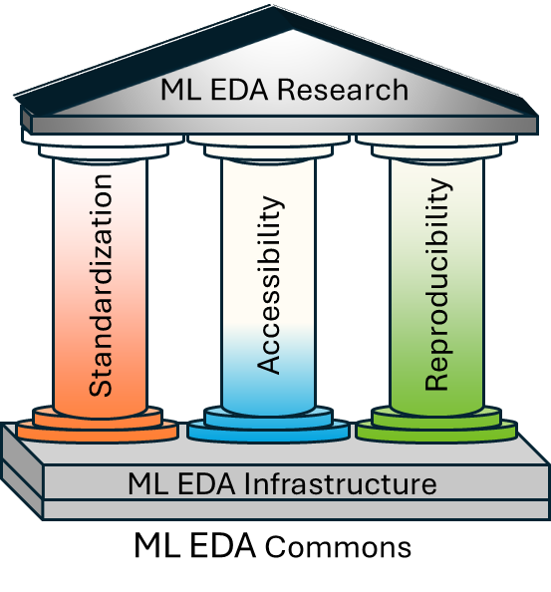
Agenda
Vision of an ML EDA Commons
Efforts toward ML EDA Commons
  Infrastructure development efforts
  Benchmarks and standardization efforts
  Accessibility and reproducibility efforts
Governance and roadmap
Conclusion
Notes:
Up until now, although I talked about this as a general ML EDA Commons for the rest of the talk, I will focus on RTL2GDS flow that is of interest to this community.
Over the course of the talk I will talk about efforts towards each of these key of the ML EDA Commons. I will start with unified infrastructure development efforts. ,

Slide 11
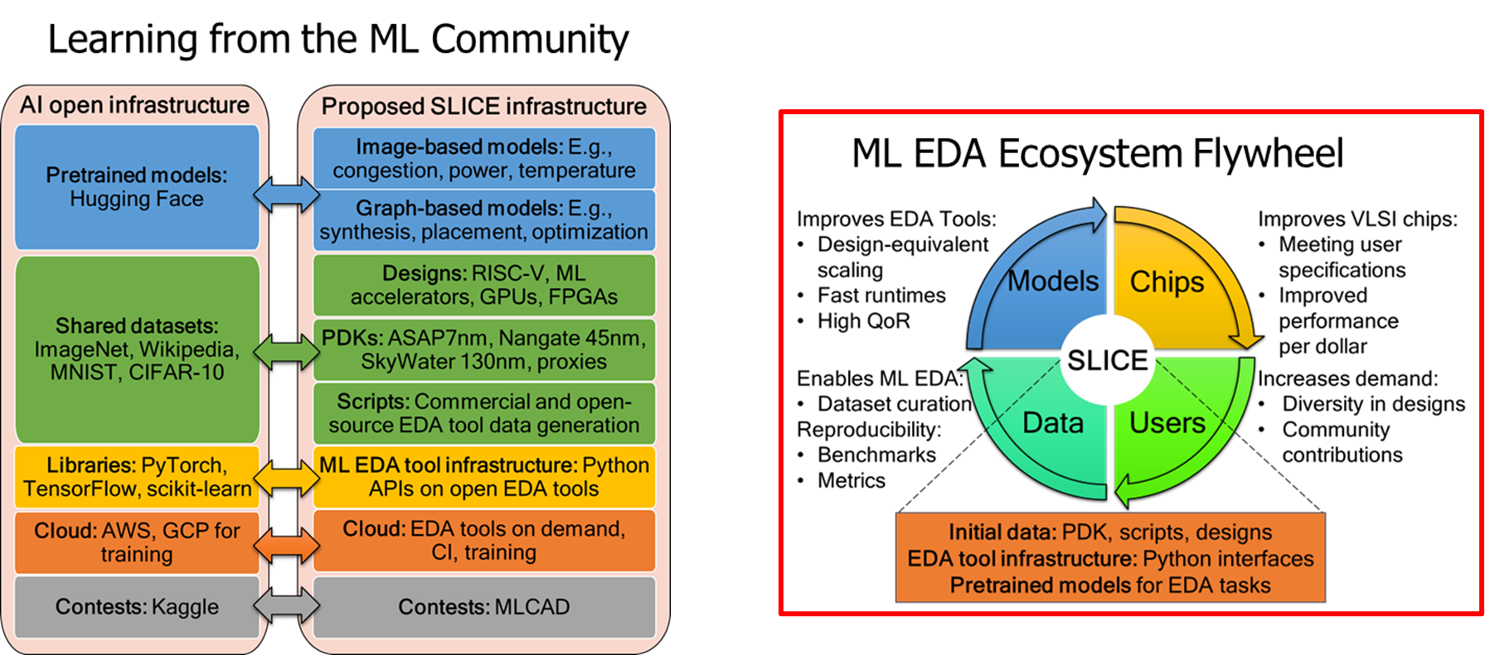
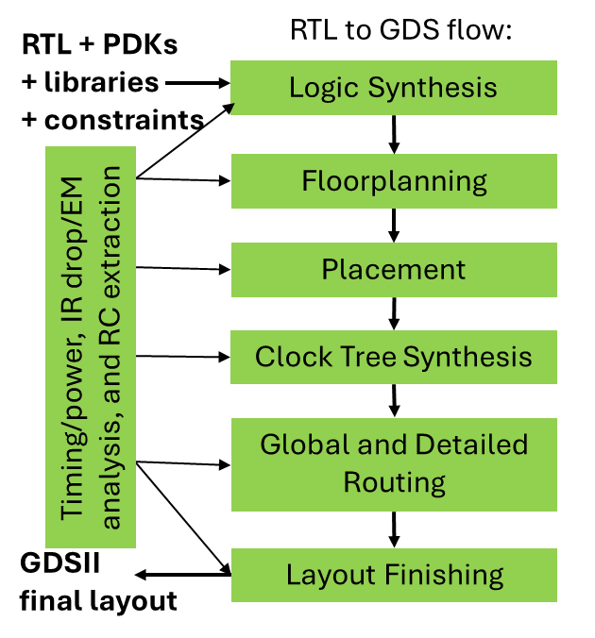







Shared open infrastructure development efforts
https://slice-ml-eda.github.io/
ML EDA Infrastructure: SLICE for RTL2GDS flow
Notes:
The first example here is SLICE which is an effort across several universities as listed below and supported by chip alliance also on creating open shared infrastructure for ML EDA.
The idea is to learn from the ML community to develop the corresponding framework for ML EDA in the form of datasets, designs, PDKS, Python APIs and libraries with support for cloud and contests.
Current efforts include creating a platform that serves as a one stop solution for datasets, flows, PDKs. With the intent to create an infrastrcutre that can accelerate this ML EDA flywheel where a good infrastructure can jump start its spinning making better EDA tools, leading to better chips more users and that leads to more data.

Slide 12
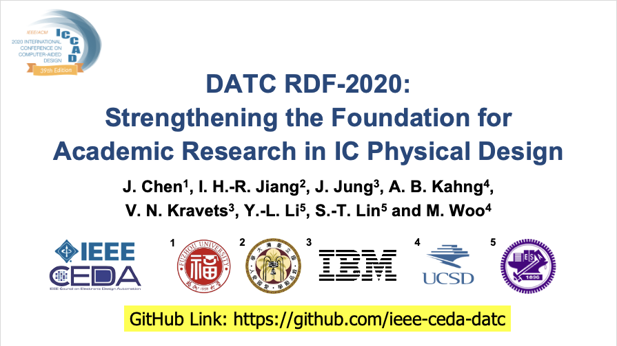
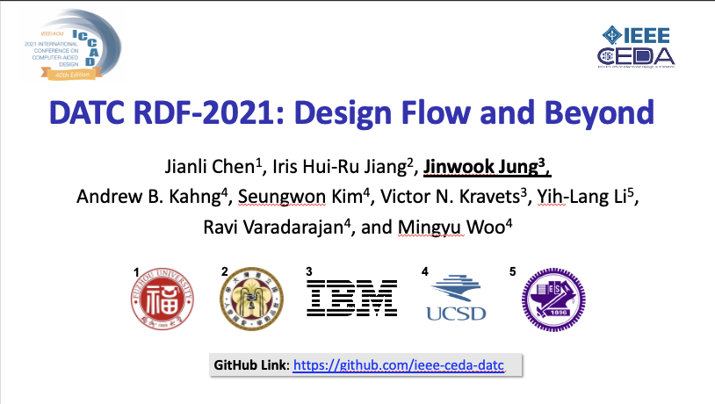
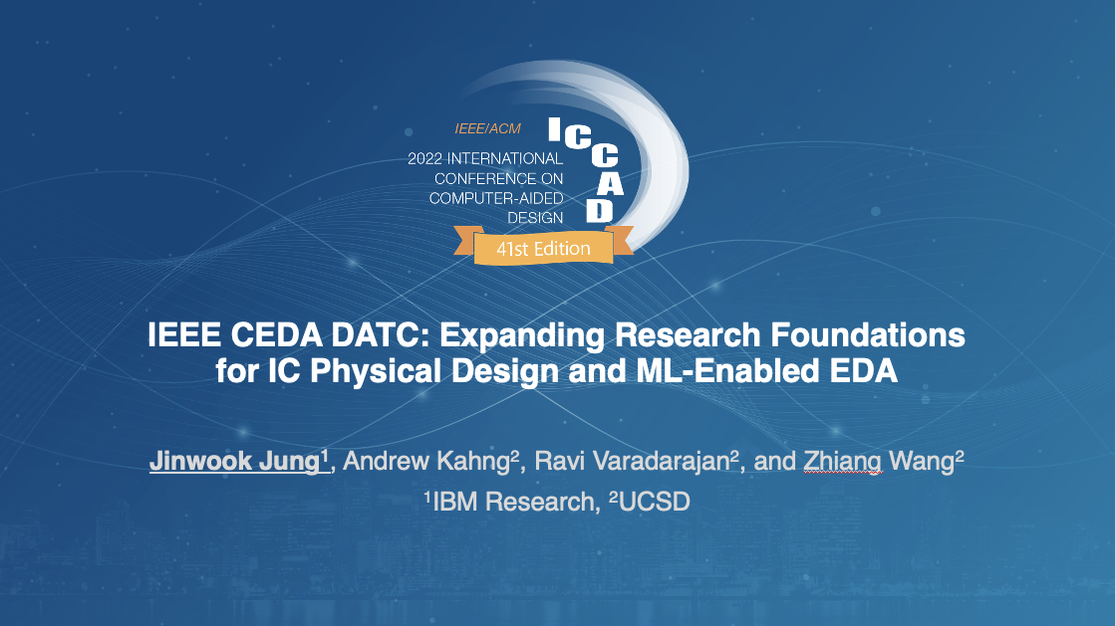
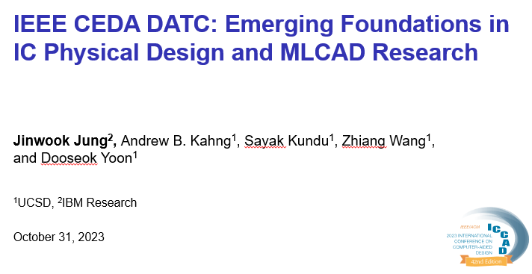
Open flows and design enablement efforts
IEEE DATC Efforts
A member technical committee of IEEE Council on EDA (CEDA)
https://ieee-ceda.org/technical-committee/datc
Since 2016, DATC has maintained Robust Design Flow (RDF) for RTL2GDSII
  An academic reference RTL-to-GDS design flow incorporating numerous contest-winning point tools and the OpenROAD tool chain, to preserve and integrate leading research codes
  https://github.com/ieee-ceda-datc/Robust-Design-Flow
Other efforts:
  Advancing benchmarks and baselines for ML enablement
  “Leaderboard” using Metrics2.1 and autotuning and calibration
V. A. Chhabria et al., "Strengthening the Foundations of IC Physical Design and ML EDA Research“, ICCAD 2024
Notes:
The second example of a community driven effort that I would like to highlight is the efforts from IEEE Design Automation Technical Committee. DATC is a member technical committee under IEEE CED and the current DATC members are me Vidya Chhabria, Prof. Andrew Kahng at UCSD, and Prof. Rhett Davis at NCSU and Rongjian Liang at NVIDIA.
[Click] Since 2016, they have maintained an academic reference design flow, named Robust Design Flow, and we have been working to incorporate numerous contest-winning tools and the OpenROAD tool chain, with a paper presented at ICCAD every year.
[Click] Other efforts of the DATC have included advancing benchmarks ad baseline for ML enablement and maintaining of a leaderboard all if which have contribute to infrastructure for ML EDA Commons.

Slide 13
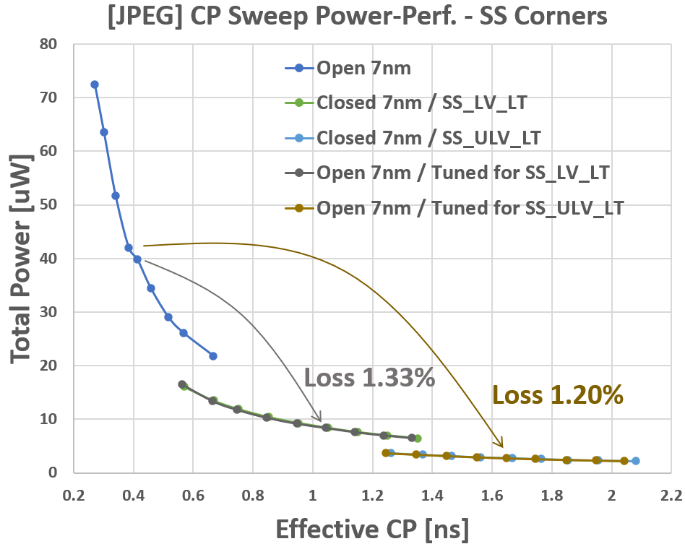
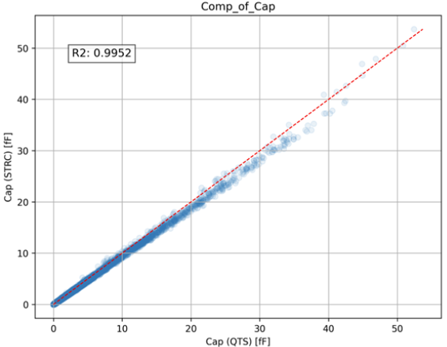
Efforts towards open data via proxies
PDK Proxies
Calibration of proxy design enablement
  RDF-2023: autotuning flow to narrow gap between ASAP7 and commercial 7nm
  RDF-2024: additional scaling factors enable matching of multiple PVT corners (https://github.com/ieee-ceda-datc/Robust-Design-Flow)
Expansion of NanGate45 research enablement
  NanGate45 (FreePDK45) was released with only Cadence enablement
  Recently: TLUPlus is developed and made public for Synopsys users (https://github.com/ABKGroup/NanGate45-Synopsys-Enablement)
V. A. Chhabria et al., "Strengthening the Foundations of IC Physical Design and ML EDA Research“, ICCAD 2024
Notes:
One example that I would like to highlight towards creating open data is to address the roadblock of “no realistic PDK” or no good enough proxy PDK. To address this challenge, in 2023 DATC RDF, introduced the concept of proxy design enablement, which narrows the gap between ASAP7 and a commercial 7nm. This was further enhanced in 2024 to include additional scaling factors to match across multiple PVT corners.
The figure on the right shows the autotuning results from a single PVT to multi-PVT experiment, confirming the wide coverage range of the proxy design enablement flow across multiple commercial PDK corners.
[CLICK] Further on the proxy PDKs, initially Nangatge45 was released only with Cadene tool enablement. Efforts from UCSD and Prof. Kahng groups have developed a NG45 enablement for Synopsys users. The picture on the right shows the capacitance value extracted from Cadence Quantus and Synopsys StarRC.

Slide 14
Agenda
Vision of an ML EDA Commons
Efforts toward ML EDA Commons
  Infrastructure development efforts
  Benchmarks and standardization efforts
  Accessibility and reproducibility efforts
Governance and roadmap
Conclusion
Notes:
I will now talk about some example efforts that have gone towards establishing benchmarks and standards in the recent past.

Slide 15
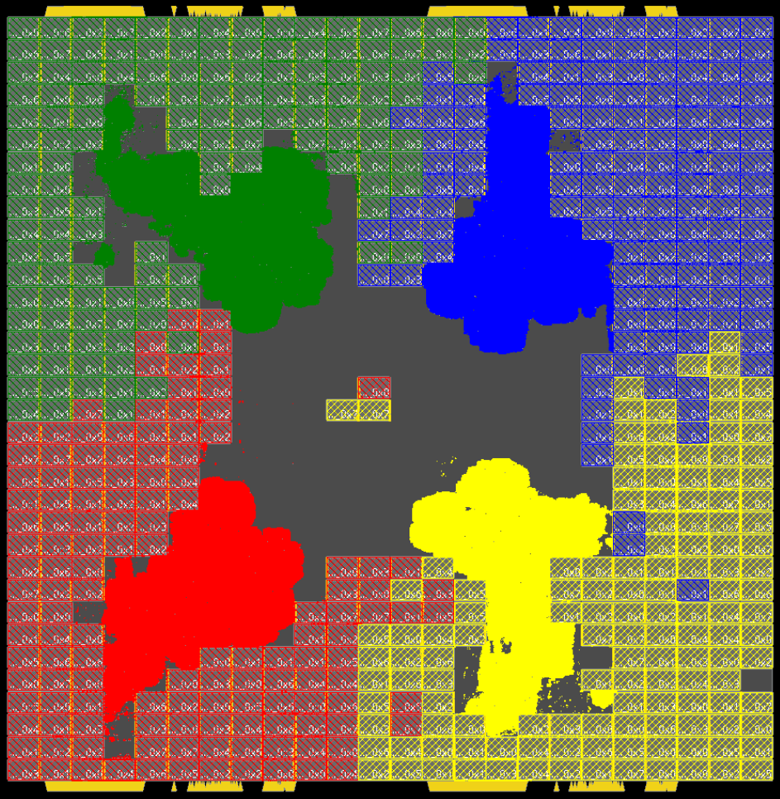
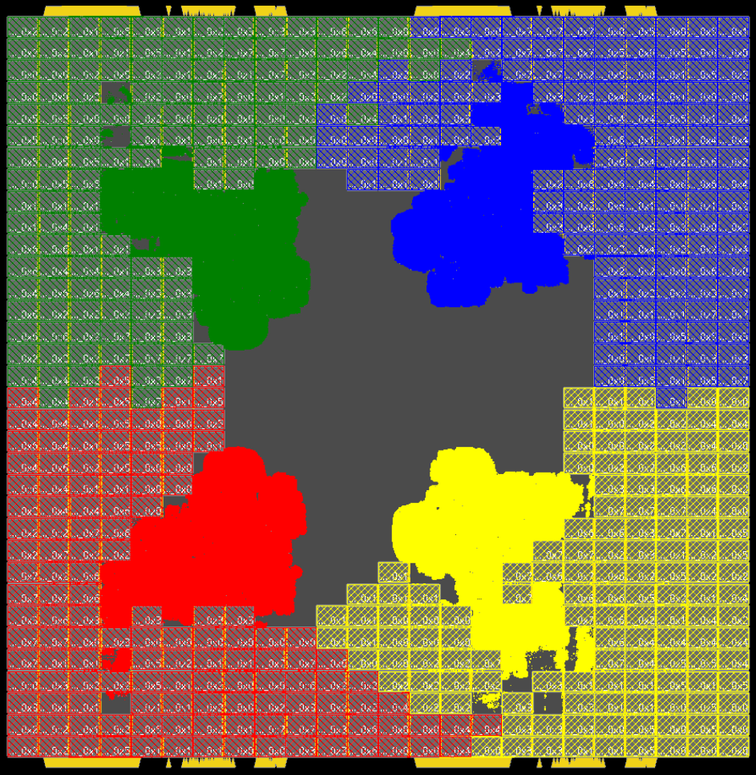
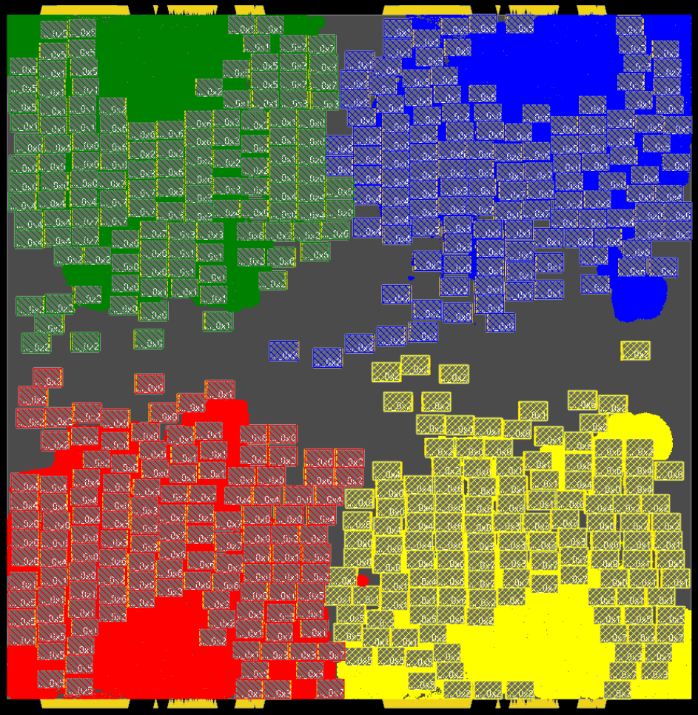
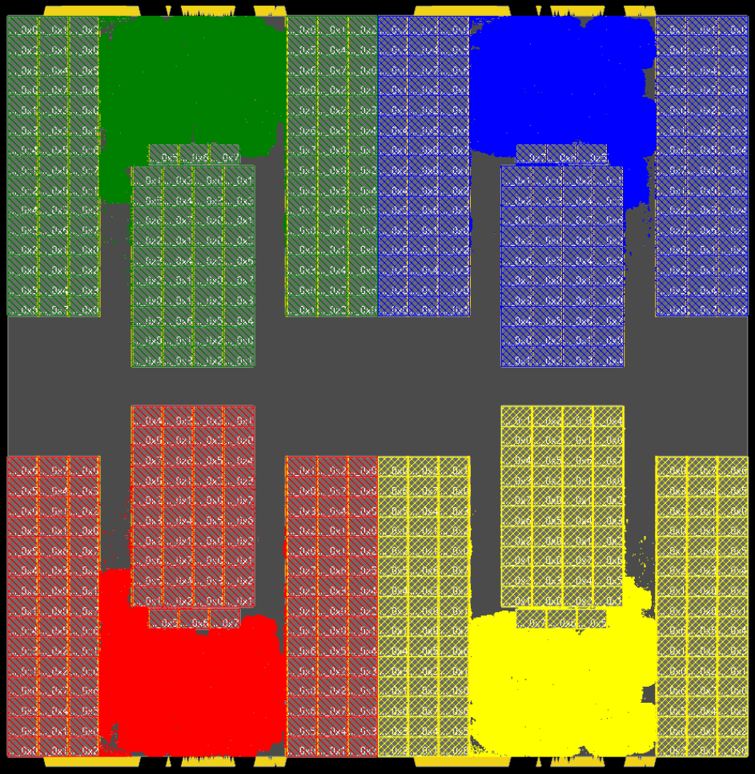
Efforts toward establishing benchmarks
Expansion of Modern Floorplan Benchmarks
MemPool Cluster has been enabled on MacroPlacement
  1,296 macros, 10.5M instances
Protobuf to LEF/DEF converter has been added
  Protobuf is used in Google AlphaChip / Circuit Training (CT)
New scaled testcases: X2, X4 scaled CT-Ariane (TSMC N7), and Ariane-133 (NG45)
https://github.com/TILOS-AI-Institute/MacroPlacement
CT-Ariane-X4 (Xflip-Yflip version): macro placement solutions
Gate-level detailed placement
from macro placement: Innovus 21.1
AlphaChip
SA
RePlAce
Human
AlphaChip = Circuit Training (AlphaChip) fine-tuned from Google’s pre-trained checkpoint
CT-Ariane-X4 has 532 macros, 332K instances (scaled from Google’s Ariane protobuf)
Notes:
As an example effort towards establishing benchmarks, I would like to highlight the MacroPlacement repository as a part of the TILOs AI Institute .
This contains modern macro placement benchmarks/ Recently a very large testcase, MemPool Cluster, has been added to the TILOS MacroPlacement repo. It contains 1,296 macros and 10.5 million instances in Nangate45 enablement.
[CLICK] Other recent updates include support for the Protobuf format is used by Google Circuit Training and their AlphaChip project. A new converter has been developed to generate LEF/DEF from Protobuf. This converter generates LEF/DEF for the only public design used by the Google Circuit Training project, allowing us to generate other baseline solutions using RePlAce, commercial macro placers, and so on for their testcases.
[CLICK] We have new 2X and 4X scaled versions of the CT-Ariane design in Protobuf format, and the Ariane-133-NG45 design in LEF/DEF format. Below we show picture of the CT Ariane-X3 and compare it against various baselines AlphaChip, SA, RePlAce, and Human.

Slide 16
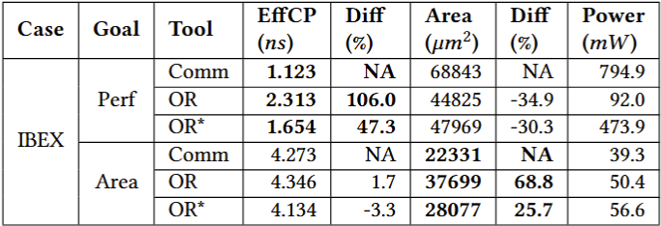
Leaderboard and calibration efforts
IEEE DATC-driven efforts
Revisited the Autotuning studies from METRICS2.1
  Added newly enabled knobs of OpenROAD such as:
  (i) ENABLE_DPO, (ii) TNS_END_PERCENT
  Extended autotuning studies to find the best implementations in terms of power and area using an unnamed commercial tool flow
  Also added results from hybrid flow
    Synthesis using unnamed commercial tool, P&R using ORFS
  All results evaluated using Open RCX and OpenSTA
Leaderboards in RDF enable:
  Tracking progress in the rapidly
  evolving OpenROAD
  Standardized baseline to easily
  plug, assess new EDA algorithms
Hybrid flow data (OR*) indicates, e.g., room for improvement in Yosys
V. A. Chhabria et al., "Strengthening the Foundations of IC Physical Design and ML EDA Research“, ICCAD 2024
Notes:
IEEE DATC efforts have conducted experiments to find the best designs in terms of power and area using an UNNAMED commercial tool flow. It also introduced a hybrid flow, where we use the best synthesis results from the UNNAMED commercial flow and run them through OpenROAD place and route. To ensure consistent evaluation metrics, we use OpenRCX for parasitic extraction and OpenSTA for power and performance evaluation.
[CLICK] OpenROAD is rapidly evolving. Having such a leaderboard will enable us to track OpenROAD's progress. These standardized baselines will also allow easy evaluation of new EDA algorithms.
This table on the bottom right presents the current leaderboard based on performance or effective clock period and area metrics generated for IBEX, on the Nangate45 enablement.
Here, we report the total power with respect to the effective clock frequency.

Slide 17
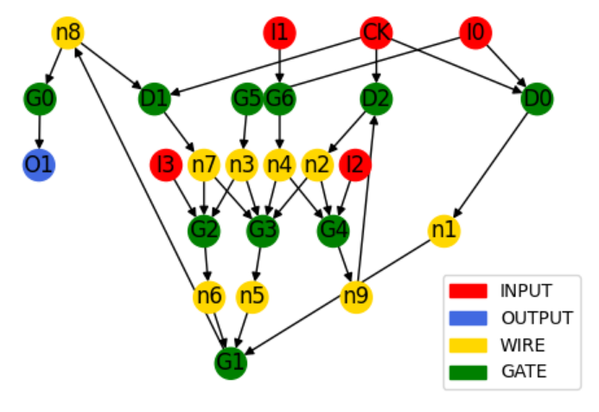
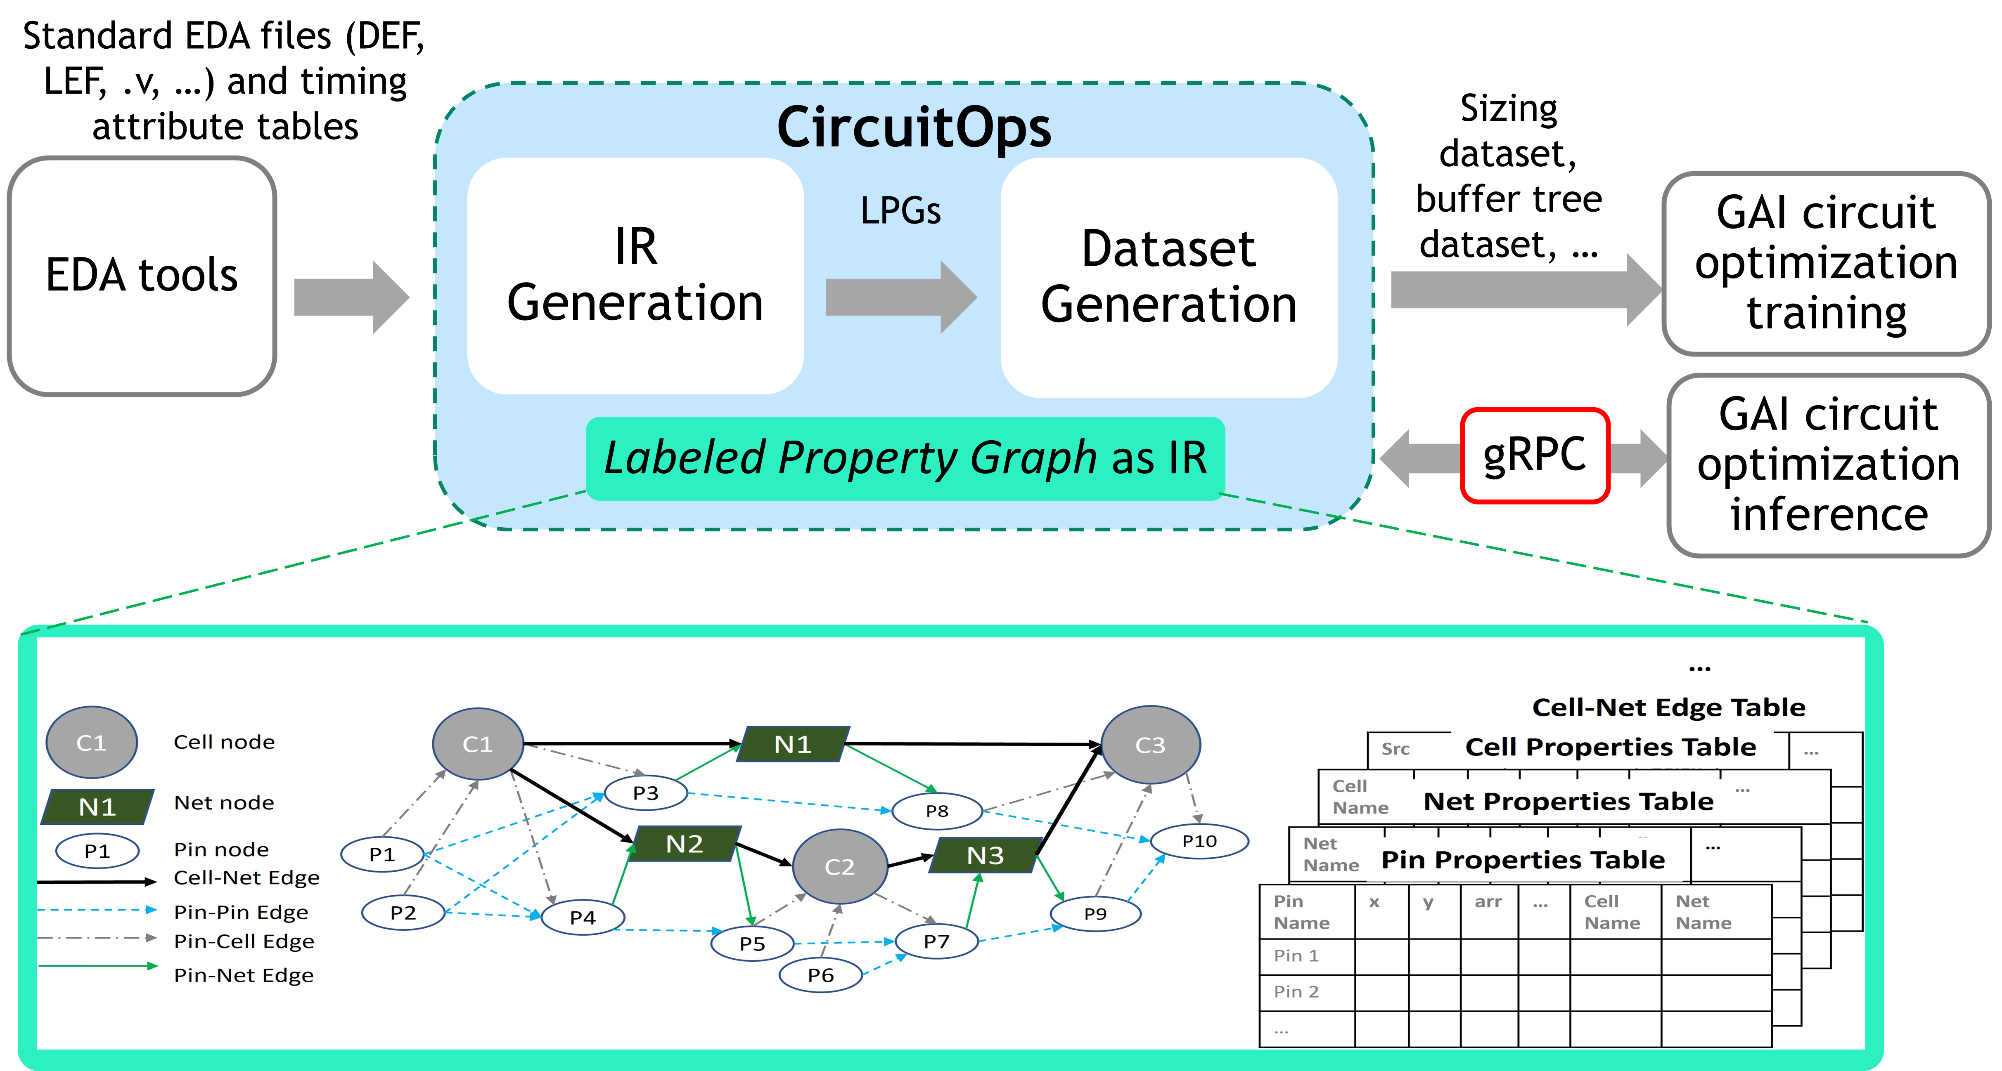
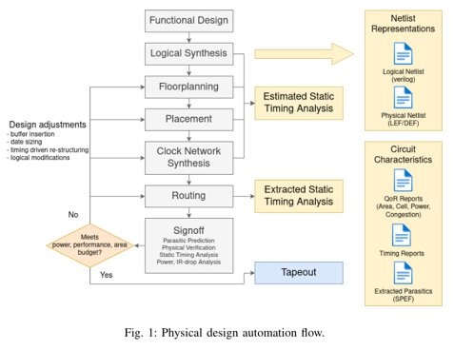
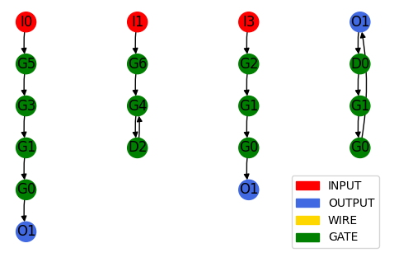


Establishing standard formats for ML EDA
CircuitOps and EDA Schema
Netlist Graph
Timing Path Graph
https://github.com/NVlabs/CircuitOps
https://github.com/drexel-ice/EDA-schema
Liang et. al “CircuitOps: An ML Infrastructure Enabling Generative AI for VLSI Circuit Optimization,” ICCAD 2023.
Pratik Shrestha et. al. “EDA-schema: Graph Datamodel Schema and Dataset for Design Automation,” GLSVLSI 2024.
Notes:
Further efforts on standardization have included developing standard data formats. Two efforts include:
One such effort is CircuitOps from NVIDIA and ASU which represents circuit netlists as labelled property graphs backed by these option of tables to support data generation for multiple ML EDA applications.
Recent efforts from ASU have added new applications supported by CircuitOps, have scaled available data in CircuitOps format on its GitHub with well documented APIs to interact with CircuitOps dataformat.
[CLICK] The second effort for data format from Drexel University is shown on the right. In EDA-schema, a circuit extracted from the design flow is represented as a graph, where nodes are IO pins, gates, and wires and edges are connections between them. There are both netlist graphs and timing path graphs.
Both these efforts CircuitOps and EDA Schema have been noticed by Si2 and its member companies and have been of interest to them.

Slide 18
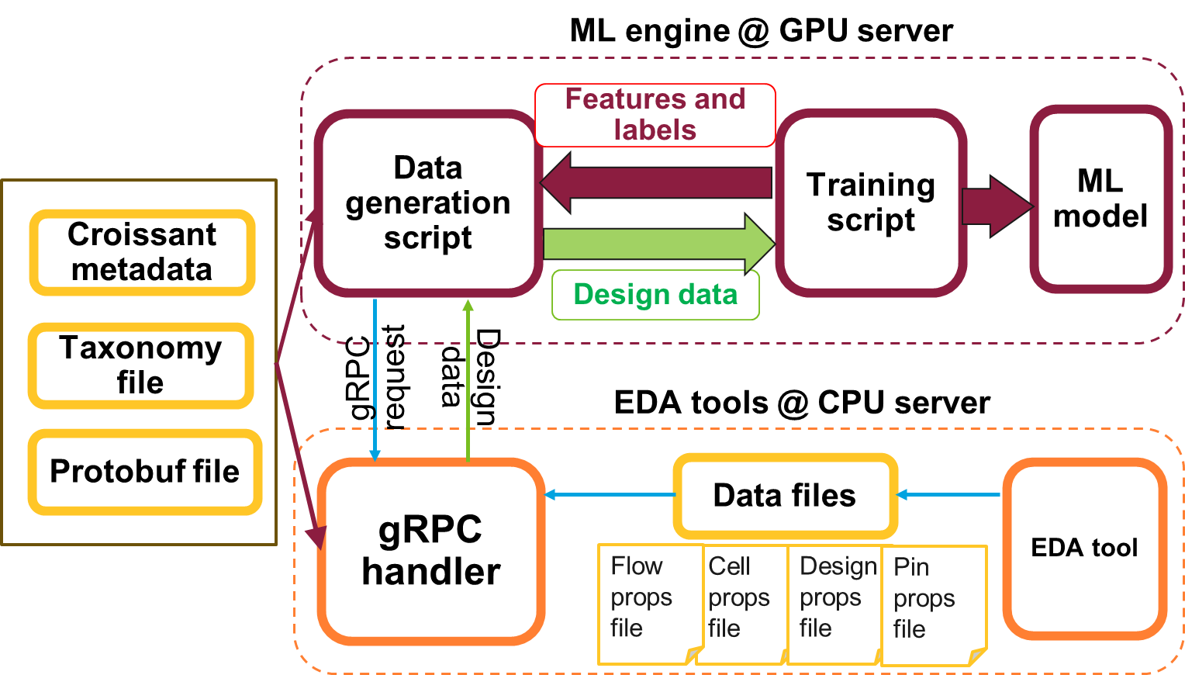

Establishing standard formats for ML EDA
Si2 ML EDA Schema Effort
Components of the proposed ML EDA schema
Taxonomy
  Standard EDA taxonomy definition
  Resource description framework
Croissant Metadata
  MLCommons proposed standard
  file format for describing datasets
Communication across servers
  gRPC and protobuf files
Currently being developed to support the applications EDA schema and CircuitOps support
Notes:
Si2 has been working with ASU and Drexel to standardize these data representation formats and scale them to be adaptable for different ML EDA applications. Components of the schema include:
Developing standard taxonomy for physical design. Definition and relationship between different entities (e.g., nets, pins, tracks)
Proposal for use of standard file formats for the description of datasets using Croissant formats
The schema includes scripts for communication across ML data on GPU servers and EDA tools on CPU servers.
These efforts are currently being developed with the applications supported by CircuitOps and EDA schema and some applications for Si2 member companies.

Slide 19
Agenda
Vision of an ML EDA Commons
Efforts toward ML EDA Commons
  Infrastructure development efforts
  Benchmarks and standardization efforts
  Accessibility and reproducibility efforts
Governance and roadmap
Conclusion
Notes:
I will next move onto accesibiltiy and reproducibility.

Slide 20
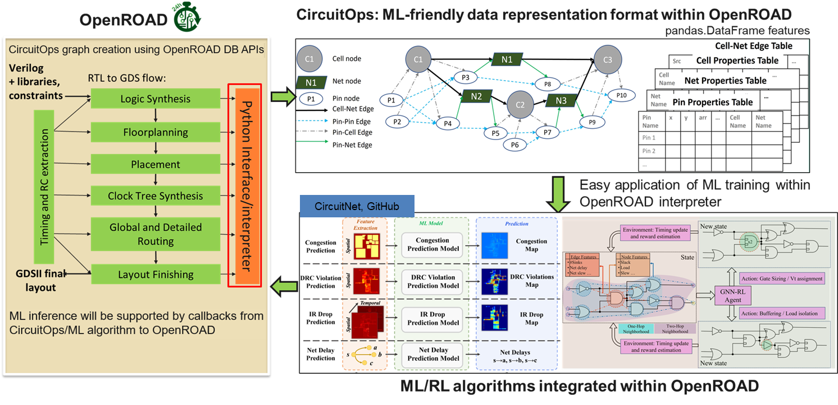
Efforts towards accessible ML EDA research
Critical role of open-source for accessibility
Lower the barriers to entry
Proxies (PDKs, tools, IP, and design) are critical for accessibility
Open-source tools can serve as a playground for ML EDA research
V. A. Chhabria et al., "OpenROAD and CircuitOps: Infrastructure for ML EDA Research and Education," VTS 2024.
Notes:
Well we cannot talk about accessibility without mentioning the critical role of open-source to lower barriers to entry and create proxies to overcome challenges related to IP whether its in the form of open-source tool, PDKs, designs etc.
[CLICK] Infact open-source tools also play a crucial role in serving as a playground for ML EDA researchers.IT allows for the direct integration of “ML inside” EDA., use of Python APIs to interact with the tools. An example of such a framework was demonstrated at an ASPDAC tutorial 2024 ar and then presented at VTS later that year.

Slide 21
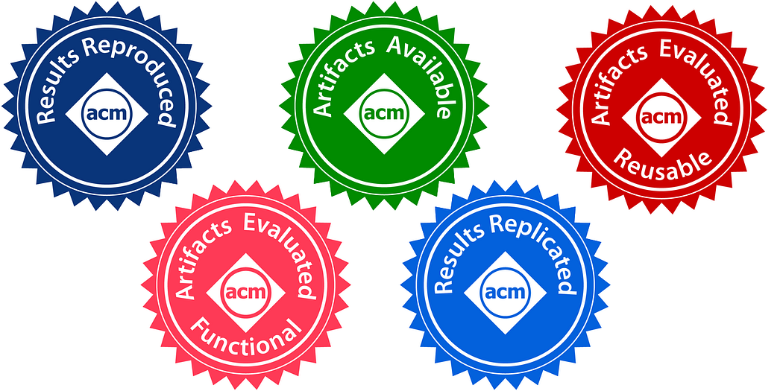
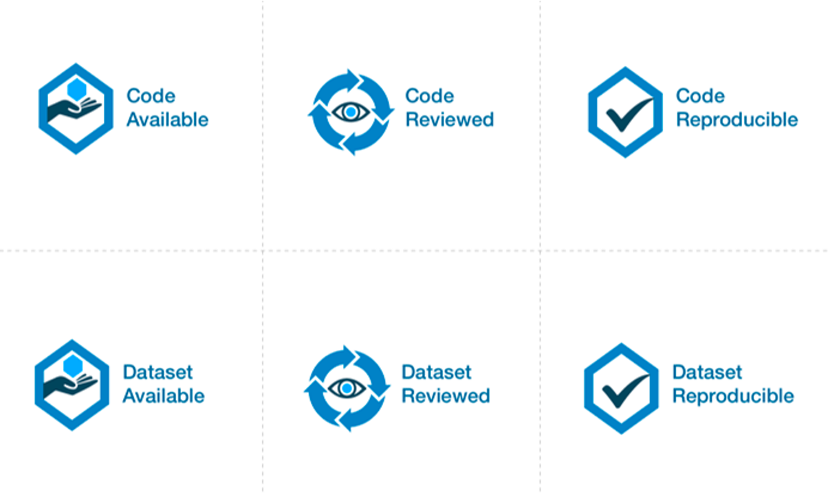
Efforts toward reproducible research
Artifact evaluation at MLCAD 2024
https://www.acm.org/publications/policies/artifact-review-and-badging-current
Artifact evaluation badges area available from IEEE and ACM to encourage reproducible research
MLCAD 2024 tailored ACM badge awarding criteria for ML EDA research
https://github.com/ml-eda/artifact-evaluation
Criteria to be revised with inputs from IEEE CEDA DATC and ACM for MLCAD2025 to encourage:
  Artifact availability with meaningful data
  Use of proxies to demonstrate key ideas of papers for functionality
  Hosting ML EDA research reproducibility challenges with incentives inspired by: https://reproml.org/
https://ieeexplore.ieee.org/Xplorehelp/overview-of-ieee-xplore/about-content#reproducibility-badges
Notes:
On the efforts for reproducible research, I would like to talk about this example of artifact evaluations. IEEE and ACM have badgegs to encourage rrepducible research. These badges that are shown on the right go onto the camera-ready version of a published paper after a peer review process of artifacts.
MLCAD in 2024 tailored the ACM badge awarding criterial for ML EDA research.
Efforts now include collaboration with IEEE CEDA DATC and ACM for MLCAD 2025 to encourage artifact availability, use of proxies to demonstrate algortihms inc as they rely on propriety data and also hosting reproducibility challenges.

Slide 22
Agenda
Vision of an ML EDA Commons
Efforts toward ML EDA Commons
  Infrastructure development efforts
  Benchmarks and standardization efforts
  Accessibility and reproducibility efforts
Governance and roadmap
Conclusion
Notes:
Lastly I would like to talk about governance of the ML EDA Commons and a roadmap of activities towards establishing this.

Slide 23
Governance
Key stakeholders and roles
Define standards
Develop infrastructure
Provide incentives
Serve on advisory boards
Ensure sustenance
Engage community
Academia
Industry
Professional societies
Government agencies
Open-source community
Notes:
So who should be a part of Commons as its members? Well key holders including all of us here including academia, industry, representors form professional societies such as IEEE ACM government agencies and the general open-source community.
Each of these stakeholders play a critical role in a variety of ML EDA activities including defining standards, developing infrastructure, providing incentives, and several other activities that are shown on the left.

Slide 24
Steps to establish the Commons
Early stage
(Year 1 and 2)
Intermediate stage (Year 3 and 4)
Late stage
(Year 5 and beyond)
ML EDA infrastructure (e.g., datasets)
Large scale datasets with proxies (PDKs, designs)
High quality complete data and golden evaluators
Maintenance and relevance updates
Standardization and governance (e.g., standard data formats)
Schemas for interoperability between ML flows and EDA
Establish policies & create CI/CD pipelines for contributions
Adapting standards to rapidly evolving AI research
Accessibility and reproducibility (e.g., artifact evaluation)
Establish widespread AE practices at conferences
Update taxonomy of AE badge criteria with IEEE/ACM
Peer review process that also prioritizes reproducibility
Notes:
So is this all just talk and no actionable items? Well here I highlight concrete steps for establishing the activities of such as Commons in the context of a timeline. Infact, the examples that I chose here for each component of the Commons is based on efforts that we have already been making and intend to make over the next few years.
[CLICK] For example, on the ML EDA infrastructure efforts I use dataset as an example to highlight activities of the Commons year by year. In the first two years activities prioritize scale, in the next they prioritize quality, and after is all about maintenance and updates. In fact, at ASU research and engineering efforts are in creating large scale dataset of netlist for timing optimization problems which we evaluate in terms of quality using industry statistical data.
[CLICK] On the standards and governance side. The first few years must focus on establishing standards in terms of quality and formats for data for ML EDA and later establish policies and adapt standards to rapidly evolving AI. At ASU we have also been working very closely with Si2 and Drexel and have been funded to develop the ML EDA schema for Si2 members.
[CLICK] For accessibility and reproducibility. Here the example we use is artifact evaluations. The first few years again is to gain traction by having AE practices at different university and then improve taxonomy and long-term efforts include making changes to the mindset of reviewers. As the IEEE DATC Chair and a member of the SLICE team, last year we worked closely with MLCAD to create an AE process for ML EDA research.

Slide 25
Conclusion
Aims to bridge the divide between the open culture of ML research and the closed EDA domain to accelerate innovation in ML EDA
Components of an ML EDA Commons
  ML EDA infrastructure
  Governance and standards
  Accessibility and reproducibility
Journey ahead requires sustained and expanded effort
  Involvement from key stakeholders
  Changing mindset of researchers, establishing incentives for researchers
  ….
Components of an ML EDA Commons:
Governance & standards
Accessibility & reproducibility
Consortium of stakeholders
Cloud infrastructure
Formats & quality
Open-source
Research artifacts
Sustainability
ML EDA infrastructure
Notes:
So we proposed this idea of an ML EDA Commons. To bridge the gap between the open culture of ML research and closed nature of EDA. We spoke about the components of such a commons including a vision for it.
However, the journey ahead requires sustained and expanded efforts with involvement from all of you as stakeholders.

Slide 26
Acknowledgements
Ioannis Savidis (Drexel Univ.)
Ivan Kissiov (Siemens)
Rongjian Liang (NVIDIA, DATC)
Haoxing (Mark) Ren (NVIDIA)
Sayak Kundu (UCSD)
Zhiang Wang (UCSD)
Dooseok Yoon (UCSD)
Vikram Gopalakrishnan (ASU)
Bing-Yue Wu (ASU)
Pratik Shrestha (Drexel Univ.)
SLICE Team
  Siddharth Garg (NYU)
  Callie Hao (GaTech)
  Aakash Tyagi (TAMU)
  Michael Quinn (TAMU)
Notes:
Thank you all for bearing with me for the last 20 minutes and here I also list all my collaborators and who have contributed to this talk in several different ways and acknowledge their efforts.

Slide 27
Backup Slides

Slide 28
Road to an ML EDA Commons
Nascent Mature
Individual-driven efforts
Ongoing efforts:
Benchmarks
  IWLS 2005, IBM power grid 2008 benchmarks, MacroPlacement etc.
Datasets
  VerilogEval, CVDP, FloorSet, BeGAN benchmarks etc.
Tools and flows
  OpenROAD, ORFS, yosys, etc.
Contests
  ICCAD, MLCAD, ISPD, ICLAD contests etc.
Proxies
  PDKs (ASAP7, NG45) and designs
Datasets
Benchmarks and metrics
Datasets
Datasets
Contests
Tools & flows
Tools & flows
Tools & flows
Tools & flows
Contests
Contests
Proxies

Slide 29
Road to an ML EDA Commons
Nascent Mature
Need for unified efforts
Ongoing efforts:
Unified ML EDA infrastructure is critical to
Identify gaps in existing infrastructure
(e.g., what parts of the flow, what can have large impact, gaps in design enablement)
Establish interoperability via standardization
Establish and maintain datasets and benchmarks with complete enablement for the entire physical design flow
Drive contests and live leaderboards on those benchmarks and datasets
Establish meaningful well-maintained proxies
ML EDA infrastructure
Datasets
Tools & flows
Benchmarks and metrics
Contests
Proxies

Slide 30
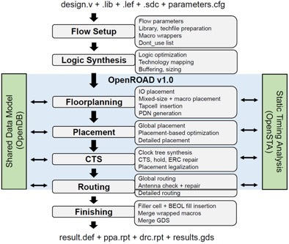
Establishing standard formats for ML EDA
CircuitOps
Dataset for task 1
IR (LPG) generated by interacting with OpenDB
AI Engine1
CircuitOps
…
…
Operating on AI and parallel-friendly LPG
Dataset for task i
AI Engine i
OpenROAD
…
…
Liang et. al “CircuitOps: An ML Infrastructure Enabling Generative AI for VLSI Circuit Optimization,” ICCAD 2023.

Slide 31
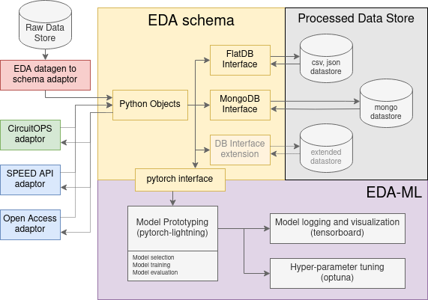
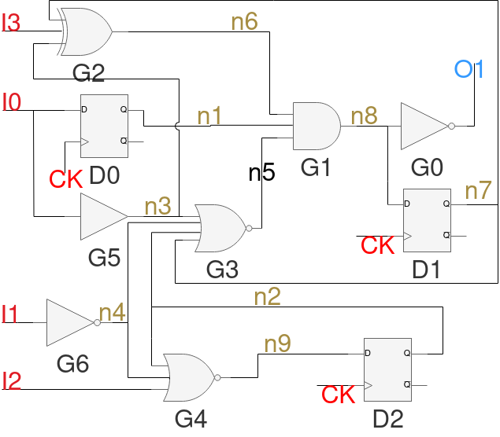
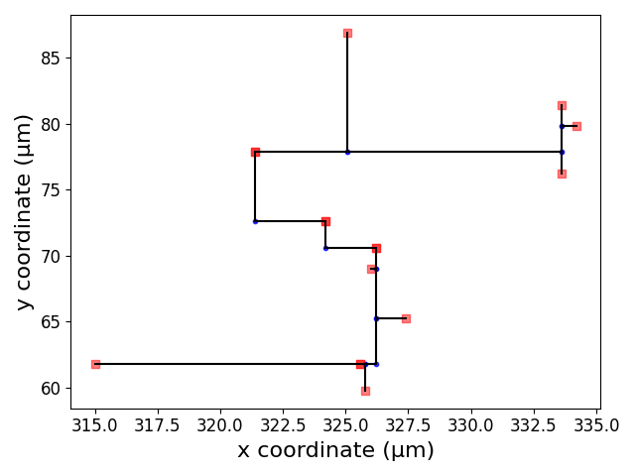
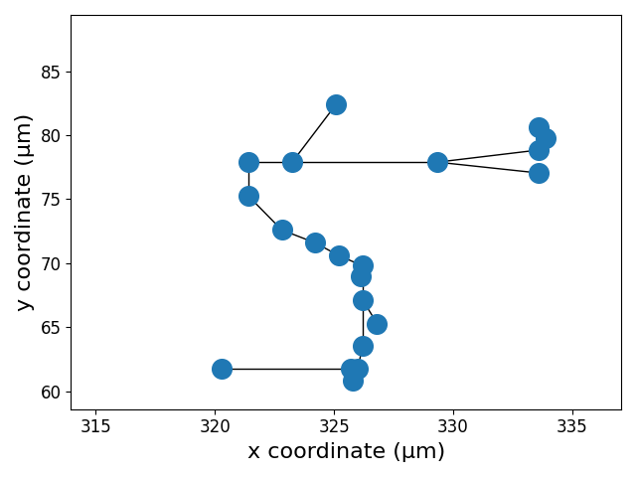
Establishing standard formats for ML EDA
EDA schema
Circuit
Physical design automation flow and corresponding netlist and circuit data formats
Prof. Ioannis Savidis is338@drexel.edu EDA-schema:
Graph Datamodel Schema and Dataset for Design Automation
Interconnect Graph
Netlist Graph
Timing Path Graph

