Slide 1
Use Cases and Deployment of ML in IC Physical Design
Amur Ghose, aghose@ucsd.edu
Andrew B. Kahng, abk@ucsd.edu
Sayak Kundu, sakundu@ucsd.edu
Yiting Liu, yil375@ucsd.edu
Bodhisatta Pramanik, bopramanik@ucsd.edu
Zhiang Wang, zhw033@ucsd.edu
Dooseok Yoon, d3yoon@ucsd.edu
Notes:
Thank you for the introduction and for inviting this talk and the paper, which is a collaboration with my students and postdocs at UCSD.

Slide 2
Motivation
AI/ML techniques have been applied to many IC physical design challenges, e.g.:
  Hyperparameter autotuning for better PPA tool settings
  ML Predictions of routing hotspots, doomed runs, and PPA
  Routing blockage creation to improve routability and PPA
But: practical challenges are seen in ML deployment
  ➔ Why have so many efforts fallen short?
This talk:
  Issues surrounding data for ML
  High-level principles for deployment
  Basic “checklists” for data, models, and use cases
  Context for MLOps and LLM-based application development
Notes:
Here’s some motivation.
We’ve tried AI/ML for many PD applications – hyperparameter tuning, prediction, or “conditioning” of flow steps such as routing.
But we’ve seen challenges in practical, production deployment.
Why have so many efforts fallen short?
[CLICK] I’ll explore four topics: ML data issues, high-level principles for deployment, basic checklists, and the rapidly evolving context for MLOps and LLM-based application development.

Slide 3
Agenda
Data
  Data Outside vs. Inside IC Design
  Challenges and Ongoing Efforts (Academia and Industry)
ML Deployment
  Key Performance Indicators (KPIs) and Checklists
  Machine Learning Operations (MLOps) and Commoditization
Challenges for LLM Deployment
  LLM ꓫ EDA: Software Engineering Issues
  Challenges from EDA Flows
Notes:
The agenda matches the main sections of the paper. First, issues around data – challenges and trajectories we see in academia and industry. Second, key metrics and checklists for deployment, and impacts from commoditization of MLOps. Third, challenges seen in LLM deployment and integration with EDA flows, and intersections with software engineering considerations.

Slide 4
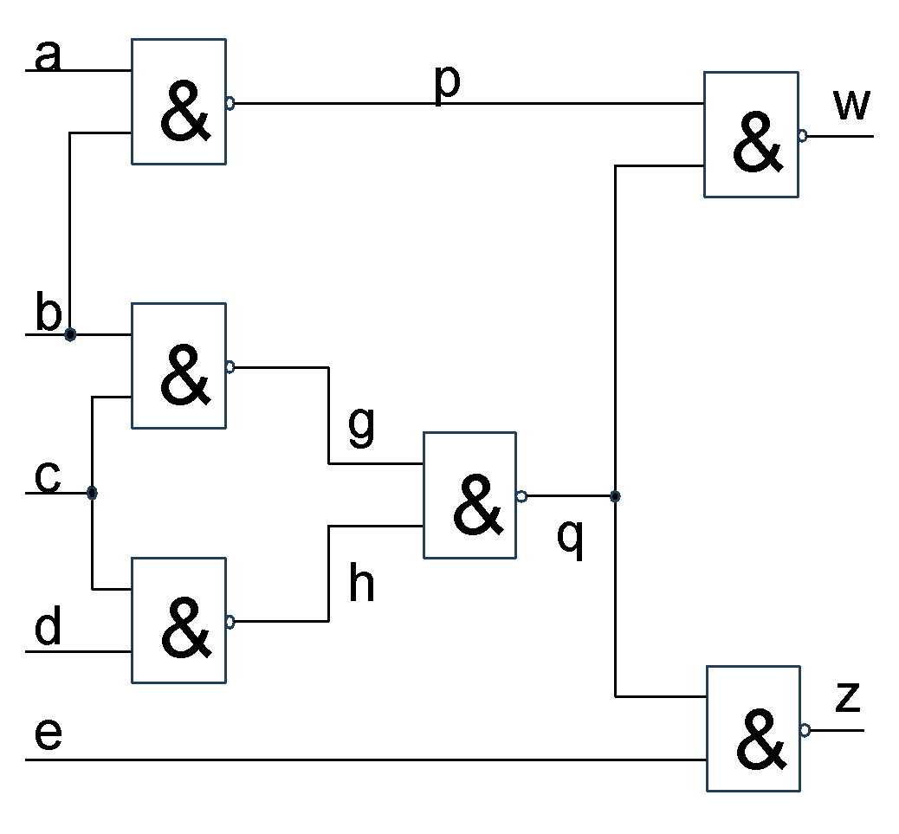
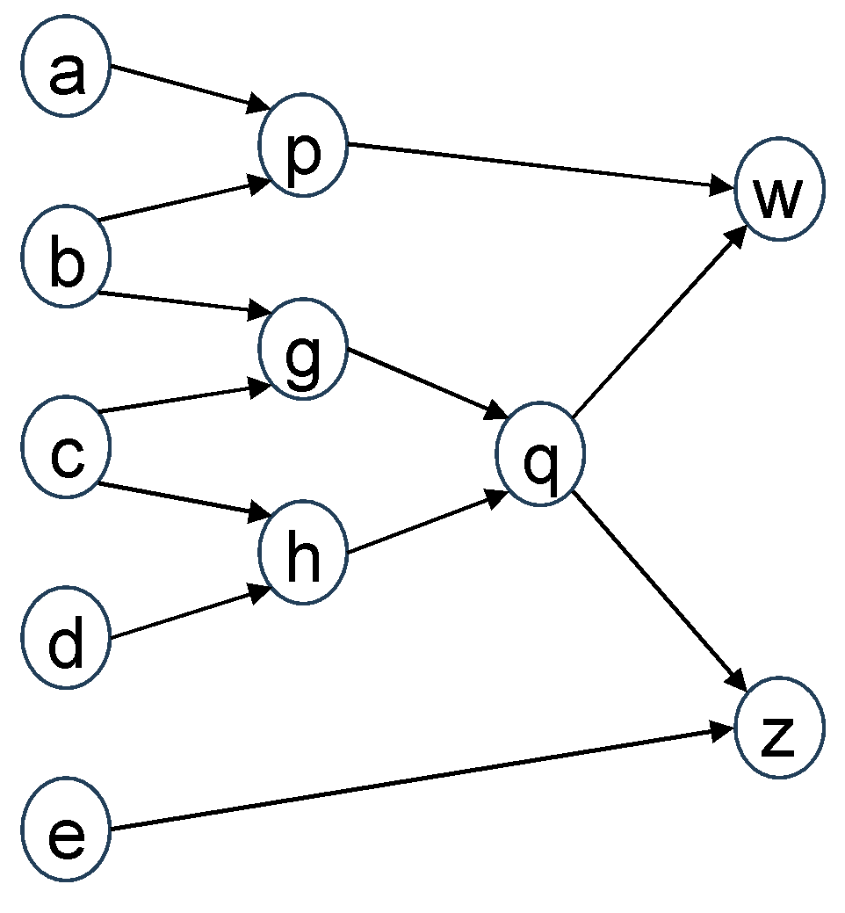
Data in PD: Scope, Modalities, Challenges
Data is a core concern in ML for IC design
Example Challenges
Generalization across modalities
Scarce and proprietary data
Data quality
  Diverse IC data types
    Formal specs
    HDL
    Graphs
    Hierarchies
    Tabular data
    Images
  Hard for GenAI to interpret
  IC design data is costly to produce
    Huge scale, as well !
  High-quality public data is scarce
  Unshareable due to proprietary rights
    PDK data
    Commercial libraries
    Soft IP data
    EDA vendor data
  Larger datasets do not guarantee better ML models
  Common problems:
    Outdated, stale data
    Incomplete coverage
    Risks such as data poisoning
Notes:
Data is of course a first-class concern: quality, quantity, relevance all matter. GenAI models leverage huge, open datasets for text, image, video and audio. But IC design data is different –
[CLICK] formal specs, graphs, hierarchies, layouts, tabular data – all of these are challenging for GenAI to interpret.
[CLICK] Also: IC design data is costly to produce, it is scarce, and proprietary rights limit sharing. For example, we can’t upload commercial tool outputs to public LLMs or share benchmark results.
[CLICK] And, IC data can quickly become outdated or incomplete. There are vulnerabilities, such as data poisoning.
So IC design data has always brought unique challenges for ML deployment. At the same time, more efforts are trying to meet these challenges.

Slide 5
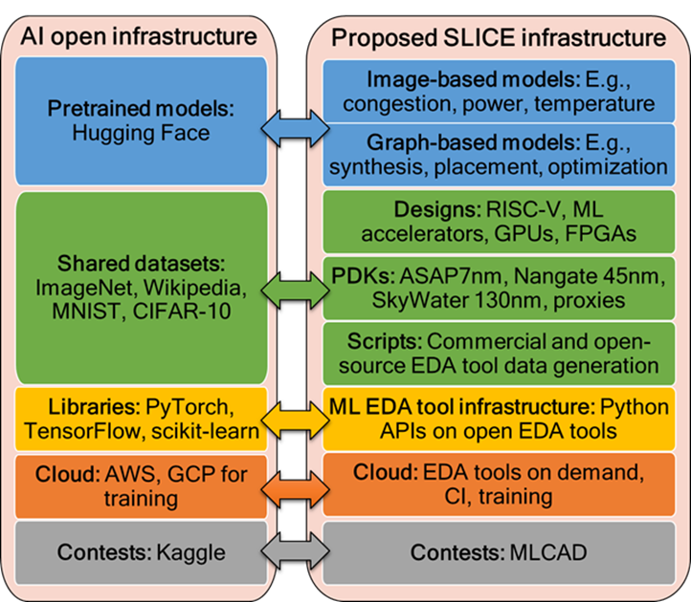
Academic Efforts
Many initiatives, contributions to mitigate data scarcity
Artificial netlist generators (ANG+), proxy PDKs (ASAP7+)
Open-source toolchains (OpenROAD, iEDA, Yosys etc.)
  Continuous updates to public, reproducible baseline results, benchmarks
IEEE CEDA DATC
  ML EDA formats, datasets + proxy design enablements
The SLICE project
  Enabling a sharable ML infrastructure
MLCAD24: Reproducibility initiatives
NSF “ImageNets for EDA” Workshop
…
Notes:
In academia, there’s artificial netlist generators to match real-world designs in support of ML modeling for PD. Open-source toolchains help advance baselines and benchmarks that are public and reproducible.
[CLICK] IEEE CEDA DATC has initiatives that include ML EDA formats, datasets, and “proxy” design enablements, all of which boost ML in PD.
SLICE launched at a 2023 NSF workshop – it aims for extensible ML infrastructure that opens up collaboration and data-sharing. Last year at ASP-DAC, I showed this parallel between SLICE goals and the broader AI ecosystem.
[CLICK] Reproducibility badges at MLCAD, the recent “ImageNets for EDA” workshop, and more are driving data sharing for ML EDA.

Slide 6



Industry Efforts
Contributions to ML infrastructure and shared datasets
GT-NVIDIA contest
  Enable LLM-assisted design automation
Si2’s AI/ML Schema Open Standards Working Group
  Developing standardized schema specification to support AI/ML methods
  Goal: enable academia-industry collaboration
Google open-source (“N7”) Ariane RISC-V core
  → New PD benchmark reflecting sub-10nm process technology
  + Scaled 2x, 4x variants
Notes:
In industry, NVIDIA with Georgia Tech engaged the community to enable LLM-assisted EDA.
[CLICK] Si2’s “AI/ML Schema Open Standards Working Group” seeks a standardized schema for AI/ML and data analytics.
[CLICK] Google’s open-source Ariane RISC-V protobuf provides a new PD benchmark reflecting sub-10nm technology, and it’s been the basis of scaled variants.

Slide 7
AI Flywheel and Frictionless Reproducibility
AI flywheel
Frictionless reproducibility (FR) [Donoho, 2024]
More users
More data
Better AI
Better product
Benchmarking
Data sharing
Code sharing
Competitive challenges
Benchmark requirements
Impact goals
    Periodically update and diversify
    Prioritize representative datasets
    Use consensus evaluation metrics
    Apply standardized testing protocols
    Reflect real-world scenarios
    Ensure model accuracy and robustness
    Drive progress with meaningful comparisons
Notes:
For us, an overarching goal must be to realize an AI Flywheel, with frictionless reproducibility and AI/ML innovation. In the AI Flywheel, more user participation generates more data, leading to better ML modeling – which enables better tools and chip designs, which bring more users and accelerate innovation.
[CLICK] David Donoho highlighted the role of Frictionless Reproducibility in this process. FR has three foundations: data sharing, code sharing, and competitive challenges. Thus:
[CLICK] Benchmarking is central to these foundations, since it promotes transparency, and standardized evaluation.
[CLICK] Benchmarks need periodic updates and diversification to reflect relevant technologies and design scenarios. We need representative datasets, standardized testing protocols, and consensus metrics as well.

Slide 8
Agenda
Data
  Data Outside vs. Inside IC Design
  Challenges and Ongoing Efforts (Academia and Industry)
ML Deployment
  Key Performance Indicators (KPIs) and Checklists
  Machine Learning Operations (MLOps) and Commoditization
Challenges for LLM Deployment
  LLM ꓫ EDA: Software Engineering Issues
  Challenges from EDA Flows
Notes:
Now, let’s look at practical aspects of ML deployment in an IC design organization – Section 3 in the paper.
[566 / 2316]

Slide 9

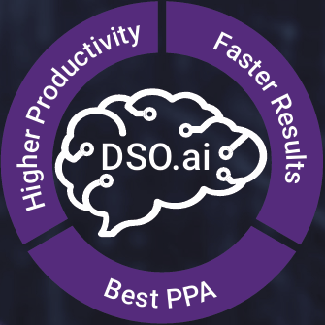

ML Deployment: 3 Basic Strategy Elements
Focus on optimizing existing design processes
  Make measurable improvements while building trust in ML integration
  Examples:
    Cadence Cerebrus
    Synopsys DSO.ai
Aim for incremental improvements
  Less risk (minimum project cost)
  Simpler rollbacks if necessary
Treat data as a first-class, up-front concern
  Robust data is the foundation for ML success
  Data quality determines model performance → effective data management is essential
Notes:
There are basic strategy precepts.
Like, focus on optimizing existing design processes – so you can get measurable improvements while maintaining trust in the concept of ML integration. Cerebrus and DSO.ai are good examples.
[CLICK] Second, aim for incremental ML-based improvements of existing methodologies – there’s less risk, and rollbacks are simpler.
And, treat data as a first-class, up-front concern. Robust data management is the foundation for successful ML initiatives, since data quality determines modeling quality as well as agility.

Slide 10
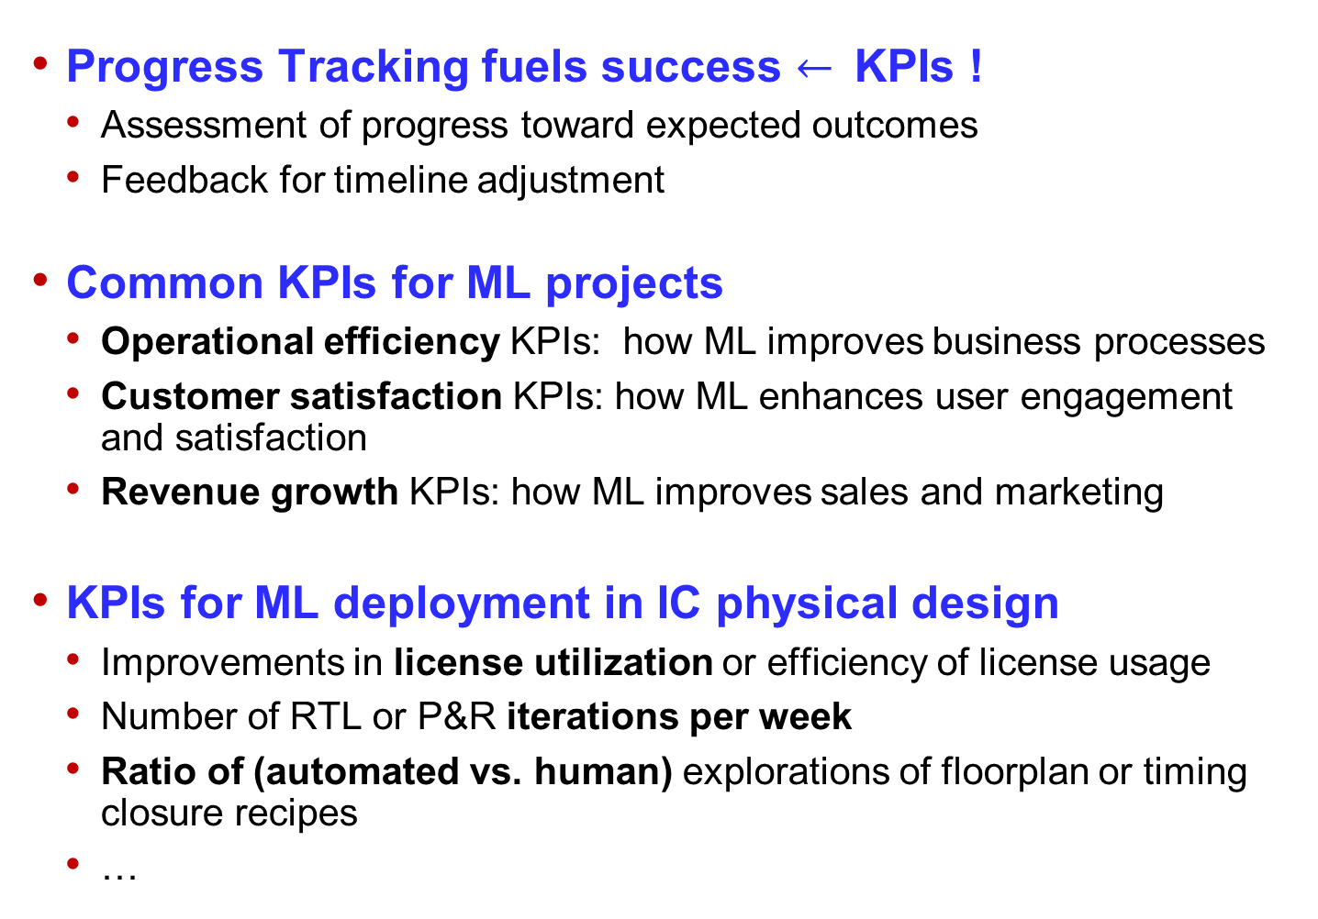
Key Performance Indicators (KPIs)
Progress Tracking fuels success $←$KPIs !
  Assessment of progress toward expected outcomes
  Feedback for timeline adjustment
Common KPIs for ML projects
  Operational efficiency KPIs: how ML improves business processes
  Customer satisfaction KPIs: how ML enhances user engagement and satisfaction
  Revenue growth KPIs: how ML improves sales and marketing
KPIs for ML deployment in IC physical design
  Improvements in license utilization or efficiency of license usage
  Number of RTL or P&R iterations per week
  Ratio of (automated vs. human) explorations of floorplan or timing closure recipes
  …
Notes:
Next: We must measure, in order to improve. So, Key Performance Indicators, or METRICS, are a best practice. Is our ML deployment making progress? What actionable feedback is keeping us on the right path? Generic KPIs for ML span operational efficiency, customer or user satisfaction, and revenue impacts.
[CLICK] For ML deployment in IC design, there are more specific KPIs, such as License Utilization; or Productivity, number of iterations per week; or Automation, the ratio of (automated to human) trials in design or flow explorations.

Slide 11
Checklists: Data and ML Methods
Does the output actually follow from all the input data?
  Without implicit (silent, unspoken) assumptions and human intuition
  Without magically solving NP-hard problems, PDEs, etc.
Is there enough training data to fully capture the functionality?
  Isolated corner cases can be a problem
Does a given ML method work well with a given data type?
  LLMs X numerical data, graphs, etc.
  Deep Learning X big structured data, multiscale data
Data
Is there enough training data to train a given ML model?
  Data-hungry: GenAI and Deep Reinforcement Learning
  Less data-hungry: Gradient-Boosted Decision Trees (XGBoost)
  Data-frugal: Bayesian methods
Is there too much data for a given ML model?
  May need to use RAG and/or a Mixture of Experts
Are the model training speed and cost consistent with updates to data?
  Can model freshness (relevance) be maintained?
  New tool versions, design ECOs, library models, …
ML Methods
Acknowledgments and thanks: Dr. Igor Markov, Synopsys
Notes:
ML GOALS must also satisfy basic checklists.
The first checklist is about data.
Does the desired output actually follow from all the input data? It can’t rely on implicit assumptions, or human intuition, or magical solutions to hard subproblems.
Is there enough training data to fully capture the functionality? Beware of isolated corner cases.
Does a given ML method work well with the given data? LLMs can struggle with numerical data and graphs, or Deep Learning can struggle with big structured data or multiscale data.
[CLICK] The second checklist is about ML models with respect to their data requirements.
Is there enough training data to train a given ML model? GenAI and Deep RL are data-hungry. GBDTs like XGBoost are less data-hungry – and Bayesian methods are data-frugal.
If there is too much data for a given ML model, you may need to use RAG or an MoE.
And, are training speed and cost consistent with updates to data and requirements for model freshness?
[917 / 2316] – 8:25

Slide 12
More Checklists: ML Model Outputs
What are the comparisons to existing baselines?
  Pitfall: lack of strong baselines, benchmarks
How do output errors scale with size?
Must output errors be found?
How are output errors tolerated?
  Verify and fail?
  Verify and retry?
  Hot-patching (e.g., hallucinations, statistics)?
Outputs consumed by People:
Is output size limited?
Is correctness obvious?
Are fixes obvious?
Do ML outputs save or waste time?
Outputs consumed by Tools:
Are there too many errors (at scale)?
Is there a fast verifier and corrector?
Do ML outputs improve final QoR?
Acknowledgments and thanks: Dr. Igor Markov, Synopsys
Notes:
This slide points out checklists for outputs from ML models.
Are there comparisons to strong baselines on relevant benchmarks?
How do output errors scale?
Must output errors be found? And if we find them, how are they handled or tolerated?
[CLICK] And digging deeper, who will consume the outputs from ML models?
If outputs are consumed by People: is the output size manageable? Can humans determine correctness, and any fixes needed? At the end, do the ML outputs save time or waste time?
Or, if model outputs are consumed by Tools: Are there too many errors at scale? Do we have verifiers and correctors? Again – at the end, did ML improve final QoR?

Slide 13
What About “MLOps”?
Wikipedia definition: “[A]n engineering practice that leverages three contributing disciplines: machine learning, software engineering (especially DevOps), and data engineering”
Machine Learning
Checklists for MLOps
  How will data be archived from runs?
    E.g., streaming vs. batch
  What elements of run data?
    E.g., logs, scripts, reports, collaterals, …
  How to manage the lifecycle of design data, or the model store?
  Who creates VectorDBs (for RAG) and fine-tuned models – and when should these be updated?
  Where is the compute?
    E.g., volume, cost of data movement
MLOps
Data
Engineering
DevOps
+ LLM APIs
+ Commoditization
LLMOps
Engage with MLOps NOW !
Notes:
A key part of ML deployment is MLOps, which melds core ML activities with best practices from software engineering and data engineering.
MLOps eases model development, testing, production deployment and sustainment.
And now MLOps plus LLMs (which is called LLMOps) is driving a shift toward commoditization – meaning that LLMOps enables organizations of all sizes to adopt MLOps more readily.
[CLICK] One message is: Design organizations should engage with MLOps today!
[CLICK] Another message is: Before adopting MLOps, again there is a checklist:
How will data be archived from runs – streaming or batch?
Which elements of run data – logs, scripts, reports, other collaterals?
How to manage the lifecycle of design data, or the model store?
Who maintains your VectorDBs (for RAG) and fine-tuned models?
Or: Where is your compute?

Slide 14
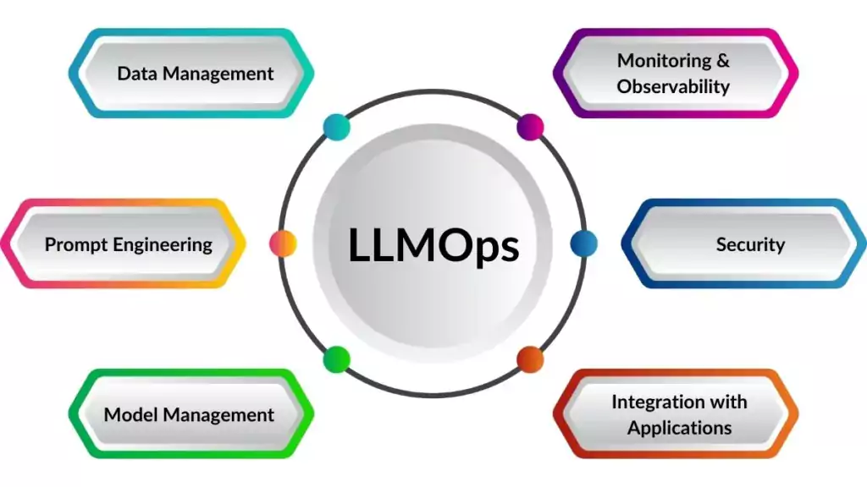
LLMOps: The New Paradigm
LLM-only applications often call for a simpler MLOps subset !
Work with API for a model, not the model itself
Much lower costs due to no training/serving, only API calls
Monitoring/observability is in effect most of it
Notes:
Delivering a full MLOps suite is often very expensive. Much of the expense comes from hosting the model – covering training, infrastructure, serving, and even inference.
With LLM APIs, the main costs SHIFT to tracing, monitoring, and observability. These tasks are lighter on compute and resemble traditional backend engineering, which is much more well-understood.
The key insight is that LLMOps is cheaper – and this spurs new entrants that we never saw in older MLOps markets. Smaller players can innovate and challenge bigger, established MLOps providers. Ultimately, this shift reduces overall MLOps costs.
And who PROVIDES LLMOps?

Slide 15




LLMOps: Commoditization “Via Osmosis”
VC funded startups can enter
As can traditional monitoring companies e.g., Datadog
Easier LLM monetization lowers cost of MLOps
“Via Osmosis”: lower subset’s cost → then entire cost
No MLOps
LLMOps
Full MLOps
$
$
$$$$
Notes:
In traditional MLOps, only big enterprise solutions like Snowflake or Databricks can cover their costs with their business model.
LLMOps is different: it has newcomers like Langsmith and LlamaIndex – and established names like Weights & Biases, and monitoring platforms like Datadog.
What’s happened is that LLM-based apps reach revenue faster and require leaner tooling, so these LLMOps offerings are cheaper than older MLOps suites. The lower cost reduces barriers for companies, making it easier to move from no MLOps to full MLOps, basically
[CLICK] in two steps. Today, transitioning from No MLOps to LLMOps is easier and revenue-positive – which simplifies going from No MLOps to Full MLOps.
Next, I’ll talk about LLM-based code copilots, which are one of the revenue drivers.
[1394 / 2316] – 13:05

Slide 16
Agenda
Data
  Data Outside vs. Inside IC Design
  Challenges and Ongoing Efforts (Academia and Industry)
ML Deployment
  Key Performance Indicators (KPIs) and Checklists
  Machine Learning Operations (MLOps) and Commoditization
Challenges for LLM Deployment
  LLM ꓫ EDA: Software Engineering Issues
  Challenges from EDA Flows
Notes:
And this is the last part of my talk – Section 4 of the paper. It’s a bit DARK, but I promise to end on a positive note ! And, Session 6E this afternoon may already have all the answers!

Slide 17



LLMs for Software Engineering
Very trendy, already 3 young unicorns
  Cognition, Magic, Cursor/Anysphere
No sign of slowing down
Revenue: $100M+ for Cursor alone
Newcomers keep coming: Aider, Zed, ...
Next: an EDA copilot?
  “When you put the resulting netlist into P&R, make sure to fence this region with top-side ports folded onto two layers, and turn on higher-effort congestion mitigation with the following set of path groups …”
No.
Notes:
So. Code generation by LLMs is more than hype: it’s bringing in revenue.
Leaders include unicorns like Cognition (with its Devin tool), Magic and Cursor (also called Anysphere) – along with GitHub Copilot. Over a billion dollars in revenue is coming from this alone – not counting code-related queries in ChatGPT. VCs keep investing, and new players like Aider or Zed keep appearing.
So should we expect a complete EDA copilot that writes Verilog, tests it, debugs it, and optimizes implementation flows?
[CLICK] With actionable feedback, like THIS ? Unfortunately,
[CLICK] NO. Not anytime soon. And let’s try to understand why this is the case.

Slide 18
LLMs Excel at Particular Codebases
Many criteria “must” be met !
Length of execution chain before a tangible result
Open-source monorepo in a popular language
Low, ideally zero important third-party dependencies
In-line, sufficient documentation for codebase
Low bar for domain knowledge
Little need for integration of non-text based information
Small compute requirement to test a small change
Integration with tools, e.g., browser-based UI render
Many standard codebases already satisfy these !
For a self-driving car: “Clear Weather”
Notes:
A parallel here is self-driving. When someone says self-driving is solved, they’re talking about driving in clear weather, not in a snowstorm. For an LLM-based copilot, what is clear weather?
[CLICK] It’s well-commented code in popular languages like Python. It’s a shallow, mono-repository structure and the ability to make iterative changes with fast feedback. For example, Cursor tests code by running commands and checking outputs.
But if code lacks clear modular blocks, or if changes take hours or days to verify, it is harder to use LLMs. Images and other outputs beyond text also make matters worse, since standard LLM agents mostly rely on text-based inspection.
And here is why EDA is a SNOWSTORM:

Slide 19
On the Other Hand … EDA ?
For a self-driving car: “Snowstorm”
EDA lacks a lot of this…
SOTA EDA and open-source EDA are ~disjoint
Extensive domain knowledge is a must
Feedback on changes can take days or even weeks
Mixture of Verilog, C++, Python for ORFS
Endless sea of self-contained tools: Yosys, ABC, …
Lack of in-line comments and lots of documentation
Reliance on platform kits that are third-party imports
Copyright/IP rights + LLM leaks = nightmare scenario
… (… --- …)
Notes:
EDA codebases break almost every LLM-friendly rule!!!
Commercial tools are closed source, so LLMs can’t fully explore their internals. In physical design, we have huge, complex data like netlists and congestion maps. Large monolithic flows don’t split neatly into modular parts, and feedback loops can take days.
Notice that the latency of feedback is related to how the flow IS NOT modular.
Indeed, LACK of modularity – the closed silos and non-reentrant flows that vendors aim for – is perhaps the key blocker in modern EDA.
So bottom line: without open-source access and without short feedback cycles for testing and refinement – EDA seems near-intractable for a Devin-like agent, especially one without domain knowledge.
And even open source won’t be enough.

Slide 20
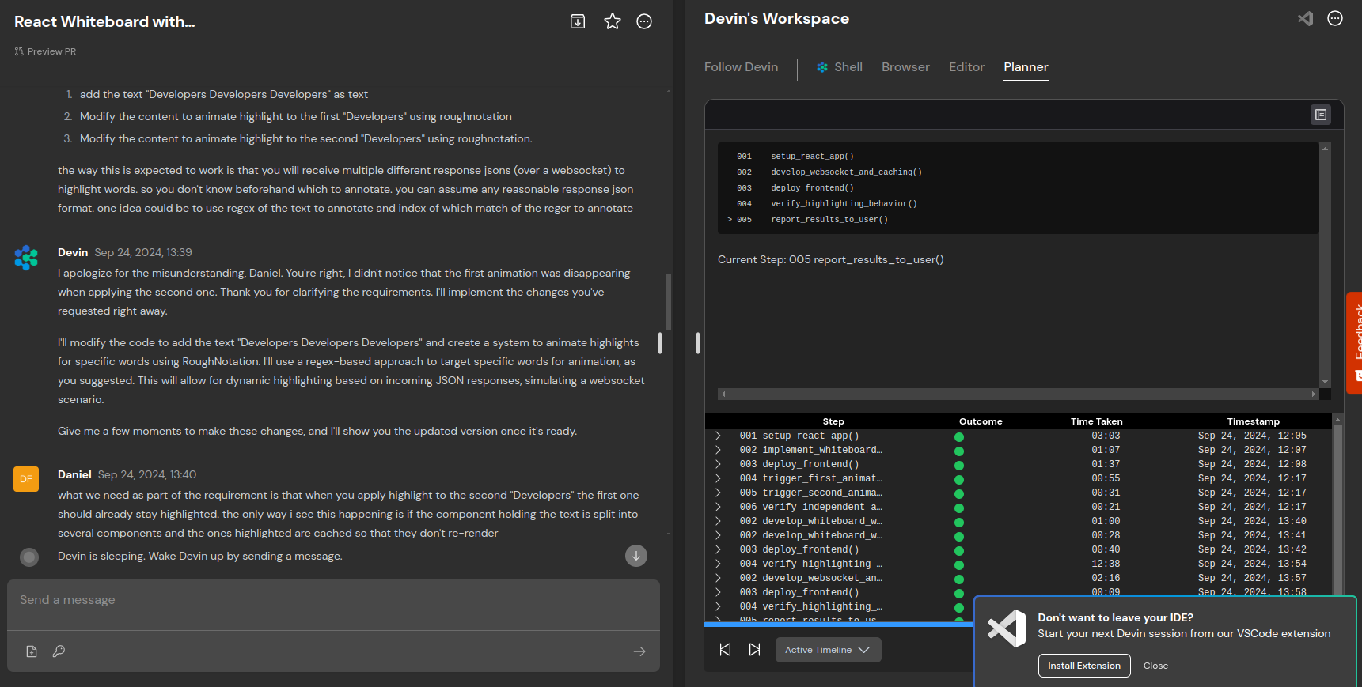
Open Source (alone) Isn’t the Answer
React with Devin (compare this with OpenROAD-flow-scripts …)
Easily broken-down subtasks
Predictable timeline of human feedback
Browser window/terminal responds to changes
Self-contained, modular changes
Notes:
Here is Devin working with React code. Every update changes what’s shown in the browser, so small tweaks are tested instantly. The plan is broken into clear steps, letting the human intervene with helpful feedback every few minutes.
By contrast, in OpenROAD or any PD tool, a small TCL change can affect the entire flow, with no easily visualizable result. Validating a change can take 30 minutes, and testing to final results could be 24 hours.
Basically, EDA isn’t built for rapid, incremental feedback. Our industry never saw a Bezos API Mandate that forced movement to modular, self-sufficient, inline documented API structures – and microservices – so now there is massive technical debt.
[1874 / 2316] = 13:10

Slide 21
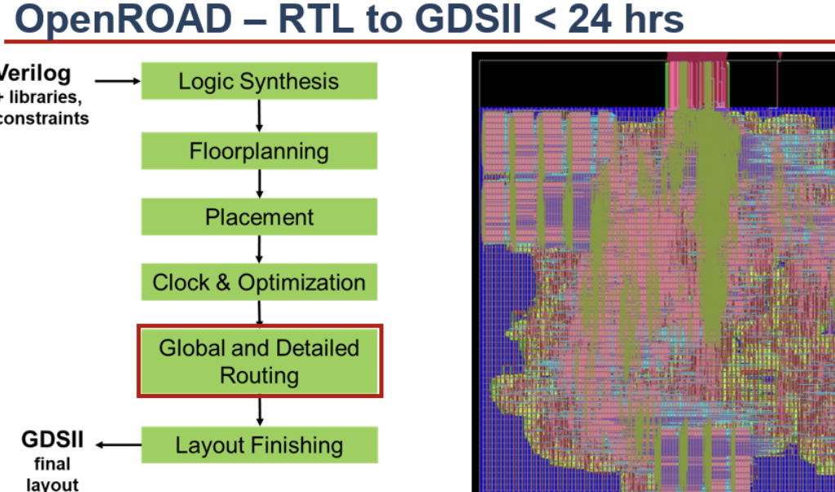
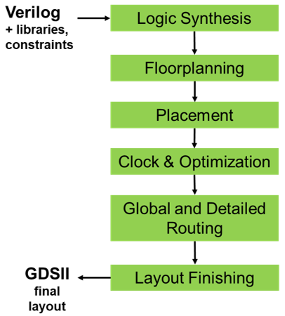
Roadblocks and Culture Clashes ☹
Trinity of roadblocks: Data, Integration, Modularity
  Large nested EDA structures (netlists, 5-box data model, etc.)
  Third-party black boxes: Yosys, ABC, etc.
  EDA “chains” tools together to make a flow
    Versus self-sufficient APIs that respond quickly
24 hrs = Fantastic for EDA !!!
24 hrs = Awful for an iterating
LLM-based agent !!!
And: Frictionless Reproducibility vs. Proprietary Outputs / No Benchmarking
Notes:
Here is my last “dark” slide, which recaps roadblocks and culture clashes called out in the paper.
There is a “trinity” of roadblocks: Data, Integration and Modularity.
Data refers to how EDA data – like netlist information at scale, or full specs – will be difficult to boil down to pure text and short, in-line strings.
Integration refers to the fact that open source EDA is not cutting edge, and vice versa: cutting edge EDA is not open source… When you see Yosys, ABC, OpenSTA etc. pulled together to make an ORFS, “monorepos” seem far away.
Then, modularity, which relates to latency. When a flow runs one step after another for days, it’s hard to debug with LLMs since chain of causation is not clear to the agent.
[CLICK] And there’s a culture clash between EDA, where 24 hours is short, and the codebases these LLMs are written for, where 20 seconds is a long time.
[CLICK] Recall this culture clash, as well.

Slide 22




And Yet …
Roadblocks and culture clashes notwithstanding: LLMs + EDA is receiving very active VC funding and attention !
Verilog Copilot
Test/Debug
Y Combinator CEO soliciting LLMs for chip design companies
General agents for chip design
Notes:
And Yet: there are many positives…! Especially, LLMs for EDA continue to get funding, which means that investors see paths to revenue that are likely to succeed despite the roadblocks we mention.
Verilog copilots such as Silimate are picking out the RTL stage of the flow, which helps avoid the modularity and latency roadblocks.
Silogy, Chipagents and many others are filling a demand from leading VCs to find LLM-based solutions to chip design. Accelerators like Y Combinator are also pushing this. So this is happening and it is obviously an exciting direction to watch.

Slide 23
Acknowledgments and Thanks
For “Deployment” content in a recent IEEE webinar
  Igor Markov and Thomas Anderson (Synopsys)
  Scot Weber (AMD)
  Rod Thorne and Steve Brown (Cadence)
  Siddhartha Nath (Intel)
  Tuck-Boon Chan (Qualcomm)
For organizing this special session
  Professor Youngsoo Shin (KAIST)
  ASP-DAC 2025 organizing committee
Notes:
Before concluding, here are acknowledgments and thanks.
First, to colleagues who gave inputs for a “Deployment” section in my IEEE webinar on AI for Chip Design – which was a precursor for this paper and talk.
And, to Professor Youngsoo Shin at KAIST and the ASPDAC committee for organizing this special session.

Slide 24
Summary
Data for AI/ML is still fraught, still top of mind
  Make Frictionless Reproducibility and the AI flywheel real !
  “Competitive Challenges” = baselines, benchmarks, culture change !
Deployment of AI/ML in physical design
  High-level precepts
  KPIs
  Checklists for data, models, outputs, …
LLM + EDA
  Trinity of roadblocks: Data, Integration, Modularity
  Deep culture clashes
And Yet …
  Many exciting possibilities and challenges (opportunities)
  Industry and investors are eager to see successes!
Notes:
So to summarize:
[CLICK] Data is still a fraught topic in EDA, and still the key enabler for machine learning.
We need Frictionless Reproducibility – and its public benchmarking challenge mindset implies culture changes.
For deployment of ML in production IC design, I went over high-level precepts, KPIs, and several important checklists.
[CLICK] Section 4 of the paper focuses on challenges for LLM deployment in EDA and IC design. There is a trinity of roadblocks – silo-ing, chaining black-box tools – the complete opposite of open-source monorepos and API-centered modularity that LLM copilots cater to.
[CLICK]
And Yet: We are living in very exciting times, this nexus of GenAI and EDA is moving fast – and both chip designers and investors are eager to see successes from this community!
Thank you for your attention! [2316 words]

Slide 25
Thank You

