Slide 1
PPA-Relevant Clustering-Driven Placement for Large-Scale VLSI Designs
Andrew B. Kahng¹, Seokhyeong Kang², Sayak Kundu¹,
Kyungjun Min², Seonghyeon Park², Bodhisatta Pramanik¹
[1] University of California San Diego
[2] Pohang University of Science and Technology
Notes:
Good afternoon, everyone. Thank you for joining this session. The title of my presentation is "PPA-Relevant Clustering-Driven Placement for Large-Scale VLSI Designs." This is a joint work between UC San Diego and POSTECH.

Slide 2
Agenda
Introduction
  Motivation
  Overview of our work
Our approach
  Overall framework
  PPA-aware clustering
  Virtualized place-and-route
Experimental results
Conclusion
Notes:
This is the outline for the presentation.
First, I will present our motivation and the overview of our work. Next, we provide details of our overall framework. After that, we discuss PPA-aware clustering and introduce virtualized place and route. Finally, I will present our results and conclude the presentation.

Slide 3
Motivation
Challenges of modern designs
Solution to the problem: clustering!
Limitation of traditional clustering: faster vs. better?
  Ignore design information affecting PPA outcomes
  Fail to improve both runtime and PPA when applied to the placement flow
    Clustering for placement runtime speedup → UCSD 2020
    Clustering for better PPA → GTech 2022
    Clustering for placement runtime speedup + better PPA → this work (UCSD + POSTECH)
Increased design
complexity & scale
Increased P&R
heuristics runtime
Tension between
TAT and PPA
Logical hierarchy, timing, switching activity, etc.
Notes:
Here is the motivation for our work. The complexity and scale of modern designs have increased significantly, leading to longer runtimes for traditional P&R heuristics. As a result, finding a balance between turnaround time and PPA has become a major concern. [CLICK]
To address this issue, we propose to use clustering. [CLICK]
However, with clustering comes the dilemma of faster vs. better. Traditional methods are cutsize based and ignore crucial PPA related information such as [CLICK] logical hierarchy, timing and power. More importantly, previous works [CLICK] have mostly used clustering to either improve PPA or runtime. The 2020 UCSD work proposes a modularity based clustering for global placement speedup with some QoR degradation. The 2022 Georgia Tech work proposes a ML-based clustering method to improve PPA at the expense of runtime.
[CLICK] In this work, our goal is to improve both PPA and runtime.

Slide 4
Overview of our work
Key contributions
  PPA-aware clustering
    Find PPA-relevant clusters by considering logical hierarchy + timing + switching activities
  Virtualized place-and-route (V-P&R)
    Estimate cluster shapes i.e., utilizations and aspect ratios
    Acceleration (~30X) with machine learning
Evaluation metrics
  Post-placement: HPWL, runtime
  Post-route: Final PPA (routed wirelength, WNS, TNS, power)
Improvement in both runtime and HPWL + final PPA
Notes:
Here is an overview of our work
[CLICK]
We make two contributions: PPA-aware clustering and Virtualized place-and-route.
PPA-aware clustering identifies high-quality clusters by considering hierarchy, timing and power. And virtualized place-and-route determines the shapes of the clusters.
[CLICK]
For evaluation, we compare the results of our clustering-based placement flow, at the post-placement and post-route stages. At the post-placement stage, we measure the HPWL and runtime, while at the post-route stage, we measure the final PPA.
Our approach can achieve better placement with faster runtime compared to standard default flows.

Slide 5
Agenda
Introduction
  Motivation
  Overview of our work
Our approach
  Overall framework
  PPA-aware clustering
  Virtualized place-and-route
Experimental results
Conclusion
Notes:
Now, I will talk about our overall approach in detail.

Slide 6
Overall framework
Estimate Shapes
Generate Clusters
Place Clusters
Evaluation metrics
*Red boxes indicate key highlights of this talk.
Notes:
The overall framework of our proposed clustering-based placement is shown here. Given a netlist, we first use [CLICK] PPA-aware clustering to generate clusters and create a clustered netlist. From the clustered netlist, we estimate the shape of each cluster [CLICK] using a methodology we term as virtualized-P&R. From the placement of the clustered netlist we generate a seed placement [CLICK]. We run the global placement with this seed and then evaluate the solution quality [CLICK].
The boxes highlighted in red are the main focus for today’s talk.

Slide 7
Logical hierarchy awareness
PPA-aware clustering
Virtualized P&R
Seeded placement
We introduce a hierarchy-based clustering that leverages OpenDB
Generate logical hierarchy tree with OpenDB
Convert logical hierarchy tree to a dendrogram
Levelize dendrogram using node replication
Pick clustering solution with lowest Rent’s parameter
* level_{max} = 3
TOP
Level 0 Clustering
TOP
A
B
X1
X2345
Level 1 Clustering
X1
C
D
X1
X23
X45
Replicated
Node
X2
X3
X4
X5
X1
X2
X3
X4
X5
Logical Hierarchy Tree
Levelized Dendrogram
Notes:
I will first talk about our PPA-aware clustering. We leverage the logical hierarchy into our clustering framework. Here is how we introduce hierarchy -awareness.
Given a netlist with a logical hierarchy, we generate a [CLICK] logical hierarchy tree with OpenDB. Then we interpret the hierarchy tree as the output of an agglomerative clustering and [CLICK] construct a dendrogram. To find clusters in this dendrogram, [CLICK] we levelize it first, by replicating leaf nodes.
Finally we evaluate several clustering solutions at different levels of the dendrogram using the Rent’s parameter [CLICK] and finally pick the solution with the lowest Rent’s parameter.

Slide 8
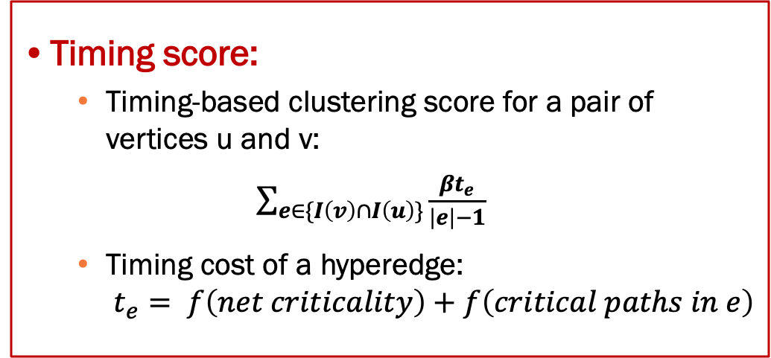
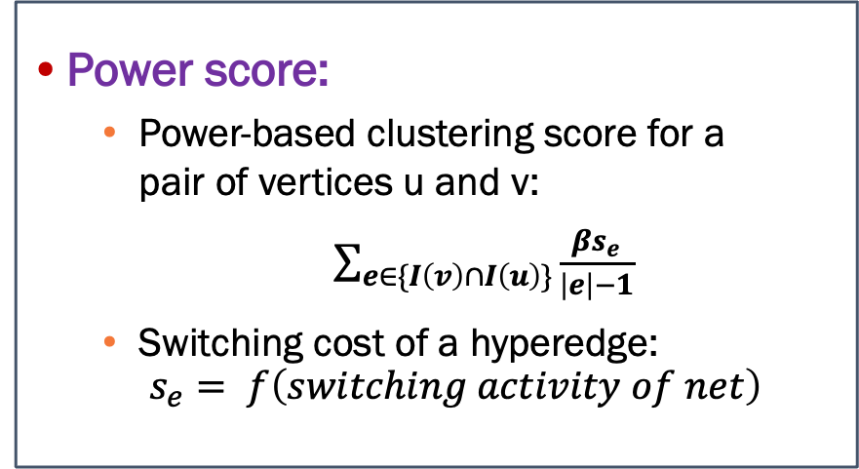
Timing and power awareness
PPA-aware clustering
Virtualized P&R
Seeded placement
Enhanced multilevel clustering: multilevel clustering + PPA-awareness
  Leverage TritonPart’s timing-driven multilevel clustering
  Leverage clusters from logical hierarchy → use grouping constraints
  Cluster score = connectivity score + timing score + power score
Timing score:
  Timing-based clustering score for a pair of vertices u and v:
  $\sum_{e∈\{I\left(v\right)∩I\left(u\right)\}}{\frac{βt_{e}}{\left|e\right|−1}}$
  Timing cost of a hyperedge:
  $t_{e}= f\left(net criticality\right)+f\left(critical paths in e\right)$
Power score:
  Power-based clustering score for a
  pair of vertices u and v:
  $\sum_{e∈\{I\left(v\right)∩I\left(u\right)\}}{\frac{βs_{e}}{\left|e\right|−1}}$
  Switching cost of a hyperedge:
  $s_{e}= f\left(switching activity of net\right)$
Cluster vertices connected by timing-critical nets (+ paths)
Cluster vertices connected by nets with high switching activity
Notes:
Next, we introduce timing and power awareness into the clustering process.
[CLICK] We leverage TritonPart’s timing-driven multilevel clustering. The clusters from the logical hierarchy are used as grouping constraints, meaning that vertices in the same hierarchy cluster are only considered for clustering together.
TritonPart’s clustering framework evaluates clustering candidates using a cluster score. We enhance this framework by augmenting it with a power score.
The timing score [CLICK], as shown on the left, remains the same as in TritonPart, where the idea is to cluster vertices connected by timing-critical nets or paths.
The power score [CLICK], shown on the right, is our addition. We extract the switching activities of all nets using vectorless power analysis with OpenSTA, employing the default tool settings. These switching activities are then considered for clustering. If two vertices share nets or hyperedges with high switching activity, they are very likely to be clustered together.

Slide 9
Virtualized place-and-route
PPA-aware clustering
Virtualized P&R
Seeded placement
Notes:
Once, the clusters are generated we have a clustered netlist. We next try to estimate the shape of these clusters. We do this with a step called virtualized P&R.

Slide 10
Cluster shapes affect PPA!
PPA-aware clustering
Virtualized P&R
Seeded placement
Cluster shape = utilization + aspect ratio
Virtualized Place-and-Route (V-P&R): run P&R for clusters on a virtual die
  Floorplan a virtual die with various aspect ratio + utilization combinations
  Pick the combination that yields the best PPA
Impact of cluster shapes on PPA
  Comparison of post-route TNS + power, for cluster shapes
  Shapes generated Randomly, Uniformly and V-P&R
R U Ours
R U Ours
R U Ours
R U Ours
TNS (ns)
Power (W)
TNS (ns)
Power (W)
Ariane
MegaBoom
Notes:
Before explaining the details of virtualized P&R, I would like to show that cluster shapes affect final PPA.
But how do we define a cluster shape? Well, it comprises of utilization and aspect ratio.
Our virtualized P&R estimates a cluster shape that typically leads to good PPA.
The idea is to run P&R on a virtual die, for a sub-netlist that is formed by the instances in a cluster. We try several aspect ratio and utilization combinations to first initialize the floorplan of the virtual die and then we run P&R on the sub-netlist. We then pick the combination which generates the best result.
[CLICK]
We next show the impact of cluster shape on post-route TNS and power. The results presented here are for the Ariane and Megaboom designs. Each bar represents the outcomes when the cluster shapes were generated randomly, uniformly, and using V-P&R. As seen in the graph, the shape of the clusters significantly affects post-route TNS and power. Therefore, determining the optimal shape of each cluster is crucial for optimizing PPA.

Slide 11
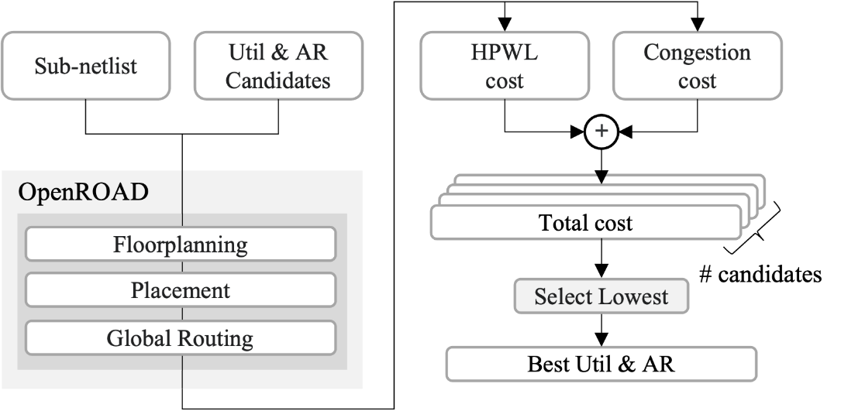
Virtualized place-and-route flow
PPA-aware clustering
Virtualized P&R
Seeded placement
Step 3.
Calculate “Total cost”
V-P&R flow
  Run P&R on sub-netlists induced by clusters on a virtual die
Step 1.
Convert cluster into sub-netlist
Step 2.
Run P&R
using OpenROAD
Notes:
Here is our complete V-P&R flow.
[CLICK]
We first convert the clusters into sub-netlist. A sub-netlist includes all cells and nets belonging to a cluster. Specifically, inter-cluster nets that are connected to other clusters are declared as ports of the sub-netlist.
[CLICK]
In the next step, we define 20 candidates of cluster shapes. For each candidate, we run P&R on the sub-netlist using OpenROAD. The virtual die is defined based on the utilization and aspect ratio of the candidate cluster shape.
[CLICK]
Finally, we calculate a cost function comprising of HPWL and congestion. A lower cost indicates a better candidate that will likely lead to lower HPWL and better congestion. We hence, pick the cluster shape candidate with the lowest cost and assign it to be the shape of that cluster.

Slide 12
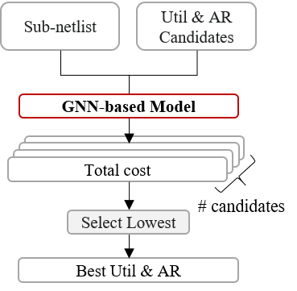
ML-accelerated V-P&R
PPA-aware clustering
Virtualized P&R
Seeded placement
V-P&R not scalable for large designs (more clusters)
ML-accelerated V-P&R
  Replace OpenROAD flow by predicting the total cost for each cluster shape candidate
  ~30x faster compared to naive V-P&R flow
Notes:
However, V-P&R suffers from scalability issues for large designs. To solve this [CLICK], we use machine learning to accelerate this process. ML-accelerated V-P&R replaces the part marked in red to predict the total cost for each cluster shape candidate. We extract 28 features for each cluster to predict the total cost and details of our ML model can be found in the paper. Overall our ML based implementation leads to a 30X faster runtime.

Slide 13
Seeded placement
PPA-aware clustering
Virtualized P&R
Seeded placement
Notes:
The last step of our flow is the seeded placement generation that generates an initial placement solution for the global placer.
[CLICK]

Slide 14
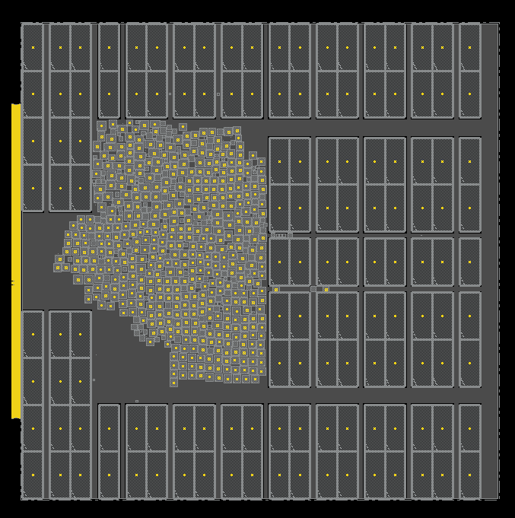
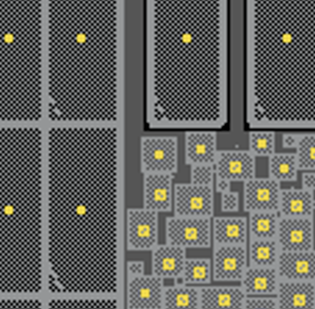
Seeded placement
PPA-aware clustering
Virtualized P&R
Seeded placement
Seed placement generation
  Cluster shapes updated in cluster .lef file
  Run placement with clustered netlist
  Determine the initial placement seed
    Centers of placed clusters become initial seeds for instances in the clusters
Run global placement with initial seed
Clusters!
Notes:
Once the shape of each cluster is determined, we [CLICK] create a cluster .lef file and then [CLICK] generate a placement of the clustered netlist.
[CLICK]
A seed placement is then generated from the placed clustered netlist. This seed placement is used as an initial seed for the global placer.
The figure on the right shows a clustered netlist placement. And here [CLICK] is a zoomed in snippet of a part of the placement. Here you can see the cluster cells.

Slide 15
Agenda
Introduction
  Motivation
  Overview of our work
Our approach
  Overall framework
  PPA-aware clustering
  Virtualized place-and-route
Experimental results
Conclusion
Notes:
Now I will present our experimental results.

Slide 16
Evaluation
Framework built on OpenROAD infrastructure
Designs from the MacroPlacement and OpenROAD repositories
  All designs use the NanGate45 open enablement
Evaluation done on OpenROAD and Innovus v.21.1
Design (NG45) | #Insts | #Nets | *TCP_OR | *TCP_Inv
aes | 15547 | 16338 | 0.55 | -
jpeg | 53042 | 58898 | 0.8 | -
ariane | 119256 | 142226 | 1.8 | -
BlackParrot (BP) | 768851 | 998716 | 2.3 | -
MegaBoom (MB) | 1086920 | 1443755 | NA | -
MemPool Group (MP-G) | 2729729 | 3087191 | NA | -
* TCP_{𝑂𝑅} and TCP_{𝐼𝑛𝑣} denote the target clock periods used in the OpenROAD and Innovus flows, respectively.
Notes:
We have developed our framework on the OpenROAD infrastructure. We use open designs from the MacroPlacement and OpenROAD repositories.
For evaluation, we report post-route PPA achieved using OpenROAD and Innovus version 21.1.
The table here shows the characteristics of the designs we have used for our evaluation. The target clock periods are masked to avoid any unintentional benchmarking of tools. The instance count in our test cases varies from 15K to 2.7M.

Slide 17
Evaluation: Post-place HPWL and runtime (OR)
Baseline(s): UCSD 2020 work [1] + default OpenROAD flow
  Results normalized to default OpenROAD flow
Compared to [1] and default OR flow:
  Up to 60% and 47% improvement in runtime respectively
  Up to 5% and 1% improvement in HPWL respectively
Design | [1] |  | Ours
 | HPWL | CPU | HPWL | CPU
aes | 1.007 | 1.567 | 1 | 0.802
jpeg | 0.973 | 1 | 1.011 | 0.524
ariane | 1.046 | 0.931 | 0.989 | 0.604
BlackParrot | 0.996 | 1.824 | 0.989 | 0.738
MegaBoom | NA | NA | 0.997 | 0.664
MemPool Group | NA | NA | 1.001 | 0.533
~1% HPWL improvement
~40% faster runtime
[1] Fogaça et al., On the superiority of modularity-based clustering for determining placement-relevant clusters, Integration 2020
Notes:
We first evaluate the post place HPWL and runtime benefits of our approach. For this we use as baselines the 2020 UCSD work and the default OpenROAD flow. All numbers in the table are normalized to the default OpenROAD flow. We see that for these designs we achieve improvements up to 60 and 47 % compared to the UCSD 2020 work and default OpenROAD respectively. For Ariane [CLICK] we get a 1% HPWL improvement with 40% faster runtime.

Slide 18
Evaluation: Post-route PPA (OR)
Baseline(s): default OpenROAD flow
  Results normalized to default OpenROAD flow
Actual numbers masked to avoid any possible
interpretation of our work as “benchmarking”
PPA improvements (%)
 | rWL | WNS | TNS | Power
Max. | 5 | 63 | 90 | 0.7
Avg. | 2 | 26 | 29 | 0.2
Design | Flow | Post-route PPA
 |  | rWL | WNS (𝑝𝑠) | TNS (𝑛𝑠) | Power (𝑊)
aes | Default | 1.00 | -1.00 | -1.00 | 1.00
 | Ours | 0.98 | -0.95 | -0.99 | 0.99
jpeg | Default | 1.00 | -1.00 | -1.00 | 1.00
 | Ours | 0.95 | -1.15 | -1.36 | 0.99
ariane | Default | 1.00 | -1.00 | -1.00 | 1.00
 | Ours | 0.99 | -0.50 | -0.10 | 1.01
BP | Default | 1.00 | -1.00 | -1.00 | 1.00
 | Ours | 0.99 | -0.37 | -0.39 | 1.00
~5% rWL improvement
~90% TNS improvement
Notes:
Here are the post-route PPA results with OpenROAD. Similar to the previous slide, all the numbers are normalized to the default flow.
For routed wirelength, we achieve an average improvement of 2%. For WNS and TNS we achieve average improvements of 26 and 29% respectively.
In particular, [CLICK] for aes, we get ~2% routed wirelength improvement and for ariane we get around 90% TNS improvement.

Slide 19
Evaluation: Post-route PPA (Innovus)
PPA improvements (%)
Baseline(s): default Innovus flow
  Results normalized to default Innovus flow
Actual numbers masked to avoid any possible
interpretation of our work as “benchmarking”
 | rWL | WNS | TNS | Power
Max. | 1.9 | 85 | 99 | 4
Avg. | 0.2 | 35 | 49 | 1
Design | Flow | Post-route PPA
 |  | rWL | WNS (𝑝𝑠) | TNS (𝑛𝑠) | Power (𝑊)
aes | Default | 1.00 | -1.00 | -1.00 | 1.00
 | Ours | 0.99 | -0.83 | -0.88 | 1.04
jpeg | Default | 1.00 | -1.00 | -1.00 | 1.00
 | Ours | 1.03 | -0.15 | -0.06 | 0.99
ariane | Default | 1.00 | -1.00 | -1.00 | 1.00
 | Ours | 0.98 | -0.87 | -0.55 | 0.99
BP | Default | 1.00 | -1.00 | -1.00 | 1.00
 | Ours | 1.07 | -0.99 | -0.99 | 1.00
~94% TNS improvement
~2% rWL improvement
Notes:
Here are the post-route PPA results with Innovus with all numbers normalized to the default Innovus flow. For routed wirelength, we achieve an average improvement of 0.2%. For WNS and TNS we achieve average improvements of 35 and 49% respectively.
In particular, [CLICK] for jpeg, we get ~94% rTNS improvement and for ariane we get around 2% rWL improvement.

Slide 20
Agenda
Introduction
  Motivation
  Overview of our work
Our approach
  Overall framework
  PPA-aware clustering
  Virtualized place-and-route
Experimental results
Conclusion
Notes:
Now, let me conclude my talk.

Slide 21
Conclusion
Improvement in Seed Placements
  PPA-aware clustering and ML-accelerated V-P&R for better seed placements
PPA-aware Clustering
  Clustering that considers logical hierarchy, timing and power
V-P&R Framework
  Estimates cluster shapes
  ML leads to 30× speedup
Improves both runtime and PPA
Future directions
  Improving power-awareness
  Clustering with no mistakes?
  Extension to GPU-based placers + 3D placement
Notes:
In conclusion, our PPA-aware clustering methodology considers logical hierarchy, timing and switching activity using a multilevel clustering framework.
Our ML-accelerated V-P&R estimates best aspect ratios and utilizations for each cluster, giving a 30X acceleration.
The PPA-aware clustering combined with the ML-accelerated V-P&R leads to improvement in both runtime and PPA.
[CLICK]
Some future directions include improvement of power awareness, better clustering that makes no mistakes, and finally extension to GPU-based placers and 3D placement.
That brings me to the end of my talk, thank you for your attention.

