Slide 1
An Effective Cost-Skew Tradeoff Heuristic for VLSI Global Routing
Andrew B. Kahng†, Shreyas Thumathy‡ and Mingyu Woo†
† UC San Diego, La Jolla, CA, USA
‡Canyon Crest Academy, San Diego, CA, USA
ISQED 2023
GitHub Repository: https://github.com/TILOS-AI-Institute/Multi-Source-Prim-Dijkstra
Notes:
Hello everyone.
My name is Shreyas Thumathy and I am a senior at Canyon Crest Academy in San Diego.
Thank you for the opportunity to present this work today on behalf of my coauthors Andrew Kahng and Mingyu Woo at UCSD.

Slide 2
Speaker Bio
Shreyas Thumathy is a senior at Canyon Crest Academy, a high school in North San Diego County.
He has been working with Professor Andrew Kahng's group at UCSD since he was a ninth-grader.
His interests include physical design algorithms, combinatorial optimization, and competitive programming.
Notes:
I have been working with Professor Andrew Kahng's group at UCSD since I was a ninth-grader.
My interests include physical design algorithms, combinatorial optimization, and competitive programming.

Slide 3
Outline
Background/Motivation
PD Characterization Results
Multi-Source Prim-Dijkstra (MSPD) Heuristic
MSPD Empirical Setup/Results
Multi-Source Selection (MSS) Heuristic
MSS Empirical Setup/Results
Conclusion
Notes:
This is the outline for today’s talk. First, I will go over the background and motivation to study our particular problem.

Slide 4
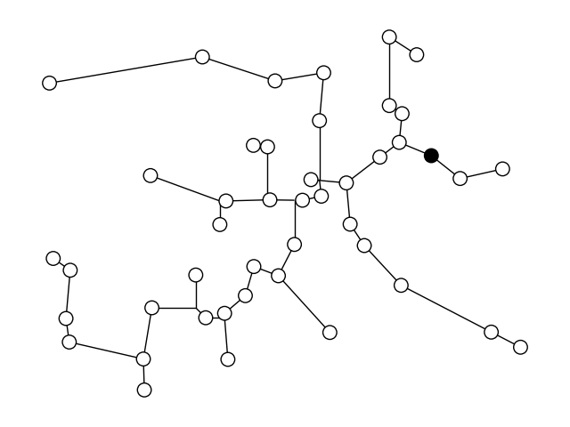
Background/Motivation
Prim-Dijkstra (PD) is a commonly used algorithm for routing tree construction
Optimizes between wirelength (WL) and pathlength (PL) using ⍺
⍺ is weight used to trade off between minimum spanning tree and shortest-paths tree constructions
⍺ = 0: the minimum spanning tree
Notes:
The Prim-Dijkstra (PD) algorithm, introduced in 1995, is widely used for VLSI routing tree construction.
Governed by the alpha parameter, the algorithm optimizes between wirelength (WL) and pathlength (PL).
alpha is a weight used to determine how much our output should resemble a minimum spanning tree and shortest paths tree.
[CLICK] When alpha = 0, PD outputs the minimum spanning tree for an input.

Slide 5
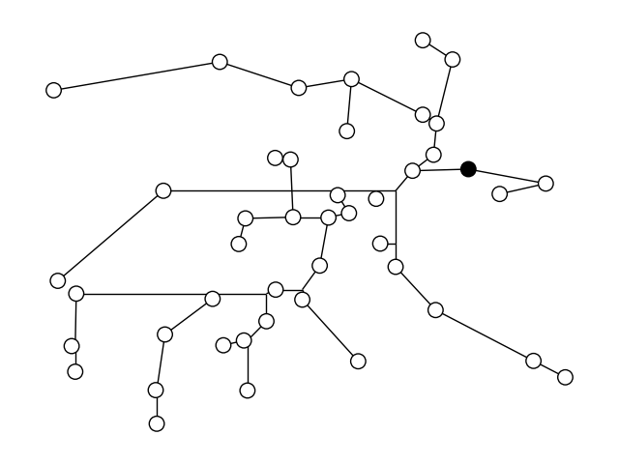
Background/Motivation
Prim-Dijkstra (PD) is a commonly used algorithm for routing tree construction
Optimizes between wirelength (WL) and pathlength (PL) using ⍺
⍺ is weight used to trade off between minimum spanning tree and shortest-paths tree constructions
⍺ = 1: the shortest-paths tree
Notes:
When alpha = 1, the output is a shortest paths tree.

Slide 6
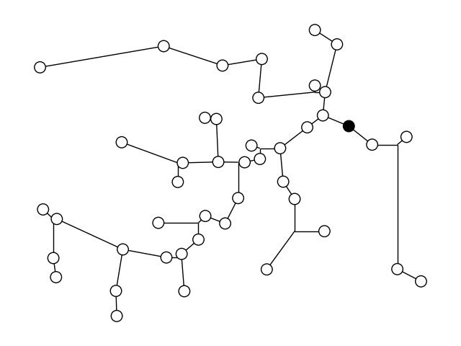
Background/Motivation
Prim-Dijkstra (PD) is a commonly used algorithm for routing tree construction
Optimizes between wirelength (WL) and pathlength (PL) using ⍺
⍺ is weight used to trade off between minimum spanning tree and shortest-paths tree constructions
⍺ = 0.3: tradeoff between minimum spanning and shortest paths trees
Notes:
When alpha is anything in-between zero and one, PD produces a tree that is a tradeoff between the shortest-paths and minimum-spanning trees.
In our example, we used alpha = 0.3 to produce the tree shown.

Slide 7
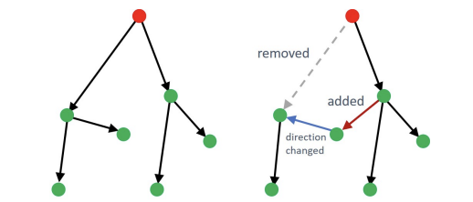
Background/Motivation
PD-II improves on WL and PL from PD using edge flipping
Further decreases WL using L-shape flipping (HVW)
Also improves detour cost using extra Steiner step, Detour-Aware Steinerization (DAS)
Continues to use the ⍺ parameter
An illustration of edge-flipping – a key component of the PD-II algorithm
Notes:
In 2018, PD-II was released. PD-II is a post-processing algorithm that
[CLICK] flips edges in order to further optimize the wirelength and pathlength tradeoffs for a PD tree.
PD and PD-II trees can further be improved in terms of wirelength and pathlength using Steinerization methods such as L-shape flipping (HVW),
and Detour-Aware Steinerization (DAS) – the latter of which was introduced in the same paper as PD-II.

Slide 8
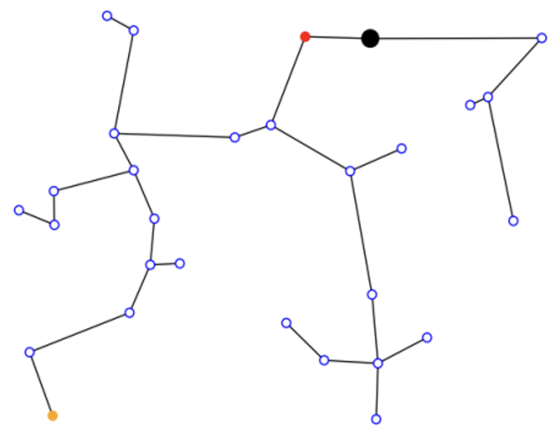
PD Ignores Skew ☹
Skew, the maximum difference in PLs, is important for chip performance
PD doesn’t consider skew, and thus produces very high skew trees
Black = root
Red = min PL from root
Orange = max PL from root
Example of a PD tree with terrible skew
8
Notes:
Skew, the maximum difference between pathlengths in a routing tree, is also an important metric for chip performance.
[CLICK]
Although PD and PD-II perform well for wirelength and pathlength tradeoffs, skew is ignored.
On the right, we can see an example of a PD tree.
The root is highlighted in black, and the vertices that have
[CLICK] minimum and maximum pathlengths from the root are highlighted in red and orange, respectively.
[CLICK] Although our minimum pathlength is very small, the maximum pathlength is too large – thus creating a very high skew value.

Slide 9
Outline
Background/Motivation
PD Characterization Results
Multi-Source Prim-Dijkstra (MSPD) Heuristic
MSPD Empirical Setup/Results
Multi-Source Selection (MSS) Heuristic
MSS Empirical Setup/Results
Conclusion
Notes:
Now, we will move onto our first study → PD characterization results with respect to normalized wirelength and normalized skew

Slide 10
PD Characterization Results
How does PD-II perform with respect to normalized WL (also called cost) and normalized skew?
We describe an input net using three parameters:
N (# of fanouts), AR (aspect ratio), and p (root location based on centrality)
0 <= p <= 1
p = 0 → root is at the center of bbox
p = 1 → root is at the edge of bbox
Notes:
We studied how the improved version of PD, PD-II, performs with respect to normalized wirelength (also called cost) and skew.
We normalized wirelength to minimum spanning tree wirelength, and normalized skew to shortest-paths tree skew.
We describe an input net using three parameters: N (the number of fanouts), AR (the aspect ratio of the bounding box) and p (the root location based on centrality)
[CLICK]
p is within the range 0 to 1.
If p = 0, that means that the root is at the center of the net’s bounding box.
If p = 1, that means that the root is at the edge of the bounding box.

Slide 11
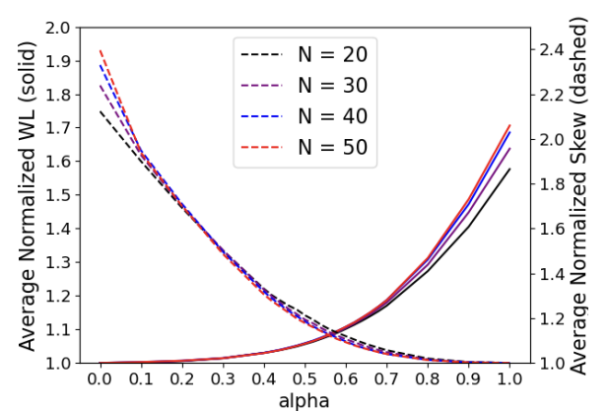
We Find a “Sweet Spot” for α
Notes:
For a fixed aspect ratio and root location, increasing N across various alpha values leads to higher normalized wirelength and skew.
Solid lines represent the average normalized WL reported for 1000+ randomly generated nets ([CLICK] labeled on left y-axis),
and the dashed lines represent the average normalized skew reported for 1000+ randomly generated nets ([CLICK] labeled on right y-axis).
We also note that both the dashed and solid lines meet when alpha is around 0.55.

Slide 12
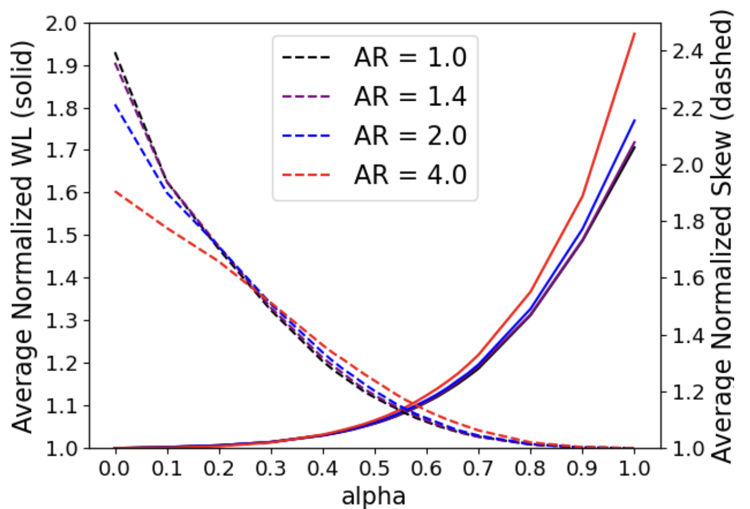
We Find a “Sweet Spot” for α
Notes:
For a fixed N and root location, increasing AR across various alpha values leads to higher normalized wirelength, but lower normalized skew
The sweet-spot of alpha = 0.55 still holds.

Slide 13
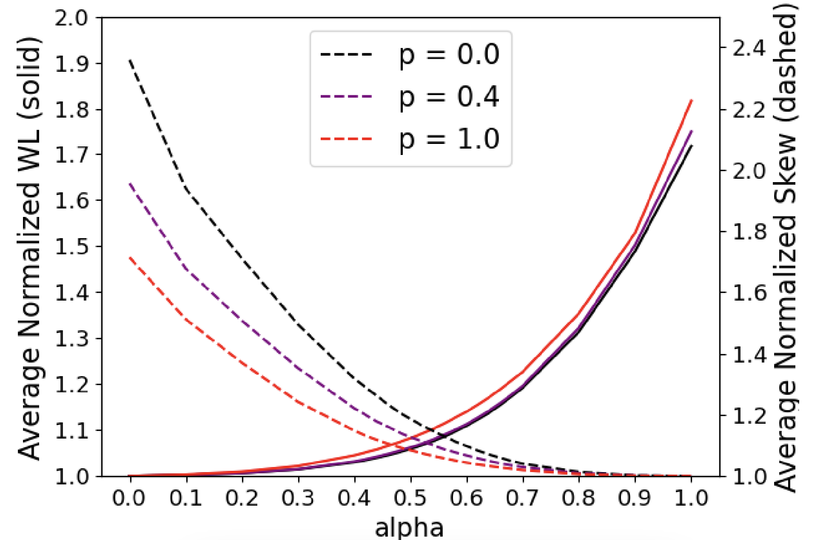
We Find a “Sweet Spot” for α
New Sweet Spot: ⍺ = ~0.55
Notes:
For a fixed aspect ratio and N, having the root deviate further from the center of the bounding-box (aka increasing p) across various alpha values leads to higher normalized wirelength, but a significant decrease in normalized skew values
[CLICK] Once again, we observe our sweet-spot of alpha = around 0.55.

Slide 14
Outline
Background/Motivation
PD Characterization Results
Multi-Source Prim-Dijkstra (MSPD) Heuristic
MSPD Empirical Setup/Results
Multi-Source Selection (MSS) Heuristic
MSS Empirical Setup/Results
Conclusion
Notes:
Now, onto our main contribution – the Multi-Source Prim-Dijkstra Heuristic

Slide 15
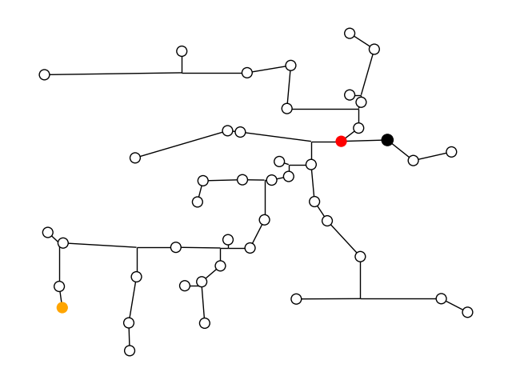
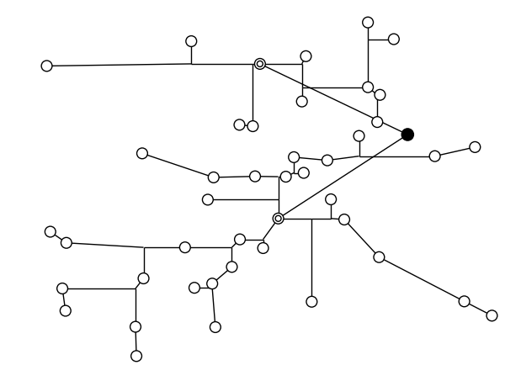
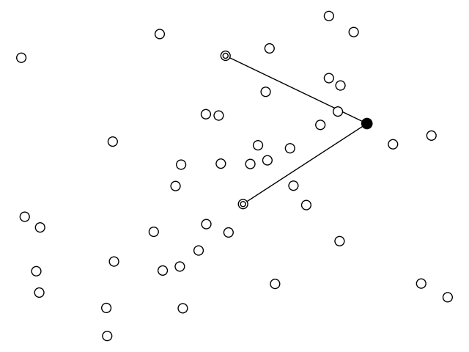
New Construction: Multi-Source Prim-Dijkstra (MSPD)
Source 2
Source 1
Original PD tree
New Multi-Source PD tree
“Teleporting” away from the root helps prevent short edges incident to the root
Notes:
The key difference between PD and our new, modified, PD is that our heuristic allows us to teleport away from the root in order to prevent short edges incident to the root.
The left-hand side shows the PD output for some input net.
In our multi-source PD algorithm, we select one to three vertices to initially connect to the root.
In this case, we select two (shown with double circles), and [CLICK] connect them directly to the root.
Then, we continue on with the PD algorithm, treating these sources as the roots of our tree
[CLICK] and get the following output.
[CLICK][CLICK]

Slide 16
Combinations of Multi-Sources for MSPD
Let R be the number of possible 0-, 1-, 2- and 3-source combinations possible for any input with N terminals, i.e., N – 1 sinks
Let R’ be the number of possible source and alpha combinations, where ⍺ = {0, 0.1, 0.2, …, 1.0}
Example: N = 45 → R = 14,235; R’ = 156,585
Challenge: How to efficiently find a good combination of sources?
$$R=1+\left({N−1 \atop 1}\right)+\left({N−1 \atop 2}\right)+\left({N−1 \atop 3}\right)$$
$$R^{′}=11 ∗ R$$
Notes:
How many combinations of sources are there?
Let N be the number of terminals in our input net. Since having the root as a source does not make sense, there are N-1 single sources that are possible.
So, {(N - 1) choose 1} plus {(N - 1) choose 2} plus {(N - 1) choose 3} would be the total number of one to three source combinations. We will add one to this value to account for just a normal PD tree (with no sources).
Let’s call this sum R.
[CLICK]Now, let’s introduce R’, the total number of source and alpha combinations. We will look at all alphas within the range [0, 1], incrementing by 0.1, so that’s a total of 11 alpha values. R’ would just be equal to 11 * R.
[CLICK] When N equals 45, R is 14,235 and R’ is 156,585.
So, how do we efficiently find good combinations of sources?

Slide 17
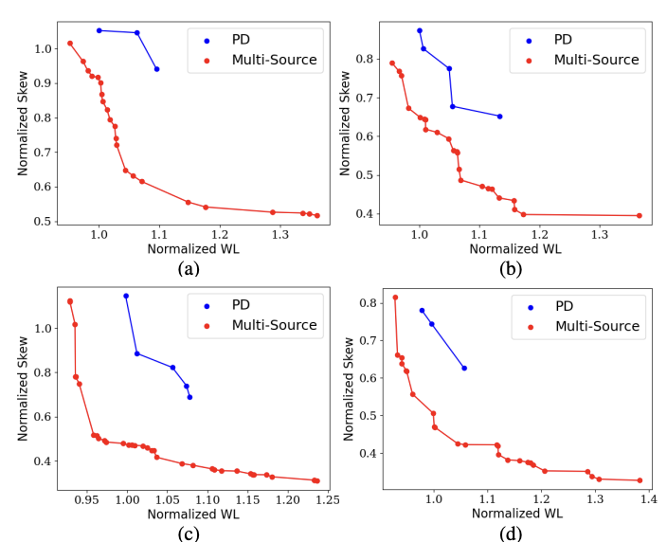
MSPD Produces Dominating Cost-Skew Tradeoff !
Our study: Generate all possible combinations of 0, 1, 2, and 3 sources, and run PD for all α values
MSPD gives a much better cost-skew tradeoff
But: How can we efficiently find a good combination of sources?
Results for four random pointsets with 45 terminals
Notes:
We show MSPD performance relative to PD for four random pointsets with N=45.
We normalized wirelength to MST wirelength. Similarly, we normalized skew to SPT skew.
[CLICK] [CLICK] Clearly, MSPD outperforms PD by a large margin.
[CLICK] But, how do we efficiently find good combinations of sources that result in good trees?

Slide 18
Outline
Background/Motivation
PD Characterization Results
Multi-Source Prim-Dijkstra (MSPD) Heuristic
MSPD Empirical Setup/Results
Multi-Source Selection (MSS) Heuristic
MSS Empirical Setup/Results
Conclusion
Notes:
Let’s go over the experimental setup and results for our MSPD heuristic.

Slide 19
MSPD Empirical Setup/Results
T = # of random input nets
All points are generated within a [0…1000] x [0…1000] bounding box (bbox)
STT ← Prim-Dijkstra Steiner tree code in The OpenROAD Project
N = [10, 15, 25, 30, 40, 45, 50] x T = 5000
PDRev ← ISPD-2018 code open-sourced by the PDRev authors
N = [10, 15, 25, 30] x T = 1000
N = [40, 45, 50] x T = 500
Note: HVW implementation in OpenROAD has an exponential runtime to PD tree depth → we limit T for higher N
All code in GitHub: https://github.com/TILOS-AI-Institute/Multi-Source-Prim-Dijkstra
Notes:
All points generated were guaranteed to be within an [0 to 1000] by [0 to 1000] bounding box.
For the STT implementation of MSPD, we collected 5000 random nets for N = [10, 15, 25, 30, 40, 45, and 50].
For the PDRev implementation, we collected 1000 random nets for N = [10, 15, 25, and 30], and 500 random nets for N = [40, 45, and 50].
[CLICK] Regarding PDRev, we decided to reduce the number of random nets (T) for larger values of N since one of the Steinerization steps, HVW, has an exponential runtime to PD-tree depth. This runtime, coupled with how large R’ can get, can create roadblocks for efficiently gathering data.
[CLICK] All of our code is open-sourced on the TILOS GitHub.

Slide 20
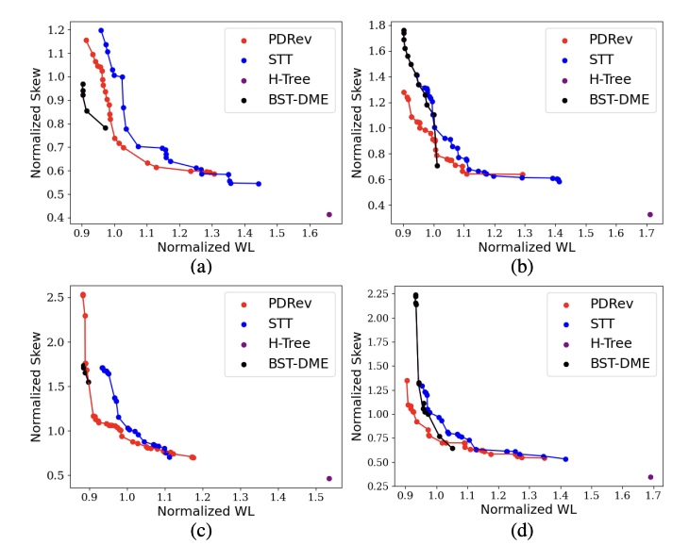
MSPD vs. BST-DME vs. H-Tree
H-Tree: Low skew but high cost
Shown: k = 2 levels
BST-DME: Bounded-Skew Tree DME (Deferred-Merge Embedding)
MSPD can give superior cost-skew tradeoff than BST-DME
Using PDRev (red Pareto) gives stronger results
Using STT (blue Pareto) is faster and more practical
MSPD performance for four random nets with N = 45
Notes:
We compare the MSPD STT and MSPD PDRev solutions to BST-DME and H-Tree with 2 levels for four random nets with N = 45.
MSPD PDRev seems to outperform BST-DME for a large portion of the Pareto curves.
[CLICK] MSPD STT and PDRev usually intersect the BST-DME Pareto somewhere, and sometimes produces even better results.
[CLICK] MSPD PDRev and MSPD STT also produce solutions that neither H-Tree or BST-DME are able to achieve.
Overall, MSPD PDRev and STT produce very good solutions to the cost-skew problem both efficiently and effectively.

Slide 21
PDRev and R'
MSPD PDRev can be very time-consuming
HVW = exponential runtime
This motivates us to find ways to reduce R’ ← Next contribution of our work
Alternatively, we can:
Not use HVW → find another Steiner method
Find ways to optimize HVW
Notes:
There’s one flaw … PDRev and R’ don’t mix well.
One of PDRev’s Steinerization steps, HVW, has an exponential runtime with respect to PD-tree depth.
This is really bad. And since R’ grows very quickly with respect to N, MSPD PDRev is almost unusable.
The runtimes of a single call to STT and PDRev (with or without MSPD) are said to be O(N^2), but PDRev seems to be inconsistent with the claim given its variable factor of tree-depth.
This motivates us to find ways to reduce R’
Alternatively, we can not use HVW or find ways to optimize HVW, but we will not focus on this in our work.

Slide 22
Outline
Background/Motivation
PD Characterization Results
Multi-Source Prim-Dijkstra (MSPD) Heuristic
MSPD Empirical Setup/Results
Multi-Source Selection (MSS) Heuristic
MSS Empirical Setup/Results
Conclusion
Notes:
Now, I will discuss our method of reducing the number of source combinations that need to be tried in order to find a good result.

Slide 23
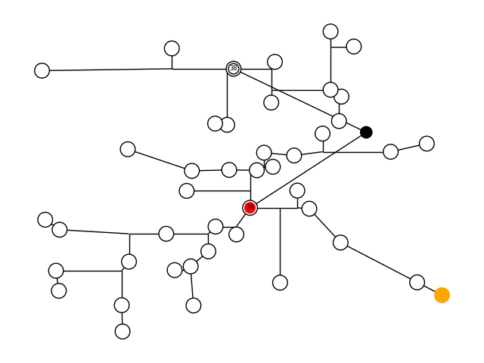
Multi-Source Selection (MSS) Heuristic
Good Potential Sources:
Near center of a net’s bounding box
In high-density clusters of other points
Vertex 39 is very close to the center of the bbox
Vertices 38 and 39 are surrounded by many other points
Vertex 38
Vertex 39
Optimal sources for given net, N = 45
Notes:
After observing thousands of MSPD trees that produced very good cost-skew tradeoffs, we started to see some patterns in source locations.
Good sources were often found near the center of a pointset’s bounding box. In the figure, [CLICK] Vertices 38 and 39 produced the lowest sum of normalized wirelength and normalized skew (along with some alpha value). [CLICK] 39 is very close to the center of the bounding box.
We also noticed that good sources were often found near clusters of many points. In the example above, [CLICK] 38 and 39 are both in close proximity to many other points.
These two observations fuel our heuristic of reducing R’ – the Multi-Source Selection (MSS) heuristic.

Slide 24
New Variables
We introduce the 𝝺 and 𝝹 variable
𝝺 = # vertices to consider for sources
Allows for control over computational expense in MSS heuristic
𝝹 = # of closest neighbors per vertex
How do we define a high-density cluster?
Notes:
For our heuristic, we introduce some new variables for control over computational expense and time –
Lambda - the number of vertices to consider for source combination generation
And Kappa - the number of vertices we should examine to determine how close a certain vertex is to other points.

Slide 25
MSS Rundown
Add all the vertices (except the root) to a set S
Until |S| <= 𝝺:
Find the closest pair of vertices in S
Remove the vertex with the higher average distance to its 𝝹 closest neighbors
Add the ”center-most” point into S:
Find the center C of the bbox
The ”center-most” point is the vertex which has a minimum distance to C
Find all MSPD trees using the vertices in S for source combinations
Notes:
First, we populate the empty set S with all vertices (except the root)
Until the size of S is equal to our desired lambda value, we find the closest pair of vertices in S and then remove one of them using the following criteria:
(a) Find the average distance to the closest kappa vertices for the two vertices.
(b) Remove the one with the higher average, as this implies that our vertex is far apart from other points.
[CLICK]
We then add the center-most point into S by finding the vertex with the minimum Manhattan distance to the dead-center of the bounding box.
[CLICK]
Finally, we find all MSPD trees using the vertices in S for source combinations.

Slide 26
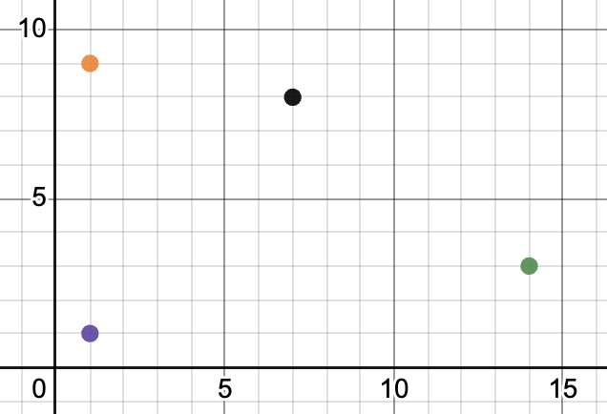
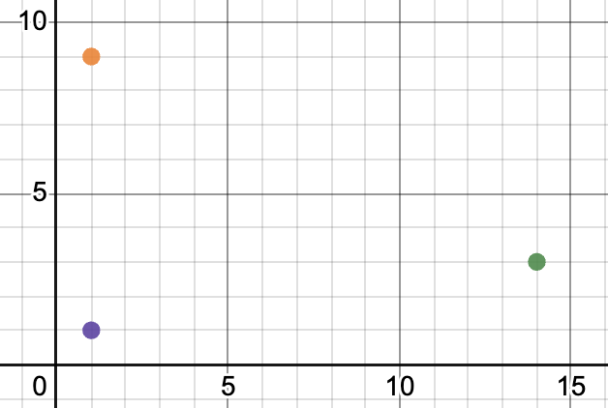
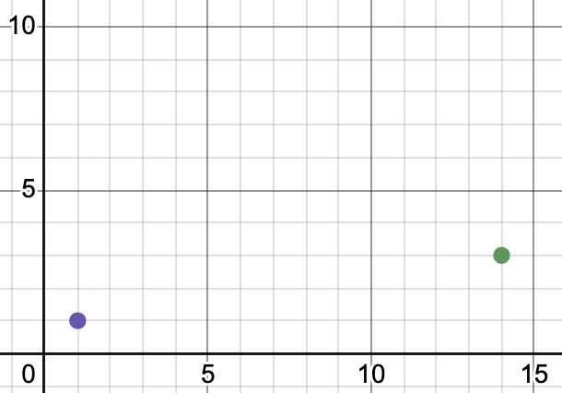
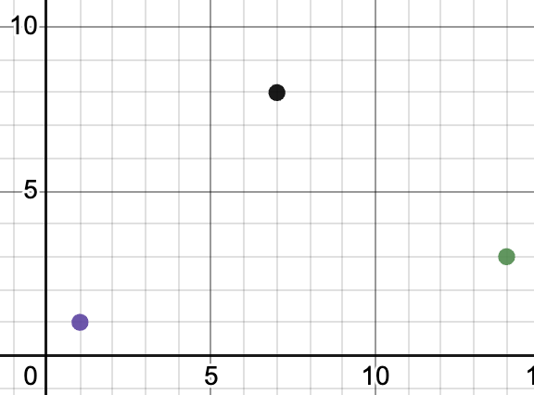
MSS Example
Example: 𝝺 = 2 and 𝝹 = 2
Let d_{v} = vertex v’s average distance to 𝝹 of its closest neighbors
Initial: All potential vertices except the root are in S
Iteration 1: black and orange are the closest pair; remove black from S since d_{black} > d_{yellow}
Iteration 2: orange and purple are the closest pair; remove orange from S since d_{orange} > d_{purple}
Final Modification to S: Add center-most point to S (in this case, the black vertex)
Notes:
Example: We have a random net of 5 vertices (the root is not shown); so, we have 4 potential source candidates at the moment.
We will see how MSS filters for potential good sources for lambda = 2 and kappa = 2.
All vertices except the root are in S before running the MSS heuristic.
[CLICK] In the first iteration of removing elements until the size of S is lambda, we find the closest pair of vertices in S. For now, this pair contains the black and orange vertices.
[CLICK] We remove the black vertex since its average distance to its kappa closest neighbors is greater than the orange vertex’s average distance.
[CLICK] For the second iteration, orange and purple are the closest vertices.
[CLICK] We remove the orange vertex since its average distance is greater than the purple vertex’s average distance to its kappa closest neighbors.
Now, the size of S is lambda, so we stop iterating.
[CLICK] We finally look through all the vertices in our input net to find the center-most point. In this case, this is the black vertex.
[CLICK] Finally, we append the black vertex to S.

Slide 27
Outline
Background/Motivation
PD Characterization Results
Multi-Source Prim-Dijkstra (MSPD) Heuristic
MSPD Empirical Setup/Results
Multi-Source Selection (MSS) Heuristic
MSS Empirical Setup/Results
Conclusion
Notes:
We will now describe the empirical setup and results of our MSS heuristic.

Slide 28
MSS Empirical Setup/Results
We ran the MSS heuristic for all nets generated in MSPD studies
We evaluate the MSS heuristic produced tree using two metrics:
J%
Rank all MSPD trees in non-decreasing order of solution cost.
The best (lowest cost) MSS-produced tree has a J% suboptimality if it ranks within J% (percentile) of all MSPD tree solutions.
K%
Percent increase in the best MSS-produced tree w.r.t. best MSPD-produced tree.
Notes:
We implemented MSS for both STT and PDRev.
We ran all the inputs generated for MSPD with MSS.
We then evaluated the quality of our MSS trees using two metrics: J% and K%.
[CLICK] J% is the ranking of our MSS-produced tree with respect to all MSPD trees. We sort all MSPD trees in non-decreasing order of solution cost -- the sum of normalized wirelength and skew . We then see what percentile our MSS-produced tree falls in this ranking.
[CLICK] K% is a direct suboptimality measure of the best (aka lowest) MSS produced tree solution cost and the best MSPD tree solution cost. Our MSS tree solution cost is K% higher in solution cost than the best MSPD tree solution cost.

Slide 29
MSS Results
For a fixed 𝝹 and fixed |V| (net size), increasing 𝝺 decreases both K% and J%
For a fixed 𝝹 and fixed 𝝺, increasing |V| decreases J% but increases K%
For a fixed 𝝺 and fixed |V|, increasing 𝝹 decreases both K% and J%
Results for 𝝹 = [1, 2, 4, 8] x 𝝺 = [1, 2, 3, 4]:
Generally, K% <= 6%
Generally, J% <= 1%
For more detailed results, please look at Table III from our paper
Notes:
We tested our MSS heuristic for all kappa = [1, 2, 4, and 8] crossed with lambda = [1, 2, 3, and 4].
We observed the following:
For a fixed size of input and kappa, we observed that increasing lambda results in lower J% and K% metrics (as expected since we search more source combinations).
[CLICK] For a fixed lambda and kappa, increasing the input size resulted in a decrease in J% but an increase in K%.
[CLICK] For a fixed size of input and lambda, increasing kappa also seemed to result in lower J% and K% metrics.
[CLICK] For both the STT and PDRev implementations of MSS, we observed that the average K% and J% metrics across all nets of size N were generally less than [CLICK] 6% and [CLICK] 1%, respectively.
[CLICK] For more detailed results, please look at Table III from our paper.

Slide 30
Runtimes
Runtimes are shown for 𝝹 = 4 and 𝝺 = 2 → ~88 calls to MSPD
Exponential complexity of PDRev’s HVW contribute to runtimes of 100+ seconds for 50 fanouts
STT runtimes are very reasonable: 𝝺 can be increased without any issue
N | 25 | 30 | 40 | 50
Average Runtime using PDRev (s) | 18.09 | 28.88 | 56.89 | 117.04
Average Runtime using STT (s) | 0.06 | 0.09 | 0.19 | 0.34
Notes:
The runtimes for our MSS heuristic were also pretty efficient, given the runtimes of both PDRev and STT.
For lambda = 2 and kappa = 4, we observed runtimes within half a second for STT for up to 50 fanouts. So, increasing lambda for higher quality of results won’t be an issue.
For PDRev however, runtimes were well beyond 10 seconds – we recorded an average of 18.09 seconds across 100 random nets of size 25, and an average of 117.04 seconds across 100 random nets of size 50.
These observed runtimes are inconsistent with the claim that PDRev has a runtime of O(N^2). Clearly, the source code of PDRev has some faults.

Slide 31
Outline
Background/Motivation
PD Characterization Results
Multi-Source Prim-Dijkstra (MSPD) Heuristic
MSPD Empirical Setup/Results
Multi-Source Selection (MSS) Heuristic
MSS Empirical Setup/Results
Conclusion
Notes:
Now, for our conclusion.

Slide 32
Conclusion
PD Characterization Results
To our knowledge, we have presented the first study on cost-skew tradeoffs for the PD-II algorithm
We note a new sweet-spot of ⍺ = ~0.55 for cost-skew construction
Multi-Source Prim-Dijkstra (MSPD) Heuristic:
An efficient and effective method of tackling cost-skew tradeoffs in routing trees
Achieved with a simple modification to the PD algorithm
Multi-Source Selection (MSS) Heuristic:
Finds potential good sources to cut down on MSPD’s computation expense
Future Work
Machine learning to identify good multi-sources: MSPD Contest launches today!
https://github.com/TILOS-AI-Institute/Multi-Source-Prim-Dijkstra/tree/main/contest
Reducing PDRev runtimes for reliability
Notes:
Our work provides characterization results of the PD-II algorithm to help researchers estimate normalized cost and skew for a random pointset with N fanouts.
The characterization results are based on the following input parameters: pointset bounding box aspect ratio, N, the alpha used for PD-II, and root location.
[CLICK] We also present two heuristics in our work:
MSPD – a new routing tree construction that makes a simple modification to the PD algorithm in order to achieve impressive cost-skew tradeoffs.
MSS – a method of reducing the computational time and expense required by MSPD, while still generating trees with good cost-skew tradeoffs.
[CLICK] For the future –
we hope our work provides a stable foundation for further studies on how to effectively and efficiently reduce the search space (R’) for MSPD.
In order to accelerate this forward progress, we have launched a new Machine Learning contest with over $7000 in prizes available -- please see the TILOS-AI Institute's GitHub repository, Multi-Source-Prim-Dijkstra
We have also identified runtime problems with PDRev, which we hope to see fixed.

Slide 33
Thank You !
Notes:
Thank you very much for your attention!

