Slide 1
Assessment of Reinforcement Learning for Macro Placement
Chung-Kuan Cheng^{[1]}, Andrew B. Kahng^{[1][2],} Sayak Kundu^{[2]}, Yucheng Wang^{[1]} and Zhiang Wang^{[2]}
^{[1]}CSE and ^{[2]}ECE Departments, UC San Diego
GitHub: https://github.com/TILOS-AI-Institute/MacroPlacement
Notes:
Hello and on behalf of my coauthors, thank you for watching this video. This talk is about our “MacroPlacement” effort.

Slide 2
Why MacroPlacement ?
June 2021: Google Brain Nature paper proposed RL-based macro placer
Claimed superior or comparable macro placement solutions compared to human experts, in under six hours
Did not release code or data as had been committed
January 2022: Google Research open-sourced Circuit Training (CT)
“reproduces the methodology published in the Nature 2021 paper”
No dataset, and insufficient code to reproduce the Nature results
March 28, 2022: “Stronger Baselines” manuscript posted during ISPD-22
States shortcomings of the Nature paper
Also lacks code and dataset to reproduce results or confirm claims
MacroPlacement: open, transparent assessment of Nature, CT
Goal: resolve controversy; foster calm discussion and scientific progress
June 2022: MacroPlacement repository open-sourced
Notes:
Why MacroPlacement?
Google Brain’s June 2021 Nature paper stated that their RL-based macro placement method could generate chip floorplans superior or comparable to those produced by humans, in under six hours.
In January 2022, Circuit Training was released -- which “reproduces the methodology published in the Nature paper”.
[CLICK] During ISPD last year, a “Stronger Baselines” manuscript was posted, stating shortcomings of the Nature paper.
[CLICK] However, neither Circuit Training nor Stronger Baselines published sufficient code and datasets to reproduce their claims.
[CLICK] The ongoing controversy motivated us to pursue an open, transparent assessment of the Nature paper’s RL-based macro placement approach.

Slide 3
Circuit Training (CT): Important Surprises and Gaps
Surprise: CT uses placement information from its input
Nature paper does not mention this
Ablation: use of placement info reduces routed wirelength by 7-10%
CT optimizes proxy cost during training
RL agent places hard macros on gridded canvas
Stdcell clusters placed using force-directed (FD) placer
Proxy cost ($R$) is then evaluated:
$$R=Wirelength+γ×Density+λ×Congestion$$
Gap: key elements hidden behind plc_client APIs
FD placer, proxy cost calculation
We reverse-engineered these and released as open source
Thanks to the TensorFlow Agents team for open-sourcing the grouping and training flows in the CT repository, and to Google Brain engineers for extensive Q&A and checking !
Placed Netlist
LEF / DEF to
Protobuf converter
Gridding
CT Grouping Flow
Grouping
Clustering
CT Training
Final Macro
Placement Solution
Notes:
Our study of CT revealed important surprises and gaps.
The biggest surprise: [CLICK] CT assumes that the input is a placed netlist – and it leverages this placement information in the CT Grouping Flow. The Nature paper does not mention this, but it matters a lot: using the placement information reduces wirelength by 7 to 10 percent!
[CLICK] Also, CT’s RL training optimizes a proxy cost. The RL agent places the macros one by one on the gridded canvas, then places standard-cell clusters using a force-directed placer, then computes proxy cost which has wirelength, density and congestion components. A major gap is that the FD placer and proxy cost calculation are hidden behind APIs. So we reverse-engineered these and open-sourced the implementation.
[CLICK] Many thanks to the TF Agents team for their work to open-source CT, and to Google Brain for extensive help and confirmations.
[[ grouper.py open-sourced on July 15, 2022 – confirms use of placement information from physical synthesis ! ]]

Slide 4
Scope of MacroPlacement
Code: Includes open-source implementation of missing, blackbox elements of CT
Missing elements: Format translators, Baselines for comparison (simulated annealing, human expert)
Blackbox elements: force-directed placement, proxy cost components
Modern benchmarks: Open testcases on open enablements
Testcases (#macros, #insts): Ariane (133, 117K), BlackParrot (220, 769K), MemPool Group (324, 2729K), NVDLA (128, 156K)
Enablements: SKY130HD+FakeStack, NanGate45, ASAP7+FakeRAM
Reproducible results with commercial synthesis, place and route evaluation flow
Cadence Genus iSpatial physical synthesis flow and Cadence Innovus P&R flow
Synopsys Design Compiler Topographical physical synthesis flow
Major changes in EDA vendor policies allow us to share our Tcl scripts in GitHub for research purposes! ← Kudos and thanks to Cadence and Synopsys !!!
Extensive documentation and data: See FAQs, Docs, “Our Progress”
*Simulated annealing is implemented following the description in the “Stronger Baselines” manuscript
Notes:
The scope of MacroPlacement includes source code for the reverse-engineered elements, and
[CLICK] new macro-heavy, modern testcases on three open enablements.
[CLICK] We give reproducible results with a commercial evaluation flow that includes Innovus P&R and both major physical synthesis tools. We thank Cadence and Synopsys for revising their policies and making it possible for us to share Tcl scripts in GitHub for research purposes.
And there is extensive documentation and data and a timeline of progress, as well.

Slide 5
CT, SA and Human results for Modern Benchmarks
*Routed Wirelength
*TNS
Proxy Cost
CT
Human
SA
SA
CT
CT
SA
Human
Human
*postRouteOpt metrics
Normalized routed wirelength, proxy cost, and TNS → Lower values are better
All data is normalized to CT results
More details: Table 1 of our paper
For postRouteOpt metrics, Human outperforms CT for macro-heavy BlackParrot, MemPool Group
Notes:
These plots show normalized wirelength, total negative slack and proxy cost for Ariane, BlackParrot and MemPool group on NanGate45 and commercial GF12 enablement. Data are normalized to the CT result.
Among CT, SA and Human:
[CLICK] For routed wirelength, Human produces the best result in 4 cases and SA in 2 cases;
For [CLICK] TNS, CT and SA each win one case, while Human wins three;
And for [CLICK] proxy cost, CT is best in two cases while SA is best in four cases.
[CLICK] Human experts outperform CT for the macro-heavy designs: BlackParrot and MemPool Group.

Slide 6
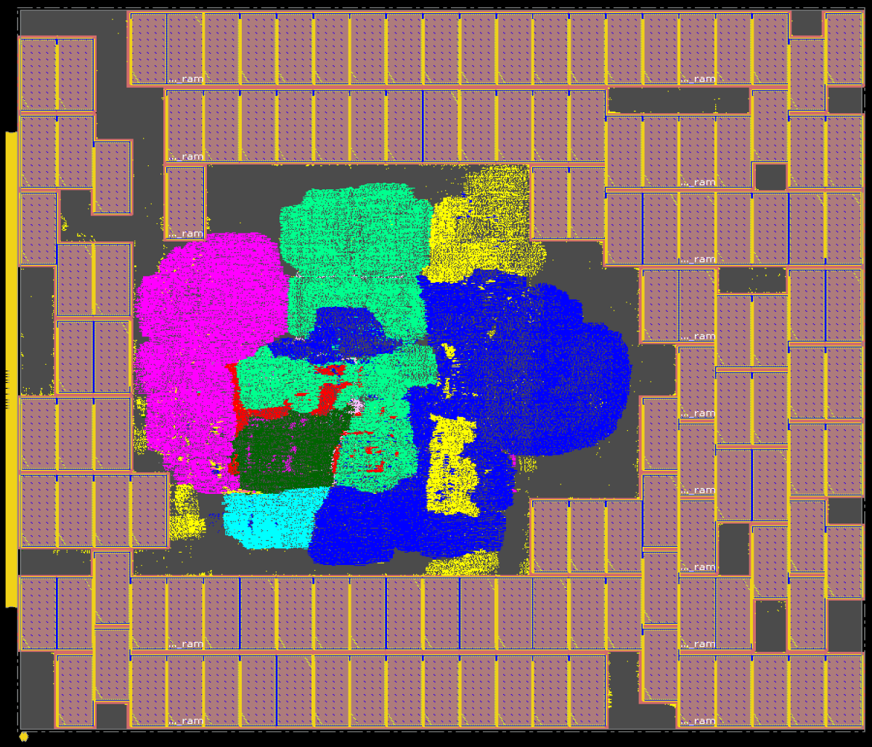
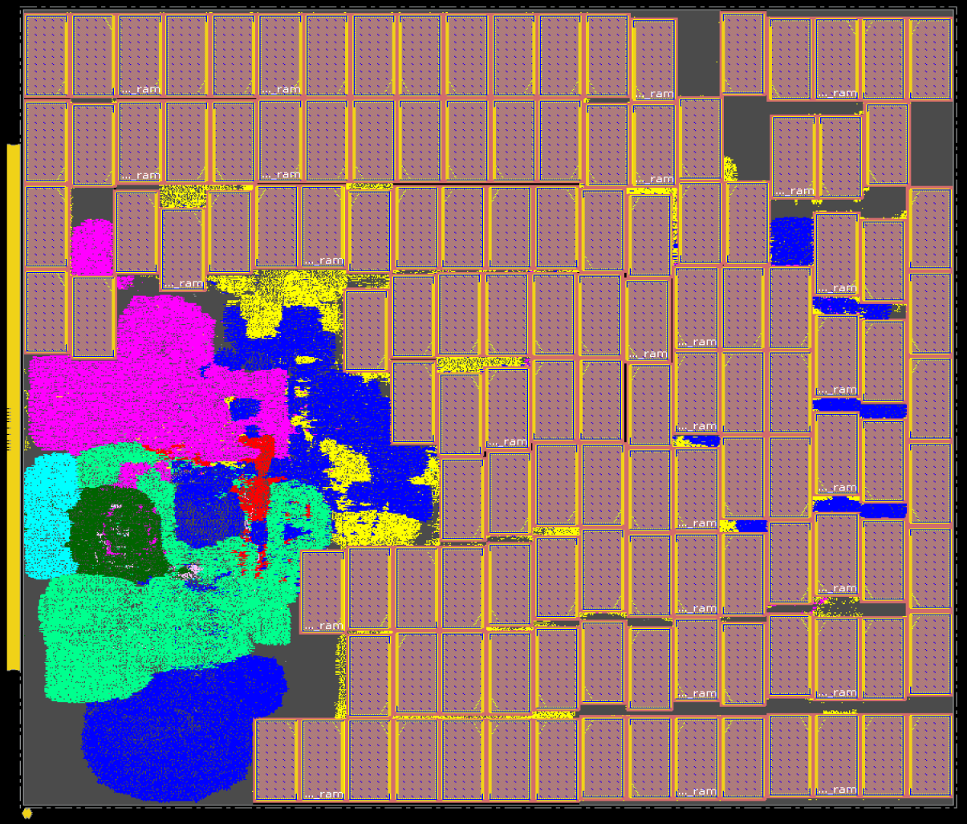
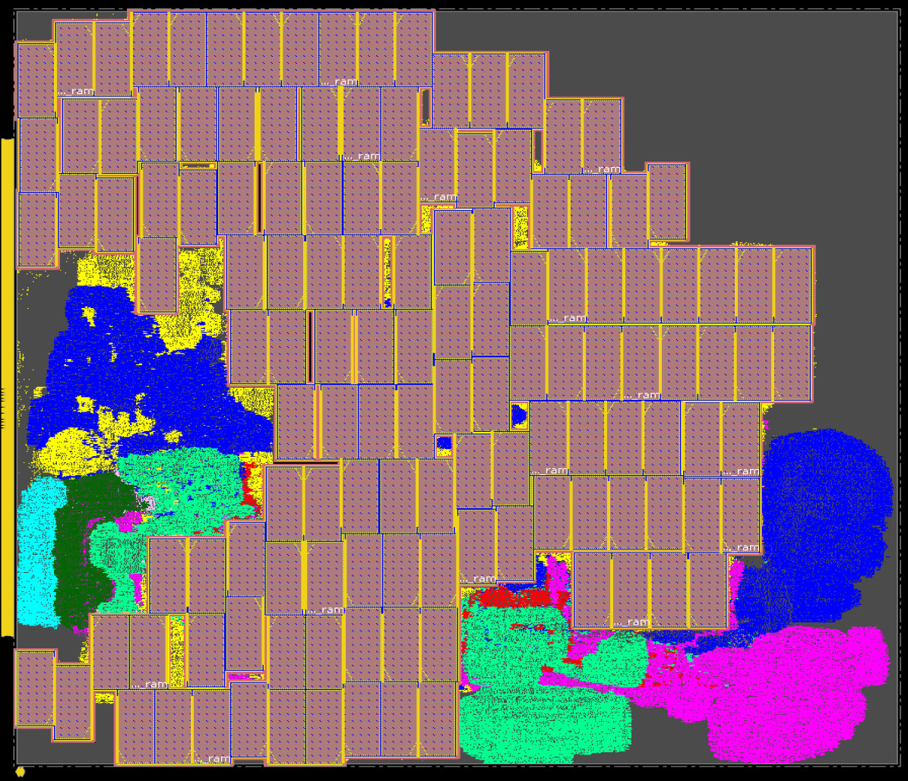
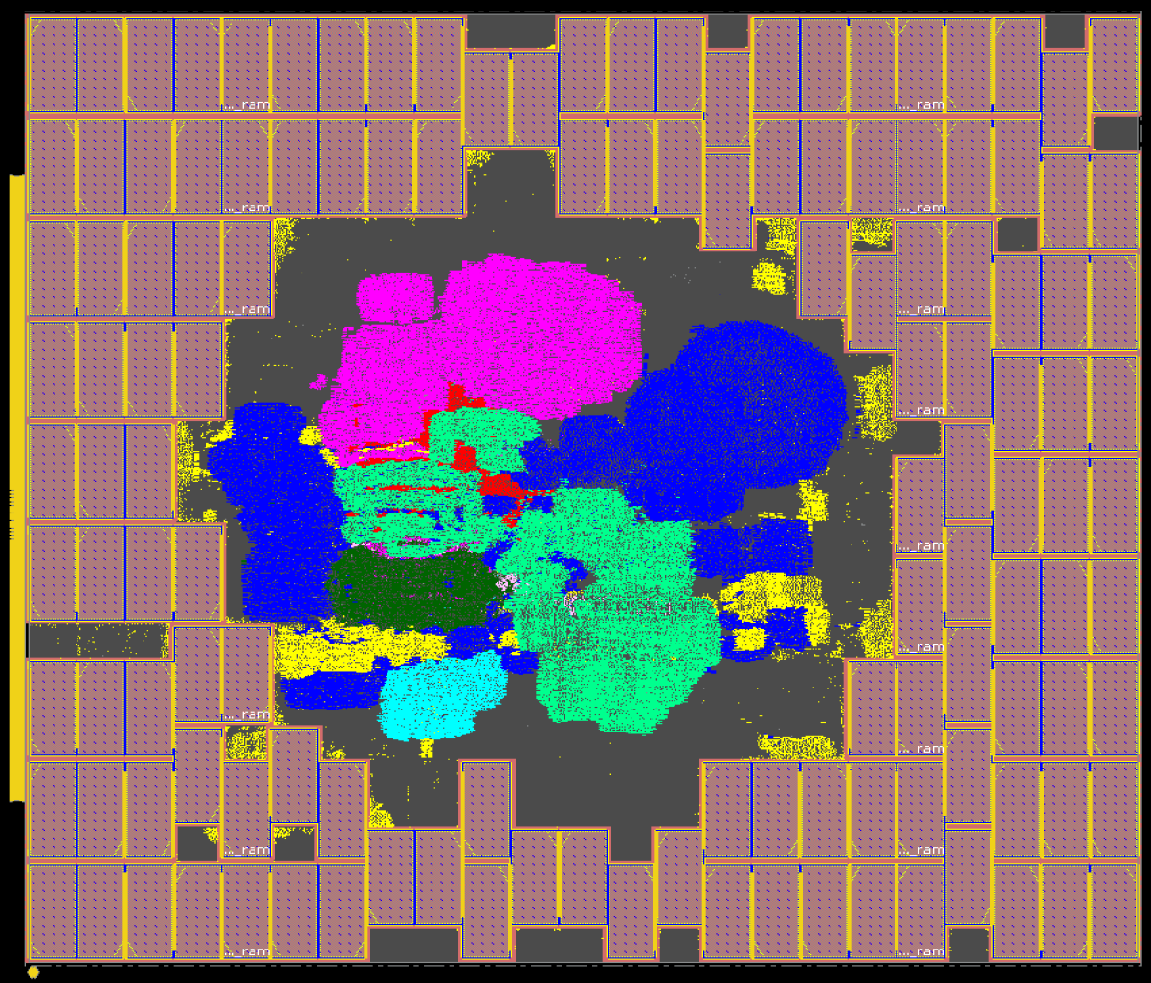
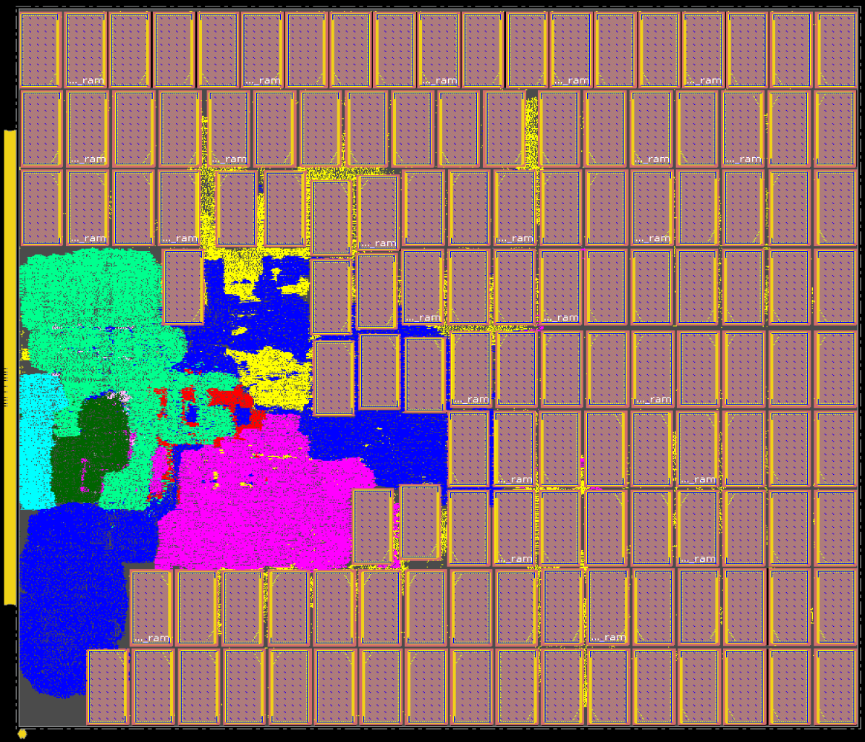
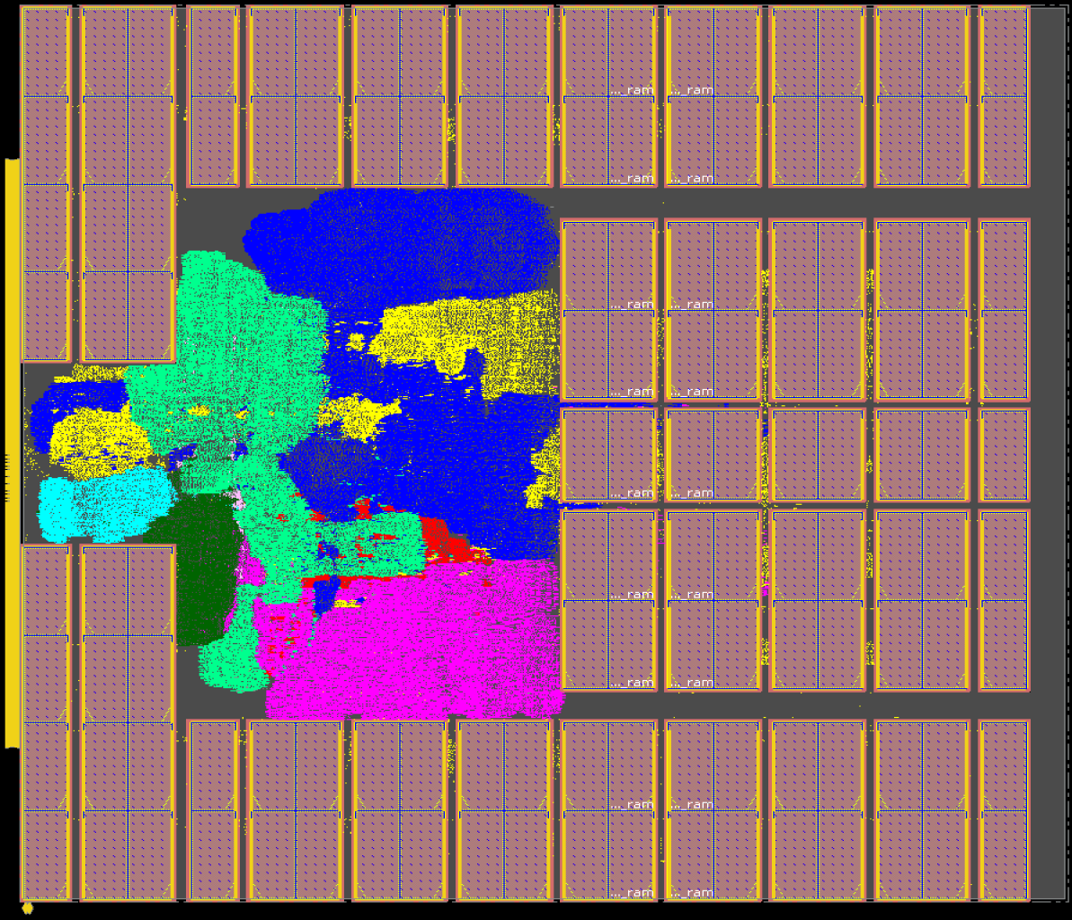
Macro Placement Solutions: Ariane133
*Ariane133 with 68% utilization, 1.3ns target clock period on NG45
CT
CMP
RePlAce
SA
AutoDMP
Human
CMP: Innovus Concurrent Macro Placer
AutoDMP: DREAMPlace based macro placer from Nvidia Research
The human macro placement is from Dr. Jinwook Jung of IBM Research
postRouteOpt metrics in Table 1 of our paper
*Nature implements Ariane133 on a different enablement
Notes:
Here are solutions for Ariane in Nangate45, generated by six different macro placers.

Slide 7
CT, SA and RePlAce Comparison on ICCAD04 Benchmarks
CT
Proxy Cost: RePlAce beats SA, and SA beats CT
SA
RePlAce
Data is normalized based on CT
Table 6 of our paper gives raw data
CT
HPWL: RePlAce beats SA and SA beats CT in most of the testcases
SA
RePlAce
In terms of proxy cost, SA outperforms CT and in terms of HPWL, SA produces better result than CT in 16 out of 17 cases
Notes:
We also performed studies using the ICCAD04 mixed-size placement benchmarks, since results were reported for them in the Stronger Baselines manuscript.
These plots show normalized proxy cost (above) and HPWL (below) for macro placement solutions generated by CT, SA and RePlAce. Data is again normalized to CT results.
[CLICK] For proxy cost, RePlAce beats SA and SA beats CT.
[CLICK] For HPWL, RePlAce beats SA in 15 out of 17 cases and SA beats CT in all but one case.

Slide 8
Conclusions
MacroPlacement = open, transparent assessment and implementation
Source code for CT’s missing and blackbox elements
Modern, macro-heavy testcases on open enablements
Commercial evaluation flow with all runscripts
Baselines cited in Nature: human expert, simulated annealing
Extensive documentation: FAQs, “Our Progress”, and more
CT benefits from placement information in incoming physical synthesis netlist
Baselines (SA and Human experts) outperform CT
For 17 ICCAD04 designs and 4 out of 6 modern testcases, SA generates better proxy cost than CT
For large macro-heavy designs, human experts outperform CT in terms of Nature Table 1 metrics
“There is no substitute for source code (and data)”
Please see the long video and our FAQs in GitHub for more information !!!
https://github.com/TILOS-AI-Institute/MacroPlacement
Notes:
Our work provides an open, transparent implementation and assessment of Nature and Circuit Training, along with key elements that are still missing or black-boxed in CT.
[CLICK] An important fact is that CT benefits from placement location data in the incoming netlist.
[CLICK] We find that SA produces better proxy cost than CT for all the ICCAD04 testcases and 4 out of 6 modern testcases.
For postRouteOpt metrics, human experts outperform CT for the large macro-heavy designs BlackParrot and MemPool Group.
So, the SA and Human expert baselines outperform CT in most cases.
[CLICK] We hope that our work helps show why source code, data and reproducibility are so essential in fields such as ours. [CLICK] And please see the long video and FAQs for more information!

Slide 9
FAQ: Runtimes (Wall Times) of Different Macro Placers
Design | CT (Hours) | CMP (Hours) | RePlAce (Hours) | SA (Hours) | AutoDMP (Hours)
Ariane-NG45 | 32.31 | 0.05 | 0.06 | 12.50 | 0.29
BlackParrot-NG45 | 50.51 | 0.33 | 2.52 | 12.50 | 0.71
MemPool-NG45 | 81.23 | 1.97 | *N.A. | 12.50 | 1.73
CT: only includes CT training time
SA: stopped after 12.5 hours automatically
CMP: only the runtime of place_design -concurrent_macros command
Resources used:
CT: Training and evaluation jobs run on (8 NVIDIA-V100 GPU, 96 CPU thread, Memory: 354 GB) machine and 13 collector jobs on each of two (96 CPU thread, Memory: 354 GB) machines
SA: 320 parallel jobs where each job used 1 thread
RePlAce: used 1 thread
CMP: Innovus launched with 8 threads
AutoDMP: run on NVIDIA DGX-A100 machine with two GPU workers
*RePlAce run for MemPool Group did not complete
Notes:
The long video flashes a couple of slides with “FAQs”. This is one of them, about wall times and resources used by different macro placers.
[[The table presents the runtime of different macro placers. Lowest runtimes are highlighted with blue texts. We see CMP has the lowest runtime in two out of three cases.
The compute resource used for each of the macro placers are as follows:
CT training and evaluation jobs were run on an 8 GPU machine, while the collector jobs were run on two 96 CPU machines.
320 SA jobs were launched in parallel for 12.50 hours, with each SA job using a single thread.
The RePlAce run was launched using a single thread, while Innovus was launched with 8 threads for the CMP run.
The AutoDMP runs were conducted on our NVIDIA DGX-A1000 machine with two GPU workers.]]

Slide 10
Thank you !
We thank David Junkin, Patrick Haspel, Angela Hwang and their colleagues at Cadence and Synopsys for policy changes that permit our methods and results to be reproducible and sharable in the open, toward advancement of research in the field. We thank many Google engineers (Azalia Mirhoseini, Anna Goldie, Mustafa Yazgan, Eric Johnson, Roger Carpenter, Sergio Guadarrama, Guanhang Wu, Joe Jiang, Ebrahim Songhori, Young-Joon Lee and Ed Chi) and the TensorFlow Agents team for their time and discussions to clarify aspects of Circuit Training, and to run their internal flow with our data. We thank Ravi Varadarajan for early discussions and flow setup, and Mingyu Woo for guidance on RePlAce versions and setup. Support from NSF CCF-2112665 (TILOS) and DARPA HR0011-18-2-0032 (OpenROAD) is gratefully acknowledged.
Notes:
We thank many folks, especially the Google engineers who have been very open and collaborative, answering questions and running studies, reviewing our paper and slides, and continuing to update the CT code. This spirit is how we will keep moving our field forward.
Thank you for your attention.

