Slide 1
Assessment of Reinforcement Learning for Macro Placement
Chung-Kuan Cheng^{[1]}, Andrew B. Kahng^{[1][2],} Sayak Kundu^{[2]}, Yucheng Wang^{[1]} and Zhiang Wang^{[2]}
^{[1]}CSE and ^{[2]}ECE Departments, UC San Diego
GitHub: https://github.com/TILOS-AI-Institute/MacroPlacement
Notes:
Hello, everyone – On behalf of my coauthors at UCSD, thanks to the ISPD organizers for inviting this talk and the accompanying paper. This talk is about our “MacroPlacement” effort.

Slide 2
June 2021: Google’s Nature Paper
Google Brain’s highly acclaimed Nature paper proposed a reinforcement learning (RL) based macro placer
Did not release code or dataset
Claimed superior or comparable macro placement solutions compared to human experts, in under six hours!
Notes:
I’ll start with background and motivation.
[CLICK] Google Brain’s highly acclaimed Nature paper, published in June 2021, stated that the proposed reinforcement learning-based macro placement method can generate chip floorplans that are superior or comparable to those produced by humans, in under six hours.
[CLICK] However, neither code nor data was released with the paper.

Slide 3
January 2022: Google’s Circuit Training
Circuit Training open-sourced “reproduces the methodology published in the Nature 2021 paper”
Missing dataset and code elements: format translator, simulated annealing
No dataset, and insufficient code to reproduce the Nature results
Notes:
In January 2022, Google Research open sourced the Circuit Training code in support of the Nature paper.
[CLICK] However, the code release did not include the training dataset OR crucial elements such as the format translator, simulated annealing implementation, OR human expert-generated baseline solutions. Also, BLACK-BOXED parts of Circuit Training are hidden behind APIs of the binary PLC-CLIENT.
[CLICK] So, to date, there is no available code and dataset that allows reproduction of the Nature results.

Slide 4
March 28, 2022: Stronger Baselines
“Stronger Baselines” manuscript was made available
Evaluated on Google’s internal benchmarks and old academic benchmarks
Used weak evaluation metrics
No open-source code
States shortcomings of the Nature paper, but also lacks code and dataset to reproduce results
Notes:
During ISPD 2022 a “Stronger Baselines” manuscript was made available -- which points out several shortcomings of the Nature paper.
[CLICK] However, the work used Google’s internal benchmarks, along with nearly two decades-old academic benchmarks and weak evaluation metrics for the analysis. This work, too, did not release the open-source code and dataset used for pretraining of the RL model.

Slide 5
Why MacroPlacement ?
March 28, 2022: Stronger Baselines manuscript
States Shortcomings
June 2021: Nature Paper
January 2022: Circuit Training
Breakthrough Claims
Partial Release of
Supporting Code
Notes:
So. As of a year ago, the Nature paper claimed breakthrough results and there was a partial release of supporting code. On the other hand, a Stronger Baselines manuscript stated that there were shortcomings.
Neither Nature nor Stronger Baselines gave code and datasets to confirm their respective claims.
With this backdrop, we started our MacroPlacement effort to provide an open, transparent assessment of the RL based macro placement approach proposed in the Nature paper. The goal has always been clarity of understanding that will allow the community to move on. And as we take pains to point out in our paper, many Google engineers have been forthcoming and helpful throughout our efforts.

Slide 6
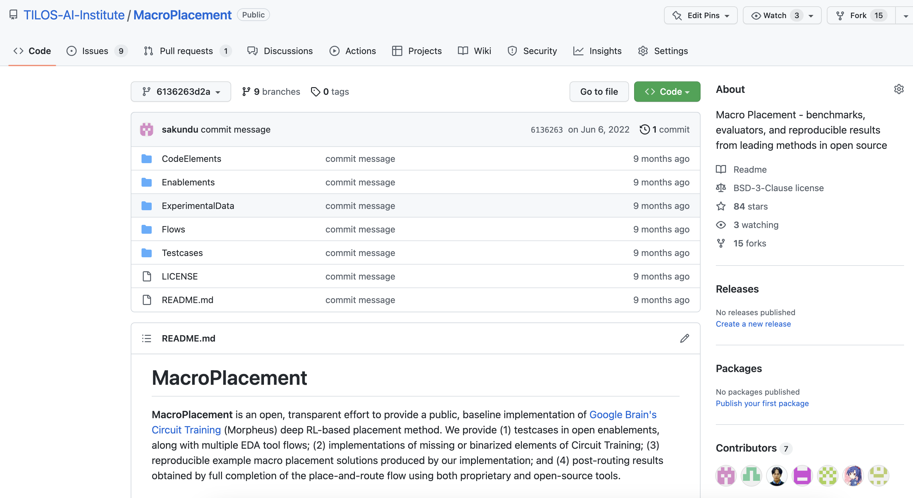
Our MacroPlacement Effort
June 2022: MacroPlacement repository open-sourced
Key elements:
New testcases
Open enablements
Public evaluation flows
Reverse engineering
Reimplementation in open source
Stronger baselines
This talk and paper: The Story of MacroPlacement
Notes:
We open-sourced our MacroPlacement repository in June 2022.
[CLICK] It features new testcases, open enablements, public evaluation flows, reverse engineering and reimplementation of binarized and missing elements of Circuit Training in open-source format, and baseline solutions for macro placement.
[CLICK] This talk, and our paper, give the story of MacroPlacement.

Slide 7
Outline
Background and Motivation
Replication of Circuit Training (CT)
Mismatch of CT and Google Nature paper
Blackbox and missing elements of CT
MacroPlacement Repository
Experimental Results
Academic Benchmarks
Conclusion
Notes:
This is the outline for the rest of my talk.
I’ll next describe the replication of Circuit Training.
Then, [CLICK] I will provide details of our MacroPlacement repository, and experimental results.
[CLICK] In light of the Stronger Baselines work, I’ll describe studies using academic benchmarks.
Last, I’ll give takeaways.
Let me start with the replication of Circuit Training, to address MISMATCHES with the Nature paper, and BLACKBOXING behind APIs.

Slide 8
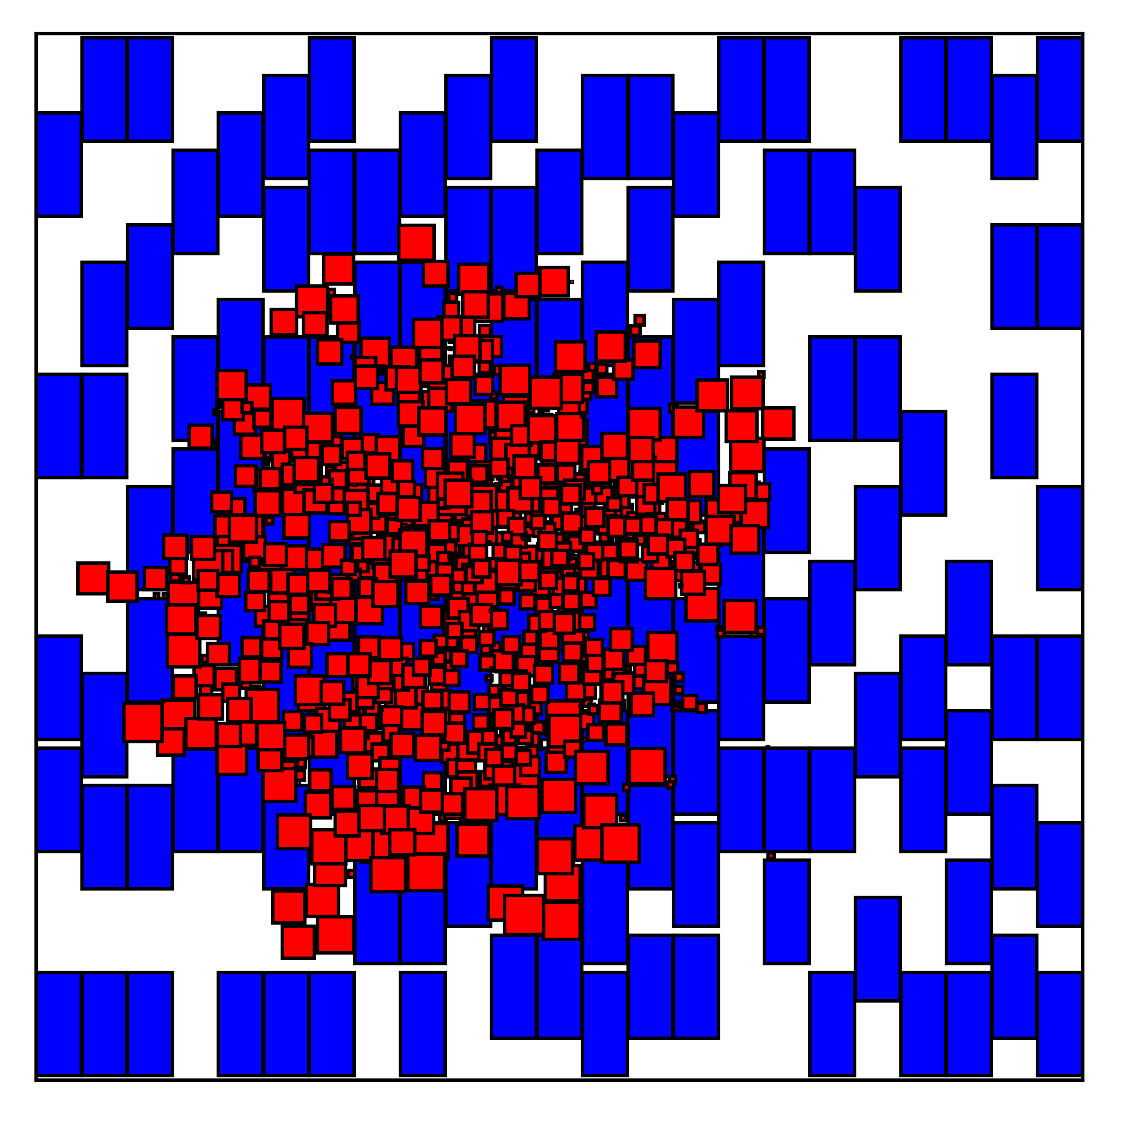
Circuit Training (CT) Flow
Input to CT: Placed Netlist
CT’s “grouping” flow consists of three steps
Gridding: divides the chip canvas into grid cells whose size promotes close packing of macros
Grouping: creates groups to ensure closely connected logic elements stay together
Clustering: creates standard-cell clusters
CT training
Input: clustered netlist
Optimizes the proxy cost ($R$):
$$R=Wirelength+γ×Density+λ×Congestion (1)$$
Placed Netlist
LEF / DEF to
Protobuf converter
Gridding
*CT Grouping Flow
Grouping
Clustering
*CT Training
Final Macro
Placement Solution
*Grouping and training flows are open-sourced in CT repository by the TensorFlow Agents team
Notes:
For CT, the input is a placed netlist in protobuf format.
So, our repository provides converters to Protobuf from LEF / DEF and Bookshelf.
[CLICK] CT first executes a grouping flow which actually consists of three steps.
Gridding divides the chip canvas into gridded blocks and ensures tight packing of macros.
The grouping step ensures that closely connected logic stays together, while the clustering step creates standard cell clusters.
[CLICK] Then the clustered netlist is used to train the RL agent.
The RL agent optimizes the proxy cost given in equation one. Here GAMMA is the density weight and LAMBDA is the congestion weight.
The GIF shows how the RL agent generates a macro placement solution for the Ariane-NanGate45 design.
The final solution produced by CT is the macro placement with the lowest proxy cost.
[CLICK] For the open-sourcing of grouping and training flows in the CT repository, kudos to Google’s TensorFlow Agents team.

Slide 9
Mismatch Between CT and The Nature Paper
CT assumes that the input is a placed netlist
Nature paper: does not mention this
Critical: poor initial placement increases routed wirelength by 7%
Different weight of proxy cost components
Nature: $γ=0.01$ and $λ=0.01$
CT: $γ=1.0$ and $λ=0.5$
Suggested by Google: $γ=0.5$ and $λ=0.5$*
Result for different weight combinations in Slide 25
Adjacency matrix generation
Nature considers register distance for a pair of nodes
CT does not consider register distance
Placed Netlist
LEF / DEF to
Protobuf converter
Gridding
CT Grouping Flow
Grouping
Clustering
CT Training
Final Macro
Placement Solution
*G. Wu, Google Brain, personal communication, August 2022
Notes:
The most crucial mismatch between the CT method and the Nature paper is that CT actually uses an initial placement (that comes from a physical synthesis tool) but this is not mentioned in the paper! All of the [CLICK] yellow-highlighted parts of the flow leverage input placement coordinates. And, our ablation study shows that [CLICK] poor initial placement can increase routed wirelength by at least 7 percent.
Our work found a number of other discrepancies. Two examples:
[CLICK] for proxy cost, different density and congestion weights are used in CT and Nature paper. In our studies, we actually used a THIRD combination of weight values that was suggested to us by Google engineers.
[CLICK] Also, the Nature paper describes generation of the adjacency matrix based on the register distance – i.e., hop-count – between pairs of nodes. However, CT builds the adjacency matrix based only on direct connections between nodes.

Slide 10
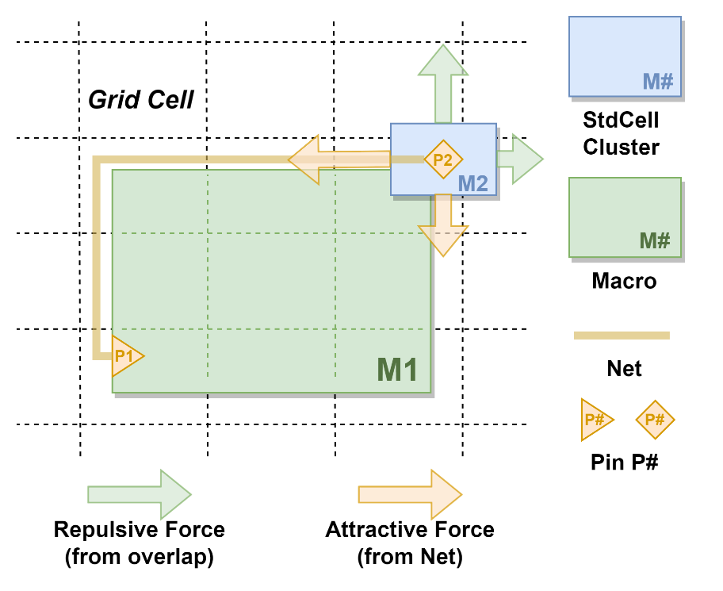
Blackbox Element: Force-Directed Placement
Main blackbox elements of CT: hidden behind plc_client
Force-directed (FD) placement
Proxy cost components: Wirelength, Density and Congestion cost
FD consists of two force components
Attractive force: $F_{a_{x}}$, attractive factor: $k_{a}$
$$F_{a_{x}}=k_{a}×abs\left(P1.x−P2.x\right) (2)$$
Repulsive force: $F_{r_{x}}$, repulsive factor:$k_{r}$ and max repulsive force: $F_{r_{max}}$
$$F_{r_{x}}=k_{r}×F_{r_{max}}×\frac{abs(M1.x −M2.x)}{dist(M1, M2)} (3)$$
→ Horizontal force $F_{x}=F_{a_{x}}+F_{r_{x}} (4)$
More details: Section 3.2.1 of our paper
Notes:
The main blackbox components of CT that are hidden behind plc_client are the force-directed placement and proxy cost components. This slide and the following slide provide a brief overview of our open-source reverse-engineering and implementation of these blackbox elements.
[CLICK] The main two components of FD are attractive and repulsive forces.
There is an attractive force if two nodes are connected by a net.
[CLICK] The horizontal attractive force between M1 and M2 due to the net connection of P1 and P2 is defined using equation two.
There is a repulsive force if two nodes are overlapping.
[CLICK] The repulsive force between node M1 and M2 is defined by equation three.
[CLICK] For more details please check Section 3.2.1 of our paper

Slide 11
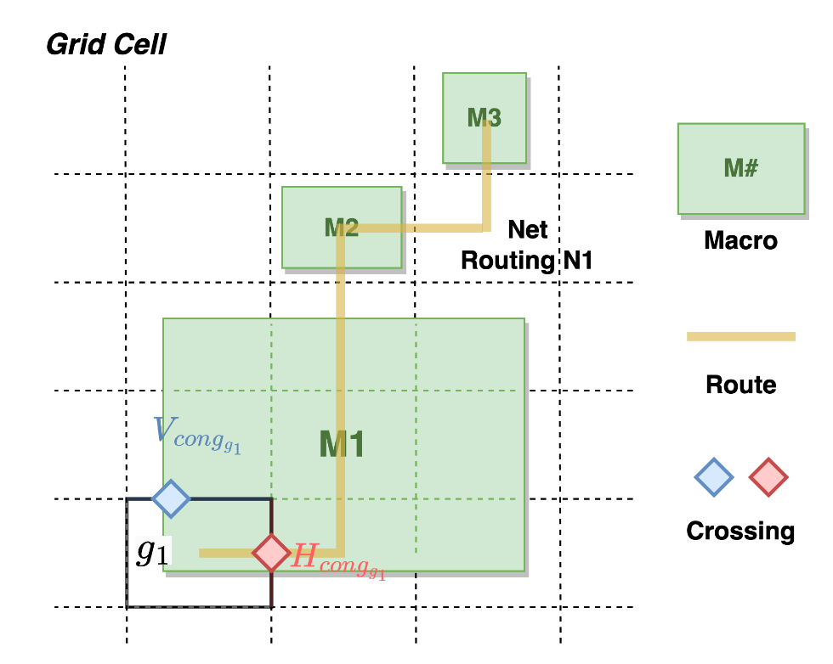
Blackbox Element: Proxy Cost
Wirelength cost:
$$\frac{1}{|nets|}\sum_{net}{\frac{net.weight ×HPWL(net) }{canvas.width + canvas.height} (5)}$$
Density cost: Average density of the top 10% densest grid cells
Congestion cost: Average of top 5% grid cell H_{cong} and V_{cong} values
Two components of congestion cost:
Macro congestion: Routing layers blocked by macros
Routing congestion: Routing resources occupied by routed nets
→ Grid cell congestion: Sum of macro and routing congestion
RL Agent optimizes these proxy cost components
Notes:
This slide gives a brief overview of the RL proxy cost components: wirelength cost, density cost and congestion cost.
[CLICK] Wirelength cost is computed using Equation five. Here HPWL is the half perimeter wirelength of the net.
[CLICK] Density cost is the average density of the top 10% densest grid cells.
[CLICK] The congestion cost is the average of top 5% horizontal and vertical congestion values of the grid cells.
Two components of congestion cost are macro congestion and routing congestion. Macro congestion is due to routing layers blocked by macros, whereas routing congestion results from occupied routing resources by routed nets. Congestion of a grid cell is the summation of macro and routing congestion.
In the figure we see, when a routed net crosses the right boundary of a grid cell, it contributes to horizontal congestion. Similarly, when it crosses the top boundary of a grid cell, it contributes to vertical congestion. The horizontal congestion of a grid cell is the summation of horizontal routing and macro congestion values, while vertical congestion is the summation of vertical routing and macro congestion values.
[CLICK] The RL Agent optimizes these Proxy cost components.

Slide 12
Missing Elements: Format Translator and SA
Format translators to generate Protobuf netlist
MacroPlacement repo includes two format translators
LEF/ DEF → Protobuf
Bookshelf → Protobuf
Simulated Annealing (SA) implementation
Our SA implementation follows the Stronger Baselines (SB) description
Five actions of our SA
Nature includes swap, shift, and mirror actions
Nature does not include move and shuffle
Two initializations
Nature includes greedy packing
Nature does not include spiral initialization
Our implementation of missing elements enables anyone to run CT and SA on their own designs !!
Notes:
There are two main missing elements in the Circuit Training GitHub: the protobuf netlist generator and the Simulated Annealing framework.
[CLICK] We provide format translators that can generate a protobuf netlist from the Bookshelf and LEF/DEF formats, enabling users to run Circuit Training on their own designs.
[CLICK] SA is one of the baselines used in the Nature paper. Our SA includes swap, shift, and mirror actions as described in the Nature paper, as well as move and shuffle actions following the description in Stronger Baselines. Also, we include the spiral initialization in our SA, in addition to the greedy packing initialization.
[CLICK] Our implementation of format translators and SA in open-source enables any user to run CT and SA on their own designs.

Slide 13
Outline
Background and Motivation
Replication of Circuit Training (CT)
MacroPlacement Repository
New benchmarks
Commercial evaluation flow
Experimental Results
Academic Benchmarks
Conclusion
Notes:
So, in our repo, you can find open-source implementations of all the blackboxed and missing elements that I’ve mentioned. Now I’ll introduce the new benchmarks and commercial flows that are available in our MacroPlacement repository.

Slide 14
MacroPlacement: Modern Benchmarks
Modern benchmarks: Open testcases on open enablements
Testcases: Ariane, BlackParrot, MemPool Group and NVDLA
Enablements: SKY130HD FakeStack, NanGate45 and ASAP7 (includes FakeRAM generator)
Major changes in EDA vendor policies allow us to share our Tcl scripts in GitHub for research purposes! ← Kudos and thanks to Cadence and Synopsys !!!
Our repo includes commercial synthesis, place-and-route (SP&R) tool flow scripts
Cadence Genus iSpatial physical synthesis flow and Cadence Innovus P&R flow
Synopsys Design Compiler Topographical physical synthesis flow
Testcase | #FFs | #Macros | #Macro Types | #Insts on NG45
Ariane | 19,807 | 133 | 1 | 117,433
NVDLA | 45,295 | 128 | 1 | 155,711
BlackParrot | 214,441 | 220 | 6 | 768,631
MemPool Group | 360,724 | 324 | 4 | 2,729,405
Notes:
Our repository contains four new macro-heavy designs: Ariane, BlackParrot, MemPool Group, and NVDLA, on three open enablements: SKY130HD, NanGate45, and ASAP7.
The table summarizes the numbers of flip-flops, macros, distinct macro sizes, and standard-cell instances of the synthesized design. BlackParrot and MemPool Group designs are more complex than Ariane and contain macros of varying sizes.
[CLICK] Recent major changes in EDA vendor policies now permit sharing of Tcl scripts on GitHub. We are grateful to Cadence and Synopsys for revising their policies and making it possible to share Tcl scripts in GitHub for research purposes. This was a true watershed moment for our field.
[CLICK] In our repository we provide scripts for Cadence Genus iSpatial physical synthesis flow, Cadence Innovus Place and Route flow and Synopsys Design Compiler Topographical physical synthesis flow.

Slide 15
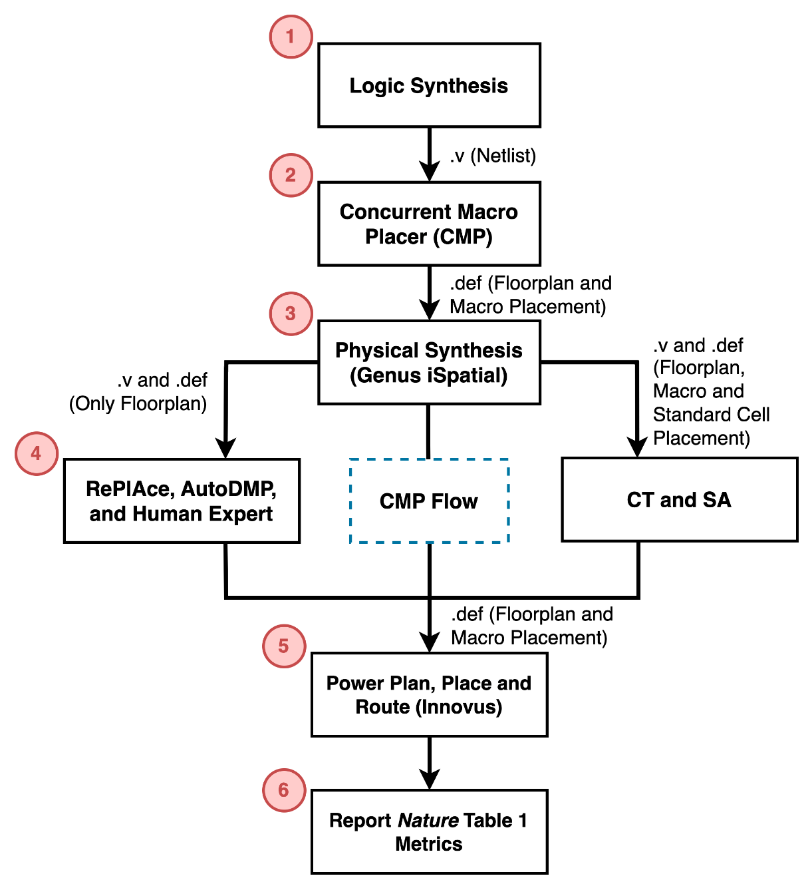
Commercial Evaluation Flow
Macro placers: CT, *CMP, SA, RePlAce, **AutoDMP and Human expert
Logic synthesis: Genus 21.1
Physical synthesis:
Genus iSpatial flow
Design Compiler Topographical R-2020.09
Place and route: Cadence Innovus 21.1
Ground truth / Nature Table 1 metrics:
***postRouteOpt wirelength, WNS, TNS, power, standard cell area and DRC count
*CMP: Cadence Innovus Concurrent Macro Placer
**AutoDMP: DREAMPlace-based macro placer from Nvidia Research
***Nature paper reports postPlaceOpt metrics
Notes:
Here we show our commercial evaluation flow as it is applied to six different macro placers that we study: CT, CMP, SA, RePlAce, AutoDMP and Human Expert.
AutoDMP is a DREAMPlace based macro placer from Nvidia Research – also in this session.
[CLICK] Step 1 performs logic synthesis and generates a synthesized netlist. Step 2 uses the concurrent macro placer (or, “CMP”) from Cadence to place the macros. In step 3, we perform physical synthesis using the Cadence Genus iSpatial flow, and generate a synthesized netlist that contains standard-cell placement information.
[CLICK] In Step 4, we generate the macro placement solutions for different macro placers. You can see three paths. Notice that in the middle path, where the input macro placement to physical synthesis is generated by CMP, we do not rerun CMP, but simply reuse the input macro placement. On the right, CT and SA use both macro and standard cell placement information.
[CLICK] Once we have the macro placement solution, we run power planning, place and route using Cadence Innovus and capture several post-route optimization metrics such as total wirelength, total power, WNS, TNS, standard cell area, and DRC count. Table 1 of Nature paper presents similar metrics to compare different macro placers. As in the paper, I’ll refer to these metrics as the "Nature Table 1 metrics" for the remainder of my talk.
This evaluation flow can be utilized to study performance of any macro placers.

Slide 16
Outline
Background and Motivation
Replication of Circuit Training (CT)
MacroPlacement Repository
Experimental Results
Ablation studies
Different macro placement solutions
Academic Benchmarks
Conclusion
Notes:
Now I will show some of our ablation studies for CT, as well as the solutions generated by different macro placers.

Slide 17
Ablation Study of CT (Section 5.2)
Similar training curve and Nature Table 1 metrics of Ariane-NG45 for our and Google’s CT runs → Correct CT Setup (Ref. [50] of our paper)
Effect of initial placement
Ran CT for three vacuous placements: all standard cells and macros are placed at lower left corner, at upper right corner and at (600, 600)
The routed wirelength of our baseline CT solution is 7.24%, 8.17% and 10.32% less than the above three cases respectively
Wirelength Cost
Density Cost
Congestion Cost
Initial placement is important for CT !!
Notes:
In our first ablation study, we shared the clustered netlist of Ariane-NG45 design with Google engineers and compared the training curve of our CT run with theirs. The plot shows that the training curves are very similar, and the Nature Table 1 metrics were also similar for both runs. This interaction confirmed that our CT setup is correct.
[CLICK] Now remember: the Nature paper does not make any reference to the use of initial placement information. To investigate the impact of initial placement on CT outcome, we generated three vacuous placements. In the first placement, all the standard cells and macros were placed at the lower left corner, in the second placement at the upper right corner, and in the third placement at (600, 600). For each, we ran CT and the commercial evaluation flow. We found that IF given placement coordinates from Cadence CMP and Genus iSPatial, CT’s solution has routed wirelength that is respectively 7.24%, 8.17% and 10.32% less than with these three vacuous input placements. These data suggest that initial placement information provides significant benefits to CT.

Slide 18
Nature Table 1 Metrics: Modern Benchmarks
Routed Wirelength
Proxy Cost
TNS
CT
Human
Human
CMP
AutoDMP
CMP
SA
SA
CMP
CT
CT
SA
AutoDMP
Human
AutoDMP
CMP outperforms CT
Lower values in normalized routed wirelength, proxy cost, and TNS → Better performance
Data is normalized based on CT
More details: Table 1 of our paper
Notes:
If you read our paper and delve into the “Our Progress” and other Docs in the GitHub repo, you’ll find very comprehensive data.
But let me try to overview main experiments.
Here, these plots -- left-to-right -- present normalized wirelength, proxy cost and total negative slack for Ariane, BlackParrot and MemPool group on NanGate45 and commercial GlobalFoundries 12nm enablement. Here, data points are normalized based on the CT result.
[CLICK] We see that in terms of routed wirelength, CMP and AutoDMP dominate other macro placers.
[CLICK] In terms of proxy cost, SA dominates other macro placers in 4 out of 6 cases and CT dominates other macro placers in 2 out of 6 cases.
[CLICK] CT generates better TNS than SA for 4 out of 5 cases,
[CLICK] while SA generates better routed wirelength in 5 out of 6 cases.
[CLICK] In the commercial evaluation flow, if we go forward (which was that “middle path” a few slides back) instead of running CT, this will generate the CMP result. We see that CMP produces better routed wirelength than CT for all cases.

Slide 19
Human Outperforms CT for Macro-Heavy Designs
Design Enablement | Macro Placers | Area (um²) | rWL (mm) | Power (mW) | Power (mW) | WNS (ps) | TNS (ns)
BlackParrot NG45 | CT | 1,956,712 | 36,845 | 4627.4 | 4627.4 | -185 | -1040.8
 | Human | 1,919,928 | 25,916 | 4469.6 | 4469.6 | -97 | -321.9
MemPool NG45 | CT | 4,890,644 | 123,330 | 2760.5 | 2760.5 | -69 | -119.3
 | Human | 4,873,872 | 107,598 | 2640.0 | 2640.0 | -49 | -11.9
Note: Metric values for GF12 are normalized
BlackParrot GF12 | CT | 0.179 | 1.000 | 1.000 |  | 0.000 | 0.0
 | Human | 0.178 | 0.642 | 0.928 |  | 0.000 | 0.0
MemPool GF12 | CT | 0.410 | 1.000 | 1.000 |  | -0.195 | -1849.4
 | Human | 0.406 | 0.888 | 0.920 |  | -0.149 | -1766.5
For GF12 metric values
Routed wirelength and total power: normalized based on CT result
TNS and WNS: normalized based on target clock frequency
Standard cell area: normalized based on canvas area
In terms of all the Nature Table 1 metrics, Human outperforms CT for macro-heavy testcases
Notes:
In terms of Nature Table 1 metrics, we see that human experts outperform CT for large, macro-heavy designs such as BlackParrot and MemPool Group. We observe similar behavior in the open enablement NanGate45 and in the commercial enablement GF12.

Slide 20
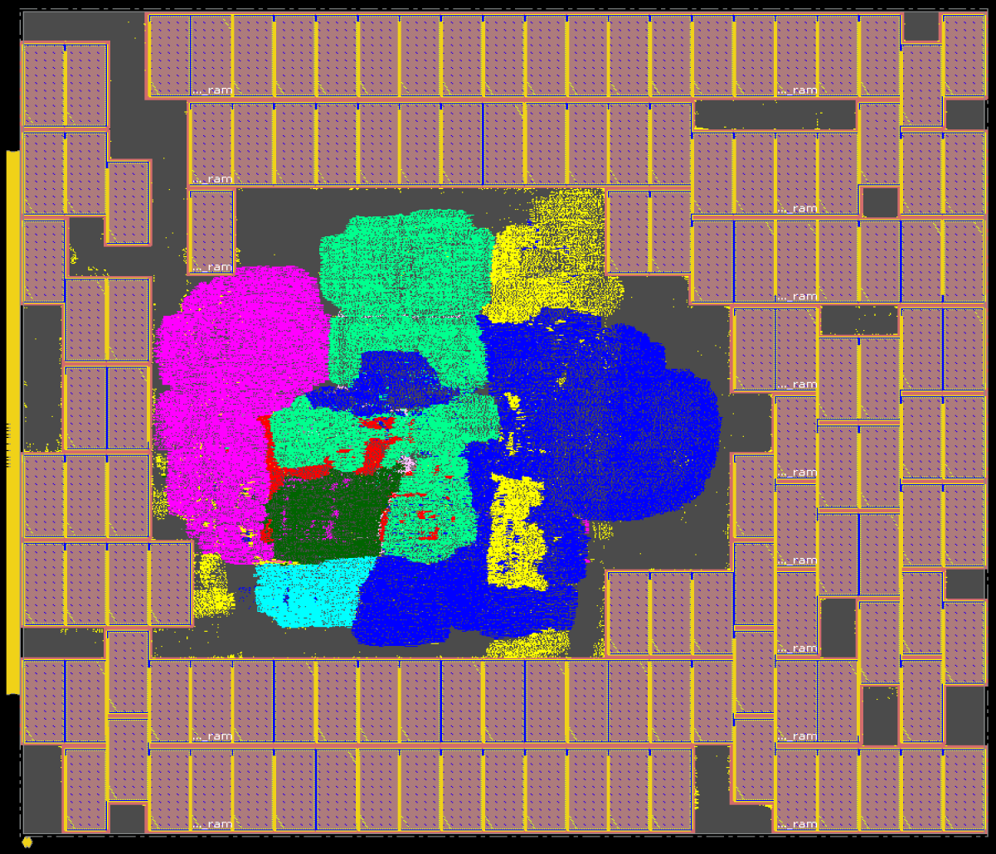
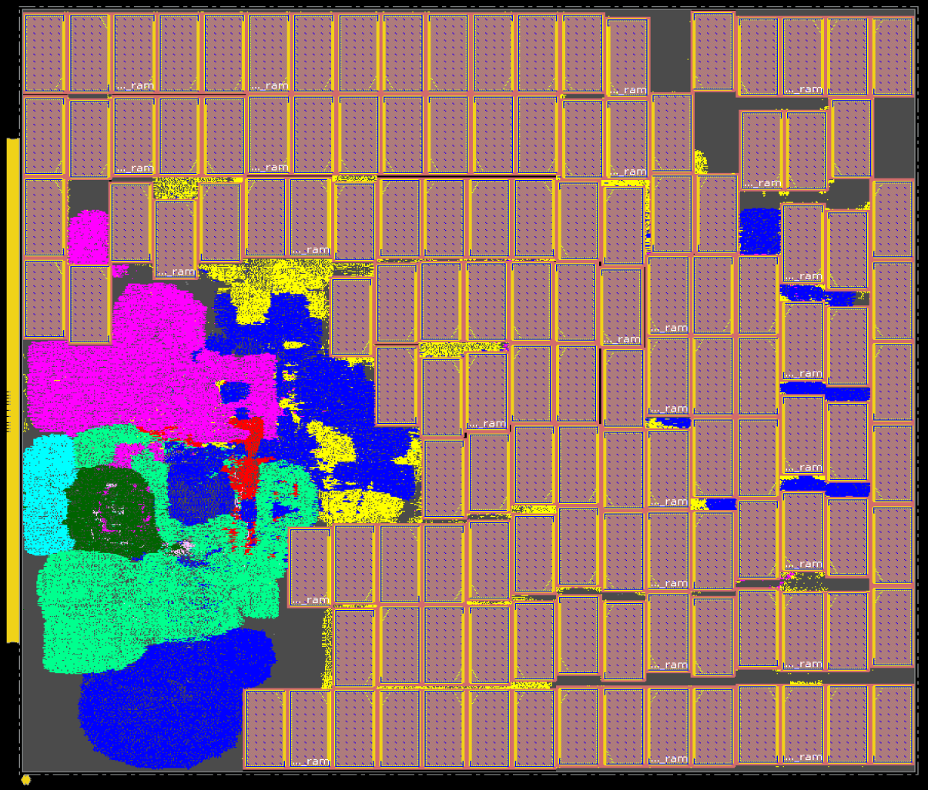
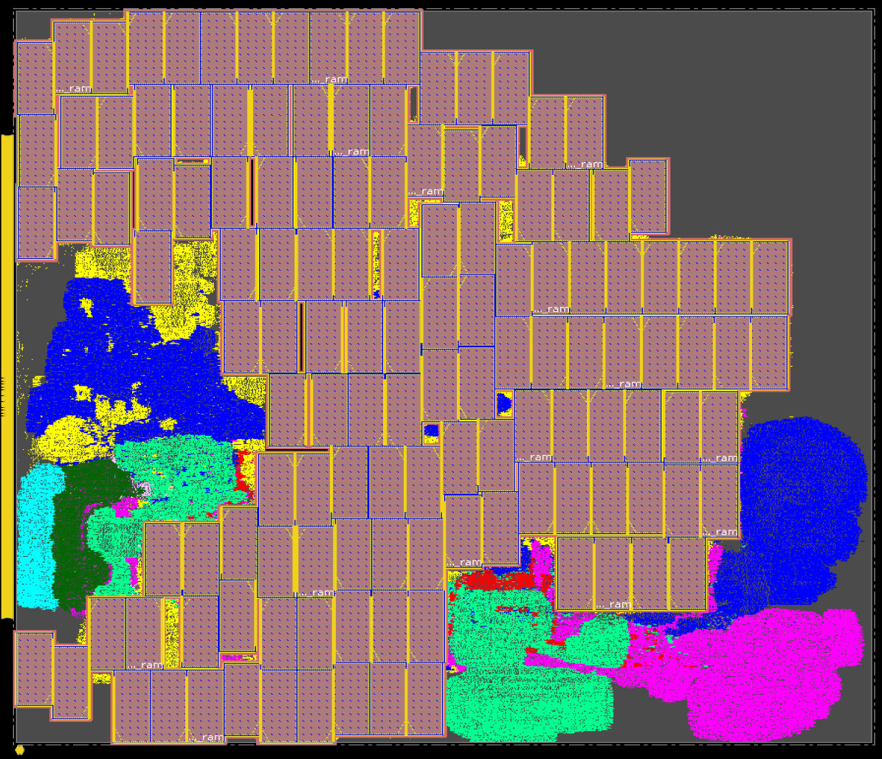
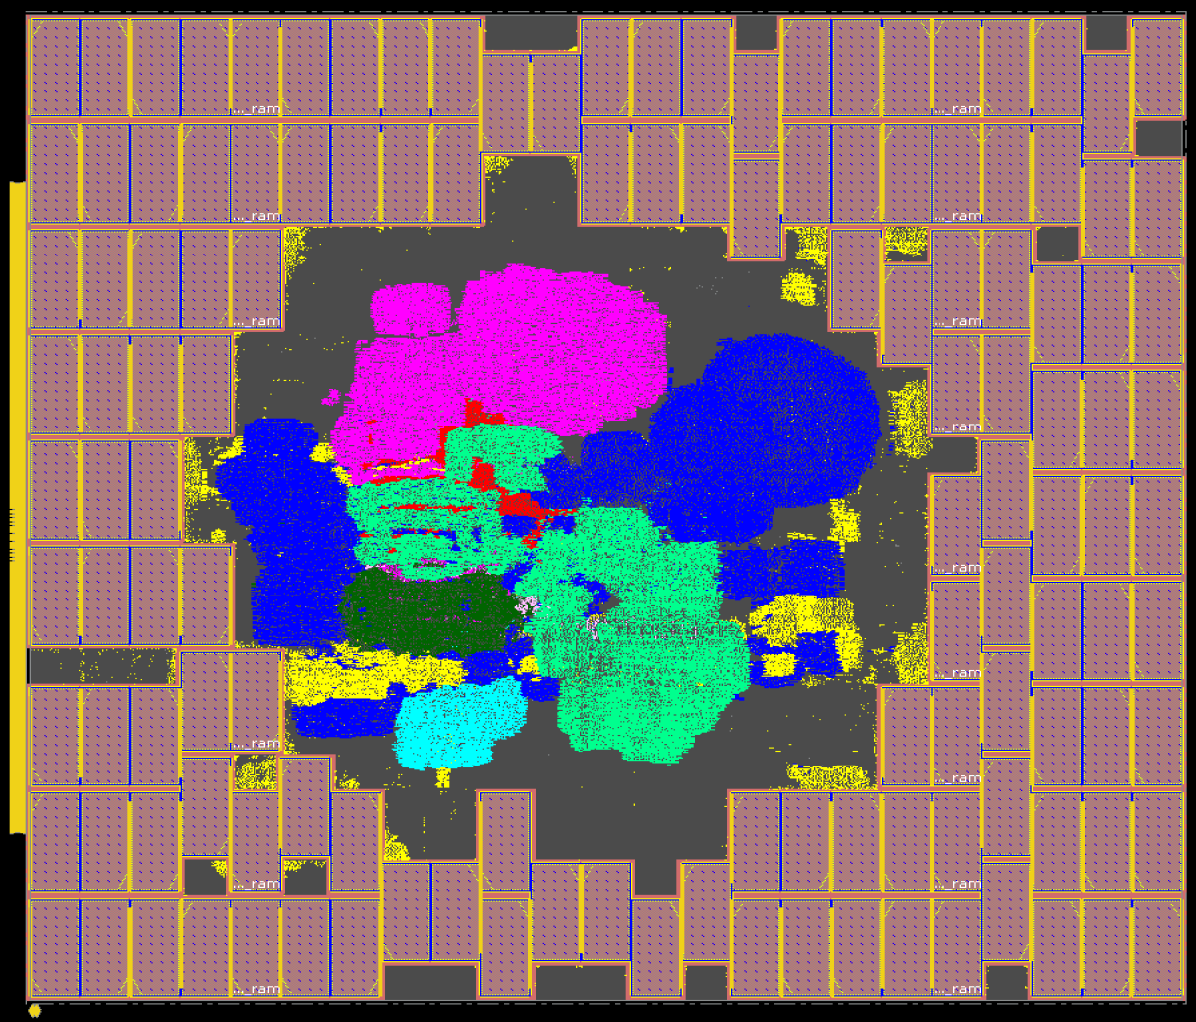
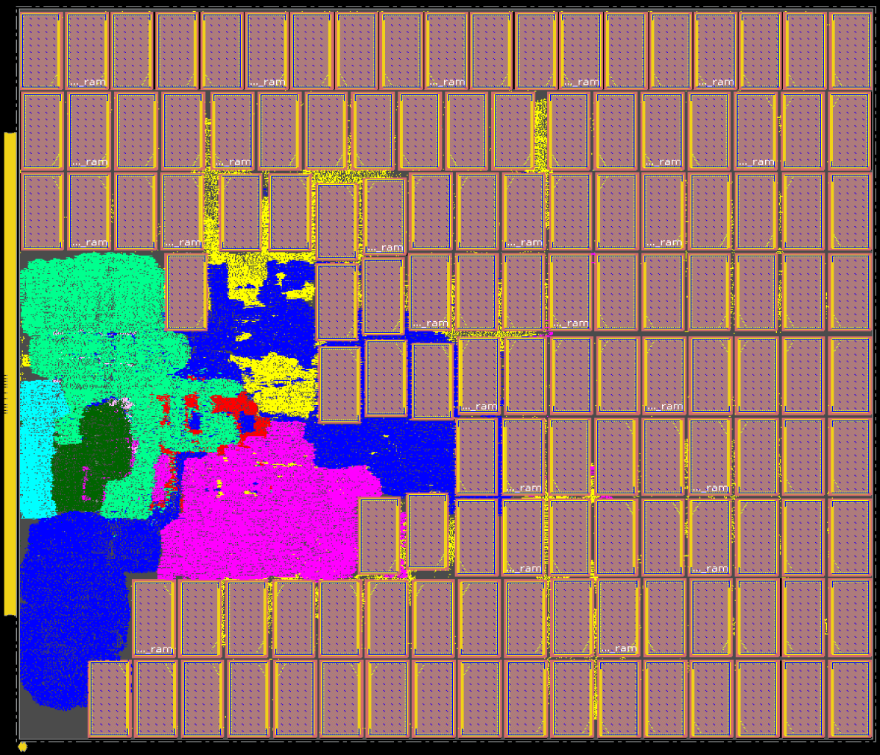
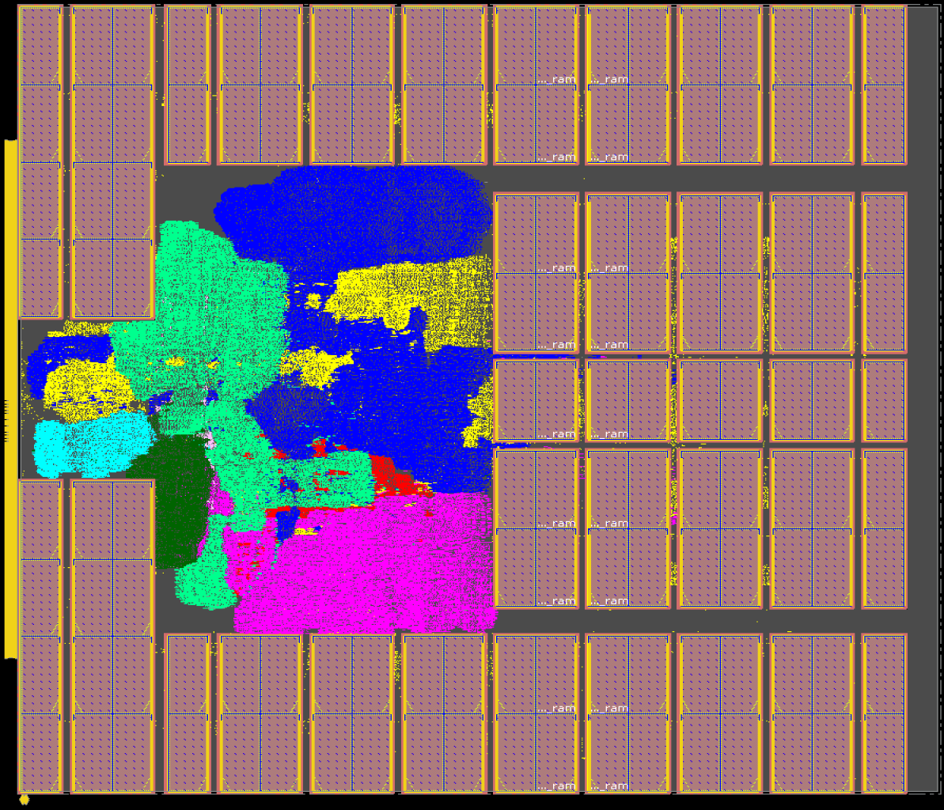
Macro Placement Solutions: Ariane133
*Ariane133 with 68% utilization, 1.3ns target clock period on NG45
CT
CMP
RePlAce
SA
AutoDMP
Human
*Nature implements Ariane133 on a different enablement
Notes:
This slide gives some visual color to the data we’ve already seen.
These are the macro placement solutions generated by six different macro placers for the Ariane133 design with 68% utilization and 1.3ns target clock period, in NanGate 45. The human macro placement is from Dr. Jinwook Jung of IBM Research.

Slide 21
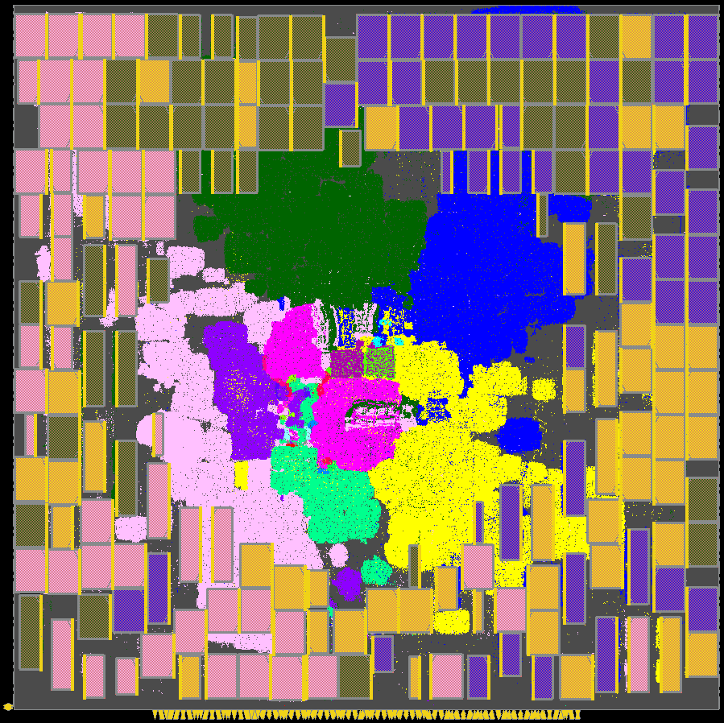
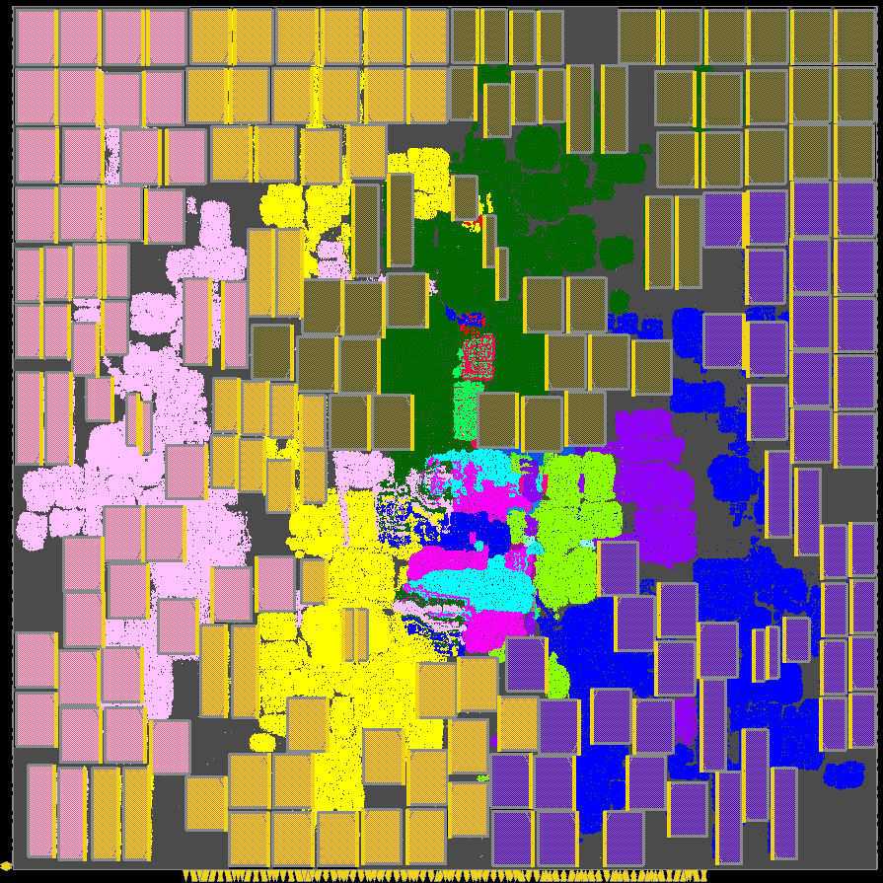
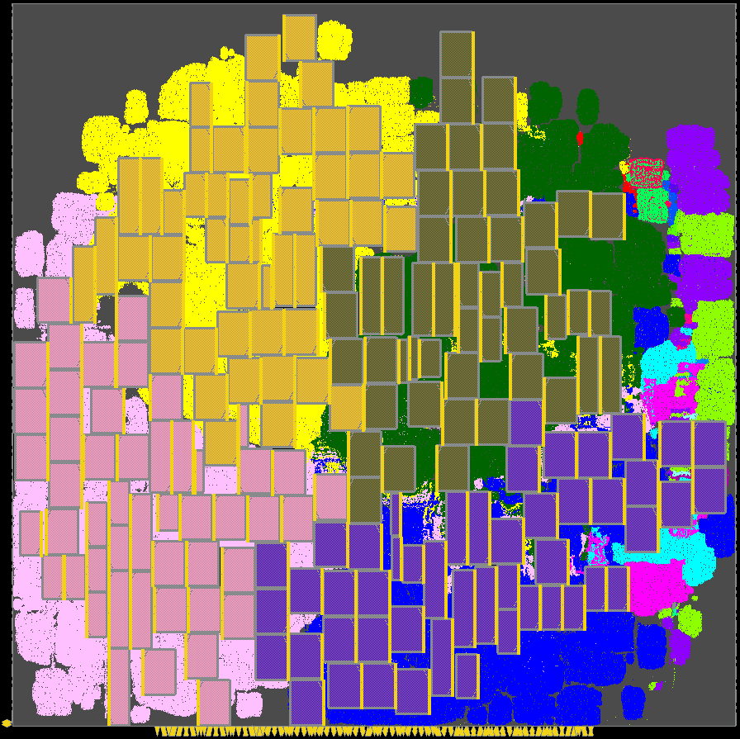
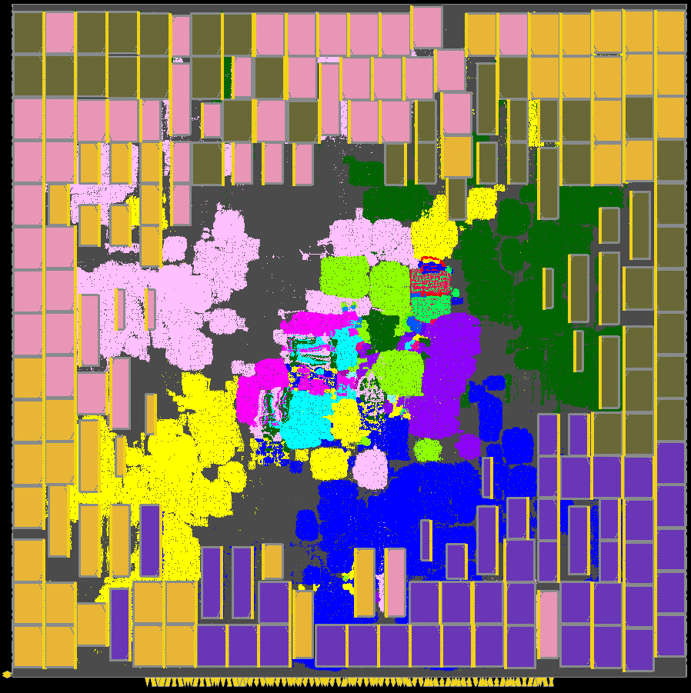
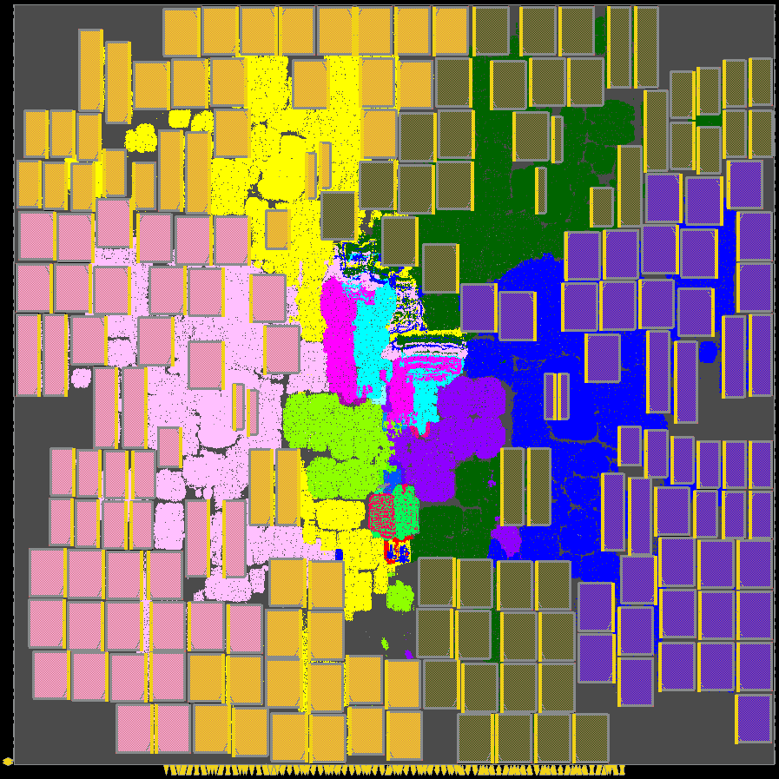
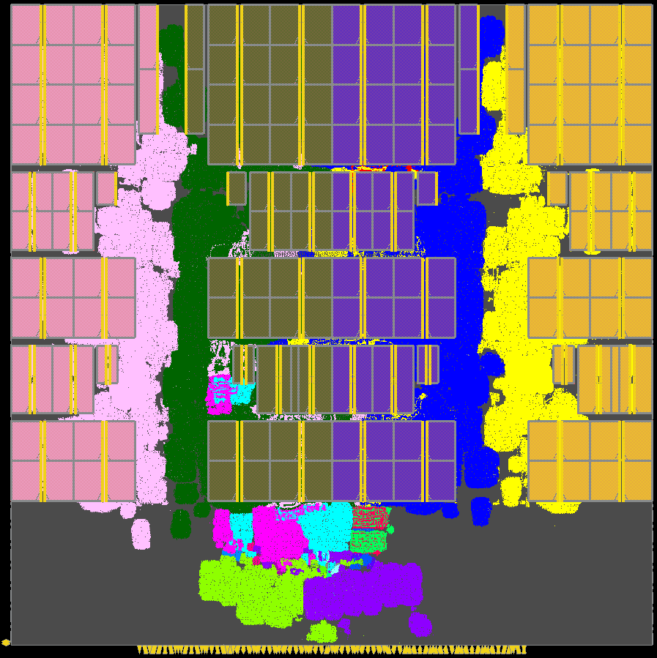
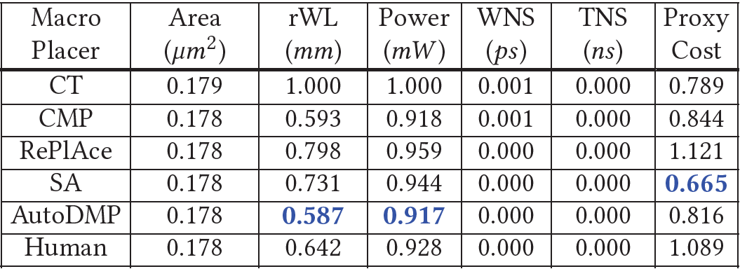
Macro Placement Solutions: BlackParrot
BlackParrot (Quad-Core) with 68% utilization on GF12
CT
CMP
RePlAce
SA
AutoDMP
Human
Note: Metric values (excluding proxy cost) are normalized
Notes:
Here are the six macro placement solutions for the BlackParrot Quad-Core design with 68% utilization, on GF 12 nanometers. Here again, the human macro placement is from Dr. Jung at IBM Research. Notice that the coloring of macros shows how different macro placers handle the quad-core design hierarchy.

Slide 22
Outline
Background and Motivation
Replication of Circuit Training (CT)
MacroPlacement Repository
Experimental Results
Academic Benchmarks
Evaluation flow and CT, SA and RePlAce results
CT vs. SA result for different weight combinations in proxy cost
Conclusion
Notes:
Now, I will discuss the experimental setup and results for “venerable” academic mixed-size placement benchmarks first used at ICCAD-04. They are of interest since results were reported for them in the Stronger Baselines manuscript.

Slide 23
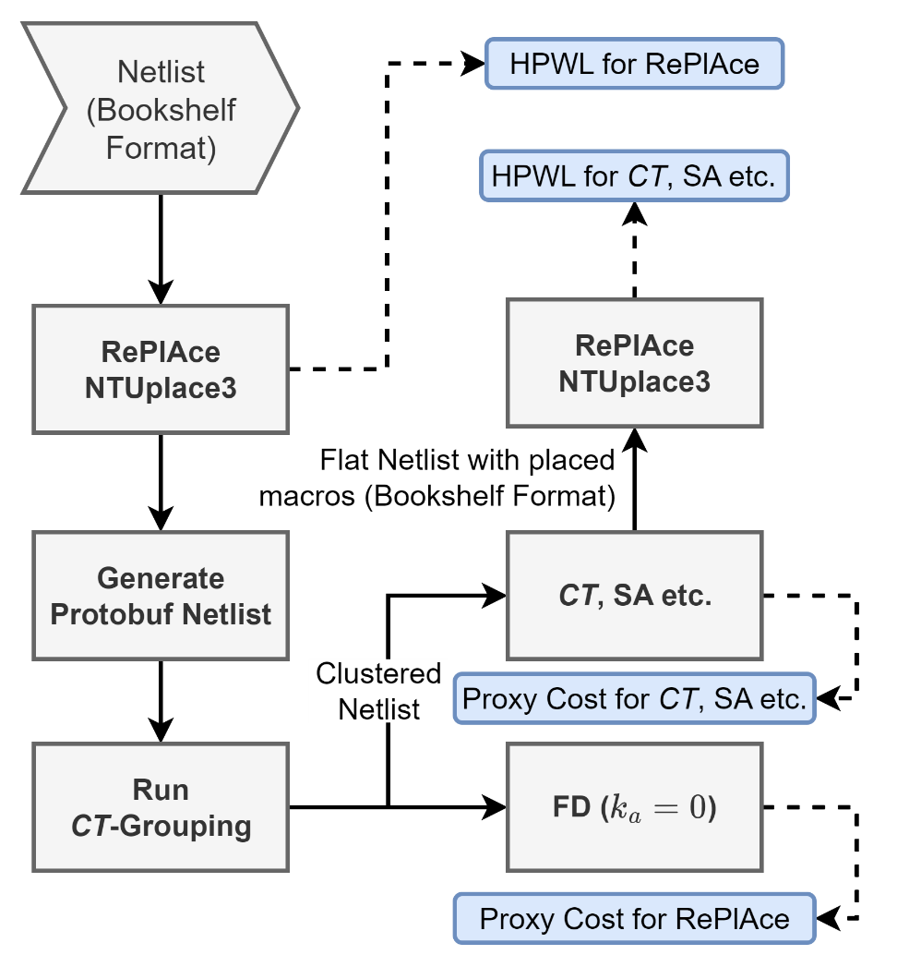
Academic Benchmark: Evaluation Flow
Study on ICCAD04 mixed-size placement benchmarks includes CT, SA, and RePlAce
Initial placement: RePlAce + NTUplace3
Used to generate clustered netlist for CT and SA
Standard cell placement of CT and SA solutions → RePlace + NTUplace3
Evaluation metrics:
Half-perimeter wirelength (HPWL) of placed design
Proxy cost reported using plc_client available in CT
More details: Section 6 of our paper
Notes:
We study the performance of CT, SA and RePlAce on the ICCAD04 mixed-size placement benchmarks. Note that these benchmarks do NOT contain all the inputs required to run a commercial P&R flow. Thus,
[CLICK] we use the evaluation flow shown here. We use RePlAce and NTUplace3 to generate the initial legal placement and then generate the clustered netlist using the CT grouping flow.
[CLICK] To evaluate the different macro placement solutions, we use the HPWL of the placed design and the proxy cost reported using the plc client from the CT repo.
We run FD placement on the input clustered netlist with zero attraction factor to capture the proxy cost of the RePlAce solution. For the CT and SA solutions, we run RePlAce and NTUplace3 to generate the standard-cell placement and capture the HPWL.
[CLICK] For more details, please check Section 6 of our paper.

Slide 24
CT, SA and RePlAce Result of ICCAD04 Benchmarks
CT
Proxy Cost: RePlAce beats SA, and SA beats CT
SA
RePlAce
Data is normalized based on CT
Table 6 of our paper gives raw data
HPWL: RePlAce beats SA, and SA beats CT , except:
HPWL: CT beats SA on 1 of 17 cases
HPWL: SA beats RePlAce on 2 of 17 cases
CT
SA
RePlAce
Notes:
The plot presents normalized proxy cost (above) and HPWL (below) metrics of the macro placement solutions generated by CT, SA and RePlAce for ICCAD04 benchmarks. Here the data points are normalized based on CT results.
[CLICK] In terms of proxy cost, RePlAce is always better than CT and SA, and SA produces better proxy cost than CT.
In terms of HPWL, RePlAce is better than SA in 15 out 17 testcases, and SA is better than CT in 16 of 17 testcases.
[CLICK] These dashed arrows point to instances for which SA beats the RePlAce HPWL, and CT beats the SA HPWL.

Slide 25
CT vs. SA: Different Proxy Cost Weight Combinations
CT
CT
SA produces better proxy cost than CT
SA
SA
SA produces better HPWL than CT
Normalized data: based on CT
Raw data: see Table 7 of the paper
γ = Density weight λ = Congestion weight
CT
CT
SA
SA
SA produces better proxy cost and HPWL results than CT, across different weight combinations, for the above two testcases
Notes:
We also evaluated CT and SA using three different density and congestion weight combinations – remember, this defines the proxy cost – for the ibm09 and ibm15 testcases.
The plot shows the normalized proxy cost and normalized HPWL.
[CLICK] In terms of proxy cost, SA produces better result than CT for ibm09 and ibm15 designs.
[CLICK] Similarly, in terms of HPWL, SA produces better solution than CT for the ibm09 and ibm15 designs.
[CLICK] So, for both HPWL and proxy cost, SA produces better results than CT across the different weight combinations for these testcases.

Slide 26
MacroPlacement Repo: More Ablation Studies
How difficult is Ariane? → Shuffling test
Are CT and SA results stable? → Variance test
What is the correlation of proxy cost with Nature Table 1 metrics?
What is the effect of physical synthesis tool choice on CT outcome?
What is the effect of target clock period on CT outcome?
What is the effect of utilization on CT outcome?
What is the effect of the coordinate descent placer on CT outcome?
Notes:
Our paper and our GitHub repo docs describe a number of additional studies.

Slide 27
Outline
Background and Motivation
Replication of Circuit Training (CT)
MacroPlacement Repository
Experimental Results
Academic Benchmarks
Conclusion
Notes:
Let me now conclude.

Slide 28
Conclusion
Nature presents a novel orchestration of multiple elements
Proxy cost function that combines wirelength, density and congestion
Sequential framework for deep RL-based macro placement
Grouping flow to manage instance complexity
Data and code (still) unavailable → our MacroPlacement assessment effort
Baselines (SA and Human experts) outperform CT
For 17 ICCAD04 designs and 4 out of 6 modern testcases, SA generates better proxy cost than CT
For large macro-heavy designs, human experts outperform CT in terms of Nature Table 1 metrics
CT benefits from placement information in the incoming physical synthesis netlist
“There is no substitute for source code (and data)”
Notes:
Google Brain’s Nature paper has been stimulating and catalyzing for our field. The authors propose a novel orchestration of several elements for chip placement:
a proxy cost function incorporating wirelength, density, and congestion;
a sequential macro placement framework; and
a grouping flow that reduces the solution space by dividing the canvas in small grids and clustering the standard cells.
Our MacroPlacement work provides an open, transparent implementation and assessment of Nature and Circuit Training, and provides key elements that are still missing or black-boxed in CT.
[CLICK] Our study finds that SA produces better proxy cost than CT for all the ICCAD04 testcases and 4 out of 6 modern testcases.
In terms of Nature Table 1 metrics, human experts outperform CT for large macro-heavy designs such as BlackParrot and MemPool Group.
So, the baseline solutions generated by SA and Human experts outperform CT in most cases – even when CT benefits from placement location data in the incoming netlist.
[CLICK] We hope that our experience and results help to highlight the bar and the value of source code, data and reproducibility for well-studied, high-stakes optimization arenas such as VLSI physical design.

Slide 29
Runtimes (Wall Times) of Different Macro Placers
Design | CT (Hours) | CMP (Hours) | RePlAce (Hours) | SA (Hours) | AutoDMP (Hours)
Ariane-NG45 | 32.31 | 0.05 | 0.06 | 12.50 | 0.29
BlackParrot-NG45 | 50.51 | 0.33 | 2.52 | 12.50 | 0.71
MemPool-NG45 | 81.23 | 1.97 | *N.A. | 12.50 | 1.73
CT: only includes CT training time
SA: stopped after 12.5 hours automatically
CMP: only the runtime of place_design -concurrent_macros command
Resource required for different macro placers
CT: Training and evaluation jobs run on (8 NVIDIA-V100 GPU, 96 CPU thread, Memory: 354 GB) machine and 13 collector jobs on each of two (96 CPU thread, Memory: 354 GB) machines
SA: 320 parallel jobs where each job used 1 thread
RePlAce: used 1 thread
CMP: Innovus launched with 8 threads
AutoDMP: run on NVIDIA DGX-A100 machine with two GPU workers
*RePlAce run for MemPool Group did not complete
Notes:
I’ll flash for the video two additional slides with “FAQs”. This slide is about wall times and resources used by the different macro placers.
[[The table presents the runtime of different macro placers. Lowest runtimes are highlighted with blue texts. We see CMP has the lowest runtime in two out of three cases.
The compute resource used for each of the macro placers are as follows:
CT training and evaluation jobs were run on an 8 GPU machine, while the collector jobs were run on two 96 CPU machines.
320 SA jobs were launched in parallel for 12.50 hours, with each SA job using a single thread.
The RePlAce run was launched using a single thread, while Innovus was launched with 8 threads for the CMP run.
The AutoDMP runs were conducted on our NVIDIA DGX-A1000 machine with two GPU workers.]]

Slide 30
FAQ
What do your results tell us about the use of RL in macro placement?
The solutions typically produced by human experts and SA are superior to those generated by the RL framework in the majority of cases we tested.
Did the work by Prof. David Pan show that Google open-source code was sufficient?
No. The arXiv paper “Delving into Macro Placement with Reinforcement Learning” was published in September 2021, before the open-sourcing of Circuit Training. To our understanding, the work focused on use of DREAMPlace instead of force-directed placement.
Did you replicate results from Stronger Baselines?
We replicated RePlAce results and believe our SA obtains similar results. However, there is no code or data available to reproduce S.B.’s reported CT results, or proxy costs of SA results.
Notes:
Several other commonly-asked questions are answered here.

Slide 31
Thank you !
We thank David Junkin, Patrick Haspel, Angela Hwang and their colleagues at Cadence and Synopsys for policy changes that permit our methods and results to be reproducible and sharable in the open, toward advancement of research in the field. We thank many Google engineers (Azalia Mirhoseini, Anna Goldie, Mustafa Yazgan, Eric Johnson, Roger Carpenter, Sergio Guadarrama, Guanhang Wu, Joe Jiang, Ebrahim Songhori, Young-Joon Lee and Ed Chi) and the TensorFlow Agents team for their time and discussions to clarify aspects of Circuit Training, and to run their internal flow with our data. We thank Ravi Varadarajan for early discussions and flow setup, and Mingyu Woo for guidance on RePlAce versions and setup. Support from NSF CCF-2112665 (TILOS) and DARPA HR0011-18-2-0032 (OpenROAD) is gratefully acknowledged.
Notes:
We thank many people, especially the Google engineers who have answered questions and run studies for many months, and the EDA companies whose recent policy changes will be a great boost for the field.
Thank you for your attention.

