Slide 1
SpecPart: A Supervised Spectral Framework for Hypergraph Partition Solution Improvement
Ismail Bustany^{[1]}, Andrew B. Kahng^{[2]}, Ioannis Koutis^{[3]}, Bodhisatta Pramanik^{[2]} and Zhiang Wang^{[2]}
^{[1] Advanced Micro Devices}
[2] University of California San Diego
[3] New Jersey Institute of Technology
Notes:
Hello everyone, I am Bodhi, a first year PhD student at UC San Diego.
This talk is about “SpecPart: A Supervised Spectral Framework for Hypergraph Partition Solution Improvement. This work is a collaboration between AMD, NJIT and UCSD.

Slide 2
SpecPart: The first supervised spectral framework for hypergraph partitioning
Three key innovations:
Leveraging Supervision: Improve spectral embeddings via supervision
Embedded Tree Partitioning: Convert embeddings to partitions
Cut-Overlay: Improve a set of partitioning solutions
Key results:
Higher quality solutions compared to hMETIS and KaHyPar (on few testcases the improvement is over 50%)
Notes:
SpecPart is the first supervised spectral framework for hypergraph partitioning and it currently generates 2-way partitions. There are three key innovations in SpecPart.
These include:
A novel supervised generalized eigenvalue problem that uses pre-computed partitions as supervision to compute eigenvectors.
These eigenvectors yield high quality vertex embeddings that are superior to those obtained without supervision.
Supervision in SpecPart is unique and is one of the major reason why SpecPart generates high quality partitions.
Next, we propose a novel tree-partitioning algorithm for obtaining partitions from a given embedding.
The algorithm uses the embedding to construct a family of trees which are partitioned using fast algorithms.
Finally, we propose a novel clustering method termed as cut-overlay based clustering for improving a small pool of partitions.
Specifically, cut overlay combines multiple partitions and generates a much better quality solution.
The key result here is that SpecPart generates higher quality partitions compared to state-of-the-art partitioners like hMETIS and KaHyPar.
In some cases SpecPart can substantially improve the QoR over 50%.

Slide 3
Outline
Background and motivation
Problem definition?
Why solve this problem?
Multilevel framework
Overview of graph Laplacians
Effect of supervision
SpecPart methodology
Overview
Supervised spectral
Conversion of embeddings to partition
Cut-overlay clustering and partitioning
Experimental setup and results
Conclusion and future work
Notes:
This is the outline of my talk.
First I will start with some background and motivation.
Then I will describe the SpecPart methodology
Following which, I will explain our Experimental setup and results
Finally I will talk about conclusion and future work.
Now I will start with some background and motivation for SpecPart.

Slide 4
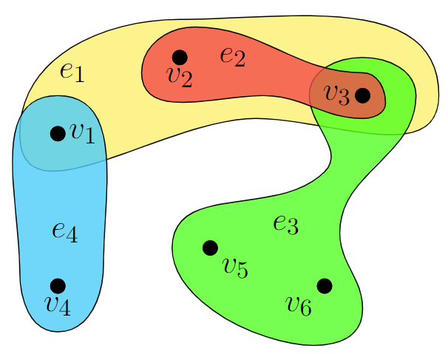
Problem definition
Hypergraphs: Hypergraphs are generalization of graphs
Hyperedges are subsets of two or more vertices
Problem definition: Given a hypergraph H = (V, E), divide V into disjoint partitions to minimize cutsize under some balance constraints
Cutsize: Number of hyperedges whose vertices lie in more than one partition (see e₁, e₂ in figure)
Balance constraint: All partitions satisfy constraints on size given by an imbalance factor
Imbalance factor of b implies maximum size of a partition:
Hypergraph with |V| = 7 and |E| = 4. Cutsize of 2-way partition = 2
$$\frac{50+b}{100}∗|V|$$
Notes:
Let us define the problem.
A hypergraph is a generalization of a graph. It consists of hyperedges that can include two or more vertices.
Now we define the problem statement.
Given a hypergraph consisting of some vertices V and hyperedges E, we want to divide the hypergraph into disjoint partitions, under a given set of balance constraints.
The objective is to minimize the cutsize, which is the number of hyperedges cut by the partition.
The balance constraint is represented by an imbalance factor which sets an upper bound on the size of a partition.

Slide 5
Why solve this problem?
Better partitions improve quality of chip implementation
Fundamental combinatorial optimization problem in VLSI CAD research and beyond
Existing state-of-the-art codes¹ are 30 years old
Previous partitioners mostly tested on old ISPD98 testcases²
Previous partitioners not permissively open-source
[1] G. Karypis, R. Aggarwal, V. Kumar and S. Shekhar, “Multilevel hypergraph partitioning: application in VLSI domain”, Proc. DAC, 1997, pp. 526–529.
[2] C. J. Alpert, “The ISPD98 circuit benchmark suite”, Proc. ISPD, 1998, pp. 80–85.
Notes:
This problem has been solved extensively for the last decade.
The question is why solve this problem.
The reason is that hypergraph partitioning is routinely used in standard EDA flow for chip implementation.
So better partitions affect quality of placement and routing and subsequent stages of the EDA design flow for chip implementation.
Furthermore, it is a fundamental combinatorial optimization problem of broader interests, not just limited to VLSI CAD research.
If we focus on the existing state-of-the-art, then it suffers from some limitations.
These partitioners are not permissively open-source.
They are almost 30 years old and have been validated on old testcases.
Furthermore, the problem sizes have increased and testcases have become more complex.
Hence a fresh look into the problem is necessary.
So we want to develop a hypergraph partitioner that addresses these limitations.
In addition, we want to incorporate more recent algorithmic advances to enhance research progress in this field and improve the state-of-the-art.
Our SpecPart is a step in this direction.

Slide 6
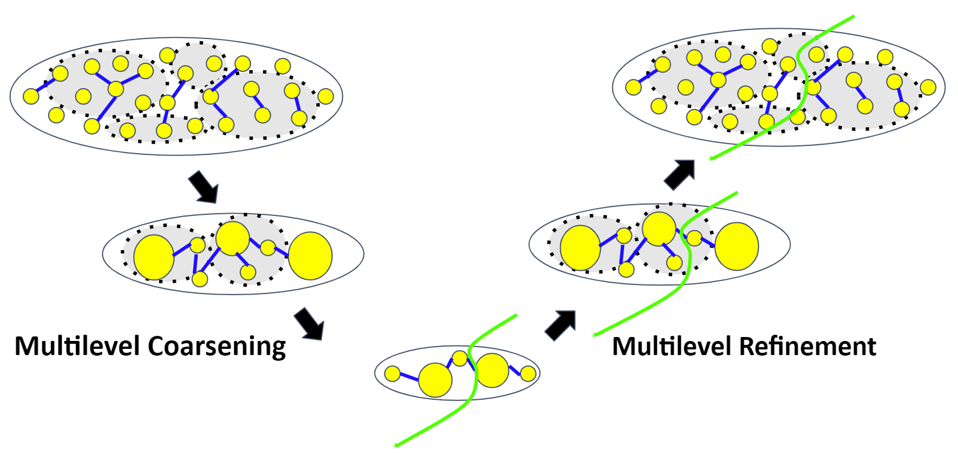
Multilevel framework
Input hypergraph
Limitations:
Local greedy coarsening heuristics
Greedy refinement gets stuck at a suboptimal solution
SpecPart Contributions:
Spectral supervision enables global view
Cut-overlay based clustering enables exploring larger solution space
Initial partitioning
Notes:
The state-of the-art multilevel framework is presented here.
We have a hypergraph which we hierarchically cluster by a process termed as multi-level coarsening, until we reduce the problem size to a small coarse hypergraph where we find an initial partitioning. Then we refine this partition at each level of the hierarchy by a process termed as “multi-level refinement”.
Now there are some limitations with the multilevel framework.
Both the clustering and refinement algorithms are local in nature.
So the partition can get stuck at a suboptimal partition as a reason.
What we offer as a solution is the idea of using eigenvectors with supervision and the cut-overlay based clustering.
The eigenvectors generate a vertex embedding which provides a global view of the hypergraph.
The cut-overlay based clustering explores a larger solution space, potentially helping to improve any suboptimal solution.
These concepts will be explained in detail in subsequent slides.

Slide 7
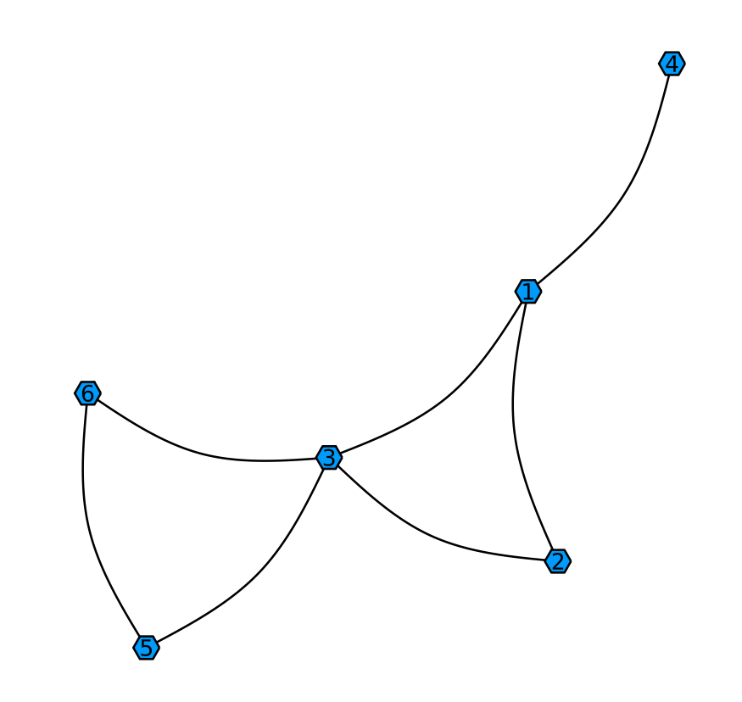
Overview of graph Laplacians
v₄
3 | 0 | 0 | 0 | 0 | 0
0 | 2 | 0 | 0 | 0 | 0
0 | 0 | 4 | 0 | 0 | 0
0 | 0 | 0 | 1 | 0 | 0
0 | 0 | 0 | 0 | 2 | 0
0 | 0 | 0 | 0 | 0 | 2
0 | 1 | 1 | 1 | 0 | 0
1 | 0 | 1 | 0 | 0 | 0
1 | 1 | 0 | 0 | 1 | 1
1 | 0 | 0 | 0 | 0 | 0
0 | 0 | 1 | 0 | 0 | 1
0 | 0 | 1 | 0 | 1 | 0
3 | -1 | -1 | -1 | 0 | 0
-1 | 2 | -1 | 0 | 0 | 0
-1 | -1 | 4 | 0 | -1 | -1
-1 | 0 | 0 | 1 | 0 | 0
0 | 0 | -1 | 0 | 2 | -1
0 | 0 | -1 | 0 | -1 | 2
G(V, E)
Block 1
Block 0
v₁
v₆
v₃
v₅
v₂
v₁ | v₂ | v₃ | v₄ | v₅ | v₆
1 | 1 | 0 | 1 | 0 | 0
Degree matrix, D
Adjacency matrix, A
Laplacian matrix, L_{G} = D - A
Partition vector, x
$Cutsize(G)=\sum_{\left(i, j\right)∈E}^{ }{{\left(x_{i}−x_{j}\right)}^{2}=x^{T}L_{G}x }$
Minimizing cutsize
$${min x}^{T}L_{G}x$$
Solve
$$L_{G}x=λx$$
$λ$ is the eigenvalue
$$min\frac{x^{T}L_{G} x}{x^{T}L_{B}x}$$
Minimizing cutsize with balance
Solve
$$L_{G}x=λL_{B}x$$
$B$captures vertex weights
Notes:
Now I present a quick overview of graph Laplacians.
[CLICK]
Given the graph on the left, we define the degree matrix and the adjacency matrix.
These are presented as follows:
The degree matrix, D is a diagonal matrix where every diagonal entry is the degree of the corresponding vertex.
The adjacency matrix, A is a square matrix that indicates whether pairs of vertices are adjacent or not.
The Laplacian matrix, L_G is now defined as the adjacency matrix subtracted from the degree matrix. It is one of the standard ways to represent a simple graph.
[CLICK]
Now we are given a 2-way partition which can be represented with a partition vector x.
x is a 0 1 indicator vector which stores the partition information for each vertex, 0 and 1 represent the 2 blocks of the partition.
The cutsize of this partition on the graph G can be expressed with the quadratic form x^T L_G x, as shown in the red box.
[CLICK]
We want to minimize the cutsize. This can be done by relaxing x over real values and solving the standard eigenvalue problem, L_Gx = lambda x
[CLICK]
Sometimes balance is often incorporated into the problem formulation.
This is done by introducing a second graph B which captures vertex weights.
Then the generalized eigenvalue problem is solved, L_Gx = lambda L_Bx.

Slide 8
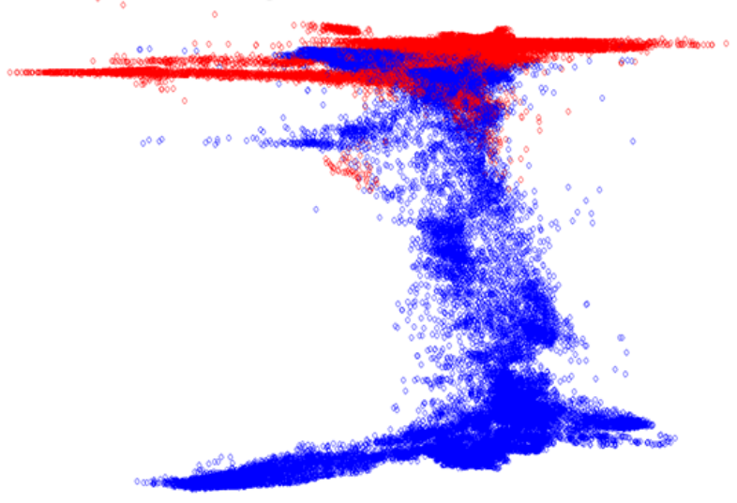
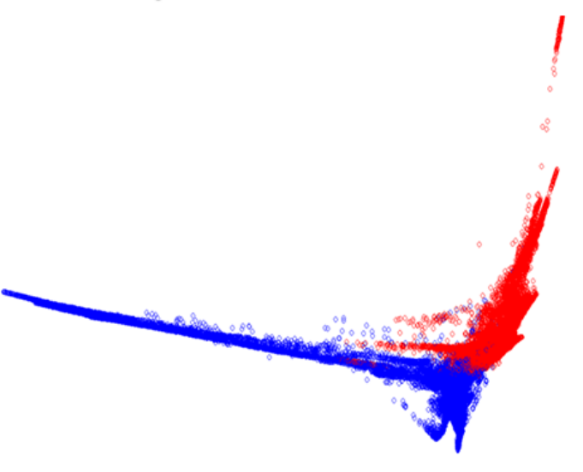
Effect of supervision: ISPD98 IBM14
Without supervision
With supervision
Supervision obtained from hMETIS
Standard embedding
$Lx=λx$
Generalized embedding $Lx=λBx$
Red and blue indicate hMETIS-bipartitioned vertices
The distinction between the partitioned vertices is clearer
Supervision generates better spectral embedding
Notes:
In these plots we show two different types of embedding on the IBM14 testcase, obtained from the smallest 2 eigenvectors
The blue and red dots indicate a known good 2-way partition computed by hMETIS with an imbalance factor of 2.
Now we observe the meaning and effect of supervision.
The embedding on the left is obtained from solving the standard eigenvalue problem, as shown in the equation.
Standard spectral partitioners solve this equation to compute their embedding.
It can be observed that there is a lot of overlaps between the red and blue dots, implying this embedding is not clean.
The embedding on the right is obtained from solving the generalized eigenvalue problem, with supervision from the known 2-way hMETIS partition.
It can be observed that, with supervision the overlap between the red and blue are lesser, i.e. the distinction between the bipartitioned vertices is cleaner.
Partitioning the vertices based on this embedding will resemble a partition similar to the known 2-way hMETIS partition used for supervision.
Hence we say that the embedding generated with supervision is of higher quality with respect to the hMETIS partition.

Slide 9
Outline
Background and motivation
Problem definition
Why solve this problem?
Multilevel framework
Overview of graph Laplacians
Effect of supervision
SpecPart methodology
Overview
Supervised spectral
Conversion of embeddings to partition
Cut-overlay clustering and partitioning
Experimental setup and results
Conclusion and future work
Notes:
Now I will now talk about the SpecPart methodology.

Slide 10
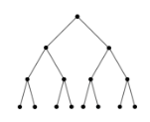
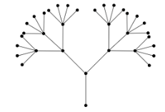
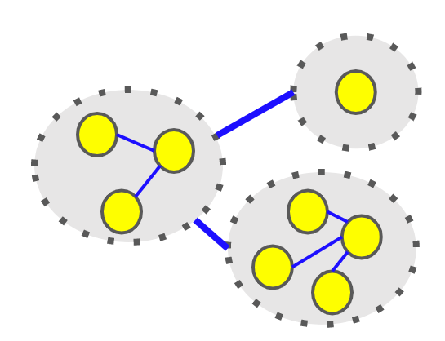
Overview
Step 2: Converting embedding to partition
Hint partition
Family of trees construction
Formulate supervised generalized eigenvalue problem $Lx=λL_{B}x$
Eigenvectors computation
Input hypergraph
Step 1: Supervised spectral embedding
Tree partitioning
Step 1 generates vertex embedding
Step 2 generates multiple partitions from embedding
Step 3 combines many partitions to generate a higher quality solution
Output partition
Partitioning of coarse hypergraph
Cut-overlay clustering
Step 3: Cut-overlay clustering and partitioning
Notes:
[CLICK]
We start with a hint partition for supervision.
[CLICK]
We use this hint to define a secondary B graph which is incorporated in the generalized eigenvalue problem as L_B, shown in the figure.
This step generates an embedding for the vertices, which gives us the global view of the hypergraph.
[CLICK]
In step 2, based on the generated embedding we construct trees and we solve the partitioning problem on these trees, thus giving us multiple partitions.
This step helps us to explore many potentially good partitions of the hypergraph.
[CLICK]
In Step 3 we combine partitions generated from the trees using the cut-overlay clustering to obtain a coarse hypergraph which is then partitioned.
This step tries to improve over suboptimal partitions by combining them and searching a larger solution space.
[CLICK]

Slide 11
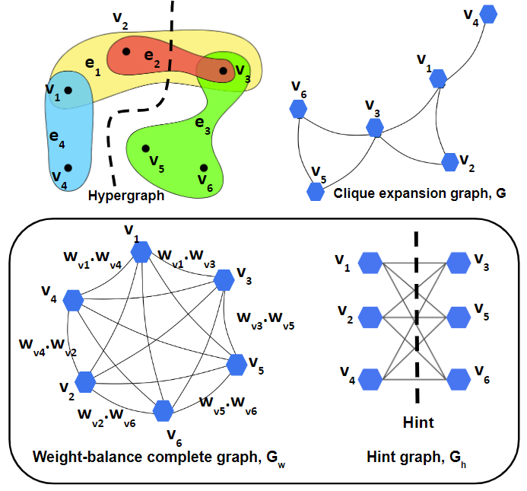
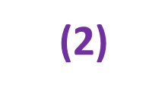
Supervised Spectral
Supervised Spectral
Embedding to partitions
Cut-overlay based clustering
L_{G}: Laplacian of G
Hint
$$\min{x^{T}L_{G}x}$$
Small cutsize on G
Minimize cut
$$x$$
$$\max{x^{T}L_{G_{w}}x}$$
Small cutsize on G_{w}
Balance cut
$$x$$
$$\max{x^{T}L_{G_{h}}x}$$
Small cutsize on G_{h}
Cut many hyperedges that are cut by hint (supervision)
$$x$$
Hint: A pre-computed partition from a black-box partitioner
Notes:
The first step of SpecPart is generating a vertex embedding using supervision with spectral.
Recall, supervision in spectral means leveraging a known 2-way partition to guide the computation of the eigenvectors.
We call this known 2-way partition a hint. This is shown with the black dashed line in the example hypergraph.
So how does supervised spectral work?
[CLICK]
First the hypergraph is converted into a proxy graph.
This is the clique expansion graph, G which is constructed from the clique transformation of hyperedges.
The clique expansion graph is the standard way of converting a hypergraph to an equivalent graph.
Equation 1 encodes the cutsize on graph G.
Minimizing equation 1 implies minimizing the cutsize on the hypergraph.
[CLICK]
Recall that we are interested in balanced partitions.
So, we construct a complete weighted graph, G_w to incentivize balance between the partitions.
The graph G_w incorporates vertex-weights and can incentivize balanced partitions.
Each edge in G_w is weighted by the product of the vertex weights that the edge connects.
In the example vertices v6 and v5 are connected with an edge weighted with the product of the weight of vertex v6 and v5.
Equation 2 encodes the cutsize on this graph. Maximizing 2 implies balance.
[CLICK] Finally, we introduce supervision into the problem formulation.
For this, we compute a complete bipartite graph, G_h from the given hint partition.
In the given example vertices v1, v2 and v4 are on one side of the partition and hence this vertex set becomes one of the two sets of the complete bipartite graph.
Equation 3 encodes the cutsize on the graph G_h.
Maximizing 3 implies preserving the hint.
In other words we incentivize the computation of partitions that are similar to the hint.
This preservation of hint is termed as supervision.
[CLICK]

Slide 12
Generalized eigenvalue problem
Supervised Spectral
Embedding to partitions
Cut-overlay based clustering
Small cutsize on G
Minimize cut
Supervision in spectral partitioning problem formulation is novel
No explicit matrix storage (solves memory bottleneck)
Supervision generates high quality embeddings
Check Section 4.1 of paper
$$\min{x^{T}L_{G}x}$$
$$x$$
Small cutsize on G_{w}
Balance cut
$$\max{x^{T}L_{G_{w}}x}$$
$$x$$
$$\max{x^{T}L_{G_{h}}x}$$
Small cutsize on G_{h}
Cut many hyperedges that are cut by hint (supervision)
$$x$$
$$min\frac{x^{T}L_{G}x}{x^{T}L_{G_{w}}x{+ x}^{T}L_{G_{h}}x}$$
$$= min\frac{x^{T}L_{G}x}{x^{T}L_{B}x}$$
where B is a graph constructed by superimposing edges of G_{w} and G_{h}
$$x$$
$$x$$
$$L_{G}x=λL_{B}x$$
$$L_{B}=L_{G_{w}}+L_{G_{h}}$$
We solve this
where
Notes:
Finally we combine equations 1,2,3 to formulate equation 4.
The graph B is obtained by superimposing edges of the hint graph and the weight balance complete graph.
[CLICK]
For real vectors x, equation 4 can be solved by solving the generalized eigenvalue problem, as shown in the bottom.
This equation is solved using a fast solver and a very efficient preconditioner.
Details about these can be found in Section 4.1 the paper.
We mentioned we use weighted complete graphs, clique expansions and complete bipartite graphs in our formulation.
These are dense graphs and would occupy a lot of memory.
But none of these are explicitly constructed and are implicitly accessed through functions which multiply their laplacians with the vector x.
[CLICK]

Slide 13
Conversion of embeddings to partition
Supervised Spectral
Embedding to partitions
Cut-overlay based clustering
v₁ and v₅ not physically connected
x₅
x₁
x₃
x₂
x₆
x₄
Traditional spectral partitioning algorithms:
Step 1: Sort the coordinates of an eigenvector to formulate a path graph
Step 2: Partition the path graph¹
Limitations:
Path graphs do not preserve physical hypergraph connectivity
Lack of physical connectivity information leads to suboptimal solution
SpecPart Solution:
Use global and local information simultaneously
Spanning trees can do this efficiently
L. Hagen and A. Kahng, “Fast spectral methods for ratio cut partitioning and clustering”, Proc. ICCAD, 1991, pp. 10-13.
Notes:
The second step of SpecPart converts the embeddings into a partition.
Traditional spectral partitioning algorithms sort the eigenvector coordinates to generate a linear ordering thus forming a path graph which is then partitioned, as shown in the figure on the right.
In the figure x5, x4 and so on represents the eigenvector coordinates of vertex v5, v4 and so on.
The path graphs naturally arrange together vertices with similar global positioning in the embedding, but neighboring vertices in the path graph may not be neighbors in the original hypergraph.
Hence local neighborhood information is not full preserved, as shown with vertices v1 and v5 in the example. This can potentially lead to poor solutions since both global and local information are equally important in partitioning.
To solve this limitation, SpecPart constructs spanning trees which incorporates both the local connectivity and the global structure of the hypergraph.

Slide 14
Tree construction
Supervised Spectral
Embedding to partitions
Cut-overlay based clustering
x₄
Graph G’ with vertices embedded onto the eigenspace
G’ is spectral sparsifier of the clique expansion graph
G’
|x₁ – x₄|
x₆
|x₃ – x₁|
x₁
Spanning tree picks edges for vertices that are :
Physically connected in the original hypergraph
Close in the embedding
|x₆ – x₃|
x₃
|x₁ – x₂|
|x₆ – x₅|
|x₃ – x₂|
|x₅ – x₃|
x₂
We compute multiple spanning trees!
x₅
Tree partitioning
(Section 4.3 of paper)
Notes:
Here is how SpecPart converts the embeddings to partitions.
Remember we do not compute the clique expansion graph explicitly.
Hence a proxy graph G’ is computed which is spectrally similar to the clique expansion graph G.
G’ is termed as the spectral sparsifier of G.
In order to preserve local connectivity of the hypergraph, this graph G’ is computed.
Next, we want to preserve the embeddings generated from the eigenvectors, i.e. we want to preserve the global view of the hypergraph.
For this we reweigh the edges of G’ according to the distances between the vertices of the edges in the given embedding
In the figure the edges of G’ are reweighed by this logic.
For example the edge between vertex v3 and v6 is reweighed with the distance between the vertices in the embedding, the absolute value of x3 – x6.
Given the graph G’, we only want to consider vertices that are physically connected and in close vicinity of each other in the embedding.
For this purpose we compute spanning trees.
[CLICK]
Given a tree, we now need to scan it for a partition.
Unlike the path graph doing this is non-trivial but still it can be done in linear time using a least common ancestor based algorithm.
[CLICK]
Different trees can generate different partitions.
This helps to explore a larger solution space for potentially good partitions.
Hence we compute multiple spanning trees, which gives us multiple partitions of the hypergraph.
More details about this, can be found in Section 4.3 of the paper.
[CLICK]

Slide 15
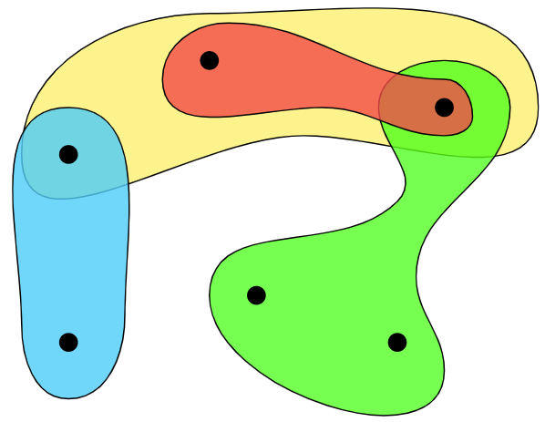
Tree partitioning
Supervised Spectral
Embedding to partitions
Cut-overlay based clustering
Hypergraph
Removing an edge of a spanning tree generates two connected components
The two connected components is a 2-way partition
v₂
v₃
v₁
Spanning tree
v₅
v₄
v₆
Reweigh each edge of the tree with equivalent cutsize of the partition (cut distilling)
A tree with n vertices can generate n-1 partitions
Pick best out of n-1 partitions
Check Section 4.3 of paper for details
Tree partition resembles hypergraph partition
Cut distilling and partitioning of tree
e₂
e₁
e₂
e₁
v₂
v₂
2
v₃
v₃
1
v₁
v₁
1
e₄
1
e₄
e₃
1
e₃
v₅
v₅
v₄
v₆
v₄
v₆
Partition cuts through e₁ and e₂
Notes:
Now I give a brief overview of how a partition is generated from a given tree.
[CLICK]
So, we are given a hypergraph and we have constructed a tree [CLICK] from the vertex embedding we generated with the eigenvectors.
Observe that given a spanning tree, removing an edge breaks the tree into two connected components.
[CLICK] These two connected components can be visualized as two partitions.
The vertices in these two partitions can induce a 2-way partition of the hypergraph.
So, every edge in the spanning tree can be removed to generate a 2-way partition.
[CLICK]
In this example, removing the spanning tree edge induces a partition with cutsize of 2.
This brings us to a process termed as cut-distilling, where we reweigh each spanning tree edge with the cutsize of the partition generated on the hypergraph, by removing that edge. In the example these are shown in the lower-left figure with the red numbers next to the tree edges.
Reweighing all edges of the spanning tree or cut-distilling can be done quickly by using a combination of least common ancestors algorithm and dynamic programming
I will not be talking about these, but details can be found in Section 4.3 of the paper.
An interesting observation is that the spanning tree with “n” vertices can generate “n-1” partitions from the n-1 edges.
However not all partitions will be within the balance constraints.
So, we scan the entire tree in linear time, for balanced partitions and pick the best.
Recall, that we have multiple trees.
So, each of these trees are partitioned by this process, which gives us multiple partitions of the hypergraph.
This in turn helps us explore a larger solution space.

Slide 16
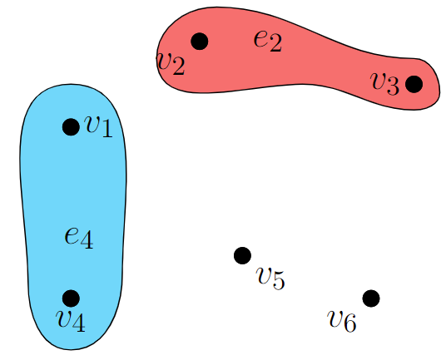
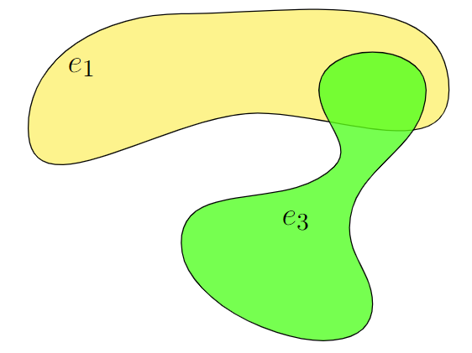
Removing cut hyperedges
Supervised Spectral
Embedding to partitions
Cut-overlay based clustering
Contract these vertices
Clustered vertex
Partition
4 connected components
Coarse hypergraph
Removing hyperedges (e1, e2, e3) in cut results in 4 connected components
Contracting these connected components result in clusters
Notes:
In the previous slide, we saw how we generate multiple 2-way partitions from multiple spanning trees.
Now we improve the solution further using cut-overlay
Let me start with an observation about what happens when we remove cut hyperedges from a hypergraph.
[CLICK]
In the example, we present a 2-way partition.
One may assume that removing the hyperedges cut by this partition would result in two connected components of the hypergraph but we get 4 connected components.
[CLICK]
The vertices in these connected components can be contracted into clusters. In bigger testcases there may be many of these connected components.
[CLICK]
Thus, removal of hyperedges cut by a partition generates a coarse hypergraph.
An interesting observation is that the partition, for example the one shown in the black dotted line on the left can still be found in the coarse hypergraph.
[CLICK]

Slide 17
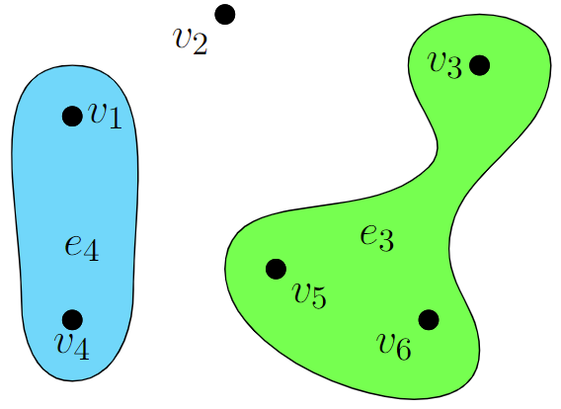
Cut-overlay clustering and partitioning
Supervised Spectral
Embedding to partitions
Cut-overlay based clustering
Partition 1
Partition 2
SpecPart partition
`
Step 1:
Partition 1 cuts hyperedge e1
Partition 2 cuts hyperedges e1 and e2
Step 2: Remove e1 and e2
Step 3: Contract connected components
Step 4: Partition coarse hypergraph
Clustered hypergraph is guaranteed to contain solutions as good as “Partition 1” and “Partition 2”
Combination of multiple solution facilitates in exploration of wider solution space (Section 3.2 of paper)
Notes:
We extend the previous example by observing a hypergraph with two different partitions.
Cut-overlay first removes all the hyperedges that are cut by the partitions.
In the example these are hyperedges e1 and e2.
This generates connected components as shown in the example which are then contracted to generate our coarse hypergraph.
By construction, this coarse hypergraph is guaranteed to contain solutions as good as partitions 1 and 2.
It can potentially contain better solutions by combining the 2 partitions.
Now in order to find the best solution and possibly improve upon any suboptimality, we run an ILP on the coarse hypergraph to obtain the optimal partition.
This ILP generated partition on the coarse hypergraph becomes the output of SpecPart.
[CLICK]

Slide 18
Outline
Background and motivation
Problem definition
Why solve this problem?
Multilevel framework
Overview of graph Laplacians
Effect of supervision
SpecPart methodology
Overview
Supervised spectral
Conversion of embeddings to partition
Cut-overlay clustering and partitioning
Experimental setup and results
Conclusion and future work
Notes:
Having talked about the steps of SpecPart, now I will talk about the experimental results of SpecPart.
[CLICK]

Slide 19
Results on ISPD98 testcases with unit weights and on Titan23 testcases
ISPD98 with unit weights | Imbalance factor | Previous record cutsize | SpecPart cutsize
IBM04 | 10 | 542 | 388
IBM06 | 10 | 885 | 733
IBM13 | 10 | 832 | 693
IBM15 | 2 | 2833 | 2741
IBM16 | 2 | 2059 | 1951
IBM17 | 2 | 2403 | 2354
Titan23 | Imbalance factor | hMETIS cutsize | SpecPart cutsize
sparcT1_core | 20 | 1242 | 903
denoise | 20 | 478 | 224
gsm_switch | 20 | 5352 | 1407
dart | 2 | 844 | 807
sparcT1_chip2 | 2 | 1198 | 899
bitcoin_miner | 2 | 1489 | 1297
New world record cutsize numbers (for almost every testcase!)
Improvement on gsm_switch ~70%
Improvement on denoise ~50%
Check Section 5 of paper (scan QR code) to find detailed results
19
19
19
19
Notes:
The table on the left shows the comparison of SpecPart cutsize with previous record cutsizes on some ISPD98 testcases.
The hint for SpecPart that is used for supervision, is generated from a single run of hMETIS.
Our SpecPart pushes the leaderboard of cutsizes for all ISPD98 testcases. These can be found in the paper.
The table on the right compares SpecPart cutsizes with hMETIS for some Titan23 testcases.
The cutsizes presented for hMETIS is the best out of 5 runs.
The reasoning behind picking 5 is motivated by iso-runtime comparison.
We however compare SpecPart with more runs of hMETIS to get a better estimate of performance.
Details about such comparisons can be found in the paper.
Some of the testcases where SpecPart generates the best results are presented in this slide. We however improve upon previous record cutsizes on almost all ISPD98 testcases and improve over hMETIS and KaHyPar on all testcases.
On some testcases like gsm_switch and denoise our improvement is dramatic.
[CLICK]

Slide 20
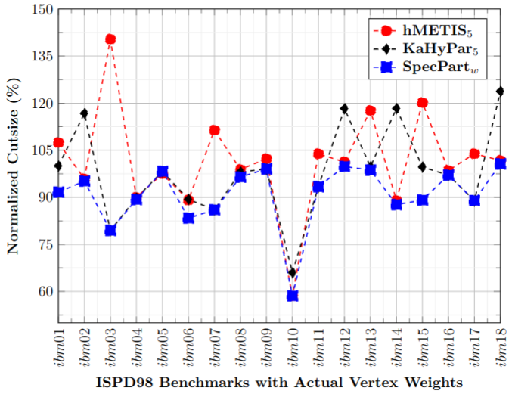
Results on ISPD98 testcases with weights
hMETIS₅ : Best hMETIS cutsize out of 5 runs
KaHyPar₅ : Best KaHyPar cutsize out of 5 runs
SpecPart_{w} : SpecPart cutsize on weighted ISPD98 testcases
Normalization with respect to best published cutsize
Green circles indicate major improvements
SpecPart better than SOTA, hMETIS and KaHyPar
imbalance factor 10
20
20
20
20
Notes:
Here we show the results of SpecPart on ISPD98 testcases with actual vertex weights for an imbalance factor of 10.
The x axis represents the ISPD98 testcases.
They y axis represents the normalized cutsize where the normalization is done with respect to the best published cutsizes for these testcases.
hMETIS5 is hMETIS cutsize from the best out of 5 runs.
KaHyPar5 is KaHyPar cutsize from the best out of 5 runs.
Each run is with a different random seed.
SpecPartw is the SpecPart cutsize on these ISPD98 testcases.
The inclusion of vertex weights makes the hypergraph partitioning problem more general and potentially more difficult to solve.
Here we see a tendency of SpecPart to yield even bigger improvements, compared to the improvements on the ISPD98 test suite with unit vertex weights.
The green circles indicate cases where there is significant improvement.
Overall, the general trend is that SpecPart generates better partitions than state-of-art hMETIS and KaHyPar for the ISPD98 test suite with actual vertex weights.

Slide 21
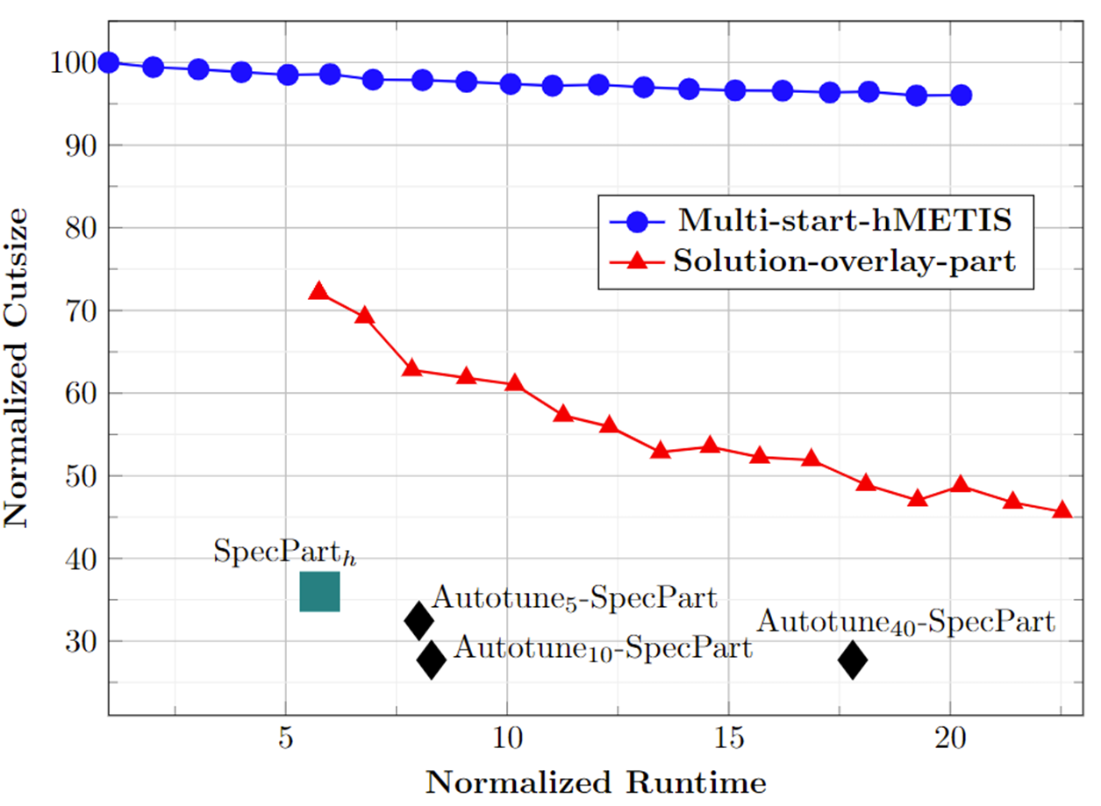
QoR vs runtime overhead comparison
Multi-start-hMETIS: hMETIS run with multiple starts
More starts generate small improvement
More runtime overhead
Solution-overlay-part: Solutions from multi-start-hMETIS are combined by cut-overlay based clustering and partitioned
Improves over multi-start-hMETIS
More runtime overhead
SpecPart_{h}: SpecPart run with hint from single run of hMETIS
Improves over multi-start-hMETIS and solution-overlay-part
Autotune_{m}: Running AutoTune with m trials
Improves over SpecPart
More runtime overhead
gsm_switch
imbalance 10
QoR vs. runtime overhead comparison
Normalization to a single run of hMETIS
21
21
21
21
Notes:
Here we compare the QoR vs runtime overhead for SpecPart and also show the effect of cut-overlay and supervised spectral.
The x and y axis represent the normalized runtime and cutsize respectively.
The normalization is done with respect to a single run of hMETIS.
[CLICK]
The blue line is hMETIS with multiple starts.
It can be observed that multi-starts improve solution quality very marginally but with more runtime.
This further shows the effect of suboptimality.
Even multiple starts with different random seeds do not generate much improvement.
[CLICK]
The red line is cut-overlay and partitioning run on the solutions from multi-start-hMETIS.
This generates significant better results than multi-start-hmetis. This shows the effect of cut-overlay clustering of SpecPart and how it can potentially improve over any suboptimal solution.
The runtime overhead incurred is because of multi-start-hmetis.
This result also demonstrates that cut-overlay based clustering can be of independent interest.
[CLICK]
The green box is SpecPart run with hint from a single run of hMETIS.
This is significantly better than both the blue line and the red line.
With the addition of supervised spectral heuristics and cut-overlay clustering SpecPart generates better solutions in much less runtime compared to multi-start-hmetis and solution-overlay-part.
The black diamonds are Autotuned-SpecPart. This generates some improvement over SpecPart but with more runtime overhead.
[CLICK]

Slide 22
Outline
Background and motivation
Problem definition
Why solve this problem?
Multilevel framework
Overview of graph Laplacians
Effect of supervision
SpecPart methodology
Overview
Supervised spectral
Conversion of embeddings to partition
Cut-overlay clustering and partitioning
Experimental setup and results
Conclusion and future work
Notes:
Finally, I will now talk about our conclusion and future directions.
[CLICK]

Slide 23
Conclusion and future directions:
Conclusion:
We proposed SpecPart, the first supervised spectral framework for hypergraph partitioning solution improvement
Experiments confirm very high QoR on some testcases
All codes/scripts/results are available here: https://github.com/TILOS-AI-Institute/HypergraphPartitioning.git
Future directions:
SpecPart extension to multi-way generalization.
Improve QoR of SpecPart further
Investigate speeding up ILP
Update leaderboard with research progress
Usage of SpecPart and collaborations with you
23
23
23
23
Notes:
To summarize, we proposed a new hypergraph partitioner SpecPart, which uses spectral supervision and cut-overlay to generate higher quality partitions compared to state-of-the-art.
The codes and scripts are available in the repository linked with the QR code.
For future directions, first we want to extend SpecPart to more than 2-way partitions.
Second, we want to improve the QoR and keep updating the leaderboard with progress.
We would also investigate speeding up the ILP solver by trying to leverage the problem structure.
Finally we would recommend everyone to use SpecPart if interested, and we are always looking for research collaborations in this field, to enhance the quality of hypergraph partitioners.

Slide 24
THANK YOU!
We thank Dr. Chris Chu and Dr. Grigor Gasparyan for their insights into the hypergraph partitioning problem
This work has been partially supported by NSF grants CCF-2112665, CCF-2039863 and CCF-1813374, and by DARPA HR0011-18-2-0032
Paper
24
24
24
24
Notes:
Thank you for listening to my talk.

