Slide 1
METRICS2.1 and Flow Tuning in the IEEE CEDA Robust Design Flow and OpenROAD
J. Jung, A. B. Kahng, S. Kim and R. Varadarajan, “METRICS2.1 and Flow Tuning in the IEEE CEDA Robust Design Flow and OpenROAD”, Proc. ICCAD, 2021, to appear.
Seungwon Kim: sek006@ucsd.edu
Ravi Varadarajan: rvaradarajan@ucsd.edu
Notes:
Thank you very much for taking your time for our presentation. Today, I would like to introduce METRICS2.1 and Flow Tuning in the IEEE CEDA Robust Design Flow and OpenROAD for ICCAD 2021 presentation.

Slide 2
ML in EDA and IC Design Requires Data and Standards
Standard ML platform(s) for EDA and design process modeling
Enable design metrics collection, tool/flow model generation, design-adaptive tool/flow configuration, prediction of tool/flow outcomes
Datasets to support ML
Real and artificial designs
Shared training
Challenges and incentives: “Kaggle for ML in IC design”
Notes:
Today, machine learning is a key for EDA and IC design.
However, the lack of a standard ML platform raises the following questions.
Can trained models be shared? Can users collaborate to develop a generic model of ICC2 or Innovus? Can we collect flex, lsf, logfile data in some common and standard way?
So, we focus on development of METRICS2.1 as a standard platform based on the open-source OpenROAD tool and its OpenDB and OpenSTA components.
In OpenROAD, this infrastructure serves many purposes, from dashboards to analytics.
With IEEE CEDA’s Design Automation Technical Committee, we’ve been creating public datasets and Jupyter notebooks as an open starting point for students, researchers and practitioners.

Slide 3
“METRICS” (DAC00, ISQED01)
METRICS 1.0 (1999; DAC00, ISQED01)
“Measure to Improve” http://vlsicad.ucsd.edu/GSRC/metrics
METRICS 2.0 (WOSET-2018) was proposed as an update of METRICS 1.0
METRICS2.1 is proposed as an extension to METRICS 2.0
Notes:
METRICS 1.0 in the late 1990s proposed to measure all design activity, mine data, predict tool outcomes and find design-specific tuning and fields of use for a given tool.
In 2018, METRICS2.0 revisited metrics and proposed an updated architecture for collecting and sharing of big data for Machine Learning.
METRICS2.1 is a proposed extension that formalizes METRICS syntax and gives an OpenROAD-based realization, plus public repos of metrics data for visualization and ML applications.

Slide 4
METRICS2.1 Overview
An initiative of the IEEE CEDA Design Automation Technical Committee (DATC)
Collection and sharing of design of experiment (DoE) public datasets using the OpenROAD tool, with intelligent setting of constraints
Sample Jupyter notebooks on the datasets to visualize and build simple prediction models
True “No-Human-in-Loop”: Automatic hyperparameter tuning of engine parameters
RTL-to-GDS flow
METRICS2.1 API
Open in the git repo
Tool logs
Tool A
Synthesis
Data Collection
Tool B
Floorplan
Tool C
Placement
METRICS2.1
JSON Dictionary
ML Applications
Tool D
Clock Tree Synthesis
Tool E
Signal Routing
Flow Autotuning
Tool F
Verification
Notes:
METRICS2.1 reflects our quest to share METRICS infrastructure more effectively.
METRICS2.1 is now with IEEE CEDA DATC, [CLICK] and uses the OpenROAD tool, which is an opensource RTL-to-GDS flow.
[CLICK] Then, METRICS2.1 provides integrated metrics from logs obtained from OpenROAD flows consisting of a variety of academic tools.
[CLICK] We upload thousands of PnR metrics datasets per each experiment to IEEE CEDA DATC's Robust Design flow git repository for effective sharing.
We also share simple analysis and ML applications in the form of Jupyter notebooks for ease of access.
Finally, we are sharing the results with the input parameter automatic tuner to achieve "No-Human-in-Loop“.
The next slides are about the METRICS2.1 dictionary format and application examples.

Slide 5
METRICS2.1 Principles
General and extensible
Syntax and semantics to support future addition of new metrics
No ambiguity!
Any desired measurement must map to a unique METRICS2.1 metric
Every METRICS2.1 metric must map to a unique interpretation as a measurement
This two-way mapping is crucial to avoid future confusion
Ability to capture the same metric at different stages of the design flow
Free, open and frictionless to everyone; agnostic to any EDA vendor
Notes:
METRICS2.1 wants to be simple, general and extensible in its syntax and semantics.
A guiding precept is that (1) any desired measurement must map to a unique METRICS2.1 metric and (2) every METRICS2.1 metric must map to unique interpretation as a measurement and should be intuitively obvious to users.
This two-way mapping is important to avoid a “tower of babel” situation. Also: In a typical design flow, the value of a specific metric changes at different stages in the flow and we want to be able to capture the same metric at different stages. This has led to the following METRICS2.1 organization and naming convention ….

Slide 6
METRICS2.1 Organization
METRICS2.1 is organized as a hierarchical JSON object
Top level: predefined stage or a user-defined snapshot
Default stages are init, synth, floorplan, globalplace, detailedplace, cts, globalroute, detailedroute and finish
Inside each stage: metrics are further organized as a predefined metrics category, a metrics name, an optional metrics name modifier, and optional metrics classification modifiers
Predefined metrics categories are flow, design, timing, power and route
A metric name and its optional name modifier uniquely define the metric and its units, e.g., design__instance__count
A metric classification modifier subdivides the metric into a specific type (stdcells, macros) or a specific structure (clock domain, analysis view etc.)
Precedence order is part of the METRICS2.1 specification
METRICS2.1 naming convention: https://github.com/ieee-ceda-datc/datc-rdf-Metrics4ML#metrics-naming-convention
Metrics Stage
Metrics Category
Metrics Name
Metrics Name Modifiers
Metrics Classification Modifiers
Notes:
METRICS2.1 is organized as a hierarchical JSON object
[CLICK] At the top level is the predefined “stage” or user define “snapshot”. Inside each stage are the metrics.
[CLICK] Metrics are further organized as a metrics name, an optional metrics name modifier, and optional metrics classification modifiers. A metric name and its optional name modifier uniquely identifies the metrics and its unit
[CLICK] Metric classification modifiers subdivide the metric into a specific type such as standard cells and hard macros, or a specific structure such as clock domain.
Precedence order is part of the specification. For example: we shouldn’t have both double-height regular VT and regular VT double-height.
[CLICK] The naming convention is explained in the DATC GitHub.

Slide 7
METRICS2.1 Examples
Sample metrics
Metric | Description
timing__setup__wns | Setup worst negative slack in the design
timing__setup__wns__clock:clk_a | Setup worst negative slack for clock “clk_a” in the design
timing__setup__wns__analysis_view:slow | Setup worst negative slack for the analysis view “slow”
power_total | Total power consumption
power__leakage | Total leakage power
power__leakage__clock | Total leakage power in the clock network
Notes:
Here are some example METRICS2.1 metrics and their interpretation.

Slide 8
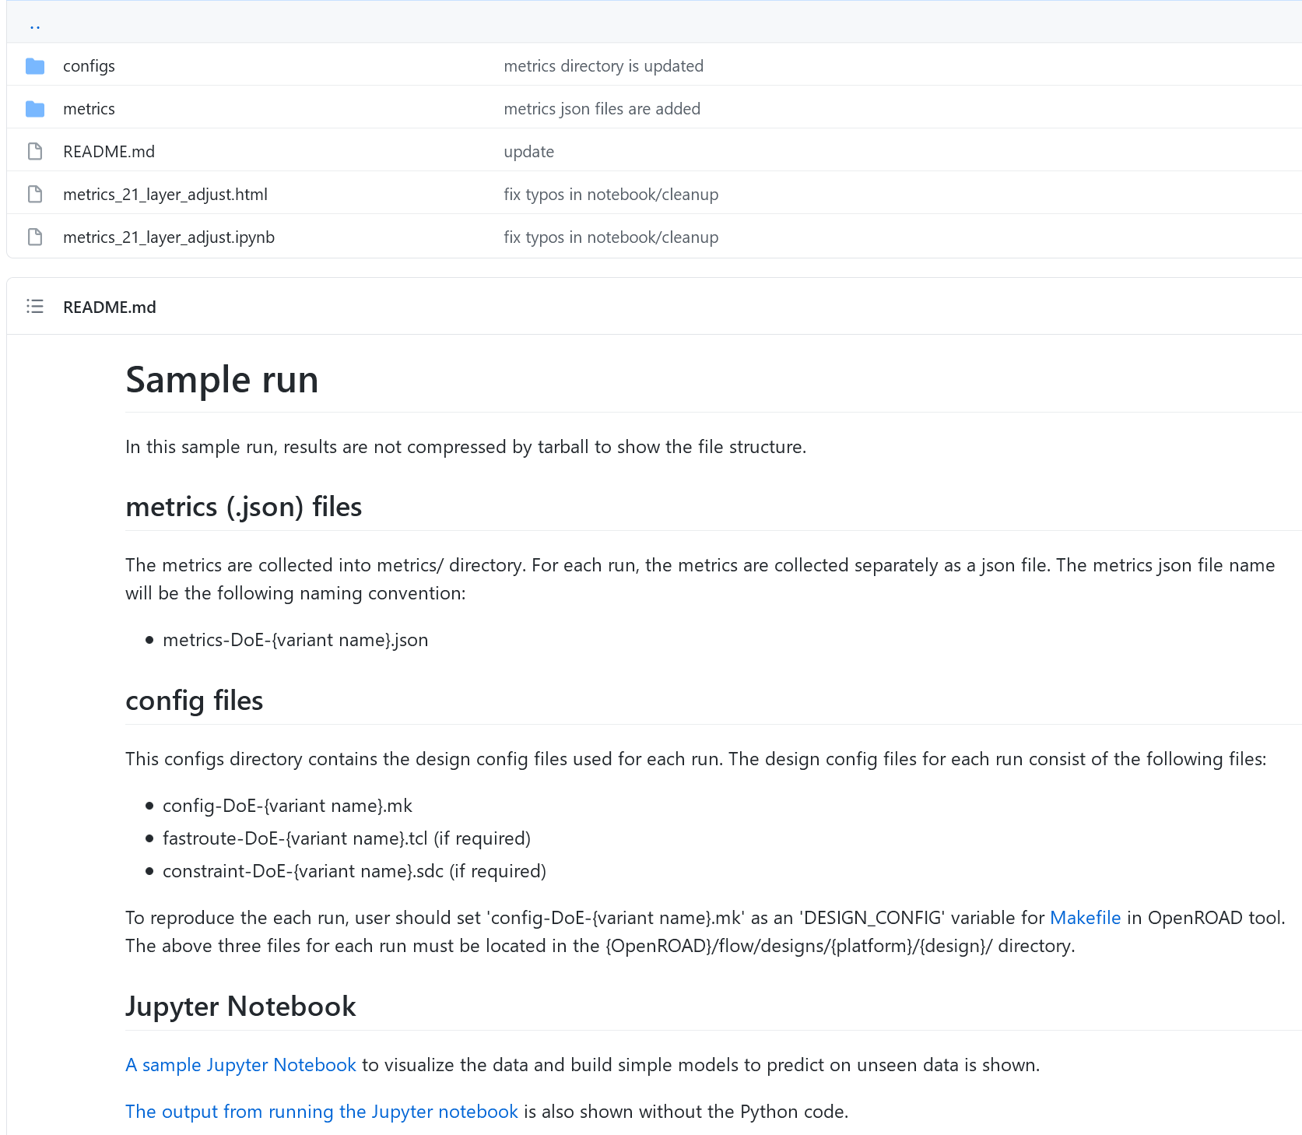
https://github.com/ieee-ceda-datc/datc-rdf-Metrics4ML/tree/main/experiments/sky130hd__ibex_core__sample
Sample Collection of DoE Runs
Name of experiment,
Description of experiment
General description of metrics (.json) files
General description of config files for reproducibility
Sample analysis and ML applications with Jupyter notebook
Notes:
We uploaded reproducible data into the github as “experiments”. Each experiment has name and a brief description of what it does. This slide shows the organization of the data for a specific Design of Experiment.
[CLICK] At the top is the name and a brief description of the experiment.
[CLICK] The Metrics for each run in the experiment are stored in the metrics directory in the METRICS2.1 format.
[CLICK] The OpenROAD tool config files and commit are stored in the config directory, with supporting files such as constraints.
[CLICK] Finally, we also uploaded a sample Jupyter notebook for data visualization and run ML prediction models.

Slide 9
Sample METRICS2.1 Application: ibex, SKY130HD
ibex = lowRISC RISC-V core [https://github.com/lowRISC/ibex] (15,708 instances)
Design run with OpenROAD flow scripts
Parameters swept:
Core utilization of 20% to 40% in increments of 2%
Layer track resource adjustment for M1 to M4 from 0.1 to 0.2 in steps of .025
Metrics of interest:
Successful or Doomed (failure in Global or Detailed Route)
Route runtime, DRC errors
Routed wirelength
Build prediction models for Success/Failure and estimated wirelength for new parameter settings
Notes:
One of the experiments is on the opensource RISC-V core “ibex” on the Skywater 130 nanometer HD platform. For this experiment, we swept the core utilization for the floorplan and the global router layer track resource adjustment.
Metrics of interest are predicting successful or doomed runs, the run time and number of DRC errors and the final routed wirelength.

Slide 10
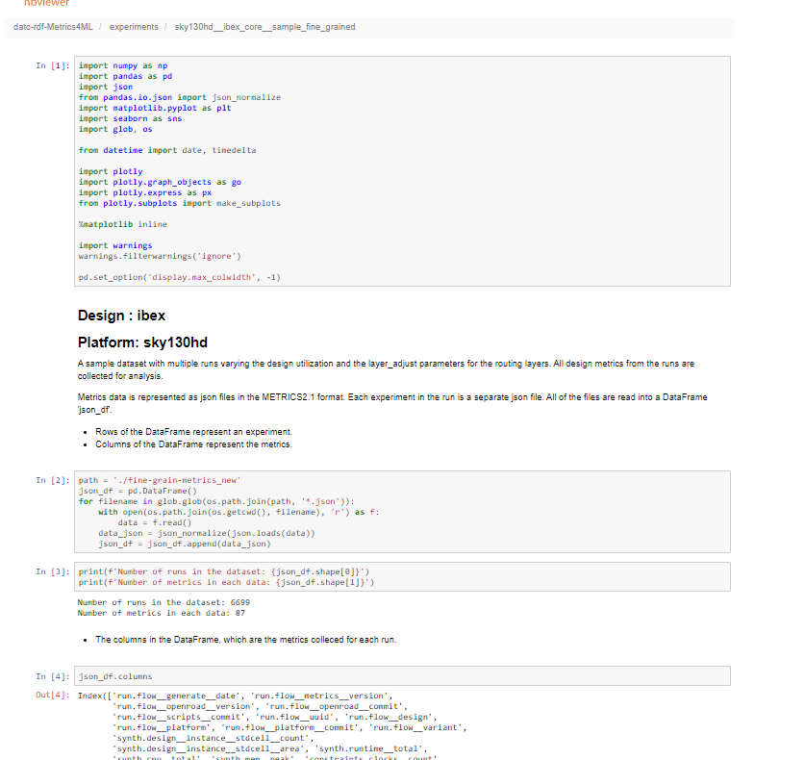
Sample METRICS2.1 Application
https://github.com/ieee-ceda-datc/datc-rdf-Metrics4ML/tree/main/experiments/sky130hd__ibex_core__sample_fine_grained contains the data and the Jupyter Notebook
Jupyter Notebook:
Read METRICS data
Data engineering to pull, organize relevant data
Visualize trends, statistics
Leverages python packages json, pandas, matplotlib, plotly, sklearn
Use sklearn
Logistic regression to predict successful/doomed runs
Linear regression to estimate wirelength, runtime
Notes:
Sample METRICS2.1 applications are uploaded into GitHub. Each experiment contains all of the data to reproduce the results, the collected metrics data, and a sample Jupyter notebook that operates on the data.
[CLICK] The Jupyter notebook reads the metrics data and performs data engineering to organize and visualize for analysis. It also leverages the python packages, namely json, pandas, matplotlib, and plot-ly to perform data engineering and visualization. It also uses scikit-learn to perform logistic regression and build prediction models to estimate wirelength and runtime for unseen parameter settings.

Slide 11
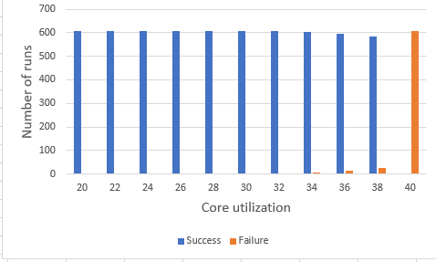
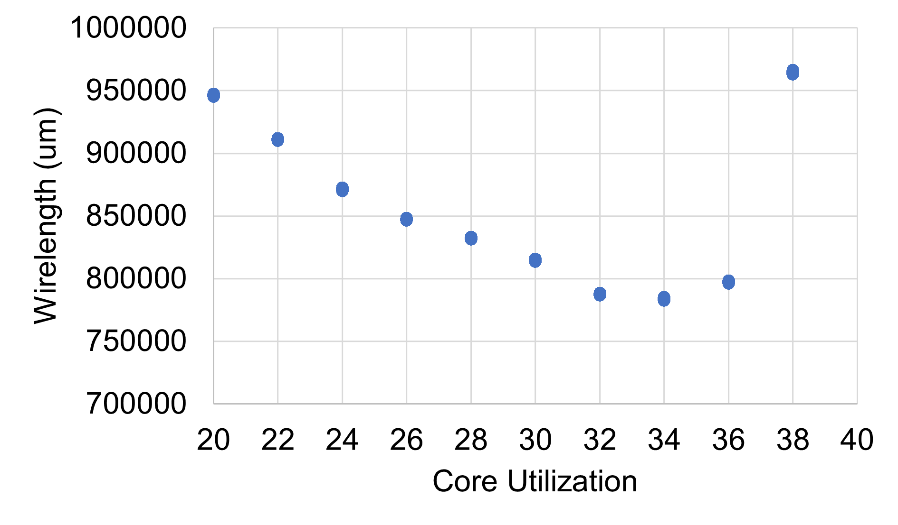
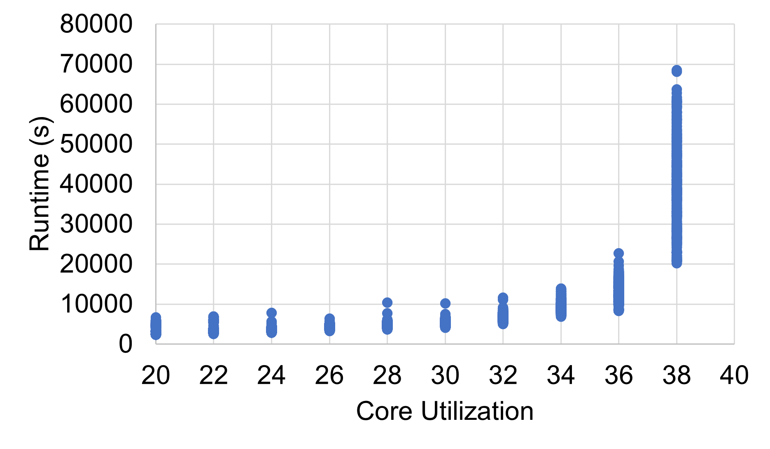
Sample Plots from Jupyter Notebook
Successes vs. Failures at Different Utilizations
Wirelength vs. Core Utilization
Runtime vs. Core Utilization
sweet spot
Sweet spot
Sweep of routing layer resource adjustment
Notes:
This shows some sample plots from the Jupytyer notebook.
[CLICK] This one is classical: total wirelength decreases with increased utilization, but beyond a certain point it starts to increase – because the lack of routing resource causes detouring to resolve DRC errors.
[CLICK] We can also see this in the Runtime chart where the runtime is fairly constant at lower utilization with little variance. However, as core utilization increases, we see not only an increase in runtimes but also a wider variance across layout resource adjustment settings.

Slide 12
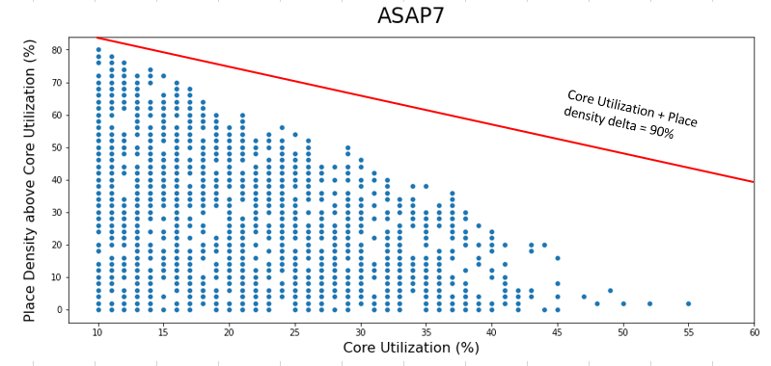
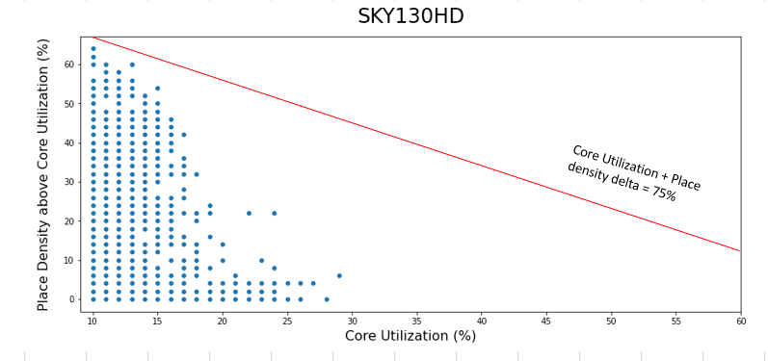
Another Sample METRICS2.1 Application
Design: ibex on ASAP7 and SKY130HD platforms
Parameters swept
Core Utilization: 10% to 60% in increments of 1%
Place Density (RePlAce) delta above Core Utilization: 0% to 90% in increments of 2%
2295 data entries for each platform
Metrics of interest
Successful or Doomed
Routed Wirelength
Shown in Plots
728 of 2295 ASAP7 runs are successful
252 of 2295 SKY130HD runs are successful
Notes:
Another experiment is on the same opensource “ibex” testcase on the SKY130HD and ASAP7 platforms. For this experiment, we swept the core utilization for the floorplan as well as the global router’s place density parameter, expressed as a delta above core utilization.
The plots show all successful runs in the cross product of these two parameters for both platforms.
As you can see in the graphs, ASAP7 had more successful runs and could achieve higher core utilization and global placement density than SKY130HD.
In each plot, the RED TRACE shows a constant value for Core Utilization PLUS Place Density Delta.
We can see that in both platforms, as core utilization increases the maximum achievable global placement density decreases.

Slide 13
Autotuning (in OpenROAD and Beyond)
Notes:
Let me switch gears now to introduce about autotuning – or, “blackbox hyperparameter optimization”

Slide 14
AutoTuner: True No-Human-in-the-Loop Operation
OpenROAD flow
Synthesis
Best human-tuned flow
vs.
Auto-tuned flow (No Human In Loop)
Floorplan
AutoTuner
Placement
Clock Tree Synthesis
A “No-Human-in-Loop” for RTL-to-GDS flow
23% Faster!
45% Less Power Consumption!
Signal Routing
Tested in SKY130HD lowRISC RISC-V core (ibex)
Verification
Note: AutoTuner being deployed on GCP for public enablements (SKY130*, ASAP7).
Notes:
OpenROAD can also be applied in conjunction with automatic tuning of flow input parameters, which achieves a true “No-Human-in-the-Loop” operation that achieves better QOR than our internal expert users.

Slide 15
Flow Parameter AutoTuner – Overview
A “No-Human-in-Loop” for RTL-to-GDS flow
Automatic iterative tuning for QoR improvement within a given hyperparameter range space
Interface: Python packages Ray/Tune
Search algorithms: HyperOpt, PBT, Optuna, etc.
Advantages:
Pre-existing big data is not necessary for execution
Fewer trials compared to random or grid parameter sweeping
Powerful parallelization management: core/thread management, external server usage, web visualization
Suboptimality gap reduces with compute resource, schedule budget
Notes:
Here we show an AutoTuner -- a top-level wrapper script which gives a “no-human-in-loop” RTL-to-GDS flow.
The AutoTuner iterates through the flow for a given parameter type and range to find a better set of hyperparameters for QoR improvement.
AutoTuner uses the Python Ray and Tune APIs, a powerful and easy-to-use parallelization implementation package.
A big advantage of AutoTuner is that it does not require large pre-prepared datasets. And, we find that it significantly improves tool outcomes within reasonable budgets for schedule and compute resource.

Slide 16
Flow Parameter AutoTuner – Architecture
No-Human-in-Loop
Best known parameter set
No given parameter set
option 2
parallel execution
option 1
Parameter config
input parameter name, range, step, type
AutoTuner
(Ray/Tune)
The RTL-to-GDS process is automatically executed in parallel by Ray/Tune API
Pick hyperparameter sets based on config / results
Parse picked set to form RTL-to-GDS tool runscript
Searching algorithm (switchable)
Evaluation objective function
Run runscript
Collect METRICS2.1 json
Ray/Tune options #trials, #cores, etc.
Evaluate results
Notes:
This is an architectural overview of the AutoTuner.
The AutoTuner iteratively searches for the best hyperparameter combination from given parameter configurations, to improve an evaluation objective function set by the user.
Users can set the number of threads and trials. Users can also check intermediate results through a Tensorboard GUI while AutoTuner is still running.

Slide 17
Case Study: SkyWater 130HD, ibex (1/3)
Tech: Skywater 130nm HD
Design: ibex
Tested Algorithms
HyperOpt
Parameter config
HyperParameter name, type, minmax, step.
When type is int and step = 0, it means constant value
When type is float and step = 0, it means continuous range
Assuming full factorial combinations,
1,058,298,150 = #possible combinations!
Notes:
For a case study, we ran auto-tuning for the IBEX design, again using SkyWater 130 nanometer HD platform. We use the HyperOpt searching algorithm for this case study.
As you can see from the screenshot, Autotuner receives the config json file. The config json file includes the input parameter’s type, range, and step size.
[CLICK] The total possible number of combinations in this parameter space is over a billion!
Of course, engineers will make smart choices, but it is not easy to predict how parameter combinations will change the outcome of the full RTL-to-GDS flow.

Slide 18
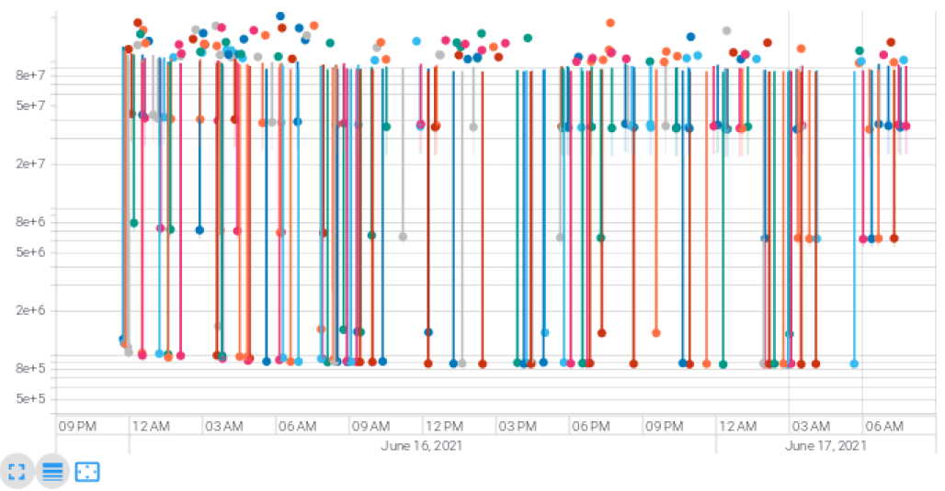
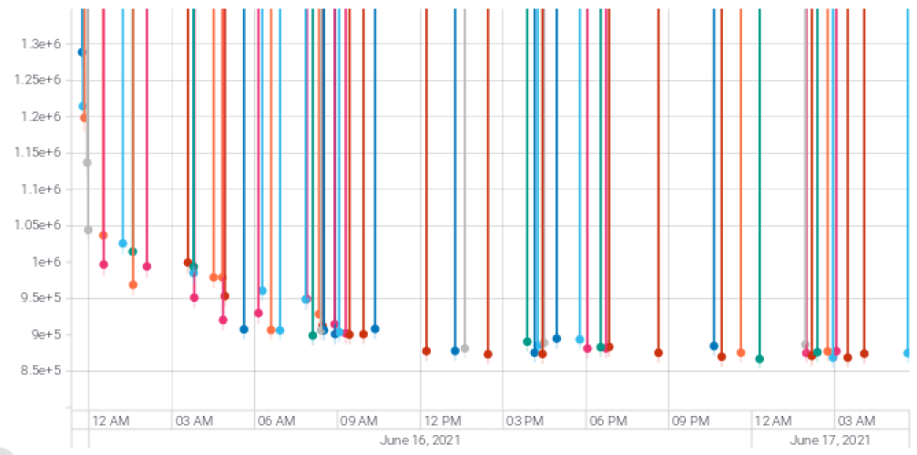
Case Study: SkyWater 130HD, ibex (2/3)
GUI feature is supported with TensorBoard
Results over Wall Time
User-defined
Score
Dots = trials
Default flow score = 1,174,346 Our Best Score = 855,373
(370 trials in total 500 #trials)
(less is better)
Improvement
WL 1003801um → 843258um (-16%)
Effective CP 20.935ns → 16.185 ns (-23%)
Total power 0.024 W→ 0.0133 W (-45%)
Results over Wall Time
Time
Notes:
The AutoTuner stores Tensorboard logs in real time and allows users to observe progress through the GUI at any time.
For this case study, we set a limit of 500 trials, and the 370th trial shows the best results.
Even without modification of utilization or timing constraint, we could get significant improvements.
The [CLICK] lower right box shows the QoR difference between the previous, manually-determined flow options found by the OpenROAD project team, and the flow options found automatically by AutoTuner.
The next slide shows how these results were achieved.

Slide 19
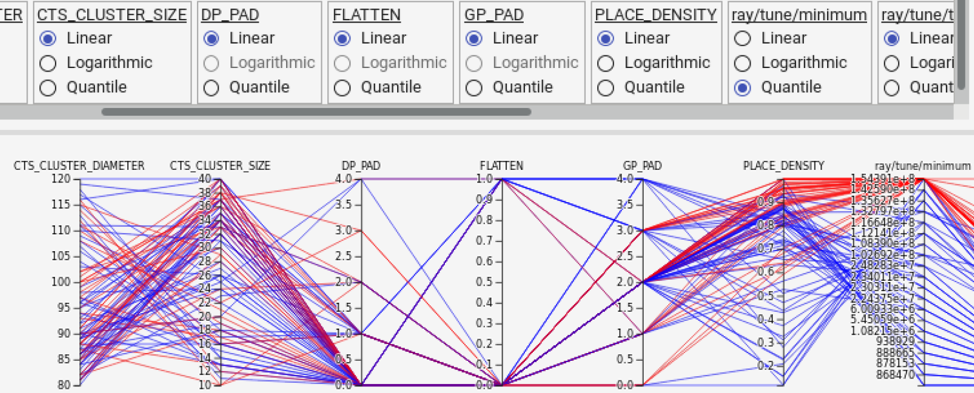
Case Study: SkyWater 130HD, ibex (3/3)
Hyperparameter Scatter Plot Matrix View
Score
Parallel Coordinates View
high risk, high return
Parameters | Human | AutoTuner
Flatten (0 = hier) | 1 | 0
Global placement padding | 4 | 2
Detailed placement padding | 2 | 0
IO pin distance (um) | 2 | 2
CTS clustering size (um) | 30 | 37
CTS clustering diameter (um) | 100 | 95
Layer resource adjustment | 0.5 | 0.42
Target GP place density | 0.6 | 0.99
Score
Notes:
The GUI lets users see a scatter plot matrix as well as a parallel coordinates view. These help users gain intuition and analyze the impact of each parameter.
The table on the right side shows the comparison of the parameters as chosen by the OpenROAD team’s users, and as chosen by the AutoTuner.
As you can see the last row [CLICK], we see improved results by reducing the cell padding and by increasing the target density for global placement.
[CLICK] But, as you can see in the scatter plot and parallel coordinates view, higher target global placement density has a higher risk of failure depending on the other parameter combination.
It is important because AutoTuner finds parameter combinations that are not only better than what expert users find, but that would NEVER be even considered by human experts.

Slide 20
Search Algorithms
Types of search algorithms currently supported by AutoTuner
Each algorithm has its pros and cons depending on:
Difficulty of the target black box problem
Number of hyperparameters
Type of hyperparameters (continuous, discrete, mixed)
Degree of parallelization, and whether synchronous / asynchronous
Types | Name | Year | Author | Affiliation
Random/Grid search | Random /Grid search
Population Based Training | PBT | 2017 | M. Jaderberg | Google Deepmind
Tree Parzen Estimator (TPE) | HyperOpt | 2013 | J. Bergstra | Rowland Institute at Harvard
Bayesian + Multi-Armed Bandit | AxSearch | 2019 | B. Letham | Facebook
TPE + CMA-ES† | Optuna | 2019 | T. Akiba | Preferred Network, Inc.
Evolutionary Algorithm (Gradient-free optimization) | Nevergrad | 2018 | J. Rapin | Facebook
†CMA-ES: Covariance matrix adaptation evolution strategy
Notes:
The table shows the types of searching algorithms currently supported by AutoTuner. Starting with the most basic model-free random/grid search, AutoTuner also supports Bayesian optimization-based algorithms, Tree Parzen Estimators, evolutionary algorithms, and population-based training algorithms. Each algorithm has its pros and cons. We should consider the difficulty level of the given black box problem, the type and number of input parameters to exercise, and scheduling feasibility for massive runs.

Slide 21
Search Algorithm Usage Strategy: Considerations (1)
Considerations for RTL-to-GDS domain
Problem size: Big
Long runtime for each trial
Difficult: Many infeasible input parameter combinations for hyperparameters
Active exploration is required to find feasible starting points
Mixed types: continuous and discrete parameters
Some Bayesian optimization algorithms do not support discrete parameters
CAD Tool noise: influence on the final QoR from very small variations in input values
Notes:
Let me introduce the AutoTuner’s strategy for selecting and scheduling algorithms. We must first look at the features of the RTL-to-GDS domain. First of all, the problem given is very heavy. Each trial consumes a long runtime. Second, the problem is difficult. The parameter space contains many infeasible combinations. However, if you reduce the parametric space to avoid infeasible consequences, you'll miss the opportunity to get close to the global optimum. Third, there is a mixture of continuous parameters and discrete parameters. This is also important because some Bayesian optimization algorithms do not support discrete parameters. Last, you should consider the noise effects in the CAD tools. I'll talk more about this consideration on the next slide.

Slide 22
Search Algorithm Usage Strategy: Considerations (2)
Considerations for algorithm selection
Most time-consuming stage is detailed routing
The runtime required per trial varies greatly
Each algorithm has different strategy of exploration and exploitation
...
worker 1:
RTL
FP
Place
CTS
GR
Detailed Routing
RTL
Floorplan
Trial 1
Trial 4
Explore
Exploit
?
Safe, but risk of local optima
worker 2:
RTL
FP
Place
CTS
GR
RTL
FP
Place
CTS
GR
Exploit
Explore
Trial 2
Explore
Trial 3
?
Unsafe, but chance to find better solution
Significant difference in total walltime with same #trials
Many infeasible hyperparameter sets
Results should be compared by the same walltime constraint
Active exploration with asynchronous scheduling helps
Explore
Trial 5
Depends on the search algorithm
Notes:
In this slide, I will talk about the considerations for comparison for algorithm selection. This consideration is also important for efficient scheduling. As you know, during the RTL-to-GDS process, detailed routing takes up a long runtime part.
[CLICK] Let’s assume there are two parallel workers for autotuner. The workers will follow an asynchronous scheduler.
[CLICK] First, two trials will be launched simultaneously, but worker2 failed in Global Route due to an infeasible parameter set.
[CLICK] Then, worker2 explores the new parameter set. Worker2 can't exploit because they don't have data yet. But unfortunately, new parameter set also failed.
[CLICK] In the meantime, worker 1 exploits to find a new set of parameters.
[CLICK] Worker2 can then explore or exploit according to the algorithm.
[CLICK] As you can see this example, each trial has a wide runtime range, and the speed of the trial queue varies depending on the algorithm. Therefore, it is better to set a walltime constraint than the number of trials, and we recommend using asynchronous schedulers to explore feasible parameter set.

Slide 23
Objective Function – Power, Performance and Area (PPA)
IC design is a multi-objective optimization (e.g., power, performance and area)
We integrate three PPA metrics into one objective function
To increase the general availability
To use algorithms that do not support multi-objective functions
User-settable coefficient values (C_{power} ⋅ C_{perform} ⋅ C_{area}) of three objectives to set the direction of tuning
Minimize Score = (${PPA}_{imp}^{UB}$- ${PPA}_{imp}$) ⋅ (1+ α ⋅N_{DRV}) α: penalty factor (default: 0.1)
s.t.
${PPA}_{imp}$= (C_{power} ⋅Power_{imp} +C_{perform} ⋅Perform_{imp} +C_{area} ⋅Area_{imp})
${PPA}_{imp}^{UB}$= (C_{power} +C_{perform} +C_{area})
Power_{imp} = (P_{ref} - P)/P_{ref} P : Total power
Perform_{imp}= (effCP_{ref} - effCP)/effCP_{ref} effCP: Effective clock period
Area_{imp}= (A_{ref} - A)}/(A_{ref}) A: Cell area
ref: Reference metric
Notes:
This slide shows the objective function to push the PPA. Some algorithms support multiple objective functions, but we have integrated them into one equation with coefficients to increase generality. By adjusting the ratio of each coefficient of PPA, a user can push the autotuner to the desired tradeoff relationship of PPA.

Slide 24
Experiments and Results
Experimental Setup
Framework is written in Python 3.8
Machine: Google Cloud Platform m1-ultramem-160. 160 2.2GHz vCPUs, 3.8TB memory
Platform: ASAP 7nm, Skywater 130nm HD
Design: aes, ibex, jpeg
Coefficient Setting (C_{power}, C_{perform}, C_{area})
power_{opt}: (10000, 100, 100)
perform_{opt}: (100, 10000, 100)
area_{opt}: (100, 100, 10000)
uniform_{opt}: (100, 100, 100)
All studies are parallelized to 40 concurrent OpenROAD jobs, with each job being assigned to 4 cores.
Notes:
This slide represents an experimental setup. We used two technology platforms, asap7nm and skywater130nm, and three designs. The coefficients for objective function were set in four modes, as you can see in the blue texts, to emphasize specific target metrics.

Slide 25
Experiments and Results
Experimental Setup
Tunable tool and design parameters
Parameters | Description | Type | Range
CLOCK_PERIOD | Target clock period (ns) | float | [T_{min}, T_{max}]
CORE_UTIL | Target core utilization (%) | int | [20, 99]
ASPECT_RATIO | Floorplan aspect ratio | float | [0.1, 2.0]
GP_PAD | Cell padding for global placement (site) | int | [0, 4]
DP_PAD | Cell padding for detailed placement (site) | int | [0, 4]
LAYER_ADJUST | Layer resource adjustment for global routing (%) | float | [0.1, 0.7]
PLACE_DENSITY_LB_ADDON | Additional lower bound increase of the target local global placement density (%) | float | [0.00, 0.99]
FLATTEN | Design hierarchy flattening | int | [0, 1]
PINS_DISTANCE | Minimum IO pad distance (#tracks) | int | [1, 3]
CTS_CLUSTER_SIZE | Target CTS sink cluster size | int | [10, 40]
CTS_CLUSTER_DIAMETER | Target CTS sink cluster diameter (um) | int | [80, 12]
Notes:
This table shows the adjustable parameters we used in the experiment. You can see from the type and range columns in the table that there is a MIX of discrete and continuous parameters in various stages.

Slide 26
Experiments and Results – Search Algorithm Comparison
Coefficient setting: perform_{opt}
Walltime constraint = 63966s (~17.8 hrs)
Tuning scheduler: asynchronous scheduler
Nevergrad have numerous trials by actively exploring loose hyperparameters or infeasible sets.
HyperOpt and Optuna shows better (i.e., smaller) final scores
However, appropriate search algorithm may vary depending on the design difficulty, experimental setup, CAD tools, degree of parallelization!
Algorithm | #trials | effCP (ns) | Improv. | Util (%) | Power | Improv. | Score
Reference |  | 17.775 |  | 20 | 0.0523 |  | 1020000
PBT | 1000 | 15.1621 | 15% | 37 | 0.0143 | 73% | 863611
HyperOpt | 742 | 14.9405 | 16% | 40 | 0.0286 | 45% | 853503
Ax | 478 | 16.0395 | 10% | 26 | 0.0172 | 67% | 914902
Optuna | 1493 | 14.8693 | 16% | 42 | 0.0278 | 47% | 849094
Nevergrad | 2925 | 15.2311 | 14% | 18 | 0.0194 | 63% | 870843
Notes:
We first compared the search algorithms. We set 18 hours as a time constraint based on 1000 trials of the PBT algorithm.
As you can see from the table, the search algorithms have all improved performance. However, please note that the appropriate search algorithm may vary depending on the design difficulty, experimental setup, CAD tools, degree of parallelization! [Results will vary depending on context …]

Slide 27
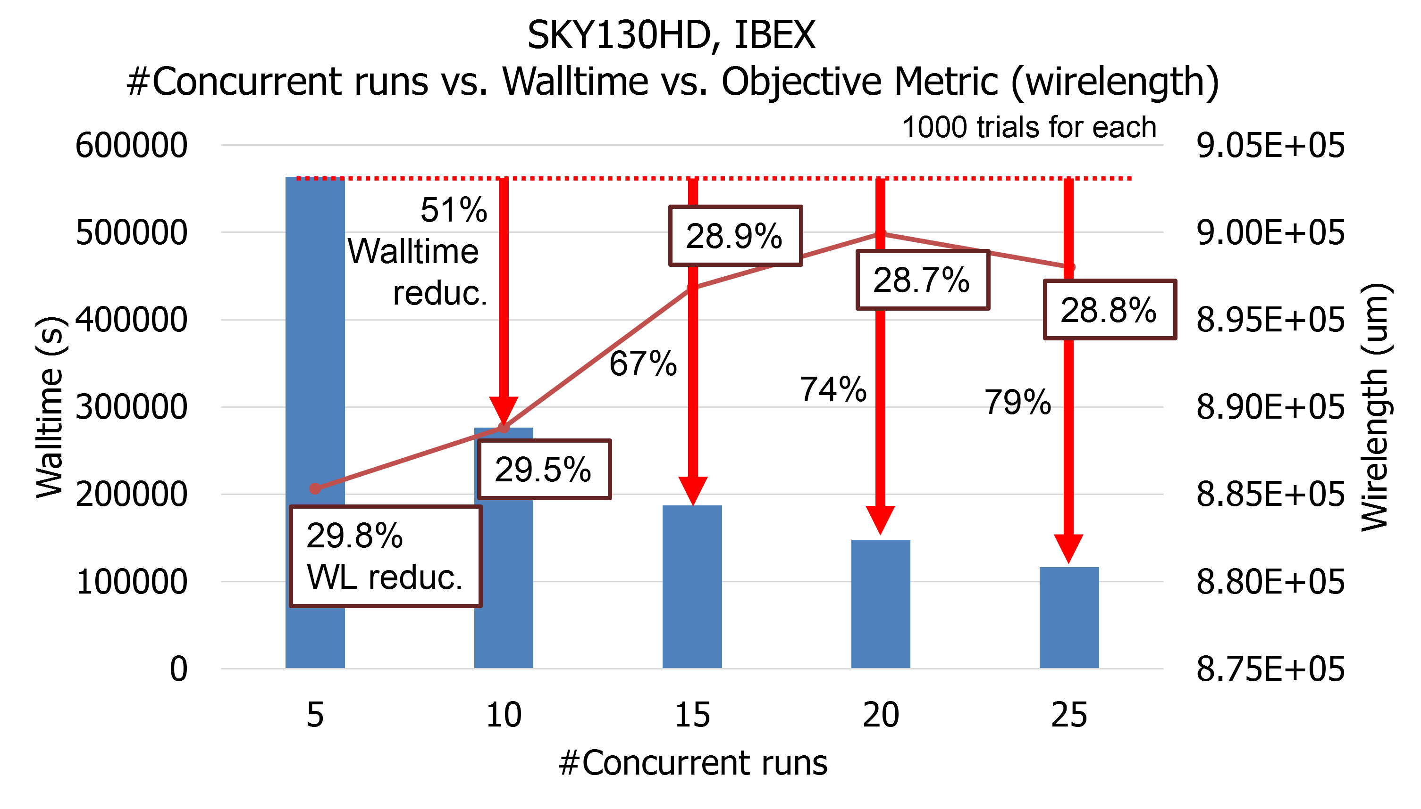
Experiments and Results – Exploration vs. Exploitation
High parallelization may cause performance degradation!
For example, if we use N concurrent jobs for N trials, walltime is minimized but this is the same as random (“multi-start”) search (no iteration, no exploitation)
Objective function: wirelength minimization
#trials = 1000
By parallelization,
Reduces the total walltime (left y-axis) up to 79%
Worse performance (wirelength) (right y-axis), but only by 1% degradation
Why? → With asynchronous scheduler:
Walltime is proportional to $\frac{1}{\#concurrent_jobs}$,
Performance degradation is almost proportional to $\frac{\#concurrent_jobs}{\#trials}$
: walltime
: wirelength
If the number of trials is large enough, active parallelization significantly reduces the total latency of autotuning
Notes:
As a second study, we looked at walltimes relative to the degree of parallelization.
More parallelization can cause performance degradation. For example, if the number of trials set and the number of jobs to run are the same, it is no different from random multi-start search.
In the right graph, the x-axis represents the number of current jobs, the left y-axis represents walltime, and the right y-axis represents wire length.
There’s only about 1% performance degradation from a human tuning reference while obtaining 79% walltime reduction.
Therefore, if the total number of trials is large enough, exploitation is not greatly reduced, and huge walltime benefit should be seen.

Slide 28
Experiments and Results – Automatic PPA Push
1000 trials for each setting. The table shows two of the three designs tested.
For {SKY130, ASAP7} respectively, we achieve on average:
{41%, 32%} power consumption reduction with power setting
{21%, 18%} performance improvement with performance setting
{68%, 58%} area reduction with area setting
Comparison to OpenROAD-flow-scripts design-platform default in master branch
Walltime: all < 2 days
Platform | Design | Setting | effCP (ns) | Improv. | Util (%) | Improv. | Power (W) | Improv.
SKY130 | aes | ref. | 4.554 | 0% | 19 | 0% | 0.0838 | 0%
 |  | power | 4.373 | 4% | 23 | 17% | 0.0569 | 32%
 |  | perf. | 3.491 | 23% | 22 | 14% | 0.0942 | -12%
 |  | area | 3.763 | 17% | 42 | 55% | 0.0558 | 33%
 |  | uniform | 3.38 | 26% | 35 | 46% | 0.0612 | 27%
 | jpeg | ref. | 9.277 | 0% | 20 | 0% | 0.0905 | 0%
 |  | power | 7.781 | 16% | 37 | 46% | 0.0711 | 21%
 |  | perf. | 7.259 | 22% | 31 | 35% | 0.135 | -49%
 |  | area | 12.186 | -31% | 89 | 78% | 0.101 | -12%
 |  | uniform | 7.88 | 15% | 84 | 76% | 0.08 | 12%
Platform | Design | Setting | effCP (ps) | Improv. | Util (%) | Improv. | Power (W) | Improv.
ASAP7 | aes | ref. | 497.630 | 0% | 29 | 0% | 0.0170 | 0%
 |  | power | 445.819 | 10% | 64 | 55% | 0.0098 | 42%
 |  | perf. | 408.012 | 18% | 52 | 44% | 0.0325 | -91%
 |  | area | 462.413 | 7% | 70 | 59% | 0.0154 | 9%
 |  | uniform | 443.146 | 11% | 60 | 52% | 0.0102 | 40%
 | jpeg | ref. | 1039.200 | 0% | 30 | 0% | 0.0348 | 0%
 |  | power | 1021.997 | 2% | 58 | 48% | 0.0340 | 2%
 |  | perf. | 838.097 | 19% | 59 | 49% | 0.0520 | -49%
 |  | area | 1066.411 | -3% | 68 | 56% | 0.0366 | -5%
 |  | uniform | 945.232 | 9% | 64 | 53% | 0.0379 | -9%
power
perf.
area
power
perf.
area
uniform
power
perf.
area
power
perf.
area
uniform
Notes:
The third experimental result shows PPA improvement for the various coefficient settings.
We tested for two platforms and three designs. As you can see from the table,
[CLICK] we have achieved significant power improvement, [CLICK]
[CLICK] Also we have achieved performance improvement, [CLICK]
[CLICK] and area improvement for all testcases. [CLICK]
In addition,
[CLICK] we can see that PPA improves in a balanced manner in uniform coefficient setting. [CLICK]
Each result was automatically achieved within 1 to 2 days after pressing the button.

Slide 29
Summary
METRICS2.1 infrastructure
An initiative of the IEEE CEDA Design Automation Technical Committee (DATC)
Enables standardized metrics collection and design process recording
We provide archives, reproducible config files and ML applications in the form of Jupyter notebooks
Flow Tuning (AutoTuner)
Open-source design flow autotuning framework
Supports synchronous/asynchronous parallelization, various search algorithms, and metrics collection using METRICS2.1
We invite you for collaboration!
METRICS2.1
https://github.com/ieee-ceda-datc/datc-rdf-Metrics4ML
Flow Tuning (AutoTuner)
https://github.com/ieee-ceda-datc/datc-rdf-flow-tuner
Notes:
In this talk, I have introduced METRICS2.1 that standardize metrics collection and design process recording.
METRICS2.1 infrastructure is an initiative of the IEEE CEDA DATC. We share archives obtained from thousands of RTL-to-GDS flow executions, reproducible config files and ML applications in the form of Jupyter notebooks.
Our flow autotuner is also shared in the github repository below, so we look forward to your participation!

Slide 30
THANK YOU ! (Questions / Followups?)
We thank the OpenROAD team and the IEEE CEDA Design Automation Technical Committee for many helpful interactions.
This work is supported in part by the U.S. National Science Foundation (CCF-2112665) and the U.S. Defense Advanced Research Projects Agency (HR0011-18-2-0032). https://theopenroadproject.org https://tilos.ai https://vlsicad.ucsd.edu
Notes:
Thank you again for your participation!

Slide 31
(BACKUP)

Slide 32
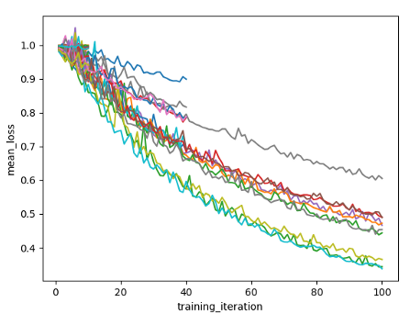
Search Algorithm Usage Strategy: Considerations (3)
CAD tool noise consideration
RTL-to-GDS domain produces the same results from the same hyperparameter if the CAD tool is deterministic
However, the final QoR may can vary by very small variations in input values (“chaotic” behavior of CAD tools)
Inspired by common ML training, training the score by noising the QoR metric for input parameter set
Magnitude of the noise can be determined by pre-experimental data
Moreover, we can analyze tuning tendencies according to the magnitude of the noise
score
each line: trial
step
common ML training
Notes:
Autotuners also consider the noise effects of CAD tools. In other ML applications, when automatic tuners are utilized to find learning rates, scores are not always the same during training. Similarly, we consider noise effects by adding noise to the QoR metric derived by one parameter set in a single trial.

Slide 33
Backup – Search Algorithms in Ray/Tune API
Ray/Tune supports the search algorithms below
Each algorithm has its pros and cons.
However, algorithms that do not support mixed type input, or prefer less parallelization workers, or prefer serialization are not suitable for RTL-to-GDS flow
SearchAlgorithm | Summary
Random search/grid search | Random search/grid search
AxSearch | Bayesian/Bandit Optimization
BlendSearch | Blended Search
CFO | Cost-Frugal hyperparameter Optimization
DragonflySearch | Scalable Bayesian Optimization
SkoptSearch | Bayesian Optimization
HyperOptSearch | Tree-Parzen Estimators
BayesOptSearch | Bayesian Optimization
TuneBOHB | Bayesian Opt/HyperBand
NevergradSearch | Gradient-free Optimization
OptunaSearch | Optuna search algorithms
ZOOptSearch | Zeroth-order Optimization
SigOptSearch | Closed source
HEBOSearch | Heteroscedastic Evolutionary Bayesian Optimization

Slide 34
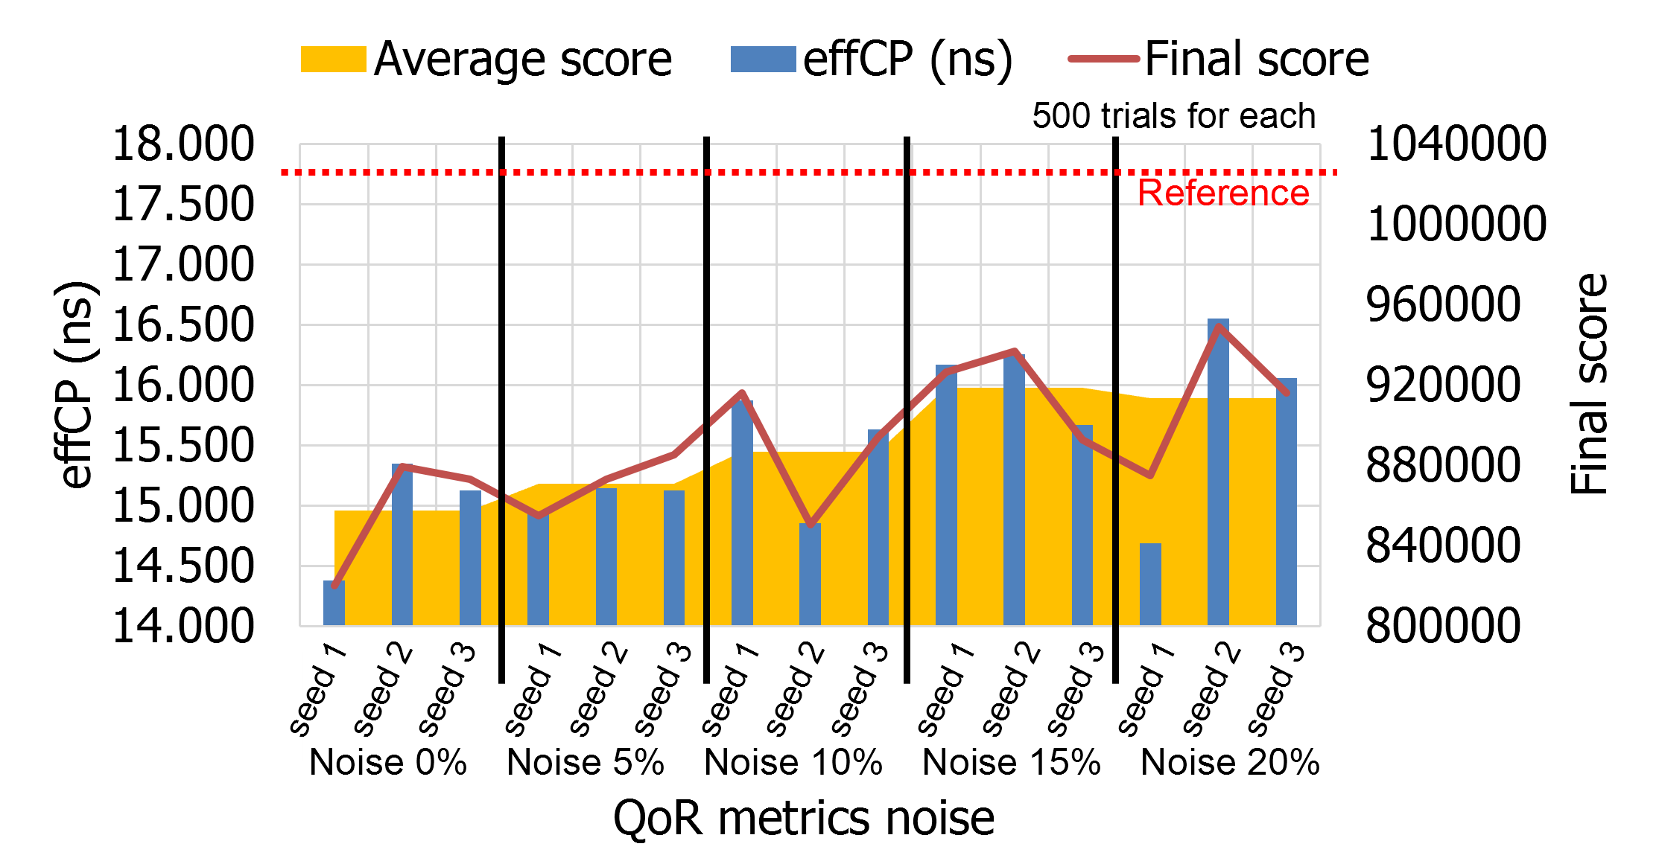
Experiments and Results – Noise Tolerance
Noise – {0%, 5%, 10%, 15%, 20%} for 100 steps of evaluation.
#Trials = 500 for each
Three different random seeds to buffer a sudden good solution case
For example, seed 1 in 20% of noise in the graph
Coefficient setting: perform_{opt}
Slight score degradation as noise increases
However, it still has large improvement of PPA metrics
Compared to the noise%, the performance reduction% is low.
Autotuning seems robust to metric noise (as a proxy for tool noise)
Hypothesis: introducing metric noise can result in more robust autotuning
Testcase: SKY130HD ibex
Notes:
Finally, we considered tool noise effects We tuned with addition of noise when evaluating the QoR metric – as a proxy for tool noise.
We conducted experiments with three different seeds for each noise percentage. It is necessary to consider sudden good solution such as seed number one in 20% of noise.
As shown in the graph, the tuning score gets a little worse as the noise increases. However, it still has a large PPA improvement, and the result reduction is small compared to the noise.
We believe that autotuning is not only robust to metric or tool noise, but that introducing metric noise can result in more robust autotuning results.

