Slide 1
IncPIRD: Fast Learning-Based Prediction of Incremental IR Drop
Chia-Tung Ho and Andrew B. Kahng
UC San Diego VLSI CAD Laboratory
Notes:
Thank you for the kind introduction. My advisor is Andrew Kahng at UCSD.
My work is about predicting incremental IR drop when ECOs are made to the floorplan or the PDN structure.

Slide 2
Outline
Background and Problem Statement
Related Work
Our Methodology
Experimental Setup and Results
Conclusion
Notes:
In my talk, I start with background and problem statement.
I will review some related works, then describe our learning-based methodology

Slide 3
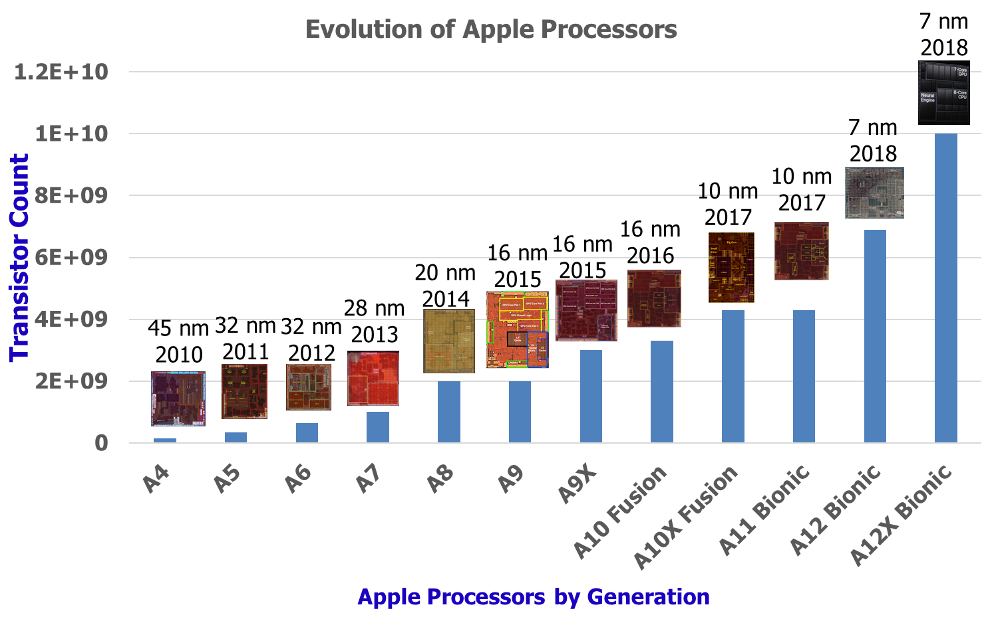
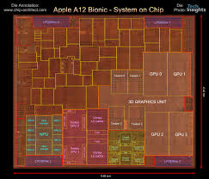
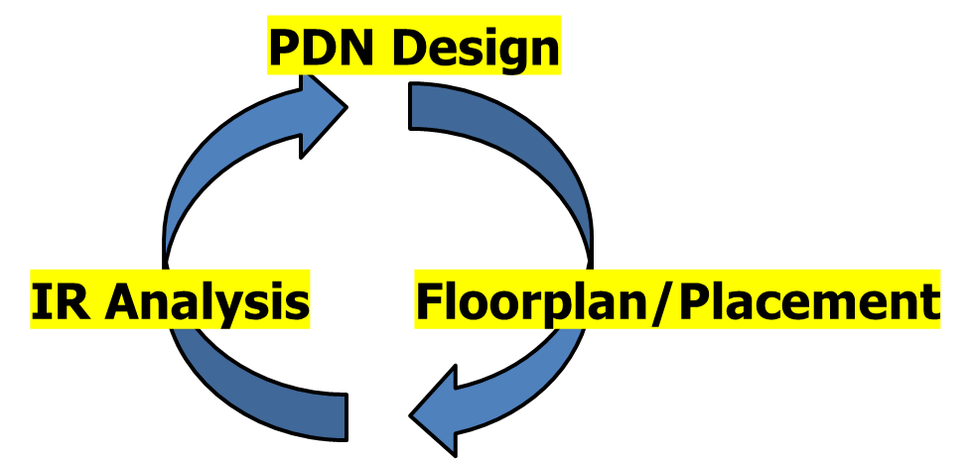
Challenge: Incremental IR Analysis for Floorplan/PDN
To meet PPA of modern high-performance designs, many iterations of PDN design, IR analysis, and Floorplanning/Placement are needed
Key Challenge: Fast and accurate incremental IR prediction to reduce design time and improve convergence
A12 SoC
Notes:
My work addresses the challenge of INCREMENTAL IR analysis.
In SOCs such as from companies like Apple, required PPA depends on [CLICK] MANY ITERATIONS
among PDN design, IR analysis, and Floorplaning/Placement.
[CLICK] The challenge is to reduce the time of this loop, to allow more design optimization and better convergence in the schedule. So, we want fast and accurate incremental IR prediction .

Slide 4
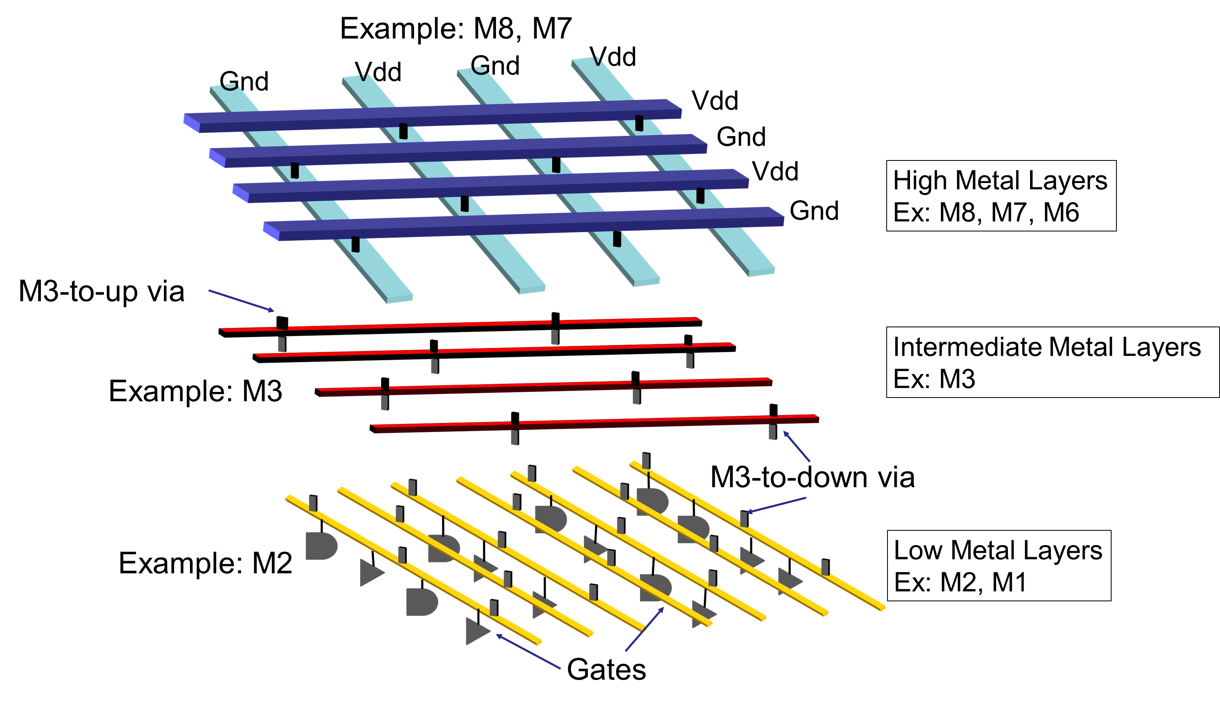
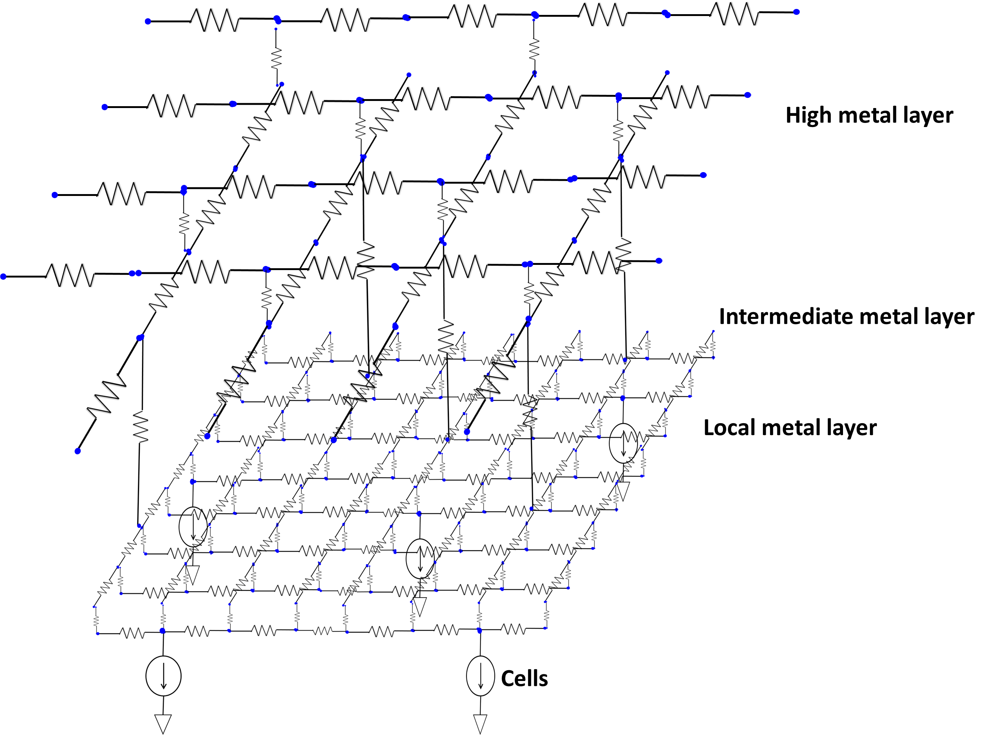
Background: Fixing IR Drop Violations
Traditional layout-based techniques for ﬁxing IR drop violations:
macro/cell block movement
macro/cell block change
modiﬁcation of the PDN to have a denser grid
adding/moving power pads
MNA System Equations: Gx=b
Layout view
Simulation view
Notes:
From the LAYOUT perspective, power is delivered from flip-chip package through power bumps, to transistors – through the PDN mesh.
From the SIMULATION perspective, resistances are extracted from metal segments and tap current sources are modeled from cell/macro blocks.
KCL, KVL, and branch equations in the circuit network give us the [CLICK] Modified Nodal Analysis system equations, Gx=b.
Here, G is the NxN conductance matrix, x is the nodal voltage vector, and b is the current source vector.
SO: HOW do physical designers fix IR drop violations? Let’s look at these methods briefly.
1 min

Slide 5
Background: Fixing IR Drop Violations
Traditional layout-based techniques for ﬁxing IR drop violations:
macro/cell block movement
macro/cell block change
modiﬁcation of the PDN to have a denser grid
adding/moving power pads
IR Hot Spot
A
B
C
D
A
E
C
D
E
B
MNA System Equations: Gx=$\hat{b}$
F
F
→ Tap current source location / value change
Layout view
Simulation view
Notes:
Given an IR Drop Map, aggressor macro/cell block movement or change can mitigate the worst IR drop.
[Click] This is [POINT TO SLIDE] because the LOCATION or VALUE of tap current sources will be changed.

Slide 6
Background: Fixing IR Drop Violations
Traditional layout-based techniques for ﬁxing IR drop violations:
macro/cell block movement
macro/cell block change
modiﬁcation of the PDN to have a denser grid
adding/moving power pads
→ Resistance network changes
IR Hot Spot
A
B
C
D
A
B
C
D
E
E
MNA System Equations: $\hat{G}$x=$\hat{b}$
F
F
Layout view
Simulation view
Notes:
If there are available interconnect resources, designers can change the PDN to a denser grid.
[Click] This changes the resistance network in the simulation view.
And, it also increases the dimension of the conductance matrix, G.

Slide 7
Background: Fixing IR Drop Violations
Traditional layout-based techniques for ﬁxing IR drop violations:
macro/cell block movement
macro/cell block change
modiﬁcation of the PDN to have a denser grid
adding/moving power pads
Add power pad
IR Hot Spot
A
B
C
D
A
B
C
D
E
E
MNA System Equations: $\hat{G}$x=$\hat{b}$
F
F
→ voltage source location change
Layout view
Simulation view
Notes:
Last, the designer can assign an additional power bump near the IR hotspot if there is an available bump.
[Click] This will change the voltage source location, conductance matrix, and current source vector as well.
OUR GOAL is to predict the new IR drop map after any of these layout-based IR fixing techniques.

Slide 8
Problem Statement
Given: LEF, DEF, current distribution, ANSYS RedHawk (RH) v15.1 technology ﬁle, RH IR drop ﬁle, and RH power pad ﬁle of ﬂoorplan design
Train Incremental IR Predictor: Extract features from input and train a learning-based model to predict static IR drop
Output: Static IR drop of each power node that has tap current source attached
Given
Train
Output: IR drop prediction
LEF, DEF,
RedHawk Technology,
IR drop, Power pad files
XGBoost
Notes:
Here is our problem statement.
We are GIVEN: LEF, DEF, current distribution, and ANSYS RedHawk technology file, RedHawk IR drop file, power pad file of floorplan.
[CLICK] We WANT TO PREDICT the updated STATIC IR MAP. To do this, we extract features from the input and train a learning-based model. Specifically, our work uses the XGBoost package.
[CLICK] FINALLY, the OUTPUT will be a MAP of updated static IR drop for each power node that had tap current source attached.

Slide 9
Outline
Background and Problem Statement
Related Work
Our Methodology
Experimental Setup and Results
Conclusion
Notes:
Let me now say a bit about related works, and how our work is DIFFERENT.

Slide 10
Related: Simulation-Based IR Analysis Works
IR drop analysis
[Zhao02] proposes hierarchical IR drop analysis
[Chen01] [Chou11] use krylov subspace methodology to solve Gx=b iteratively.
[Su03] [Huang07] [Zhuo08] [Yang11] exploit multi-grid techniques to solve IR analysis.
[Qian05] develops random walk algorithms for solving IR analysis.
→ Reanalyze modified design as a whole even when the power grid has only been modified locally
Incremental IR drop analysis
[Sun11] [Chang12] [Lee17] exploit sparse recovery and orthogonal matching pursuit to reduce the dimensionality of incremental IR drop problem
→ When design changes significantly, runtime complexity is similar to performing power grid simulation on the entire design
Notes:
There are many related simulation-based IR analysis works.
For IR drop analysis, hierarchical method, krylov subspace, and multi-grid technique have been proposed.
However, THESE methods are typically NOT INCREMENTAL: They re-analyze a modified design from scratch, even when the power grid has only been modified locally.
[CLICK] For incremental IR drop analysis, THESE methods use sparse recovery and orthogonal matching pursuit to reduce the dimensionality of the incremental IR drop problem.
But, when the design is changed significantly such as pitch modification of PDN, the runtime complexity is similar to that of performing power grid simulation on the entire design.

Slide 11
Related: Machine Learning-Based (Incremental) IR Estimation
[Zhang17]: fast power integrity classifier to detect IR/EM hotspots using ML
→ Hotspot location and worst IR drop value, both of which may be needed in
PDN design context, are not provided
[Lin18] [Fang18] propose ECO-based dynamic IR drop prediction methods to reduce the TAT for ECO steps involving cell location changes.
→ Model retraining for different designs; unclear performance of IR drop
prediction when PDN is modified.
Our method (“IncPIRD”) can predict (updated) IR drop at each instance node without solving Gx=b for entire/significantly modified system.
Can handle layout modifications to macro/cell block locations, PDN structure, and power pads
Can be used across different block/chip sizes and designs without model retraining
Notes:
There are ALSO several machine learning-based (Incremental) IR estimation works in recent years.
ZHANG develops a fast power integrity classifier to detect IR/EM hotspots with ML techniques, but does not provide hotspot location and worst IR drop value, which may be needed in PDN design.
LIN and FANG propose ECO-based dynamic IR drop prediction methods to reduce the turnaround time for ECO steps involving cell location changes. These models require retraining for different designs and the model performance is unclear when the PDN is modified.
So, the contributions of our work, which we call “IncPIRD”, are:
First, we predict (updated) IR drop at each instance node without solving Gx=b for the entire system
Second, we handle the above-mentioned types of layout modifications: to macro/cell block locations, PDN structure, and power pads.
Third, IncPIRD can be used across different block/chip sizes and designs without model retraining.
2 and half mins

Slide 12
Related: Machine Learning-Based (Incremental) IR Estimation
[Zhang17]: fast power integrity classifier to detect IR/EM hotspots using ML
→ Hotspot location and worst IR drop value, both of which may be needed in
PDN design context, are not provided
[Lin18] [Fang18] propose ECO-based dynamic IR drop prediction methods to reduce the TAT for ECO steps involving cell location changes.
→ Model retraining for different designs; unclear performance of IR drop
prediction when PDN is modified.
IncPIRD makes progress toward combining (1) FLEXIBILITY of simulation-based methods with (2) SPEEDUPS and SCALABILITY of machine learning-based methods !!!
Our method (“IncPIRD”) can predict (updated) IR drop at each instance node without solving Gx=b for entire/significantly modified system.
Can handle layout modifications to macro/cell block locations, PDN structure, and power pads
Can be used across different block/chip sizes and designs without model retraining
Notes:
In summary, IncPIRD makes progress toward combining the FLEXIBILITY of simulation-based methods with the SPEEDUPS AND SCALABILITY of machine learning-based methods.
6:40

Slide 13
Outline
Background and Problem Statement
Related Work
Our Methodology
Experimental Setup and Results
Conclusion
Notes:
I will now introduce the IncPIRD methodology.

Slide 14
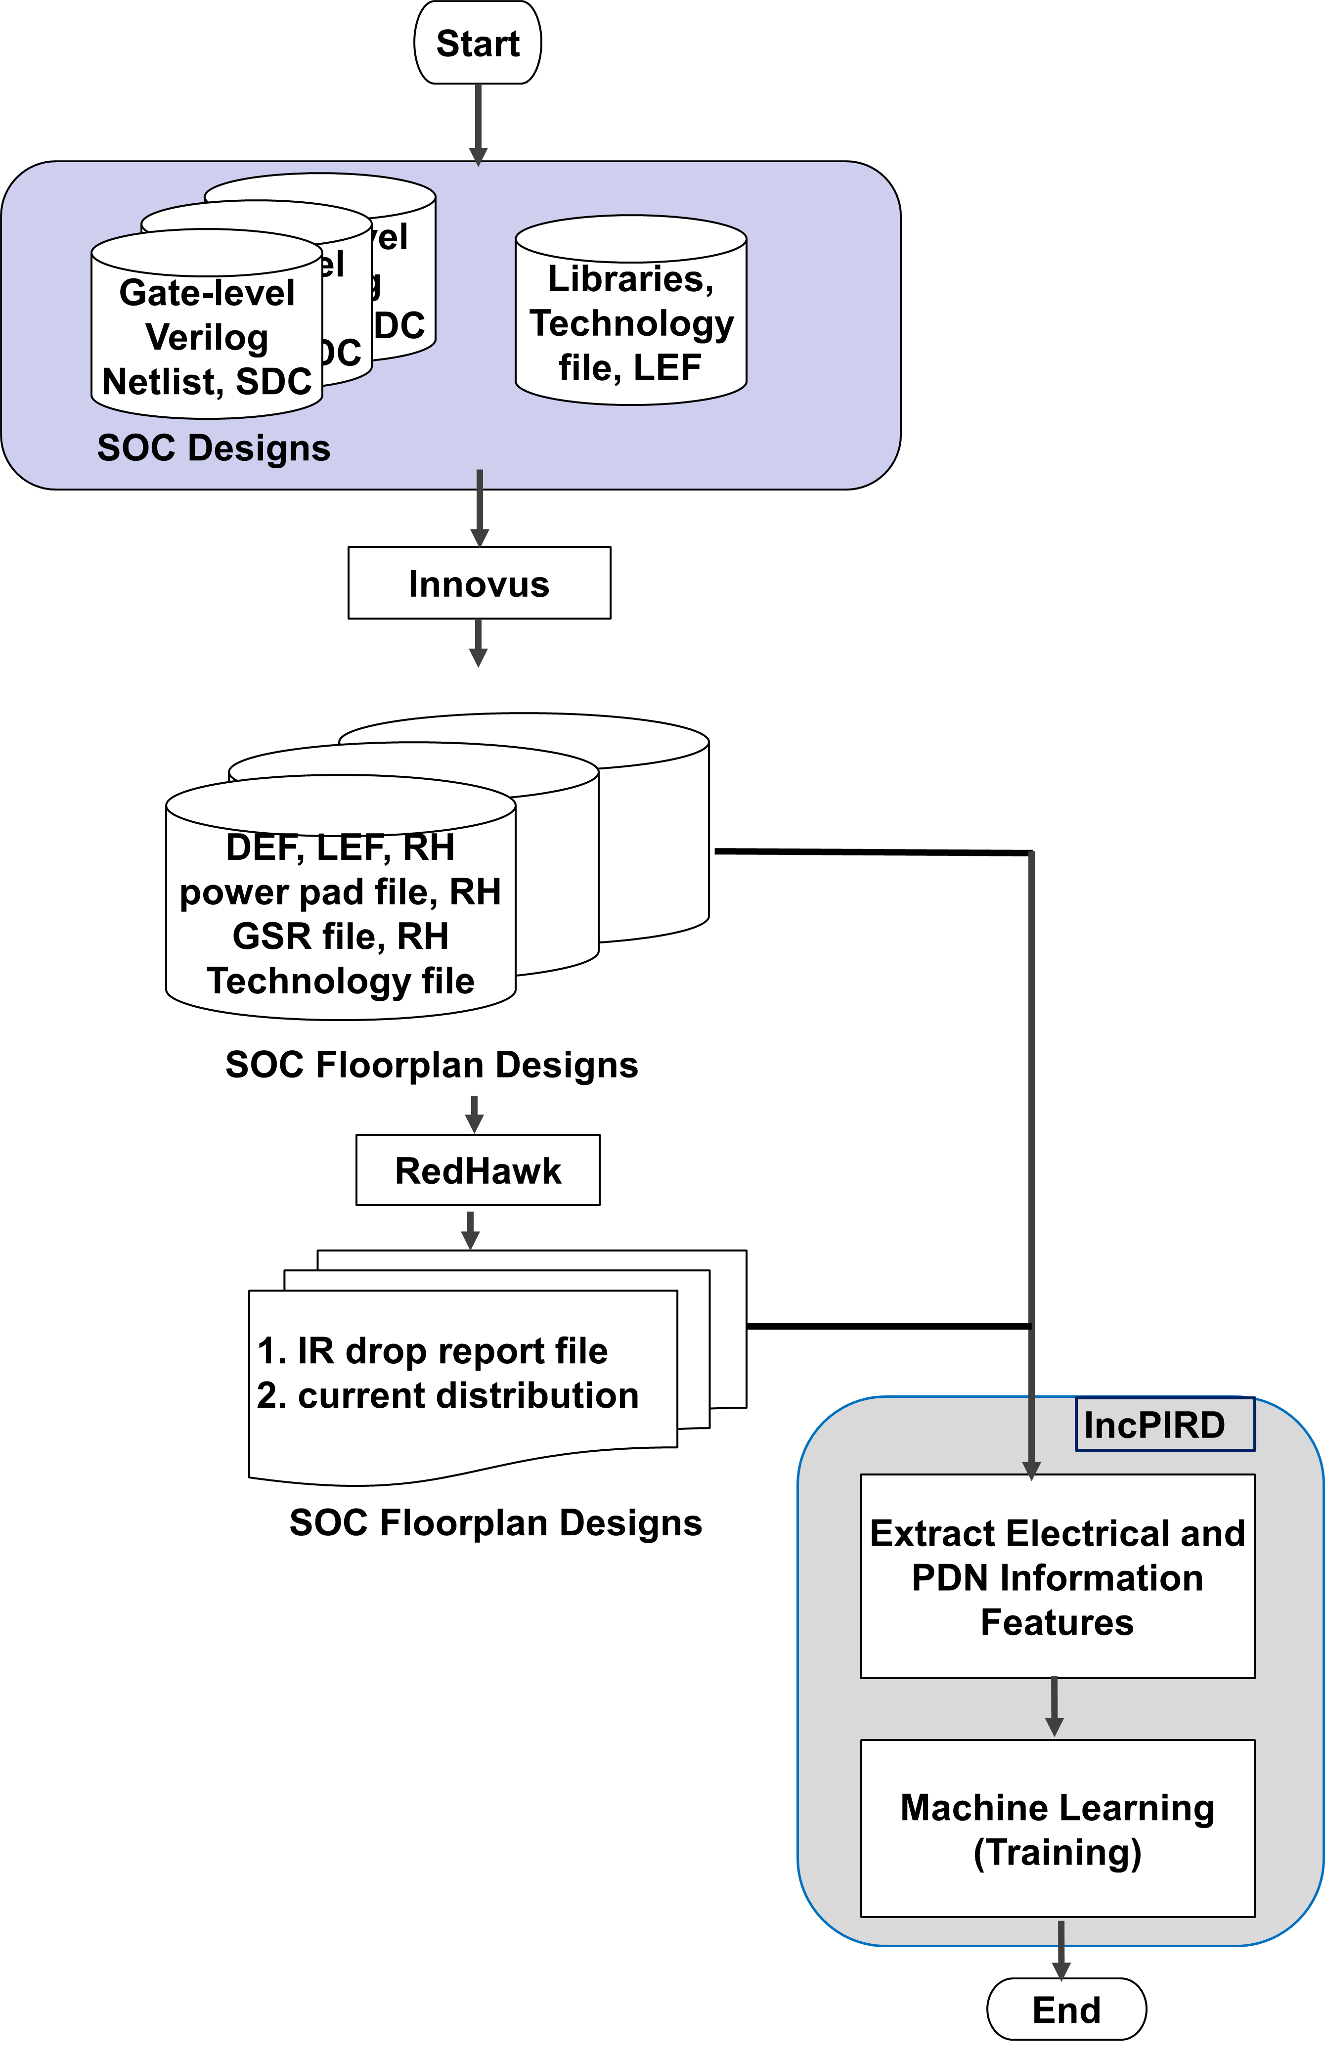
IncPIRD Training Flow
Input: LEF, DEF, current distribution, RH technology ﬁle, RH IR drop ﬁle, and RH power pad ﬁle
Output: A learning-based model to predict static IR drop. (gray box)
Objective: Minimize Mean Absolute Error (MAE)
Notes:
Here is our IncPIRD training flow.
Given LEF, DEF, current distribution, and ANSYS RedHawk technology file, IR drop file, and power pad file of floorplan:
We extract input features and train our model with Mean Absolute Error objective function as shown in the gray box.

Slide 15
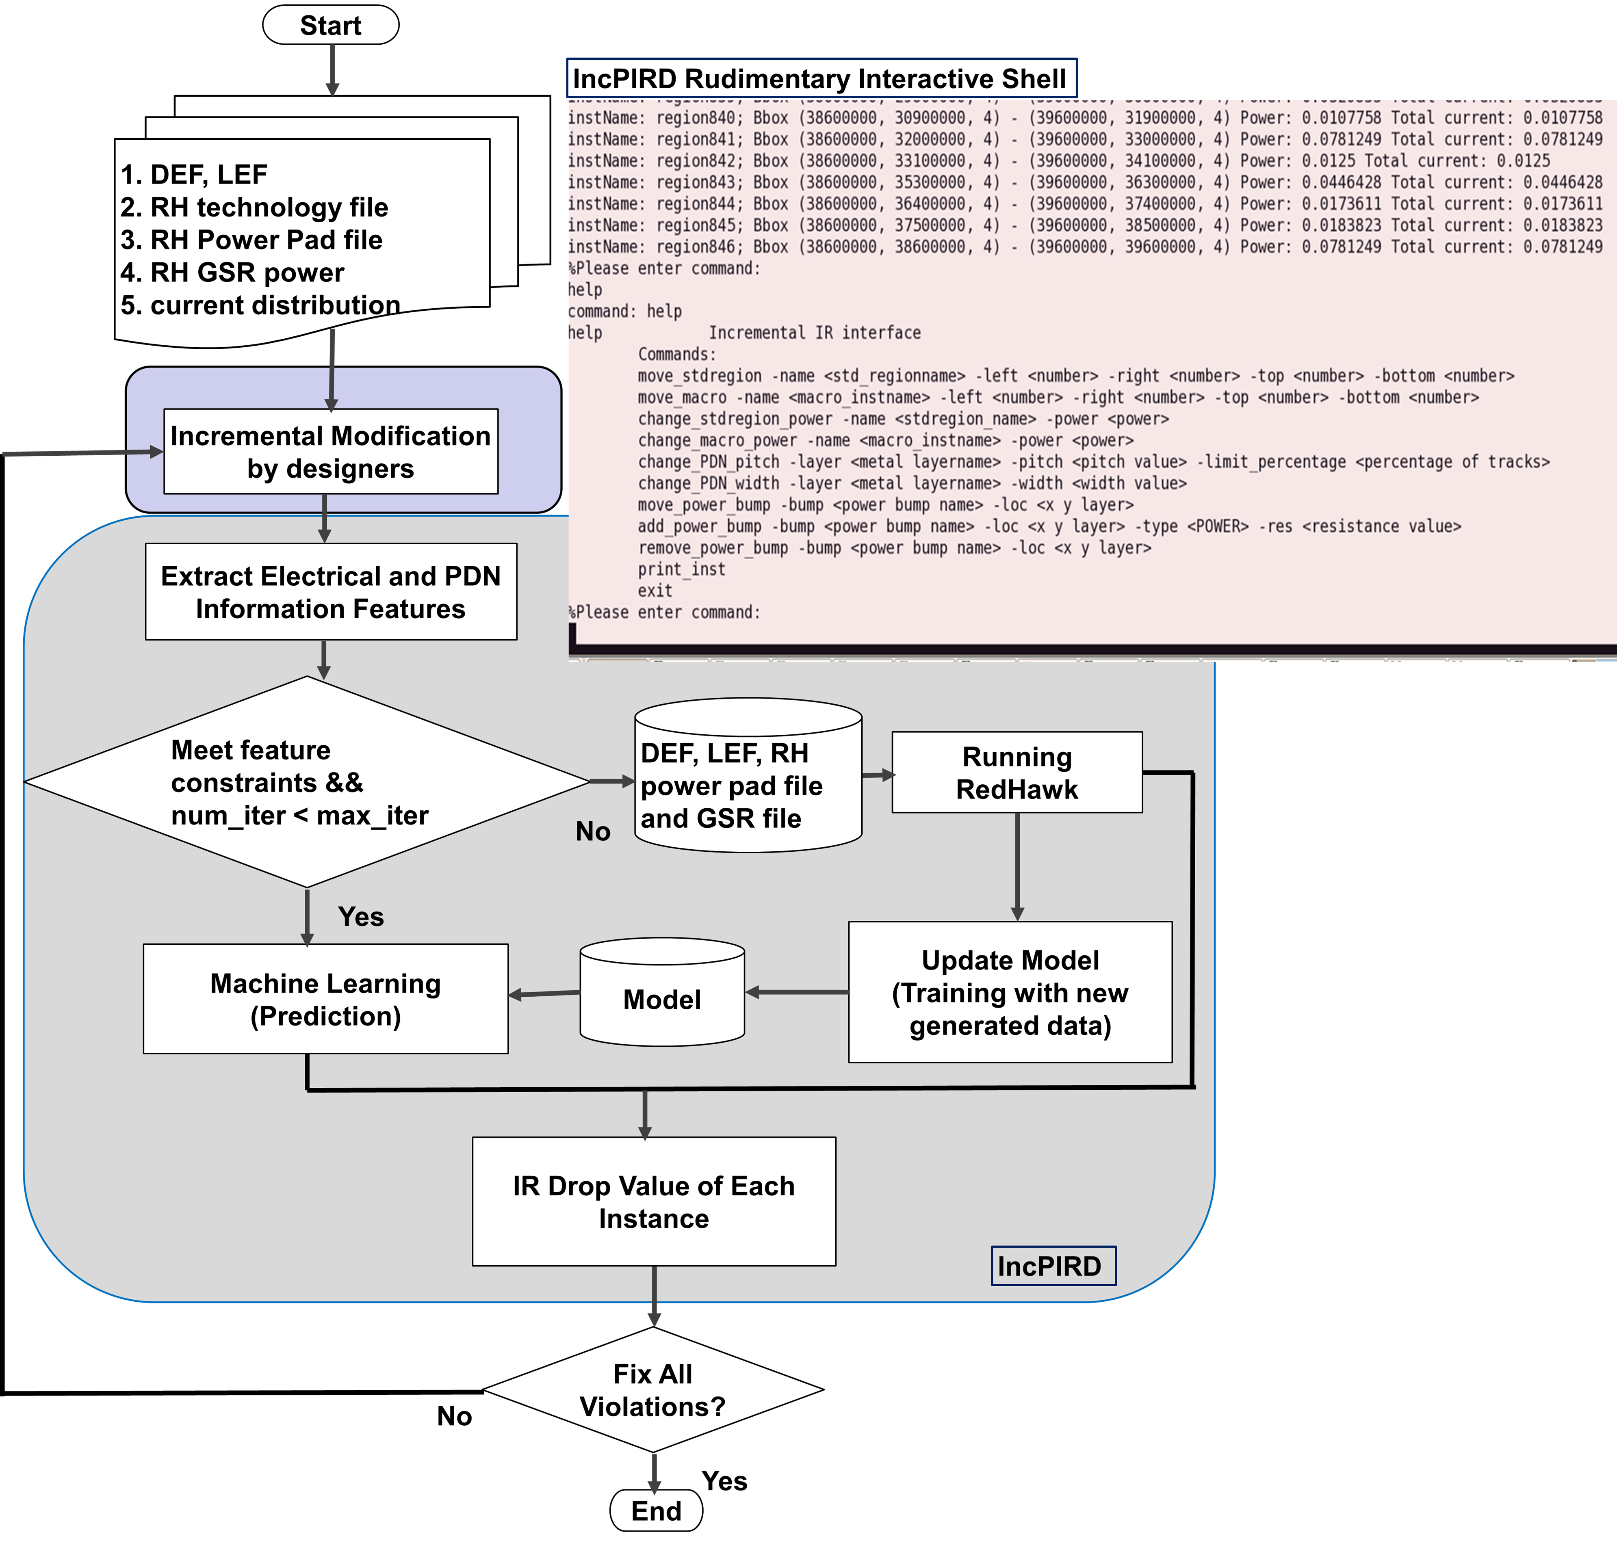
IncPIRD Prediction Flow
Input: LEF, DEF, current distribution, RH technology ﬁle, RH IR drop ﬁle, and RH power pad ﬁle
Predict: Static IR drop of each power node that has tap current source attached
Model Update Conditions :
Symbolic IR drop: $δ_{{PC}_{down}}<ε_{th,{PC}_{down} }$
Effective resistance: $δ_{{PC}_{up}}<ε_{th,{PC}_{up} }$
Notes:
Here is our IncPIRD Prediction flow.
Firstly, the input files are as same as in the training flow.
IncPIRD predicts the IR drop of each power node that has tap current source attached, after incremental modification of the PDN have been made by designers.
Our model update conditions are related to symbolic IR drop and Effective resistance which will be introduced in detail when I describe our robustness experiment.
If the new electrical features do not satisfy the model update conditions, IncPIRD will update the model automatically.
As shown in the BIG LOOP, the iteration between IncPIRD incremental IR prediction AND the PDN layout modification ends when there is no IR violations.

Slide 16
Input Features
Name | Description
$$width$$ | Width of the Chip/Block
$$length$$ | Length of the Chip/Block
$${Pitch}_{top,h}$$ | Pitch of top horizontal metal layer
$${Pitch}_{top,v}$$ | Pitch of top vertical metal layer
$${Pitch}_{inter,h}$$ | Pitch of intermediate horizontal metal layer
$${Pitch}_{inter,v}$$ | Pitch of intermediate vertical metal layer
$${Pitch}_{lower}$$ | Pitch of lower metal layer
$${PC}_{down,n}$$ | Pulldown component at node n
$${PC}_{up,h}$$ | Pullup component at node n
$${PC}_{down,neighbor1}$$ | Pulldown component of node n’s Neighbor1
$${PC}_{up,neighbor1}$$ | Pullup component of node n’s Neighbor1
$${PC}_{down,neighbor2}$$ | Pulldown component of node n’s Neighbor2
$${PC}_{up,neighbor2}$$ | Pullup component of node n’s Neighbor2
Chip/PDN structural features
Electrical features
Notes:
Now that we have seen the big picture of IncPIRD, I will now introduce the input features.
The first part is Chip/PDN structural features, chip width/length and the pitch of PDN metal layers.
[Click] The second part is Electrical features, Pulldown and Pullup component.

Slide 17
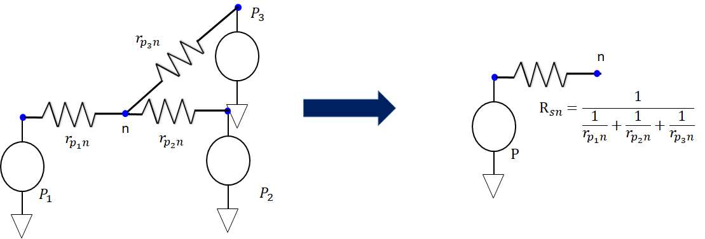
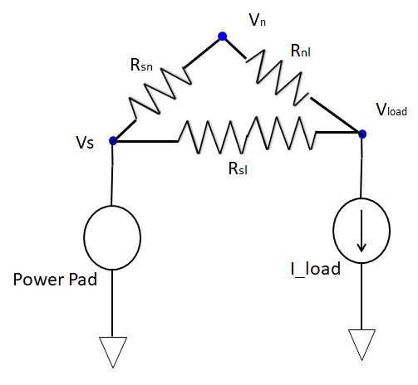
Electrical Features
Name | Description
$$I_{k}$$ | $k^{th}$ tap current source
$$R_{{sl}_{k}}$$ | Effective resistance of minimum-resistance path resistance between power pads and $k^{th}$ tap current source
$$R_{sn}$$ | Effective resistance of minimum-resistance path resistance between power pads and node $n$
$$R_{{nl}_{k}}$$ | minimum-resistance path resistance value between $k^{th}$ tap current source and node $n$
$${IR}_{n, symbolic}$$ | Symbolic IR drop value at node $n$
Pullup Component of node n, ${PC}_{up, n}$:
${PC}_{up, n}=R_{sn}=\frac{1}{\sum_{p=0}^{N^{pad}}{\frac{1}{r_{pn}}}}$
Pulldown Component of node n, ${PC}_{down, n}$:
${PC}_{down, n}={IR}_{n, symbolic}=\sum_{k=1}^{N^{tap}}{I_{k}(\frac{R_{{sl}_{k}}}{{R_{sn}+R}_{{sl}_{k}}+R_{{nl}_{k}}})R_{sn}}$
An example of ${PC}_{up, n}$
An example of ${PC}_{down, n}$
Notes:
In this slide, we introduce electrical features.
The first one is Pullup Component. To compute the Pullup Component at node n, we calculate the effective resistance between power pads and node n as shown in the figure.
In this simple example, the Pullup component of node n is calculated with the minimum-resistance path resistances between power pads and node n.
[Click] The second one is Pulldown Component, also called symbolic IR drop. To compute the Pulldown Component at node n, we superpose the effective IR drop caused by each current source.
1 min

Slide 18
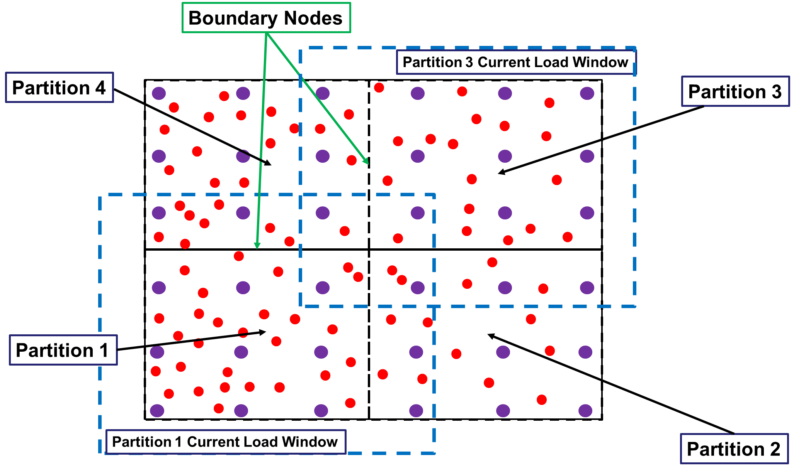
Partition-Based Electrical Features Extraction
Spatial locality characteristics of (flip-chip) power grids
Current load window based internal node ${PC}_{down}$ calcualtion
Inter-partition current load propagation on boundary node for ${PC}_{down}$
Global power pad-aware ${PC}_{up}$ extraction
Partition Boundary
Current load window
Power pads
Tap current sources
Illustration of partitions in the PDN.
Notes:
Here is our partition-based electrical feature extraction methodology.
We exploit the spatial locality characteristics of (flip-chip) power grids.
[Click] In the figure below, there are four partitions and their current windows. The larger current window is used to reduce the Pulldown component error on the boundary nodes.
To extract ${PC}_{down}$, we calculate the ${PC}_{down}$ of internal nodes in the partition by considering the tap current sources in its current load window.
[Click] If ${PC}_{down}$ on the boundary of one partition exceeds a threshold, its neighboring partitions’ Pulldown component needs to be calculated with the current loads in the partition.
[Click] All of the power pads in the design are used to extract ${PC}_{up}$ of each partition nodes.
1:40

Slide 19
Algorithm
Initialization
1: Partition the PDN and create the partition database;
2: Calculate original electrical features in the design;
3: Violations = getIRViolations;
4: While Violation > 0 do
5: If Macro/Cell Block Modification then
6: If Add/Move macro/cell block then
7: Update tap current sources location/value;
8: endif
9: Find set of modified partitions, Pmod;
10: Update electrical features in Pmod and Update electrical features of impacted partitions;
11: endif
12: if PDN structure or power pad modification then
13: if PDN structure modification then
14: Update PDN structure database and distribute tap current sources to new PDN power node;
15: endif
16: if power pad modification then
17: Update power pad database;
18: endif
19: Update electrical features of all partitions and Update electrical features of impacted partitions;
20: endif
21: if $δ_{{PC}_{down}}<ε_{th,{PC}_{down} }$&& $δ_{{PC}_{up}}<ε_{th,{PC}_{up} }$ then // Model update condition
22: Perform model prediction;
23: else
24: Update model with new DEF, LEF, RedHawk GSR, RedHawk Power Pad, and RedHawk IR report files.
25: endif
26: Violations = getIRViolations;
27:End while
Electrical Features Update
Model prediction/update
Notes:
This is our algorithm.
[Click] Firstly we partition the PDN and create the database.
[Click] Then, IncPIRD updates the database and extracts the electrical features based on different types of modifications.
Add/Move macro/cell block only needs to update the tap current source location or value.
PDN structure modification needs to update the PDN structure and redistribute the tap current sources to new PDN power nodes.
Power pad modification needs to update the power pad database.
[Click] After electrical feature extraction, IncPIRD will perform IR prediction or model update based on the model update condition.
Then, at an outer loop with the layout engineer, we can continue to make IR fixes in the PDN layout until there are no violations.
1:20

Slide 20
Electrical Feature Extraction: Scaling Behavior
Complexity to find a min-resistance path in the PDN is $O(LN_{l,max}^{track}\left(\log\left(N_{l,max}^{track}\right)\right))$
Complexity to calculate ${PC}_{up}$ is ${O(N}_{tap}N_{pad}(LN_{l,max}^{track}\left(\log\left(N_{l,max}^{track}\right)\right))$
Complexity to calculate ${PC}_{down}$ is $O(N_{part}N_{p,max}^{tap}N_{p,w,max}^{tap}(LN_{l,max}^{track}\left(\log\left(N_{l,max}^{track}\right)\right))$
Electric Feature Extraction Complexity is $O\left(LN_{l,max}^{track}\left(\log\left(N_{l,max}^{track}\right)\right)\left(N_{tap}N_{pad}+N_{part}N_{p,max}^{tap}N_{p,w,max}^{tap}\right)\right), where N_{part}≪N_{l,max}^{track}$
Name | Description | Name | Description
$$L$$ | Number of metal layers used in PDN. | $$N_{p}^{tap}$$ | Number of tap current sources in partition p.
$$N^{pad}$$ | Number of power pads in the design. | $$N_{p, max}^{tap}$$ | Maximum number of tap current sources among partitions.
$$N^{tap}$$ | Number of tap current sources in the design. | $$N_{p, w}^{tap}$$ | Number of tap current sources in current load window of partition p.
$$N_{l}^{track}$$ | Number of tracks on metal layer l. | $$N_{p, w, max}^{tap}$$ | Maximum number of tap current sources in current load window among all partitions.
$$N_{l,max}^{track}$$ | Maximum number of tracks among L metal layers. | $$N_{part}$$ | Number of partitions.
With fixed partition size, feature extraction roughly
scales as $LN_{l,max}^{track}\left(\log\left(N_{l,max}^{track}\right)\right)$
Notes:
Here are some comment about runtime behavior. Our runtime is separately helped by multithreading.
Using std map implementation, the complexity to find the via points between two metals is Big-O of the maximum number of tracks in a layer, times log of the maximum number of tracks in a layer.
Hence the complexity of finding a minimum-resistance path between two nodes is the number of layers between these two nodes , TIMES N log N where N is the maximum number of tracks in a layer.
Then, The complexity of Pullup Component calculation is N_tap times N_pad , times this complexity of finding a single minimum-resistance path.
[Point] Next, the complexity of PullDown Component calculation is the number of partitions , TIMES the number of tap current sources in the partition, TIMES the number of tap current sources in its current load window, TIMES the complexity of finding a minimum-resistance path.
Hence, with fixed partition size, our overall electrical feature extraction scales as shown here, and it depends chiefly on the number of layers and the maximum number of tracks in a layer in the partition.
13:40 ~ 14:00

Slide 21
Outline
Background and Motivation
Related Work
Our Methodology
Experimental Setup and Results
Conclusion
Notes:
I will now show our experimental results.

Slide 22
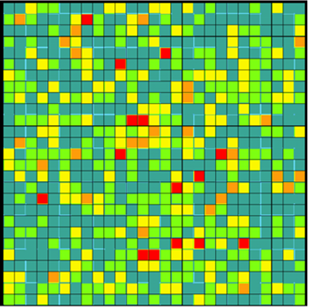
Experimental Setup
150 SOC floorplan designs with different
Power distributions
PDN structures
Power pad pitches
Technology | 28nm foundry technology | Intermediate Metal Layer Track Usage | 10 % - 20 %
Package | Flip Chip | Supply Voltage | 1V
Chip/Block Size | 6000$μm$ – 30000$μm$ | Power Pad Pitch | 250$μm$ – 1000$μm$
Power | 10 W – 20 W | Max Number of Instances | 759850
Training data information
Name | # of Nodes (million) | Total Power (W) | # of tap current sources
Design1 | 5.4 | 10.87 | 95K
Design2 | 9.6 | 14.34 | 263K
Design3 | 17 | 19.27 | 481K
Design4 | 27 | 24.87 | 742K
Design5 | 10.6 | 14.34 | 183K
Generated Power distribution figure
Design information
Notes:
Here is our experimental setup.
We use 28nm foundry technology to generate the test cases.
[Optional]
The training data information table shows the package, range of chip size, power, intermediate metal layer track usage, supply voltage, power pad pitch, and max number of instances.
We generate 150 SOC floorplan designs with different
[Click] Power distributions, PDN structures, and power pad pitches to train our model.
[Click] We use 5 designs for the following experiments. The max number of Nodes is 27 MILLION and the max number of tap
Current sources is around 742 THOUSAND.

Slide 23
Experiment 1: Model Accuracy
Mean average error: -$4.26×{10}^{−3}$mV
Standard deviation: 0.52mV
99.7% predicted IR drop errors < 1.5mV
+/- 5mV
+/- 5mV
Notes:
Experiment 1 shows our model accuracy.
Figure (a) and (b) show the golden IR versus predicted IR of training set and testing set, respectively.
The middle blue solid line represents a perfect match of predicted IR and golden IR. Our predicted IR errors in training and testing set are within 5mV.
From the error distribution, the mean average error is -$4.26×{10}^{−3}$mV.
The standard deviation is 0.52mV.
99.7% of predicted IR drop errors are smaller than 1.5mV.
1 min

Slide 24
Experiment 2: Incremental IR Prediction
IR prediction for single incremental modification
22 to 919 speedup with $e_{avg}$ < 1mV and $e_{max}$ < 5.07mV
PDN info | Modifications |  |  |  | RedHawk |  | Our Proposed Method (IncPIRD) |  |  |  |  |  | Speedup
Name | $${∆Power}_{region}$$ |  | $∆Track Usage$ (%) | Power Pad Modification | Runtime (sec) | WIR (mV) | $t_{fx}$ (sec) | $t_{pred}$ (sec) | $e_{avg}$ (mV) | $e_{max}$ (mV) | $e_{WIR}$ (mV) | $e_{WIR, rel}$ (%) | RedHawk (X)
 | (%) | (mW)
Design 1 | 272 | 20.0 | - | - | 308 | 25 | 0.11 | 0.28 | 0.55 | 3.94 | 0.57 | 2.3 | 787
 | - |  | - | V | 308 | 25 | 5.76 | 0.27 | 0.32 | 2.51 | 0.45 | 1.9 | 51
 | - |  | 5 | - | 370 | 22 | 4.98 | 0.38 | 0.31 | 2.47 | 0.47 | 2.1 | 69
Design 2 | 200 | 50.0 | - | - | 562 | 24 | 0.75 | 0.55 | 0.29 | 3.40 | 0.44 | 1.8 | 432
 | - |  | - | V | 562 | 24 | 24.11 | 0.56 | 0.28 | 3.25 | 0.44 | 1.8 | 22
 | - |  | -10 | - | 473 | 21 | 10.13 | 0.34 | 0.45 | 3.70 | 1.40 | 6.7 | 45
Design 3 | 400 | 23.4 | - | - | 2021 | 27 | 0.48 | 1.72 | 0.34 | 4.16 | 0.32 | 1.2 | 919
 | - |  | - | V | 2021 | 26 | 48.84 | 2.26 | 0.33 | 5.07 | 0.12 | 0.5 | 40
 | - |  | -10 | - | 1489 | 31 | 32.65 | 1.42 | 0.39 | 4.07 | 1.13 | 3.7 | 44
Design 4 | 500 | 76.9 | - | - | 3273 | 21 | 0.70 | 3.34 | 0.27 | 3.04 | 0.41 | 2.0 | 810
 | - |  | - | V | 3273 | 19 | 72.94 | 3.01 | 0.27 | 3.84 | 0.53 | 2.7 | 43
 | - |  | -10 | - | 2653 | 22 | 52.10 | 1.87 | 0.29 | 3.90 | 1.27 | 5.9 | 49
Incremental modification table
Note: $e_{}$stands for error
Notes:
In Experiment 2, [click] We perform one incremental modification and validate the predicted IR drop with RedHawk.
[click] IncPIRD achieves 22 to 919x speedup compared with from-scratch analysis using the golden IR tool.
[click] The $e_{avg}$ is less than 1mV and $e_{max}$ is around 5.07mV.
Since PDN modification needs to recalculate minimum-resistance paths, it takes longer runtime compared to macro/cell block and power pad modifications.

Slide 25
Experiment 2: Incremental IR Prediction
IR prediction for chain incremental modifications of Design5
Change the power of one cell block from 10mW to 100mW
Move a macro
Add a power pad
Use denser intermediate metal layer
47 to 1112 speedup with $e_{avg}$ < 1mV and $e_{max}$ < 3mV
Moves | RedHawk |  | Proposed Method |  |  |  |  |  | Speedup
 | Runtime (sec) | WIR (mV) | $t_{fx}$ (sec) | $t_{pred}$ (sec) | $e_{avg}$ (mV) | $e_{max}$ (mV) | $e_{WIR}$ (mV) | $e_{WIR, rel}$ (%) | RedHawk (X)
1st Move | 640 | 53 | 0.20 | 0.43 | 0.23 | 1.93 | 0.67 | 3.76 | 1015
2nd Move | 634 | 53 | 0.19 | 0.38 | 0.23 | 1.93 | 0.67 | 3.76 | 1112
3rd Move | 638 | 52 | 8.68 | 0.35 | 0.23 | 2.12 | 0.04 | 0.24 | 71
4th Move | 2033 | 48.8 | 42.57 | 0.68 | 0.25 | 2.37 | 0.80 | 5.60 | 47
Results from an example chain incremental modification
Notes:
Here, we perform four modifications in succession: (i) change the power of one cell block from 10mW to 100mW, (ii) move a macro, (iii) add a power pad, and (iv) use denser intermediate metal layer.
[click] IncPIRD achieves 47 to 1112 speedup compared with the golden IR tool to update the IR map after each of these modifications.
[click] After all four modifications, the final $e_{avg}$ is less than 1mV and $e_{max}$ is less than 3mV.

Slide 26
Experiment 3: Robustness Experiment
To test model robustness, we vary:
Power
Intermediate metal layer track usage
Power pad pitch
Range of values for each feature $R_{f}$ is found from the designs in training set
If input feature of changed design is within $R_{f}$
→ $δ_{feature}$ is zero
If input feature of changed design is outside of $R_{f}$
$`\text{→}{ δ}_{feature}$ equals the distance of the input feature to closest end point of $R_{f}$
Notes:
In Experiment 3, we vary the (1) power, (2) intermediate metal layer track usage, and (3) power pad pitch to test the robustness of our model.
The range of values for each feature $R_{f}$ is found from the designs in training set.
If the input feature of the changed design is within $R_{f}$
[Click] The $δ_{feature}$ is zero
If the input feature of the changed design is outside of $R_{f}$
[Click] The $δ_{feature}$ equals the distance of the input feature to closest end point of $R_{f}$.

Slide 27
Experiment 3: Robustness Experiment
Use 5mV as max error tolerance
Model update condition
Symbolic IR drop: $δ_{{PC}_{down}}<0.0025$
Effective resistance: $δ_{{PC}_{up}}<0.4375$
Power |  | Intermediate metal layer track usage |  | Power pad pitch
$$δ_{{PC}_{down}}$$ | $$δ_{{PC}_{up}}$$ | $$δ_{{PC}_{down}}$$ | $$δ_{{PC}_{up}}$$ | $$δ_{{PC}_{down}}$$ | $$δ_{{PC}_{up}}$$
0.0025 | - | - | - | 0.00846 | 0.4375
Notes:
The figures show varying power, intermediate metal layer track usage and power pad pitch respectively.
From varying power and power pad pitch experiment, when the maximum absolute error goes up, the delta Pulldown and Pullup are also growing.
The impact of different track usage of intermediate layer on our model accuracy is not so obvious.
Using 5mV as max error tolerance, we can observe the corresponding delta Pulldown and Pullup components in these three cases.
We pick the minimum delta Pulldown and Pullup component value among the three cases for our model update condition.

Slide 28
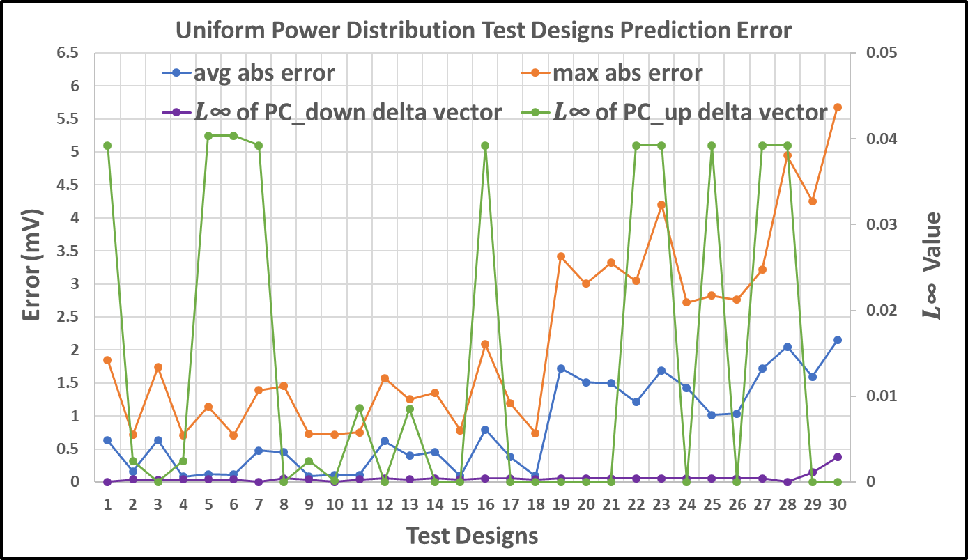
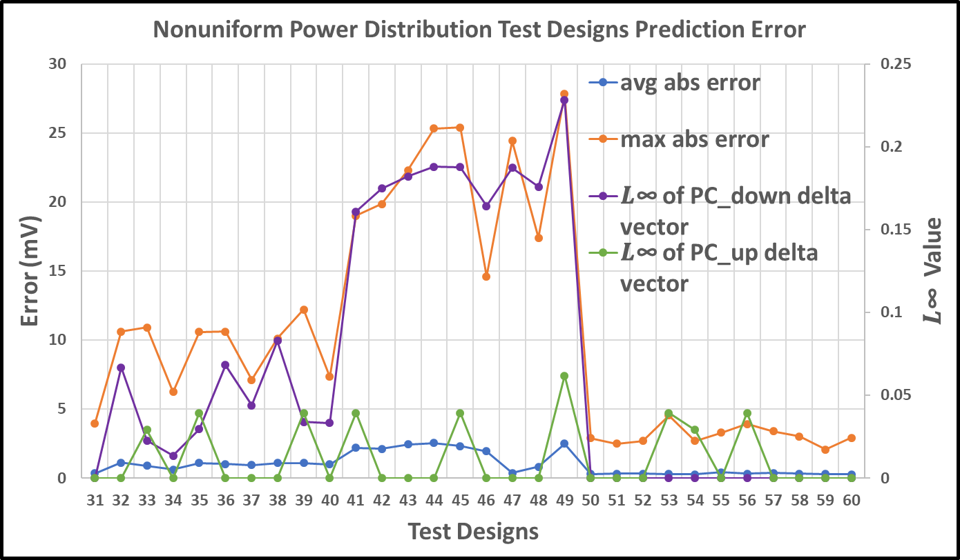
Experiment 4: Model Accuracy on Different Designs
Ability to predict incremental IR drop in new designs without retraining
Design setup
30 non-uniform power distribution
30 uniform power distribution
Model is quite robust as long as the new extracted features satisfy the model update condition
Uniform power distribution test designs prediction error
Nonuniform power distribution test designs prediction error
Notes:
In our last experiment, which is Experiment 4, we try to confirm the ability to predict incremental IR drop in new designs without retraining our model.
We generate 30 different non-uniform power distribution and 30 uniform power distribution test designs to test our model.
[Point] From the figures, when the maximum absolute error exceeds 5mV, the delta Pullup and Pulldown components also exceed the model update condition.
Our model is quite robust as long as the new extracted features satisfy the model update condition
20:32

Slide 29
Outline
Background and Motivation
Related Work
Our Methodology
Experimental Setup and Results
Conclusion
Notes:
I will now conclude my talk.

Slide 30
Conclusion
Propose a learning-based incremental IR drop prediction method based on electrical and structural features
Compared to commercial golden IR analysis tool
22-1000X speedup
average error < 1mV
max error ~ 5mV
Propose model update condition to improve the robustness
Ongoing / Future works
Improvement of accuracy and speed (with better machine learning techniques)
Extension of this work to dynamic voltage drop prediction
Notes:
We propose a learning-based incremental IR drop prediction method based on electrical and structural features
Compared to a golden commercial IR analysis tool, IncPIRD achieves 22-1000X speedup with average error less than 1mV and maximum error around 5mV in our studies.
We propose a model update condition to improve the robustness of our model.
There are two main directions for future works.
The first one is Improvement of accuracy and speed. This can certainly include more research on machine learning techniques, and industry platforms such as ANSYS’s SeaScape big data framework look really interesting to us for this.
The second one is extension of this work to dynamic voltage drop prediction, which we know is a much harder prediction problem.

Slide 31
Thank you!
UCSD ABKGroup is grateful to Qualcomm, Samsung, NXP, the IMPACT+/C-DEN centers, Mentor Graphics and the NSF for research support. We thank IMEC and Cadence for additional research enablements and collaborations.
Notes:
Thank you for your attention!
22:00

