Slide 1
Diffusion Break-Aware Leakage Power Optimization and Detailed Placement in Sub-10nm VLSI
Sun ik Heo†, Andrew B. Kahng‡, Minsoo Kim‡ and Lutong Wang‡ ‡UC San Diego, †Samsung Electronics Co., Ltd.
Notes:
START STOPWATCH !
Good morning, everyone. Today, I will present a detailed placement optimization to mitigate a model-hardware miscorrelation that comes from neighbor diffusion effects.
This work is in collaboration with Samsung. My students are Minsoo Kim and Lutong Wang.

Slide 2
Outline
Motivation: second diffusion break “surprise”
2nd DB-aware leakage optimization and placement
2nd DB-aware relocation
2nd DB-aware sizing
Experiments
Conclusion
Notes:
I will start with motivation: chiefly, a “Second Diffusion Break leakage surprise”. I’ll then describe our 2nd DB-aware leakage optimization and placement, including heuristics for relocation and sizing.
Then, I will show experimental results and conclude the talk.

Slide 3
Motivation
Diffusion Break (DB): adjacent device isolation
0.5CPP placement grid offset between SDB (green) and DDB (purple)
Large spacing constraint between SDB and DDB
Key: distance D2 to 2nd DB (matters for SDB cells only)
Diffusion Break (DB) | Speed | Leakage | Area
Single Diffusion Break (SDB) | ↓ | ↓ | ↓
Double Diffusion Break (DDB) | ↑ | ↑ | ↑
Notes:
[click] Diffusion break is a physical barrier that isolates two adjacent devices.
[click] There are two types of diffusion break: single diffusion break, or SDB, and double diffusion break – DDB.
[click] SDB cells have lower speed and leakage, and smaller area, while
[click] DDB cells have higher speed and leakage, with larger area.
[click] The two types of diffusion break have different placement grids with 0.5 CPP (contacted poly pitch) offset (see the green and purple lines), and there is also a minimum spacing constraint between SDB and DDB cells.
[click] For a given transistor, the 2nd DB distance is the distance between the first closest DB to a given transistor, and the second closest DB.
This figure illustrates the 2nd DB distance in an SDB-DDB mixed design. For the target device in green, the first DB distance is D1, and the second DB distance is D2. The challenge we study is that the timing and power of the device in green are both functions of D2. This “second DB effect” applies only to SDB cells.

Slide 4
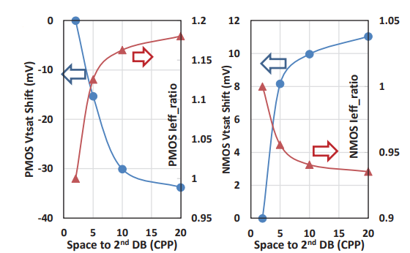
Motivation (cont’d)
Measured Vt and Ieff of PMOS, NMOS vs. 2nd DB distance [1]
Delay and leakage of standard cells change according to 2nd DB distance !
[1] S. Yang, Y. Liu, M. Cai, J. Bao, P. Feng, X. Chen et al., “10nm High Performance Mobile SoC Design and Technology Co-developed for Performance, Power, and Area Scaling”, Proc. VTS, 2017, pp. T70–T71.
Notes:
[click] In this figure from VTS-2017, we see a Vt shift of PMOS on the left and NMOS on the right (the blue traces), according to 2nd DB distance. The x-axis is 2nd DB distance in CPPs, increasing to the right. [click] Because this effect is not captured in the library model of the cell, devices in silicon will have different characteristics from what is assumed during the signoff analysis.
So: delay and leakage of standard cells will change according to 2nd DB distance.
[2:54]

Slide 5
Our Work
Goal: to mitigate model-hardware miscorrelation
8.8% to 144.4% “leakage surprise” in our preliminary study
Design | Hold WS (ns) | Setup WS (ns) | Leakage (mW) (Δ%)
Case 1 | 0.108 / 0.108 | -0.056 / -0.047 | 0.387 / 0.742 (91.7%)
Case 2 | 0.113 / 0.113 | -0.055 / -0.055 | 0.419 / 0.456 (8.8%)
Case 3 | 0.080 / 0.113 | 0.016 / 0.022 | 1.486 / 3.186 (114.4%)
Case 4 | 0.086 / 0.086 | -0.002 / -0.002 | 1.523 / 2.439 (60.1%)
Case 5 | 0.108 / 0.108 | -0.056 / -0.045 | 0.387 / 0.909 (134.9%)
Case 6 | 0.113 / 0.113 | -0.055 / -0.054 | 0.419 / 0.474 (13.1%)
Case 7 | 0.080 / 0.080 | 0.016 / 0.045 | 1.486 / 3.632 (144.4%)
Case 8 | 0.086 / 0.086 | -0.002 / -0.001 | 1.523 / 2.640 (73.3%)
Our work:
We study design impacts of the 2nd DB effect for designs using only SDB cells and both SDB and DDB cells
We propose a 2nd DB-aware leakage optimization and placement methodology which honors the placement constraints for SDB and DDB
We achieve 80% leakage recovery on average without changing design performance
Notes:
Our goal is to improve quality of the tapeout by improving model to hardware correlation.
[Since 2nd DB distance can be seen as the adjacent SDB cell width.]
In a motivating study, here are 8 cases that use different types of filler cell, and different types of standard cells.
[click] In each column: hold slack, setup slack, leakage – the left value is with generic library models. The right value is with timing and power models that are properly derated for the 2nd DB effect. [click] We see that 8.8% to 144.4% leakage surprise is caused by 2nd DB effect.
In other words, if you sign off your block with this left value of leakage power, it is actually expected to have up to 144.4% more leakage as given by the right value.
[click] In this work, we study design impacts of the 2nd DB effect for designs using only SDB cells and both SDB and DDB cells. [click] We also propose a 2nd DB-aware leakage optimization and placement methodology which honors the placement grid for each DB and a specified minimum spacing constraint between SDB and DDB cells. [click] We achieve 80% leakage recovery on average without changing design performance.
[4:36]

Slide 6
Outline
Motivation
2nd DB-aware leakage optimization and placement
2nd DB-aware relocation
2nd DB-aware sizing
Experiments
Conclusion
Notes:
Now I will describe our 2nd DB-aware leakage optimization and detailed placement.

Slide 7
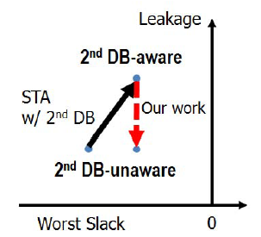
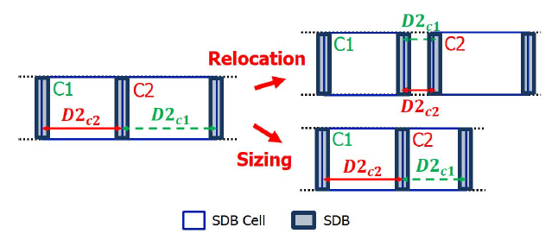
Problem Statement
Goal: swap cells and perturb placement so as to minimize leakage power of the design with 2nd DB awareness
Input: A post-P&R design database from a commercial tool without 2nd DB-awareness
Output: An optimized design with 2nd DB-awareness
Do: Relocation, gate sizing, Vt swapping and DB swapping
Constraints: No total negative slack (TNS) degradation, no cell overlap, grid-based placement for each DB and a spacing constraint between SDB and DDB
Notes:
In our problem,
[click] the input is an post-P&R database from a commercial tool. We swap the cells and perturb the placement to minimize leakage power, with 2nd DB awareness. [click] The output is a design that has been optimized with 2nd DB awareness.
[click] In this cartoon, 2nd DB-aware timing analysis reports more leakage but better slack than the designer had thought based on his or her original 2nd DB-unaware analysis. That’s the black arrow. Our goal in the red arrow is to recover leakage surprise caused by 2nd DB effect without timing degradation.
[click] We do cell relocation, gate sizing, Vt swapping and DB swapping.
[Click] This figure illustrates relocation and sizing. D2_c1 in green denotes the 2nd DB distance of cell C1 and D2_c2 in red denotes the 2nd DB distance of cell C2. When C2 is moved to the right, the 2nd DB distances of both C1 and C2 will be decreased. Also, when C2 is downsized, the 2nd DB distance of C1 will be decreased. This means that we need to care about the 2nd DB effect for neighboring cells when we size or swap a given cell.
[click] There are four constraints in our formulation, no TNS degradation, the cell non-overlapping constraint, grid-based placement for each DB and a spacing constraint between SDB and DDB.

Slide 8
Overall Flow
Input: post-route design
2nd DB-unaware
$i_{max}$ iterations of optimization
Incr. routing and Vt swapping
To recover timing degradation by routing changes
Output: optimized design
2nd DB-aware
Post-P&R database
$$i←1$$
Relocation
Leakage
Optimization
Sizing, Vt/DB swapping
$$i←i+1$$
$$i<i_{max} ?$$
Yes
No
Incremental routing
Timing Recovery
Vt swapping
with fixed cell location
An optimized design
Our flow
Notes:
Our overall flow has several steps.
[click] The input is an post-routed design from a commercial P&R tool, without 2nd DB-awareness, and [click] we perform our optimization with i_max iterations as shown in the red box. I’ll explain details of our optimization in the next slides.
[click] And then, we do incremental routing and Vt swapping to recover timing degradation from routing changes.
[click] The output of our flow is an optimized design with 2nd DB-awareness.
[A commercial tool doesn’t understand 2nd DB-awareness. This optimized input from a commercial tool is 2nd DB-unaware. ]
[The red box indicates our flow and the remaining part is performed by a commercial tool.]

Slide 9
2nd DB-Aware Relocation Algorithm 1 in paper
Cell list (Combinational)
Build candidate list
Find a best candidate move per cell
Best = Maximum $∆leakage$
Considering 2nd distance changes for neighboring cells
Commit best move from candidate list
No TNS degradation
Find best candidate move
Remove cell from cell list
Y
Cell list ≠ φ
Done
N
N
Candidates ≠ φ
Y
Pick best move
and commit
Remove move from candidate list
N
TNS degrades?
Y
Revert
Notes:
This slide explains our cell relocation, which is Algorithm 1 in the paper.
[click] First, we build a candidate move list. For all the combinational cells in the design, we find a best candidate move according to the leakage reduction. Here, we consider 2nd distance changes for neighboring cells as well.
[click] This figure is a reminder of our two-cell example: When cell C2 is shifted to the right, the 2nd DB distance decreases for BOTH C1 and C2. So, this could be a good move to make.
[click] We greedily commit the best move with the highest leakage reduction as long as there is no TNS degradation and the placement is legal.
[9:00]
[D2_c1 is the 2nd DB distance of cell c1 and D2_c2 is the 2nd DB distance of cell c2]

Slide 10
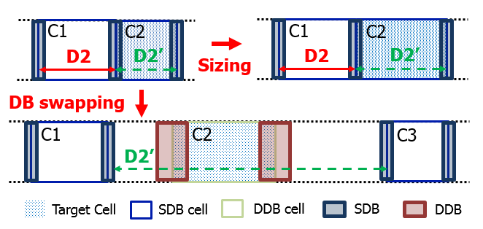
2nd DB-Aware Sizing Algorithm 2 in paper
Cell list (Combinational)
Build candidate list
Sensitivity = $∆leakage/∆slack$
‘Sensitivity calculation’ step includes cell swap by sizing, Vt and DB swapping
Considering 2nd distance changes for neighboring cells
No 2nd distance change for Vt swapping
Commit best move from candidate list
No TNS degradation
Sensitivity calculation and
find best candidate
Remove cell from cell list
Y
Cell list ≠ φ
Done
N
N
Candidates ≠ φ
Y
Pick best move
and commit
Remove move from candidate list
N
TNS degrades?
Y
Revert
Notes:
This slide explains our 2nd DB-aware sizing (Algorithm 2 in the paper).
[click] We greedily perform either gate sizing, Vt swapping or DB (diffusion break) swapping for each combinational cell.
We first populate the candidate list with all candidate moves per cell, and [click] we use delta leakage/ delta slack as our sensitivity function at sensitivity calculation step.
[We perform the sensitivity calculations for downsizing, Vt swapping and DB swapping, respectively.]
[click] We need to consider 2nd DB distance changes for neighboring cells.
[click] For example, as shown in this figure, upsizing C2, and or swapping C2 to DDB, both change the GREEN 2nd DB distance of cell C1.
[click] We then greedily commit the candidate move with the highest sensitivity [click] as long as there is no TNS degradation.
[10:30]

Slide 11
Outline
Motivation
2nd DB-aware leakage optimization and placement
2nd DB-aware relocation
2nd DB-aware sizing
Experiments
Conclusion
Notes:
Now, I will show experimental results.

Slide 12
Experimental Environment
Synthesis: Synopsys Design Compiler L-2016.03-SP4
P&R: Cadence Innovus Implementation System v17.1
Timer: OpenSTA https://github.com/abk-openroad/OpenSTA
We implement our heuristics in C++ with OpenAccess 2.2.43 to support LEF/DEF
14nm FinFET technology with 9T triple-Vt libraries
Testcase: AES, MPEG, JPEG, VGA from OpenCores
All experiments: 8 threads on a 2.6GHz Intel Xeon server
Design | #Insts
AES | ~13K
MPEG | ~12K
JPEG | ~47K
VGA | ~67K
Notes:
[click] We use DC and Innovus for logic synthesis and P&R. We also use the open-source OpenSTA (which is the Parallax timer) as our golden timer.
[we implement our code in C++ with OpenAccess to support LEF and DEF.]
[click] We use foundry 14nm technology with 9 track cells.
[click] Four testcases from OpenCores, are listed here.
[All experiments are performed with eight threads on a 2.6GHz Intel Xeon server]
[Our derating values are in backup slide. We pre-process liberty files with different 2nd DB derating values and make Liberty for every 2nd DB distance. During STA, we use these derated Liberty models for each cell instance.]
[we get vth difference between LVT, RVT, SLVT, and delay/leakage difference. Vt shift of PMOS and NMOS are different but we added up the shift for the cell. We can guess how much delay/leakage changes from Vt shift caused by 2nd DB distance. Vt shift for 20cpp 2nd DB distance is from the slide 4.]

Slide 13
Exploring the Heuristic Design Space
Common practice - 2CPP padding for F/Fs
Flow tunable parameters
$i_{max}$, enable/disable DB swap
Expt. | Settings
Baseline | w/ 2CPP padding + DB swapping + 2 iterations
Expt. 1 | w/o 2CPP padding + DB swapping + 2 iterations
Expt. 2 | w/ 2CPP padding + disabled DB swapping + 2 iterations
Expt. 3 | w/ 2CPP padding + DB swapping + 4 iterations
Expt. | 2nd DB-Unaware |  | 2nd DB-Aware |  | Our results
 | TNS (ns) | $l_{base}$(mW) | TNS (ns) | $l_{actual}$(mW) | TNS (ns) | $l_{opt}$(mW) | Recovery
Baseline | 0.000 | 0.182 | 0.000 | 0.190 (4%) | -0.002 | 0.180 (-1%) | >100%
Expt. 1 | 0.000 | 0.178 | 0.000 | 0.198 (11%) | -0.002 | 0.186 (4%) | 60.0%
Expt. 2 | 0.000 | 0.182 | 0.000 | 0.190 (4%) | -0.002 | 0.183 (1%) | 87.5%
Expt. 3 | 0.000 | 0.182 | 0.000 | 0.190 (4%) | -0.003 | 0.178 (-2%) | >100%
Notes:
[click] We study the sensitivity of outcomes to three main heuristic design space choices: 2CPP padding for all flip-flops (permitting a small filler cell to be inserted, and thus ensuring a small 2nd DB distance for any neighbor of a flop), DB swapping (which is flipping between SDB and DDB cell versions), and multiple optimization iterations. We show here a baseline, where we use 2CPP padding for flip-flops and execute two iterations with inclusion of DB swapping.
[We apply a padding between flip-flops, because our optimization does not touch flip-flops. Flip-flops can be abutted with other cells but we require at least 2CPP space between flip-flops.]
[click] Experiments 1 and 2 show less leakage recovery than the baseline, and [click] Experiment 3 shows that using 4 iterations gives almost no improvement over using 2 iterations.
The bottom line is that this is how we determine our baseline of using 2CPP padding of flip-flops, DB swapping and 2 iterations in all of our reported experiments.

Slide 14
Runtime
Runtime improvement of OpenSTA incremental timing
Tolerance: a minimum percentage change in delay that causes propagated delays to be recomputed during incremental timing updates.
0.8% tolerance gives 67% runtime reduction with same QOR
Tolerance | 1st loop |  | 2nd loop |  | Our results
 | Reloc. (s) | Sizing (s) | Reloc. (s) | Sizing (s) | Runtime (s) | WS (ns) | Leak (mW)
0.0% | 23 | 320 | 22 | 316 | 681 | -0.001 | 0.180
0.2% | 23 | 142 | 22 | 140 | 327 | -0.001 | 0.180
0.4% | 23 | 134 | 22 | 130 | 309 | -0.001 | 0.180
0.6% | 23 | 119 | 22 | 117 | 281 | -0.001 | 0.180
0.8% | 23 | 94 | 21 | 90 | 228 | -0.001 | 0.180
1.0% | 23 | 87 | 22 | 84 | 216 | -0.001 | 0.187
Notes:
[click] Incremental STA for candidate moves is a major key to runtime. We reduce runtime using a ‘tolerance’ parameter that is built in to the timer. Tolerance denotes the minimum percentage change in cell delay that causes propagated delays to be recomputed during incremental timing updates.
[click] When we sweep the tolerance parameter, as shown in this table, a design optimization using 0.8% tolerance (the red row) in the incremental STA update shows 67% runtime reduction [click] but achieves the same leakage recovery as an optimization using 0% tolerance. As a result, we use 0.8% tolerance in all of our experiments.
[14:00]

Slide 15
Experimental Results
80% leakage reduction on average
A: Initial post-P&R + 2nd DB-unaware timing/power analysis
B: Initial post-P&R + 2nd DB-aware timing/power analysis
C: Optimized post-P&R + 2nd DB-aware timing/power analysis
A
B
C
Design | Type | 2nd DB-Unaware |  | 2nd DB-Aware |  | Our Result
 |  | WS (ns) | Leakage (mW) | WS (ns) | Leakage (mW, %) | WS (ns) | Leakage (mW, %) | Recovery (%) | Runtime (sec)
AES | I | 0.011 | 0.225 | 0.012 | 0.295 (31%) | 0.000 | 0.227 (1%) | 97.1% | 207
MPEG | I | 0.004 | 0.227 | 0.005 | 0.272 (20%) | -0.001 | 0.245 (8%) | 60.0% | 257
JPEG | I | 0.002 | 0.683 | 0.002 | 0.867 (27%) | 0.002 | 0.745 (9%) | 66.3% | 1820
VGA | I | 0.011 | 1.203 | 0.012 | 1.786 (48%) | 0.001 | 1.295 (8%) | 75.0% | 3819
AES | II | 0.002 | 0.182 | 0.002 | 0.190 (4%) | -0.001 | 0.180 (-1%) | >100% | 228
MPEG | II | 0.004 | 0.228 | 0.004 | 0.264 (16%) | 0.002 | 0.237 (4%) | 75.0% | 261
JPEG | II | 0.003 | 0.697 | 0.003 | 0.765 (10%) | 0.002 | 0.714 (2%) | 75.0% | 2039
VGA | II | 0.015 | 1.230 | 0.015 | 1.449 (18%) | -0.002 | 1.256 (2%) | 88.1% | 2998
*$Recovery=1−\frac{C−A}{B−A}$
Design type
Type-I (SDB only) : Area saving
Type-II (SDB-DDB mixed) : High performance
*$Recovery=1−\frac{C−A}{B−A}$
Notes:
[click] This table summarizes our main results.
[click] We study designs that use only SDB cells (we call these Type-I in the second column, Type), and designs that use both SDB and DDB cells (we call these Type-II designs). Type I designs can be used to save area, and Type-II designs can be used to meet high performance requirements.
[click] 2nd DB-unaware results (A) are from a commercial P&R tool without 2nd DB consideration. [click] The 2nd DB-aware analysis result (B) applies DB-aware derated libraries to the P&R tool’s output, without any optimization. So, A versus B shows the Leakage Surprise.
[click] Our Result, (in C), is for our optimized designs that are driven by 2nd DB-aware timing and power analysis.
[We measure how much recovery we achieve by our flow]
So if we compare column B with column A, we can see 4% to 48% leakage increment due to consideration of the 2nd DB effect. After our optimization, we can achieve on average 80% reduction of this Leakage Surprise. Here, 100% leakage recovery means that after applying the correct derating values and our optimization, we can reach the same leakage values of column A. Our optimization retains similar timing, with slight degradations of worst slack (that comes from, basically, uncontrollable commercial router effects).
[16:20]
[Slight timing degradation (worst slack) is cause by routing change. It can be ignorable.]

Slide 16
Sensitivity to Clock Period and Utilization
Target clock period (0.3~0.5ns) and utilization (60~80%)
As target clock period ↓ ↓, Type-I case has more leakage increments
Smaller changes for Type-II case because DDB cells mitigate the 2nd DB effect (dotted lines)
2nd DB effect ↑ ↑ with high utilization in Type-I cases, in general
But DDB cells mitigate the effect in Type-II case
Notes:
[click] Here, for our four testcases, we sweep clock period from 0.3 to 0.5ns and utilization from 60 to 80% to study sensitivity to these design parameters.
[click] The top plots show the 2nd DB effect as a percentage Delta on y-axis, with clock period increasing from left to right on the x-axis.
The bottom plots similarly show the recovery of the leakage surprise that we achieve.
Going from right to left in the figure (a) and (c) traces, we see that when target clock period decreases, the Type-I case has more leakage surprise from the 2nd DB effect, because DDB cells in Type-II designs do not suffer 2nd DB effects.
[click] Also, 2nd DB effect gets higher in high utilization cases of Type-I, but DDB cells mitigate the effect in Type-II designs.
From this experiment, we believe that we can achieve good leakage recovery – which is in the bottom plots -- using our flow, across a range of performance and density scenarios.
[17:50]

Slide 17
Outline
Motivation
2nd DB-aware leakage optimization and placement
2nd DB-aware relocation
2nd DB-aware sizing
Experiments
Conclusion
Notes:
Now I will conclude my talk.

Slide 18
Conclusion and Future Goals
2nd DB effect is prominent example of Local Layout Effect cause of model-hardware miscorrelation
80% recovery of “leakage surprise” from 2nd DB effect
Ongoing / future works
Runtime improvement
Comprehensive study of sensitivity functions for improved leakage recovery, multi-corner signoff
Mixed-DB in cell architecture: e.g., PMOS has SDB and NMOS has DDB within one standard cell
General approach to LLE mitigation in detailed placement !
Notes:
[click] In conclusion, 2nd DB effect is a well-known example of Local Layout Effect, which is a root cause of model-hardware miscorrelation and costly signoff guardbanding in advanced nodes.
[click] In this work, we achieve 80% recovery of the “leakage surprise” that arises from 2nd DB effect, by using our proposed optimization flow
[click] Our future works include runtime improvement, [click] more study on sensitivity and multi-corner signoff, and [click] mixed-DB in the cell architecture itself.
[click] A general approach to LLE modeling and mitigation in detailed placement is also an important direction for future work.

Slide 19
Thank you!
Notes:
Thank you for your attention!
Why DDB doesn't affect SDB distance?
DDB doesn’t have any stress effects to its neighboring gates. Our collaborator mentioned 2nd DB effect is only found for SDB
How do you model 2nd DB effect to your library?
We average the effect for PMOS and NMOS and assume the standard cell has the averaged effect from 2nd DB distance. And, we measure the threshold voltage difference and calculate speed and leakage changes from the vth difference.
How will you achieve runtime improvement?
We will implement a multi-thread function to reduce the runtime. We also can use this for multi-corners or quality improvement. (E.g., multiple sensitivity function to reduce more leakage.)
How did you get >100% of leakage reduction?
For 2nd DB-aware, we can reduce more leakage from a commercial tool because other cells are faster (more leakage) than 2nd DB-unaware. So, we sometimes get smaller leakage.

Slide 20
BACKUP

Slide 21
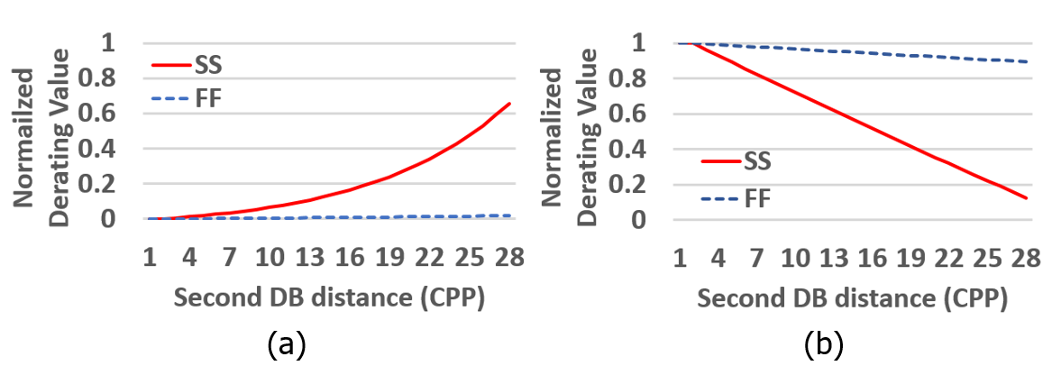
Derating Values
Notes:
The left side (a) is derating for leakage, and the right side (b) is derating for delay.
SS has more derating effect: The sensitivity to delay and leakage are much smaller for FF corner. This is from a comparison between RVT and LVT in 14nm. If we have the same vth difference for SS and FF, the leakage and delay difference were very small for FF……………

Slide 22
FAQ
Why DDB doesn't affect SDB distance?
DDB doesn’t have any stress effects to its neighboring gates. Our collaborator mentioned 2nd DB effect is only found for SDB
How do you model 2nd DB effect to your library?
We average the effect for PMOS and NMOS and assume the standard cell has the averaged effect from 2nd DB distance. And, we measure the threshold voltage difference and calculate speed and leakage changes from the vth difference.

Slide 23
FAQ
How will you achieve runtime improvement?
We will implement a multi-thread function to reduce the runtime. We also can use this for multi-corners or quality improvement. (E.g., multiple sensitivity function to reduce more leakage.)
How did you get >100% of leakage reduction?
For 2nd DB-aware, we can reduce more leakage from a commercial tool because other cells are faster (more leakage) than 2nd DB-unaware. So, we sometimes get smaller leakage.

