Slide 1
Revisiting and Bounding the Benefit From 3D Integration
Wei-Ting J. Chan†, Andrew B. Kahng†‡ and Jiajia Li†
†ECE and ‡CSE Departments, UC San Diego
{wechan, abk, jil150}@ucsd.edu
Notes:
Thanks you for the introduction.

Slide 2
Outline
Motivation
Previous Work
Implementation in Various Dimensions
Netlist Structure vs. 3D Benefit
Conclusions

Slide 3
Motivation
3DIC is a promising technology in “More-than-Moore” era
3DIC with > 2 tiers is expected to achieve more benefits
[Song15]: Three-tier 3DIC achieve 15% more power reduction compared to two-tier 3DIC
But: No upper bounds on power and area benefits from 3DIC have ever been established !
Goal: study upper bound of power and area reduction for 3DICs

Slide 4
Outline
Motivation
Previous Work
Implementation in Various Dimensions
Netlist Structure vs. 3D Benefit
Conclusions

Slide 5
Previous Work (Power Benefit)
Many previous works on 3DIC optimization
More details are given in Table I of the paper
Evaluations include both power and wirelength benefits

Slide 6
Previous Work (Wirelength Benefit)
Many previous works on 3DIC optimization
More details are given in Table I of the paper
Evaluations include both power and wirelength benefits
No previous work proposes upper bounds on 3DIC power and area reductions
Chan et. al derive an upper bound of 67% on WL reduction

Slide 7
Outline
Motivation
Previous Work
Implementation in Various Dimensions
Netlist Structure vs. 3D Benefit
Conclusions

Slide 8
Implementation in Various Dimensions
Key idea: Infinite dimension gives us a bound on what 3 dimensions can deliver
Infinite dimension: netlist optimization with zero wireload model
3D (w/ N tiers): placement and routing with shrunk LEF (by 1/$\sqrt{N}$) and annotated TSV RC
Best 2D conventional implementation: vary key parameters → select best solution
Parameters = synthesis frequency/utilization, placement utilization, BEOL options
Pseudo-1D: placement and routing with large layout aspect ratio (e.g., 10:1)

Slide 9
Benefit Evaluation Flow: 3DIC (w/N Tiers)
Cells and BEOL are scaled according to tier number T (X/Y to $\sqrt{N}$)
2D P&R are spilt into M x M to apply FM-based partitioning
RC of TSV are annotated according to tier number
RC of cut nets = RC of 6 metals $×$ N + TSV $×$ (N-1)
Cell and BEOL LEFs
Scaled X/Y to $\sqrt{N}$
RC-annotation
for TSVs
Power Evaluation
2D P&R
Split floorplan into M x M grids
FM-based min-cut partition for N tiers
Incremental
optimization

Slide 10
Benefit Evaluation Flow: Conventional 2D
Search within multiple design parameters to find optimum implementations
Synthesis frequency
Clock period (PnR)
Tight (loose) timing: Slightly smaller (larger) synthesis clock period → Smaller power after P&R
Placement utilization
Unimodal model:
Too compact → routing congestion
Too sparse → longer wirelength

Slide 11
Benefit Evaluation Flow: Pseudo-1D
Pseudo-1D implementations use floorplans with very large aspect ratios
Routing along the long side is difficult
PnR Aspect ratio = 10:1 to emulate 1D placement
Limited routing channels along the long side

Slide 12
Infinite-Dimension Bound on 3D Power Benefits
Iso-performance power comparison among implementations in different dimensions
Gaps between infinite dimension vs. 2D → maximum 3D benefits = 36% and 20% for M0 and JPEG
CORTEX M0
AES
infD
20%
36%
clock period (ns)
clock period (ns)

Slide 13
Infinite-Dimension Bound on 3D Area Benefits
Iso-performance area comparison among implementations in different dimensions
3D integration offers very small (< 10%) area benefits over 2D
3D integration may have converted area benefit into power benefit (e.g., buffer sizing or duplication)
CORTEX M0
AES
3D (2 tier)
3D (3 tier)
3D (4 tier)
infD
10%
10%
clock period (ns)
clock period (ns)

Slide 14
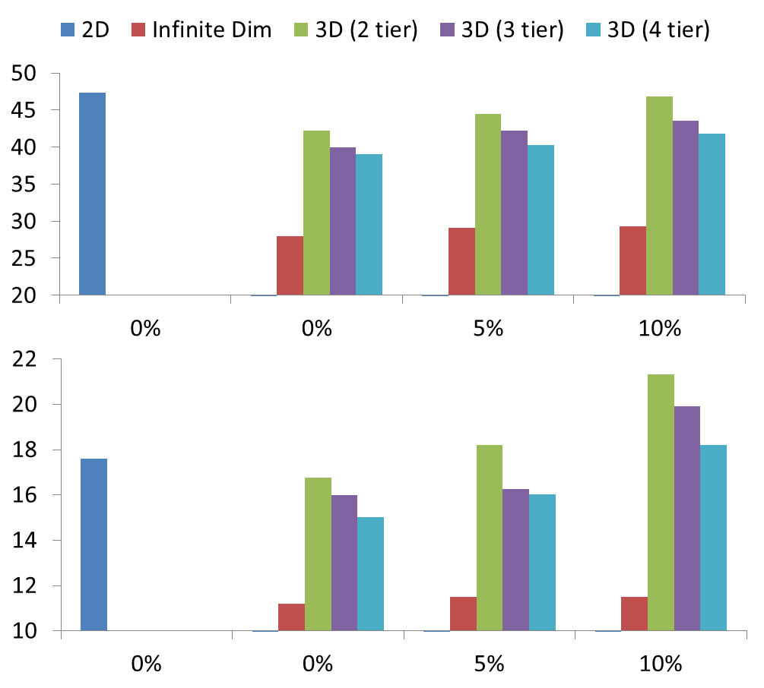
Impact of Clock Skews on 3D Benefits
Implementations with higher dimensions are more susceptible to clock skews
Lower wire delays lead to less hold time margin
P&R added more buffers to reduce the skew
infD
AES
11%
6%
1%
Power (mW)
2D (0%)
CORTEXM0
-21%
5%
-3%
Power (mW)
2D (0%)
Clock uncertainty (% of clock period)

Slide 15
Outline
Motivation
Previous Work
Implementation in Various Dimensions
Netlist Structure vs. 3D Benefit
Conclusions

Slide 16
Netlist Structure vs. 3D Benefits
Observation: 3D benefits vary across designs
Goal: Find parameter(s) to indicate 3D benefits
Studied parameters
Timing slack distribution (Low correlation)
Fanout / fanin distribution (Low correlation)
Rent parameter (i.e., Rent exponent) (High correlation)
Rent Parameter
Empirical observation T = t∙g^{p}
T = #terminals
t = constant
g = #gates
p = Rent exponent (indicator of netlist complexity)
“Surface area to volume” power law: e.g., has p = 0.5

Slide 17
New Connection between Rent and 3D Benefit!
More complex netlists demonstrate higher max 3D power benefit
Benefits increase for higher-dimension implementations
Iso-power post-synthesis netlists
Rent (input / actual) | Power (mW) | Area (um²)
0.50 / 0.63 | 46.4 (100%) | 39552 (100%)
0.55 / 0.66 | 46.8 (101%) | 40262 (102%)
0.60 / 0.69 | 46.7 (101%) | 40404 (102%)
0.65 / 0.71 | 47.4 (102%) | 40532 (102%)
0.70 / 0.74 | 46.9 (101%) | 40607 (103%)
More complex netlists
infD
Lower complexity:
Max benefit = 22%
Higher complexity:
Max benefit = 42%
Power benefit to 2D

Slide 18
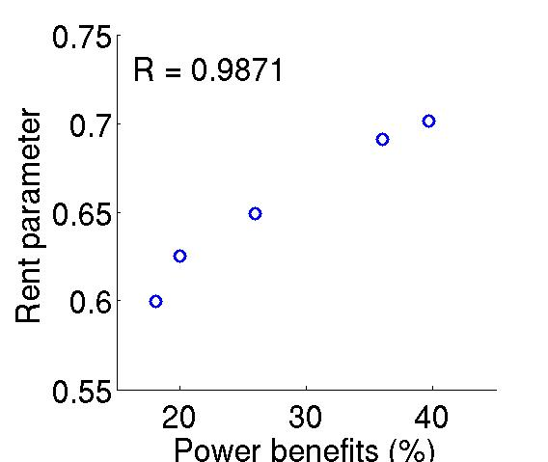
Rent and 3D Benefit: Real Designs
Placement-based Rent exponent is well correlated with 3D benefits
Rent parameter is possibly a simple indicator of 3D power benefits
AES
CORTEX M0
Placement-based Rent parameter
LEON3MP
JPEG
VGA

Slide 19
Rent Parameter Modulation for 3D
Attempt to synthesize same design into netlists of different Rent parameters
Binning cells in 28FDSOI into four types {2-input, 3-input, 4-input, >4-input}
Rent parameter modulation: scale area of cells by different ratios
Example of Rent parameter modulation in commercial synthesis tool
Rent | 2-input | 3-input | 4-input | >4-input
0.600 | 1 | 0.5 | 1 | 1
0.605 | 2 | 0.5 | 1 | 1
0.611 | 1 | 1 | 1 | 1
0.653 | 2 | 1 | 0.5 | 0.5
0.656 | 2 | 0.5 | 0.5 | 0.5
0.663 | 1 | 0.5 | 1 | 0.5

Slide 20
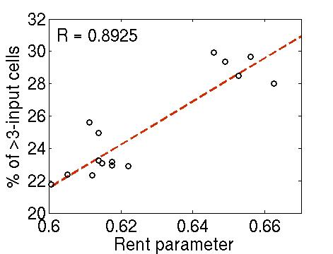
Ongoing: Dimension-Aware Implementation
Observations:
Rent parameter increases when more cells with high pin counts
Observe correlated Rent parameter vs. % of >3-input cells
Future work:
Direct control in academic logic synthesizer
Design: JPEG
Placement-based Rent parameter

Slide 21
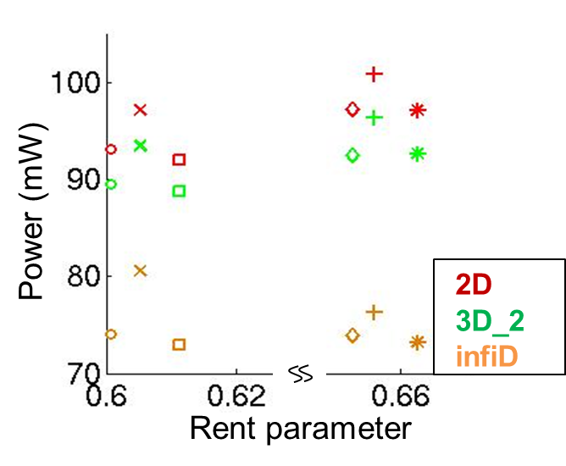
Ongoing: Dimension-Aware Implementation
Shapes = set of implementations w/ different Rent; Colors = dimensions
infD (≈ post-synthesis) power: x > +, 3D power: x ≈ +, 2D power: x < +
Implementation | Rent
O | 0.600
X | 0.605
 | 0.611
 | 0.653
 | 0.656
 | 0.663
Design: JPEG
infD
Placement-based Rent parameter

Slide 22
Takeaways
Synthesis optimization changes Rent parameter of netlists
Design implementation (synthesis, P&R) should be aware of dimension
Netlists with simple connections can be implemented in any dimension
Netlists with complex connections are more suitable for 3D implementation
(This is not surprising)

Slide 23
Outline
Motivation
Previous Work
Implementation in Various Dimensions
Netlist Structure vs. 3D Benefit
Conclusions

Slide 24
Conclusion and Future Goals
Revisit 3D power and area benefit
Implementation with infinite dimension upper-bounds 3D power and area benefits
Correlation between placement-based Rent parameter and 3D benefits
Ongoing/future work: Dimension-aware design implementation

