Slide 1
Toward Metrics of Design Automation Research Impact
Andrew B. Kahng‡†, Mulong Luo†, Gi-Joon Nam¹, Siddhartha Nath†,
David Z. Pan² and Gabriel Robins³
UC San Diego, ‡† ECE and †CSE Depts., {abk, muluo, sinath}@ucsd.edu
¹IBM Research, {gnam@us.ibm.edu}
²UT Austin, ECE Dept., {dpan@ece.utexas.edu}
³Univ. of Virginia, CS Dept., {robins@cs.Virginia.edu}
Notes:
Thanks you for the introduction.

Slide 2
Motivation
Design automation (DA) research outcomes have many forms
Publications, patents, degrees awarded, …
Research impacts are hard to quantify
There is an entire “life cycle” of DA research
Could understanding research impacts help with
Early identification of high-value research directions ?
Increased overall investment in DA research ?
DA Conferences
Government
workshops
Journal papers
Consortia
keynotes
(early)
tutorials
technical
papers
Semiconductor industry
Academia
special sessions
(late)
Patents
hands-on tutorials
exhibits
EDA industry

Slide 3
Our Study
Compiled DA research corpora
750K+ patents, 47K papers, government-funded project abstracts, industry needs statements
Applied bibliometric analyses
Latent Dirichlet allocation (LDA) for topic modeling
Structure in patent citation graph
Notional analyses of papers, patents, funding, industry structure (startups, tools)
Stasis vs. change
Latencies
SRC program -> research papers
Papers -> commercial tools
Still unsolved: “metrics of DA research impact”

Slide 4
Overall Data Collection and Analysis Flows
Data collection
Conference PDFs
Journal PDFs
DA-Related USPTO Patent HTMLs
Types of Studies
Convert to Text and Preprocess
Create Citation Graph
Run LDA and Extract Topics
Perform Network Analyses
Example Results
Statistics of Word Counts, Bhatta, Entropy Distance Metrics, Visualizations
Report Centrality, Transitive Fanouts, Fanins
DA Metrics (Future)

Slide 5
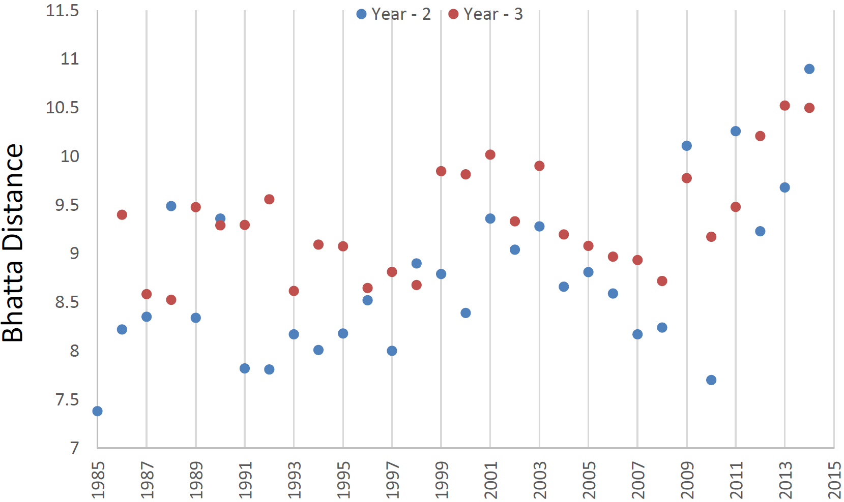
Stasis vs. Change in DA Research
Papers evolving rapidly over 2011-2014, 2006-2009, 1998-2001 (= “new fields” ?)
Papers exhibited stasis over 1994-1997, 1991-1993, 2004-2007, 2005-2008 (= “consolidation” ?)
Bhatta distance (see backup) between ICCAD papers of a given year and ICCAD papers of two or three years earlier.

Slide 6
Latency Analysis
Conference literature reflects NSF, SRC project topic mix of three years earlier [distance decreases]
Project topic mix could be a trailing indicator that is then reinforced by “mass market” [early uptick?]

Slide 7
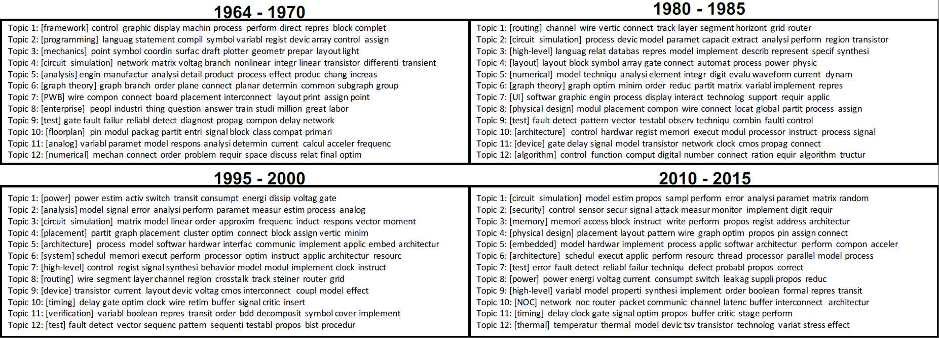
Topic Evolution via LDA
Each textfile represented as a vector based on word frequency
Corpus of papers (e.g., ICCAD99) = set of vectors which are inputs to the LDA analysis
LDA analysis finds top-K topics
12-topic LDA models for years 1964-1970, 1980-1985, 1995-2000, 2010-2015 of DAC, ICCAD, DATE and ASPDAC

Slide 8
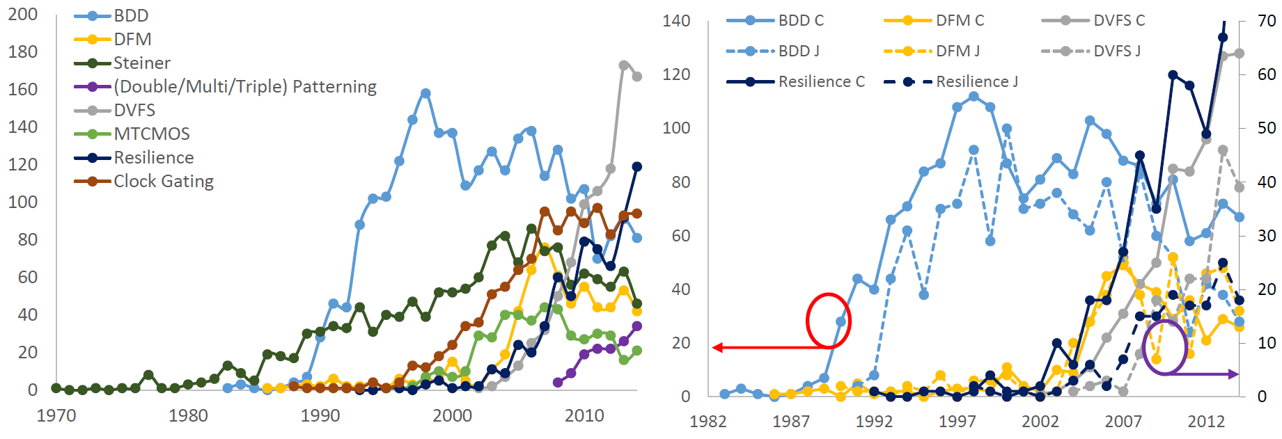
Evolution and Latency via Incidence Curves
Incidence curves of selected terms, in all 47000+ papers
Incidence curves of several of these terms, in conference (solid) and journal (dotted) papers

Slide 9
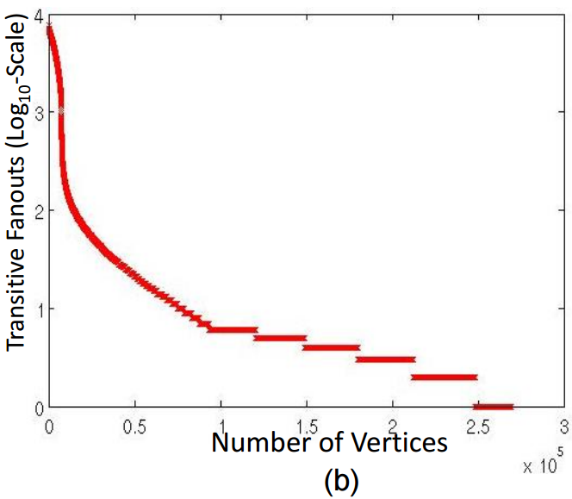
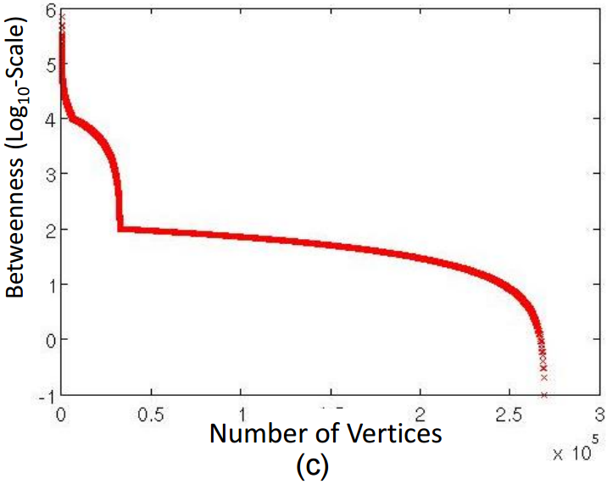
USPTO Patent Citation Graph Analyses
759507 USPTO patents corpus
4717209 edges, 490079 sinks
Calculate transitive fanouts and betweenness centrality measures
Betweenness centrality [1] measures the extent to which a vertex impacts and connects related fields
Fanout cone size distribution of vertices (patents)
Fanout cone size distribution of vertices (patents)
[1] L. Leydesdorff, ““Betweenness Centrality” as an Indicator of the “Interdisciplinarity” of Scientific Journals”, J. of ASIST 58(9) (2007), pp. 1303-1319.

Slide 10
Many Gaps (we have made only initial steps!)
Little progress toward “metrics” of research impact
How to measure:
Professor X trains student who founds an EDA company… ?
Paper Y proposes a technique that is incorporated in many EDA tools and product ICs… ?
Need analyses of citation graphs, papers as in [2]
Dynamic growth, core-periphery analysis, etc.
Temporal analyses of topic evolution are simple so far
Not yet applied: autoregression, temporal latent factors and time-series modeling to track topic evolution
[2] T. Chakraborty et al., “On the Categorization of Scientific Citation Profiles in Computer Sciences”, Communications of the ACM 58(9) (2015), pp. 82-90.

Slide 11
Toward DA Research Metrics
Inputs, participation welcome (form at http://vlsicad.ucsd.edu/DA-METRICS/)
Apply more known analysis methods (e.g., as in [2])
Develop paper citation graphs
Retrospective assessment of indicators of impact (“best paper” vs. “test of time”)
Statistical, machine-learning temporal models for real-world impacts of both individuals and research results
Develop predictors of future high-impact DA research!

Slide 12
THANK YOU !

