Slide 1
New Game, New Goal Posts:
A Recent History of Timing Closure
Andrew B. Kahng
UCSD CSE and ECE Departments
abk@ucsd.edu
http://vlsicad.ucsd.edu

Slide 2
What is Timing Closure?
Most critical phase of modern system-on-chip implementation
  No timing closure = no tapeout
Timing closure is end result of
  Years of methodology/script/signoff development
  Months of block- and top-level final physical implementation
  Weeks of final pass including manual noise, DRC fixes
Changes
  Process/device technology
  Modeling standards
  EDA tooling
  Design methodology
  Signoff criteria
Demand
for innovations
in timing closure

Slide 3
Agenda
Timing Closure and New Contexts
Example Challenges
Example Near-Term Mitigations
Futures and Conclusions

Slide 4
Traditional View of Timing Closure
N. MacDonald, Broadcom Corp., “Timing Closure in Deep Submicron Designs”, 2010 DAC Knowledge Center article
TOP-LEVEL NETLIST / SPEF
BLOCK-LEVEL NETLIST / SPEF
Static Timing Analysis for all Modes / Corners
Timing Closed
About 5
iterations
Breakdown of Timing Violations on per Block Basis
Manual Repair of Timing Failures
Operations Permitted at Each Iteration
(in order of preference)
Violation Classes Addressed
for Each Iteration (in order of priority)
(1) Vt Swap, Resizing, Buffer Insertion, NDR Changes, Useful Skew
(1) Electrical Rule Violations
(2) Vt Swap, Resizing, Buffer Insertion,
NDR Changes
(2) Noise Violations
(3) Setup Violations
(3) Vt Swap, Resizing, Buffer Insertion
(4) Hold Violations
(4) Vt Swap, Resizing
(5) Vt Swap

Slide 5
Context I: Race to End of Roadmap
Paper model to v1.0 SPICE model: ~12 months @N10
Many near-term “red bricks”: ArF, Cu, low-k, …
Foundry-fabless dynamics: who gives up margin ?
Time constants limit design-manufacturing co-evolution
(Years) Tech development, app market definition, architecture/front-end design
Model-hardware miscorrelation
Model guardbanding
Faster node enablement is challenging !!
(Months) RTL-to-GDS implementation,
reliability qualification
Mismatches among
these time constants
(Weeks) Fab latency, cycles of yield learning,
design re-spins, mask flows
(Days) Process tweaks, design ECOs

Slide 6
Context II: Low-Power Grand Challenge
Green datacenters
Cloud
Big data
Low power =
High complexity
multiple supply voltages,
power and clock gating,
DVFS, MTCMOS,
multi-Lgate, …
Mobility
Internet of Things
Increased timing closure burden

Slide 7
Recent History
90nm
65nm
45/40nm
28nm
20nm
16/14nm
10nm
≤7nm
Temp inversion
Maxtrans
Dynamic IR
Multi-patterning
MOL, BEOL R ↑
PBA
Fixed-margin spec
MIS
Noise
EM
Cell-POCV
MCMM
Phys-aware timing ECO
AOCV / POCV
Min implant
LVF
BTI
BEOL, MOL variations
Signoff criteria with AVS
SOC complexity
Fill effects
Layout rules

Slide 8
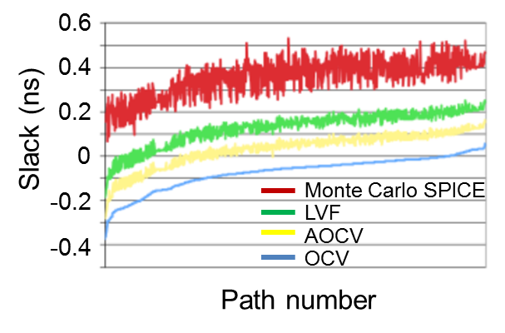
Changes I
Rise of MOL and BEOL → resistivity, variability impacts
  Multi-patterning → BEOL corner explosion
Criticality of margin reduction
  Higher-dimensional delay/slew modeling; color-aware P&R + signoff
M2
V1
BEOL
M1
M3
V0
Inter-layer dielectric
M_{int}
M2
V_{int}
MOL
spacing
M0G
M0A
M1
Fin
Inter-metal dielectric
Poly
Liberty Variation Format (LVF) shows reduced pessimism

Slide 9
Changes II
Rapid, near-universal adoption of adaptivity (e.g., AVS)
  “setup violation” becomes hazy; removes “DC” part of timing margin
Path-based analysis with SI enabled is needed earlier in flow
  Runtime, license cost overheads
Performance monitor
Control block
Supply voltage
Circuit
pba has >4x runtime
Runtime of pba vs. gba to find top 10K timing paths with SI enabled (28 FDSOI)
See: http://vlsicad.ucsd.edu/Publications/Conferences/311/c311.pdf
http://vlsicad.ucsd.edu/Publications/Conferences/325/c325.pdf
JPEG
AES

Slide 10
New Game, New Goal Posts?
Design Synthesis/Opt
Architecture; RTL; SP&R; Timing/Noise ECOs
Technology and Design Enablement
SPICE; ITF; Library/IP; Testchips
OLD
NEW
1 mode
Setup-hold
SI
Cw only
NLDM
MCMM
Cell-POCV / LVF
Dynamic IR
Wide/exploding corners, corner reduction, cross-corners
(BEOL Cw, Ccw, RCw, temp, VDD)
Flat margin selection
Noise closure
Aging/AVS
Modeling
LVF; BEOL/MOL σ’s; Lib groups
Analysis
MIS; SHPR; SI; PBA; -dynamic
Signoff
Yield vs. Slack; MCMM; TBC; AVS; Corner vs. Flat Margins
Timing Closure

Slide 11
Agenda
Timing Closure and New Contexts
Example Challenges
Example Near-Term Mitigations
Futures and Conclusions

Slide 12
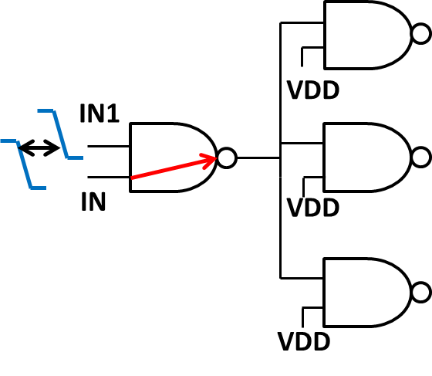
Multi-Input Switching
Multi-input Switching (MIS) = More than one input switches at the same time
Conventional timing libraries consider only single-input switching (SIS)
MIS can significantly change arc delays
→ Need more comprehensive timing model
Technology: 28FDSOI
Design: chained NAND2 gates with FO3

Slide 13
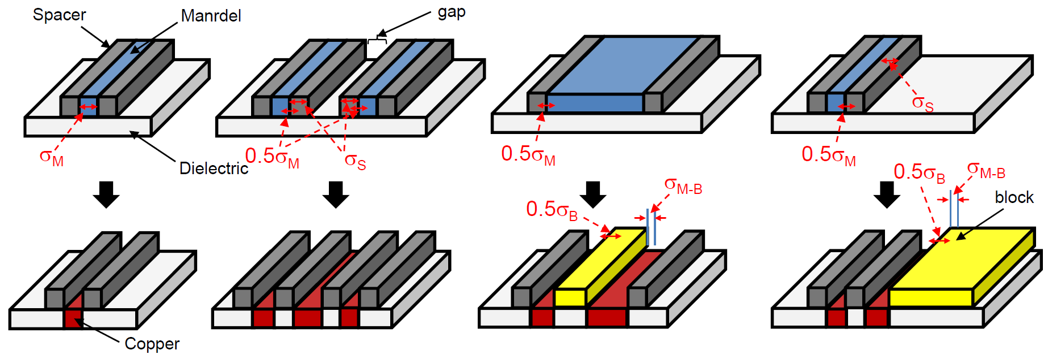
BEOL Multi-Patterning Impacts
Mandrel
Spacer
Mx metal
Line-end cuts
M_{width}
Wire1_{width} = M_{width}
Line-end extensions
S_{width}
Floating fill wires
M_{space}
Wire2_{width} = M_{space} – 2*S_{width}
Mandrel

Slide 14
Placement-Sizing Interference
New “interferences” between post-layout optimization and P&R
Rules for device layers (FEOL) become considerably more complex and restrictive
  Minimum implant width rules for implant region
  Minimum notch and jog width rule for oxide diffusion (OD)
OD
HVT
LVT
HVT
LVT
HVT
HVT
LVT
HVT
Cell boundary

Slide 15
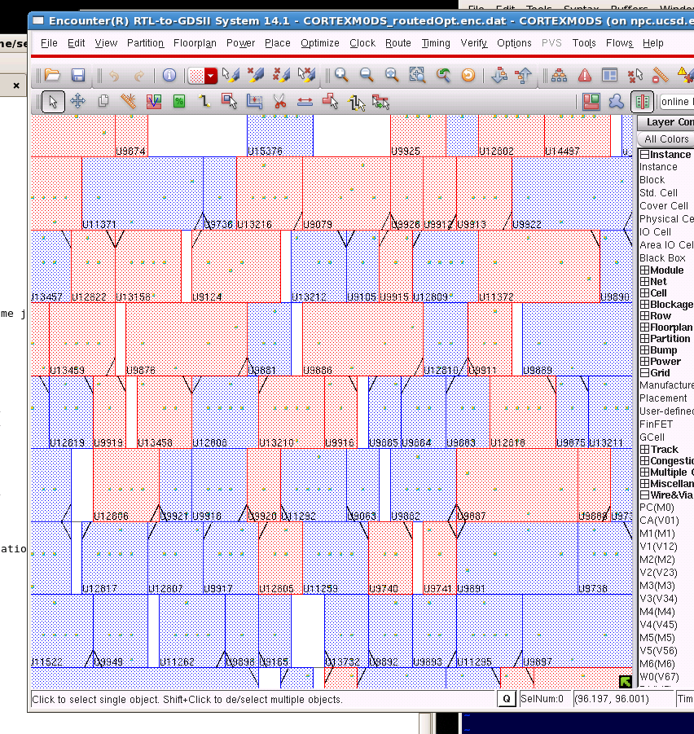
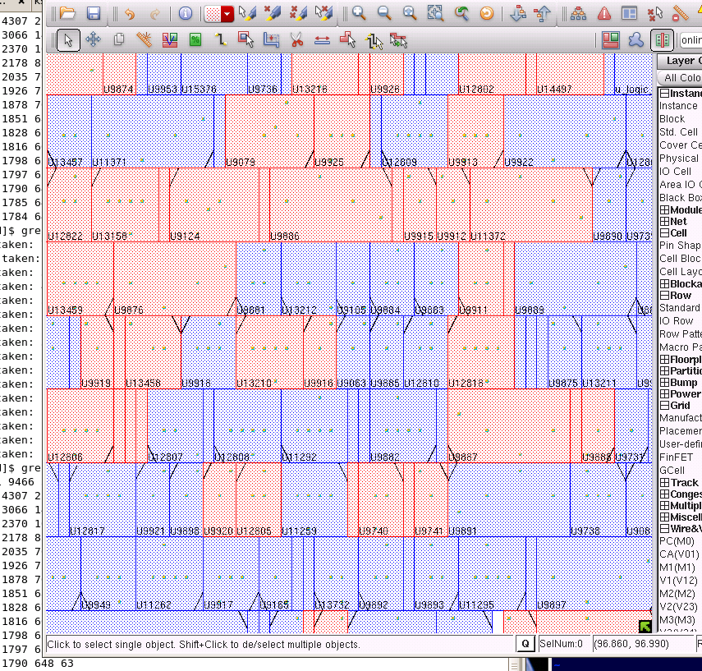
Placement-Sizing Interference (cont.)
Drain-to-drain abutment (DDA)
Example solution
√
Poly
D
D
D
S
Active region
Cell boundary
D
S
Connection
Power/ground
Min implant width
violation
Intertwine the historically separate tasks of P&R and post-route optimization
DDA
violation
Min jog/notch width
violation
Min implant width
violation

Slide 16
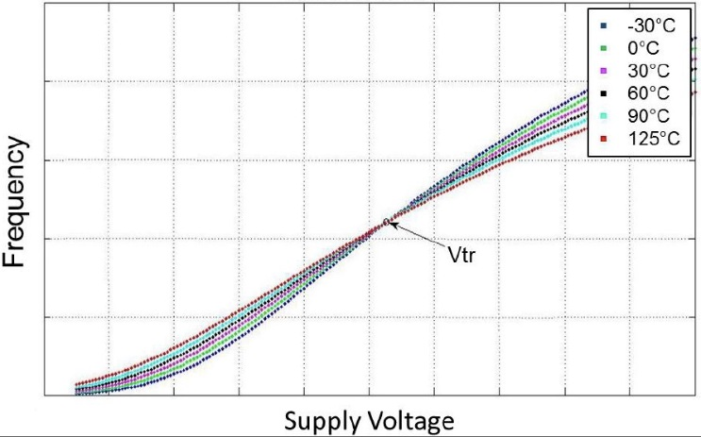
Corner Explosion
Operating modes: nominal, turbo, LP1, LP2 …
V_{dd}
Turbo
×
NOM
NOM
lifetime
FE corners: FF, FFG, FS, SF, TT, SSG, SS …
×
Transistor speed
SS
SSG
TT
FFG
FF
BE corners: C-worst, Cc-worst, RC-best …
T₃
M3
 | ΔW | ΔT | ΔH
Typical | typical | typical | Typical
C-best | min | min | max
C-worst | max | max | min
RC-best | max | max | max
RC-worst | min | min | min
H₂
Inter-layer dielectric
×
T₂
S₂
W₂
M2
H₁
T₁
M1
Temp corners: temperature inversion corners …
Inter-metal dielectric
×
Split corners: memory, logic rails with synch interfaces

Slide 17
Agenda
Timing Closure and New Contexts
Example Challenges
Example Near-Term Mitigations
Futures and Conclusions

Slide 18
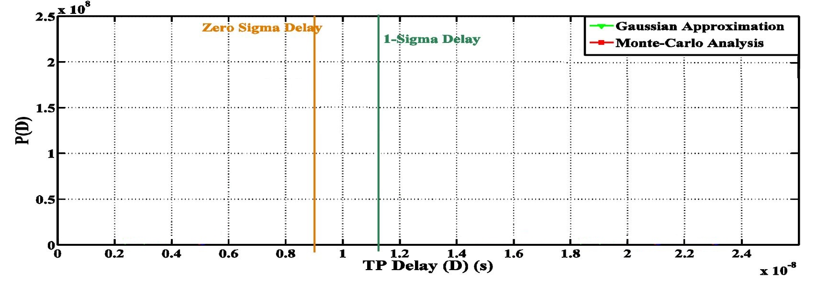
I. Improved Variation Modeling
Monte Carlo path delay simulation shows asymmetric path delay distribution under process variation
→ Need separate σ values for setup and hold analysis
LVF can handle such non-Gaussian distribution
(from [Rithe et al.])

Slide 19
II. Tightened BEOL Corners (“TBC”)
[ICCD14]
Routed design
Routed design
Classify timing critical paths
G_{TBC}
G_{CBC}
Timing analysis using conventional BEOL corners (CBC)
ECO
using CBC
ECO
using TBC
ECO
using CBC
Timing analysis using TBC
Timing analysis using CBC
violation = 0?
violation = 0?
violation = 0?
No
No
No
done
done
Conventional Signoff
Our work
Notes:
This slide summarizes our approach to reduce the cost of pessimism. In a conventional flow, given a routed design, we will run timing analysis. If there are timing violations, we will fix them in the ECO step. In this work, we first analyze and classify the timing critical paths into two groups. G_{TBC} are the paths which have enough wire averaging and G_{CBC} are those which do not. For the paths in G_{TBC}, we signoff these paths using tightened BEOL corners. For the remaining paths, we will use the conventional BEOL corners. Since a lot of paths will use TBC, this makes the timing signoff a lot easier.

Slide 20
Pessimism in Conventional BEOL Corners (CBC)
Assumption: a max (setup) path p_{j} is “safe” when the delay evaluated at a given CBC is larger than nominal delay + 3σ_{j}
d_{j}(Y_{CBC}) ≥ 3σ_{j} + d_{j}(Y_{typ})
For a given path, we can compare the statistical delay variation and the delay obtained from a given CBC
α_{j} = 3σ_{j} / Δd_{j}(Y_{CBC})
Δd_{j}(Y_{CBC})= [d_{j}(Y_{CBC}) - d_{j}(Y_{typ})]
Y_{CBC} ∈ {Y_{cw}, Y_{cb}, Y_{rcw}, Y_{rcb}}
A small α_{j} implies there is a large pessimism
3σ_{j}
d_{j}(Y_{CBC})-d_{j}(Y_{typ})
-3σ
delay
Large pessimism
Notes:
To quantify the pessimism of the conventional BEOL corner, we assume that a setup critical path is safe when the delay at a CBC corner is larger than the nominal delay plus three sigma delay variation.
For a given path, we can compare the statistical delay variation and the delay at a CBC corner to obtain a scaling factor “alpha”. The value of alpha is an indicator of pessimism. For example, when the alpha is small, it means that the delta delay at a corner is larger than the mean plus 3sigma delay variation. Therefore, when the alpha is small, there is a large pessimism.

Slide 21
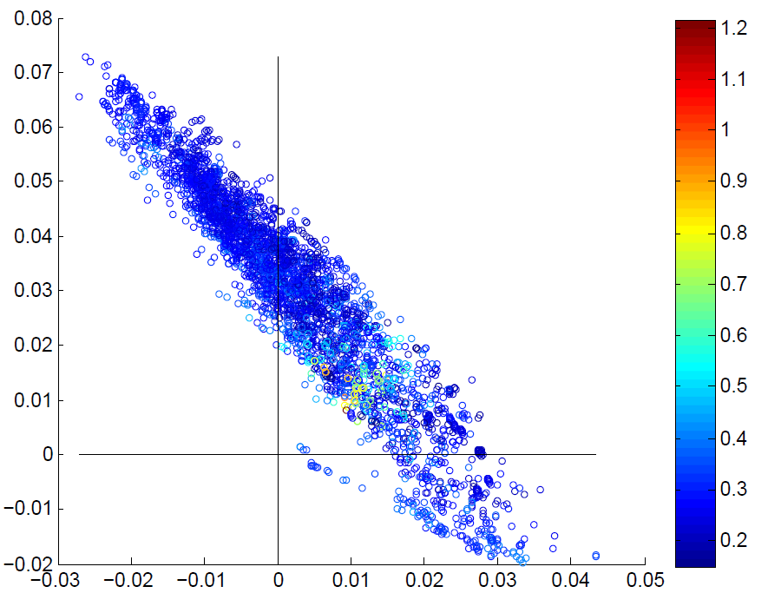
Scaling Factor α ⇔ Delay Variation @Cw,RCw
Paths with small Δd_{rcw} and Δd_{cw} have large α
E.g., there are α_{j} > 0.6 when ((Δd_{rcw} < 3%) AND (Δd_{cw} < 3%))
Identify paths for tightened BEOL corners based on Δd_{rcw} and Δd_{cw}
Δd(Y_{rcw})/d(Y_{typ})
α
Δd(Y_{cw})/d(Y_{typ})
Notes:
As shown in the figure, we figure out that the paths with small delta delay at the C-worst and RC-worst corners have a large alpha. For example, the alpha is larger than 0.6 when delta delay at the C-worst and RC-worst corners are smaller than 3% of the nominal delay. This means that by checking the delta delay we can identify the paths for tightened corner.

Slide 22
→ Practical Filter for TBC-Amenable Paths
G_{tbc} = paths which can be safely signed off using tightened corners:
(Path with (Δd_{cw} larger than A_{cw})) OR (Path with (Δd_{rcw} larger than A_{rcw}))
A_{cw}
Δd(Y_{rcw})/d(Y_{typ})
A_{rcw}
Δd(Y_{cw})/d(Y_{typ})
Notes:
Based on the analysis, we propose to filter the paths by using two threshold values. When the delta delay of a path at the Rcworst is larger than the threshold value Arcw OR if the delta delay at Cworst is larger than the Acw, we put the path in the group Gtbc, which will use the tightened corner.

Slide 23
Benefits of Tightened BEOL Corners
WNS and TNS are reduced by up to 100ps and 53ns
  #Timing violations reduced by 24% to 100% [Moore’s Law: 1% / week !]
  TBC-0.6 : more benefits
  Tradeoff between reduced margin vs. #paths which use TBC
Notes:
This slide shows our experimental results for a 28nm technology. In this experiment, we try different tightened corner, TBC-0.5, 0.6 and 0.7. A smaller number means the tightened corner has smaller variation compared to the CBC. For example, TBC-0.5 means the variation in the TBC is about half of that in CBC. The results show that, by using the tightened corners, we can reduce WNS and TNS by upto 100ps and 53ns. Meanwhile, the number timing violations are also reduced. From the figure, we can see that the tightened corner with an alpha value 0.6 is better compared to an alpha value 0.5 and 0.7. When the alpha value is too small, not many paths can use the tightened corners because many of the paths do not have enough averaging to use the tightened corner. But when the alpha value is too big, the different between the conventional corner and tightened corner becomes smaller, so there is not much benefit to use the tightened corner.

Slide 24
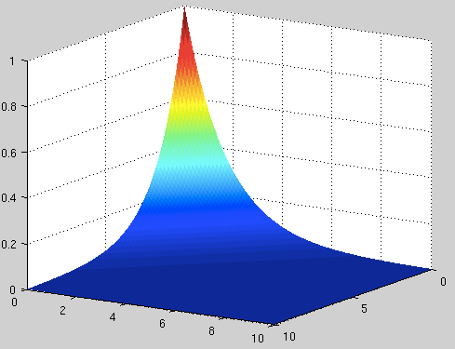
III. Flexible FF Timing → Margin Recovery
[ISQED14]
Setup time, hold time and clock-to-q (c2q) delay of FF
⇒ values interdependent, but NOT fixed
Flexible FF timing model can exploit operating (function/test) modes
⇒ “Free” pessimism reduction in STA
hold
setup-hold-c2q
flexible model
c2q₁
...
setup-hold-c2q
fixed model
c2q_{n}
Goal: Find best {setup, hold, c2q} for each FF instance
Sequential LP:
  setup-c2q opt
  hold-c2q opt
C2q-setup-hold surface
c2q
c2q
setup
hold
setup
c2q
hold
Notes:
For conventional FF timing model, setup/hold/clock-to-q delay is given as fixed values according to input slew and output load. However, setup and hold times and c2q delay are not single values. That is, there’s a tradeoff relationship among them.
As shown in the right figure, setup and hold times can have smaller values at the expense of c2q delay.
Also, there’s a tradeoff between setup and hold times.
Combining with c2q delay, we can have multiple setup-hold time curves.
In this work, we try to use these tradeoff relationship for timing analysis.
With flexible FF timing model, we can reduce pessimism in conventional timing analysis.

Slide 25
Flexible Timing Model → Reduce Pessimism
Independent datapaths in PBA: using fixed FF timing model loses performance optimization opportunity
setup: 10ps
FF₁
c2q: 20ps
480ps
470ps
470ps
Total: 500ps
460ps
Total: 500ps
FF₃
FF₂
460ps
setup: 10ps
c2q: 10ps
→20ps
→20ps
c2q: 20ps
480ps
setup: 20ps
→10ps
→10ps
Total: 500ps
→ 500ps!
→ 520ps?

Slide 26
Improved Timing Signoff Flow
Netlist (and SPEF, if routed)
Takeaways
Fix timing violations “for free”
48ps average improvement of slack over 5 designs in a foundry 65nm technology
Extract path timing information
LP formulation
with flexible flip-flop timing model
Next
Better exploitation of disjoint cycles/modes
More accurate modeling of setup-hold-c2q tradeoff
Circuit optimization should natively exploit FF timing model flexibility
Solve Sequential LP
(STA_FT_{max} , STA_FT_{min})
Solution
Annotate new timing model
for each flip-flop
Timing signoff with annotated timing
Notes:
This chart shows the overall flow of our proposed method.
With a placed and/or routed netlist, we extract path timing information.
Based on that, we formulate LP with pre-characterized flexible flip-flop timing model.
After solving the LP, we annotate the new timing values to each flip-flop in the design.
Finally, we perform timing signoff with the annotated timing.

Slide 27
IV. Better Signoff Definition
[DATE13]
V_{BTI} : Voltage for BTI-aging estimation
V_{lib} : Supply voltage for timing library characterization
V_{final}: V_{dd} of a circuit with AVS at end-of-lifetime
V_{BTI}
|ΔV_{t}|
Derated library
Circuit implementation and signoff
V_{lib}
  Circuit implementation depends on V_{BTI} and V_{lib}
  V_{BTI} and V_{lib} depend on aging during AVS (V_{final})
?
Chicken & Egg Loop
  V_{final} depends on circuit
V_{final}
BTI degradation and AVS
circuit

Slide 28
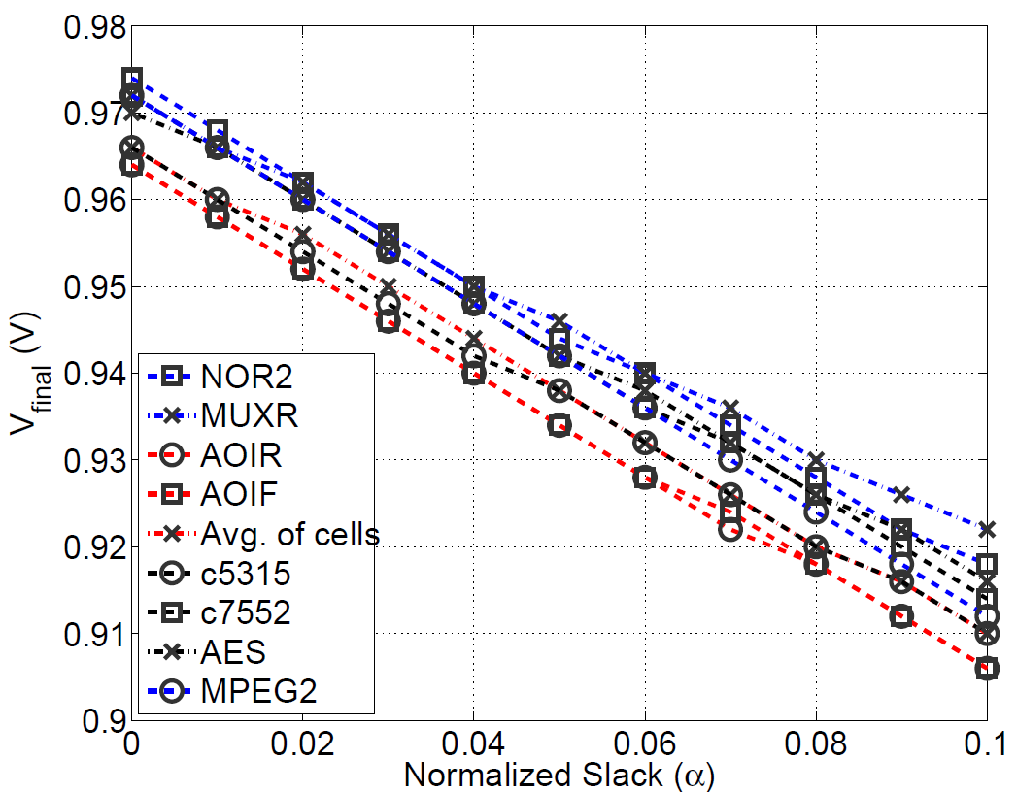
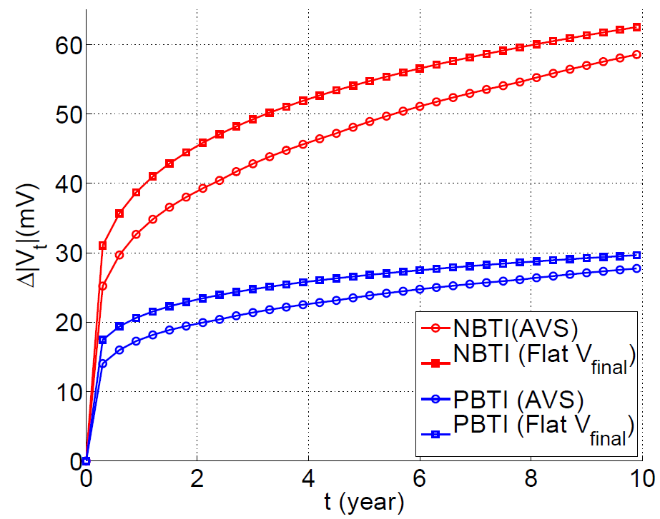
Observations and Heuristics
  Observation #1: V_{final} is not sensitive to cells along the timing-critical path
  Observation #2: ΔV_{t} with a constant V_{final} throughout lifetime ≈ adaptive V_{dd}
Heuristic #1: Use average of critical path replicas to estimate V_{final} (V_{heur})
Heuristic #2: approximate V_{dd} in AVS by constant V_{heur}
Solve “Chicken & Egg Loop” by having V_{BTI} = V_{lib} = V_{heur}≈ V_{final}

Slide 29
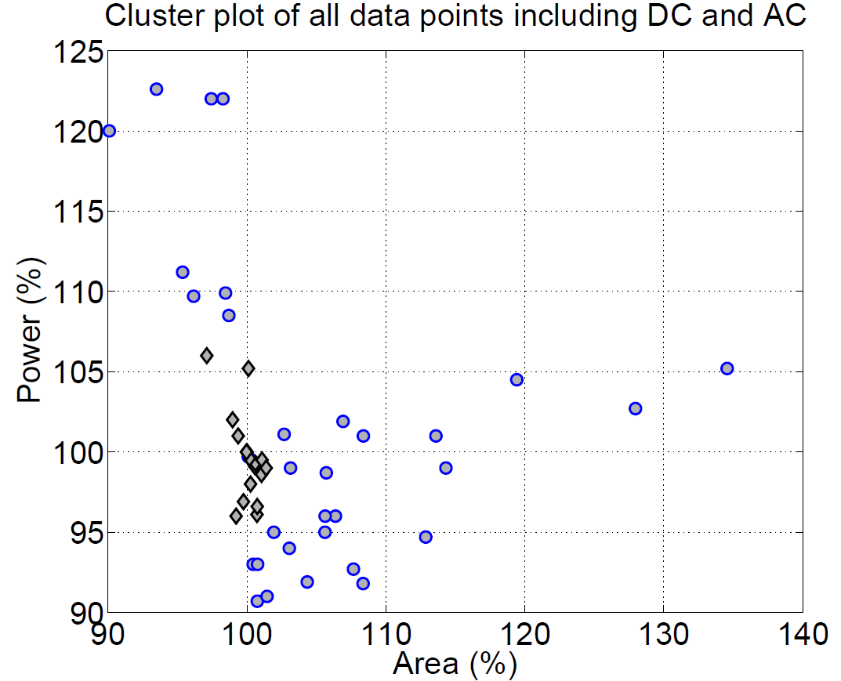
Experimental Results: A “Knee” Point
Optimistic aging library
→ large power penalty
Ignore AVS → larger area
 | Low V_{lib} | High V_{lib}
Low V_{BTI} | Slower circuit Less aging | Faster circuit Less aging
High V_{BTI} | Slower circuit More aging | Faster circuit More aging
Overly pessimistic aging library → large area penalty
Our method finds “Knee” point for balanced area and power tradeoff
Experiment setup:
DC/AC BTI @ 125°C
32nm PTM technology
4 benchmark circuit implementations

Slide 30
Agenda
Timing Closure and New Contexts
Example Challenges
Example Near-Term Mitigations
Futures and Conclusions

Slide 31
Food for Thought
EDA tool innovation in timing closure space has been helpful
  E.g., physically-aware ECO, dynamic IR-aware STA, …
Process and device innovation will continue to challenge timing closure
  “Actual” foundry-specific metal fill early in design
  Process enhancement (e.g., air gap)
  Self-heating from high current density in FinFET
What about SoC-level design closure complexity?
  Better timing budgeting, constraints evolution, coordination of top- vs. block-level effort

Slide 32
Look Out For …
Margin becomes scarcer
  Low-hanging fruits being rapidly harvested
  Critical: better analysis accuracy, model-hardware correlation at extreme modes
BEOL + MOL + Multi-Patterning
  Resistance scaling, pitch scaling, variation → delicate balancing act
  Need better modeling and corner definition
  Bring together library, placement, routing, STA
Variation modeling
  Statistical SPEF
  LVF, unified model of PVT variation (reduce #libraries!)
Signoff
  Wide adoption of adaptivity (e.g., AVS) with new signoff criteria/goals
  Design-specific tightened corners
  Cross corners (FSG, SFG)
Thermal and stress?
3D integration!

Slide 33
Thanks to …
Rob Aitken for inviting this talk
Christian Lutkemeyer, Isadore Katz, Sorin Dobre, Tuck-Boon Chan, Kwangok Jeong, Nancy MacDonald and John Redmond for discussions and inputs
UCSD VLSI CAD Laboratory students: Hyein Lee, Jiajia Li, Mulong Luo, Yaping Sun, Wei-Ting Jonas Chan

Slide 34
THANK YOU !

Slide 35
Backup Slides

Slide 36
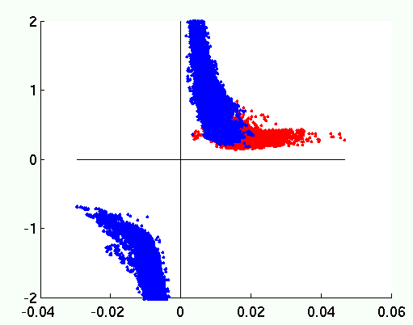
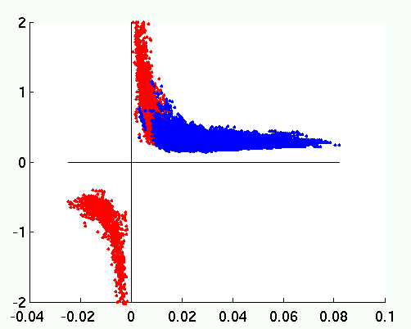
Delay Variation
Some paths have α > 1.0 → a CBC can underestimate delay variations
But these paths have larger delays at the other corner
C-worst corner underestimates delay variations, but these paths are dominated by the RC-worst corner
RC-worst is the dominant corner
Δdelay at RC-worst > Δdelay at C-worst
C-worst is the dominant corner
Δdelay at C-worst > Δdelay at RC-worst
α
α
α < 1.0 → delay variations are covered by the RC-worst corner
Δdelay at C-worst
[d(Y_{cw}) – d(Y_{typ})] / d(Y_{typ})
Δdelay at RC-worst
[d(Y_{rcw}) – d(Y_{typ})] / d(Y_{typ})
Notes:
In these figures, we show the alpha value for different critical paths at the C-worst corner and the RC-worst corner. A red dot is a path which has a large delta delay at the C-worst corner, and a blue dot is a path which has a larger delta delay at the RC-worst corner. In this experiment, we can see that some of the paths have alpha larger than 1.0. This means that the Cworst corner actually underestimates the delay variation compared to the statistical analysis. However, these paths are dominated by the RC-worst corner, and the alpha value at the RC-worst corner is smaller than one.

Slide 37
Aging Signoff Corner with AVS
Timing signoff: ensure circuit meets performance target under PVT variations & aging
Conventional signoff approach:
  Analyze circuit timing at worst-case corners
  Fix timing violations, re-run timing analysis
What is the Vdd signoff corner for aging + AVS?
 |  | Circuit performance model (V_{lib})
 |  | Low Vdd | High Vdd
BTI model (V_{BTI}) | Low Vdd | Slower circuit Less aging | Faster circuit Less aging
 | High Vdd | Slower circuit More aging | Faster circuit More aging
?
Too optimistic
Too pessimistic
?

Slide 38
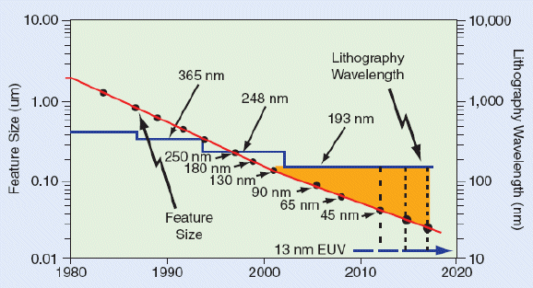
Minimum Implant Area Constraint
Small feature sizes cannot be patterned with ArF
One example of challenges: control of implant area
→ Minimum implant area is constrained
  A narrow cell cannot be sandwiched
  with different Vt cells
436 nm
365 nm
248 nm
193 nm
250nm
180nm
130nm
90nm
65nm
45nm
32nm
22nm
Source: L. Liebmann and A. Torres, DAC, 2011
Min implant area constraint
Vt₂
Vt₁
Vt₂
Violation

Slide 39
