Slide 1
Toward Holistic Modeling, Margining and Tolerance of IC Variability
Andrew B. Kahng
UCSD CSE and ECE Departments
abk@ucsd.edu
http://vlsicad.ucsd.edu

Slide 2
IC Variability
In manufacturing process
  FEOL
  BEOL
During operation
  Voltage
  Temperature
Across lifetime
  Aging
  Breakdown
Notes:
Here I use fixed voltage scaling for area, power, drive current. And show full scaling in Vdd plot.

Slide 3
Challenge: Value of Technology
Design quality (e.g., frequency)
Margin ⇒ lost benefits of technology
Nominal Scaling
margin
Lost benefits!
Design with margins
Technology generation
Notes:
One of the main challenge in VLSI is the value of technology scaling. As shown in the figure, the design quality improves as technology scales. However, the magnitude of manufacturing process variation is also increasing. To cover the process variation, we have to insert margins in the design to ensure they can work correct. And as a result of that, we lost the benefits of technology scaling.

Slide 4
Solutions: Modeling, Margining, Tolerance
Holistic mitigation of variability spans models, margins, tolerance mechanisms
  Signoff criteria, monitors, adaptivity/resilience, approximate computing, …
Solutions | Modeling | Margining | Tolerance
BEOL Corner Optimization | √
Process-Aware V_{dd} Scaling |  | √
{BTI, EM}-AVS Interactions |  | √
Overdrive Signoff |  | √
Min Cost of Resilience |  |  | √

Slide 5
Outline
Introduction
Modeling of IC Variability
Tolerance of IC Variability
Margining of IC Variability
Conclusions

Slide 6
BEOL Corner Optimization
20nm and below: increased timing variation due to interconnect R, C
  Design closure becomes much more difficult
Costs of BEOL variations
  More design effort (e.g., “last month” of manual ECO iteration)
  Compromised circuit performance at high V_{dd}
Recent work: reduce signoff margin by using tightened BEOL corners without sacrificing parametric yield
  Signoff at conventional BEOL corners is pessimistic for most timing-critical paths
  We identify paths which can be safely signed off using tightened BEOL corners (TBC)
  Joint work with Sorin Dobre (Qualcomm) and Tuck-Boon Chan
Notes:
At 20nm node and below, timing variation due to interconnect R, C is increasing.
Timing violation caused by BEOL variation is difficult to be fixed because the path data is dominated by wire delay, so increasing cell size does not work.
The costs of BEOL variations are significant. To fix the timing violations, designers need to spend more design effort which may delay product schedule. In case when we cannot fix the timing violations, we have to compromise for a lower circuit performance.
To address this problem, we propose to reduce signoff margin by using tightened BEOL corners without sacrificing parametric yield. We observe that signoff at the conventional BEOL corners is pessimistic for most of the timing-critical paths. Therefore, we propose a method to identify paths which can be safely signed off using tightened BEOL corners.

Slide 7
Proposed Timing Signoff Flow
Routed design
Routed design
Classify timing critical paths
G_{TBC}
G_{CBC}
Timing analysis using conventional BEOL corners (CBC)
ECO
using CBC
ECO
using TBC
ECO
using CBC
Timing analysis using TBC
Timing analysis using CBC
violation = 0?
violation = 0?
violation = 0?
No
No
No
done
done
Conventional Signoff
This work
Notes:
This figure shows a conventional signoff flow. Given a routed design, we will run timing analysis. If there are timing violations, we will fix them in the ECO step. In this work, we propose a different approach. Given the routed design we will analyze and classify the timing critical paths into two groups, G_{TBC} and G_{CBC}. For the paths in G_{TBC}, we signoff these paths using the tightened BEOL corner. For the remaining paths, we will use the conventional BEOL corners. Since a lot of paths will use TBC, this makes the timing signoff a lot easier.

Slide 8
Conventional BEOL Corners
H₃
 | ΔW | ΔT | ΔH
Y_{typ} | typical | typical | Typical
Y_{cb} | min | min | max
Y_{cw} | max | max | min
Y_{rcb} | max | max | max
Y_{rcw} | min | min | min
T₃
M3
H₂
Inter-layer dielectric
T₂
S₂
W₂
M2
H₁
T₁
M1
Inter-metal dielectric
Three major variation sources per layer: {ΔW, ΔT, ΔH}
Conventional BEOL corners (CBC)
  Homogeneous corners: all variation sources are skewed in the same direction
BEOL RC variations are modeled in interconnect technology file (.itf)
Notes:
There are three major variation sources for each layer.
The metal width variation, metal thickness variation and inter-layer dielectric thickness variation.
In the conventional BEOL corners (CBC), , all variation sources are skewed in the same direction.
This table shows examples of conventional corners and the corresponding skewed parameters.

Slide 9
Statistical RC Model
3 variation sources in each layer, {ΔW, ΔT, ΔH}
9-layer metal stack has 27 variation sources z₁, z₂, …, z₂₇
  BEOL layers in the same process module use the same manufacturing equipment and process steps
z_{u} and z_{v} are correlated if and only if
  z_{u} and z_{v} are the same type (ΔW, ΔT or ΔH)
  z_{u} and z_{v} are in the same process module
ΔW
ΔT
ΔH
M9: z₂₅, z₂₆, z₂₇
Process module #3
Examples:
ΔW in layer M4 has a positive correlation with ΔW in layers M5, M6, and M7
But ΔW in layer M4 is not correlated with ΔT in M4
M8: z₂₂, z₂₃, z₂₄
M7: z₁₉, z₂₀, z₂₁
M6: z₁₆, z₁₇, z₁₈
Process module #2
M5: z₁₃, z₁₄, z₁₅
M4: z₁₀, z₁₁, z₁₂
M3: z₇, z₈, z₉
M2: z₄, z₅, z₆
Process module #1
M1: z₁, z₂, z₃
Notes:
Another approach to model RC variation is to use statistical RC extraction. Our model consider 3 variation sources in each layer and there is a total of 27 variation sources
In a 9-layer metal stack. We assume the BEOL layers in the same process module use the same manufacturing equipment and process steps.
Two variation sources are correlated if and only if they are the same variation and they are in the same process module. For example, ΔW in layer M4 has a positive correlation with ΔW in layers M5, M6, and M7 because they are the same type and they are in the same process module. But ΔW in layer M4 is not correlated with ΔH in M4.

Slide 10
Pessimism of Conventional BEOL Corners (CBC)
Assumption: a max (setup) path p_{j} is “safe” when delay evaluated at a given CBC is larger than nominal delay + 3σ_{j}
d_{j}(Y_{CBC}) ≥ 3σ_{j} + d_{j}(Y_{typ})
For a given path, we can compare the statistical delay variation and the delay obtained from a given CBC
α_{j} = 3σ_{j} / Δd_{j}(Y_{CBC})
Δd_{j}(Y_{CBC})= [d_{j}(Y_{CBC}) - d_{j}(Y_{typ})]
Y_{CBC} ∈ {Y_{cw}, Y_{cb}, Y_{rcw}, Y_{rcb}}
Small α_{j} ⇔ large pessimism of CBC
3σ_{j}
d_{j}(Y_{CBC}) - d_{j}(Y_{typ})
-3σ
delay
Large pessimism
Notes:
Based on the extracted delay variation, we assume a setup path is safe when the delay evaluated at a conventional corner is larger than the nominal + 3 sigma delay obtained from the statistical analysis. For a given path, we define an alpha factor, which is the ratio of the 3 sigma delay of the path to the delta delay at a corner. The alpha is an indicator of pessimism. A small alpha implies that the delta delay at a BEOL corner is larger than the 3 sigma delay.

Slide 11
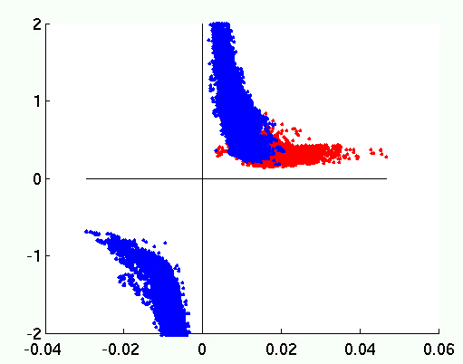
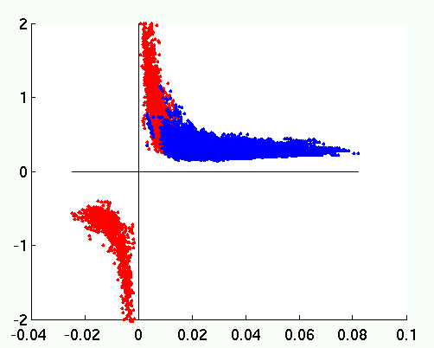
Intuition on Delay Variability Across C_{w}, RC_{w}
Some paths have α > 1.0 → a CBC can underestimate delay variations
But these paths often have smaller α values at the other corner (!)
Dominated by RC-worst:
Δdelay at RC-worst > Δdelay at C-worst
C-worst corner underestimates delay variations, but these paths are dominated by the RC-worst corner
Dominated by C-worst:
Δdelay at C-worst > Δdelay at RC-worst
α
α
α < 1.0 here → delay variations covered by RC-worst corner
Δdelay (vs. typ) at C-worst
[d(Y_{cw}) – d(Y_{typ})] / d(Y_{typ})
Δdelay (vs. typ) at RC-worst
[d(Y_{cw}) – d(Y_{typ})] / d(Y_{typ})

Slide 12
Intuition on Delay Variability Across C_{w}, RC_{w}
Some paths have α > 1.0 → a CBC can underestimate delay variations
But these paths often have smaller α values at the other corner (!)
Dominated by RC-worst:
Δdelay at RC-worst > Δdelay at C-worst
C-worst corner underestimates delay variations, but these paths are dominated by the RC-worst corner
Dominated by C-worst:
Δdelay at C-worst > Δdelay at RC-worst
α
α
α < 1.0 → delay variations are covered by the RC-worst corner
Paths are more sensitive to R or to C
Using RC-worst or C-worst only will underestimate delay variations
Need both RC- and C-worst corners to cover process variations
In the following, α is defined at the dominant corner
Δdelay at C-worst
[d(Y_{cw}) – d(Y_{typ})] / d(Y_{typ})
Δdelay at RC-worst
[d(Y_{cw}) – d(Y_{typ})] / d(Y_{typ})

Slide 13
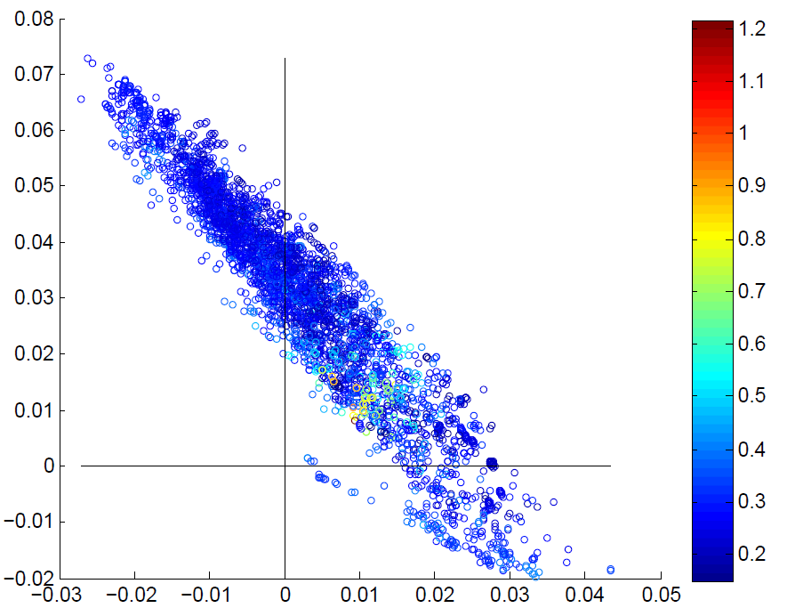
Scaling Factor α and Delay Variation
Paths with small Δd_{rcw} and Δd_{cw} have large α
E.g., here we see α_{j} > 0.6 when ((Δd_{rcw} < 3%) AND (Δd_{cw} < 3%))
Identify paths for tightened BEOL corners based on Δd_{rcw} and Δd_{cw}
Δd(Y_{rcw})/d(Y_{typ})
α
Δd(Y_{cw})/d(Y_{typ})
Notes:
In this figure, we plot the alpha values for a set of critical paths. The x-axis is the delta delay of the paths at the C-worst corner, the y-axis is the delta delay at the RC-worst corner. Each circle in the plot is a timing-critical path and the color represents the value of alpha. As shown in the figure, we figure out that the paths with small delta delay at the C-worst and RC-worst corners have a large alpha. For example, the alpha is larger than 0.6 when delta delay at the C-worst and RC-worst corners are smaller than 3% of the nominal delay. This means that by checking the delta delay we can identify the paths for tightened corner.

Slide 14
Find Paths for Which TBCs Can Be Used
Paths with small Δd_{rcw} and Δd_{cw} have large α
E.g., there are α_{j} > 0.6 when ((Δd_{rcw} < 3%) AND (Δd_{cw} < 3%))
Identify paths for tightened BEOL corners based on Δd_{rcw} and Δd_{cw}
G_{tbc} = Set of paths that can be safely signed off using TBC:
( (Path with Δd_{cw} larger than A_{cw}) OR (Path with Δd_{rcw} larger than A_{rcw}) )
A_{cw}
Δd(Y_{rcw})/d(Y_{typ})
A_{rcw}
α
Δd(Y_{cw})/d(Y_{typ})
Notes:
Therefore, we propose to filter out the paths which can use tightened corners by using two threshold values, Acw and Arcw. A path which has a delta delay larger than any of the threshold can be signed off using TBC corners.

Slide 15
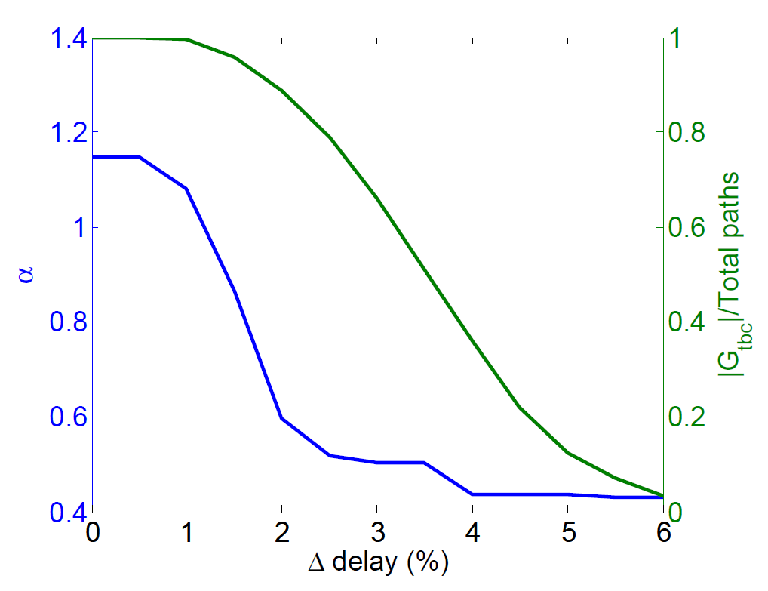
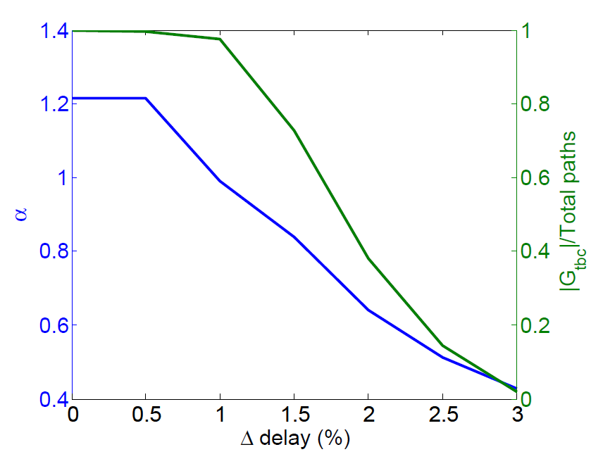
Determining α, A_{rcw} and A_{cw}
A_{rcw}
A_{cw}
Δd at RC-worst corner (%)
Δd at C-worst corner (%)
Δd at C-worst corner (%)
Assumption: critical paths in different designs have similar trends
Extract A_{rcw} and A_{cw} from a set of representative paths
  Plot α vs. Δdelay, find A_{rcw} and A_{cw} for a given α
  Add +1% margin on A_{rcw} and A_{cw} to account for sampling error
Smaller α → larger thresholds (A_{rcw} and A_{cw}) → fewer paths in G_{TBC}
Notes:
To determine the threshold values Arcw and Acw, we assume that the critical paths in different design have similar trends. Therefore, we can extract the alpha, Arcw and Acw from a set of representative paths. For example, the figure shows the maximum alpha of the paths in a design and the number of paths in the G_{TBC}. Based on the figure, we can select the values of alpha and the corresponding Arcw and Acw. Note that when we use a smaller alpha value, the threshold values are larger. This means that when we use a tighter corner, the number of paths which can use the tightened corner is also reduced. To account for sampling error, we add 1% margin on Arcw and Acw.

Slide 16
Benefits of Tightened BEOL Corners
Correlation factor, γ = 0.5
WNS and TNS are reduced by up to 100ps and 53ns
  #Timing violations reduced by 24% to 100%
  TBC-0.6 : more benefits
  Tradeoff between reduced margin vs. #paths which use TBC
Notes:
In this experiment, we apply our filtering method for three testcases. We use a 0.5 correlation factor for statistical analysis. The results show that, by using the tightened corners, we can reduce WNS and TNS by upto 100ps and 53ns. The timing violations are also reduced. From the figure, we can see that the tightened corner with an alpha value 0.6 is better compared to an alpha value 0.5 and 0.7. When the alpha value is too small, not many paths can use the tightened corners. But when the alpha value is too big, the different between the conventional corner and tightened corner becomes smaller, so there is not much benefit to use the tightened corner.

Slide 17
Outline
Introduction
Modeling of IC Variability
Tolerance of IC Variability
Margining of IC Variability
Conclusions

Slide 18
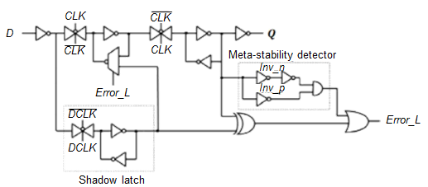
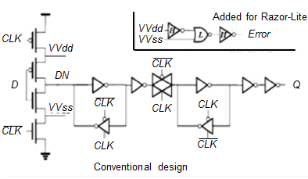
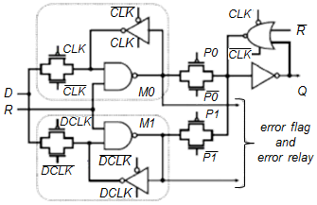
How to Minimize Cost of Resilience ?
Additional circuits ⇒ area and power penalties
Recovery from errors ⇒ throughput degradation
Large hold margin ⇒ short-path padding cost
Want benefits (e.g., energy) to maximally outweigh costs
 | Razor | Razor-Lite | TIMBER
Power penalty | 30% [Das08] | ~0% [Kim13] | 100% [Choudhury09]
Area penalty | 182% [Kim13] | 33% [Kim13] | 255% [Chen13]
#recovery cycles | 5 [Wan09] | 11 [Kim13] | 0 [Choudhury09]
Razor
Razor-Lite
TIMBER

Slide 19
Tradeoff: Resilience Cost vs. Datapath Cost
#Razor FFs
(resilience cost)
Tradeoff
Power/area of fanin circuits
We seek to minimize total energy via this tradeoff (joint work with Seokhyeong Kang and Jiajia Li; extensions ongoing in collaboration with NXP)
300 100 50 0

Slide 20
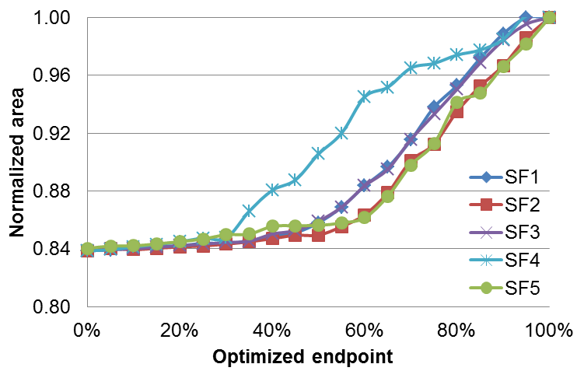
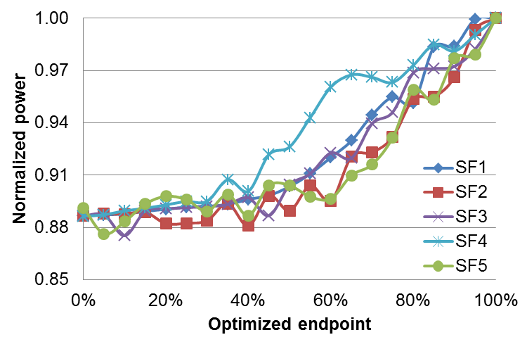
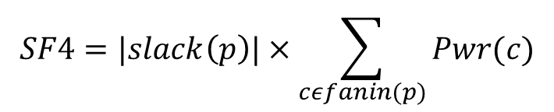
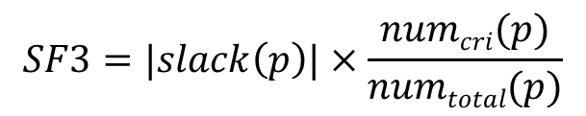


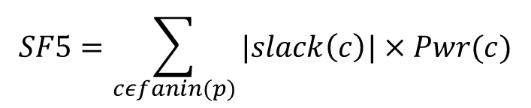
Selective-Endpoint Optimization (SEOpt)
  Optimize fanin cone of an endpoint w/ tighter constraints
  ⇒ Allows replacement of Razor FF w/ normal FF
  Pick endpoints based on heuristic sensitivity functions
Candidate Sensitivity Functions
Vary #endpoints → compare area/power penalty
$$SF1=|slack\left(p\right)|$$
$$SF2=|slack\left(p\right)|×numcri(p)$$
$$SF3=|slack\left(p\right)|×\frac{numcri(p)}{numtotal(p)}$$
$$SF4=|slack\left(p\right)|×\sum_{cεfanin(p)}{Pwr(c)}$$
$$SF5=\sum_{cεfanin(p)}{|slack\left(c\right)|}×Pwr(c)$$
p negative slack endpoint
c cells within fanin cone
Num_{cri} number of negative slack cells

Slide 21
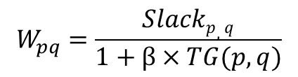
Clock Skew Optimization (SkewOpt)
Increase slacks on timing-critical and/or frequently-exercised paths
  Generate sequential graph
  Find cycle of paths with minimum total weight
  → adjust clock latencies
  → contract the cycle into one vertex
  Iterate Step 2 until all endpoints are optimized
W’ = average weight on cycle
W₃₁
W’
Setup slack of path p-q
$$W_{pq}=\frac{Slackp,q}{1+β×TG(p,q)}$$
FF1
W’
FF2
W’
FF3
W₁₂
W₂₃
Weighting factor
Clock
Toggle rate of path p-q
Data path
Clock tree

Slide 22
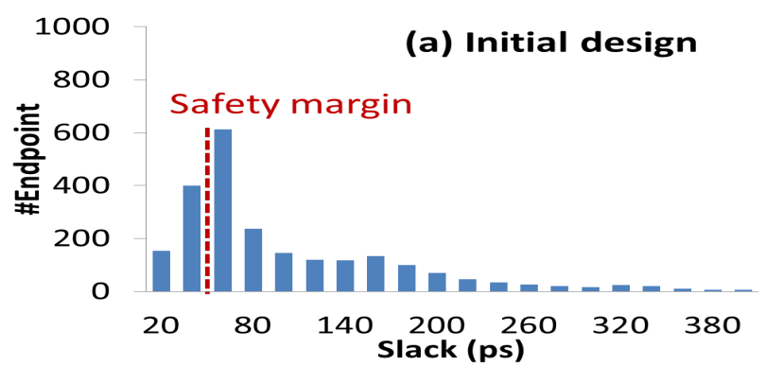
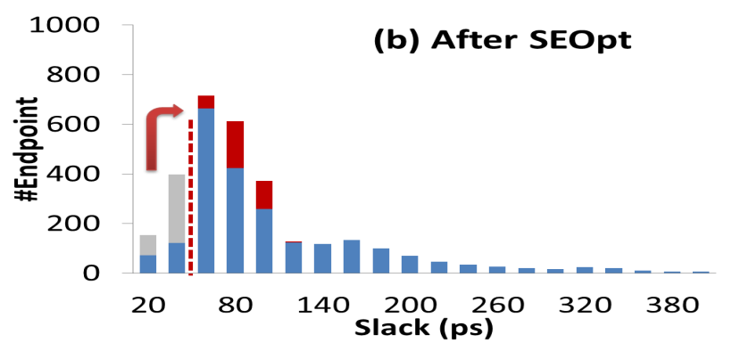
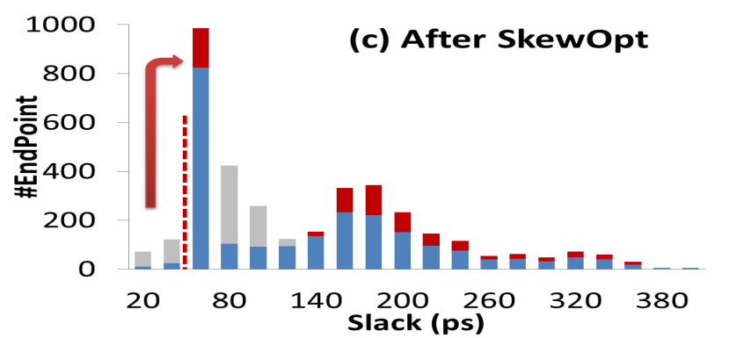
Overall Optimization Flow
Iteratively optimize with SEOpt and SkewOpt
Initial placement
(all FFs = error-tolerant FFs)
OR-tree insertion
Margin insertion on K paths based on sensitivity function
SEOpt
Replace error-tolerant FFs
w/ normal FFs
SkewOpt
Activity aware clock skew optimization
Energy < min energy?
Save current solution

Slide 23
Benefit of Low-Cost Resilience
Reference flows
  Pure-margin (PM): conventional method w/ only margin insertion
  Brute-force (BF): use error-tolerant FFs for timing-critical endpoints
Proposed method (CO) achieves up to 21% energy reduction compared to reference methods
Resilience benefits increase with larger process variation
EXU
MUL
Small margin
Medium margin
Large margin
Small margin
Medium margin
Large margin
Small/medium/large margin ⇒ 1σ/2σ/3σ for SS corner
Technology: foundry 28nm

Slide 24
Increased Benefit of Resilience with AVS
Adaptive voltage scaling allows a lower supply voltage for resilient designs, thus reduced power
Proposed method trades off between timing-error penalty vs. reduced power at a lower supply voltage
Proposed method achieves an average of 17% energy reduction compared to pure-margin designs
⇒ Resilience benefits increase in the context of AVS strategy
Minimum achievable energy
MUL
EXU
Technology: foundry 28nm

Slide 25
Outline
Introduction
Modeling of IC Variability
Tolerance of IC Variability
Margining of IC Variability
Conclusions

Slide 26
Breaking Chicken-Egg Loops → Less Margin
Example: Interaction between reliability margin and AVS designs
Bias temperature instability (BTI) aging → higher |ΔV_{th}| → lower f_{max}
AVS can be used to compensate for performance degradation
Circuit frequency
Without AVS
Circuit
On-chip aging monitor
With AVS
target
time
Voltage regulator
Circuit performance
Vdd
Closed-loop AVS
time
Notes:
Because of the BTI aging, threshold voltages of the devices increases, which leads to a slower circuit. To compensate for the performance degradation we can use adaptive voltage scaling to speed up the circuit. Whenever the circuit performance drops below the target, we can increase the supply voltage.

Slide 27
Derated Library Characterization and AVS
V_{BTI} = Voltage for BTI aging estimation
V_{lib} = Voltage for circuit performance estimation (library characterization)
V_{BTI} and V_{lib} are required in signoff
V_{BTI} and V_{lib} selection should consider BTI + AVS interaction
Aging and V_{final} are unknowns before circuit implementation
Step 1
Step 2
Step 3
V_{BTI}
|ΔV_{t}|
Derated library
Circuit implementation and signoff
V_{lib}
?
V_{final}
BTI degradation and AVS
circuit
Notes:
To have a better understanding on the effect of VBTI and Vlib, lets us look at the derated library characterization flow and adaptive voltage scaling.
In the first step of a library characterization, we use VBTI to estimate delta Vth due to aging. Then, we add the delta threshold voltages to standard cells to characterize a derated library. In this step, Vlib is used as the supply voltage of the standard cells. After getting a derated library, we can implement and signoff the circuit. During operation, the circuit will experience BTI degradation and AVS will be used to compensate for the aging effect. Therefore, at the end of the circuit lifetime, the circuit will operate at a higher voltage level and we call it as Vfinal. In this figure, we can see that the VBTI and Vlib are required in signoff and they should be defined to represent the effect of aging and AVS. However, circuit aging and Vfinal resulted from AVS are unknowns before circuit implementation.

Slide 28
Library Characterization for AVS
V_{BTI} = Voltage for BTI aging estimation
V_{lib} = Voltage for circuit performance estimation (library characterization)
V_{BTI} and V_{lib} are required in signoff
V_{BTI} and V_{lib} depend on aging during AVS
Aging and V_{final} are unknowns before
circuit implementation
Inconsistency among V_{final} , V_{lib} , V_{BTI}
What is the design overhead when timing libraries are not properly characterized?
Can we define BTI- and AVS-aware signoff corners that ensure product goals with small design, lifetime energy overheads? Joint work with Wei-Ting Jonas Chan, Tuck-Boon Chan, Siddhartha Nath
No obvious guideline to define V_{BTI} and V_{lib}
Step 1
Step 2
Step 3
V_{BTI}
|ΔV_{t}|
Derated library
Circuit implementation and signoff
V_{lib}
?
V_{final}
BTI degradation and AVS
circuit
Notes:
The figure shows that the there is no obvious guideline to define VBTI and VLIB when Vfinal remains unknown. This can lead to inconsistency among Vfinal, Vlib and Vbti.
In this work, we are interested in addressing two questions. First, what is the design overhead when timing libraries are not properly characterized? and second, what are the guidelines to define BTI- and AVS-aware signoff corners that guarantee timing correctness with little design overhead?

Slide 29
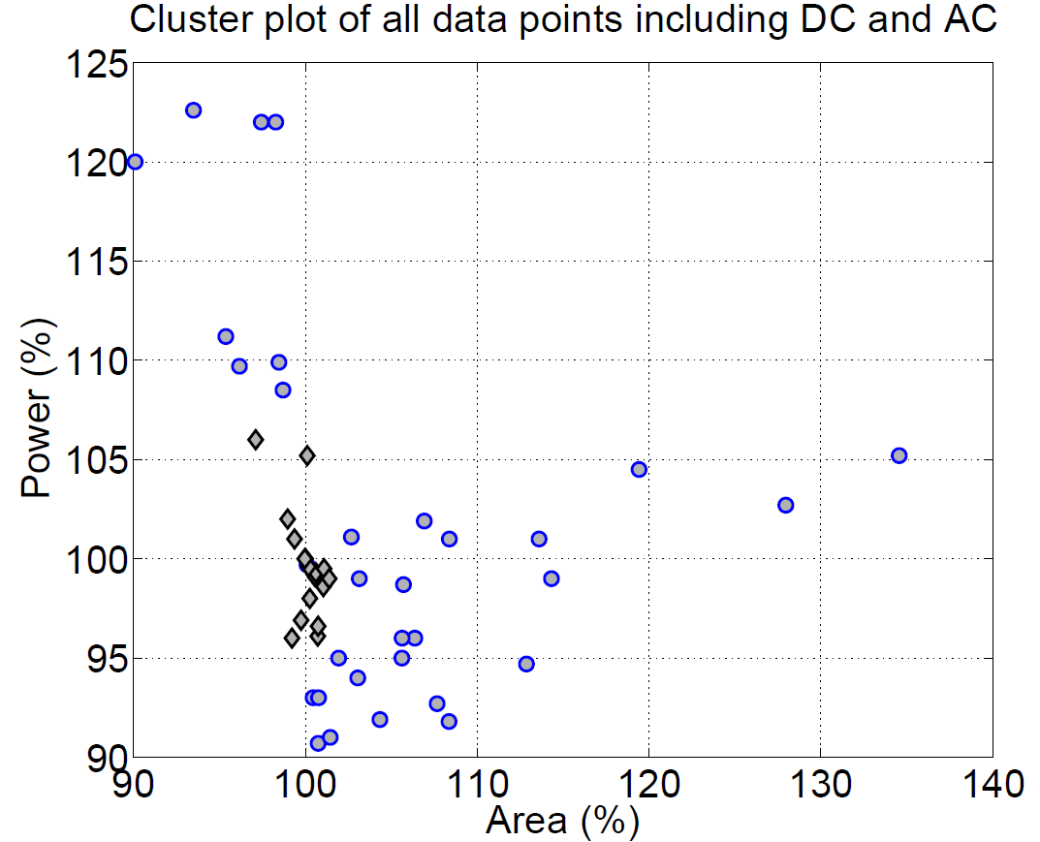
Power vs. Area Across Different Signoffs
Pessimistic signoff corner
Ovestimate aging and/or underestimate circuit performance
Large area overhead
Optimistic signoff corner
AVS increases supply voltage aggressively to compensate aging
Large lifetime energy overhead
May fail to meet timing if desired supply voltage > V_{max}
“Knee” point for balanced area and power tradeoff
Notes:
This figure shows the data points for four designs overlay on the same plot. From the figure, we can see that the circuits signed off using our derated libraries are located at the knee point in the power vs. area tradeoff curve. This shows that the circuits will have good area and power tradeoffs. Large area or power penalty can be avoided using our derated libraries. From the figure, we can see that some corners are pessimistic that they overestimate the aging effect or underestimate circuit performance. As a result, the implemented circuit has large area overheads. On the other hand, the are some optimistic corners which underestimate the aging effect. As a result, the AVS needs to increases supply voltage rapidly to compensate for aging. This causes large power overhead. In certain cases, the circuit signoff using these libraries may fail to meet timing if the desired supply voltage is larger than the maximum allowed voltage.

Slide 30
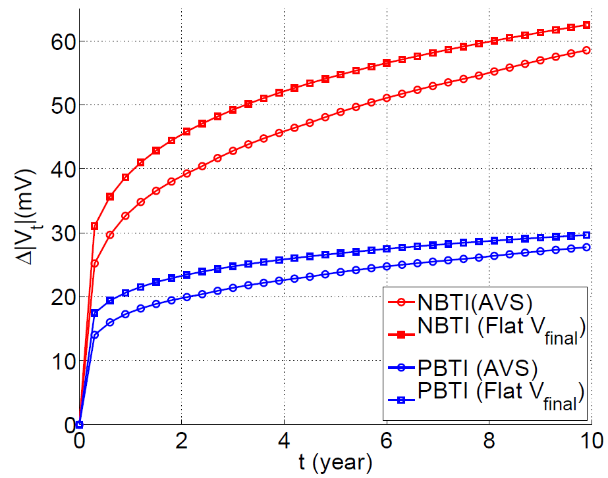
Heuristics #1
Model BTI degradation with V_{final} throughout lifetime
  Aging of a flat V_{final} ≈ aging of an adaptive V_{dd}
  But slightly pessimistic
V_{BTI} = V_{lib} ≈ V_{final}
NBTI
V_{dd}
PBTI
time
Notes:
Since the Vdd of a circuit will quickly converge to the Vfinal, we propose to model BTI degradation with the Vfinal throughout circuit lifetime.
This figure shows that BTI degradation due to a flat Vfinal is similar to the time varying Vdd in a AVS using a flat Vfinal slightly overestimate the aging effect. The small overestimation is okay because we want to be conservative during signoff.

Slide 31
V_{final} Estimation
Problem: V_{final} is not available at early design stage (design has not been implemented)
V_{final} = V_{dd} @ end of life (to compensate BTI aging)
  Gates along critical path
  Timing slack at t = 0
  Circuit activity (BTI aging)
BTI aging depends on circuit activity
  Assume DC or AC stress in derated library characterization
?
?
✔
Notes:
However, making the Vfinal approximation is insufficient because Vfinal is not avaible at the early design stage.
To estimate Vfinal, we need to understand what are the factors that affect Vfinal. Vfinal is the circuit voltage at the end of lifetime. This value is determine by the gate of critical paths because each gate response differently to the aging and voltage scaling. Another factor that affect Vfinal is the timing slack of the circuit at the beginning of its lifetime. For example, if the circuit has very large timing slack, the AVS may not happen at all through the circuit lifetime. The Vfinal is also affected by circuit activity. But this is not a critical issue because we can assume DC or AC stress as the worst-case BTI aging.
As a short summary, we can assume a worst-case circuit activity for Vfinal estimation but we still need to estimate the impact of gate type and timing slack.

Slide 32
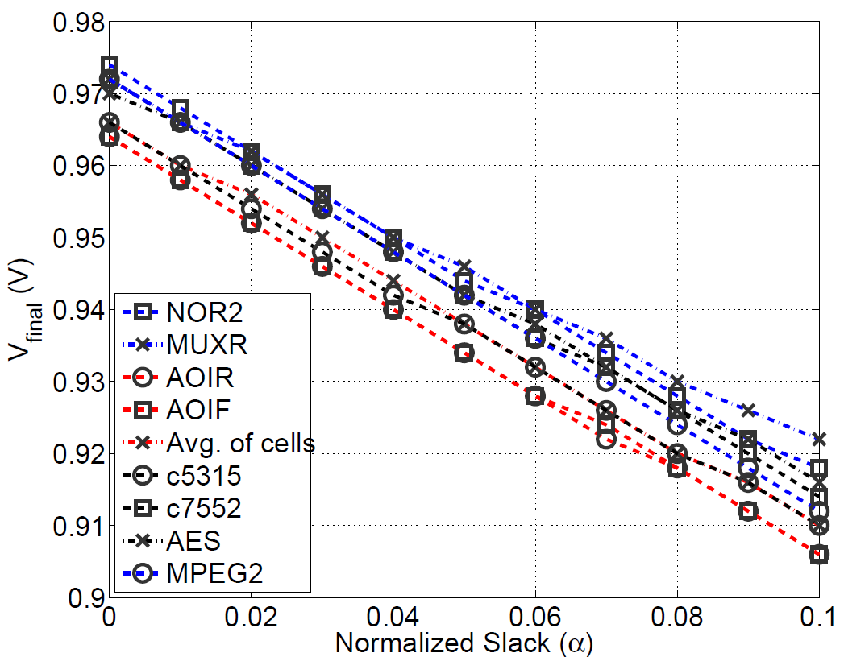
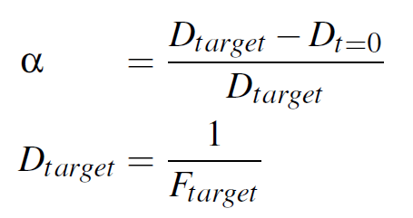
Observation and Heuristic #2
Observation #2: V_{final} is not sensitive to gate types
Heuristic #2: use average V_{final} of different gate types
  V_{final} is a function of timing slack
  Assume timing slack = 0
10mV
Notes:
To analyze the impact of gate type and timing slack, we construct different artificial critical paths with different gate types and extract the value of Vfinal for different timing slack.
In this figure, the x-axis is the timing slack of the critical paths and each line represent a critical path. From the figure, we can see that the Vfinal value of different paths are very similar.
The difference between them is typically less than 10mV. Therefore, we propose our second heuristic that we use average Vfinal of different cells to estimate the Vfinal for library characterization.
The figure also shows that when timing slack increases, Vfinal reduces and eventually converge to the supply voltage at the beginning of circuit lifetime.

Slide 33
Proposed Library Characterization Flow
Obtain V_{heur} (average of standard cells)
Heuristic: obtain V_{heur} by averaging V_{final} of different cells
Heuristic: use a “flat” V_{heur} to estimate BTI degradation
Obtain derated library with V_{BTI} = V_{lib} = V_{heur}
Signoff circuit with derated library
Notes:
To solve the problem, we propose two heuristics. By using the first heuristic, we obtain the average Vifnal of critical paths with different cell types and we call it as V heuristic. Then, we can use this Vheuristic to estimate BTI degradation. In other words, we can now characterize a derated library with both VBTI and Vlib equal to the V heuristic.

Slide 34
Power vs. Area for All Designs
4 designs x {DC, AC} x {derating methods})
Circuit signed off using
other derated libraries
Pessimistic signoff corner
Ovestimate aging and/or underestimate circuit performance
Large area overhead
Proposed method
Optimistic signoff corner
AVS increases supply voltage aggressively to compensate aging
Consume more power
May fail to meet timing if desired supply voltage > V_{max}
“Knee” point for balanced area and power tradeoff
Notes:
This figure shows the data points for four designs overlay on the same plot. From the figure, we can see that the circuits signed off using our derated libraries are located at the knee point in the power vs. area tradeoff curve. This shows that the circuits will have good area and power tradeoffs. Large area or power penalty can be avoided using our derated libraries. From the figure, we can see that some corners are pessimistic that they overestimate the aging effect or underestimate circuit performance. As a result, the implemented circuit has large area overheads. On the other hand, the are some optimistic corners which underestimate the aging effect. As a result, the AVS needs to increases supply voltage rapidly to compensate for aging. This causes large power overhead. In certain cases, the circuit signoff using these libraries may fail to meet timing if the desired supply voltage is larger than the maximum allowed voltage.

Slide 35
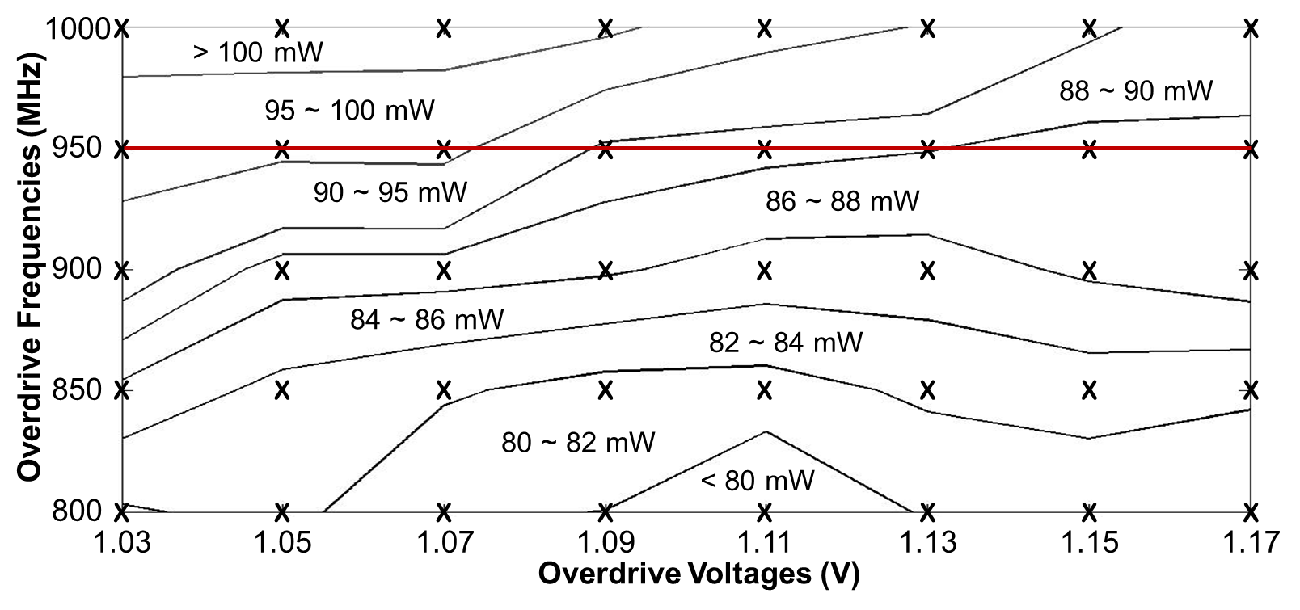
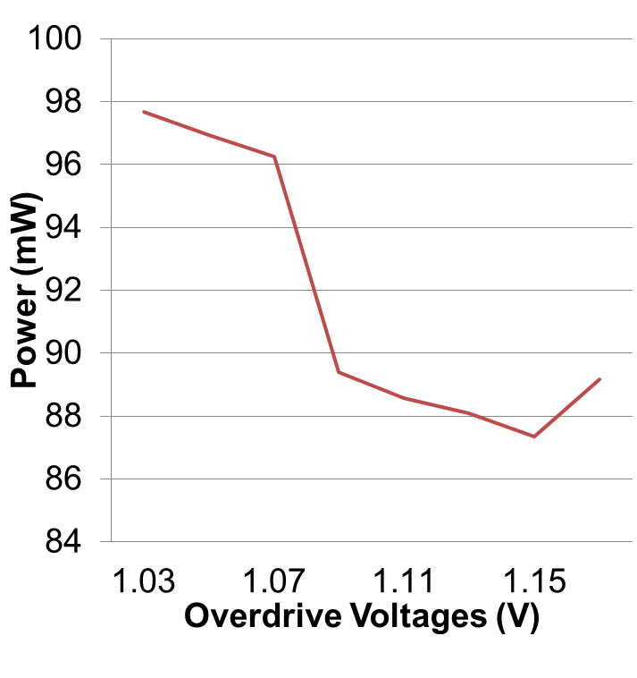
Also: Multi-Mode Signoff Choices Matter !
Signoff mode = (voltage, frequency) pair
Multi-mode operation requires multi-mode signoff
  Example: nominal mode and overdrive mode
Selection of signoff modes affects area, power
ASP-DAC 2013: Optimization of signoff modes
⇒ Improve performance, power, or area
⇒ Reduce overdesign
V_{dd}
OD
OD
NOM
NOM
t_{nom}
t_{OD}
t_{nom}
t_{OD}
time
Power of circuits w/ different overdrive modes
Fix f_{OD,} still 14% power range
Different overdrive modes ⇒ 26% power range
12%
f_{nom} = 800MHz
V_{nom} = 0.8V

Slide 36
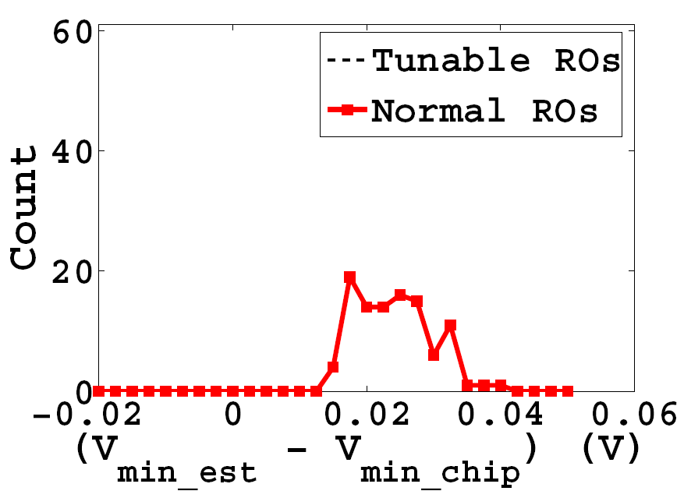
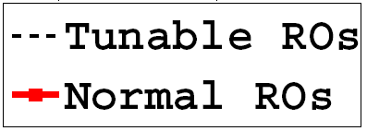
Also: Tunable Monitors ⇒ Less Margin
Aggressive config.
→ V_{min_est} < V_{min_chip}
→ Some chips will fail
Optimized config.
Increase % high resistance passgates
V_{min_est} ≈ V_{min_chip}
Default config.
Low resistance passgates
Guardband for worst-case
V_{min_est} > V_{min_chip}
13mV margin
Notes:
Our result show that when we use the default configuration to guardband for the worst-case scenario there is a 13mV Vmin margin.
By tuning the passgates to high resistance, we can reduce the margin to 0. When we tune the ROs to allow for more aggressive
voltage scaling some of the chips will start having a lower Vmin and fail to meet circuit timing.

Slide 37
Also: Tunable Monitors ⇒ Less Margin
Aggressive config.
→ V_{min_est} < V_{min_chip}
→ Some chips will fail
Optimized config.
Increase % high resistance passgates
V_{min_est} ≈ V_{min_chip}
Default config.
Low resistance passgates
Guardband for worst-case
V_{min_est} > V_{min_chip}
13mV margin
Benefits of tunability
Compensate for difference between model vs. silicon
Recover margin when variation is reduced due to improved process
Notes:
Our result show that when we use the default configuration to guardband for the worst-case scenario there is a 13mV Vmin margin.
By tuning the passgates to high resistance, we can reduce the margin to 0. When we tune the ROs to allow for more aggressive
voltage scaling some of the chips will start having a lower Vmin and fail to meet circuit timing.

Slide 38
Outline
Introduction
Modeling of IC Variability
Margining of IC Variability
Tolerance of IC Variability
Conclusions

Slide 39
Conclusions
Variability severely challenges IC value
  In manufacturing process, during operation, across lifetime
Benefit of “next node” is increasingly hard to find
  Entire node is a “20/20/20” value proposition
  5-10% in P/P/A metrics is now substantial at leading edge
Variability is connected to tapeout, IC properties by models, margins, tolerances used in signoff
Some takeaways from this talk
  Substantial benefit from tightening BEOL corners (= signoff)
  “Minimum cost of resilience” is a rich optimization challenge
  Chicken-egg loops in signoff definition can be broken
  Holistic approaches will provide “equivalent scaling” that extends the value trajectory of Moore’s Law

Slide 40
Thank You !

Slide 41
Backup

Slide 42

Power Penalty to Fix EM with AVS
Core power increases due to elevated voltage
P/G power increases due to both elevated voltage and mesh degradation
A tradeoff between invested guardband in signoff
14% power penalty
Least
invested guardband
Highest
invested guardband
Notes:
We also study the power impact due to AVS in a similar way.
The core powers of implementations are different due to different Vfinal and the difference could be 14%.
We apply Mishra’s model to study EM degradation on the P/G mesh.
Power penalty on the P/G mesh is more significant than core. The possible reason is because the increased resistance on the mesh contributes to more power penalty.

Slide 43
Homogeneous Corners
  (1) Define RC corners of each layer separately
  (2) Use corners from each layer to construct a
  homogeneous corner for an interconnect stack
  Example: worst-case capacitance corner
Interconnect stack with M1 and M2
Homogeneous C_{w} corner
M2 C
Layer M2
3σ
  Pessimism
-3σ
3σ
C
M1 C
Layer M1
-3σ
3σ
C
Notes:
To construct a homogeneous corner, we first define the corners for each layer. For example, here we define the worst-case capacitance corners for layers M1 and M2. Then, these corners are used to define the C-worst corner for an interconnect stack with M1 and M2. From the figure, we can clearly see that this approach is pessimistic because the C-worst corner is far away from the 3sigma distribution of capacitance.

Slide 44
Homogeneous Corners
  (1) Define RC corners of each layer separately
  (2) Use corners from each layer to construct a
  homogeneous corner for an interconnect stack
  Example: worst-case capacitance corner
Interconnect stack with M1 and M2
Homogeneous C_{w} corner
M2 C
Layer M2
3σ
  Pessimism
-3σ
3σ
C
  When variations in different layers are not fully correlated, pessimism of homogeneous corners increase with #layers
M1 C
Layer M1
-3σ
3σ
C
Notes:
Moreover, when the variations in different layers are not fully correlated, the pessimism of homogeneous corners increase with #layers.

Slide 45
Correlation Matrix
Let Σ be the correlation matrix for variation sources
 |  | M1 |  |  | M2 |  |  | M3 |  |  | M4
 |  | ΔW | ΔT | ΔH | ΔW | ΔT | ΔH | ΔW | ΔT | ΔH | ΔW | ΔT | ΔH
M1 | ΔW | 1 | 0 | 0 | γ | 0 | 0 | γ | 0 | 0 | 0 | 0 | 0
 | ΔT | 0 | 1 | 0 | 0 | γ | 0 | 0 | γ | 0 | 0 | 0 | 0
 | ΔH | 0 | 0 | 1 | 0 | 0 | γ | 0 | 0 | γ | 0 | 0 | 0
M2 | ΔW | γ | 0 | 0 | 1 | 0 | 0 | γ | 0 | 0 | 0 | 0 | 0
 | ΔT | 0 | γ | 0 | 0 | 1 | 0 | 0 | γ | 0 | 0 | 0 | 0
 | ΔH | 0 | 0 | γ | 0 | 0 | 1 | 0 | 0 | γ | 0 | 0 | 0
M3 | ΔW | γ | 0 | 0 | γ | 0 | 0 | 1 | 0 | 0 | 0 | 0 | 0
 | ΔT | 0 | γ | 0 | 0 | γ | 0 | 0 | 1 | 0 | 0 | 0 | 0
 | ΔH | 0 | 0 | γ | 0 | 0 | γ | 0 | 0 | 1 | 0 | 0 | 0
M4 | ΔW | 0 | 0 | 0 | 0 | 0 | 0 | 0 | 0 | 0 | 1 | 0 | 0
 | ΔT | 0 | 0 | 0 | 0 | 0 | 0 | 0 | 0 | 0 | 0 | 1 | 0
 | ΔH | 0 | 0 | 0 | 0 | 0 | 0 | 0 | 0 | 0 | 0 | 0 | 1
= Σ
Correlation for variation sources with the same variation type and in the process module, γ ≈ 0.5
Variation sources in different process modules are independent

Slide 46
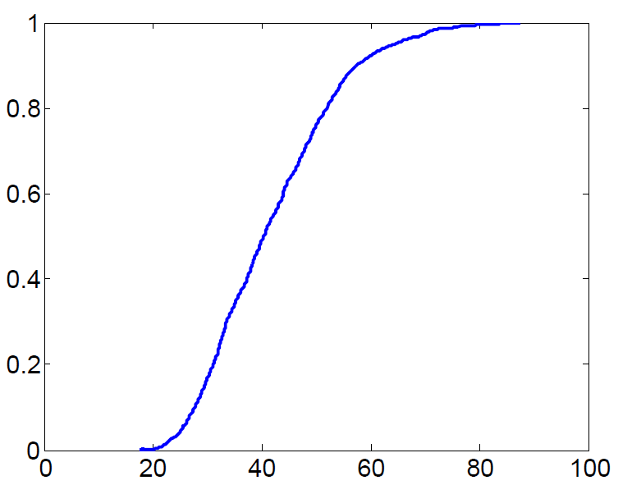
Wiring Structure in Timing-Critical Paths (2)
92% of paths have < 60% of wirelength on any single layer
Variations in different layers are not fully correlated
Averaging uncorrelated variation → smaller RC variation
0.92
Cumulative probability
60%
Max. wirelength ratio across all layers (%)

Slide 47
Delay Variation
Some paths have α > 1.0 → a CBC can underestimate delay variations
But these paths have larger delays at the other corner
Dominated by RC-worst:
Δdelay at RC-worst > Δdelay at C-worst
C-worst corner underestimates delay variations, but these paths are dominated by the RC-worst corner
Dominated by C-worst:
Δdelay at C-worst > Δdelay at RC-worst
α
α
α < 1.0 → delay variations are covered by the RC-worst corner
Δdelay at C-worst
[d(Y_{cw}) – d(Y_{typ})] / d(Y_{typ})
Δdelay at RC-worst
[d(Y_{cw}) – d(Y_{typ})] / d(Y_{typ})

Slide 48
Delay Variation
Some paths have α > 1.0 → a CBC can underestimate delay variations
But these paths have larger delays at the other corner
Dominated by RC-worst:
Δdelay at RC-worst > Δdelay at C-worst
C-worst corner underestimates delay variations, but these paths are dominated by the RC-worst corner
Dominated by C-worst:
Δdelay at C-worst > Δdelay at RC-worst
α
α
α < 1.0 → delay variations are covered by the RC-worst corner
Paths are more sensitive to R or to C
Using RC-worst or C-worst only will underestimate delay variations
Need both RC- and C-worst corners to cover process variations
In the following discussions, α is defined at the dominant corner
Δdelay at C-worst
[d(Y_{cw}) – d(Y_{typ})] / d(Y_{typ})
Δdelay at RC-worst
[d(Y_{cw}) – d(Y_{typ})] / d(Y_{typ})

Slide 49
Non-Homogeneous Corner
Each layer can have different skewed variations
3σ
Interconnect stack with M1 and M2
M1 C
Non-homogeneous corner
M1 == C_{w} (3σ)
M2 == C_{typ}
M2 C
Less pessimism with non-homogeneous corners
Challenge:
  Many feasible combinations
  A corner can only cover certain paths
  How to choose the best combinations?

Slide 50
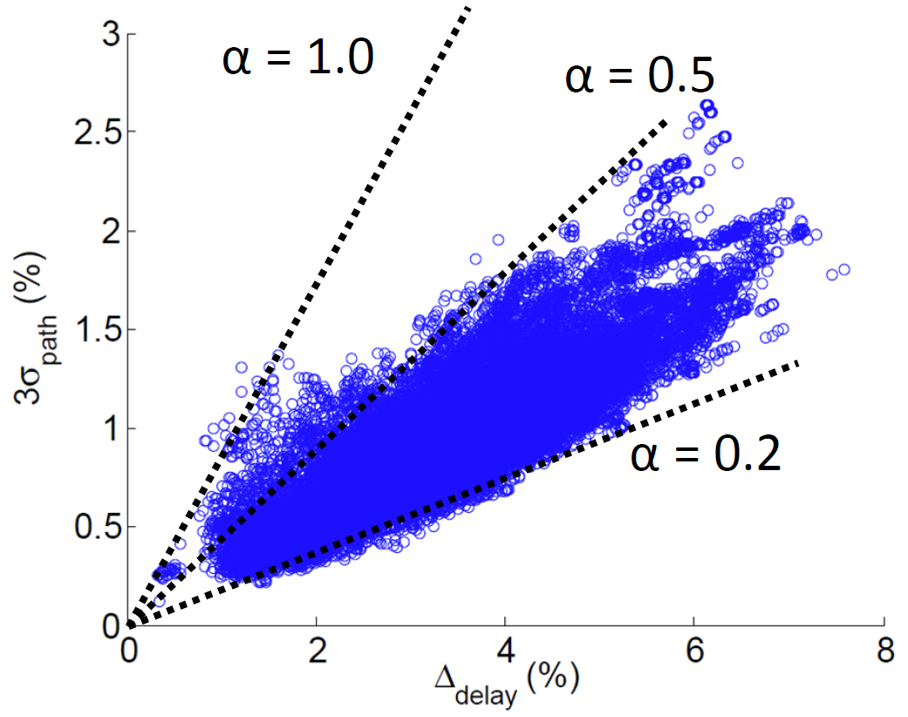
Opportunities for Tightened BEOL Corners
Challenge: how to avoid underestimating delay variation to preserve parametric yield
3σ_{j}/d(Y_{typ}) x 100%
Δd_{j}(Y_{rcw})/d_{j}(Y_{typ}) x 100%
CBC can be pessimistic! Most paths have α < 0.5
Use tightened BEOL corners, e.g., scale BEOL variation in .itf with α = 0.5
Notes:
Based on the same data, we found that the conventional BEOL corner is pessimistic, because most of the paths have a alpha value smaller than 0.5. Therefore, we propose to use tightened BEOL corners, for example, scale the variation parameters in itf by 0.5. Scaling the corner is simple but the challenge is, how do we avoid underestimate delay variation to preserve parametric yield.

Slide 51
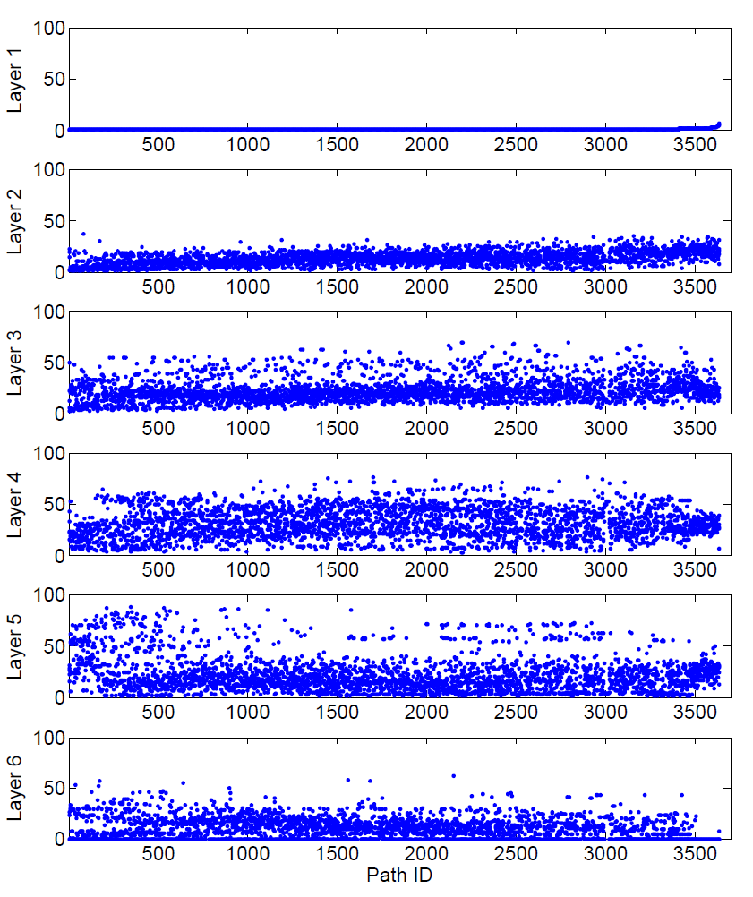
Wiring Structure in Timing-Critical Paths
Testcase:
  45nm foundry library (wire resistivity scaled by 8X)
  Netlist: NETCARD 1mm², 570K standard cell instances
  9 metal layers
  Extract critical paths from different PVT and BEOL corners
Wirelength ratio (%)
Critical paths are structurally similar
Wires on critical paths are routed on many layers
Structure is an outcome of the design flow
Notes:
To study the pessimism in the conventional BEOL corner, we implemented a testcase using 45nm library with 9 metal layers. From the results, we can see that the critical paths have similar wiring structure. All the wires are routed on layers 2 to 6 and the wirelengths are not dominated by a single layer. This result is expected because the wiring structure is driven by the design flow such as the maximum transition constraint, preferred routing direction, etc.

Slide 52
Proposed Timing Signoff Flow
Extract RC at RC-worst, C-worst and the typical corners
Calculate Δdelay of critical paths
Put path j in the group G_{tbc} if
Δdelay is larger than a threshold
Fix only the paths in G_{tbc} using tightened BEOL corners
Since tightened corners have smaller delay variations, timing closure is easier
Routed design
Timing analysis at BEOL corners Y_{typ,} Y_{cw,} Y_{rcw}
ECO
using TBC
ECO
using CBC
G_{TBC}
G_{CBC}
Timing analysis using TBC
Timing analysis using CBC
violation = 0?
violation = 0?
done
Notes:
This figure shows our timing signoff flow. First we implement the design using conventional corners. Given a routed design, we extract RC and calculate the delta delay of the critical paths. Then, we filter the paths based on their delta delay. For the paths in Gtbc, we will run timing analysis using the tightened corner. For all other paths, we will use the conventional corner. Then, we run the timing eco with different corners until there are no timing violations. Since the paths which use the tightened corner will have smaller delay variation, the timing closure becomes easier.

Slide 53
Experiment Setup
  Testcases for validation (45nm library with 8X wire resistivity)
 | LEON3MP | NETCARD | SUPERBLUE12
Clock period (ns) | 1.8 | 2.0 | 3.1
Gate count | 232K | 575K | 1031K
Utilization (%) | 84 | 79 | 82
Core area (mm²) | 0.45 | 1.04 | 1.91
Max. transition (ps) | 330 | 330 | 330
  Statistical models: (1) no correlation and (2) same kind of variation sources in the same process module have correlation factor = 0.5
 | α | Correlation factor = 0.5
 |  | A_{cw} (%) | A_{rcw} (%)
TBC-0.5 | 0.5 | 4.3 | 7.3
TBC-0.6 | 0.6 | 3.3 | 5.0
TBC-0.7 | 0.7 | 3.0 | 3.4
Implement another NETCARD (clock period = 2.3ns) to obtain α, A_{cw} and A_{rcw}
Notes:
In this experiment setup, we use three testcases and we try two statistical setups. First, we assume there is no correlation among the variation sources, and second, we assume same kind of variation sources in the same process module have a correlation factor 0.5. Also, we extract the threshold values for different alpha values.

Slide 54
Further Analysis
Paths with small Δd(Y_{rcw}) and Δd(Y_{cw}) have large α
A path has small Δdelays
→ the path is equally sensitive to R and C
Example:
d_{j} = d_{j}(Y_{typ}) + 0.5 Δd_{R-M1} + 0.5 Δd_{C-M1}
For a given CBC = Y_{cw}, Δd_{R-M1} is small but Δd_{C-M1} is large
→ delay variation of Δd_{R-M1} and Δd_{C-M1} are cancelled out
→ Δd(Y_{cw}) ≈ 0 < σ_{j}
Nominal delay
Delay sensitivity to unit change in M1 resistance
Delay sensitivity to unit change in M1 capacitance
Notes:
Based on our study, we see the same trend on different critical paths. When a path has a small delta delay, this means that the path is not dominated by resistance or capacitance. For example, in this case, a path is equally sensitive to R and C. For a given BEOL corner, if the resistance becomes small, the capacitance becomes larger. Because of the opposite directions in delta R and C, the delay variation is cancelled out at the BEOL corner. As a result, the delay variation becomes very small compared to the delay variation obtained from a statistical analysis. Therefore, the path will have a large alpha.

Slide 55
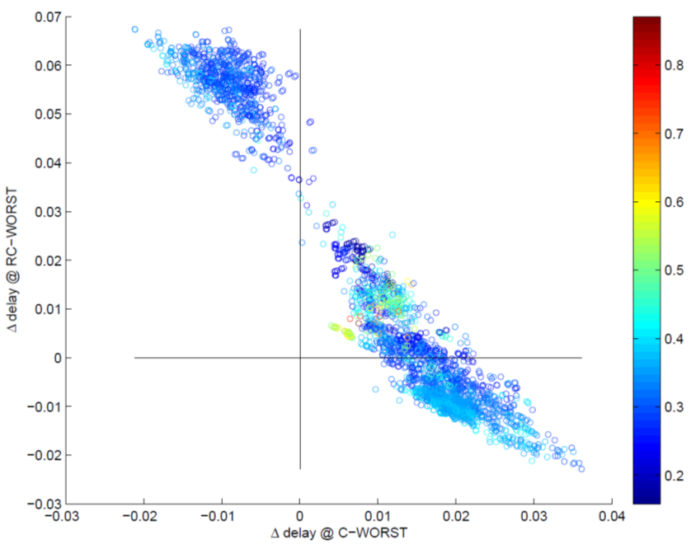
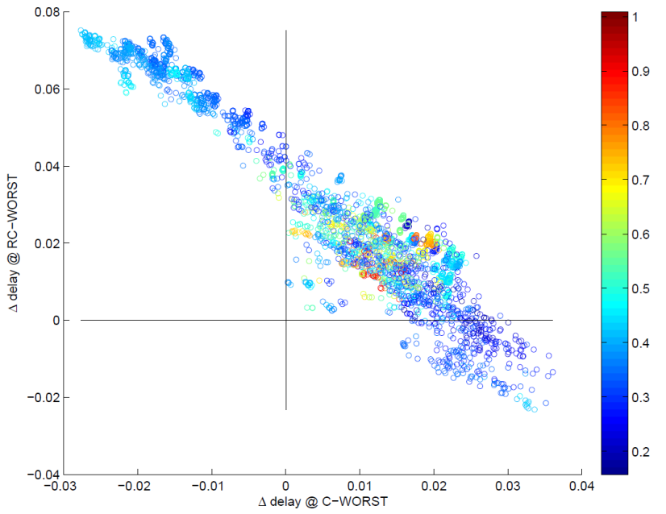
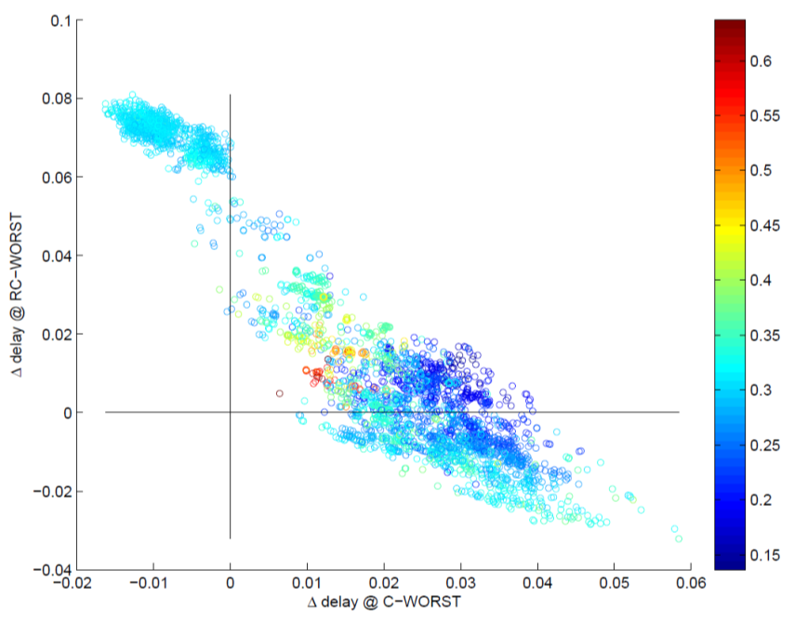
Scaling Factor Results
Similar trends in different designs
Large α when Δd(Y_{rcw})/d(Y_{typ}) and Δd(Y_{cw})/d(Y_{typ}) are small
LEON3MP
α > 0.5
NETCARD
SUPERBLUE12
α > 0.5
α > 0.5

Slide 56
Benefits of Tightened BEOL Corners (1)
Correlation factor, γ = 0 (variation sources are independent)
WNS and TNS are reduced by up to 120ps and 61ns
#Timing violations reduces by 31% to 100%

Slide 57
Heuristics #1
Model BTI degradation with V_{final} throughout lifetime
  Aging of a flat V_{final} ≈ aging of an adaptive V_{dd}
  But slightly pessimistic
V_{BTI} = V_{lib} ≈ V_{final}
NBTI
V_{dd}
PBTI
time
Notes:
To address the inconsistency between the voltages, we study the trend of BTI degradation. Because of the front-loaded nature of BTI effect, we found that we can model BTI degradation with a fix Vdd throughout the lifetime. This figure shows that BTI degradation due to a flat Vfinal is similar to the time varying Vdd in a AVS using a flat Vfinal slightly overestimate the aging effect. The small overestimation is okay because we want to be conservative during signoff.

Slide 58
V_{final} Estimation
Problem: V_{final} is not available at early design stage (design has not been implemented)
V_{final} = V_{dd} @ end of life (to compensate BTI aging)
  Gates along critical path
  Timing slack at t = 0
Circuit activity is not an issue
  Because BTI effect is not sensitive to circuit activity
  DC or AC stress model is sufficient
Notes:
However, making the Vfinal approximation is insufficient because Vfinal is not avaible at the early design stage.
To estimate Vfinal, we need to understand what are the factors that affect Vfinal. Vfinal is the circuit voltage at the end of lifetime. This value is determine by the gate of critical paths because each gate response differently to the aging and voltage scaling. Another factor that affect Vfinal is the timing slack of the circuit at the beginning of its lifetime. For example, if the circuit has very large timing slack, the AVS may not happen at all through the circuit lifetime.
Circuit activity is not a critical issue because BTI effect is not sensitive to circuit activity. Therefore, it is sufficient to use a DC or AC stress model.

Slide 59
Observation and Heuristic #2
Observation #2: V_{final} is not sensitive to gate types
Heuristic #2: use average V_{final} of different gate types
  V_{final} is a function of timing slack
  Assume timing slack = 0
10mV
Notes:
To analyze the impact of gate type and timing slack, we construct different artificial critical paths with different gate types and extract the value of Vfinal for different timing slack.
In this figure, the x-axis is the timing slack of the critical paths and each line represent a critical path. From the figure, we can see that the Vfinal value of different paths are very similar.
The difference between them is typically less than 10mV. Therefore, we propose our second heuristic that we use average Vfinal of different cells to estimate the Vfinal for library characterization.
The figure also shows that when timing slack increases, Vfinal reduces and eventually converge to the supply voltage at the beginning of circuit lifetime.

Slide 60
Technology and Benchmark Circuits
NANGATE library with 32nm PTM technology
Signoff for setup time violation
Temperature = 125°C
Process corner = slow NMOS and PMOS
BTI degradation = {DC, AC}
Supply voltages
V_{max} | 1.05V
V_{init} | 0.90V
V_{heur1} (DC) | 0.97V
V_{heur1} (AC) | 0.95V
V_{heur2} (DC) | 0.95V
V_{heur2} (AC) | 0.93V
Circuit | Frequency (GHz)
C5315 | 1.38
c7552 | 1.25
AES | 0.89
MPEG2 | 1.05
Notes:
In this experiment, we use the NANGATE library with 32nm PTM technology for the active devices.
The circuits are signoff for setup time violation at 125 degree celcius and at the slow slow process corner.
We consider both DC and AC BTI degradation separately in our experiment
We use four benchmark circuits in this experiment. The frequencies of the benchmark circuits ranges from 900MHz to 1.4 Ghz. We assume the initial voltage of the circuit Is 0.9V and the maximum allowed voltage is 1.05V. As expected the V heuristic for our method is slightly smaller for the AC stress scenario. Also, the value of Vheuristics is smaller when we read the value of Vheuristic with 3% timing slack.

Slide 61
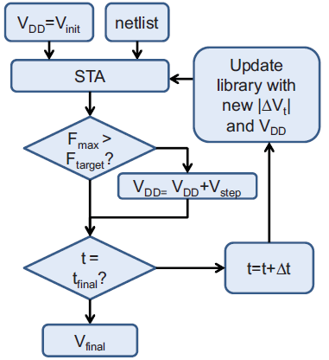
A Reference Signoff Flow
Basic idea: keep a consistent V_{BTI} , V_{LIB} and V_{dd} throughout circuit lifetime
Signoff flow:
  Estimate aging at each time step
  Update circuit timing and V_{dd}
  Repeat until t = t_{final}
  Modify circuit and start over if V_{final} > maximum allowed voltage
No overhead in timing analysis, but very slow
Many STA runs
and library
V_{step}: AVS voltage step
V_{final}: converged voltage
Notes:
Before I describe the details of our experiment, I want to introduce a reference signoff flow which is used in this work for comparison. The basic idea of the reference signoff flow is to keep a consistent VBTI, VLIB and Vdd throughout circuit lifetime. In this signoff flow, we estimate aging at each time step. Based on the estimated aging, we update Vdd and circuit timing. The circuit is modified and the analysis flow will start over if the Vfinal is larger than maximum allowed voltage. Although this reference signoff flow has no overhead in timing analysis, it is very slow because we need to validate timing at each time step and update the libraries according to the aging and changes in supply voltage.

Slide 62
Experiment Setup
Characterize different derated libraries
  Evaluate impact of library characterization
Seven setups
1 : V_{BTI} = V_{lib} = V_{init} → Ignore AVS
2 : Most pessimistic derated library
3 : V_{BTI} = V_{lib} = V_{max} → Extreme corner for AVS
4 : V_{BTI} = V_{final} → Do not overestimate aging but ignores AVS
5 : No derated library (reference)
6 : Proposed method with α=0
7 : Proposed method with α=0.03
Case | 1 | 2 | 3 | 4 | 5 | 6 | 7
V_{lib}(V) | V_{init} | V_{init} | V_{max} | V_{init} | N/A | V_{heur1} | V_{heur2}
V_{BTI} (V) | V_{init} | V_{max} | V_{max} | V_{final} | N/A | V_{heur1} | V_{heur2}
Notes:
In our experiment setup, we characterize different derated libraries to evaluate the impact of library characterization.
There are 6 testcases. In the first testcase, we let both VBTI and Vlib to be the same as the initial voltage of the circuit. This setup represent the case where we ignore AVS.
In the second testcase, we let the Vlib to be Vinit and use maximum voltage value to estimate BTI aging. This represents the most pessimistic derated library. In the third testcase, we let both VBTI and Vlib to be the same as the maximum voltage. This is an extreme corner for a circuit with AVS. In the fourth experiment, we let the VBTI to be the same as the final obtained from the reference flow but keep the Vlib same as initial voltage of the circuit. This setup represent the case where we do not overestimate the aging but the effect of AVS is ignored.
The fifth testcase is the results of the reference flow and the Last two testcases are our proposed method which uses V heuristics to characterize the derated library. In the six testcase we choose the Vheuristic without timing slack. In the seventh testcase, we choose the Vheur with 3% timing slack to see the impact of using a different timing slack.
Hypothesis

Slide 63
“Chicken and Egg” Loop
“Chicken and egg” loop in signoff
  Derated library characterization is related to BTI + AVS
  AVS affected by circuit implementation
    Timing constraints, critical paths, etc.
  Circuit is affected by library characterization
V_{final}
Circuit
V_{lib} , V_{BTI}
Derated Libraries
Notes:
From the previous slides, we know that the signoff problem is actually a chicken and egg loop.
As you can see, the characterization of a derated library is related to BTI aging and adaptive voltage scaling. At the same time, the adaptive voltage scaling is affected by the circuit implementation such as the timing constraints of the circuit, the critical paths, etc. Unfortunately, the circuit is also affected the library characterization. So everything is inter-related. The derated library, the circuit, BTI aging and adaptive voltage scaling. To solve such a chicken and egg problem, we need to break the loop.

Slide 64
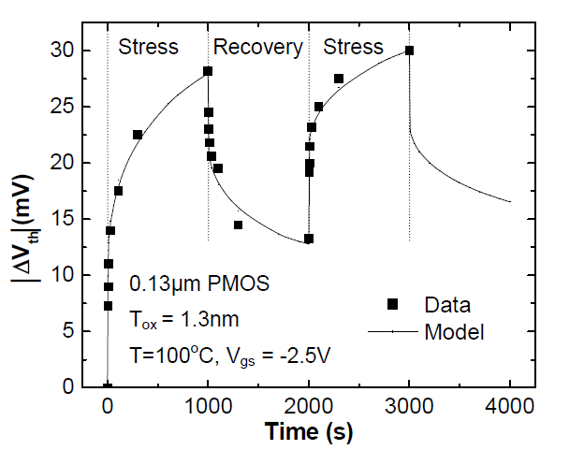
Bias Temperature Instability (BTI)
[TCAS’14]
|ΔV_{th}| increases when device is on (stressed)
|ΔV_{th}| is partially recovered when device is off (relaxed)
NBTI: PMOS PBTI:NMOS
|V_{gs}|
ON
OFF
ON
OFF
time
Device aging (|ΔV_{th}|) accumulates over time
[VattikondaWC06]
Notes:
BTI aging is a physical phenomenon which affects threshold voltage of a device. We call it NBTI for a PMOS and PBTI for a NMOS. When a device is turned on, BTI aging increases the threshold voltage. When the device is turned off, part of the threshold voltage increment will be recovered. Since the threshold voltage cannot be fully recovered, delta threshold voltage due to the BTI aging will accumulates over time.

Slide 65
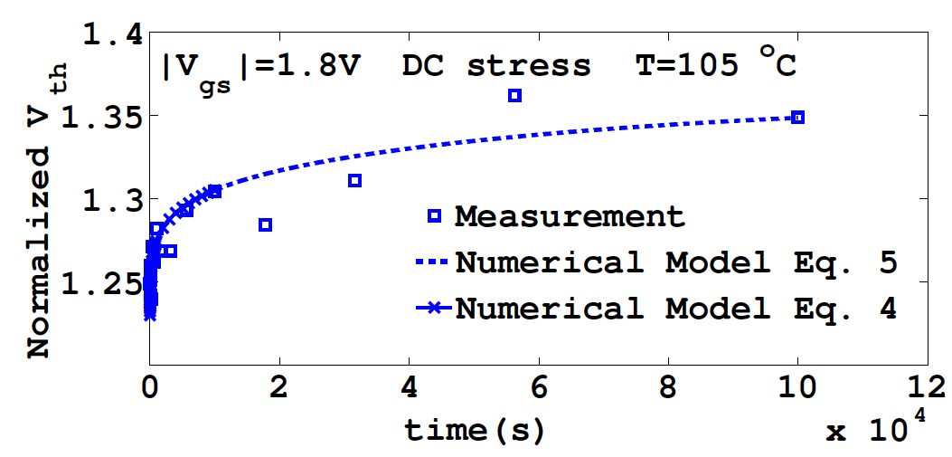
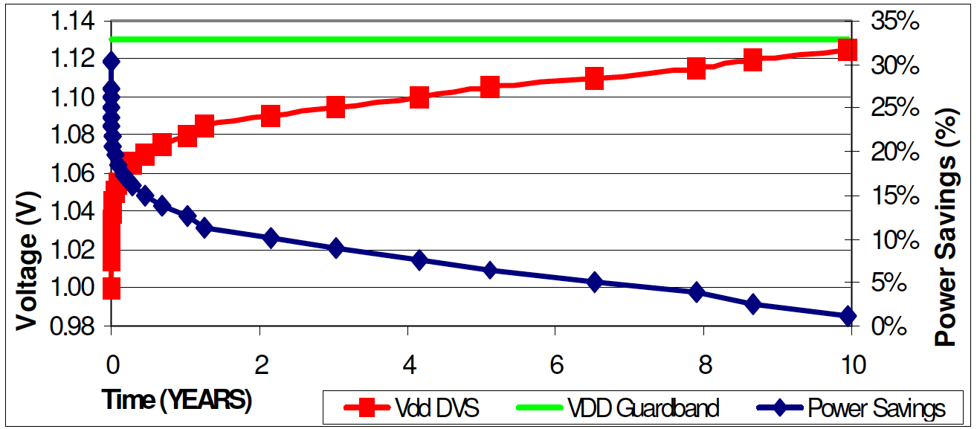
Observation #1
BTI is a “front-loaded” phenomenon
50% BTI aging happens within the 1st year of circuit lifetime (total lifetime = 10 years)
[Chan11]
V_{final}
Most V_{dd} increment happens in early lifetime
Gap between V_{dd} and V_{final} reduces rapidly
≈70% V_{dd} increment in 1 year
(remaining 30% over 9 years)
Notes:
Based on previous studies, we observe that BTI degradation is “front-loaded”. For example, 50% of BTI degradation happens within the first year of chip lifetime. This means that Vdd increment due to AVS is very frequent initially and the gap between Vdd and Vfinal of the circuit reduces rapidly over it’s lifetime.

Slide 66
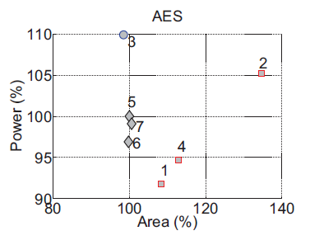
Results for DC Scenario
1 : V_{BTI} = V_{lib} = V_{init} → Ignore AVS
2 : Most pessimistic derated library
3 : V_{BTI} = V_{lib} = V_{max} → Extreme corner for AVS
4 : V_{bti} = V_{final} → Do not overestimate aging but ignores AVS
5 : No derated library (reference)
6 : Proposed method with α=0
7 : Proposed method with α=0.03
Good corners
Optimistic signoff corner
AVS increases supply voltage aggressively to compensate aging
Consume more power
May fail to meet timing if desired supply voltage > V_{max}
Pessimistic signoff corner
Ovestimate aging and/or underestimate circuit performance
Large area overhead
Notes:
These figures show the power and are of different circuits implemented and signoff using different derated libraries. We can see that circuit implemented using derated library number 3 has slightly less area but the power is approximately 10% larger than the reference method. This is because the derated library is too optimistic. Therefore, AVS has to increase the supply voltage aggressively to compensate aging. This cases the circuit to consume more power. Moreover, the circuit may fail to meet timing if the desired supply voltage is larger than maximum voltage. On the other hand, we can see that testcases 1,2 and 4, that are pessimistic in aging or circuit performance will lead to larger circuit area. On the other hand, we can see that by using our heuristics to characterize the derated libraries, the implemented circuits have similar area and power compared to the one obtained from the reference flow. This shows that our method can avoid power or area design overheads.

Slide 67
Problem: Signoff Corner Definition
Timing signoff: ensure circuit meets performance target under PVT variations & aging
Conventional signoff approach:
  Analyze circuit timing at worst-case corners
  Fix timing violations, re-run timing analysis
With BTI aging and AVS, what is the V_{dd} of the worst-cast corner for timing analysis?
With BTI aging and AVS, the worst-case voltage corner is not obvious
 |  | V_{lib} for circuit performance estimation
 |  | Min V_{dd} | Max V_{dd}
V_{BTI} for aging estimation | MinV_{dd} |  | Not applicable (Optimistic)
 | Max V_{dd}
?
Slowest circuit
Less aging
Slowest circuit
Worst-case aging
Faster circuit
Worst-case aging
Too pessimistic
?
Notes:
In timing signoff, we want to ensure that a circuit meets its performance target under process, voltage, temperature variations as well as aging. There are two important steps in timing signoff. First, we analyze circuit timing at worst-case corners and check is there any timing violation. Second, if there is any violation, we need to fix the violation by making change in the circuit and then re-run timing analysis. The problem is that, with BTI aging and AVS, what Vdd should we use in the worst-case corner for timing analysis? This table shows that there are two variables when we define a worst case corner. Here VBTI is the voltage for aging estimation and Vlib is the voltage for circuit performance estimation. You can treat Vlib as the supply voltage of the standard cells when we characterize a timing library. Now, suppose we use the minimum voltages for both BTI aging and circuit performance estimations. We get the slowest circuit speed but at the same time we are underestimating the aging effect. So, it is not clear whether we should use this combination. Now, suppose we use the maximum Vdd for both BTI aging estimation and circuit performance estimation, the circuit will have the worst-case aging but the circuit is faster because of the higher Vlib. The worst-case corner is when we use the maximum voltage for aging estimation and minimum voltage for circuit performance estimation. However, we know that this combination is pessimistic because we will not have different voltages at the same time for a circuit. By now, I hope it is clear that with BTI aging and AVS, the worst-case voltage corner is not obvious.

Slide 68
AVS Signoff Corner Selection
Optimistic about AVS
Pessimistic about AVS
Notes:
For different signoff corners, a design has different area-power tradeoffs.
Let us take #2 and #3 as examples,
#3 is the most optimistic in signoff, so the supply voltage increases by more than other implementations at runtime; hence, consumes more power.
#2 is the most pessimistic in signoff, so the supply voltage is fixed at runtime but consumes more area during implementation.

Slide 69

AVS Impact on EM Lifetime
Assume no EM fix at signoff
BTI degradation is checked at each step and MTTF is updated as
$$MTTF\left(i\right)=MTTF(i−1)×{\left(\frac{V_{DD}\left(i−1\right)}{V_{DD}\left(i\right)}\right)}^{2}$$
V_{final} (V)
30% MTTF penalty
200mV voltage compensation
Notes:
We study the impact on EM MTTF degradation by Black’s equation.
We assume the current density is proportional to the supply voltage, and MTTF is inversely proportional to the current density or voltage.
We assume there is no EM fix for AVS at the signoff; The implementation has 10 year MTTF if the supply voltage is fixed at its nominal voltage.
When the voltage increases to compensate BTI degradation, lifetime decreases because of higher EM stress.
We update the delay degradation at each time step in the simulation, and increase the supply voltage to meet the timing constraint.
We then update the MTTF at each time step until the end of the circuit’s lifetime.
We observe up to 30% MTTF difference between the most pessimistic and optimistic signoff corners.
The discrepancy arises due to Vfinal. This implies that AVS scheduling is important for EM degradation.

Slide 70
EM Impact on AVS Scheduling
1.2 years MTTF penalty
Notes:
The simulation results are shown here with five schedules S1 to S5. Each schedule uses a different voltage step size.
When we increase the voltage step sizes, MTTF changes significantly.
With schedule S5, the MTTF penalty can be up to 1.5 years.
S5 increases voltage early in the lifetime as compared to other schedules. As a result, it causes worst EM stress on the wires.

Slide 71
What is “Signoff”?
Foundation of contract between design house and foundry
  “chip should work”: stack of models, margins, analyses
  Function, timing, signal integrity, power integrity, …
Problem: Margins = pessimism
⇒ overdesign, schedule delay
Voltage
Operating voltage
Nominal Vdd
Static IR drop
Power grid IR gradient
Dynamic IR
HCI/NBTI
“margin stack” for voltage signoff
Signoff Vdd

Slide 72
Statistical Timing Analysis (1)
Delay sensitivity of path p_{j} to variation source z_{v}
Assumptions:
  Δd_{j,v} is linear with respect to variation sources
  Variation sources are normal distributions
Obtain Δd_{j,v} using 28 runs of
RC extraction and
static timing analysis (STA)
Δd_{j,v} = [ - ] / 3
d_{j}(Y_{v})
d_{j}(Y_{typ})
28 .itf files
(27 variation sources + Y_{typ})
Routed Netlist
RC extraction
STA
Δd_{j,v}
Note: Path delay includes gate and wire delays
Notes:
To extract the impact of BEOL variation, we need to collect path delay sensitivities. The delay sensitivity is defined as the delta delay at a perturbed corner divided by the magnitude of the variation source. In this work, we extract the BEOL variations from the itf files and assume the variations are normal distributions and the value in the existing corners is the 3 sigma value.
Given a routed netlist, we run 28 RC extractions and STA to collect the delay sensitivities of setup data path to each BEOL variation source.

Slide 73
Statistical Timing Analysis (2)
Σ is the correlation matrix for variation sources (e.g., 27 x 27)
Σ = λλ^{T} (Note: λ is obtained by Cholesky decomposition)
Delay sensitivities with correlation
[Δd’_{j,1} … Δd’_{j,27}] = [Δd_{j,1} … Δd_{j,27}].λ
Standard deviation of path delay
σ_{j} = ((Δd’_{j,1})² + … + (Δd’_{j,27})²)^{0.5}
Note: we use the delay variation from the statistical analysis as a reference
Notes:
Given the correlation matrix of variation sources, we factor out the lambda using Cholesky decomposition. Then, by using lambda, we can obtain the delay sensitivities with correlation and calculate the standard deviation of the path delay. Note that this statistical analysis is only used for reference. This kind of analysis cannot be used for design implementation because the RC extractions and timing analysis is very slow.

Slide 74
Resilient Designs
Detect and recover from timing errors
⇒ Ensure correct operation with dynamic variations
(e.g., IR drop, temperature fluctuation, cross-coupling, etc.)
Trade off design robustness vs. design quality
⇒ E.g., enable margin reduction
Improve performance (i.e., timing speculation)
Conventional design:
Worst-case signoff
No Vdd downscaling
Resilient design:
Typical-case signoff
Vdd downscaling → reduced energy
15% reduction

Slide 75
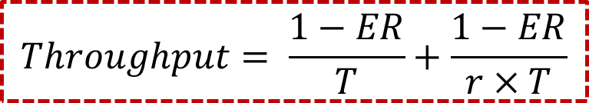
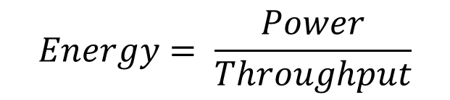
Resilience Cost Reduction Problem
Given: RTL design, throughput requirement and error-tolerant registers
Objective: implement design to minimize energy
Estimation of design energy:
$$Energy= \frac{Power}{Throughput}$$
$$Throughput= \frac{1−ER}{T}+\frac{1−ER}{r×T}$$
Clock period
Error rate [Kahng10]
#recovery cycles

Slide 76
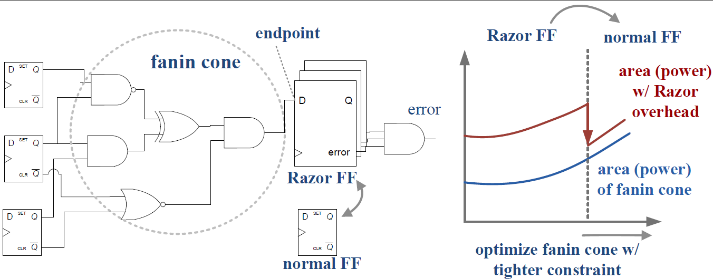
Selective-Endpoint Optimization
Optimize fanin cone w/ tighter constraints
⇒ Allows replacement of Razor FF w/ normal FF
  Trade off cost of resilience vs. data path optimization
  Question: Which endpoint to be optimized?

Slide 77
Process-Aware V_{dd} Scaling (PVS)
AVS classes
approaches
Open-Loop
AVS
Freq. & V_{dd} LUT
AVS
Pre-characterize LUT [Martin02]
Post-silicon
characterization
Process-aware AVS
Post-silicon characterization [Tschanz03]
Closed-
Loop AVS
Generic monitor
Process and temperature-aware AVS
Generic on-chip monitor [Burd00]
Power
Design-dependent monitor [Elgebaly07, Drake08, Chan12]
Design dependent
replica
In-situ performance monitor
Measure actual critical paths [Hartman06, Fick10]
In-situ
monitor
Error
Tolerance
AVS
Error Detection
System
Error detection and correction system
V_{dd} scaling until error occurs [Das06,Tschanz10]
Notes:
There are many existing AVS techniques and they can be broadly classified into three catagories. The open-loop AVS, closed-loop AVS, and Error tolerance AVS. Open-loop AVS typically adjust the voltage based on a pre-characterized lookup table. To achieve more power reduction, closed-loop AVS utilize on-chip monitor to measure the performance variation of the chip and adjust the voltage accordingly. For further power reduction, error tolerance AVS reduce the voltage aggressively until an error occurs. In this work, we focus on closed-loop AVS because it offers better power reduction compared to the open-loop AVS, and it is easier to design compared to the Error tolerance AVS.

Slide 78
Challenge: Variability
Ideal
Non-ideality
Non-ideality
Ideal
Source: [CPUDB]
DENSITY
SUPPLY VOLTAGE
Ideal
Non-ideality
Non-ideality
Ideal
Source: [JeongK08]
Source: [ITRS]
POWER
DRIVE CURRENT
Notes:
Here I use fixed voltage scaling for area, power, drive current. And show full scaling in Vdd plot.

Slide 79
Energy Reduction in AVS Context
Adaptive voltage scaling allows lower supply voltage for resilient designs, thus reduced power
Proposed method trades off between timing-error penalty vs. reduced power at a lower supply voltage
Proposed method achieves an average of 18% energy reduction compared to pure-margin designs
⇒ Resilience benefits increase in the context of AVS strategy
Minimum achievable energy
MUL
EXU

Slide 80
Our Concept: Mode Dominance
Design cone (of mode A) is the union of all the feasible operating modes for circuits signed of at mode A
Design cone is determined by tradeoff between voltage and frequency (mainly threshold voltages)
One mode is outside of the design cone of the other
⇒ failed design / overdesign
Mode A has positive timing slacks with respect to mode B
⇒ mode A dominates mode B
Equivalent dominance: no mode is dominated by the other
  Modes are in each others’ design cone
Frequency
Negative Slacks = failed design
Design Cone of mode A
C
Multi-mode signoff at modes which do not exhibit equivalent dominance leads to overdesign
B
A
Guideline: search for signoff modes within design cone ⇒ reduce overdesign
Positive Slacks = overdesign
Voltage

Slide 81
Our Method: Global Optimization
Iteratively sample and refine power models
  Avoid circuit implementation at each mode
  Small constant # of runs is enough ⇒ Scalable
Global optimization flow
Power estimation of adaptive search
Sample (SP&R)
Construct power models
Estimate optimal
signoff modes
Design: AES
f : 700MHz
Sample (SP&R)
Refine power models
Ovals indicate sample points
1st / 2nd: power from power models at first / second iteration
real: power from real implemented circuits
Adaptive search

Slide 82
Classes of Closed-Loop AVS
Closed-
Loop AVS
Generic monitor
Design-dependent
replica
In-situ
monitor
Does not capture design-specific performance variation
Critical path may be difficult to identify (IP from 3rd party)
Calibrating monitors at multiple modes/voltages requires long test time
This work: Tunable monitor for closed-loop AVS
Can be applied as a generic monitor
Or tuned to capture design-specific performance
Notes:
A closed loop AVS can be implemented by different monitors.
For example, we can use a generic monitor such as an inverter-based ring-oscillator to measure the performance variation of a chip. But this monitor does not capture the design-specific performance variation. To capture the design-specific performance variation, we may use design-dependent replica circuits or in-situ monitors. However, these monitors usually requires information on critical paths, which may be difficult to be identified. Also, calibrating monitors at multiple modes and voltages requires long test time. In this work, we propose a method to design a closed-loop AVS monitor, which can be used as a generic monitor or tuned for a specific design when silicon samples are available.

Slide 83
Design of RO with Tunable V_{min}
Identified two circuit knobs to tune V_{min}
    Series resistance
    Cell types (INV, NAND, NOR)
Proposed circuit
    Different cell type covers different process corners
    Tune series resistance of each stage to high or low
Control pins
1 bit
1 bit
1 bit
High resistance
Low resistance
Notes:
Based on the analysis, we have identified that Vmin of a circuit is mainly affected by series resistance and the cell types. To guardband for the worst-case voltage scaling across different process conditions, we use the cells with the largest Vmin in our RO design. We also introduce a series passgate at each stage along the signal path. By tuning all stages to low resistance, we will obtain the maximum Vmin, which represents the worst-case voltage scaling condition. To reduce the Vmin, we can tune the passgates to high resistance.
To design ROs with the maximum Vmin across different process conditions, we have ROs with different cell types. To tune the Vmin of the ROs, we add a configurable series passgate at each stage of the RO. When the series passgate have low resistance, the Vmin is higher and vise versa.

Slide 84
Benefit of Resilience Cost Reduction
Reference flows
  Pure-margin (PM): conventional methodology w/ only margin insertion
  Brute-force (BF): insert error-tolerant FFs at timing-critical endpoints
Proposed method (CO) achieves up to 20% energy reduction compared to reference methods
Resilience benefits increase with safety margin
EXU
MUL
Small margin
Medium margin
Large margin
Small margin
Medium margin
Large margin
Small/medium/large margin ⇒ safety margin = 5%/10%/15% of clock period

Slide 85
Increased Benefit of Resilience With AVS
AVS (Adaptive Voltage Scaling) allows lower supply voltage for resilient designs ⇒reduced power
We trade off between timing-error penalty vs. reduced power at a lower supply voltage
Average 18% energy reduction compared to pure-margin designs
⇒ Resilience benefits increase in AVS context
Minimum achievable energy
MUL
EXU

Slide 86
Overall Optimization Flow
Iteratively optimize with SEOpt and SkewOpt
Initial placement
(all FFs = error-tolerant FFs)
Margin insertion on K paths based on sensitivity function
SEOpt
Replace error-tolerant FFs
w/ normal FFs
SkewOpt
Activity-aware clock skew optimization
Energy < min energy?
Save current solution

