Slide 1
Timing Margin Recovery With Flexible Flip-Flop Timing Model
Andrew B. Kahng and Hyein Lee
UC San Diego VLSI CAD Laboratory

Slide 2
Outline
Preliminary
Motivation
Related Work
Sequential LP-based Optimization
Experimental Results
Conclusions and Future Work

Slide 3
Preliminary: Static Timing Analysis
Timing corners
Min corner: the corner where gate/wire delay is minimum
Max corner: the corner where gate/wire delay is maximum
Timing modes
Scenarios where different functions are performed in a design
Test mode, function mode, etc.
Types of analyses
Graph-based analysis: Considers only the worst/best case
Path-based analysis: Considers input vectors for more accurate analysis

Slide 4
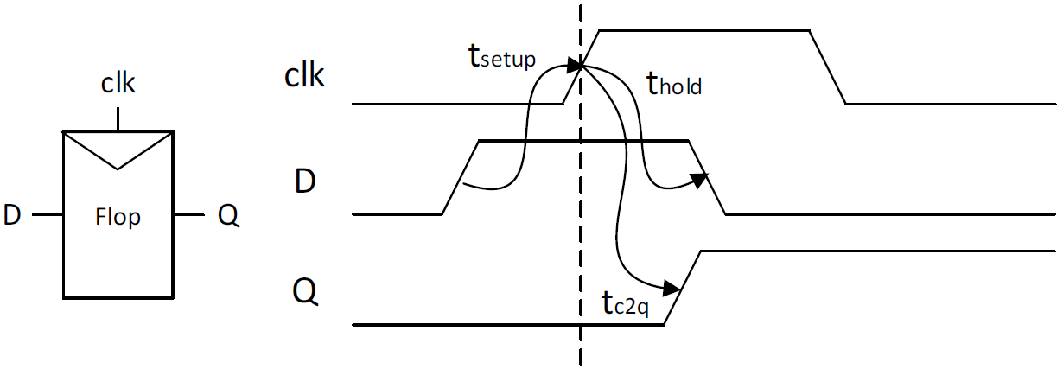
Preliminary: Flip-Flop (FF) Timing Model
FF timing components
Setup time: the minimum amount of time input data should be steady before clock
Hold time: the minimum amount of time input data should be steady after clock
Clock-to-q (c2q) delay: the delay of output from clock
Conventional timing model: Setup/hold time and c2q delay are fixed values

Slide 5
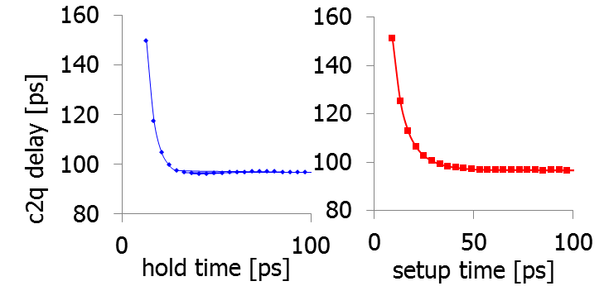
Motivation: Flexible FF Timing
Setup/hold time/c2q delay is NOT a single value
Various setup-hold-c2q sets can be used for timing analysis ⇒ Flexible FF timing model ⇒ Reduce pessimism
⇒ Tradeoff among setup/hold/c2q delay
hold
setup-hold-c2q
flexible model
c2q₁
...
c2q_{n}
setup

Slide 6
Motivation: Why Flexible FF Timing?
If data paths are independent of each other in PBA,
Using fixed FF timing model can loose performance optimization opportunity
Flexible timing model could reduce pessimism
setup: 10ps
FF₁
c2q: 20ps
480ps
470ps
470ps
Total: 500ps
460ps
Total: 500ps
FF₃
FF₂
460ps
setup: 10ps
c2q: 10ps
→20ps
→20ps
c2q: 20ps
480ps
setup: 20ps
→10ps
→10ps
Total: 500ps
→ 500ps!
→ 520ps?

Slide 7
Related Work
Setup-hold time interdependency
Characterization [7] [8] [10]
Timing analysis [1] [2] [3] [4] [5] [6]
However, no consideration of c2q delay
Setup-hold-c2q interdependency [1]
Propose a timing analysis method by exploiting flexible flip-flop timing model
However, iterative search can result in suboptimal solutions
Our work
Based on setup-hold-c2q interdependency
Linear programming-based global optimization
Mode/corner-specific timing analysis by exploiting flexible FF timing model

Slide 8
Outline
Preliminary
Motivation
Related Work
Sequential LP-based Optimization
Experimental Results
Conclusions and Future Work

Slide 9
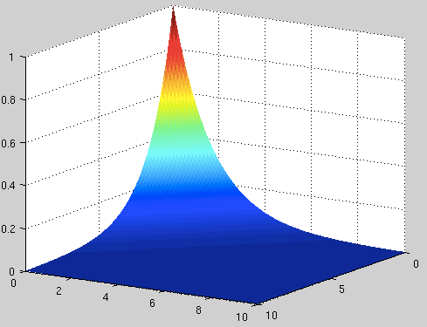
Problem Formulation
Objective: Find the best combination of setup/hold time and c2q for each FF to minimize setup/hold violations
Solution space: 3d surface → not easy to obtain an accurate analytical model with three variables
To reduce the dimension, we divide setup-hold-c2q optimization into: setup-c2q optimization + hold-c2q optimization
c2q
C2q-setup-hold surface
c2q
setup
hold
setup
c2q
hold

Slide 10
Problem Formulation: Sequential LP
Solve two sub-problems sequentially
The solution from one problem ⇒ used as input to another problem
The sequence of solving problems can change depending on which problem is more critical
Setup-c2q optimization
Maximize setup slack
Subject to
c2q + d_{max} + T_{su} + S_{su} ≤ P
c2q = f(T_{su})
L ≤ T_{su} ≤ U
Hold-c2q optimization
Maximize setup and hold slack
Subject to
c2q + d_{max} + T_{su} + S_{su} ≤ P
d_{min} + S_{h} > T_{h}
c2q = f(T_{h})
L ≤ T_{h} ≤ U
Where d_{max}/d_{min} : max/min data path delay, T_{su}: setup time, T_{h}: hold time, S_{su}: setup slack, S_{h}: hold slack

Slide 11
Timing Signoff Across Corners/Modes
Setup/hold time does not have to be a single value across corners/modes!
Timing signoff across corners
Max delay corner → hold violation ↓, setup violation ↑ ⇒ Select optimal setup time first
Min delay corner → setup violation ↓, hold violation ↑ ⇒ Select optimal hold time first
Timing signoff across modes
Scan test mode → hold violation ↑ ⇒ Select optimal hold time first
Notes:
The flexible flip-flop timing model is helpful especially for multi-corner multi-mode timing analysis.
This is because, we don’t need to use a single value for each of setup time, hold time and c2q delay.
For example, considering multiple corners, we have less hold time violations and more setup time violations at max delay corner.
So, we can first optimize setup time.
Similarly, at min delay corner, we have less setup time violations and more hold time violations.
In this case, we can optimize hold time first.
For multi-mode analysis, the same method can be applied.
For instance, scan test mode can have more hold time violations because scan paths have less number of stages.
In this case, we can optimize hold time first.

Slide 12
New Timing Signoff: Max Corner
Setup-c2q optimization is performed first
setup-c2q optimization
for max delay paths
Annotate setup/c2q to each FF
hold-c2q optimization
for hold violated paths
Annotate hold/c2q to each FF

Slide 13
Characterization
Setup-hold-c2q curves are characterized with exhaustive SPICE simulation
Setup-hold-c2q triplets are obtained at every 5ps of timing points
Use a pulse as the input data to characterize setup/hold time interdependency
setup time: data rise to clock rise, hold time: clock rise to data fall, c2q: clock rise to q rise
clock
q output
c2q
setup time
data
input
hold time
data slew
clock slew
(for rising edge triggered FF and rise input)

Slide 14
New Timing Signoff: Overall Flow
Netlist (and SPEF, if routed)
Extract path timing information
LP formulation
with flexible flip-flop timing model
Solve Sequential LP
(STA_FT_{max} , STA_FT_{min})
Solution
Annotate new timing model
for each flip-flop
Timing signoff with annotated timing

Slide 15
Outline
Preliminary
Motivation
Related Work
Sequential LP-based Optimization
Experimental Results
Conclusions and Future Work

Slide 16
Experimental Setup
Testcases
Open source designs with 65nm foundry technology
Commercial flow
Logic synthesis: Synopsys Design/DFT Compiler H-2013.03-SP3
P&R: Cadence Encounter Digital Implementation System XL 10.1
Timing signoff: Synopsys PrimeTime H-2013.06-SP2
LP solver: CPLEX 12.5.1
Our method is compared with
Conventional: Conventional fixed FF timing model
[4]: Flexible setup/hold time with fixed c2q delays
cTool: a commercial tool with setup-hold pessimism reduction functionality

Slide 17
Experiment Results
Results of corner-specific timing analysis at max/min corner
In mode-specific analysis, the summation of setup/hold slacks is improved
Our method fixes negative setup/hold time violations “for free”
[ns]
Worst setup slack
Worst hold slack

Slide 18
Conclusion
We exploit a flexible flip-flop timing model: three-dimensional tradeoff among setup time, hold time and clock-to-q delay
We apply sequential LP-based approaches for multi-corner/mode timing signoff
Worst slack improves by 48ps on average and by up to 130ps with 65nm technology (inverter delay = ~50ps)
Future work
Demonstration with advanced technologies
More accurate timing model of setup-hold-c2q tradeoff
Circuit optimization by exploiting FF timing model flexibility

Slide 19
Thank you!

