Slide 1
Solvers, Engines, Tools and Flows: The Next Wave for AI/ML in Physical Design
Andrew B. Kahng
UCSD CSE and ECE Departments
abk@ucsd.edu
https://vlsicad.ucsd.edu
Notes:
Hello and thank you for your interest in this invited talk and paper.

Slide 2
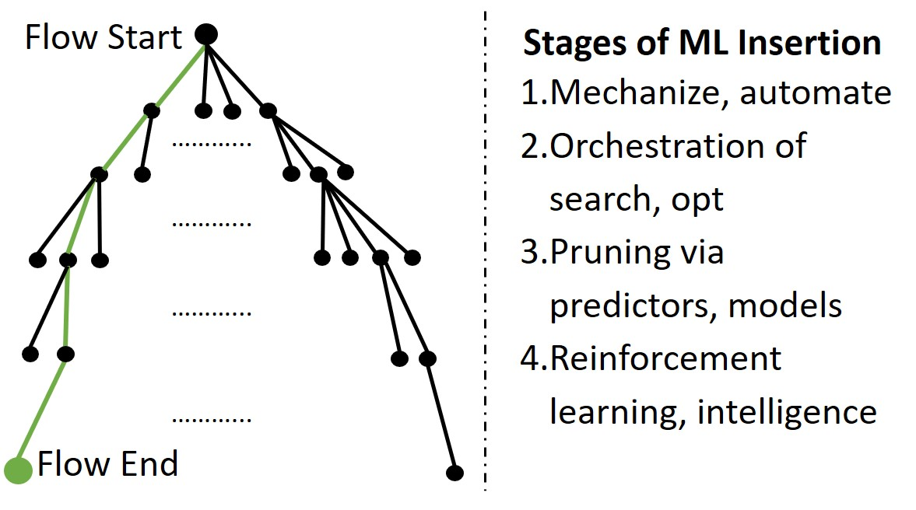
AI/ML in Physical Design
Main Threads:
Prediction
Optimization
Generation
ISPD-2018
Notes:
My ISPD talk six years ago suggested four oncoming stages of ML insertion into PD tools – and the field has focused on three main threads: prediction of downstream outcomes, direct optimization of EDA problems, and use of generative methods to produce solutions.

Slide 3
Since ISPD-2018
Successes
Simple physics by regression: timing across corners, EM/IR, …
Black-box hyperparameter search: Cerebrus, DSO.ai
Use of ML for hints and ballpark starting points
Disappointments
Tool silos are more closed
No prospect of companies sharing data, or of public foundation models
Costs (#machines, #licenses, #training/learning passes, …)
Surprises
Rush to LLMs and Generative AI
Understanding of Challenges and Limits for AI/ML in PD
Optimization QoR: Strong baselines
Scale: Problem decomposition
Chaos: Sampling
Accuracy: High bars for deployment
(+ Data, Generalization, Validation, Cost, …)
Notes:
Since then: successes include speedups of physics analyses, “ML around EDA” – especially black-box hyperparameter optimization in Cerebrus and DSO.ai – and methods to give hints or ballpark starting solutions.
[CLICK] Disappointments include the difficulty of getting data out of tools, or of using ML inference results to control the tool. It now seems unlikely that we’ll see companies sharing data, or public foundation models. And COSTS of machine learning have turned out to be significant.
[CLICK] Surprises include the rush to LLMs and Generative AI.
[CLICK] And we now see concrete challenges and limits: optimization QoR, scalability, modeling of chaotic tools and flows, high bars for production deployment, data, and more.

Slide 4
Lens: Solvers, Engines, Tools and Flows
ISPD-2024, Figure 3
Foundations that are orthogonal (but enabling) to AI/ML
Speed: enables data, iterations
Scalability: enables parallel, D/Q
Stability: enables prediction, proxies
Quality: optimization cost, prediction accuracy
AI/ML in PD: context, culture will matter more than “porting”
Open data, open source, standard APIs, reproducibility, benchmarking …
Notes:
The paper starts with a hierarchy of design technology elements, from Solvers up to Flows. And, this figure calls out where Boosters such as GPU acceleration or ML “around” EDA will have the most impact.
[CLICK] One takeaway is that many foundations are orthogonal – but enabling – to AI/ML. All of these items – speed, scalability, stability, QoR – have virtuous cycles with deploying AI/ML in PD.
[CLICK] And, culture and community will matter more than “porting” the latest ideas from ML conferences. Will we solve challenges of data or assessment or reproducibility, for example.

Slide 5
Section 2: PD Challenges and Levers
Challenges
Design partitioning and block shaping
Placement-aware hierarchical floorplanning
Datapath-aware floorplanning
Drive for area reduction
Levers
GPU-based speedups
Cloud
Sampling for stability
Multiple views in unit time: Tomography
Notes:
Section 2 of the paper discusses PD challenges and “levers”. Several high-value challenges are in partitioning and floorplanning – they come from design scale and complexity, and arise in early PD stages, where big mistakes can be made and solution space exploration matters the most, and where neither human experts nor PD tools are scaling well.
[CLICK] I’ll spend some time on these four “Levers”, which provide the foundations mentioned in the last slide -- orthogonal to but enabling to future wins from AI/ML in PD. The first is GPU-based speedup.

Slide 6
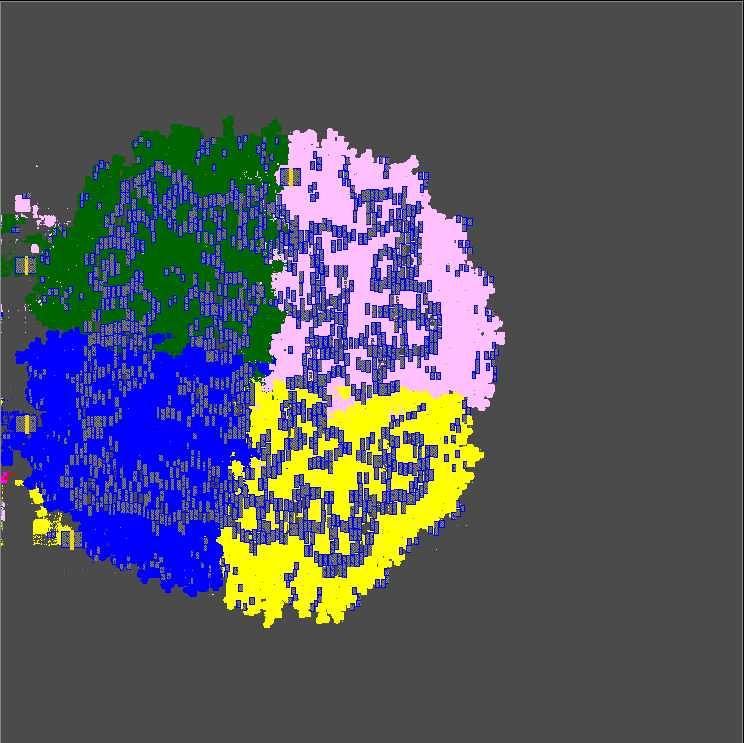
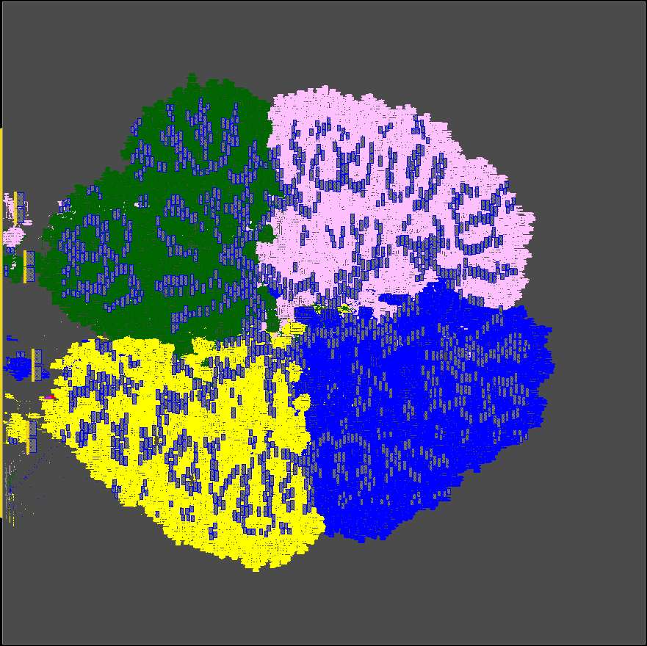
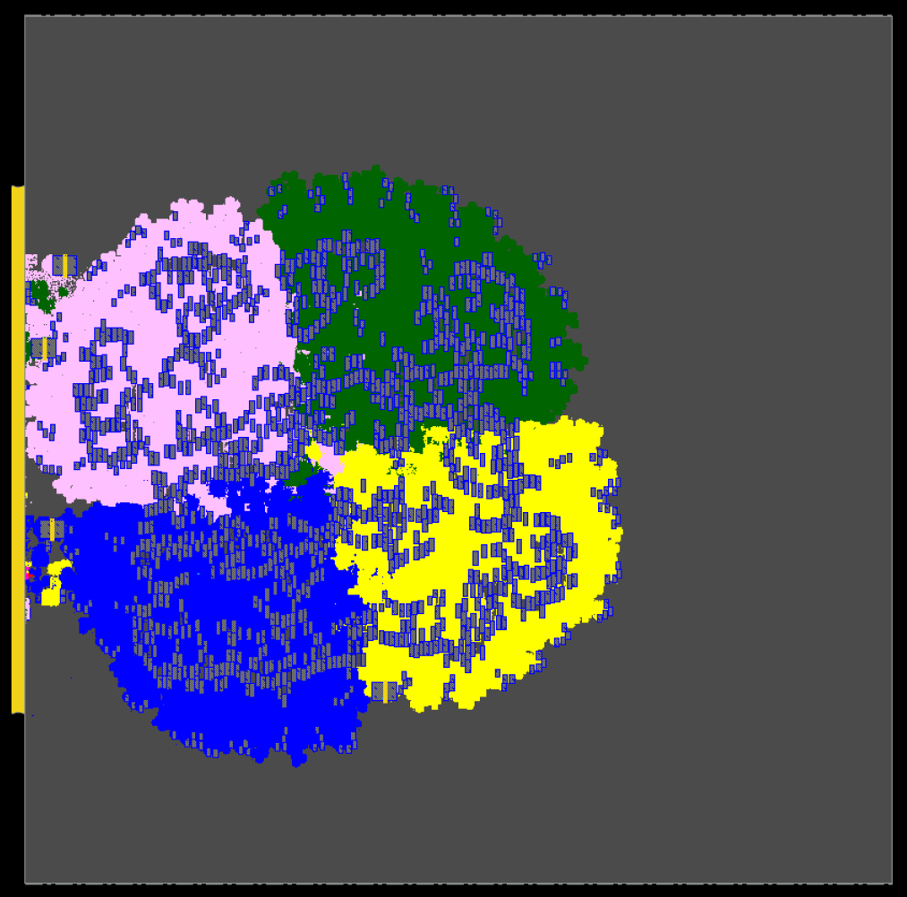
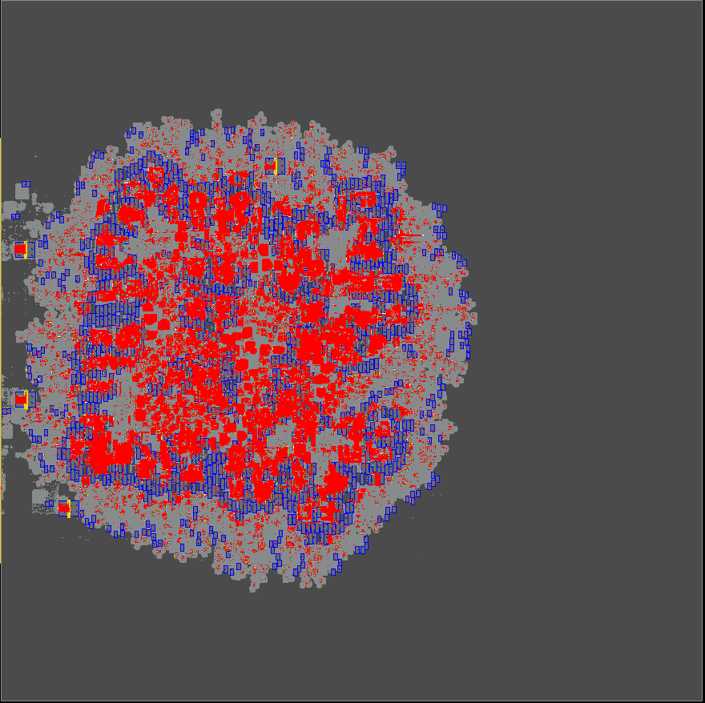
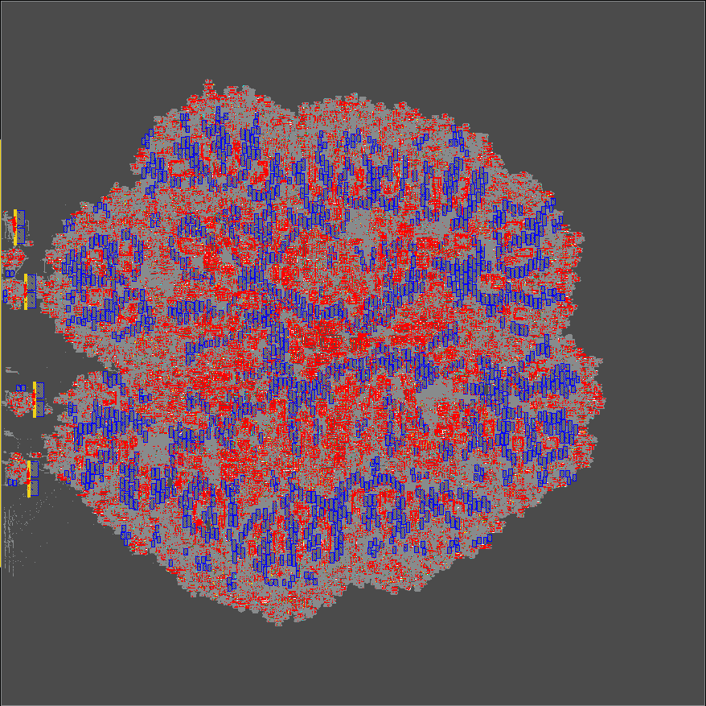
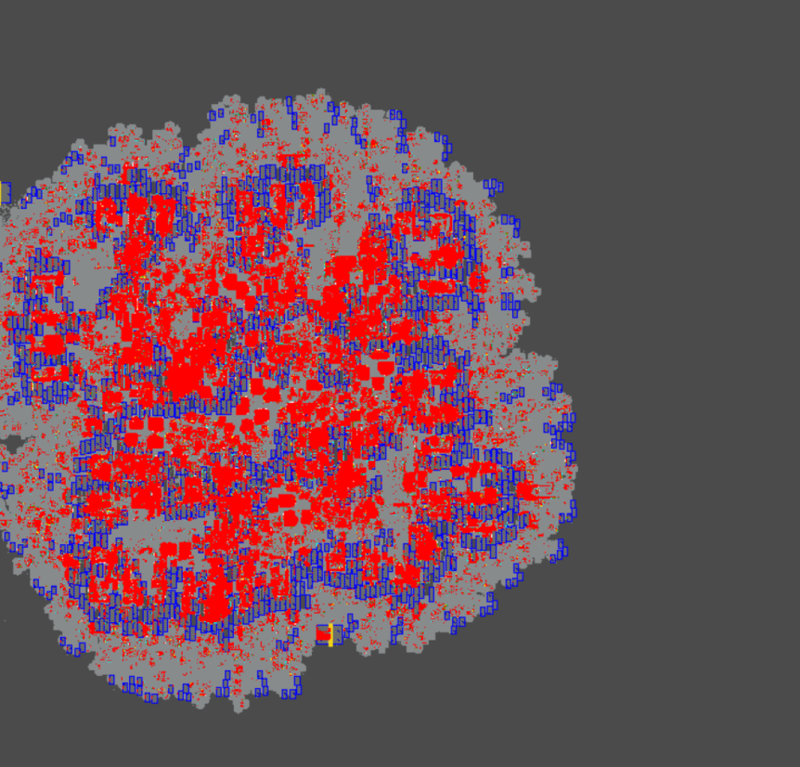
Dataflow-Driven GPU-Accelerated RePlAce
Global placer for large-scale IP blocks
Speed and scalability: > 30X speedup vs. RePlAce; 10M insts in 30 min
Quality: dataflow-driven, physical hierarchy aware placement
Accessibility: permissive open source, integrated in OpenROAD (coming)
Ease of use: OpenROAD flow or plug into commercial flow
RePlAce
Commercial
New
GP Runtime (s): 65381
HPWL/eGR WL (m): 325/404
GP Runtime (s): 24561
HPWL/eGR WL (m): 414/478
GP Runtime (s): 1808
HPWL/eGR WL (m): 327/407
Testcase: MemPool Cluster, ETH Zurich (9.5M cells, 1296 macros in NG45)
Notes:
This new global placer from UCSD is well-suited for large IP blocks, especially large-scale machine learning accelerators.
Speed and scalability come from GPU-acceleration and clustering.
Quality comes from dataflow and physical hierarchy awareness. This is permissive open-source that is currently being integrated into OpenROAD, and it plugs into commercial flows.
[CLICK] Here are results for the MemPool Cluster RISC-V design from ETH Zurich – the netlist has more than 9 million cells and nearly 1300 macros. OpenROAD’s RePlAce takes 18 hours to place this testcase, and a Commercial placer takes about 7 hours. Our new placer runs in half an hour, with reasonable congestion.

Slide 7
To Do: Fill in GPU-Accelerated PD Flow
→ and unleash ML !?
Physical Design Flow
Academic GPU-Accelerated Tools
RTL Simulation
RTLFlow [ICPP’22]
Logic Synthesis
CULS [DAC’23]
Macro Placement
AutoDMP [ISPD’23]
Global Placement
DREAMPlace [DAC’19] , Xplace [DAC’22]
Detailed Placement
ABCDPlace [TCAD’20]
Clock Tree Synthesis
Missing
Global Routing
GAMER [ICCAD’21], FastGR [DATE’22], GGR [ICCAD’22]
Detailed Routing
Missing
DRC Checker
OpenDRC [DAC’23]
STA Engine
[TCAD’23a], [TCAD’23b] (From Prof. Yibo Lin)
Design Closure, Opt
Missing
Notes:
Advanced SoCs can contain billions of instances, but P&R and optimization can take days even for a 2 million-instance block. Which forces a lot of physical hierarchy and problem decomposition.
We need to accelerate PD using the massive parallelism in GPUs – [CLICK] and this will help scale data and iterations in ML.
But in this inventory of academic works (from many people in this room), key gaps today include
[CLICK] Clock Tree Synthesis and [CLICK] Detailed Routing and [CLICK] final design closure and optimization – which today dominate the overall turnaround time.

Slide 8
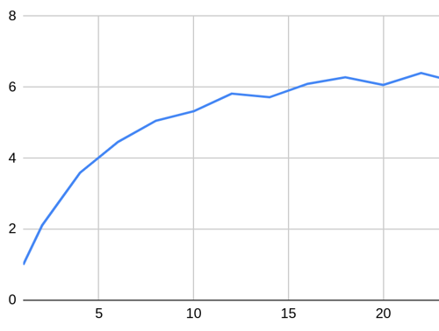
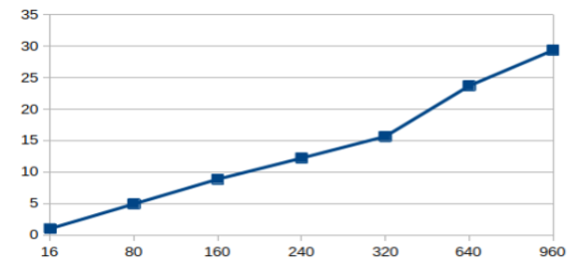
Cloud Deployment of Optimizers
Complements GPU acceleration; also a “low-hanging fruit”
Poor alignment with traditional EDA business models
Distributed incremental DR: ~100X speedup w/20 16-core workers
Cloud-based pin access analysis: 30X speedup
Speedup
Speedup
#16-CPU workers
#CPUs
Notes:
There’s also the CLOUD lever, which like GPU acceleration is a low-hanging fruit. Figure 5 of the paper shows how [CLICK] in OpenROAD, distributed incremental detailed routing gets a 100X speedup with 20 16-core workers. [CLICK] Or, pin access analysis takes two and a half minutes on the cloud, which is a 30X speedup over using a single machine.

Slide 9
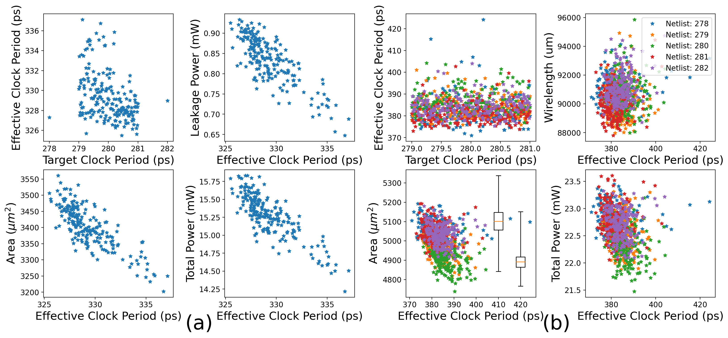
Chaos Demands Sampling (Example: GF12 AES)
Synthesis
P&R
Effective CP: 3.4%
Leakage Power: 38%
Effective CP: 15%
Wirelength: 9%
STD Cell Area: 11%
Total Power: 11%
STD Cell Area: 9%
Total Power: 9%
Notes:
This is Figure 6, showing Synthesis and P&R tool “chaos” for AES in GF12LP.
On the left, the synthesis SDC is stepped by 0.01ps to get 201 runs all within a 2ps range of target clock periods.
On the right, five netlists are taken into P&R, again with 201 runs per netlist, so there are a thousand and five P&R runs in the dataset.
[CLICK] This is the variation of metrics due to tool noise.
So before we can see ML success, we will need a mindset of sampling.

Slide 10
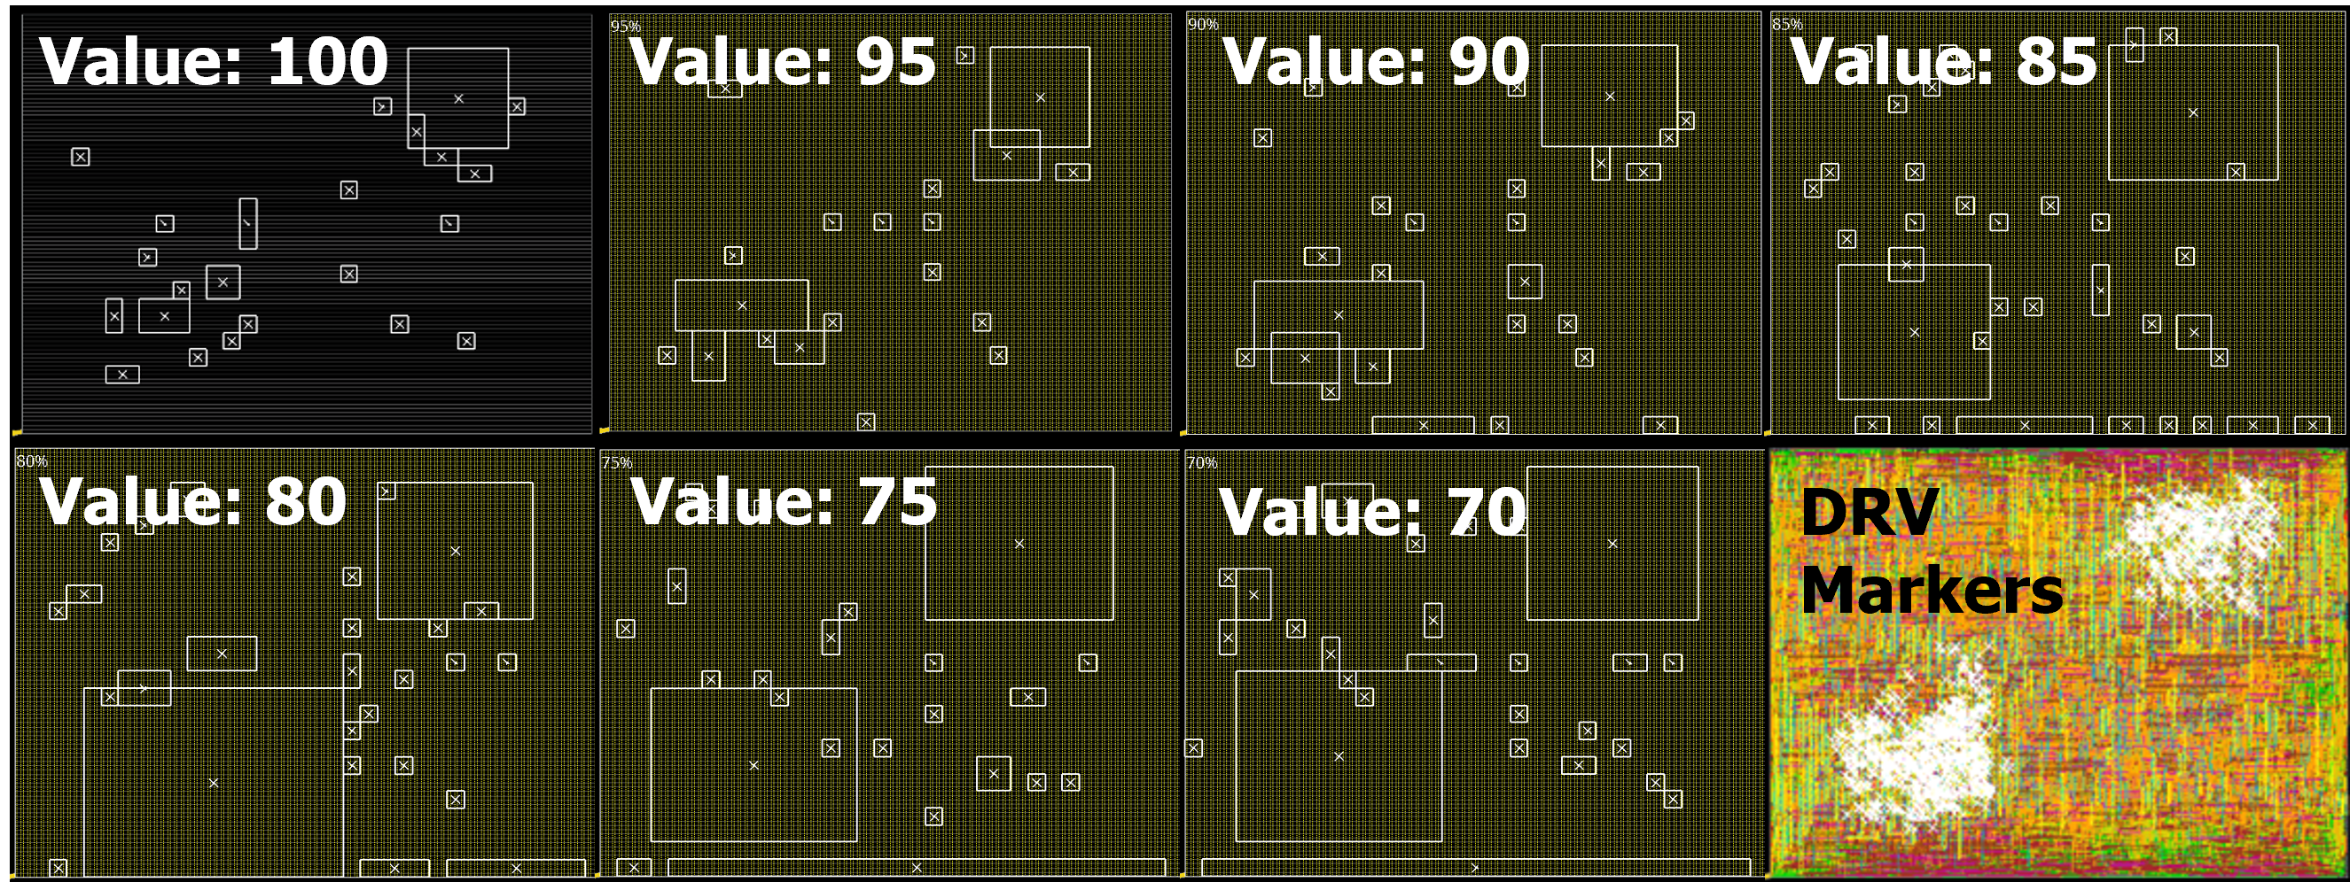
Multiple Views in Unit Time: Tomography
Congestion report using Innovus eGR
Varying partial density value of the routing blockage from 70 – 100
Union of congestion reports enables better ML-based alignment with actual DRC markers
Partial density = 75 is closest match to actual markers, in this case
Routing runtime = 1.5 hours; eGR runtime < 1 second
A. B. Kahng, 240124 ASP-DAC keynote
Notes:
Another mindset is: get more data and feed richer models, in the same runtime.
Here are seven congestion reports generated using Innovus eGR, each with a different partial density value for the routing blockage covering the design.
When partial density is 75, the congestion report aligns best with the actual DRC markers. But, using ALL the images enables better congestion / DRC hotspot prediction. We call this Tomography.

Slide 11
Section 3: Elements of a Next Wave
Generative AI
ML at Interstices
Notes:
Section 3 of the paper proposes some elements of a “Next Wave” for AI/ML in physical design.
Let me start with “Interstices”.

Slide 12
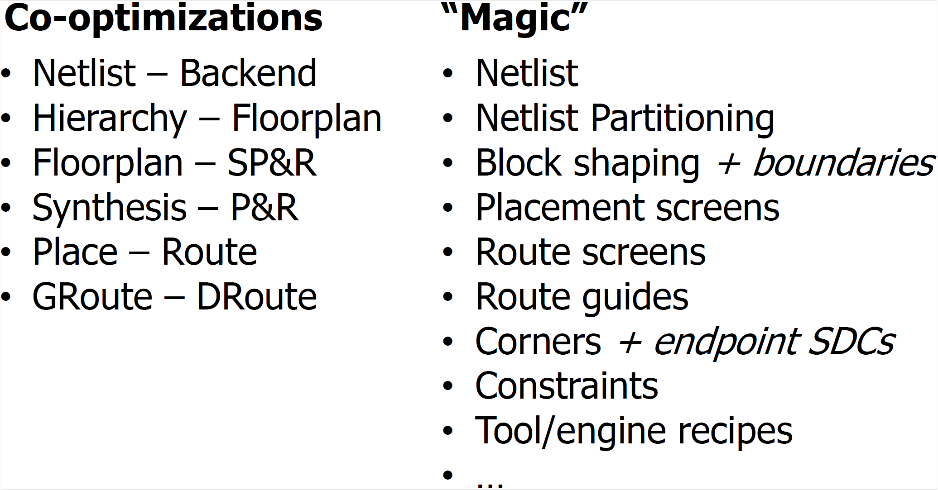
“Magic” at Interstices
Co-evolutions, Co-optimizations are often at arm’s length
Interstices = opportunities for “Conditioning Magic” via ML
Notes:
Over the years, I’ve talked about co-evolutions and co-optimizations, and I’ve also talked about ML “target lists” – including “magic” density screens or netlists. Like, there’s ONE netlist that comes into P&R – how can ML help us find “the magic netlist”?
The biggest opportunities for “magic” lie in what I call conditioning at the “arm’s length” interstices between flow stages and steps.

Slide 13
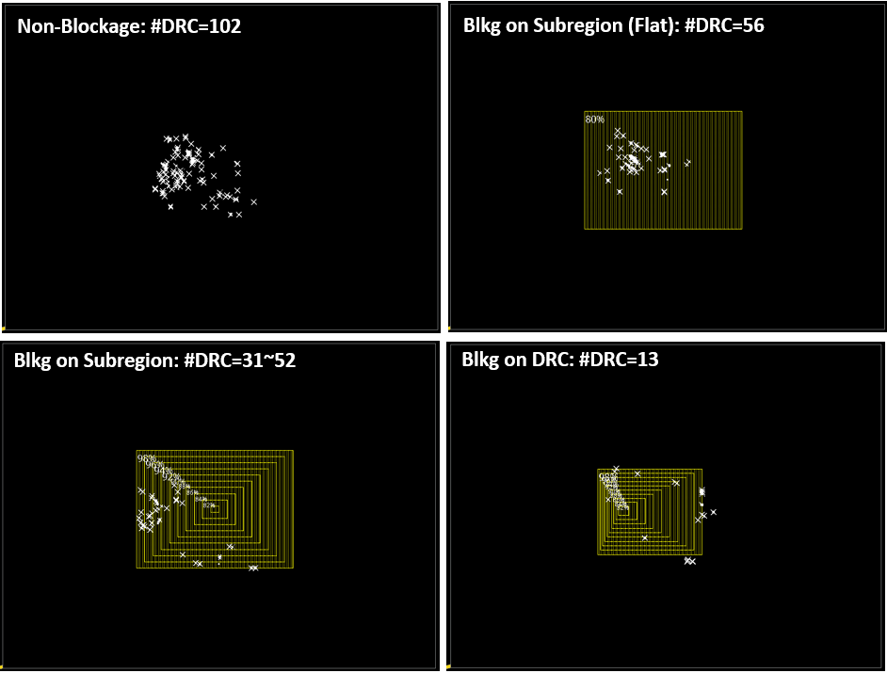
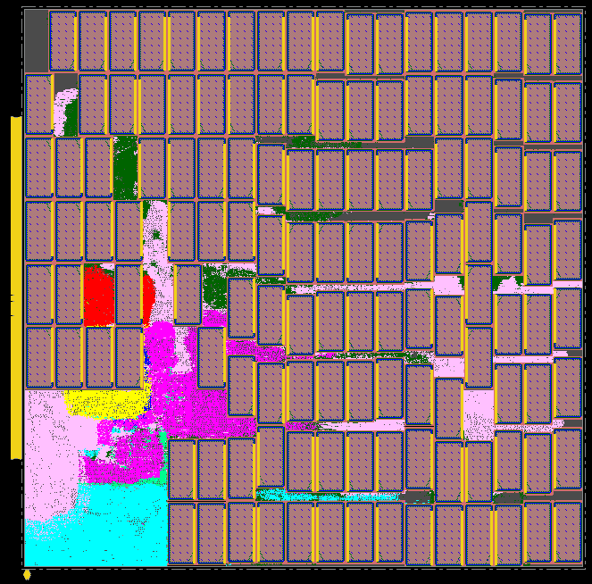
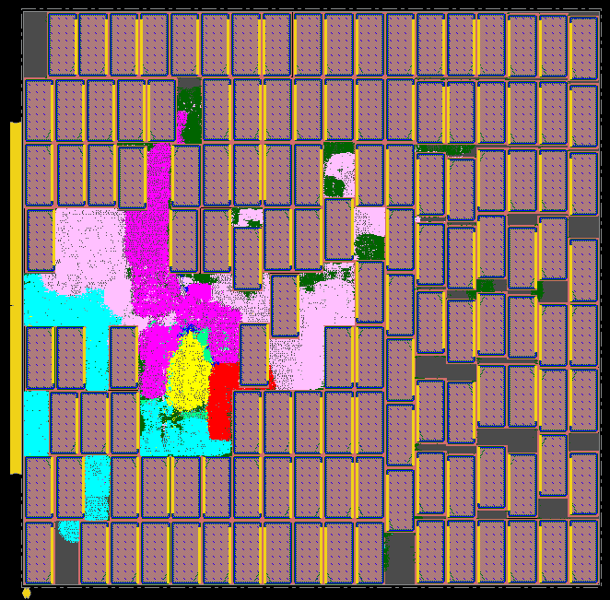
ML to Condition the PD Canvas
Can “condition” PD with target density, cell padding, placement and routing blockages, …
“Magic screens”: placement and routing blockages
ML goal: Find best settings for these knobs
Default
Target Density: 0.95
No Blockage: #DRC = 102
Flat Blkg: #DRC = 56
Conc. Blkg: #DRC = 31
ModConc. Blkg: #DRC = 13
Notes:
In PD, we condition the canvas for optimization, using target density, placement and routing blockages, and other knobs.
[CLICK] For example, conditioning with target density improves post-route-opt wirelength, power and timing metrics for Ariane in NanGate 45.
[CLICK] This picture shows conditioning with routing blockages: a default DRC count of 102 drops to 56 with what we call a flat routing blockage, to 31 with concentric blockage, and to 13 with a modified concentric blockage.
[CLICK] My group calls these routing and placement blockages “magic screens”, and we use ML – with input data such as from tomography – to predict best magic screens to reduce iterations and improve PPA.

Slide 14
Section 3: Elements of a Next Wave
Generative AI
ML at Interstices
Infrastructure for ML: platforms, proxies
Notes:
Another part of the “Next Wave” is solving the infrastructure problem.
After so many hundreds of academic papers – do we have a common research infrastructure for AI/ML in physical design? Standard testcases, PDKs, formats, naming, datasets, …?

Slide 15
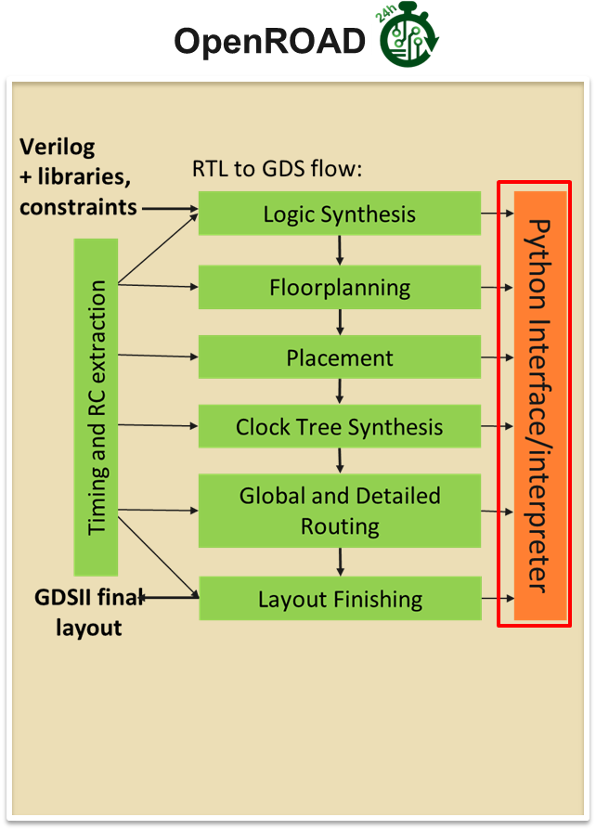
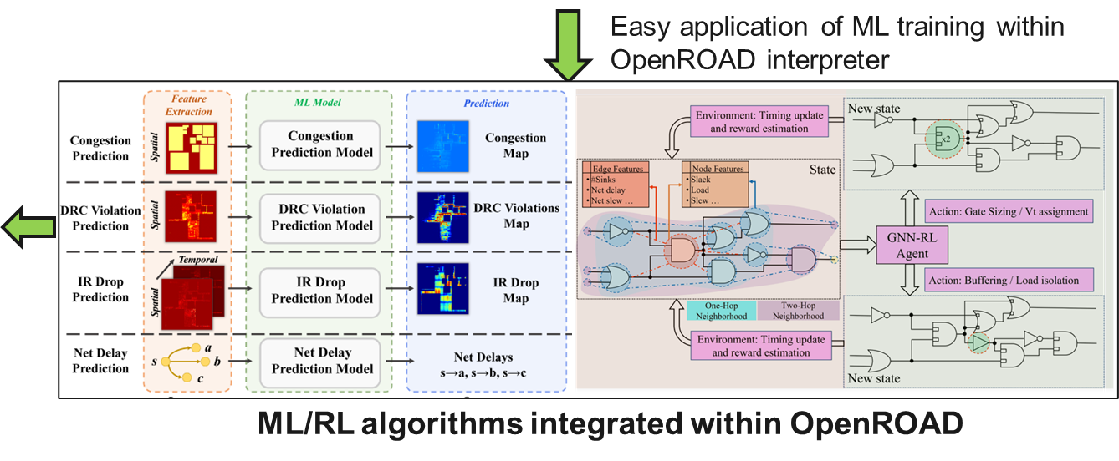
AI/ML for PD: Infrastructure https://github.com/NVlabs/CircuitOps
ASP-DAC 2024 Tutorial #8
https://github.com/ASU-VDA-Lab/ASP-DAC24-Tutorial
Notes:
Infrastructure for ML EDA must at a minimum have
[CLICK] Python APIs for faster data generation compared to typical TCL interfaces.
[CLICK] ML-ready Data Formats like NVIDIA’s CircuitOps, which models chip data as labeled property graphs, and uses pandas data frames to store graph properties as features. This connects ML algorithms to EDA infrastructure.
[CLICK] And more python APIs to enable results of ML inference to be integrated back into the database, giving a feedback path from ML back into the EDA platform.
[CLICK] You can see examples from this past January’s tutorial at ASP-DAC, at Vidya Chhabria’s GitHub.

Slide 16
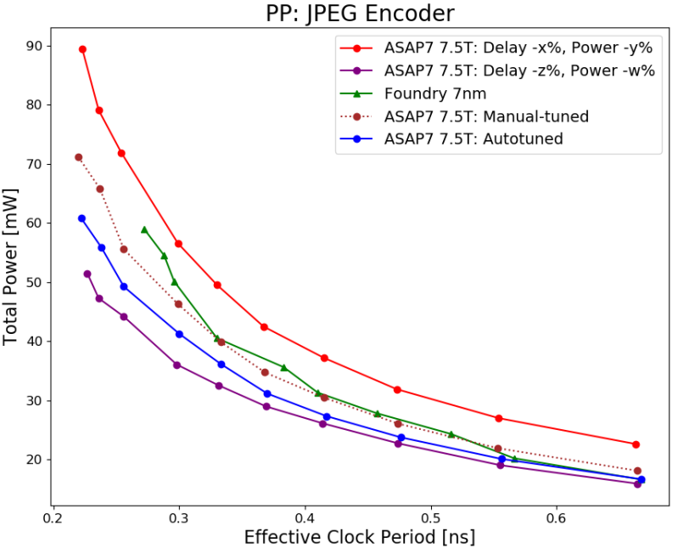
AI/ML and EDA: Data From Proxies
Mindset for AI/ML data: if it is not sharable, develop a proxy!
PDK: ASAP7/5 + scaling, autotuning
Power v. Effective CP hockey stick
Foundry 7nm in green
Red, purple bounds from simple scaling of ASAP7 delay, power
Autotuning (Ray/Tune) with (~11%) loss = MAPE of power, fmax errors at 10 target clock periods
Tuning parameters: delay, pin cap, internal/switching power, setup/hold …
Scripts are open-sourced in RDF-2023: https://github.com/ieee-ceda-datc/RDF-2023
Notes:
And because technology and design data are proprietary and so sensitive, the next wave must come from research with “proxies”. Can we make the design- and research-relevant characteristics of a source PDK MATCH the characteristics of a target PDK? Here, “Source” is ASAP7 and “Target” is a commercial 7nm technology. And the answer is yes, with autotuning of just a few scaling parameters.
The plot shows the Power versus Effective Clock Period “hockey stick” for ten target clock periods.
The foundry 7 nanometer hockey stick is in GREEN.
Simple scaling of ASAP7 delay and power gives the RED and PURPLE bounds around the GREEN.
[CLICK] Autotuning with a loss function of Mean Absolute Percentage Error across the 10 target clock periods yields the BLUE hockey stick.
[CLICK] Code and scripts are open-sourced in the IEEE CEDA DATC’s RDF-2023 GitHub.

Slide 17
Section 3: Elements of a Next Wave
Generative AI
ML at Interstices
Infrastructure for ML: platforms, proxies
Culture changes
Notes:
The last part of Section 3 talks about culture changes – and I’ll call out just one. You can probably guess which one.

Slide 18
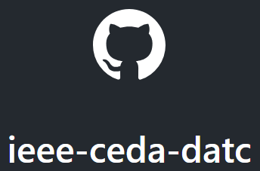
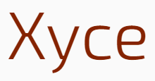
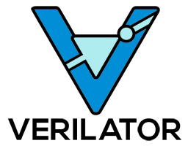
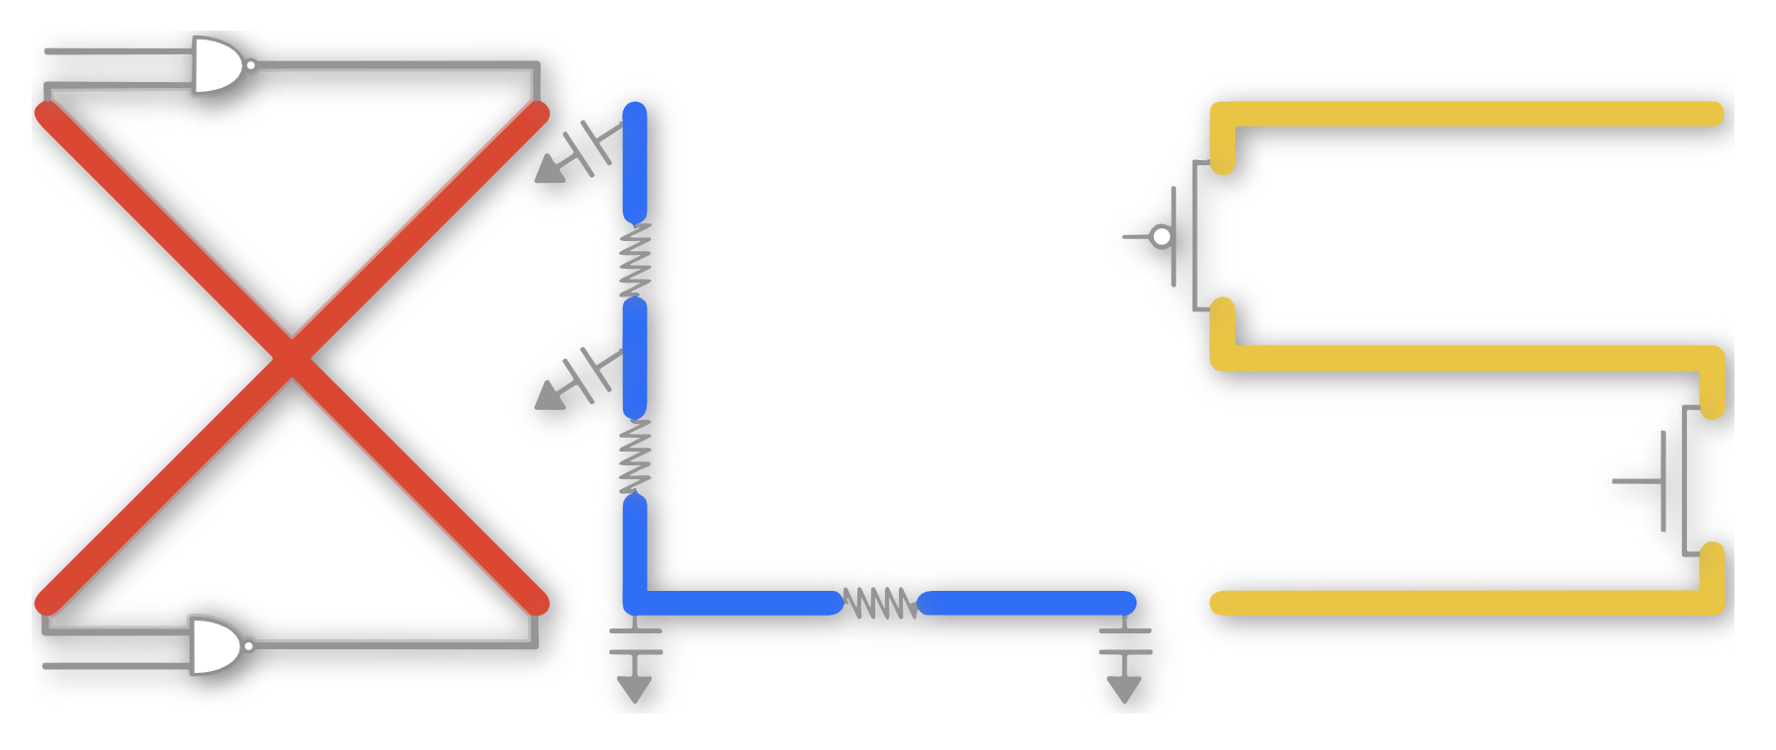
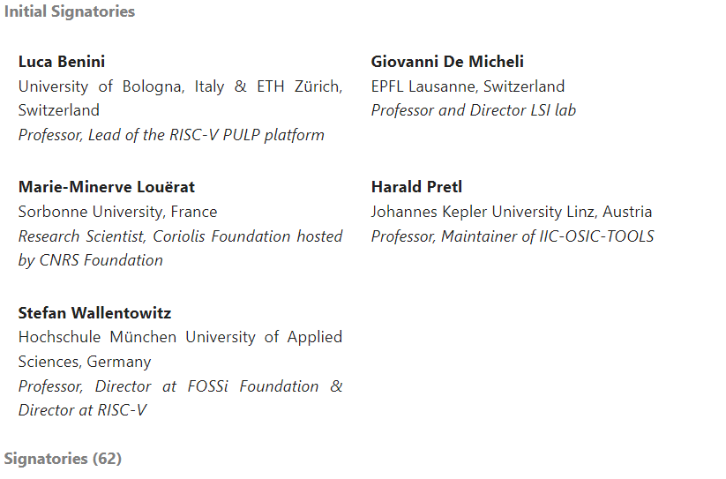
Opening Doors and Minds
“Next Wave of AI/ML in Physical Design” will be sparked by the accessibility, scale and velocity of open-source EDA (& more) !
https://open-source-eda-letter.eu/
Notes:
I am thrilled by the advance of open-source EDA tools and infrastructure in recent years – which has been led by the physical design community. iEDA and iPD, Evangeline’s lab at CUHK – these are very inspiring efforts. [CLICK] With full visibility into code and knobs, with proxy enablements and standard metrics and infrastructure -- we can apply ML both IN *and* AROUND these open-source engines, tools and flows.
[CLICK] And the momentum is growing – this open letter in Europe is from last Friday.

Slide 19
Thank You For Watching !
I look forward to seeing you soon in Taipei !
Acknowledgments: Many thanks to Sayak Kundu, Bodhisatta Pramanik, Zhiang Wang and Dooseok Yoon for their help with the figures and text in this paper. Discussions with Siddhartha Nath, Igor Markov, Chuck Alpert and Ilgweon Kang are also gratefully acknowledged. Research at UCSD is partially supported by DARPA, Samsung, the C-DEN center, and gifts from Google, Intel and others.
Notes:
There’s much more in the paper, and I look forward to your feedback and questions in Taipei. Thank you for watching!

