Slide 1
An Open-Source Constraints-Driven General Partitioning Multi-Tool for
VLSI Physical Design
Ismail Bustany^{[1]}, Grigor Gasparyan^{[1]}, Andrew B. Kahng,
Ioannis Koutis^{[2]}, Bodhisatta Pramanik
and Zhiang Wang
University of California San Diego
[1] Advanced Micro Devices
[2] New Jersey Institute of Technology
Notes:
Hi everyone.
Here is the topic of my presentation “An Open-Source Constraints Driven General Partitioning Multi-Tool for VLSI Physical Design”.
[CLICK]

Slide 2
Overview
TritonPart: open-source replacement for hMETIS in all contexts
  Integrated with OpenROAD
  GitHub: https://github.com/The-OpenROAD-Project/OpenROAD/tree/master/src/par
Key features
  Real-valued + multi-dimensional vertex weights and balance constraints
  e.g., satisfy multi-FPGA balance
  Community constraints: groups of vertices that stay together during partitioning
  e.g., keep macros and their direct fanins/fanouts together
  Multi-way partitioning
  Embedding-aware partitioning e.g., placement coordinates
  Timing-driven partitioning e.g., minimize cuts on critical paths
  Slack propagation methodology
Key results
  Improvements over hMETIS up to ~20% on some benchmarks
  ~21X reduction of cuts on timing-critical paths compared to hMETIS and KaHyPar
Notes:
Here is a quick overview of our work.
We are introducing TritonPart that serves as an open-source replacement for hMETIS in all contexts.
The code is integrated with OpenROAD and available on GitHub.
[CLICK]
Here are some key features:
Real valued multi-dimensional vertex weights and balance constraints ,
Community constraints,
Multi-way partitioning,
Embedding-aware partitioning and Timing driven partitioning
We also propose a novel slack propagation methodology
[CLICK]
Here are some key results:
TritonPart achieves upto 20% improvement over hMETIS on some benchmarks
And achieves around 21X reduction in cuts on timing-critical paths compared to other partitioners.
[CLICK]

Slide 3
Outline
Background and motivation
  Hypergraph partitioning
  Modern VLSI partitioning
TritonPart framework
  Constrained and Timing-driven clustering
  Initial partitioning
  Multilevel and Timing-driven refinement
Experimental setup and results
Conclusion and future directions
Notes:
Here is the outline of my presentation.
I will start with some background and motivation and then move on to talk about the TritonPart framework.
Here I will talk about the three key components of our framework:
Constrained and timing-driven clustering, initial partitioning and multilevel and timing-driven refinement.
Then I will present our experimental setup and results and end my talk with conclusion and future directions.
Let’s start with the background and motivation.
[CLICK]

Slide 4
Hypergraph partitioning
Given a hypergraph, divide the vertices into disjoint blocks
  Optimize a cost function
  Satisfy constraints
Classical balanced min-cut problem!
Properties | Classical hypergraph partitioning | General hypergraph partitioning
Vertex weights | Scalar | Vector
Hyperedge weights | Scalar | Vector
Weights type | Integer | Real
Constraints | Balance | Modern constraints
Cost objective | Min-cut | Any cost function
Available partitioners | hMETIS, KaHyPar, SpecPart, BiPart | TritonPart this work (!)
Notes:
We are given a hypergraph that is a netlist and the objective is to divide the vertices of the hypergraph into disjoint blocks while optimizing a cost function under some constraints.
The table here shows the differences between classical and general hypergraph partitioning problem.
[CLICK] The vertex and hyperedge weights in the general problem are real-valued vectors as opposed to integer scalar values for the classical type.
[CLICK] The general problem accommodates a wide variety of constraints apart from balance.
[CLICK] In the general problem the objective can be any cost function not just min-cut.
In other words, the classical problem is the popular balanced min-cut problem.
[CLICK] Majority of literature have focused on solving the classical hypergraph partitioning.
[CLICK] and to the best of our knowledge TritonPart is the first partitioner to solve the general hypergraph partitioning problem.
[CLICK]

Slide 5
Modern VLSI partitioning
Multi-dimensional balance
  Multi-dimensional vertex weights → multi-dimensional block weights
  Satisfy balance for each dimension of block weight
Fixed vertices
  Some vertices preassigned to certain blocks
Grouping
  Vertices in the same group should end up in the same block
Embedding guidance
  Vertices closer in the embedding are more likely to be in the same block
Timing
  Minimize cuts on timing-critical paths, prevent timing-noncritical paths
  from becoming critical, etc.
Not handled by the SOTA + we want an open research foundation !
Notes:
But let’s first talk about modern VLSI partitioning that involves several constraints and additional problem formulations.
First we can have the multi-dimensional balance constraint. Here multiple vertex types are modelled as multi-dimensional vertex weights. Then the balance of a block of partition must be satisfied for each dimension.
[CLICK]
Next we can have fixed vertices where some vertices are preassigned to certain blocks.
In grouping constraints, we assign some vertices to certain groups and all vertices in the same group should belong to the same block.
Next is embedding. These can be based on placement coordinates. Vertices close in the embedding are more likely to be in the same block.
[CLICK]
Finally we can optimize timing by minimizing cuts on timing-critical paths, preventing timing-noncritical paths from becoming critical or optimizing a timing cost function.
[CLICK]
These requirements are not handled by state-of-the-art partitioners. This forms the foundation of our motivation plus the fact that we want an open research foundation that leads to further developments in partitioning.
[CLICK]

Slide 6
Outline
Background and motivation
  Hypergraph partitioning
  Modern VLSI partitioning
TritonPart framework
  Constrained and Timing-driven clustering
  Initial partitioning
  Multilevel and Timing-driven refinement
Experimental setup and results
Conclusion and future directions
Notes:
Now I will talk about our TritonPart framework.
[CLICK]

Slide 7
TritonPart framework
Hypergraph/netlist, imbalance factor, #blocks, cost function
Fixed, grouping, timing, embedding
Timing info
OpenSTA
Primary inputs
Optional inputs
Multilevel constrained clustering
First-Choice clustering
Constraints-aware
Embedding guidance
Timing-driven
Initial partitioning
Random, VILE, ILP
Multi-dimensional balance
Enhanced multilevel refinement
K-way FM
Pairwise K-way FM
Greedy refinement (HER)
Cut-overlay
Slack propagation (timing)
Output partition
Notes:
Here is the overall framework of TritonPart.
[CLICK]
The primary inputs are a hypergraph or a netlist, with an imbalance factor, number of blocks, and a cost function.
The optional inputs are the various constraints. For timing optimization we use the OpenSTA timer to extract timing information.
[CLICK]
The first step in our framework is the multilevel constrained clustering that generates a multilevel hierarchy of successively coarser hypergraphs.
Here we leverage the First-Choice clustering algorithm with enhancements.
Next we run partitioning of the coarsest hypergraph.
Finally, we run our enhanced multilevel refinement. Here we use several type of refinement methods as shown here on the right
[CLICK].
[CLICK]

Slide 8


Constrained clustering
Multilevel Constrained Clustering
Initial Partitioning
Enhanced Multilevel Refinement
Multilevel clustering paradigm (similar to hMETIS + enhancements) Section III.A
First-Choice (FC) clustering
  Generate vertex ordering
  For each vertex $v$ in the order:
    Find neighbors of $v$
    Cluster $v$ with neighbor $u$ having
    highest connectivity score
Fixed vertex constraints
  All fixed vertices in same block are merged into
  single cluster
Grouping constraints
  All vertices belonging to same group are merged into
  single cluster
Embedding guidance
  Leverage embedding score + connectivity score
  during FC clustering
  After clustering, set cluster coordinate to the
  center of gravity of all vertices in the cluster
Connectivity score ($u, v$) = $\sum_{e∈\{I\left(v\right)∩I\left(u\right)\}}{\frac{⟨α, w_{e}⟩}{\left|e\right|−1}}$
$I\left(v\right):$Set of hyperedges incident to a vertex $v$
$w_{e}:$ Hyperedge weight vector
$α:$Scaling factors vector
Embedding score ($u, v$) = $ρ\frac{1}{{\left|\left|X_{u}−X_{v}\right|\right|}_{2}}$
$X_{v}:$Embedding of vertex $v$
$ρ:$Normalization factor
Notes:
Now I describe the key components of our TritonPart framework starting with the constrained clustering.
We use the multilevel clustering paradigm (similar to hMETIS) but with enhancements.
[CLICK]
Our clustering algorithm is First Choice, briefly described here.
In First-Choice, we traverse vertices based on an ordering and cluster them based on higher connectivity scores.
[CLICK]
The connectivity score definition is shown here on the right. Vertices sharing strong connectivity are assigned a larger connectivity score.
[CLICK]
We handle fixed constraints by merging fixed vertices in the same block into a single cluster.
[CLICK]
We handle grouping constraints by merging vertices in the same group into a single cluster.
[CLICK]
For embedding we use an embedding score shown here on the right.
Vertices that are close in the embedding are assigned a larger embedding score.
After clustering we set the new coordinates of the cluster to the center of gravity of all vertices in that cluster.
[CLICK]

Slide 9
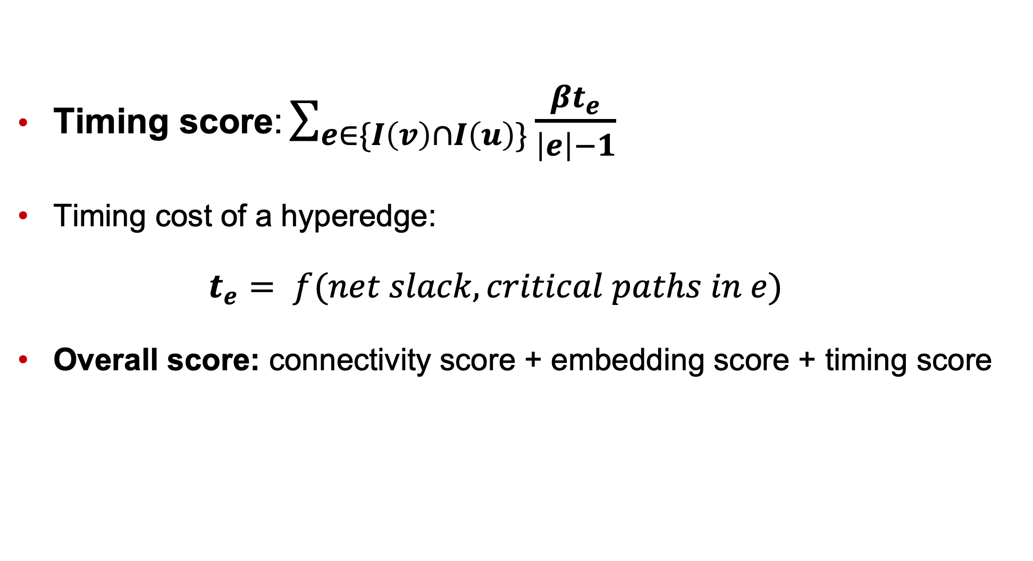
Timing-driven clustering
Multilevel Constrained Clustering
Initial Partitioning
Enhanced Multilevel Refinement
Timing score: $\sum_{e∈\{I\left(v\right)∩I\left(u\right)\}}{\frac{βt_{e}}{\left|e\right|−1}}$
Timing cost of a hyperedge:
  $$t_{e}= f(net slack, critical paths in e)$$
Overall score: connectivity score + embedding score + timing score
We obtain net slacks and critical paths from the OpenSTA timer
We use this score for clustering in TritonPart
Notes:
Here is how we handle timing during clustering.
The key idea is that vertices incident on multiple critical paths should be merged into the same cluster to avoid cutting those paths.
To incentivize this, we introduce a timing score for clustering
[CLICK].
T_e is the timing cost of cutting a hyperedge and it is a function of the net slack and the critical paths traversing the hyperedge.
A pair of vertices that share multiple critical hyperedges or share many critical paths will have a large timing score.
[CLICK]
The overall clustering score we use in our TritonPart framework is a combination
of connectivity, embedding and timing.
[CLICK]

Slide 10
Initial partitioning
Multilevel Constrained Clustering
Initial Partitioning
Enhanced Multilevel Refinement
Partitioning of coarsest hypergraph in the multilevel hierarchy Section III.B of paper
  Random: Randomly assign vertices to blocks
  VILE: Generate imbalanced partitions (from [5])
  ILP: Solve ILP instance of the partitioning problem
    Optimize cutsize only
    Run if #vertices < 50
Notes:
After clustering we do initial partitioning and multilevel refinement.
For initial partitioning, we use a random partitioning, a VILE, a very illegal imbalanced partitioning and an ILP. For ILP we only optimize the cutisze and run if the number of vertices is less than 50.
For more details on VILE you can check the reference
[CLICK]
from our paper.
[CLICK]

Slide 11
Multilevel refinement
Multilevel Constrained Clustering
Initial Partitioning
Enhanced Multilevel Refinement
Uncoarsen and refine partition along the multilevel hierarchy Section III.C of paper
  K-way pairwise FM (PM): Pairwise-restricted K-way FM
  (from [9])
  Direct K-way FM
  Greedy hyperedge refinement (HER): Move groups of vertices belonging to cut hyperedges
  Cut-overlay clustering (From SpecPart)
  Above methods are applied in sequence
Notes:
For multilevel refinement, we use a K-way pairwise FM which is a restricted version of the direct K-way FM.
In addition we use the direct K-way FM and the hMETIS-based HER refinement.
We also we use a cut-overlay clustering methodology borrowed from SpecPart.
All the above refinement methods are applied in sequence.
For more details on these you can check the references from our paper [CLICK].
[CLICK]

Slide 12
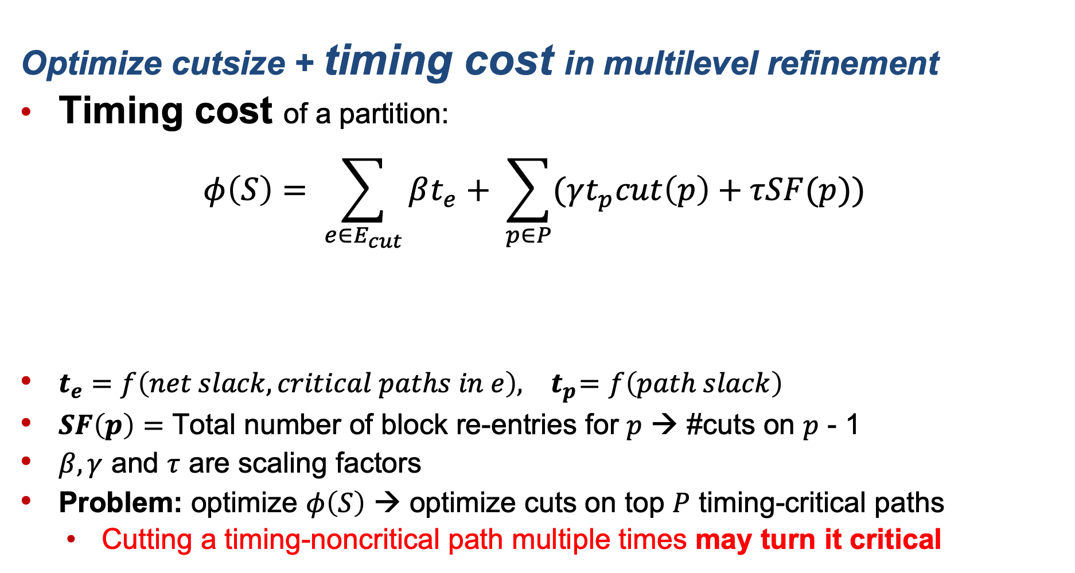
Timing-driven refinement
Multilevel Constrained Clustering
Initial Partitioning
Enhanced Multilevel Refinement
Optimize cutsize + timing cost in multilevel refinement
Timing cost of a partition:
$$φ\left(S\right)= \sum_{e∈E_{cut}}{βt_{e}+ \sum_{p∈P}{(γt_{p}cut\left(p\right)+τSF(p))} }$$
$t_{e}=f\left(net slack, critical paths in e\right), { t}_{p}=f\left(path slack\right)$
$SF\left(p\right)=$ Total number of block re-entries for $p$ → #cuts on $p$ - 1
$β, γ$ and $τ$ are scaling factors
Problem: optimize $φ\left(S\right)$ → optimize cuts on top $P$ timing-critical paths
  Cutting a timing-noncritical path multiple times may turn it critical
Snaking factors cost
Timing cost of cutting hyperedges
Timing cost of cutting timing paths
Notes:
We consider timing in our refinement by optimizing a timing cost in addition to the cutsize.
Our timing cost has three components:
[CLICK]
timing cost of cutting hyperedges,
[CLICK]
cutting timing paths and
[CLICK]
the snaking factor.
T_e in the 1st component of the equation is a function of net slack and critical paths traversing the hyperedge e.
T_p in the 2nd component of the equation is a function of path slack.
SF(p) in the 3rd component is the snaking factor i.e. the number of times a path zigzags its way through different blocks of partition.
[CLICK]
While optimizing this timing cost function will optimize cuts on the top P timing critical paths, there is a limitation with this approach.
During the course of multilevel refinement timing-noncritical paths may become critical.
The challenge is how to handle such cases.
[CLICK]

Slide 13
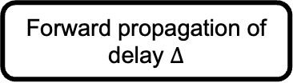





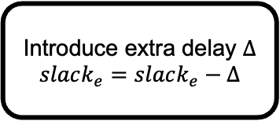


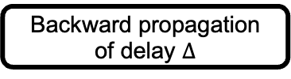
Slack propagation
Multilevel Constrained Clustering
Initial Partitioning
Enhanced Multilevel Refinement
Idea: introduce delay for a cut hyperedge + update slacks of all paths affected by delay → slack propagation
$E_{cut}:$ Cut hyperedges, $slack_{p}:$ Slack of path $p$, $t_{p}:$ timing cost of a path,
$t_{e}$: timing cost of a hyperedge
Perform slack propagation after every FM pass; we set $Δ$ to 20% of clock period
Introduce extra delay $Δ$
$$slack_{e}=slack_{e}−Δ$$
Find all paths traversing $e$
$$E_{cut}$$
Cut hyperedge $e$
$$P_{e}$$
Propagation
Update slack of all timing paths
Forward propagation of delay $Δ$
Timing path $p$
Backward propagation of delay $Δ$
Update $t_{p}, t_{e}$
Slack propagation methodology
Notes:
The solution that we propose is a new slack propagation methodology.
The idea is to introduce a fixed delay every time a hyperedge is cut and update slacks of all paths affected by the introduced delay.
This way we can manage the noncritical timing paths from turning critical by adjusting their timing costs during multilevel refinement.
The input to the slack propagation framework starts with the list of cut hyperedges.
[CLICK]
Then for each cut hyperedge we introduce delay delta and reduce the slack.
[CLICK]
Then we look at all paths traversing the hyperedge and propagate the delay forward and backward on the hypergraph.
[CLICK]
Finally, we update the slacks of all timing paths and then update all timing costs.
For computational reasons, we only run slack propagation after every FM pass and set delta to 20% of the clock period of the design.
[CLICK]

Slide 14
Outline
Background and motivation
  Hypergraph partitioning
  Modern VLSI partitioning
TritonPart framework
  Constrained and Timing-driven clustering
  Initial partitioning
  Multilevel and Timing-driven refinement
Experimental setup and results
Conclusion and future directions
Notes:
Now I will talk about experimental setup and results
[CLICK]

Slide 15
Results for classical hypergraph partitioning
Benchmarks: Titan23 Murray et al. 2013
Previous state-of-the-art: hMETIS, KaHyPar, SpecPart
Two-way, three-way, four-way cutsize presented
On average 4.5% better than hMETIS and 1% better than SpecPart
(for all benchmarks)
On average. 8% better than hMETIS
(for all benchmarks)
Two-way
Three-way
Four-way
Titan23 | hMETIS | SpecPart | TritonPart | hMETIS | TritonPart | hMETIS | TritonPart
stap_qrd | 377 | 464 | 370 | 501 | 467 | 715 | 696
gsm_switch | 4235 | 1833 | 1483 | 4149 | 2446 | 5169 | 2813
LU230 | 3334 | 3363 | 3314 | 4550 | 4498 | 6235 | 5591
bitcoin_miner | 1514 | 1562 | 1492 | 1945 | 1879 | 2605 | 1860
bitonic_mesh | 585 | 585 | 582 | 895 | 898 | 1304 | 1123
2% imbalance
Best of 20 runs (averaged over 50 samples)
Notes:
First I show results of TritonPart for the classical hypergraph partitioning problem.
The benchmarks we use are the Titan23 FPGA benchmarks available in hypergraph format.
We compare results with previous state-of-the-art hMETIS, KaHyPar and SpecPart.
[CLICK]
Here are the results for 2-way, 3-way and 4-way cutsizes with 2% imbalance and cutsizes averaged over 50 samples.
We find that TritonPart generates better cutsizes compared to the state-of-the-art.
For gsm_switch in particular, [CLICK] shown in the red box, we generate significant improvement.
[CLICK]

Slide 16
Cutsizes with embedding guidance
Generate two-dimensional embedding from SpecPart
On average ~11%, ~2%, ~8% better than hMETIS, SpecPart and embedding-unaware TritonPart for presented benchmarks
Results for SpecPart are from a single run
Two-way cutsizes
Titan23 | hMETIS | SpecPart | TritonPart | TritonPart_{emb}
dart | 837 | 805 | 835 | 784
denoise | 497 | 418 | 454 | 416
sparcT1_chip2 | 914 | 876 | 997 | 877
directrf | 603 | 515 | 526 | 493
2% imbalance
Best of 20 runs (averaged over 50 samples)
Notes:
Next I show results with embeddings.
For this experiment we generate a two dimensional using SpecPart.
Then we run TritonPart with this embedding and present cutsizes on some Titan23 benchmarks and compare with hMETIS, SpecPart and TritonPart with no embedding.
Here are the results for two-way cutsizes with a 2% imbalance.
We find that with the embedding information, TritonPart can generate even better quality cutsizes.
[CLICK]
For sparcT1_chip2 for example, shown in the red box, we observe significant improvement with embedding guided TritonPart
[CLICK]

Slide 17
Metrics for timing-driven partitioning
Metric 1: Cuts on timing-critical paths
  Average #cuts on each timing critical path
  Max. #cuts on any timing critical path
Metric 2: Cuts on timing-noncritical paths that have turned critical
  Total number of such paths
  Average number of cuts on each path
Top 100000 paths extracted using OpenSTA timer
Comparison baselines: hMETIS, KaHyPar, TritonPart with timing-driven feature disabled (timing-reweighted hypergraph as input)
Benchmarks: Modern benchmarks from the MacroPlacement repo.
  E.g., Mempool Group has ~2.7M instances (361K FFs, 324 macros)
Notes:
Next we show results of timing-driven partitioning
But before that we establish some metrics we use for evaluation.
The first metric we use is cuts on timing-critical paths.
Here we consider the average number of cuts on each path and maximum number of cut on any timing critical path.
The second metric is cuts on timing-noncritical paths that have turned critical.
Here we consider the number of such paths and the average number of cuts on each new timing-critical path.
[CLICK]
In all our experiments we extract the top 100000 paths from OpenSTA and our baselines are hMETIS, KaHyPar and timing-unaware TritonPart.
To make a fair comparison we use a timing reweighted hypergraph and use that as an input for the other partitioners.
The benchmarks we consider are from the MacroPlacement repository that has some large designs such as the Mempool group.
[CLICK]

Slide 18

Results for timing-driven partitioning (cont’d)
Delay $Δ$ for each cut: 20% of clock period
Evaluation of cuts on timing-critical paths
Evaluation of cuts on timing-noncritical paths
Average cuts
Worst cut
Design | hM | KHPr | TPart | TPart_{t} | hM | KHPr | TPart | TPart_{t}
BlackParrot (GF12) | 0.13 | 0.29 | 0.66 | 0.06 | 1 | 1 | 3 | 1
MemPool-G (GF12) | 0.03 | 0.21 | 0.19 | 0.00 | 2 | 5 | 2 | 0
Number of paths that turn critical
Average cuts
Design | hM | KHPr | TPart | TPart_{t} | hM | KHPr | Tpart | Tpart_{t}
BlackParrot (GF12) | 13954 | 15511 | 21752 | 786 | 1.38 | 1.09 | 1.40 | 1.01
MemPool-G (GF12) | 2084 | 11553 | 6441 | 97 | 1.86 | 2.01 | 1.32 | 1.00
Notes:
Here are the results.
First I present results using metric 1.
[CLICK]
Here we find that with timing-aware TritonPart cuts almost negligible critical paths compared to other baselines.
[CLICK]
For mempool group shown in the red box, we cut through no timing critical path.
[CLICK]
For metric 2, we find that the number of timing-noncritical paths that turned critical are very low compared to other baselines.
[CLICK]
For mempool group we get significant reduction in timing-noncritical paths.
More detailed results are available in our paper.
These results show the benefits of our timing-driven features and our slack propagation methodology.
[CLICK]

Slide 19
Outline
Background and motivation
  Hypergraph partitioning
  Modern VLSI partitioning
TritonPart framework
  Constrained and Timing-driven clustering
  Initial partitioning
  Multilevel and Timing-driven refinement
Experimental setup and results
Conclusion and future directions
Notes:
Now I will talk about our conclusions and future directions
[CLICK]

Slide 20
Conclusion and future directions
Conclusion:
  We proposed TritonPart, the first constraints-driven general partitioner for VLSI physical design
  21st century features (constraints + timing + embedding)
  Novel slack propagation methodology
  All codes and scripts on OpenROAD https://github.com/The-OpenROAD-Project/OpenROAD/tree/master/src/par
Future directions:
  Improvement of core hypergraph partitioning framework
    Usage of GNNs/HNNs
  Improvement of core timing-driven framework
    Usage of accurate delay budgeting
  Spatial arrangement-aware partitioning framework
    Extension to 3D partitioning
  Runtime speedup (currently ~2.4X hMETIS runtime)
Notes:
We have described the general hypergraph partitioning problem and proposed TritonPart to handle the problem.
TritonPart is the first constraints-driven general partitioner for VLSI physical design.
Our framework incorporates modern constraints and features such as timing and embedding.
We also proposed a novel slack propagation methodology and our codes and scripts are available on OpenROAD.
For future directions, [CLICK]
We are planning to improve our core hypergraph partitioning framework through usage of embeddings from GNNs/HNNs.
For improving the timing-driven framework, we can leverage more accurate delay budgeting-based methods.
Finally, a spatial arrangement aware partitioning framework could be beneficial to 3D partitioning and multi-FPGA implementation where blocks are known to be configured in various arrangements.
Finally, it would be good to accelerate the implementation.
For further details about TritonPart, please come visit me at my poster.
This completes my talk and I am open for questions. Thank you.

