Slide 1

IEEE CEDA DATC: Emerging Foundations in IC Physical Design and MLCAD Research
Jinwook Jung², Andrew B. Kahng¹, Sayak Kundu¹, Zhiang Wang¹,
and Dooseok Yoon¹
¹UCSD, ²IBM Research
October 31, 2023
Notes:
Hello, my name is Jinwook Jung, and I am from IBM Research.
Today, I am going to present our invited paper, “IEEE CEDA DATC, Emerging Foundations in IC Physical Design and MLCAD Research ”
The paper was written with my coauthors at UCSD, Prof. Andrew Kahng, Sayak Kundu, Zhiang Wang, and Dooseok Yoon.

Slide 2

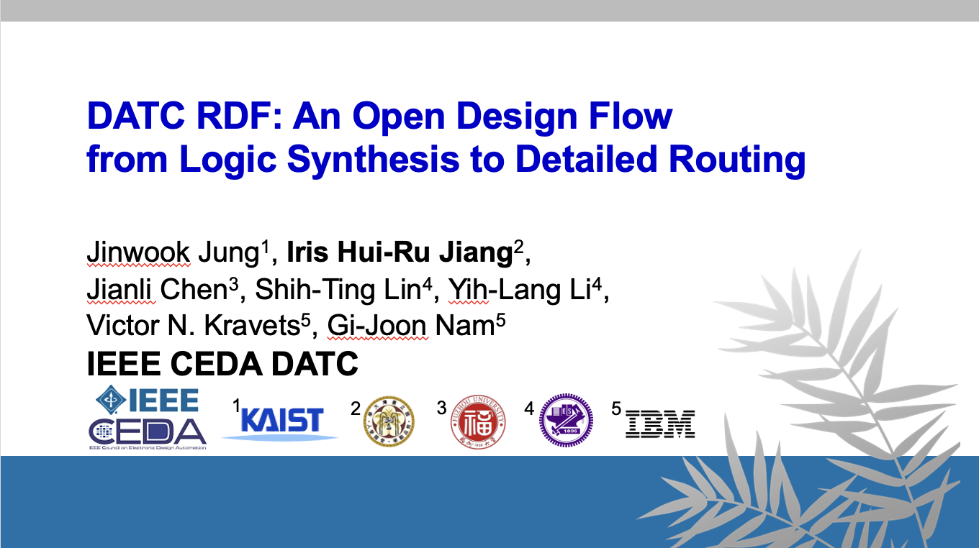
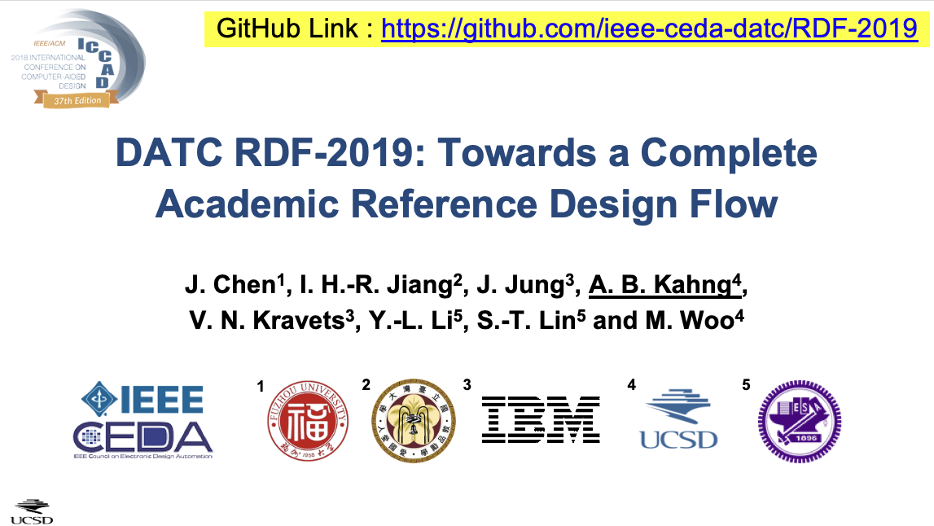
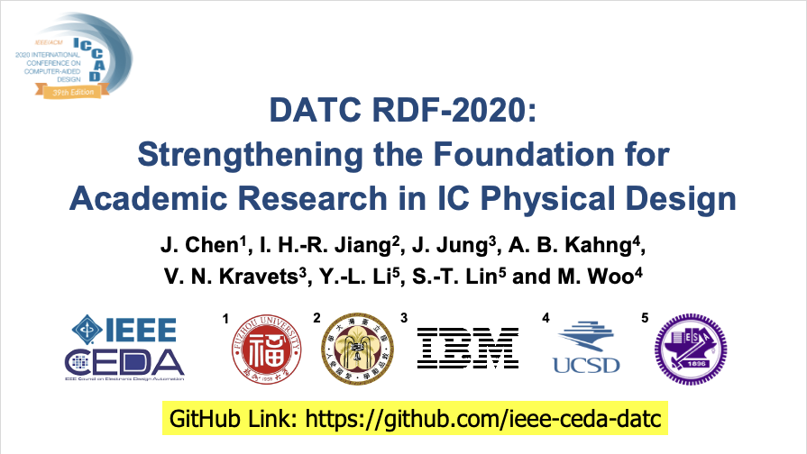
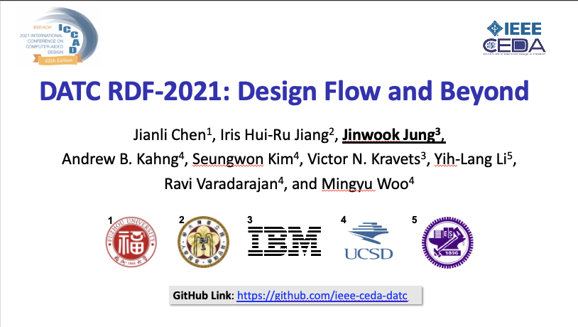

Design Automation Technical Committee (DATC)
A member technical committee of IEEE Council on EDA (CEDA)
  Provide a forum for discussing current issues and future strategies in design automation field
  Current rosters: Jinwook Jung (IBM), Andrew Kahng (UCSD), Rhett Davis (NCSU)
  Web page: https://ieee-ceda.org/technical-committee/datc
Since 2016, DATC has maintained Robust Design Flow (RDF)
  An academic reference RTL-to-GDS design flow incorporating numerous contest-winning point tools and the OpenROAD tool chain, to preserve and integrate leading research codes
  Invited papers at previous ICCAD Contest special sessions have provided updates on RDF and DATC’s strategic directions and activities
Notes:
First, in case you haven’t heard about DATC and its work before,
[C1]
The Design Automation Technical Committee, DATC, is a member technical committee under IEEE CEDA, which is one of the main sponsors of this ICCAD contest.
We work to provide a forum for discussing current issues and future strategies in the design automation field.
And the current DATC members are myself Jinwook Jung, Prof. Andrew Kahng at UCSD, and Prof. Rhett Davis at NCSU.
[C2]
Since 2016, we have maintained an academic reference design flow, named Robust Design Flow, and we have been working to incorporate numerous contest-winning tools and the OpenROAD tool chain.
We have been doing this in order to preserve and integrate leading research codes.
Our work has been presented in the previous ICCAD Contest special sessions, and we have provided updates on RDF and DATC’s activities.

Slide 3
Recent DATC Efforts Beyond Flow Enablement
Establish and expand research foundations for IC physical design & MLCAD
  Improvements of RDF
    TritonPart netlist partitioner
    DPO detailed placement optimizer
    OpenSTA-based power analysis
    PROBE3.0 DTCO platform
  Advancing benchmarking and baselines
    Balanced hypergraph partitioning
    Macro placement
  MLCAD research foundations
    Artificial netlist generation
    Calibration and ML benchmarks for IR drop prediction
    Calibration of proxy design enablement
    MLCAD data generation and accessibility
Notes:
My presentation today is about DATC’s latest activities beyond flow enablement.
[C1] In the past year, we have been working to establish and expand research foundations for IC physical design and ML-CAD.
Under that overarching goal,
[C2] we have made improvements on the DATC RDF,
[C3] we have tried to advance benchmarking activities and baselines,
[C4] and we also work to support the activities for MLCAD research foundation.

Slide 4
Outline
Introduction
Recent improvements of RDF
Advancing benchmarking and baselines
MLCAD research foundations
Summary
Introduction
Recent improvements of RDF
Advancing benchmarking and baselines
MLCAD research foundations
Summary
Notes:
In the rest of the presentation, I am going to present some details of DATC’s activities in the past year.
[C1]
Let me first start from the recent improvements on DATC RDF.

Slide 5
DATC Robust Design Flow (RDF)
An academic reference design flow Initiated in 2016
  Preserve leading research codes, originally built with academic CAD contest outcomes
  With OpenROAD, RDF supports complete LEF/DEF-based RTL-to-GDS flow
Latest updates
      https://github.com/ieee-ceda-datc/RDF-2023
      Netlist partitioner with TritonPart
      Detailed placement optimizer DPO
      Dynamic power analysis
      PROBE3.0 DTCO platform
Component | Tool
RTL generator | Chisel/FIRRTL
RTL obfuscation | ASSURE
Logic synthesis | Yosys+ABC
DFT insertion | Fault
Hypergraph partitioner | SpecPart, TritonPart
Floorplanning | TritonFP
Macro Placement | TritonMP, RTL-MP, Hier-RTLMP, AutoDMP
Global placement | RePlAce, FZUplace, NTUPlace3, ComPLx, Eh?Placer, FastPlace3-GP
Detailed placement | OpenDP, MCHL, FastPlace3-DP, DPO
Flip-flop clustering | Mean-shift, FlopTray
Clock tree synthesis | TritonCTS
Global routing | FastRoute4-lefdef, NCTUgr, CUGR
Detailed routing | TritonRoute, NCTUdr, DrCU
Layout finishing | KLayout, Magic
Gate sizing | Resizer, TritonSizer
Parasitic extraction | OpenRCX
STA | OpenSTA, iTimerC
Integrated P&R app | OpenROAD
Database | OpenDB
Libraries/PDK | NanGate45, SKY130, ASAP7, GF180MCU, ASAP5
Benchmark conversion | RosettaStone (timing-sensible)
Metrics system | METRICS2.1 (JSON-native
DTCO | PROBE3.0
Notes:
First, let me briefly introduce what the DATC RDF is.
[C1] The reference design flow created by DATC is called “DATC Robust Design Flow, RDF for short.”
It was initiated in 2016 based on the winning tools and research outcomes from the previous CAD contests.
RDF also includes OpenROAD tool chains now, and so it can support complete LEF/DEF-based design flow.
This table shows the tools in the current RDF inventory, and the tools highlighted in red are the newly added components this year.
[C3] The latest updates of DATC RDF are captured in the github link shown here, and in the next couple of slides, I am going to highlight the 4 main updates listed here, ...

Slide 6
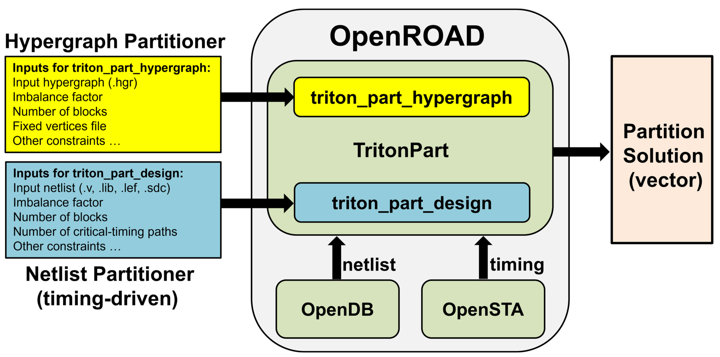
Netlist partitioning with TritonPart
Netlist partitioning has long been missing piece in RDF
TritonPart, integrated into OpenROAD, has been added to RDF
  Provide timing-aware netlist partitioning together with classical hypergraph partitioning
  Handle rich constraint types: fixed vertex, multi-dimensional balance, grouping, embedding, and timing constraints
  Open-sourced permissively and scalable to accommodate future problem instances
Notes:
First netlist partitioning with TritonPart.
[C1] Netlist partitioning has long been a missing piece of RDF since 2016.
[C2] Thanks to the latest development and release of TritonPart , we're now able to add a netlist partitioner in the RDF inventory.
It is integrated into OpenROAD.
Here are three key differentiators that make TritonPart different from the other conventional netlist partitioner.
[C3]
First, TritonPart provides a timing-aware VLSI netlist partitioner along with classical hypergraph partitioning engine.
Second, it can handle various constraint types, such as fixed vertex, multi-dimensional balance, grouping, embedding and even timing constraints.
Moreove, it is permissively open-sourced and is suitable to accommodate future netlist partitioning problem instances.

Slide 7
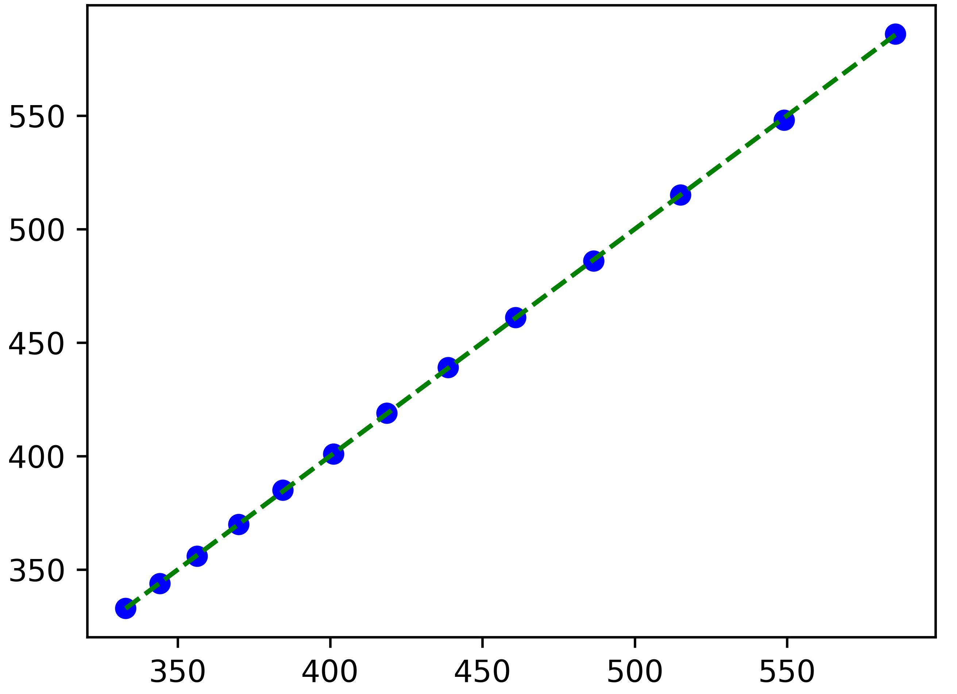
Dynamic Power Analysis based on OpenSTA
OpenROAD now supports vectorless/vector-based dynamic power analysis
  Vectorless: set_power_activity -global -activity <factor>; report_power
  Vector-based: read_power_activities -scope <scope> -vcd <filename>; report_power
Example results: Ariane on NanGate45 with different clock periods
Vectorless
Vector-based (at publication)
Vector-based (latest OpenROAD)
OpenROAD Total Power (mW)
OpenROAD Total Power (mW)
OpenROAD Total Power (mW)
Golden Total Power (mW)
Golden Total Power (mW)
Golden Total Power (mW)
Notes:
The second highlight of recent RDF improvement is dynamic power analysis.
[C1] In the latest version of OpenROAD, it now supports both vectorless and vector-based dynamic power analysis.
[C2] For vectorless analysis, we can set the global activity factor and run the report_power command.
[C3] For vector-based analysis, we can read the VCD activity file and run the report power command.
[C4] Here are the example power analysis results obtained with the Ariane design on Nangate 45 with different clock period.
The graph shows the correlation between the total power reported by OpenROAD and by a commercial, golden sign-off power analyzer.
We can see that the vectorless power analysis result has very nice correlation with the golden result.
The vector-based analysis result had a miscorrelation issue at the time of publication.
[C5] But in the latest OpenROAD version, the issues are all fixed and we now observe very good correlation against the golden result here.

Slide 8
DPO Detailed Placement Optimizer
New detailed placement optimizer added to RDF
  Developed by Prof. Andrew Kennings at University of Waterloo
  Invoked using improve_placement in OpenROAD
  Performs global/vertical/random cell swaps and cell reordering with varying or combined goals, e.g., HPWL minimization, utilization maximization, and cell displacement minimization
Benefit: 1.13%–5.34% routed wirelength reduction compared to baseline
Design | Enablement | Baseline |  | With DPO |  | ΔHPWL (%) | ΔrWL (%)
 |  | HPWL (um) | rWL (um) | HPWL (um) | rWL (um)
aes | ASAP7 | 74320 | 112370 | 71781 | 109239 | -3.42% | -2.79%
aes | NanGate45 | 210408 | 329984 | 199669 | 312472 | -5.10% | -5.31%
aes | SKY130 | 553464 | 838329 | 519277 | 793545 | -6.18% | -5.34%
ibex | ASAP7 | 62158 | 89161 | 61114 | 88154 | -1.68% | -1.13%
ibex | NanGate45 | 192412 | 269948 | 186931 | 263464 | -2.85% | -2.40%
ibex | SKY130 | 446404 | 664436 | 435363 | 647759 | -2.47% | -2.51%
jpeg | ASAP7 | 138651 | 162624 | 134810 | 159228 | -2.77% | -2.09%
jpeg | NanGate45 | 475774 | 568330 | 456260 | 548508 | -4.10% | -3.49%
jpeg | SKY130 | 972223 | 1185920 | 927963 | 1136801 | -4.55% | -4.14%
Notes:
Another notable updates of DATC RDF is a new detailed placement optimizer DPO.
It was developed by Prof. Andrew Kennings at University of Waterloo, and is incorporated in the OpenROAD app as the improve_placement command.
The DPO optimizer performs cell swapping and reordering with various optimization goals, such as wirelength minimization and cell displacement minimization.
[C1] The table shown here lists the wirelength with and without DPO, and we can see that DPO can reduce the routed wirelength across all the circuits, and can achieve upto 5% wirelength reduction compared to the baseline.

Slide 9
PROBE3.0 DTCO Pathfinding Framework
DTCO (Design-Technology Co-Optimization) becomes essential in advanced nodes
  Bottleneck: manual standard cell library and PDK generation
PROBE3.0 DTCO framework with automatic library/PDK generation
  Enables foundation for “end-to-end” DTCO pathfinding spanning from ground rules, device models to PPAC assessment of real design blocks
Cell height, gear ratio, CPP,
Mx pitch, BEOL stack, etc.
Automatic standard
cell layout generation
Generated design enablement
Notes:
The last highlight of recent RDF improvement is PROBE3.0, the DTCO pathfinding framework.
[C1] DTCO, Design Technology Co-Optimization, has been a main driver in advanced technology to maximize its benefit.
However, the manual standard cell library design and characterization, as well as PDK generation have long been a bottleneck for DTCO pathfinding.
[C2] PROBE3.0 is a DTCO pathfinding framework incorporated with automatic cell library and PDK generation capability.
It enables “end to end” DTCO pathfinding, spanning from ground rules and device models, all the way down to PPAC assessment of real design blocks.
The overall flow of PROBE3.0 is shown in this slide.
By varying technology and design parameters, such as cell height, CPP, Mx pitch, and BEOL stack, PROBE3.0 can generate standard cell layouts and corresponding design enablement automatically.

Slide 10
Outline
Introduction
Recent improvements of RDF
Advancing benchmarking and baselines
MLCAD research foundations
Summary
Notes:
Now, let me briefly go over the DATC effort toward advancing benchmarking and baselines.

Slide 11
Advancing Benchmarking and Baselines
Goal: change culture and academia-industry interaction models to improve velocity and accessibility of EDA and MLCAD research
Our activities have included:
  Creating open enablements and data sharing for research
  Overcoming commercial restrictions on benchmarking and data sharing
  Enhancing transparency, reproducibility and continual ML model refinement
Two recent advances in benchmarking and baselines
  Balanced hypergraph partitioning
  Macro placement
Notes:
Regarding benchmarking and baselines, we have been trying to change the culture and academia-industry interaction models, in order to improve both the velocity and the accessibility of EDA and MLCAD research.
[C1] Under that goal, our activities have included
- Open enablements and data sharing for research.
- Overcoming the commercial restrictions on benchmarking and data sharing.
- We also seek to enhance transparency, reproducibility, and continual ML model refinement.
[C2] With that said, I would like to introduce our recent efforts in benchmarking and baselines around hypergraph partitioning, and macro placement.

Slide 12

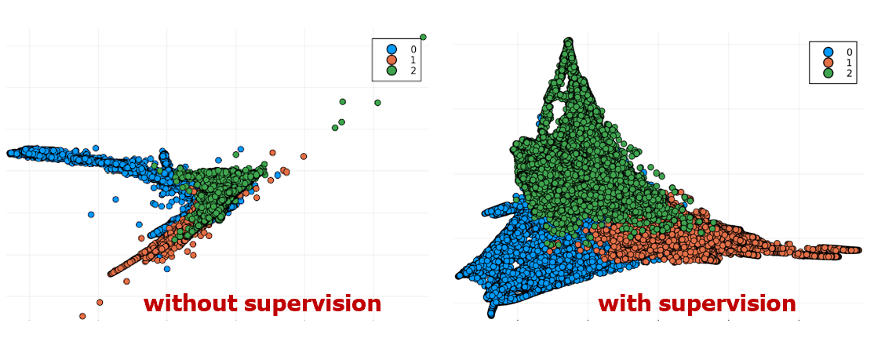
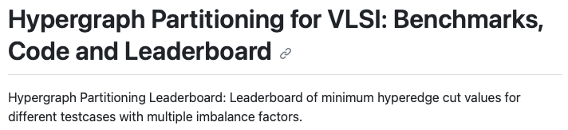
Hypergraph Partitioning
The HypergraphPartitioning repo
  https://github.com/TILOS-AI-Institute/HypergraphPartitioning
  Provides various partitioning solutions and runscripts to ensure transparency/reproducibility
  Maintains leaderboard of K-way partitioning results for ISPD98/Titan23 benchmarks
SpecPart: new stronger baseline for balanced hypergraph partitioning
  Supervised spectral framework for partitioning solution improvement, while avoiding local optimal issue of multilevel partitioners (e.g., hMETIS and KaHyPar)
  Substantial improvement of min hyperedge cutsize for ISPD98/Titan23 benchmarks
Notes:
First, hypergraph partitioning, a well-studied, fundamental optimization problem throughout VLSI CAD.
[C1] The DATC UCSD team has recently created a HypergraphPartitioning repository under the TILOS GitHub organization.
[C2] It provides various partitioning solutions and runscripts to ensure transparency and reproducibility of the results.
[C3] Moreover, it maintains the leaderboard of K-way partitioning results for the ISPD98 and Titan23 benchmark suites.
[C4] We also would like to highlight the recent SpecPart hypergraph partitioner, which can serve as a new, stronger baseline for hypergraph partitioning.
It uses a supervised spectral framework to improve partitioning solutions, while avoiding local optima issues seen in the previous multilevel partitioners such as hMETIS.
Thanks to the supervised framework, SpecPart provides a substantial improvement on the minimum hyperedge cutsize metric, and we think that it can serve as a stronger baseline for this problem.
It is also available in the HypergraphPartitioning repo.

Slide 13
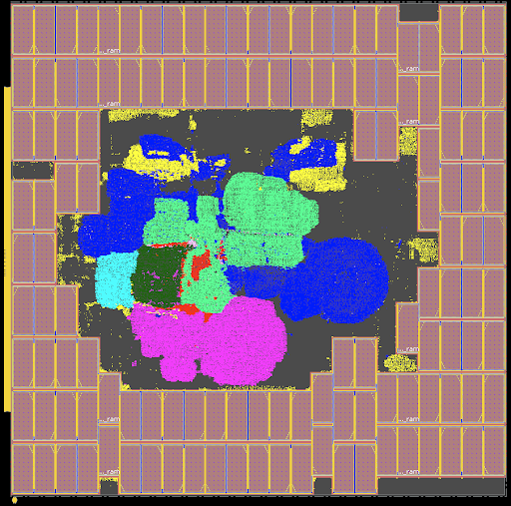
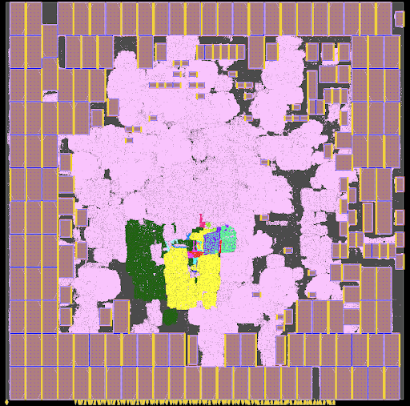
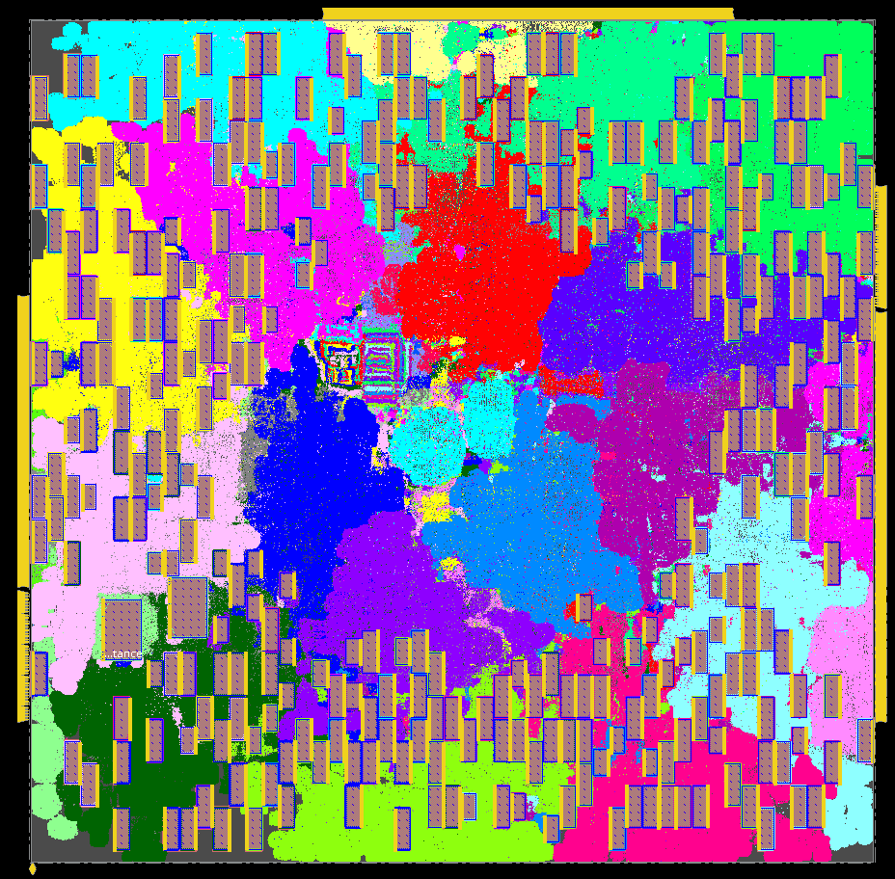
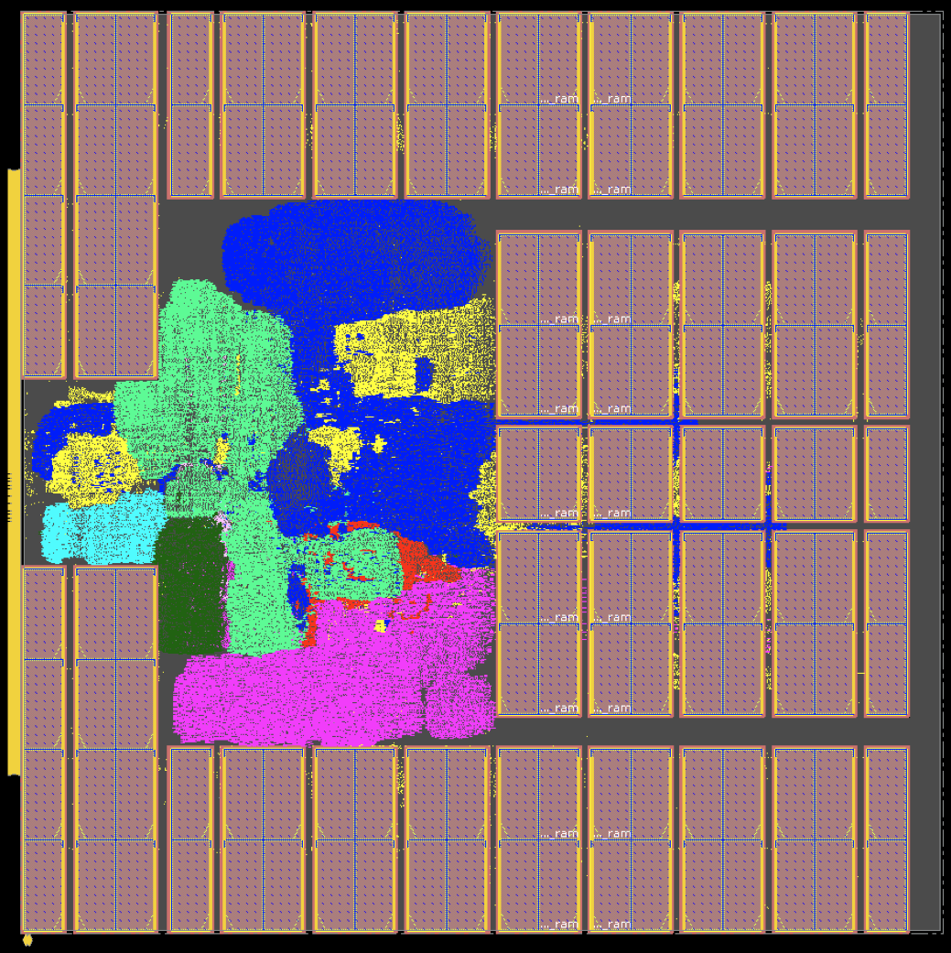
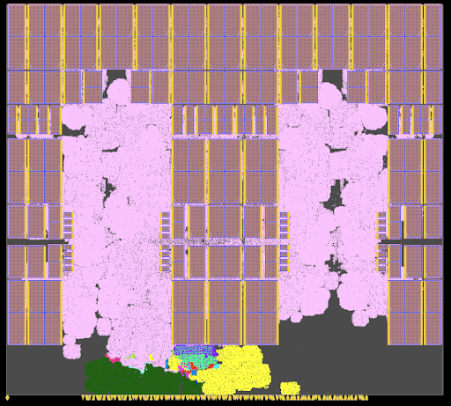
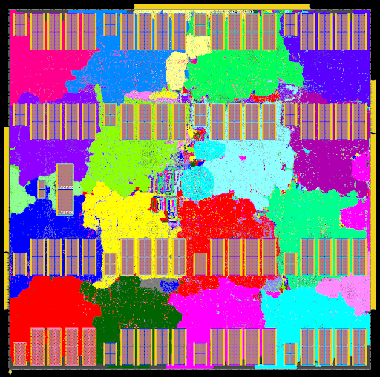
Macro Placement
Classical EDA problem, but lacking in established research foundations
The MacroPlacement repo introduced in RDF-2022
  https://github.com/TILOS-AI-Institute/MacroPlacement
  New benchmarks: BlackParrot QP (220 macros/800K cells), MemPool (324/2.8M)
  New evaluation flow*: Synthesis with Synopsys DC-Topo and P&R with Cadence Innovus
  New baseline solutions: Using simulated annealing and by human experts
  New baseline macro placer: AutoDMP (developed and open-sourced by NVIDIA Research)
Macro placement solution obtained using simulated annealing
Macro placement solution by human experts
* The flow scripts made available via recently-granted permissions from major EDA suppliers, which provide a major step forward for the research community.
Notes:
Another DATC’s efforts toward better benchmarking and baselines is macro placement.
[C1] It is also a classical EDA problem, but there had been no established, common foundations for macro placement research.
[C2] So, to provide an established platform for macro placement research, Prof. Andrew Kahng’s group created the MacroPlacement repo last year, and there has been substantial updates in the past year.
[C3] First, the MacroPlacement repo has more benchmarks now, such as the BlackParrot quad-core processor and the mempool design, both of which have hundreds of macros.
[C4] New evaluation flow scripts have also been made public, to facilitate physical synthesis using Synopsys DC Topographical and post-P&R evaluation of macro placement solutions using Cadence Innovus.
[C5] Baseline solutions are also updated and expanded using simulated annealing and by human expert generated solutions, which are shown in the bottom of this slide.
[C6] Moreover, a recent macro placer named AutoDMP from NVIDIA has been added as a new baseline macro placer.

Slide 14
Outline
Introduction
Recent improvements of RDF
Advancing benchmarking and baselines
MLCAD research foundations
Summary
Notes:
Now, let me introduce the recent, emerging foundations for MLCAD research observed in our research society.

Slide 15
MLCAD Research Foundations
Challenges in MLCAD research
  Scarcity of training data
  Confidentiality – PDKs, designs, EDA tool reports, etc.
  Lack of standardized data formats
  → Further amplified as needs for education/workforce development of semiconductor
  and EDA industries grow more urgent
Recent, emerging foundations of MLCAD research
  Artificial netlist generation for realistic/synthetic datasets
  ML-based IR drop prediction benchmarks
  Automated proxy design enablement
  Improved MLCAD data generation and interface
Notes:
Research in MLCAD has some long-standing challenges.
The scarcity of training data,
The confidentiality issue related to sensitive information like PDKs, designs, and tool reports
and the lack of standardized data formats.
[C1] These challenges have been amplified further, as the needs for education and workforce development in this field is getting more urgent.
[C2] On the positive side, there have been notable emerging foundations of MLCAD research, trying to provide potential solutions to address these challenges and advance the field.
Such innovations include artificial netlist generation for synthetic datasets, ML-based IR drop prediction benchmarks, automated proxy design enablement, and improved MLCAD data generation and interface

Slide 16
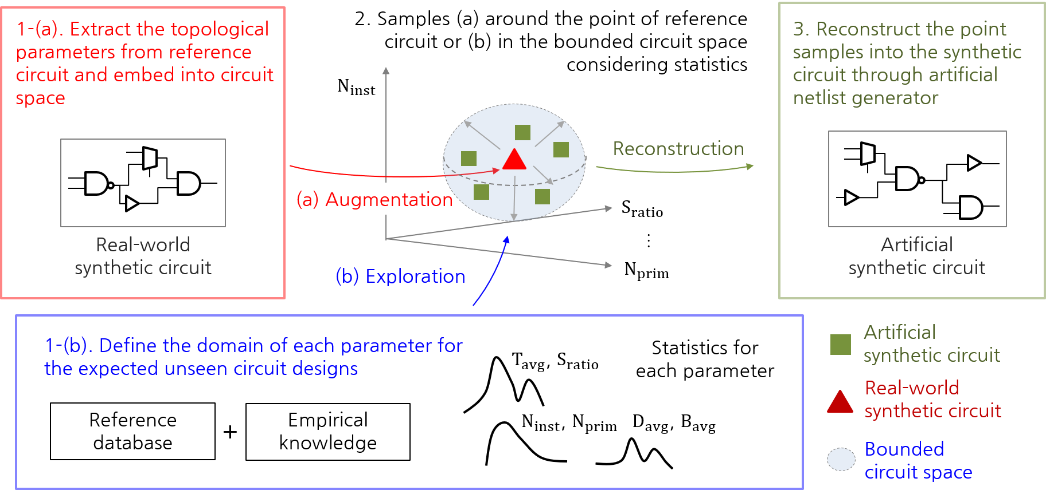
Artificial Netlist Generation
Challenge: lack of realistic, shareable place-and-route (P&R) data
Artificial Netlist Generator (ANG) [Kim et al., TCAD’22]
  Offers structured approach to creating realistic P&R benchmarks for ML applications
  Uses various topological and layout parameters, e.g., #insts, #IOs, average net degree and HPWL, average timing path depths, proportion of FFs to total insts, etc.
[Figure adapted from Kim et al., TCAD’22]
Notes:
This slide is about Artificial Netlist Generation.
It is to tackle the lack of shareable P&R data.
And the recent development of Artificial Netlist Generator (ANG) from POSTECH Korea, can be a potential solution for this issue.
It offers a systematic approach to create artificial yet realistic P&R benchmarks.
It uses various topological and layout parameters, such as instance count, IOs, net characteristics, path characteristics, to create realistic netlists.
The figure shown here illustrates the P&R data generation process using ANG.
With ANG, we can generate an artificial yet practical P&R datasets necessary for MLCAD.

Slide 17
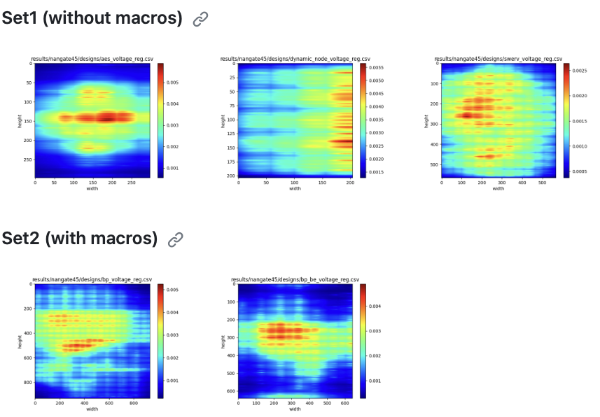
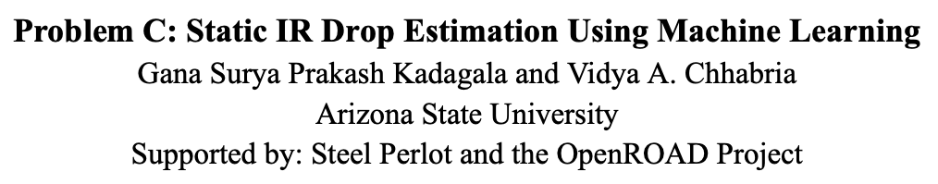
Calibration and Benchmarks for IR-Drop Prediction
Challenge: Scarcity of standardized training data for MLCAD
ICCAD-2023 Contest Problem C: ML-based static IR drop prediction
  20 real circuit testcases created using OpenROAD and PDNSim on NanGate45
  1000+ synthetic circuit testcases created from GAN-based framework, featuring varied power distributions and grid densities
  Golden IR drop data produced by SPICE simulation accompanies each data point
  → Supports calibration and ML-based power integrity research
Notes:
This year’s ICCAD contest problem C // is also an excellent exemplar of emerging MLCAD research foundation.
Addressing the scarcity of standardized dataset, the contest problem offers benchmarks and datasets for ML-based IR drop prediction.
The dataset includes 20 real circuit test cases, generated using OpenROAD and PDNSim on NanGate45.
It also includes more than 1,000 synthetic test cases produced by a GAN-based framework with various power distribution and grid densities.
Golden IR drop analysis data, obtained by SPICE simulation, are also provided, in order to support calibration as well as future ML-based power integrity research.

Slide 18
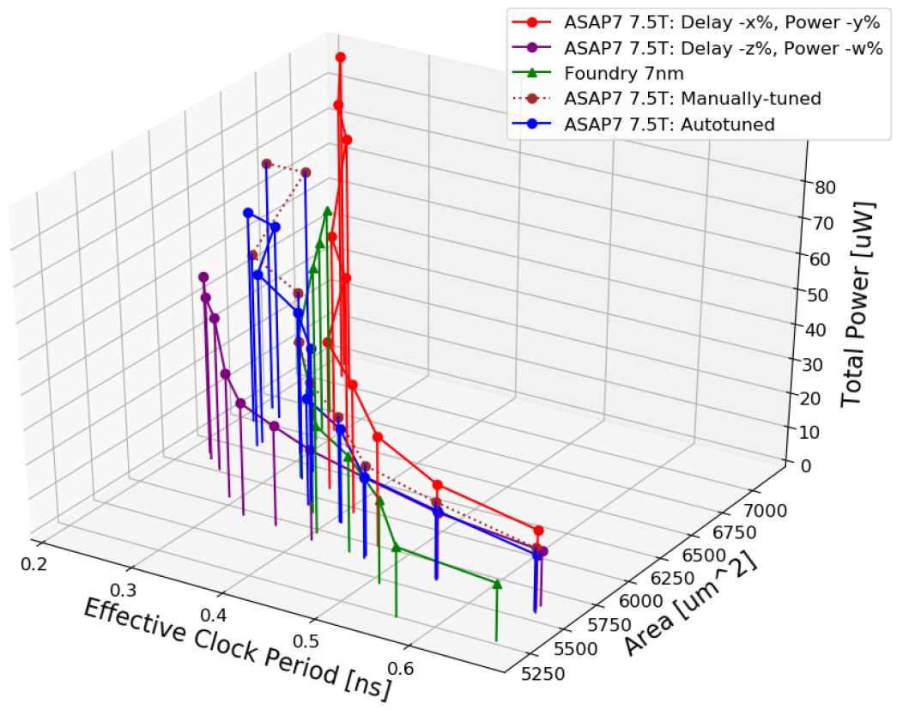
Automated Proxy Design Enablement
Challenge: Gap between open research PDKs and closed commercial PDKs
Public PDK/library calibration to achieve proxy commercial enablement
  Strives to match commercial design enablement in terms of design PPA outcomes
  Example code: https://github.com/ieee-ceda-datc/RDF-2023
    Approximately scales ASAP7 or NanGate45 to a target library for a given design
    Tuned attributes: cell delay/slew, Internal/switching power
    Ray Tune* for automatic tuning of attributes
  Results: JPEG with ASAP7
    Autotuned 7nm proxy matches well with
    commercial enablement at higher clock frequency
*https://docs.ray.io/en/latest/tune/index.html
Notes:
Another roadblock toward a solid research foundation is the gap between open research PDKs and closed commercial PDKs.
[C1] To address this gap, we have recently created an automated methodology for proxy design enablement, in which a public PDK and libraries are calibrated to commercial enablement.
[C2] The proposed methodology tries to match the commercial design enablement in terms of design PPA outcomes.
[C3] Some example code can be found in the github repo shown here.
The repo provides example codes that approximately scales ASAP7 or NanGate45 to a given target library for a specific design.
It tunes library attributes such as delay, slew, and power, using an automatic parameter tuning engine called Ray Tune.
[C4] Here is an example result of the autotuned 7nm proxy enablement, and we can see that it aligns pretty well with commercial enablement at higher clock frequencies.

Slide 19
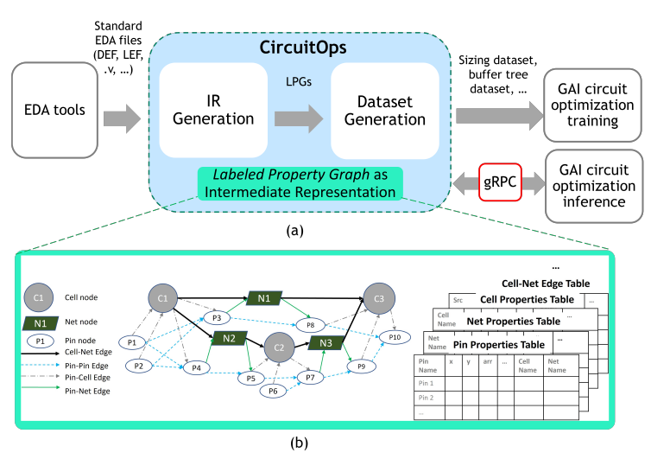
Improved MLCAD Data Generation and Interface
Challenge: Lack of standardized MLCAD data generation and accessibility
CircuitOps: ML-friendly circuit data representation for easy operation with ML
  Developed by NVIDIA Research, presented at ICCAD’23 [Liang et al., ICCAD’23]
  Uses OpenROAD to generate an intermediate representation (IR) of given circuit
  Creates labeled property graph (LPG) from IR for graph-based ML applications with PyTorch
[Figure source: https://github.com/NVlabs/CircuitOps]
Notes:
Finally, let me introduce recent efforts to confront the lack of standardized MLCAD data generation and accessibility.
Yesterday here, there was a presentation about CircuitOps from NVIDIA Research, which provides an ML-friendly circuit data representation.
It uses OpenROAD to create an intermediate representation of the given circuit, which is then transformed into a labeled property graph, which is readily usable for graph-based ML applications with PyTorch.

Slide 20
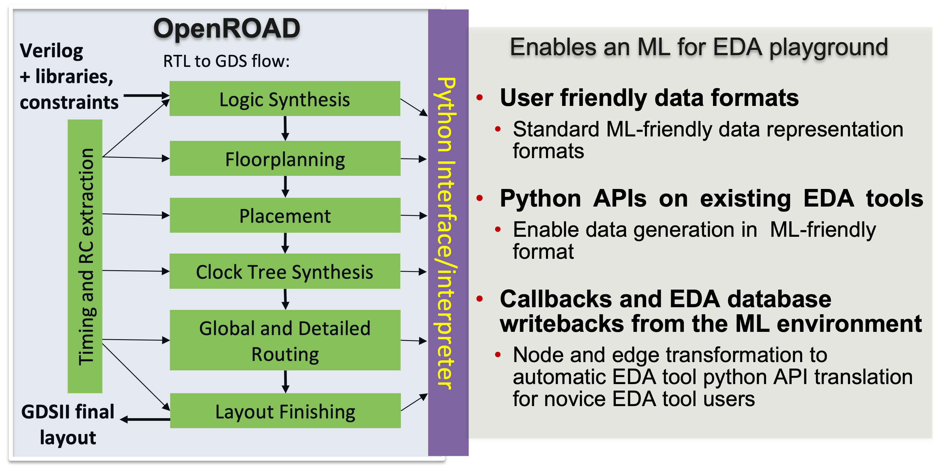
Enhanced OpenROAD-Python Interface
Make OpenROAD in RDF “common playground of ML for EDA”, by enabling seamless integration with Python ML packages:
  ML-friendly data representation of LEF/DEF/Verilog data
  Python APIs that return information from OpenDB in formats ML algorithms can interpret
  Python APIs that can annotate ML inference results back to the design database.
[Figure courtesy of Prof. Vidya Chhabria at ASU]
Notes:
In the same vein, there is a recent initiative to make an enhanced OpenROAD-Python interface.
The grand goal is to make OpenROAD a common playground of ML for EDA, as illustrated in the diagram shown in this slide.
There are some Python APIs in OpenROAD already, but a true ML for EDA playground requires three key elements:
ML-friendly data representation of LEF/DEF/Verilog data,
Python APIs that return information from OpenDB in the formats that ML algorithms can interpret,
and Python interface that can send ML inference results back to the design database.
So, realizing this roadmap will be a significant goal in the future activities of DATC in the coming year.

Slide 21
Summary
IEEE CEDA DATC: works to establish and expand research foundations for IC physical design / ML-enabled EDA
Recent work of IEEE CEDA DATC:
  Improvements of RDF
    Netlist partitioner with TritonPart
    Detailed placement optimizer DPO
    Dynamic power analysis
    PROBE3.0 DTCO platform
  Advancing benchmarking and baselines
    Balanced hypergraph partitioning
    Macro placement
  MLCAD research enablement
    Artificial netlist generation for realistic/synthetic datasets
    ML-based IR drop prediction benchmarks
    Automated proxy design enablement
    Improved MLCAD data generation and interface
Notes:
Here’s the summary of my presentation today...

Slide 22
Acknowledgments
We thank Vidya Chhabria, Bodhisatta Pramanik, Minsoo Kim and
Haoxing (Mark) Ren for many helpful discussions and contributions
This work is supported in part by the IEEE Council on Electronic Design Automation (CEDA)
The work of UCSD is supported in part by DARPA HR0011-18-2-0032, and by NSF CCF-2112665
Notes:
Thank you.

