Slide 1
A Mixed Open-Source and Proprietary EDA Commons for Education and Prototyping
Andrew B. Kahng
^{UCSD CSE and ECE Departments}
^{abk@ucsd.edu}
Notes:
Hello everyone! Thanks to Antonino for proposing and organizing this special session. Today I will say a bit about the concept of a mixed open-source and proprietary “EDA Commons”. If you’re interested in this concept of an EDA Commons, please read the paper and its references – and please get in touch to discuss how an EDA Commons can become real.

Slide 2
Agenda
Motivations
Notes:
Let me start with motivations for a MIXED Open-source and Proprietary Commons. And before I begin – this talk – this concept – is part of an ongoing conversation about how to enable the next revolution in hardware design, how to attract the next generation of young people to our field, and – ultimately, how we in the EDA world can help keep semiconductor scaling alive and well.

Slide 3
The Design Crisis and Opportunity
2017 DARPA Electronics Resurgence Initiative: Can we dramatically lower the time and complexity required to design modern SoCs, and unleash a new era of circuit and system specialization?
Notes:
So, Winston Churchill is credited with saying “Never let a good crisis go to waste”. What this means is that with every crisis, there is opportunity and openness to trying new things.
Five years ago, the U.S. DARPA Electronics Resurgence Initiative asked: Can we dramatically lower the time and complexity required to design modern SoCs, and unleash a new era of circuit and system specialization?
And this question was motivated by a Crisis of Design.

Slide 4
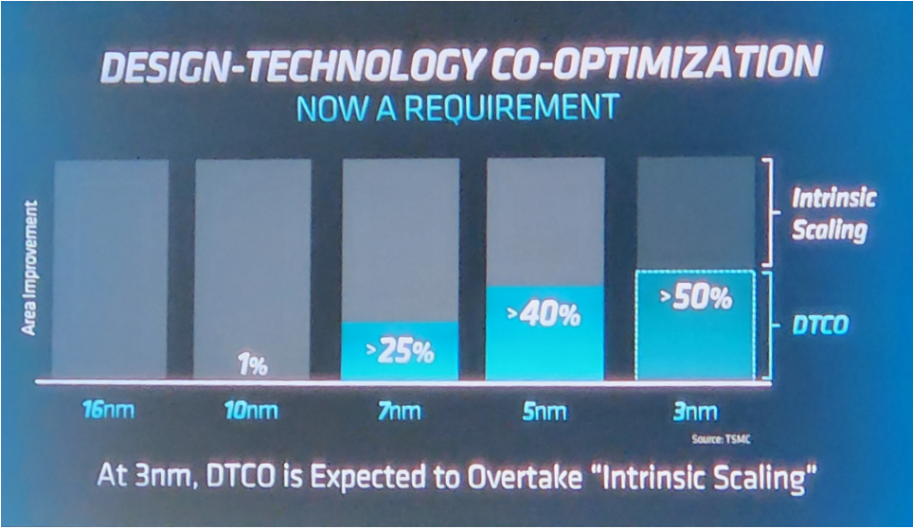
What Do These Pictures Mean?
Andreas Olofsson, DARPA
ISPD-2018 Keynote, March 27, 2018
Mark Papermaster, AMD CTO 59th Design Automation Conference Opening Keynote, July 11, 2022
Scaling has become design-based
4
Notes:
Here is a famous picture from Andreas Olofsson, who was at DARPA at the time, in a keynote talk at ISPD-2018.
It is the red curve that is scary: it says that the cost of designing silicon in leading nodes has gotten out of control.
You can see this in the huge size of hardware teams, the growing size of chips and the whitespace in them, the talks from NVIDIA and other product companies about the cost of transistors and product design – plus many other indicators.
This is SCARY because we rely on DESIGN to give us “design-based equivalent scaling” of IC value. In other words, design and EDA have the main burden of maintaining the value proposition of silicon in new nodes.
[CLICK] Which is what we heard from AMD’s CTO, Mark Papermaster, in his opening keynote at last July’s Design Automation Conference.
He showed this slide, which says that by the 3 nanometer node, Design-Technology Co-Optimization (or, DTCO) overtakes intrinsic scaling, and this trend will continue.
[CLICK] So, scaling as we understand it – which is offering more value with each new technology generation – has become design-based.

Slide 5
Scaling: Design, EDA and People
Scaling = getting better results with less resources
People, money, time
Fact: Design scaling and innovation require EDA scaling and innovation
Fact: EDA scaling and innovation, with more designers and designs, require more EDA engineers
5
Notes:
Put another way: Scaling means doing better with less resources, including people and time.…
And, I want to propose two statements as FACTS.
[CLICK] First, if you want to scale and innovate in hardware system design (including system-on-chip or heterogeneous integration), then you MUST have EDA innovation.
And second, [CLICK] if the future brings a larger population of designers and innovative designs, in addition to the need for EDA innovation, then we MUST have more EDA engineers.

Slide 6
Agenda
Motivations
Definitions
Notes:
So the high-level motivation for discussing an “EDA Commons” today is that maybe – hopefully – it will be part of solving our design crisis and unblocking hardware system innovation. Even, can an EDA Commons help enable a second VLSI revolution?
Before we think about that, let me provide some important definitions.

Slide 7
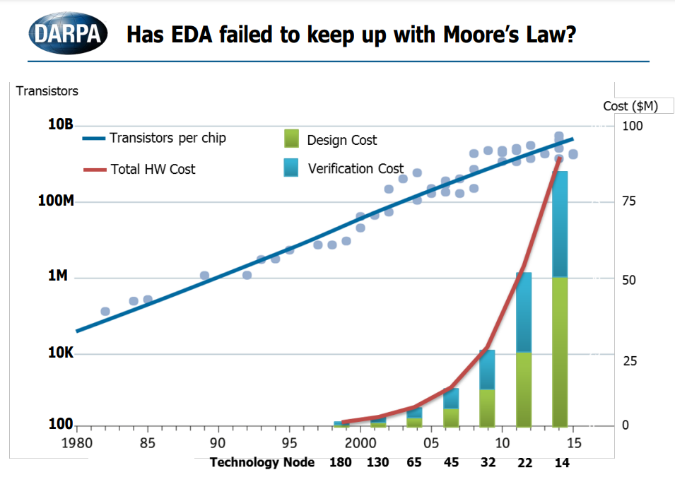
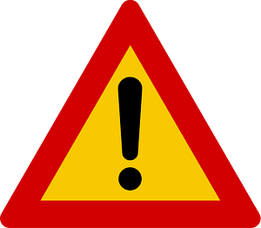
A “Commons”
“resources belonging to or affecting the whole of a community”
Often arises in context of “the tragedy of the commons”
A “social and political problem in which each individual is incentivized to act in a way that will ultimately be harmful to all individuals”
Leads to overconsumption, underinvestment, and ultimately depletion of a common pool resource
Relevant examples
Depletion of (EDA) technology base
Depletion of (EDA) workforce
Notes:
The first definition: What is a “Commons”?
The dictionary tells us that a Commons consists of resources belonging to or affecting the whole of a community.
And where do we hear this word most often (assuming we’re not from the U.K.)? [CLICK] It’s when there’s danger ahead in the form of what’s called the tragedy of the commons. Straight from the definitions again: this kind of tragedy is a “social and political problem in which each individual is incentivized to act in a way that will ultimately be harmful to all individuals”. It leads to overconsumption, underinvestment, and ultimately depletion of a common pool resource. And I’d claim that for us, two very relevant examples of this DEPLETION are
[CLICK] First, the depletion of the EDA technology base – which leads to that scary red cost-of-design curve. And [CLICK] what I didn’t include in the picture before was the title that Andreas Olofsson used in his keynote: Has EDA failed to keep up with Moore’s Law? This is not a good look!
[CLICK] Second, there is the depletion of the EDA workforce. One of these pictures is from the exhibit floor at DAC-2018 in San Francisco. The other is from DAC-2000 in Los Angeles. So, two pictures, taken 18 years apart. How do you tell which is which? By the density of people, and by the gray hair.

Slide 8
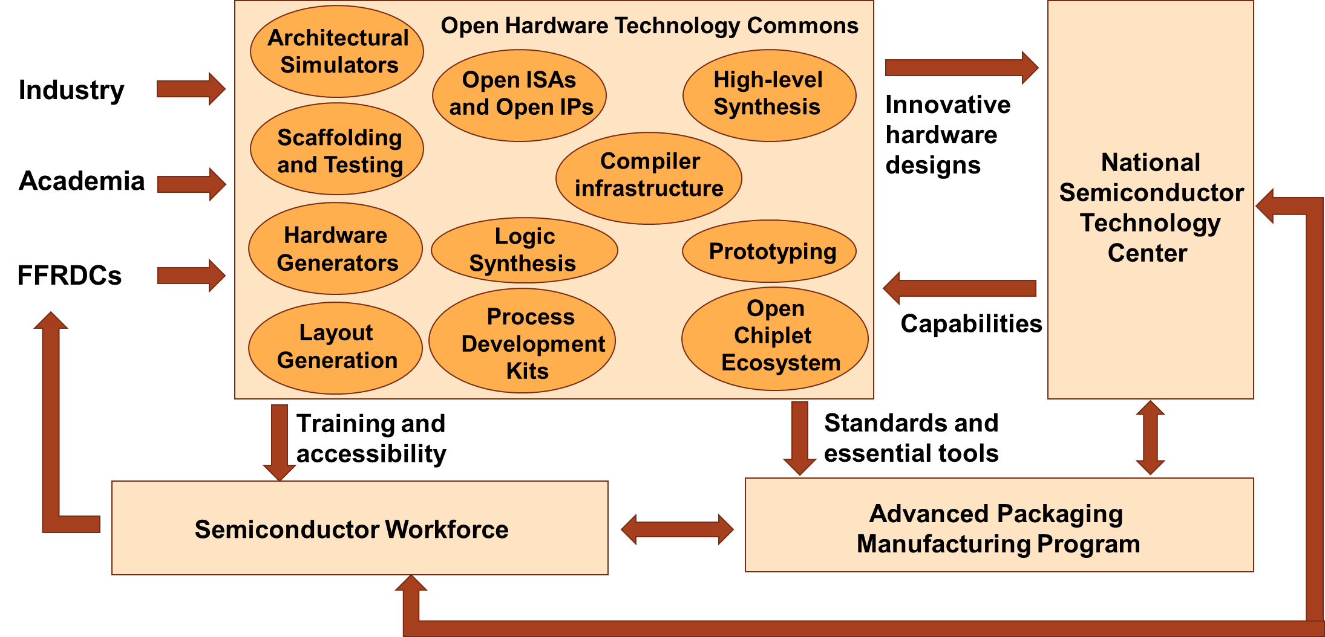
An Open Hardware Technology Commons (OHTC)
Vision proposed by Tumeo et al., 2022
Open and extensible, composable and interoperable
Helps to bridge the lab-to-fab “valley of death”
Unlocks today’s barriers to hardware system innovation
FFRDC = Federally Funded R&D Center
Notes:
A second important definition is what Antonino Tumeo and others have called an Open Hardware Technology Commons. My paper points to Antonino’s presentation at a DAC Birds-of-a-Feather meeting in July, which gives more details. In fact, you could say that ALL of the papers and talks in this session describe different elements of this picture.
[CLICK] Here is the OHTC itself, where the arrows show how it might interact with and boost other entities or stakeholders – industry and academia, government research labs, workforce development, and advanced technology centers that focus on semiconductor manufacturing and advanced packaging.
Inside the OHTC are solutions to what blocks hardware system innovation today: from PDKs to open IPs, enablement of an open chiplet and heterogeneous integration ecosystem, hardware compilers, architectural simulators, and more.
As envisioned, there is a mantra of open and extensible, composable and interoperable. Which we can think of as a reaction to closed systems or standards that today do not interoperate or play well together. [8:08]
And the ultimate goal is to unlock innovation.

Slide 9
Open-Source and Proprietary EDA
Open-source EDA [examples: Magic, OpenROAD, Yosys, Verilator, …]
Code that is released publicly under a recognized open-source license
Always: Freely usable, freely modifiable, and shareable
Generally: Free redistribution, creation of derived works, use by anyone for any purpose
“Copyleft” licenses (e.g., GPL-3) are often showstoppers to industry adoption
Proprietary EDA [examples: Synopsys, Cadence, Siemens, …]
Industry consolidation → increasingly closed platforms
End-user license agreements: no benchmarking; confidentiality of documentation, command languages and reports; no reverse-engineering, etc.
Academic program licenses: no usage for commercial purposes
Notes:
The third definition to be clear on is what is meant by open-source EDA and proprietary EDA.
Open-source EDA is EDA tooling with available code that satisfies the definition of open source: released publicly, under a recognized open-source license. Open source is always freely usable, freely modifiable, and shareable. Generally, it can be freely redistributed, derived works can be created, and it can be used by anyone for any purpose.
[CLICK] Proprietary EDA is what we all use in design and research: tools from the big two or big three and from smaller companies. These are incredible tools with billions of dollars in accumulated R&D investment. On the other hand, flexibility to target new research and new EDA applications is limited, because tools serve existing markets. Consolidation has also led to more closed platforms, and there are restrictions that make perfect business sense for the EDA vendors, but slow down our ability to advance the research leading edge.

Slide 10
Agenda
Motivations
Definitions
EDA Commons
Notes:
So then, what is an EDA Commons?

Slide 11
An “EDA Commons”: Role and Capability
Nation-scale shared infrastructure
Amortize setup and maintenance overheads
Serve stakeholders that span research, education and workforce development
Secure and cloud-based
Offer access to leading-edge EDA tools, PDKs, IPs
Accelerate hardware design and system innovation
Offer sharable curriculum and modular, scalable training
Engage a next generation, open up “front end of pipeline”
Upskill the existing workforce
Notes:
As the paper mentions, there have been many discussions worldwide of how to grow design talents, and there is always a shared design infrastructure and a type of “EDA Commons” in the conversation. Some main themes are as follows.
First, an EDA Commons should be a shared infrastructure that is potentially at Nation-Scale. Think: all the best aspects of ITRI or EuroPractice or CMC, and more!
A Commons should remove barriers and overheads, such as running your own license servers or doing your own IT – or, coming up with $10000 a year to renew your big-3 EDA university program memberships. And it should be able to handle a wide range of stakeholders. Both research and education, for both Design and EDA. From labs to tapeouts. From high schoolers and undergraduates to Ph.D. students, to working engineers who want to learn more about emerging chiplet integration standards or how AI is changing chip design.
[CLICK] Then, an EDA Commons should be secure and cloud-based – kind of obvious. And, it should offer access to leading-edge EDA tools, and PDKs, and design IPs. All this is in the name of accelerating hardware design and system innovation – and I feel a challenge here is to measure the benefit from having a Commons.
[CLICK] Last, an EDA Commons must help solve the “next generation” problem. How will it attract the best and brightest to careers in hardware design and EDA? So this alone is worth many days of deep thinking – it’s all of our problem. Sharable, modular, scalable, early engagement – we know all these keywords but we don’t have any playbooks that work well. What’s missing – like, financial incentives or good career paths? What demographics or geographies do we need to attract – military veterans, women, the global South, … ?
And I apologize that these are such broad strokes, at the level of role and capability.

Slide 12
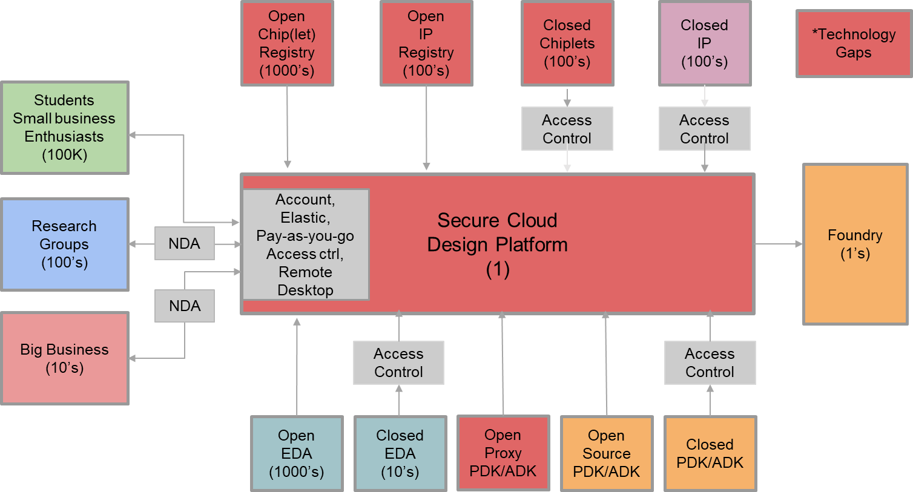
Secure Cloud-Based Design (Andreas Olofsson, Zero ASIC)
Notes:
More concretely, folks like Andreas Olofsson at Zero ASIC have thought a lot about what a nation-scale Secure Cloud Design Infrastructure might include. With his permission, I show this figure. [CLICK] There is a Secure Cloud Design Platform in the middle.
[CLICK] On the left, there are users of the Design Platform – the design innovators ranging from students to small businesses to research labs, to big businesses.
[CLICK] In this vision, there is both Open and Closed EDA, as well as PDKs and ADKs that range across Open-but-Proxy (like ASAP7), Open-Source (like SkyWater 130) and Closed (like TSMC or GF).
[CLICK] And registries for both open and closed IPs and chiplets.
[CLICK] Everything that is colored red is a technology gap today. But it’s good to see that there’s a lot that is NOT red, as well !

Slide 13
Agenda
Motivations
Definitions
EDA Commons
Open-Source and Proprietary: A Continuum
Notes:
In the last section of my talk, I want to say why I believe it is inevitable that both open-source EDA and proprietary EDA will complement each other in a future EDA Commons. Because – really, there is a rich continuum between the two, and each serves different needs.

Slide 14
Strengths of Open-Source and Proprietary EDA
Criterion | Open-Source | Proprietary
Technology |  | +
Support |  | +
Sustainability |  | +
Extensibility | +
Accessibility | +
Scalability | +
Workforce Development | + | +
Ecosystem | + | +
Notes:
This is Table 1 from the paper. It sets out at a REALLY high level where open-source and proprietary EDA might each have clear advantages – which are the plus signs in the table – according to the criteria on the left such as scalability or support.
The next couple of slides explain why the plus signs are placed as you see here.

Slide 15
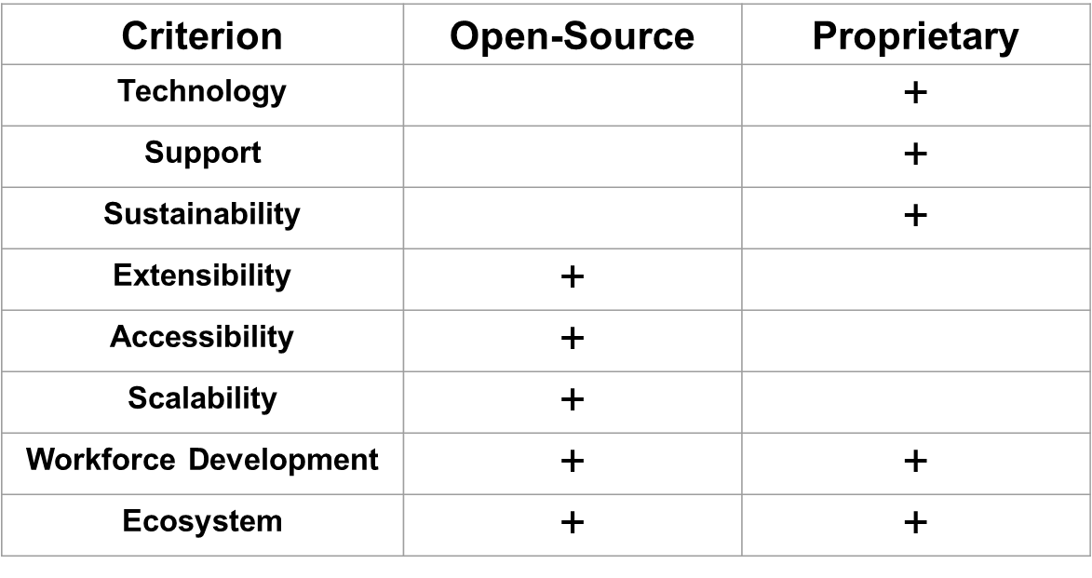
Advantages of Proprietary EDA
Technology and IP
Tens of $B of R&D investment, 1000s of patents
Decades of use, 1000s of paying customers
Tens of 1000s of tapeouts
Hyperoptimization that extracts best possible QOR from foundry and design enablement
Support and training
Potentially difficult to scale to, e.g., high school and undergraduate students
Sustainability via proven, stable business and licensing models
Difficult to evolve away from these (open innovation ecosystems, cloud …)
Notes:
The advantages of proprietary EDA are pretty clear. Proprietary wins on technology and IP – tens of billions of dollars of accumulated R&D investment, thousands of patents, decades of use, tens of thousands of tapeouts. The EDA industry has been “hyperoptimizing” the same basic methodology and tool architecture for 20+ years, to extract the best possible QOR from each foundry node and design enablement.
Proprietary also wins on support and training – assuming you can access these. It’s interesting to think how this might scale up to serve more high schoolers and undergraduate students as well.
EDA also has a proven business model which will continue to be successful for the foreseeable future. But there is a bit of an innovator’s dilemma here – how will the EDA industry evolve and adapt to the new world of cloud, open innovation ecosystems, open source, and so on.

Slide 16
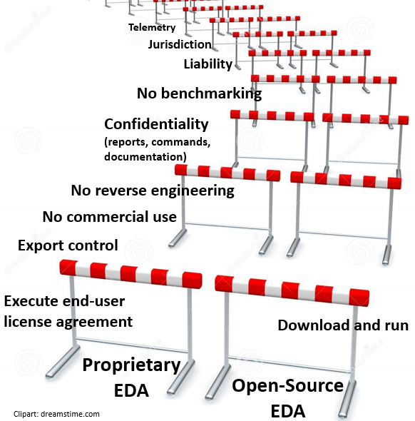
Advantages of Open-Source EDA
Extensibility
Users can see, clone, edit source code
OpenROAD: 13K+ commits, 66 contributors
Scalability
Zero incremental cost of “license”
Accessibility
Gap between “near-free” and “free”
Hurdles when getting started Fig. 3 →
Unique value propositions
Training next-gen EDA workforce
Open data for machine learning
System/architecture exploration
Notes:
On the other side, open-source EDA has its own clear advantages.
It’s extensible by users – OpenROAD code has been contributed by 66 GitHub users. Yosys has 195 contributors to its code base.
It’s scalable in the sense that there is no cost to another “license” – there is only the open-source license that says you can do anything you want with the code.
[CLICK] I feel an increasingly big differentiator for open source is accessibility. For us in academia, the commercial tools are near-free – like, $10 average cost for a seat of every tool offered by Cadence or Synopsys is incredible!!! But there is a gap between near-free and free! The cartoon on the right shows how getting started with proprietary EDA comes with many steps and many constraints. With open-source EDA, it’s download, build and run.
[CLICK] Overall, there are three absolutely unique value propositions of open-source EDA. First, by showing how an EDA tool is architected, how the software is engineered, or the guts of an algorithm implementation, open source can train the next generation of EDA R&D. Second, open source is our only path for getting open data for machine learning – and so you see efforts such as the IEEE CEDA METRICS2.1 initiative for this. Third, with scalability and machine learning, open-source EDA can enable system and architecture exploration – using cloud resources, for example.

Slide 17
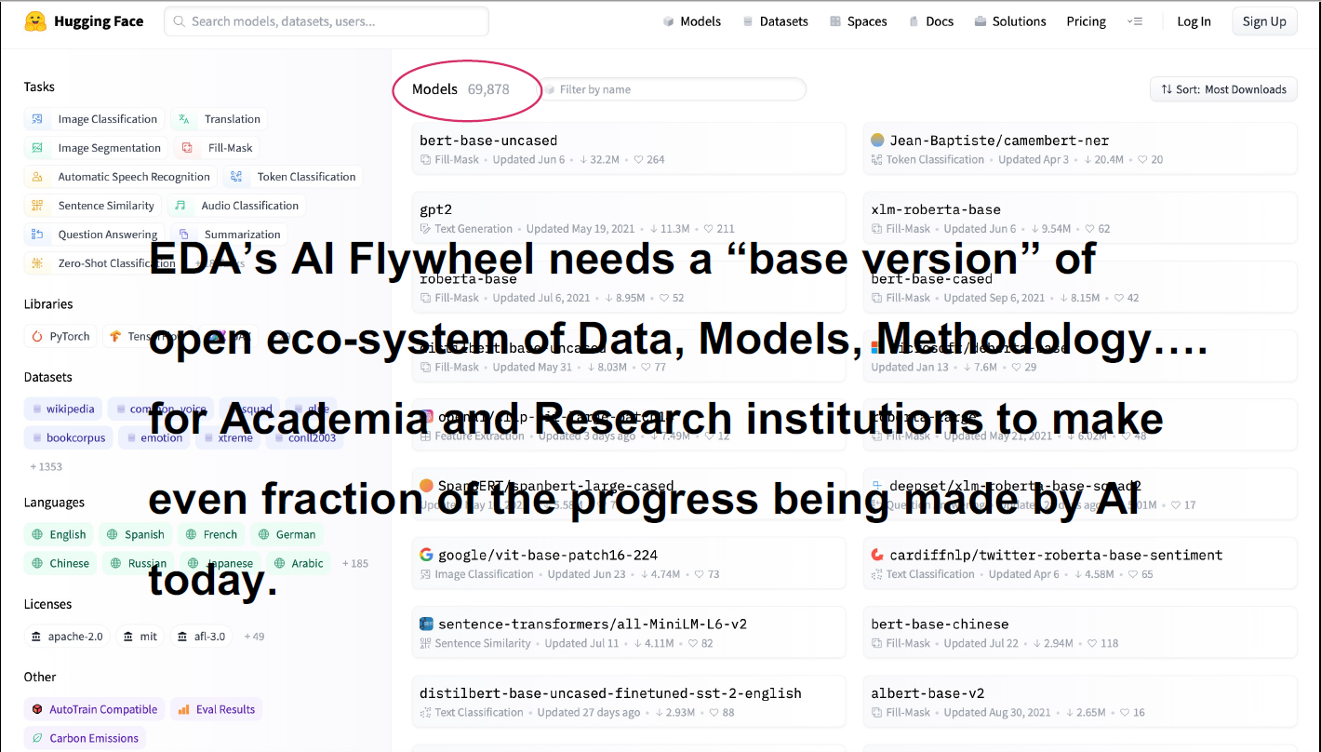
Ruchir Puri, IBM Research (opening keynote, MLCAD-2022)
Notes:
A quick side note is that others are saying the same thing. For example, Ruchir Puri’s recent keynote at the MLCAD workshop pointed out the amazing velocity of AI/ML for other domains such as large language models or vision. The most downloaded model out of the 69 THOUSAND models at Hugging Face has been downloaded 32 MILLION times! So Ruchir’s message was that
[CLICK] there is an AI Flywheel – it runs on the “exhaust” of DATA – and only with an open eco-system of data, models, methodology and more (which basically requires open-source EDA) can we hope for this kind of progress.
Engineering the Flywheel of AI: Lessons for EDA & future opportunities

Slide 18
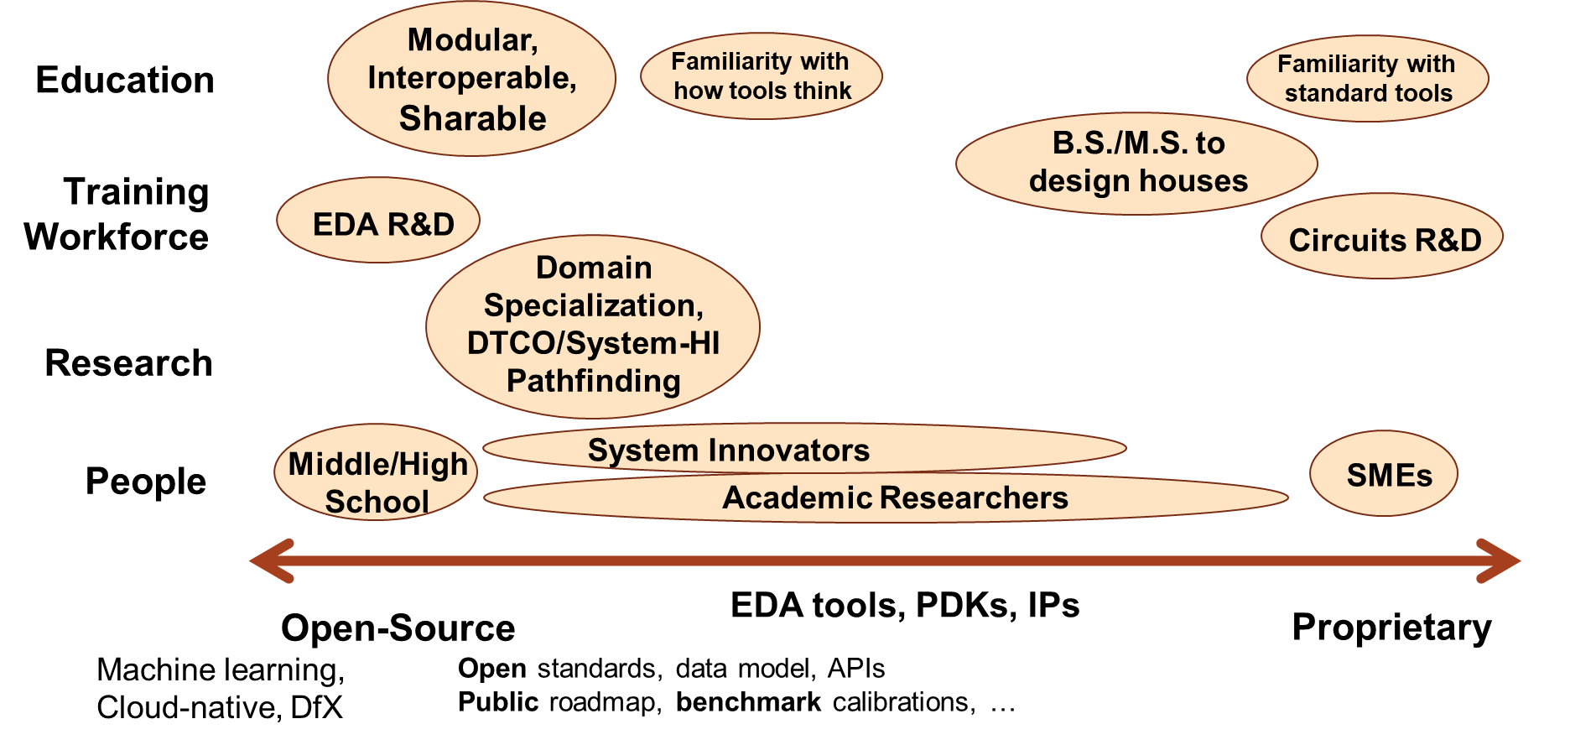
Open-Source and Proprietary: A Continuum
Notes:
I’d like to conclude with Figure 2 from the paper, which I feel has a very positive message. Remember: A Commons consists of resources belonging to or affecting the whole of a community.
An EDA Commons must be a resource to many. Are you a middle schooler? A Ph.D. student who wants to work for Innovus R&D? A community college instructor? Or a research lab trying to do CFET and Chiplet-based pathfinding – which is an example of design for a new “X” ? Then, open-source EDA on the left side is likely for you.
But if you’re a master’s student who wants to design chips at Apple next year, or a circuits researcher aiming for the next ISSCC – then you should go with proprietary EDA on the right side. There’s room for both.

Slide 19
Agenda
Motivations
Definitions
EDA Commons
Open-Source and Proprietary: A Continuum
Conclusions
Notes:
So …

Slide 20
Conclusions
This talk: food for thought
Who should an EDA Commons serve?
What problems must it solve?
What must it deliver?
What are metrics of success?
How should it be funded, governed, staffed and sustained?
How should open-source and proprietary EDA mix in service of a Commons?
Creating an EDA Commons may soon be a real challenge!
Will we be ready?
Notes:
I hope this talk starts our session off with some food for thought.
We DO need to think as a community about shared infrastructures and how to move faster.
For an EDA Commons: who should it serve, and what problems must it solve? How do we measure success? How do we fund it or staff it or sustain it? And, today’s topic: How would open-source and proprietary EDA (inevitably, in my opinion) come together in service of an EDA Commons?
[CLICK] The scary and thrilling part here is that creating an EDA Commons may soon be a real challenge! The question is: Will we be ready?

Slide 21
THANK YOU!
Research at UCSD is partially supported by NSF CCF-2112665 and by DARPA HR0011-18-2-0032.
Many thanks to Antonino Tumeo, James Ang, Andreas Olofsson and others for discussions of this and related topics.
Questions and Feedback: abk@ucsd.edu
21
21
21
21
Notes:
Thank you for your attention, and I hope that we will have the chance to define and create an EDA Commons together !

