Slide 1
IEEE CEDA DATC: Expanding Research Foundations for IC Physical Design and ML-Enabled EDA
Jinwook Jung¹, Andrew Kahng², Ravi Varadarajan², and Zhiang Wang²
¹IBM Research, ²UCSD
Notes:
Hello, my name is Jinwook Jung, and I am from IBM Research.
Today, I am going to present our invited paper, “IEEE CEDA DATC, Expanding the Research Foundations for IC Physical Design and ML-Enabled EDA.”
The paper was written with my coauthors, Prof. Andrew Kahng, Mr. Ravi Varadarajan, and Mr. Zhiang Wang from UCSD.

Slide 2

Design Automation Technical Committee
Member technical committees of IEEE Council on EDA (CEDA)
  Design Automation Technical Committee (established in 2013)
  Hardware Security and Trust Technical Committee
  System Validation and Debug Technology Committee
  Technical Committee on Cyber-Physical Systems
  Test Technology Technical Council
DATC Mission Statement
  “Provide forum for discussion of strategic and topical issues in design automation, including coordinating efforts to produce publicly available design flows and test cases and to arrange workshops, meetings, activities, and publications on related topics”
Has been invited to ICCAD CAD Contest Special Session since 2016
Current roster:
  Jinwook Jung (IBM Research)
  Andrew B. Kahng (UCSD)
  Rhett Davis (NCSU)
Notes:
Let me first start with an introduction about Design Automation Technical Committee.
[C1] It is a member technical committees of IEEE CEDA. IEEE CEDA actually has several committees as shown here, and DATC is one of them.
[C2] And here’s our mission statement.
We were established to investigate the current to'pical issues of EDA.
We’ve been working to produce publicly available designs flows and test cases, and to arrange discussion forums for the current EDA issues.
[C3] Thankfully, DATC has been invited to ICCAD Contest Special Session since 2016. And we’ve been able to advertise our latest activities to the broader research community.
[C4] Currently we have three members, myself, Prof Andrew Kahng from UCSD, and Prof Rhett Davis from NCSU.
[PAUSE]
[NEXT SLIDE] Today’s presentation is about ...

Slide 3
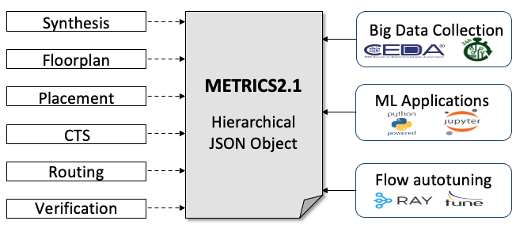
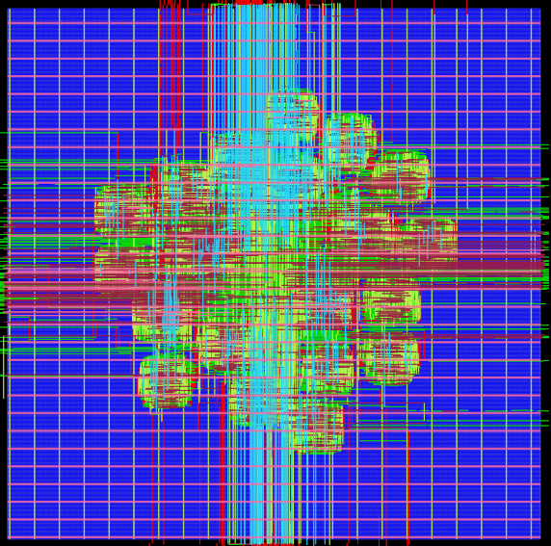
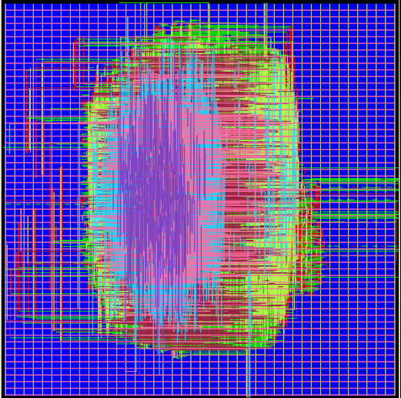
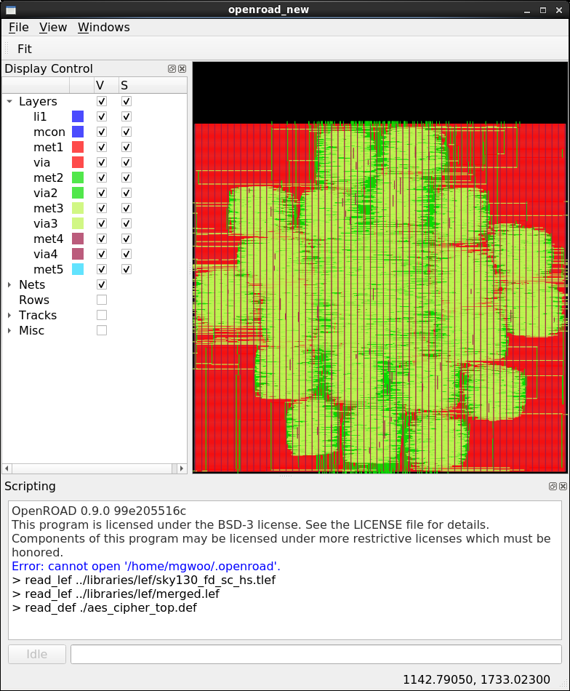
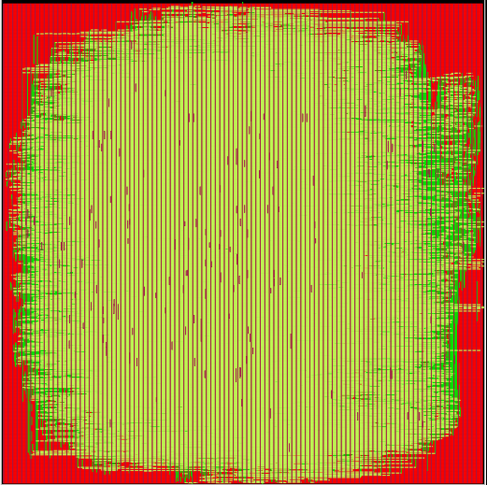
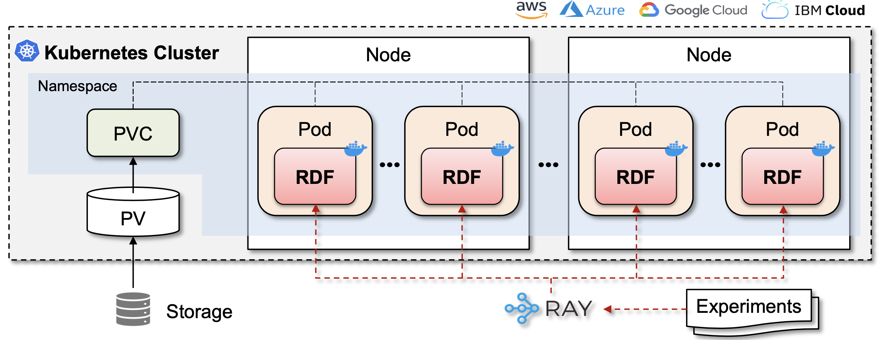
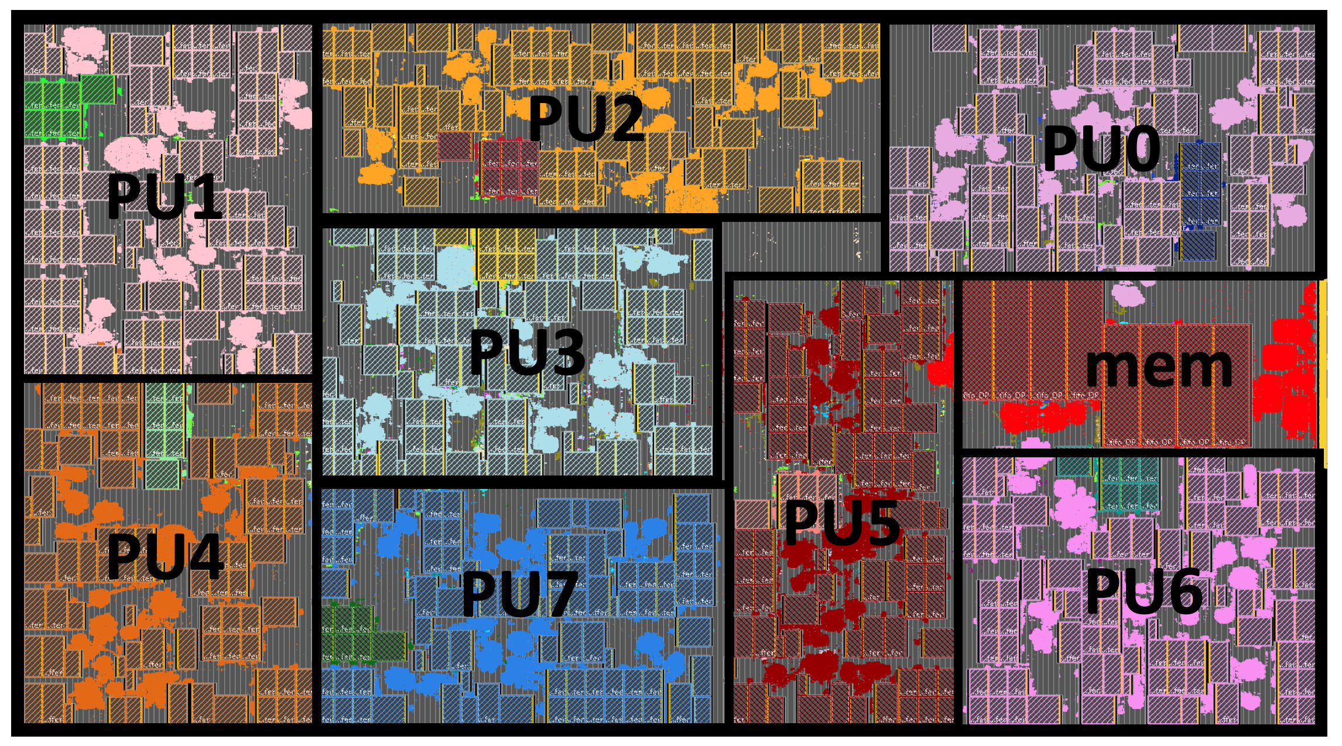
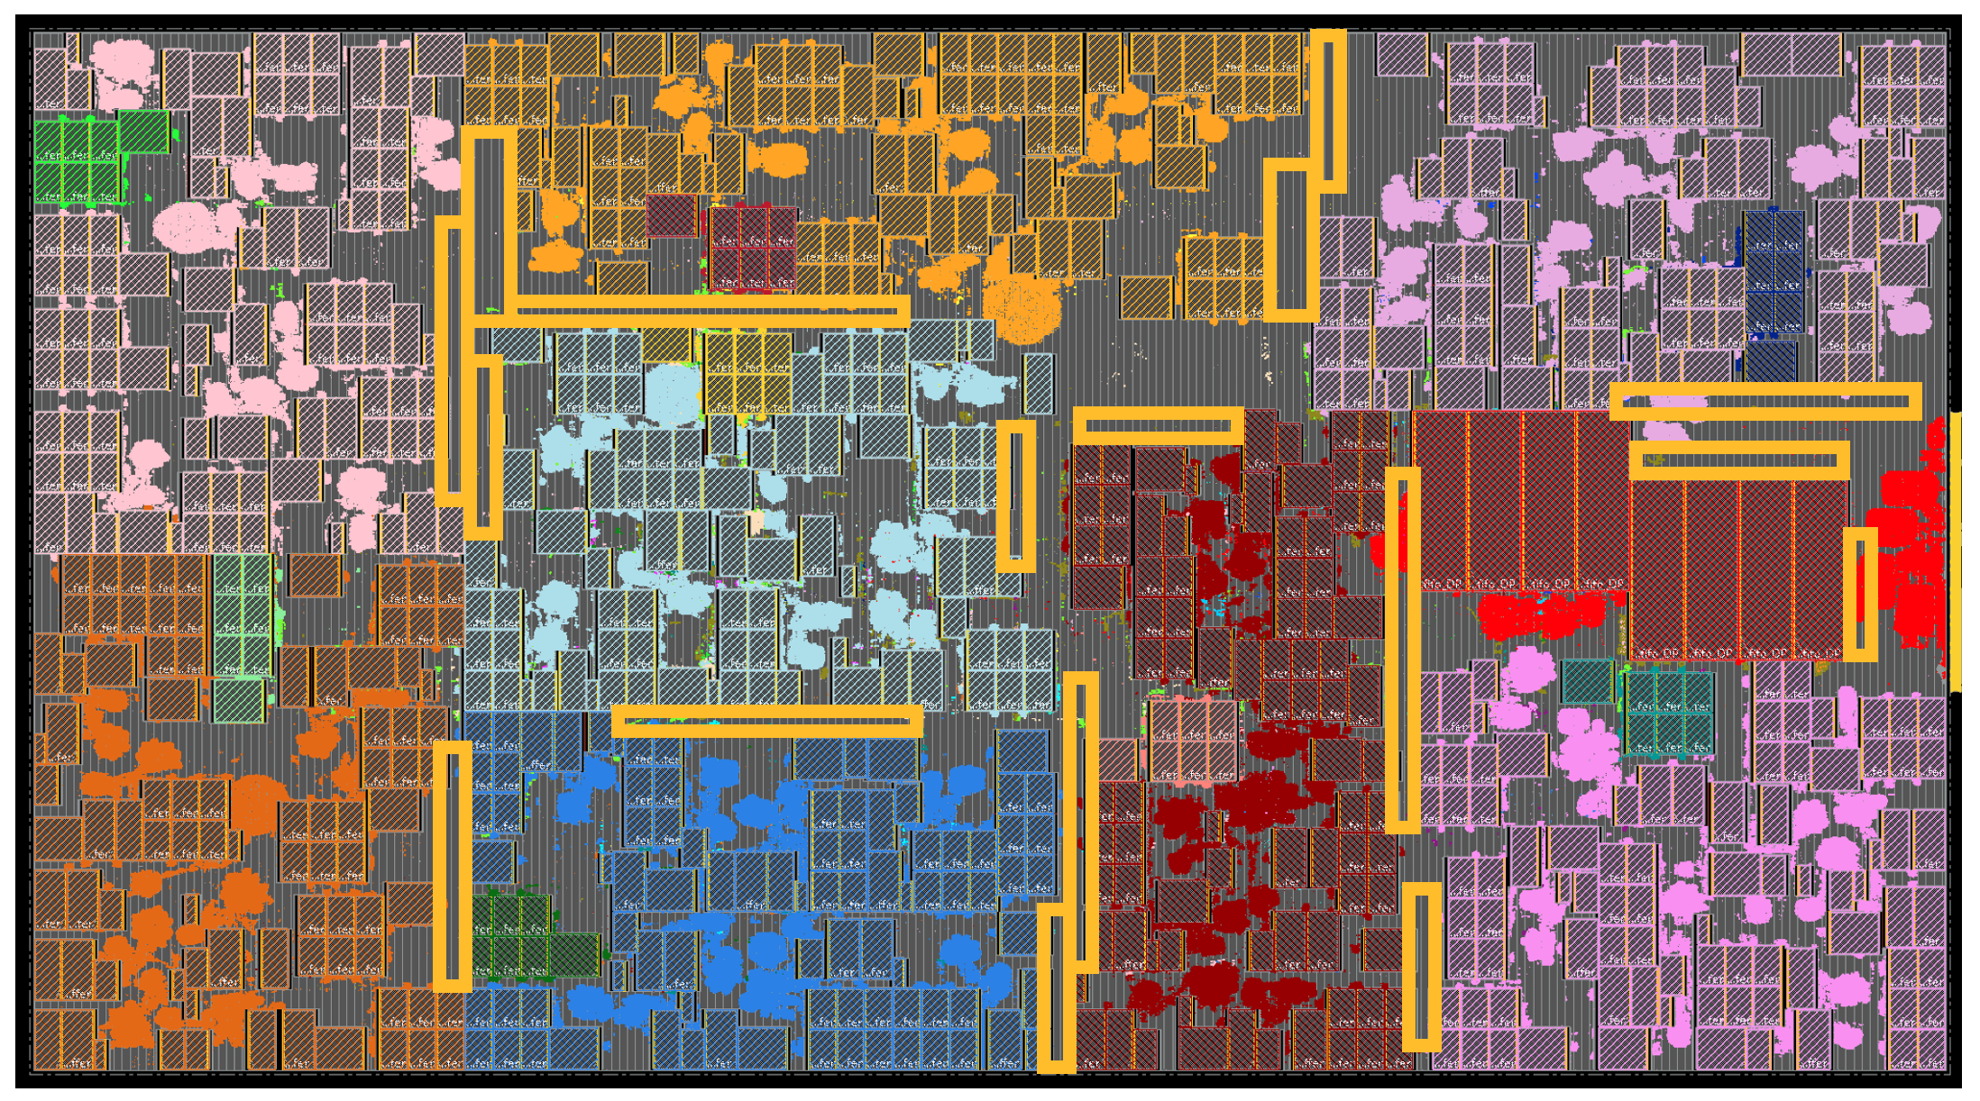
Introduction
This presentation is about IEEE CEDA DATC’s latest activities to establish
and expand research foundations for IC Physical Design and ML-EDA
  Academic reference design flow preserving leading research codes
  Standardized metrics system for flow measurement
  Golden calibration datasets for electrical analysis and verification tasks
  Modern and complete benchmarks for physical design
  Cloud enablement of large-scale distributed design of experiments
DATC RDF
METRICS2.1
Calibration
Dataset
Cloud-native large-scale DoE
Macro placement benchmarks
Notes:
[C0] Today’s presentation is about the DATC’s latest activities related to research foundations for IC Physical Design and ML-Enabled EDA.
[Pause]
So, there are actually a couple of DATC activities around this goal, which are shown here:
[C1] Academic reference design flow preserving leading research codes
[C2] Standardized metrics system for flow measurement
[C3] Golden calibration datasets for electrical analysis and verification tasks
[C4] Modern and complete benchmarks for physical design
[C5] Large-scale distributed design of experiments on cloud environment
[Pause]

Slide 4
Outline
Academic reference design flow preserving leading research codes
Standardized metrics system for flow measurement
Golden calibration datasets for electrical analysis and verification tasks
Modern and complete benchmarks for physical design
Cloud enablement of large-scale distributed design of experiments
Academic reference design flow preserving leading research codes
Standardized metrics system for flow measurement
Golden calibration datasets for electrical analysis and verification tasks
Modern and complete benchmarks for physical design
Cloud enablement of large-scale distributed design of experiments
Notes:
In the rest of my presentation, I’ll go over these DATC’s activities one by one, and introduce what we are doing under DATC.
[C1] So, let’s start from the academic reference design flow.

Slide 5
DATC Robust Design Flow (RDF)
Academic reference design flow by DATC
Initiated in 2016 from contest outcome
Goals:
  Preserve leading research codes
  Foster flow-scale research
Flow components | Tools
RTL generator | Chisel/FIRRTL
RTL obfuscation | ASSURE
Logic synthesis | Yosys+ABC
DFT insertion | Fault
Floorplanning | TritonFP
Macro Placement | TritonMP, RTL-MP, Hier-RTLMP
Global placement | RePlAce, FZUplace, NTUPlace3, ComPLx, Eh?Placer, FastPlace3-GP
Detailed placement | OpenDP, MCHL, FastPlace3-DP
Flip-flop clustering | Mean-shift, FlopTray
Clock tree synthesis | TritonCTS
Global routing | FastRoute4-lefdef, NCTUgr, CUGR
Detailed routing | TritonRoute, NCTUdr, DrCU
Layout finishing | KLayout, Magic
Gate sizing | Resizer, TritonSizer
Parasitic extraction | OpenRCX
STA | OpenSTA, iTimerC
Integrated P&R app | OpenROAD
Database | OpenDB
Libraries/PDK | NanGate45, SKY130, ASAP7, GF180MCU
Benchmark conversion | RosettaStone (timing-sensible)
Metrics system | METRICS2.1 (JSON-native)
Verilog
Scala
Netlist, SDC, parms
Chisel/FIRRTL
P&R Flow
OpenROAD
Integrated App
RDF Point Tool Based Flow
Key
RTL Obfuscation (ASSURE)
Locked RTL
SDC
Logic Synthesis
DFT Insertion (Fault)
Routed design
Notes:
The academic reference design flow created by DATC is called “DATC Robust Design Flow, RDF for short.”
It was initiated in 2016 based on the winning tools and research outcomes from the previous CAD contests.
With RDF development, we would like to preserve leading research codes, and we also want to foster flow-scale research.
The diagram below shows the entire design flow in RDF, which includes Scala/Chisel RTL generator, RTL obfuscation, synthesis and DFT, and finally the full P&R flow.
[C1] This table shows all the tools that are currently included in DATC RDF.
The tools highlighted in red fonts are the latest updates made in the past year.
[NEXT SLIDE] Among the latest updates, ...

Slide 6
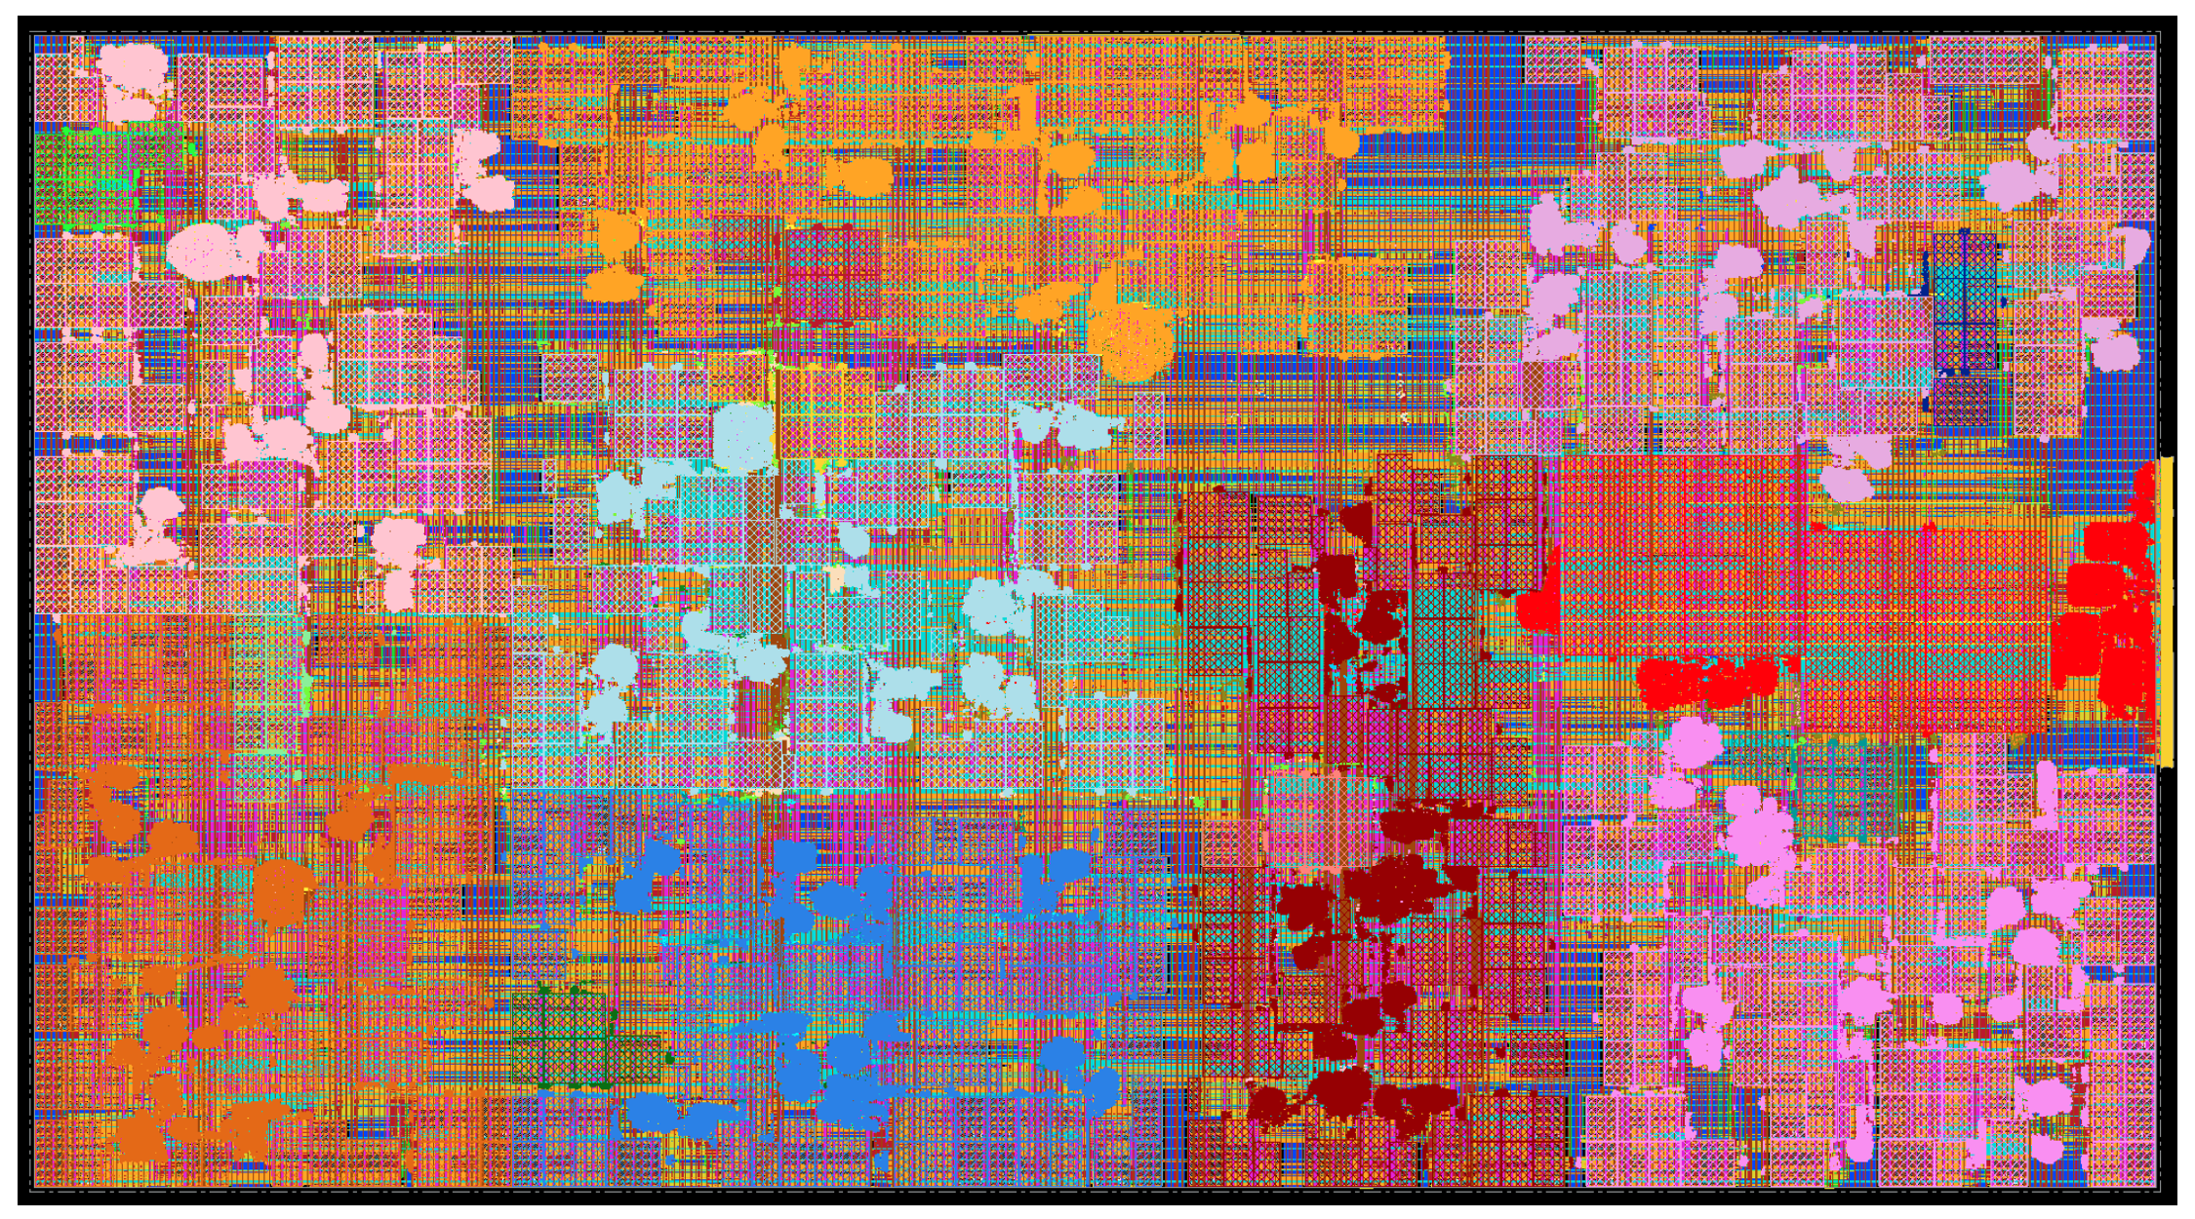
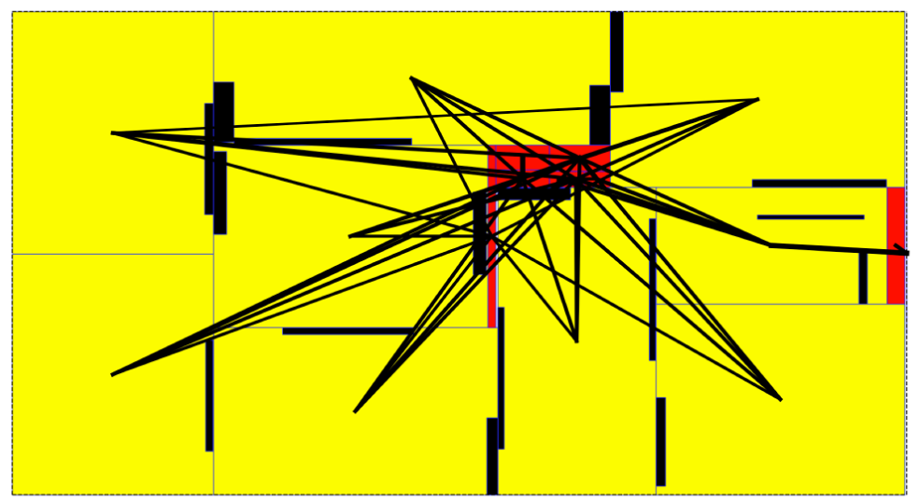
DATC RDF Update: Automatic Macro Placers
RTL-MP: Macro placer for human-quality macro placements [Kahng et al., ISPD’22]
  Auto-clustering, shaping, pin access comprehension, notch region avoidance, etc.
Hier-RTLMP: Multi-level macro placement for large-scale designs
  Logical hierarchy of the netlist converted into multi-level physical hierarchy
  Dataflow awareness; hierarchical bus planning for better pin access
  Two-step cluster shaping process for improved runtime and quality of result
Results from Hier-RTLMP:
  tabla_02: a complex AI accelerator having 760 macros
Post-placement layout
Pin access regions
Post-routing layout
Top-level bus planning
Notes:
Among the latest updates, I want to particularly highlight the new automatic macro placers in DATC RDF.
[C1] This year, we have included a recent automatic macro placer, called RTL-MP in the RDF inventory.
It provides human-quality macro placement solution by combining its key components, such as auto-clustering, shaping, pin access comprehension, and notch region avoidance.
[C2] We also have included a newer version of macro placer named Hier-RTLMP.
It is an updated version of RTL-MP to support large-scale designs having a large number of macros.
So, on top of RTL-MP, it leverages logical hierarchy and dataflow of the design, and creates a multi-level physical hierarchy.
Based on that, it uses two-step cluster shaping process for runtime and QoR improvement.
[C3] These plots show a result obtained by Hier-RTLMP, on a complex AI accelerator having 760 macros.
You can see that Hier-RTLMP creates a nice macro placement for such a big design.

Slide 7
Outline
Academic reference design flow preserving leading research codes
Standardized metrics system for flow measurement
Golden calibration datasets for electrical analysis and verification tasks
Modern and complete benchmarks for physical design
Cloud enablement of large-scale distributed design of experiments
Notes:
Next, I’ll introduce our activities to establish a metrics system for flow measurement.
[NEXT SLIDE] ... which is METRICS2.1

Slide 8






METRICS2.1: Metrics System for Flow Measurement
Motivation: Lack of standard tool metrics and reporting formats
  Hampers sharing of know-how, ML models, as well as results
METRICS2.1: Standardized metrics collection and design process recording
  Provides standardized naming and format for design tool and flow metrics data
  Defines robust structure for large-scale metrics archives
Synthesis
Big Data Collection
Floorplan
METRICS2.1
Hierarchical
JSON Object
Placement
ML Applications
CTS
Routing
Flow autotuning
Verification
GitHub repository: https://github.com/ieee-ceda-datc/datc-rdf-Metrics4ML
  Provides metrics dataset collection obtained from OpenROAD flow with public enablement
  Has sample Jupyter notebooks on datasets to provide example ML applications
Notes:
... which is METRICS2.1...
[C1] So the motivation of this activity is from the lack of standard tool metrics and reporting formats in the EDA domain.
There are many academic and commercial EDA tools, but each tool uses its own naming conventions, metrics format, and parameters.
We think that such divergence hampers sharing of knowledge and built machine learning models, as well as reproduction of results.
[C2] So, we DATC have been working to establish a generalized metrics collection system, named METRICS2.1.
It provides a standard format for flow metrics data, and defines a robust structure for large-scale metrics datasets.
[C3] We have created a GitHub repository, as shown here.
The repository provides a set of metrics data obtained from OpenROAD flow with public enablements.
It also has sample Jupyter notebooks, which demonstrate example machine learning applications using METRICS2.1.

Slide 9
METRICS2.1 Updates
Now included in the latest public releases of OpenROAD and OpenROAD Flow Scripts
  Invoke OpenROAD with -metrics <filename>.json
  set_metrics_stage “<stage_name>__{}”
  push_metrics_stage and pop_metrics_stage
Example:
{
"detailedroute__route__net": 78790,
"detailedroute__route__net__special": 2,
"detailedroute__route__wirelength__iter1": 384221,
"detailedroute__route__wirelength__iter2": 378133,
"detailedroute__route__wirelength__iter3": 376415,
"detailedroute__route__wirelength__iter4": 376298,
"detailedroute__route__drc_errors__iter1": 13959,
"detailedroute__route__drc_errors__iter2": 13053,
"detailedroute__route__drc_errors__iter3": 19,
"detailedroute__route__drc_errors__iter4": 0,
...
}
Metrics naming convention
<stage>__<category>__<name>__<modifier>
Notes:
So, the METRICS2.1 system is now included in the latest releases of OpenROAD and OpenROAD Flow Scripts.
Users can specify the dash metrics option to create a METRICS JSON file from OpenROAD flow execution.
[C1] This shows an example metrics data for detailed routing.
As you can see here, each metrics data is stored as JSON object, essentially a key-value pair.
This shows the metrics naming convention, and each metric is uniquefly defined by stage, category, name, and the modifier.

Slide 10
Outline
DATC RDF: Academic reference design flow
METRICS2.1: Standardized metrics system for flow measurement
Golden calibration datasets for electrical analysis and verification tasks
Modern and complete benchmarks for physical design
Cloud enablement of large-scale distributed design of experiments
Notes:
Now, I’ll explain DATC efforts for calibration datasets.

Slide 11
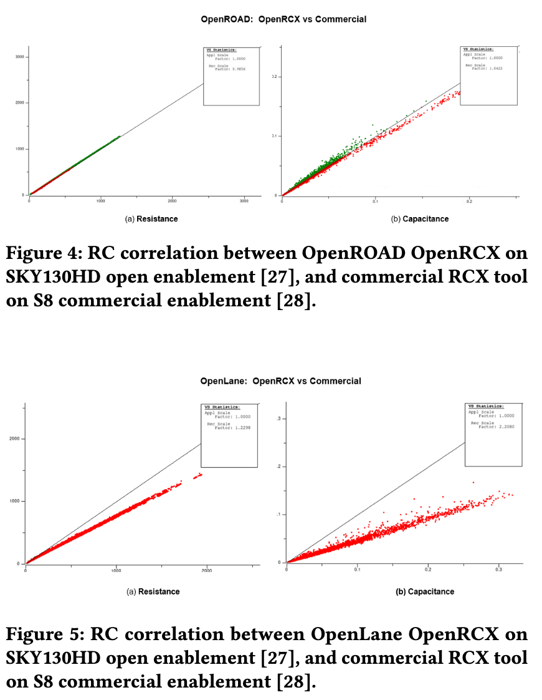
Calibrations Datasets... Why?
Open enablements (tools, PDKs, libraries) are only as good as how they are used
  Open enablements may NOT guarantee the required accuracy due to lack of strong regression and thorough validation processes
Example: OpenRCX 2.5D RCXT usage for SKY130HD enablement
  Case 1: SKY130 Golden commercial enablement vs OpenROAD (calibrated)
  Case 2: SKY130 Golden commercial enablement vs OpenLane (commit hash: 7b15116)
Good correlation
Bad correlation
Case 1: SKY130 golden enablement vs OpenRoad
Case 2: SKY130 golden enablement vs OpenLane
Needs calibration efforts to enable reliable results from open-source EDA
Notes:
So, why are we doing this.
[C1] In open-source EDA context, we have seen that open enablements are only as good as how they are being used.
What does that mean... sometimes, we see that open enablements can NOT guarantee the best accuracy or required accuracy due to the lack of strong regression and thorough validation processes.
[C2] Here’s an example, showing two different OpenRCX usages for SKY130, one from an OpenROAD flow and the other from an OpenLane flow.
From the left plots, you can see that OpenROAD’s RC data is very well correlated with the golden enablement.
This is because the OpenROAD flow is very well calibrated to the golden data.
On the other hand, from the plots on the right, the RC extraction data obtained from an OpenLane flow does not correlate well with the golden data.
[C3] So, we think this highlights a necessity of calibrations effort in the open-source EDA contexts.
And we need calibration efforts to obtain reliable results from open-source EDA tools.

Slide 12
DATC Calibrations Repository
GitHub: https://github.com/ieee-ceda-datc/datc-rdf-calibrations
Provides reference analysis data for STA, RC extraction, and IR drop analysis
  Obtained from DRV-free routed testcases in open enablements
  Dataset: 39 cases from {NanGate45, SKY130HD/HS} X {GCD, AES, JPEG, IBEX, SWERV}
  Obfuscated by introducing noise
Hope that our datasets facilitate calibration in opensource enablements
NanGate45-AES
NanGate45-JPEG
SKY130-AES
SKY130-JPEG
Notes:
From that motivation, we DATC have been working to build a calibration repository as shown here.
The repository provides a collection of reference analysis data, including STA, RC extraction, and IR drop analysis.
The calibration datasets were generated from DRV-free routed testcases from open enablements.
And we currently provides 39 cases in our dataset.
So, we hope that our datasets facilitates calibration in opensource enablements.

Slide 13
Outline
DATC RDF: Academic reference design flow
METRICS2.1: Standardized metrics system for flow measurement
Golden calibration datasets for electrical analysis and verification tasks
Modern and complete benchmarks for physical design
Cloud enablement of large-scale distributed design of experiments
Notes:
Now, I’ll explain our fourth activity, modern and complete benchmarks for physical design.

Slide 14
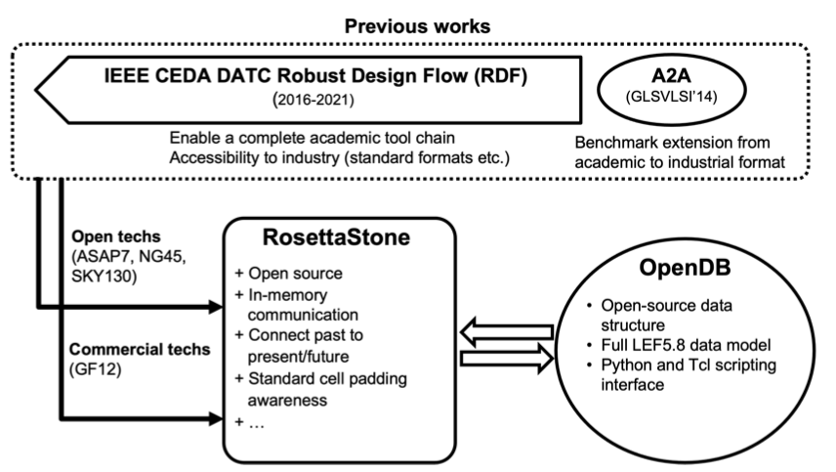
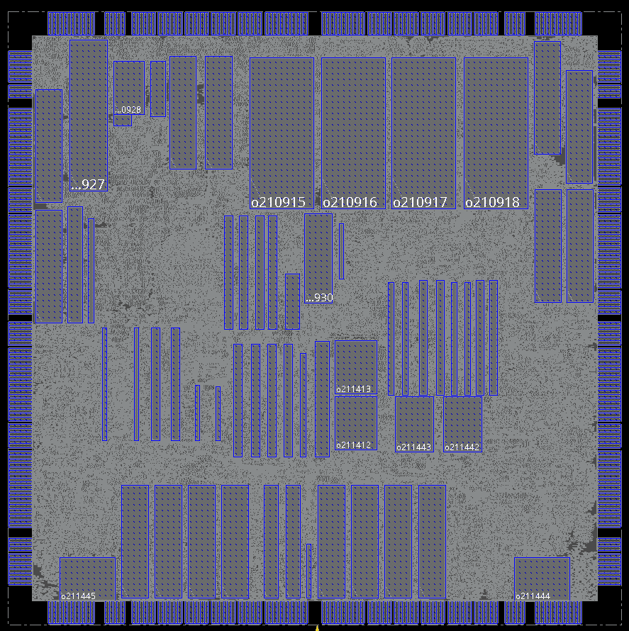
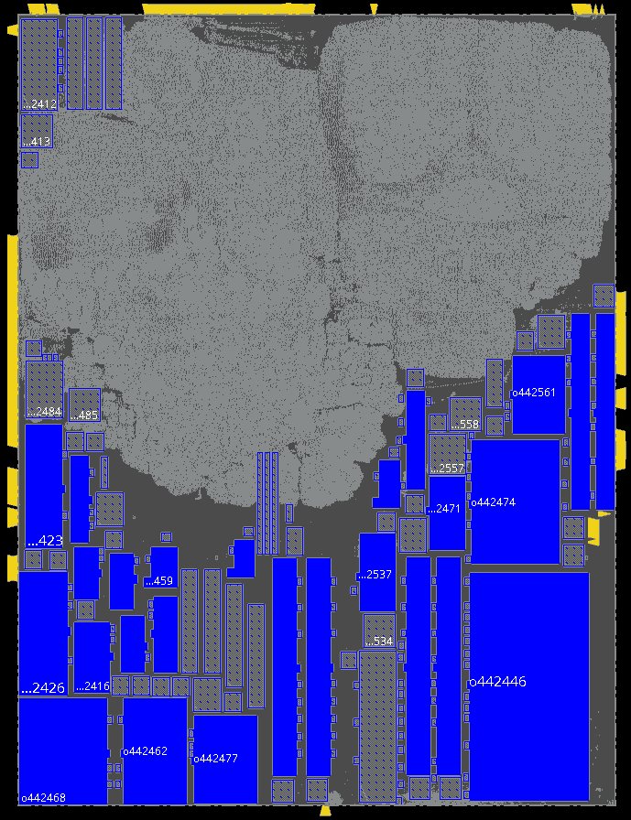
Revitalizing Classical CAD Contest Benchmarks
Classical benchmarks are outdated and/or incomplete
  e.g., bookshelf-based ISPD CAD contest benchmarks – no cell types, timing info, tech info, etc.
RosettaStone: Bookshelf to LEF/DEF converter [Kahng et al., IEEE D&T 2022]
  Given bookshelfs and target PDK information, it creates OpenDB databases
  Populates missing information and scales macros based on target PDK
  Link: https://github.com/ABKGroup/RosettaStone (35 benchmarks in 4 open enablements)
NanGate45-adaptec1
(ISPD05)
NanGate45-superblue18
(ISPD06)
Notes:
First, classical benchmark revitalization.
[C1] There have been several classical benchmarks, but they are either outdated or incomplete.
For example, the ISPD placement benchmarks written in bookshelf format has no cell types, timing information, and technology information.
[C2] So, under DATC, we have supported development of [Rose'ttaStone], a bookshelf to LEF/DEF converter.
Given a bookshelf-based benchmark and PDK information, it creates an OpenDB database.
Then, [Rosetta’Stone] populates the missing information, such as cell types, and scales existing macro blocks properly based on technology information.
The GitHub link is also shown in this slide, which provides 35 benchmarks in 4 open enablements.
These two plots show two example results, one for an ISPD’05 benchmark and the other for an ISPD’06 benchmark.
You can see that RosettaStone successfully converts the previous CAD contest benchmarks into NanGate45 technology.

Slide 15
RosettaStone Timing Sensibility
Created benchmarks can have many impractically long timing paths
RosettaStone provides logic path cutting capability
  User can specify maximum path length
  Using OpenSTA APIs, it retrieves timing paths and convert single-output/single-input combinational logic gates into flip-flops, or insert flip-flops and create associated output nets
Design | Before logic cutting |  | After logic cutting
Design | Path delay | Logic stage | Path delay | Logic stage
superblue2 | 8.55 | 327 | 2.47 | 11
superblue3 | 13.28 | 495 | 1.89 | 24
superblue5 | 7.26 | 271 | 2.62 | 26
superblue6 | 7.18 | 267 | 2.67 | 26
superblue7 | 5.42 | 211 | 2.87 | 10
superblue9 | 8.14 | 308 | 2.05 | 82
superblue11 | 70.47 | 2497 | 2.37 | 27
superblue12 | 3.91 | 141 | 3.11 | 20
superblue14 | 16.76 | 450 | 2.78 | 26
superblue16 | 4.72 | 144 | 1.31 | 21
superblue19 | 7.25 | 279 | 1.79 | 18
Notes:
While developing RosettaStone, we have found that the converted benchmarks have impractically long timing paths.
To cope with the problem, RosettaStone provides a logic path cutting capability.
Users can specify maximum path length constraint as an input to RosettaStone.
Then, using OpenSTA API, Rose'ttaStone retrieves timing paths of the design, and insert flip-flops and transforms the netlists properly.
This table shows the result.
Before logic cutting, the benchmarks have very long critical paths.
But with logic cutting, we can create benchmarks having reasonable logic stages and path delay.
[PAUSE]

Slide 16
Modern Benchmarks for Macro Placement
Macro placement: Important challenge for physical design and ML-enabled EDA
  Need to establish research foundations for macro placement
MacroPlacement Repo: https://github.com/TILOS-AI-Institute/MacroPlacement
  Provides modern macro placement benchmarks and research foundations
  3 open-source designs:
    Ariane: A 64-bit RISC-V CPU design. 136 or 133 macros
    MemPool: A many-core system targeting image processing applications
    NVDLA: An open-source deep learning inference accelerators
  3 open-source enablements with SRAM generators:
    NanGate45/FreePDK45 with bsg_fakeram black-box SRAM generator
    ASAP7 with FakeRAM2.0-generated fake single-port SRAMs
    SKY130HD with metal stack extended to 9 layers and FakeRAM2.0
  3 implementation flows
    Two Cadence Digital Implementation flows along with one OpenROAD-based flow
Notes:
I’d like to also introduce one more benchmark activity, the macro placement benchmarks.
[C1] Macro placement is an important challenge for physical design and ML-enabled EDA.
But we haven’t really seen an established foundations for macro placement research.
[C2] Under TILOS AI Institute, Prof. Andrew Kahng’s team at UCSD has established the MacroPlacement repository which is shown here.
It provides modern macro placement benchmarks as well as the research foundation.
[C3] The repository includes three well-known open-source designs: Ariane RISC-V CPUs, MemPool many core system, and NVDLA deep learning accelerator.
[C4] It supports three open-source enablements with SRAM genearators,
[C5] and provides three different implementation flows, including two commercial, Cadence-based flows, as well as one OpenROAD flow.
[PAUSE]
[NEXT SLIDE]
So, with this MacroPlacement repo, our hope is that ...

Slide 17
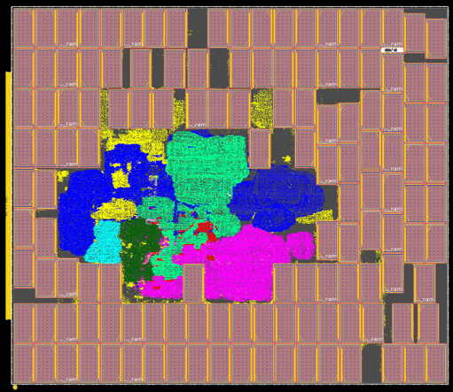
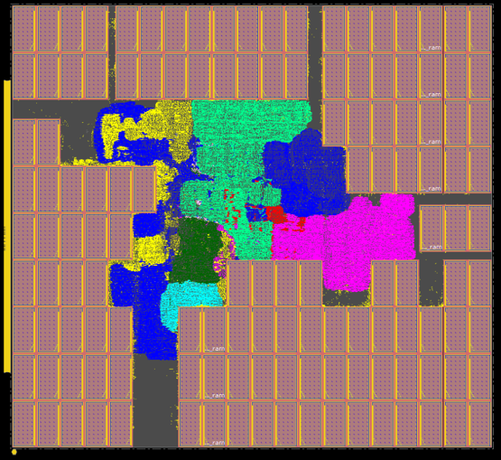

Facilitating ML-Enabled Macro Placement Research
ML-guided macro placement
  Cost function of Hier-RTLMP:
    $Cost=α∙Area+β∙WL+γ∙p_{outline}+ζ∙p_{bias}+η∙p_{blockage}+θ∙p_{guidance}+λ∙p_{notch}$
  Use hyperparameter tuning to determine optimal weights in cost function for different designs
ML-driven macro placement
  MacroPlacement repo provides Google’s RL-based macro placement implementation
  Arian-133 results on NanGate45
RL-based macro placement
Hier-RTLMP
Notes:
So, our hope is that this MacroPlacement repo facilitates ML-enabled macro placement research.
[C1] For example, we can study machine-learning guided macro placement methodology using the MacroPlacement repo.
Actually, the cost function in Hier-RTLMP has several tunable parameters, such as weight for area and weight for wirelength.
We can utilize hyperparameter tuning methods to find optimal weights in the cost function for different designs.
That could be one interesting research direction.
[C2] Another thing we can do with the MacroPlacement repo is machine-learning driven macro placement.
The MacroPlacement repository in fact provides a baseline implementation of Google’s reinforcement learning based macro placement method.
This picture shown here were created using that baseline implementation on Ariane RISC-V design.
So, with the MacroPlacement repo, we want to facilitate ML-enabled macro placement research.

Slide 18
Outline
DATC RDF: Academic reference design flow
METRICS2.1: Standardized metrics system for flow measurement
Golden calibration datasets for electrical analysis and verification tasks
Modern and complete benchmarks for physical design
Cloud enablement of large-scale distributed design of experiments
Notes:
Lastly, I’ll briefly introduce a cloud-native enablement of large-scale design of experiments.

Slide 19
Why Cloud-Native Enablement of Large-Scale DoE?
Machine learning (and ML-CAD too) requires data
  Generating data for ML-enabled EDA needs compute resource and time
  How to establish efficient way of generating large amount data for ML-enabled EDA?
Public cloud provides compute resources on-demand
  Now, how to best-utilize public cloud to generate large data for ML-CAD?
  Obtain bare cloud instances, install libraries, compile tools, ... → Not scale well
Need to establish generic and cloud-native way to enable large-scale design of experiments on public cloud services
Notes:
So, again, why do we need this?
[C1] We all know that machine learning requires data, and the same applies to the ML-CAD research.
However, generating large amount of data for ML-CAD needs huge amount of compute resources and takes significant time.
So, we want to establish an efficient way of generating the large amount of data for ML-CAD.
[C2] Here, we would like to utilize cloud computing.
But now the question becomes, how to best-utilize public cloud services to generate large data specifically for ML-CAD.
We can just obtain bare cloud instances, install OSes, libraries, and compiles tools every time, all manually, but it won’t scale very well.
[C3] In that sense, we need to establish a generic, cloud-native way to enable large-scale design of experiments on cloud.

Slide 20







Cloud-Native Enablement of Large-Scale DoE
Containerization → Proven way to build cloud-native applications
  Custom container image for flow and tool execution (RDF/OpenROAD)
  Volume resources for hosting design enablements (PDK, libraries)
  Parallel workload distribution capability enabled by Kubernetes and Ray
Kubernetes
Node
Node
Namespace
PVC
Pod
Pod
Pod
Pod
RDF
OpenROAD
RDF
OpenROAD
RDF
OpenROAD
RDF
OpenROAD
PV
Storage
Experiments
Experiments
Notes:
So, this is the cloud architecture that we think is suitable for large-scale DoE.
To realize cloud-native enablement, we utilize containerization, which is a proven way of building cloud-native applications.
For that,
[C1] We have created custom container images of flow and tool execution.
[C2] We also have persistent volume resources to retain PDK and libraries,
[C3] And this environment is hosted in Kubernetes cluster, and individual experiments are distributed using Ray framework.
[C4] Since this is a cloud-native enablement, we can host this architecture anywhere in public cloud, AWS, Azure, GCP, and IBM Cloud, and even in local machines.

Slide 21
Summary
DATC: expanding research foundations for IC Physical Design and ML-EDA
  Academic reference design flow preserving leading research codes
  Standardized metrics system for flow measurement
  Golden calibration datasets for electrical analysis and verification tasks
  Modern and complete benchmarks for physical design
  Cloud enablement of large-scale distributed design of experiments
DATC RDF
METRICS2.1
Calibration
Dataset
Cloud-native large-scale DoE
Macro placement benchmarks
Notes:
So, here’s the summary of today’s presentation.
DATC is a technical committee under IEEE CEDA, and we are working to establish and expand research foundations for IC Physical Design and ML-Enabled EDA.
In today’s presentation, I have introduced the five activities that we have been doing for the past year.
Thanks very much for your attention, and also thank you the ICCAD Contest Organizer for giving us the chance to speak in this session.
Thank you.

