Slide 1
Physically Accurate Learning-based Performance Prediction of Hardware-accelerated ML Algorithms
Hadi Esmaeilzadeh^{[1]}, Soroush Ghodrati^{[1]}, Andrew B. Kahng^{[1] [2]}, Joon Kyung Kim^{[1]}, Sean Kinzer^{[1]}, Sayak Kundu^{[2]}, Rohan Mahapatra^{[2]}, Susmita Dey Manasi^{[3]}, Sachin S. Sapatnekar^{[3]}, Zhiang Wang^{[2]} and Ziqing Zeng^{[3]}
^{[1]}Department of Computer Science and Engineering, University of California, San Diego
^{[2]}Department of Electrical and Computer Engineering, University of California, San Diego
^{[3]}Department of Electrical and Computer Engineering, University of Minnesota
Notes:
Hello everyone, I am Sayak Kundu, a third year PhD student at UC San Diego.
Today, the title of my presentation is “Physically Accurate Learning-based Performance Prediction of Hardware-accelerated ML Algorithms”.

Slide 2
Outline
Background and Motivation
Main Contributions
Our Approach
Experimental Setup and Results
Application of Our Approach
Conclusion
Notes:
This is the outline of my presentation.
I will start with the background and motivation of our work.
Then I will summarize our main contributions and explain our approach.
Next, I will describe our experimental setup, results and the application of our approach.
Finally, I will conclude my talk with a quick summary.

Slide 3
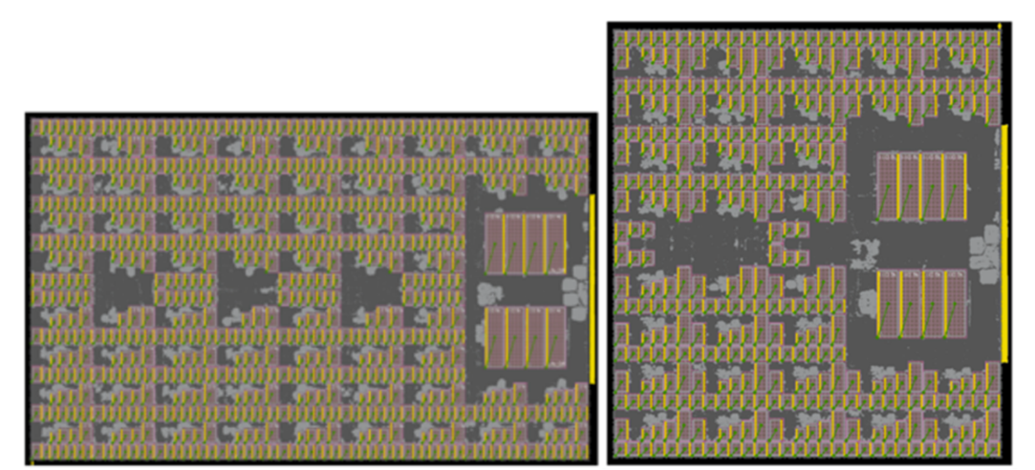
Background and Motivation
ML accelerators are the key component of real-time machine learning
Highly parameterizable, complex design
Optimized with design space exploration (DSE)
Design-A
Design-B
Design | PU | PE/PU | Input bitwidth | Internal bitwidth | Area (mm²) | Power (mW) | Frequency (GHz) | Runtime (µs) | Energy (µJ)
Design-A | 8 | 8 | 16 | 32 | 2.96 | 580 | 0.95 | 14.51 | 8.41
Design-B | 4 | 8 | 8 | 24 | 2.10 | 300 | 0.95 | 22.62 | 6.80
Notes:
ML accelerators are the key component of real-time machine learning.
These designs are highly parameterizable and very complex.
So, design space exploration is required to find the optimal ML accelerator.
[CLICK]
Here are the post-synthesis-place-&-route layouts of two ML architectures that implement the SAME ML algorithm.
In the table number of processing unit PU, number of processing engine PE per PU, input bitwidth and internal bitwidth are the hyperparameters,
area, power and frequency are the backend performance metrics and
energy and runtime are the system level performance metrics.
We see Design-A achieves better runtime, but Design-B achieves better energy.

Slide 4
Background and Motivation
ML accelerators are the key component of real-time machine learning
Highly parameterizable, complex design
Optimized with design space exploration (DSE)
Challenges for DSE
Huge design space: exponential in number of architectural hyperparameters
Huge runtimes: SP&R flow takes days to weeks
Design-A
Design-B
Notes:
The main challenges for DSE are huge design space and high runtime.
Large number of architectural hyperparameters of ML accelerators results in exponentially large design space.
SP&R flow of these designs takes days to weeks.

Slide 5
What Blocks DSE Today?
Design space complexity
High number of parallel runs: Limited by the availability of compute resources and tool licenses
SP&R runtime
Post-synthesis PPA estimation: Miscorrelation with post-SP&R PPA number
Notes:
Fast exploration of design space seems to be achieved using high number of parallel runs.
But the number of parallel runs are limited by the availability of compute resources and tool licenses. And both are very expensive.
[CLICK]
Also, high SP&R runtime can be addressed by using less time-consuming post-synthesis PPA estimation.
However, it is not feasible because of the miscorrelation between the post-synthesis and post SP&R PPA number.
[CLICK]
Here is the post-synthesis vs. post-route power plot of four ML-accelerator designs.
Even though the scatter plot follows the 45-degree straight line, the power numbers are not correlated.
[CLICK]
The post-synthesis power varies from 200mW to 350mW whereas the post-route power varies from 500mW to 750mW.
[CLICK]
The data point inside the red box has almost similar post-route power but the post-synthesis power varies a lot.
[CLICK]
This is the post-synthesis vs post-route frequency plot. It is obvious from the plot that the post-synthesis and post-route frequency data points are not at all correlated.
In the paper we also show the Kendall rank correlation coefficient which indicates the miscorrelation.
So, it is obvious that we need post SP&R PPA number for Accurate DSE.

Slide 6
What Blocks DSE Today?
Design space complexity
High number of parallel runs: Limited by the availability of compute resources and tool licenses
SP&R runtime
Post-synthesis PPA estimation: Miscorrelation with post-SP&R PPA number
Inaccuracy of predictive frameworks
Low accuracy of analytical models in modern technology node
We propose an ML-based model to predict backend performance
Delivers high level of accuracy
Conducts rapid evaluation of performance
Notes:
One solution to mitigate these challenges is to use prediction framework. But using analytical models is not feasible because of its low level of accuracy in modern technology nodes.
[CLICK]
We propose an ML-based model to predict post-SP&R PPA which delivers high level of accuracy and conducts rapid evaluation of performance.

Slide 7
Outline
Background and Motivation
Main Contributions
Our Approach
Experimental Setup and Results
Application of Our Approach
Conclusion and Future work
Notes:
Now I will summarize our main contributions.

Slide 8
Main Contributions
First ML model to predict post-SP&R backend and system-level metrics for ML accelerators
Novel two-stage inference model for efficient DSE
Validated using ASIC implementation of designs from ML hardware generators:
DNN-based: GeneSys and VTA
Non-DNN-based: TABLA and Axiline
Also validated using FPGA implementation of TABLA designs
Notes:
In this work, we build the first ML model that predicts post-SP&R backend and system level metrics for ML accelerators.
[CLICK]
We propose a novel two-stage inference model for efficient DSE. It also helps to improve ML-model performance.
[CLICK]
We validate our framework using ASIC implementations of designs from ML hardware generators:
Deep neural network-based hardware generators GeneSys and VTA implement ML algorithms such as ResNet and Mobile net.
And Non DNN based hardware generators TABLA, Axiline implement ML algorithms such as support vector machine, recommender system and logistic and linear regression.
[CLICK]
We also validate our framework using the FPGA implementation of TABLA designs.

Slide 9
Outline
Background and Motivation
Main Contributions
Our Approach
Two models: Backend and System predictors
Multiple ML modeling methods
Key concept: Region of Interest
Two-Stage Model
Experimental Setup and Results
Application of Our Approach
Conclusion and Future work
Notes:
Now I will explain our approach.
First, I will introduce two models for backend and system level metric prediction.
Then I will touch on multiple ML modeling methods that we have used.
Finally, I will discuss the key concept of region of interest and introduce the two-stage inference model.

Slide 10
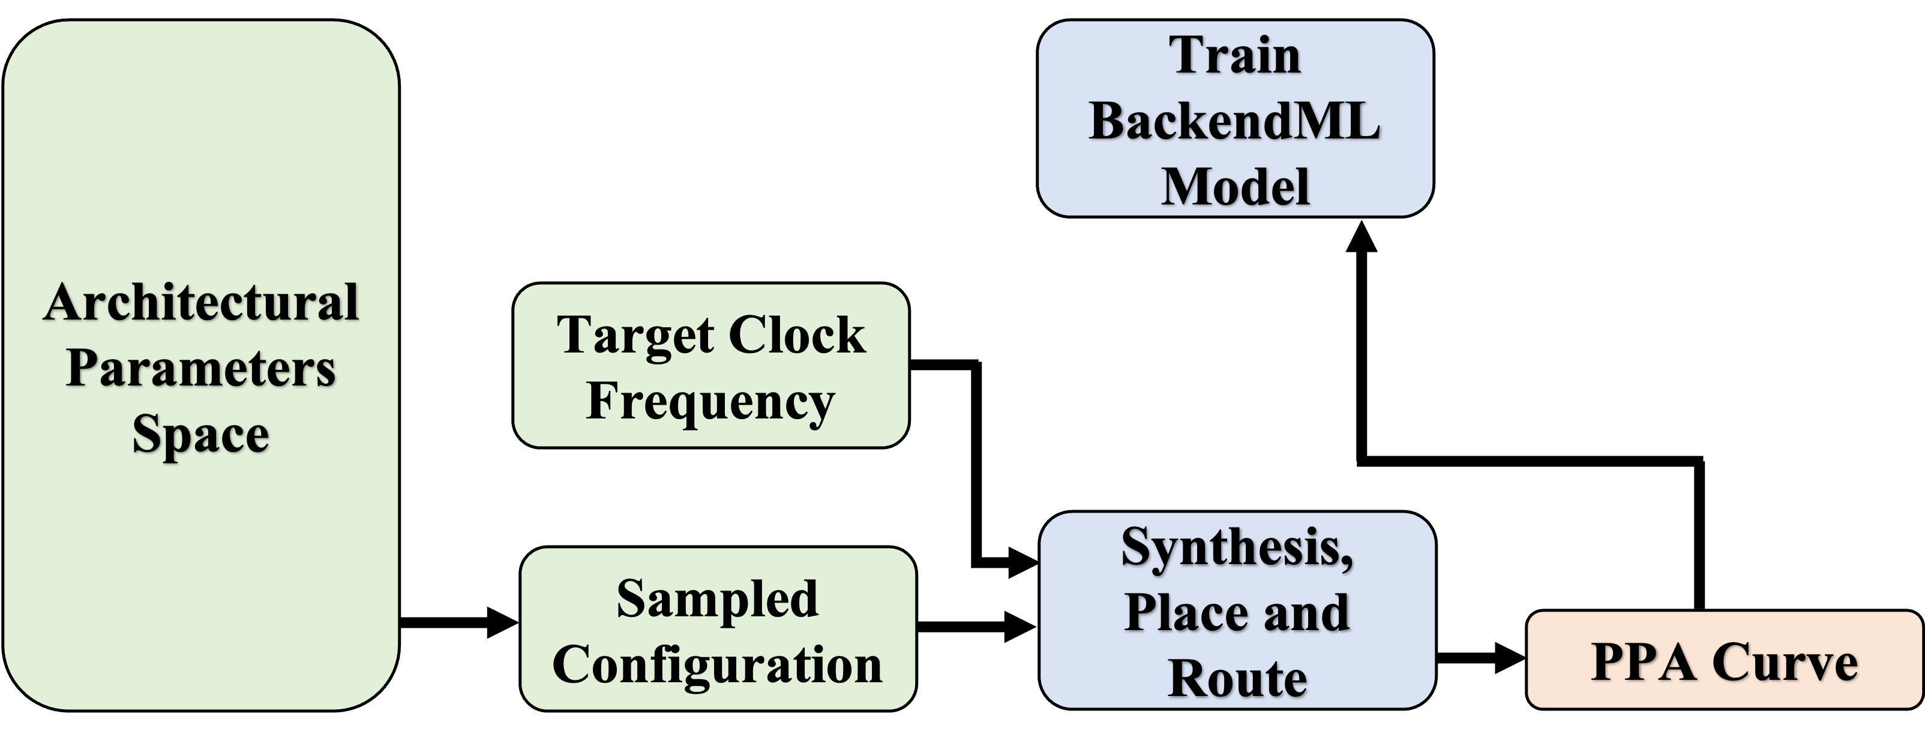
Backend Predictor
Backend Predictor
ML Modeling Method
Key Concept: ROI
System Predictor
Two-Stage Model
$$\left(P,f\right)=BackendMLModel(\left\{x_{1},x_{2}, ..,x_{n},f_{target}\right\})$$
Predicts total power ($P$) and effective clock frequency ($f$) of a given ML hardware generator
$\left\{x_{1},x_{2}, ..,x_{n}\right\}$ = User-specified configuration
$f_{target}$ = Target clock frequency
Effective clock frequency $=\frac{1}{(Target Clock Period − Worst Slack)}$
Notes:
Backend-ML-Model predicts total power and effective clock frequency of a specific ML hardware generator
for a user specified configuration and target clock frequency.
[CLICK]
The flow chart shows the steps of Backend-ML-Model training.
[CLICK]
We first sample configurations from the architectural parameter space and generate RTL.
[CLICK]
Then we run SP&R for a set of target clock frequencies and
[CLICK]
capture the PPA data.
[CLICK]
Afterwards, these data points are used to train the Backend-ML-Model.

Slide 11
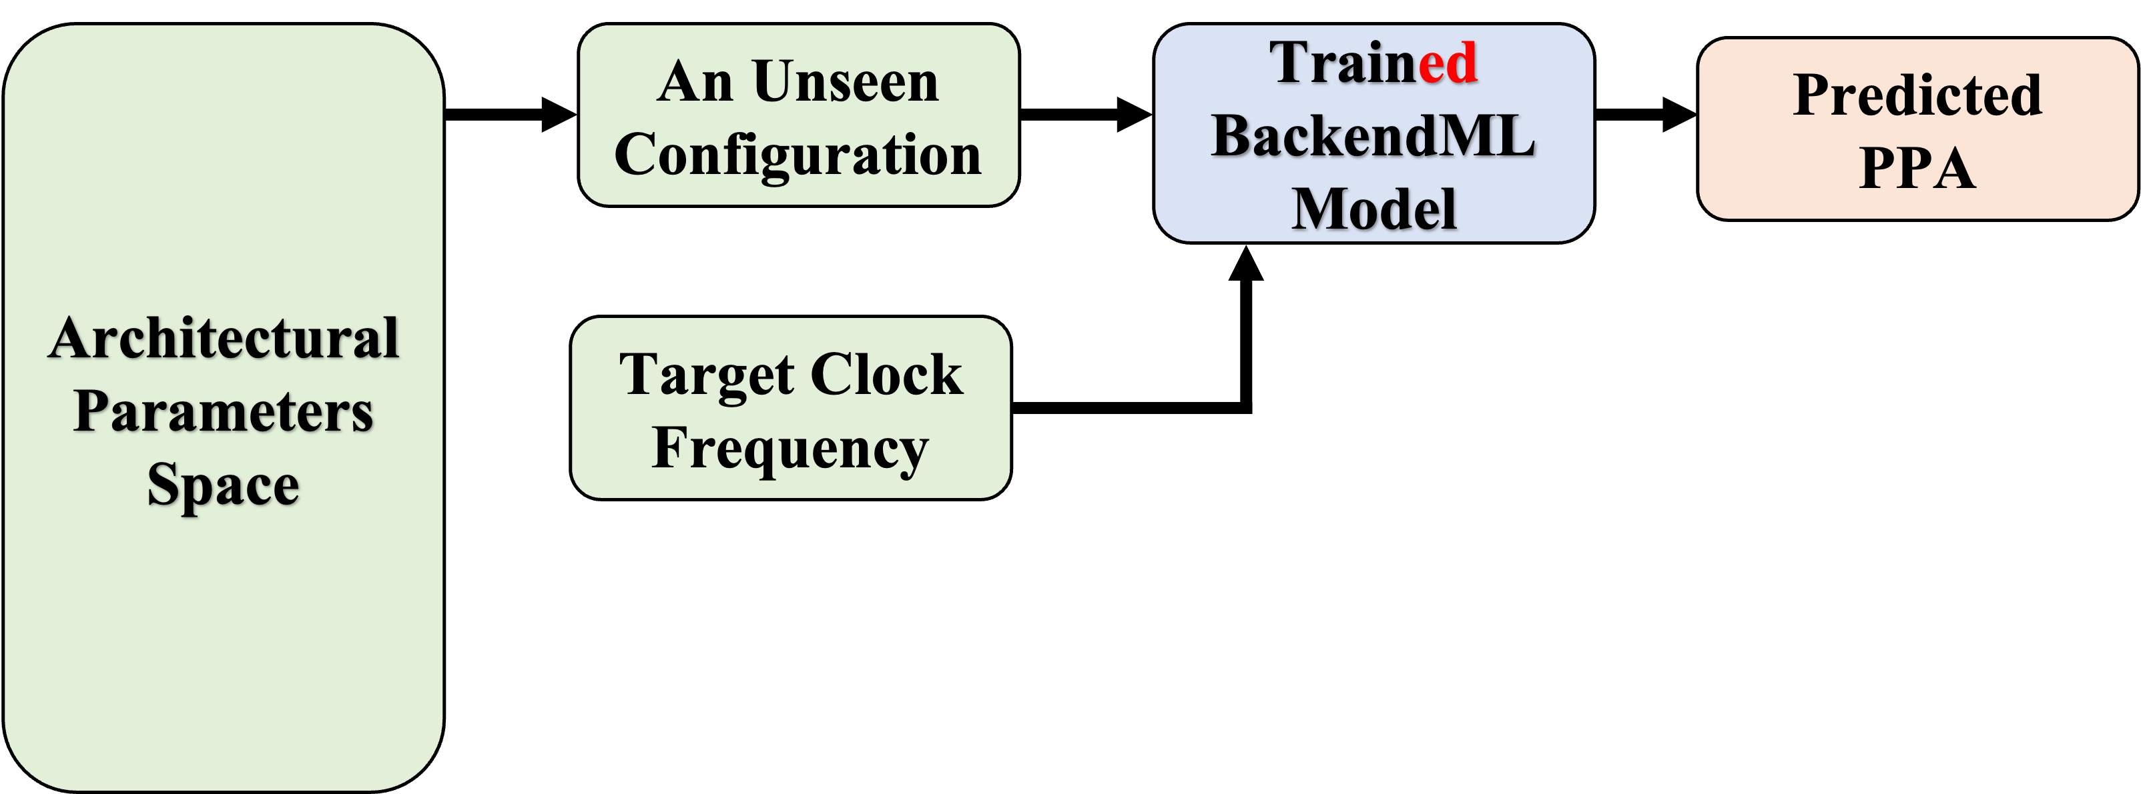
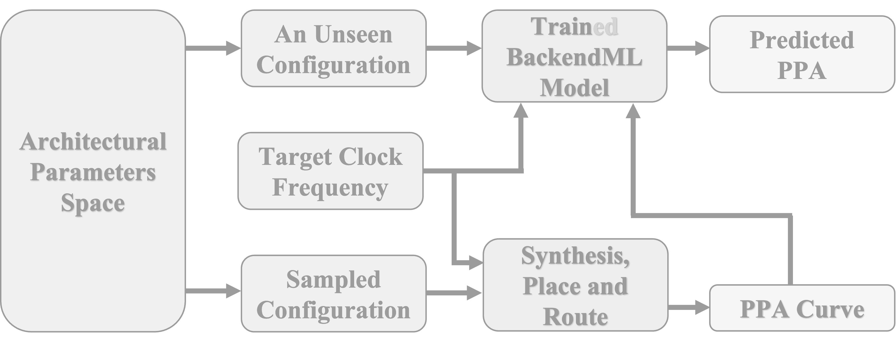
Backend Predictor
Backend Predictor
ML Modeling Method
Key Concept: ROI
System Predictor
Two-Stage Model
$$\left(P,f\right)=BackendMLModel(\left\{x_{1},x_{2}, ..,x_{n},f_{target}\right\})$$
Predicts total power ($P$) and effective clock frequency ($f$) of a given ML hardware generator
$\left\{x_{1},x_{2}, ..,x_{n}\right\}$ = User-specified configuration
$f_{target}$ = Target clock frequency
Effective clock frequency $=\frac{1}{(Target Clock Period − Worst Slack)}$
Notes:
Now the flow chart shows the steps of backend PPA prediction.
Finally,
[CLICK]
for an unseen configuration and target clock period
[CLICK]
the trained Backend ML model
[CLICK]
predicts PPA.

Slide 12
System Predictor
Backend Predictor
ML Modeling Method
Key Concept: ROI
System Predictor
Two-Stage Model
$$\left(E, T\right)=SystemMLModel(\left\{x_{1},x_{2}, ..,x_{n},f_{target}\right\})$$
Predicts energy ($E$) and runtime ($T$) of a given ML hardware generator
$\left\{x_{1},x_{2}, ..,x_{n}\right\}$ = User-specified configuration
$f_{target}$ = Target clock frequency
Notes:
System-ML-Model predicts energy and runtime of a specific ML hardware generator
for a user specified configuration and target clock fre
[CLICK]
The flow chart shows the steps of System-ML-Model training.
[CLICK]
The steps are same as the backend ml model training till PPA curve generation.
[CLICK]
So, we use that PPA curve to run simulation and capture the energy and runtime curve.
[CLICK]
Then the energy and runtime data points are used to train the System-ML-Model.

Slide 13
System Predictor
Backend Predictor
ML Modeling Method
Key Concept: ROI
System Predictor
Two-Stage Model
$$\left(E, T\right)=SystemMLModel(\left\{x_{1},x_{2}, ..,x_{n},f_{target}\right\})$$
Predicts energy ($E$) and runtime ($T$) of a given ML hardware generator
$\left\{x_{1},x_{2}, ..,x_{n}\right\}$ = User-specified configuration
$f_{target}$ = Target clock frequency
Notes:
Now the flow chart shows the steps of system level metric prediction.
Finally,
[CLICK]
for an unseen configuration and target clock period
[CLICK]
the trained System ML model
[CLICK]
predicts system level performance.

Slide 14
ML Models
Backend Predictor
ML Modeling Method
Key Concept: ROI
System Predictor
Two-Stage Model
Regression approaches are used
Gradient Boosted Decision Trees (GBDT)
Random Forest (RF)
Artificial Neural Network (ANN)
Stacked Ensemble
Model training: using open-source platform H2O
For stacked ensemble model
Base learners: GBDT, RF and ANN
Meta learner: linear regression
Notes:
We use four regression-based ML-models for backend and system-level performance prediction.
The ML models are
[CLICK]
Gradient Boosted Decision Trees or GBDT
Random Forest or RF
Artificial Neural Network or ANN
And Stacked Ensemble
[CLICK]
To train the models we use the open-source platform H2O
[CLICK]
For stacked ensemble model
Trained GBDT, RF and ANN models are used as base learners and
Linear regression model as the meta learner.

Slide 15
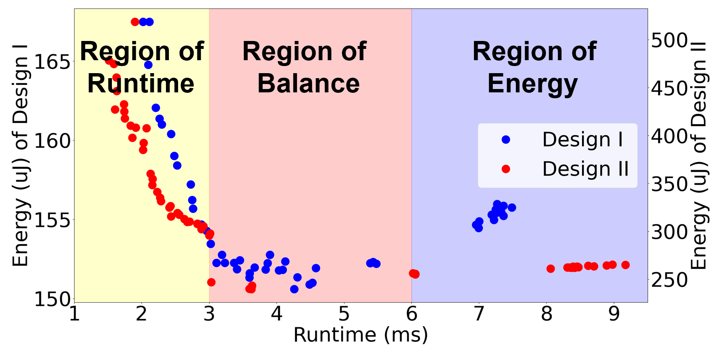
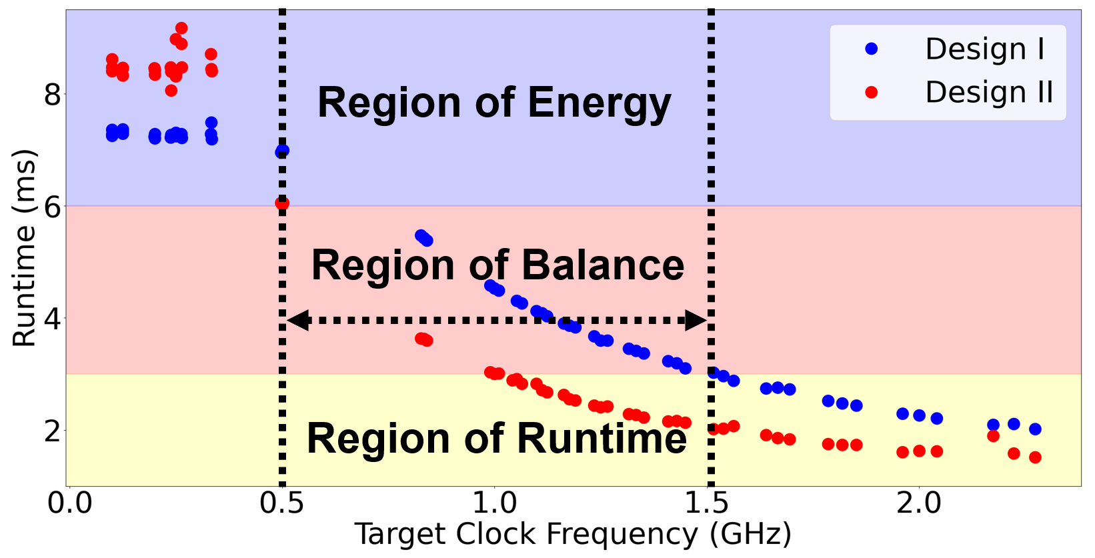
Region of Interest for DSE
Backend Predictor
ML Modeling Method
Key Concept: ROI
System Predictor
Two-Stage Model
Objective of DSE
Minimize runtime
Minimize energy
Region of Energy: optimize runtime and energy
Region of Runtime: optimize runtime at the cost of very high energy overhead
Region of Balance: lowest energy, less runtime overhead
Region of Balance is our Region of Interest (ROI)
Notes:
The main object of DSE is to minimize runtime and energy
[CLICK]
The figure shows the energy vs. runtime plot for two Axiline designs.
[Show in the figure]
In Region of Energy, energy and runtime both can be optimized. But the runtime is comparatively high.
[Show in the figure]
In Region of Runtime, runtime can be optimized at the cost of high energy overhead.
[Show in the figure]
In Region of Balance, lowest energy is achieved at comparatively less runtime overhead.
[CLICK]
So, region of balance is the region of interest.
[CLICK]
This figure shows the runtime vs target clock frequency plot for the same Axiline designs.
The region between the dotted vertical lines is the region of balance.

Slide 16
Region of Interest Definition
Backend Predictor
ML Modeling Method
Key Concept: ROI
System Predictor
Two-Stage Model
Excludes both high and low $f_{target}$
$f_{effective}$ follows $f_{target}$ in ROI
Characterized using
$ε=0.1$ is used in our experiments
$$ROI=\left\{f_{target}\right| abs\left(f_{effective}−f_{target}\right)≤ε×f_{target}\}$$
Notes:
This is the runtime vs target clock frequency plot from the previous slide.
We see that the region of Interest excludes both high and low target clock frequencies.
[CLICK]
The figure on the right is the effective clock frequency vs target clock frequency plot for the same Axiline design.
We see that in the ROI, effective clock frequency follows the target clock frequency.
[CLICK]
Based on these observations, we characterize ROI using this equation. We use epsilon equal to 0.1 for our experiment

Slide 17
Two-Stage Inference Model
Backend Predictor
ML Modeling Method
Key Concept: ROI
System Predictor
Two-Stage Model
Proposed based on the ROI definition
Train $BackendMLModel$ and $SystemMLModel$
Predict the $feffective$ from $ftarget$ and$\left\{x_{1},x_{2}, ..,x_{n}\right\}$
If $feffective$ and $ftarget$ satisfy the ROI definition:
Predict total power, runtime and energy
Otherwise exclude $ftarget$
Explores the design space efficiently
Improves model prediction accuracy
Notes:
We propose our two-stage inference model based on the definition of ROI.
[CLICK]
We first train the Backend-ML-Model and the System-ML-Model.
Then, we predict the effective clock frequency using the trained model.
[CLICK]
If effective clock frequency and target clock frequency satisfy ROI definition, then only we predict total power, runtime and energy.
Otherwise, we exclude the target clock frequency from the search space.
[CLICK]
So, the two-stage inference model approach helps us to explore the design space efficiently by reducing the search space.
And our experimental results show that it improves model prediction accuracy.

Slide 18
Outline
Background and Motivation
Main Contributions
Our Approach
Experimental Setup and Results
Data Generation
Model Training
Model Testing
Results for ASIC
Results for FPGA
Application of Our Approach
Conclusion and Future work
Notes:
Now I will describe our experimental setup and show our results.
First, I will discuss the data generation steps of ASIC and FPGA.
Then I will show the steps of training and testing our models and
Finally, I will present the results of our model performance.

Slide 19
Architectural Parameter Space
Data Generation
Results: ASIC
Results: FPGA
Model Training
Model Testing
Notes:
This is a part of the Table 1 from our paper. It presents the tunable architectural hyperparameters and the corresponding values. We see that the design space is huge for these ML hardware generators. We use these parameters along with target clock frequency as features of our ML models. We sample configurations from this architectural parameter space and generate RTL. We use this RTL for the data generation.

Slide 20
Data Generation
Data Generation
Results: ASIC
Results: FPGA
Model Training
Model Testing
ASIC flow: GLOBALFOUNDRIES 12LP enablement and commercial SP&R tools.
Sweep target clock period (TCP) from 0.5ns to 10ns
Denoising: two extra runs by varying TCP by ±0.01ns
Collected data points
Feed to simulators to obtain system metrics
ASIC: 480 (TABLA), 344 (GeneSys), 473 (VTA) and 4558 (Axiline)
FPGA flow: Virtex-7 and Kintex
Sweep TCP from 2ns to 30ns
Denoising: two extra runs by varying TCP by ±0.01ns
Collected data points
Feed to simulators to obtain system metrics
FPGA: 630 (TABLA)
For both ASIC and FPGA: Data points are split into train and test in 4:1 ratio
Notes:
The generated RTLs are run through the ASIC and FPGA SP&R flow to collect the backend metrics.
[CLICK]
For ASIC flow we use GLOBALFOUNDRIES 12LP enablement and commercial SP&R tools.
The target clock period is swept from 0.5ns to 10ns to capture the PPA curve.
We run two extra SP&R runs by varying the TCP by plus/minus 0.01ns to consider the tool noise.
The PPA data points are fed to simulators to obtain system metrics.
[Show in the slide] We capture these data points for ASIC.
[CLICK]
We use the Xilinx Virtex-7 and Kintex FPGAs for FPGA flow.
The same steps as ASIC are followed for FPGA data generation.
Considering the lower performance of FPGAs compared to 12nm ASIC, we sweep the TCP from 2ns to 30ns to capture the PPA curve.
[Show in the slide] And We capture these data points for FPGA.
[CLICK]
The collected data points are split into train and test in a 4:1 ratio for both ASIC and FPGA.

Slide 21
Model Training
Data Generation
Results: ASIC
Results: FPGA
Model Training
Model Testing
Search over hyperparameters space using H2O
Random discrete grid search method: hyperparameters from the table
For scoring
Five-fold cross validation is enabled
Root mean squared error function is used
Wall time of grid search: 300s, 300s and 600s for GBDT, RF and ANN respectively
Trained model with the best score is used to perform prediction on test dataset
For stacked ensemble model
Base learner: top-seven model from grid search of GBDT, RF and ANN
Meta learner: train using default hyperparameters
Notes:
We use H2O for model training
Random discrete grid search method in H2O is utilized to tune the hyperparameters given in the table.
Five-fold cross validation is enabled, and root mean squared error function is used for scoring during the search process.
We set these wall times for grid search.
[CLICK]
We choose the trained model that achieves the best score during the search process. This trained model is used to perform prediction on the test dataset.
[CLICK]
The top seven trained models of GBDT, RF and ANN based on scoring, are chosen as base learners for the stacked ensemble model.
We then train the meta learner with the default hyper parameters.

Slide 22
Model Testing
Data Generation
Results: ASIC
Results: FPGA
Model Training
Model Testing
For a ML hardware generator trained and test models are:
Four ML models: GBDT, RF, ANN and Stacked Ensemble
Four metrics: backend power and performance and system level runtime and energy
Total of 16 ML models are trained and tested
For ASIC and FPGA, models are trained separately
ASIC: TABLA, GeneSys, VTA and Axiline
FPGA: TABLA
Models are trained and tested in two ways:
Unseen clock frequencies: different 𝑓_{𝑡𝑎𝑟𝑔𝑒𝑡} in train and test
Unseen configurations: different configurations in train and test
Two-stage model is used for backend power and system level metrics prediction of unseen configurations
Notes:
Now I will describe how we test our trained models.
The four regression approaches are trained to predict each of the four metrics for a ML hardware generator. So total of 16 models are train and we test all these models against the test dataset.
[CLICK]
Separate models are trained and tested for ASIC and each FPGA platform. We test the model performance for the ASIC implementation of TABLA, GeneSys VTA and Axiline designs and FPGA implementation of TABLA designs.
[CLICK]
Two datasets are generated from the collected data points to train and test the models.
One unseen clock frequency dataset where the train and test datasets do not contain the same TCPs.
Another unseen configuration dataset, where the train and test datasets do not contain the same configurations.
We have tested the two-stage model for the unseen configuration dataset.

Slide 23
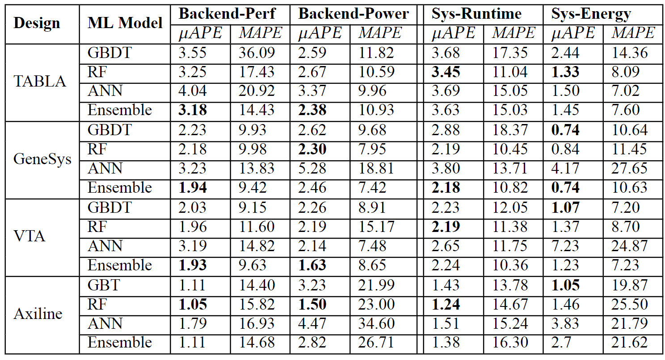
Model Performance for Unseen f_{target}: ASIC
Results: ASIC
Results: FPGA
𝜇APE: Mean absolute percentage error MAPE: Max absolute percentage error
Notes:
This slide shows Table 3 from our paper.
It represents the model performance for the unseen clock frequency ASIC dataset.
We train and test 16 models for each TABLA, GeneSys, VTA and Axiline designs. The table shows the performance of these 64 trained models.
[CLICK]
The green boxes highlight the best performing models based on Mean Absolute Percentage Error for each design and metric.
The average error is less than 4% for backend PPA metric and system-level metric prediction
The maximum prediction error for TABLA, GeneSys and VTA is less than 15% and for Axiline it is less than 23%.

Slide 24
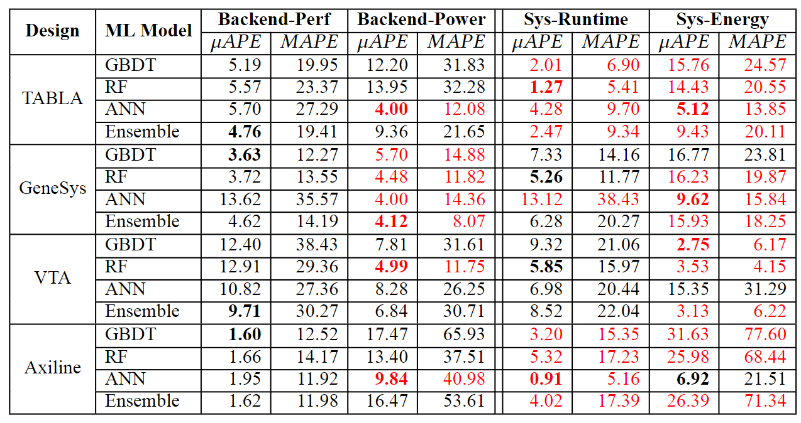
Model Performance for Unseen Configurations: ASIC
Results: ASIC
Notes:
This is Table 5 from our paper. It presents the model performance for the unseen configuration ASIC dataset.
The better prediction results of single-stage and two-stage models are reported here.
The numbers highlighted with red represent the performance of the two-stage inference model.
As we can see that a large proportion of model performance results are highlighted with red. It indicates that the two-stage inference model is dominating over the single stage model.
[CLICK]
The best performing model based on 𝜇APE for each design and metric is highlighted using a green box.
The average error of the best model is less than 10% for backend PPA metric prediction and less than 7% for system-level metric prediction.

Slide 25
Experimental Results: FPGA
Data Generation
Results: ASIC
Results: FPGA
Model Training
Model Testing
Performance of ML models for TABLA designs at unseen $ftarget$
Performance of ML models for TABLA designs at unseen configuration
Notes:
This is the Table 4 from our paper. It presents the model performance at unseen clock frequency dataset for different FPGA implementation of TABLA designs.
We observe similar model performance compared to the corresponding ASIC dataset.
[CLICK]
This is Table 6 from our paper. It shows the model performance for unseen configuration FPGA dataset.
Similar to the previous slide, the better performance results of single-stage and two-stage models are reported here. The numbers highlighted with red represent the performance of the two-stage inference model. We see similar dominance of two-stage model over single-stage model.
[CLICK]
The best performing model based on 𝜇APE for each design and metric is highlighted using a green box.
The average error of the best model is less than 7% for backend metrics prediction, and less than 11% for system-level metrics prediction. The maximum error of the best model is less than 21% for the backend metrics prediction and 17% for the system level metrics prediction.

Slide 26
Outline
Background and Motivation
Main Contributions
Our Approach
Experimental Setup and Results
Application of Our Approach
Conclusion and Future work
Notes:
Now I will discuss application of our approach for the DSE of Axiline and VTA designs.

Slide 27
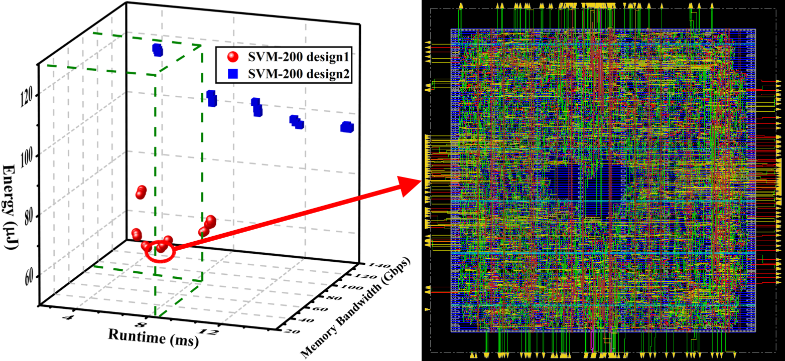
DSE for Axiline
Two candidate configurations: implements SVM with 200 features
Predict system metrics using the trained model for 36 different TCPs
System requirements: runtime and memory bandwidth
Satisfied datapoints are inside the green box
Configuration with lowest energy withing the box: Optimal accelerator
Verification against ground truth: Matched
Notes:
Here we utilize our method to find the optimal Axiline design from two candidate configurations that implement support vector machine with 200 features.
[CLICK]
We use our trained model to predict backend and system level metrics for 36 different TCPs for both configurations. The predicted runtime and energy data points are shown in the plot.
[CLICK]
Data points inside the green dotted box satisfy the system requirement for runtime and memory bandwidth.
[CLICK]
Finally, we choose the configuration with the lowest energy as the optimal accelerator.
We have verified that it matches with the ground truth. All the 72 data points predicted using the trained model are within 5% error range compared to the ground truth.
The post-SP&R layout of the optimal accelerator is shown here.

Slide 28
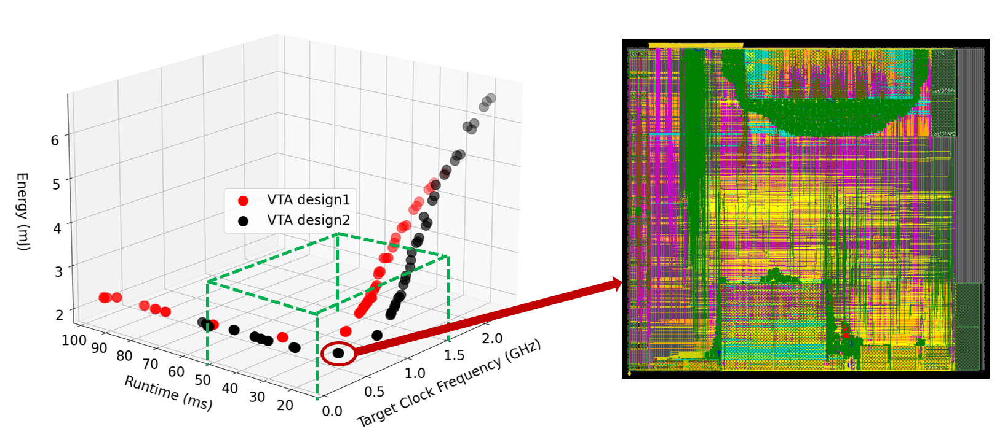
DSE for VTA
Two candidate configurations: implements MobileNet-v1
Predict system metrics using the trained model for 63 different TCPs
System requirements: runtime and energy
Satisfied datapoints are inside the green box
Configuration with lowest energy withing the box: Optimal accelerator
Verification against ground truth: Matched
Notes:
Another example of DSE for VTA design that implements MobielNet-V1 is shown here.
Data points inside the green dotted box satisfy the system requirement for runtime and energy.
Here also we choose the configuration with the lowest energy from the green dotted box as the optimal accelerator.
We have verified that it matches with the ground truth. All the 126 data points predicted using the trained model are within 12% error range compared to the ground truth.
The post-SP&R layout of the optimal accelerator is shown here.

Slide 29
Outline
Background and Motivation
Main Contributions
Our Approach
Experimental Setup and Results
Application of Our Approach
Conclusion
Notes:
Now I will conclude my talk.

Slide 30
Conclusion
ML-based framework achieves high accuracy
Backend PPA
System level performance metric
A novel two-stage inference model
Explores design space efficiently
Improves model performance
Extensive validation:
Multiple architectural platforms: VeriGOOD-ML and VTA
ASIC and FPGA flows
Notes:
Our physical-design-driven ML-based framework achieves high accuracy for backend PPA and system level performance metric prediction.
[CLICK]
A novel two-stage inference model is proposed which helps to explore design space efficiently and improve model performance.
[CLICK]
Our framework is extensively validated for ASIC implementation of multiple platforms:
DNN and Non-DNN based ML hardware generators such as GeneSys, TABLA and Axiline from VeriGOOD-ML and the DNN based generator from VTA.
We have also validated our framework for the FPGA implementation of TABLA designs.

Slide 31
Thank you!
We thank M.Burns and Anton A. Sorokin from Intel Labs for helping us to setup the VTA.
This material is based on research sponsored in part by Air Force Research Laboratory (AFRL) and Defense Advanced Research Projects Agency (DARPA) under agreement number FA8650-20-2-7009. Andrew B. Kahng is also supported in part by NSF CCF-2112665. The U. S. government is authorized to reproduce and distribute reprints for Governmental purposes notwithstanding any copyright notation thereon. The views and conclusions contained herein are those of the authors and should not be interpreted as necessarily representing the official policies endorsements, either expressed or implied, of AFRL, DARPA, or the U. S. government.
Notes:
Thank you very much for listening.

Slide 32
BACKUP

Slide 33
OLD

Slide 34
This material is based on research sponsored in part by Air Force Research
Laboratory (AFRL) and Defense Advanced Research Projects
Agency (DARPA) under agreement number FA8650-20-2-7009. Andrew
B. Kahng is also supported in part by NSF CCF-2112665. The
U. S. government is authorized to reproduce and distribute reprints
for Governmental purposes notwithstanding any copyright notation
thereon. The views and conclusions contained herein are those of
the authors and should not be interpreted as necessarily representing
the official policies or endorsements, either expressed or implied, of
AFRL, DARPA, or the U. S. government.

Slide 35
Challenges of DSE and Proposed Solution
Design | Kendall rank correlation coefficient for power | Kendall rank correlation coefficient for frequency
Design-1 | 0.60 | -0.06
Design-2 | 0.09 | -0.06
Design-3 | 0.35 | 0.09
Design-4 | 0.54 | 0.14
Notes:
Here are the post-synthesis vs. post-route power and frequency plots of four ML-accelerator designs.
The post-synthesis power varies from 200mW to 350mW whereas the post-route power varies from 500mW to 750mW. We see a similar mismatch for the frequency plot.
[Show in the plot]
The Design-2 data point (orange) with the lowest post-synthesis power does not have the lowest post-route power.
It is obvious from the plot on the right side that the post-synthesis and post-route frequency data points are not at all correlated.
Kendall rank correlation coefficients are also shown in the table. Here values near 0 indicate high miscorrelation and near +- 1 indicate high correlation or anti-correlation.
High miscorrelation between post-synthesis and post-route performance metrics indicates that we need post-SP&R PPA number to evaluate the ML-accelerators.

Slide 36
Data Generation
Data Generation
Results: ASIC
Results: FPGA
Model Training
Model Testing
ASIC flow: GLOBALFOUNDRIES 12LP enablement and commercial SP&R tools.
Sweep target clock period (TCP) from 0.5ns to 10ns
Denoising: two extra runs by varying TCP by ±0.01ns
Collected data points
Feed to simulators to obtain system metrics
ASIC: 480 (TABLA), 344 (GeneSys), 473 (VTA) and 4558 (Axiline)
FPGA flow: Virtex-7 and Kintex
Sweep TCP from 2ns to 30ns
Denoising: two extra runs by varying TCP by ±0.01ns
Collected data points
Feed to simulators to obtain system metrics
FPGA: 630 (TABLA)
For both ASIC and FPGA data points are split into train and test in 4:1
Notes:
Sorry for the eyechart. This is a part from the Table 1 of our paper. It presents the architectural parameter space from which we sample configurations and generate RTL using the RTL-generator.
These RTLs are run through the ASIC and FPGA SP&R flow to collect the backend metrics.
[CLICK]
For ASIC flow we use GLOBALFOUNDRIES 12LP enablement and commercial SP&R tools.
The target clock period is swept from 0.5ns to 10ns to capture the PPA curve.
We run two extra SP&R runs by varying the TCP by plus/minus 0.01ns to consider the tool noise.
The PPA data points are fed to simulators to obtain system metrics.
[Show in the slide] We capture these data points for ASIC.
[CLICK]
We use the Xilinx Virtex-7 and Kintex FPGAs for FPGA flow.
The same steps are followed for FPGA data generation.
Considering the lower performance of FPGAs compared to 12nm ASIC, we sweep the TCP from 2ns to 30ns to capture the PPA curve.
[Show in the slide] And We capture these data points for FPGA.
[CLICK]
The collected data points are split into train and test in a 4:1 ratio for both ASIC and FPGA.

