Slide 1
Leveling Up: A Trajectory of OpenROAD, TILOS and Beyond
Andrew B. Kahng
UCSD CSE and ECE Departments
abk@ucsd.edu
http://vlsicad.ucsd.edu
Notes:
Hello, everyone – Thank you for the kind introduction and for the invitation to give this talk.

Slide 2
Agenda
  Leveling Up: A Trajectory
  The OpenROAD Project
  The TILOS AI Institute
  And Beyond
Notes:
Here’s the agenda – and let me start with what I mean by “Leveling Up”.

Slide 3
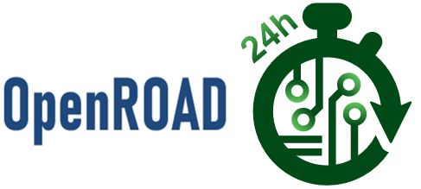


Leveling Up
  A trajectory of openness, infrastructure and culture change
    Open source, open data, benchmarking, roadmapping
  Scaling and empowerment of people and a future workforce
  Culture change at academia-industry research interface
  Two waypoints:
Notes:
Leveling up means following a trajectory as a field: evolving, advancing and maturing.
For EDA and physical design, as we try to do better with machine learning and cloud, in my view this means openness, infrastructure and culture change.
[CLICK] This is important because we want to amplify the efforts of our people, and we want to attract a next generation to this field.
[CLICK] And a big part of culture change must happen at the interface between academic research and industry.
[CLICK] Today I’ll talk about two out of MANY “waypoints” in this trajectory – knowing that EDA is 60-plus years old, ISPD has been going for a quarter century, and our field has become a focal point in the creation of new hardware-software systems.
[CLICK] So let’s level up.

Slide 4
Agenda
  Leveling Up: A Trajectory
  The OpenROAD Project
  The TILOS AI Institute
  And Beyond
Notes:
I’ll start with OpenROAD.

Slide 5
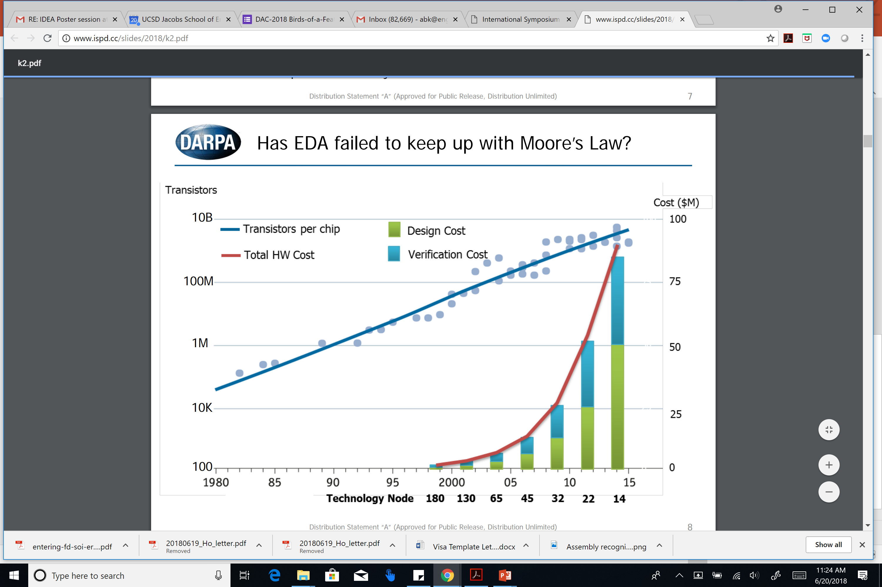
The Crisis of Hardware Design
ASIC design in advanced nodes: barriers of Cost, Expertise, Risk
Innovators can’t evaluate “SWaP”, “PPA” of their design ideas
“Foundations and Realization of Open, Accessible Design”
A. Olofsson, ISPD-2018
Notes:
For some years, we’ve watched this crisis of design: taking ideas into silicon runs into BARRIERS of Cost, Expertise, and Risk.
[CLICK] This is from Andreas Olofsson’s ISPD keynote four years ago: the red curve says that the cost of DESIGN is OUT OF CONTROL.
[CLICK] Innovators can’t tell how good their ideas are, in terms of metrics they care about: size-weight-and-power, or PPA. This is because it’s too difficult to take their ideas into silicon.
In the name “OpenROAD”, ROAD has always stood for Realization of Open, Accessible Design.

Slide 6
OpenROAD: No Humans, 24 Hours
FOCUS: Ease of use and runtime
Directly attack the crises of design and innovation
  Schedule barrier: RTL-to-GDS in 24 hours
  Expertise barrier: No-human-in-loop, tapeout GDS
  Cost barrier: Open source (and, runs in 24 hours)
Unleash system innovation and design innovation
Enable tool customization to system, application needs
Notes:
Unlike commercial EDA, the focus of OpenROAD is on ease of use and runtime.
[CLICK] It attacks the crisis of design AND the crisis of innovation by attacking the barriers of schedule, expertise and cost.
[CLICK] This matters, because it unblocks system ideation and design space exploration – friction-free, with almost zero overheads. And because it’s open source, it’s agile, transparent and customizable as well.

Slide 7
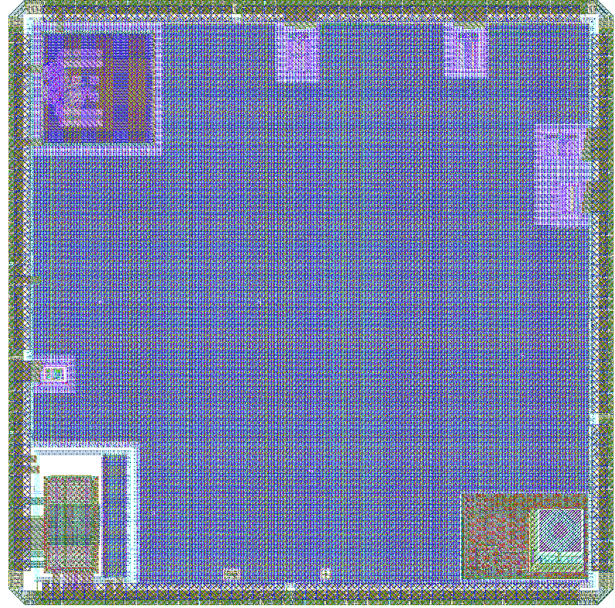
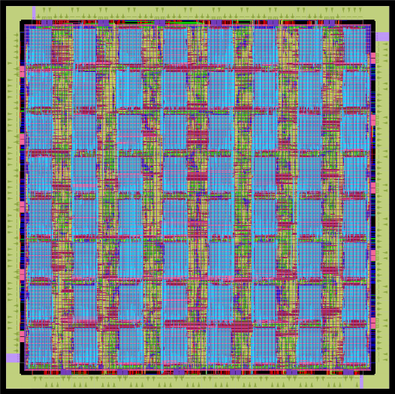
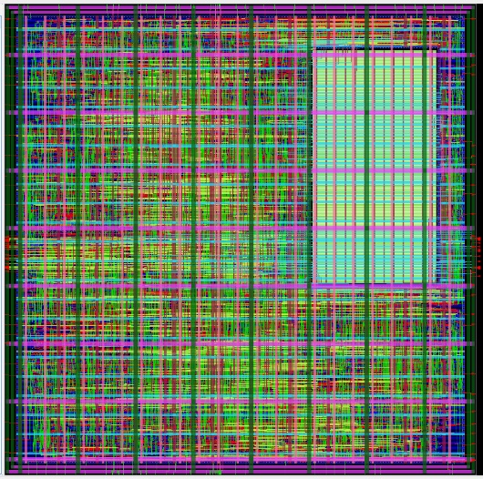
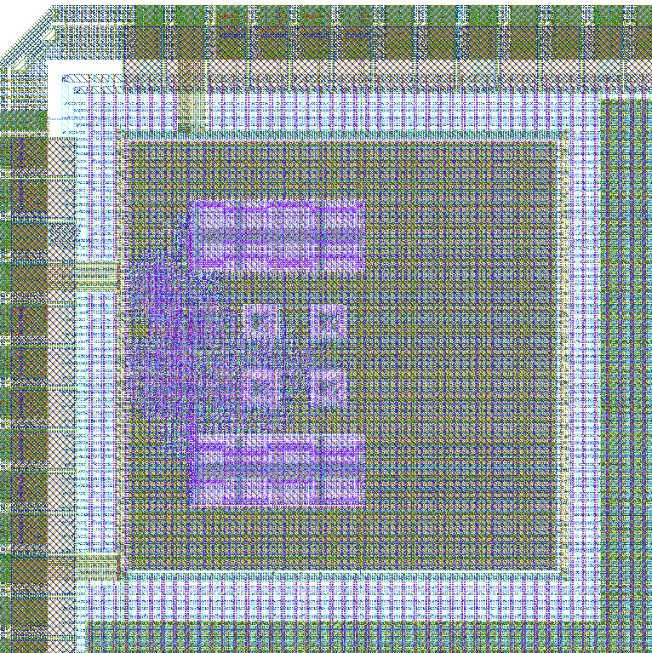
OpenROAD Usage Today
GF55 AI platform
GF12LP AI tile
OpenTitan SoC
Army Research Labs
GF55, GF12LP
U. Michigan / FASoC GF12LP
Notes:
Here on the left, you see a reprogrammable AI platform in GF 55 nanometer, and a reprogrammable AI computing tile in GF 12 nanometer, from the Army Research Lab -- using OpenROAD.
On the right, the FASoC team led by the University of Michigan made a GF 12 nanometer tapeout that included this OpenTitan SoC with integrated temperature sensors.
All of the physical design and timing optimization was done with OpenROAD.
[[This work includes a GF55 (3.5mm x 3.5mm, 64 8kB SRAMs, ~800k instances) reprogrammable AI platform and a GF12 (245 um x 245 um, 8kB SRAMs, ~30k instances) reprogrammable AI computing tile.]]

Slide 8
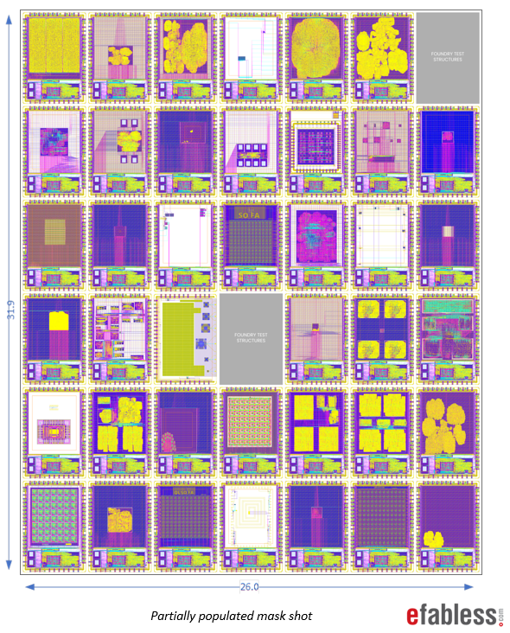
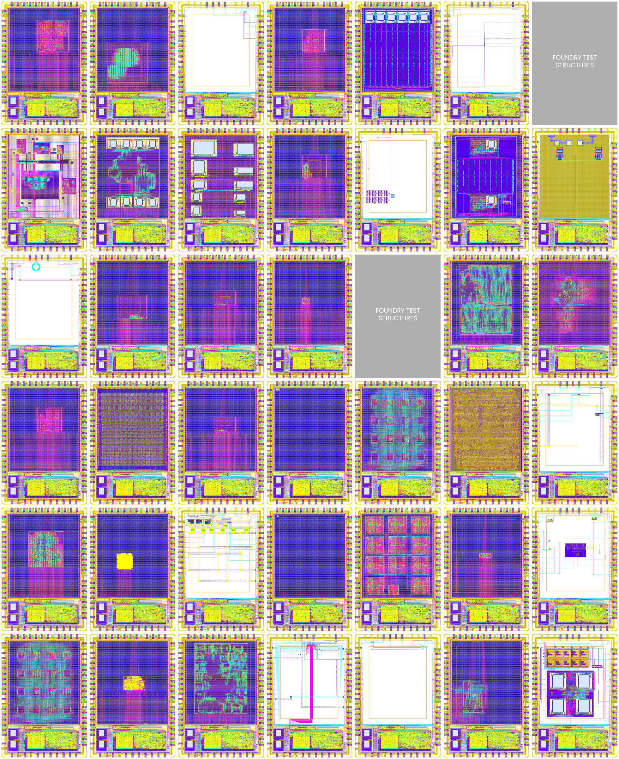
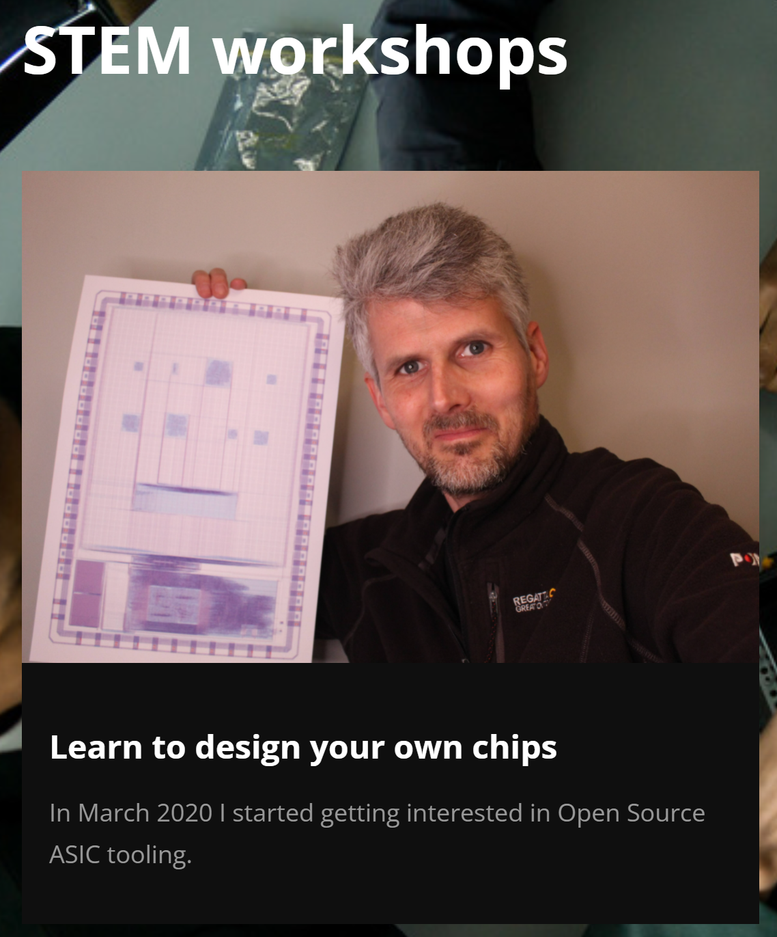
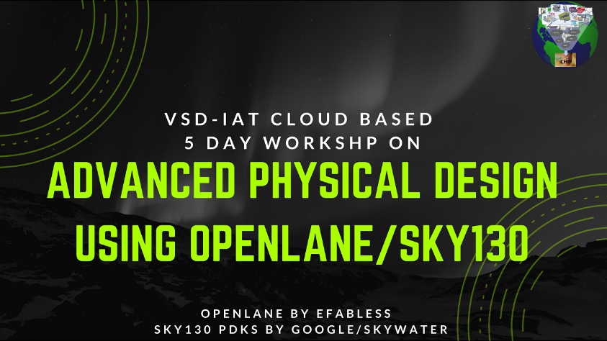
OpenROAD Usage Today
220+ tapeouts in SKY130
  Google-funded shuttles
Efabless “chipIgnite” commercial offering
Matt Venn: From Zero to ASIC
VLSI System Design (VSD)
  Total enrollment > 2500 in OpenLane / OpenROAD courses and workshops
  Students: 85 countries, 26 languages
Notes:
OpenROAD is also the heart of the ASIC design platform from Efabless called OpenLane. This has been used in the design work for tapeouts on five shuttle runs in SkyWater 130 nanometer. Last July, Efabless transferred their OpenLane flow repo to The OpenROAD Project. OpenROAD is also the default EDA solution in Efabless’s commercial offering called ChipIgnite.
[CLICK] You can see usage in STEM outreach via folks like Matt Venn.
[CLICK] Or upskilling and workforce development via folks like VLSI System Design in India – where cumulative enrollments are now in the thousands.

Slide 9
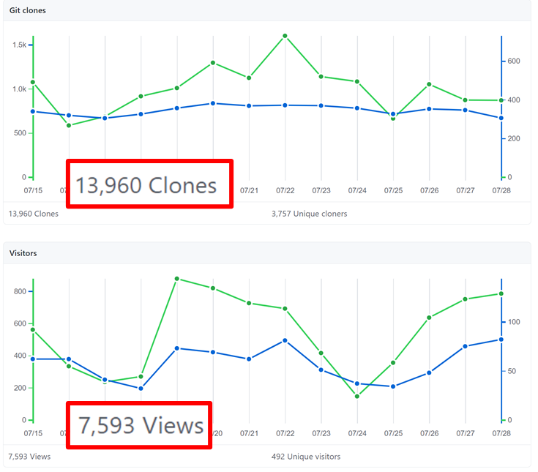
Growing User Community
Users: novice to expert
Applications: Trust, 3DIC, AI/ML, …
Community metrics all growing
  2-week period in July 2021
  Git clones (downloads), visitors, views
Notes:
The project is getting traction with a broad community of users and developers. Users range from novices to experts. Their applications include Trust, 3D-IC, and AI and machine learning -- to name just a few.
The plots that you see here show daily statistics from a two-week period at the end of last July. Metrics of our community and engagement with the project are good -- for instance, the upper plot shows nearly a thousand downloads a day from nearly four thousand unique GitHub users.
And the OpenROAD app is now well past 11,000 commits from over 50 contributors.

Slide 10
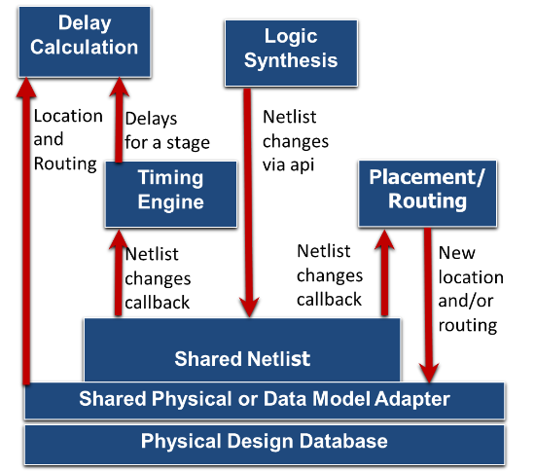
Industry-Strength Incremental Architecture: Built to Last
Further notes: link link link
Notes:
OpenROAD has the architecture of a modern EDA place-and-route tool.
This incremental Shared Netlist Architecture is the guts of commercial P&R tools since the early 2000s.
The Shared Netlist or Abstract Network Adapter enables incremental netlist modification, and communicates with Synthesis, Placement, CTS, Optimization, Routing, and the Timer. This picture shows how if Synthesis changes the netlist, then there is a callback that place-and-route is listening for – Then, if P&R changes the location or the routing, this is updated via the Shared Physical or Data Model Adapter which handles physical information such as location or routed shapes.
The timer is listening for a netlist change, and to update delays and slews, the delay calculation uses the updated location and routing information.
This architecture is what enables thousands of sizing or incremental moves per second – which is the heart of modern physical synthesis and P&R.

Slide 11
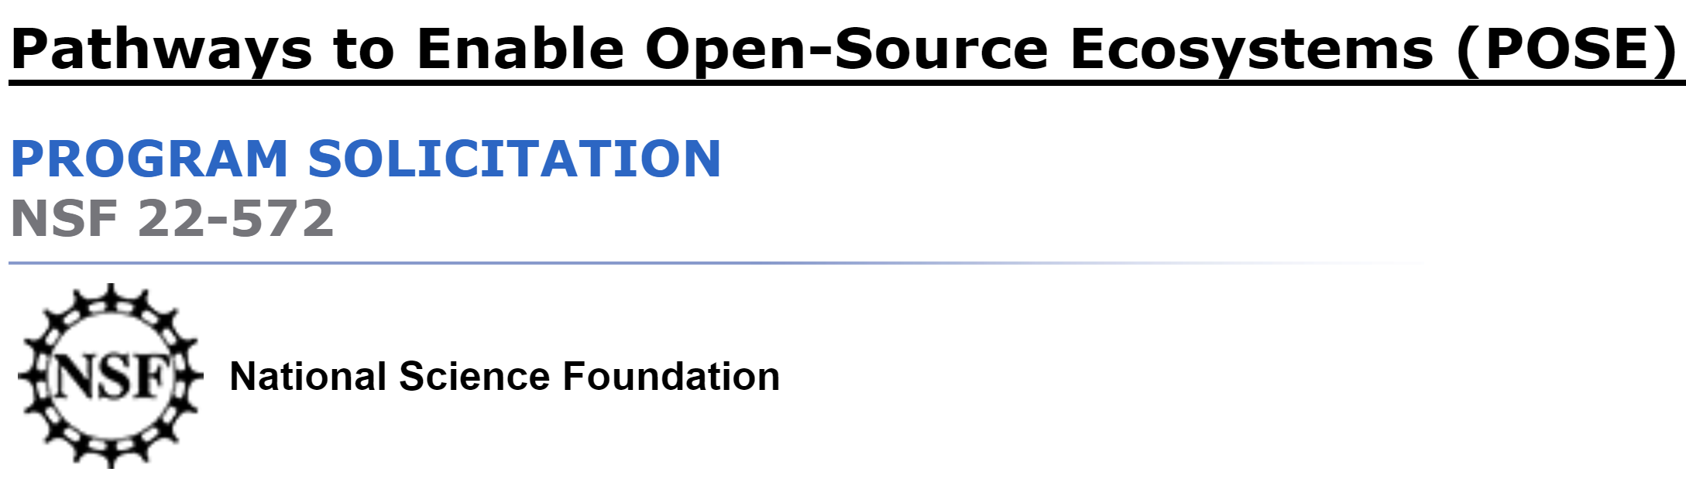
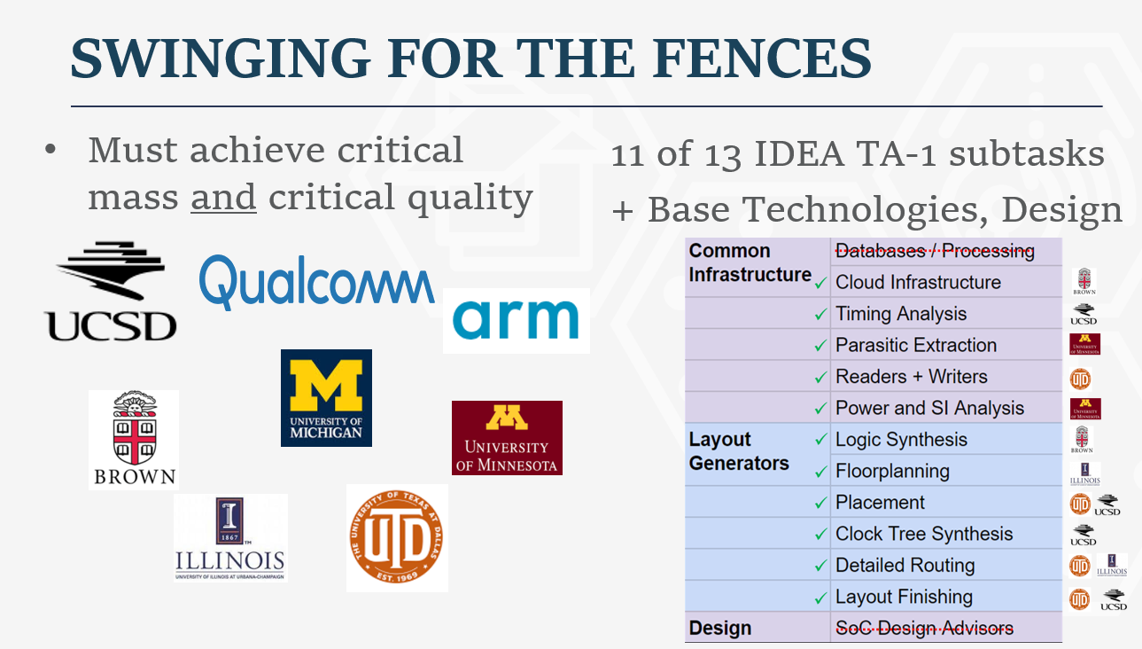
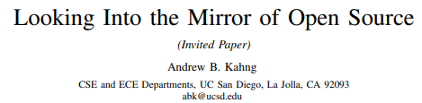
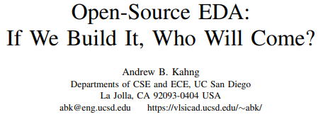
Leveling Up: “Seeding an Ecosystem”
ERI Summit 2018: Critical mass and critical quality
ICCAD 2019: Open Source is a mirror
VLSI-SoC 2020: If we build it, who will come?
Notes:
We knew from the start that the biggest challenge would be Critical Mass and Critical Quality. So, swing for the fences – “seeding the Linux of EDA” were the taglines four years ago.
[CLICK] NSF is actually now very conscious of seeding ecosystems.
[CLICK] Some talks have commented on related challenges. For example, openness with source code at the research leading edge is a matter of culture and personal choice. It’s a mirror of ourselves. And, for whom are we building OpenROAD? If we build it, who will come? Who is we? What is “it”? Who will use “it” and contribute to “it”?
To build an ecosystem, OpenROAD must serve many stakeholders: government, semi companies, strong supporters such as Google, makers, IC startups, academic researchers and students, partners, and more.

Slide 12



Leveling Up: “Not Research As Usual”
An academic research project, delivering tapeout-clean layout generation for commercial FinFET nodes in permissive open source, per contract with the U.S. Government
→ expectations, names, “signoff”, …
“Not Research As Usual”
Notes:
There are other challenges just from being an academic project that by contract must deliver tapeout-clean layout generation in commercial FinFET nodes, via permissive open source. These links hint at some issues that had to be navigated: For example, our Tcl command names and timing reports needed to stay clear of industry copyrights. And “not research as usual” includes not just writing tapeout-capable tools, but supporting them.
Now, in the next ten slides, I want to give the flavor of how many balls are in the air, how broadly the project needs to push itself forward, and why this is part of a shared trajectory of “leveling up”.

Slide 13
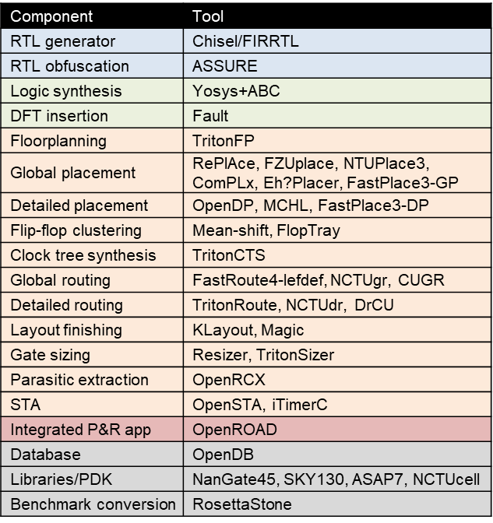
IEEE CEDA DATC Robust Design Flow (RDF)
Academic reference design flow
  Initiated 2016; latest release 2021
  Design flow built upon academic tools
  Also supports complete, industrial format-based RTL-to-GDS flow with OpenROAD
GitHub: https://github.com/ieee-ceda-datc/datc-rdf
High-level goals:
  Preserve leading research codes, and integrate them into design flow
  Trigger design flow-scale and
  cross-stage optimization research
Jinwook Jung, IBM Research
Notes:
A huge part of OpenROAD’s ecosystem is the academic research community, especially this ISPD community.
We work closely with the IEEE CEDA Design Automation Technical Committee, whose main task in recent years has been to develop and support an ACADEMIC reference design flow called RDF.
The Robust Design Flow was launched in 2016, based on the winning tools and research outcomes from many academic contests in the field. Since 2019, it has included the OpenROAD tool chain and thus covered the complete RTL-to-GDS flow.
The flow goes from logic synthesis all the way through detailed routing, and also includes RTL generators, obfuscation, and DFT insertion.
[CLICK] High-level goals include preserving leading research codes and academic contest benchmarks and outcomes – going back nearly 20 years. I’ll say more about how OpenROAD helps make this happen in a minute.
[CLICK] And, providing this complete flow as a backplane for research stimulates flow-scale research as well as new cross-stage optimizations. For example, with OpenROAD we might have a basis for cross-stage optimization in a future ISPD contest.

Slide 14
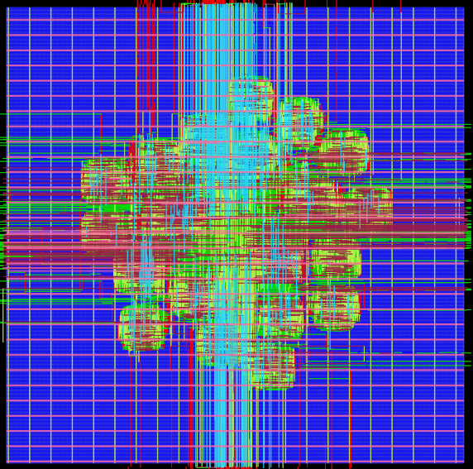
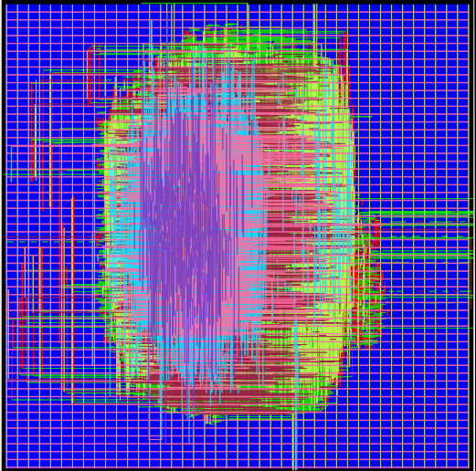
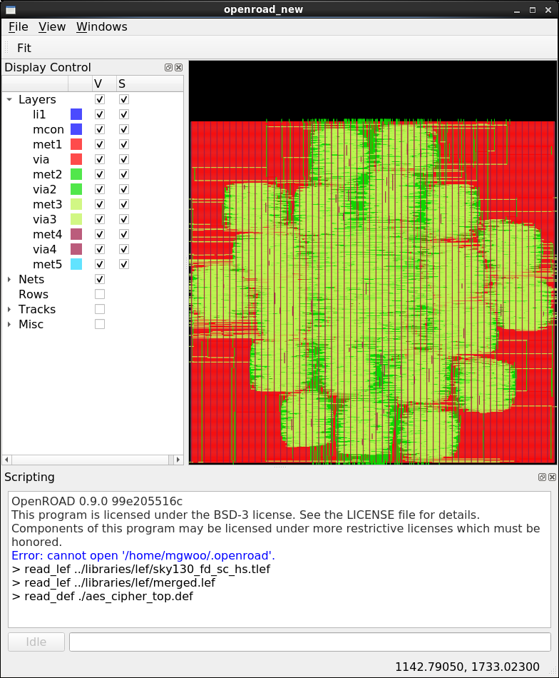
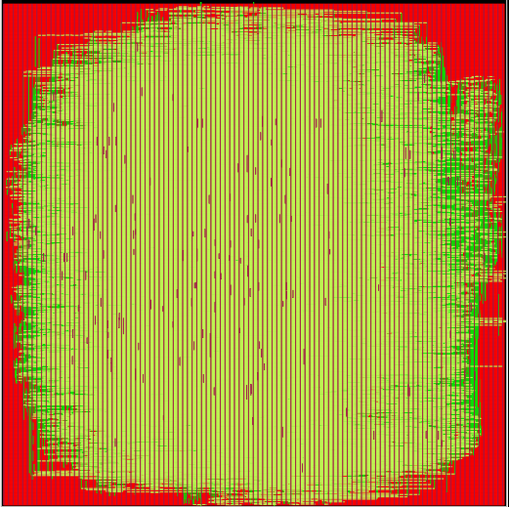
Calibrations Repository
Link: https://github.com/ieee-ceda-datc/datc-rdf-calibrations
Reference analysis data for STA, RCX, and IR drop obtained from DRV-free routed testcases using OpenROAD in open enablements
Support academic research on analyses and verifications
Routed *.v, *.def, *.sdc, and *.spef as well as *.json data
  Two JSON formats for timer calibration (5-worst paths, worst slacks at endpoints)
NanGate45-AES
NanGate45-JPEG
SKY130-AES
SKY130-JPEG
Notes:
There’s also a CALIBRATIONS repo, which supports academic research on electrical analyses and verifications.
The repo has a collection of reference analysis results for STA, RC extraction, and IR drop analysis.
Each design is produced by OpenROAD, which is an open-source EDA tool, from open PDK data such as SkyWater.
Then, we get publishable routed *.v, *.def, *.sdc, and *.spef in an OPEN *.json format to capture worst paths or endpoint slacks.

Slide 15
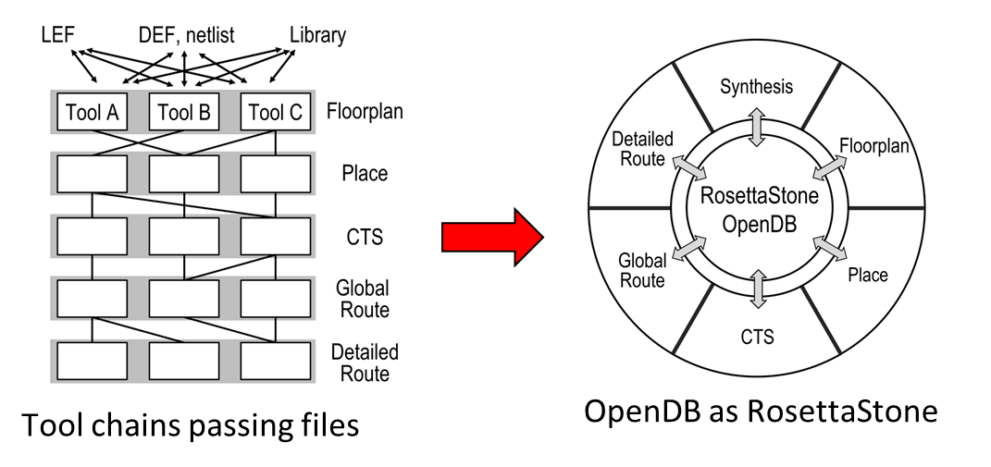
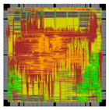
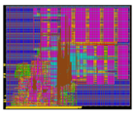
OpenDB as RosettaStone
+ RDF-2021
Link: https://github.com/ABKGroup/RosettaStone
How to connect Past, Present and Future of PD research?
  Answer: Data model (e.g., LEF/DEF 5.8) + in-memory DB
Modern tools can run on old benchmarks
Old academic tools can run on modern designs, enablements
Global placement: NTUPlace4h
Detailed placement: NTUPlace4h
Clock Tree Synthesis: TritonCTS
Global routing: FastRoute
Detailed routing: TritonRoute
adaptec1 (ISPD05) on SKY130HD
swerv_wrapper (RISC-V) on Commercial 12nm
Notes:
So I mentioned that the DATC RDF includes academic contest benchmarks and contest-winning tools from more than 15 years ago. For some years, these benchmarks and tools were stuck in what I call a “parallel universe”: the old tools could not be run on modern designs, and the old benchmarks could not be fed to modern tools! The missing piece is a unifying DATA MODEL.
When tools read and write files in various contest formats, it’s hard to make a working tool chain. But with a common data model – which is implicit in OpenDB – we can connect not just past, present and future of academic research, but research and industry practice as well.
[CLICK] This “RosettaStone” effort lets us run modern tools on old benchmarks.
And the other direction is to run old academic tools on modern designs.
This flow at the bottom-left mixes academic closed source and open source, and it runs on commercial 130 and 12nm enablements, with industrial designs.

Slide 16
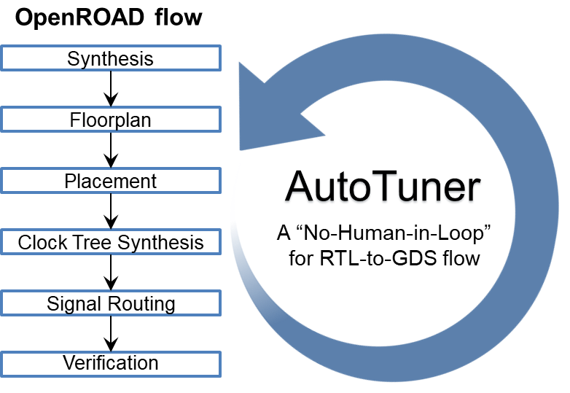
AutoTuner: True No-Human-in-Loop Operation
Best human-tuned flow vs. AutoTuned flow (No-Human-In-Loop)
23% Faster
45% Less Power
lowRISC RISC-V core (ibex), SKY130HD
Notes:
This slide is from a tutorial we gave at ASP-DAC in January. It shows that OpenROAD can be applied in conjunction with automatic tuning of flow input parameters --- which you can think of as black-box optimization or adaptive sampling --- giving a true “No-Human-in-the-Loop” operation that achieves better quality of results than our internal expert users. The AutoTuner is now being deployed on Google Cloud with the help of Google engineers.

Slide 17
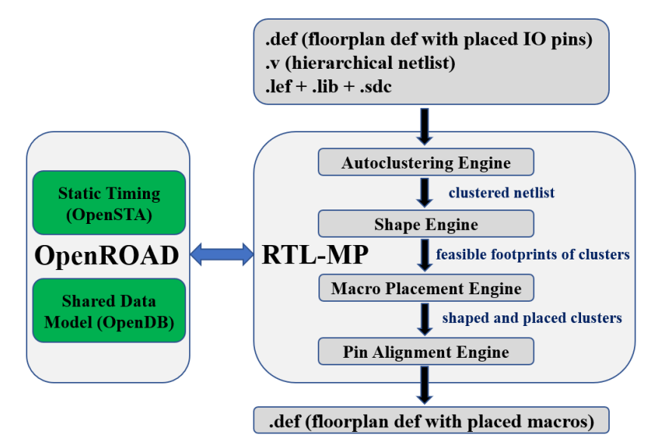
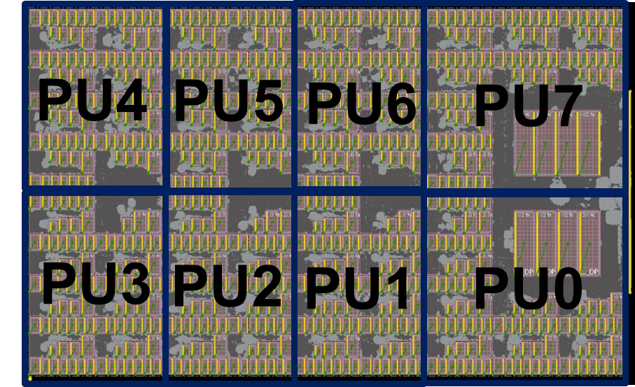
RTL-Macro Placer
“Mimic” behavior of human experts
Capture dataflow defined by RTL designers
  Exploit logical hierarchy
  Extract connection signatures between modules
Understand key constraint types
  Macro placement blockages
  Preferred locations for macros
Next: Hierarchical RTL-MP
Overview of RTL-MP flow
Notes:
Yesterday morning Zhiang Wang presented RTL-Macro Placer, which addresses a well-known critical problem, and aims for human-quality results.
RTL-MP tries to ``mimic’’ the behavior of human experts.
It captures the dataflow defined by RTL designers by exploiting logical hierarchy, and by extracting connection signatures between modules.
And, it understands relevant constraints such as blockages and preferred locations.
[CLICK] Next is to enable hierarchical planning that handles cases such as this TABLA machine learning architecture.

Slide 18
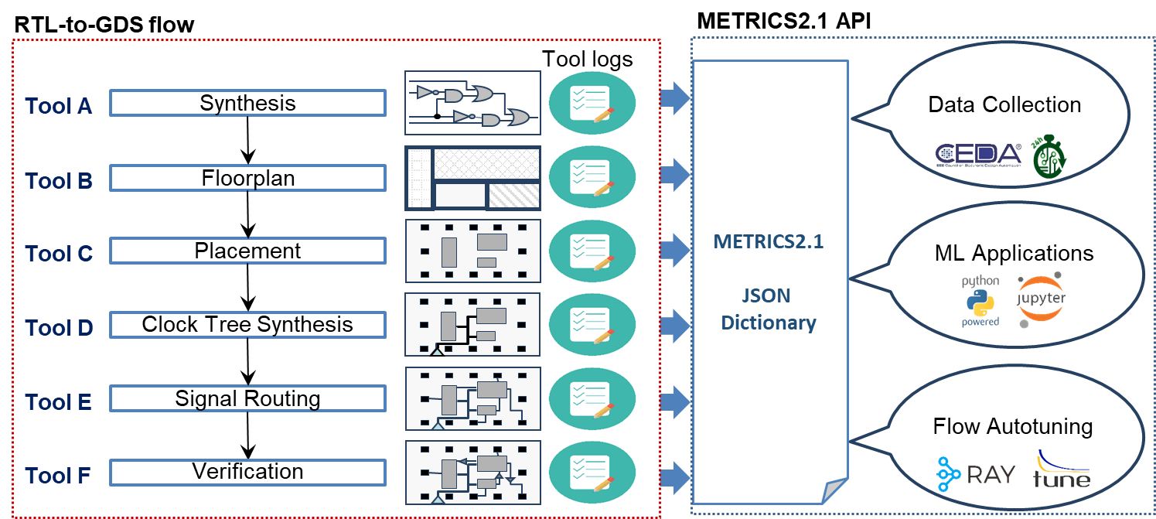
METRICS2.1 https://github.com/ieee-ceda-datc/datc-rdf-Metrics4ML
“Measure, to Improve”: enables collection and sharing of public datasets for research on ML in EDA
  Sample Jupyter notebooks to visualize and build simple prediction models
Feeds the score function evaluations used by AutoTuner
Guiding principles
  General and extensible
  No ambiguity: 1-1 mapping between measurements and names
  Free, open and frictionless; agnostic to EDA provider
Notes:
Openness also lets us perform research on machine learning for EDA and IC design, in a way that is currently impossible with commercial tools. Again in collaboration with IEEE CEDA, we have published large-scale metrics datasets harvested from thousands of runs of the OpenROAD flow, to stimulate data collection and publication of data that we hope will enable machine learning research.
[CLICK] Logging and metrics infrastructure feeds into the score function evaluations that are used by the AutoTuner.
[CLICK] And METRICS2.1 builds on lessons learned: it’s simple, general and extensible in its syntax and semantics; it avoids ambiguity and today’s Tower of Babel; and it’s agnostic to the tool provider.

Slide 19
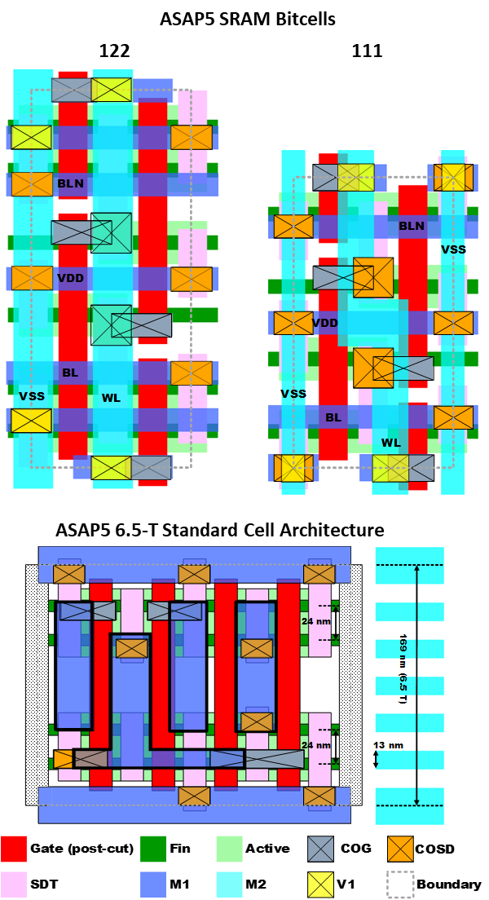
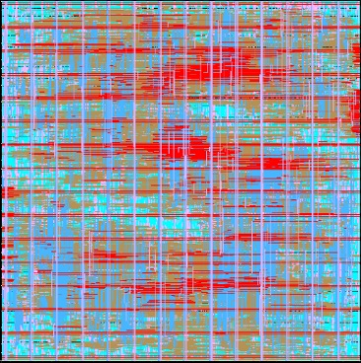
“Base Technologies” Task: ASAP7 / ASAP5
ASAP7: 7nm FinFET predictive PDK
  https://github.com/The-OpenROAD-Project/asap7
  7.5-track: 212 cells × four Vt’s
  6-track: 242 cells x four Vt’s
  Cell CDL, GDS (RVT only), LEF, LIB (NLDM and CCS), Verilog, and parasitic extracted CDL views
ASAP5: horizontal nanowire transistors
  3-D TCAD based compact models
  Reflects scaling boosters: single diffusion breaks, contact over-active gate, denser cross-overs
  Near release; ASAP5 PDK journal paper in review
Pipelined TMR AES
D-Latch (6-track)
D-Latch (7.5-track)
Notes:
One of the OpenROAD project’s sixteen tasks is called “Base Technologies”.
Arizona State joined OpenROAD as part of Task 1 activities, at the start of our Phase 2 -- leading to the December 2020 open-sourcing of the ASAP7 PDK and cell libraries. Here you see 7-point-5 track and 6-track D-latch layouts, and a post-routing screenshot of a pipelined AES implementation.
[CLICK] And, Larry Clark’s team will be releasing the ASAP5 PDK and libraries. ASAP5 uses horizontal nanowire transistors, and the ground rules track advanced-node scaling boosters such as single diffusion break and contact over active gate.

Slide 20
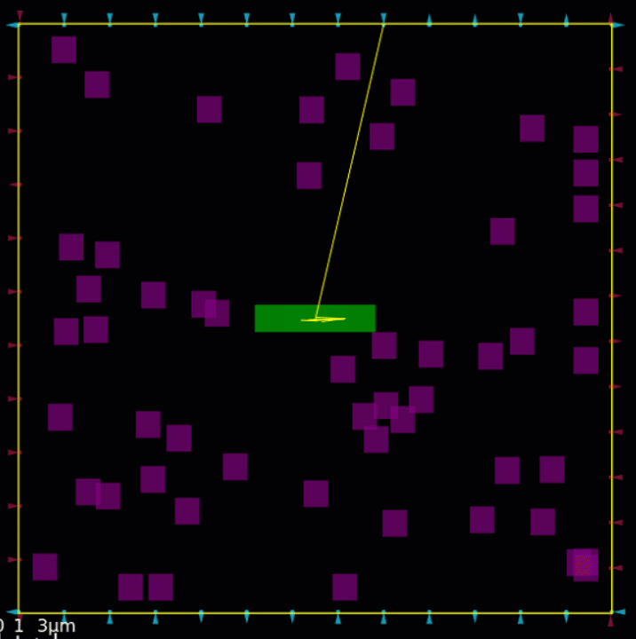
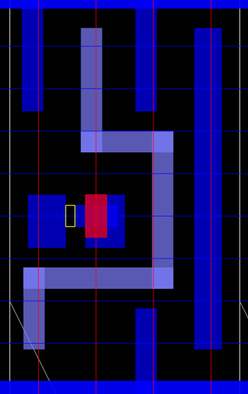
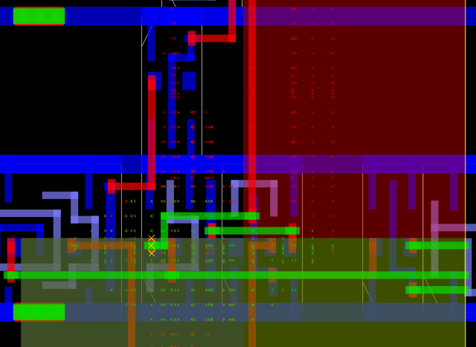
Many GUI Features for Algorithm Developers
Watching a cell in global placement
Via-to-pin spacing violation with track pattern overlaid
Grid points searched by the A* maze router, colored by layer
Notes:
Next, let me say a bit about OpenROAD’s GUI. Of course, everyone asks -- Why would a self-driving tool need a GUI?
The answer is because OpenROAD DEVELOPMENT must proceed with minimum pain and maximum velocity, while supporting tapeout and other needs of early-adopter users.
So on the way to no-human-in-the-loop, the tool needs a GUI.
This slide shows some GUI features that directly support algorithm and tool developers. For example, this GIF is from the GUI displaying a live global placement, where the developer can pause the algorithm, highlight and inspect an individual cell, and then track the cell through the algorithm execution.
[CLICK] Here is an overlay of the track pattern onto an instance of a via-to-pin spacing violation.
[CLICK] And this shows the maze search in detailed routing: Global route guides are the big red and green overlays, and the small x’s represent grid points searched (colored by layer). The larger yellow XXX’s represent the access points of the target pin. So the vertical red segment ran into a net that blocked its progress inside the guide and had to detour around it -- outside the guide.

Slide 21
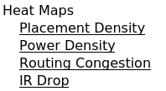
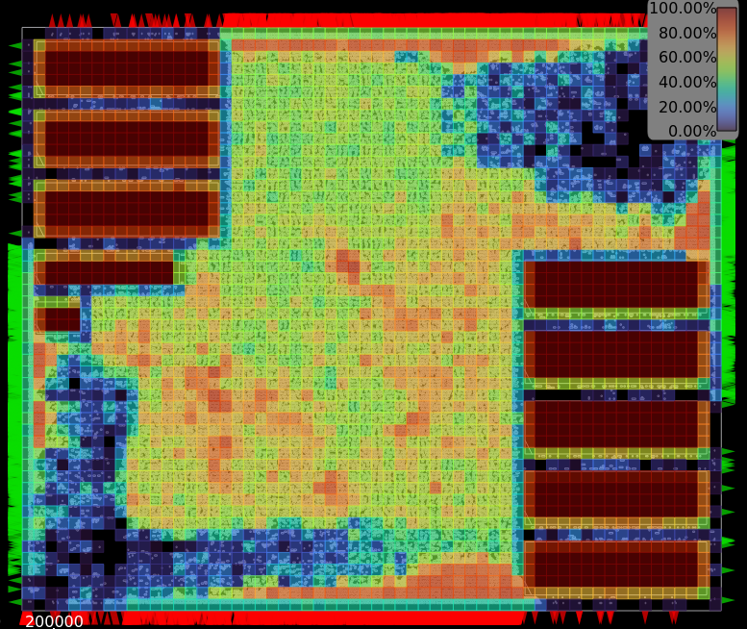
Heatmaps
Dump to files for machine learning
Example:
“gui::dump_heatmap Placement
pd.csv” produces:
x0,y0,x1,y1,value
0,960,20,980,7.200000e-01
0,940,20,960,2.400000e-01
0,920,20,940,1.200000e+00
0,900,20,920,0.000000e+00
0,700,20,720,1.440000e+00
0,720,20,740,2.520000e+00
0,740,20,760,1.200000e+00
…
Notes:
The GUI has heatmaps such as this placement density heatmap.
[CLICK] Recently we added the ability to dump this data to a file for machine learning – a Brazilian Ph.D. student made the request and got his wish a few days later.
The example shows how you can dump out a CSV.

Slide 22
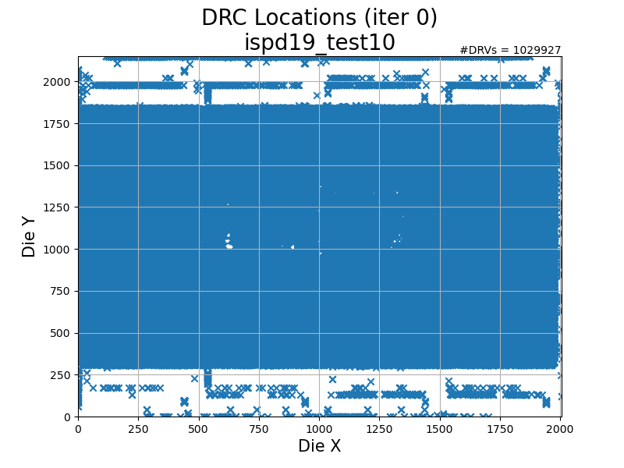
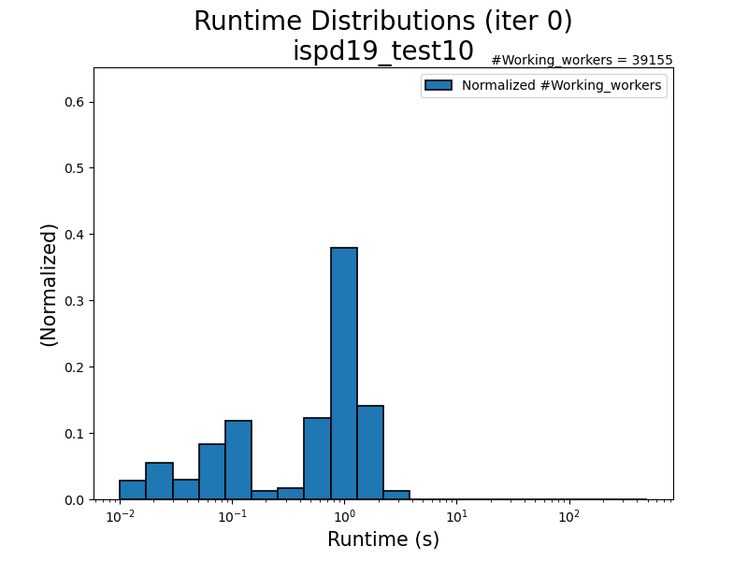
Real Accessibility of Real ML Challenges
  ispd19_test10, TritonRoute [drt in OpenROAD]
    Left: Tiles with DRVs (down to 21 at final iteration #64)
    Right: Runtimes of workers (up to > 500s in late iterations)
  Prediction
    Doomed runs? Hotspots, long tails? DRVs from placement, global route?
  Learning
    Costing strategies for workers? Sampling / multi-start strategies for tiles?
Notes:
OpenROAD also gives access to much deeper and higher-value machine learning challenges.
Here’s is TritonRoute running for its default 64 terations on ISPD19 Test10. On the left, it gets stuck with around 20 tiles (or sboxes) still having DRVs at the final iteration. On the right, the runtimes per tile worker start at less than a second but can reach 500 seconds in late iterations.
[CLICK] This is GREAT data for prediction – which runs are doomed, which tiles are in the long tail, where will the stubborn DRVs occur.
[CLICK] And, for learning as well – how to adaptively try to clean a tile, or how to budget worker threads among remaining tiles.

Slide 23
Trajectory Impacts of OpenROAD
“Leveling up” amplifies researchers’ efforts, reduce wasted energy
  More efficient discovery, innovation in physical design
  More accessible education and training of a future workforce
Openness and infrastructure
  Documentation in code of how to architect and build an EDA tool
  Integration backplane that lowers barriers and improves transparency
Virtuous cycle of democratization and innovation
  High-schoolers making tapeouts → disruptive enabler for education
  Rewarding for project contributors
Critical mass and critical quality are possible
Sustainability and translation are first-class concerns
  Governance, stable funding, organizational structure, roadmap, stakeholders, …
On the road to “EDA2.0”: Intelligence + Cloud
  COPILOT: Cloud Optimized Physical Implementation Leveraging OpenROAD Technology
Notes:
So, some of OpenROAD’s impacts so far:
[CLICK] “Leveling up” does amplify efforts and reduce waste. It leads to efficient discovery and innovation, and more accessible education and training of a future workforce.
[CLICK] Openness and infrastructure are good things. Like, OpenROAD documents in source code how to architect a modern back-end EDA tool.
[CLICK] There is a virtuous cycle of democratization and innovation. Folks who contribute feel good when they see high-schoolers making tapeouts with the tool.
[CLICK] Critical mass and critical quality are possible
[CLICK] Sustainability and translation into the real world are absolutely first-class concerns.
[CLICK] And now we can see future waypoints, like an “EDA2.0” that brings more intelligence and truly exploits modern compute.

Slide 24

Agenda
  Leveling Up: A Trajectory
  The OpenROAD Project
  The TILOS AI Institute
  And Beyond
Notes:
Let me move on to the second, much more recent waypoint: the TILOS AI Institute.

Slide 25

What is TILOS?
NSF National AI Research Institute for Advances in Optimization
Mission: make impossible optimizations possible, at scale
and in practice.
5-year grant, $20M total funding from NSF (started November 1st)
Partial support is from Intel Corporation
Notes:
TILOS is an NSF National AI Research Institute, FOR ADVANCES IN OPTIMIZATION.
[CLICK] Our mission is to make impossible optimizations possible, at scale and in practice.
[CLICK] NSF has awarded a 5-year, $20 million grant – we started on November 1st. And, our institute is partially funded by Intel.
UCSD is the lead institution, with [CLICK] five partner institutions MIT, National University, Penn, UT Austin and Yale.

Slide 26
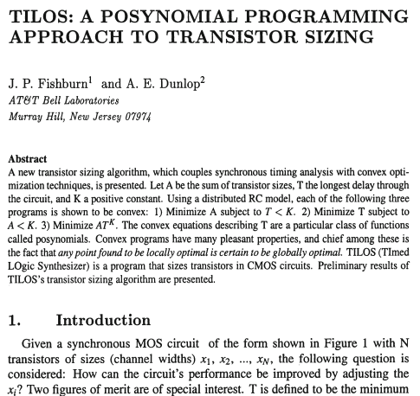
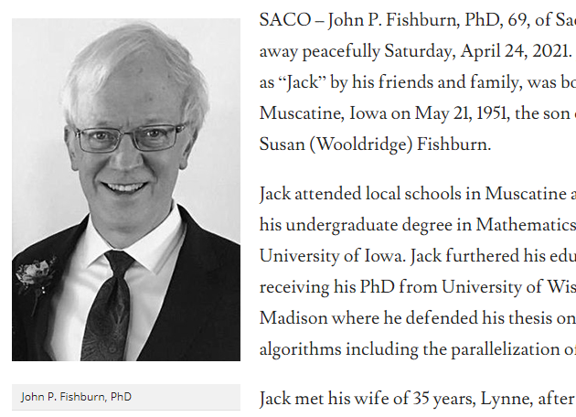
TILOS: Fishburn and Dunlop, ICCAD85
Notes:
And yes, the name is not a coincidence. TILOS was a real milestone in our field, and folks like Kurt Keutzer or Dwight Hill were in that Bell Labs group as it happened. It was very poignant to hear from Al Dunlop that Jack Fishburn had passed away less than six weeks before NSF told us about TILOS being awarded.

Slide 27
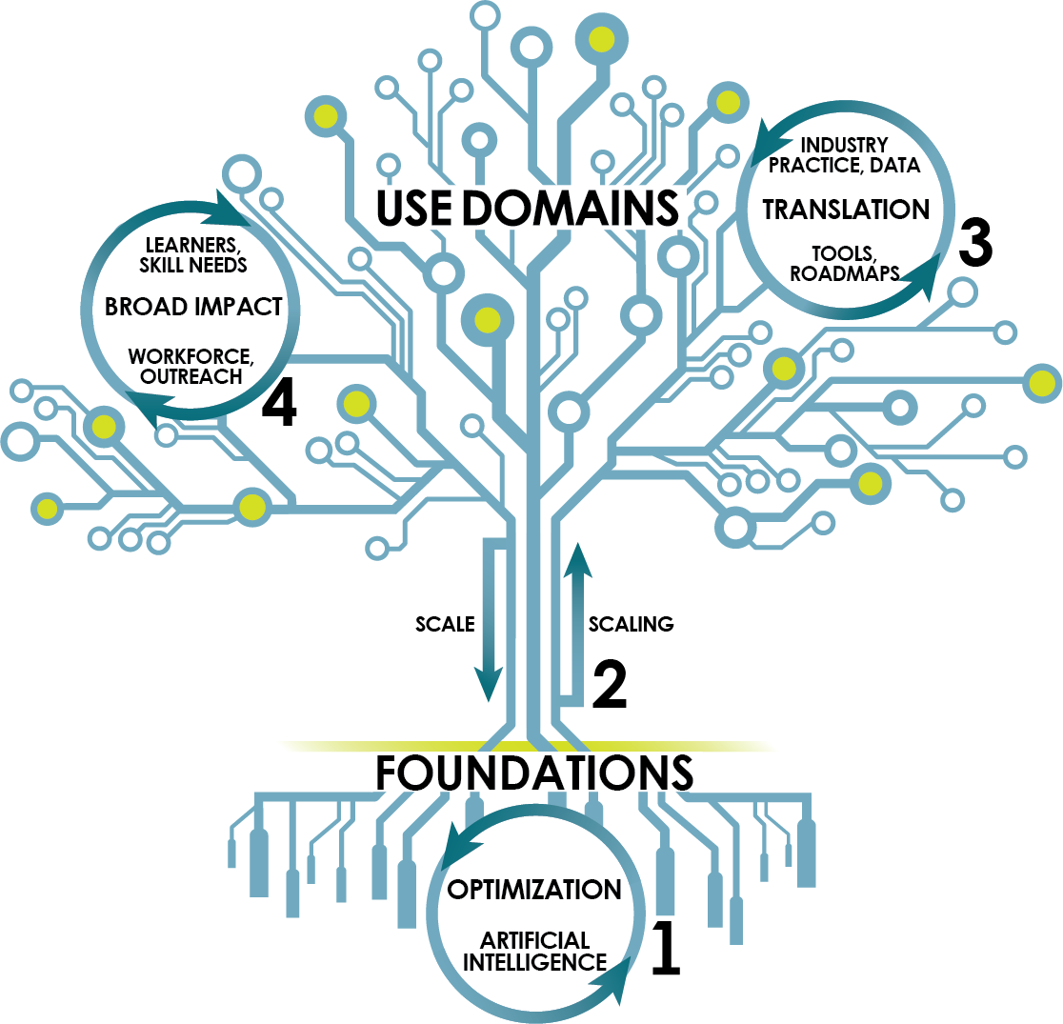
The Institute for Learning-enabled Optimization at Scale
Optimization: Find a best-possible solution
Fundamental challenges: scale and complexity
→ Nexus of AI/ML, optimization, use in practice
Vision: Four “virtuous cycles”
1. Foundations: AI and Optimization
2. Scaling: Foundations and Use Domains
3. Translation: Academia and Industry leading edge
4. Broad Impact: Education, Outreach, and Research
Notes:
Optimization means finding the best possible solution to a given problem – but real-world optimizations always run into challenges of scale and complexity.
TILOS aims for breakthroughs and impact at a new nexus of AI and machine learning, optimization, and use in practice.
[CLICK] In TILOS, we envision FOUR VIRTUOUS CYCLES.
[CLICK] First: mutual advances of AI and Optimization are our FOUNDATIONS.
[CLICK] Second: challenges of scale and breakthroughs from scaling bind together the Foundations and our Use Domains (like, chip design).
[CLICK] Third: we see a virtuous cycle of TRANSLATION between research and the leading edge of practice. This is one area where we aim to go far beyond “research as usual”: for us, translation and impact are first-class objectives for research and industry interactions. We really hope to crack the code for this.
[CLICK] Fourth is the virtuous cycle of education, broadening participation and research.
[CLICK]

Slide 28
Learning and Optimization: Foundations
AI advances → new challenges, new tools for optimization
  Bridging Discrete and Continuous
  Distributed, Parallel, and Federated
  Optimization on Manifolds
  Dynamic Decisions under Uncertainty
  Nonconvex Optimization in Deep Learning
New perspectives on classic problems of optimization
Credit: N. Vishnoi, S. Jegelka, D. Spielman, Y. Wang +
Notes:
Why spend the next five-plus years on this? Because Design and EDA are all about Optimizations that are desperately looking to AI and ML as boosters.
From the standpoint of AI and Optimization, the starting insight is that the scale and complexity of modern AI goals pose new challenges to optimization – while, in turn, advances in AI provide new ways to approach the problems of optimization.
In this context, there are five foundational pillars of optimization that bear watching.
[CLICK] Bridges between continuous and discrete optimization.
[CLICK] Parallel, Distributed, and Federated optimization.
[CLICK] Optimization on Manifolds.
[CLICK] Dynamic decision making under uncertain environments. And,
[CLICK] Non-convex optimization for Deep Learning.
[CLICK] Beyond providing new perspectives on classic problems of optimization, these pillars are strongly interrelated, and each connects to multiple applications.

Slide 29
IC Design and Design Automation Challenges
Challenges
Scale
Representation
Uncertain objectives
Multi-stage, Multi-scale
Dynamics
Reliability, Generalization
Federated, Distributed
IC Design Optimization Problems
  Need new Foundations
  of
  Learning, Optimization
Credit: N. Vishnoi, S. Jegelka, D. Spielman, Y. Wang +
Notes:
IC design optimizations raise challenges that we can recite in our sleep: (1) large scales, (2) the right representations are key; (3) objectives are often uncertain, in multi-stage design pipelines and in dynamic settings, (4) there are demands for reliability and generalization, and (5) we need federated learning and optimization to scale productivity.
[CLICK] TILOS starts out with the fact that moving the needle on these challenges will require new foundations.

Slide 30
EDA is Optimization and Machine Learning, too …
EDA is about optimizations and algorithms
  High stakes: performance, power, design closure
Discrete, combinatorial formulations at huge scale
  Optimizations: ILP, MCF, QAP, SAT/SMT, LR, …
  Algorithms: min-cost flow, high-dim DP, …
But need an answer overnight
Reality under the hood: metaheuristics
  Annealing, multi-start, PSO, NGSA-II, ripup-reroute, greed, …
  Convenient objectives, customer-/tech-specific tuning, …
  … which comes at a cost
Notes:
As we know: EDA *is* Optimization.
[CLICK] It’s high-stakes optimizations.
[CLICK] At enormous scale. Where we know how to write down classical formulations and we know the classical optimization or algorithm frameworks – but
[CLICK] we need near-linear answers and we need the whole thing overnight !!!
[CLICK] And so the reality under the hood is that EDA has always dealt with ever-larger problems by applying metaheuristics and figuring out how to cut more corners.
We’ve been conditioned to NOT want to beat problems to death – they’re NP-hard after all.
But I want to make the point that this comes at a cost.

Slide 31
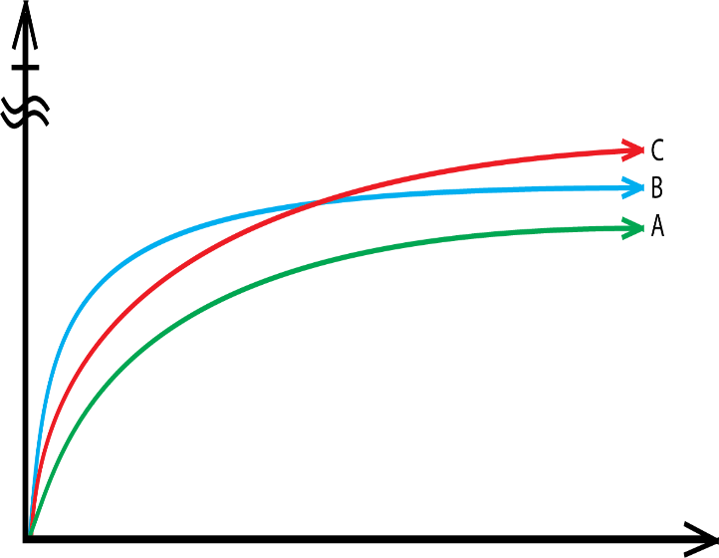
Optimization and Optimality
Reality of optimization
  Better, faster, cheaper – pick any two
IC EDA: want all three at once
  “Unfortunately, the runtime of …”
But the world has changed
  Automation, cloud, …
Optimal
?
Time
Question: If you give your SP&R flow 3 extra days of runtime, would it know how to use this extra time?
Question: If you could run 10,000 copies of your P&R tool at the same time, what QOR improvement should you expect?
Notes:
I’ll claim that in the past quarter century, we have NOT materially advanced our understanding of the suboptimality gap in CAD. But CAD is optimization! For optimization, if the x-axis on the right is TIME and the y-axis is QUALITY, then the blue heuristic dominates red, which dominates green.
[CLICK] In optimization of course, out of “better, faster, cheaper” – we know that you get only two. Our field tends to demand all three at once –customers want tools to still run overnight, and reviewers don’t like it if QOR improvements come with longer runtimes.
[CLICK] So Heuristic C in red may never see the light of day. And by the way, we have no clue how far any of these is from optimality.
[CLICK] But the world has changed in the past quarter century. [CLICK] And we need better answers to questions such as these.

Slide 32
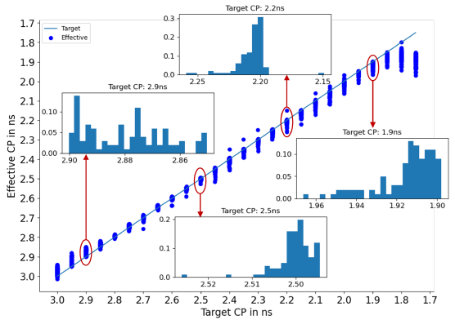
“Noise”, “Chaos” → Learning and Sampling
“Actual” vs. “Target” clock period
Best Actual fmax
= what we want
Notes:
Here’s another learning and optimization challenge. Over 20+ years, I’ve written maybe three “generations” of papers about “noise” and “chaos” in EDA heuristic optimization. In our latest efforts, my students are trying to understand and model the “mapping” between what we ask for and what we get.
Here, the x-axis has the TARGET clock period while the y-axis is the EFFECTIVE, i.e., ACTUAL clock period of the P&R outcome.
The x-axis has 26 target clock periods, spaced 50 picoseconds apart. And for each, we make 101 distinct runs, all aiming within half a picosecond of that target. (Basically, we step the SDC constraint by 0.01ps).
How do we learn the shape of this transition between EASY on the left, and IMPOSSIBLE on the right? And, the mapping between TARGET and EFFECTIVE? Better modeling and sampling could really help here.

Slide 33
Refocus on Suboptimality [to get closer to Optimality!]
Suboptimality … in what sense?
Learn proper objective/loss functions
Evaluate in proper context (e.g., full flow, post-detailed route)
Benchmarking considered helpful
“Real” benchmarks in EDA are obfuscated, incomplete, non-vertical, old…
“Artificial” benchmarks wander between realism, known optimal solution quality, scalability …
It’s time to level up: e.g., “Underwriters Laboratories for IC Design Tools”
Modern compute resources cloud, GPU, accelerators, …
EDA Optimization + Learning naturally live in the cloud
Many EDA optimizer implementations today: “EDA1.0” from the 1980s
  → Can TILOS help discover new, cloud-scalable “EDA2.0” foundations?
Notes:
Here’s one attitude adjustment I hope to see before I retire.
We really need to return to EDA’s optimization roots, and refocus on closing the suboptimality gap – including in what sense. Because we now have full flows, metrics and evaluators that go beyond HPWL.
[CLICK] We need to grapple once more with benchmarking. Benchmarks must somehow help to drive the leading edge forward, and be accessible to everyone – not just a well-connected few.
[CLICK] And the leading edge runs on a modern compute resource.

Slide 34
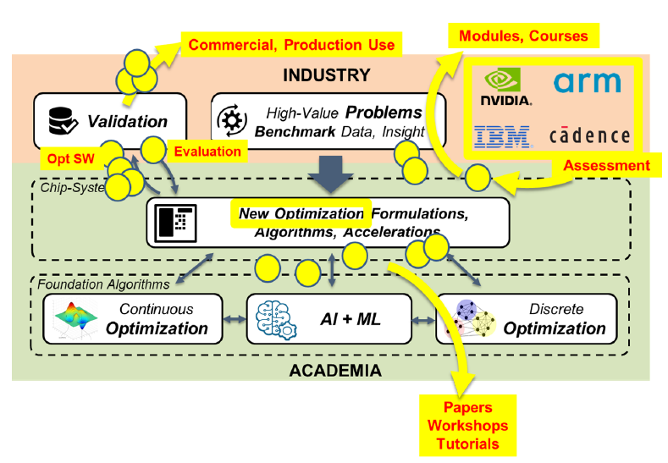
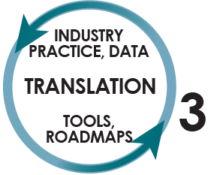
“Life Cycle” of Research and Translation
Translation is here
Notes:
To explain the synergy I see between the past four years of OpenROAD and the coming five years of TILOS, I want to say a bit more about TRANSLATION, which takes place at this interface (where you see the blue arrow) between Industry and Academia. Earlier, I mentioned that TRANSLATION is the THIRD VIRTUOUS CYCLE of TILOS.
Here, the yellow dots are people.
You see that real-world practitioners supply problems and data, folks in academia bridge foundations and use to find new methods, and this goes back into the real world.
So in this picture, we see: Industry and Academia, Theorists and Applied researchers – working together to move our field forward.

Slide 35
“Life Cycle” of Research and Translation
X
X
Translation is here
Translation requires solutions to the X’s:
data
benchmarking
roadmapping
Notes:
But actually, for Chip Design, this picture is spoiled by the red X’s.
In TILOS, we want to FIX THIS PICTURE by erasing fundamental obstacles that involve Data – and Benchmarking, and Roadmapping.
Before I go on, please think about being a student in VLSI CAD. Looking for testcases, writing your own parsers and translators, trying to reimplement some algorithm based on what that ISPD paper said. Some folks had TSMC and Arm. Others had FreePDK45 and ISCAS89. And sadly, things haven’t gotten a lot better.

Slide 36
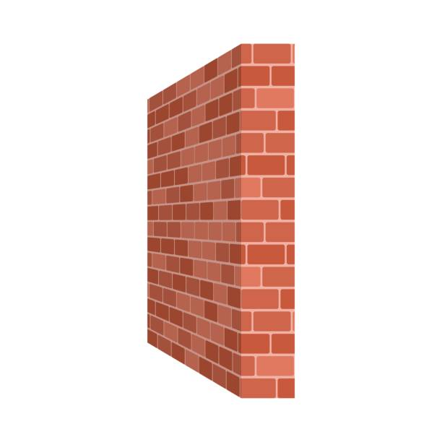
Make the “Third Virtuous Cycle” Real
Real data is sensitive, artificial data isn’t valued
Multi-way NDAs, export control, …
Irreproducible research
Haves vs. Have-Nots
Risks: bias, ethics, fairness
…
What we need
  Democratization and accessibility of research at the leading edge
  New norms for transparency, reproducibility, translation
  New norms of benchmarking in a high-stakes use domain
  Principled roadmapping to guide investment of time and $
Notes:
So I’ll claim that today, the ideal of a “Virtuous Cycle of Translation” faces a wall of blockers. Relevant datasets are missing. Access to research data is a world of Haves and Have-Nots.
Getting to a culture of transparency and replication and benchmarking – I think we can agree that as we saw with yesterday’s Session 4, we’re not there yet.
When there’s a wall like this, it’s INEFFICIENT. This matters because we already struggle with having too few people, and too little time.
[CLICK] As an AI Institute for Advances in Optimization with CHIP DESIGN as a key use domain... Our goals include these --- democratizations, new cultural and scientific or technical NORMS, principled bases for looking forward and investing – that’s what an AI Institute is about.
[CLICK] And that would help make this virtuous cycle real.

Slide 37
Example Research Questions on the path to Translation
  Can’t access or expose real data
    Generate artificial circuit designs that are indistinguishable from real circuit designs from the perspective of optimizers
    Learn from much less data
  Can’t access the best optimizers
    Model of “strong optimizer” outcomes based on instance attributes and “weak optimizer” outcomes
  Can’t reveal sources of data
    Privacy-preserving anonymization and obfuscation
  Benchmarking brings risks of misuse
    Develop ethical principles and validations to enable fair benchmarking
  Can’t identify the most crucial learning, optimization goals
    Roadmaps + Drivers
Notes:
I also want to emphasize that Translation itself brings open research challenges. Here are some of them, and why we care about them.
Real data is rare and it’s shared with only elite researchers. The research challenge is to democratize: Can we generate artificial circuit designs that are indistinguishable from real circuit designs from the perspective of optimizers?
[CLICK] People can’t access the best optimizers. Can we learn to model outcomes of a strong optimizer based on the instance and outcomes of weak optimizers?
[CLICK] Designs and tools often need to be anonymous. Privacy and anonymization is an arms race. We need trusted anonymization methodologies and trusted tests for identity leakage.
[CLICK] Companies forbid benchmarking in large part because benchmarks can be misused. In TILOS, one goal is to develop new principles and mechanisms that provide a foundation for fair benchmarking.
[CLICK] And we want to work on relevant problems, we don’t like to drive by the rear-view mirror. Which is where Roadmaps and Drivers are needed.
If you’d like to join “roundtable” discussions of what Core Optimizations in physical design need more focus, send me a note.

Slide 38
My Personal Target List
Learning to Optimize (L2O)
  Models, predictors and objectives; sampling; RL; hybridized optimizers
Scaling the reach of optimizers
  Partitioning, clustering, sparsification; cloud/parallel; multi-{dims,objs}
  Optimal solvers as well (e.g., optimal peephole/clip P&R&Opt)
System/Arch/SoC PPAC exploration
  Learning to cluster+shape+pack+plan; pathfinding with confidence
    Stack of abstractions: device, circuit, memory, integration fabrics
Notes:
Here’s my personal top-3 target list.
I want to understand “Learning To Optimize” – chained optimizations, surrogate objectives, sampling and sequential learning (in the cloud) and RL – and how to hybridize classic heavyweight solvers like flows or ILP or SAT.
[CLICK] I want to understand how to scale the reach of optimizers: splitting up problems, or making them smaller or sparser, without losing solution quality – leveraging the cloud, and handling multiple weights and objectives. And I see a roadmap ahead for optimal layout solvers and what they can handle.
[CLICK] We need high-accuracy, early design space exploration and pathfinding. There is a cluster-shape-pack-plan co-optimization in the middle of this, and I think a lot about what “pathfinding with confidence” implies. And I feel the stack of abstractions must go all the way down to the bottom.
There’s more of course.

Slide 39
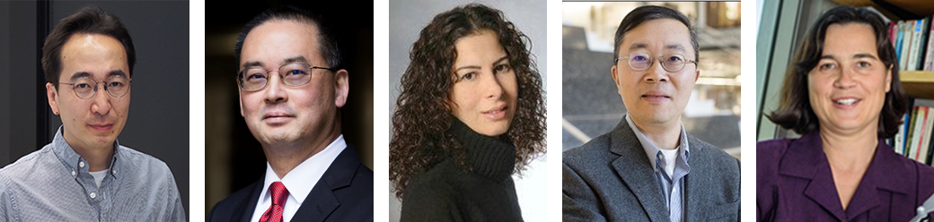
TILOS Chips Team
Layout
  Optimal embedding, “modern partitioning”
  Nexus of sampling, sequential decision-making, learning to optimize
Verification
  E.g., interior search methods to scale SMT solving
Quantifying the cost of “X” (e.g., X = security)
  Intrinsic cost of robustness in optimization and learning
  Data anonymity, data integrity, privacy in federated and distributed settings
Data, benchmarking and roadmapping
  “Artificial but realistic” benchmarks
  Principles for ethical and fair benchmarking
Notes:
Here are the TILOS Chips faculty. As a group, we are pursuing four main thrusts in collaboration with each other, and with folks who work on foundations of learning and optimization.
Very briefly, these thrusts are Layout, Verification, Quantifying the Cost of “X” (where X includes security, robustness, and aspects of data integrity and privacy), and research centered around data, benchmarking and roadmapping. And the institute is establishing mechanisms for visiting students and affiliated faculty, as well.

Slide 40
Trajectory Impacts of TILOS
Cracking the code of translation
  Unblocking data and benchmarking → transparency, reproducibility, efficiency
  Roadmapping of core optimization problems → where to invest time and effort
Improved understanding of suboptimality
  Modern compute context → federated learning and optimization; sequential decision-making and sampling
A new nexus of learning, optimization and practice
  Learning to learn, learning to optimize
Notes:
Some of TILOS’s hoped-for impacts in the coming years:
Cracking the code of translation. Can we instill culture change toward transparency and reproducibility, and benchmarking and roadmapping?
[CLICK] Returning to the optimization roots of EDA. First, because EDA is the source of design-based equivalent scaling and pathfinding for as far out as we can see. Second, because during our careers, cloud and CPU have become reality, and there’s TeraFLOPs of compute in a mobile phone: Will we succeed in rebuilding CAD *optimizations* in this new context?
[CLICK] And I hope we figure out how to connect with foundations of AI and Optimization – folks who hang out at ICML and INFORMS and FOCS, or Amazon and MSR – to help discover this new nexus for chip design.

Slide 41
Agenda
  Leveling Up: A Trajectory
  The OpenROAD Project
  The TILOS AI Institute
  And Beyond
Notes:
Now, let me conclude with a brief “what’s next”.

Slide 42
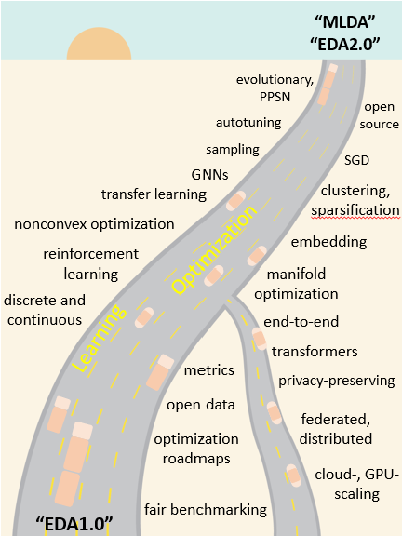
What Next?
“ML-enabled DA”, “EDA2.0” are also waypoints in the trajectory
Enabled by learning and optimization technologies
Some elements arrive before others
  E.g., autotuning and sampling before fair benchmarking
Can we deliver on this picture within 5-10 years?
Notes:
This is Figure 6 in the paper. My point is that OpenROAD and TILOS and a huge part of R&D in our field are all taking us to some intelligent, scalable, better future -- EDA2.0.
[CLICK] There’s a big warning here – which may even be the main takeaway. Infrastructure and culture changes that help our own research move faster, attract bright young students, and unblock machine learning and reproducible progress – these changes just lay a “roadbed” for this road ahead. Realizing the actual road ahead then brings its own challenges.
The figure also shows how in this part of EDA’s trajectory, some elements like autotuning will mature earlier than other elements, such as an ecosystem-wide consensus on fair EDA benchmarking.
[CLICK] But my hope is that the bulk of this figure will become real within the next 5-10 years.

Slide 43
Leveling Up: ISPD-2030
Did a new nexus of AI, optimization and chip design bring excitement and accessibility, and attract more young people?
Did we fully leverage advances in optimization and learning?
  How did we scale the reach of optimizers, e.g., by splitting up problems, or making them smaller or sparser, without losing solution quality?
Did we advance the most critical optimizations to target with “MLDA” or EDA2.0?
  E.g., partition-cluster-shape-pack-plan co-optimization to serve design space exploration and pathfinding = essential for pathfinding in the beyond-{Moore, CMOS, von Neumann} era
Did we make advances in representation to complement advances in learning and optimization?
Notes:
Concretely, at ISPD-2030 it would be great to say YES, we leveled up – and we checked these boxes:
[CLICK] We improved accessibility and openness – because we realized that training a future workforce depends on attracting it in the first place.
[CLICK] We refocused on scaling the quality and reach of optimization – because EDA is optimization.
[CLICK] We figured out the most critical optimizations to target, and we made game-changing progress.
[CLICK] And we made progress toward uniting data-centric and knowledge-centric approaches – so as to leverage the decades of designer knowledge, and stacks of models and representations -- that underlie chip design today.

Slide 44
Links and Acknowledgments
More info (papers and talks)
  OpenROAD publications and ERI Summit presentations page
  GOMACTech 2021 “The OpenROAD Project: Unleashing Hardware Innovation” .pdf .mp4
  DARPA MTO ERI Summit 2021 “OpenROAD: Foundations and Realization of Open, Accessible Design” slides .mp4
  ICCAD 2021 “METRICS2.1 and Flow Tuning in the IEEE CEDA Robust Design Flow and OpenROAD” .pdf .pptx .mp4
  Synopsys APUP 2022 “AI/ML, Optimization and EDA in TILOS, an NSF National AI Research Institute” .pptx .mp4
  UCLA ECE 2022 “The OpenROAD Project: Today and Beyond” .pptx
  NSF Integrated Circuits Research, Education, and Workforce Development Workshop talk (Oct. 15, 2021) .pptx
Many thanks are due to many great colleagues in OpenROAD and TILOS, as well as numerous students and collaborators. Research at UCSD is partially supported by NSF CCF-2112665 and CCF-1564302, DARPA HR0011-18-2-0032 and FA8650-20-2-7009, Samsung, Qualcomm, NXP Semiconductors and the C-DEN Center.
  https://theopenroadproject.org
  https://vlsicad.ucsd.edu
  https://tilos.ai
Notes:
You can find this PowerPoint on my lab website, and this slide has heartfelt acknowledgments and some links.

Slide 45
THANK YOU !
Notes:
Thank you for your attention and for the opportunity to be here -- and [CLICK] let’s level up !

