Slide 1
RTL-MP: Toward Practical, Human-Quality Chip Planning and Macro Placement
Andrew B. Kahng^{[1] [2]},
Ravi Varadarajan^{[2]} and Zhiang Wang^{[2]}
^{[1]}Department of Computer Science and Engineering, University of California, San Diego
^{[2]}Department of Electrical and Computer Engineering, University of California, San Diego
Notes:
Hello everyone, my name is Zhiang Wang, a third year PhD student at UC San Diego.
Today, the title of my presentation is “RTL-MP: Toward Practical, Human-Quality Chip Planning and Macro Placement”.

Slide 2
Outline
Background and Motivation
Main Contributions
Our Methodology
Experimental Setup and Results
Conclusion and Future work
Notes:
This is the outline of my presentation.
Firstly, I will start with the background and motivation of our work.
Then I will summarize our main contributions and explain our main methodology.
Next I will describe our experimental setup and results.
Finally, I will conclude my talk with a quick summary and our ongoing work.

Slide 3
Background and Motivation
Macro placement is crucial to SoC design closure
Sets the direction for all of place-and-route
Basis of architecture/RTL exploration, and design planning
Machine learning accelerators make macro placement more challenging
Autogenerated complex RTL structure with long, inscrutable autogenerated module names
Hundreds of macros (see following TABLA designs as examples)
TABLA designs are produced in an open-source project VeriGOOD-ML
Notes:
Let me start with the background and motivation.
Why is “a macro placement” a hugely important, crucial issue ?
Because fixing the big blocks in the chip floorplan sets the direction for all of the place-and-route that follows.
Just like a person with a wrong direction can never arrive at his destination,
a bad macro placement can lead to significant congestion and timing issues.
And the macro placement is the basis for efficient design space exploration of the SoC designs.
[CLICK] Besides, the emerging machine learning accelerators make the macro placement more challenging.
Machine learning accelerators usually have autogenerated complex RTL structures with long, inscrutable autogenerated module names.
And they usually have hundreds of macros due to the need of storing online data.
We can see the following TABLA designs as examples.
The TABLA designs are produced by professor Hadi Esmaielzadeh’s group at UCSD, in a joint project called VeriGOOD-ML.

Slide 4
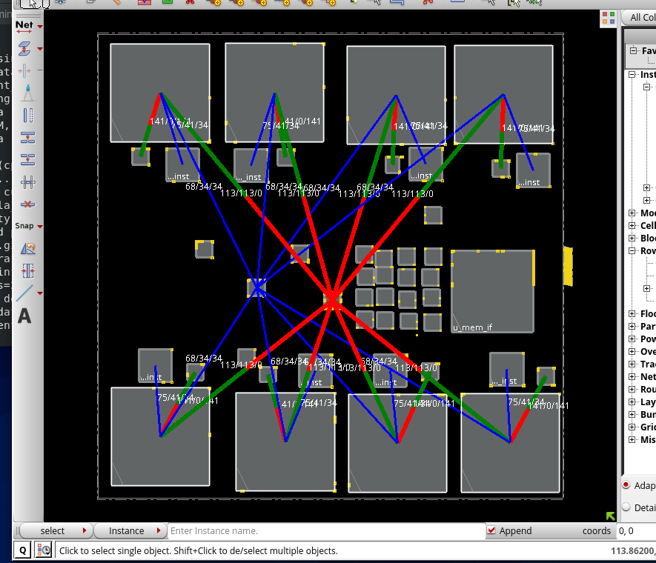
Background and Motivation
How do human physical design experts create high-quality macro placements?
Example floorplan analysis of TABLA designs
Notes:
how do physical design experts create high-quality macro placements ?
[CLICK]
Here we still use the TABLA design as an example.
Firstly, The backend designers will talk to the frontend designers,
and try to capture the conceptual abstractions of the designs, and functional interactions between logic modules.
As you can see here, there are grey boxes corresponding to logical modules.
The red and blue lines are bundled connections between logical modules.
Then they perform dataflow analysis to determine the relative positions of each module.
Basically, here they trace the bundled connections for each module one by one.
Here I show the bundled connections for some modules one by one.

Slide 5
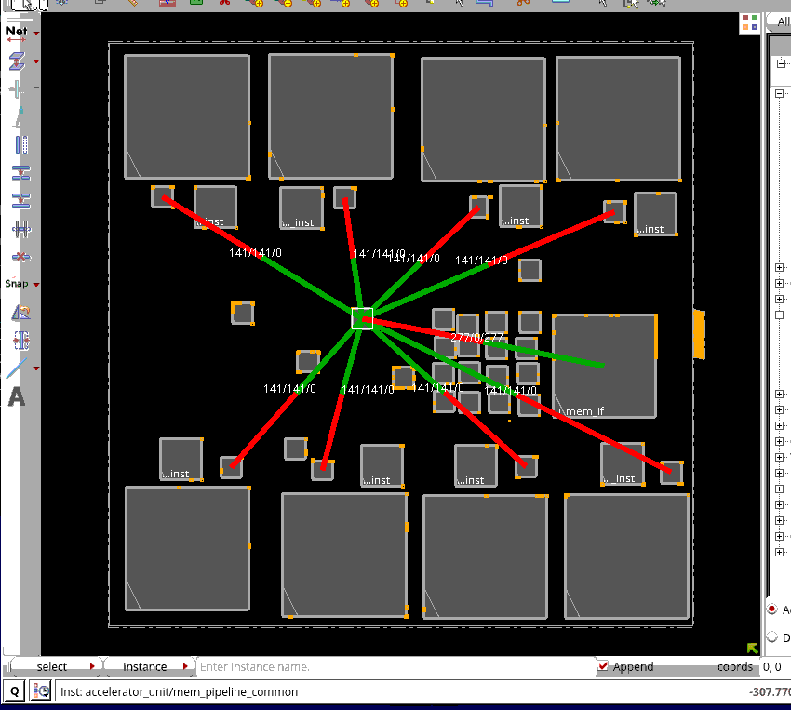
Background and Motivation
How do human physical design experts create high-quality macro placements?
Example floorplan analysis of TABLA designs

Slide 6
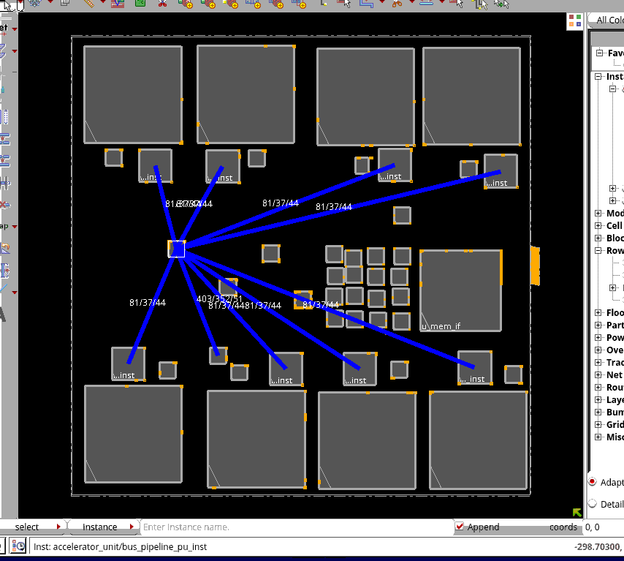
Background and Motivation
How do human physical design experts create high-quality macro placements?
Example floorplan analysis of TABLA designs

Slide 7
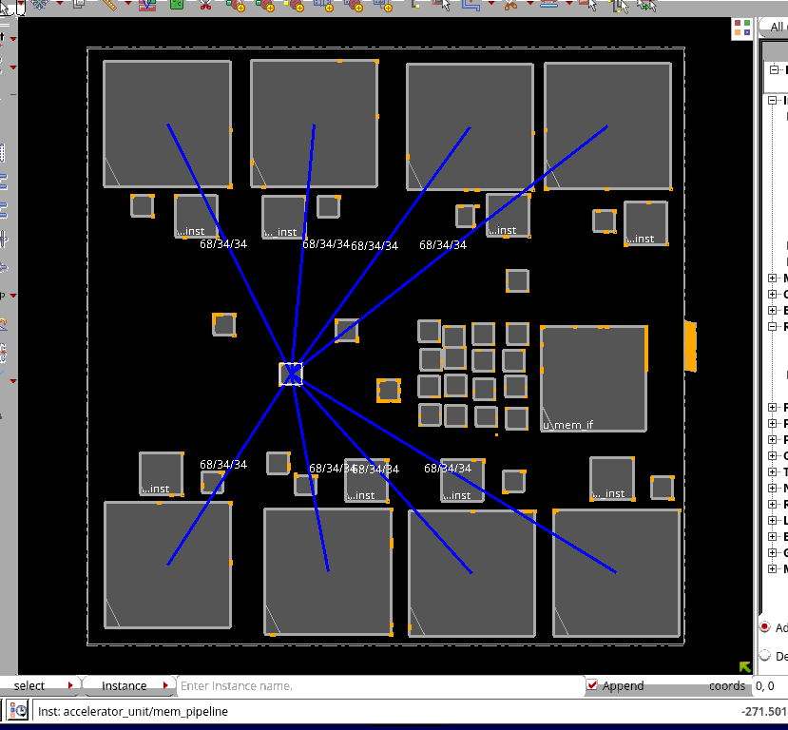
Background and Motivation
How do human physical design experts create high-quality macro placements?
Example floorplan analysis of TABLA designs

Slide 8
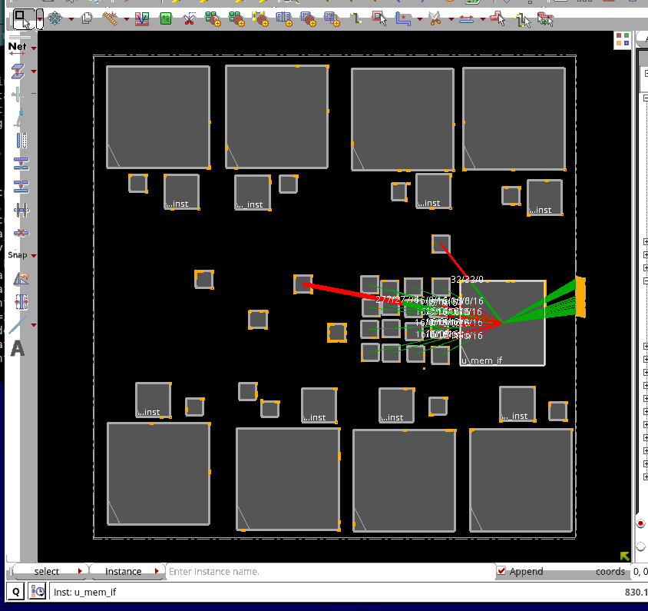
Background and Motivation
How do human physical design experts create high-quality macro placements?
Example floorplan analysis of TABLA designs

Slide 9
Background and Motivation
A “human-quality” macro placer must correctly comprehend
Conceptual abstractions devised by the frontend designer
Functional interactions and dataflow between logical modules
Macro placement guidance with preferred locations for macros
Common constraints such as macro placement blockages
1
2
“human-quality”
macro placer
3
4
Notes:
So a human-quality macro placer must correctly comprehend
[CLICK]
Conceptual abstractions devised by the front designer,
[CLICK]
Functional interactions and dataflow between logical modules,
[CLICK]
Macro placement guidance with preferred locations for macros,
[CLICK]
And common constraints such as macro placement blockages and so on.

Slide 10
Outline
Background and Motivation
Main Contributions
Our Methodology
Experimental Setup and Results
Conclusion and Future work
Notes:
Now I will summarize our main contributions.

Slide 11
Main Contributions
We propose RTL-MP, which utilizes RTL information and tries to “mimic” the behavior of human experts
Conceptual abstractions devised by the frontend designer
Through converting the structural netlist representation of the RTL design into a clustered netlist
RTL-MP
cluster
bundled
connections
Notes:
In this work, we propose RTL-MP, which utilizes RTL information and tries to “mimic” the behavior of human experts.
To achieve human-quality macro placement, our RTL-MP has following features:
[CLICK] Firstly, RTL-MP converts the structural netlist representation of the RTL design into a clustered netlist,
which captures the conceptual abstractions devised by the frontend designer.

Slide 12
Main Contributions
We propose RTL-MP, which utilizes RTL information and tries to “mimic” the behavior of human experts
Functional interactions
Through analyzing the dataflow between logical modules (including Input-output pins)
RTL-MP
Notes:
Secondly, RTL-MP analyzes the dataflow between logical modules (including input-output pins) to understand their functional interactions.

Slide 13
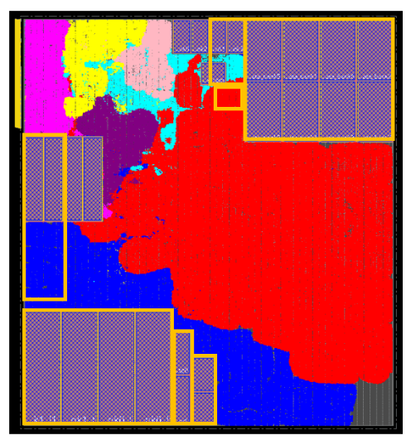
Main Contributions
We propose RTL-MP, which utilizes RTL information and tries to “mimic” the behavior of human experts
Macro placement guidance
Through pushing macros to their preferred locations
RTL-MP
macro
guidance
Notes:
Thirdly, RTL-MP will push macros to their preferred locations if users specify the macro placement guidance.

Slide 14
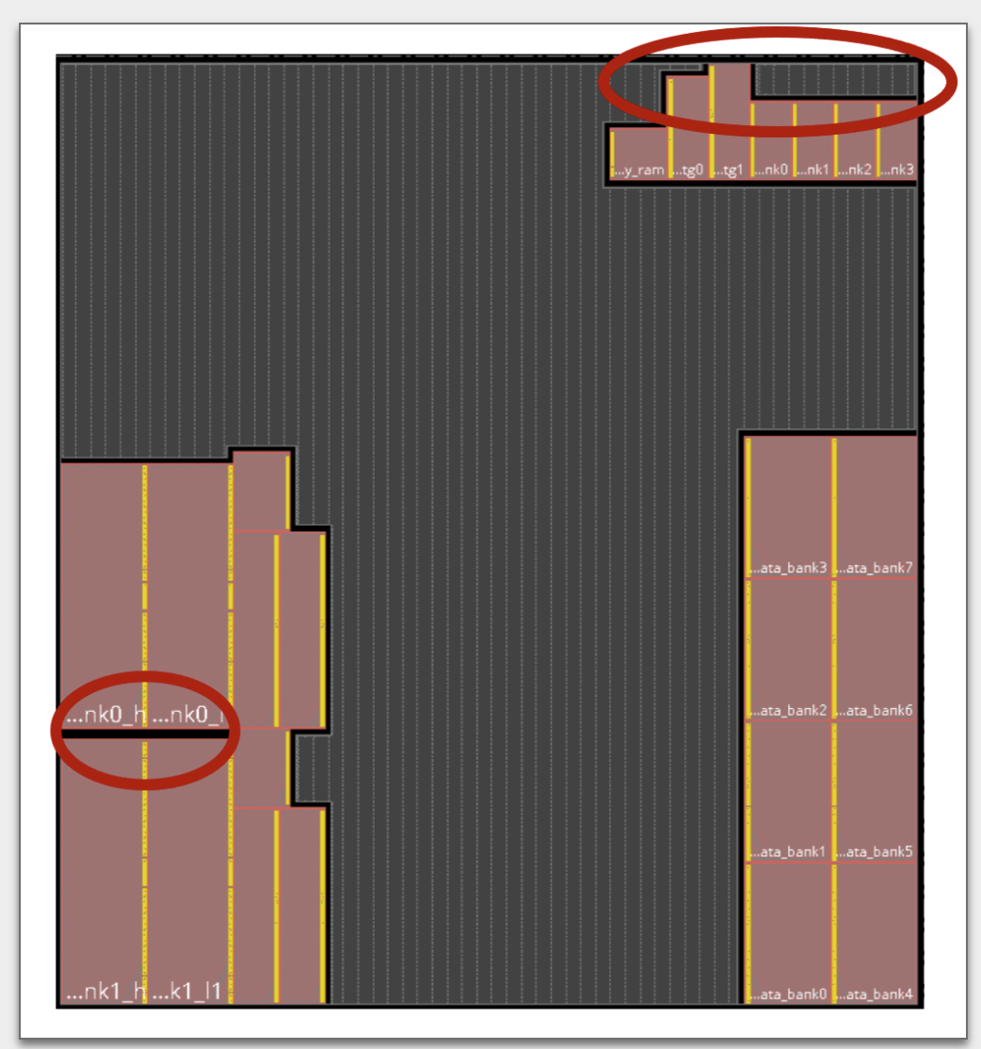
Main Contributions
We propose RTL-MP, which utilizes RTL information and tries to “mimic” the behavior of human experts
Common constraints
Fixed macro constraints
Macro placement blockages
Small dead space (notch) avoidance
Pushing macros to peripheries
RTL-MP
notch
Notes:
Lastly, RTL-MP understands common constraints such as fixed macros, macro placement blockages,
notch avoidance and pushing macros to peripheries.

Slide 15
Main Contributions
We propose RTL-MP, which utilizes RTL information and tries to “mimic” the behavior of human experts
Conceptual abstractions devised by the frontend designer
Functional interactions and dataflow between logical modules
Macro placement guidance with preferred locations for macros
Common constraints such as macro placement blockages
1
2
RTL-MP
3
4
Notes:
In summary, our RTL-MP is able to comprehend
[CLICK]
Conceptual abstractions devised by the front designer,
[CLICK]
Functional interactions and dataflow between logical modules,
[CLICK]
Macro placement guidance with preferred locations for macros,
[CLICK]
And common constraints such as macro placement blockages and so on.

Slide 16
Outline
Background and Motivation
Main Contributions
Our Methodology
Experimental Setup and Results
Conclusion and Future work
Notes:
Now I will explain our methodology.

Slide 17
Our Methodology - RTL-MP Flow
.def (floorplan def with placed IO pins)
.v (hierarchical netlist)
.lef + .lib + .sdc
.def (floorplan def with placed IO pins)
.v (hierarchical gate-level netlist)
.lef + .lib + .sdc
Autoclustering Engine
Autoclustering Engine
Static Timing
(OpenSTA)
clustered netlist
Shape Engine
Shape Engine
OpenROAD
RTL-MP
feasible footprints of clusters
Macro Placement Engine
Shared Data
Model (OpenDB)
Macro Placement Engine
shaped and placed clusters
Pin Alignment Engine
Pin Alignment Engine
.def (floorplan def with placed macros)
.def (floorplan def with placed macros)
Notes:
This figure shows the flow of our RTL-MP.
RTL-MP is built based on OpenROAD infrastructure.
RTL-MP takes floorplan def with placed IO pins, synthesized hierarchical netlist and timing constraint as input,
and generates floorplan def with placed macros.
RTL-MP consists of four major components: Autoclustering Engine, Shape Engine, Macro Placement Engine and Pin Alignment Engine.
[CLICK] Autoclustering engine converts the structural netlist representation of the RTL design into a clustered netlist.
After autoclustering, we have a clustered netlist in which the nodes
are clusters and nets are bundled connections between clusters.
[CLICK][CLICK] Then we use shape engine to determine the possible shapes and aspect ratio constraints for all the clusters.
After calling the shape engine, we have aspect ratio choices for all the clusters.
[CLICK][CLICK] Then we call macro placement engine to determine position and shape for each cluster
[CLICK][CLICK] Finally we use Pin Alignment Engine to finalize the location and orientation of macros in each macro cluster, one macro cluster at a time.

Slide 18
Our Methodology - RTL-MP Flow
.def (floorplan def with placed IO pins)
.v (hierarchical netlist)
.lef + .lib + .sdc
.def (floorplan def with placed IO pins)
.v (hierarchical gate-level netlist)
.lef + .lib + .sdc
Autoclustering Engine
Static Timing
(OpenSTA)
clustered netlist
Shape Engine
OpenROAD
RTL-MP
feasible footprints of clusters
Shared Data
Model (OpenDB)
Macro Placement Engine
shaped and placed clusters
Pin Alignment Engine
.def (floorplan def with placed macros)
.def (floorplan def with placed macros)
Notes:
Now let’s look at the autoclustering engine.

Slide 19
Autoclustering Engine
Converts the structural netlist representation of the RTL design into a clustered netlist
In the clustered netlist, we may have following two types of clusters
Standard-Cell Cluster containing only standard cells
Macro Cluster containing only macros
Notes:
The autoclustering engine converts the structural netlist representation of the RTL design
into a clustered netlist.
[CLICK] In the clustered netlist, we may have following two types of clusters:
Standard-cell cluster containing only standard cells
and macro cluster containing only macros.

Slide 20
Autoclustering Engine
Converts the structural netlist representation of the RTL design into a clustered netlist
Logical hierarchy
Connection topology between clusters
Macro regularity = grouping macros based on footprints
Separation between macros and their corresponding standard cell logic
Dataflow between logical modules (including Input-output pins)
1
2
3
Autoclustering
Engine
4
5
Notes:
During autoclustering process, we consider following factors:
[CLICK]
Logical hierarchy,
[CLICK]
connection topology,
[CLICK]
macro regularity,
[CLICK]
separation between macros and their corresponding standard cell logics
[CLICK]
and dataflow between logical modules (including input-output pins)

Slide 21
Autoclustering Engine - Dataflow Analysis
Cluster A
Macro Cluster
16 bits (1 hop)
Macro Cluster
32 bits
Macro Cluster
32 bits
32 bits
Cluster B
8 bits (2 hops)
Cluster C
Real Connections
Flip Flop
Combinational Cells
Virtual Connections
Notes:
Here we define virtual connections between macro clusters to capture the dataflow information.
Virtual connection is defined as the connection bitwidth between two clusters
divided by 2 to the power of their register distance.
In this example, the connection between cluster A and cluster B is 32 bits and their register distance is 1,
so the virtual connection has 16 bits.
Similarly, the virtual connection between cluster B and cluster C has 8 bits.

Slide 22
Our Methodology - RTL-MP Flow
.def (floorplan def with placed IO pins)
.v (hierarchical netlist)
.lef + .lib + .sdc
.def (floorplan def with placed IO pins)
.v (hierarchical gate-level netlist)
.lef + .lib + .sdc
Autoclustering Engine
Static Timing
(OpenSTA)
clustered netlist
Shape Engine
OpenROAD
RTL-MP
feasible footprints of clusters
Shared Data
Model (OpenDB)
Macro Placement Engine
shaped and placed clusters
Pin Alignment Engine
.def (floorplan def with placed macros)
.def (floorplan def with placed macros)
Notes:
Now let’s look at the shape engine.

Slide 23
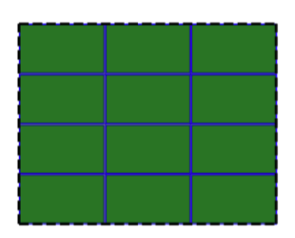
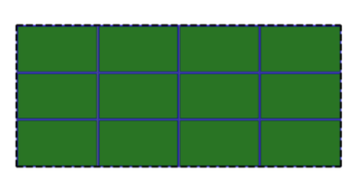
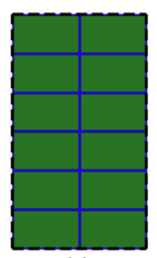
Shape Engine
Determines possible shapes and aspect ratio constraints for all clusters
Standard-Cell cluster : the aspect ratio is specified by the upper bound (max_ar) and lower bound (min_ar)
Macro cluster : enumerate all the possible macro tilings and keep the macro tilings with minimum area
Notes:
After autoclustering, we have a clustered netlist in which the nodes are clusters and nets are bundled connections between clusters.
Then we use the shape engine to determine the possible shapes and aspect ratio constraints for all the clusters.
[CLICK] For a standard-cell cluster, the aspect ratio is specified by the upper bound and the lower bound.
[CLICK] For a macro cluster, we simply enumerate all the possible macro tilings
and keep the macro tilings with minimum area.
Here we show an example of a macro cluster with 12 macros.

Slide 24
Our Methodology - RTL-MP Flow
.def (floorplan def with placed IO pins)
.v (hierarchical netlist)
.lef + .lib + .sdc
.def (floorplan def with placed IO pins)
.v (hierarchical gate-level netlist)
.lef + .lib + .sdc
Autoclustering Engine
Static Timing
(OpenSTA)
clustered netlist
Shape Engine
OpenROAD
RTL-MP
feasible footprints of clusters
Shared Data
Model (OpenDB)
Macro Placement Engine
shaped and placed clusters
Pin Alignment Engine
.def (floorplan def with placed macros)
.def (floorplan def with placed macros)
Notes:
Now let’s look at the macro placement engine.

Slide 25
Macro Placement Engine
Determines position and shape for each cluster
Sequence Pair to represent clusters in the netlist
Simulated Annealing to optimize the cost function
“Go-with-the-winners” scheme to improve the performance of Simulated Annealing
Notes:
After calling the shape engine, we have aspect ratio choices for all the clusters.
Now we call the macro placement engine to determine position and shape for each cluster.
[CLICK] We use Sequence Pair to represent the clusters in the netlist and
Simulated Annealing to optimize the cost function.
And we adopt the “Go-with-the-winners” scheme to
improve the performance of Simulated Annealing.

Slide 26
Macro Placement Engine
Handle multiple constraints
1
Fixed outline: All clusters should be placed within the fixed outline specified by users
Macro peripheral bias: All macros should be pushed to peripheries as much as possible
2
3
Macro blockage: All macros should not overlap with macro placement blockages
4
Preplaced macros: Other macros should not overlap with preplaced macros
5
Pin access: All macros should be kept from blocking access of input-output pins.
6
Macro guidance: All macros should be placed near specified regions if users provide such constraints
7
Notch avoidance: A decent floorplan should avoid “dead space” which cannot be used effectively by P&R tools
Notes:
And The macro placement engine can handle multiple constraints:
[CLICK][CLICK]
Fixed outline : All clusters should be placed within the fixed outline specified by users.
[CLICK] macro peripheral bias : All macros should be pushed to peripheries as much as possible.
[CLICK] macro blockage: All macros should not overlap with macro placement engine.
[CLICK] preplaced macros: Other macros should not overlap with preplaced macros.
[CLICK] pin access : All macros should be kept from blocking access of input-output pins.
[CLICK] macro guidance : All macros should be placed near specified regions if users provide such constraints.
[CLICK] and notch avoidance : A decent floorplan should avoid ”dead space” which cannot be used effectively by P&R tools.

Slide 27
Macro Placement Engine
Handle multiple constraints
Model each constraint as a term in the cost function
Autotuning tool – Tune is used to tune the weights for different objectives in the cost function
Notes:
Here we model each constraint as a term in the cost function.
And we use autotuning tool – Tune to tune the weights for different objectives in the cost function.

Slide 28
Our Methodology - RTL-MP Flow
.def (floorplan def with placed IO pins)
.v (hierarchical netlist)
.lef + .lib + .sdc
.def (floorplan def with placed IO pins)
.v (hierarchical gate-level netlist)
.lef + .lib + .sdc
Autoclustering Engine
Static Timing
(OpenSTA)
clustered netlist
Shape Engine
OpenROAD
RTL-MP
feasible footprints of clusters
Shared Data
Model (OpenDB)
Macro Placement Engine
shaped and placed clusters
Pin Alignment Engine
.def (floorplan def with placed macros)
.def (floorplan def with placed macros)
Notes:
Now let’s look at the pin alignment engine.

Slide 29
Pin Alignment Engine
Finalizes the location and orientation of macros in each macro cluster, one macro cluster at a time
For a given macro cluster
Other clusters behave like fixed terminals
Simulated Annealing to optimize the cost function
“Go-with-the-winners” scheme to improve the performance of Simulated Annealing
Sequence Pair to represent the macros in the cluster
Op1: Swap two macros in the first sequence
Op2: Swap two macros in the second sequence
Op3: Swap two macros in both sequences
Op4: Flip all the macros
Notes:
After calling the macro placement engine, we know the position and shape for each cluster.
Now we use Pin Alignment Engine to finalize the location and orientation of macros in each macro cluster, one macro cluster at a time.
[CLICK] When we deal with a given macro cluster, other clusters behave like fixed terminals.
[CLICK]
Here we still use Sequence Pair to represent the macros in the macro cluster
and Simulated Annealing with the Go-with-the-winners scheme to optimize the cost function.
Here we flip all the macros at the same time to force
all the macros in a macro cluster with the same orientation.

Slide 30
Outline
Background and Motivation
Main Contributions
Our Methodology
Experimental Setup and Results
Conclusion and Future work
Notes:
Now I will describe experimental setup and results.

Slide 31
Experimental Setup and Results
Macro placement scenarios
Comm: Macro placement obtained by the 2020 release of a state-of-the-art commercial P&R tool using high-effort settings
Manual: All macros are manually placed by backend engineers
TMP: Macro placement is generated by TritonMP (default macro placer in the OpenROAD project)
HiDaP: Macros are placed by a recent state-of-the-art academic tool HiDaP
RTL-MP: Results are obtained using our macro placer
$RTL$-${MP}_{B}$: Results are obtained using RTL-MP with user-specified macro blockages
$RTL$-${MP}_{L}$ and $RTL$-${MP}_{T}$ : Results are obtained using RTL-MP with “loose” and “tight” macro guidance separately
Notes:
To show the effectiveness of our macro placer, the following five scenarios
are evaluated and compared.
[CLICK] Commercial: Macro placement obtained by the 2020 release of a state-of-the-art commercial P&R
tool using high­-effort settings.
[CLICK] Manual: All macros are manually placed by backend engineers.
[CLICK] TMP: Macro placement is generated by TritonMP,
which is the default macro placer in the OpenROAD project.
[CLICK] HiDaP: Macros are placed by a recent state-of-the-art academic tool ­ HiDaP from Professor Jordi Cortadella’s group.
[CLICK] RTL-MP: Results are obtained using our macro placer.

Slide 32
Experimental Setup and Results
Testcases (Implemented in GF12LP)
Design | Std Cells | Macros | I/Os | Nets | Macro Blockage | Macro Guide
swerv_ wrapper | 78K | 28 | 1416 | 94K
ariane | 114K | 37 | 495 | 131K
simd | 207K | 46 | 4210 | 236K | 😀
coyote | 208K | 15 | 784 | 327K
bp_single | 323K | 49 | 135 | 508K
ca53 | 445K | 25 | 1352 | 483K |  | 😀
Notes:
This slide shows statistics of the five testcases we used in our experiments.
We implement all the designs in GF12LP technology.
Here swerv_wrapper, ariane, coyote and bp_single are all open-source designs.
SIMD is a machine learning accelerator.
CA53 is a high-efficiency processor from Arm.
Here we provide a macro blockage for design simd and
macro guidance for design ca53 to study the effect of different constraints.

Slide 33
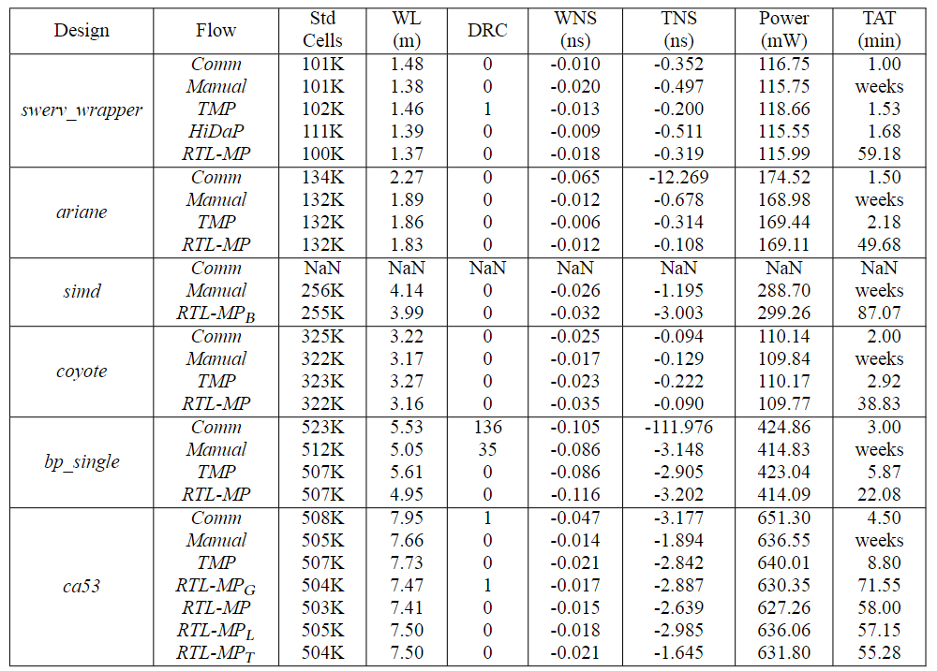
Experimental Setup and Results
Summary of post-routing metrics
Notes:
This slide shows the experimental results after completion of post-routing optimization.
Here we all the standard cell placement and routing are done by commercial tools.
And all the timing metrics are reported at the worst cases.
In this table, Rows represent circuits and macro placement flows,
and columns give information on number of standard cells,
wirelength (in meters),
number of DRCs,
timing information (worst negative slack and total negative slack, in ns),
power (in mW)
and turnaround time (in minutes) for a single run.
We see clearly that RTL-­MP achieves the smallest routed wirelength for all testcases.
In the next few slides, I will show some example post-routing layouts.

Slide 34
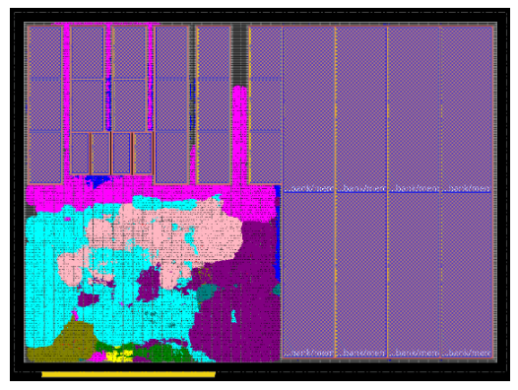
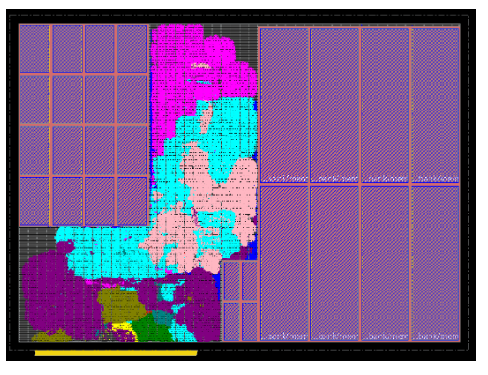
Experimental Setup and Results
Comparison between HiDaP and RTL-MP
(A) swerv_wrapper (HiDaP)
(B) swerv_wrapper (RTL-MP)
Notes:
This slide shows the comparison between HiDaP and RTL-MP.

Slide 35
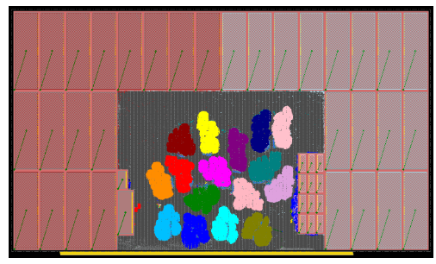
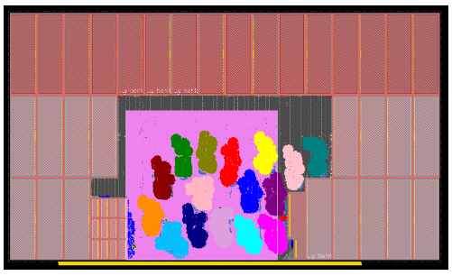
Experimental Setup and Results
The effect of macro blockage for RTL-MP
macro blockage
(C) SIMD (Manual)
(D) SIMD ($RTL$-${MP}_{B}$)
Notes:
This slide shows the effect of user-defined macro placement blockage.
In Figure (d), the magenta rectangle is the user-specified macro blockage
that RTL-MP can honor.

Slide 36
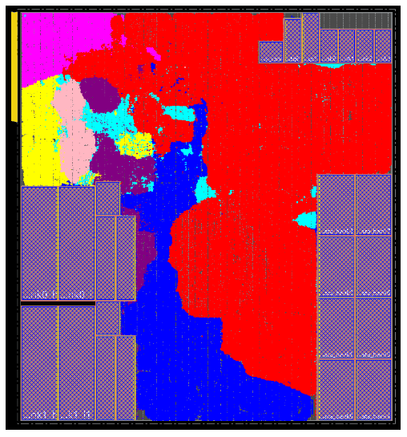
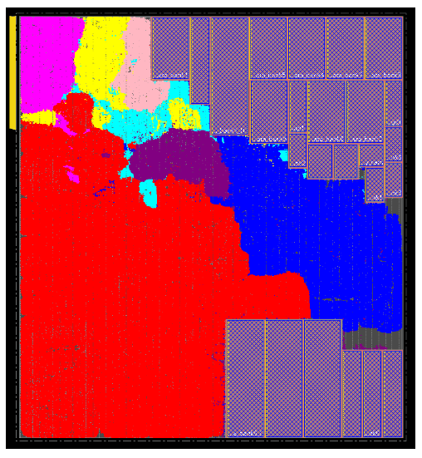
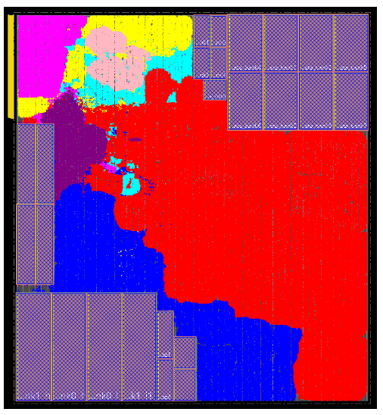
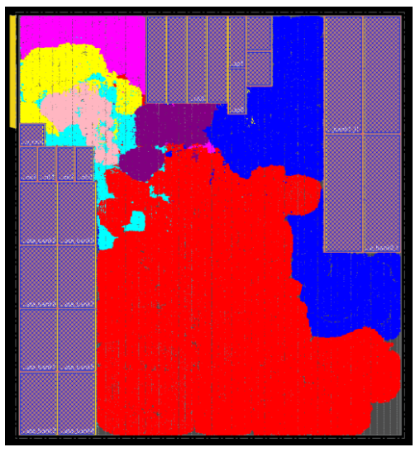
Experimental Setup and Results
Comparison between Comm, TMP, Manual and RTL-MP
(E) CA53 (Comm)
(F) CA53 (TMP)
(G) CA53 (Manual)
(H) CA53 (RTL-MP)
Notes:
This slide shows the comparison of the results obtained by Commercial, Manual, TMP and RTL-MP flow.

Slide 37
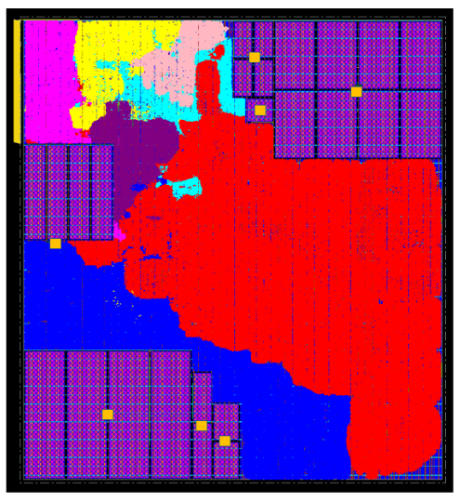
Experimental Setup and Results
The effect of macro guidance
tight macro
guidance
loose macro
guidance
(G) CA53 (Manual)
(H) CA53 (RTL-MP)
(I) CA53 ($RTL$-${MP}_{L}$)
(J) CA53 ($RTL$-${MP}_{T}$)
Notes:
This slide shows the effect of macro placement guidance.
In Figure (i), we use the bounding box of each macro cluster in Figure (g) as its preferred region,
shown as the orange boxes.
In figure (j), we use the center region of each macro cluster in Figure (g) as its preferred region,
shown as the orange rectangles.
The point of figure (i) and (j) is that RTL-MP responds smoothly to such constraints
that can arise from earlier steps in the flow.

Slide 38
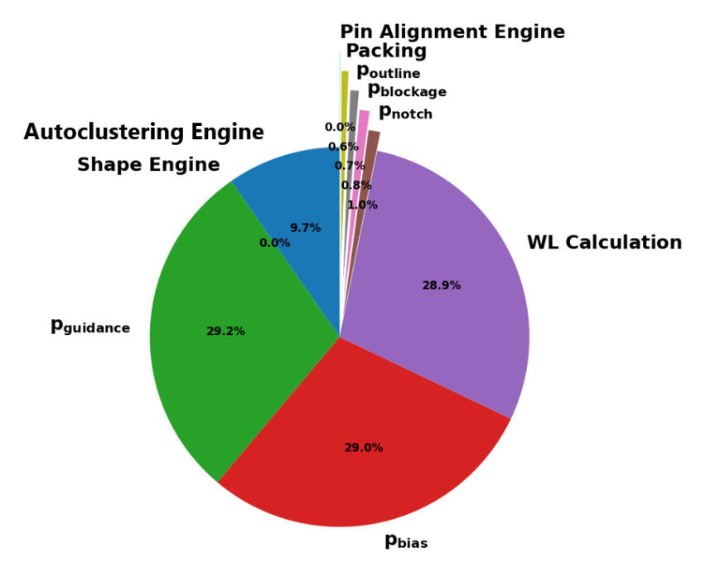
Experimental Setup and Results
Runtime profiling of RTL-MP on the ca53 testcase
Notes:
One drawback of RTL-MP is that its runtime is relatively long compared to other macro placers.
Here I show the runtime profiling of RTL-MP on the ca53 testcase.
We can see that nearly 90% of the runtime is spent on solution evaluation.
We need to improve the implementation of solution evaluation to reduce runtime.

Slide 39
Outline
Background and Motivation
Main Contributions
Our Methodology
Experimental Setup and Results
Conclusion and Future work
Notes:
Now I will conclude my talk and introduce our ongoing work.

Slide 40
Conclusion
We propose RTL-MP, which utilizes RTL information and tries to “mimic” the behavior of human experts
Conceptual abstractions devised by the frontend designer
Functional interactions and dataflow between logical modules
Macro placement guidance with preferred locations for macros
Common constraints such as macro placement blockages
1
2
RTL-MP
3
4
Notes:
In summary, we proposes RTL-MP, which utilizes RTL information and tries to
Mimic the behavior of human experts.
To achieve human-quality macro placement, our RTL-MP is able to comprehend
[CLICK]
Conceptual abstractions devised by the front designer,
[CLICK]
Functional interactions and dataflow between logical modules,
[CLICK]
Macro placement guidance with preferred locations for macros,
[CLICK]
And common constraints such as macro placement blockages and so on.

Slide 41
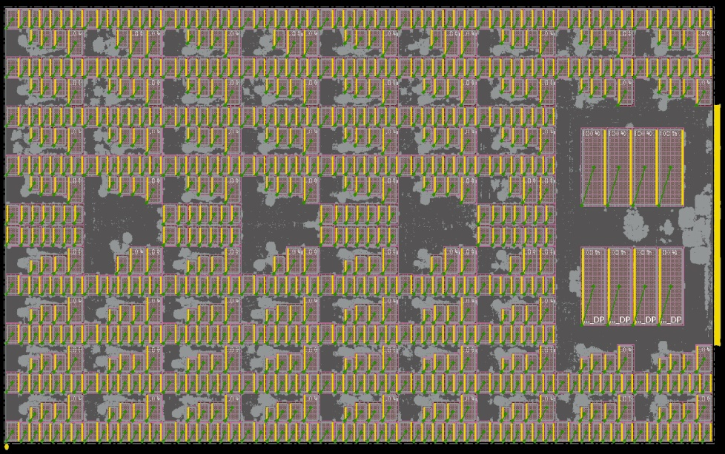
Future Work
Reduce runtime
Improve the autoclustering engine to support hierarchical clustering, so we can handle designs like TABLA shown below.
PU4
PU5
PU6
PU7
PU3
PU2
PU1
PU0
Notes:
This slide shows the future work I am still working on.
Firstly, as I mentioned before, we need to reduce the runtime.
[CLICK] Secondly, I am improving the autoclustering engine to support hierarchical clustering,
so we can handle designs like TABLA shown below.
In the TABLA example, we first determine the position of each PU and then place the macros in each PU.

Slide 42
Thank you!
Notes:
Thank you very much for listening. Any questions?

