Slide 1
VeriGOOD-ML: An Open-Source Flow for Automated ML Hardware Synthesis
Hadi Esmaeilzadeh¹, Soroush Ghodrati¹, Jie Gu², Shiyu Guo², Andrew B. Kahng¹,
Joon Kyung Kim¹, Sean Kinzer¹, Rohan Mahapatra¹, Susmita Dey Manasi³, Edwin Mascarenhas¹,
Sachin S. Sapatnekar³, Ravi Varadarajan¹, Zhiang Wang¹, Hanyang Xu¹,
Brahmendra Reddy Yatham¹, Ziqing Zeng³
¹UC San Diego ²Northwestern University ³University of Minnesota
Supported in part by the DARPA RTML program

Slide 2
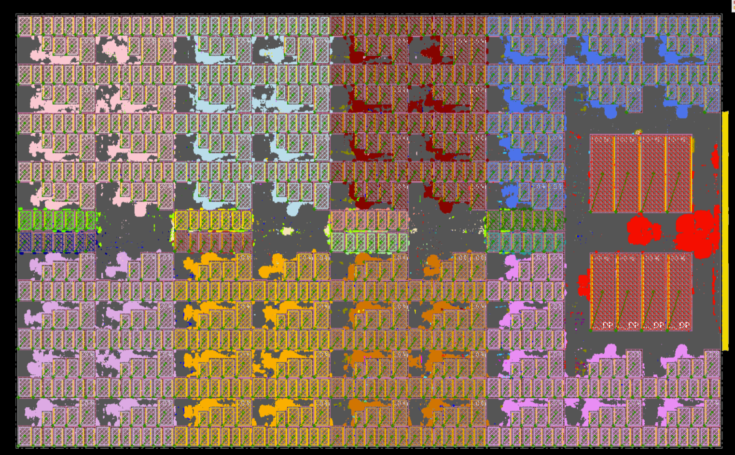
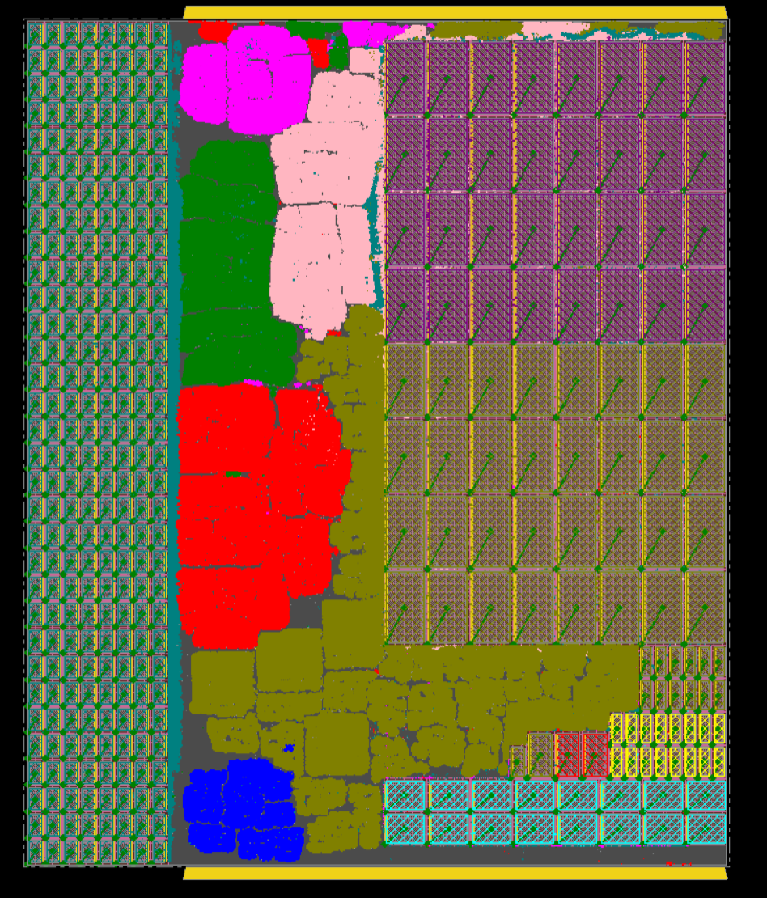
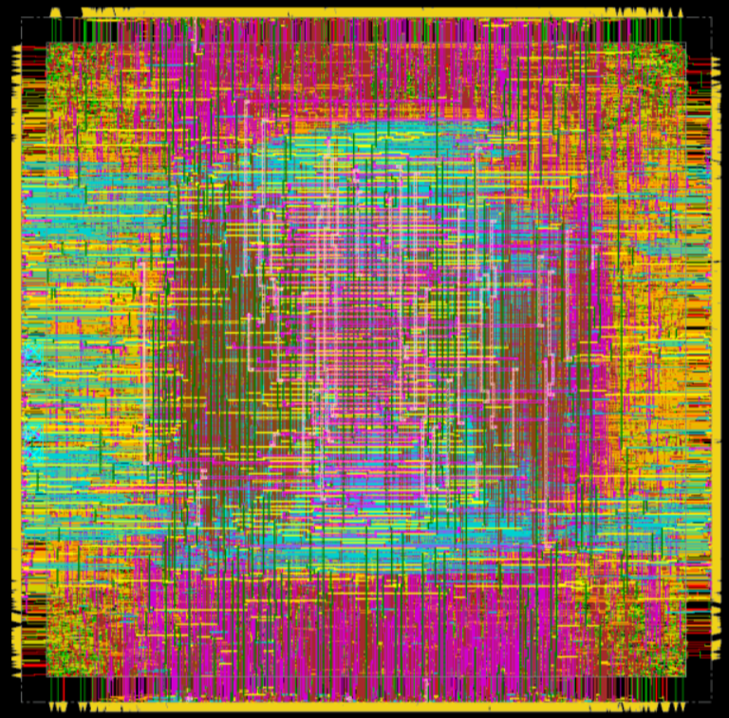
Overview of VeriGOOD-ML
TABLA
8 PUs, 8 PEs/PU,
16 bits
2.96mm²
Open-source ML hardware generator
Input: ONNX
Output: Verilog
Back-end implementation of Verilog using GF12/Arm libraries using a commercial tool flow
PolyMath compiles ONNX to IR/instructions for hardware
Three engines covering a range of ML algorithms (training + inference)
TABLA platform for non-DNN ML applications
  SVM, linear regression, logistic regression, recommender systems, backpropagation
GeneSys platform for DNNs
  LeNet, AlexNet, VGG-16, MobileNet-v2, ResNet18, ResNet50, …
Axiline hardwiring for small ML problems
  SVM, linear regression, logistic regression, recommender systems
GeneSys
16╳16 systolic array
SIMD array
4 bits
2.04mm²
Axiline SVM-200
0.016mm²

Slide 3
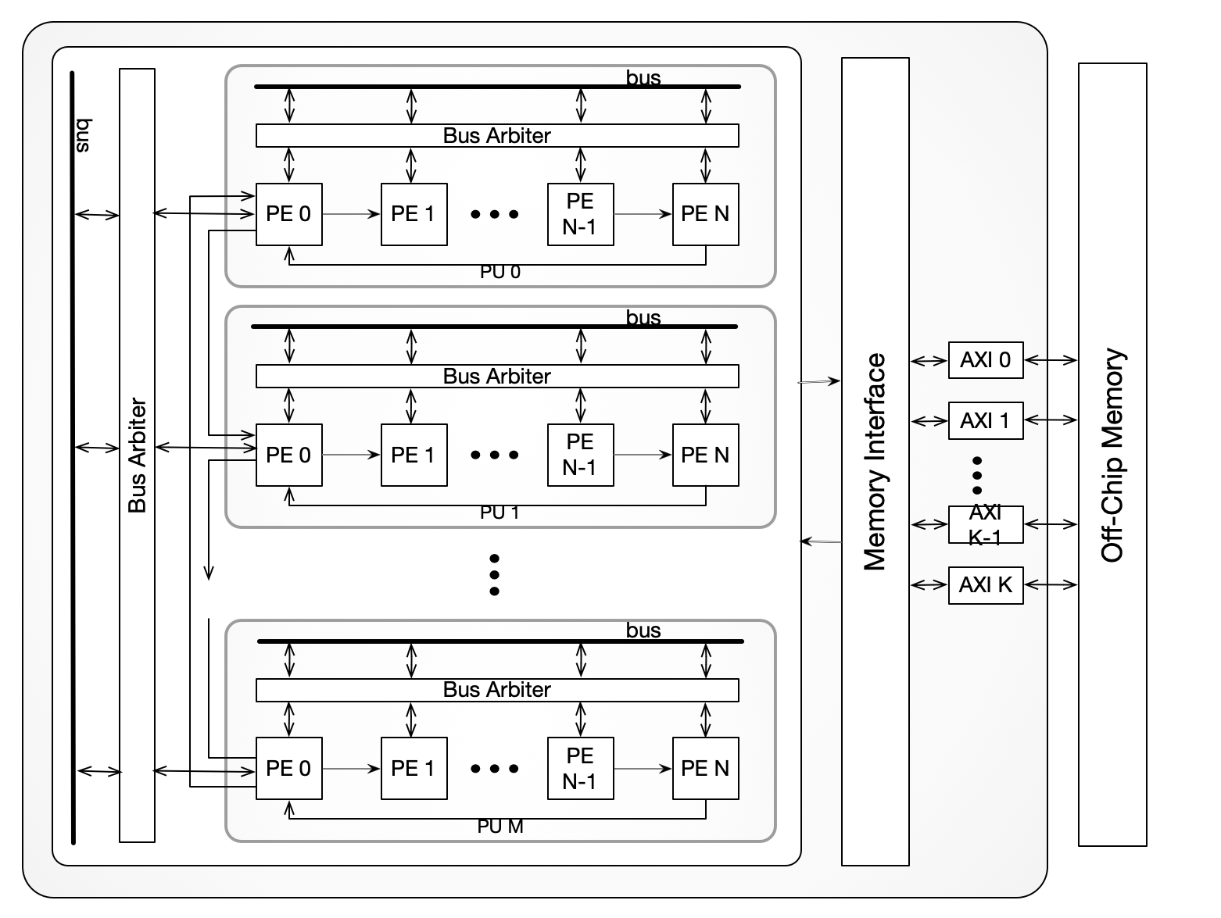
Technical Approach
TABLA (non-DNN algorithms)
Processing Engines (PEs) and an ISA for compute
Processing Units (PUs) with a configurable # PEs
Neighbor busing across PEs in a PU, across PUs
ISA, external memory interface
Parameterizable: bit widths, #PEs, #PUs, PE structure
GeneSys (DNNs)
Systolic array for convolution operations
SIMD-Array for other non-convolution/matrix-multiplication layers of the DNNs (e.g., ReLU, pooling, softmax, …)
Parameterizable: systolic PEs, SIMD PEs, memories
Systolic array
SIMD Array

Slide 4
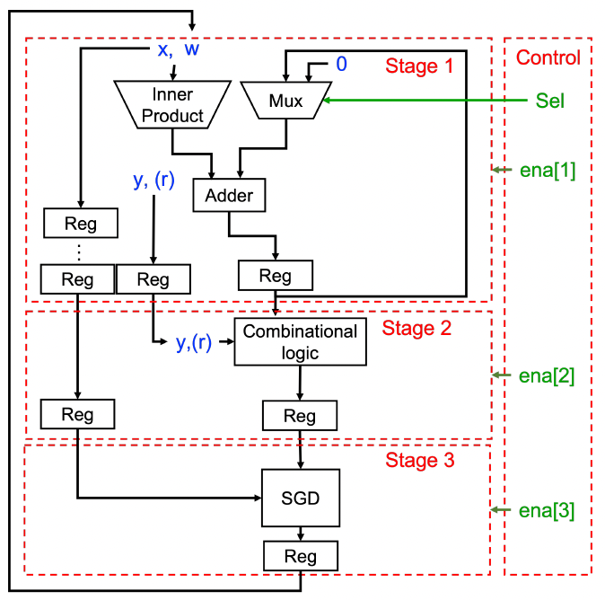
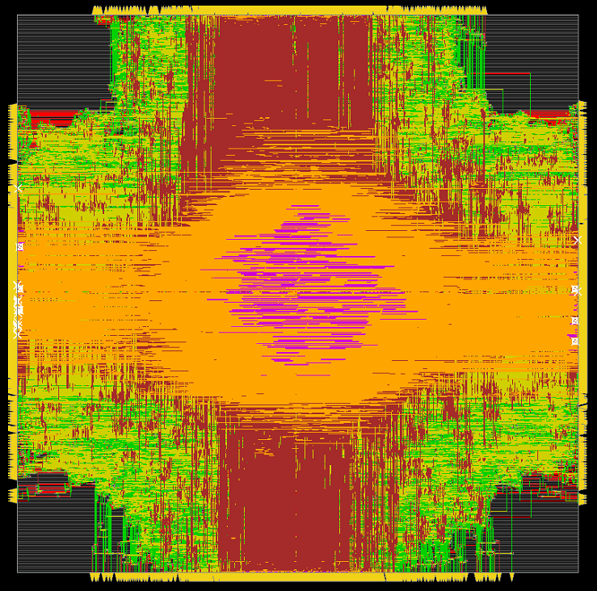
Technical Approach
Axiline
Maps IR (mg-DFG) to custom hardware
Not a general platform, tied to specific ML parameters (e.g., SVM-54)
Supporting infrastructure
PolyMath compiler that translates ONNX to an intermediate representation (IR)
  IR is mapped to code compiled to TABLA, GeneSys, Axiline
Simulators for GeneSys, TABLA to emulate compute, analyze power/energy, execution time
Axiline implementation of linear_regression_784

Slide 5
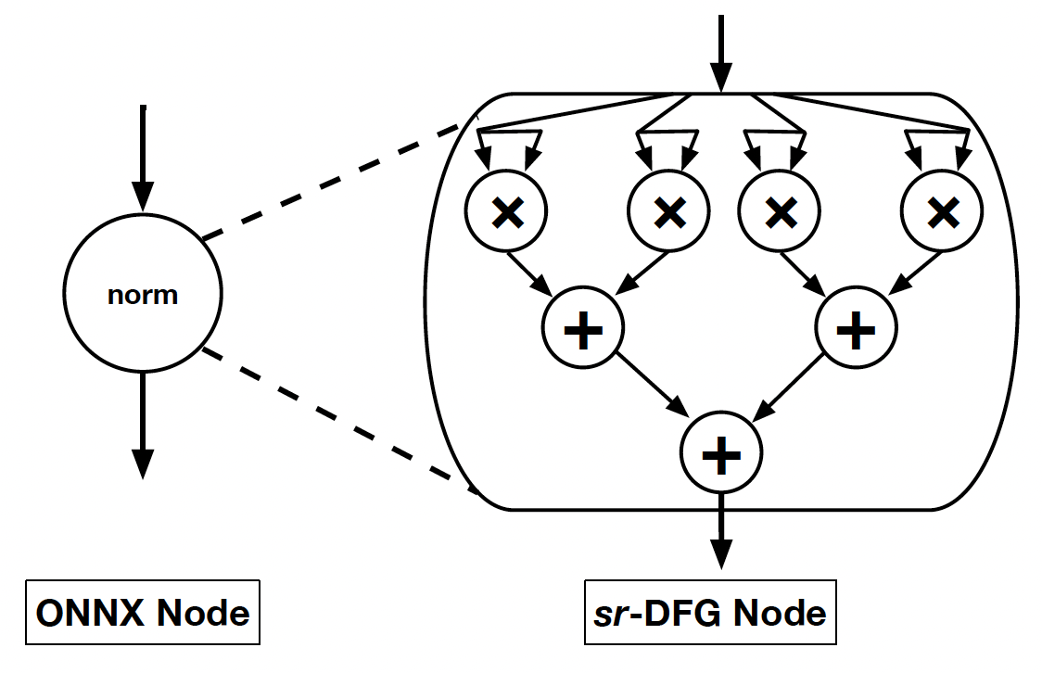
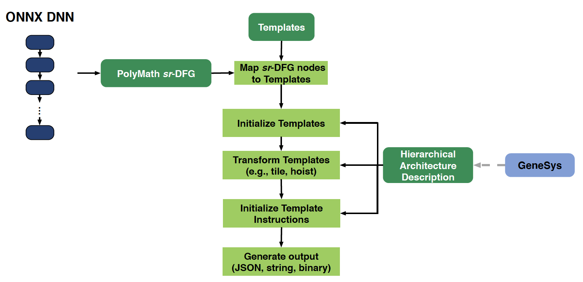
PolyMath: ONNX IR Generator, Compiler
PolyMath IR: multi-granular dataflow graph (sr-DFG)
Multi-level abstraction: DNN operations as parameterizable templates, mapped to hardware architecture description (HAD)
Upper level Templates – coarse sr-DFG (IR) nodes
Templates contain Operations
  Types: “configuration”, “transfer”, “compute”, “loop”
Operations compiled to a sequence of instructions by using instruction templates defined in hierarchical architecture graph
Operations can be transformed by splitting, fusing, reordering, or applying HAD attributes to parameterize them
Compilation workflow
Notes:
Tied together the following compilation workflow:
Convert ONNX DNN to PolyMath mg-DFG
Map mg-DFG nodes to Codelets using mg-DFG node names
Instantiate Codelet operations using parameters from mg-DFG node
Transform operations by tiling, hoisting, and reordering them
Instantiate instruction templates for each operation in each codelet
Generate output depending on the desired format: JSON for simulation, string instructions for visualization, or binary for execution

Slide 6
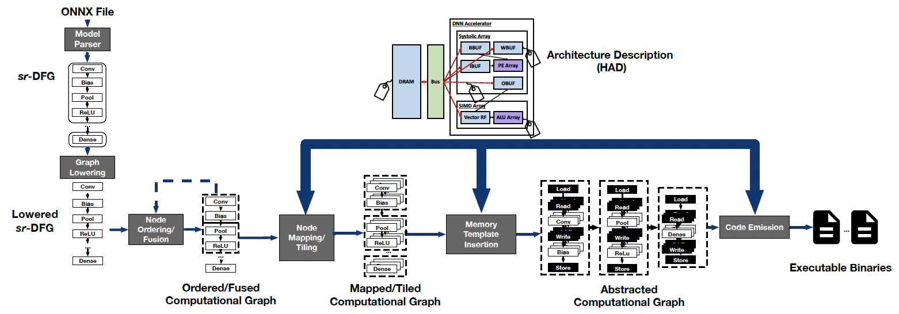
Overall ONNX-to-Hardware Mapping Flow

Slide 7
Back-end hardware implementation flow
Back-end implementation
  GF12LP technology
  Arm memory compiler
Automated design planner
  Mimics expert designer’s floorplan
  Multiple engines
    Auto-clustering engine
    Shape engine
    Macro placement engine (SP+SA)
    Pin alignment engine
RTL Generator
VeriGOOD-ML RTL Generator:
TABLA, GeneSys, Axiline
Design Compiler
Synthesis
Design Planner
Macro Placement
PDN Generator
Automatic Power Delivery Network Generation
Innovus
Standard Cell Placement,
Clock Tree Synthesis and Routing

Slide 8
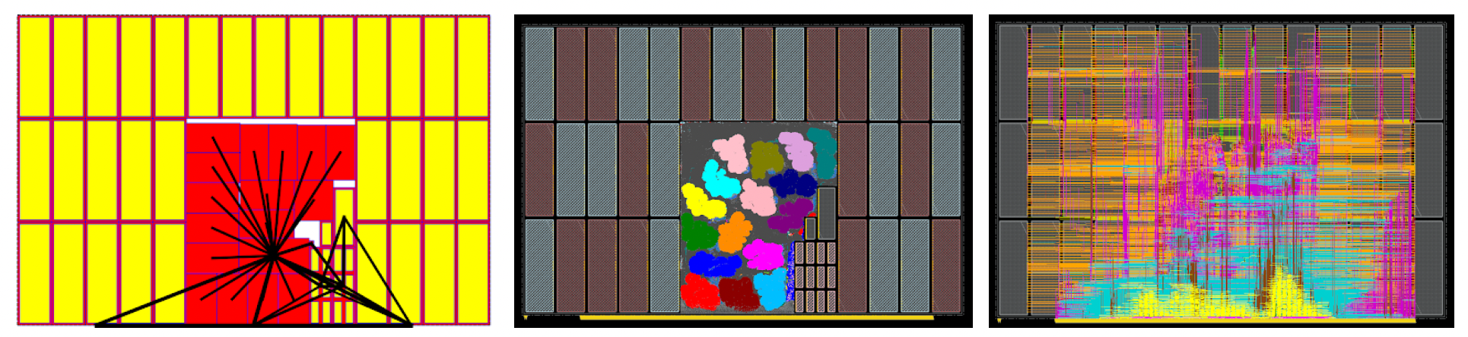
Back-end design
Signal Flow
Floorplan
Layout after SPR

Slide 9
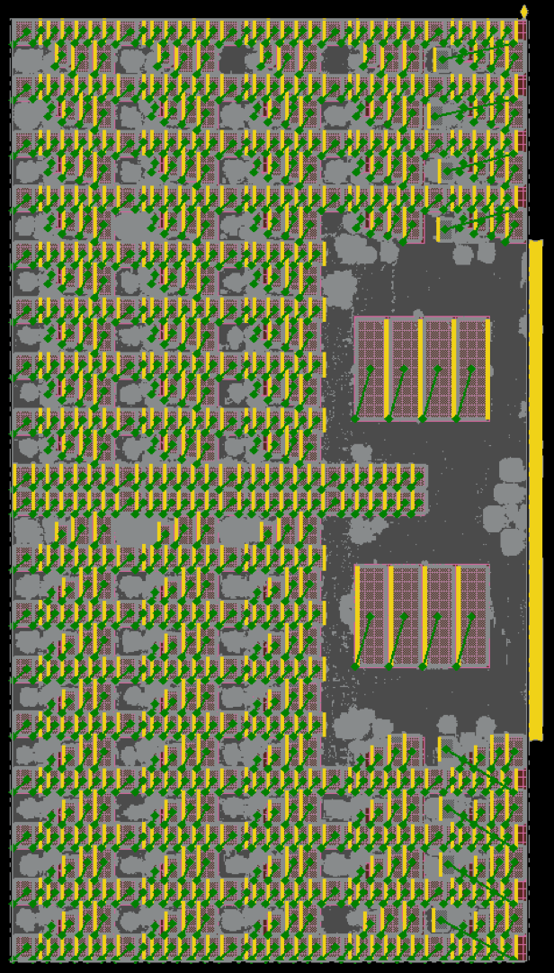
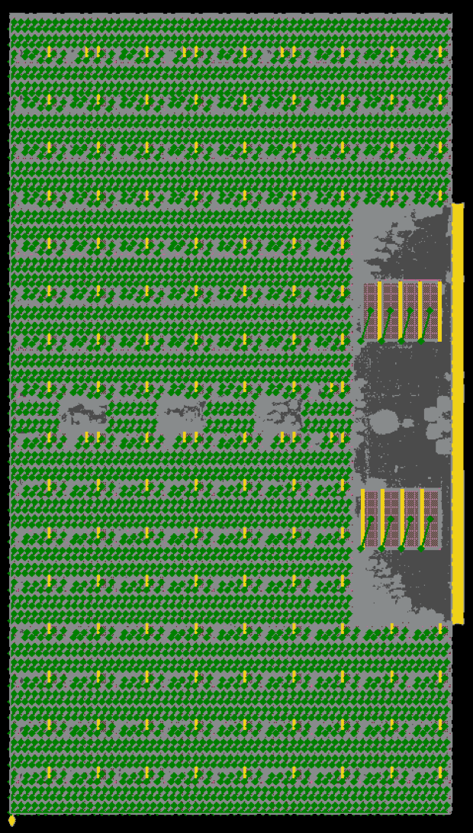
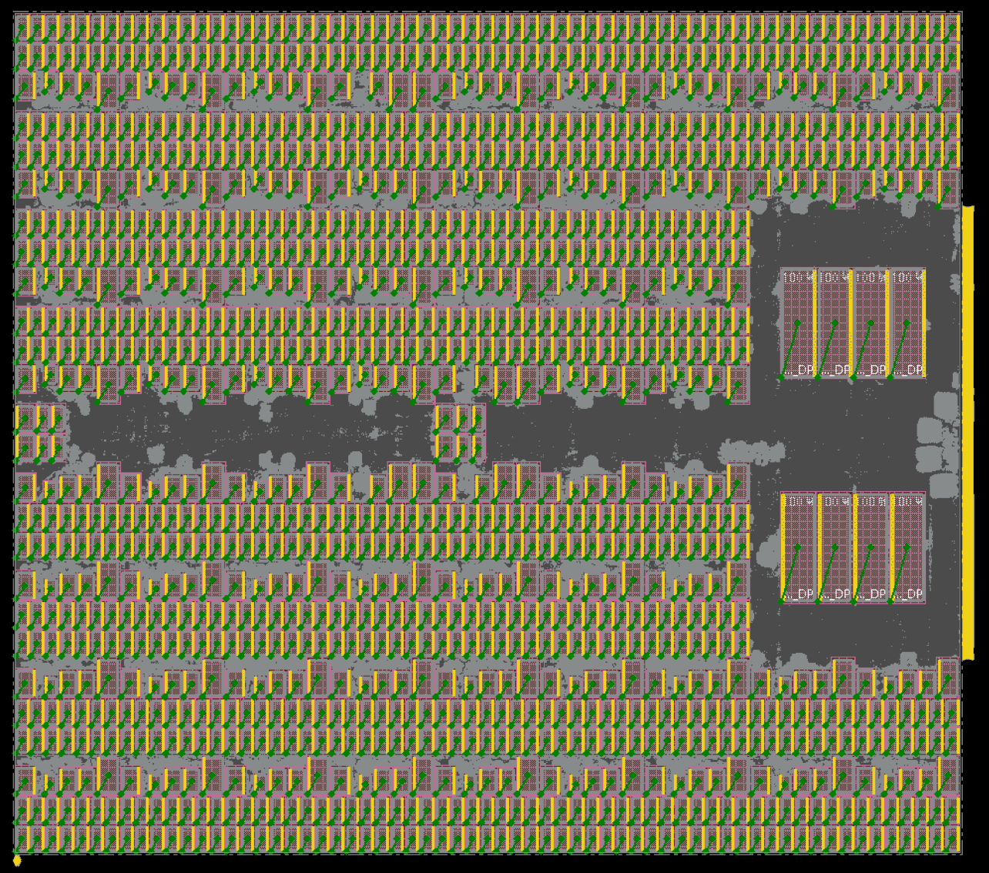
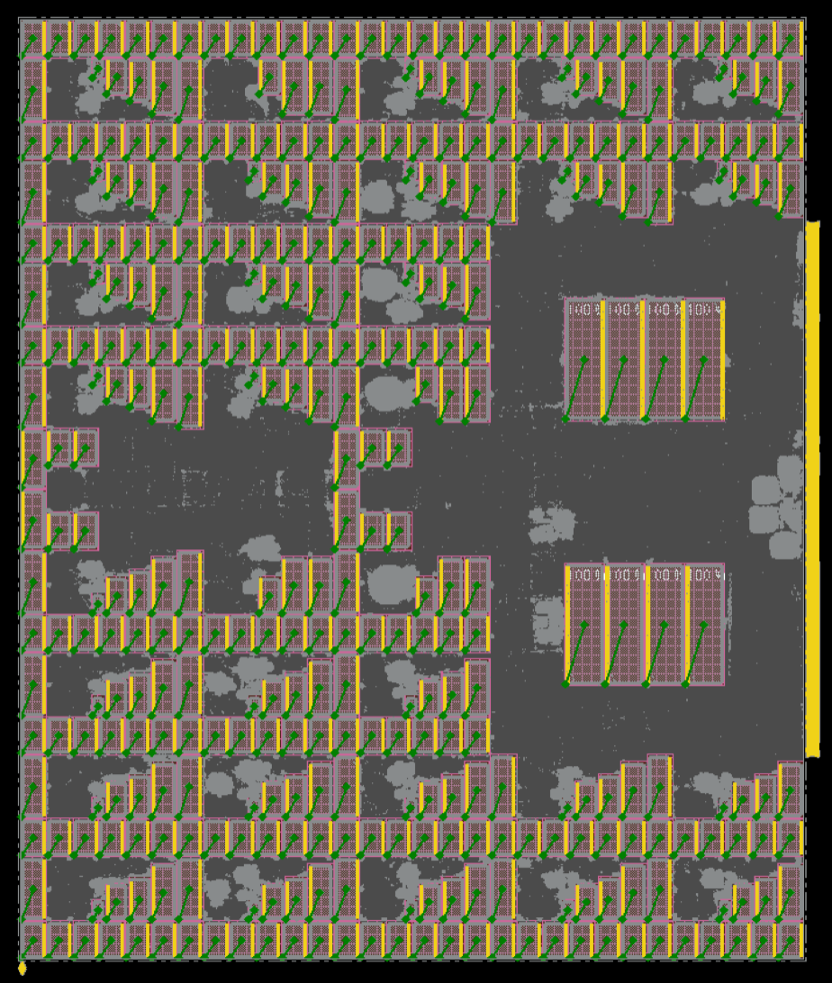
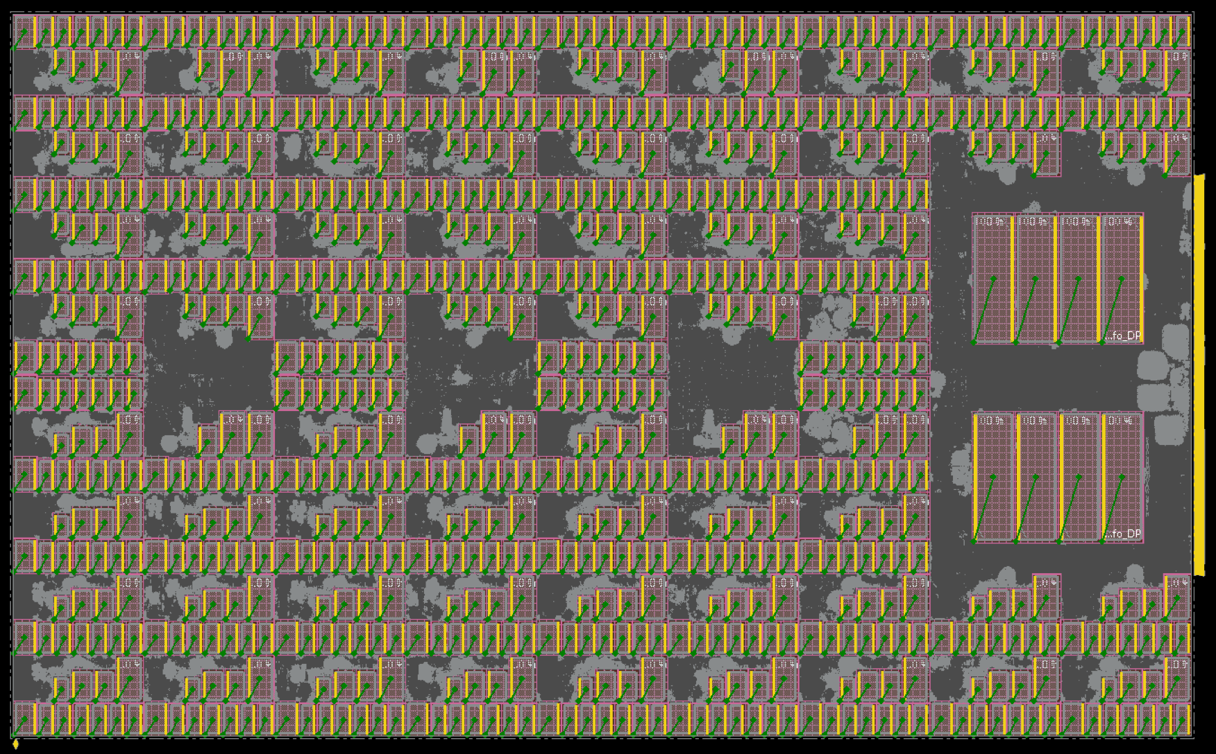
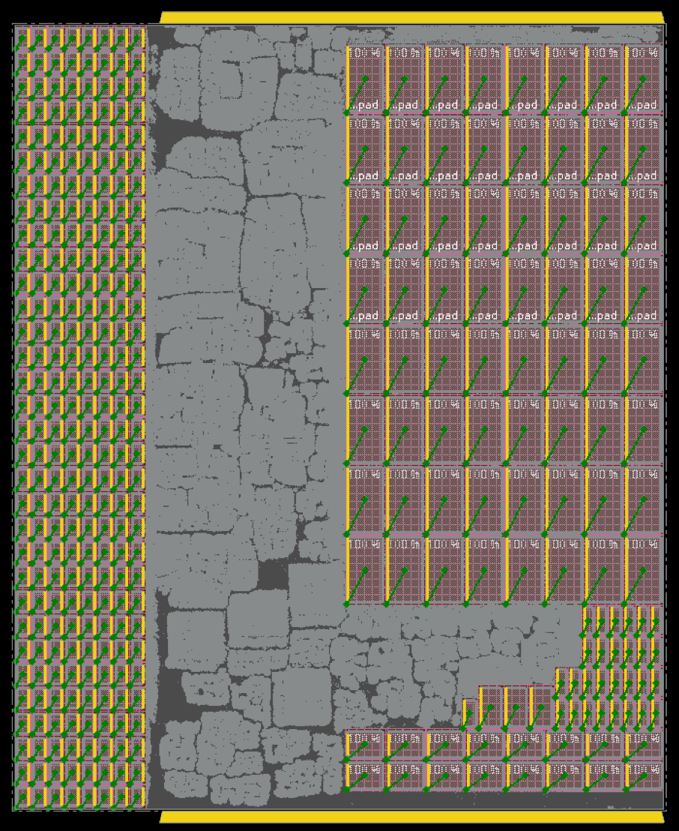
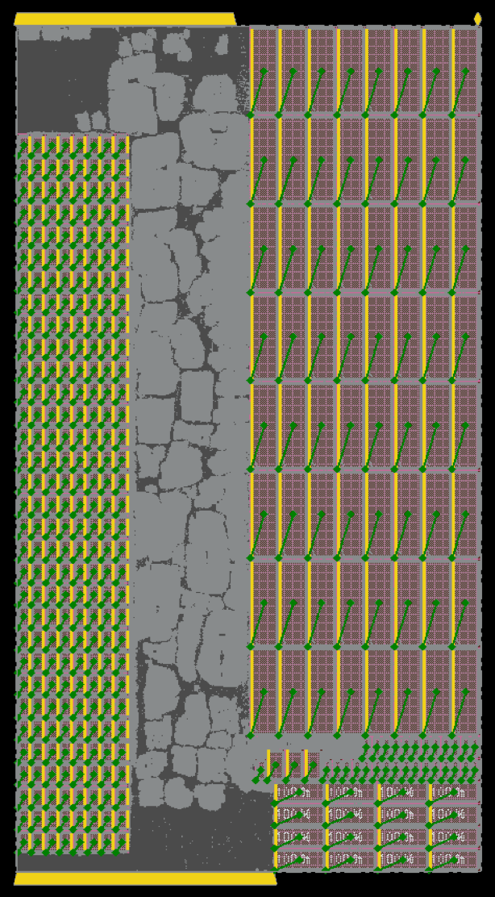
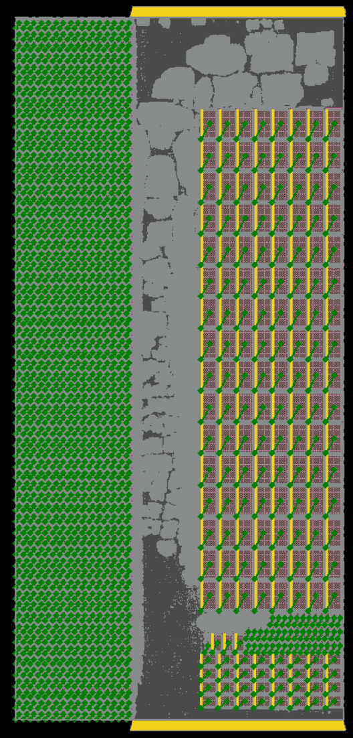
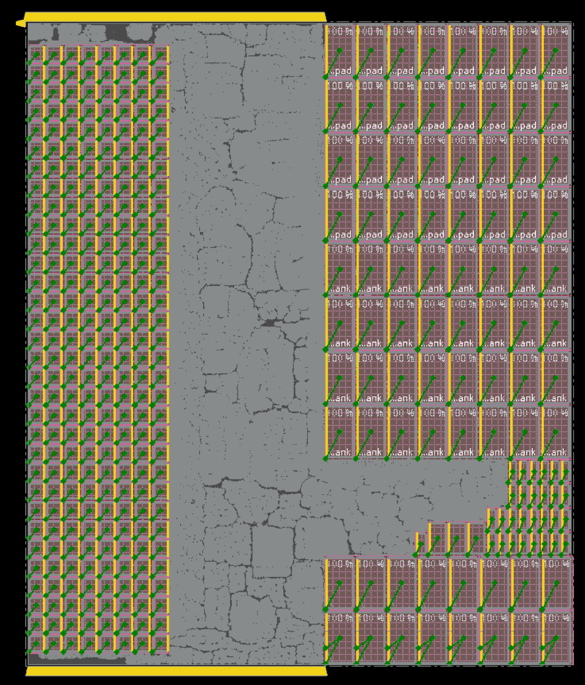
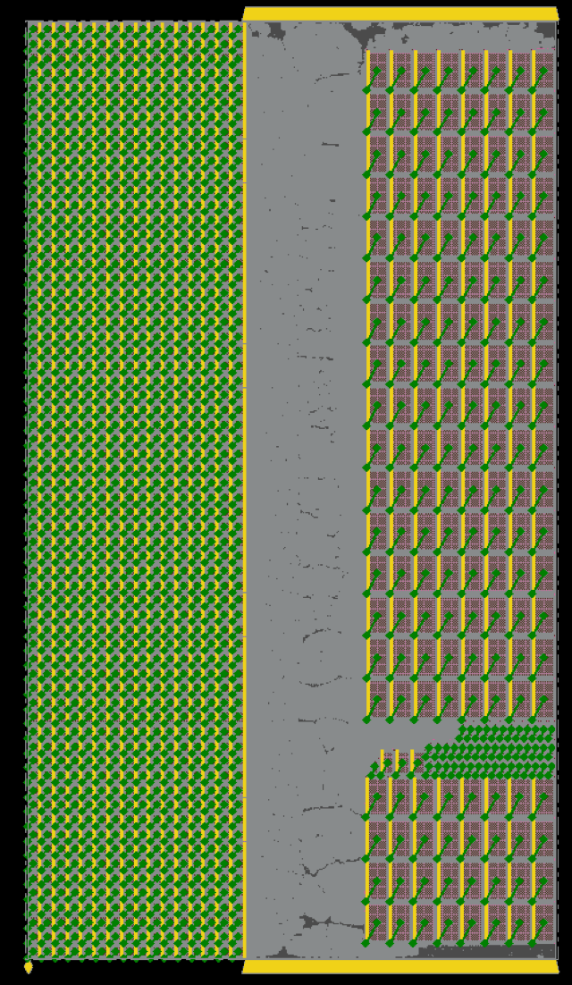
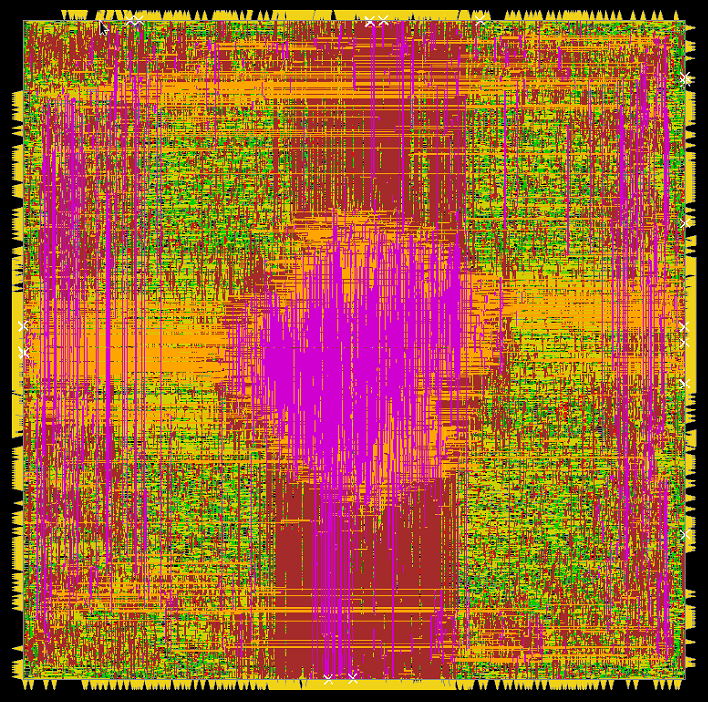
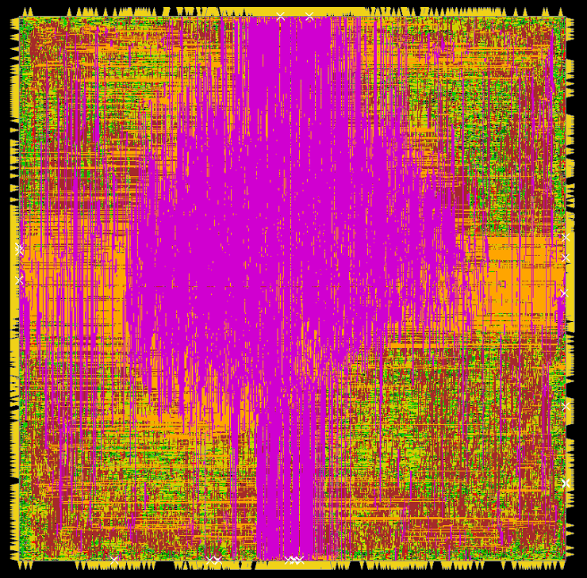
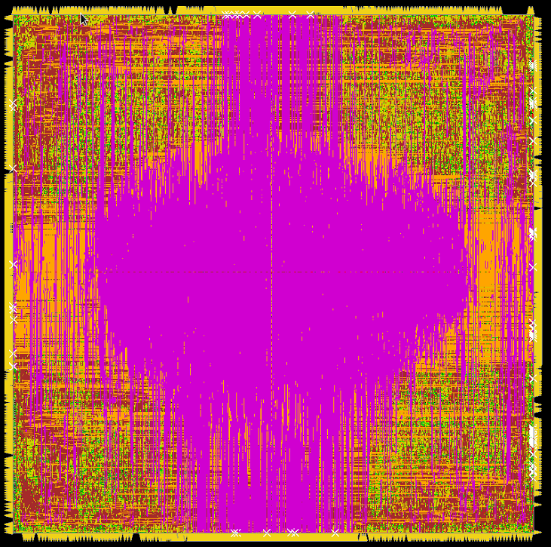
A Few of our Designs
TABLA
2.96 mm²
1120 ps
363 mW
391K instances
760 macros
5.65 mm²
959 ps
1029 mW
817K instances
2488 macros
2.72 mm²
1023 ps
436 mW
648K instances
760 macros
3.84 mm²
1096 ps
461 mW
463K instances
1232 macros
2.92 mm²
917 ps
240 mW
313K instances
368 macros
GeneSys
Axiline
2.04 mm²
918 ps
954 mW
914K instances
368 macros
2.98 mm²
931 ps
971 mW
928K instances
368 macros
4.59 mm²
1033 ps
1289 mW
1.2M instances
1232 macros
2.31 mm²
919 ps
1162 mW
1.1M instances
368 macros
5.55 mm²
926 ps
2296 mW
1.95M instances
1232 macros
0.03 mm²
919 ps
28 mW
0.04 mm²
2080 ps
46 mW
0.09 mm²
2040 ps
84 mW

Slide 10
TABLA results on non-DNN algorithms
Classification and localization using SVM
  WLAN indoor localization benchmark
Multiple configurations considered
Performance simulator predicts # of cycles, combined
with PPA information
#PUs | #PEs/PU | Frequency | Area | Power | Training Time | Inference Time
8 | 8 | 1 GHz | 2.96 mm² | 1.28W | 30.6m | 0.21s
8 | 8 | 0.25 GHz | 2.96 mm² | 0.29W | 122.3m | 0.85s
8 | 16 | 1 GHz | 5.65 mm² | 1.90W | 26.3m | 0.17s
8 | 16 | 0.25 GHz | 5.65 mm² | 0.56W | 105.1m | 0.68s

Slide 11
GeneSys results on DNN
Systolic array
GeneSys inference on ResNet50
Multiple hardware platforms, different PE array sizes, bitwidths
PPA combined with performance simulator that predicts number of execution cycles
PE Array Size | Bitwidth | Frequency | Area | Power | Inference Time
16 × 16 | 4 | 1.09 GHz | 2.0 mm² | 0.44 W | 25.6 s
16 × 16* | 4 | 0.27 GHz | 3.0 mm² | 0.10 W | 89.1 s
32 × 32 | 8 | 1.04 GHz | 8.5 mm² | 1.04 W | 10.0 s
64 × 64 | 4 | 0.97 GHz | 18.9 mm² | 1.31 W | 6.9 s
*larger on-chip buffers than the first row

Slide 12
Axiline results
Applied to a set of non-DNN benchmarks
Benchmark | # Features | Frequency | Area | Training Time | On-chip Power | Total Power
Logistic regression | 54 | 495 MHz | 0.024 mm² | 4.70ms | 24 mW | 0.47 W
Logistic regression | 54 | 500 MHz | 0.014 mm² | 6.98ms | 13 mW | 0.31 W
SVM | 200 | 500 MHz | 0.042 mm² | 6.01ms | 46 mW | 3.42 W
 |  | 497 MHz | 0.030 mm² | 10.01ms | 27 mW | 2.04 W
Linear regression | 784 | 492 MHz | 0.091 mm² | 0.37ms | 84 mW | 4.45 W

Slide 13
Conclusion
Automated ONNX-to-Verilog translation
  Verilog-to-GDSII using commercial tools (for now)
Three engines
  TABLA platform for non-DNN ML applications
  GeneSys platform for DNNs
  Axiline hardwiring for small ML problems

Slide 14
Thank you!

