Slide 1




DATC RDF-2021: Design Flow and Beyond
Jianli Chen¹, Iris Hui-Ru Jiang², Jinwook Jung³,
Andrew B. Kahng⁴, Seungwon Kim⁴, Victor N. Kravets³, Yih-Lang Li⁵,
Ravi Varadarajan⁴, and Mingyu Woo⁴
1
2
3
4
5
GitHub Link: https://github.com/ieee-ceda-datc
Notes:
Hello everyone.
My name is Jinwook Jung and I am working at IBM TJ Watson Research Center.
I also serve as the chair of IEEE CEDA design automation technical committee.
This video is about the paper, “DATC RDF-2021: Design Flow and Beyond.”
I am going to present this paper // on behalf of IEEE CEDA’s Design Automation Technical Committee.

Slide 2
Outline
Introduction
  Design Automation Technical Committee (DATC)
  DATC Robust Design Flow (RDF)
DATC RDF-2021 Flow and Updates
  DATC RDF-2021 Flow
  DATC RDF-2021 Updates
New Directions
  METRICS2.1
  Flow parameter auto-tuning
  Calibration repository
Summary
Notes:
This slide shows the outline of this video.
I will start with the introduction of IEEE CEDA’s Design Automation Technical Committee, DATC in short, and the Robust Design Flow, RDF.
Then, I will describe the latest RDF Flow as well as its key updates made the past year.
New directions of DATC activities will be described later, and finally, I’ll summarize this talk.

Slide 3
Design Automation Technical Committee (DATC)
A technical committee of IEEE Council on EDA (CEDA)
  Provide a forum for discussing strategies and issues in design automation
Task: DATC Robust Design Flow (RDF)
  Academic reference RTL-to-GDS design flow
  Free for academic and noncommercial research
  Supports complete RTL-to-GDS path for any use based on OpenROAD tool chains
Committee | Affiliation | Role
Jinwook Jung | IBM Research, USA | Chair / Integration
Andrew B. Kahng | UC San Diego, USA | Vice chair / Flow
Victor N. Kravets | IBM Research, USA | Logic synthesis
Jianli Chen | Fudan Univ., China | Placement
Yih-Lang Li | National Yang Ming Chiao Tung Univ., Taiwan | Routing
Iris Hui-Ru Jiang | National Taiwan Univ., Taiwan | Previous chair
Notes:
The DATC, is a technical committee of IEEE CEDA.
The goal of this committee is to provide a forum where we can discuss strategies and issues in design automation field.
In this regard, the main task of DATC for several years has been to develop and support an ACADEMIC reference design flow called RDF.
The RDF has evolved for six years now.
It is free for academic and non-commercial research use.
The latest version of RDF supports a complete RTL-to-GDS path for any purposes based on OpenROAD tool chains.
The table shown below shows the current member of DATC.
I myself serves as the chair of DATC at this moment, and Prof. Andrew Kahng at UCSD serves as the vice chair.
Dr. Victor Kravets from IBM, Prof. Jianli Chen from Fudan University, Prof. Yih-Lang Li from NYCU, and Prof. Iris Hui-Ru Jiang from NTU also serves as the committee members.

Slide 4
DATC Robust Design Flow (RDF)
Academic reference design flow
  Initiated 2016; latest release 2021
  Synthesis to detailed routing flow built upon outstanding contest-winning academic tools
  Also supports complete RTL-to-GDS flow with OpenROAD tool chains
RDF Goal:
  Preserve and integrate leading research codes, including contest outcomes
  Trigger design flow and cross-stage optimization research via various EDA tools developed from academia
GitHub repository
Component | Tool
RTL generator | Chisel/FIRRTL
RTL obfuscation | ASSURE
Logic synthesis | Yosys+ABC
DFT insertion | Fault
Floorplanning | TritonFP
Global placement | RePlAce, FZUplace, NTUPlace3, ComPLx, Eh?Placer, FastPlace3-GP
Detailed placement | OpenDP, MCHL, FastPlace3-DP
Flip-flop clustering | Mean-shift, FlopTray
Clock tree synthesis | TritonCTS
Global routing | FastRoute4-lefdef, NCTUgr, CUGR
Detailed routing | TritonRoute, NCTUdr, DrCU
Layout finishing | KLayout, Magic
Gate sizing | Resizer, TritonSizer
Parasitic extraction | OpenRCX
STA | OpenSTA, iTimerC
Database | OpenDB
Libraries/PDK | NanGate45, SKY130, ASAP7, NCTUcell
Benchmark conversion | RosettaStone
https://github.com/ieee-ceda-datc/datc-rdf
Notes:
The RDF was initiated in 2016, based on the winning tools and research outcomes from the previous CAD contests.
Now it covers a complete RTL-to-GDS flow with support from the OpenROAD tool chains.
The table shown in this slide shows all the tools that are supported in DATC RDF.
The scope is basically the entire RTL-to-GDS flow from logic synthesis all the way through detailed routing.
You can see here that it includes the complete RTL-to-GDS flow components, along with RTL generator, obfuscation, and DFT insertion.
With RDF development, we would like to preserve leading research codes and academic contest outcomes.
We also would like to bring attention to flow-scale research as well as cross-stage optimization rather than point-tool development and research.

Slide 5
Outline
Introduction
  Design Automation Technical Committee (DATC)
  DATC Robust Design Flow (RDF)
DATC RDF-2021 Flow and Updates
  DATC RDF-2021 Flow
  DATC RDF-2021 Updates
New Directions
  METRICS2.1
  Flow parameter AutoTuner
  Calibration repository
Summary
Notes:
Now, I am going to describe the latest updates of DATC RDF.

Slide 6
DATC RDF-2021 Flow
Starts from pure Verilog or Chisel-generated Verilog (optionally obfuscated)
Logic synthesis followed by DFT insertion
P&R done with OpenROAD integrated app or point tool-based RDF flow
Verilog
Scala
Netlist, SDC, parms
Chisel/FIRRTL
P&R Flow
OpenROAD
Integrated App
RDF Point Tool Based Flow
Locking key
RTL Obfuscation
Locked RTL
SDC
Logic Synthesis
DFT Insertion
Routed design
Notes:
This diagram shows the overall RDF flow.
It starts from a pure Verilog design or Chisel-generated Verilog.
The RTL can be optionally obfuscated using an RTL obfuscation tool, named ASSURE.
Logic synthesis is performed using Yosys with ABC engine.
Then we do DFT insertion, which is done by Fault toolchain.
For P&R, RDF includes the OpenROAD integrated app as well as the point tool-based RDF flow.

Slide 7
DATC RDF-2021 Updates
Chisel and hardware generator designs support
RTL obfuscation with ASSURE
ABC synthesis script updates
DFT support with Fault
Robust Bookshelf-LEF/DEF conversion with RosettaStone
Notes:
This slides summarizes the key updates of RDF-2021.
We have included the Chisel compiler to support recent hardware generator designs written in Chisel.
RTL obfuscation with ASSURE, and new ABC synthesis scripts are also added this year.
Also, we included the Fault tool chain to add DFT support in RDF.
And, an open-source benchmark conversion tool, named RosettaStone, has also been added this year.
In the next few slides, I’ll describe each of these updates more in detail.

Slide 8
Chisel and Hardware Generator Designs
Chisel: Constructing Hardware In a Scala Embedded Language
  Provides special classes, predefined objects, language convention for hardware design
  Easy to implement highly-parameterized, abstract hardware generators
  Substantial interest from computer architecture researchers
  Link: https://www.chisel-lang.org
Example open-source Chisel designs
  Rocket Chip Generator
  Gemmini deep learning accelerator
  RISC-V BOOM
  Hwacha vector processor
  Davis In-Order (DINO) CPU models
import chisel3._
class Filter (bitWidth: Int) extends Module {
val io = IO(new Bundle {
val in = Input(UInt(bitWidth.W))
val out = Output(UInt(bitWidth.W))
})
val z1 = RegNext(io.in)
val z2 = RegNext(z1)
io.out := (io.in*1.U) + (z1*1.U) + (z2*1.U)
}
// Parameterized instantiation
val movingSum3Filter = Module(new Filter(8))
Notes:
First, I'll describe Chisel.
Chisel is an open-source, domain-specific hardware design language written in Scala.
It consists of a set of special classes, predefined objects, and language conventions for facilitating hardware design.
Using Chisel, it is possible to write highly-parameterized hardware “generators” utilizing the functional programming feature of Scala language.
This allows hardware designers to easily explore multiple architectural design choices, and best-customize the resulting hardware implementations.
Because of this, Chisel has obtained substantial interests from hardware architecture and design researchers, and there are many open-sourced Chisel designs including Rocket Chip Generator, Gemmini deep-learning accelerator, and RISC-V Boom core, just to name but a few.
The enablement of Chisel makes it possible to use recent processor and accelerator designs for design flow research.
We also envision that RDF will also benefit hardware design research // by providing a readily usable, public design flow to evaluate multiple architectural and design choices.

Slide 9
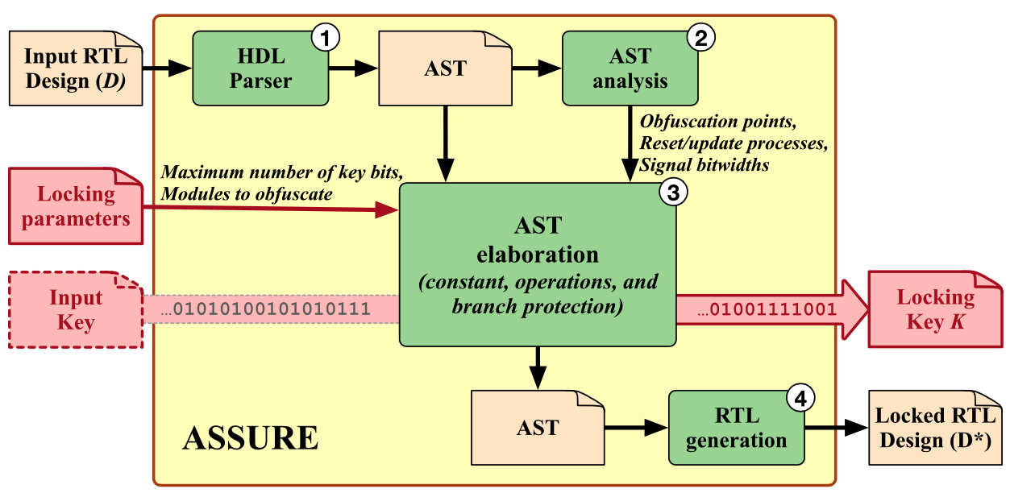
RTL Obfuscation with ASSURE
ASSURE: RTL obfuscation framework assuming netlist-only threat model
3 obfuscation techniques:
  Constant: substitute constants in RTL with secret locking key
  Operation: adds redundant operators alongside original operators in RTL
  Branch: obfuscates branch conditions in RTL
[Pilato et al., IEEE TVLSI 2021]
Notes:
Another key updates of RDF-2021 is support of logic locking.
Logic locking has emerged as an attractive technique to prevent hardware IP piracy.
In RDF-2021, we have included a recently-released RTL obfuscation tool, called ASSURE.
ASSURE is an RTL obfuscation framework assuming a netlist-only threat model.
Given a secret locking key and an RTL design, ASSURE obfuscates the design using three obfuscation techniques: constant obfuscation, operation obfuscation, and branch obfuscation.
Using these techniques, ASSURE can hide essential design semantics, against hardware IP piracy.
Also, since it directly obfuscates RTL itself, the ASSURE techniques are compatible with virtually any RTL- to-GDS flows.

Slide 10
ABC Synthesis Script Updates
Latest ABC updates incorporated in RDF-2021
  Tight integration of SAT solver with internal design representation
  Improved scalability and new options to improve technology mapping quality
  Example: verification task runtime improvement (10x faster than previous version)
LazyMan synthesis scripts
  Reuse logic rewriting choices empirically discovered in earilier runs
  Included in RDF-2021 logic synthesis script
abc 01> &cec -x cnn.170.aig
cnn.187.aig Networks are equivalent. Time = 1238.07 sec
abc 02> &cec cnn.170.aig cnn.187.aig
Networks are equivalent. Time = 12058.28 sec
Combinational equivalence checking runtime comparison
Notes:
Next, we incorporated the latest ABC updates in RDF 2021.
It comes with improved scalability and new options for better technology mapping quality.
The scalability improvement is mainly from the tight SAT solver integration with the internal design representation.
It enables dramatic performance improvement of logic synthesis and verification tasks in ABC.
For example, a combinational equivalence checking of two large neural networks exhibits 10× runtime improvement as shown in the picture at the bottom of this slide.
The released synthesis scripts in RDF are also updated to include the LazyMan synthesis script.
It uses a database of logic rewriting choices, which were empirically discovered in earlier synthesis runs.
Such reuse of learned data reduces optimization runtime significantly, while enabling more accurate assessment of logic transformations.

Slide 11
DFT Support with Fault
Fault: open-source DFT infrastructure including scan insertion and ATPG
  Supports scan chain insertion as well as ATPG flows
  Scan chain insertion: add test signals, scan chains, and JTAG interface
  ATPG: generate compressed test vectors
Scan insertion
Netlist
Chain
Netlist with
scan chains
Tap
Netlist with
tap ports
ATPG
Cut
Comb-only
netlist
PGen
Test vectors
Compact
Compacted test vectors
Notes:
DFT support is another key addition to RDF 2021.
In the open-source EDA ecosystem, there has not been a usable DFT solution until recently.
Thanks to the release of the Fault tool chain, RDF now includes DFT support in its inventory.
The Fault toolchain consists of five DFT tools that enable automatic test pattern generation, the ATPG, and scan chain insertion.

Slide 12
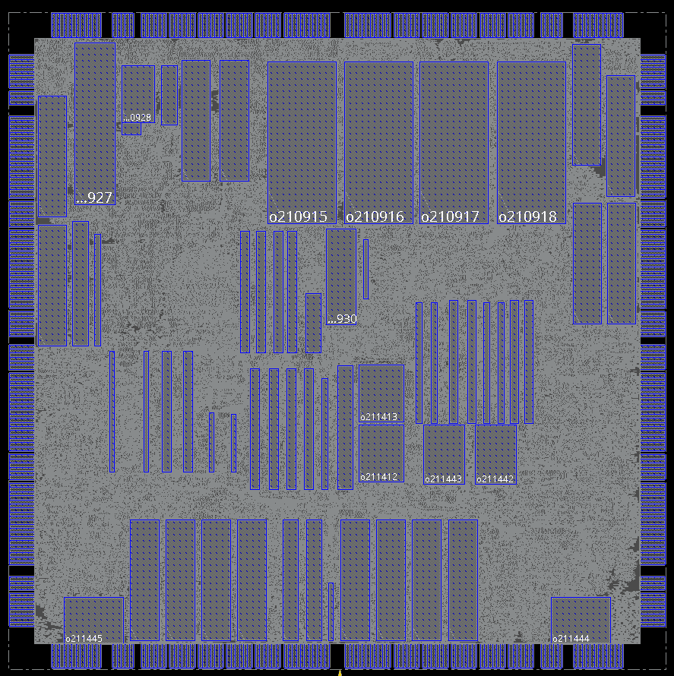
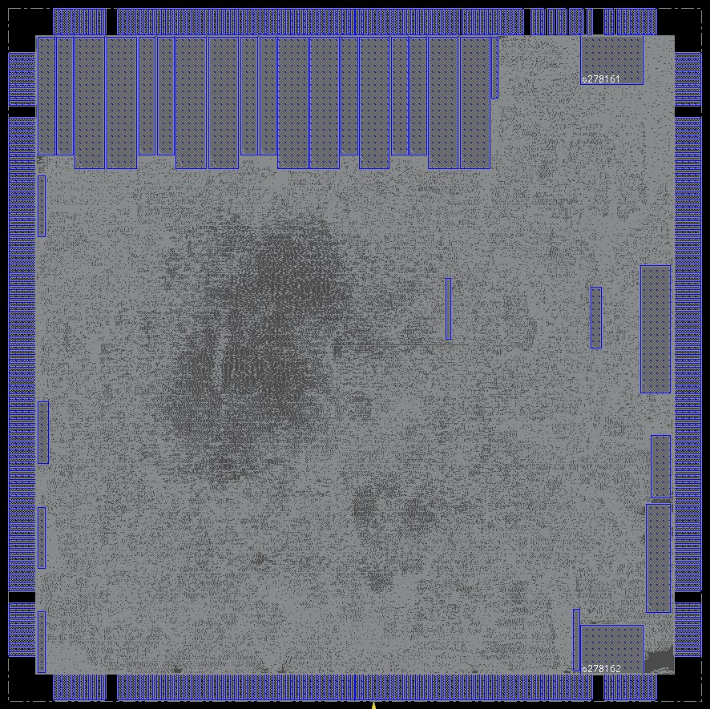
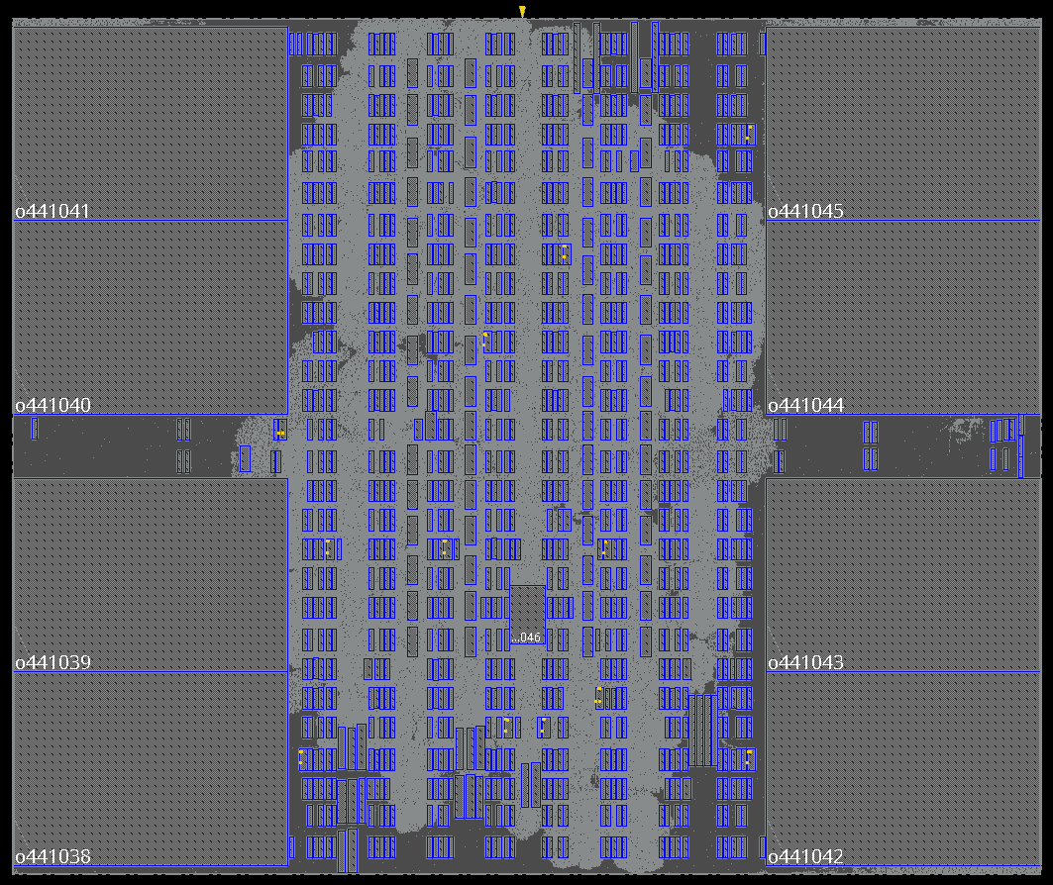
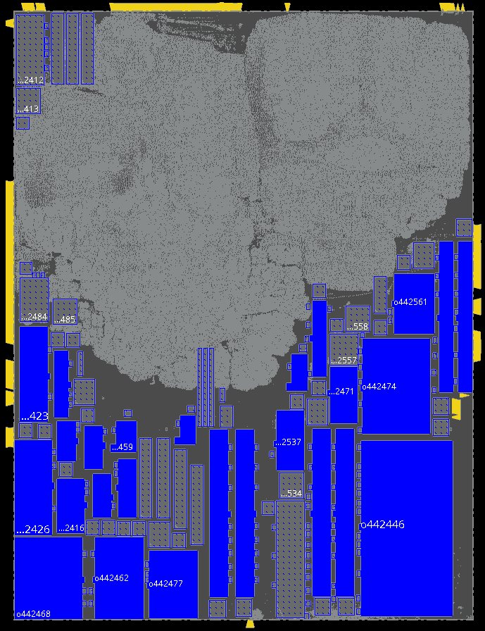
Robust Bookshelf-LEF/DEF Conversion with RosettaStone
RosettaStone: robust benchmark converter powered by OpenDB
  Creates OpenDB databases from bookshelf and PDK information
    Missing information (e.g., cell types) are populated based on target PDK
    Existing macro blocks are properly scaled based on placement site definitions
  Also capable of converting LEF/DEF into bookshelf through OpenDB
adaptec1
bigblue1
newblue2
superblue18
Notes:
Finally, RDF now includes RosettaStone as an enabler of robust benchmark conversion.
It is a bookshelf to LEF/DEF converter powered by OpenDB.
It takes a bookshelf benchmark, PDK, and standard cell library, and creates OpenDB databases.
There may be missing information in the bookshelf benchmarks, such as cell names and master cell types;
RosettaStone properly populates such information based on the target PDK and libraries.
The resulting OpenDB can be accessed using the OpenDB APIs, and we can also dump DEF files from them.
The pictures shown here are examples of contest benchmarks conversion obtained by RosettaStone.

Slide 13
Outline
Introduction
  Design Automation Technical Committee (DATC)
  DATC Robust Design Flow (RDF)
DATC RDF-2021 Flow and Updates
  DATC RDF-2021 Flow
  DATC RDF-2021 Updates
New Directions
  METRICS2.1
  Flow parameter AutoTuner
  Calibration repository
Summary
Notes:
Now, I’ll describe new initiatives of DATC this year,
which include a common metrics system, design flow autotuning, and calibration repository.

Slide 14
METRICS2.1 – Previous Works on “METRICS”
METRICS 1.0 [Fenstermaker et al., DAC’99; Kahng et al., ISQED’01]
  “METRICS encompasses the instrumentation of design tools and design processes, the collection of design artifact and design process data, and the prediction of future results and data based on current information.” – Source: http://vlsicad.ucsd.edu/GSRC/metrics
METRICS 2.0 [Hashemi et al., WOSET’18]
  Revisit METRICS1.0 and propose updated architecture for collection and sharing of data for machine learning applications
METRICS2.1
  Extension to METRICS 2.0, formalizing METRICS syntax and realization
  Provides OpenROAD-based realization as well as public metrics data repositories
Notes:
I’ll start from the common metrics system, METRICS 2.1.
It is an extension made on top of the previous research for defining common metrics systems of design activities and flow.
In late 1990s, METRICS 1.0 was proposed.
The goal was to define a metrics system, which measures design activity, mine the useful data, predict tool outcomes and find design-specific tuning.
Then, three years ago, the METRICS2.0 paper, which was presented at the Workshop on Open-Source EDA Technology
, revisited the original goal.
It proposed a new architecture to share big metrics data collection for Machine Learning application.
And here, we describe METRICS 2.1
It formalizes METRICS syntax, and gives an OpenROAD-based realization.
It also provides a public repository of big metrics datasets for future ML applications.

Slide 15






METRICS2.1
Link: https://github.com/ieee-ceda-datc/datc-rdf-Metrics4ML
Consolidated design and flow metrics collected from tool logs
DATC’s GitHub repository provides:
  Metrics dataset collection obtained from OpenROAD flow with public enablement
  Sample Jupyter notebooks on datasets to provide example ML applications
Log
Tool A
Synthesis
Big Data Collection
Tool B
Floorplan
METRICS2.1
Hierarchical
JSON Object
Tool C
Placement
ML Applications
Tool D
CTS
Tool E
Routing
Flow autotuning
Tool F
Verification
SPECIAL SESSION 7C-1 “METRICS2.1 and Flow Tuning in the IEEE CEDA Robust Design Flow and OpenROAD”
Notes:
This slide shows an overview of METRICS2.1.
METRICS2.1 provides consolidated design and flow metrics, which are collected from the tool log files.
The metrics data are represented as JSON objects, and so it is easy to use for various applications.
We provide metrics datasets obtained from thousands of P&R experiments using OpenROAD flow under the DATC’s GitHub repositories.
We also share sample Jupyter notebooks to show example machine learning applications.
The details of METRICS2.1 will be presented in the Special Session 7C.
So, if you are interested in it, please visit the session and the talk.

Slide 16
Flow Parameter AutoTuner
Link: https://github.com/ieee-ceda-datc/datc-rdf-flow-tuner
Smart flow parameter tuner of RTL-to-GDS flow utilizing UC Berkeley Tune
  Flexible interface to define target parameters and objective function
  Design flow agnostic; support both academic and commercial flows
  Multiple search algorithm, e.g., PBT, HyperOpt, Optuna, etc.
  Parallel flow execution for efficient tuning
Option 1
Best known
parameter set
Option 2
No prior
knowledge
Parallel execution
Parameter config
parameter name, range, step, type
Select parameter set
based on config / results
Flow AutoTuner
RTL-to-GDS
flows are
automatically
executed
in parallel
Create RTL-to-GDS flow with selected parameter set
Search algorithm
(switchable)
Execute RTL-to-GDS flow
Objective function
Collect METRICS2.1 json
Tuning options
#trials, #cores, etc.
Evaluate reward function
Notes:
Next, I am going to introduce the smart design flow tuning.
The complete design flow usually includes various tool options and “recipes” at each flow stage.
And choosing such tool options and recipes to obtain the best outcome from the flow requires expert intuition and experience.
With that, we have added a design flow autotuning framework to RDF 2021.
The AutoTuner framework provides a smart parameter tuning capability utilizing UC Berkeley’s Tune package.
The diagram shown here shows an overview of the framework.
It has a flexible interface where users can define their own target parameters and tuning objectives.
This flexibility makes the proposed AutoTuner // design flow agnostic, meaning that it can support any kind of design flows.
It also supports various parameter search algorithms, for example, PBT, HyperOpt, and Optuna, to name but a few.
Also, it supports parallel flow execution for efficient flow tuning.

Slide 17
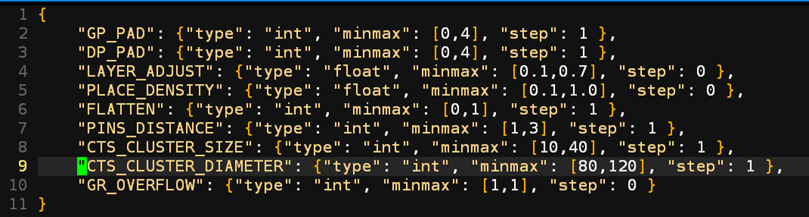
Flow Parameter AutoTuner – Demonstration
Design/tech: ibex/SkyWater 130nm HD
Design flow: OpenROAD
Flow parameter: 9 OpenROAD tool parameters
Objective function: weighted sum of wirelength, delay, and power
Search algorithm: HyperOpt
Notes:
Here, we show an example flow parameter tuning result.
We took a public design IBEX and SkyWater 130 enablement.
We used OpenROAD flow, and selected 9 tool parameters.
The objective function was defined as a weighted sum of wirelength, critical path delay, and total power.
We used HyperOpt as the search algorithm.

Slide 18
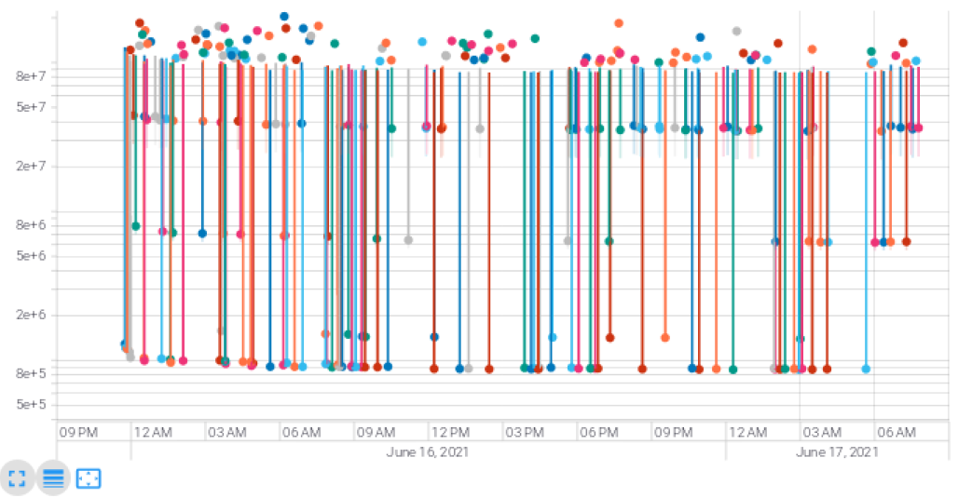
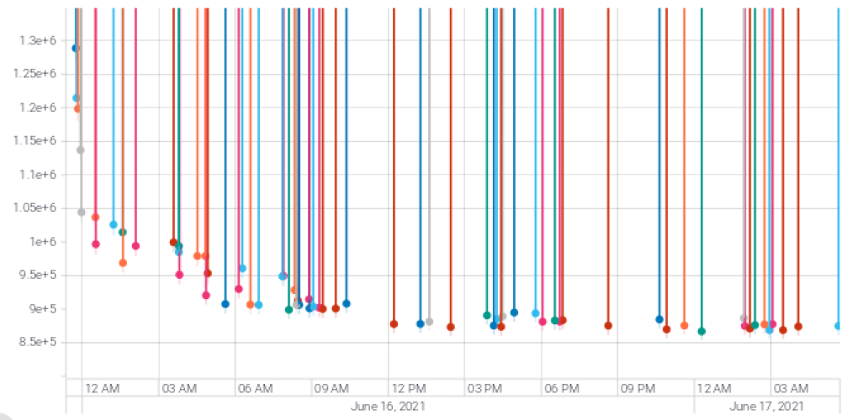
Flow Parameter AutoTuner – Demonstration
Parameter tuning results (visualized by TensorBoard)
Objective
Dots = trials
Default flow score = 1,174,346
Best Score = 855,373 (less is better)
Wirelength 1003801um → 843258um (-16%)
Critical path delay 20.935ns → 16.185 ns (-23%)
Power 0.024 W→ 0.0133 W (-45%)
Wall time
SPECIAL SESSION 7C-1 “METRICS2.1 and Flow Tuning in the IEEE CEDA Robust Design Flow and OpenROAD”
Notes:
This slides shows the tuning result, which is visualized by TensorBoard.
The x axis of the graph shows the walltime, and the y axis shows the objective function value.
Each dot in the graph represents an individual tuning trial.
As you can see here, throughout the flow tuning, we were able to obtain 16% shorter wirelength, 23% shorter critical path delay, and 45% lower power.
CLICK
More details of the flow autotuner will be presented in special session 7C.
So, If you're interested in the details of the auto tuner, please visit the Special Session 7C.

Slide 19
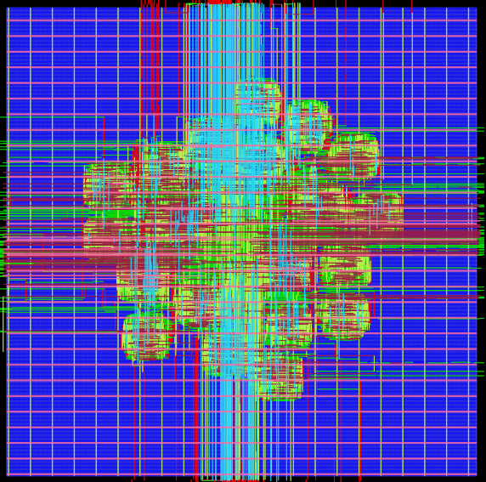
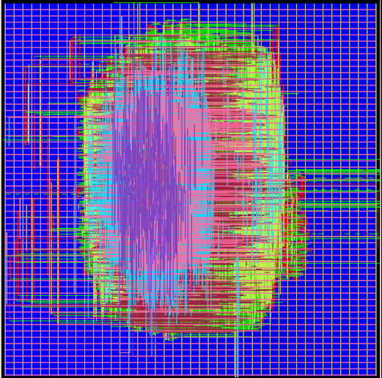
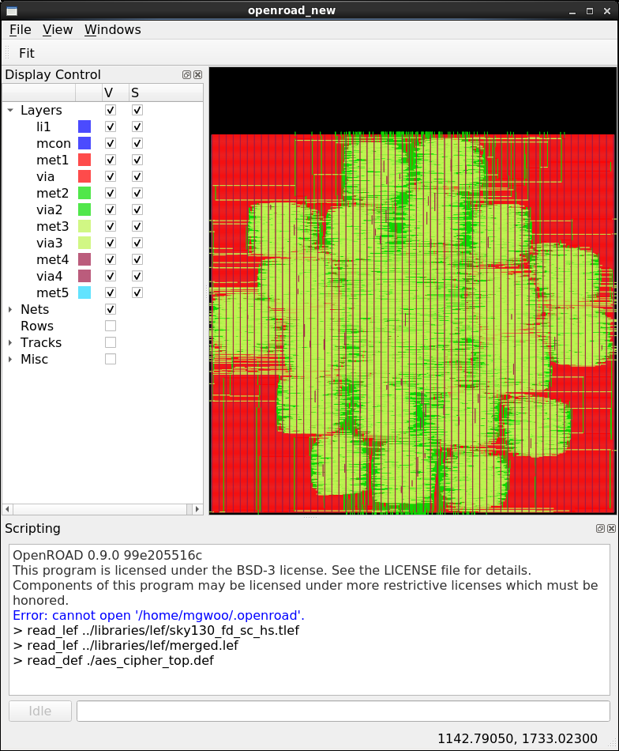
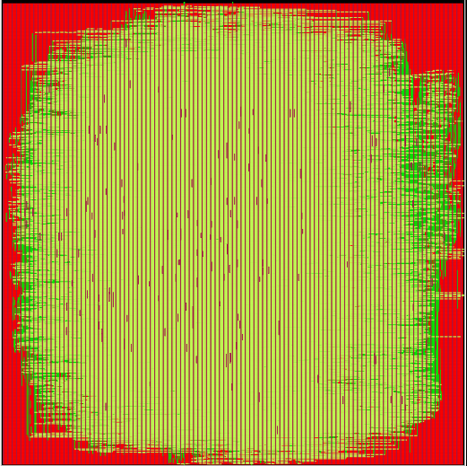
Calibration Repository
Link: https://github.com/ieee-ceda-datc/datc-rdf-calibrations
To support academic research on analyses and verifications (started in 2020)
Provides reference analysis data for STA, RCX, and IR drop obtained from DRV-free routed testcases in open enablements
Updates in 2021
  Expanded dataset: {NanGate45, SKY130} X {GCD, AES, JPEG, IBEX}
  New scripts to introduce noise in calibration data to enable obfuscations
NanGate45-AES
NanGate45-JPEG
SKY130-AES
SKY130-JPEG
Notes:
Last, I would like to introduce calibration repository updates.
Last year, we started building a calibration repository to support academic research in electrical analysis and other design verification tasks.
The repository provides a collection of reference analysis results, which include STA, RC extraction, and IR drop analysis.
Over the past year, the calibration data collection has further expanded.
The new calibration data were extracted from DRV-free routed designs, which were obtained from the latest OpenROAD flow.
We used three PDKs and four designs, each with three different floorplan utilization and placement density.
Furthermore, we have written new scripts to introduce noise in the calibration data, to enable the data obfuscations.

Slide 20
Outline
Introduction
  Design Automation Technical Committee (DATC)
  DATC Robust Design Flow (RDF)
DATC RDF-2021 Flow and Updates
  DATC RDF-2021 Flow
  DATC RDF-2021 Updates
New Directions
  METRICS2.1
  Flow parameter AutoTuner
  Calibration repository
Summary
Notes:
Now I’ll give a summary of this talk.

Slide 21
Summary
DATC RDF 2021 Updates
  Chisel and hardware generator support
  RTL obfuscation using ASSURE
  ABC synthesis script updates
  DFT support with Fault toolchain
  Robust benchmark conversion with RosettaStone
New initiatives
  METRICS2.1 for common metrics standardization for AI/ML applications
  Flow autotuning framework supporting various design flows and search algorithms
  Expanded calibration repository with open-sourced noise introduction script
We are open! Please give any suggestion and contribute to our effort!
GitHub Link: https://github.com/ieee-ceda-datc
Notes:
In this talk, I have described the latest release of DATC RDF.
It has five key updates to the previous RDF releases, which include Chisel and hardware generator designs, RTL obfuscation, new ABC synthesis script, DFT support, and robust benchmark conversion.
I have also presented three new initiatives of DATC this year.
They include: common metrics system for AI/ML applications, a flexible flow autotuning framework supporting various flows and search algorithms, and the expanded calibration repository with noise introduction.
We are looking forward to any suggestions and contributions to our efforts, and please visit our GitHub organization page for finding our recent activities.

Slide 22
Thank You!
GitHub Link: https://github.com/ieee-ceda-datc
Notes:
This concludes my talk. Thank you for your attention!

