Slide 1
[Paper ID : 103]
CoRe-ECO: Concurrent Reﬁnement of Detailed Place-and-Route for an Efﬁcient ECO Automation
Chung-Kuan Cheng¹, Andrew B. Kahng^{1,2}, Ilgweon Kang³, Minsoo Kim²,
Daeyeal Lee², Bill Lin², Dongwon Park², and Mingyu Woo²
¹Department of Computer Science and Engineering, University of California, San Diego
²Department of Electrical and Computer Engineering, University of California, San Diego
³Digital & Signoff Group, Cadence Design Systems Inc.

Slide 2
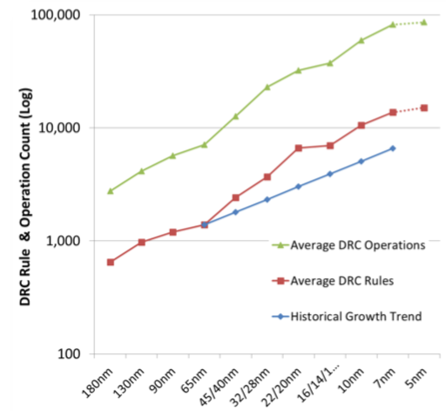
Challenges in Layout Refinement (ECO*) Flow
* ECO : Engineering Change Order
* DRV : Design Rule Violation
Iterative Manual Placement Refinement & Re-routing
Gate-level Netlist
(After Logic-Synthesis)
DRV Correction Flow
Standard-Cell
Library
Correct DRVs (Re-Route)
Partitioning/Floor-planning
Routable?
Complex design rules
Placement
No
Finish
Placement Adjustment
[Design Rule Complexity Rising , semiengineering.com]
Cell Swap/Flip/Shift
Routing
(Through the commercial tool)
Fewer routing tracks
#DRV* < 300?
Master Cell Change
Swap
DRV Correction
(Through manual stitch/modify)
Higher pin density
Pin-length Extension
DRV-Clean Layout
[Source: https://www.imec-int.com/en/imec-magazine/imec-magazine-november-2018/the-supervia-a-promising-scaling-booster-for-the-sub-3nm-technology-node]

Slide 3
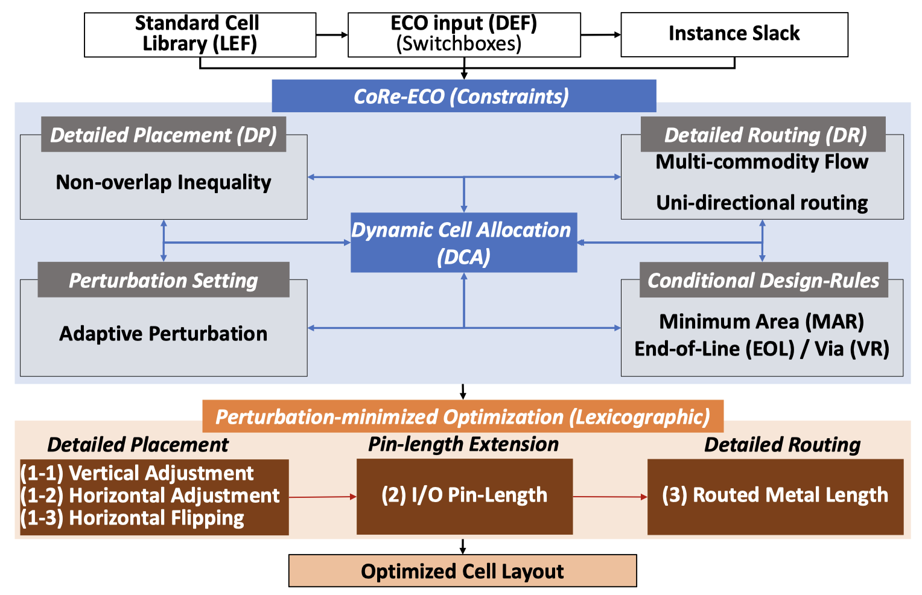
Concurrent Refinement Framework at the ECO stage
Concurrent optimization of DP, DR, and cell replacement for each local window (i.e., switchbox)

Slide 4
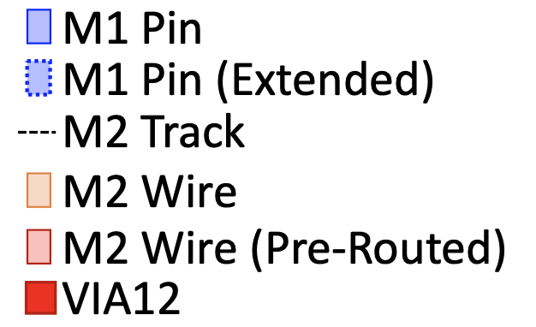
Refinement Operations
Placement Adjustment
Pin-length Extension
(Cell Replacement)
Initial Placement
Horizontal Shifting
Initial Placement
Vertical Shifting
Horizontal Flipping
Cell Swapping
Pin-length Extension

Slide 5
Overall ECO flow using CoRe-ECO framework
Standard Cell Library (LEF)
Initial Detailed P&R Result (DEF)
ECO w/ CoRe-ECO Framework
LEF/DEF Conversion
(pinLayout)
ECO Result (DEF)
Multi-threaded
DRV Correction
Remaining DRVs?
No
Yes
Non-overlapping Switchbox?
No
Yes
Switchbox Generation
(pinLayout)
CoRe-ECO SMT Code Generation
(smt2)
SMT Solutions to DEF Conversion
SMT Solving
ECO Result (DEF)
Routable?
Another Round?
No
Yes
Yes
No
Final ECO Result (DEF)

Slide 6
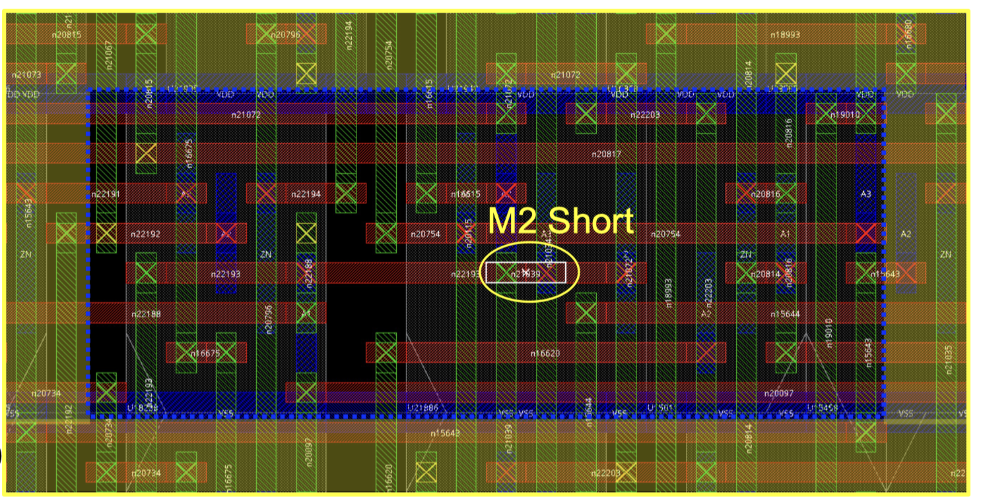
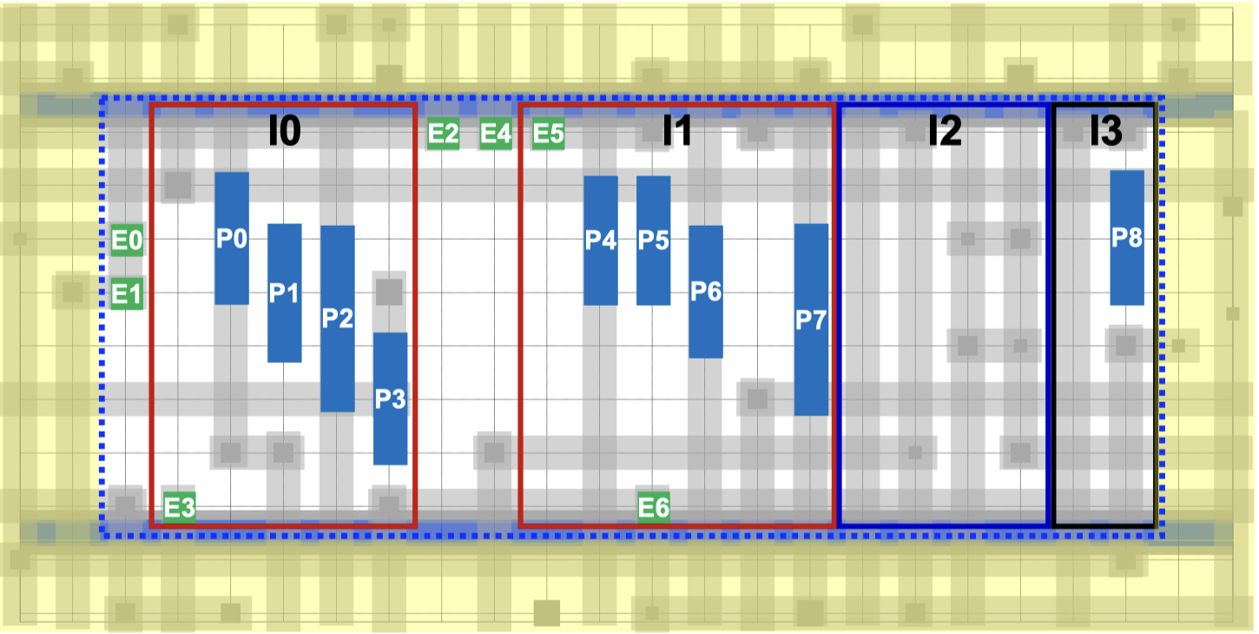
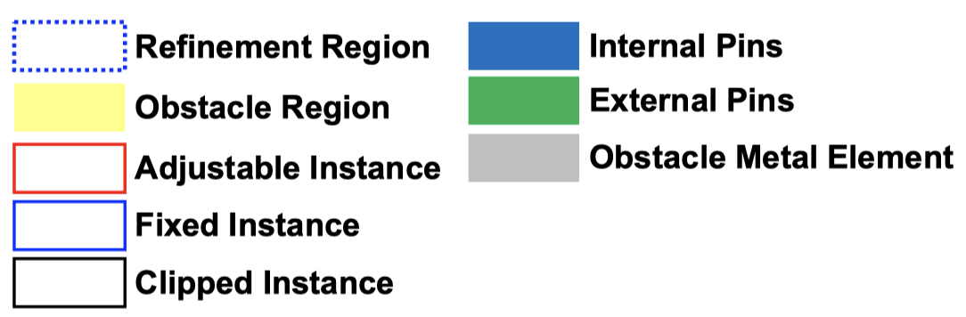
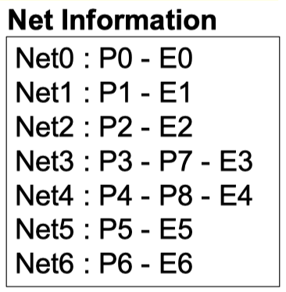
Switchbox Generation
Local window with 1 DRV, displayed by the commercial tool
Visualization of the generated switchbox

Slide 7

SMT Code Generation – Grid-based Place-and-Route Architecture
Cell Placement Grid
Routing Grid
Standard Cell Instance
Pins on Metal1
Pins on Metal2
Internal Pin Candidates (P_{IN})
Origin of Cell Instance
Pins on boundary
of switchbox
External Pin Candidates (P_{EX})
M1 Track

Slide 8
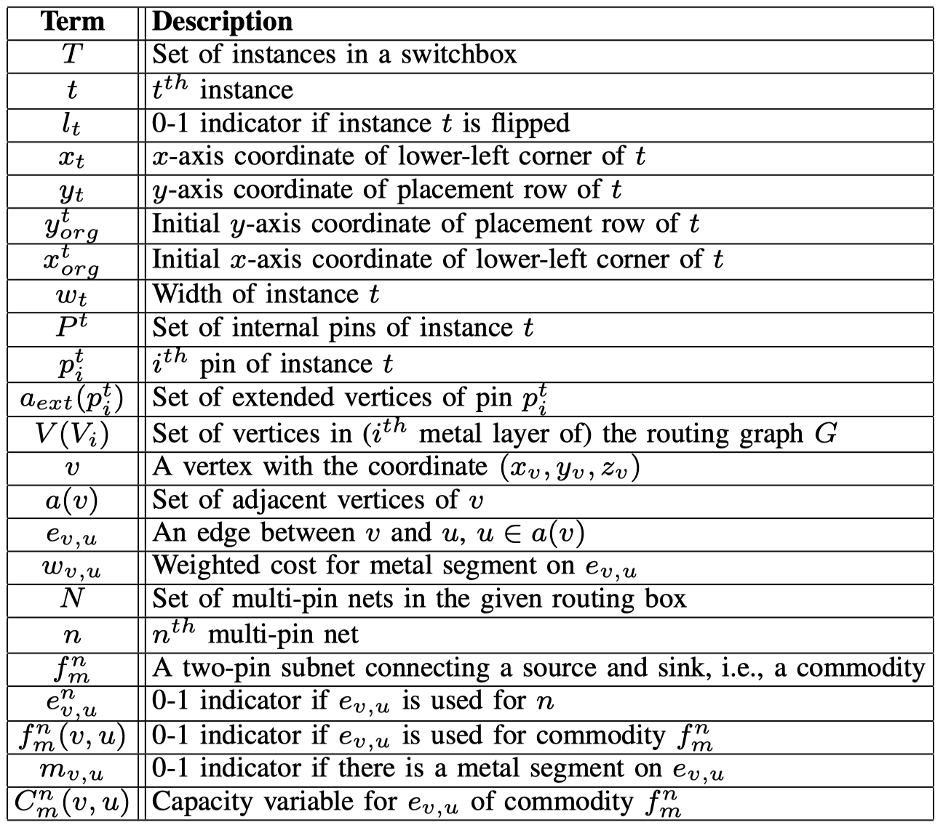
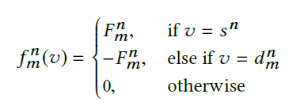
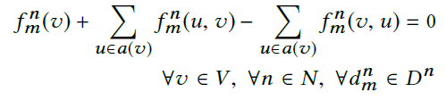
SMT Code Generation – Placement and Routing Model
Cell Placement Formulation
  Relative Positioning Constraints between Adjacent Cells
Notations for the proposed framework
Detailed Routing Formulation
  Grid-based Routing Graph using Multi-Commodity Flow
[Ilgweon Kang et al., Fast and precise routability analysis with conditional design rules, SLIP 2018]
  Conditional Design Rules
(a) MAR(Minimum Area Rule)
(b) EOL (End-Of-Line Spacing)
(c) VR (VIA Rule)

Slide 9
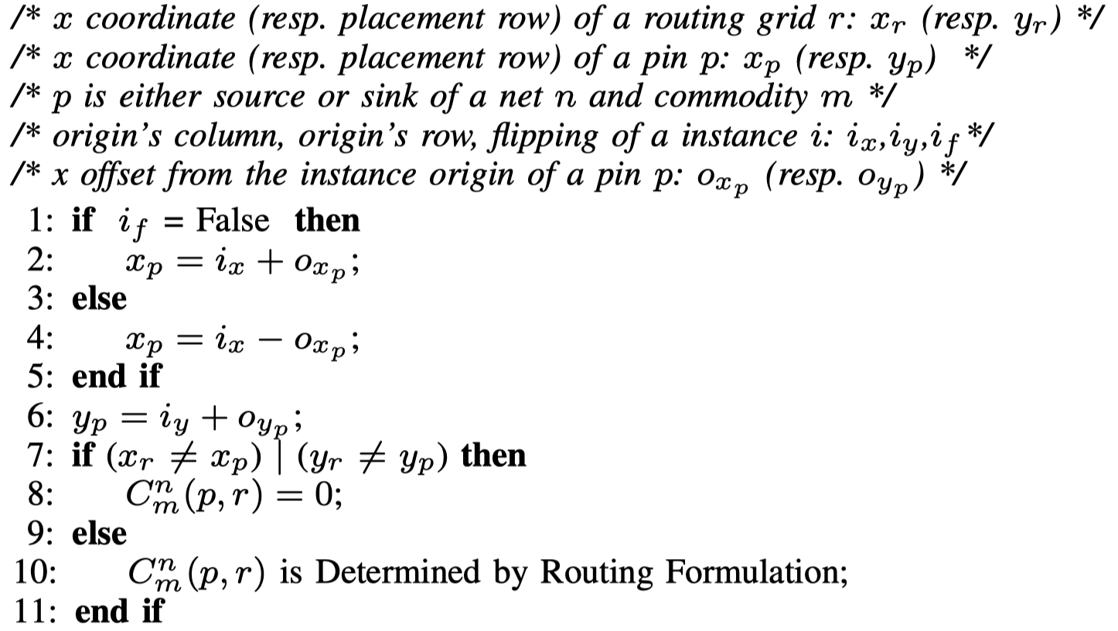
SMT Code Generation – Dynamic Cell Allocation (DCA)
Flow Capacity Control (from Placement)
Flow Variable Connection (to Route)

Slide 10





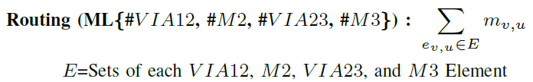
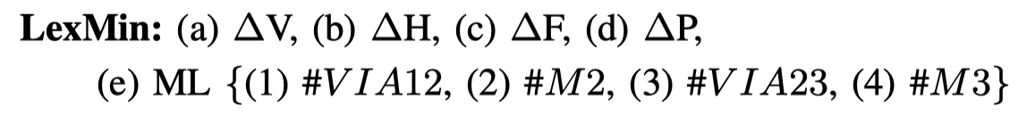
SMT Code Generation – Perturbation-Minimized Optimization
Lexicographic Multiple-Objective Optimization

Slide 11
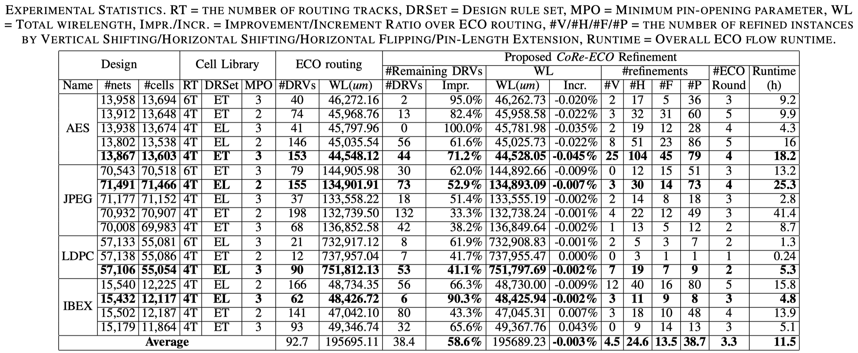
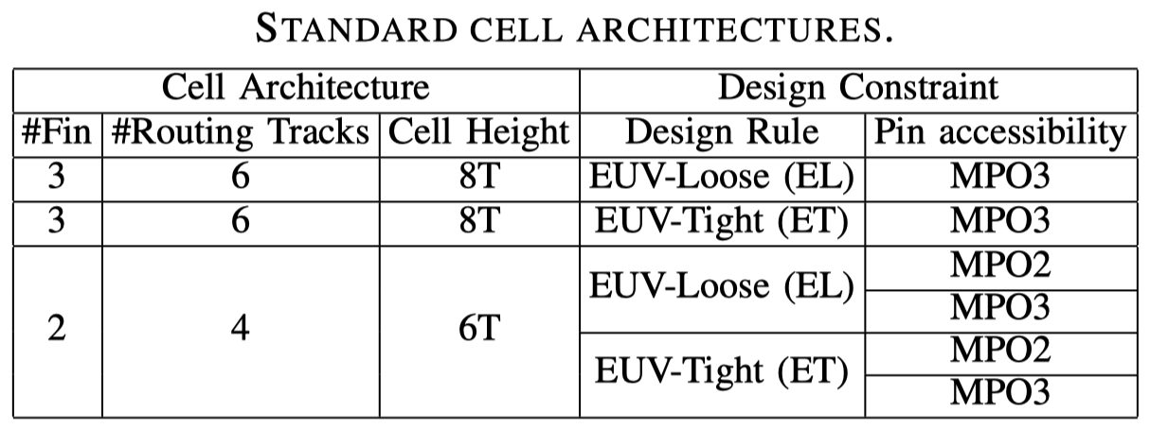
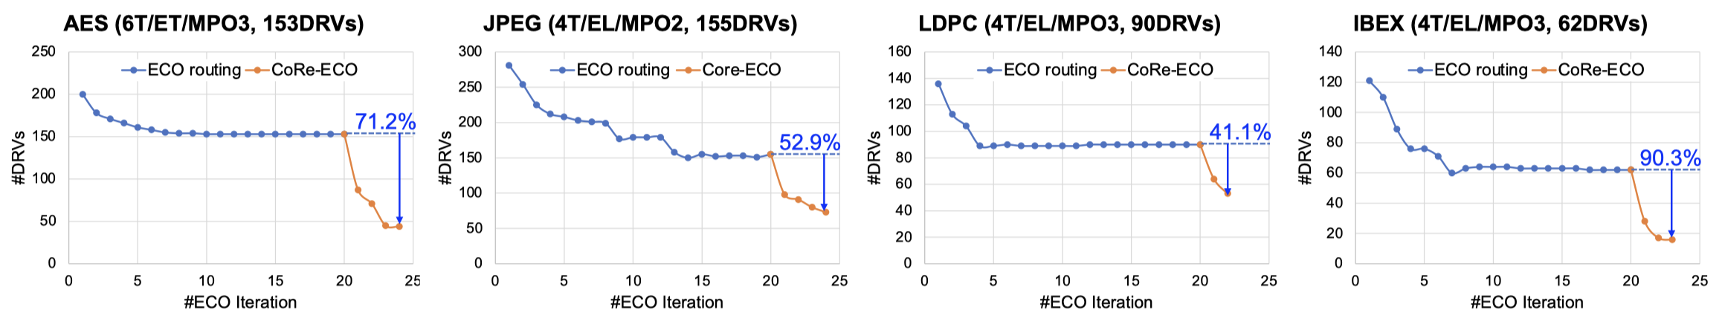
Experimental Results – Statistics
EUV-Loose (EL) : MAR/EOL/VR = 1/1/1
EUV-Tight (ET) : MAR/EOL/VR = 1/2/1

Slide 12
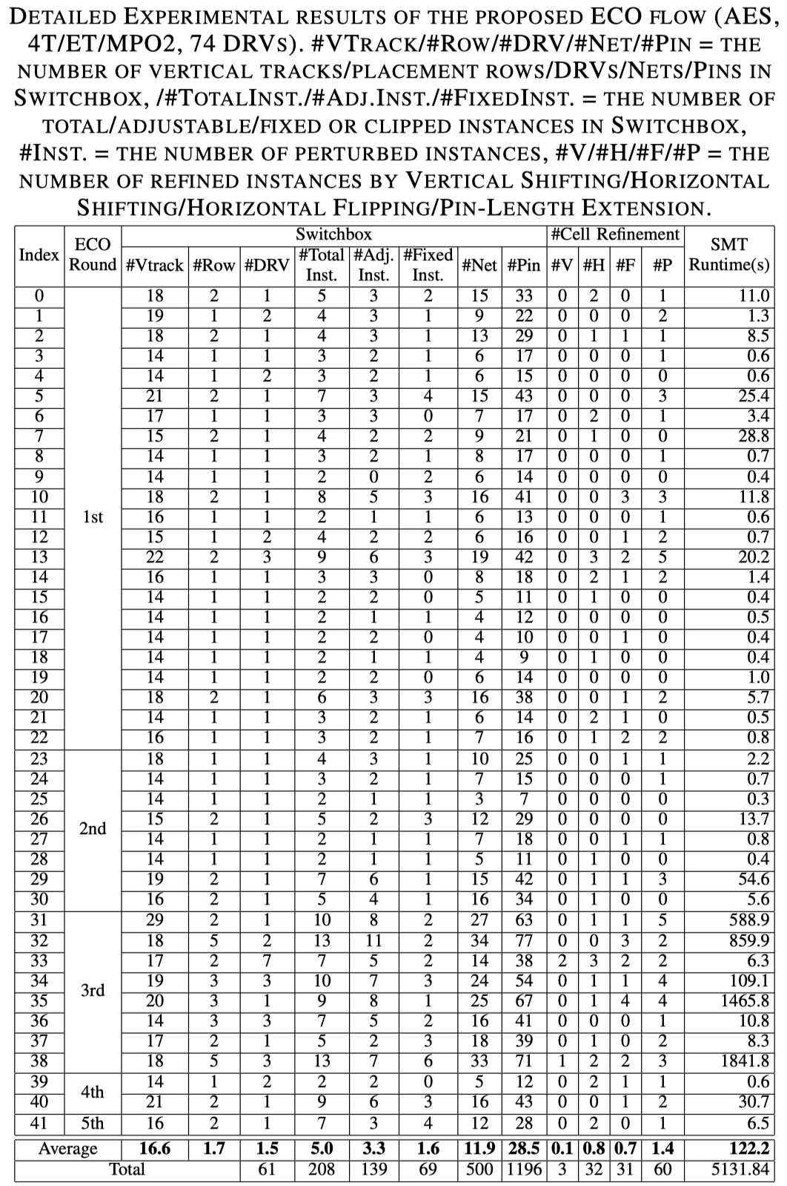
Experimental Results – Detailed ECO Operations
DRV Reduction by CoRe-ECO rounds for AES (4T/ET/MPO2)
Example of refinement operations
in the proposed ECO flow (Index 38)
Switchbox with 3 DRVs
Routable solution of
the CoRe-ECO framework

Slide 13
Summary
We propose a novel concurrent reﬁnement framework (CoRe-ECO) for the automated ECO flow by devising a dynamic cell allocation (DCA), merging the reﬁnement steps into a single-step optimization.
CoRe-ECO provides simultaneous and perturbation-minimized reﬁnements of DP-, DR-, and cell-optimized layout solutions to address the DRVs during the ECO stage.
CoRe-ECO is capable of achieving a DRV-clean layout solution by ripping up and reﬁning a local window of the whole layout design.
CoRe-ECO successfully resolves an average of 58.6% (range: 33.3% to 100.0%) of remaining post-ECO route DRVs on M1-M3 layers, across a range of benchmark circuits with various cell architectures, with no adverse effect on total routed wirelength (average of 0.003% reduction).

Slide 14
Thank you

