Slide 1
A Novel Framework for DTCO: Fast and Automatic Routability Assessment with Machine Learning for Sub-3nm Technology Options
Chidi Chidambaram$‡$, Andrew B. Kahng$†$, Minsoo Kim$†$,
Giri Nallapati$‡$, S.C. Song$‡$ and Mingyu Woo$†$
$†$University of California, San Diego
$‡$Qualcomm Technologies, Inc.
Notes:
Hello everyone. My name is Minsoo Kim, PhD student at UC San Diego.
Today, the title of my presentation is “A Novel Framework for DTCO: Fast and Automatic Routability Assessment with Machine Learning for Sub-3nm Technology Options”.
This work is in collaboration with Qualcomm.

Slide 2
Outline
Background
PROBE2.0 framework
Experimental Results with Sub-3nm Technology
Conclusion
Notes:
This is an outline of my presentation. First, I will start with background of our work and then explain what PROBE2.0 framework is.
Then, I will explain our study with sub-3nm technology configurations. And, I will conclude my talk.

Slide 3
Outline
Background
PROBE2.0 framework
Experimental Results with Sub-3nm Technology
Conclusion
Notes:
Let me start with the background.
[1:00]

Slide 4
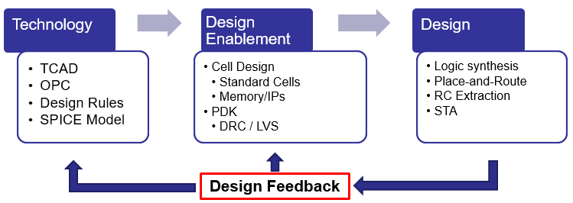
Background
Design-Technology Co-Optimization (DTCO)
Essential for technology development; Large TAT and engineering efforts
Standard-cell area scaling $≠$ block area scaling
Significant impact on routability by standard-cell architectures w/ scaling boosters (BPR, etc.)
=> Block-level area need to be estimated at early stage of technology development
Notes:
[Click] Design Technology Co-Optimization (also known as DTCO) is an essential process for technology development at advanced nodes.
However, the process requires large turnaround time and engineering efforts for design feedback, as shown in the figure below.
[Click] Also, scaling boosters, such as buried power rails, backside PDN, etc., are used at advanced technology nodes for the best PPA.
Due to the routability impact by standard-cell architectures with scaling boosters, small standard-cell area does not always bring small block-level area.
[Click] Therefore, block-level area needs to be estimated at an early stage of technology development.
[2:00]

Slide 5
Outline
Background
PROBE2.0 framework
Experimental Results with Sub-3nm Technology
Conclusion
Notes:
Now I will explain about PROBE2.0, which is the baseline framework for our study.

Slide 6
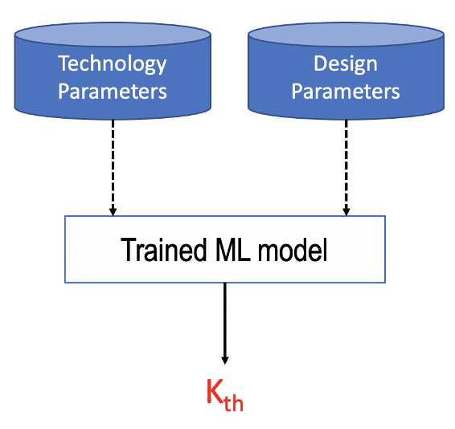
PROBE2.0 Overview
PROBE2.0: A Systematic Framework for Routability Assessment [1]
Satisfiability Modulo Theories (SMT)-based automatic std-cell layout generation
Rank ordering (Kth)-based routability assessment
Machine learning (ML)-based Kth prediction
[1] C.-K. Cheng, A. B. Kahng, H. Kim, M. Kim, D. Lee, D. Park and M. Woo, "PROBE2.0: A Systematic Framework for Routability Assessment from Technology to Design in Advanced Nodes", IEEE Trans. on CAD (2021), in revision.
Notes:
[Click] As I mentioned earlier, we use PROBE2.0 framework to evaluate routability for sub-3nm technology configurations.
PROBE2.0 framework is a fast and systematic framework for routability assessment.
[Click] This includes satisfiability modulo theories (SMT)-based automatic standard-cell layout generation.
[Click] PROBE2.0 routability evaluations are based on rank-ordering with K threshold. I will explain what Kth is in the later slide.
[Click] Also, we utilize machine learning to expedite the assessment. Here, with the trained models, we don’t need to generate all the design enablements and perform large numbers of place-and-route runs. I will also give more detailed information in the later slide.
[3:30]

Slide 7
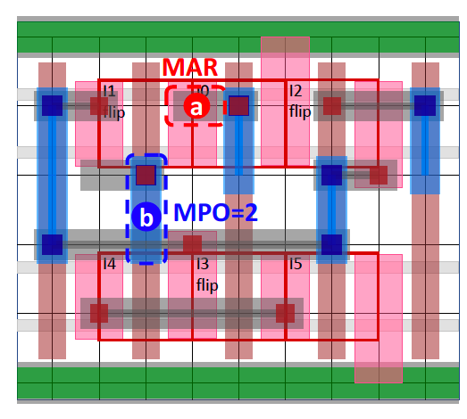
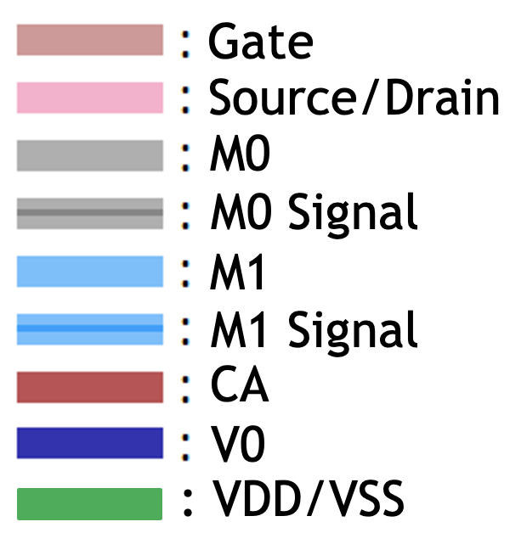
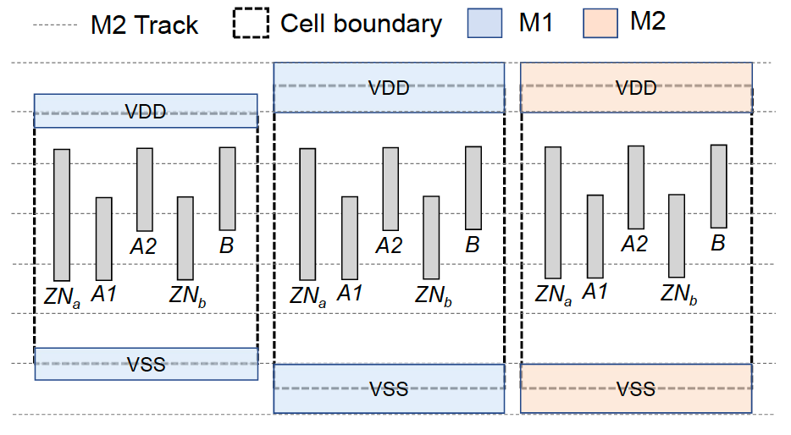
Standard-Cell Layout
SMT-based “automatic” standard-cell layout generation
Cell-level simultaneous placement and routing
Complete and optimal layout with grid-based conditional design rules
Open-sourced at GitHub
https://github.com/ckchengucsd/SMT-based-STDCELL-Layout-Generator-for-PROBE2.0
Generate signal and power/ground pins and convert into LEF format
Notes:
[Click] PROBE2.0 includes SMT-based “automatic” standard-cell layout generation.
[Click] Given technology and design configurations, the SMT-based standard cell layout generation generates complete and optimal solutions with simultaneous placement and routing in standard cells.
It supports conditional design rules which are fully grid-based rules.
[Click] In case that you are interested, our code has been open-sourced at the GitHub repository here.
[Click] Also, we build the LEF generator which generates LEF format of layouts. We convert the layouts from SMT-based generator to LEF format while we add power/ground pin shapes in LEF.

Slide 8
Placement “Tangling” and Kth
Placement “Tangling”: repeatedly make neighbor-swaps
Randomly perform neighbor-swaps to increase routing difficulty
K threshold (Kth) = minimum K (number of neighbor-swaps normalized to #cells) that leads to an unroutable placement (>500 DRC violations)
Higher Kth == Better “intrinsic routability”
PROBE2.0 routability evaluation: Rank ordering based on Kth
Cell to be swapped
Neighbor cells
Connectivity
Notes:
There are two previous works, PROBE1.0 and PROBE2.0, and both are based on the idea of placement tangling.
[Click] Placement tangling means repeatedly making neighbor-swaps.
[Click] The basic idea of PROBE is to randomly perform a neighbor-swap operation to increase the routing difficulty.
[Click] Here we show an example of neighbor swaps for better understanding. For the cell to be swapped, we randomly select one of the neighboring cells.
[Click] And we swap the cells, we have more complex connectivity after the swap.
[Click] Here, we use ”K” and the number of swaps is K times the total number of instances in design.
K threshold is our metric for routability. K threshold is defined as the minimum K which leads to an unroutable placement.
[Click] Based on the definition of Kth, higher Kth means better intrinsic routability.
[Click] So, PROBE2.0 routability evaluation is based on rank ordering with K threshold.
[6:00]

Slide 9
ML-Based Kth Prediction
ML can help to mitigate potential disadvantages of the framework
SOLUTION: Given technology and design parameters, we generate Kth for partial configurations for training and predict Kth for the remaining configurations
E.g., 30 P&R runs per Kth takes a few hours of runtime vs. Kth prediction takes seconds
We predict Kth by using AutoML which recommends best ML models (XGBoost, DL, etc.)
PROBLEM: Large runtime, storage and limit of tool licenses
Notes:
This slide explains the machine learning-based Kth prediction.
[Click] PROBE2.0 had three disadvantages. To obtain Kth, we need to launch a number of P&R runs, and it requires large runtime, storage and number of licenses.
[Click] This machine learning-based Kth prediction helps us to mitigate the drawbacks.
[Click] The solution is that, given technology and design parameters, we generate Kth for partial configurations for training and predict Kth for the remaining configurations. In this way, we can significantly reduce the number of the required P&R runs and design enablement.
[Click] For example, we run by default 30 P&R runs to obtain a single Kth, which takes a few hours of runtime. However, Kth prediction takes a few seconds.
[Click] AutoML is used as a platform of the ML work. The benefit of AutoML is that AutoML can recommend best ML models for our problem.

Slide 10
Outline
Background
PROBE2.0 framework
Experimental Results with Sub-3nm Technology
Conclusion
Notes:
Now, I will explain our study for sub-3nm technology options.
[7:30]

Slide 11
Our Study
In this work, we perform an early-stage routability assessment with sub-3nm configurations
Reminder: The PROBE2.0 framework is used for routability assessment and we can assess routability with extended configurations
Technology and design parameters for sub-3nm technology
Cell height (CH): 80~150nm
Contacted poly pitch (CPP): 39~57nm
Metal pitch (MP): 16~30nm
PDN strategy (power/ground pin & rails) : Includes buried power rails (BPR)
Notes:
[Click] As a part of DTCO process, we perform an early-stage routability assessment using PROBE2.0, with sub-3nm configurations.
[Click] To remind, the PROBE2.0 framework is to evaluate routability and we can assess routability with extended configurations.
[Click] In this work, we use the following configurations for our study, which reflect to sub-3nm technology options.
[Click] We generate standard-cell architectures with 80 to 150nm cell height.
[Click] We also consider 39 to 57nm contacted poly pitch and [Click] 16 to 30nm metal pitch.
[Click] For power delivery network, we have an option whether we use buried power rails or not.

Slide 12
Standard-Cell Architecture
Nine standard-cell libraries are generated based on
Available M2 routing tracks (RT) on standard cells
4 and 5 tracks
Buried Power Rails (BPR)
Use / Non-use of BPR
Gear ratios for MP to CPP
1:2 and 2:3
Different available M2 RT with same CH
120nm with 4 and 5 tracks
Name | Fin | CPP | MP | RT | PGpin | CH (T) | CH (nm)
Lib1 | 2 | 40 | 20 | 4 | BPR | 5T | 100
Lib2 | 2 | 40 | 20 | 4 | M1 | 6T | 120
Lib3 | 3 | 40 | 20 | 5 | BPR | 6T | 120
Lib4 | 3 | 40 | 20 | 5 | M1 | 7T | 140
Lib5 | 2 | 39 | 26 | 4 | BPR | 5T | 130
Lib6 | 2 | 39 | 26 | 4 | M1 | 6T | 156
Lib7 | 3 | 39 | 26 | 5 | BPR | 6T | 156
Lib8 | 3 | 39 | 26 | 5 | M1 | 7T | 182
Lib9 | 2 | 40 | 24 | 4 | BPR | 5T | 120
Lib{1,2,5,6} → 4 RT, Lib{3,4,7,8} → 5 RT
Lib{1,3,5,7,9} → BPR, Lib{2,4,6,8} → M1
Lib{1,2,3,4} → 1:2, Lib{5,6,7,8} → 2:3
Lib3 → 5 RT w/ 120nm, Lib9 → 4 RT
Notes:
[Click] To study sub-3nm technology configurations, we first generate nine standard-cell libraries based on the following aspects.
[Click] Available M2 routing tracks on standard cells, 4 and 5 tracks.
[Click] Use/non-use of buried power rails and
[Click] Gear ratios for metal pitch to CPP.
[Click] Also, different numbers of routing tracks with the same cell height. 120nm with 4 and 5 tracks.
[Click] This table shows nine sets of configurations in detail.
[Click] Here, Lib{1,2,5,6} have 4 available M2 routing tracks while Lib{3,4,7,8} have 5 tracks.
[Click] Lib{1,3,5,7,9} have BPR while Lib{2,4,6,8} have M1 power/ground pins.
[Click] Also, Lib{1,2,3,4} have a 1:2 gear ratio while Lib{5,6,7,8} have a 2:3 ratio.
[Click] Last, Lib3 has 5 M2 routing tracks with 120nm cell height and Lib9 has 4 tracks with the same cell height.
[10:40]

Slide 13
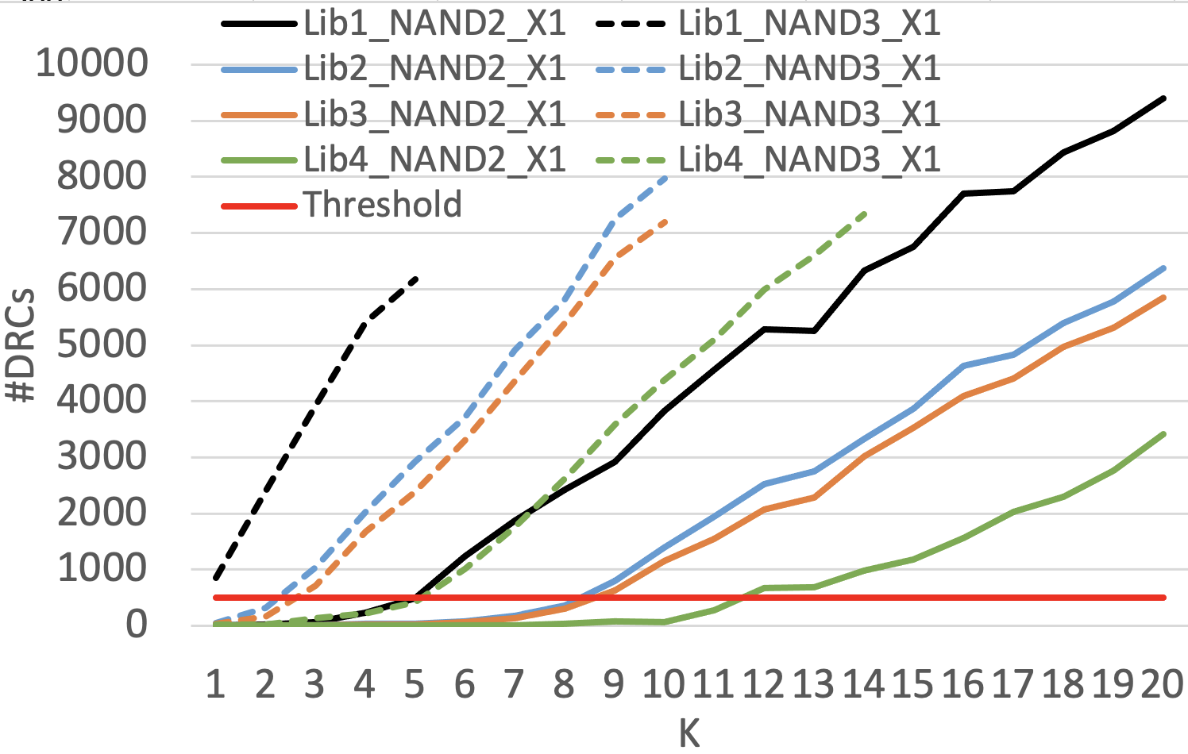
Cell-level Assessment
Cell-level assessment (15 cells per library)
Capability of cell routability assessment (pin accessibility per cell)
E.g., NAND2_X1 (2-input) > NAND3_X1 (3-input) in the same library
E.g., Lib4 (140nm CH) > Lib{2,3} (120nm) > Lib1 (100nm) with the same cell
**Reminder: Larger Kth → Better routability
Notes:
The following slides show how to evaluate routability using PROBE2.0.
[Click] With the generated libraries in the previous slides, we perform routability assessments. PROBE2.0 supports two types of routability assessment, cell- and block-level assessment.
In this cell-level assessment, we assess 15 cells in each library.
[Click] This graph shows the result of cell-level assessment. And, as a reminder, larger Kth means better routability.
[Click] If we focus on NAND cells, here’s a picture of how more tangling – increasing on the x-axis, leads to more routing DRCs, on the y-axis.
Here, [Click] the NAND3_X1 (dashed lines) has the worse inherent routability – it fails first, [Click] while the NAND2_X1 (solid lines) has the better inherent routability.
[Click] Also, if we focus on library, we can see that the cells with larger cell height (140nm) has better inherent routability.
[12:10]

Slide 14
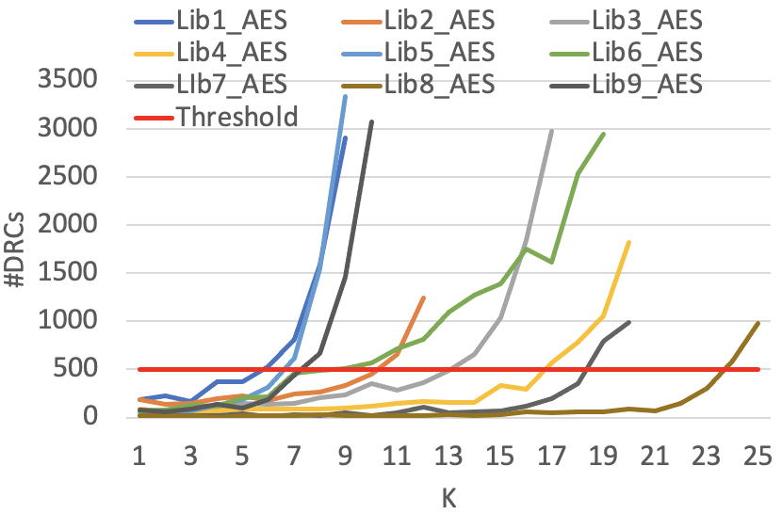
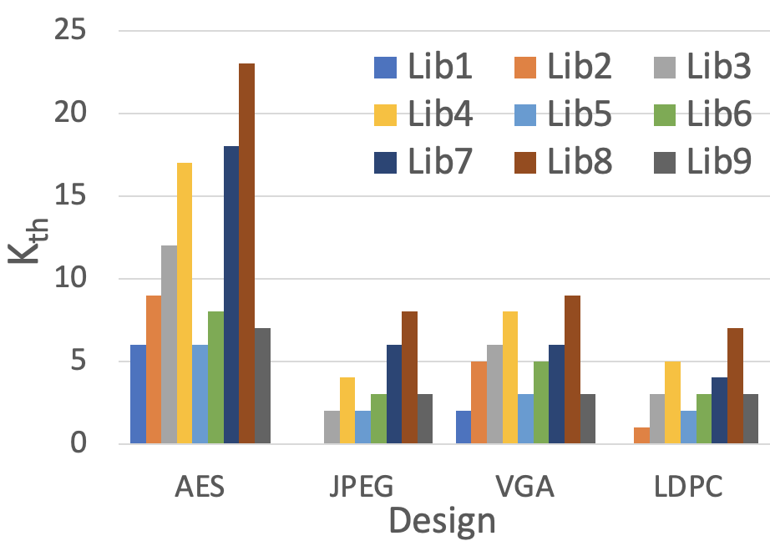
Block-Level Assessment
Block-level assessment
Capability of library (cell set) routability assessment
E.g., Lib8 > Lib7 > Lib4 > Lib3 > Lib2 > Lib6 > Lib9 > Lib{1,5}
PROBE2.0 gives new insight for pathfinding/DTCO !
Notes:
[Click] Also, we can assess library (cell set) with block-level routability assessment.
[Click] This graph shows Kth per library in four designs, AES, JPEG, VGA and LDPC. 39 standard cells are included in each library. Also, again, larger Kth means better routability.
[Click] Similarly, when we look in detail for the aes case, we measure DRC counts as we increase routing difficulty (K).
[Click] Based on K threshold, the rank-ordering would be following the order. Lib8 is the best cell set in terms of routability [Click] while Lib{1,5} are the worst.
[Click] From this slide, we show that PROBE2.0 is a useful framework for routability assessment in pathfinding and DTCO problems.
[13:20]

Slide 15
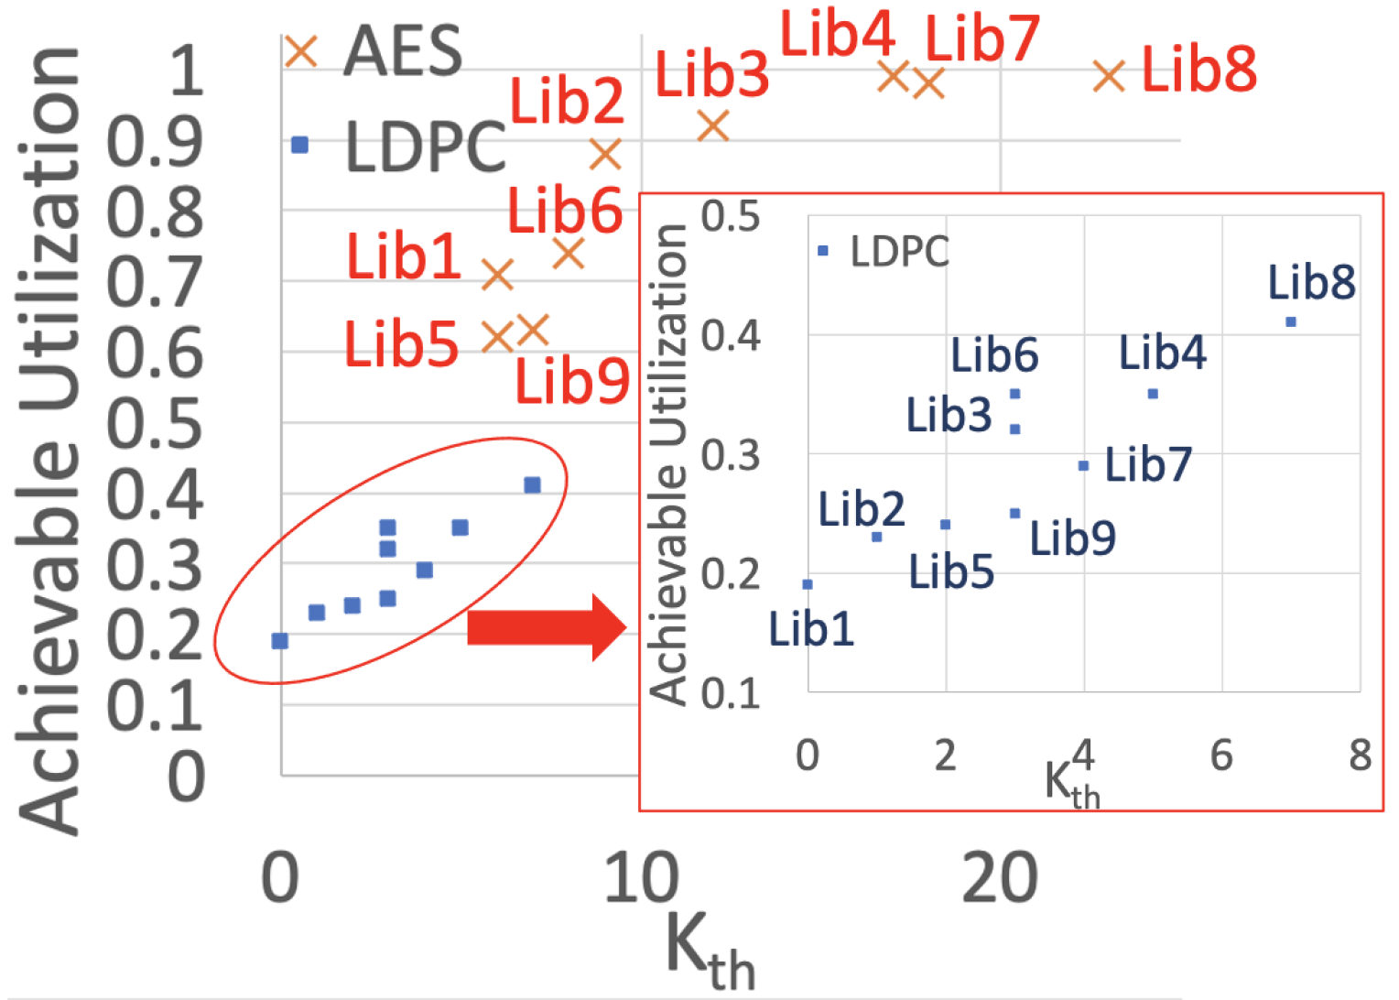
Achievable Utilization
Comparison between Kth and achievable utilization
Achievable utilization (A-Util): a common metric in real world
P&R with various utilizations
The largest utilization #DRCs is smaller than the DRC threshold
The plot shows the relationship between Kth and A-Util
A-Util increases by approximately the same rate as Kth changes (linear relationship)
Notes:
[Click] In order to measure block-level area scaling, we define achievable utilization and compare it with K threshold. Achievable utilization is a metric that is used in the real world.
[Click] We perform P&R with various utilization and measure Kth for each case. Achievable utilization is defined as the largest utilization when the number of DRCs is smaller than the threshold.
[Click] This scatter plot shows the relationship between Kth and achievable utilization.
[Click] As you see in the plot, achievable utilization increases by approximately the same rate as Kth changes.
[14:30]

Slide 16
Cell- vs. Block-Level Area
Case 1: Available M2 routing tracks (RT) (4RT for Lib1 vs. 5RT for Lib3)
Case 2: Use of buried power rails (BPR) (BPR for Lib1 vs. M1 for Lib2)
Case 3: Gear ratios for MP to CPP (1:2 for Lib1 vs. 2:3 for Lib5)
Case 4: Different RT with the same CH (5RT/120nm for Lib3 vs. 4RT/120nm for Lib9)
**Block-level scaling $≠$ cell-level scaling
Case | Lib A |  | Lib B |  | Cell-Level Area Overhead | Block-Level Area Overhead
 | Name | CH | Name | CH
Case 1 | Lib1 | 100nm | Lib3 | 120nm | 20% | -7%
Case 2 | Lib1 | 100nm | Lib2 | 120nm | 20% | 19%
Case 3 | Lib1 | 100nm | Lib5 | 130nm | 30% | 14%
Case 4 | Lib3 | 120nm | Lib9 | 120nm | 0% | 15%
Notes:
Based on cell height and achievable block-level area, we measure cell- and block-level area overhead in the following cases.
[Click] For case 1, we compare standard cells with different available M2 routing tracks.
[Click] For case 2, we compare standard cells with and without BPR.
[Click] For case 3, we use cells with different metal pitch to CPP ratios, and [Click] different routing track with the same cell height For case 4.
[Click] We report cell- and block-level area and [Click] in this case, we can see that block-level area decreases due to routability even though cell-level area is larger.
[15:30]

Slide 17
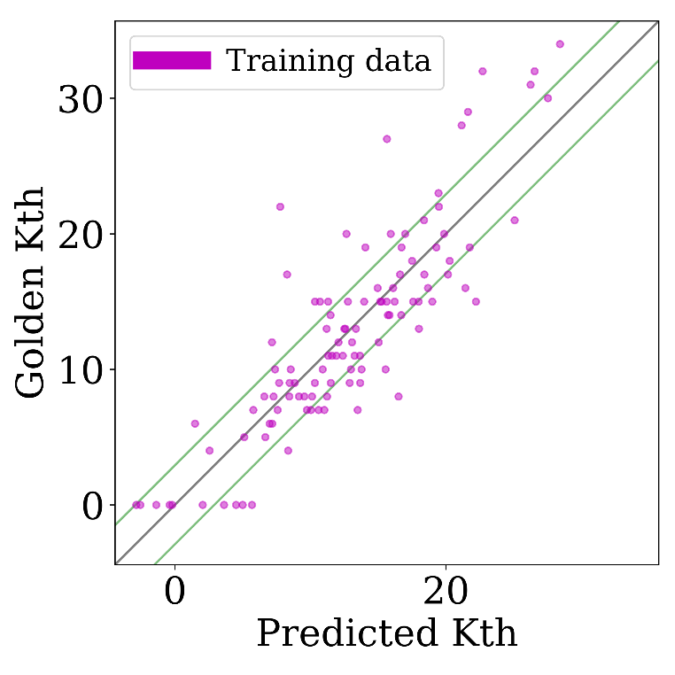
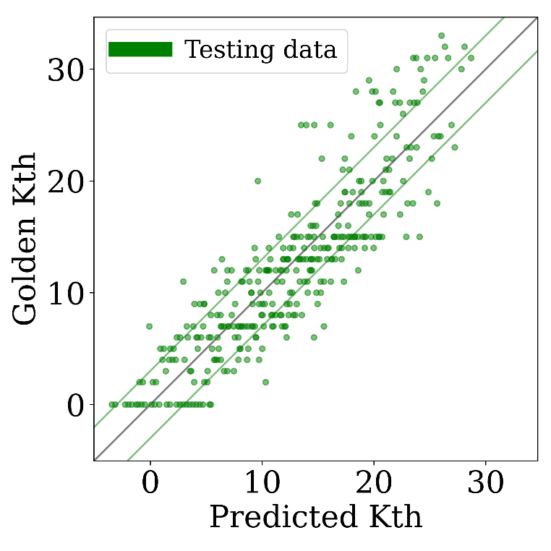
ML-Based Kth Prediction Result
Question: What data should we generate for training?
Latin hypercube sampling (LHS): Efficient training set selection
448 libraries generated
Param. | Options
CPP | 29, 42, 45, 48, 51, 54, 57nm
MP | 16, 18, 20, 22, 24, 26, 28, 30nm
RT | 4, 5
PGpin | BPR, M1
M3P:CPP | 1:2, 2:3
AE =2.91
AE =3.00
Prediction result with 128 training data and 320 testing data
Notes:
This slide shows our ML-based Kth prediction results.
[Click] Here, we have a question. What data should we actually generate for training?
[Click] In this work, we propose to use Latin Hypercube Sampling for efficient training set selection.
[Click] For our experiment, we generate 448 standard-cell libraries with the configurations in this table.
And [Click], we select training sets by using Latin Hypercube Sampling. These figures show our prediction results with reasonably small average errors.

Slide 18
Outline
Background
PROBE2.0 framework
Experimental Results with Sub-3nm Technology
Conclusion
Notes:
Now,, I will conclude my talk.

Slide 19
Conclusion
We report, for the first time, that block-level scaling can be reversed from cell-level scaling in cell height <150nm regime
PROBE2.0 framework is useful for pathfinding/DTCO problems
Machine learning (ML) assists our routability evaluation
>400 unique standard-cell architectures studied
80~150nm cell height; 39~57nm contacted poly pitch (CPP); 16~30nm metal pitch; Use/non-use of buried power rails (BPR)
Future work
We are adding power and performance aspects into the framework
Notes:
[Click] In this work, we report block-level area scaling can be reversed from cell-level area scaling based on our experiment.
[Click] We use the PROBE2.0 framework and show that it is a useful framework for an early-stage routability evaluation.
[Click] We also show that machine learning can help the assessment.
[Click] We study more than 400 unique standard-cell libraries with sub-3nm technology configurations.
[Click] As our future work, we will bring power and performance aspects into the framework.

Slide 20
Thank You !
Notes:
Thank you for listening my presentation.

Slide 21
BACKUP SLIDES

Slide 22
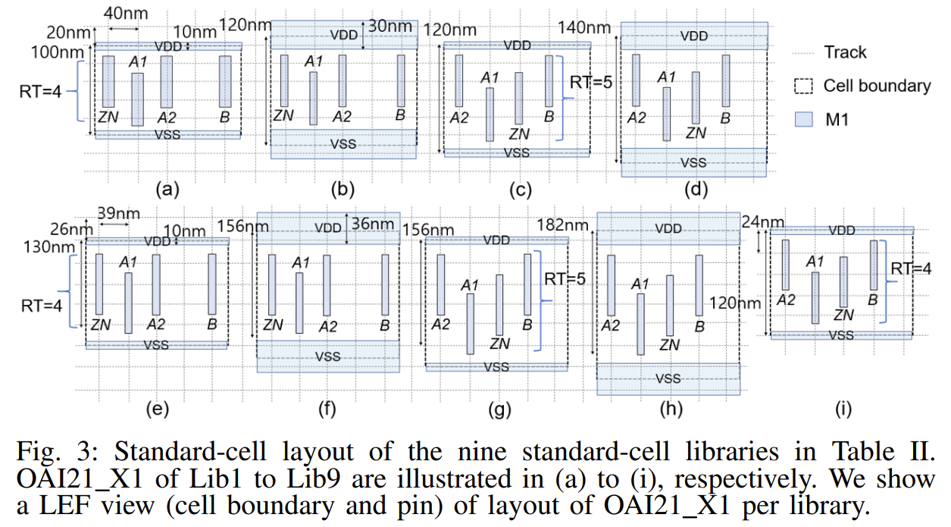
Standard-Cell Layout

Slide 23
Technology and Design Parameter

