Slide 1
Advancing Placement
ISPD-2021
March 22, 2021
Andrew B. Kahng
Depts. of CSE and ECE
UC San Diego
abk@ucsd.edu
https://vlsicad.ucsd.edu
Notes:
Hello, everyone. In this talk, I’ll try to give a guided tour of a pretty dense paper.

Slide 2
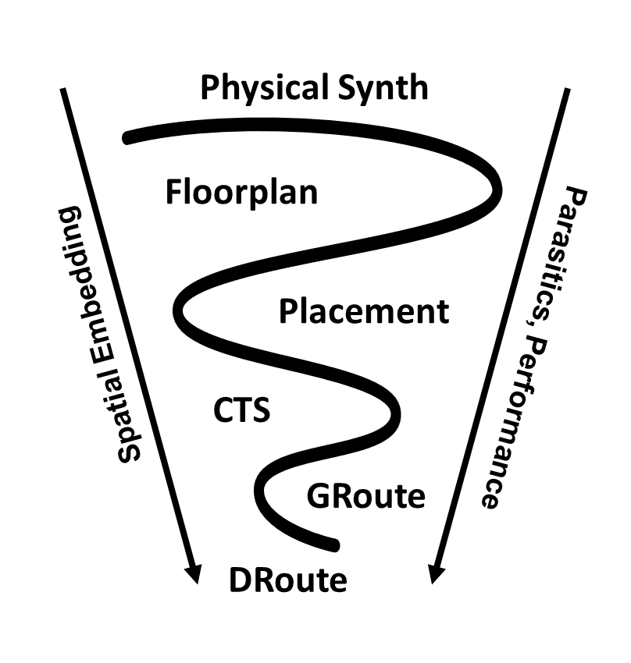
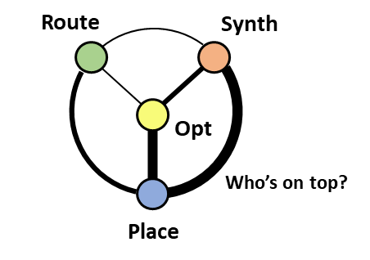
Placement
Central to physical design: determines spatial embedding
Conjointly optimized: with logic, performance, routability, clock and power distribution, manufacturability, …
Challenge 1: Improve understanding of “Who’s on top?”
Notes:
Placement is so central to physical design because it strongly determines spatial embedding. And placement is never in isolation: it is conjointly optimized with logic, clock and power delivery, and other products of other PD steps.
[CLICK] Here are two views of the placement context. In some ways, both pictures apply today. The first of 25 challenges proposed in the paper: Better understanding of who should be on top.

Slide 3
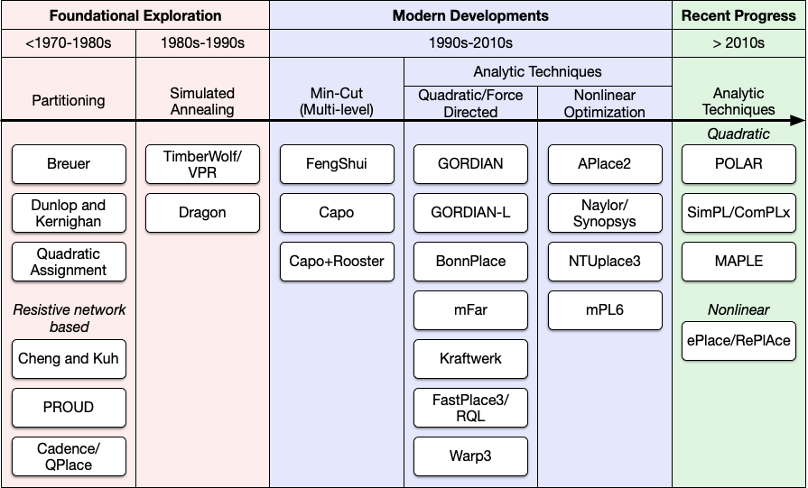
Markov, Hu, Kim Proceedings of the IEEE 2015
50+ years of placement advances
Notes:
One key piece of background, that I tried to NOT repeat, is this great survey by Igor, Jin and Myung-Chul. It gives the state of placement up through 2015.

Slide 4
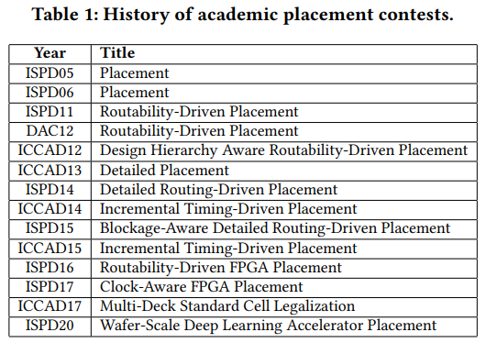
First ISPD Contest: Placement
Placement contests have shaped the PD research agenda
Notes:
There have also been 14 academic placement contests over 16 years – beginning of course with the first ISPD Contest.
These have had enormous influence on the PD research agenda.

Slide 5
Advancing Placement: What’s Left?
Placement Optimization
  Predictability and Stability
  Closing the Suboptimality Gap
Co-Optimization and Co-Operation
  The Art of Co-Optimization
  Co-Optimization Through Co-Operation
“New” Foci for Placement
  Physical Context
  Design Context
  Specializations
Learning and Placement
Support for Placement Research
  Flow-scale Context and Open Source
  Metrics Collection and ML Enablement
Conclusions: Looking back and looking forward
A LOT !!!
Notes:
So after 50-plus years and 14 contests, what can be said about Advancing Placement? What’s Left?
[CLICK] The answer is: A LOT.
The paper calls out challenges in [CLICK] fundamentals of placement optimization; [CLICK] the need to turn to research where placement is co-optimizing and co-operating; [CLICK] “new” foci for research, many of which are actually old, but newly urgent to address. And then [CLICK] the nexus of learning and placement optimization; support for placement research; and conclusions.

Slide 6
Advancing Placement
Placement Optimization
  Predictability and Stability
  Closing the Suboptimality Gap
Co-Optimization and Co-Operation
  The Art of Co-Optimization
  Co-Optimization Through Co-Operation
“New” Foci for Placement
  Physical Context
  Design Context
  Specializations
Learning and Placement
Support for Placement Research
  Flow-scale Context and Open Source
  Metrics Collection and ML Enablement
Conclusions: Looking back and looking forward
Notes:
So let’s start with placement optimization, Section 2 of the paper.

Slide 7
Placement is Optimization
“Quadratic assignment”
Incredible complexity: objectives, constraints, scale
Notes:
The first observation is that Placement IS optimization.
It’s high stakes, where one percent QOR matters a lot, and turnaround time matters a lot as well.
Generically, placement is “quadratic assignment”, but there is incredible complexity in objective functions, constraints and scale.
And as the Markov paper points out, this field has not just tried but also pioneered a wide range of optimization techniques.

Slide 8
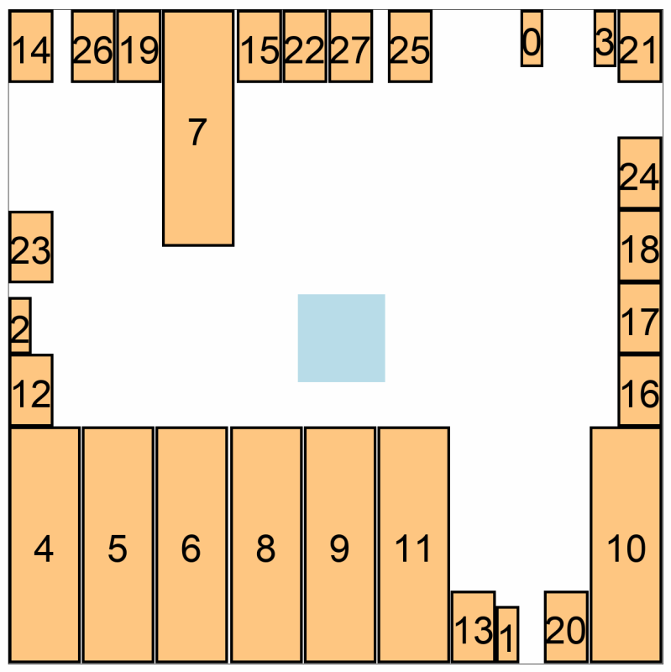
Predictable? Stable?
SLIP-2020 paper link
14.4% WL range
Blockage (6um movements)
Notes:
In any convergent, top-down flow, we want estimates and predictions to be accurate. This is because we want to use predictive models as objectives in higher-level optimizations. So just this GIF motivates challenges such as

Slide 9
Optimization: Predictability and Stability
Challenge 2: Develop more predictable placement optimization methods
Challenge 3: Orchestrate placement methods on modern (parallel, distributed, AI) compute substrates with predictability of outcomes (from ensembles of optimization runs) as the driving criterion
Challenge 4: Develop placement optimizers that have (provably) smooth behavior
Challenge 5: Develop incremental and re-entrant placement methods that maintain from-scratch solution quality
Challenge 6: Develop methods to solve the tethered placement problem
Notes:
… THESE. How do we make optimizers that are more predictable, whether as single runs or as ensembles of concurrent runs? [CLICK] Can we achieve smoothness of the input-to-output transform? [CLICK] And support the fact that the design is always changing?

Slide 10
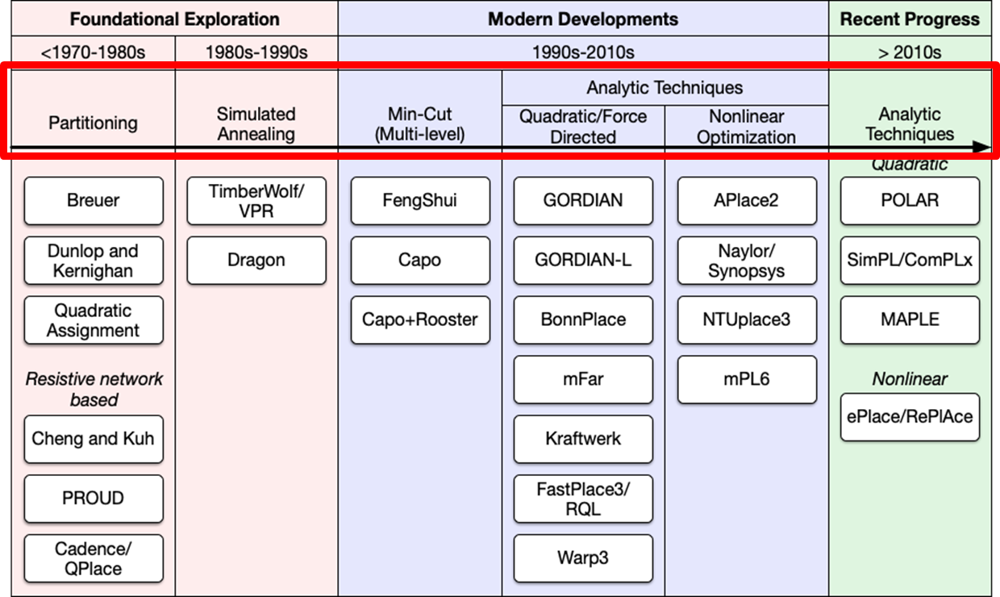
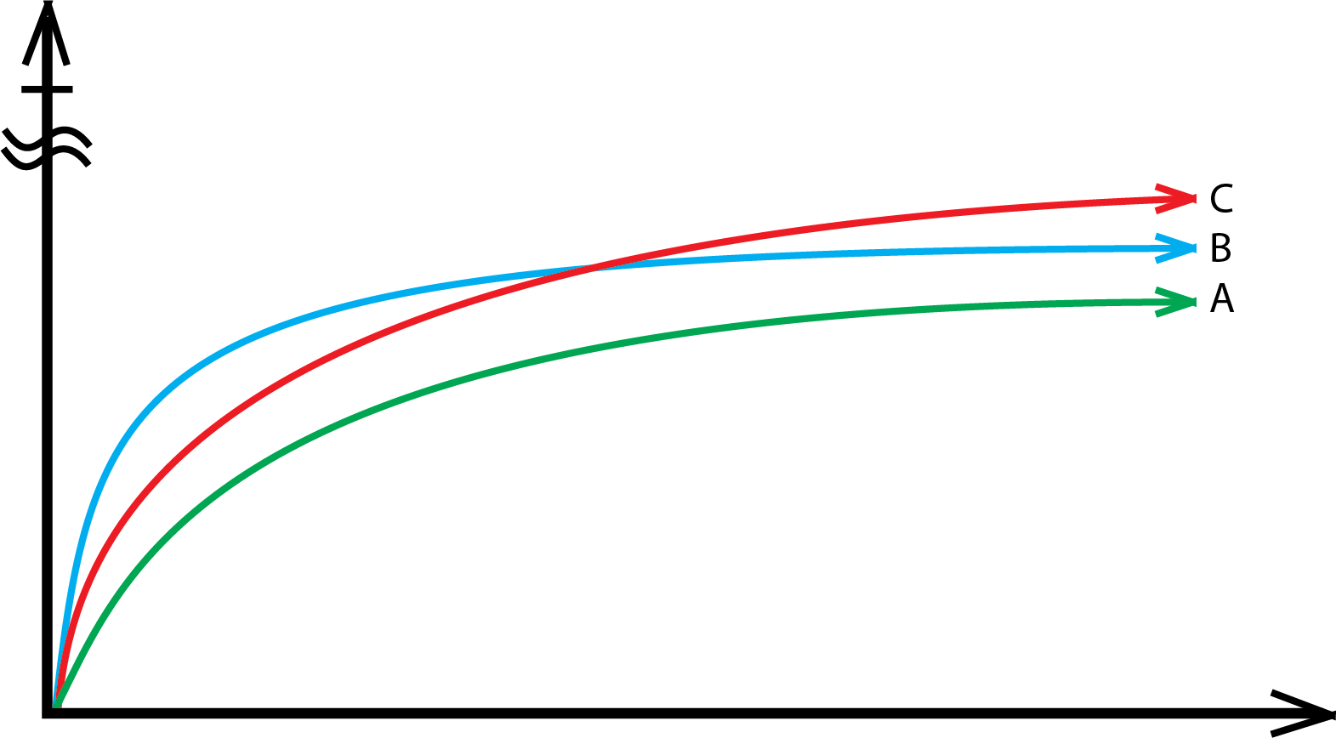
Optimization: Closing the Suboptimality Gap
Placement is optimization
  Better, faster, cheaper – pick any two
IC EDA: want all three at once
  “Unfortunately, the runtime of …”
But the world has changed
  Automation, cloud, …
Optimal
Question: If you give your P&R tool 3 extra days of runtime, would it know how to use this extra time?
Question: If you could run 10,000 copies of your P&R tool at the same time, what QOR improvement should you expect?
Time
Notes:
In the past quarter century, we have NOT materially advanced our understanding of the suboptimality gap. But this is optimization! For optimization, if the x-axis at lower-left is TIME and the y-axis is QUALITY, then the blue heuristic dominates red, which dominates green.
[CLICK] In optimization of course, out of “better, faster, cheaper” – we know that you get only two. Our field tends to demand all three at once –customers want tools to still run overnight, and reviewers don’t like it if QOR improvements come with longer runtimes.
[CLICK] So Heuristic C in red may never see the light of day. And by the way, we have no clue how far any of these is from optimality.
[CLICK] But the world has changed in the past quarter century. And we need better answers to questions such as these.

Slide 11
Optimization: Closing the Suboptimality Gap
Suboptimality … in what sense?
Need proper aiming points for research
“Core and clean”, updated problem statements
Benchmarking
“Real” benchmarks = obfuscated, incomplete, non-vertical, old…
  RISC-V, CHIPS Alliance, OpenHW Group, DARPA POSH, Google-SkyWater, ... = a good start, but these aren’t drivers
“Artificial” benchmarks = tiptoeing between realism, known optimal solution quality, scalability …
  30+ years of NCSU/MCNC, planted solutions (PEKO), perturbed real designs (ZCNT), matching to topological parameters (gnl, circ/gen, …) …
With modern compute resource
Notes:
To close the suboptimality gap, we probably should refresh our definitions of suboptimality: in what sense.
We need to grapple once more with benchmarking. Benchmarks must somehow drive the leading edge forward, and be accessible to everyone – not just a well-connected few.
And the leading edge runs on a modern compute resource.

Slide 12
Optimization: Closing the Suboptimality Gap
Challenge 7: Update core placement optimization formulations, and develop long-lived benchmarks and solution criteria
Challenge 8: Develop and widely adopt generators and suites of artificial testcases that are representative (to optimizers) of diverse design types and future instance complexities
Challenge 9: Develop and improve placement methods with solution quality that increases monotonically with the given “footprint” (threads × runtime) of computational resource
Challenge 10: Establish an “Underwriters Laboratories” for measurement, benchmarking of IC design automation and designs
Notes:
This brings more challenges, in Section 2.2 of the paper.

Slide 13
Advancing Placement
Placement Optimization
  Predictability and Stability
  Closing the Suboptimality Gap
Co-Optimization and Co-Operation
  The Art of Co-Optimization
  Co-Optimization Through Co-Operation
“New” Foci for Placement
  Physical Context
  Design Context
  Specializations
Learning and Placement
Support for Placement Research
  Flow-scale Context and Open Source
  Metrics Collection and ML Enablement
Conclusions: Looking back and looking forward
Notes:
Section 3 is about Co-Optimization and Co-Operation, because today …

Slide 14
Placement Optimization Has Context
Tightly integrated optimizations, common analysis engines
  Need on-demand constructive estimations, reduced miscorrelations
Art of Co-Optimization: “What should the placer know, and when should the placer know it?”
  WL → timing → density → congestion → non-overlap → pin accessibility
  Constraint or objective? overlap or setup violation = weight or penalty?
  Treat or mask or ignore (until later)? edge-type conflict, in-context pin access
Co-Optimization through Co-Operation
  Interleaving or alternation that leverages tight integration cf. “fusion”
  Find viable solutions to take forward: physical synthesis, floorplan
  Find fixed points in chicken-egg loops: PDN, clock skew
  Tight loops: with global routing or with detailed routing
Notes:
… Placement is tough to separate from its context. The placer sits inside a unified infrastructure with tightly-integrated optimization engines and common analysis engines. This is not because EDA engineers love software complexity: it’s because on-demand constructive estimations, reduced miscorrelation, and incremental optimization are all mandatory.
[CLICK] Here we see the Art of Placement Co-Optimization: What should the placer know, and when should the placer know it? For example, what we think of as “the placement step” might focus on wirelength at the start, and pin access at the end. Timing might be a constraint or an objective. Some things might be fixable just with post-processing – for now.
[CLICK] And many co-optimizations must be achieved through co-operation with other heavy-weight engines – like synthesis, floorplan, CTS or power routing. This co-operation has several basic flavors, as well.

Slide 15
Co-Optimization and Co-Operation
Challenge 11: Develop improved congestion formulations for use in analytic placement
Challenge 12: Improve foundational understanding of how objective function estimation accuracy, constraint relaxation and instance evolution determine solution quality
Challenge 13: Develop stronger, distributable “heavy optimizations” in detailed placement
Challenge 14: Develop methods to directly solve for the fixed point of simultaneous “chicken-egg” optimizations
Challenge 15: Develop improved conjoint optimization of placement and clock distribution.
Challenge 16: Develop foundational understanding of placement-centered co-optimizations
Notes:
So Section 3 also has its list of challenges.

Slide 16
Advancing Placement
Placement Optimization
  Predictability and Stability
  Closing the Suboptimality Gap
Co-Optimization and Co-Operation
  The Art of Co-Optimization
  Co-Optimization Through Co-Operation
“New” Foci for Placement
  Physical Context
  Design Context
  Specializations
Learning and Placement
Support for Placement Research
  Flow-scale Context and Open Source
  Metrics Collection and ML Enablement
Conclusions: Looking back and looking forward
Notes:
Section 4 of the paper is about “new” near-term foci – a number of which we’ve known about for a long time, but just haven’t solved well enough.

Slide 17
“New” Foci
Physical context
3D
“Island-heavy”
Design context
Extreme memory-dominance
System interconnect
Specializations
Datapath
+ analog, IO, die-package, reliability-driven, …
Notes:
These are broken out according to physical contexts for placement, or design contexts, or specialized placement tasks which are now more urgent to solve.

Slide 18
“Island-Heavy”: Multiple Row and Cell Heights
Consequence of density and performance scaling
Simplest Example: Two Types of Rows
    Tall row Height is not a multiple of Short row Height
    Pattern: A-B-A-B-A-B
  Two Types of Single-Height Cells
    CH131 and CH223
  Several Possible Types of Multi-Height Cells
    CH354 (131+223), CH485 (131+223+131), CH577 (223+131+223), …
CH131
CH485
RH131
CH223
CH354
CH577
RH223
RH131
RH223
RH: Row Height
CH: Cell Height
Notes:
There are many works on “islands” in placement that are induced by voltage domains, well structures, and non-integer multiple-height cell rows.
But in the coming years, say, at the foundry 3nm node, we have extreme consequences of density and performance scaling: 4-track cells for density but high-drive, output resistance-optimized cells for performance. And the place-and-route optimization must extract maximum value from this fabric.
[CLICK] The simplest scenario has two types of single-height cells with heights, say, 131 and 223 nanometers. You might lay down a site map that alternates these row heights. But then the library would have multi-height cells with heights of 354 or 577 nanometers.

Slide 19
Floorplanning, Density, Puzzle-Fitting, …
Global placement density control for both Short and Tall rows
Local density can be bad even if overall density looks good
Whitespace distribution must be able to absorb changes
How to control cell movement during detailed placement?
How to control congestion?
RH131
RH223
where?
RH131
RH223
RH131
Notes:
This brings new challenges for floorplanning, power delivery, density control, sizing optimizations: Placement has a phase transition to puzzle-fitting that I don’t think we’ve ever had to deal with before.
THIS picture shows that local density can be bad for one type of site. And how to deal with ECOs and legalization has become harder. There is risk that the current art of placement optimization will no longer converge – or, convergence will leave too much PPA on the table.

Slide 20
Can Get Much More Complicated …
A-A-B-A-A-B (shown), or A-B-C-A-B-C, or A-B-C-B-A, or …
Detailed placement complexity (DRC, pin accessibility, etc.)
CH354
CH223
CH223
CH485
CH223
CH131
CH485
CH131
CH131
CH262
RH131
CH354
CH131
CH131
CH485
CH131
RH131
CH223
CH354
CH223
CH485
CH223
RH223
CH131
CH485
CH131
CH131
CH262
RH131
CH131
CH354
CH131
CH485
CH131
RH131
CH354
CH223
CH223
CH485
CH223
RH223
CH131
CH485
CH131
CH131
CH262
RH131
CH354
CH131
CH131
CH485
CH131
RH131
CH223
CH354
CH223
CH223
RH223
CH131
CH131
CH131
Notes:
And this will actually get much more complicated, with row patterns like A-A-B-A-A-B which is shown here, or A-B-C-B-A etcetera.

Slide 21
“New” Foci
Physical Context
Challenge 17: Develop “true 3D” placement
Challenge 18: Develop techniques for “island-heavy” placement
Notes:
And this is Challenge Number 18.

Slide 22
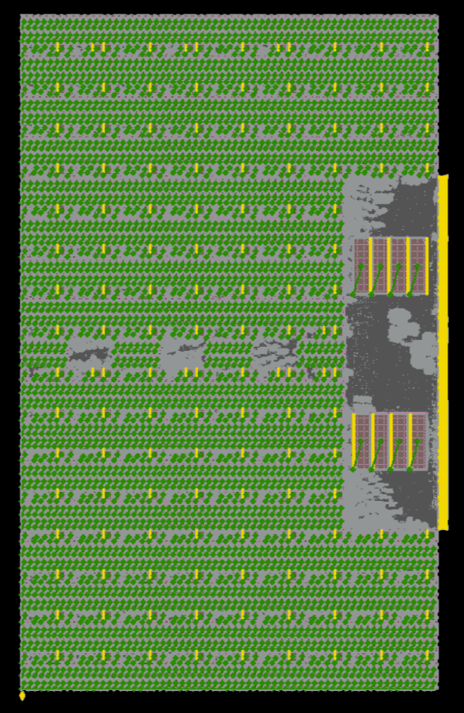
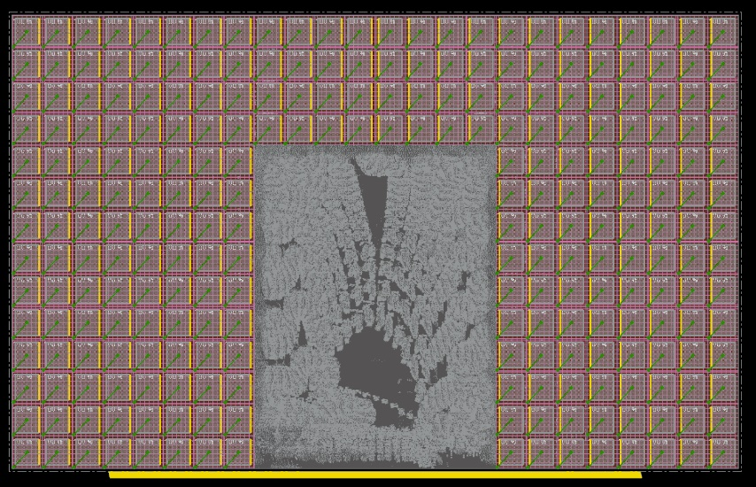
Extreme Memory-Dominance
AI and Machine Learning accelerators
  Can have very high fractions of die or block area occupied by SRAM and register file instances
  Can have thousands of SRAM macros
  Examples from DARPA Real Time Machine Learning project
tabla_wrapper (2488 macros)
systolic_array (256 macros)
Notes:
The designs are evolving as well, especially with neural processing and machine learning architectures. Placement sees much more of what the paper calls extreme memory-dominance, and more tiling.
These pictures are from an ongoing project that is part of the DARPA RTML program. The right-hand picture has nearly 2500 macro blocks. Automating this kind of human quality, let alone superhuman quality, is not easy.

Slide 23
“New” Foci
Physical Context
Challenge 17: Develop “true 3D” placement
Challenge 18: Develop techniques for “island-heavy” placement
Design Context
Challenge 19: Develop performance-driven macro packing and floorplan automation that matches or surpasses human solution quality
Challenge 20: Develop system interconnect-savvy SOC floorplan optimizations with expert-human solution quality
Notes:
And that was Challenge Number 19.

Slide 24
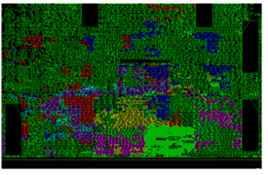
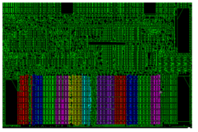
Regular Structures in Datapaths
Datapaths → highly regular structures embedded in the synthesized netlist
Extracting and placing in aligned rows and columns can improve PPA
  Latency and skew in clock distribution
  Wiring predictability for bussed nets
PPA gains are multiplied in tiled designs
Opportunity for automation to achieve custom QOR
Traditional Placement
Structured Placement
Images copyright Cadence Design Systems, Inc. From Cadence SDP documentation: http://free-online-ebooks.appspot.com/enc/14.17/soceUG/Using_Structured_Data_Paths.html
Notes:
One last example of a focus problem that is very old -- but about to be new again – is regular structure handling in datapath placement.
With highly tiled, high-performance AI and signal processing chips, datapath place-and-route becomes much more exposed.
And, any PPA gain or loss is seen in every copy of a tile. My student found the pictures below on the web – they’re from Cadence. They show what structured placement can achieve, given a human-directed result that is scripted in the SDP tool. There is a need for automation that can achieve this kind of custom QOR.

Slide 25
“New” Foci
Physical Context
Challenge 17: Develop “true 3D” placement
Challenge 18: Develop techniques for “island-heavy” placement
Design Context
Challenge 19: Develop performance-driven macro packing and floorplan automation that matches or surpasses human solution quality
Challenge 20: Develop system interconnect-savvy SOC floorplan optimizations with expert-human solution quality
Specializations
Challenge 21: Develop niche placement automations that remove human expertise bottlenecks
Challenge 22: Develop datapath placement automation that surpasses human-directed solution quality
Notes:
And that was Challenge Number 22.

Slide 26
Advancing Placement
Placement Optimization
  Predictability and Stability
  Closing the Suboptimality Gap
Co-Optimization and Co-Operation
  The Art of Co-Optimization
  Co-Optimization Through Co-Operation
“New” Foci for Placement
  Physical Context
  Design Context
  Specializations
Learning and Placement
Support for Placement Research
  Flow-scale Context and Open Source
  Metrics Collection and ML Enablement
Conclusions: Looking back and looking forward
Notes:
Section 5 is on Learning and Placement.

Slide 27
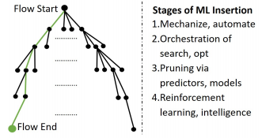
Why Machine Learning
See ahead
Avoid doomed runs
Use resources better
Capture expertise
Transfer/imitation
Algorithm alignment
ISPD-2018
What you can’t predict, you guardband
What you don’t explore, you leave on the table
Notes:
Why machine learning? For me, it’s an inevitable last hope and last lever to scale optimization such as in placement. [CLICK] If we can see ahead farther, we can avoid doomed runs and use people, compute and schedule resources better. We can capture human expertise, or learn complex heuristics in an end-to-end sense. [CLICK] More simply stated: if we can’t predict forward, we have to guardband. And if we don’t have time to explore a solution, we leave it on the table.
[CLICK] So this picture from ISPD three years ago is still pretty much where we are heading.

Slide 28
Learning and Placement
Tremendous progress since, e.g., ISPD-2018
  MLCAD Workshop, IEEE CEDA DAWN, Huang et al. “Machine Learning for Electronic Design Automation: A Survey” (ACM TODAES, 2021)
  Many great works
  Many remaining challenges
Learning objectives what to optimize?
Smart flow and flow control how to optimize within “box” of resources
Embedding and clustering distance measures, complexity reductions
Deep learning for placement Google Brain!
Domain expertise algorithm alignment, transfer/imitation... but… Bitter Lesson?
AI hardware DREAMPlace!
Open source …
Notes:
Here I’d like to point out Reference 49, which is an excellent ACM TODAES survey paper from Huang and coauthors at Tsinghua and CUHK.
This slide also gives a few targets at the intersection of ML and placement. Learning objective functions, steering tools, embedding and clustering – I have a lot of hope for these directions.
And there is going to be a long road to having robust results in production.

Slide 29
Learning and Placement
Challenge 23: Develop accurate predictors of closed-source tool outcomes using open-source tools
Challenge 24: Find quantum leaps in solution quality and speed at the nexus of ML and placement
Challenge 25: Launch organized, multi-entity metrics collection to support ML studies and contests.
Notes:
These are the last three challenges in the paper.

Slide 30
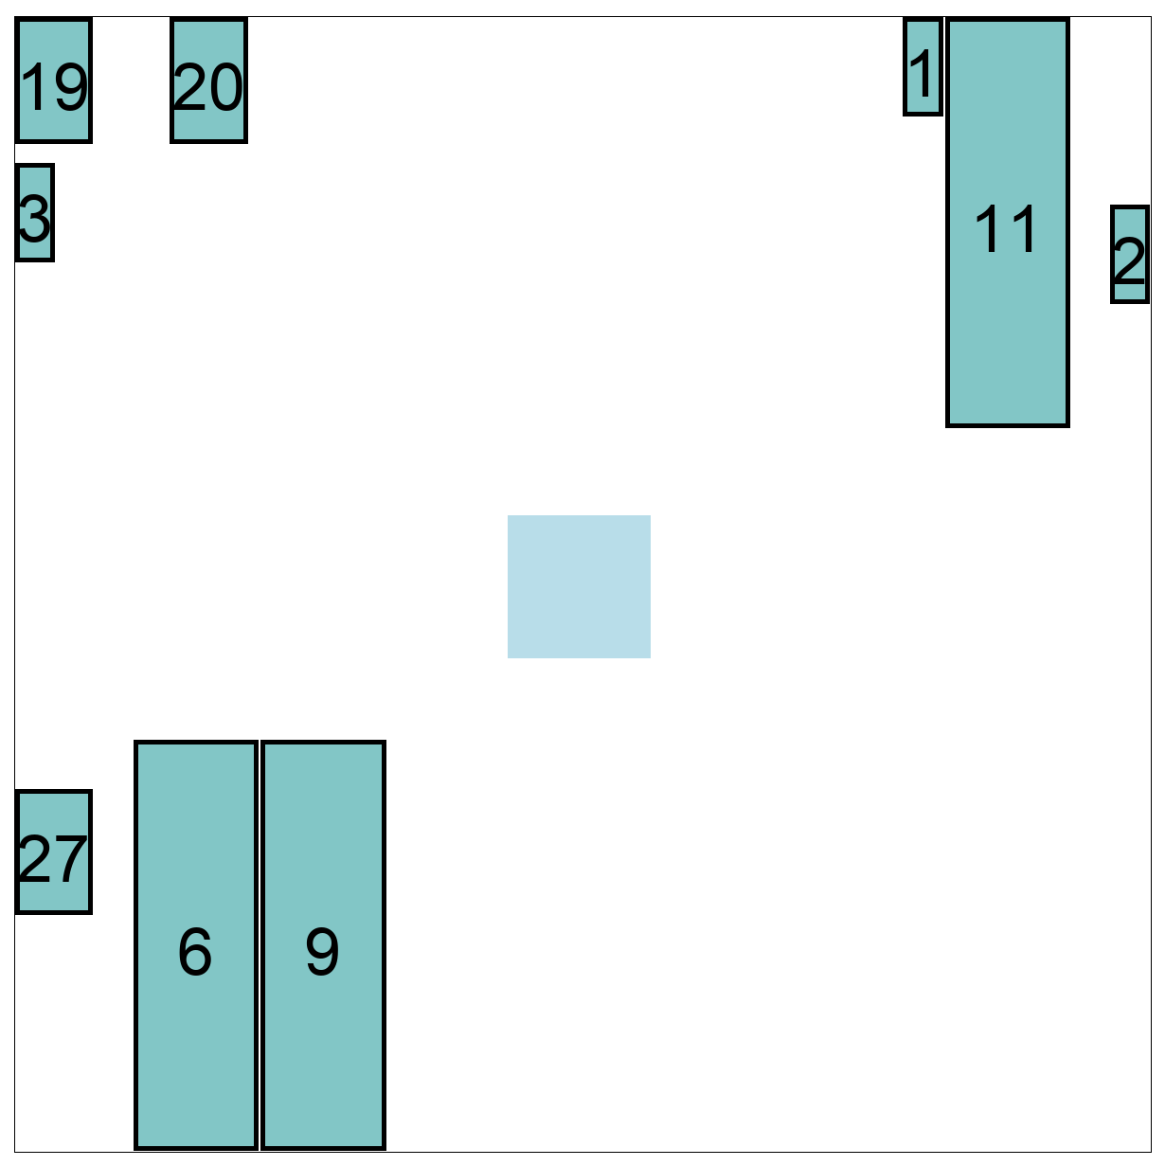
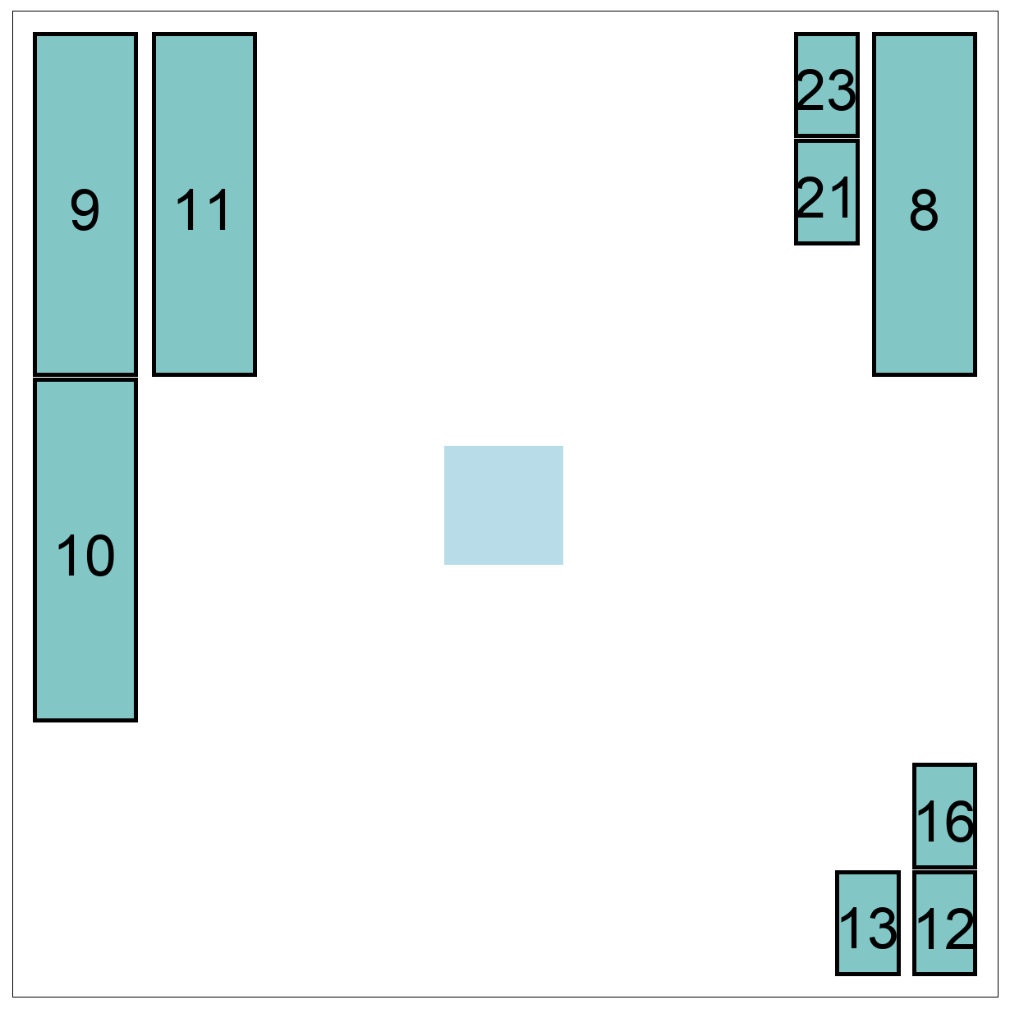
“Be Careful What You Ask For”
SLIP-2020 paper link
What if I know some of the macro placer’s solution in advance …
Original
Preplace
Preplace + macro place
P&R_1
  ~ 3.5% ΔWL, different structure
P&R_2
  ~ 0.5% ΔWL, different structure
Notes:
With ML and heuristic optimization flows, an extra challenge is to understand limits on applying our ML models.
For example, what if acting on a prediction changes the predicted outcome?
Here, suppose I know part of the macro placer’s solution ([CLICK] shown for two tools, on the left) in advance. So I feed exact locations for a third of the RAMs [CLICK] as BLUE pre-placements to the macro placer.
[CLICK] [CLICK] We see that this changes the structure of the solution, especially for Tool 1 above. It’s no longer what we had predicted!
So: BE CAREFUL WHAT YOU ASK FOR.

Slide 31
Advancing Placement
Placement Optimization
  Predictability and Stability
  Closing the Suboptimality Gap
Co-Optimization and Co-Operation
  The Art of Co-Optimization
  Co-Optimization Through Co-Operation
“New” Foci for Placement
  Physical Context
  Design Context
  Specializations
Learning and Placement
Support for Placement Research
  Flow-scale Context and Open Source
  Metrics Collection and ML Enablement
Conclusions: Looking back and looking forward
Notes:
Section 6 is about how academic placement research is steered and supported by the community. The paper calls out two promising vectors.

Slide 32
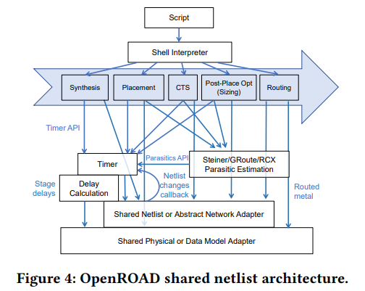
Support for Placement Research
Flow-scale context and open source
  IEEE CEDA DATC Robust Design Flow: https://github.com/ieee-ceda-datc
  RTL-to-GDS backplane for research includes open-source DB, STA
Notes:
The first vector is the IEEE CEDA DATC’s Robust Design Flow, which integrates contest-winning and other academic tools into a freely available RTL-to-GDS flow. In a world that focuses more and more on co-optimizations and co-operations, this is an important backplane for research.
This figure from the ICCAD-2020 RDF paper shows the incremental shared netlist architecture that is at the heart of a modern P&R tool. So we can envision contests or research in a context of full flow, PPA, industry collaboration, and tight incremental timing and optimization (and even routing) loops.

Slide 33
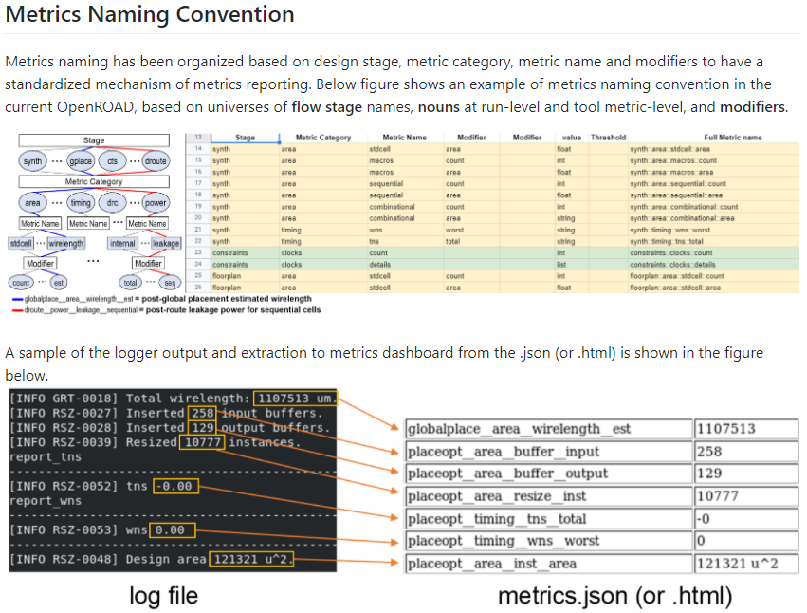
Support for Placement Research
Metrics collection and ML enablement
  Standard terms and semantics, underlying data model, implementation, …
  “Metrics4ML” repo: https://github.com/ieee-ceda-datc/datc-rdf-Metrics4ML
Notes:
A second vector is to support data collection for machine learning. We can’t share commercial tool scripts or logfiles or models with each other. So how can the leading edge of research become visible?
This is a repo, “Metrics4ML”, that is also in the DATC’s GitHub, and shows some initial steps. The DATC is pursuing both open data for analysis calibrations, and open data for machine learning in the RTL-to-GDS space.

Slide 34
Conclusion: Looking Back, Looking Forward
Looking Back
Exciting advances since Markov et al. (2015)
  RDF-2020 and industry-compatible “full flow”
  Focus at a nexus of learning and optimization
  Google Brain: deep RL for macro placement
  UT Austin and Nvidia: DREAMPlace and ABCDPlace
The sweep of history
  Influence of ISPD-2005 contest, key ideas and papers clearer today [115]
Looking Forward
Return to optimization roots
  Learning-enabled, adaptive, self-tuning
  Distributed, federated in the cloud
Culture changes
  Open source + benchmarking, re-commit to closing the suboptimality gap
Notes:
The last section of the paper takes a look back, and a look forward.
[CLICK] Looking back: since Igor’s 2015 review, there have been exciting advances such as DREAMPlace or the Google Brain work. And the historical significance of several works as well as the first ISPD contest has become clearer over time. The bit.ly link in reference [115] will try to maintain an updated reading list for placement.
[CLICK] Looking forward: I hope we can look forward to returning to optimization roots, boosted by new kinds of compute resources and by advances in machine learning. With some culture changes as well.

Slide 35
Advancing Placement: What’s Left?
Placement Optimization
  Predictability and Stability
  Closing the Suboptimality Gap
Co-Optimization and Co-Operation
  The Art of Co-Optimization
  Co-Optimization Through Co-Operation
“New” Foci for Placement
  Physical Context
  Design Context
  Specializations
Learning and Placement
Support for Placement Research
  Flow-scale Context and Open Source
  Metrics Collection and ML Enablement
Conclusions: Looking back and looking forward
A LOT !!!
Notes:
Advancing placement: what’s left? [CLICK] A lot!

Slide 36
THANK YOU !
Many thanks are due to colleagues who generously provided thoughts on futures for placement which have been incorporated here: David Chinnery, Dennis Huang, Ilgweon Kang, Stefanus Mantik, Igor Markov, Siddhartha Nath, David Pan, Ravi Varadarajan and Joe Shinnerl. Thanks are also due to the ISPD-2021 organizers for inviting this paper and talk.
Support: ABKGroup research is supported by NSF CCF-1564302, DARPA HR0011-18-2-0032 and HR0011-19-S-0037, Samsung, Qualcomm, NXP Semiconductors, Mentor Graphics, and the C-DEN Center.
Links: (i) OpenROAD Project: readthedocs, website, GitHub ; (ii) set of basic links on ML in EDA / IC design from my group; (iii) talks are generally posted as .PPTX source with speaker notes at https://vlsicad.ucsd.edu/
Notes:
Thank you for your attention – and I look forward to your questions at the Monday session. And many thanks are due to many people, as shown here. Some links are in the bottom part of the slide, and talk slides can always be found on my lab’s website. Thank you again !

