Slide 1
Optimal Bounded-Skew Steiner Trees to Minimize Maximum k-Active Dynamic Power
Hamed Fatemi¹, Andrew B. Kahng², Minsoo Kim²
and Jose Pineda de Gyvez¹
¹NXP Semiconductors
²University of California San Diego
Notes:
Thank you for the introduction. My name is Minsoo Kim from UC San Diego.
My talk title is “Optimal Bounded-Skew Steiner Trees to Minimize Maximum k-Active Dynamic Power”.
This is joint work with NXP Semiconductors.

Slide 2
Outline
Introduction
Review of Previous Work
Our Formulation
Experimental Results
Conclusion
Notes:
This is the outline of my talk.

Slide 3
Outline
Introduction
Review of Previous Work
Our Formulation
Experimental Results
Conclusion
Notes:
Let me begin with introduction.

Slide 4
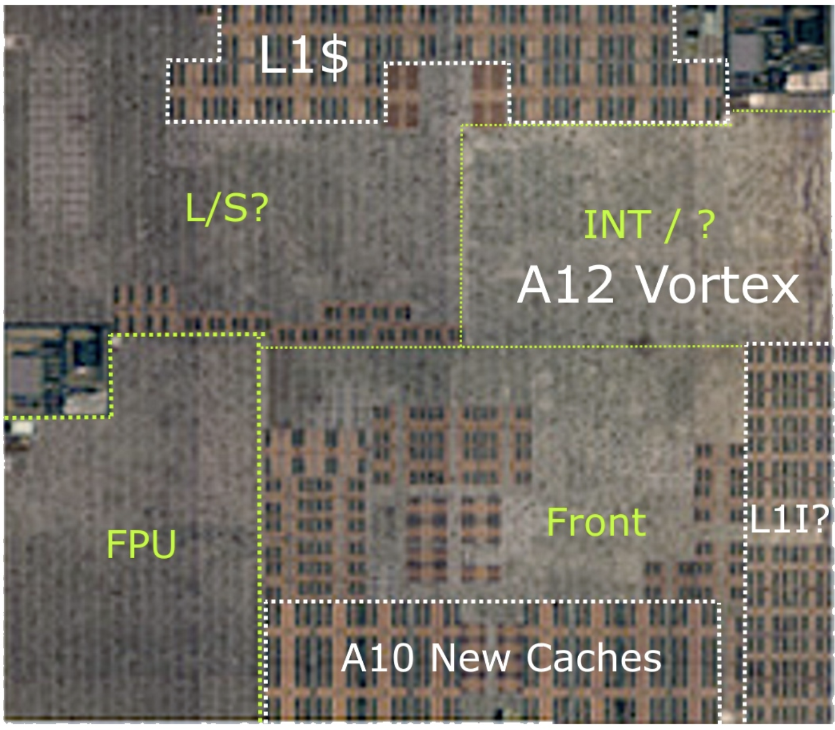
Low Power in Memory-Dominant Designs
Memory-dominant modern SOC designs
Microcontroller units (MCUs), AI/ML architectures
Many “masters” dynamically access memory components
SRAMs area occupies ~60% of chip area at advanced nodes
Memory components
Low power for clock distributions
All SRAMs are not always active
→ Low power for active memory components according to power usage scenarios
Need to minimize power for “active clock subtree”
Notes:
[Click] Modern SOC designs have many memory components. In the chips like MCUs and ML/AI chips, many masters dynamically access memory components.
[Click] Also, the area of SRAMs occupies around 60% of chip area at advanced nodes.
Here, we show the die shot of modern SOC from one of the leading companies and it shows heavy memory hierarchies.
[Click] Our work focuses on low power for clock distribution.
In today’s memory-dominant designs, all SRAMs are not always active.
[Click] We focus on power for active memories according to power usage scenarios and [click] minimizing power of the active clock subtree.

Slide 5
k-Active Dynamic Power
k-active dynamic power minimization
Power is linear in distance for long buffered interconnects
Clock power when k clusters are active
Wirelength (WL) of clock trees $∝$ clock power in SOC scale
→ Minimize maximum wirelength of k-active clock subtrees
k-consecutive-active dynamic power minimization
We address potentially more realistic scenarios
Only consecutive (neighboring) clusters can be active simultaneously
Notes:
[Click] We introduce the problem of k-active dynamic power minimization.
For example, as shown in the figure below, when we have green active memory clusters, ONLY the red clock subtree is active.
Also, at the scale of an SOC chip, both delay and power are linear in distance for long buffered interconnects.
We focus on clock power when k clusters are active. And, at the scale of SOC floorplans, clock power is proportional to wirelength of clock trees.
For clock tree construction, SOCs are evolving so that simple models become accurate again.
[Click] We solve the problem of minimizing the “maximum” power of clock subtrees over k active sinks.
[Click] We also address this k-consecutive-active power when only neighboring clusters can be active simultaneously.

Slide 6
Outline
Introduction
Review of Previous Work
Our Formulation
Experimental Results
Conclusion
Notes:
Next, I review some previous work.

Slide 7
Optimal Bounded-Skew Routing Tree (BST)
Ref. [1] (SLIP-2018): Optimal flow-based ILP
Given pointset $P$, minimize tree cost (wirelength)
Subject to skew bound $B$
Max source-sink pathlength – Min source-sink pathlength < $B$
Source point
Sink points
Steiner points
Bounded-Skew Steiner Tree
[1] K. Han, A. B. Kahng, C. Moyes and A. Zelikovsky, “A Study of Optimal Cost-Skew Tradeoff and Remaining Suboptimality in Interconnect Tree Constructions”, Proc. ACM/IEEE International Workshop on System-Level Interconnect Prediction, 2018, pp. 2:1-2:8
Notes:
[Click] This work published in SLIP-2018 addressed the optimal bounded-skew tree problem. We build on this work to address the new k-active dynamic power problem.
[Click] Given a pointset P, the objective is to minimize total wirelength [click] with skew bound constraints.
[Click] This example shows a bounded-skew Steiner tree. Given the red source and blue sink points, we introduce green Steiner points to get an optimal bounded-skew tree.

Slide 8
Tree Optimization in a Graph
Solve Steiner tree construction in a graph $G=(V, E)$
Given pointset $P$, build Hanan grid ($P⊂V$)
+ additional half grids (Green lines)
Source $p_{1}=v_{1}$, sinks $\left\{p_{2}…p_{\left|P\right|}\right\}=\left\{v_{2}…v_{\left|P\right|}\right\}$
Additional non-terminal vertices $\left\{v_{\left|P\right|+1}…v_{\left|V\right|}\right\}$
$e_{uw}$: a directed edge from vertex $v_{u}$to vertex $v_{w}$
$c_{uw}$: cost (length) of $e_{uw}$
Each vertex has four incoming and four outgoing edges
$$p_{1}$$
$$p_{4}$$
$$p_{3}$$
$$v_{u}$$
$$v_{w}$$
$$p_{2}$$
$$e_{uw}$$
Notes:
[Click] Given a set of points, we generate routing graph G, which is a collection of vertices and edges.
[Click] Given P, we create Hanan grids along with P
[Click] As shown in the figure, we have given P, [click] and build Hanan grids, and put additional half grids.
In this grid, every crossing point is a vertex.
[Click] So, point set P is a subset of V.
We assume p_1 is source and corresponds to vertex v_1. Also, p_2 to p_P are the sinks and correspond to v_2 to v_p.
Then, the remaining vertices are non-terminal vertices.
[Click] e_uw means a directed edge from vertex v_u to v_w and c_uw is the cost of the edge.
[Click] Each vertex has four incoming and outgoing edges.

Slide 9
Review of ILP Formulation [1]
Slide from [1]
Objective
$$\min{\sum_{e_{uw}∈E}{λ_{uw}⋅c_{uw}}}$$
c: cost e: edge f: flow
⇒ Minimize cost (wirelength)
For each path from source ($v_{1}$) to sink ($p_{i}=v_{i}$) terminal
$$λ_{uw}≥f_{uw}^{i}$$
⇒ Edge $e_{uw}$ is taken when there is a flow
$$\sum_{u}{f^{i}uw}−\sum_{u}{f^{i}wu}=\left\{\begin{aligned} \#\#1 if v_{w}=source \left(v_{1}\right) \\ −1 if v_{w}=sink \left(v_{i}\right) \\ 0 otherwise \end{aligned}\right.$$
⇒ Flow conservation (= connection)
+ more constraints to support skew bound, etc. (See paper/backup slides)
Notes:
This slide is from the previous SLIP-2018 work.
The objective is to minimize total cost, which is total wirelength.
Lambda_uw is a binary indicator of whether e_uw is finally selected or not in the solution.
[CLICK] Then, we apply the below constraints for each source-to-sink path INDIVIDUALLY in the solution.
This constraint is to make sure Lambda_uw is one when there is a flow on edge e_uw in the path to SOME terminal.
[CLICK] These constraints are for flow conservation in each path from source to sink i.
(//For each vertex, if v_u is a source there is one outgoing flow. If it is sink, one incoming flow. Otherwise, it is zero. )
[CLICK] There are more constraints to enforce the skew bound, etc. Those additional constraints are explained in our paper and backup slides.

Slide 10
Outline
Introduction
Review of Previous Work
Our Formulation
Experimental Results
Conclusion
Notes:
Now I will explain our EXTENDED ILP formulation for k-active dynamic power minimization.

Slide 11
Objective Function
k-active dynamic power minimization
Objective: weighted sum of total WL, $PMax(1)$ and $PMax(2)$
$PMax(1)$: pathlength of the longest source-sink ($p_{i}$) path ($p_{1}$- $p_{i}$)
$PMax(2)$: length of the longest source-2_sinks ($p_{i}$, $p_{j}$) subtree ($p_{1}$- $p_{i}$- $p_{j}$)
Objective
$$\min{\sum_{e_{uw}∈E}{λ_{uw}⋅c_{uw}+α∙PMax(1)+β∙PMax(2)}}$$
Notes:
[Click] For k-active dynamic power minimization problem, we add two terms into the objective function.
[Click] We define two terms, Pmax(1) and Pmax(2), and the objective is a weighted sum of total wirelength, Pmax(1) and PMax(2).
[Click] PMax(1) denotes the longest source-to-sink pathlength.
[Click] Pmax(2) denotes the largest source-to-TWO-sinks subtree cost.

Slide 12
Constraints
Constraints for k-active dynamic power minimization
For k-consecutive-active dynamic power minimization
→ Use i+1 instead of j
$$S_{i}≤PMax\left(1\right), ∀p_{i}∈P$$
⇒ Maximum pathlength ($p_{1}$-$p_{i}$)
$$S_{i,j}≤PMax\left(2\right), ∀p_{i},p_{j}∈P$$
⇒ Maximum length of subtree ($p_{1}$-$p_{i}$-$p_{j}$)
$$\sum_{u,w}{c_{uw}∙f_{uw}^{i}}≤S_{i}, ∀p_{i}∈P$$
⇒ Pathlength constraint
$${S_{i}+S_{j}−C}_{i,j}≤S_{i,j}, ∀p_{i},p_{j}∈P$$
⇒ Subtree length constraint
$$2∙f_{uw}^{i,j}≤f_{uw}^{i}+f_{uw}^{j}$$
⇒ Flow constraint for common path
$$\sum_{u,w}{c_{uw}∙f_{uw}^{i,j}}=C_{i,j},∀p_{i},p_{j}∈P$$
⇒ Common pathlength
Notes:
[Click] These are new constraints for k-active dynamic power minimization.
[Click] Here, these two constraints are for maximum pathlength Pmax(1) and maximum subtree length Pmax(2).
[Click] Also, these constraints are for pathlength S_i for each path, and subtree length S_i,j with common path C_i,j.
[Click] And, the last two constraints are for common path for p_1 to p_i and p_j.
[Click] For k-consecutive-active dynamic power minimization problem, we have same constraints but use i+1 instead of j since we only consider the cases with consecutive active sinks.

Slide 13
Non-Uniform Grid
Channel intersection graph
Channels between macros, clock pin locations
More accurate location than integer (uniform) grids in [1]
Removal of unusable edges in the grid
Improve ILP runtimes
Uniform grids
Non-uniform grids
Non-uniform grids + Removal of unusable edges
Notes:
[Click] This slide shows how we build grids in this work.
We use channel intersections graphs. Channels are between macros and on clock pin locations.
[Click] Compared to uniform grids, we have more accurate locations as shown in the figures.
[Click] Also, we remove unusable edges in the grids [click] so we can improve ILP runtime.

Slide 14
Flexible Clock Source Location
Clock source location can be flexible
Find clock source location while minimizing objective
Set a virtual clock source ($v_{0}$) and virtual edges ($e_{0u}$) to every vertex
The non-terminal vertex which connected to virtual clock source becomes new clock source
virtual clock source ($v_{0}$)
virtual clock source ($v_{0}$)
virtual edges
(cost=0)
sinks
new clock source
$$\sum_{0,u}{λ_{0u}}=1, ∀e_{0u}∈E$$
⇒ only one of virtual edge can be used
$$λ_{0u}=0, ∀v_{u}=v_{i}, p_{i}∈P, i≠1$$
⇒ block virtual edge to sinks
Notes:
[Click] Also, we consider flexible clock source locations to optimize objective further.
[Click] To implement this into ILP, we define a virtual clock source v_0 and virtual edges to every vertex with zero cost.
[Click] So, the non-terminal vertex which connected to virtual clock source becomes new clock source.
[Click] The first constraint is to select one of the virtual edges in the tree.
[Click] The second constraint is to block virtual edges to sinks.

Slide 15
Forbidden Clock Source Location
Clock source can't be located within specific area
Set forbidden area for flexible clock source
$$λ_{0u}=0, ∀v_{u}∈V_{r}$$
⇒ block virtual edge to forbidden area
Fixed Clock Source
Flexible Clock Source
Forbidden Area
Metric | Fixed | Flexible | Forbidden
WL | 25.6 | 24.4 | 25.4
Skew | 5 | 2 | 4.1
PMax(1) | 8.6 | 5.6 | 7.6
PMax(2) | 12.2 | 11.2 | 11.4
Cost | 40.3 | 35.6 | 38.7
Param. | Value
𝛼 | 1
𝛽 | 0.5
𝐿 | 3.44
𝐵 | 0.6·𝑀
Notes:
[Click] We also set forbidden clock source locations to address constraints in real designs.
[Click] The constraint is to block virtual edges within the given forbidden area.
[Click] In this example, when we have a flexible clock source, [click] we find the tree with less cost. [click] Also, adding forbidden area is making the solution have larger cost, but still less than the fixed case.

Slide 16
Outline
Introduction
Review of Previous Work
Our Formulation
Experimental Results
Conclusion
Notes:
We show our experimental results.

Slide 17
Example Trees with Weighting Factors
Example tree solutions according to weighting factors ($α$, $β$)
(a) $α=β=0$; (b) $α=100, β=0$; (c) $α=0, β=100$
Metric | (a) | (b) | (c)
WL | 26.6 | 28.7 | 28.7
Skew | 3.2 | 2.4 | 2.6
PMax(1) | 9.4 | 8.6 | 8.8
PMax(2) | 14.6 | 14 | 13.6
Notes:
[Click] In this example, we can see the tree solution varies according to the weighting factors.
[Click] We minimize total wirelength when alpha and beta are zero.
[Click] When we increase alpha, we have the least Pmax(1).
[Click] Similarly, when we increase beta, we have the least Pmax(2).

Slide 18
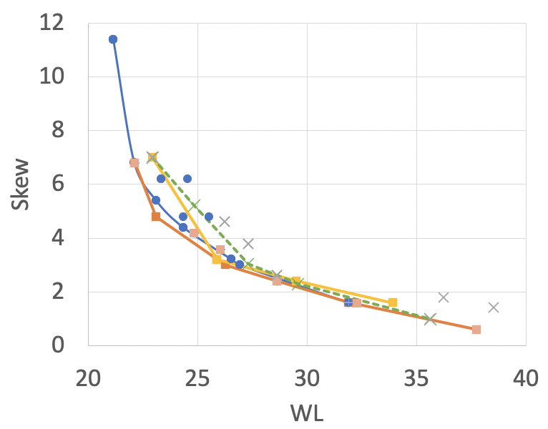
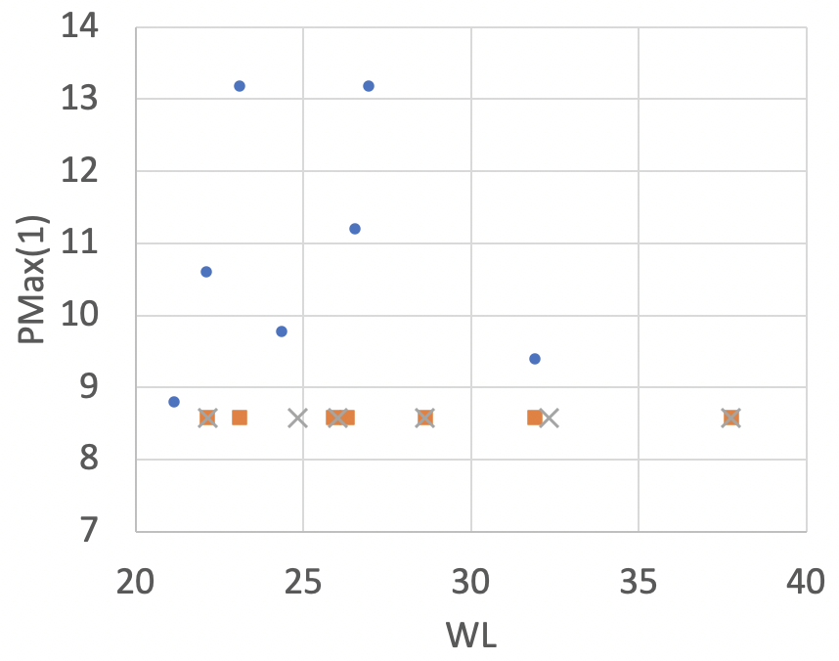
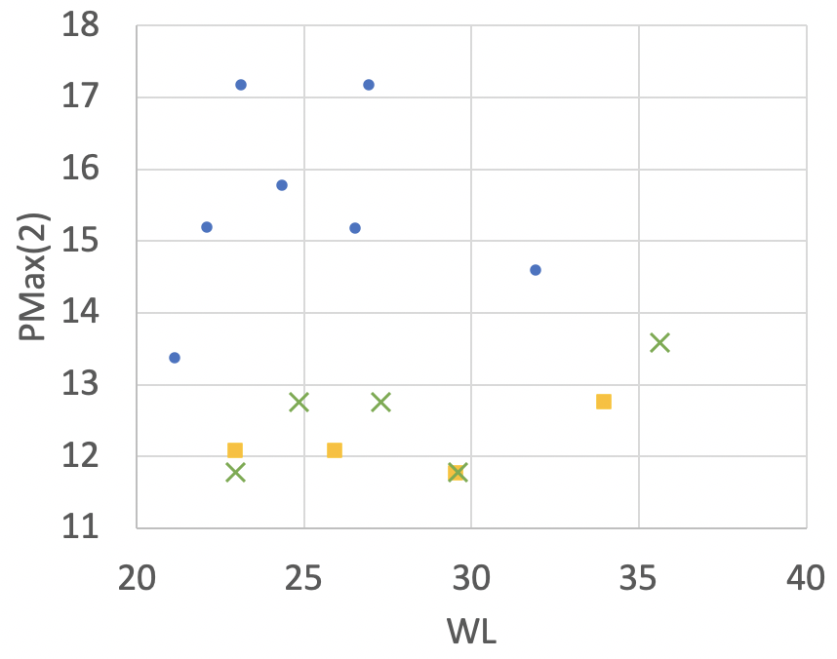
Weighting Factors
Plots for Skew-WL, PMax(1)-WL, PMax(2)-WL
Skew-wirelength tradeoff
PMax(1)-WL: less PMax(1) when alpha is nonzero
PMax(2)-WL: less PMax(2) when beta is nonzero
Notes:
[Click] The plots show Skew Versus wirelength, Pmax(1) Versus wirelength and Pmax(2) Versus wirelength, respectively.
[Click] In the same example, the skew-wirelength tradeoff is similar for all the cases.
[Click] Also, we have less Pmax(1) with nonzero alpha, [click] and less Pmax(2) with nonzero beta.

Slide 19
k-Active vs. k-Consecutive-Active Dynamic Power
Plots for Skew-WL, PMax(1)-WL, PMax(2)-WL
Similar Skew/PMax(1) results
Better PMax(2) results
Notes:
[Click] We also compare k-active and k-consecutive-active dynamic power minimization.
[Click] We can see that we have similar results for skew and Pmax(1) and [click] better Pmax(2) results since we only consider k consecutive sinks.

Slide 20
Flexible or Forbidden Clock Source
Results of “flexible” clock source
Tree solutions with flexible clock source locations have better metrics (WL, PMax(1), PMax(2))
Adding a forbidden area (reducing flexibility) worsens metrics
Notes:
These plots are Figure 9 in the paper, comparing fixed source versus flexible with forbidden area. We see that the cases with flexible clock source have lower-cost optimal tree solutions.
[Click] Also, adding a forbidden area worsens the metrics.

Slide 21
Outline
Introduction
Review of Previous Work
Our Formulation
Experimental Results
Conclusion

Slide 22
Conclusion
We build on [1] to address a new problem: k-active dynamic power minimization
Our ILP formulation minimizes a weighted sum of total WL and the maximum WL of subtrees that reach k-active sinks
We also address k-consecutive-active dynamic power
We propose non-uniform grids and flexible clock source locations with forbidden area for practical improvements
Future works
Implementation flows to implement our tree solutions into real designs
Heuristics to address larger-scale instances
Runtime improvements of the ILP solution step
Notes:
[Click] In this work, we build on the previous work from SLIP-2018 to address new problem, k-active dynamic power minimization.
[Click] We introduce our ILP formulation to minimize a weighted sum of total WL and the maximum WL of subtrees that reach k-active sinks.
[Click] We also addresses k-consecutive-active dynamic power and [click] we propose non-uniform grids, flexible clock source locations with forbidden area.
[Click] As our future work, we need to implement the tree solution into real designs. Also we need to study heuristic approaches to address larger-scale instances. Runtime improvement is also one of our future work.

Slide 23
Thank you!
Notes:
Thank you for your attention.

Slide 24
BACKUP
Notes:
Thank you for your attention.

Slide 25
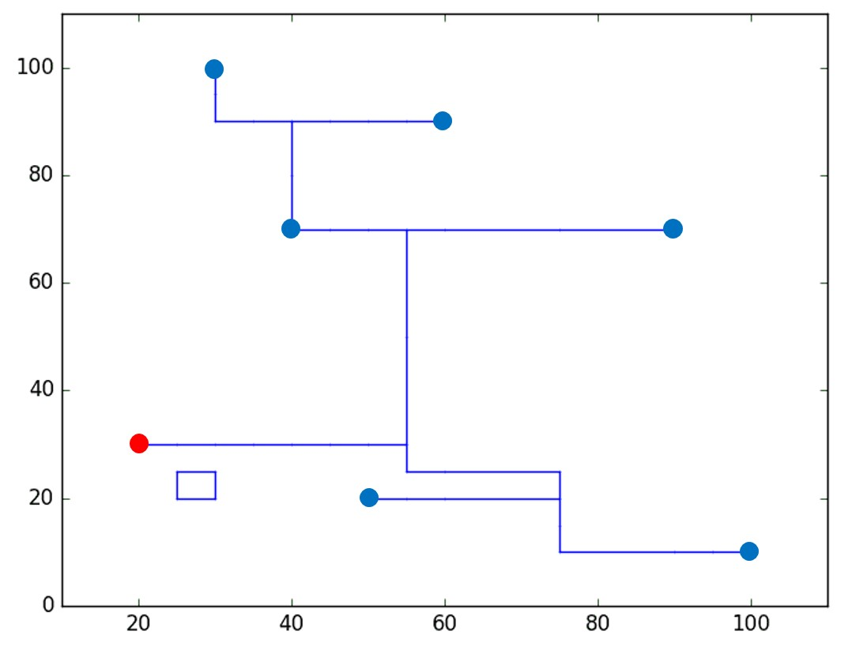
Skew Bound Constraints
Slide from [1]
For each path to $p_{i}$
$$L ≤\sum_{e_{jk}∈E}{c_{jk}⋅f_{jk}^{i}≤L+B }$$
⇒ Cost of each path within {L, L + B} L: lower bound, B: target skew
Invalid Solution with Cycle
Flow conservation constraints are satisfied
Cost of creating cycle < cost of detouring to leaf terminals to satisfy target skew
Cycle
Notes:
Since we are considering each source-to-sink path separately, we can get each pathlength easily.
Then, this constraint just makes sure the pathlength is within target skew range.
Here, L is the lower bound which is an input parameter. This could cause suboptimality depending on how the L value is given.
[CLICK] Unfortunately, this could give us invalid solutions with cycles.
Right figure shows an example solution. Based on the constraints I just explained, we cannot avoid this cycle.
This satisfies flow conservation and skew bound.
[CLICK] This happened when the cost of creating cycle is smaller than the cost of detouring to leaf terminals to satisfy target skew.
Thus, we need more constraints to avoid this issue and I will explain it on next slide.

Slide 26
Cycle Correction
Slide from [1]
New: $d_{j}^{i}$ pathlength from $v_{1}$ to $v_{j}$for path to $p_{i}$
Additional constraints to compute $d_{j}^{i}$
$d_{j}^{i}=d_{k}^{i}$ + $c_{kj}$ if $f_{kj}^{i}=1$
$$\left\{\begin{aligned}\#\#d_{j}^{i} =0 if v_{j}=source \left(v_{1}\right) \\ d_{j}^{i}≥L if v_{j}=sink \left(v_{i}\right) \\ d_{j}^{i}≤L+B otherwise \end{aligned}\right.$$
$$d_{j}^{i}+U⋅\left(1−f_{kj}^{i}\right)≥d_{k}^{i}+c_{kj}$$
$$d_{j}^{i}−U⋅\left(1−f_{kj}^{i}\right)≤d_{k}^{i}+c_{kj}$$
Notes:
We define new variable d^i_j, which represent the pathlength from the source to vertex j for the path to sink p_i.
With this variable, we can keep pathlength from source to any intermediate, non-terminal vertex j within skew bound.
[CLICK] This d^i_j variable should satisfy the following constraints.
If vertex j is source, d^i_j is zero. If vertex j is sink, d^i_j should be larger than lower bound L.
Otherwise, d^i_j should be smaller than the upper bound L + B.
[CLICK] Then, we need additional constraints to compute d^i_j.
If vertex k is a neighbor of vertex j, then d^i_j is equal to the sum of d^i_k and the cost of e_kj if there is flow from vertex k to j.
The bottom two constraints achieve this.
U is a big constant so that the constraints are always met when there is no flow from vertex k to j.

Slide 27
Constraints for Runtime Improvement
Slide from [1]
Chief drawback of using ILP → poor scalability
Idea: find flow variables that cannot coexist
$m_{ji}$: Manhattan distance from $v_{j}$ to $v_{i}$
For each point $p_{i}$
$$if m_{1j}+m_{ji}>L+B$$
$f_{jk}^{i}=0, f_{kj}^{i}=0$
⇒ Sum of Manhattan length via non-terminal vertex $v_{j}$ > upper bound on pathlength
$if m_{1j}+m_{jj′}+m_{j^{′}i}>L+B$
$and{ m}_{1j′}+m_{j′j}+m_{ji}>L+B$
$f_{jk}^{i}+f_{j^{′}k^{′}}^{i}=1, f_{kj}^{i}+f_{j^{′}k^{′}}^{i}=1$
$f_{jk}^{i}+f_{k^{′}j^{′}}^{i}=1, f_{kj}^{i}+f_{k^{′}j^{′}}^{i}=1$
⇒ Similarly, consider
for two non-terminal
vertices $v_{j}$ and $v_{j^{′}}$
Notes:
Although our formulation can find optimal solution, the chief drawback of using ILP is poor scalability.
Thus, we add some more constraints for speedup.
[CLICK] The idea is to find flow variables that cannot coexist.
We define m_ji as Manhattan distance from vertex j to i.
[CLICK] Again, we apply this constraints for each path.
The first equation means that the Manhattan distance from source to sink i through vertex j is larger than the upper bound.
So, in this condition, we can set all incoming and outgoing flows to the vertex j as zero.
[CLICK] Similarly, we can consider two intermediate vertices j and j’.
If this Manhattan length is larger than the upper bound, any combinations of incoming and outgoing flows going through vertices j and j’ cannot coexist.

Slide 28
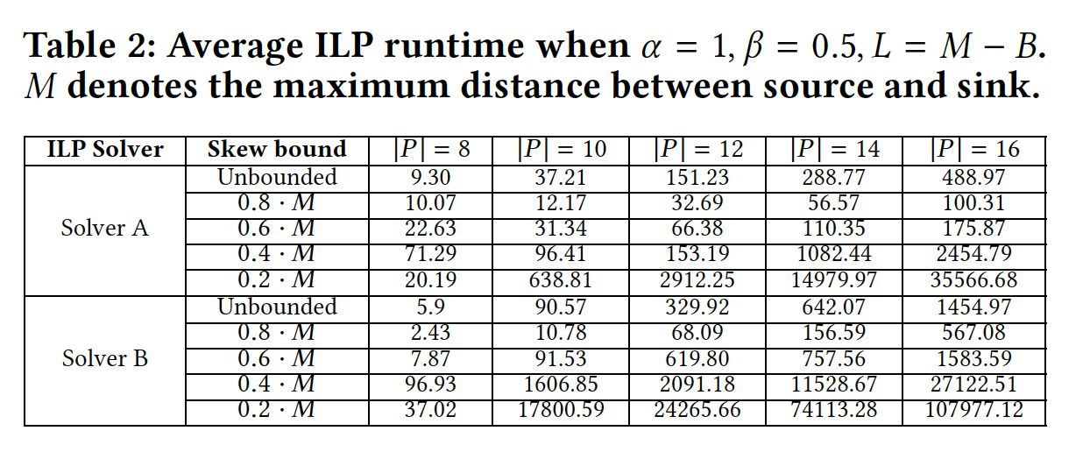
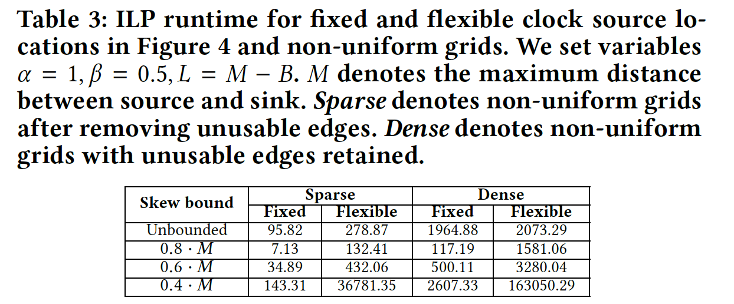
Runtime

