Slide 1
Revisiting Inherent Noise Floors for Interconnect Prediction
Tuck-Boon Chan¹, Andrew. B. Kahng² and Mingyu Woo²
1: Qualcomm
2: UC San Diego CSE and ECE Departments
Notes:
Thank you for the introduction. My name is Mingyu Woo and I’m a PhD student in UCSD. I’ll present the paper, “Revisiting inherent noise floors for interconnect prediction”. The main point of this work is to analyze the noise sources in the recent SP&R CAD tools to have better insight for interconnect prediction. We’ll analyze the possible noise sources and new trends in recent leading commercial P&R tools.

Slide 2
Outline
Motivation and Related Works
Revisit Previous Noise Studies
  Renaming / Reordering / Hierarchical Swap
  Chaotic Behavior
New Noise Sources: Macro Placement
  Placement Blockage
  Symmetry Test
Predictions Can Be Harmful
  Preplacements of Macros
  Partial P&R Solutions
Conclusion
Notes:
This is the outline of my talk. After motivations, I will revisit previous studies of Noise and Chaos going back to nearly 20 years ago.Then, I will discuss NEW noise sources that are very important to understand today.
And, an important question for modeling and prediction is: How will predictions be used in practice? We point out that predictions can be harmful.
Let me begin with motivations and related works.

Slide 3
Motivation
Interconnect prediction is critical in CAD tools
But… prediction is limited by intrinsic tool noise
Revisiting tool noise on interconnect
  Are there any improvements?
  How does noise affect interconnect prediction?
  Can we use prediction efficiently?
Notes:
Interconnect prediction is critical in CAD tools [Click]
But, the prediction is sometimes limited by intrinsic tool noise [Click]
To recover the limitation, we should revisit the tool noise on interconnect.
The following question can be raised:
[Click]
Are there any improvements from recently released CAD tools?
[Click]
2) How does noise effect interconnect prediction?
[Click]
3) Can we use prediction efficiently?

Slide 4
Related Works on Noise
Noise from local optima
  TSP problem with globally-convex structure [Boese94]
  Solution quality over local minima change according to the heuristic [Hagen97]
  Predictions of solution quality must deal with the existence of noise [Kearns93]
Noise sources in EDA tools
  Noise inheritance [Kahng02]
    Monotonicity and random seed
    Reordering and renaming instances, …
  Chaotic behavior [Jeong10]
    Changes 5% in clock periods, Util, AR, ...
Exploitation of noise
  Multi-armed bandit (MAB) formulation [Kahng18]
    Proposed adaptive sampling strategy from noise sources
Do recent tools
have similar behavior?
Notes:
Let me show you the related works on noise.
The local minima have been raised as noise sources in the literature.
Traditionally, the travel salesman problem(TSP) is easy to fall into local optima. The globally-convex structure has been proposed to avoid the local optima.
There has been a work that the solution quality over local minima changed according to the strongness of heuristics.
Besides, there has been a work that the predictions of solution quality must deal with the existence of noise, so we should focus on the noise before predicting the tools.
[Click]
In CAD tools, there have been two works that analyze the noise sources.
Noise inheritance with monotonicity, random seed, instance reordering, and instance renaming have been studied in 2002.
The chaotic behavior of CAD tools has been studied in 2010. This work showed that very small changes less than 3% caused up to 16% noise.
[Click]
Based on the studies in noise inheritance and chaotic behavior,
Multi-armed bandit (e.g. MAB) formulation has been proposed.
From these related works, we can raise a question:
[Click]
Do recent tools have similar behavior?

Slide 5
Our Contributions
We study the noise floor on interconnect prediction accuracy
  Used recently releases of leading commercial P&R tools
  Used commercial sub-20nm foundry technology
We reproduce earlier studies of noise [Kahng02] and “chaos” [Jeong10]
We observe a new form of chaotic behavior in macro placement
  A slight movement of a placement blockage
  Preplace macros in symmetry
Notes:
Therefore, our contribution is
We study the noise floor on the interconnect prediction accuracy. We use recent releases of leading commercial P&R tools and recent sub-20nm foundry technology.
(Click)
We reproduce earlier studies of noise and chaos with recent tech and new P&R tools.
(Click)
We further propose a new form of chaotic behavior in macro placement
We’ll check the chaotic behavior when placement blockage and macros in symmetry are applied.

Slide 6
Outline
Motivation and Related Works
Revisit Previous Noise Studies
  Renaming / Reordering / Hierarchical Swap
  Chaotic Behavior
New Noise Sources: Macro Placement
  Placement Blockage
  Symmetry Test
Predictions Can Be Harmful
  Preplacements of Macros
  Partial P&R Solutions
Conclusion
Notes:
I’ll start with revisiting the previous noise studies; renaming, reordering, hierarchical swap and chaotic behavior.
The point of these previous studies was to show that input changes that should NOT affect the tool output actually DO change the tool output

Slide 7
Noise Study Setup
Perform experiments using recent releases of leading commercial SP&R tools
  Synthesis
    Cadence Genus
    Synopsys Design Compiler
    Mentor Oasys-RTL
  P&R
    Cadence Innovus
    Synopsys IC Compiler II
    Mentor Olympus-SOC
We select two tools from among the three major tools
We do not disclose the mapping of names to tools
  We use “SYN_1”, “SYN_2”, “P&R_1” and “P&R_2”
  We report anonymized results to comply with EULA restrictions
Notes:
To analyze the noise studies, we set up the environment as in the following.
(Click)
There are three leading commercial Synthesis tools, and
(Click)
There are three leading commercial P&R tools.
(Click)
We select two tools from among the three major tools, but
(Click)
We do not disclose the mapping of names to tools. We’ll use SYN_1, SYN_2, P&R_1, and P&R_2 to anonymize the results to comply with EULA restrictions.

Slide 8
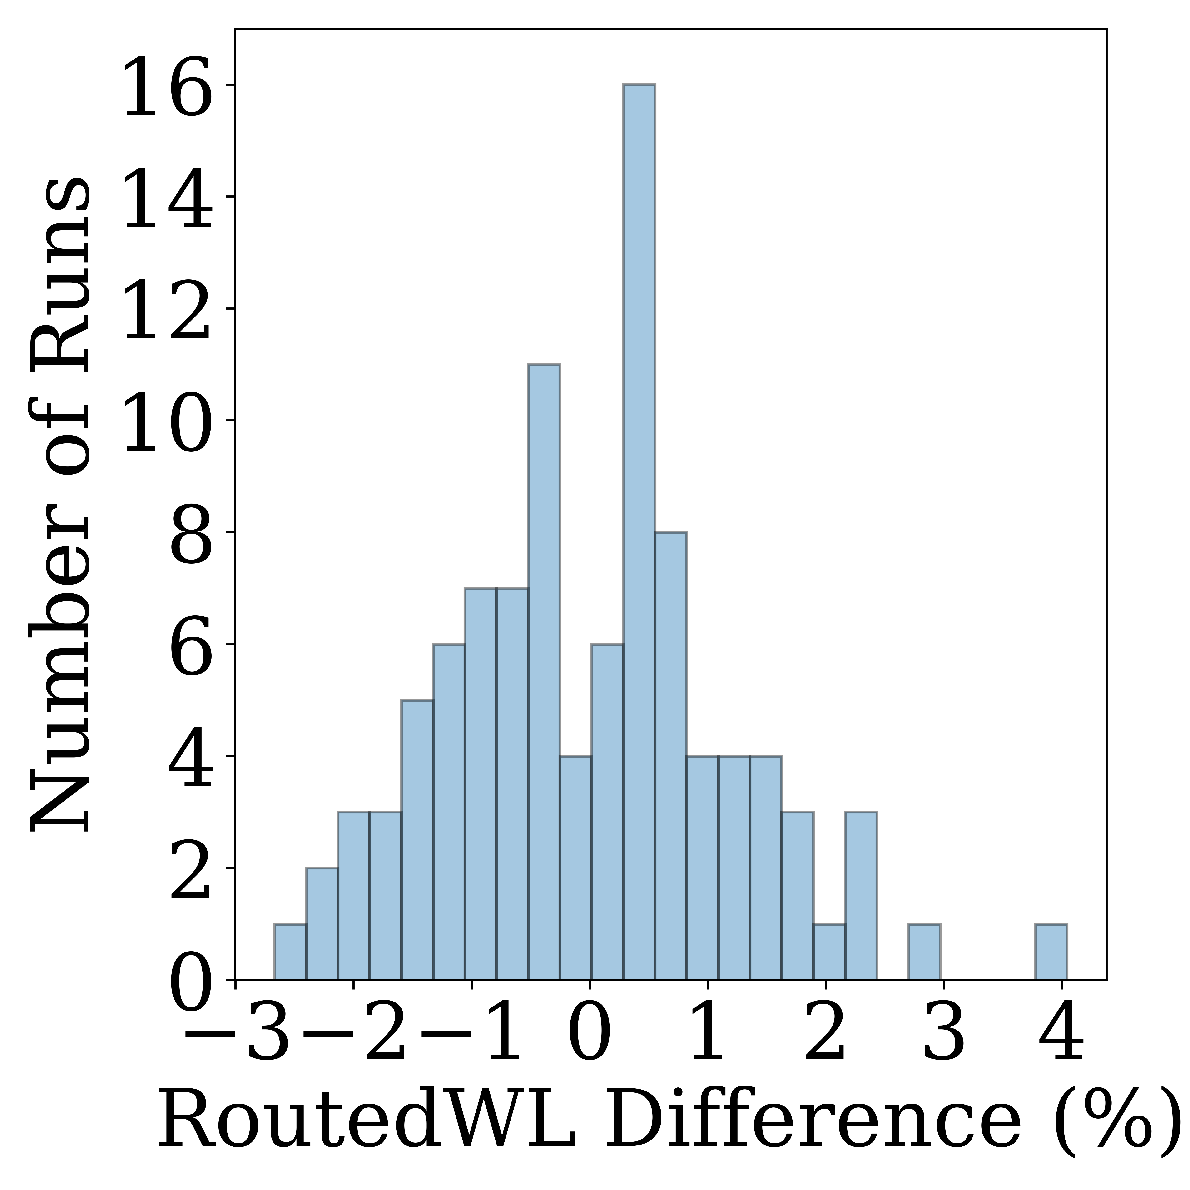
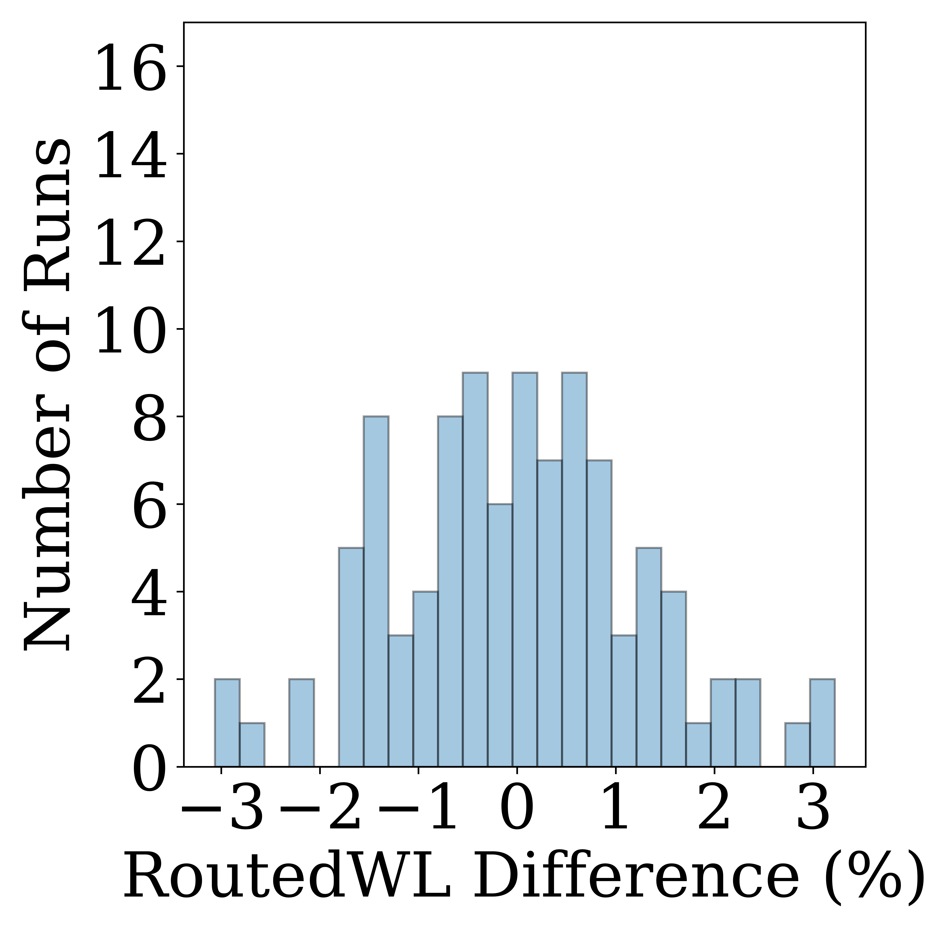
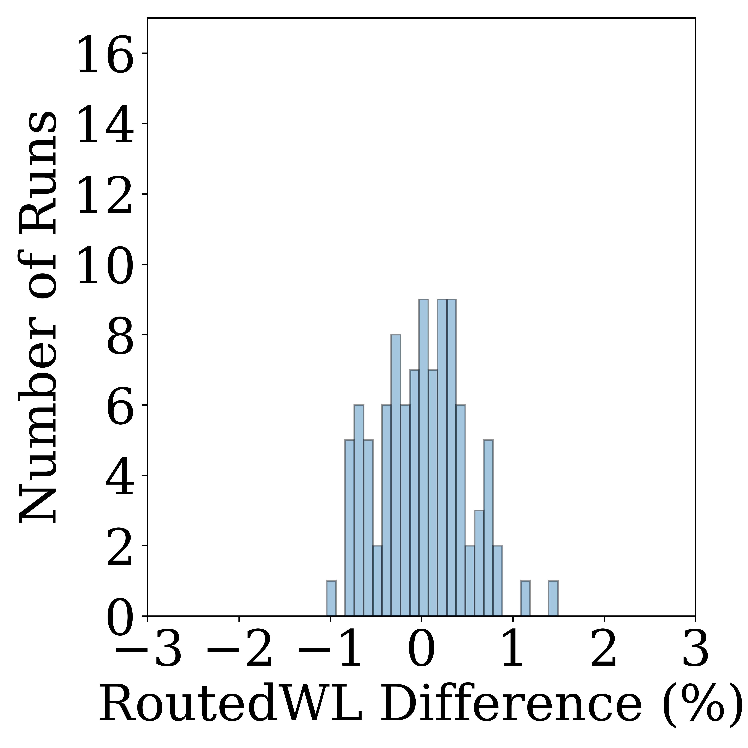
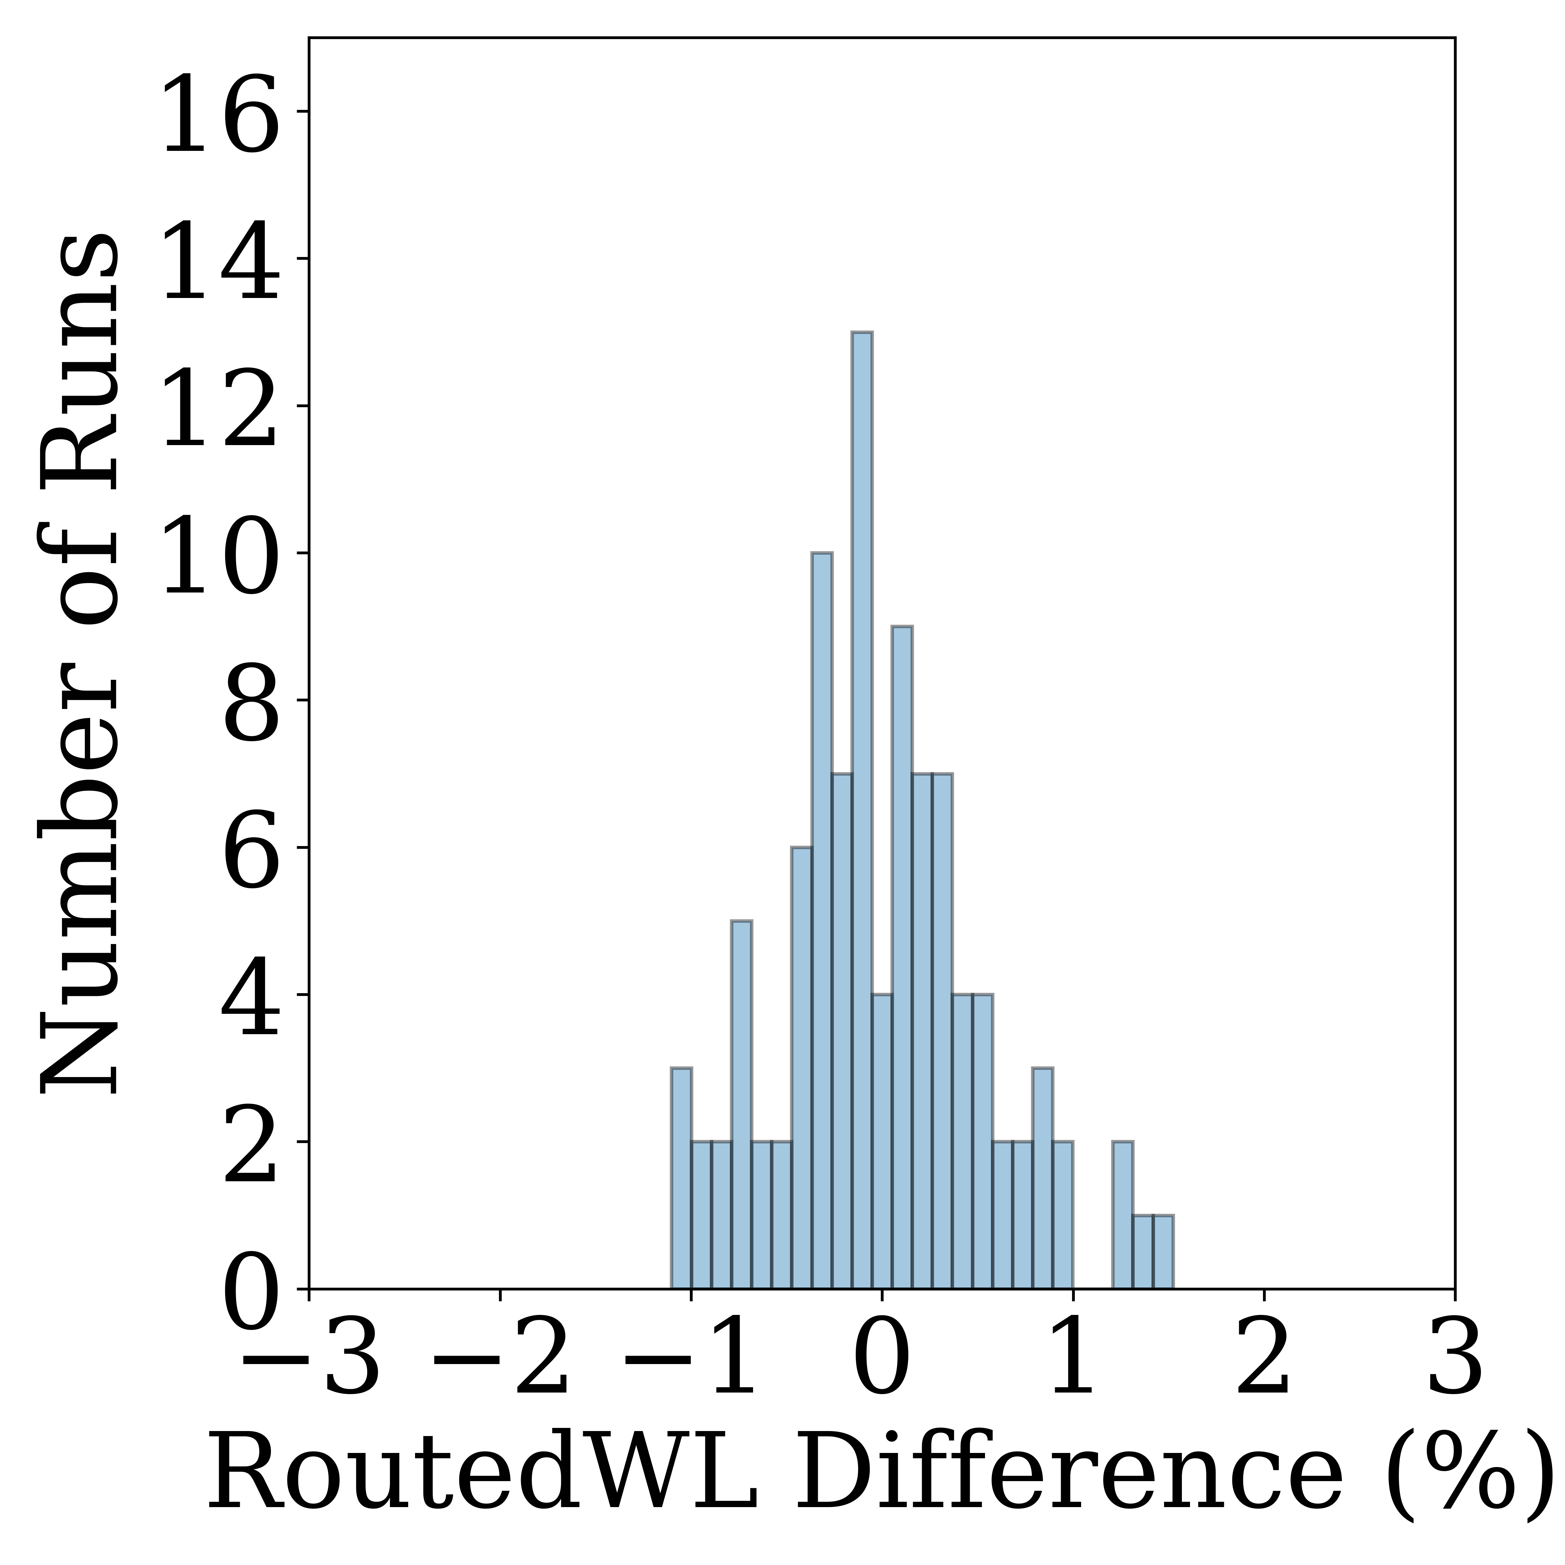
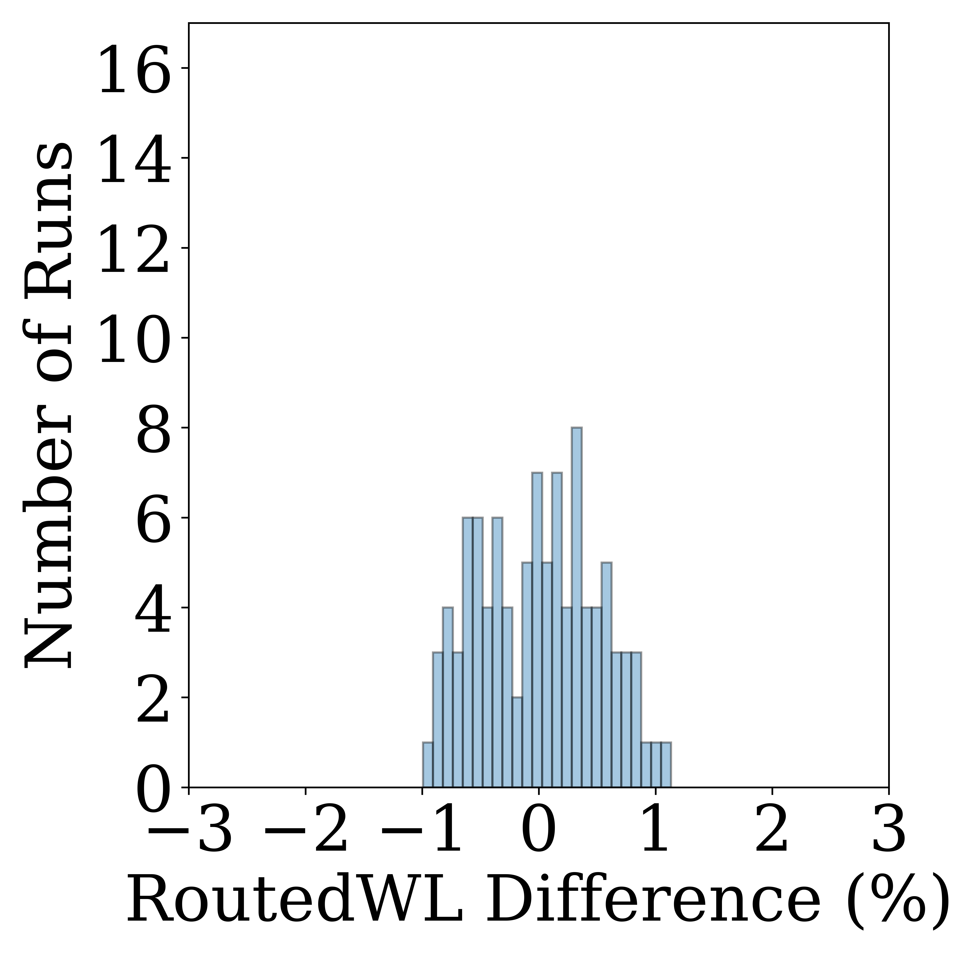
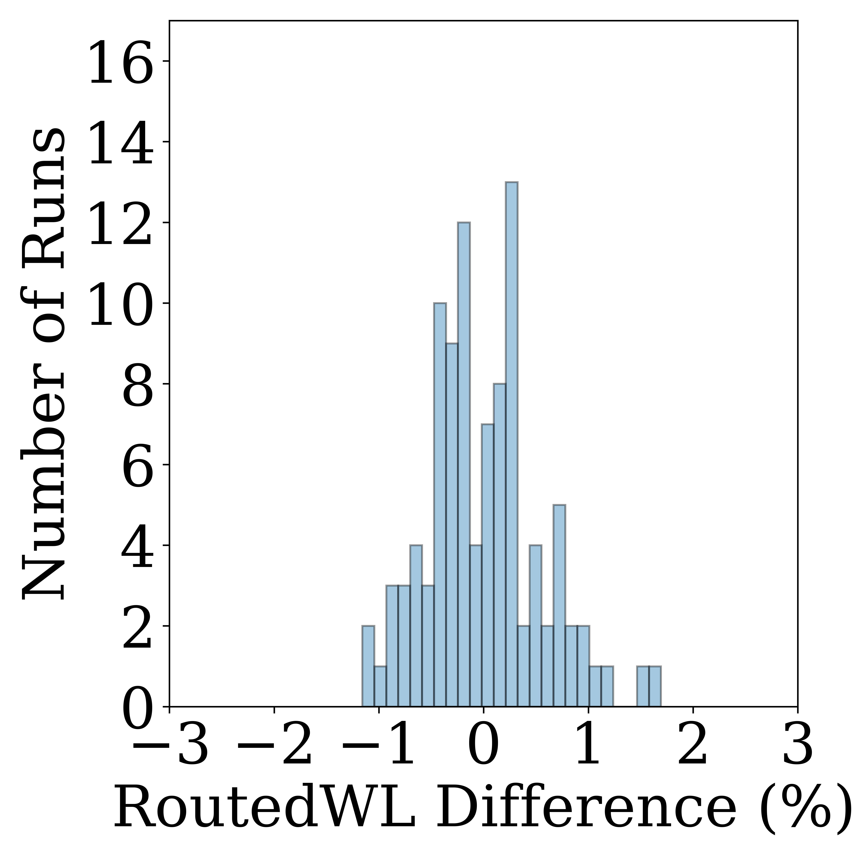
Revisiting Tool Noise: Ordering and Naming
Renaming and reordering instances/nets in Verilogs [Kahng02]
  Launch 100 P&R runs with AES
  Extract routed wirelengths
Result:
  P&R_1
    Immune on renaming
    < 7% noise in reordering
  P&R_2
    < 4% noise in reordering
P&R_1 Instance Reorder
P&R_1 Net Reorder
~7%
~6%
P&R_2 Instance Rename
P&R_2 Net Rename
P&R_2 Instance Reorder
P&R_2 Net Reorder
~3%
~3%
~2%
~3%
Notes:
We revisit renaming and reordering the instances.
As we all know, P&R flows started with the gate-level Verilog.
In the Verilog, we can rename and reorder instances randomly.
We launched 100 P&R runs with AES design and compared the final routed wirelengths.
(Click)
The result was quite interesting. The P&R_1 is immune to renaming but caused up to 7% noise in reordering, but
(Click)
The P&R_2 has up to 4% noise in both renaming and reordering. (3s)

Slide 9
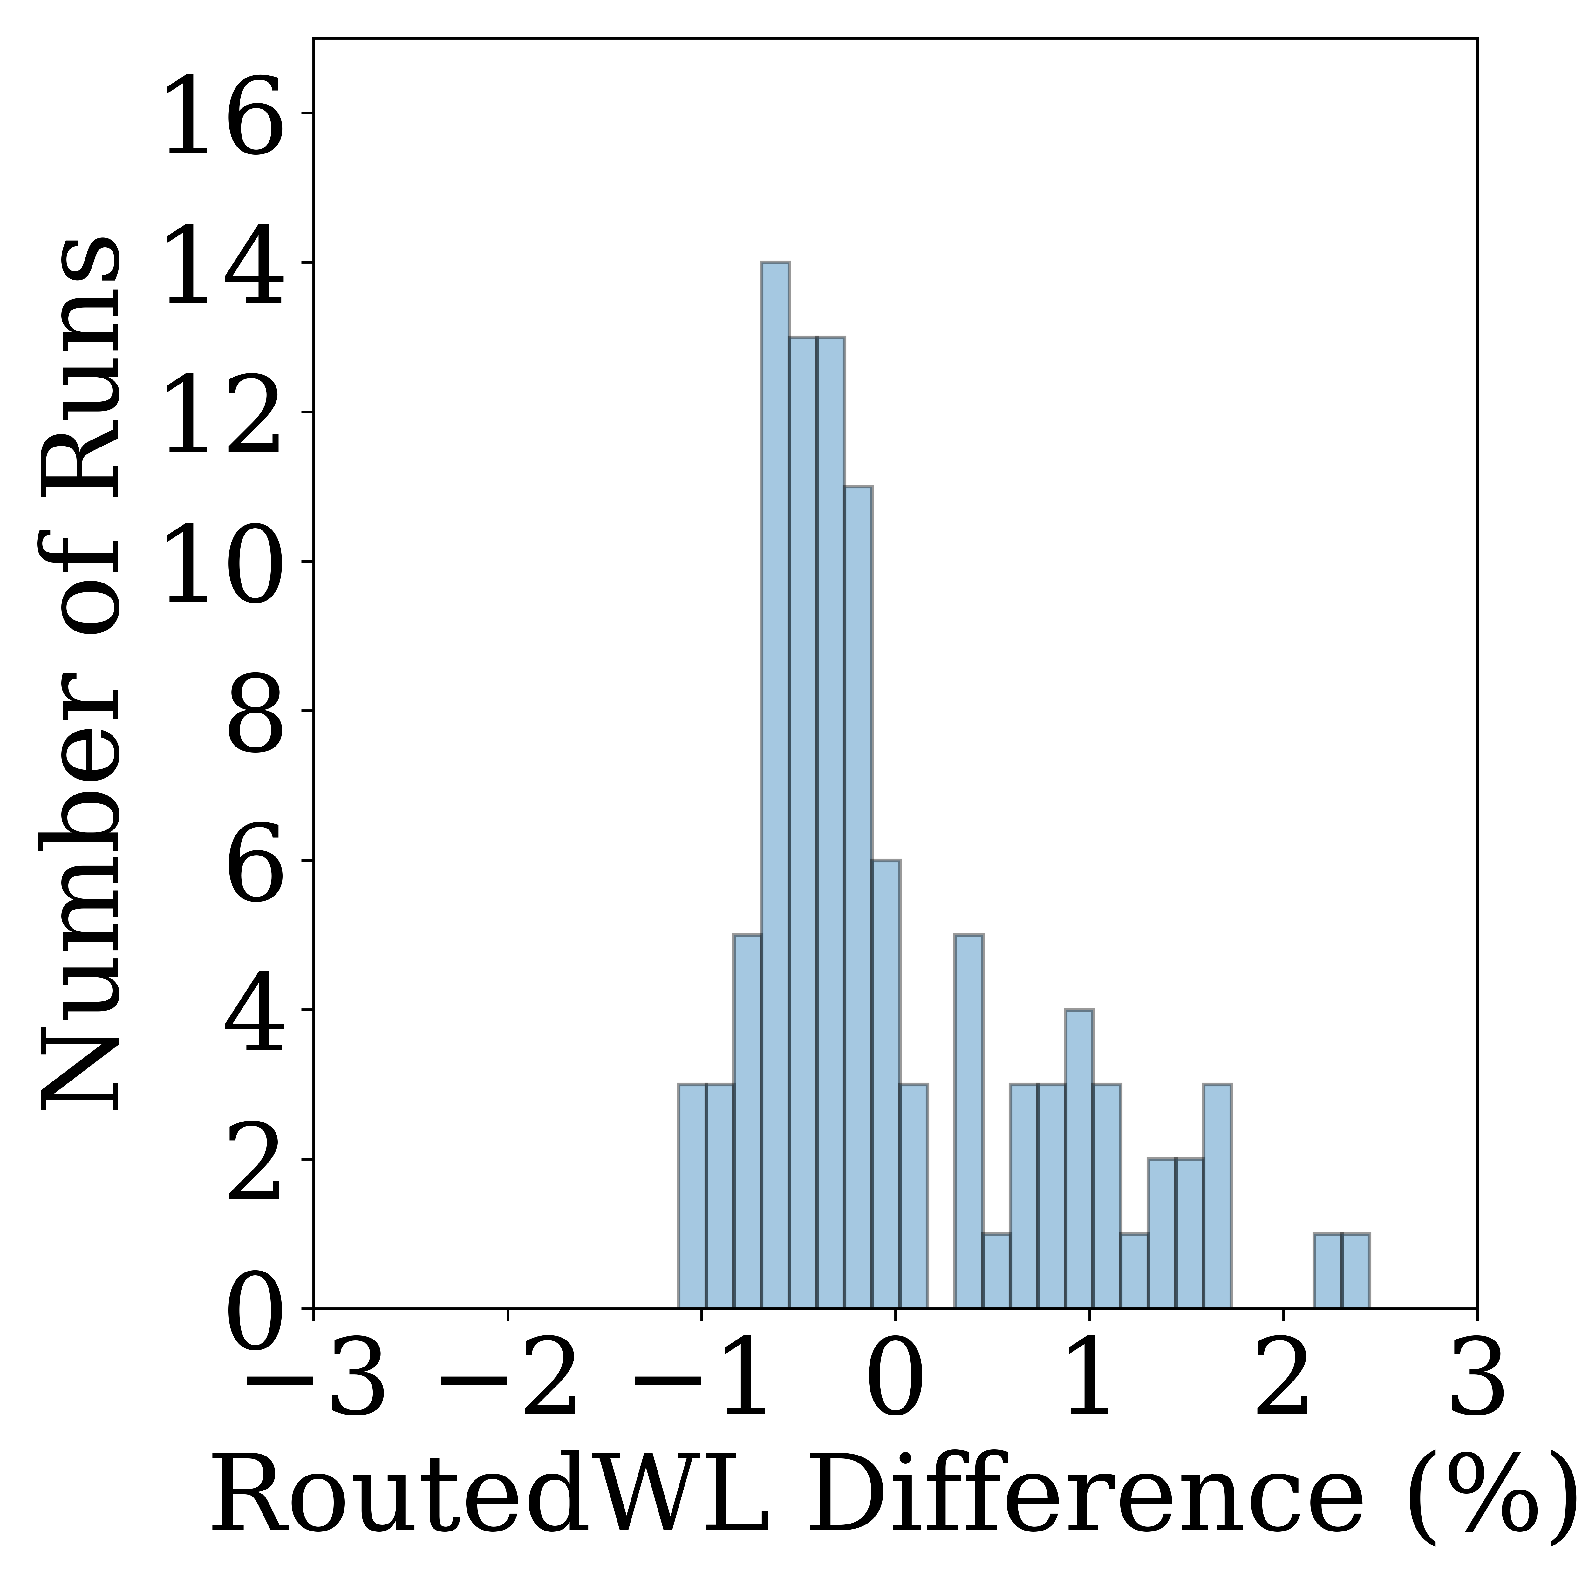
Revisiting Tool Noise: Hierarchical Swaps
Hierarchical swapping [Kahng02]
  Randomly swaps instance names inside the same hierarchical-level modules
  Caused up to 12% routed wirelength variation in 2002
Result:
  P&R_1: Immune
  P&R_2: < 4% noise variation
P&R_2 Hierarchical Swap
~4%
Notes:
One of the most noised factors was hierarchical swapping in a 2002 study.
The hierarchical swapping means randomly swaps instance names inside the same hierarchical-level modules in Verilog. It caused up to 12% routed wirelength variation in the previous study.
(Click)
In recent P&R tools, however, showed noise-improved results as in this figure.
P&R_1 is immune to hierarchical swapping, but P&R_2 showed a 4% noise variation.

Slide 10
Revisiting Tool Noise: Chaos
Chaotic behavior on SP&R tools [Jeong10]
  Small changes to inputs are observed to cause large changes
    Clock Period (± 3ps)
    I/O Delay (± 3ps)
    Clock Uncertainty (± 3ps)
    Aspect Ratio (± 0.03)
    Placement Util (± 3%)
Benchmark descriptions
For
Synthesis
For P&R
Design | ClkPer (ns) | IO Delay (ns) | Post-P&R WNS (ns) | Post-P&R TNS (ns) | Num Macros | Num Insts
AES | 0.300 | 0.000 | -0.235 | -56.502 | 0 | 14837
JPEG | 0.400 | 0.000 | -0.038 | -8.939 | 0 | 60127
SweRV_Wrapper | 0.500 | 0.000 | -0.204 | -252.882 | 28 | 109692
BlackParrot | 0.800 | 0.760 | -0.128 | -21.676 | 49 | 314393
Notes:
Next, we revisit the chaotic behavior that was published 8 years ago.
[Click]
Changes in Clock Period, I/O delay, Clock uncertainty, aspect ratio, and placement utilization less than 3ps and 3% caused chaotic behavior in the SP&R tools.
[Click]
The upper three inputs can be used for Synthesis, and
[Click]
All five inputs can be used for P&R runs.
Note that clock period, I/O delay, and clock uncertainty can be modified in the *.sdc file.
[Click]
Our benchmarks are described in this table. As you can see, we use two non-macro designs and two macro designs. All designs are open-sourced in OpenCores and GitHub repo. [3s pause]

Slide 11
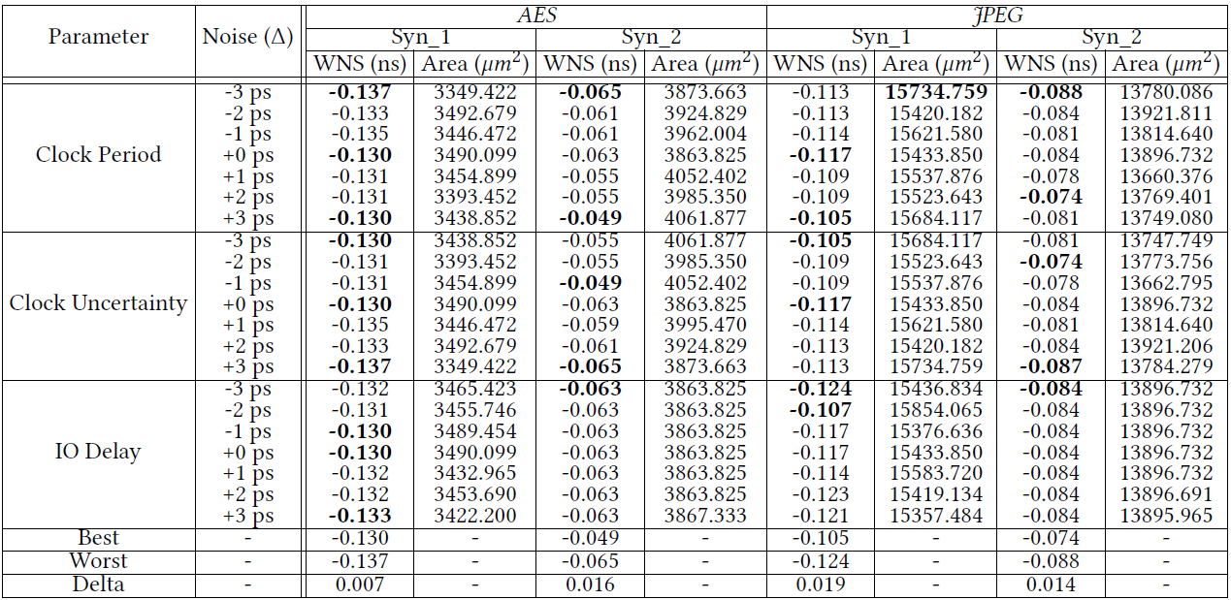
Revisiting Tool Noise: Chaos
Notes:
If you read our paper, you can see the gigantic table we filled in, but I’ll not handle the whole tables in this presentation.
I summarized the chaotic results in the next slide.

Slide 12
Revisiting Tool Noise: Chaos
Chaotic behavior in Post-Synthesis results (Table 3)
  Noise parameters: Clock Period (± 3ps), I/O Delay (± 3ps), Clock Uncertainty (± 3ps)
Design | Δ WNS (ns)
 | Syn_1 | Syn_2
AES | 0.007 | 0.016
JPEG | 0.019 | 0.014
SweRV_wrapper | 0.036 | 0.023
BlackParrot | 0.023 | 0.031
Chaotic behavior in Post-P&R results (Table 4)
  Noise parameters: Clock Period (± 3ps), I/O Delay (± 3ps), Clock Uncertainty (± 3ps), Aspect Ratio (± 0.03), Placement Util (± 3%)
Design | Δ WNS (ns) |  | Δ TNS (ns)
 | P&R_1 | P&R_2 | P&R_1 | P&R_2
AES | 0.023 | 0.028 | 3.971 | 3.929
JPEG | 0.035 | 0.048 | 8.843 | 93.874
SweRV_wrapper | 0.265 | 0.420 | 199.63 | 170.035
BlackParrot | 0.137 | 0.100 | 294.91 | 57.344
Notes:
From our experiments, the synthesis tool showed improved noise results as in the upper table. The Delta WNS was up to 36ps in macro designs.
[Click]
However, the P&R tool still has the chaotic behaviors as in the lower table. Two macro designs have few hundreds of ps in delta WNS and few hundreds of ns in delta TNS [3s pause]. We can conclude that the recent P&R tools still have chaotic behavior, pretty much in the same way that was demonstrated 10 years ago.

Slide 13
Outline
Motivation and Related Works
Revisit Previous Noise Studies
  Renaming / Reordering / Hierarchical Swap
  Chaotic Behavior
New Noise Sources: Macro Placement
  Placement Blockage
  Symmetry Test
Predictions Can Be Harmful
  Preplacements of Macros
  Partial P&R Solutions
Conclusion
Notes:
Now, I will describe and show behavior of new noise sources that we have studied, from macro placement; placement blockage and symmetry test.

Slide 14
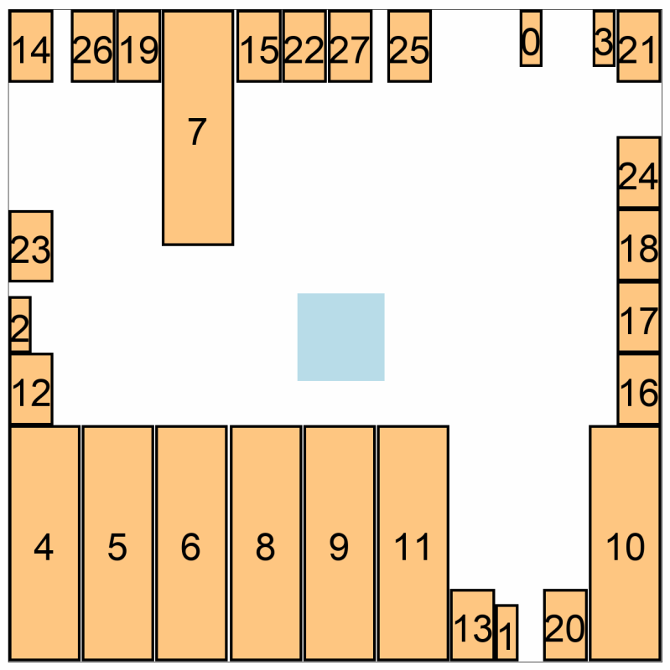
New Noise Sources: Placement Blockages
Macro placement blockage
  Pushing macros to corners to maintain routability [Chen08]
  Commercial tools also push macros to corners
  An artificial macro blockage is supported.
  Tested on SweRV_wrapper design.
Results
P&R_1 : < 14.4% Noise
P&R_2 : Immune
Blockage (6um movements)
Notes:
In literature, pushing macros to corners in macro placement is recommended to maintain the routability. Even the commercial tools leave empty spaces in the center.
A user can specify artificial macro blockages at the center to control pushing macros.
[Click]
However, Our experimental results are quite striking. The left gif image showed that how the macro placement solutions are changed as the blockage is shifted by 6um on each step. This blockage caused up to 14% wirelength variation in P&R_1. However, P&R_2 is immune to macro blockages.

Slide 15
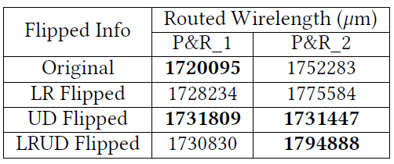
New Noise Sources: Symmetry Test
Symmetry test on macro placement
  Continue P&R after preplacing all macros in symmetry
  Tested on SweRV_wrapper design.
Original
LR Flipped
UD Flipped
LRUD Flipped
P&R_1 < 0.6% noise
P&R_2 < 3.6% noise
Notes:
We also identify SYMMETRY in the floorplan definition as another source of significant noise.
As in the left figure, we can get the original solution from macro placement.
Next, we can flip it in left-right, up-down, left-right-up-down ways. We compared the routed wirelength in four cases.
[Click]
Among the four cases, P&R_2 shows up to 4% wirelength variations, but P&R_1 shows only up to 1% wirelength variations.

Slide 16
Noise Summary
Synthesis
Noise sources | Noise | [J10] | SYN_1 | SYN_2
Chaos [J10] | ΔWNS (ns) | 0.052 | 0.036 | 0.031
Better
P&R
Noise sources | Noise | [K02] | [J10] | P&R_1 | P&R_2
Renaming [K02] | ΔWL (um) | ~ 7% | N/A | Immune | ~ 4%
Reordering [K02] | ΔWL (um) | ~ 8% | N/A | ~ 7% | ~ 4%
Hierarchical Swap [K02] | ΔWL (um) | ~ 13% | N/A | Immune | ~ 4%
Chaos [J10] | ΔWNS (ns) | N/A | 0.190 | 0.265 | 0.420
Chaos [J10] | ΔTNS (ns) | N/A | 69.958 | 294.91 | 170.035
Blockage [New] | ΔWL (um) | N/A | N/A | ~ 14.4% | Immune
Symmetry [New] | ΔWL (um) | N/A | N/A | ~ 0.6% | ~ 3.6%
Better
Notes:
This slide summarizes all the noise sources that we have studied, and the noise seen in recent tools.
For Synthesis tools, the delta WNS noise becomes better in both tools.
[Click]
For P&R tools, renaming, reordering, and hierarchical swapping showed better results, but chaotic behaviors are still not resolved yet.
P&R_1 has up to 14% noise from placement blockages.

Slide 17
Outline
Motivation and Related Works
Revisit Previous Noise Studies
  Renaming / Reordering / Hierarchical Swap
  Chaotic Behavior
New Noise Sources: Macro Placement
  Placement Blockage
  Symmetry Test
Predictions Can Be Harmful
  Preplacements of Macros
  Partial P&R Solutions
Conclusion
Notes:
I’ll show you the possible scenario that predictions can be harmful to CAD tools;

Slide 18
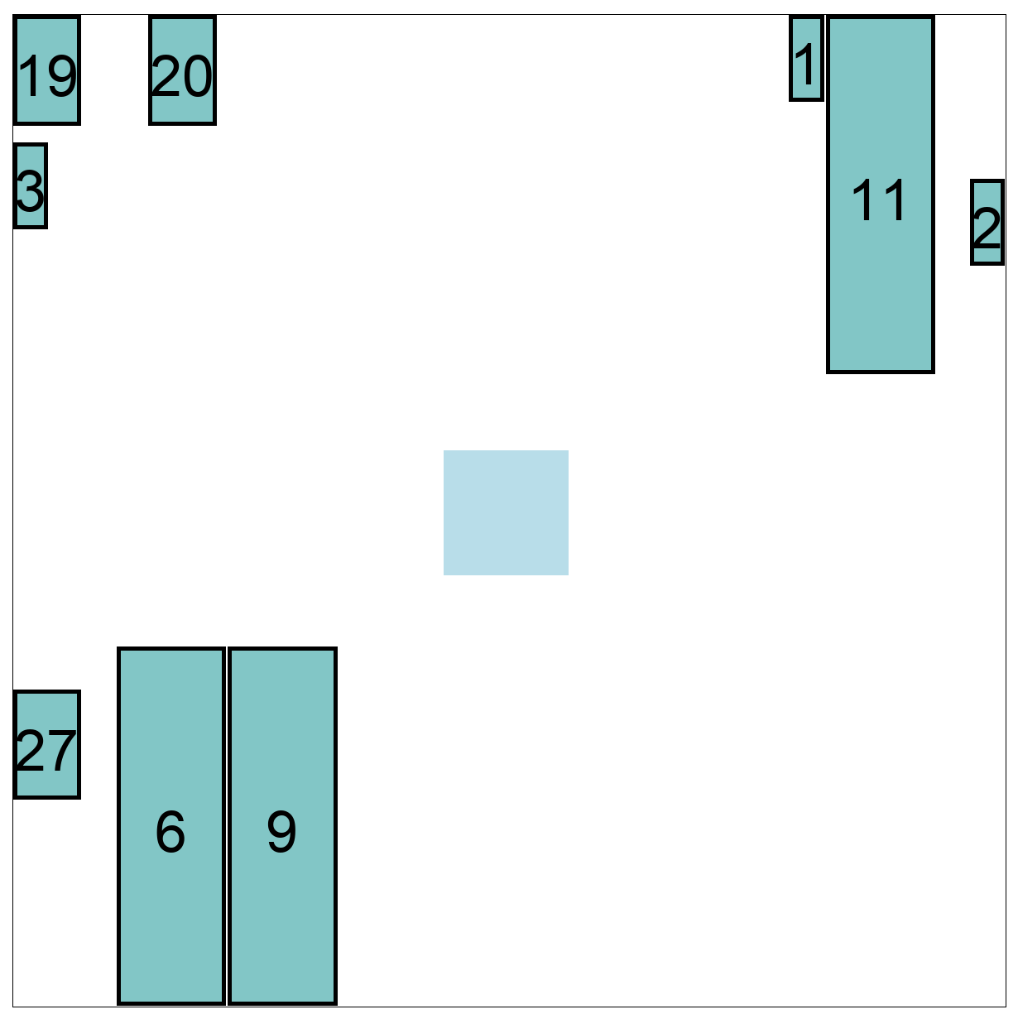
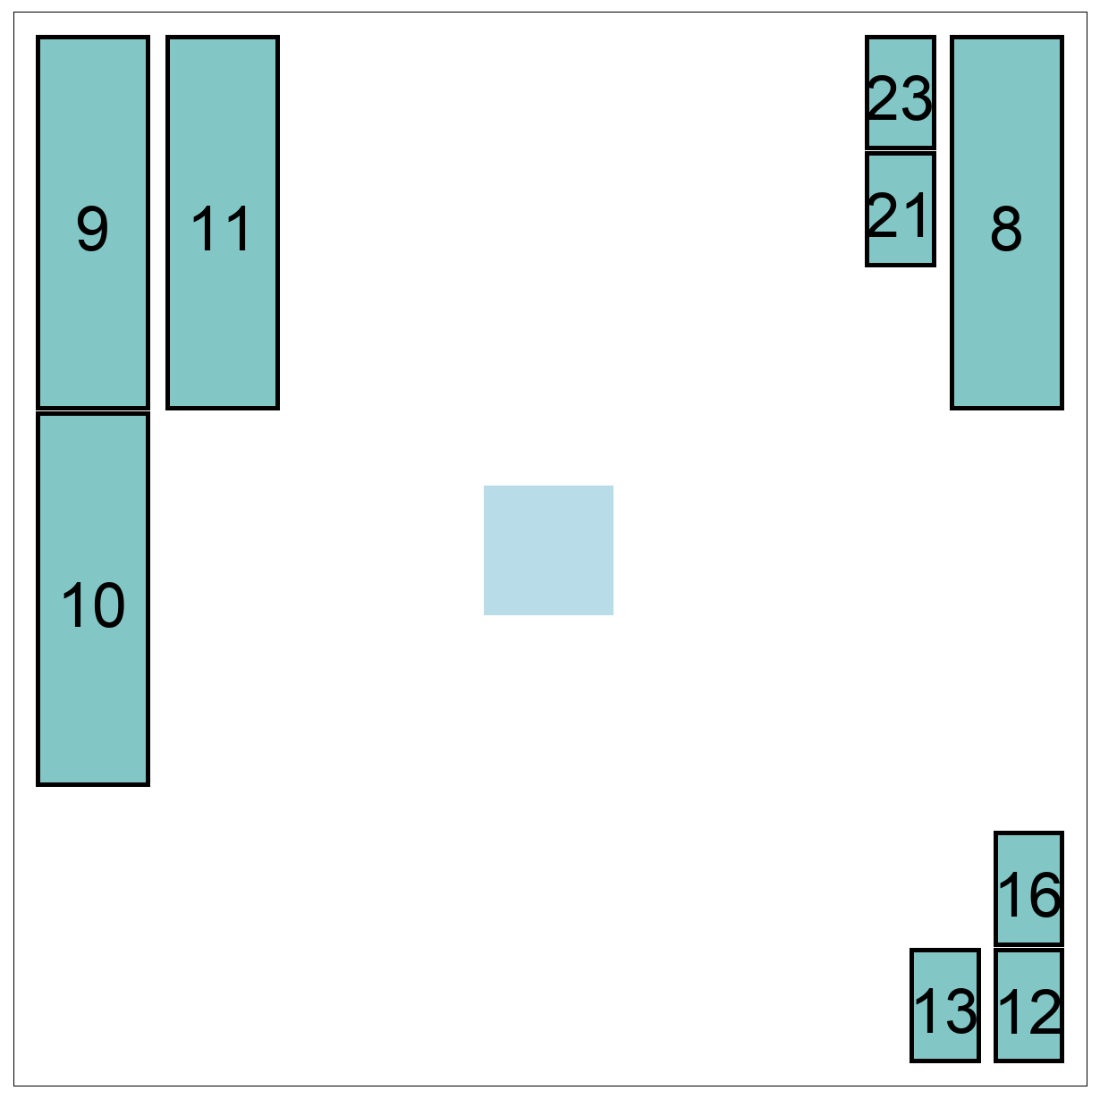
Prediction Can Be Harmful
Preplace some of macros from original solutions.
  Tested on SweRV_wrapper design.
Original
Preplace
Preplace + macro place
P&R_1
  ~ 3.5% noise
P&R_2
  ~ 0.5% noise
Notes:
We used SweRV_wrapper design that has 28 macros.
First, We started with the original macro placement solution from each tool.
The upper solution is from P&R_1 and the lower solution is from P&R_2.
[Click]
Second, we randomly choose three macros on each three corner and preplace the macros.
[Click]
Finally, we run the macro placement again. The dark-blue macros denote the fixed macros and orange-color macros denote the placed macros from 2nd run. [3s pause]
[Click]
P&R_1 has 3.5% wirelength variations on preplacing some of macros, but P&R_2 has 0.5% wirelength variations.

Slide 19
Prediction Can Be Harmful
Start P&R from the post-routed netlist
  Tested on AES design
Result:
  P&R_1
    ~10% more wirelength
  P&R_2
    ~4% more wirelength
Tool | 1St Run |  | 2nd Run
 | WNS(ns) | Wirelength | WNS(ns) | Wirelength
P&R_1 | -0.061 | 101667.24 | -0.50 | 112284.63
P&R_2 | -0.064 | 110604.19 | -0.075 | 114939.83
Difficulty of using prediction leads us to warn
  ➔ Be Careful What You Ask For (BCWYAF)
Notes:
We also tested the commercial P&R flow when post-routed netlist is taken.
We tested with AES design.
[Click]
The 2nd run has 10% more wirelength compared with the 1st run in P&R_1. The P&R_2 has 4% more wirelength on 2nd run compared with the 1st run.
It showed that precisely predicted results like post-routed netlist from 1st run makes the wirelength worse on both tools.
[Click]
We discovered that the difficulty of using predictions in a helpful way leads us to warn:
[Click]
“Be Careful What You Ask For”

Slide 20
Outline
Motivation and Related Works
Revisit Previous Noise Studies
  Renaming / Reordering / Hierarchical Swap
  Chaotic Behavior
New Noise Sources: Macro Placement
  Placement Blockage
  Symmetry Test
Predictions Can Be Harmful
  Preplacements of Macros
  Partial P&R Solutions
Conclusion
Notes:
Now, I will conclude this presentation.

Slide 21
Conclusion
We have revisited the studies of tool noise and chaos by [Kahng02] [Jeong10]
  Today’s major vendor tools show different susceptibilities to noise sources
We further identify a new source of tool noise
  Chaotic effects on auto-macro placement from a fixed obstacle.
  Symmetry in the floorplan definition
“How should predictions be used?”
  Knowing part of a macro placement solution.
  Knowing the post-route netlist in advance of P&R.
  → Both types of predictions can harm the solution quality
Future Work
  Propose a new prediction strategy that is aware of noise.
Notes:
In this work, we have revisited the previous works: noise inheritance and chaotic behavior.
Today’s major vendor tools show different susceptibilities. Some noise sources are still discovered in recent tools.
[Click]
We identified a new source of tool noise.
Fixed obstacles and symmetry in the floorplan definition caused the tool noise.
[Click]
We also tried to answer the question:
How should predictions be used?
Knowing part of a macro placement solution and Knowing the post-route netlist,
[Click]
Both types of predictions can HARM the solution quality of P&R tools, which raises the question of how to even USE predictions, IF we are able to make them.
[Click]
Our future work is to propose a new prediction strategy that aware of these noise sources.

Slide 22
Thank you!
Notes:
Thank you for your attention.

Slide 23
Back UP

Slide 24
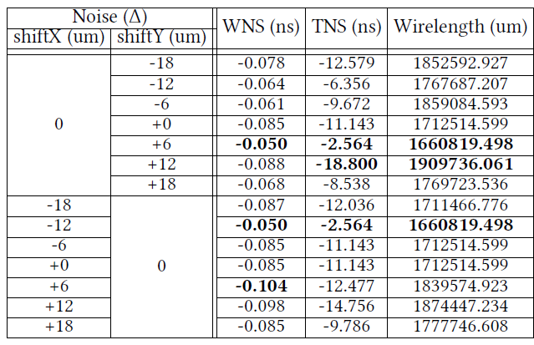
Backup: Blockage noise
Placement blockage noise from P&R_1
Up to
14.4%

