Slide 1




DATC RDF-2020:
Strengthening the Foundation for Academic Research in IC Physical Design
J. Chen¹, I. H.-R. Jiang², J. Jung³, A. B. Kahng⁴,
V. N. Kravets³, Y.-L. Li⁵, S.-T. Lin⁵ and M. Woo⁴
1
2
3
4
5
GitHub Link: https://github.com/ieee-ceda-datc

Slide 2
Design Automation Technical Committee (DATC)
A technical committee of IEEE CEDA
  Provide a forum for discussing strategies and issues in design automation
Task: Robust Design Flow Database
  Academic version reference design flow
  Free! for academic and noncommercial research
Organization
Name | Affiliation | Role
Iris Hui-Ru Jiang | National Taiwan Univ., Taiwan | Chair / Timer
Victor N. Kravets | IBM, USA | Logic synthesis
Jianli Chen | Fuzhou Univ., China | Placement
Yih-Lang Li | National Chiao Tung Univ., Taiwan | Routing
Jinwook Jung | IBM, USA | Integration
Andrew B. Kahng | UC San Diego, USA | Vice chair / Flow

Slide 3
RDF-2019 Flow
Benchmarks
  2017 TAU Contest, IWLS 2005 Benchmarks, UW BSG Benchmarks
Logic synthesis
  ABC, Yosys+ABC (Brown Univ.)
Global placers
  NTUPlace3, ComPLx, mPL5/6, Capo, FastPlace3-GP, Eh?Placer,
  FZUplace, RePlAce
Detailed placers
  FastPlace3-DP, MCHL-T, OpenDP
Global routers
  NCTUgr, FastRoute4.1, BFG-R, FastRoute4-lefdef
Detailed router
  NCTUdr, Dr. CU, TritonRoute
Gate sizers
  USizer 2013, USizer 2012, Resizer, TritonSizer
Timers
  Open Timer, iTimerC2.0, OpenSTA
Cell libraries
  ISPD 2012/2013 Contests, ASAP 7nm library, NanGate45, NCTUcell
RDF-2019
Logic synthesis
Floorplanning
Global Placement
Detailed Placement
RC Extraction / STA
Gate Sizing
Clock Tree Synthesis
Global Routing
Detailed Routing
RC Extraction / STA
GDSII Streamout

Slide 4
Key Updates of RDF-2020 (1/2)
RDF-2020 extends the previous four years of DATC efforts to
Preserve and integrate leading research codes, including from past academic contests
Provide a foundation and backplane for academic research in the RTL-to-GDS IC implementation arena.

Slide 5
Key Updates of RDF-2020 (2/2)
Enhance the flow by adding
Multi-bit flip-flop clustering
Parasitic extraction and antenna checking
A recent contest-winning global router
RDF-2020’s new delta:
  Open a new “Calibrations” direction
  Other new items:
  An open-source physical design database with Tcl/Python/C++ APIs
  A flow integration into a single scriptable application
  Support for the newly-opened SKY130 manufacturable PDK

Slide 6
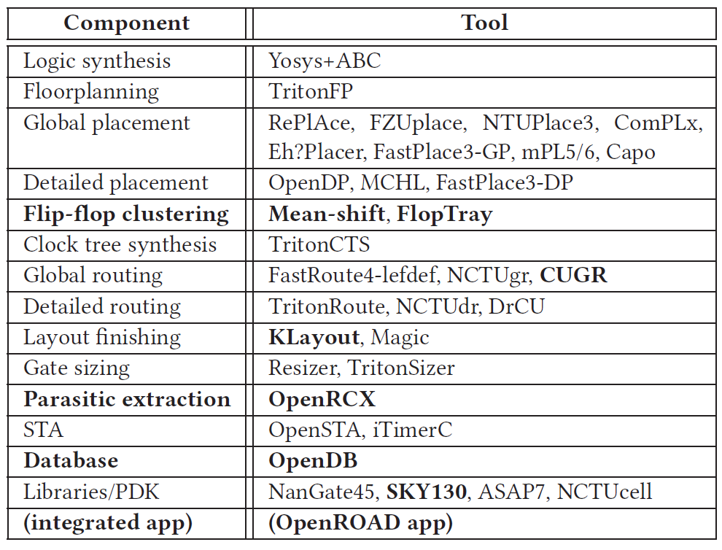
RDF-2020 Flow Evolution

Slide 7
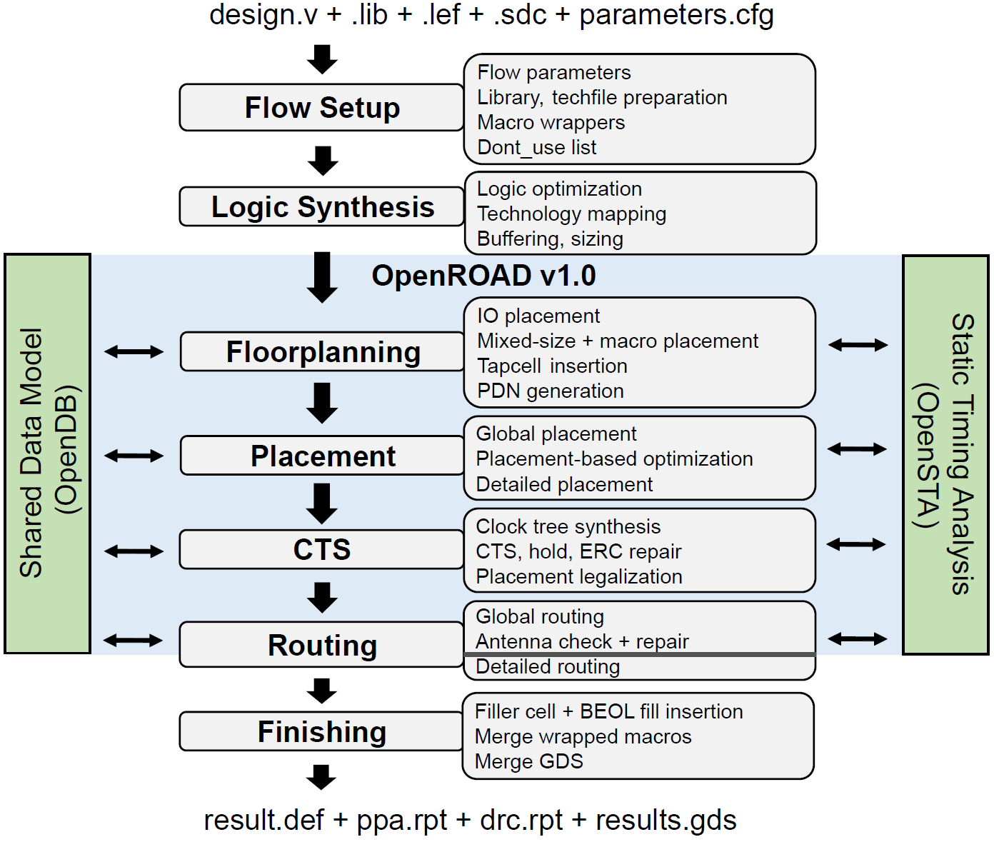
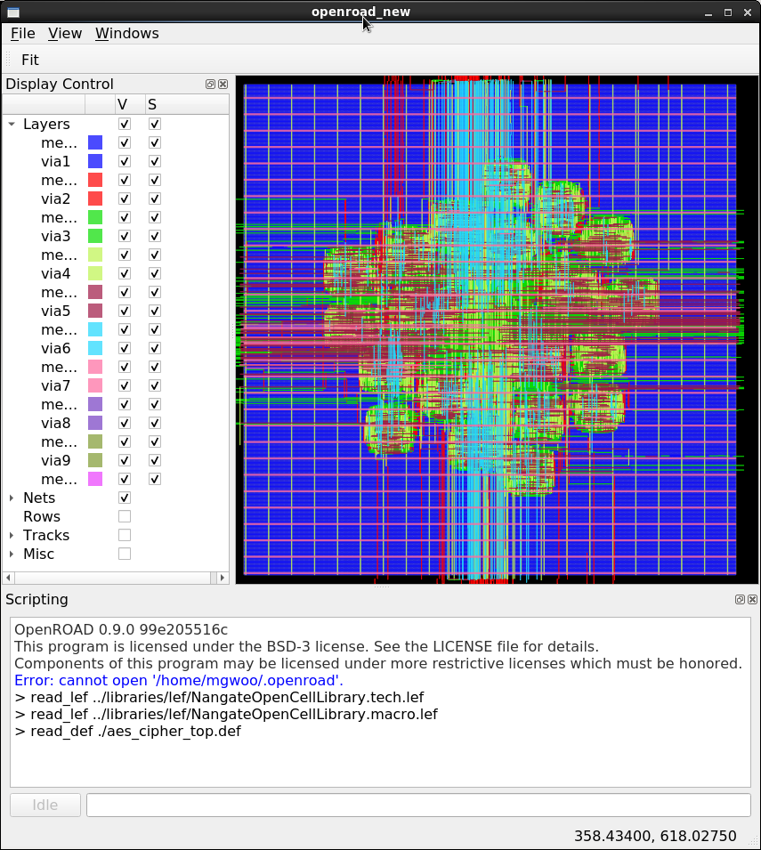
OpenROAD Flow and Integrated App Today
OpenROAD Flow
OpenROAD GUI example (new)
NanGate45-AES
Notes:
The overall OpenROAD-flow is illustrated as in the left figure.
The blue box shows that OpenROAD has evolved to have a single integrated binary.
OpenROAD-app has more than 20 tools from the floorplanning to global routing.
All tools can be called using the corresponding TCL commands from the binary.
Also, OpenROAD has a new GUI feature with QT.
The NanGate45-AES is visualized as in the right figure.

Slide 8
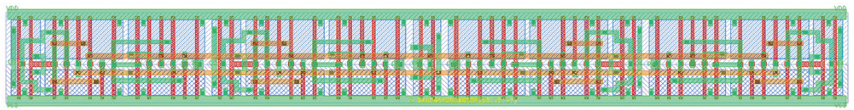
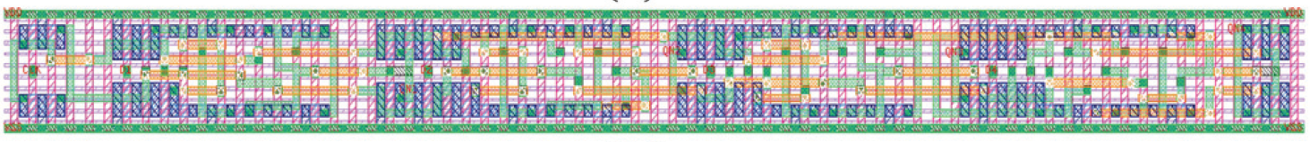
Multi-bit Flip-Flops (MBFFs)
Reduce clock power effectively
Synthesize 2-bit and 4-bit MBFFs by NCTUcell [DAC-19]
  Differences:
  ASAP7 requires uniform and aligned gates
  FreePDK45 can use poly as a routing layer
4-bit MBFF for FreePDK45
4-bit MBFF for ASAP7

Slide 9
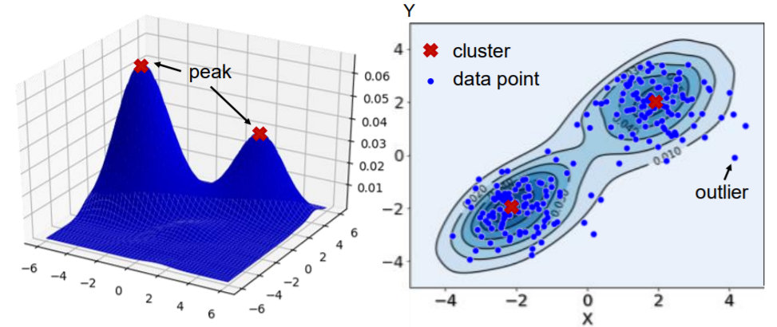
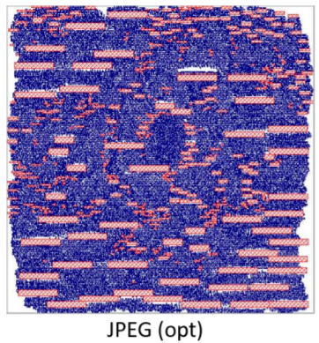
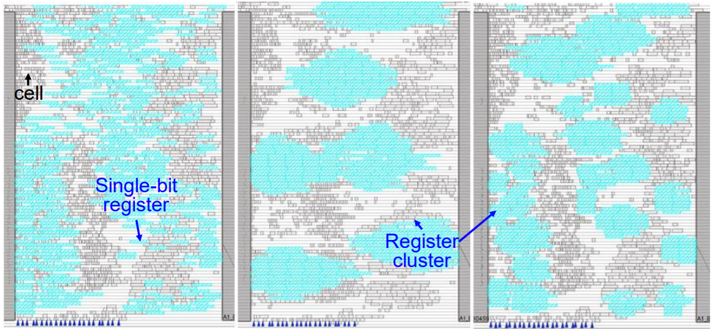
Post-Placement Flip-Flop Clustering
Mean-shift [ISPD-19]
  Naturally cluster FFs according to flip-flop distributions
  Balance power and timing
FlopTray [ICCAD-18]
  Capacited K-means (min-cost flow) cluster FFs
  LP determines locations considering the aspect ratio

Slide 10
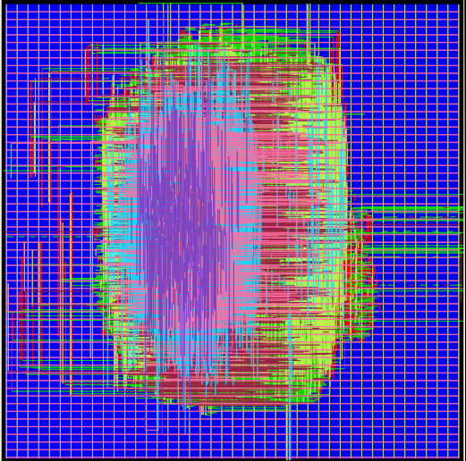
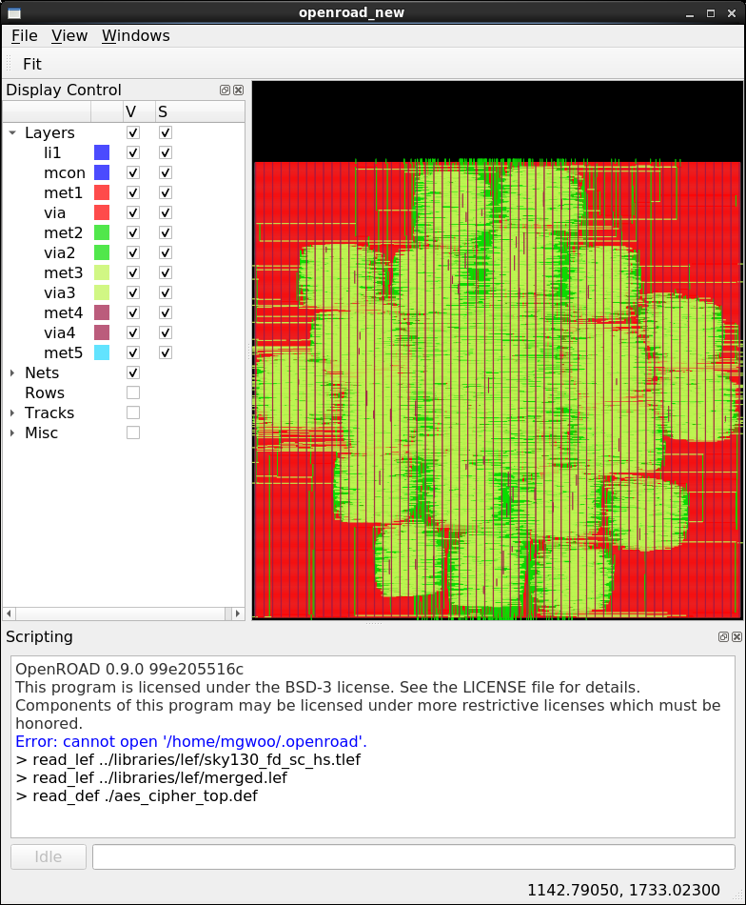
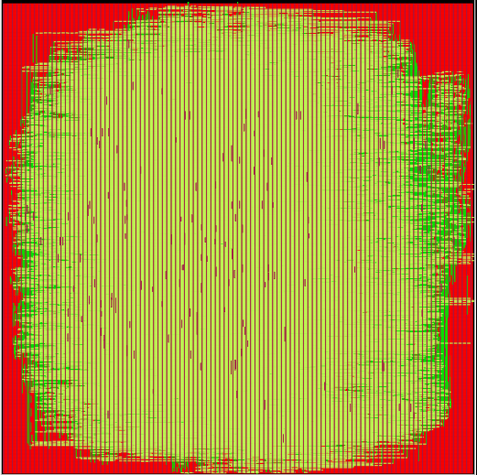
SKY130 Enablement on RDF-2020
Four DRV-free routed designs are provided as calibration testcases.
  {NanGate45, SKY130} X {AES, JPEG}.
Routed *.v, *.def, *.sdc, and *.spef as well as *.json are provided for calibration.
  Two JSON are provided for timer calibration (5-worst, endpoints slacks)
NanGate45-AES
NanGate45-JPEG
SKY130-AES
SKY130-JPEG
Visualized calibration designs from OpenROAD-gui
Notes:
Using the RDF-2020 flow, we can generate four DRV-free routed designs as in these figures.
Each design, we provide routed *.v, *.def, *.sdc, and *.spef as well as *.json.
There are two kinds of *.json. We’ll describe the JSON format in detail in the later slide.

Slide 11
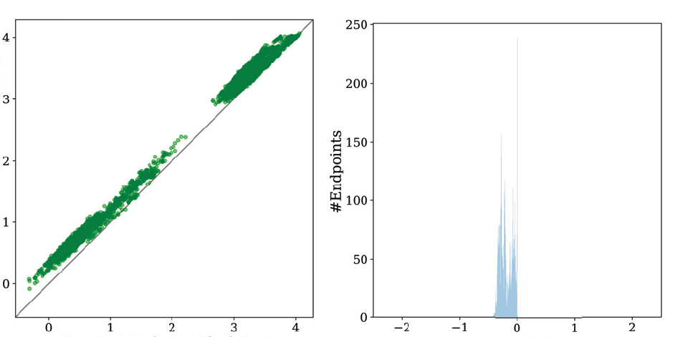
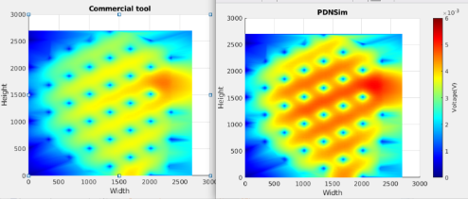
New Direction: Analysis and Verification
The calibration data can begin with Verilog (.v), timing constraints (.sdc), routed .def, and an extracted .spef
Timing correlation analysis results on jpeg_encoder with NanGate45
Late-Breaking News:
  IR drop calibration analysis results on jpeg_encoder with SKY130 (Vidya Chhabria, UMN)
Commercial Endpoints Slack
OpenSTA Endpoints Slack
Error (ns)
Commercial
PDNSim
Timing Calibration Results (Comm vs OpenSTA)
NanGate45 – jpeg_encoder
IR Drop Calibration Results (Comm vs PDNSim)
SKY130 – jpeg_encoder
Notes:
We can also extract the calibration results from our testcases.
The left figure shows timing calibration results (e.g. Commercial vs OpenSTA endpoints slack comparison) on NanGate45-JPEG design. There is less than half of the nanoseconds gap on endpoints between Commercial and OpenSTA.
Late-breaking news: Recently, we can compare the IR drop results between Commercial and PDNSim from UMN’s help.
A UMN student, Vidya, could generate the commercial vs PDNSim results on SKY130-JPEG design as in the right figure.

Slide 12
JSON formats for Timing Calibrations
endpoint_slacks.json
  Contains all endpoints and corresponding slacks.
  Can be used to compare the timer’s performance.
5_worst.json
  Design summary (WNS, TNS, FEP) as well as top 5 worst timing paths are provided.
  The JSON formatter is provided. (Python script)
=========================================================
aes_cipher_top (freepdk45) Summary
=========================================================
WNS: -0.230
TNS: -10.560
FEP: 139
---------------------------------------------------------
aes_cipher_top (freepdk45) top1 worst timing path
---------------------------------------------------------
Startpoint: _28827_/Q (Falling)
Endpoint: _28884_/D (Rising)
Path Group: reg2reg
Delay Time Description
---------------------------------------------------------
0.00 0.00 ^ clk
0.01 0.01 ^ clkbuf_0_clk/A (BUF_X4)
0.03 0.04 ^ clkbuf_0_clk/Z (BUF_X4)
...
0.00 1.23 ^ clkbuf_4_6_0_clk/A (CLKBUF_X1)
0.08 1.31 ^ clkbuf_4_6_0_clk/Z (CLKBUF_X1)
0.00 1.32 ^ clkbuf_6_27__f_clk/A (BUF_X4)
0.03 1.35 ^ clkbuf_6_27__f_clk/Z (BUF_X4)
0.00 1.35 ^ _28884_/CK (DFF_X1)
-0.04 1.31 library setup time
1.31 data required time
---------------------------------------------------------
1.31 data required time
1.54 data arrival time
---------------------------------------------------------
-0.23 slack (VIOLATED)
"tech": "freepdk45",
"design": "aes_cipher_top",
"pins": [
"_28572_/D",
"_28573_/D",
...
],
"slacks": [
"0.648",
"0.731",
...
]
"top1": {
"endPoint": "_28884_/D",
"endPointStatus": "Rising",
"startPoint": "_28827_/Q",
"startPointStatus": "Falling",
…
"slack": "-0.230",
"pathList": [
{
"pin": "clk",
"status": "Rising",
"net": "clk",
…
Endpoint slacks JSON
5-worst JSON
Example of NanGate45 AES Timing Report
from 5-worst JSON
https://github.com/ieee-ceda-datc/datc-rdf-timer-calibration
Notes:
Two JSONs are provided in RDF-2020 for timer calibration.
The Endpoint_slacks.json contains all endpoints (e.g. FF’s D pins) and corresponding slacks as in the lower left figure.
The Endpoint_slacks.json can be used to compare the timer’s performance.
The 5_worst.json contains the top 5 worst paths in the routed design as in the lower middle figure.
We also provide a timing report converter using Python.
If you use this converter, you can extract OpenSTA-style timing reports as in the right figure.
All of JSON and converter is open-sourced in the datc-rdf-timer-calibration GitHub repo.

Slide 13
Future Scope
Non-Integer Multiple-Height (NIMH) Cells
Logic Locking for Hardware Security
A “Smarter” RDF Flow
  The “machine learning” research challenge is to learn how to identify “most promising” states of the design at key junctures (floorplan, global placement, post-CTS, post-global route).
Continue vertical and horizontal expansions

Slide 14
Conclusion
Several significant developments from the past year are seen in RDF-2020.
We also describe several research challenges now addressable by the research community with RDF-2020, along with potential future extensions.
RDF will explore these and other directions of growth as it continues to improve its support of academic physical design research.
We are open! Please give any suggestion through our GitHub repo.

Slide 15
Thank you!
GitHub Link: https://github.com/ieee-ceda-datc
https://github.com/datc-rdf-timer-calibration

