Slide 1
Open-Source EDA: If We Build It, Who Will Come? VLSI-SoC 2020 October 6, 2020
Andrew B. Kahng
Depts. of CSE and ECE
UC San Diego
abk@eng.ucsd.edu
https://vlsicad.ucsd.edu
Notes:
Good morning, everyone! Thank you for the kind introduction and it is a great pleasure to be here today.
The URL **HERE** is my lab’s website – it has a lot of related talks and links.

Slide 2
Agenda
Perspective
Open-Source EDA and OpenROAD
Open-Source EDA: If We Build It, Who Will Come?
OpenROAD Today
Looking Back, Looking Ahead
Conclusion
Notes:
Here is the agenda for today.
My goal is to give some food for thought about “Open-Source EDA – If We Build It, Who Will Come?”, based on experience trying to create open-source EDA.
I will start with one slide about my perspective, which comes from decades really working on one word: SCALING.

Slide 3
Perspective: Scaling
Scaling of Design Technology
Physical design optimization
Margins, signoff and “ultimate PPAC”
DFM → DTCO → Pathfinding
“Design-Based Equivalent Scaling”
“The Last Scaling Levers”: Quality, Schedule, Cost
+ Roadmapping of Design Technology and Designs
Scaling of Research
CAD-IP Reuse: The MARCO GSRC Bookshelf
Open Source: Capo, UCLApack, …
2018-present: The OpenROAD Project (Jan 2017 onward)
Notes:
Scaling means one percent per week – which is the meta-law of Moore’s Law – PPAC, UX, value, societal good, all advancing at one percent every week.
So a lot of my work has fallen into two buckets.
[CLICK] SCALING of DESIGN TECHNOLOGY – which is EDA . Optimizing physical design, squeezing out ultimate PPAC from technology, and improving the design-manufacturing interface.
We are in an era of design-based equivalent scaling – yes, this includes Architecture Design … where the last scaling levers are quality, schedule and cost – to keep winning another percent and another week of scaling. And we need to see ahead, as well.
[CLICK] Then there is SCALING of RESEARCH by open-source: making research BETTER through IP Reuse in the VLSI CAD and EDA universe. Which I tried in the Bookshelf and Capo or MLPart, UCLAPack, and other efforts.
And more recently in The OpenROAD Project.

Slide 4
Agenda
Perspective
Open-Source EDA and OpenROAD
WHY “Open-source”?
Notes:
The theme of this conference is [CLICK] Open-Source VLSI Technologies. Why “OPEN SOURCE” ?
[CLICK] Which brings me to Open-Source EDA and learnings from the project I’m most familiar with, which is the OpenROAD project.

Slide 5
ASIC Design: Expertise, Schedule, Cost, RISK
Modern “Place and Route” tool: 10000+ commands/options
Hard to design with latest tools in latest technologies
Quality and schedule are unpredictable
Expert users are required
Cost and risk block innovation
Notes:
We all know that ASIC Design is difficult, expensive, and risky.
[CLICK]
Tools have thousands of command-option combinations.
They are complicated and unpredictable. You need expert users.
This brings cost and risk that that block innovation.
We see pictures like [CLICK] this – the cost of silicon is under control. The cost of designing in silicon is out of control.
So innovators have a hard time innovating – doing design ideation and design space exploration – in hardware.
When we talk about the DESIGN CRISIS, we really mean that access to silicon is out of the reach of designers.

Slide 6
Need Democratization of Hardware Innovation
Democratize: to make available to all people https://www.merriam-webster.com/dictionary/democratize
Application-specific ICs, not only FPGAs
ASIC = Design + PDK + EDA
Notes:
We often hear the term: Democratization – and that we need to DEMOCRATIZE hardware design and innovation.
[CLICK] According to Merriam-Webster, Democratize means to make available to all people. Yes, we do want to democratize hardware innovation – to keep finding and addressing new killer apps, and to keep the fabs full of high-value products.
[CLICK] Implementation in ASIC is not like implementation in CUDA or in an FPGA. You need THREE elements.
You need design IPs like cell libraries, IOs, and memory generators.
You need an underlying process design kit from a manufacturer.
You need EDA tools like synthesis place-and-route or simulation.
And then there is the “available to all people” part as well.

Slide 7
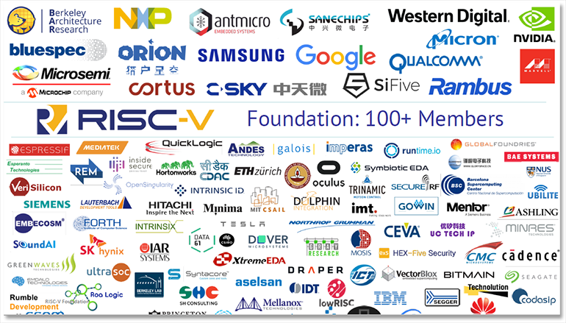
Democratization: ASIC = Design + PDK + EDA
RISC-V
Notes:
Today, we see a vibrant open source hardware DESIGN ecosystem, with RISC-V being an extremely visible example. There’s FOSSi, CHIPS Alliance, Open HW Group … and the DARPA POSH program.

Slide 8
Democratization: ASIC = Design + PDK + EDA
Google/SkyWater, June 2020: first open-sourced 130nm PDK
Notes:
There’s an open-source manufacturable PDK available, since Google and SkyWater foundry open-sourced a 130nm PDK this summer.
This is a screenshot from Tim Ansell’s FOSSi Dial-Up talk on June 30th – which had over ten thousand views on YouTube in its first week. The open-source hardware community is large and active – no question.

Slide 9
Need Democratization of Hardware Innovation
Democratize: to make available to all people https://www.merriam-webster.com/dictionary/democratize
Application-specific ICs, not only FPGAs
ASIC = Design + PDK + ?? EDA ??
Notes:
But what about EDA? In the picture of democratization and access to all: the real missing piece today is EDA.

Slide 10
U.S. DARPA IDEA: No-Humans, 24-Hours
A. Olofsson, DARPA
ISPD-2018 keynote
Part of DARPA Electronics Resurgence Initiative
Traditional focus: ultimate performance, power, area
IDEA focus: ultimate ease of use and runtime
Restore designer access to silicon
Notes:
How do you change hardware design so that it is LESS difficult, needs FEWER EXPERTS, and COSTS less?
The obvious answer is a combination of automation and intelligence, with “self-driving” design tools and flows. And there is open source.
In 2018, DARPA launched the IDEA program as part of the U.S. Electronics Resurgence Initiative. The IDEA program aims for Hardware Compilers 2.0 – no humans, 24-hour turnaround time, eventually with zero loss of quality.
[CLICK] This shifts the focus FROM tools that enable expert users to achieve ultimate PPA, TO SELF-DRIVING tools that don’t require experts or time to tape out a working chip.
[CLICK] Leading to democratization of hardware design.

Slide 11
The OpenROAD Project
open-source, digital hardware
OpenROAD
A. Olofsson, DARPA
ISPD-2018 keynote
Traditional focus: ultimate performance, power, area
OpenROAD focus: ultimate ease of use and runtime
Digital IC RTL-to-GDS
Notes:
As part of the IDEA program, I lead a project on the DIGITAL IC side, called
[CLICK] OpenROAD.
The goal is Verilog in, merged tapeout-ready GDS out -- in 24 hours, with no-human-in-the-loop.
And, at the same time we’re trying to seed an OPEN SOURCE EDA based ecosystem as well.
[CLICK] Our team includes Qualcomm, Arm, and FIVE universities.
Automation plus Open-Source equals progress toward DEMOCRATIZATION, which …

Slide 12
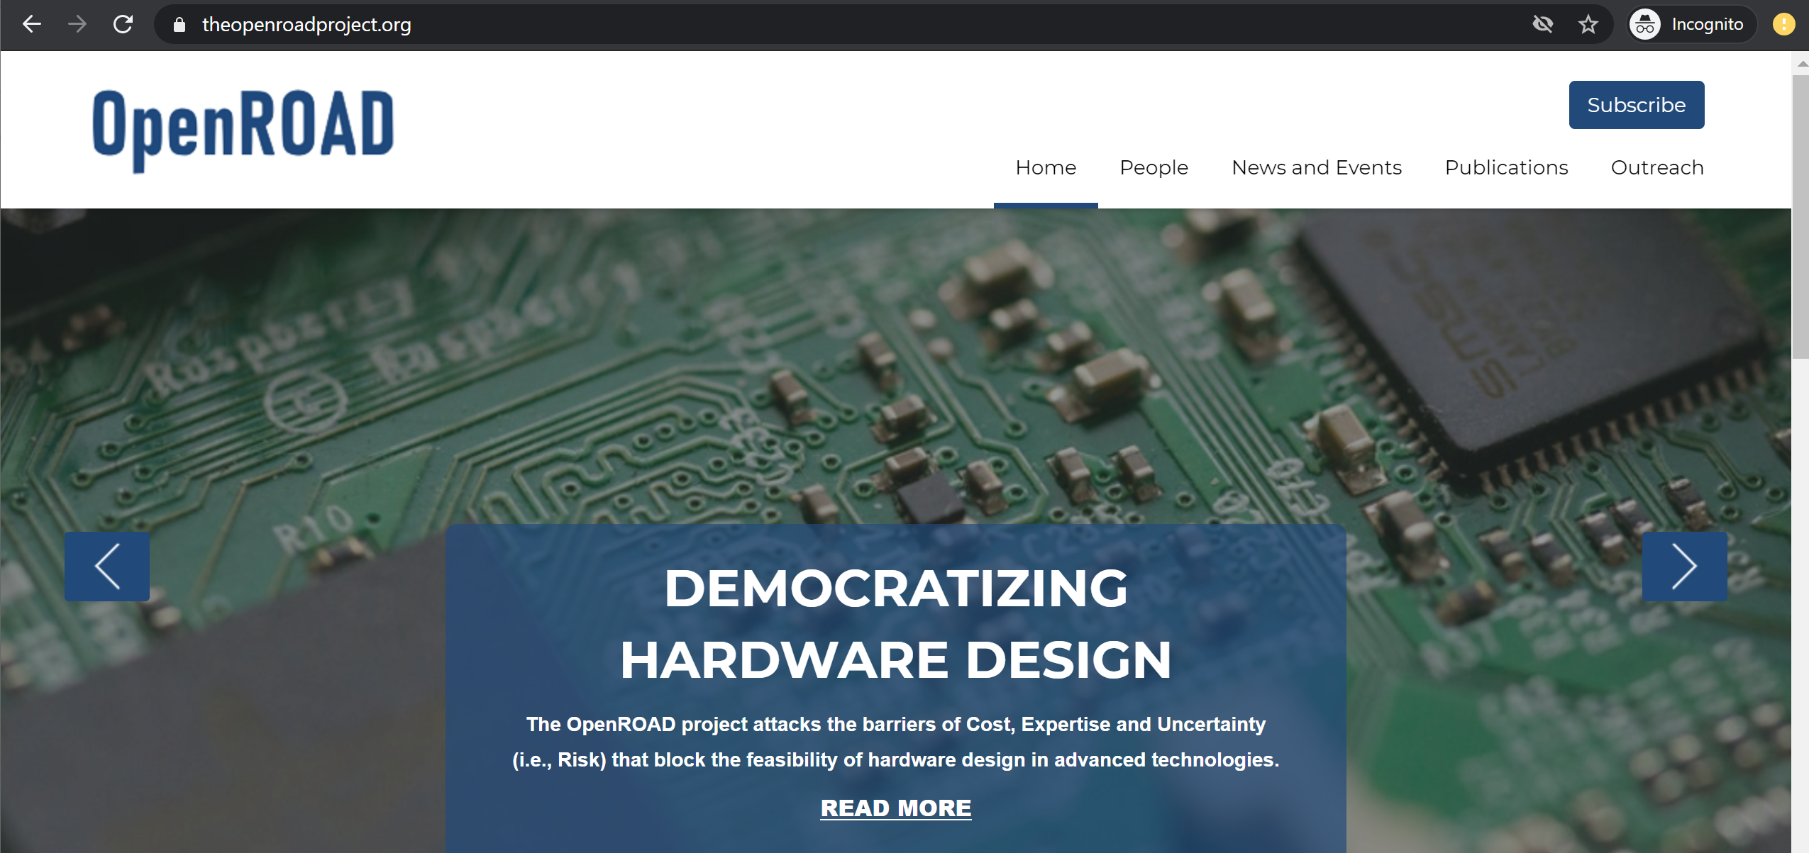
The OpenROAD Project
open-source, digital hardware
OpenROAD
A. Olofsson, DARPA
ISPD-2018 keynote
Notes:
Has been front and center for us ever since we started.

Slide 13
Why Open-Source EDA?
ICCAD19: Looking into the Mirror of Open Source paper, slides
Clarity, better science
Leading edge becomes visible and well-defined
Advances are verifiable: no more “irreproducible results” !
Google Research Philosophy: “First and foremost, sharing knowledge accelerates progress for everyone.”
Avoid reinventing wheels
Students don’t waste months trying to reconstruct papers
Field advances more rapidly
Strong correlation with maturity, health of field
AI / ML, computer vision, NLP, …
Strategic advantages to researchers and companies alike
Notes:
Why open-source EDA? In the context of democratizing access to silicon – we want open-source EDA for the same reasons we want open-source IP cores and open-source PDKs.
But for me, the reasons are deeper than that.
As an academic, I’ve pursued open-source EDA over some decades, for one basic reason: Clarity of SCIENCE. Open source enables research to be principled and verifiable.
Amazingly: BY CONSTRUCTION my research cannot be reproduced by others! (Since I cannot share my students’ Tcl scripts with anyone… This is crazy.)
[CLICK] And with open source, we won’t waste time! People are precious in the EDA world – too many of them go to Google instead of Synopsys, or AI instead of CAD, without the EDA field itself making research unnecessarily tough or impossible! We drive students away by making them reinvent a zillion wheels when they do research!
[CLICK] And mature fields flourish with open-source culture.

Slide 14
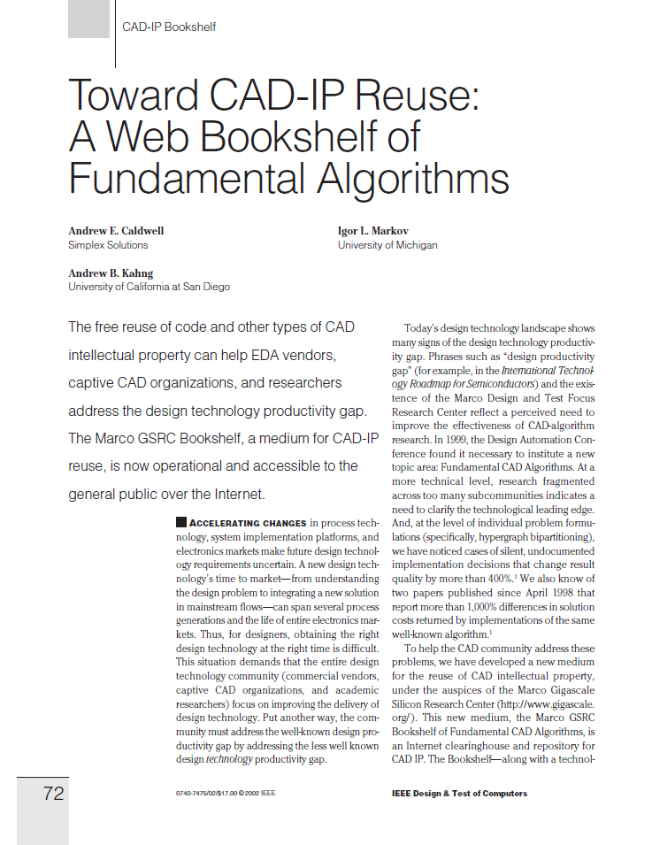
Open-Source EDA = A Recurring Dream
MARCO Gigascale Silicon Research Center, 1998
Bookshelf still at http://vlsicad.eecs.umich.edu/BK
Notes:
Open-source EDA has been somewhat of a recurring DREAM -- for most of my career.
[CLICK] If you’ve used Capo or codes from the Bookshelf, or benchmarks that are distributed in Bookshelf formats – that was part of my group’s early history with open sourcing in the late 1990s, in the first MARCO DARPA Gigascale Silicon Research Center. Same motivation: open access to reusable CAD IP, to enable RESEARCH.

Slide 15
Agenda
Perspective
Open-Source EDA and OpenROAD
Open-Source EDA: If We Build It, Who Will Come?
Notes:
So now let me get to the core of this talk, which is a question about Open-Source EDA: IF WE BUILD IT, WHO WILL COME?

Slide 16
If We Build It, Who Will Come?
1989 film: “Field of Dreams”
Book: W. P. Kinsella, “Shoeless Joe”
“If you build it, he will come”
“It” is a baseball field
Story of curing the sins of the past to bring a brighter future
Open-source EDA is truly a field of dreams.
Notes:
The movie “Field of Dreams” had this famous line that some of us might remember: “If you build it, he will come”.
In the movie, “IT” is a baseball field -- an Iowa farmer hears a voice telling him to build it, and he builds it in the middle of a cornfield.
The “IT” is the field where dreams are realized – and where curing the mistakes of the past brings closure and a brighter future.
So I would like to say first of all: Open-source EDA is truly a field of dreams.
BUT IF WE BUILD IT, WHO WILL COME?

Slide 17
If We Build It, Who Will Come? What is “It”?
7/2018 DAC Birds-of-a-Feather meeting
11/2018 Workshop on Open-Source EDA Technology
→ Want to see a complete RTL-to-GDS flow
7/2019 DAC Birds-of-a-Feather meeting
11/2019 Workshop on Open-Source EDA Technology
Showed flow, DRC-clean layout generation in TSMC 65LP
→ Want to see integrated tool and tapeout proofs
7/2020
Showed integrated tool, at least one third-party tapeout
→ Want to see advanced-node foundry support, PPA calibrations, DFT, functional simulation, DRC/LVS engine, …
Open-source EDA is a moving, many-faceted target
Notes:
Whenever I talk about OpenROAD, I always make sure to say that we’re very focused on delivering “critical mass and critical quality to seed a FOSS EDA ecosystem”.
But what exactly do we need to deliver? What is “IT”? From years of conversations: open-source EDA can mean many things to many people.
[CLICK] In 2018, when we started with a bunch of engines in GitHub, the community (such as folks in this audience) said that they wanted to see a COMPLETE RTL-to-GDS flow.
[CLICK] A year later, after showing a flow, and DRC-clean layout generation in a foundry 65 nanometer process, the community said
[CLICK] We want to see an INTEGRATED TOOL – not just a tool chain – and TAPEOUT PROOFS.
[CLICK] A year later – which is now – we’ve shown an integrated tool and a third-party tapeout was made this past May.
[CLICK] And now the community is asking for advanced-node foundry support, DFT, functional simulation, and so on.
[CLICK] So: Open-source EDA is a moving, many-faceted target

Slide 18
Contradiction: No-Humans vs. Users
OpenROAD deliverable: no-human-in-the-loop, automated generation of tapeout database
Many requests: “Here are my favorite Tcl commands that I’d like to see in OpenROAD”
Commercial EDA has 1000s of Tcl commands because it enables humans to achieve ultimate PPA
Open-source EDA as envisioned by DARPA IDEA program: ultimate ease of use, total automation
Driverless car: ultimately, no steering wheel or gas pedal
These are two different universes.
Notes:
OpenROAD’s “no human in the loop” goal is essentially to be a self-driving tool, like a car that doesn’t even need a steering wheel or a gas pedal.
[CLICK] There is a fundamental contradiction with what many users typically ask, which is: Here are my 20 favorite Tcl commands in ICC or Innovus – can you please add them?
[CLICK] Commercial RTL-to-GDS has thousands of commands and options BECAUSE it has become a giant swiss army knife with which users can (in theory) achieve ultimate PPA.
But the IDEA program is about research on EDA that will one day bring ultimate ease of use and total automation.
[CLICK] These are two different universes.

Slide 19
OpenROAD = Many Research Challenges
24 hours, no humans – no PPA loss
Extreme partitioning
Parallel optimization
Machine Learning of tools, flows
Restricted layout
Design Complexity
Example mindsets
Cloud/parallel → predictability, recover solution quality
Machine learning → intelligence to “keep design in a box” of compute resource and schedule
Notes:
And this is really RESEARCH. To get FROM here TO here --
We pursue as RESEARCH three foundational “TECHNOLOGIES”.
[CLICK] Extreme Partitioning to decompose the design problem into bite-sized chunks. [CLICK] Orchestration of distributed and parallel optimization threads. And [CLICK] Machine Learning to model and predict what will happen when a heuristic is run in some way on some input with some target. (There’s also [CLICK] “freedoms FROM choice” which we expect in a no-humans tool, just as self-driving cars will eventually have no steering wheel.)
And [CLICK] here are key MINDSETS that we hope will get us to predictability and quality and intelligence.

Slide 20
If We Build It, Who Will Come? Who is “We”?
“We” evolves with “It”, and depends on “Who”
Open-source EDA goes beyond academic research abilities
Original proposal: OpenROAD would be developed by Ph.D. students and post-docs at four universities.
Separately, students and post-docs at a fifth university would be the “internal design advisors”
Vision: span product engineering, expert user testing, corporate AE-like functions
Key point: clear separation between “internal design advisors” and “tool developers” is built into OpenROAD
Deliverables such as PPA assessment and calibration must come from design advisors
Notes:
Next, who is the “WE” in If WE build it … ?
[CLICK] First point: the WE will depend on the tool you’re building, which depends on who’s going to use the tool. (Which we kind of don’t know yet…)
[CLICK] Second point, and I would say a KEY LESSON learned: Open-source EDA goes beyond academic research skillsets.
[CLICK] In the case of OpenROAD --- originally, we proposed to develop the whole thing with Ph.D. students and post-docs at four universities.
[CLICK] Separately, students
and post-docs at a fifth university would serve in an “internal design advisors” role – users, product engineers, and AEs all rolled together.
[CLICK] We built in this separation to ensure that when commercial tools are used to report metrics to DARPA, the students who write the tools aren’t the ones doing this. So… that was the vision…

Slide 21
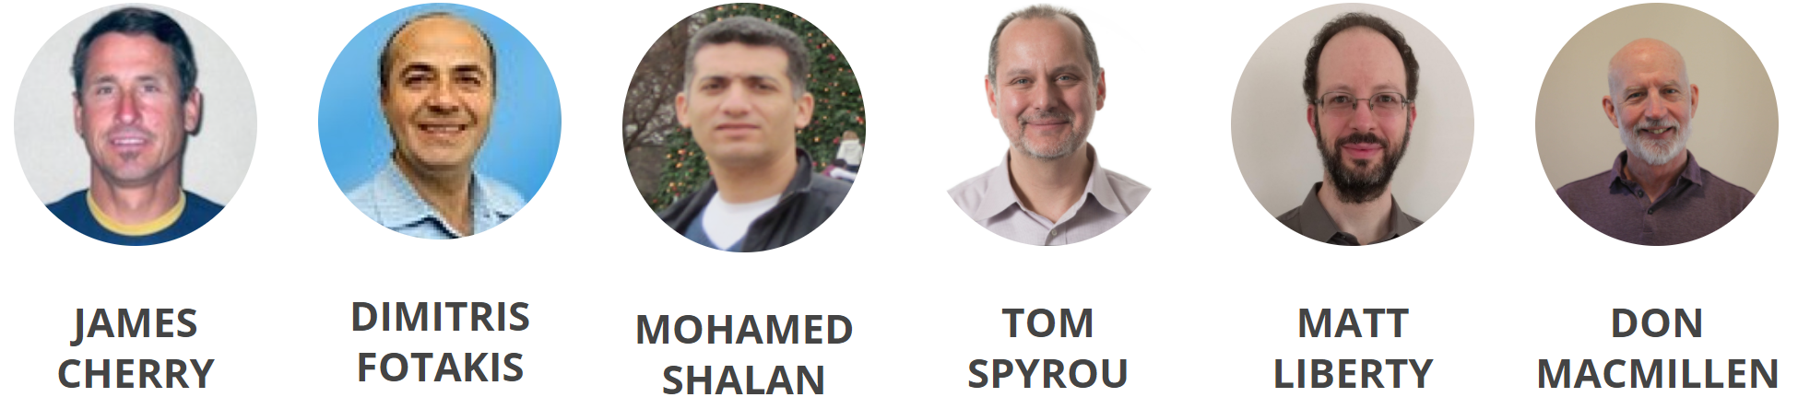
If We Build It, Who Will Come? Who is “We”?
What actually happened …
By 9 months in, need for experienced EDA architect was clear → belt-tightening and non-DARPA gift funds allowed EDA veterans to be brought into the project
Technical leadership and know-how: tool delivery, project management, infrastructure (DB, GUI, build/CI), key engines (STA, RCX)
“We” must include professional EDA software developers and architects.
Notes:
What actually happened –
[CLICK] In OpenROAD, very soon we knew we needed a dedicated, experienced EDA architect and technical manager from outside the team.
So [CLICK] we figured out how to make this happen.
Tom Spyrou has been OpenROAD’s chief architect since July of last year. James Cherry was with us from the start. Matt Liberty has been full-time since January. There’s nearly 200 years of EDA industry experience on this slide --- tool delivery, project management, infrastructure, and key engines. More important, these are industry veterans who share the vision of open-source EDA as an enabler of research and how we will train up a new generation of EDA technologists.
[CLICK] “We” has to include professional EDA software developers and architects. (Students and professors can’t do it.)

Slide 22
Skills and Mindset Matter!
Strongest contributors have software skills and the right mindset
E.g., undergraduate and graduate students from CS backgrounds, in other countries (!)
Coached by EDA veterans
Obtain thesis topics, publications along the way
To appear at ICCAD-2020
Notes:
We’ve also learned a lot about skills and mindset.
[CLICK] The strongest contributors will have software skills AND the right mindset. Some of OpenROAD’s strongest developers have been undergraduate and graduate students from outside the U.S.
They have interest in EDA, and are willing to be coached by industry veterans – and they have gotten thesis topics and publications along the way.
[CLICK] This is the ICCAD-2020 paper where students from Brazil document their experiences as developers on four separate tools within OpenROAD: global routing, clock tree synthesis, IO placement, and tapcell insertion.
The observation here is that physical design understanding is easier to grow than software development maturity.

Slide 23
Contradiction: Success vs. Research
A successful project will see more demands for productization and user support …
... which is less attractive to academic researchers
Rigorous software methodology brings quality, maintainability, velocity of development …
… but brings overheads and barriers
Integration and testing
Credit assignment, authorship of publications, …
Notes:
And here’s another contradiction: the more successful an open-source EDA project is, the more it will see real-world usage, and more support requests – which is not a role that academic researchers want.
[CLICK] Software methodology is essential, BUT it brings overheads such as integration and testing.
And, even more crucially, open source exposes all sorts of weird incentives and thinking – should I fork instead of merge upstream, should I keep a separate repo, should I reject this pull request, and so on – due to people thinking about credit or authorship of papers.

Slide 24
“We” Must Include the Right Users
Open-source EDA is still EDA
There has never been a successful EDA tool that hasn’t had an amazing AE and power user behind it
“we’re still in taxicab mode with our key beta customer”
Mainstream tool user attitude: file bug, wait for fix
Passive, problem-reporting
Power user / AE attitude: find fixes and workarounds, and package these up for R&D (developers)
Active, problem-solving
OpenROAD team has a design services / tapeout consultant
Notes:
The “WE” who builds open-source EDA must include the right USERS.
Because ultimately, [CLICK] Open-Source EDA is still EDA.
[CLICK] No successful EDA tool in the history of the field has ever existed without intensive “taxicab mode” support delivered by field AEs to key “beta customer” power users.
[CLICK] A mainstream user files bugs and waits for fixes.
[CLICK] A power user finds fixes and workarounds, and brings these to R&D – basically, a problem-solver rather than a problem-reporter.
And in OpenROAD, we needed to hire an experienced design services consultant to bring in the timeline for 12nm tapeout capability.

Slide 25
If We Build It, Who Will Come? Who is “Who”?
Who will use open-source EDA in the future?
Original vision: Users will make enhancements and pull requests …
What we found: This is a very rare type of user !
(Greatly outnumbered by the “want poor-man’s Innovus” crowd)
Notes:
Next, there is the question of WHO: Who will use Open-Source EDA in the future?
I’d like to start with another key learning.
[CLICK] Originally, we imagined that Open-Source EDA would be a kind of Utopia where users would read the code, make enhancements and pull requests – so, the availability of source code would fundamentally unleash a new form of user engagement.
[CLICK] But really, such users are very rare. Many folks who contact us are basically hoping for a poor-man’s Innovus -- they don’t understand the thousands of years of professional R&D needed for that.

Slide 26
If We Build It, Who Will Come? Who is “Who”?
Who will use open-source EDA in the future?
Open Hardware Community is engaged, supportive
Academic EDA researchers
Improve research efficiency – leverage a robust code base that grows stronger over time
Notes:
[CLICK] Definitely, the open hardware community is very supportive. We meet every week with Google and with Efabless, for example.
[CLICK] Academic EDA researchers also see the benefit of a robust backplane for research and technology transfer to industry.
[CLICK] And over the past two years, OpenROAD has become a key part of the IEEE Council on EDA’s Robust Design Flow, which is an activity of the Design Automation Technical Committee. This is the paper being presented at ICCAD in a few weeks. It will describe the past year’s updates – and if you stare at [CLICK] this flow, you’ll see that there is a complete OpenROAD flow -- as well as OpenROAD’s integrated app -- inside the Robust Design Flow.

Slide 27
If We Build It, Who Will Come? Who is “Who”?
Who will use open-source EDA in the future?
Academic EDA researchers
Improve research efficiency – leverage a robust code base that grows stronger over time
Contests, other research infrastructure → shift to open source
Teachers and trainers
Open source is transparent, low cost, usable worldwide
Insight into back-end DB, Tcl/Python scripting interfaces, GUI
Mixed-signal (“big A, little d”) SOC designers
Underserved design organizations (startups, govt labs)
Transparent, customizable tooling → security, privacy, trust
Open-source EDA is part of a movement.
Notes:
Teachers and trainers can scale across borders, at low cost – and their students can learn about back-end data model and database, Tcl and python tool scripting, P&R GUI – all of the basics, on an open-source tool.
[CLICK] Big-A / Little-D designers may use open-source EDA to tape out those 5K gates of digital glue logic.
[CLICK] There are underserved design organizations who want customizable, transparent tooling – whether for security and privacy reasons, or because there is no commercial EDA offering that matches their need.
[CLICK] All of these are part of the WHO. Open-Source EDA is part of a movement.

Slide 28
If We Build It, Who Will Come? Who is “Who”?
Who will NOT use open-source EDA in the future (???)
Academic design teams?
Have low-cost licenses to leading-edge commercial tools
Leading-edge product companies?
Only commercial EDA can deliver best-possible PPA in latest nodes
But … see Looking Ahead later in this talk
Notes:
And actually, there are folks who are unlikely to use open-source EDA.
[CLICK] Most academics have low-cost licenses to the leading commercial tools – no need to struggle with an open-source tool.
[CLICK] And product companies who are at the latest foundry node can only use commercial EDA – open-source tools would certainly not be capable or qualified at the leading edge.
[CLICK] But …. Even these folks can leverage open source – I’ll touch on this later.

Slide 29
Agenda
Perspective
Open-Source EDA and OpenROAD
Open-Source EDA: If We Build It, Who Will Come?
OpenROAD Today
Notes:
Obviously OpenROAD is what I’m familiar with, and it is a decent example of what open-source EDA – the IT – looks like today. So here is a very quick overview.

Slide 30
OpenROAD v1.0 (~now)
Verilog
+ libraries, constraints
Logic Synthesis
July 2019: Proof of capability
DRC-clean RTL-to-GDS, 65nm
“File-based flow” 1980’s EDA
July 2020: v1.0 EDA tool
DRC-clean RTL-to-GDS, 12nm
UW’s “BlackParrot” SoC
Integrated tool, modern EDA
Floorplanning
Placement
Clock Tree Synthesis
Global and Detailed Routing
GDSII final layout
Layout Finishing
Notes:
OpenROAD performs the “RTL-to-GDS” chip implementation flow, starting with logic synthesis and ending with a GDSII tapeout database.
[CLICK] A year ago, we showed a proof of capability: automatic generation of design rule-clean layout in a foundry 65nm technology. The flow passed files from tool to tool – what you might call “1980s EDA”.
[CLICK] Today we have a v1.0 EDA tool: a modern integrated architecture, industry-strength database and timing analysis, scripting interfaces for users -- and we’ve achieved design-rule clean layout generation in GLOBALFOUNDRIES’ 12LP process.

Slide 31
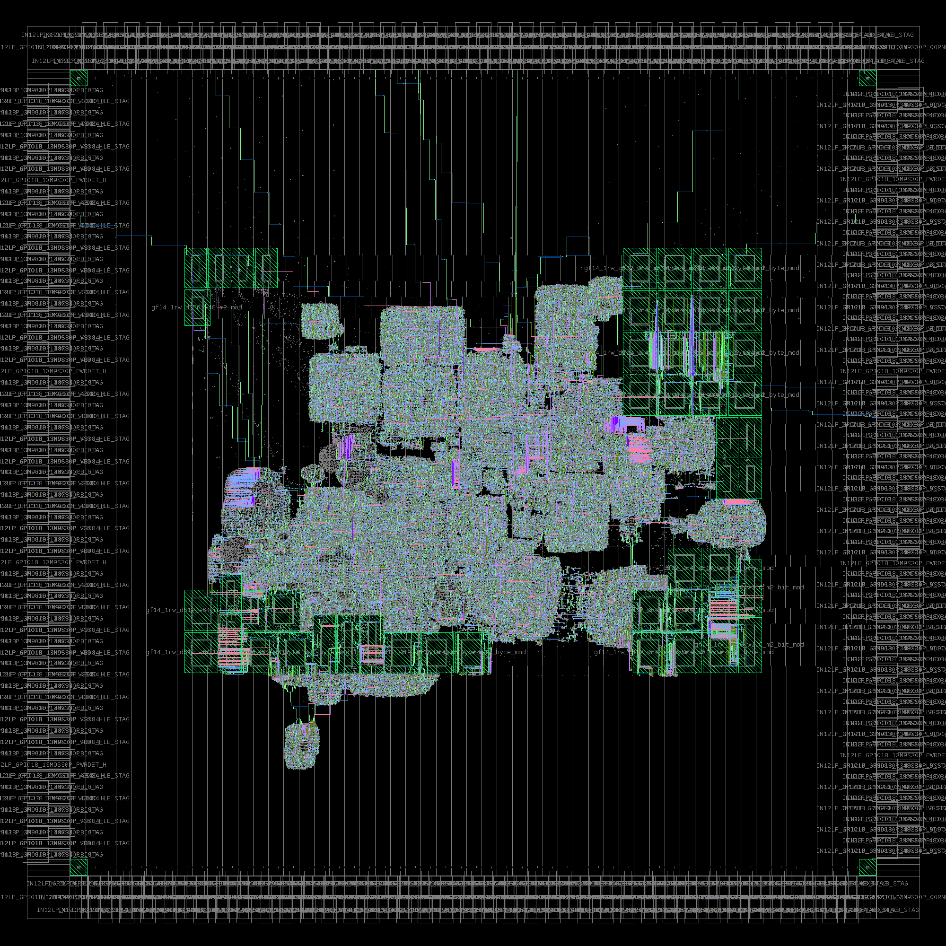
OpenROAD v1.0 (~now)
Verilog
+ libraries, constraints
Logic Synthesis
July 2019: Proof of capability
DRC-clean RTL-to-GDS, 65nm
“File-based flow” 1980’s EDA
July 2020: v1.0 EDA tool
DRC-clean RTL-to-GDS, 12nm
UW’s “BlackParrot” SoC
Integrated tool, modern EDA
Floorplanning
Placement
Clock Tree Synthesis
Global and Detailed Routing
GDSII final layout
Layout Finishing
Single-core BlackParrot, final netlist ~530K insts, 49 SRAMs, clean DRC, LVS, Antenna checks in Calibre on July 15. (GF12LP, Invecas IOs, Arm 9T cells and memories.)
Notes:
In mid-July, we achieved an automated, totally clean result --- by which I mean DRC, LVS, Antenna all clean in Calibre --- for a single-core version of the University of Washington BlackParrot SOC. This was implemented in GF12LP using Arm 9-track cells, Arm SRAMs, and Invecas IOs in the same 3mm x 3mm package design that the BlackParrot team had used for their original GF12 tapeout.

Slide 32
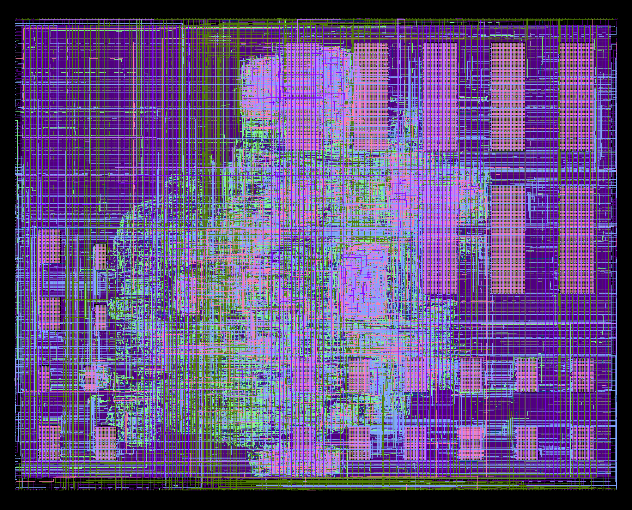
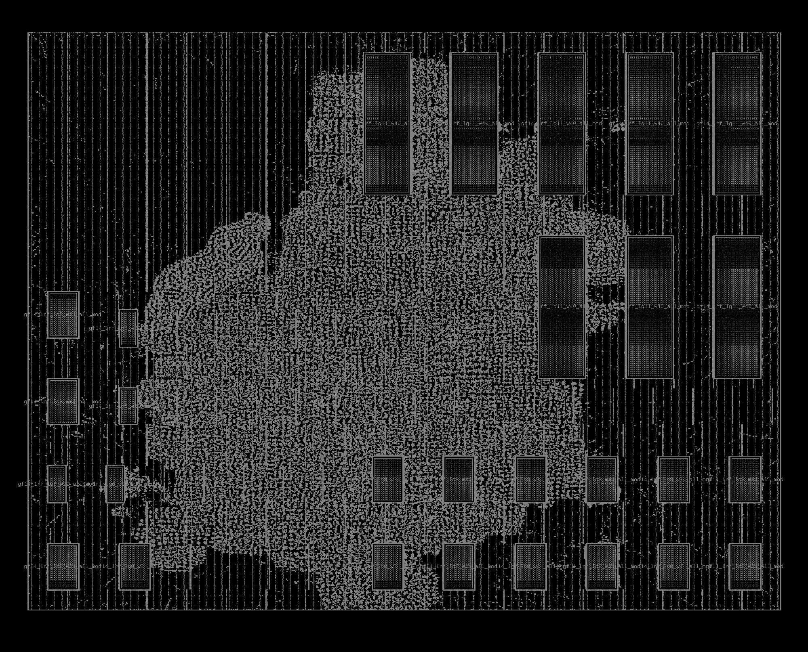
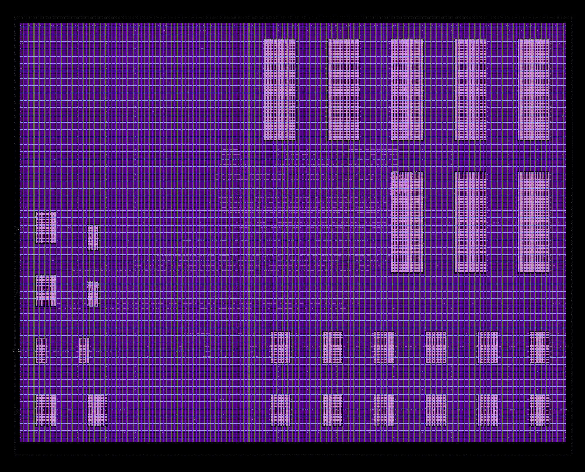
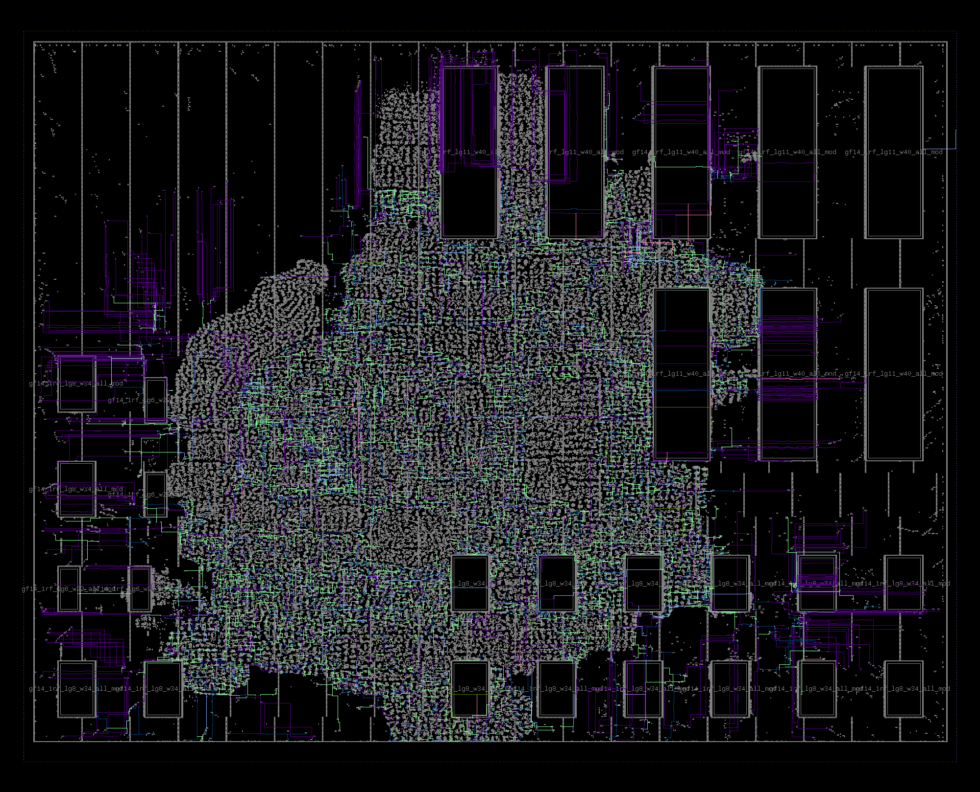
swerv_wrapper in gf12LP
Verilog
+ libraries, constraints
Logic Synthesis
Floorplanning
Placement
Clock Tree Synthesis
Global and Detailed Routing
GDSII final layout
Layout Finishing
swerv_wrapper (2019). Western Digital SweRV RISC-V Core 1.1
https://github.com/westerndigitalcorporation/swerv_eh1
Notes:
Here’s OpenROAD running on SweRV-wrapper from Western Digital, in the same GF12LP / Arm enablement.
Starting from RTL Verilog, the tool performs logic synthesis, [CLICK] then macro placement with power/ground mesh, standard-cell placement, clock tree synthesis, and final routing. The whole flow takes about an hour.

Slide 33
Industrial Strength Incremental Architecture
Synthesis
Further notes: link link link
Delay Calc
10K moves per second, cannot use files
Netlist
changes
via api
Location
and Routing
Delays
for a stage
Timer
Placement/
Routing
Netlist changes
callback
Netlist
changes
callback
New location
and/or routing
Shared Netlist
Shared Physical or Data Model Adapter
Notes:
When I say that OpenROAD has the architecture of a modern EDA place-and-route tool, this is what I mean.
This incremental Shared Netlist Architecture is the guts of commercial P&R tools since the early 2000s.
The Shared Netlist or Abstract Network Adapter enables incremental netlist modification, and communicates with Synthesis, Placement, CTS, Post-Place Opt, Routing, and the Timer. This picture shows how if Synthesis changes the netlist, then there is a callback that place-and-route is listening for – Then, if P&R changes the location or the routing, this is updated via the Shared Physical or Data Model Adapter which handles physical information such as placement location or routed metal shapes.
The timer is listening for a netlist change, and to update delays and slews, the delay calculation must use the updated location and routing information.
This architecture enables thousands of sizing or incremental moves a second – which is the heart of optimization in modern physical synthesis and P&R – and totally impossible with a file-based flow.
AND WHAT’S INSIDE OPENROAD ?

Slide 34
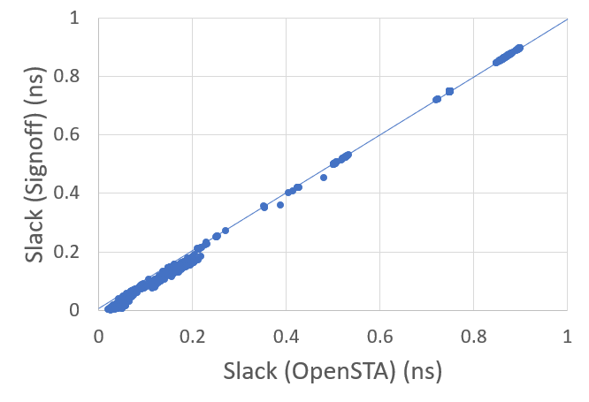
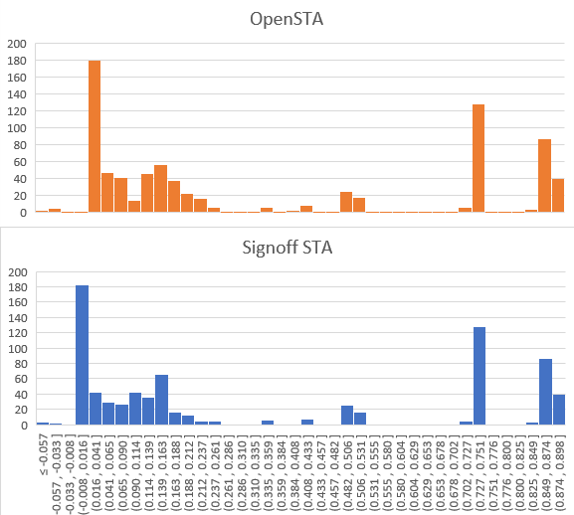
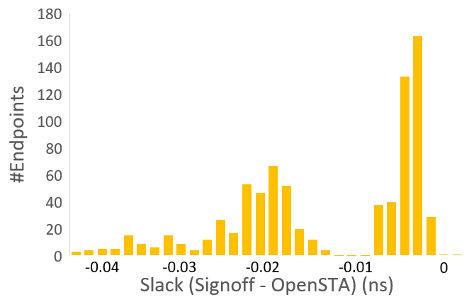
OpenSTA Slack, WNS, TNS 28nm
https://github.com/The-OpenROAD-Project/OpenSTA
aes_cipher_top (28nm, 12T, clkp=1000ps)
Reg-to-Out/ In-to-Reg
Reg-to-Reg
aes_cipher_top | WNS (ps) | TNS (ps) | #viol.
Signoff STA | -61 | -289 | 7
OpenSTA (arnoldi) | -57 | -314 | 9
Notes:
James Cherry’s OpenSTA timer was a huge breakthrough for EDA open source. It is a commercial timer that’s been embedded in about 15 commercial EDA tools, including most FPGA tools.
This slide shows slack histograms, WNS and TNS for a commercial signoff timer and for OpenSTA, on a small 28 nanometer block. Differences are on the order of a few tens of picoseconds.
A REAL, incremental STA engine is central to a modern RTL-to-GDS tool. I would not have submitted the OpenROAD proposal without James’s letter of commitment to open-source his timer if the project was launched.

Slide 35
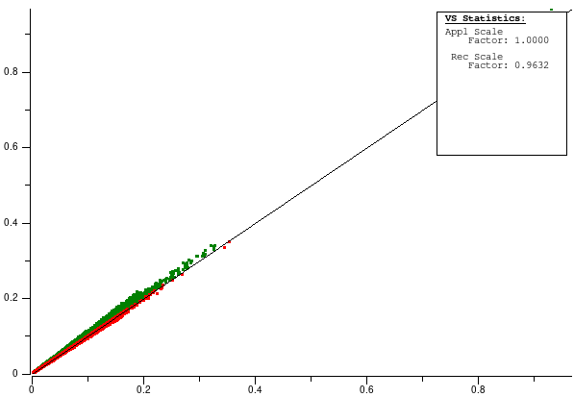
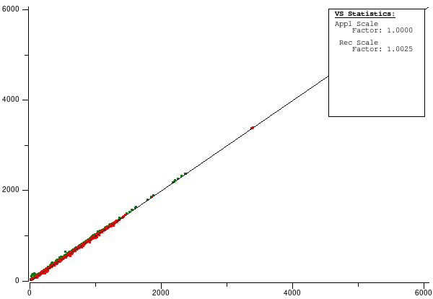
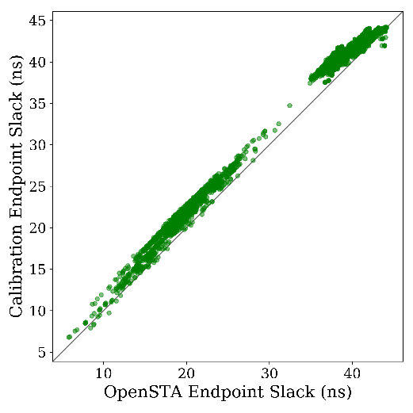
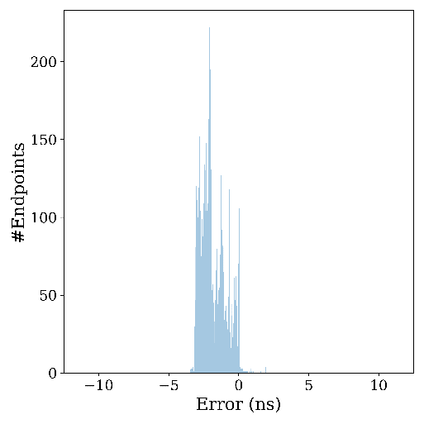
OpenRCX + OpenSTA Calibration (SKY130)
jpeg_encoder (168K insts), OpenROAD SP&R, 0 DRCs
Ostrich correlation analysis plots
Below the 45-degree line is pessimistic
CAP: ComRCX (y-axis) vs. OpenRCX (x-axis)
RES: ComRCX (y-axis) vs. OpenRCX (x-axis)
Endpoint slack correlation: OpenRCX + OpenSTA (x-axis) vs. ComRCX + ComSTA (y-axis)
Above the 45-degree line is pessimistic
Notes:
OpenRCX is both new and old. New – as in we’re pretty close to announcing it.
Old: it’s from the code base of Athena Design Systems, a startup that closed its doors during the late 2000’s downturn.
These plots are from a jpeg_encoder block – final-routed with ZERO DRVs – in SkyWater 130.
Ostrich correlation for Capacitance and for Resistance versus a commercial tool is pretty decent.
[CLICK] And endpoint slack correlations between OpenRCX plus OpenSTA, versus commercial extraction and timing, are also pretty good.
Notice that OpenROAD’s analysis is staying on the pessimistic side of the 45-degree line, which is what we want to see.

Slide 36
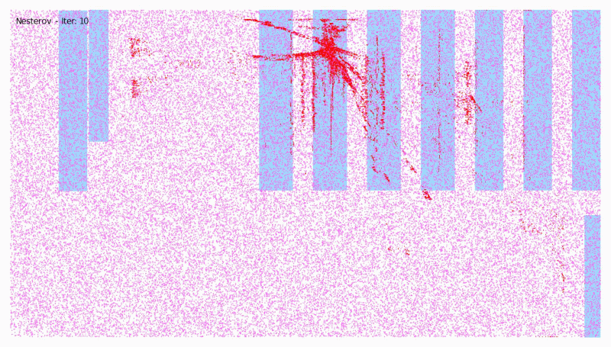
RePlAce
RePlAce: Nesterov-based global placement tool
https://github.com/The-OpenROAD-Project/RePlAce
Open-sourced July 2018
96 ★s and 510 commits since then
51/61 issues solved
“coyote” (bsg_rocket) in TSMC16FFC, Arm 7.5T cells
Notes:
RePlAce was open-sourced at the start of our project. It is used for global placement, and is also under the hood of our IO placement and macro placement engines.

Slide 37
OpenDB
Dimitris Fotakis: founder and CEO of Athena Design Systems
Platform for hyperscaling design: parasitic extraction and layout-driven optimization
2019: Contributed Athena’s code base in support of OpenROAD
Similar LEF/DEF data model as OpenAccess – but actually open!
Released on GitHub October 5, 2019
Notes:
OpenDB is the heart of that integrated, incremental tool architecture I showed a few slides ago.
Dimitris Fotakis contributed the code base of Athena Design Systems as BSD open source to support OpenROAD. And, from this code base, OpenDB went live on October 5 of last year.
[CLICK] If you’ve worked with OpenAccess or any other back-end database OpenDB is similar – even, the same key developer as OpenAccess – but it’s really open.

Slide 38
OpenROAD Flow and Integrated App Today
Notes:
And so this is where we are today.
The Integrated App “openroad” is in blue, and is tightly tied into the timer and the DB. Most of our tools are integrated today, and are sitting in a mono-repo. This trend of consolidating repos and not using submodules is accelerating in our project.
There are three other executables in the flow: Yosys for synthesis, TritonRoute for detailed routing, and Klayout for layout finishing and GDS merge.

Slide 39
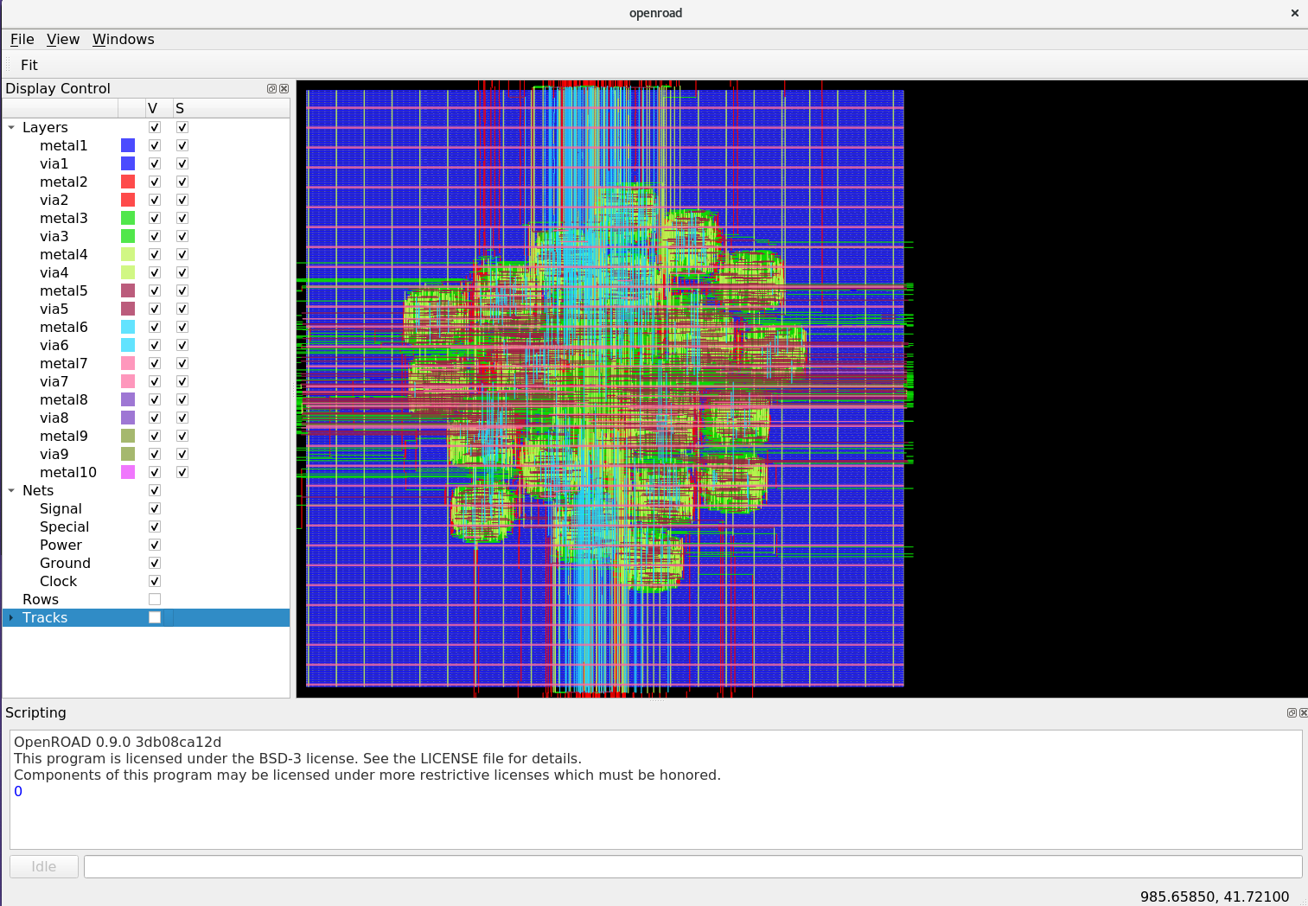
OpenROAD Has a GUI Now !
openroad –gui <your_tcl_script>
Qt must be installed when you build openroad (get “GUI is enabled” from cmake)
AES in NanGate45
Notes:
In the past month, a GUI has been added which is really helpful to developers – it is being enhanced rapidly these days, especially as we start to think about supporting front-end design exploration. More on that later.

Slide 40
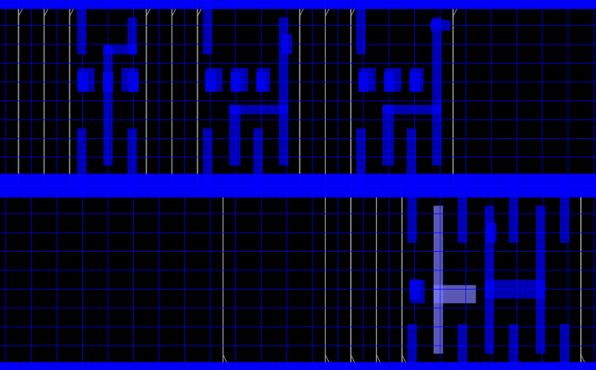
OpenROAD Has a GUI Now !
AES in NanGate45
Zoom in to placement, showing routing tracks
Notes:
Zoom in to placement, showing routing tracks.

Slide 41
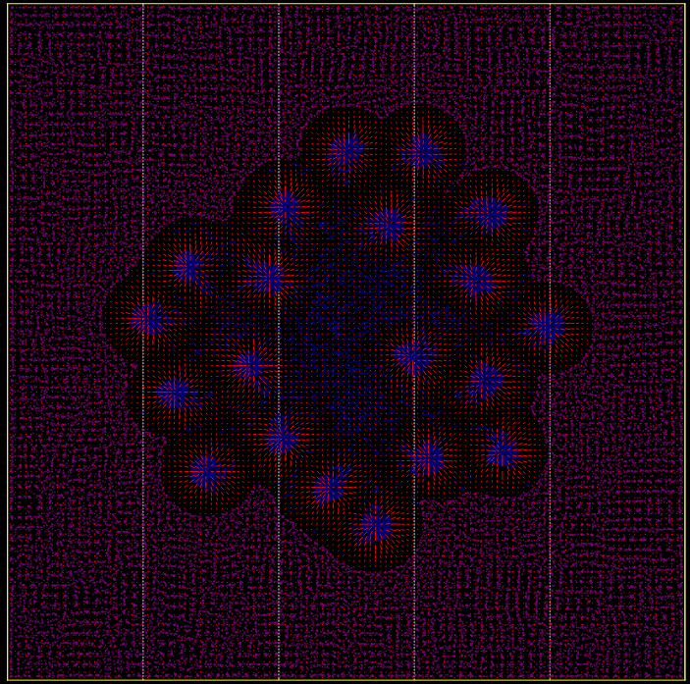
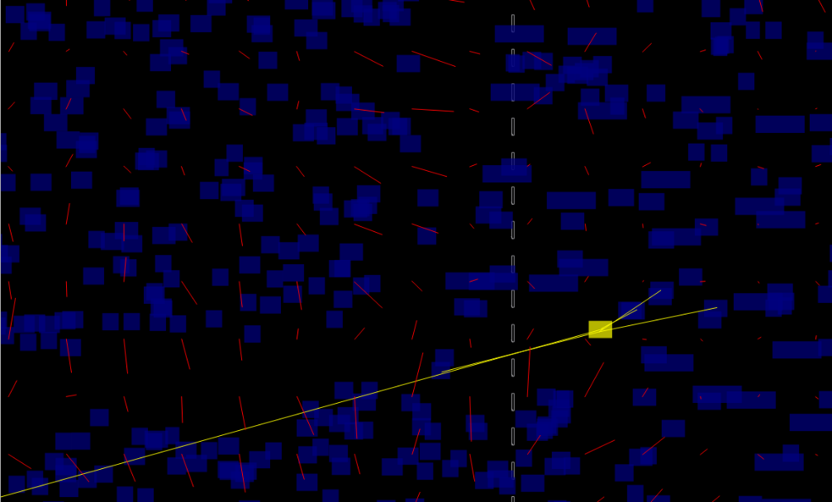
OpenROAD Has a GUI Now !
AES in NanGate45
Diagnosing the force vectors in the Nesterov global placement
Notes:
We can visualize force vectors from density balance in the global placement.
[CLICK] And zoom in to look in detail.

Slide 42
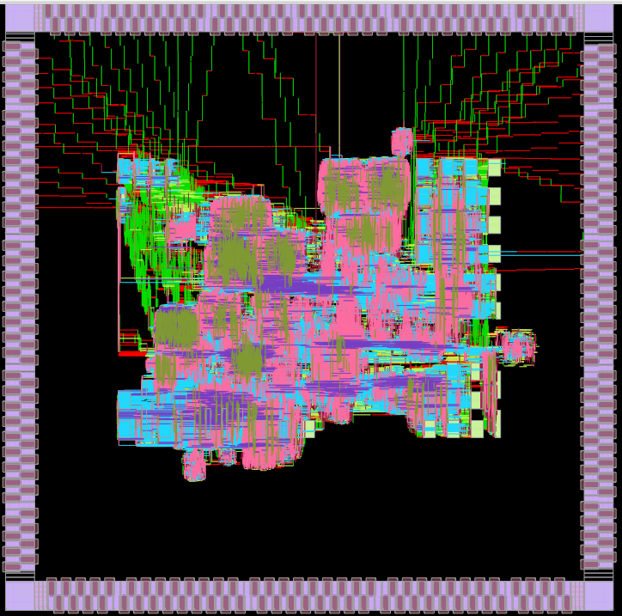
OpenROAD Has a GUI Now !
AES in NanGate45
Black Parrot, single core, in GF12LP with power distribution off
Notes:
Here is a single core of the BlackParrot SOC from Professor Taylor’s group at Washington – showing wiring except for power/ground distribution.

Slide 43
Efabless: striVe 1 and striVe 2 Tapeouts
Family of SoC designs to exercise SKY130
To scale.
1kB synthesized SRAM (FFs) vs. 1kB SRAM block from OpenRAM
Notes:
Efabless’s OpenLANE flow uses quite a bit of OpenROAD, and will continue to bring in more of our project. The first striVe SOC on the left was taped out in May to SkyWater. striVe 2 on the right was another tapeout – it’s smaller because it uses a 1kByte SRAM block instead of synthesized memory. There are at least five SOCs so far in the striVe family.

Slide 44
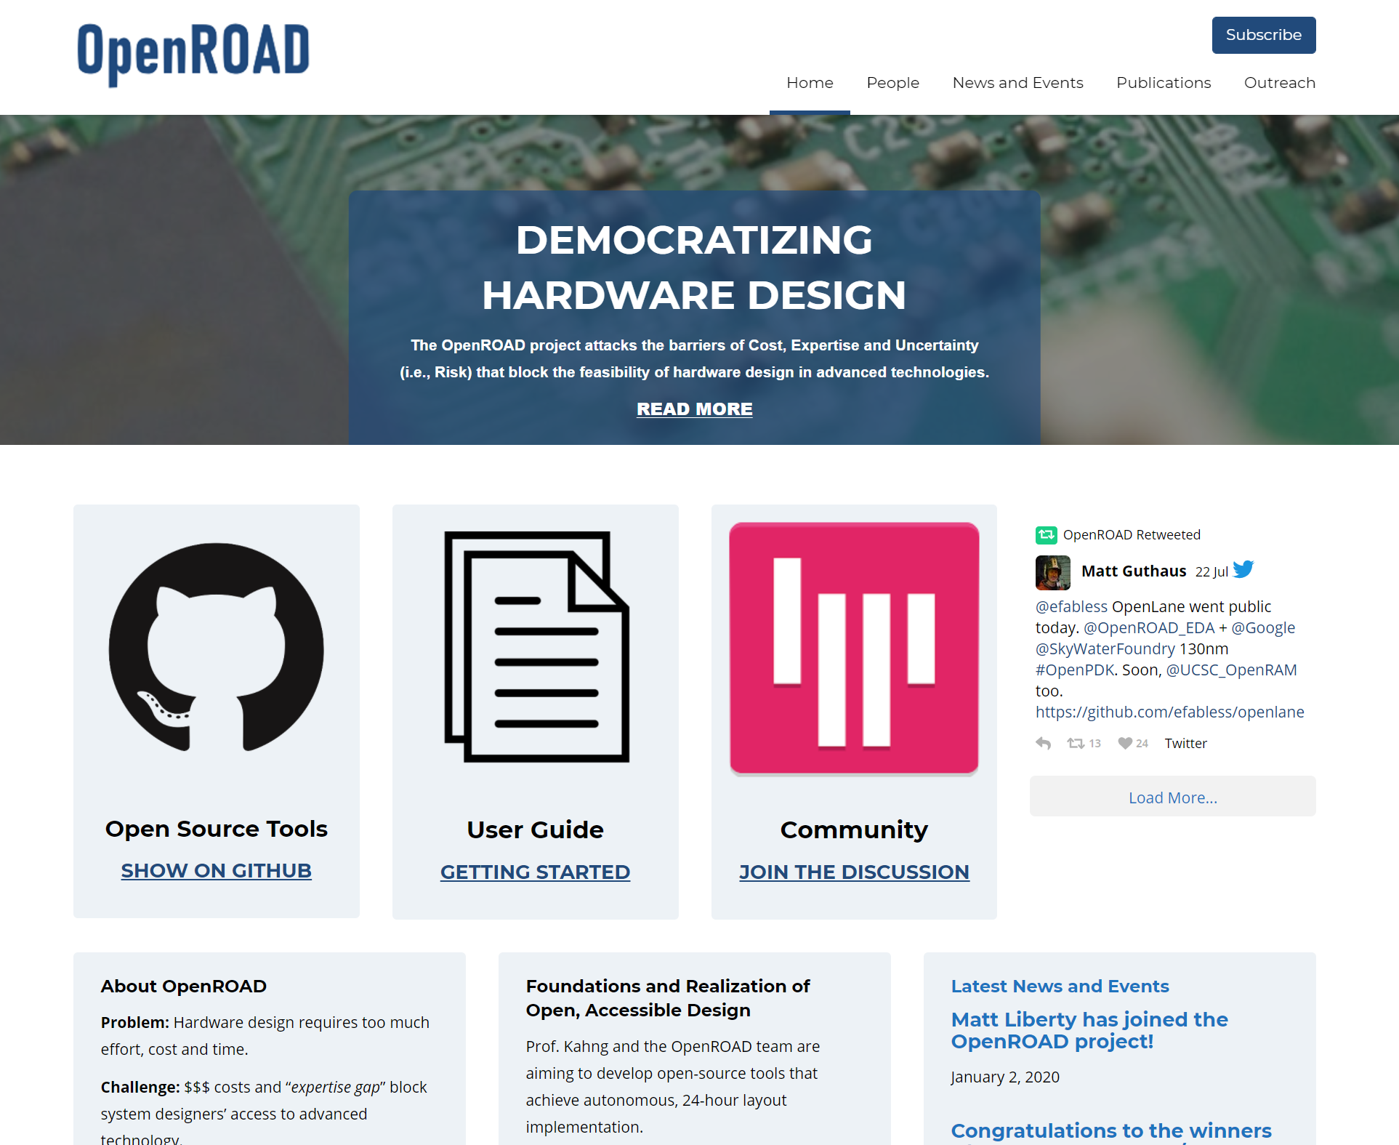
theopenroadproject.org
Notes:
Our website is where you can find the basics and history of the project.
Again, our mission is to achieve 24-hour no-humans RTL-to-GDS in advanced foundry nodes, WHILE catalyzing an open-source ecosystem for researchers, tool developers and users. And DEMOCRATIZING Hardware Design.

Slide 45
OpenROAD Project Links
The Project on GitHub
https://github.com/The-OpenROAD-Project
The Flow, developed by internal design advisors subteam
Drives the entire automation of the full flow using tool components focused on automation
https://github.com/The-OpenROAD-Project/OpenROAD-flow
The top level application
An integrated EDA tool focused on full automation
https://github.com/The-OpenROAD-Project/OpenROAD
Documentation
https://openroad.readthedocs.io/en/latest/
Notes:
Here are some links. Our repositories on GitHub,
[CLICK] a nicely automated flow, and
[CLICK] the integrated “app”, as we call it, which is the EDA tool.
[CLICK] and our documentation…
The next few slides give a quick “walk-through” of the project – for users and for developers.

Slide 46
Agenda
Perspective
Open-Source EDA and OpenROAD
Open-Source EDA: If We Build It, Who Will Come?
OpenROAD Today
Looking Back, Looking Ahead
Notes:
So, in this last part of the talk, let me look back and look ahead a bit.

Slide 47
Looking Back: It Takes A Village (and more)
Five perspectives at ICCAD-2020 next month
ICCAD-2020 special session on Taking Open-Source EDA to the Next Level: From Research to Production IC Design
ICCAD-2020 invited paper on IEEE CEDA DATC’s 2020 Robust Design Flow release
Notes:
One look back into the past reminds me of our team’s evolution, and how efabless and Google have been really great supporters and collaborators.
At ICCAD in November, a special session on TAKING OPEN-SOURCE EDA TO THE NEXT LEVEL will include papers from efabless on OpenLANE, [CLICK] the role of our internal design advisors sub-team in the project, [CLICK] the many facets of the Google-SkyWater enablement of open ASIC innovation, and [CLICK] a “view from abroad” from the students in Brazil who have contributed a lot to OpenROAD.
And, [CLICK] the “Robust Design Flow” that serves as an academic research backplane, as I mentioned a few minutes ago.

Slide 48
Looking Back: More Contradictions
Strict SW methodology and tight integration in a single repository vs. community participation
Push-button tapeout capability in advanced foundry technology vs. sharing with external developers
Ph.D. research vs. EDA tool development, support
IDEA kickoff, June 2018: “not research as usual” and “working code, not papers”
Push-button, automated vs. flexible, controllable
Exploratory, early-adopter use cases
Stakeholder goals and mindsets (EDA researchers, HW innovators, EDA industry, open-source community, …) vs. FOSS EDA tool development
From credit assignment to competitive advantage to startup goals to …
ICCAD19: Looking into the Mirror of Open Source paper, slides
Notes:
Looking BACK also reminds me of the many contradictions, or at least tensions, that we’ve had to get through in just the first half of this one open-source EDA project:
[CLICK] Rigorous software methodology and tight integration, versus broad participation
[CLICK] Tapeout-clean capability in advanced nodes versus being able to include external developers
[CLICK] Research versus developing and supporting a real tool. We were told that this is not research as usual, and that the program manager cared about working code, not papers ….. But some people didn’t quite get this.
[CLICK] I mentioned automated versus user-controllable --- which is REALLY important when you think about who actually wants to use OpenROAD today – namely, the pioneers for whom there is no available EDA solution.
[CLICK] And many other reasons why things can get wedged – sharing credit versus publishing a paper, users who want to tape out but who can’t send a testcase with their bug report. You can find more in papers like [CLICK] this one.

Slide 49
Looking Ahead: Where Can Open Source Help?
One theme: early planning and design space exploration
2009 ITRS roadmap: earlier PPA knobs become stronger over time
Notes:
Looking forward, Where can open source HELP? Remember, there’s democratization, but there’s also that overarching imperative of SCALING.
[CLICK] One theme is to use open-source EDA in planning and design space exploration.
[CLICK] This is from the Design Chapter in the 2009 ITRS Roadmap.
Earlier knobs in the flow grow relatively more powerful over time – system-level, architecture, RTL.

Slide 50
Design Space Exploration: Ideal vs. Actual
2009 ITRS roadmap: earlier PPA knobs become stronger over time
Reality: difficult to explore and set the earlier knobs!
Actual DSE
Ideal DSE
Notes:
But the reality is that we can’t get our arms around these early-stage knobs for PPA.
[CLICK] Design Space Exploration should ideally explore the more powerful knobs more thoroughly, as shown on the right.
[CLICK] But we tend to budget our attention as shown on the left.
The root-cause is that optimizing and exploring in early stages has limited value – we can’t predict the back end accurately enough, our decisions don’t correlate to what can be closed and signed off – and so we just give up and beat on physical design.

Slide 51
Open-Source EDA Helps Closed-Source EDA?
Open-source EDA is inferior to commercial EDA:
QOR
TAT
Open-source EDA is superior to commercial EDA:
Transparency
Customizability
Simplicity
(Cost, Scalability)
Opportunities early and late in flow
Early: “Predicting Closed-Source PPA from Open-Source PPA”
Late: Last-mile “heavy optimizations”
See: https://vlsicad.ucsd.edu/NEWS20/PPA-Optimization-200715-CLEAN.pptx
Notes:
But guess what: Maybe open-source EDA can be a BOOST to closed-source commercial flows !!!
Its QOR is not good, and it’s not really any faster than commercial EDA.
[CLICK] But on the other hand, it’s simple, transparent, customizable, and scalable.
[CLICK] So I think there MAY be opportunities both early and late in chip implementation: Predicting closed-source PPA from open-source PPA is a machine learning challenge. Or, [CLICK] open-source tools may be effective for last-mile optimizations. [CLICK] Some more details are at this link.

Slide 52
Looking Ahead: Front End for Exploration
Example: standalone front end for PPA exploration of SoCs and IP subsystems → predictable SP&R handoff
Leverages recent GUI, PartClusManager, OpenDB/OpenSTA ...
Notes:
We see a lot of users asking for OpenROAD to be more usable in front-end planning – architecture and RTL design space exploration. We think building this on top of a scalable, cloud-deployed OpenROAD RTL-to-GDS could have compelling value – so we are scoping this out now. At the same time, this is just one more example of the tension between our no-human-in-the-loop mission VERSUS flexibility and controllability that users want.

Slide 53
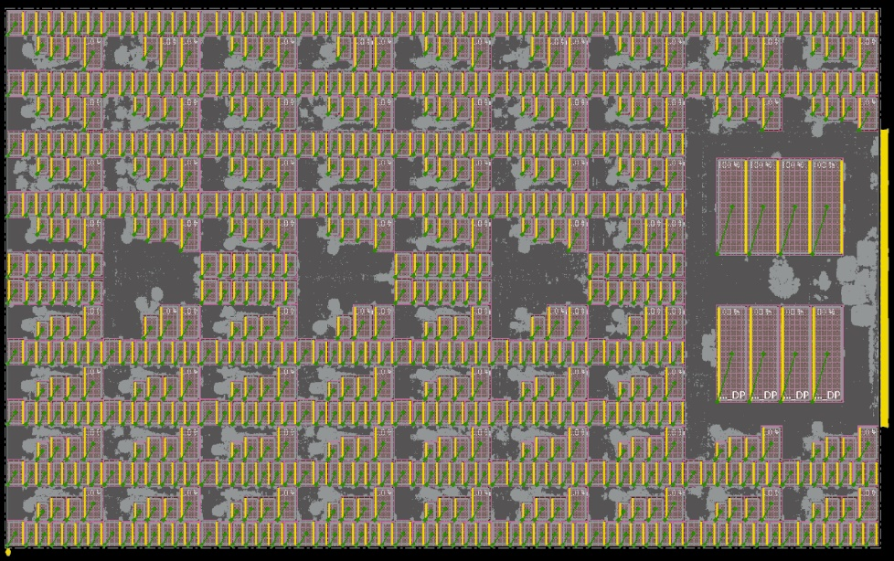
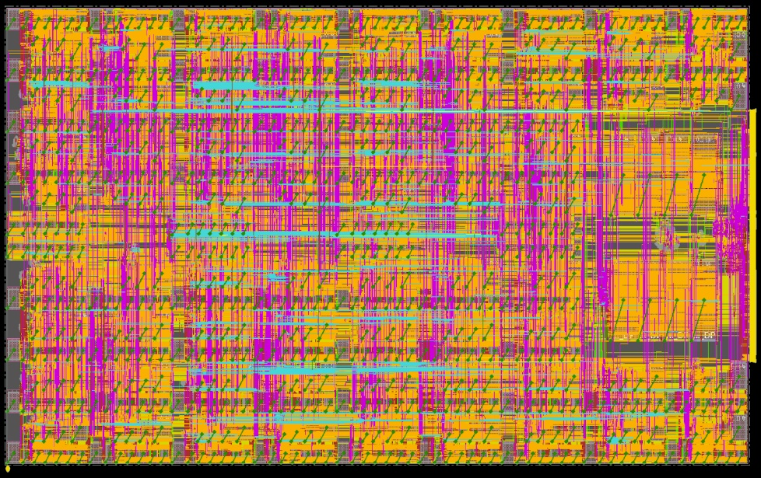
ML ASICs: Auto-Handoff to Commercial P&R
DARPA Real-Time Machine Learning program
Goal: Hardware generators and compilers to enable fully automated creation of ML ASICs from high-level source code
→ Design space exploration and pathfinding for ML architectures
Challenge: Auto-generate both RTL and SP&R recipe
Built in OpenROAD: netlist connectivity analysis and auto-generation of floorplan .def for commercial P&R
Example: TABLA ML architecture (UCSD, Esmaielzadeh)
OpenROAD auto-macro floorplan + commercial placement
760 macros, 426K stdcells, zero DRCs
(clock period 436ps)
Notes:
So, I hope everyone was inspired by Uri Weiser’s keynote yesterday – it was just amazing.
To make a small connection with his talk, let me just point out how powerful is the OPEN INFRASTRUCTURE in a project like OpenROAD.
My students do some work in DARPA’s real-time machine learning program – which seeks fully automated creation of machine learning ASICs, from high-level source codes. This is all about design space exploration and pathfinding in the ML architecture space.
[CLICK] We do the automatic dialing in of the recipe for commercial SP&R, to get the best possible final result after routing. And our current focus is: [CLICK] How can you get from connectivity analysis to the floorplan .def that will guide P&R to a great result. [CLICK] This automated macro tiling leads to DRC-clean P&R that clocks at well over 2 gigahertz.

Slide 54
Looking Ahead: EDA + Design Ecosystem?
Is open-source design enablement (PDK, IPs, tooling) a disruptive technology?
Cf. Clayton Christensen, The Innovator’s Dilemma
Notes:
And my last bit of “Looking Ahead” is on how open-source EDA might continue beyond the DARPA IDEA program or the OpenROAD project. How will it be transitioned out of the academic research context, and productized and supported for use by ASIC/SOC designers in commercial contexts?
[CLICK] This is a picture of “disruptive innovation” due to [CLICK] Clayton Christensen. There needs to be a market that is addressed – typically from the bottom up starting with those whose needs aren’t served well, or who need only low quality of results.

Slide 55
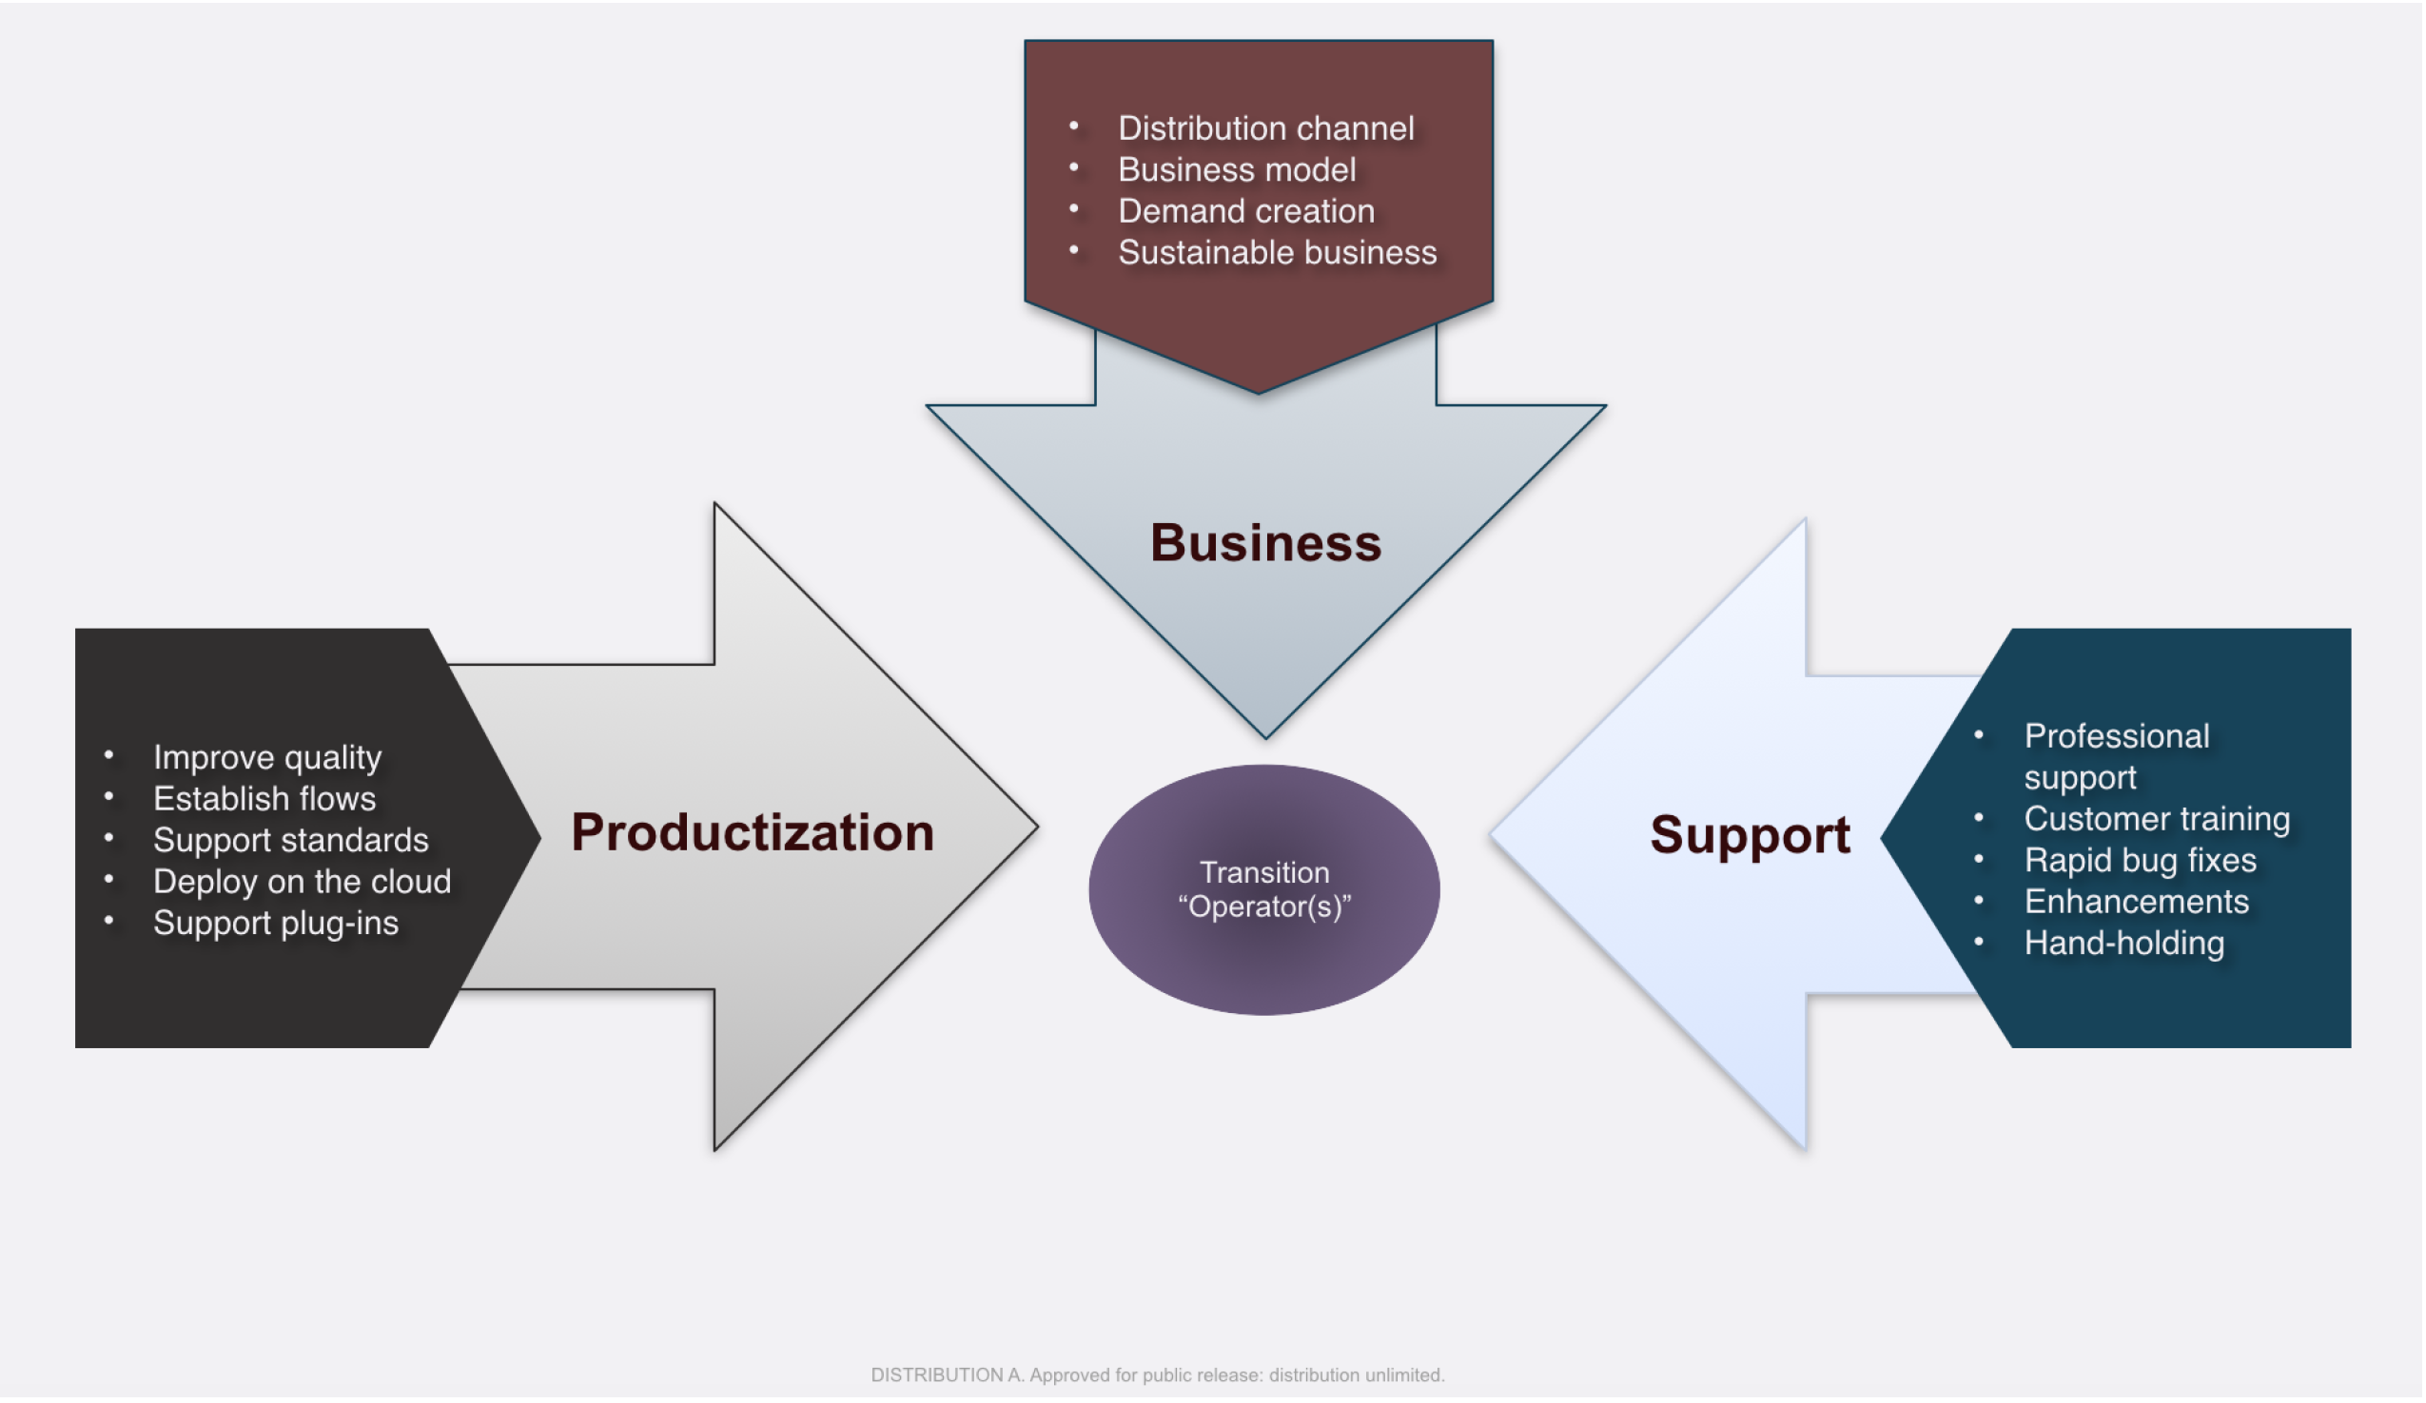
Need Scalable, Sustainable Business Model
Goal: framework to deliver open-source EDA technology to an IC designer market.
Below: key functions of a potential “Transition Operator”
Source: Mr. Serge Leef, DARPA. August 2020.
Notes:
Indeed, the DARPA program manager for the IDEA program, Mr. Serge Leef, has given this a lot of thought.
How will open-source EDA technology be transitioned to address a market of IC designers?
[CLICK] This picture illustrates the key functions of a “Transition Operator” – productization, support, and creating a business model that is scalable and sustainable.
Obviously, the industry veterans who are part of OpenROAD today are a great fit for this future trajectory. Food for THOUGHT.

Slide 56
Agenda
Perspective
Open-Source EDA and OpenROAD
Open-Source EDA: If We Build It, Who Will Come?
OpenROAD Today
Looking Back, Looking Ahead
Conclusion
Notes:
Let me conclude.

Slide 57
If We Build It, Who Will Come?
Open-source EDA is truly a field of dreams.
Open-source EDA is a moving, many-faceted target.
Open-source EDA goes beyond academic research abilities.
Open-source EDA is part of a movement.
Open-source EDA is a journey.
(Please be part of it!)
Notes:
So, we look to open-source EDA as part of democratizing hardware innovation, and as part of SCALING.
If we build it, who will come? [CLICK] We have to dream a bit.
[CLICK] What is IT? Many things to many people -- a moving target.
[CLICK] Who is WE? Not just academics, but enough experienced professionals. Software skills and attitude are key. And some folks who think like AEs more than like tool runners.
[CLICK] Who is WHO? EDA researchers, hardware startups, government labs, the open hardware community -- open-source EDA is part of a movement.
[CLICK] And it is a journey --- [CLICK] Please be part of it !

Slide 58
THANK YOU !
ABKGroup research is supported by U.S. National Science Foundation, U.S. DARPA, Samsung, Qualcomm, NXP Semiconductors, Mentor Graphics, and the C-DEN Center.
OpenROAD: Many thanks to the team https://theopenroadproject.org/our-team/ and to Tim Ansell (Google gift)
Some Links:
The OpenROAD Project: readthedocs, website, GitHub
“Looking into the Mirror of Open Source” (ICCAD-2019): paper, slides
“On Future Scaling Mechanisms for Semiconductor Design and Manufacturing Technologies” (May 2019 Ho-Am Lecture): slides
ABKGroup basic links on ML in EDA / IC design; 6/10/2020 Google Brain slides, video; 7/15/2020 PPA Optimization keynote slides, video
Notes:
I’d like to thank these companies, NSF and DARPA for supporting research in my group.
For OpenROAD, the TEAM is at this link, and we are super-thankful to Tim Ansell for arranging a gift from Google last Fall.
Thank you very much for your attention !

Slide 59
BACKUP

Slide 60
OpenROAD-flow vs OpenROAD “integrated app”
OpenROAD-flow
Yosys
Synthesis
OpenROAD-app
STA, PEX, Floorplan, GlobalPlace,
DetailedPlace, CTS, GlobalRoute, …
TritonRoute
DetailedRoute
Klayout
GDS
: Single binary
OpenROAD “integrated app”
A single binary that has most of OpenROAD-flow
List of projects/Tools that currently exist in the OpenROAD app:
OpenROAD-app
FastRoute, ICeWall, OpenDB, OpenPhySyn, OpenRCX, OpenSTA, PDNSim, TritonCTS, TritonMacroPlace, Flute3, ioPlacer, OpenDP,
Pdngen, RePlAce, Resizer, Tapcell, AntennaChecker, GUI
09.09.20
Notes:
Just to keep this oriented, let me again point out the distinction between “OpenROAD flow” and “OpenROAD integrated app”.
Remember: the “flow” runs four binaries: synthesis, the OpenROAD app, TritonRoute, and Klayout.
[CLICK] The integrated app contains most of our tools – and it will have TritonRoute integrated by the end of the year. A GUI was added in the past month.

Slide 61
Walk-Through: For Users
User Guide in readthedocs
https://openroad.readthedocs.io/en/latest/user/user-guide.html#
Strongly recommended to use OpenROAD-flow repo.
For OpenROAD commands, you can also see https://github.com/The-OpenROAD-Project/OpenROAD/blob/master/README.md .
OpenROAD-flow Structure
https://github.com/The-OpenROAD-Project/OpenROAD-flow-public/tree/master/flow
Designs: makefile setup for design and sdc
Platforms: PDKs for technology (NanGate45, SkyWater130 example)
DRC rule deck for KLayout, Standard-cell GDS, LEF, Liberty, etc.
Setup for PDNgen (pdn.cfg, grid_*.cfg)
Makefile setup for technology (config.mk)
Scripts: Tcl scripts for OpenROAD top-level app
Makefile: Setup for OpenROAD flow runs
See: https://github.com/The-OpenROAD-Project/OpenROAD-flow-public/blob/master/flow/scripts/run_all.tcl
Scripting interface, generic flow test: https://github.com/The-OpenROAD-Project/OpenROAD/blob/master/test/flow.tcl
Notes:
For a user’s guide to both OpenROAD-flow and OpenROAD app, you can see the documents in readthedocs.
We strongly recommend to use OpenROAD-flow to run the tool.
(The README in the OpenROAD repo is basically the same as what you see in readthedocs.)
[CLICK] In the OpenROAD-flow repo, you can see the basic setup to run your designs.
[CLICK] The Designs directory has makefile setup for each technology and each design.
The Platforms directory includes PDK information for a given technology, such as the DRC rule deck for Klayout – as well as standard-cell gds, lef, and Liberty.
Also, there are some setup files for OpenROAD. For example, PDNgen in OpenROAD requires a couple of config files.
Config.mk includes some setup for the technology in general for the designs.
[CLICK] The Scripts directory has Tcl scripts for OpenROAD for each step in the flow.
And, Makefile is the main file to launch OpenROAD runs. You can specify your design, steps, etc.

Slide 62
Walk-Through: For Developers
Continuous Integration (CI) to maintain tool quality and stability
Jenkins CI webpages (only open to OpenROAD project members):
https://jenkins.theopenroadproject.org/job/OpenROAD/job/openroad/
Every commit to the code is checked before being allowed in (green check mark)
https://github.com/The-OpenROAD-Project/OpenROAD/commits/openroad
Code reviews from experienced industry developers on all proposed code changes or pull requests in GitHub
Issues on top-level OpenROAD app (60 / 84 Issues are solved)
https://github.com/The-OpenROAD-Project/OpenROAD/issues
PRs on top-level OpenROAD app (414 PRs raised)
https://github.com/The-OpenROAD-Project/OpenROAD/pulls
OpenDB C++ API public header for shared netlist structure:
SWIG used to enable OpenDB Tcl/Python API support from C++ API.
https://github.com/The-OpenROAD-Project/OpenDB/blob/openroad/include/opendb/db.h
OpenSTA C++ API public header for timing network structure:
https://github.com/The-OpenROAD-Project/OpenROAD/blob/master/src/dbSta/include/db_sta/dbNetwork.hh
Notes:
Development in OpenROAD uses continuous integration (CI) to maintain tool quality and stability.
Jenkins CI webpages are only for OpenROAD project members.
[CLICK] Our CI checks every commit to the code. As you see in this link, you can see the green check mark when the CI tests is passed. OPEN LINK
[CLICK] Developers and Users can freely raise issues and pull requests for the top-level app, as seen in these two links.
[CLICK] The OpenDB C++ API is seen here.
[CLICK] And, the OpenSTA C++ API is seen here.

Slide 63
Walk-Through: For Developers (DAC-2020 Tutorial)
OpenROAD top-level app Tcl implementation example
AntennaChecker
https://github.com/The-OpenROAD-Project/DAC-2020-Tutorial/tree/master/5_antenna_fix_example
OpenDB Python API example
https://github.com/The-OpenROAD-Project/DAC-2020-Tutorial/tree/master/7_opendb_python_api
OpenDB C++ API and adding a tool examples
ClipGraphExtractor
https://github.com/The-OpenROAD-Project/DAC-2020-Tutorial/tree/master/9_adding_a_tool_example
Video presented during DAC-2020-Tutorial
https://github.com/The-OpenROAD-Project/DAC-2020-Tutorial/blob/master/9_adding_a_tool_example/videos/tutorial_presentation_v3.mp4
OpenROAD top-level app structure
CMakeLists.txt writing examples.
Registering private Tcl commands using SWIG
Registering public Tcl commands using sta::define_cmd_args functions
Notes:
Last, in July we gave a tutorial at the Design Automation Conference, for folks who want to contribute to or develop on OpenROAD’s code base.
While most OpenROAD tools are written in C++, flow steps CAN be implemented in the top-level app as Tcl scripts.
For example, our AntennaChecker and pdngen are both implemented as pure Tcl.
[CLICK] The use of OpenDB’s Python API is illustrated in this link.
[CLICK] A “ClipGraphExtractor” – say, for when you want to feed a graph convolutional network with graphs corresponding to clips from the placed design – was presented as an example of OpenDB C++ API usage, and of adding a tool.
[CLICK] And, my student made a video that describes some other information for developers: the top-level app’s detailed structure, how to write CMakeLists.txt, and how to register private and public Tcl commands.

Slide 64
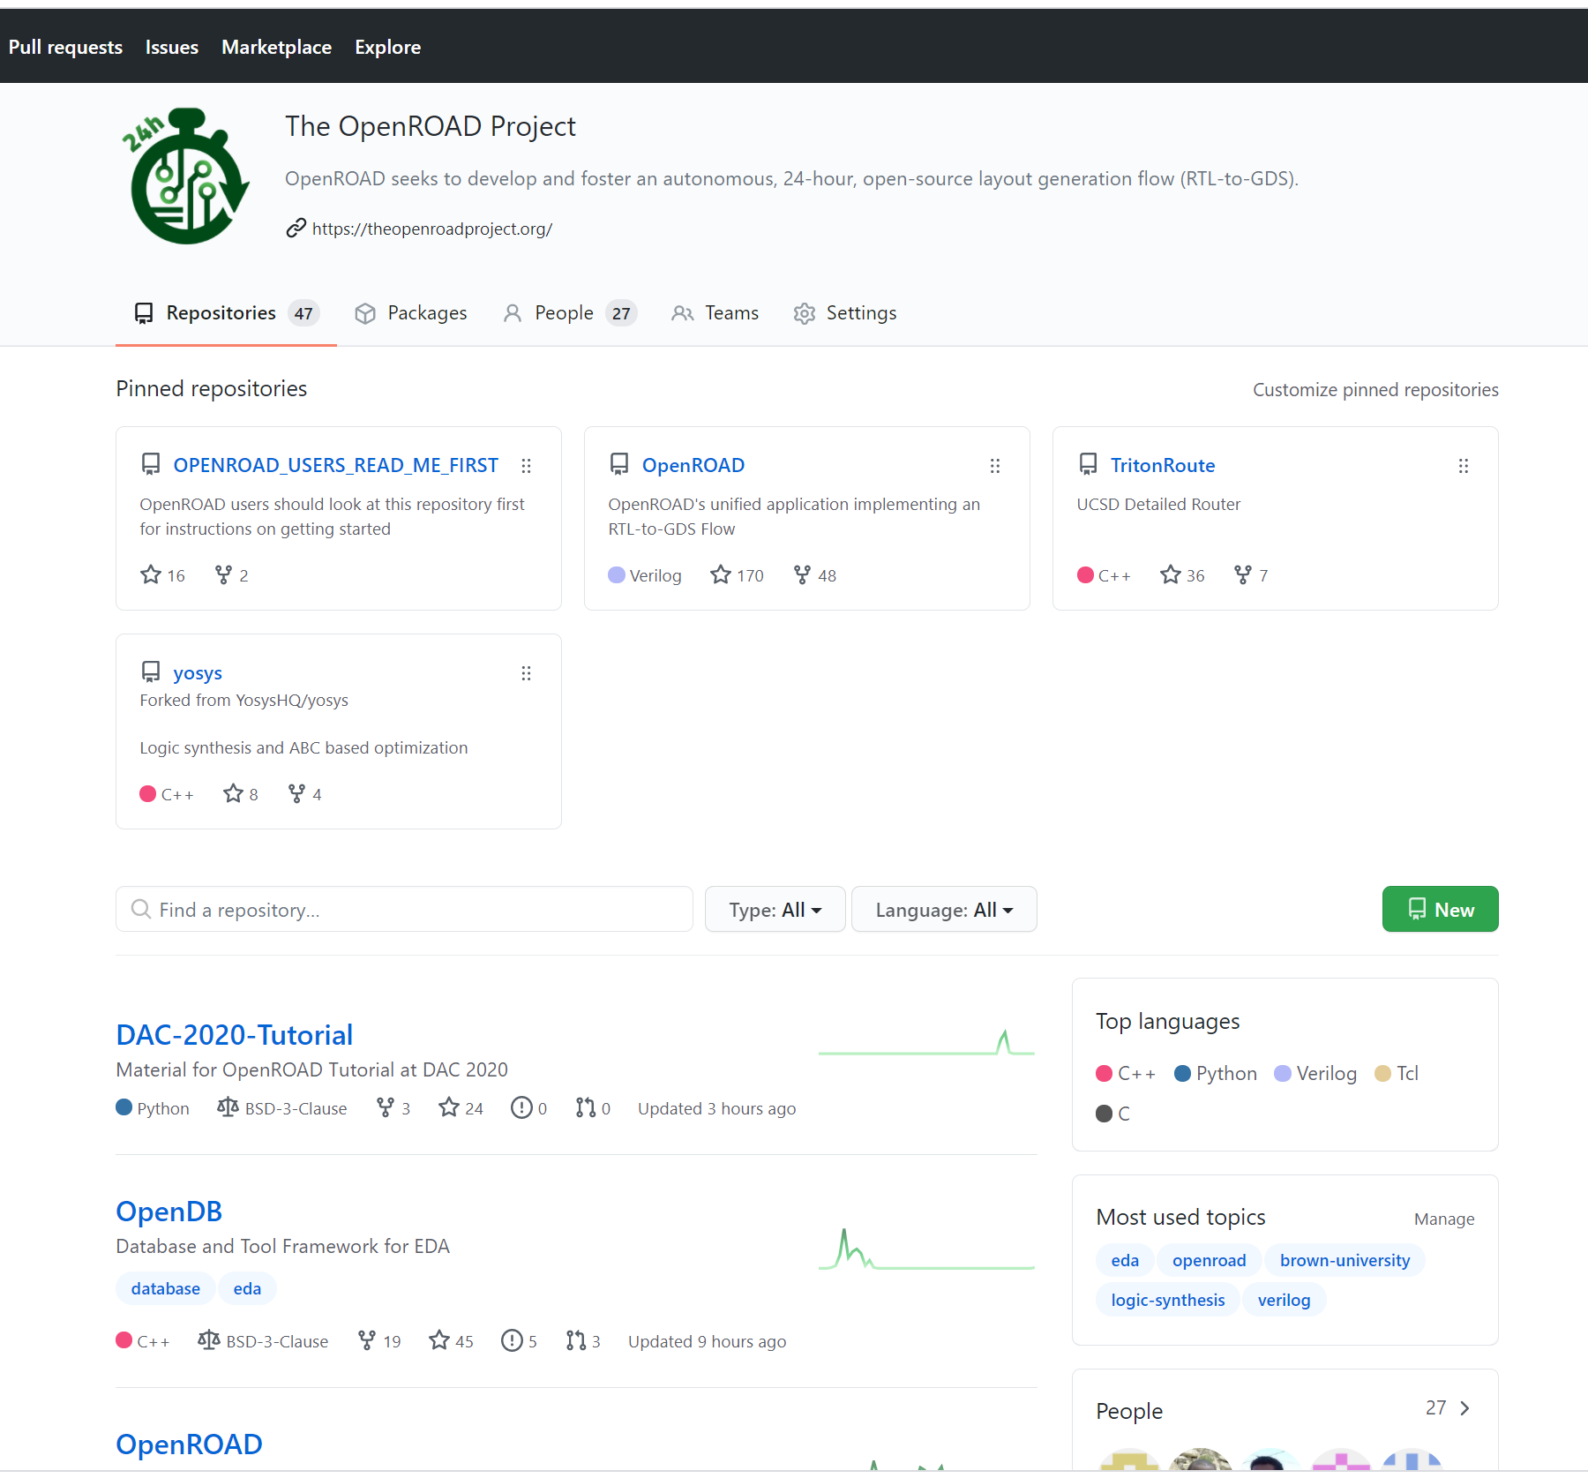
So … What is OpenROAD?
4-year project (2018 – 2022)
RTL-to-GDS EDA tool
Seed for open-source EDA innovation
Enabler of open-source HW community
And many future possibilities… !
Notes:
What is OpenROAD?
I think of it as trying to fill many shoes, and meet many goals.
[CLICK] It’s a four-year BASIC RESEARCH project sponsored by DARPA as part of the Electronics Resurgence Initiative.
[CLICK] It’s an RTL-to-GDS EDA *TOOL* that people are starting to tape out chips with even now.
[CLICK] It’s a seed with hopefully critical mass and critical quality for OPEN-SOURCE EDA innovation and research.
[CLICK] And it’s an enabler of a large and active open-source HARDWARE community – this FOSSi Dial-Up video I mentioned before was seen over 10 thousand times in its first week on YouTube.
[CLICK] And it has many possibilities for the future.

Slide 65
ICCAD-2019: “Table Stakes” to Attract Users
(1) Unified tool that achieves full RTL-to-GDS flow
(2) Shared netlist architecture that enables tight incremental optimization loops
(3) Continuous build and integration within a strong software development methodology
(4) Proper open-source licensing to enable unfettered usage across research and commercial settings
Notes:
ICCAD-2019 “Mirror” paper went into the “table stakes” and “unblocking milestones”
needed to attract users to an open-source EDA tool.
These included: (1) a unified tool that achieves a full RTLto-
GDS flow; (2) a shared netlist architecture for the tool that
enables tight incremental optimization loops; (3) continuous
build and integration within a strong software development
methodology; and (4) proper open-source licensing to enable
unfettered usage across research and commercial settings.

Slide 66
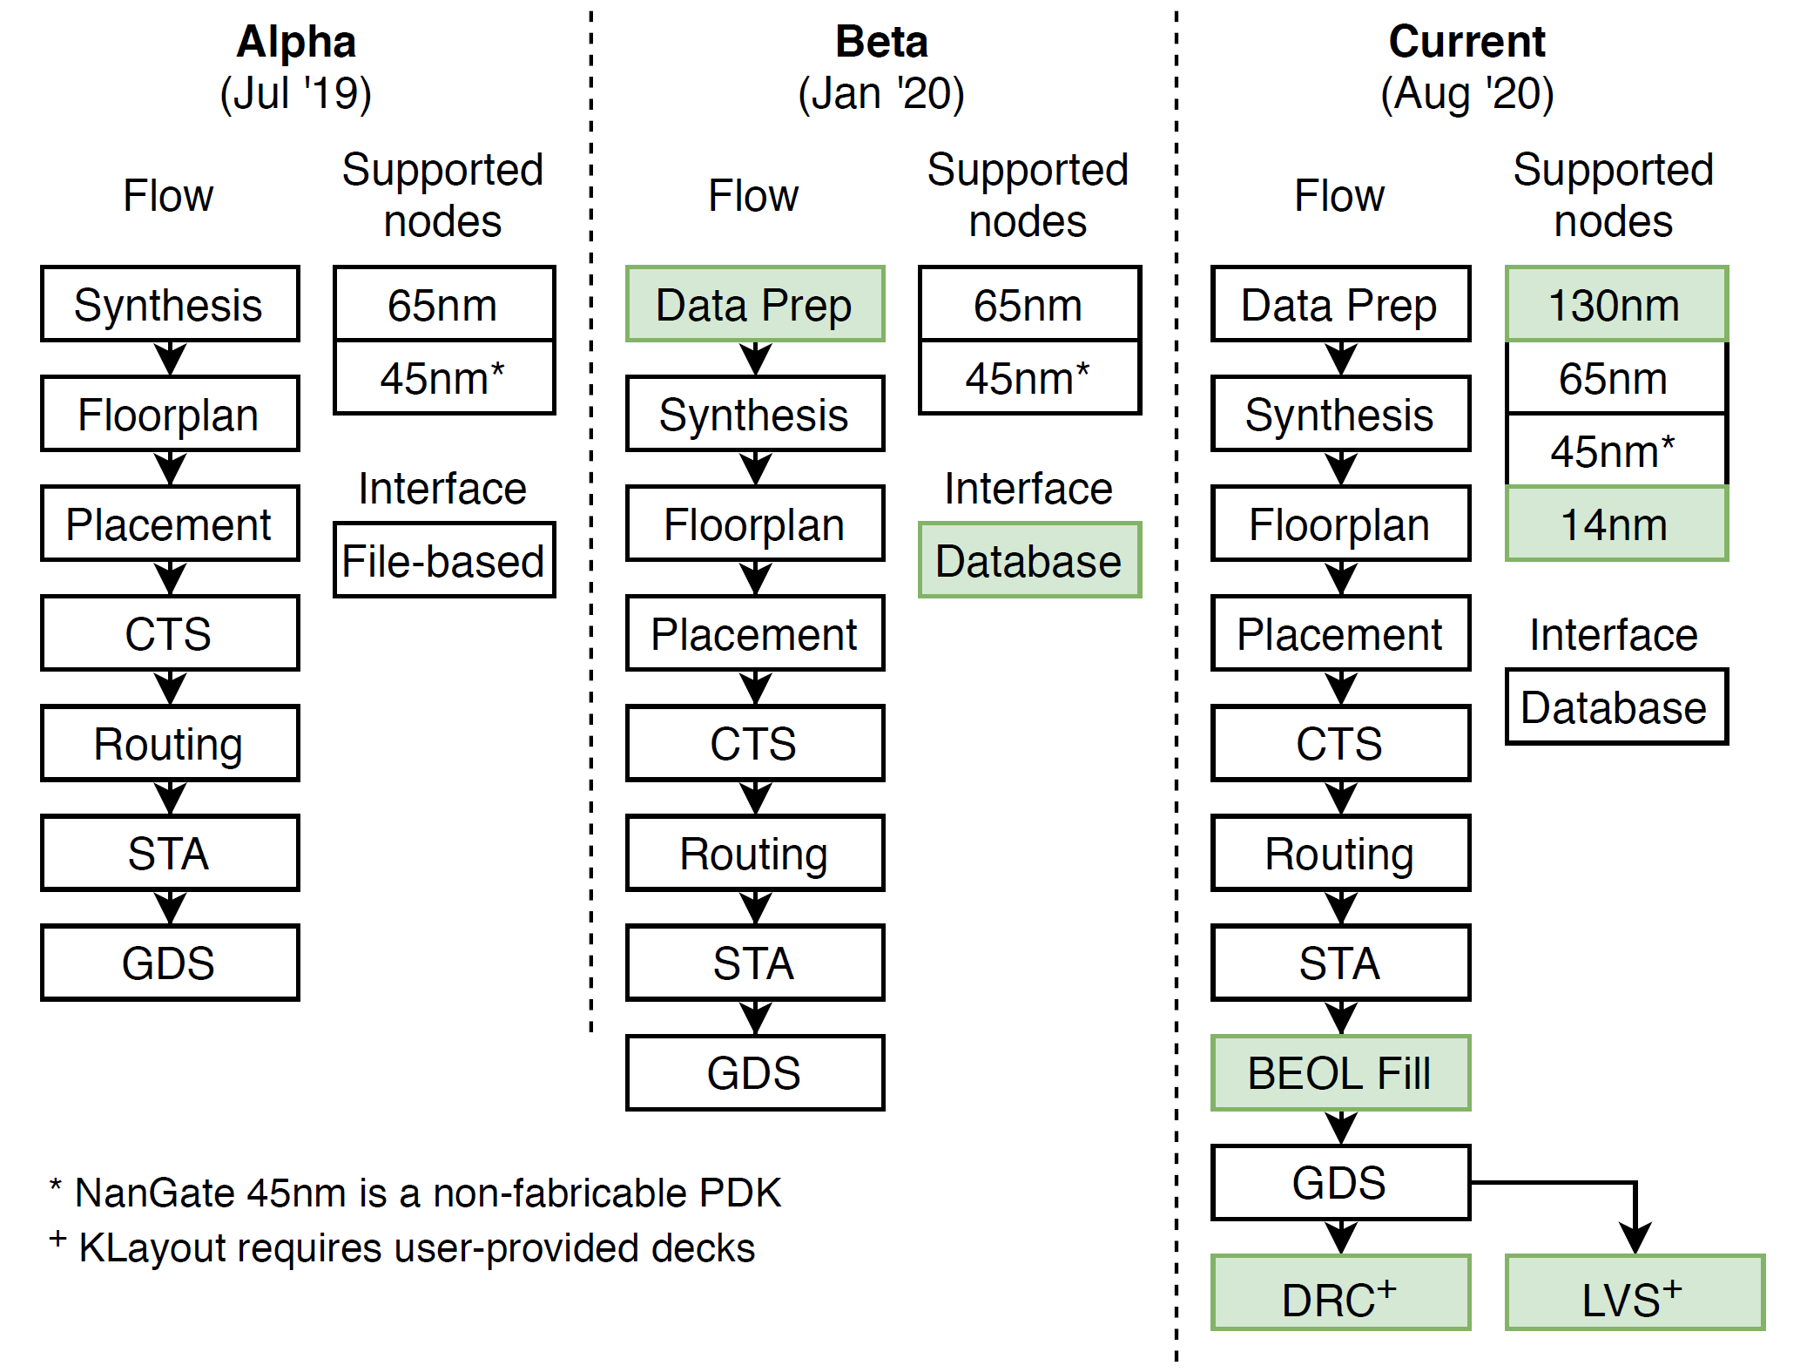
Looking Back: Evolutions
Source: Rovinski et al., ICCAD-2020 to appear
Notes:
This is one look in the rear-view mirror: transitioning to our new database between October and December of last year, then the big push in the first half of this year to achieve tapeout-clean layout generation in GF12 (plus, another recent push to bring OpenROAD up on SkyWater130).

Slide 67
Looking Ahead: PDN and SOC Planning
PDNGen
Phase 1:
Strategy files → P/G meshes for single-voltage, unswitched power domains
Phase 2:
Broader range of technologies: SKY130, CMP28, Intel22FFL …
Better connection with OpeNPDN
Separate design-specific configuration data from library configuration data
Add hierarchical design support
ICeWall
Phase 1:
“Footprint” = IO ring description allowing reuse of existing IO floorplan in a new design
Phase 2:
Support for flipchip footprints
Use data from design, IO library documents and designer to generate IO ring for given design
Derive signal pad requirements, #supply pads, generate IO padring placement …
Extract footprint file from DEF of existing SOC design → fast creation of reusable templates
Base RTL
+ Signal Pads
+ Supply Pads
IO Footprint
+ Control cells
+ Breaker cells
+ Corners/Fillers
+ Seal/Guard Ring
Notes:
Looking ahead, we have been doing a lot of planning for our “Phase 2”, which has just started and which we hope will continue until July of 2022. As one example, PDNGen has numerous directions planned out. [CLICK] And our SOC planning tool, ICeWall, is adding support for flipchip and more automated generation of IO padring placements.

Slide 68
Early Design Space Exploration
2009 ITRS roadmap: earlier PPA knobs become stronger over time
Reality: difficult to explore and set the earlier knobs!
A root cause: inability to predict and to path-find
Notes:
And just to elaborate on the “DSE” – Design Space Exploration – aspect of OpenROAD’s future use … This picture is from the Design Chapter in the 2009 ITRS Roadmap.
Earlier knobs in the flow grow relatively more powerful over time – system-level, architecture, RTL.
[CLICK] But the reality is that we can’t get our arms around these early-stage knobs for PPA.
[CLICK] Design Space Exploration should ideally explore the more powerful knobs more thoroughly, as shown on the right.
But we really tend to budget our attention as shown on the left.
[CLICK] The root-cause is that optimizing and exploring in early stages has limited value – we can’t predict the back end accurately enough, so decisions don’t correlate to what can be closed and signed off. This is an inability to PREDICT, and to PATH-FIND --- [[superposed back onto the “Ideal DSE” triangle at the right]] --- but this is a whole other talk.
Let me point out that there is a “Machine Learning in IC Design” at the lower right …..

Slide 69
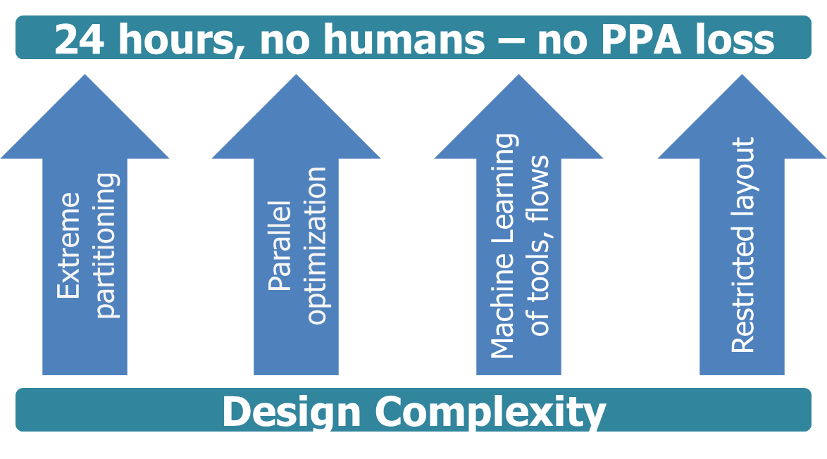
(Not in This Talk: AI/ML in EDA, IC Design
Big part of my research, and a foundation of OpenROAD’s no-human-in-the-loop, 24-hour RTL-to-GDS development
Two recent talks can be seen at https://vlsicad.ucsd.edu
Notes:
Which isn’t in my talk today.
At the same time, Machine Learning for EDA and IC Design has occupied a lot of my group’s attention for quite a few years. And, as mentioned right at the start – machine learning is one of the foundational “base technologies” that will enable OpenROAD to reach its ultimate goals.
[CLICK] In case useful --- at my group’s website here are a couple of recent talks --- the one I gave at Google Brain in June gives a pretty good picture of my recent thinking. A few slides from my usual ML talk….

