Slide 1

The Tao of PAO: Anatomy of a Pin Access Oracle for Detailed Routing
Andrew B. Kahng, Lutong Wang and Bangqi Xu

Slide 2
About Me
Bangqi Xu received B.S. degree in electrical engineering from the University of Michigan, Ann Arbor, MI, USA in 2015 and the M.S. degree in electrical and computer engineering from the University of California at San Diego, La Jolla, in 2017. He is currently pursuing the Ph.D. degree at the University of California at San Diego, La Jolla. His current research interests include detailed placement, routing methodology and optimization.

Slide 3
Outline
Background
Preliminaries
Three-stage pin access analysis methodology
Experiments
Conclusion

Slide 4
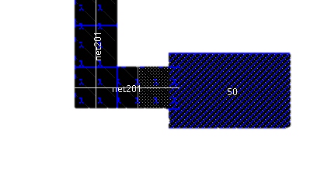
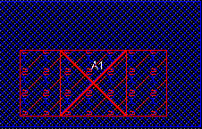
Motivation
Pin access = wire / via connection to access a pin
Critical to decrease design rule violations (DRCs) in detailed routing
  Failure results in repeating violation patterns
Need robust and scalable pin access analysis (!)
Wire access
Via access

Slide 5

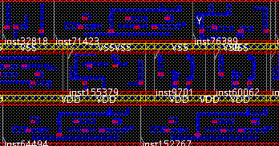
What Does Pin Access Analysis Do?
Testcase: ISPD18_test10
  290K standard cell instances
  182K nets
DRC clean pin access pattern generation in 241s
Zoomed-in region
(red dots are via access locations)
Whole design layout

Slide 6
Previous Works / Our Work
Existing work [Han15] assumes on-track access
Usually assume alignment between routing track and placement site
  → Not always true (ISPD18/19 contest benchmarks)
LUT-based abutting cell pair analysis [Xu16]
  → Not scalable (>10M combinations for an industry standard cell library)
Our work:
Robust pin access point enumeration
Boundary conflict-aware access pattern generation
Dynamic programming-based access pattern selection for standard cell instance cluster

Slide 7
Outline
Background
Preliminaries
Three-stage pin access analysis methodology
Experiments
Conclusion

Slide 8
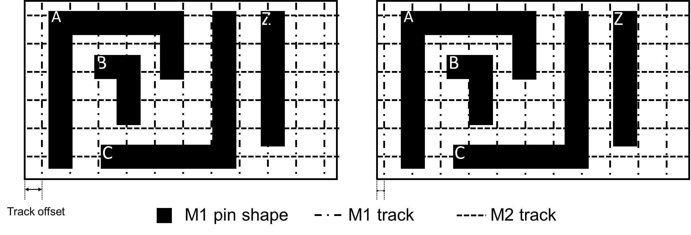
Unique Instance
These cell instances are NOT the same for pin access analysis!
Defined by a signature consisting of
  Cell master (e.g., BUFFX4)
  Orientation
  Offsets to all track patterns
Instances point to the same unique instance if they have same signature
≠
Two different unique instances due to M1 track offset

Slide 9
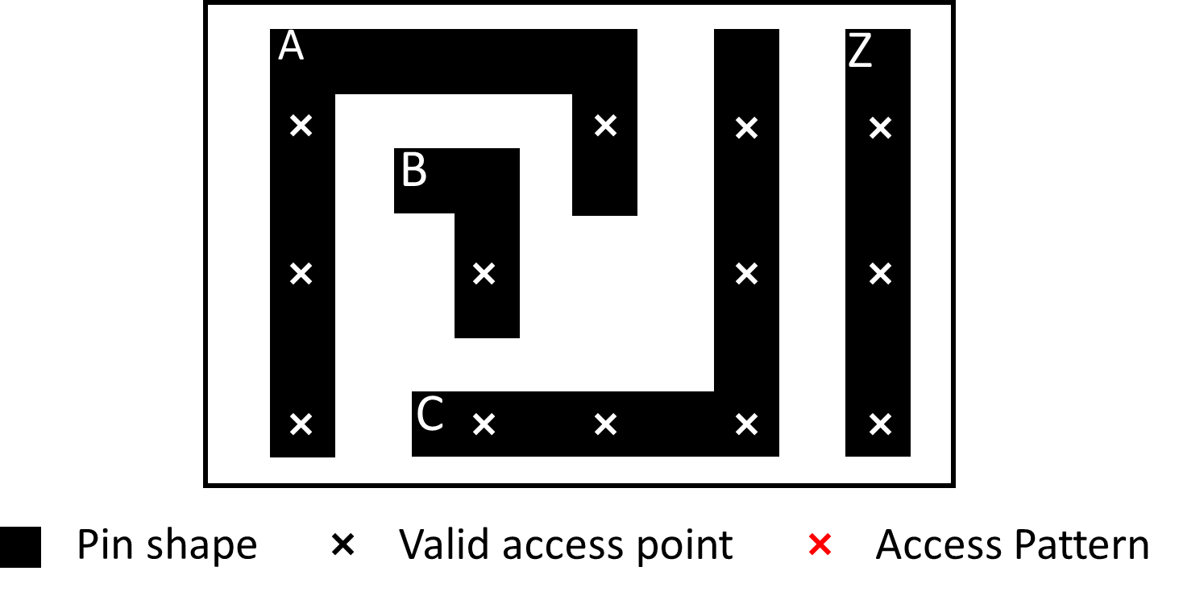

Access Point & Access Pattern
Access point (AP)
  A location (x, y, layer) that detailed router (DR) can make route to
Valid access point
  An access point that allows DRC-clean routing
Valid access pattern: combination of mutually DRC-clean access points (one access point per pin)

Slide 10
Outline
Background
Preliminaries
Three-stage pin access analysis methodology
  Unique instance pin (stage 1)
  Unique instance (stage 2)
  Instance cluster (stage 3)
Experiments
Conclusion

Slide 11
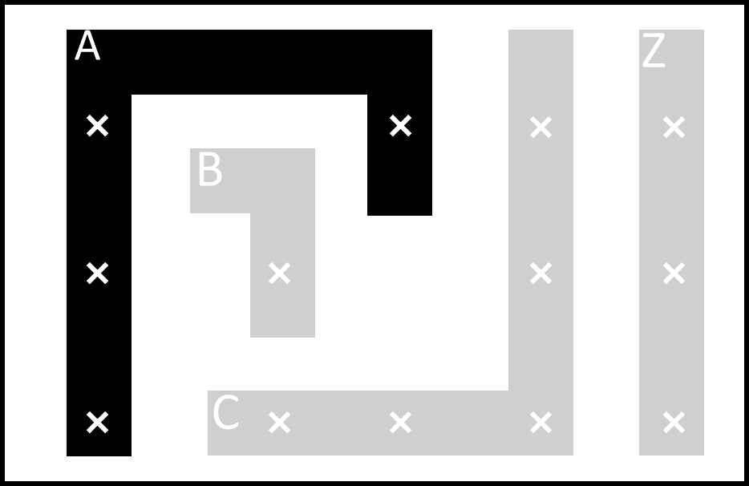


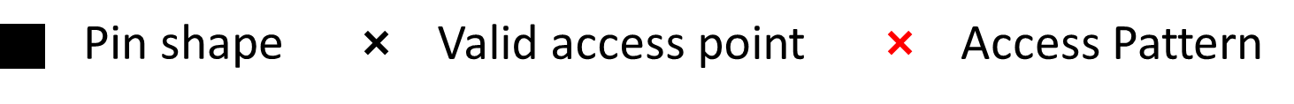
Our Methodology
Three-stage pin access analysis
  Unique instance pin (stage 1)
  Unique instance (stage 2)
  Instance cluster (stage 3)
Stage 1: Unique inst. pin
Stage 2: Unique inst.
Stage 3: Inst. cluster

Slide 12
Stage 1: Unique Instance Pin Based AP Generation
M1 (H)
M2 (V)
Pin Shape
Pin access point
Valid pin access point
Track
Stage 1: Unique inst. pin
Stage 2: Unique inst.
Stage 3: Inst. cluster

Slide 13
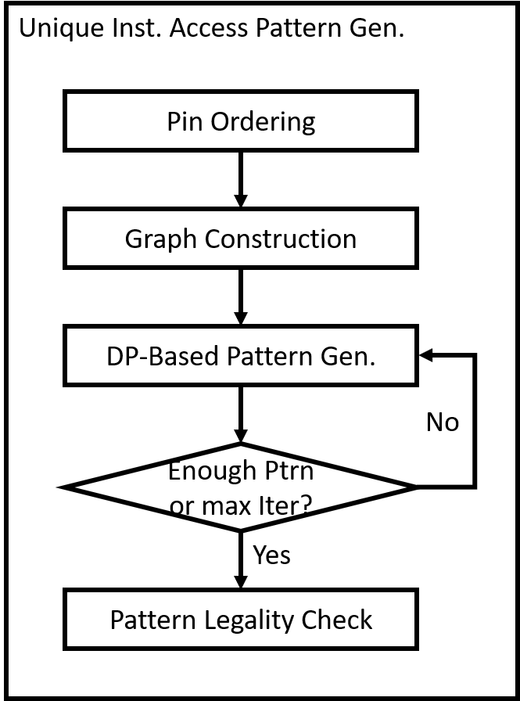
Stage 2: Unique Instance Based Access Pattern Generation
Input
  Valid access points of pins in a unique instance
Output
  Valid access patterns
Stage 1: Unique inst. pin
Stage 2: Unique inst.
Stage 3: Inst. cluster

Slide 14
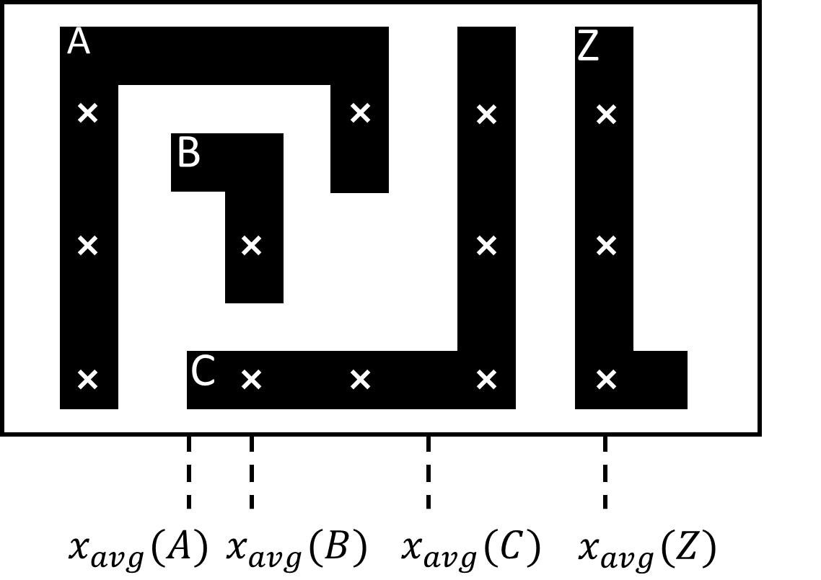
Pin Ordering
Sort pins according to their average x coordinate of valid access points
Idea: neighbors in sorted list are more likely to have DRC conflicts
  I.e., pins A - B are more likely to have conflict compared to pins A - C
Pin Shape
Valid pin access point
Stage 1: Unique inst. pin
Stage 2: Unique inst.
Stage 3: Inst. cluster

Slide 15
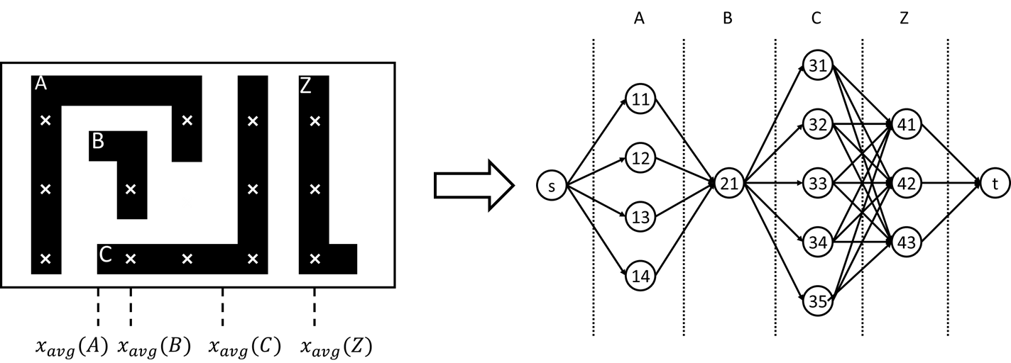
Graph Construction
Vertex = access point
  Marked with pin index and access point index
  s and t are virtual start and end points
Pin correspond to a “group” of vertices in graph
Edge exists between pair of access points from neighboring groups, weighted by physical distance
Access pattern = path from s to t
11
41
s
21
t
32
Stage 1: Unique inst. pin
Stage 2: Unique inst.
Stage 3: Inst. cluster

Slide 16
Stage 3: Cluster Based Access Pattern Selection
Inputs
  Instances in a cluster (of the same row)
  Access patterns of each unique instance
  Map from instance to corresponding unique instance
Output
  Access pattern for each instance in the cluster with minimized overall cost
Access Pattern Sel.
Inst Ordering
Graph Construction
DP-Based Pattern Sel.
Stage 1: Unique inst. pin
Stage 2: Unique inst.
Stage 3: Inst. cluster

Slide 17
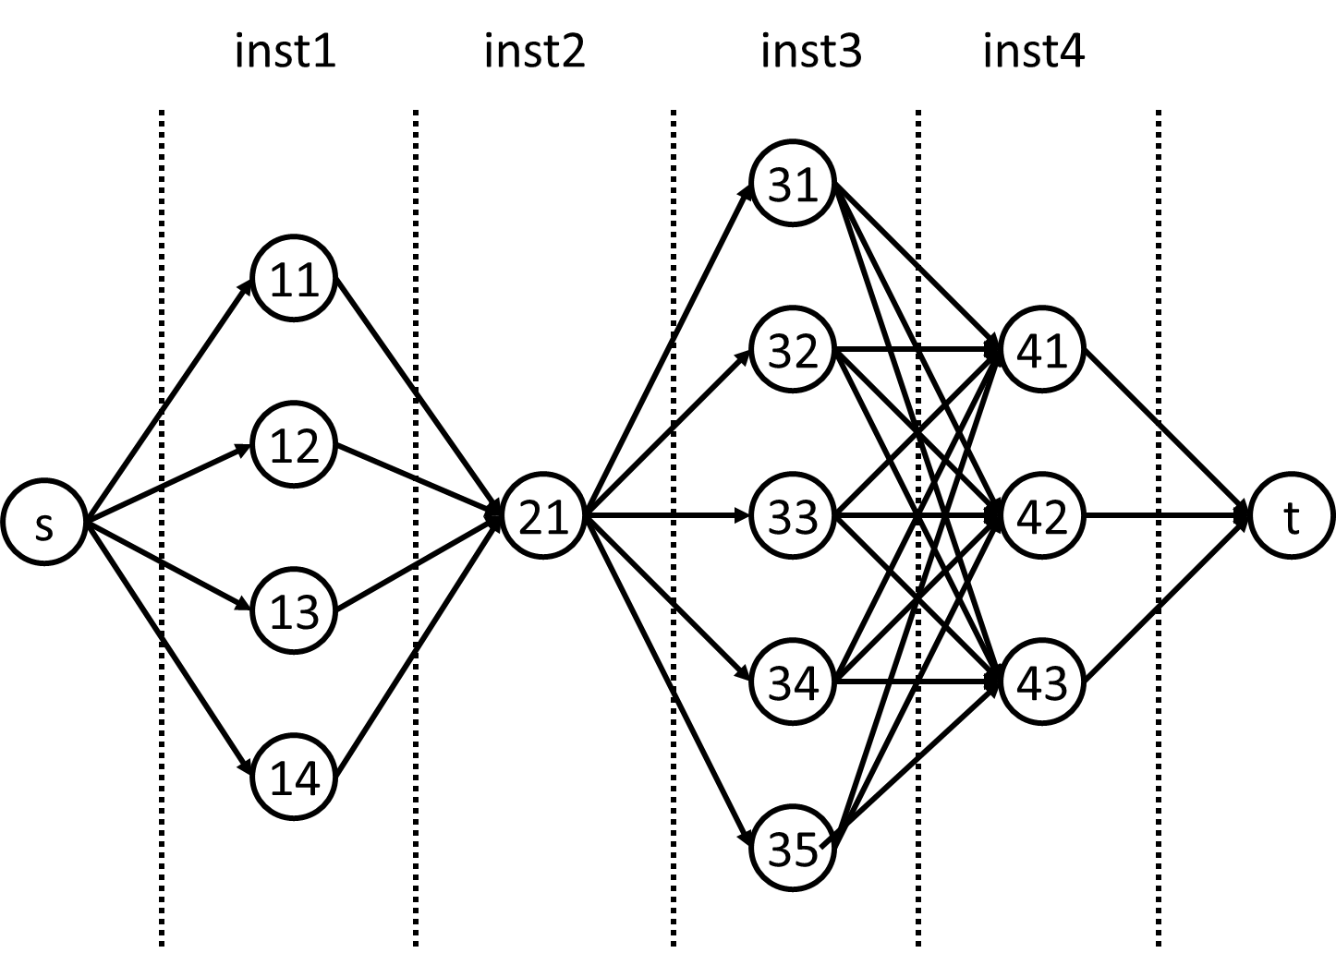
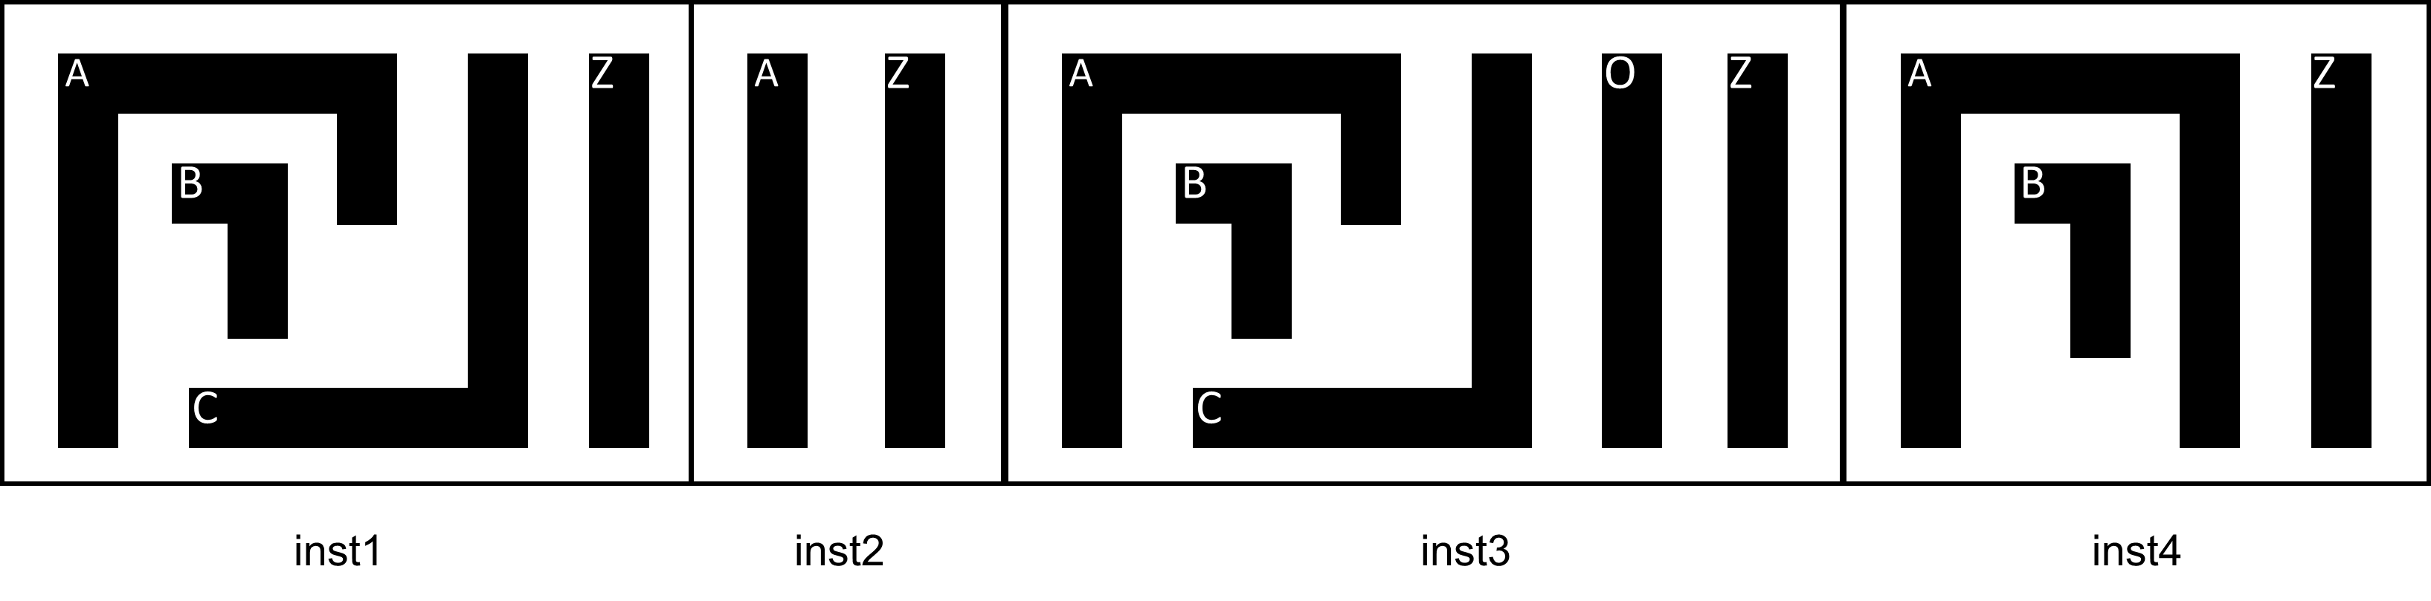
Cluster Based Access Pattern Selection
Instance ordering
  Sort instances in the cluster according to x coordinate of the lower-left corner
Graph construction
  Vertex = access pattern
  Shortest path from s to t is the best pattern combination
DP formulation
  Similar as previous formulation
  No iteration
11
41
s
21
t
32
Stage 1: Unique inst. pin
Stage 2: Unique inst.
Stage 3: Inst. cluster

Slide 18
Outline
Background
Preliminaries
Three-stage pin access analysis methodology
Experiments
Conclusion

Slide 19
Experiment 1: Unique Instance Pin AP
Unique instance pin access analysis
  Without considering intra-cell or inter-cell pin access compatibility
Benchmark | #Unique Inst. | Total #APs | #Dirty AP | Runtime (s)
ispd18_test1 | 182 | 3102 | 0 | 2
ispd18_test2 | 222 | 4867 | 0 | 4
ispd18_test3 | 227 | 4970 | 0 | 4
ispd18_test4 | 2725 | 99356 | 0 | 63
ispd18_test5 | 2733 | 80027 | 0 | 71
ispd18_test6 | 2886 | 87876 | 0 | 78
ispd18_test7 | 148 | 4152 | 0 | 3
ispd18_test8 | 414 | 12316 | 0 | 12
ispd18_test9 | 404 | 12342 | 0 | 11
ispd18_test10 | 426 | 12254 | 0 | 13
Unique instance pin

Slide 20
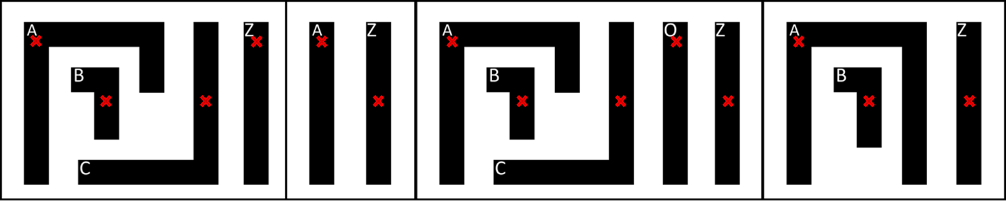
Experiment 2: All Instance Pins
Pin access analysis for all instance pins
  Considering intra-cell or inter-cell pin access compatibility
Benchmark | Total #Pins | #Failed Pins | Runtime (s)
ispd18_test1 | 17203 | 0 | 5
ispd18_test2 | 157990 | 0 | 8
ispd18_test3 | 158110 | 0 | 7
ispd18_test4 | 316652 | 0 | 94
ispd18_test5 | 316220 | 0 | 98
ispd18_test6 | 474300 | 0 | 121
ispd18_test7 | 790550 | 0 | 23
ispd18_test8 | 790550 | 0 | 39
ispd18_test9 | 790550 | 0 | 38
ispd18_test10 | 790550 | 0 | 49
Instance pins

Slide 21
Preliminary Result in Foundry 14nm Node

Slide 22
Outline
Background
Preliminaries
Three-stage pin access analysis methodology
Experiments
Conclusion

Slide 23
Conclusion
Three-stage pin access analysis methodology
DRC-clean pin access for ISPD18 contest benchmarks
Preliminary result shows capability on foundry 14nm node

Slide 24
THANK YOU!

