Slide 1
Template-based PDN Synthesis in
Floorplan and Placement Using
Classifier and CNN Techniques
Vidya A Chhabria¹, Andrew B Kahng², Minsoo Kim²,
Uday Mallappa², Sachin S Sapatnekar¹, and Bangqi Xu²
¹University of Minnesota; ²University of California, San Diego
Supported in part by the DARPA IDEA program as a part of the OpenROAD project
ASP-DAC20
Notes:
Hi everyone,
Today I will present our paper which is about “Template-based power delivery network (PDN) synthesis using Machin learning techniques”
This is a collaborative work between UCSD and UMN and is supported in part by the DARPA IDEA program as a part of the OpenROAD project.

Slide 2
Outline
Introduction
ML-based PDN synthesis and refinement methodology
Neural network training
Neural network evaluation
Conclusion
Notes:
Here is what I will go over today. I will begin with a motivation of why we went with this approach and how machine learning fits into PDN synthesis. Talk about the ML-based methodology followed by training and inference.

Slide 3
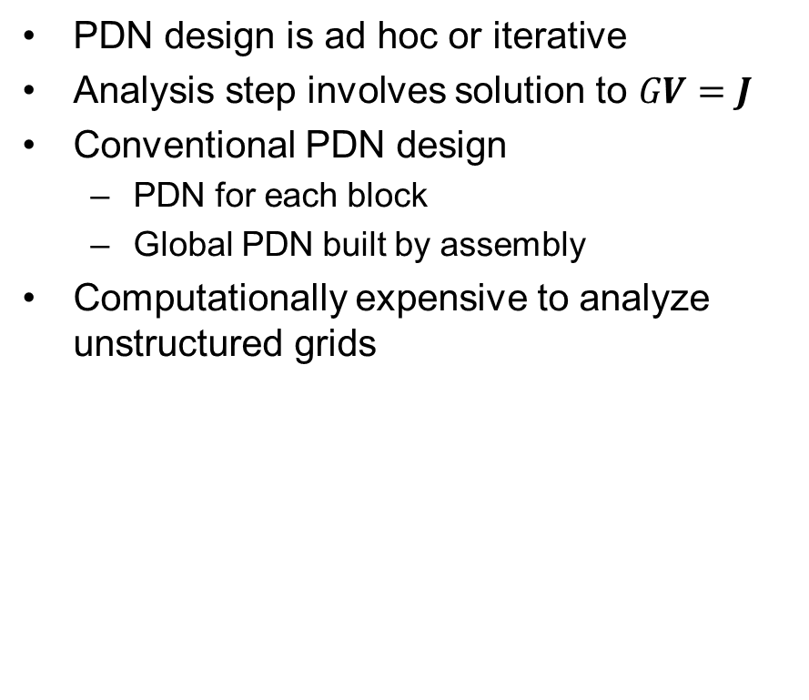
Introduction: Motivation
PDN model
PDN design is ad hoc or iterative
Analysis step involves solution to $GV=J$
Conventional PDN design
  PDN for each block
  Global PDN built by assembly
Computationally expensive to analyze unstructured grids
C4 bump
Notes:
Traditionally, PDN design has been very ad hoc or iterative. It involves constructing grids on a block-level basis and stitching them globally to form the complete network. Such power networks are extremely unstructured and computationally very expensive to analyze.

Slide 4
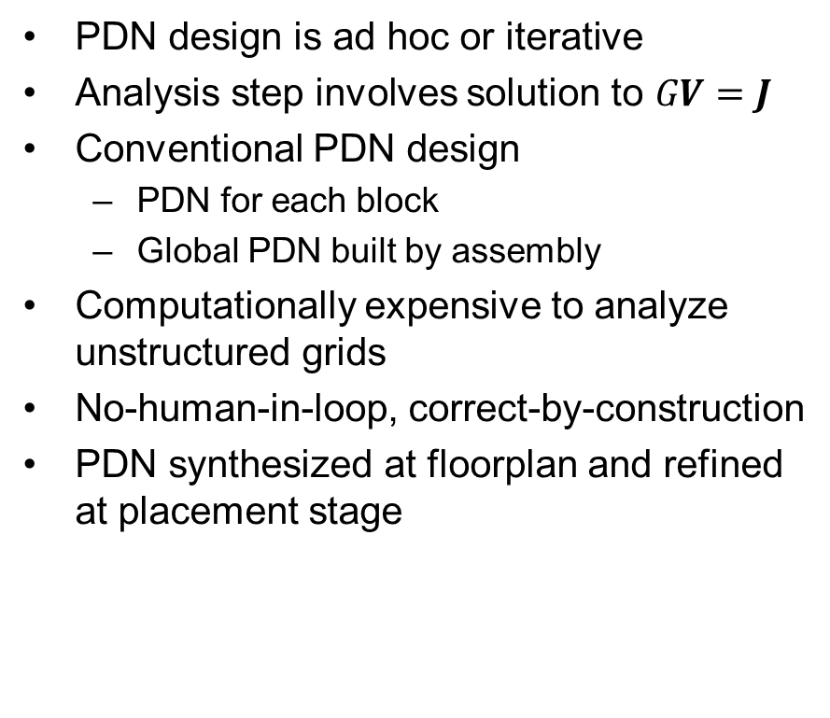
Introduction: Motivation
PDN model
PDN design is ad hoc or iterative
Analysis step involves solution to $GV=J$
Conventional PDN design
  PDN for each block
  Global PDN built by assembly
Computationally expensive to analyze unstructured grids
No-human-in-loop, correct-by-construction
PDN synthesized at floorplan and refined at placement stage
C4 bump
Notes:
Moreover, there has also been a recent keen interest in NHIL, 24-hour turn-around-time design methodology. Machine learning helps such a methodology, by using previously available correct data and predict a correct by construction grid at floorplan stage. In our approach, we construct a grid at floorplan and incrementally refine it at placement stage.

Slide 5



Introduction: Template Definition
$$T_{1}$$
$$T_{2}$$
$$T_{3}$$
Template-based PDN synthesis:
  PDN building blocks
  Pre-defined, PDK-specific templates
  Piecewise regular PDN
  Dense templates good for power integrity but bad for congestion
  Must be stitchable
Templates with different densities
Notes:
To help enable a NHIL, correct by construction methodology we define what we call a PDN template. This is essentially pre-defined, DRC clean, technology specific building blocks of the PDN. The templates are defined across layers and defined across multiple layers. The important thing here is they differ in their metal layer utilization, where templates with a high metal layer utilization are good for power integrity but bad for congestion. So there does exist an optimization problem here. Basically, the optimization problem which states what is the power delivery deliver network that uses the minimal possible routing resources while still meeting power integrity constraints. Here pwower integrity constraints are basically voltage drop and Electromigration constraints.
In our approach, we tessellate the chip into multiple regions such that each template just fits into one region. Now that we have defined templates and regions, we translate the problem of PDN synthesis as:

Slide 6
Introduction: Template Definition
PDN model
Template-based PDN synthesis:
  PDN building blocks
  Pre-defined, PDK-specific templates
  Piecewise regular PDN
  Dense templates good for power integrity but bad for congestion
  Must be stitchable
“Which template goes where?”
C4 bump
R1
R2
R3
R4
Notes:
Which template goes into which region on the chip?
And when put in that form it sounds like a machine-answerable question. Specifically, it can be translated into a classification problem which answers which template goes into which regions of the chip, where each class is a template. This is how we bring machine learning to help us solve this problem.

Slide 7
Outline
Introduction
ML-based PDN synthesis and refinement methodology
Neural network training
Neural network evaluation
Conclusion
Notes:
Coming to the methodology of PDN synthesis

Slide 8






Template Pruning Scheme
Ranked based on equivalent resistance and metal utilization
Sub-optimal templates are discarded
$$T_{1}$$
$$T_{2}$$
$$T_{3}$$
Higher utilization
$$T_{1}$$
$$T_{3}$$
$$T_{2}$$
Higher equivalent resistance
Notes:
Since the templates are user-defined with some estimates of PDN utilization in every layer, there is potentially the scope of defining sub-optimal template. Here by sub-optimal I mean something that is bad for both congestion and power integrity. To solve this each of the templates are ranked in terms of metal layer utilization and equivalent resistance. So if you look at the picture, it shows three templates with two metal layers, the blue stripe is a higher metal layer there and the orange is a lower metal layer stripe. Even though T3 has a lower metal layer utilization it still has a lower equivalent resistance when compared to T2 which has a higher utilization. Essentially what this means is that T2 is sub-optimal when compared to T3 and must be discarded.

Slide 9
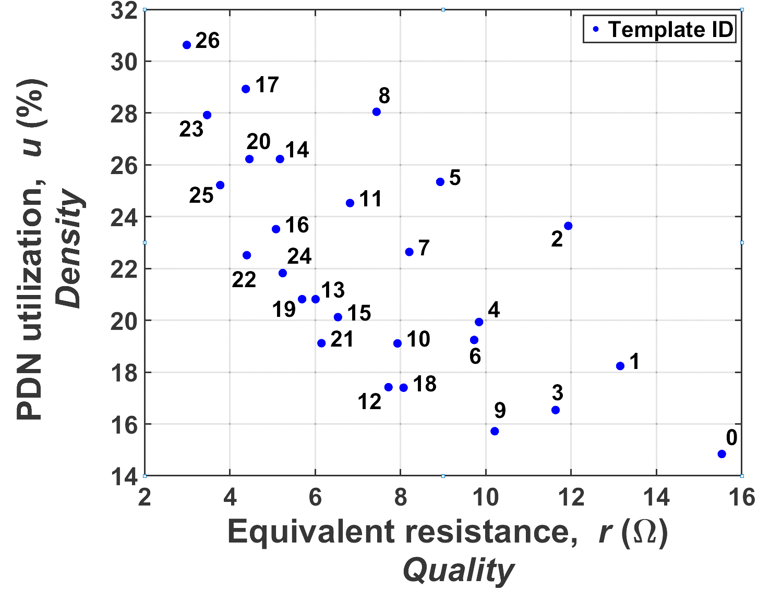
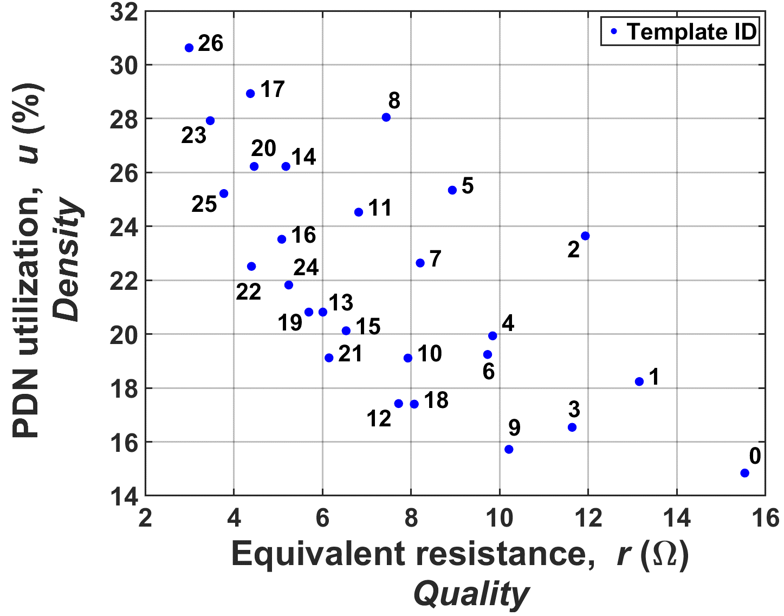
Template Pruning Scheme
Ranked based on equivalent resistance and metal utilization
Sub-optimal templates are discarded
$$T_{1}$$
$$T_{2}$$
$$T_{3}$$
Higher utilization
$$T_{1}$$
$$T_{3}$$
$$T_{2}$$
Higher equivalent resistance
Notes:
So say we have a bunch of 27 template id’ed from 0-26 shows with the blue dots here, we rank each of them in terms of the equivalent resistance and utilization.

Slide 10
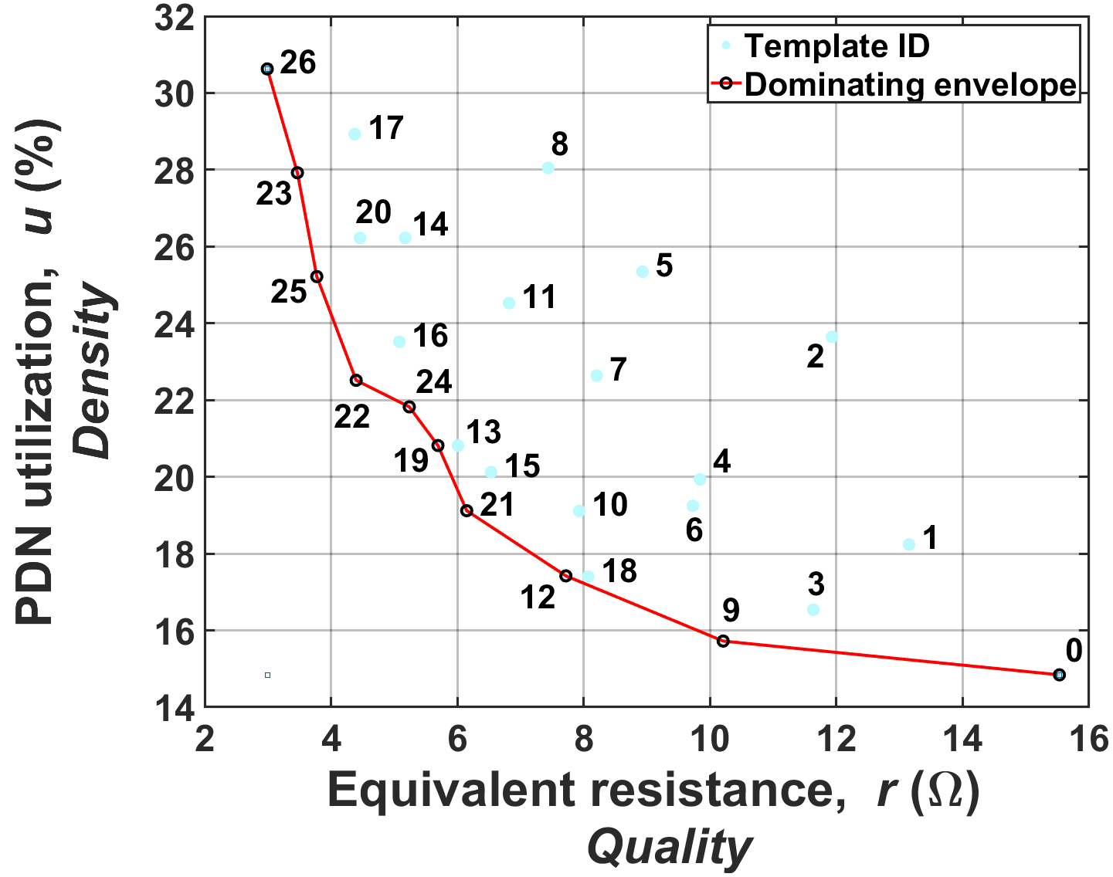
Template Pruning Scheme
Ranked based on equivalent resistance and metal utilization
Sub-optimal templates are discarded
$$T_{1}$$
$$T_{2}$$
$$T_{3}$$
Higher utilization
$$T_{1}$$
$$T_{3}$$
$$T_{2}$$
Higher equivalent resistance
Notes:
In such a plot if any template lies to the north east corner of another template then it is sub -optimal. So in this case 17, and 8 are suboptimal.

Slide 11

Template Pruning Scheme
Ranked based on equivalent resistance and metal utilization
Sub-optimal templates are discarded
$$T_{1}$$
$$T_{2}$$
$$T_{3}$$
Higher utilization
$$T_{1}$$
$$T_{3}$$
$$T_{2}$$
Higher equivalent resistance
Pruned template set: {0, 9, 12, 21, 19, 22, 25, 23, 26}
Notes:
So after eliminating all the templates you are left with templates that lie on this red envelop. This forms our template set that is fed into the ML model.

Slide 12
Current Distribution Representation
ML model considerations:
  Current distributions
  Congestion estimates
Notes:
To be able to predict the template in every region of the chip, we consider two parameters: current and congestion. However, as you are at different stages of the flow the distributions of these two parameters are different. For instance,

Slide 13
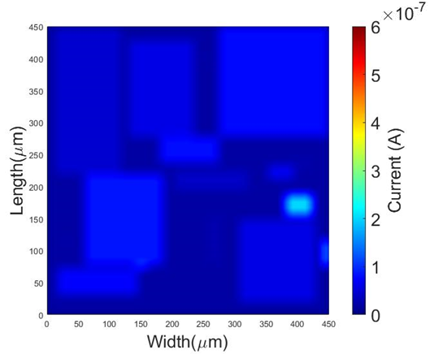
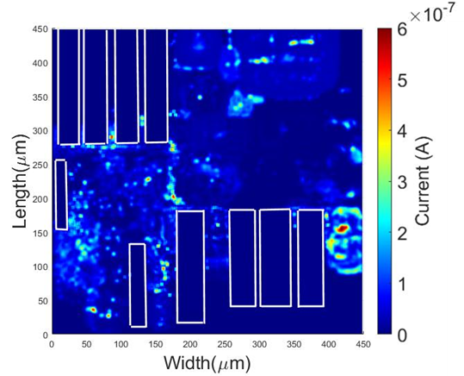
Current Distribution Representation
ML model considerations:
  Current distributions
  Congestion estimates
RISC V core current estimates through two stages of the design cycle
Floorplan (FP) stage
Placement (PL) stage
Two-staged approach for PDN synthesis and refinement
Notes:
The picture here shows current distributions, at the floorplan and placement stage. At the floorplan stage, the current distribution is available at the block-level basis average across the block, while at the placement stage, a detailed distribution of current is available. At the floorplan stage, the distribution is simple while more detailed distributions are at the placement stage. This called for two different approaches one at the floorplan and other at the placement. Here we synthesize the PDN at the floorplan stage and incrementally refine the PDN at the placement stage.

Slide 14
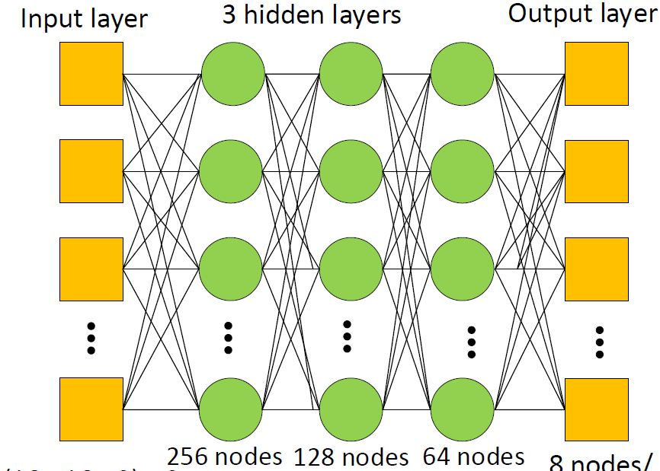

Neural Network Topology
Floorplan stage multi-layer perceptron
Input layer
3 hidden layers
Output layers
2313
nodes
256
nodes
128
nodes
64
nodes
8
classes
Notes:
We train two neural networks an MLP classifier and CNN, because of the kind of data available at each stage of the design cycle. The structure of the MLP is shown here, it is a simple 3 layered multi-layered perceptron, at the floorplans stage while the placement stage

Slide 15
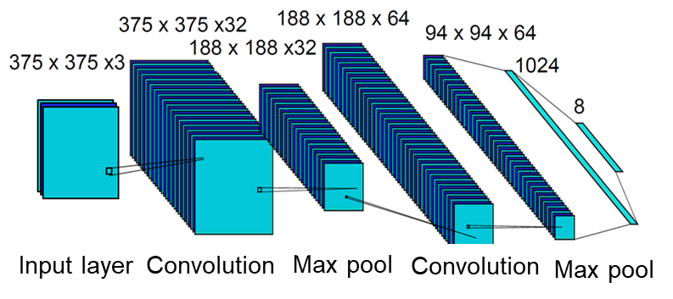
Neural Network Topology
Floorplan stage multi-layer perceptron
Placement stage convolution neural network
Input layer
3 hidden layers
Output layers
2313
nodes
256
nodes
128
nodes
64
nodes
8
classes
Notes:
we have a deeper neural network, LeNET based CNN. At the placement stage, we refine the MLP synthesized template and ensure that the placement-stage CNN does not modify the PDN synthesized at the floorplan stage drastically.

Slide 16

ML-based PDN Synthesis and Refinement Flow
Technology constraints
Inference flow:
Templates (T_{i})
Floorplan stage
Coarse current map
Coarse congestion map
Notes:
Looking at the overall methodology of the PDN synthesis and refinement methodology. So after defining the templates, eliminate the sub-optimal templates and you have a technology specific set of templates. The coarse current map, congestion map from the floorplan stage are used as input to the MLP to select a template in every region and hence synthesize a PDN.

Slide 17
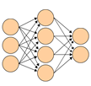
ML-based PDN Synthesis and Refinement Flow
Technology constraints
Inference flow:
Templates (T_{i})
Multi layer perceptron (MLP)
Floorplan stage
Coarse current map
Coarse congestion map
Synthesized IR- and EM-safe PDN

Slide 18
ML-based PDN Synthesis and Refinement Flow
Technology constraints
Inference flow:
Templates (T_{i})
Multi layer perceptron (MLP)
Floorplan stage
Coarse current map
Coarse congestion map
Synthesized IR- and EM-safe PDN
Synthesized PDN
Detailed current map
Placement stage
Detailed congestion map
Notes:
The synthesized MLP is taken as an input to the CNN at the placement stage, along with the detailed current and congestion map to incrementally refine the synthesized PDN.

Slide 19

ML-based PDN Synthesis and Refinement Flow
Technology constraints
Inference flow:
Templates (T_{i})
Multi layer perceptron (MLP)
Floorplan stage
Coarse current map
Coarse congestion map
Synthesized IR- and EM-safe PDN
Synthesized PDN
Detailed current map
Convolution neural network (CNN)
Placement stage
Detailed congestion map
Refined IR- and EM-safe PDN
Notes:
The synthesized MLP is taken as an input to the CNN at the placement stage, along with the detailed current and congestion map to incrementally refine the synthesized PDN.
Its important here that the placement refined synthesis is only an incremental change from the initially synthesized PDN.
Once trained, these models are trained its important to note that the same model can be reused if the technology and regions size remains the same.

Slide 20
Outline
Introduction
ML-based PDN synthesis and refinement methodology
Neural network training
Neural network evaluation
Conclusion
Notes:
Anyway coming to the ML model training. Here I will talk about the golden data generation and then I will move on to the training of the neural network itself.

Slide 21
ML Model Training: “Golden Data” Generation
Technology constraints
Training flow:
Templates (T_{i})
Floorplan stage
Coarse current maps
Training data generator
Coarse congestion maps
Synthesized IR- and EM-safe PDN
Synthesized PDNs
Notes:
So since we are using a supervised approach for training the model, we need labeled samples of data which are as optimized ass possible. So the data generation is a one-time step and it does not matter how long it takes to get the data, but it must be as near-optimal as possible.
So we use a SA engine:

Slide 22
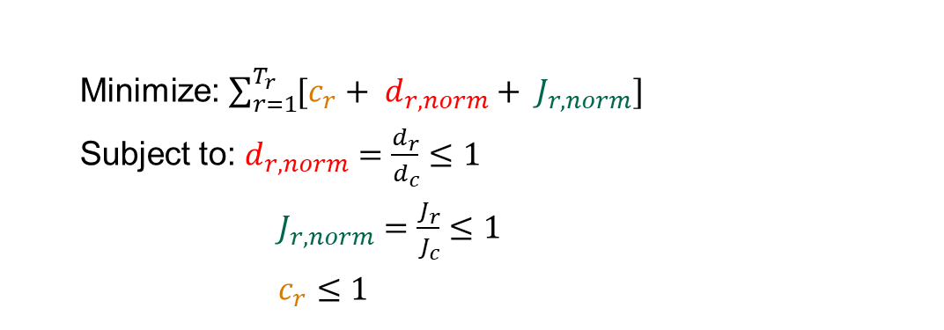
ML Model Training: “Golden Data” Generation
Technology constraints
Training flow:
Templates (T_{i})
Floorplan stage
Coarse current maps
Simulated annealing, GV=J solution at each step
IR drop limit
Coarse congestion maps
EM constraint
Synthesized IR- and EM-safe PDN
Synthesized PDNs
  Minimize: $\sum_{r=1}^{T_{r}}{[c_{r}+ d_{r,norm}+ J_{r,norm}] }$
  Subject to: $d_{r,norm}=\frac{d_{r}}{d_{c}}≤1$
  $J_{r,norm}=\frac{J_{r}}{J_{c}}≤1$
  $c_{r}≤1$
IR drop constraint
EM constraint
Congestion limit
Notes:
where the simulated annealing engine optimizes the cost function shown in the slide. The cost is a function of the IR drop, congestion, and current density. This is the cost function at the floorplan stage. At the placement stage however,

Slide 23
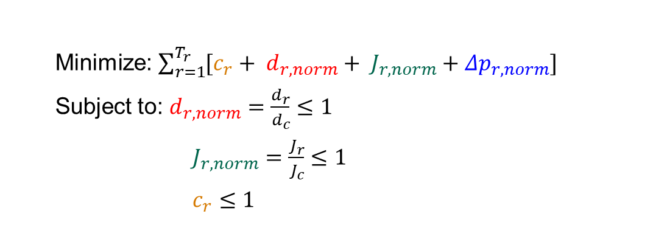
ML Model Training: “Golden Data” Generation
Technology constraints
Synthesized PDNs
Training flow:
Templates (T_{i})
Coarse current maps
Placement stage
Simulated annealing, GV=J solution at each step
IR drop limit
Coarse congestion maps
EM constraint
Refined IR- and EM-safe PDN
  Minimize: $\sum_{r=1}^{T_{r}}{[c_{r}+ d_{r,norm}+ J_{r,norm}+{Δp}_{r,norm}] }$
  Subject to: $d_{r,norm}=\frac{d_{r}}{d_{c}}≤1$
  $J_{r,norm}=\frac{J_{r}}{J_{c}}≤1$
  $c_{r}≤1$
IR drop constraint
EM constraint
Congestion limit
Notes:
There is an additional box and which is the synthesized PDN from the floorplan stage, and an additional term in blue which is a representation of the distance between the two templates. This term minimizes the distance between the synthesized PDN at FP and that is going to be predicted at the placement stage. This ensure consistence between the two predictions.

Slide 24
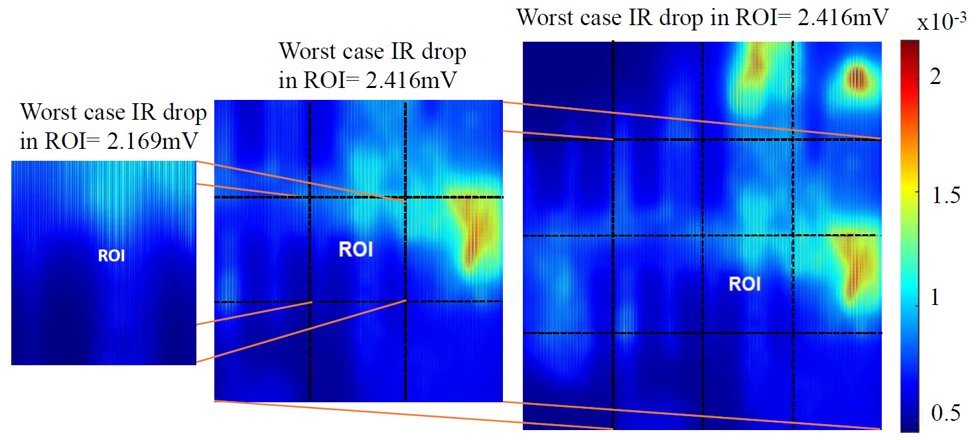
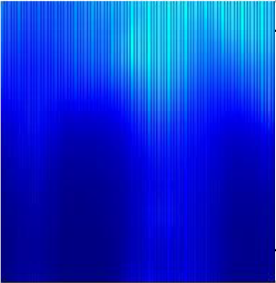
ML Model Training: Training Set
Principal of locality is leveraged:
  Neural network is independent of chip size
  Speeds up training, reduces dimensions of the neural network input data
3x3 region is enough for training
Worst case IR drop = 2.416mV
Worst case IR drop = 2.416mV
x10⁻³
Worst case IR drop = 2.169mV
Notes:
Another aspect to the training is that we leverage the principle of locality. What this states is that if you break the chips into regions the IR-drop or the voltage drop in one region does not depend on the voltage drops in regions beyond the region of interest and its immediate neighbors. So for example the picture on the slide shows that the chip is divided into 16 regions, the voltage drop in the central region is identical when compared the immediate 3x3 neighborhood currents is considered or when all the regions current is considered. Therefore, each data point in our training is a 3x3 region of current and congestion. This provides us two advantages (i) the most important one here is that it makes the model independent of the size of the chip and can be used for any design as long as the region size and technology and region size remains the same. (ii) instead of using the entire chip we only use a 3x3 window si this reduces the size of the input layerof the CNN makes training faster.

Slide 25
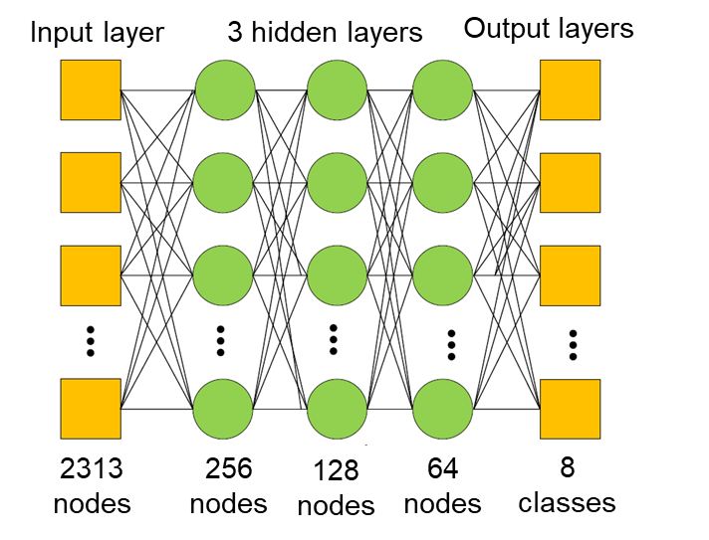
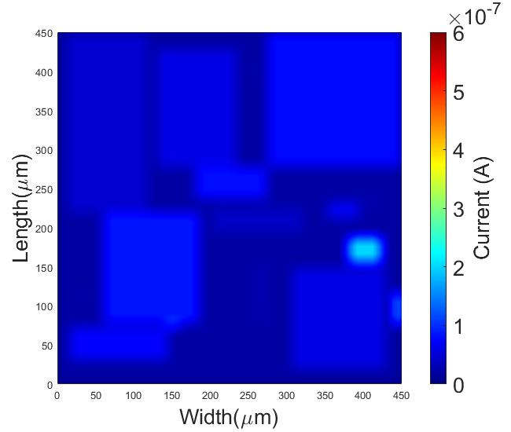
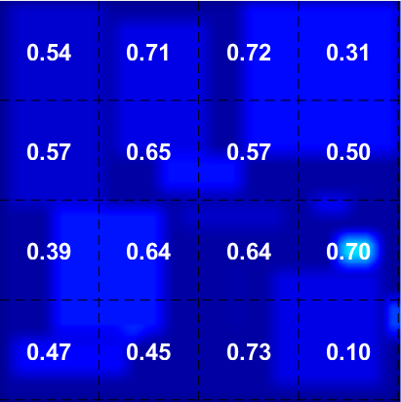
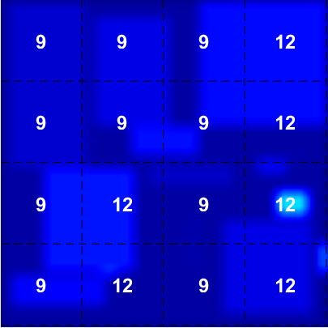

ML Model Training: Training Set Data Point
Principal of locality is leveraged:
  Neural network is independent of chip size
  Speeds up training, reduces dimensions of the neural network input data
MLP training:
  Data point: 3x3 region current and congestion, golden template ID
<average
congestion>
Input current and
congestion map
<golden template ID>
Golden template ID map
ROI
16
16
Template set:
{0, 9, 12, 21, 19, 22, 25, 23, 26}
Notes:
So essentially one data point is the 3x3 window of current and average congestion values in each region as shown on the left with the current map and congestion numbers along with the golden data which is the golden data or template ID or the representation of a PDN and then you train the ML model, this case shows the MLP a very similar training scheme is used for placement stage with with the MLP replaced by the CNN.

Slide 26
Outline
Introduction
ML-based PDN synthesis and refinement methodology
Neural network training
Neural network evaluation
Conclusion
Notes:
Once we have the models trained, we move to evulating the result. We generated 10000 data points using simulated annealing separated into a 80 10 10 ration where 80 was fror training 10 for test and 10 for validation.

Slide 27
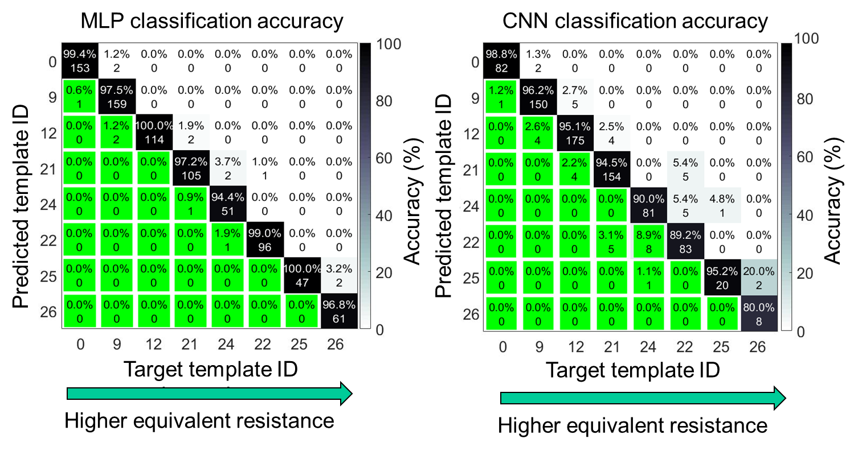
Results: Confusion Matrix for Test Set
10% of data generated is separated out as the test set
Lower equivalent resistance
98.87% IR- and EM-safety accuracy
Notes:
A typical way of visualizing the accuracy of a classifier is a confusion matrix. Here the x axis sows the real ID and the y axis is the predicted. Our trained MLP shows an accuracy of 98.87%. However, even the reaming 1 per cent is not all bad. Since these template ID s are sorted by decreasing equivalent resistance, any mis prediction that lies in the lower have of the triangle is IR and EM safe.

Slide 28
Results: Confusion Matrix for Test Set
10% of data generated is separated out as the test set
Lower equivalent resistance
Lower equivalent resistance
98.87% IR- and EM-safety accuracy
97% IR- and EM-safety accuracy
Notes:
Similarly on the right we see the confusion matrix for placement stage. Here we have a 97% IR and EM safety.

Slide 29
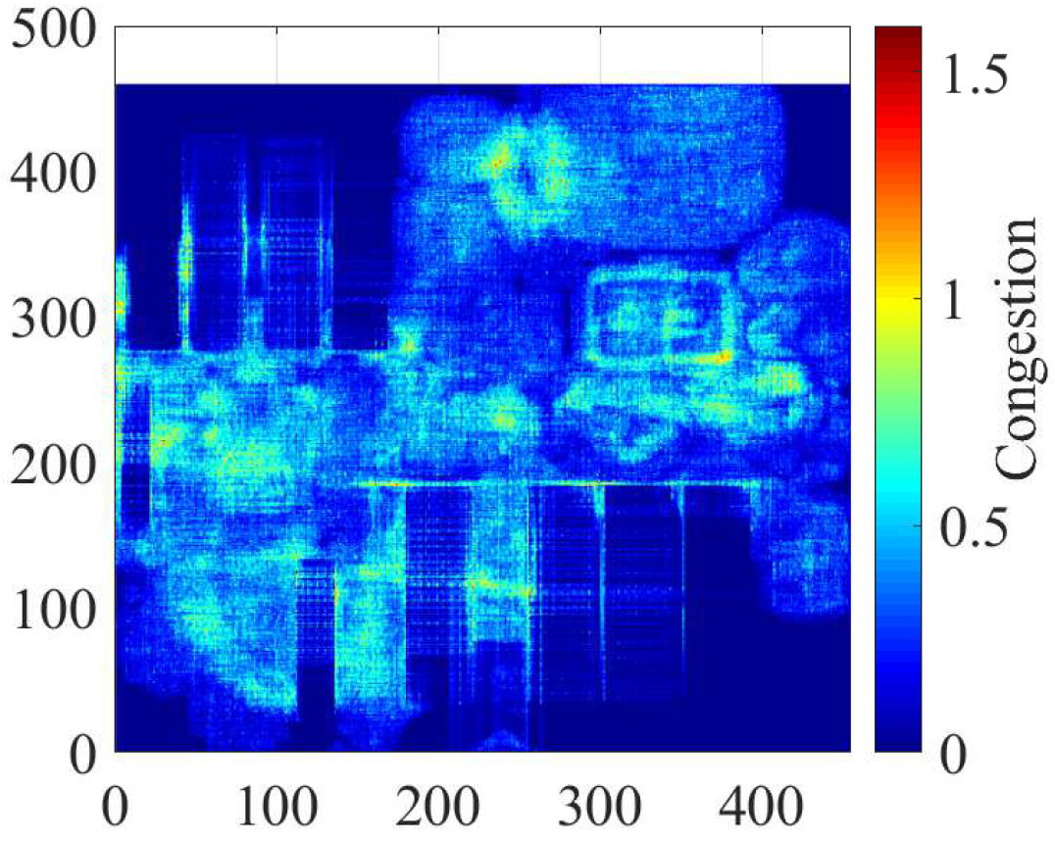
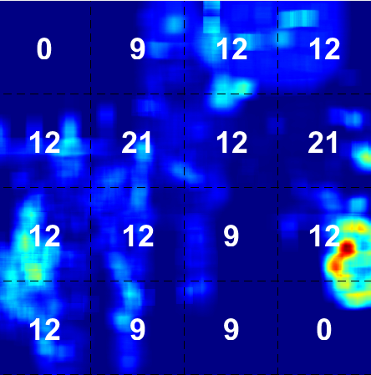

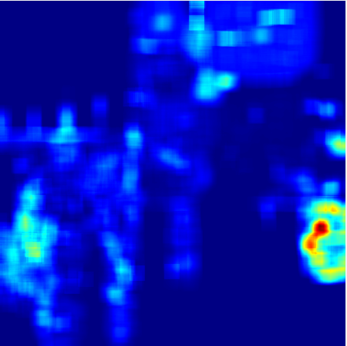
Results: RISC V Core 16FF Technology
MLP-synthesized and CNN-refined PDN after placement
Input signal
congestion map
<predicted template ID>
Input current map
Notes:
On this design, the 800 testcases were synthetically current and congestion maps. Here we have a real RISC V core congestion and current generation in the first two pictures, and the this shows the c

Slide 30
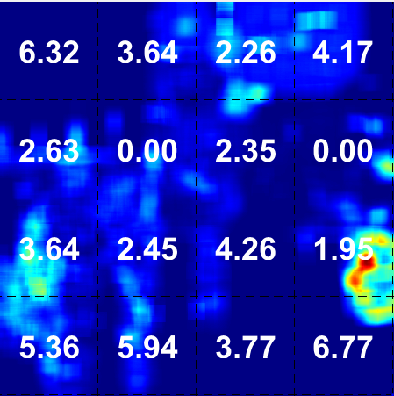

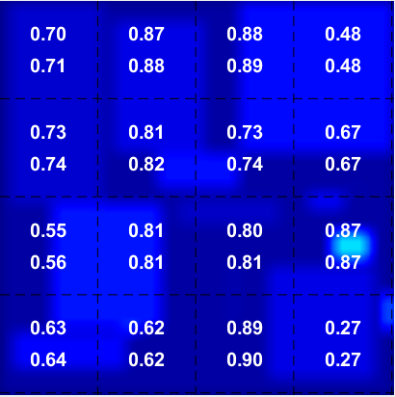
Results: RISC V Core 16FF Technology
MLP-synthesized and CNN-refined PDN after placement
Input signal
congestion map
Predicted
template ID map
Total congestion improvement (%)
<predicted template ID>
Notes:
After placement, the template ID and the irregular PDN structure. Each number represents a PDN template with different density. The last picture shows the congestion improvement in each region with the irregular PDN when compared to using a uniform PDN or a single template ID across that just meets IR drop.

Slide 31
Results: RISC V Core 16FF Technology
MLP-synthesized and CNN-refined PDN after placement
Input signal
congestion map
Predicted
template ID map
Total congestion improvement
<predicted template ID>
Congestion critical region
Congestion improvement (ACE metric) = 2.39% in congestion critical regions
Notes:
The red boxes here highlight critical regions. Basically, regions where the average congestion is higher than 0.5. Such that the improvement is in regions which are critical or regions where the sparse PDN templates will make a difference. An average improvement of 2.39% is seen. Even though it may seem small 2% actually corresponds to thousands of routing resources.

Slide 32
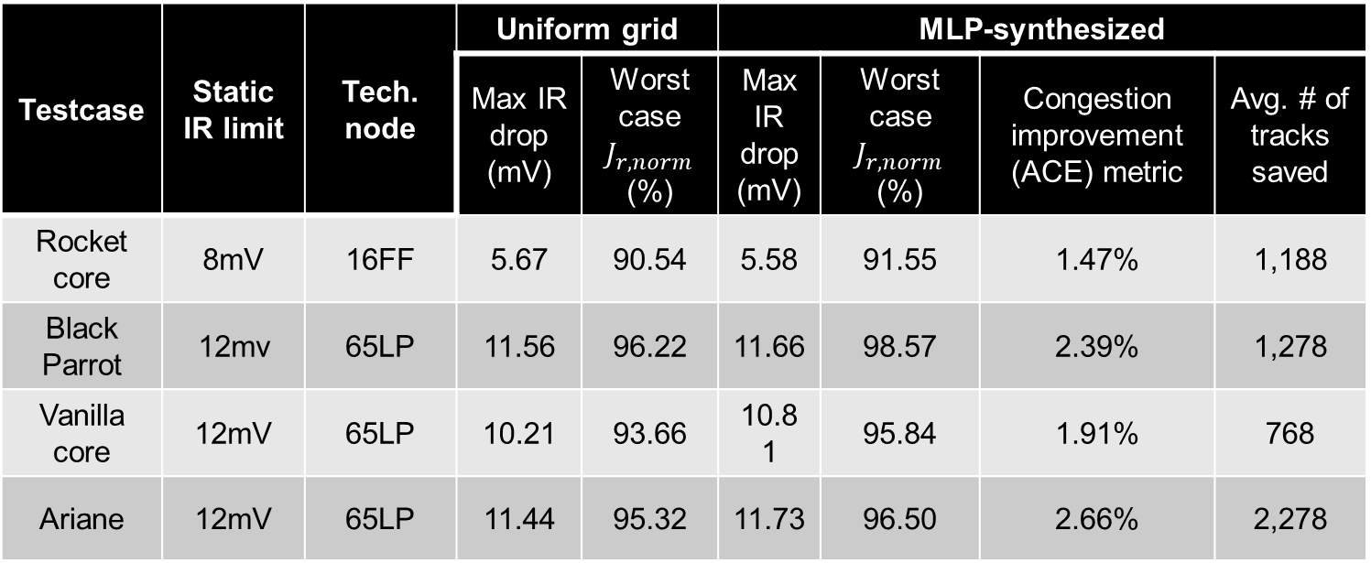
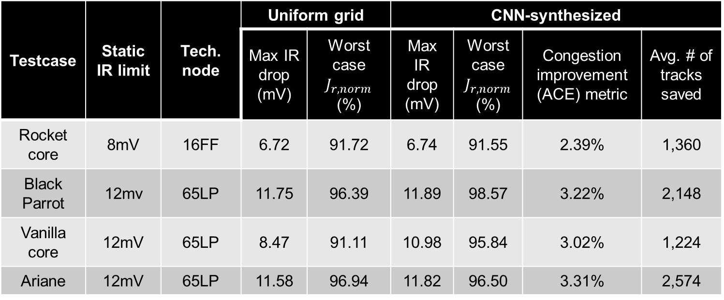
Results: Placement stage
Testcase | Static IR limit | Tech. node | Uniform grid |  | CNN-synthesized
 |  |  | Max IR drop (mV) | Worst case $J_{r,norm}$ (%) | Max IR drop (mV) | Worst case $J_{r,norm}$ (%) | Congestion improvement (ACE) metric | Avg. # of tracks saved
Rocket core | 8mV | 16FF | 6.72 | 91.72 | 6.74 | 91.55 | 2.39% | 1,360
Black Parrot | 12mv | 65LP | 11.75 | 96.39 | 11.89 | 98.57 | 3.22% | 2,148
Vanilla core | 12mV | 65LP | 8.47 | 91.11 | 10.98 | 95.84 | 3.02% | 1,224
Ariane | 12mV | 65LP | 11.58 | 96.94 | 11.82 | 96.50 | 3.31% | 2,574
Testcase | Static IR limit | Tech. node | Uniform grid |  | MLP-synthesized
 |  |  | Max IR drop (mV) | Worst case $J_{r,norm}$ (%) | Max IR drop (mV) | Worst case $J_{r,norm}$ (%) | Congestion improvement (ACE) metric | Avg. # of tracks saved
Rocket core | 8mV | 16FF | 5.67 | 90.54 | 5.58 | 91.55 | 1.47% | 1,188
Black Parrot | 12mv | 65LP | 11.56 | 96.22 | 11.66 | 98.57 | 2.39% | 1,278
Vanilla core | 12mV | 65LP | 10.21 | 93.66 | 10.81 | 95.84 | 1.91% | 768
Ariane | 12mV | 65LP | 11.44 | 95.32 | 11.73 | 96.50 | 2.66% | 2,278
Notes:
These are a summary of results across different designs across two different technologies. Thse designs are RISC V cores with a handful of macros and 100,000 standard cells. Thousands od routing resources are saved.

Slide 33
Conclusion
No-human-in-loop, correct-by-construction PDN synthesis and refinement using predefined templates
Encapsulate the expensive analysis step in the one-time ML model training
Notes:
To conclude, we proposed a NHIL, correct by construction PDN mentholody that solves the iterative nature of PDN sythnesis using predefined templates. This encapsulates the expensive analysis step into a one-time ML model training step.

Slide 34
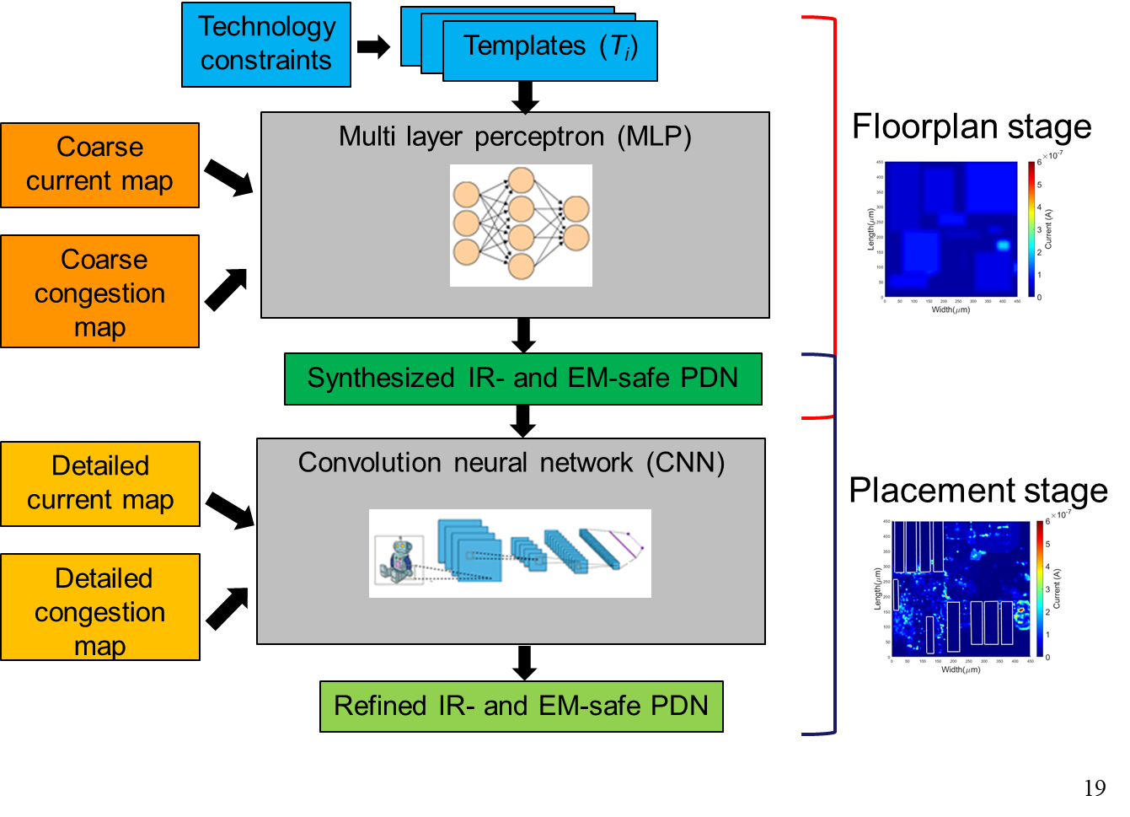
Conclusion
No-human-in-loop, correct-by-construction PDN synthesis and refinement using predefined templates
Encapsulate the expensive analysis step in the one-time ML model training
Average congestion improvement 2.98% (ACE metric).
Notes:
We use a two-step methodology to synthesize and then refine the synthesized PDN. The irregular nature of the PDN provides us a 3% improvement in congestion that corresponds to thousands of routing tracks, which can potentially aid routing another critical signal net and possible enable timing closure.

Slide 35

Conclusion: Open-sourced on GitHub
OpeNPDN: Neural-network for PDN synthesis
https://github.com/The-OpenROAD-Project/OpeNPDN
Integration into OpenROAD flow: Placement stage PDN refinement as a PDN stripe “depopulation” flow

Slide 36
Backup Slides

Slide 37
Results: Floorplan stage
Testcase | Static IR limit | Tech. node | Uniform grid |  | MLP-synthesized
 |  |  | Max IR drop (mV) | Worst case $J_{r,norm}$ (%) | Max IR drop (mV) | Worst case $J_{r,norm}$ (%) | Congestion improvement (ACE) metric | Avg. # of tracks saved
Rocket core | 8mV | 16FF | 5.67 | 90.54 | 5.58 | 91.55 | 1.47% | 1,188
Black Parrot | 12mv | 65LP | 11.56 | 96.22 | 11.66 | 98.57 | 2.39% | 1,278
Vanilla core | 12mV | 65LP | 10.21 | 93.66 | 10.81 | 95.84 | 1.91% | 768
Ariane | 12mV | 65LP | 11.44 | 95.32 | 11.73 | 96.50 | 2.66% | 2,278

Slide 38
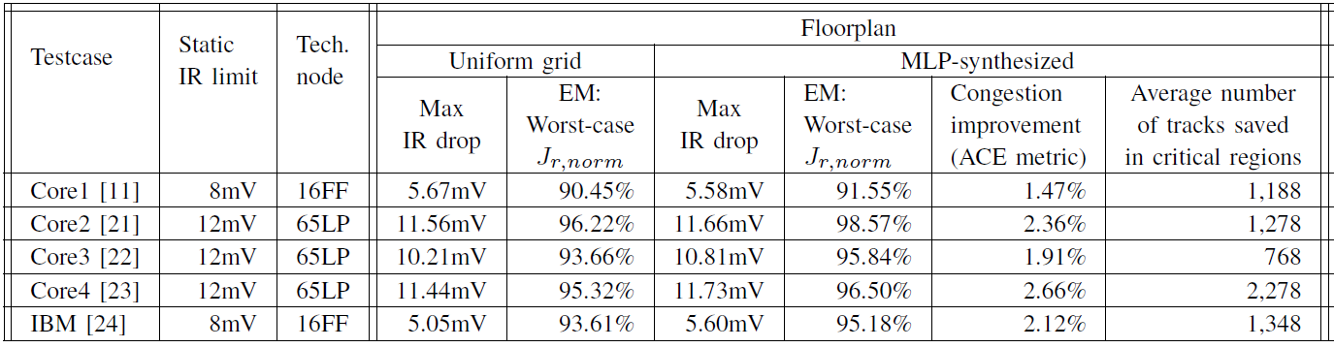
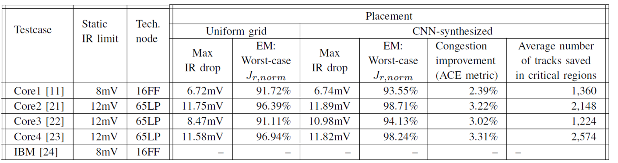
Results: Different Testcases

Slide 39
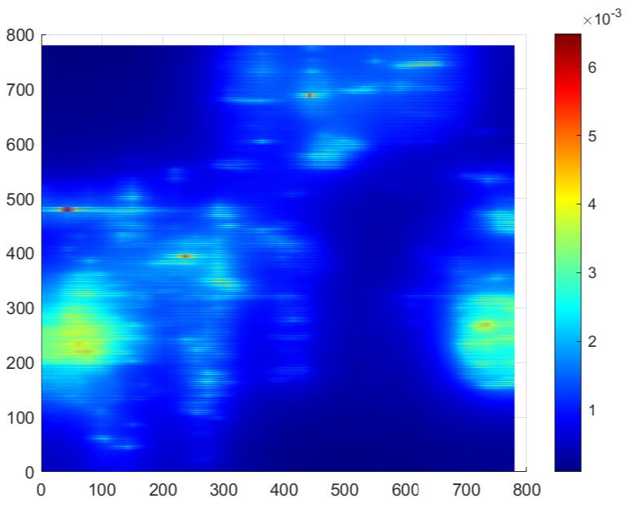

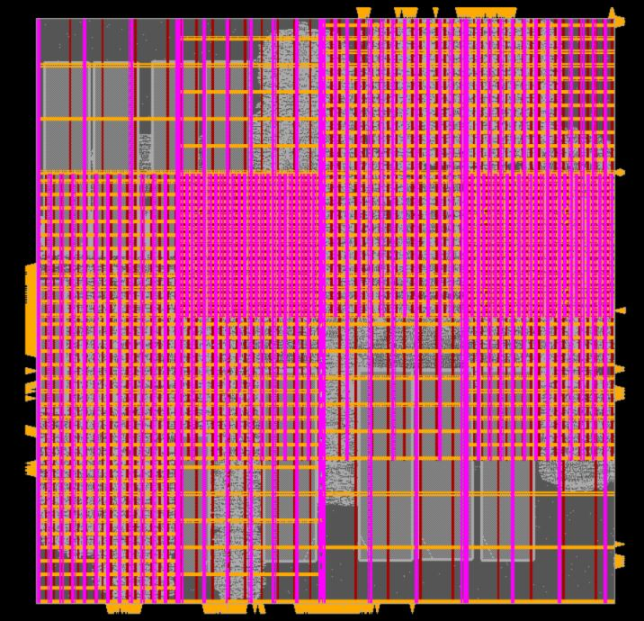
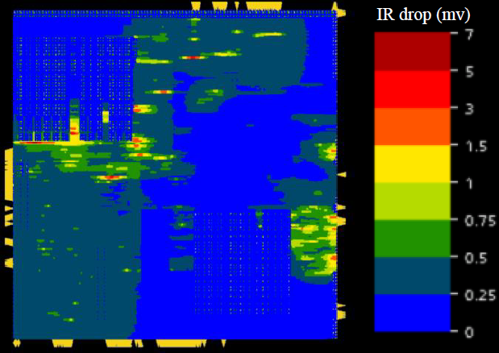
Current Map, Template Map, and IR Map
Custom implementation:
IR drop (V)
Length (μm)
Length (μm)
Width (μm)
Width (μm)
Cadence Innovus verification:

Slide 40
Results: RISC V Core 16FF Technology
MLP-synthesized PDN at floorplan stage
Input current and
congestion map
Predicted
template ID map
Total congestion improvement
<average
congestion>
<predicted template ID>
<uniform PDN>
Notes:
ACE metric, lower uniform template

Slide 41
Machine Learning Training
Hyper parameter tuning
Loss function: Cross entropy loss

