Slide 1
Looking Into the Mirror of Open Source
Andrew B. Kahng
UCSD Depts. of CSE and ECE
abk@ucsd.edu
https://vlsicad.ucsd.edu
ICCAD-2019 Session 8D
Notes:
Thank you, Alexandre – and good morning, everyone !
Let’s start by first understanding: What is open source?

Slide 2
What is Open Source?
Very good primers from Tim Ansell (Google):
j.mp/eri19-foss101
j.mp/eri19-foss102
Freely usable, freely modifiable, and shareable
Notes:
Open Source is Code that is RELEASED. Under an Open-Source License.
Without BOTH of these properties, a piece of code is not actually open source.
Tim Ansell of Google (who is here and who will be at the WOSET Workshop on Open-Source EDA Technology tomorrow) has very nice primers about open source at these links. Please take a look.
Open Source is freely usable, freely modifiable, and SHAREABLE. So, codes such as OpenAccess from SI2 are not actually open source. :51

Slide 3
Why Open-Source EDA?
Accelerate research and innovation
EDA research: avoid reinventing wheels
VLSI design: bring ideas into reality at zero cost
Anyone can use it, for any purpose
To learn
To tape out
To research new algorithmic ideas
Anyone can contribute
Worldwide collective effort is both powerful and needed !
Many ways to help
Making documentation better is a contribution
Contribute a testcase!
If you see room for improvement:
Work on it and create a pull request to be merged
If you don’t code, give feedback!
Notes:
Why open-source EDA?
[CLICK] To accelerate research and innovation: Open-source removes the burden of reinventing wheels. It enables tech transfer from research to commercial EDA. It helps train up EDA software engineers while still in school. So with open source EDA, your GitHub pull requests or your repo are your resume.
For designers, there is the promise of bringing ideas into reality with no blockers.
[CLICK] Anyone can use it to learn or tape out or do research.
[CLICK] Anyone can contribute. And there are many ways to help.

Slide 4
Open-Source EDA: Why Now?
Crisis of DESIGN: it’s difficult, expensive and risky!
This blocks innovation
A. Olofsson, DARPA ISPD-2018 keynote
Notes:
Why *NOW* ?
The simple answer: BECAUSE DESIGN has become JUST TOO DIFFICULT.
Today’s tools are complex and need expert users. Innovators are blocked by the cost and risk OF DESIGN.
[CLICK] So we see pictures like this – cost of silicon stays at ten cents per square millimeter in the blue trace, but the cost of designing that square millimeter is out of control in the red trace. And we see questions like [CLICK] THIS – which, as an EDA community, we should HATE to see! And the past 20-plus years of my career have been spent fighting against this question in various ways. In my view, open source IS A KEY LEVER to scale the future value of EDA.

Slide 5
The “IDEA” Program (2018-2022): Silicon Compilers 2.0
A. Olofsson, DARPA
ISPD-2018 keynote
Part of DARPA Electronics Resurgence Initiative
Traditional focus: ultimate performance, power, area
IDEA focus: ultimate ease of use and runtime
Restore designer access to silicon
Notes:
To address the DESIGN CRISIS, the IDEA program was launched in June of last year.
IDEA is part of the U.S. Electronics Resurgence Initiative, and it aims for Hardware Compilers 2.0 – no humans, 24-hour turnaround, eventually no loss of quality.
[CLICK] This shifts the focus FROM today’s tools that go after ultimate quality of results, TO SELF-DRIVING tools that don’t require years of training or months of schedule to tape out a working chip.
[CLICK] The broader goal is to restore designer access to silicon.

Slide 6
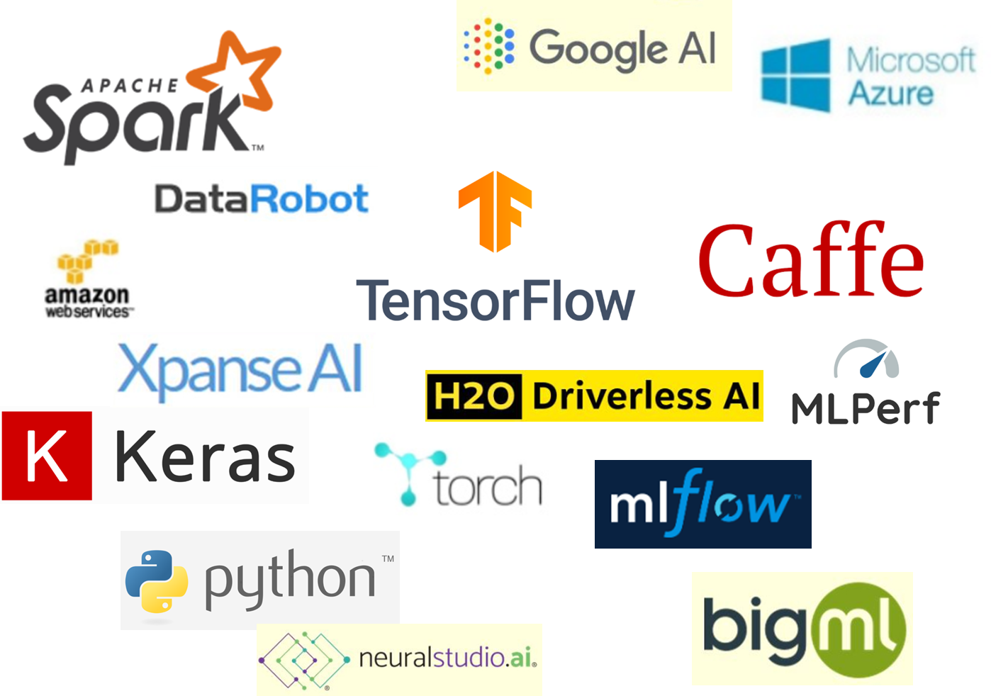
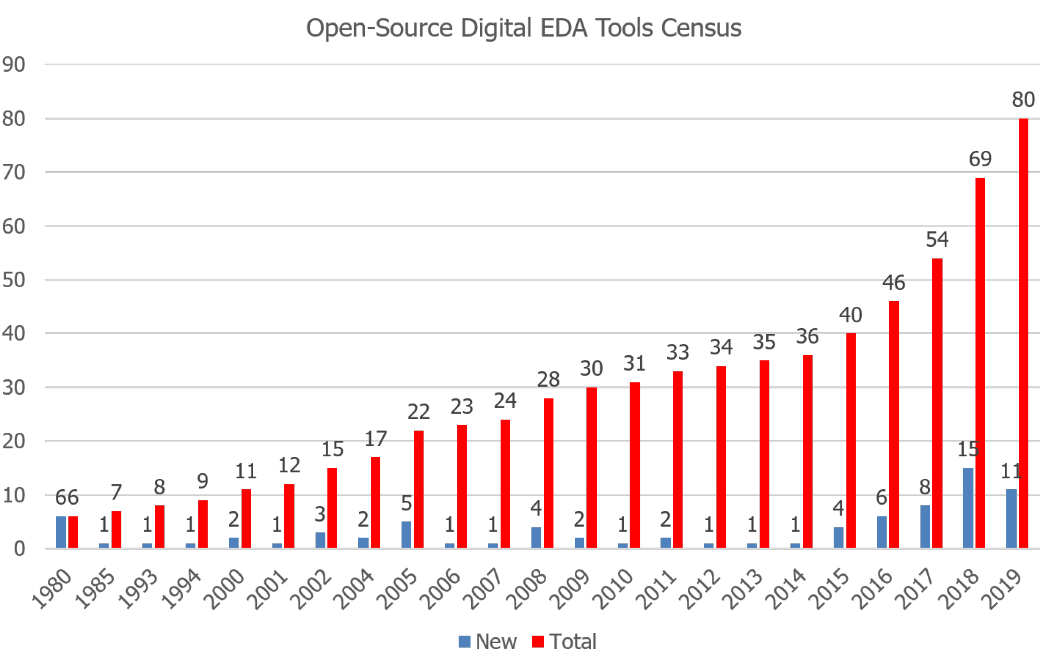
The World is Opening Up
AI/ML, Computer Vision → rapid advance of field, along with its value and attractiveness
Researchers and companies derive strategic value from open-sourcing
Open-source HW ecosystem rapidly following open-source SW models
What about EDA ?
Census of Open-Source Academic EDA Software (Digital IC)
https://github.com/ abk-openroad/Academic-Open-Source-Tool-and-Contest-Winners/wiki/ Academic-Open-Source-Tool-and-Contest-Winner-Stats/
CAUTION: Many released codes do not have proper open-source licenses!
Notes:
All around us, the world has been opening up.
Machine learning, AI, computer vision have advanced very rapidly; these fields have high value, they are attractive – they’re one hundred percent bought in to open source as a strategic lever for both researchers and companies.
[CLICK] The Open-source HARDWARE community is rapidly following what we’ve seen in open-source SOFTWARE. (AND: by the way: These are EDA users!)
[CLICK] And what about EDA itself? There are more open-source contributions in recent years – correlated with the launch of IDEA … BUT: Many quote-unquote “released” codes are not actually open-source, and these tools typically don’t interoperate.
[4:40]

Slide 7
II. ON OPEN SOURCE IN EDA
Notes:
Part TWO of my paper is about open source in EDA.
WHICH IS NOT A NEW IDEA.
[CLICK]

Slide 8
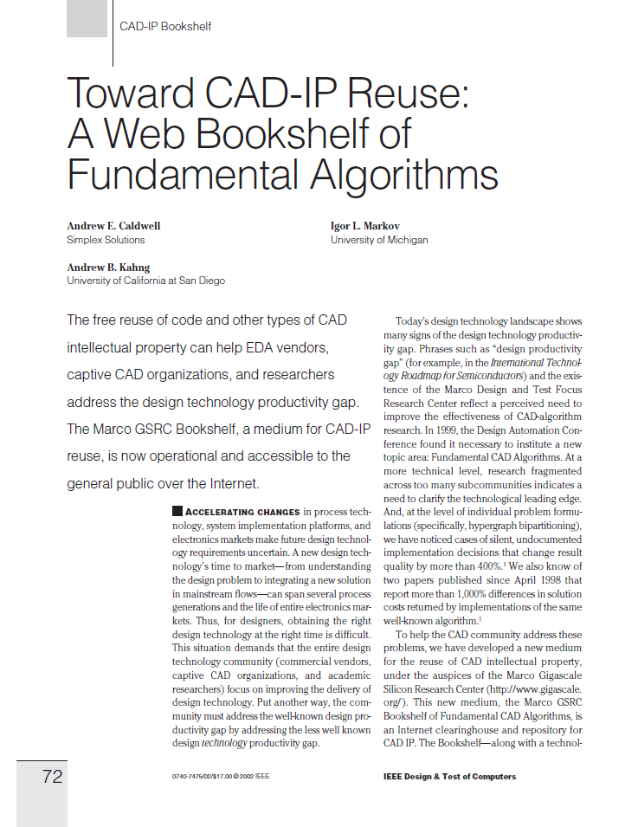
Open-Source EDA for Research: Tried It, Didn’t Like It!
☹
Observation: Our field was founded on open source (!)
SPICE, SUPREM, MAGIC, ESPRESSO, FASTCAP, MIS/SIS, … um, pay it forward?
Next slides: Diagnoses; Motivations; Lessons Learned
Notes:
TWENTY years ago, we tried to launch open-source in the EDA research community, with The VLSI CAD Bookshelf.
[CLICK] We wanted to start a new culture of CAD-IP Reuse and better science, with less reinventing of wheels. But for many reasons, it didn’t take root.
[CLICK] Ironically, FORTY-plus years ago, our field was founded on open source. So what happened?
Well …. In the next slides, I’ll touch on some diagnoses, current motivations, and lessons learned from the past.

Slide 9
Diagnoses
“Straight-out blockers”
Our published results are “irreproducible by construction”
Cannot publish industry tools’ Tcl commands, reports must find workarounds (binarized Tcl, EDA companies …)
Cannot “benchmark” must find workarounds to show benefits of innovation
Lack of an open-source EDA ecosystem
No open foundry PDK, library, IPs, …
No signoff verifications that enable designers to tape out foundry qualification needed to feed verifiers
No “entity” that has all the multi-way NDAs to enable receiving bug reports with testcases
Resulting drivers and incentives
Ripple effects of irreproducibility no culture of “independent confirmation” in our literature, unclear leading edge
Benchmarking, “compare with previous work” → incrementality closed source = competitive advantage
Personal (student, faculty) goals, sponsor restrictions, moral objections, … all perfectly reasonable
Ripple effects of lack of research “backplane” without full-flow testbed → isolated worlds of HPWL, IWLS95, …
“Parallel universe” problem is being addressed by latest IEEE CEDA Robust Design Flow !
RDF-2019: See Paper 2D.5 in Proceedings
Notes:
It’s pretty easy to diagnose why open-source is not part of our EDA research culture.
[CLICK] To start, there are what I call “straight-out blockers”:
First, we can’t share commercial tools’ Tcl scripts or reports with each other. And we can’t benchmark commercial tools, even though our papers need to show improvements over previous work and the state of the art.
Second, there is no open-source EDA ecosystem – PDK, library, signoff verifications are all missing. There is no mechanism by which a grad student tool developer can see an IC designer’s testcase that comes with a bug report.
[CLICK] The RESULTING bad news is that:
--- When results are irreproducible BY CONSTRUCTION, there is no culture of independent confirmation and verification. So no one knows where the leading edge is. And in this context, your closed source can be a real competitive advantage when it comes to publishing papers.
--- Also, without a “research backplane”, we live in a kind of “parallel universe” to the real world – we cannot assess our impact on chips or full flows, so we have little niches of half-perimeter wirelength, RC metric, IWLS95 benchmarks, and so on. The good news here is that this year, the IEEE CEDA RDF flow has made a big step toward curing the “parallel universe” problem.

Slide 10
13 Years Ago Today, ICCAD-2006 Monday Evening Panel
“CAD Research, Pay Now or Pay Later”
Organized and moderated by Dr. Leon Stok, VP EDA at IBM
https://vlsicad.ucsd.edu/Presentations/talk/ICCADPanel-abk-v3.ppt
Modern terminology: “Technical Debt”
Observation: As a field, we have all been paying interest on “technical debt”
Notes:
And, I’m sorry, but this is one of my “Those Who Do Not Recall The Past Are Doomed To Repeat It …” kind of slides.
It was exactly thirteen years ago TODAY that Leon Stok of IBM moderated an ICCAD evening panel called “CAD Research, Pay Now or Pay Later”.
You can see my slides and my Top 5 CAD research challenges from that panel – culture, software, and so on.
I truly believe that the urgency of Open-Source EDA TODAY comes from a form of “technical debt”, and my point here is that we’ve been paying interest on this debt for too many years.

Slide 11
Benefits of Open-Source EDA
Improve Science and Relevance
Leading edge becomes visible and well-defined
Interoperability with IC design, commercial EDA
True CAD-IP Reuse = no reinventing wheels
No wasted time trying to reconstruct code from papers
Remove “structural” barriers
Can share Tcl scripts, support “METRICS 2.0” + ML, …
Improve maturity and attractiveness of field
To students and entrepreneurs/innovators alike
Ethos of openness, paying it forward
Notes:
Twenty years after the Bookshelf, what benefits can open-source bring us?
Well I’ve shown you this slide already.
In the paper, I go into more detail about how science and relevance – including interoperability with the IC design and commercial EDA worlds – can result.
[CLICK] True CAD-IP reuse means no reinventing wheels – which helps vendors, CAD organizations and researchers. We wrote this 17 years ago.
[CLICK] With open-source tools, we can share Tcl scripts, we can enable MACHINE LEARNING in and around our tools, our field becomes more mature and attractive.

Slide 12
Lessons Learned
Lessons from the Bookshelf experience
Must drive culture change and worldwide engagement
Must achieve critical mass, critical quality
MANY stakeholders today: societies, open-source SW/HW, academic contests, funding sources, worldwide geographies
DAC-2019 Birds-of-a-Feather Meeting on “Open-Source Academic EDA Software”
https://github.com/The-OpenROAD-Project/Birds-of-a-Feather-Open-Source-Academic-EDA-Software
Clear feedback especially from potential users (designers):
Get a full flow working
Integrate tools on a shared back-end database
Software quality is essential
= “Table Stakes”
+ Latest feedback: Show us tapeouts !
Notes:
And here are some lessons learned.
Two lessons from the Bookshelf experience are that Open-Source EDA must achieve worldwide engagement, and it must achieve CRITICAL MASS and CRITICAL QUALITY.
And today, there are MANY kinds of stakeholders for open-source EDA – notably in the open-source hardware ecosystem.
I am part of a project that has been having many interactions with the community, through contests and open-source contribution awards and the WOSET workshop which is tomorrow in the Westminster IV Room.
[CLICK] At DAC, we’ve had two years of birds-of-a-feather meetings on open-source academic EDA software.
[CLICK] And this past June, the clear feedback about EDA open source was: SHOW US.
Show a full flow, integrated on a database, with strong software engineering quality.
These are the TABLE STAKES just to be in the game.
[CLICK] And the latest feedback is: Show us your Tapeouts.

Slide 13
III. UNBLOCKING: NEAR-TERM MILESTONES
Flow
Integrated architecture: STA, DB, Tool
Continuous build / test / integration
Generic node support
Notes:
Section III of my paper discusses the UNBLOCKING of open-source EDA with some “near-term milestones.”
I’ll now go over current status for these. Keep an eye out for the keywords in RED FONT ! + 6:09 = 10:49

Slide 14
Flow: IEEE CEDA DATC “Robust Design Flow”: RDF-2019
“RDF-2019”: Paper 2D.5 in ICCAD-2019 Proceedings
https://github.com/ieee-ceda-datc/RDF-2019
OpenROAD tools fill in gaps to complete the first full reference academic flow for RTL-to-GDS
All tools have open-source licenses
Notes:
The first MILESTONE is a COMPLETE FLOW.
On Monday afternoon, the new Robust Design Flow from IEEE CEDA’s Design Automation Technical Committee was announced. It is the first reference academic flow that takes behavioral Verilog all the way to GDS stream out.
[CLICK] RDF-2019 includes open-source tools from The OpenROAD Project that fill in some previous gaps such as floorplanning and CTS.

Slide 15
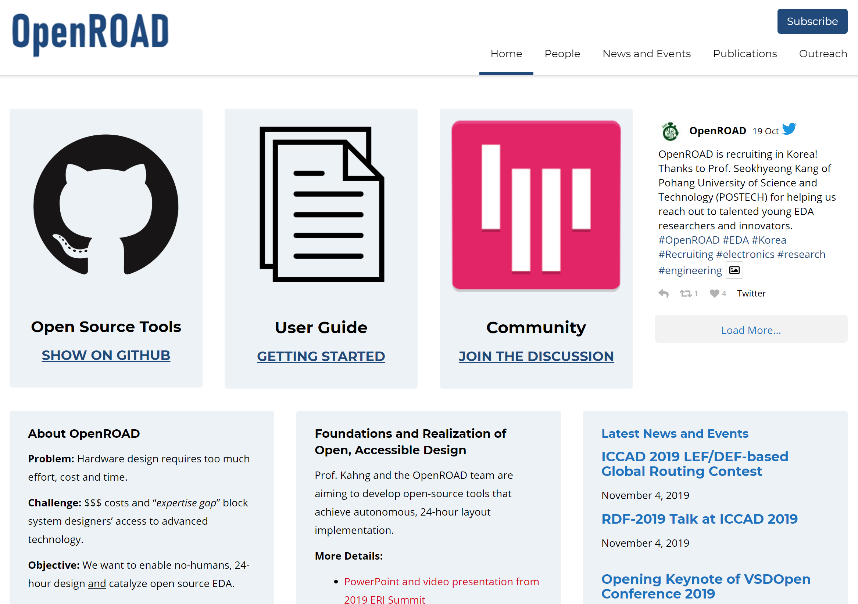
The OpenROAD Project: theopenroadproject.org
Focus: Digital RTL-to-GDS flow
“Alpha” in July 2019
DRC-clean layout in TSMC65LP w/ Arm cells, IPs
“v1.0” release target in July 2020
DRC-clean tapeout in foundry FinFET node
GitHub: https://github.com/The-OpenROAD-Project
Notes:
The OpenROAD Project can be found at this website and GitHub.
All tools in the project are open source.
A capability of DRC-clean layout in TSMC 65LP was shown over the summer, and by next summer the target is automated DRC-clean tapeout in a foundry FinFET node.
This project aims to deliver the CRITICAL MASS and CRITICAL QUALITY that will be the seed of an open-source EDA ecosystem for researchers, tool developers and users.
And, a lot of my following remarks are going to be illustrated with pointers into the OpenROAD project.
[[There are many ways to help – file an issue or a pull request, contribute a test, add a missing tool.]]

Slide 16
Architecture: SP&R Demands Tight Integrations!
How is modern synthesis-place-route architected?
40 years of EDA industry learning curve:
1980s: file-based integration “Tool Chain” (OpenROAD “Alpha”, July 2019)
1990s: “common timing engine”
2000s: tightly coupled algorithms on a shared incremental substrate “Tight Integration” (OpenROAD v1.0, July 2020)
→ must have open-source incremental STA engine
→ must have open-source shared DB layer
2010s: “hyperoptimization” on same architecture
Notes:
The SECOND MILESTONE to unblock is ARCHITECTURE.
How do you architect a modern synthesis-place-and-route tool? Well, the EDA industry figured out the answer – over the course of 40 years.
OpenROAD’s ALPHA tool chain from last JULY, with its file-based integration, is 1980’s EDA.
In the 90’s, EDA companies figured out they needed a common timing engine in the back end.
Since the 2000’s, all of commercial EDA has had the same canonical architecture for RTL-to-GDS: tightly coupled algorithms on a shared incremental substrate. So OpenROAD version 1.0 will depend on advancing 20 years up the EDA industry learning curve, in a single year.
THE GOOD NEWS is: It’s very clear what has to be built. Like, for starters, you need a real STA ENGINE and a real DATABASE.

Slide 17
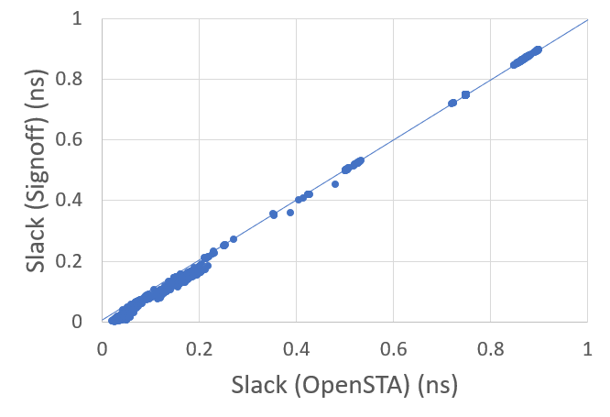
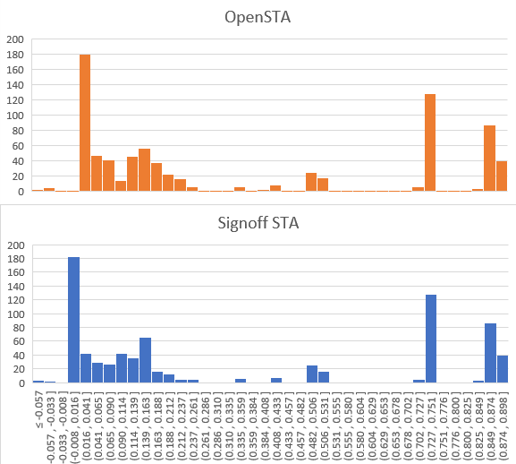
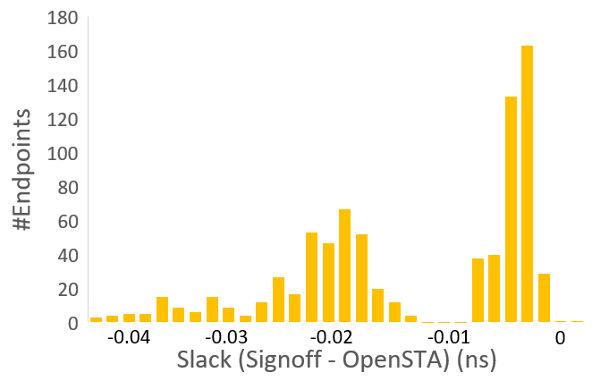
Timer: OpenSTA Slack, WNS, TNS 28nm
https://github.com/The-OpenROAD-Project/OpenSTA
aes_cipher_top (28nm, 12T, clkp=1000ps)
Reg-to-Out/ In-to-Reg
Reg-to-Reg
aes_cipher_top | WNS (ps) | TNS (ps) | #viol.
Signoff STA | -61 | -289 | 7
OpenSTA (arnoldi) | -57 | -314 | 9
Notes:
OpenSTA was a breakthrough MILESTONE for EDA open source. It is a commercial timer that’s been embedded in about 15 commercial EDA tools, including most FPGA tools.
This slide shows how 28nm slack histograms, WNS and TNS of a commercial signoff timer and OpenSTA differ by up to a few tens of picoseconds. This incremental STA engine is central to any modern RTL-to-GDS tool.

Slide 18
Incremental Shared Netlist Architecture
Notes:
This is the Incremental Shared Netlist Architecture: 21st Century EDA.
By calling the Timer API, all of Synthesis, Placement, CTS, and Post-placement Optimization can be timing-driven.
The Shared Physical or Data Model Adapter contains physical information such as placement location or routed metal shapes, and communicates with Synthesis, Placement, Routing, and the Timer.
The Shared Netlist or Abstract Network Adapter enables incremental netlist modification, and communicates additionally with CTS and Post-Place Opt.
In commercial EDA tools, thousands of incremental optimizations iterations per second can be supported by this architecture.
AND NOTICE that this picture assumes a back-end database, like a MilkyWay or OpenAccess, underneath the bottom.

Slide 19
Database: OpenDB Released on October 5, 2019
Commercially developed back-end database and EDA framework
https://github.com/The-OpenROAD-Project/OpenDB
A huge milestone for open-source RTL-to-GDS ! Note: OpenAccess is not freely redistributable
Notes:
And so, another UNBLOCKING MILESTONE occurred 32 days ago, with open-sourcing of OpenDB, which is a commercially-developed back-end database plus an EDA framework. The owner agreed to open-source this for the OpenROAD project.

Slide 20
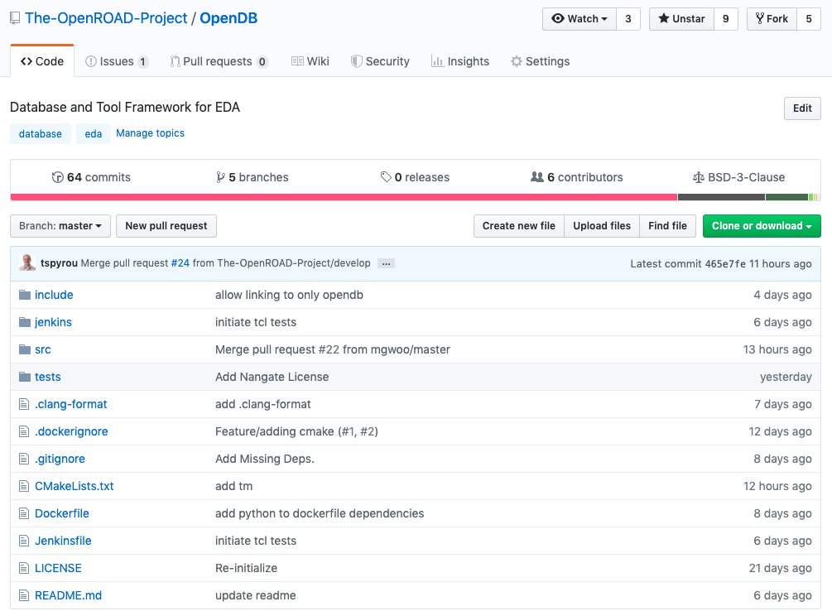
Foundation of a Tool
Architecture and Development Environment
Tools and Integrations
Jenkins CI
#include “opendb.h”
TCL
Python
Unit Tests
SWIG
CMake
OpenDB
Notes:
Around the core of OpenDB code
[CLICK] The build system now uses CMake, and so OpenDB can be used from
[CLICK] C++, by including opendb public headers.
[CLICK] SWIG wrappers allow use of OpenDB from
[CLICK] both Tcl and Python. [[Tool users have their traditional Tcl interface to the DB, and developers can access DB functionality from Python.]]
[CLICK] A Jenkins-based continuous integration pipeline ensures integrity of the codebase.
[CLICK] Unit tests have been added [[around major functionality of the database.]]
[CLICK] Bottom line: tools and integrations can safely use OpenDB from C++, Tcl and Python.
This is the foundation of an integrated “OpenROAD” application, i.e., an EDA tool. TOMORROW, at the WOSET workshop, Tom Spyrou, who [left Intel in July, moved to San Diego, and] is now OpenROAD’s chief architect -- will present and demo OpenDB during the poster sessions.

Slide 21
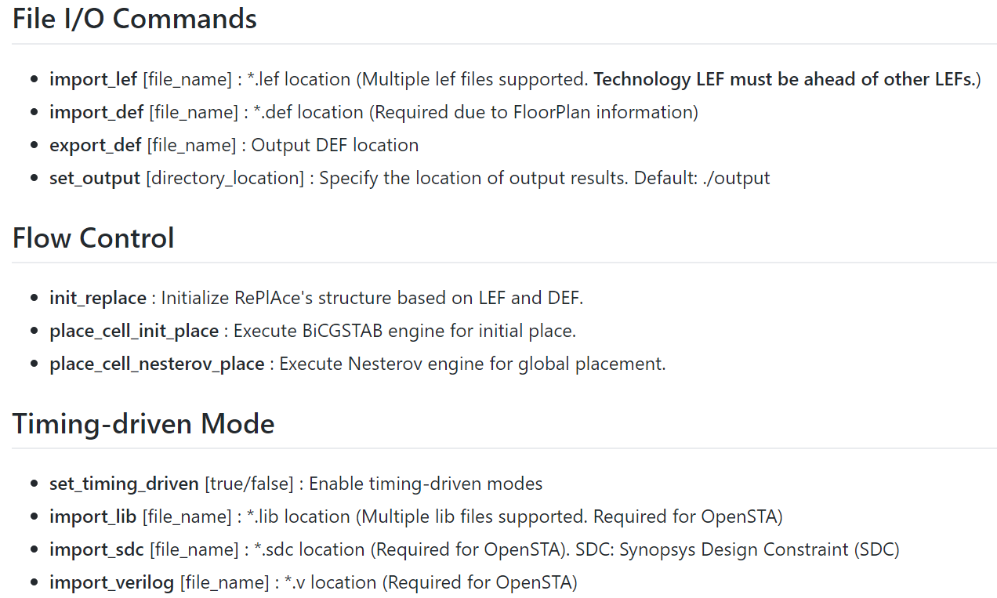
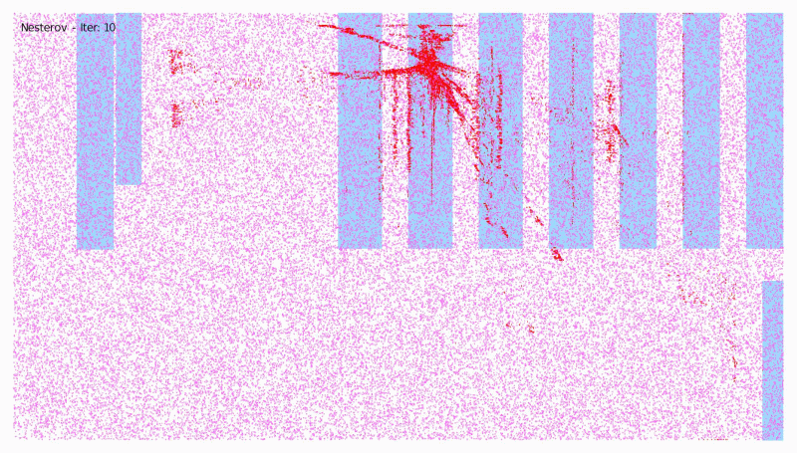
Usability: Tcl Interfacing
Example: RePlAce Tcl commands
Link: https://github.com/The-OpenROAD-Project/RePlAce/blob/master/doc/TclCommands.md
Notes:
An architecture such as this gives the usability that designers expect.
Here, this slide shows a snippet of DOCUMENTATION for the RePlAce global placer’s Tcl commands.
RePlAce supports File I/O, Flow control and Timing-Driven mode commands.
The link has more explanation of RePlAce’s Tcl commands.

Slide 22
Usability: Example Tcl Script for Timing-Driven RePlAce
# Tcl example for Timing-driven RePlAce
set design wb_dma_top
set lib_dir ./library/a2a/
set design_dir ./design/a2a/${design}
replace_external rep
# Import LEF/DEF files
rep import_lef ${lib_dir}/contest.lef
rep import_def ${design_dir}/${design}.def
rep set_output ./output/
# timing-driven parameters
rep import_verilog ${design_dir}/${design}.v
rep import_sdc ${design_dir}/${design}.sdc
rep import_lib ${lib_dir}/contest.lib
rep set_unit_res 16
rep set_unit_cap 0.23e-15
rep set_timing_driven 1
rep set_bin_grid_count 64
# Initialize RePlAce
rep init_replace
# place_cell with Nesterov method
rep place_cell_nesterov_place
# Export DEF file
rep export_def ./${design}_a2a_td.def
puts "nesterovPlace HPWL: [rep get_hpwl]"
puts "final WNS: [rep get_wns]"
puts "final TNS: [rep get_tns]"
Link: https://github.com/The-OpenROAD-Project/RePlAce/blob/master/test/wb_td_test.tcl
Notes:
Here is an example script for timing-driven placement
RePlAce has a internal Tcl Interpreter, so the user can use TCL functions like set and puts.
[CLICK] In the RED BOX, a user can create a replace_external object, here it’s named “rep”.
We see RePlAce’s Tcl commands used to read library and constraint info, and to import LEF/DEF and export DEF.
To invoke Timing-Driven mode, the user specifies [CLICK] “set_timing_driven 1” for the rep object, as seen in the BLUE BOX.
More Tcl examples are at this link.

Slide 23
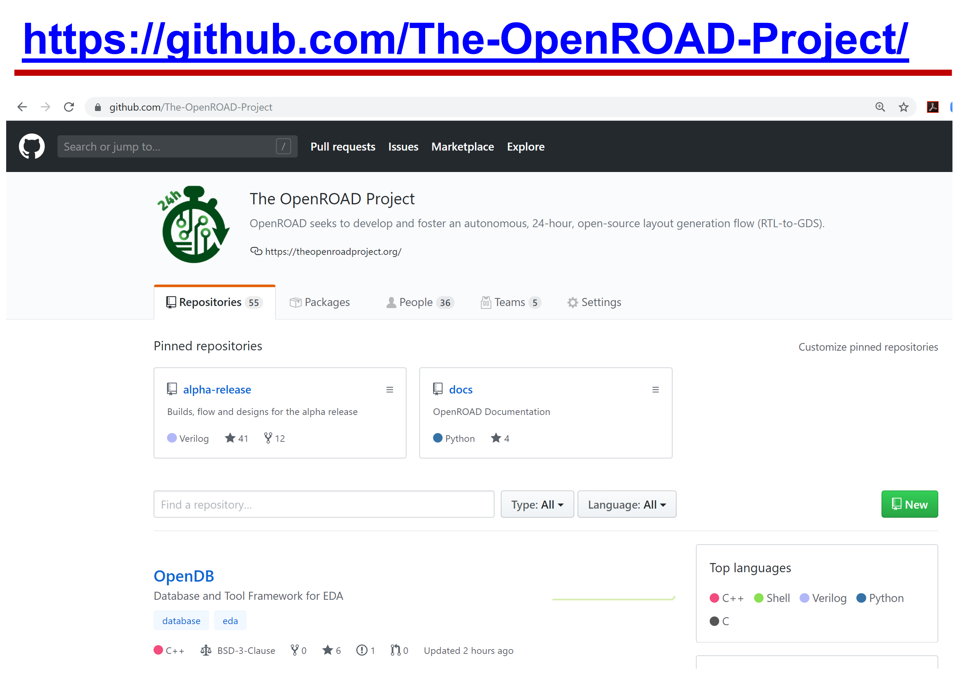
Software Quality: Agile + Community, Git, Jenkins CI
Notes:
One of the slides at the very beginning of this talk noted a key benefit of open source: ANYONE can contribute.
[CLICK] And there’s our GitHub with a timer, a database, and many integrated tools.
This combination is POWERFUL – once we have a foundation of SOFTWARE QUALITY and ASSURANCE, which is ANOTHER MILESTONE that open-source EDA must UNBLOCK.
+7:35 = 18:25

Slide 24
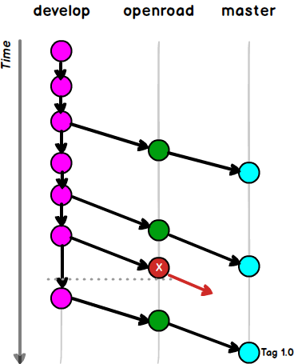
OpenROAD Git Flow
The ‘develop’ branch maintains day-to-day development activities
Runs unit tests and tool regression tests
All contributions (PRs) are issued to ‘develop’
Changes merged to the ‘openroad’ branch are tested against the end-to-end flow
A repo owner initiates this merge to ensure that tools still run within OpenROAD flow
The ‘master’ branch holds a stable release of the codebase
Notes:
[I’m short on time, so I’ll leave these next three slides in my posted powerpoint, with speaker notes. My main point is that any open-source EDA tool will likely need continuous integration infrastructure, along with strong tests and tool and flow regressions.]
[CLICK] The ‘develop’ branch maintains day-to-day development activities – it runs unit tests and tool regression tests
All contributions (that is, PULL REQUESTS) are issued to ‘develop’.
[CLICK] Changes merged to the ‘openroad’ branch are tested against the end-to-end flow.
A repo owner initiates this merge to ensure that tools still run within OpenROAD flow.
[CLICK] The ‘master’ branch holds a stable release of the codebase

Slide 25
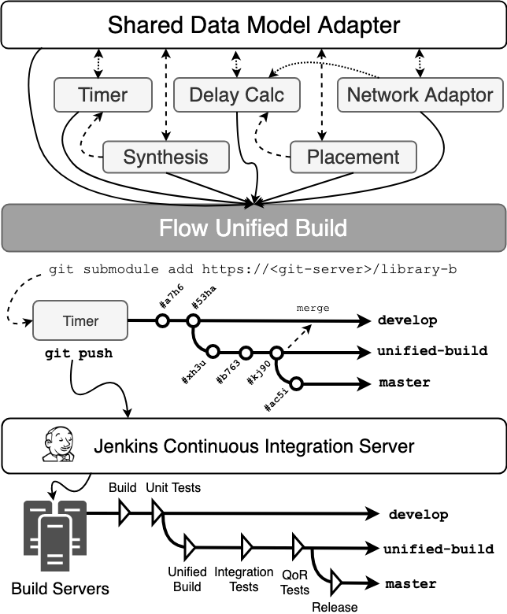
OpenROAD Continuous Integration (CI)
Notes:
[For example, OpenROAD has a Jenkins-based CI infrastructure.]
This leads to the Jenkins-based, continuous integration infrastructure that has been brought up at OpenROAD to help ensure integrity and quality of the codebase …
[[In this picture, you see the same three key branches: a tool’s develop branch, the flow unified-build (which is the same as the openroad branch in the previous slide), and the master branch.]]

Slide 26
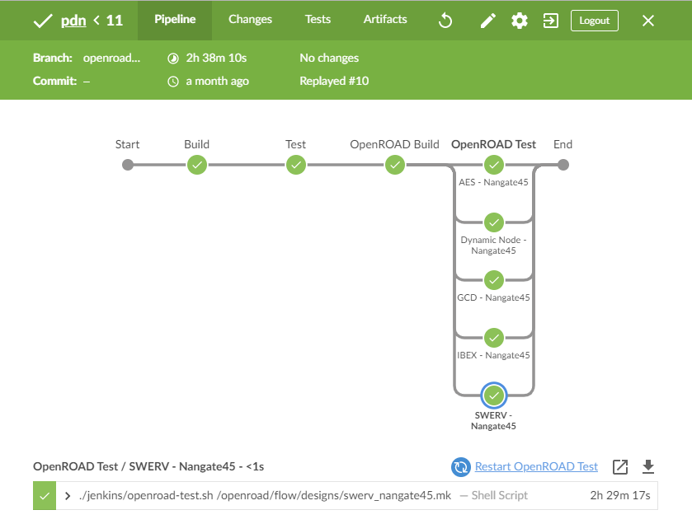
OpenROAD Continuous Integration (CI)
Parallel Tests
Saving Developer Time
Notes:
[This is a CI pipeline from GitHub to Jenkins, where tool build and test, then flow build, then parallel tests on available testcases are all automatically triggered.]
This slide shows a pipeline that was triggered automatically from GitHub to Jenkins.
The top-left shows that it ran on the branch 'openroad'.
It built and tested one of the tools (pdn) and when the two steps were successful, it tested the new code changes within the OpenROAD flow.
First, it makes sure that it still can be built within OpenROAD unified build environment. Then, it runs available test cases in parallel. Some of them are small and take a few minutes, but others can take longer.
The end-to-end pipeline took over 2 hours, but the developer did not have to initiate or babysit this process.
Ultimately, this ensures that new code contributed by the open-source community is safe to merge and doesn’t cause a problem that someone needs to track down in the future.

Slide 27
Generic Node Enablement and “14nm+”
Goal of Open-Source EDA: build a flow that works for any given node
Challenge: Advanced-node design rules and TechLEF are too complex
Solution: “Generic Node Enablement” = foundry DRC/LVS-compatible “wrapping” of node enablement, including stdcells, macros and BEOL stack
For OpenROAD, Generic Node Enablement supports the following METAL rules:
WIDTH / AREA / SPACING ENDOFLINE / SPACINGTABLE PARALLELRUNLENGTH
MINWIDTH / MAXWIDTH / MINSTEP / MINENCLOSEDAREA
And the following CUT rules:
WIDTH / SPACING
To ensure convergence of routing, additional high-level assumptions must be satisfied
Cells and macros must have on-grid, on-pref-direction, in-pin access (i.e., enclosure is completely inside pin shape)
Complex rules (e.g., PDN via-array-related) need to be modeled with pre-constructed OBS (i.e., should avoid “LEF5X” prefix in lef)
Notes:
Well, the last “UNBLOCKING” milestone for open-source EDA that I want to mention today is “GENERIC NODE ENABLEMENT”.
Basically, open-source EDA should work for any node.
The challenge is that advanced-node rules and Tech LEF for routing are too complex.
The solution is what we call Generic Node Enablement – which includes simplified LEF syntax and, if needed, the creation of “wrapped” LEF abstracts to enable on-grid pin access in a DRC-clean manner.
[CLICK] OpenROAD’s detailed router supports this restricted LEF syntax for METAL and CUT rules, with additional conditions such as on-grid, on-preferred direction, in-pin access needed to ensure routing convergence.
[[Complex rules need to be modeled with pre-constructed OBS.]]

Slide 28
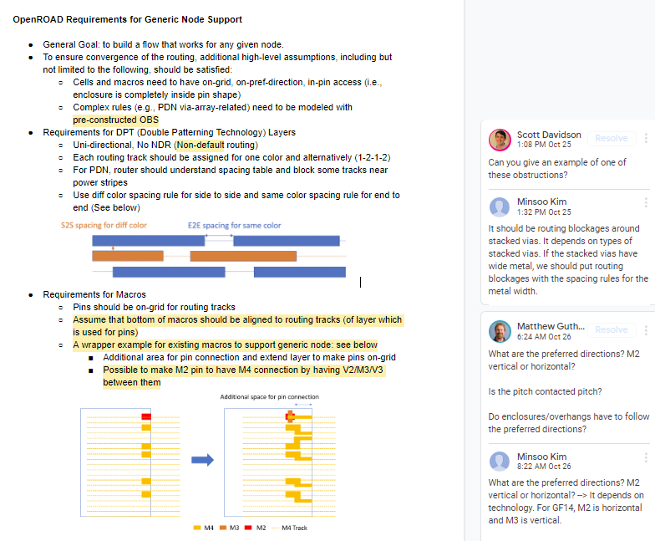
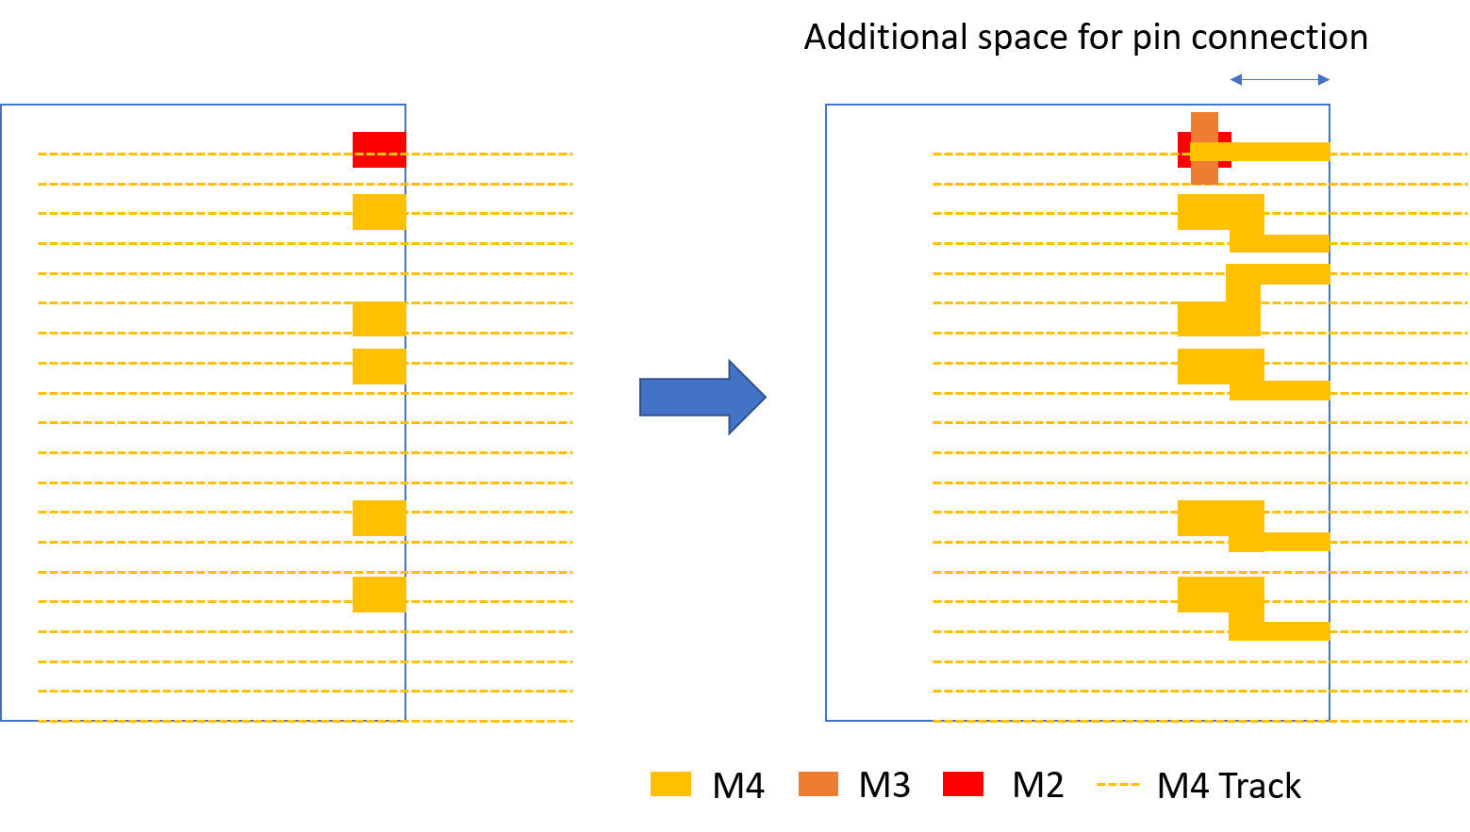
Requirements for Generic Node Support
DRAFT “Requirements for Generic Node Support” Google Doc: see link at below-right
Requirements for Double Patterning Technology (DPT) Layers
Mx on-pref-directional (unidirectional) routing (e.g., M2 horizontal, M3 vertical)
Each track assigned one color, in alternation (1-2-1-2)
Below-left figure: (1) diff-color side to side (S2S) spacing; (2) same-color end to end (E2E) spacing
No NDR (non-default routing)
Requirements for Macros
Pins should be on-grid for routing tracks
Assume that bottom of macros should be aligned to routing tracks
Wrapper example for existing macros to support generic node: see below
Additional area for pin connection and extend layer to make pins on-grid
Can use V2/M3/V3 to make M2 pin have M4 connection point
Link to Google Doc:
https://docs.google.com/document/d/1-KyRNu7qU_7oMYxXB5ToTkLv2C9AJbUAHJQr24rIU7U/edit?usp=sharing
Notes:
This slide illustrates requirements for a “generic node”.
For example, in 14nm there is Double Patterning Technology.
But with on-grid and unidirectional routing, alternatively colored tracks, no NDRs, and simplified spacing rules, open-source tools can support DPT routing.
[CLICK] Macros can be wrapped to expose macro pins on-grid.
[CLICK] There is a draft Google Doc on generic node enablement shown in the screenshot at the right – which shows current discussions with the community.

Slide 29
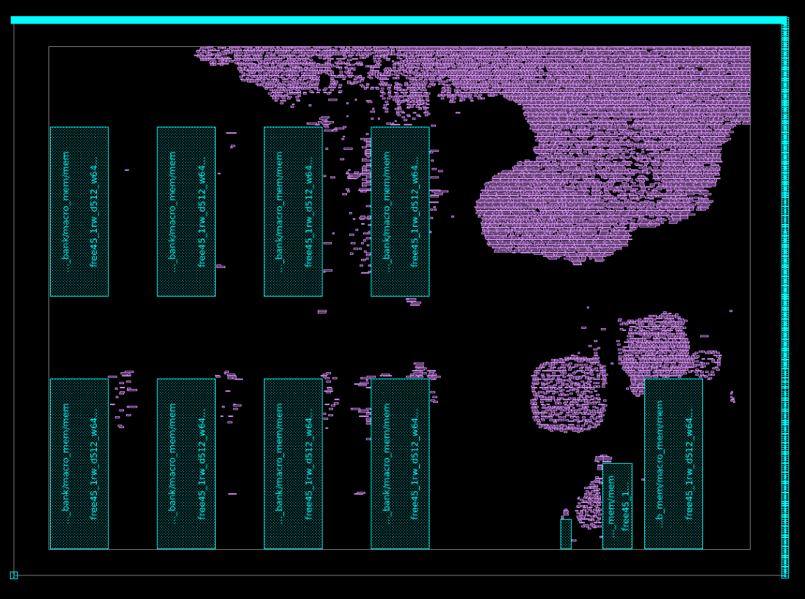
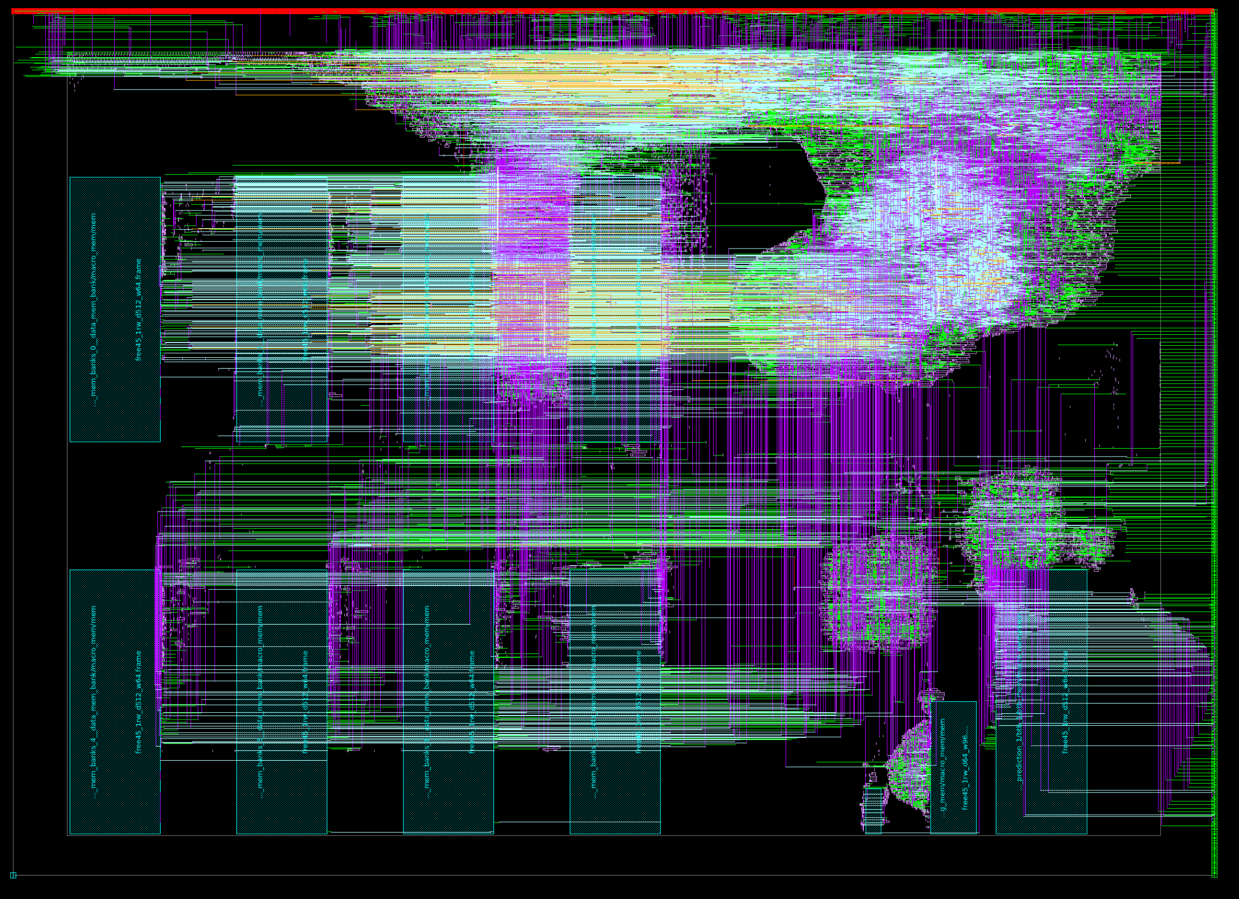
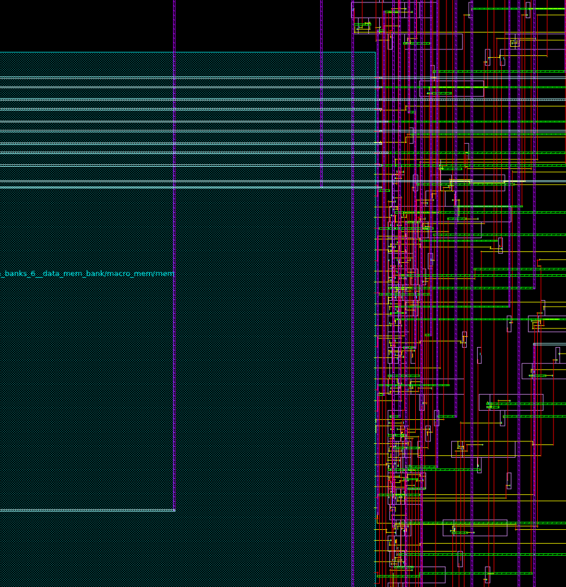
From Community: BSG Fakeram
SRAM abstract view generator for digital place-and-route tools
Uses CACTI for PPA estimates to generate LEF, LIB and V models (no GDS)
Compatible with OpenROAD’s “Generic Node Enablement” specification
Motivation: Open-source PDKs and cell libraries (e.g. NCSU Free45PDK and Nangate Open Cell Library) are valuable assets in the open-source hardware community
Lack of SRAM models makes evaluating a design’s PPA difficult
Free (open-source) + no NDA lowers the barrier for researchers and enthusiasts
Link: https://github.com/bespoke-silicon-group/bsg_fakeram
Notes:
And, for example, in their release last Monday, the BSG group at the University of Washington have updated their “fakeram” tool to be compliant with the Generic Node Enablement spec.

Slide 30
Generic Node: Status with Foundry 14nm
OpenROAD alpha-release tool chain from GitHub
LEF’ == Wrapped 14nm macro and standard-cell LEF from commercial foundry + leading IP provider
TritonRoute detailed router (single-threaded) ends with 305 DRCs as of last week
Flow Step | Runs? | Design | #Insts (K) | Time (s) | Mem (MB)
v2def | Y | aes + macro | 12K | 3 | 156 MB
ioPlacer | Y | aes + macro | 12K | 1 | 27 MB
TritonMPlace | Y | aes + macro | 12K | 10 | 243 MB
pdn | Y | aes + macro | 12K | 2 | 61 MB
RePlAce | Y | aes + macro | 12K | 54 | 418 MB
OpenDP | Y | aes + macro | 12K | 2 | 331 MB
OpenSTA | Y | aes + macro | 12K | 5 | 154 MB
Resizer | Y | aes + macro | 12K | 7 | 217 MB
TritonCTS | Y | aes + macro | 12K | 10 | 331 MB
FR4-lefdef | Y | aes + macro | 12K | 3 | 152 MB
TritonRoute | Y | aes | 12K | 2872 | 247 MB
Notes:
Finally, Generic Node Enablement works ! This slide shows status of OpenROAD alpha-release tools from last July, with 14nm foundry technology and generic node enablement.
All steps from floorplanning to detailed routing are tested with a small 14nm design, using wrapped standard and macro cell LEF and simplified technology LEF as I’ve described. At the end, detailed route leaves about 300 DRCs, but this looks to be on track for next July.
+3:51 = 22:16 (22:00 ?)

Slide 31
IV. FUTURES
Ethos of Open Source Community Sec. IV.A in the paper
Outreach
SW Quality Assurance https://t.co/liJFVToLIc?amp=1
Roadmapping Open-Source EDA
Long-Term Issues
Notes:
And the paper in Section IV gives various comments on “Futures”. I’ll be skipping over most of this -- but I do want to point out this video of a seminar on Regression Testing and Quality Assurance, given by Lukas van Ginneken. It’s really good for students to watch, I think. And Lukas’s slides are also posted.
So, a few of the futures that I think about are:

Slide 32
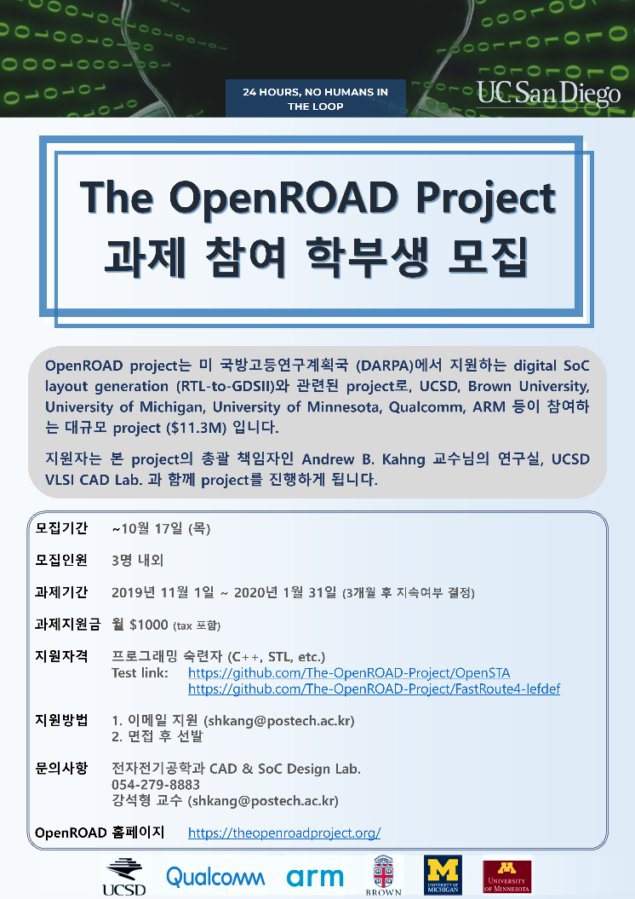
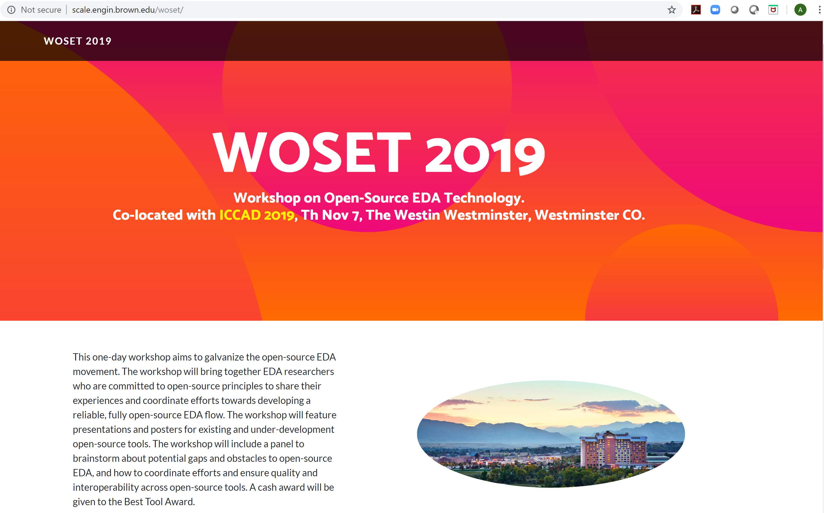
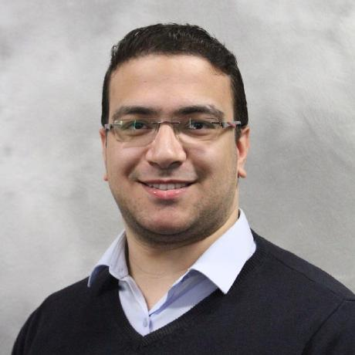
Outreach = Staying in Touch as a Community
Open-Source Community Contribution Award
3 UFRGS undergrads wrote global router
Recruiting in Brazil, Korea
ICCAD-2019 LEF/DEF Global Routing Contest (UCSD+Mentor, w/Cadence)
WOSET-2019 (tomorrow!)
IEEE CEDA DATC “RDF-2019” flow (paper 2D.5 yesterday)
Arm SoC Labs workshop
VSDOpen Conference 2019 keynote
Full-day tutorial at VLSI Design 2020
Bangalore, early Jan. (Kahng, Hosny)
CHIPS Alliance membership
… (how do you want to engage w/open source?)
Notes:
There’s OUTREACH, which broadly means staying in touch as a community, and listening.
Recognizing contributions to open source.
Recruiting.
Open-source bonus prizes for contests.
WOSET tomorrow.
Contributing to key projects such as the DATC’s RDF flow.
Talks …
Abdelrahman Hosny of Brown University and I will be giving a full-day tutorial – a kind of “live update” on open-source EDA and machine learning for IC design in Bangalore in January.
And as mentioned, connecting with stakeholders such as the Open-Source Hardware initiatives.
(How do you want to engage with open-source EDA?)

Slide 33
Roadmapping Open-Source Design Technology
Flavors of open-source EDA metrics that might be projected and tracked in the “ITRS classic” 15-year, white-yellow-red roadmap table style
Notes:
My paper should have focused more on “roadmapping” – because open-source EDA is a TECHNOLOGY, and technologies advance best when they have roadmaps.
Section IV.D does suggest flavors of metrics that might be relevant to open-source EDA.
Beyond tables like this, a roadmap might also call out important phase transitions, such as the emergence of the first foundry-qualified DRC engine or power analysis tool.
[24:07]

Slide 34
Long-Term Challenges and Potential Solutions
Signoff-quality verifications
Power and timing analyses, or DRC/ERC/LVS checkers
Barriers caused by non-commercial status of academic research labs
Blocks traditional bug-fix and support interactions between EDA provider and user
Academic researchers often lack training and motivation to produce, support production-quality tools
Enablement of machine learning
For future cost and schedule savings in IC design
ML in the context of open-source tools and designs can advance more rapidly than in typical commercial context → open-source HW+EDA ecosystem can lead discovery
Viable business and support models
“RedHat of FOSS EDA”, GPL open-sourcing plus consulting services, funding development via an open-source foundation, …
Potential alignments to open hardware organizations may provide a path forward
Open-source EDA should accelerate growth paths for commercial EDA
Faster research-to-production pathways in existing scope of EDA
Boost quality of research tools for new “XDA” challenges, bring commercialization closer in
Notes:
The paper also gives a sampling of long-term challenges and potential solutions, which are another dimension of “roadmapping”.
Signoff verifications, overcoming barriers arising from non-commercial status, finding viable business and support models, and so on.
In RED font, I highlight a culture and personality barrier which calls to mind those challenges mentioned in that ICCAD panel 13 years ago. I don’t know any solutions.
On the other hand, in BLUE font I call out two areas in which open-source EDA can really lead the way and become a valuable booster for commercial EDA.

Slide 35
V. CONCLUSIONS
Notes:
So let me conclude.

Slide 36
Let’s Look Into the Mirror of Open Source
“Whether to open-source is always a 100% personal decision”
Our field started with open source
(-) EDA has endured 25+ years of blame for “design productivity gap”, “crisis of design”, “has EDA failed to keep up with Moore’s Law”, etc.
(-) EDA blocks itself: parallel universes (academia – industry), “irreproducible by construction” research, students reinventing wheels, …
Open source has accelerated growth and innovation in many other fields
Open-source EDA is:
A means of paying it forward, sharing wisdoms, and teaching a next generation
A complement and a booster to commercial EDA
At a personal level, liberating
Open source is doable. Let’s not be afraid.
Notes:
Open source is a mirror - for ourselves.
Our field has endured at least 25 years of blame – since SEMATECH’s 1993 “design productivity gap”, “crisis of design”, “fail to keep up”, etc. EDA blocks itself with parallel universes, irreproducibility of research BY CONSTRUCTION, reinventing wheels.
[CLICK] Yet our field started with open source. And open source has accelerated growth and innovation in many other fields.
[CLICK] Open-source EDA is a way to pay it forward, share wisdom, and teach a next generation. It is a complement and a booster to commercial EDA. At a personal level, it is liberating.
[CLICK] As a foundation for research and innovation, open source is absolutely doable. My sincere wish is that we will not be afraid of it. [26:41]

Slide 37
Acknowledgments and Links
OpenROAD material: All thanks and credits are due to the students and collaborators in the project: https://theopenroadproject.org/our-team/
This paper: Thanks to Tom Spyrou, Lukas van Ginneken and Abdelrahman Hosny for their substantial inputs and on testing, incremental tool architecture, and CI/repository organization
OpenROAD project links:
https://theopenroadproject.org/
https://github.com/The-OpenROAD-Project/
Twitter: https://twitter.com/OpenROAD_EDA
Newsletter: https://theopenroadproject.org/newsletter/
Forthcoming tutorial on January 4, 2020 in Bangalore:
https://theopenroadproject.org/open-source-eda-and-machine-learning-for-ic-design-a-live-update/
Many presentations linked under News at https://vlsicad.ucsd.edu/
E.g., VSDOpen 2019 keynote: https://vlsicad.ucsd.edu/NEWS19/VSDOpen_2019_Kahng-v7-DISTRIBUTED.pdf
Background on Machine Learning “in and around IC design tools”:
https://vlsicad.ucsd.edu/Publications/Conferences/356/c356.pdf
https://vlsicad.ucsd.edu/Publications/Conferences/360/c360.pdf
And a collection of links is HERE.
Research at UCSD is supported by U.S. National Science Foundation, U.S. DARPA, Samsung, Qualcomm, NXP Semiconductors, Mentor Graphics, and the C-DEN Center.
Notes:
[CLICK] All credit and thanks are due to my colleagues in the OpenROAD project – please check out the team at this link. And these links, plus ways to keep tuned in to our latest news.
[CLICK] Here’s where we’ll be maintaining the latest information so that you can prepare and gain maximum value when you attend our tutorial in Bangalore.
[CLICK] And here are some other links, especially about Machine Learning in and around IC design tools. My lab’s research sponsors are listed here.

Slide 38
THANK YOU !

Slide 39
BACKUP

Slide 40
Looking Forward: Capacity, TAT, Scaling …
Run each tool separately
Table shows largest designs studied
Flow Step | Design | PDK | #Insts (M) | Time (s) | Mem (GB)
Yosys | Ariane | TSMC65LP | 228K+ | 2459 | 9.1 GB
v2def | MegaBoom_x4 | GF14LPPXL | 5.1M+ | 152 | 7.2 GB
ioPlacer | MegaBoom_x4 | GF14LPPXL | 5.1M+ | 711 | 142 GB
TritonMPlace | Ariane x4 | TSMC65LP | 445K (148 macros) | 13478 | 4.1 GB
pdn | MegaBoom_x4 | GF14LPPXL | 5.1M+ | 424 | 24 GB
RePlAce | MegaBoom_x4 | GF14LPPXL | 5.1M+ | 12358 | 35 GB
OpenDP | MegaBoom_x4 | GF14LPPXL | 5.1M+ | 396 | 23 GB
OpenSTA | MegaBoom_x4 | ASAP7 | 8.8M+ | 346 | 3.0 GB
Resizer | MegaBoom_x4 | GF14LPPXL | 5.1M+ | 2942 | 33 GB
TritonCTS | sparc_core | TSMC65LP | 256K (67K FFs) | 4141* | 125 GB*
FR4-lefdef | MegaBoom_x2 | GF14LPPXL | 2.6M+ | 1191 | 23 GB
TritonRoute | - | - | - | - | -
*TritonCTS memory bug-fix in progress

Slide 41
Well-Known Naysayer Arguments …
Open source brings a new world where research is reproducible, and progress is made directly at leading edge
Benchmarking is encouraged !
Tcl scripts for open-source tools can be shared !
“It’s really, really difficult”? (+ $B’s of R&D, 1000’s of eng-years)
Agree! Contributors, advisers, reviewers, cooperation/coordination all needed.
And open-source EDA has a totally different target than commercial EDA
“Students shouldn’t spend time polishing code for open-sourcing” ?
They saved months if not years because of open source (and so did their advisors…) → Pay it forward!
“Student developers can’t possibly … {see foundry PDK, accept a commercial testcase with bug report, make golden verifiers, …}” ?
An engaged community and design ecosystem will find workarounds
“Not everyone believes in open source” ?
Open-source EDA will be a movement and ecosystem (not a law)
Notes:
SLIDE 4. In response to arguments made by our esteemed opponents: [it’s tough to argue against the future, and you’ve graciously made the best arguments you could...]
FIRST: OPEN SOURCE BRINGS A NEW WORLD: reproducible research, and progress at the leading edge.
We know the naysayer point of view very well.
Yes, it’s really difficult and yes, EDA has invested many thousands of engineer-years --- my own students account for hundreds of those years. Open-source requires contributors and reviewers and coordination. But let’s be clear: the target is different – (1) build a base for RESEARCH that complements commercial EDA; and focus on automation rather than hyperoptimization.
It requires more effort from students? Yes, but it also saves a LOT MORE effort.
There are blockers? Yes, but there will be workarounds and transformative, watershed moments I am sure – open PDKs, open SOC designs, open benchmark suites.
And if you don’t believe in open source, that’s okay too.

Slide 42
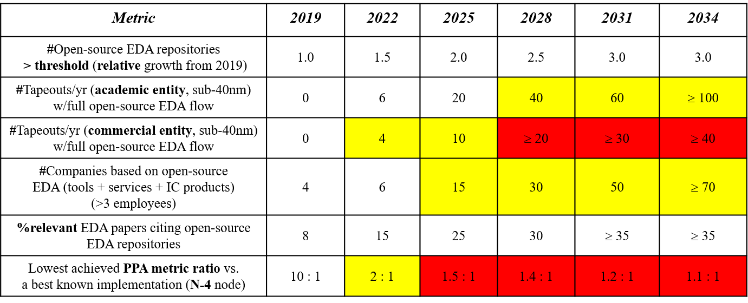
Normalized or Relative Metrics
Growth can be tracked relative to a starting year
“threshold” = function of (contributors, commits, forks, pull requests, usage, …)
Notes:
Metrics can be normalized to a starting year, such as 2019.

Slide 43
Numerically Quantified Metrics
#tapeouts, #companies, etc. (if clearly and appropriately defined)
Yellow, Red color convention: #companies depends on new market emerging
Notes:
They can have numerical values – numbers or percents, etc.

Slide 44
Metrics with Bounded Value
“PPA metric ratio”, illustrates a metric with bounded value
In this case, bounded from below, by 1.
Notes:
They can have bounded value – e.g., a ratio that is bounded below by 1.

Slide 45
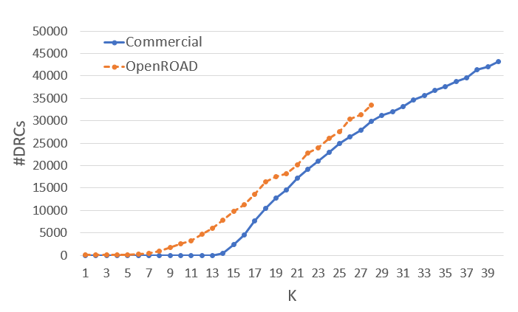
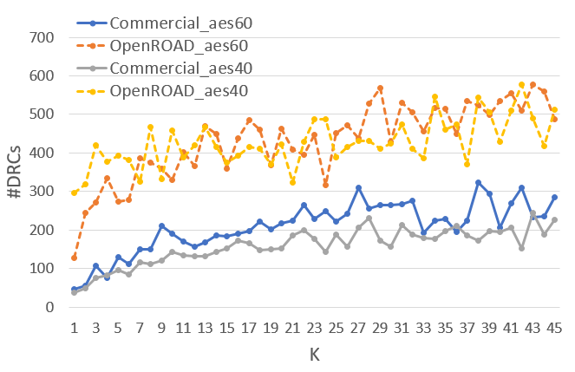
Comparison Metric for Design Technologies, Enablements
“N – 4” == “at four nodes behind the leading-edge node” in the “PPA metric ratio” example helps enable longitudinal assessment of progress
PROBE: testcase-insensitive methodology to compare design enablement elements: from placement and routing tools to back-end-of-line (metal layer) stacks
K_{th} criterion defines a continuum of layout problem difficulty
Tools can be compared by, e.g., the K_{th} value at which #post-route DRC violations exceeds a given threshold
K_{th}
K_{th}
A. Kahng, A. B. Kahng, H. Lee and J. Li, “PROBE: A Placement, Routing, Back-End-of-Line Measurement Utility”, IEEE Trans. on CAD 37(7) (2018), pp. 1459-1472.
Notes:
There are generic comparison metrics for design technologies and design enablements.
For example, the “PROBE” methodology measures the amount of “tangling” of a placement that can be endured before the number of routing DRCs explodes.
A better placement will endure more tangling than a worse one. And similarly for a better router, or a better metal stack. Here, we see that DRCs for the OpenROAD tool explode much earlier than for a commercial P&R tool. So, OpenROAD’s tool is still weak.

Slide 46
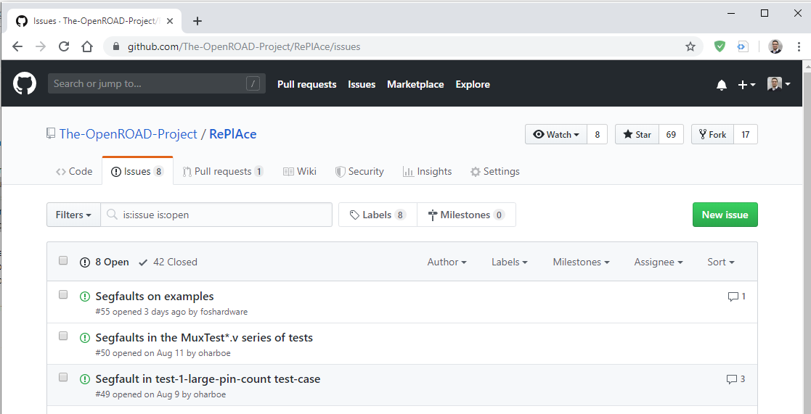
Open Source: You Can Create a GitHub Issue
Notes:
For you, as you get to know OpenROAD tools, starting a discussion on GitHub is simple. Here’s an example from the RePlAce repository. Users navigate to the Issues tab and create a New Issue. As you can see here, there are 42 resolved issues/discussions and 8 are still ongoing. [this screen capture was a couple of weeks ago. Now 9 ongoing.] You can click on any of the open issues to read the discussion.
[CLICK]

Slide 47
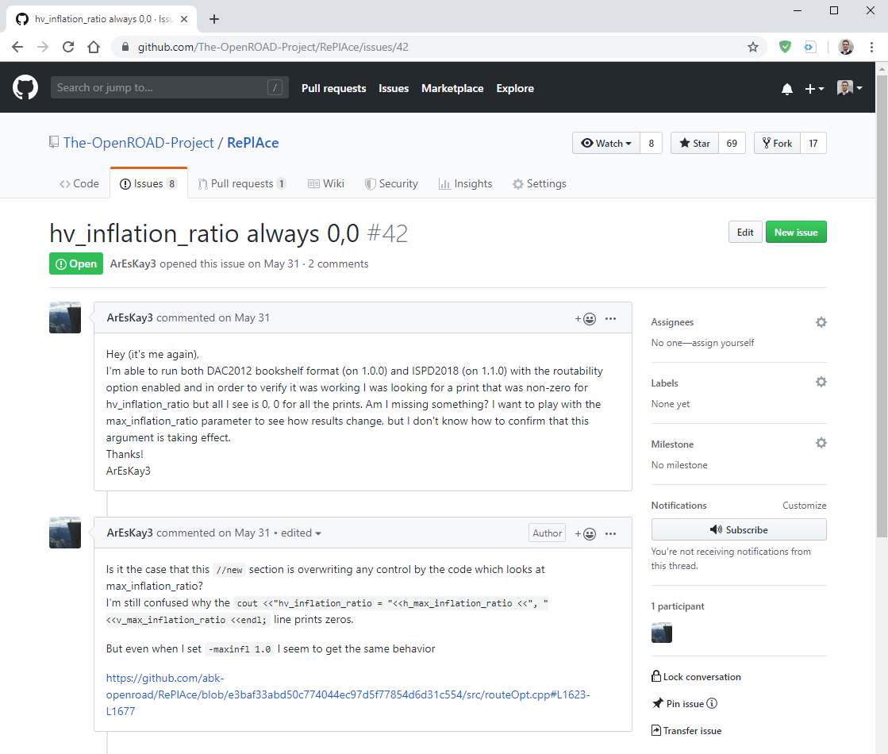
Open Source: You Can Create a GitHub Issue
Notes:
The expanded discussion appears in full. And you can provide your input or, if you code, offer to fix the issue or add the requested feature.
I should ADD: A good issue has a test case and is detailed and easy to reproduce.
If possible, reduce the test case to the smallest possible size that can still show the problem. Filing high quality issues is a great way to contribute when done well.

Slide 48
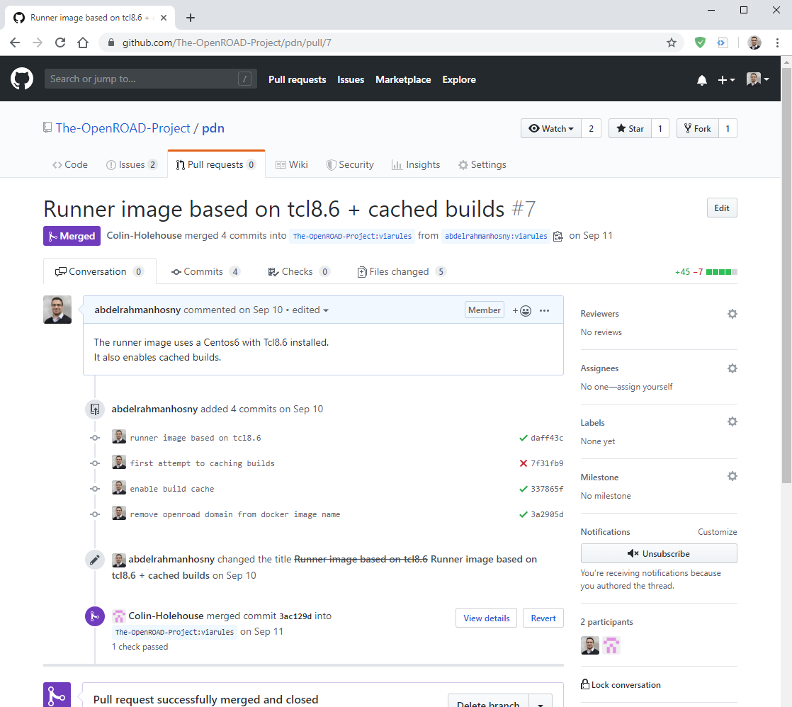
You Can Create a Pull Request
Notes:
Contributions are accepted in the form of pull requests.
You can fork a copy of the repository to your personal account, code the new changes, and create a pull request that asks a repo maintainer to merge the new code.
Pull requests are found under the pull requests tab and as you can see, new code shows “green check” or “red cross” marks to validate the new code against a set of predefined tests. Here at the end, the maintainer of the repo merged the pull request and the contribution is marked as merged.
IN PRACTICE, developers should read the contributor guidelines document that will soon be posted in the OpenDB repo and linked to from the OpenROAD app repo. It takes work to have a pull request accepted – fit with existing code, unit test, comments in the code, etc. And please talk with us about major contributions so that the path to accepting a pull request can be as smooth as possible.
[CLICK]

Slide 49
END BACKUP

