Slide 1




DATC RDF-2019: Towards a Complete Academic Reference Design Flow
GitHub Link : https://github.com/ieee-ceda-datc/RDF-2019
J. Chen¹, I. H.-R. Jiang², J. Jung³, A. B. Kahng⁴,
V. N. Kravets³, Y.-L. Li⁵, S.-T. Lin⁵ and M. Woo⁴
1
2
3
4
5
Notes:
Thank you for the introduction and good afternoon everyone.
I am really happy to present this talk on behalf of CEDA’s Design Automation Technical Committee.
The Robust Design Flow is available at this GitHub link.

Slide 2
Outline
Introduction
  DATC Committee
  RDF-2018 Flow
Challenges and Goals for RDF-2019
RDF-2019 Flow Evolution
  Horizontal extensions
  Vertical extensions
Demonstrations
  des_perf3 / NanGate45
    Global Placement / Detailed Placement / Detailed Routing
  des_perf3 / ASAP7
    Global Placement / Detailed Placement / Global Routing
Conclusions
Notes:
I’ll start with some background for this year’s Robust Design Flow update.
What are key challenges that the new release hopes to make progress on.
Some details of what has been added in the past year.
And, a couple of quick illustrations of the tool and flow integrations that are possible.

Slide 3
Outline
Introduction
  DATC Committee
  RDF-2018 Flow
Challenges and Goals for RDF-2019
RDF-2019 Flow Evolution
  Horizontal extensions
  Vertical extensions
Demonstrations
  des_perf3 / NanGate45
    Global Placement / Detailed Placement / Detailed Routing
  des_perf3 / ASAP7
    Global Placement / Detailed Placement / Global Routing
Conclusions
Notes:
Let me begin with some introduction and goals.

Slide 4
Design Automation Technical Committee (DATC)
A technical committee of IEEE CEDA
  Provide a forum for discussing strategies and issues in design automation
Task: Robust Design Flow Database
  Academic version reference design flow
  Free! for academic and noncommercial research
Organization
Name | Affiliation | Role
Iris Hui-Ru Jiang | National Taiwan Univ., Taiwan | Chair / Timer
Victor N. Kravets | IBM, USA | Logic synthesis
Jianli Chen | Fuzhou Univ., China | Placement
Yih-Lang Li | National Chiao Tung Univ., Taiwan | Routing
Jinwook Jung | IBM, USA | Integration
Andrew B. Kahng | UC San Diego, USA | Vice chair / Flow
NEW
Notes:
First, if you haven’t seen its work before, the CEDA DATC has been very influential to our field over decades. It has evolved from pure industry to a mix of academic and industry folks, and it was really a privilege to be able to join the DATC this past summer.
DATC’s task for several years has been to develop and support an ACADEMIC reference design flow that is free for academic and non-commercial research use.
Updates have been reported at each of the past three ICCAD conferences.
Professor Iris JIANG at NTU is the chair of DATC.

Slide 5
Robust Design Flow (RDF): Initiated 2016, Last Updated 2018
From logic synthesis to detailed routing
Build upon outstanding contest-winning academic tools
Trigger design flow and cross-stage optimization research via various EDA tools developed from academia.
Standard industrial formats
  1. A circuit in a structural Verilog
  2. Cell timing library in Liberty
  3. Cell technology library in LEF
  4. Placement in DEF
  5. RC parasitic in SPEF
  6. Timing constraints in SDC
Design Library
Liberty, DEF/LEF,
Verilog, SDC
Verilog
Verilog to BLIF
Liberty
.blif
Logic synthesis
.v
Flip-flop mapping
Verilog’
Floorplanning
LEF/DEF
Placement
RC extraction
Verilog’, DEF’, SPEF
Timing analysis
Liberty, SDC
Gate sizing
Legalization
Verilog’’, DEF’’
LEF/DEF
Global routing
Design result
Notes:
The scope of the Robust Design Flow is basically RTL-to-layout, including synthesis and detailed routing. An older flowchart is HERE on the right.
[CLICK] RDF has been built on many years of outstanding contest-winning academic tools.
[CLICK] And its goal is to enable flow-scale or cross-stage research.
[CLICK] Importantly, RDF has committed to support standard, real-world formats such as Verilog, SDC, SPEF, etcetera.

Slide 6
RDF-2018: Challenges to Impact and Benefit
Chaining of academic contest-winning tools can leave gaps that preclude research on flow-scale or cross-stage optimizations
  RDF-2018 flow does not provide floorplan DEF generation, I/O placement, macro placement, clock tree synthesis, and generation of SPEF from placed or routed DEF
Closed-source binaries cannot be updated
  Also, tools with “no commercial use” typically cannot be opened by industry collaborators
Often, academic contests out of necessity use testcases that embody strong simplifications to data models and/or industry formats
  These simplifications (e.g., translating Bookshelf variant to LEF/DEF) can live on for many years
  Keeps academic research in a kind of parallel universe of “translated” (or, “interpreted”), as opposed to “standard”, industry formats and testcases.
  Tools developed in this parallel universe are often unable to accept real-world designs and enablements
Notes:
But of course improvements are always possible!
In the past year, RDF has tried to address a few key challenges, to increase its impact and benefit for the field.
For example: [CLICK] Putting just our academic contest codes together leaves some gaps in the flow – IO placement, macro placement, SPEF generation, and so on.
And, [CLICK] older, closed-source binaries cannot be easily updated to fix bugs or support more recent format versions.
Sometimes the conditions of release block industry from even trying to work with us on collaborative research using these tools.
Last, [CLICK] our academic contests – for many good reasons – often simplify data models or industry formats. These simplifications live on for many years, which keeps our research in a kind of “parallel universe” of non-standard industry formats. By this, I mean that, for example, being able to handle Bookshelf format that is translated to DEF is not the same as being able to handle the full DEF standard itself. So, connections with the real world are blocked.

Slide 7
Contributions of New RDF-2019
We extend RDF-2019 from RDF-2018, both horizontally and vertically
  Horizontal Extension: Include more tools of a given type
  Vertical Extension: Fill in gaps of the RTL-to-GDS flow
RDF-2019 now embraces two flavors of academic tool flows
  Flows with genealogy in academic contests that use “translated / interpreted” industry formats (e.g., subsets of LEF/DEF recast in Bookshelf format variants)
  Flows that attempt to support “standard” industry formats
Notes:
As I’ll describe next, the new RDF-2019 has made two basic kinds of improvements.
First, it extends RDF both HORIZONTALLY – meaning more tools of a given type – and VERTICALLY – meaning that gaps in the flow are filled in.
[CLICK] Second, RDF-2019 now fully embraces two flavors of academic tool flows.
The traditional tools in RDF have roots in academic contests and may be limited to “translated” or “interpreted” variants of real-world formats.
But now we also include tools that try to fully support “standard” industry formats. <5:00

Slide 8
Outline
Introduction
  DATC Committee
  RDF-2018 Flow
Challenges and Goals for RDF-2019
RDF-2019 Flow Evolution
  Horizontal extensions
  Vertical extensions
Demonstrations
  des_perf3 / NanGate45
    Global Placement / Detailed Placement / Detailed Routing
  des_perf3 / ASAP7
    Global Placement / Detailed Placement / Global Routing
Conclusions
Notes:
Let me now mention some specific horizontal and vertical extensions made in the past year.

Slide 9
RDF-2019 Flow Evolution – Horizontal Extensions
Benchmarks:
  2017 TAU Contest, IWLS 2005 Benchmarks
Logic synthesis 1
  ABC
Global placers: 6
  NTUPlace3, ComPLx, mPL5/6, Capo, FastPlace3-GP, Eh?Placer
Detailed placers: 2
  FastPlace3-DP, MCHL-T
Global routers: 3
  NCTUgr, FastRoute4.1, BFG-R,
Detailed router: 1
  NCTUdr
Gate sizers: 2
  USizer 2013, USizer 2012
Timers: 2
  Open Timer, iTimerC2.0
Cell libraries: 2
  ISPD 2012/2013 Contests, ASAP 7nm library
Notes:
This is from a year ago.
You can see the scope of RDF includes several classic contest domains – Timing, Placement, Sizing.
RDF also provides enablement: libraries and benchmarks, plus a Jenkins-based, continuously integrated flow implementation.

Slide 10
RDF-2019 Flow Evolution – Horizontal Extensions
Benchmarks:
  2017 TAU Contest, IWLS 2005 Benchmarks, UW BSG Benchmarks
Logic synthesis 1 → 2
  ABC, Yosys+ABC (Brown Univ.)
Global placers: 6 → 8
  NTUPlace3, ComPLx, mPL5/6, Capo, FastPlace3-GP, Eh?Placer, FZUplace, RePlAce
Detailed placers: 2 → 3
  FastPlace3-DP, MCHL-T, OpenDP
Global routers: 3 → 4
  NCTUgr, FastRoute4.1, BFG-R,
  FastRoute4-lefdef
Detailed router: 1 → 3
  NCTUdr, Dr. CU, TritonRoute
Gate sizers: 2 → 4
  USizer 2013, USizer 2012, Resizer, TritonSizer
Timers: 2 → 3
  Open Timer, iTimerC2.0, OpenSTA
Cell libraries: 2 → 4
  ISPD 2012/2013 Contests, ASAP 7nm library, NanGate45, NCTUcell
Blue: New OpenROAD tools
Red: New Non-OpenROAD tools
Notes:
Now here, you can see how many HORIZONTAL EXTENSIONS have been made. Everything in RED or BLUE is new this year.
The numbers of tools at each flow stage have changed, as shown by the numbers in the slide.
In the slide, BLUE indicates tools from a project called OpenROAD.
RED indicates tools from other sources. And let me highlight just three of these additions.

Slide 11

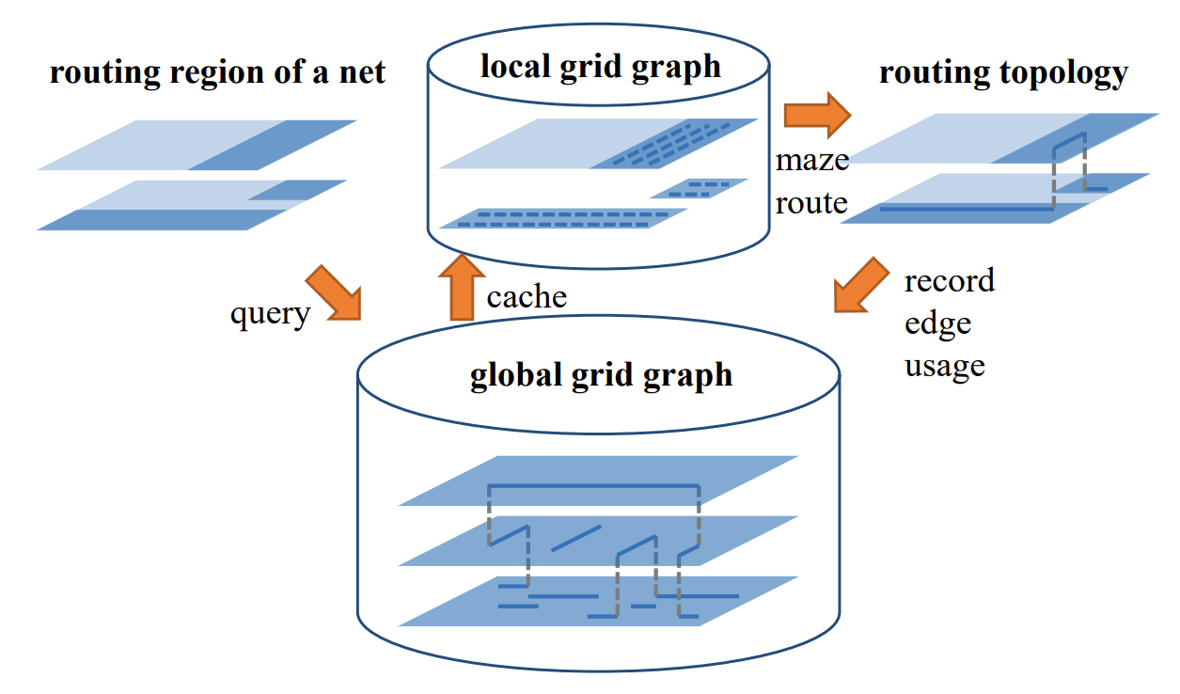
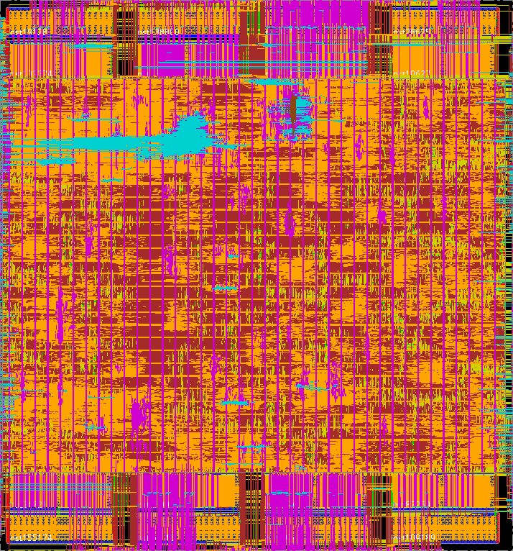
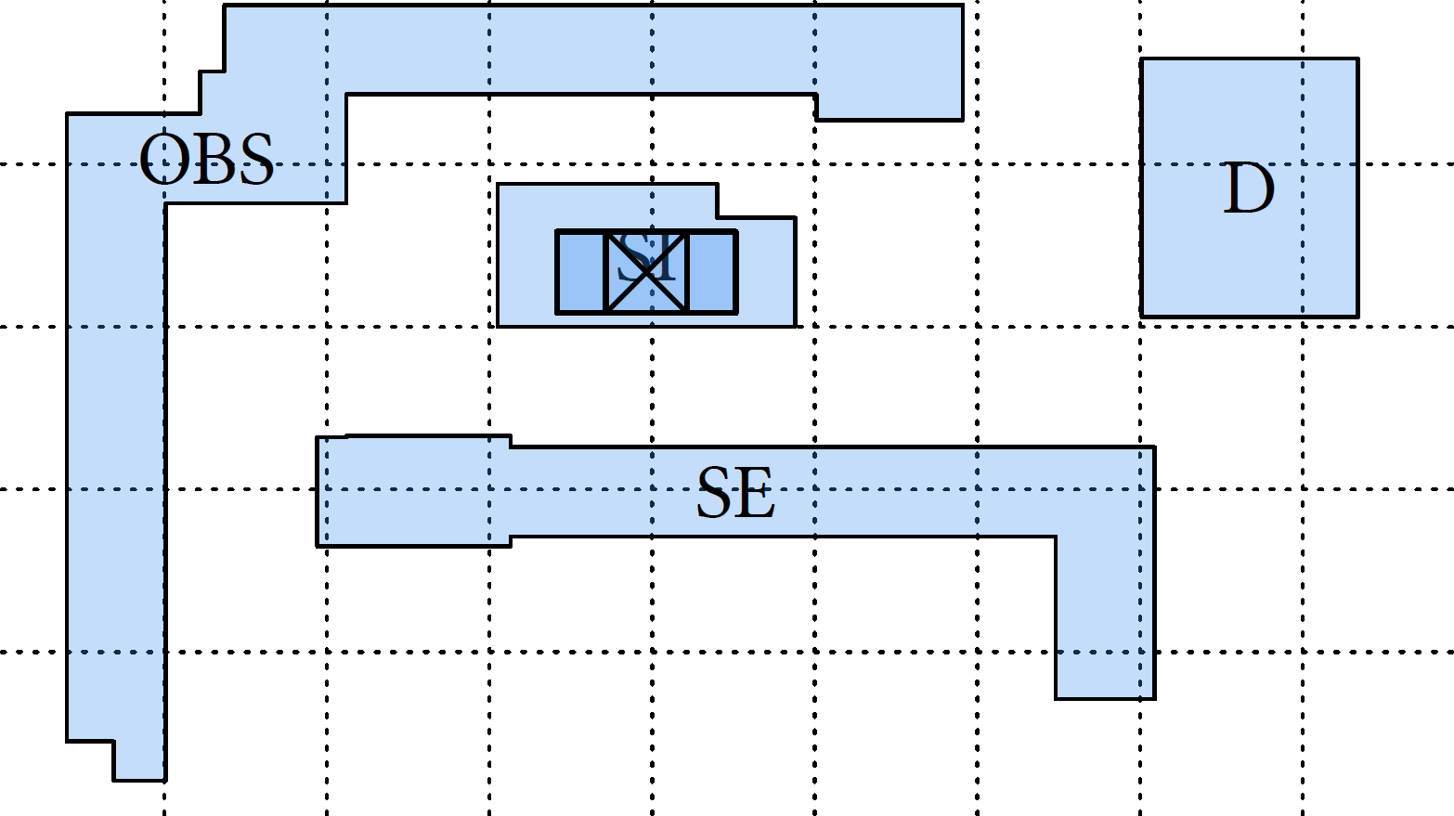
Dr. CU
Detailed router with efficient bulk synchronous parallel scheme
  LEF/DEF input and output compatible with ISPD 2018/2019 Contests
  Two-level sparse data structures for a 3D detailed routing grid graph
  Access point assignment capable of off-track pin access
  Correct-by-construction path search optimally capturing the min-area constraint
Two-level grid graph data structures
Off-track pin access
Detailed routing solution
Link: github.com/cuhk-eda/dr-cu
Notes:
Dr.CU is a contest-winning open-source detailed router from CUHK.
Dr.CU can understand commercial formats (meaning LEF and DEF) and it uses two-level sparse data structures for its 3D detailed routing gridgraph.
It can handle off-track pin access and min-area constraints.
And, Dr. CU is open-sourced at this GitHub repo. Anyone can build on it without trying to reinvent the team’s years of effort.

Slide 12
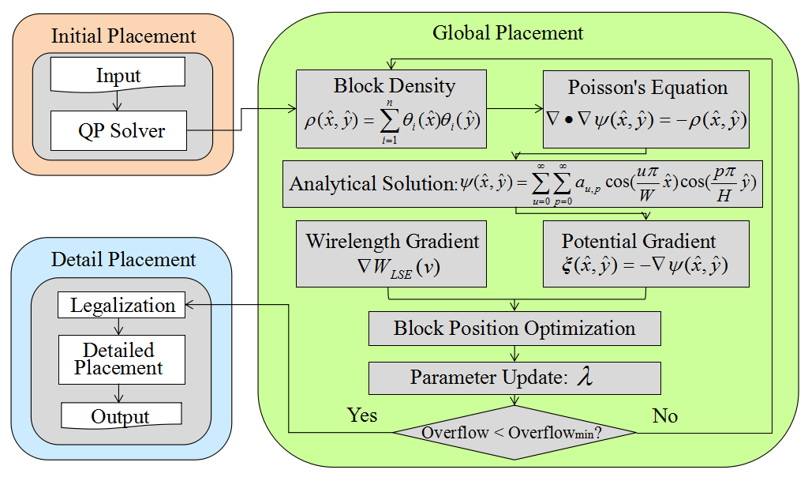
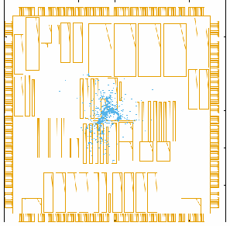
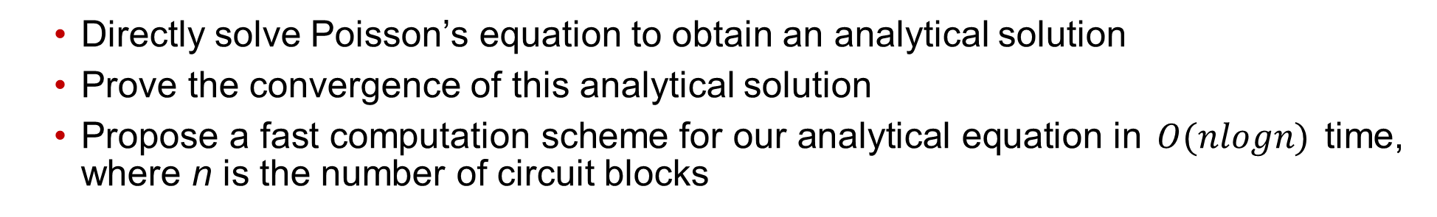
FZUplace
FZUplace
  Directly solve Poisson’s equation to obtain an analytical solution
  Prove the convergence of this analytical solution
  Propose a fast computation scheme for our analytical equation in $O(nlogn)$ time, where n is the number of circuit blocks
Notes:
The FZUplace global placer binary is from Jianli Chen’s group at Fuzhou University.
FZUplace solves Poisson’s equation to obtain an analytic solution in a provably convergent manner.
Runtime scales as N log N, where N is the number of placeable instances.
The binary is available in DATC’s RDF GitHub repo.

Slide 13

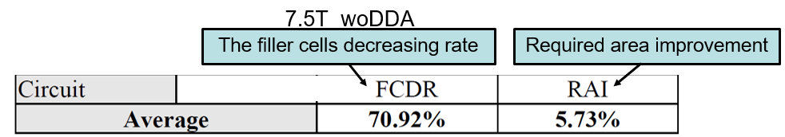
NCTUcell @ ASAP 7nm PDK
Improvements made relative to ARM/ASU ASAP 7.5T cell library
76 more high-driving strength cells than ARM/ASU ASAP library → more flexible ways to fix timing issues
The library considering drain-drain abutment constraint can diminish required number of filler cells and required area by 70.92% and 5.73% (respectively) in block design
#T | Area | Leak | Cap | D/C | Pow | Tran | RT
Track height of cells | Cell area | leakage | input/output capacitance | delay/timing constraint | Total power consumption | Transition time | Runtime in second
Notes:
And, NCTUcell is an example of NEW ENABLEMENT. It fills the need to achieve block area improvement with fewer filler cells, and the need for more high-drive cells to fix timing issues.
Note that the underlying ASAP7 PDK is still separately distributed by Arizona State University, and it has some restrictions that are reflected in NCTUcell’s own distribution.

Slide 14
RDF-2019 Flow Evolution – Vertical Extensions
RDF-2019
OpenROAD
Each is a vertical extension made in RDF-2019
  Logic Synthesis with RTL Verilog
  Floorplan with I/O Pin + PDN + Macro and Tapcell placement
  Clock Tree Synthesis
  RC extraction / STA from routed DEF
  GDSII Stream generation
The vertical flow extensions lead to a full academic flow from behavioral (RTL) Verilog to final detail-routed DEF and GDSII out
<flow step>
Logic synthesis
Yosys+ABC
Floorplanning
TritonFP : v2def (Resizer) + ioPlacer + RePlAce (MS mode) + TritonMacroPlace + pdn + tapcell
Global Placement
RePlAce + Resizer + OpenDP
Detailed Placement
OpenDP
RC Extraction / STA
OpenSTA + SPEF from placed DEF
Gate Sizing
Resizer, TritonSizer
Clock Tree Synthesis
TritonCTS + OpenDP
Global Routing
FastRoute4-lefdef
Detailed Routing
TritonRoute
RC Extraction / STA
OpenSTA + SPEF from routed DEF
GDSII Streamout
Magic8.2
Notes:
Now, this slide shows VERTICAL extensions in RDF-2019.
Each blue box is new in the RDF flow this year. Synthesis from RTL, floorplanning which includes substeps like tapcell and IO placement, floorplan DEF initialization, PDN, and also macro placement.
Also we see CTS, PEX, GDS merge and stream out from routed DEF, using an updated Magic version 8.2.
The key takeaway here is that with these vertical extensions, RDF offers a full academic flow from behavioral Verilog through detailed routing and GDS out.

Slide 15
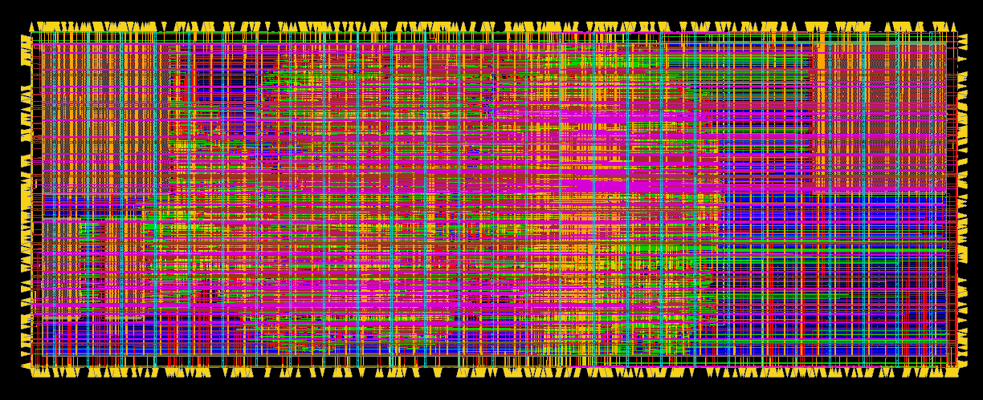
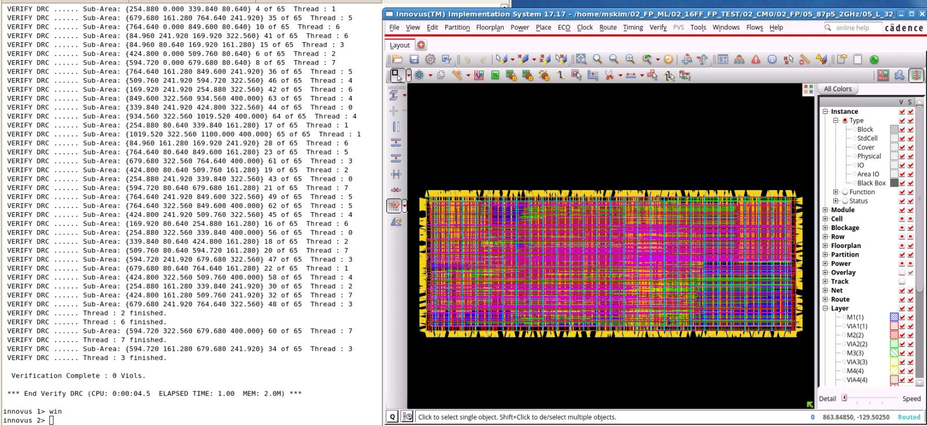
OpenROAD Project: Open-Source Flow from RTL to GDS
https://github.com/The-OpenROAD-Project is a recently released academic RTL-to-GDS tool chain that fully supports industry formats
July 2019: The OpenROAD tool chain has been added into RDF to give a “vertical extension” (floorplan, CTS and DEF-to-GDS steps)
This gives more robust handling of industry design enablements (e.g., DRC-clean output in TSMC 65LP / Arm libraries + IPs) in RDF
DRC-clean results using OpenROAD tools. “VanillaBean” in TSMC 65LP library (17k instances.)
Ref: Tim Ansell, “Open Source 101”, https://j.mp/eri19-foss101
Ref: Tim Ansell, “Open Source 102”, https://j.mp/eri19-foss102
Ref: ERI Summit 2019, https://theopenroadproject.org/openroad_event/openroad-presentation-at-the-eri-summit-2019/
Notes:
I mentioned the OpenROAD project a few minutes ago. It is an example of that “second” flavor of academic tool flow, which is the kind that tries to fully support real-world industry formats.
This flow was capable of generating [CLICK] DRC-clean routed DEF at TSMC 65LP, this past July.
The project repo shows quite a few improvements since then, including an open-source DATABASE, CMake, clean build from sources, Tcl and Python APIs exposed through SWIG, and a framework for robust software engineering and academic research.

Slide 16
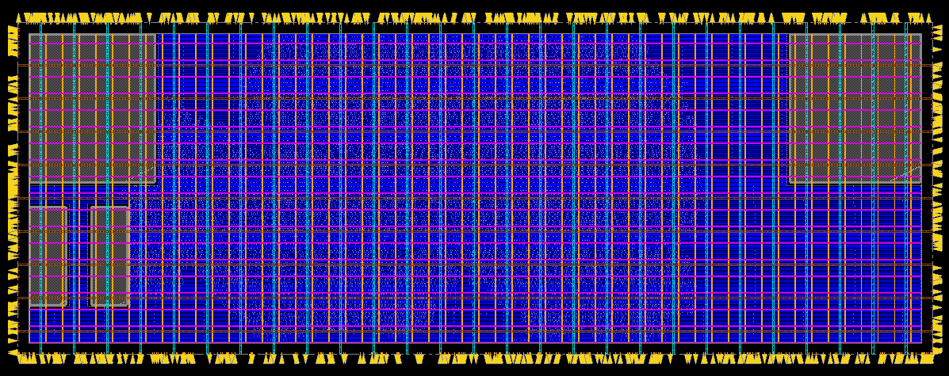
From OpenROAD: TritonFP
TritonFP
  Open-Source Floorplanner flows
    https://github.com/The-OpenROAD-Project/TritonFP
  Takes Verilog, and generates I/O pins, macros, PDN, and tapcell placed DEF
.v, .cfg, .sdc, .lib, .lef
TritonFP
Verilog to DEF
ioPlacer
MS-TD-RePlAce
TritonMPlacer
P/G mesh generator
Well tap insertion
Example output of TritonFP. “VanillaBean” in TSMC 65LP library
.def
Ref: ERI Summit 2019, https://theopenroadproject.org/openroad_event/openroad-presentation-at-the-eri-summit-2019/
Notes:
Here is a screenshot of what comes out of the FLOORPLAN STEP: This is a small RISC-V based core in 65LP, after IO placement, macro placement, P/G mesh, and tapcell insertion.

Slide 17


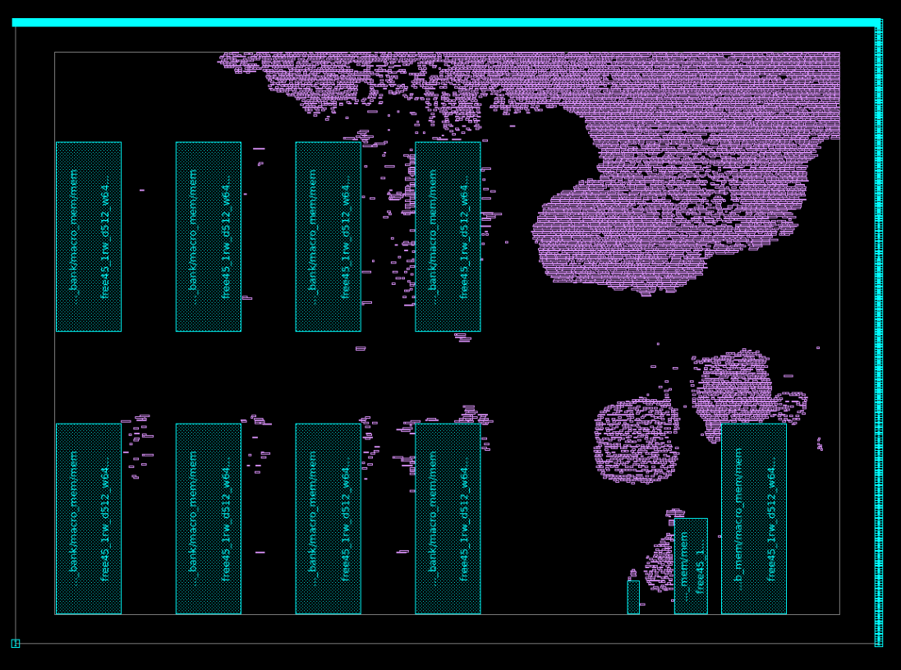
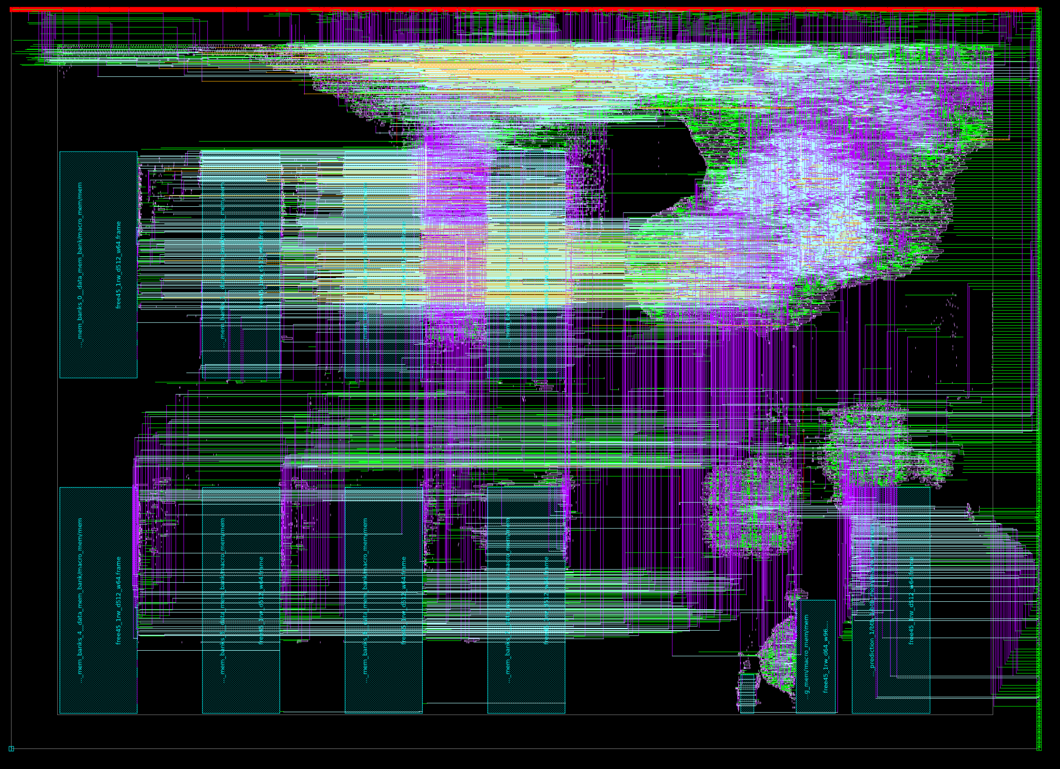
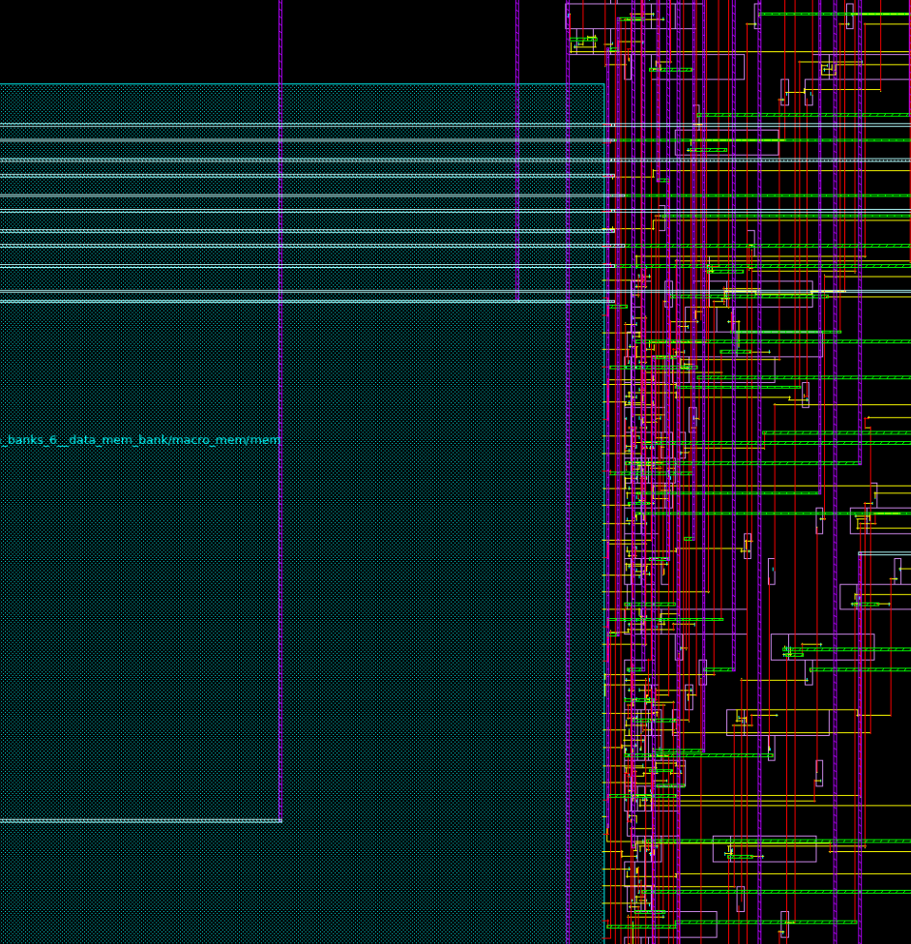
From Community: BSG Fakeram
SRAM abstract view generator for digital place-and-route tools
  Uses CACTI for PPA estimates to generate LEF, LIB and V models (no GDS)
  Compatible with OpenROAD’s “Generic Node Enablement” specification
Motivation: Open-source PDKs and cell libraries (e.g. NCSU Free45PDK and Nangate Open Cell Library) are valuable assets in the open-source hardware community
  Lack of SRAM models makes evaluating a design’s PPA difficult
  Free (open-source) + no NDA lowers the barrier for researchers and enthusiasts
Link: https://github.com/bespoke-silicon-group/bsg_fakeram
Notes:
And vertical extensions also come from the community.
Many of us know that FreePDK 45 and the Nangate cell library are pretty much the most advanced, truly open enablement for research. But, this enablement has no memory generators. Last Monday, the University of Washington updated their “fakeram” tool so that researchers can work with “fake” Liberty and LEF for memories that at least go through commercial P&R tools. This opens up many new testcases for the research community.

Slide 18
RDF-2019 Flow Evolution – Summary
Component | RDF-2018 | New in RDF-2019
Logic Synthesis from RTL | --- | Yosys+ABC
Logic Synthesis from Gate-level | ABC | ---
Floorplan | --- | TritonFP
Global Placement | NTUPlace3, ComPLx, mPL5/6, Capo, FastPlace3-GP, EH?Placer | FZUplace, RePlAce
Detailed Placement | FastPlace3-DP, MCHL-T | OpenDP
Clock Tree Synthesis | --- | TritonCTS
Global Routing | NCTUgr, FastRoute4.1, BFG-R | FastRoute4-lefdef
Detailed Routing | NCTUdr | Dr. CU, TritonRoute
Gate Sizing | USizer 2013, USizer 2012 | Resizer, TritonSizer
Static Timing Analysis | Open Timer, iTimerC2.0 | OpenSTA
Libraries/Technologies | ISPD 2012/2013 Contests, ASAP 7nm library | Nangate45, NCTUCell
Testcases | 2017 TAU Contest, IWLS 2005 Benchmarks | UW BSG group
Vertical
Extension
Notes:
This slide summarizes the numerous vertical and horizontal extensions in RDF-2019.

Slide 19
Outline
Introduction
  DATC Committee
  RDF-2018 Flow
Challenges and Goals for RDF-2019
RDF-2019 Flow Evolution
  Horizontal extensions
  Vertical extensions
Demonstrations
  des_perf3 / NanGate45
    Global Placement / Detailed Placement / Detailed Routing
  des_perf3 / ASAP7
    Global Placement / Detailed Placement / Global Routing
Conclusions
Notes:
With RDF-2019, you will be able to achieve many types of subflows and experiments.
Here are a couple that are mentioned in the proceedings paper. < 12:00

Slide 20
Demonstration: des3_perf / NanGate45
Floorplanned des3_perf.def with NanGate45
RePlAce
ComPLx
NTUPlace3
Eh?Placer
FZUplace
Global Placer
OpenDP
Detailed Placer
FastRoute4
-lefdef
Global Router
TritonRoute
Detailed Router
Notes:
Here we start with a floorplanned des3_perf DEF file with NanGate45 library.
This demonstration applies five different Global Placers and we want to generate routed DEFs using the OpenROAD tools for legalization, global routing and detailed routing.

Slide 21
Demonstration: des3_perf / NanGate45
(a) RePlAce
(b) ComPLx
(c) NTUplace3
(d) Eh?Placer
(e) FZUplace
Visualized Results after OpenDP. Flip-flops are colored red
Visualized Results after FastRoute4-lefdef and TritonRoute
Notes:
In the upper row of images, which is post-legalization, the flipflops are colored RED, and we see that the five different placers generate quite distinct results.
Continuing with global route and detailed route yields five different detailed-routed results as shown in the lower row.
This shows how smooth interoperability can be across older tools and newer tools.
The paper also comments on how this kind of experiment can show divergence between traditional HPWL metric and #DRCs.

Slide 22
Demonstration: des3_perf / ASAP7
Floorplanned des3_perf.def with ASAP7
RePlAce
Global Placer
OpenDP
Detailed Placer
NCTUgr
Global Router
Notes:
Here is a second demonstration, also given in the paper.
We start with a floorplanned des3_perf DEF file in the ASAP7 enablement, which reflects the 7 nanometer node but is restricted to academic researchers.
Here, our goal is to show how we can run placement tools and then generate congestion maps using the NCTUgr global router.

Slide 23
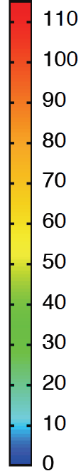
Demonstration: des3_perf / ASAP7
Placement Solution (RePlAce + OpenDP)
(b) M5 Congestion Map of (a)
(NCTUgr)
(c) M6 Congestion Map of (a)
(NCTUgr)
Notes:
This shows M5/M6 congestion maps calculated by the NCTUgr tool.
Again, the old and new tools, and the ASAP7 library, play well together.

Slide 24
Outline
Introduction
  DATC Committee
  RDF-2018 Flow
Challenges and Goals for RDF-2019
RDF-2019 Flow Evolution
  Horizontal extensions
  Vertical extensions
Demonstrations
  des_perf3 / NanGate45
    Global Placement / Detailed Placement / Detailed Routing
  des_perf3 / ASAP7
    Global Placement / Detailed Placement / Global Routing
Conclusions
Notes:
Now I will conclude this talk. < 14:00

Slide 25
Conclusions
RDF2019 = union of RDF2018 + OpenROAD tool chains, + even more tools
  Achieve horizontal and vertical extensions
  Bring academic researchers and industry practitioners closer together
RDF is a proper superset of OpenROAD
  OpenROAD only includes open-source
  RDF includes both open and closed source
Vision for RDF-2020+
  Brings researchers and practitioners closer together
  Enables more efficient and exciting research progress for all of us !
  Please contribute to DATC / RDF efforts !
RDF-2019
RDF-2018
OpenROAD
Verilog
Logic synthesis
Yosys+ABC
Verilog’
TritonFP = v2def (Resizer)
+ ioPlacer + RePlAce (MS mode)
+ TritonMacroPlace + pdn + tapcell
Floorplanning
Global placement
RePlAce + Resizer + OpenDP
Detailed placement
TritonCTS + OpenDP
RC extraction
(Note: RePlAce generates
.spef for STA and TD-place) (U. Minn PEX tool is pending)
Verilog’, DEF’, SPEF
Timing analysis
OpenSTA
Gate sizing
Resizer, TritonSizer
Legalization
OpenDP
Verilog’’, DEF’’
Global routing
FastRoute4-lefdef
Routing guide
Detailed routing
TritonRoute
Design result (Verilog, DEF)
(DEF to GDS = Magic8.2)
Notes:
In conclusion, RDF-2019 is a union of RDF2018 and OpenROAD tool chains, with even more tools on top of that.
It achieves horizontal and vertical extensions, and brings academic research and industry practice closer together.
[CLICK] A key point is that RDF is always a PROPER SUPERSET of OpenROAD.
OpenROAD only includes true open source codes.
RDF includes both open and closed source, because ultimately everyone is free to choose whether to make their code open or closed.
[CLICK] Looking forward, the future updates of RDF should continue to bring researchers and practitioners closer together. And, RDF will continue to enable more efficient, more relevant, and more exciting research progress for all of us.
Please contribute to these efforts!

Slide 26
Acknowledgments
This work was supported by IEEE CEDA Design Automation Technical Committee (DATC).
We thank the OpenROAD project team for contributions and support for RDF-2019.
We thank Myung-Chul Kim of IBM and Igor Markov of University of Michigan (current: Facebook) for their generosity in providing the ComPLx placer binary.
We thank Shinichi Nishizawa of Fukuoka University and Hidetoshi Onodera of Kyoto University for supporting NCTUcell release under RDF-2019.
Notes:
There are many people to thank for the existence and success of RDF.
RDF exists because of the support of IEEE CEDA and its Design Automation Technical Committee.
Myung-Chul Kim, Igor Markov, and Professors Nishizawa and Onodera have graciously given some important permissions to RDF.

Slide 27
Thank you!
GitHub Link : https://github.com/ieee-ceda-datc/RDF-2019
Notes:
This concludes my talk. Thank you for your attention!

Slide 28
BACKUP

Slide 29
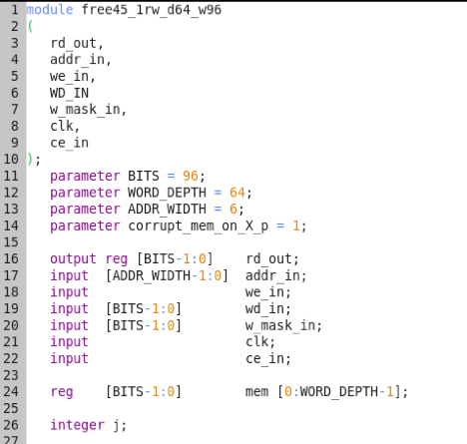
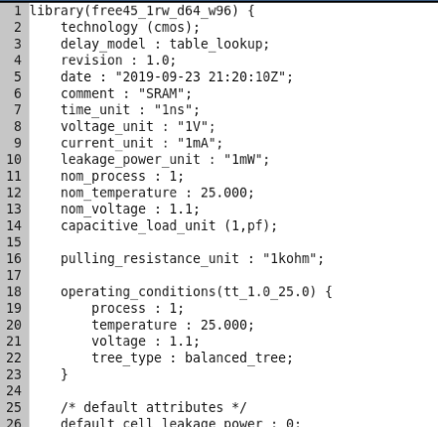
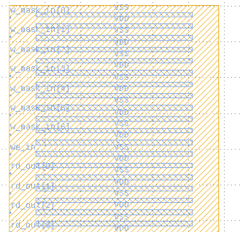
BSG Fakeram Flow Diagram
User Input
BSG Fakeram
ram_config.json
{
"tech_nm": 45,
"pinWidth_nm": 70,
"pinPitch_nm": 140,
"metalPrefix": "metal",
"voltage": 1.1,
"flipPins": true,
"srams": [
{"name": "myram",
"width": 96,
"depth": 64,
"banks": 1
},
{ ... },
{ ... }
]
}
Verilog
Gen. (.v)
CACTI
Liberty
Gen.
(.lib)
LEF
Gen.
(.lef)
CACTI
Template

Slide 30
RDF-2019 Flow Evolution – Vertical
RDF-2019
OpenROAD
Logic synthesis (RTL)
Yosys+ABC
RDF-2018
TritonFP : v2def (Resizer) + ioPlacer + RePlAce (MS mode) + TritonMacroPlace + pdn + tapcell
Floorplanning
Logic synthesis
(Gate-level)
Global Placement
RePlAce + Resizer + OpenDP
Global Placement
Detailed Placement
OpenDP
Detailed Placement
RC Extraction / STA
OpenSTA + SPEF from placed DEF
RC Extraction / STA
Gate Sizing
Resizer, TritonSizer
Gate Sizing
Clock Tree Synthesis
TritonCTS + OpenDP
Global Routing
Global Routing
FastRoute4-lefdef
Detailed Routing
Detailed Routing
TritonRoute
RC Extraction / STA
OpenSTA + SPEF from routed DEF
GDSII Streamout
Magic8.2

