Slide 1
SVM Learning for GFIS Trimer Health Monitoring in Helium-Neon Ion Beam Microscopy
Prof. Andrew B. Kahng†‡,
Hsin-Yu Liu, M.S.E.E.‡,
Chris Park, M.Sc.+, Ramani Pichumani, Ph.D.+, and
Prof. Lawrence Saul†
†CSE and ‡ECE Departments, UC San Diego
in affiliation with +Carl Zeiss SMT Inc., Pleasanton, CA.
APC Conference 2019 - 19035
Notes:
Good afternoon and thank you for the introduction. I am really honored to be among so many distinguished speakers in today’s program.
Today I will introduce a research project called “Support Vector Machine Learning for Gas Field Ion Source Trimer Health Monitoring in Helium-Neon Ion Beam Microscopy”.
This project is in affiliation with Carl Zeiss SMT, Pleasanton, CA.
I am Hsin-Yu (Desmond) Liu, 2nd year PhD student in the Electrical and Computer Engineering department, University California, San Diego.
My advisor is Professor Andrew Kahng. [CLICK]

Slide 2
Outline
Background
Problem Statement
Challenges and Techniques
Experimental Setup and Results
Conclusions
Notes:
There will be five sections of my talk: Background, Problem Statement, Challenges and Techniques, Experimental Setup and Results, and Conclusion. First, I will go through the background to explain why this problem is important, and how do machine learning methodologies help us to achieve acceptable classification results for monitoring the healthiness of trimer source for imaging. [CLICK]

Slide 3
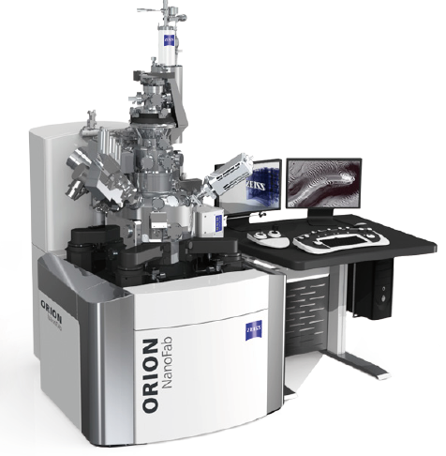
Background – Introduction to Apparatus
Background
Problem Statement
Challenges and Techniques
Experimental Setup and Results
Conclusions
High Resolution 2D and 3D Imaging of semiconductor samples and polymer resists.
Nanofabrication and Characterization of sub-10nm structures for semiconductor, material sciences, and life sciences applications.
Precise Machining with He/Ne beams and Rapid Prototyping with Ga beam – only platform offering unique combination of three different ion beams.
The ORION NanoFab Platform
Notes:
Our data is extracted by the Carl Zeiss ORION NanoFab Platform.
It is a powerful apparatus which is capable of implementing high resolution imaging tasks, and 3D nanofabrication of sub-10nm structures.
And, it is the only platform to offer this unique combination of three different ion beams. [CLICK]

Slide 4
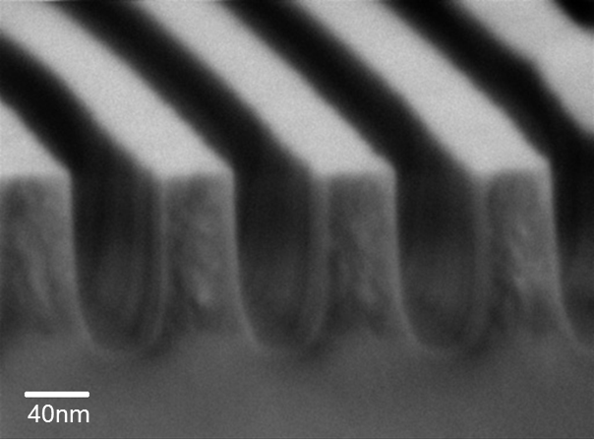
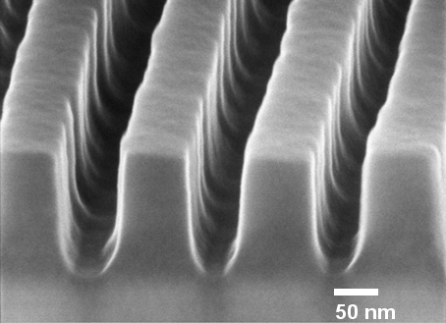
Motivation for Helium Ion Microscopy: Resolution
Background
Problem Statement
Challenges and Techniques
Experimental Setup and Results
Conclusions
SEM
Helium Ion
Ions have lower velocity than electrons of equivalent energy – therefore the wavelength of the ion beam is smaller than electrons
Resolution is dependent on wavelength
– smaller is better
Images: Si-CH₃ enriched MSQ polymer (low-k dielectric)
Rayleigh Criterion
Resolution (r) = 0.61λ/NA
Notes:
These two images show that for a polymer structure with different imaging apparatuses, as the Rayleigh Criterion depicts, resolution is dependent on wavelength (smaller is better). [CLICK]
HIM shows a better resolution compared to traditional SEM. [CLICK]

Slide 5
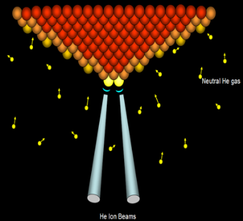
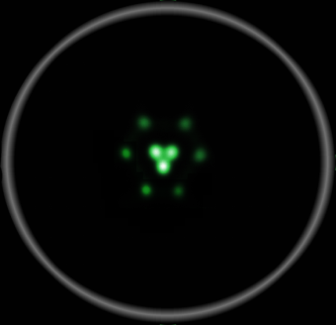
Introduction to “Trimer"
Background
Problem Statement
Challenges and Techniques
Experimental Setup and Results
Conclusions
A trimer, a stable configuration of just three atoms at the apex of the tip, is formed via a repeatable in-situ process.
Notes:
This nano-tip structure shown on the left-hand-side image is called a “trimer”.
A trimer is a stable configuration of exactly three atoms at the apex of the tip. It is formed via a repeatable in-situ process. Our goal in this research is to automatically identify if the current trimer is in a stable and healthy stage. This would provide a consistently high imaging quality through machine learning techniques without human intervention.
Typically the trimer health checking operation is done periodically by experienced operators. [CLICK]

Slide 6
Outline
Background
Problem Statement
Challenges and Techniques
Experimental Setup and Results
Conclusions
Notes:
Next, I will go through the details of the problem statement to describe in-detail what are the inputs, outputs, objective, and methodology we use for this problem. [CLICK]

Slide 7
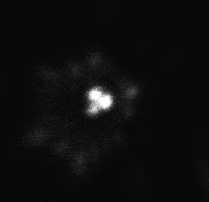
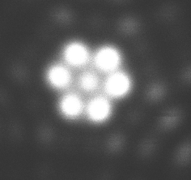
Problem Statement
Background
Problem Statement
Challenges and Techniques
Experimental Setup and Results
Conclusions
Healthy
Unhealthy
Train Cross-Validation
Unknown
This is a “Healthy” trimer
Input Data
Machine Learning
Model
Output Data
?
Objective: To improve the repeatability and stability of the NanoFab, and to automate trimer source monitoring to improve its predictive maintenance performance
Notes:
In our experiments, the input is a data set of machine-captured GFIS images. [CLICK] They are labeled as “Healthy” or “Unhealthy” by experts. [CLICK] We develop a machine learning model which classifies if the images are: “Healthy” or “Unhealthy”.
This modeling process involves steps of data pre-processing, data augmentation, model training, train/test split, cross-validation, hyper-parameter optimization, and so on, which I will go through in detail later. [CLICK] Finally, the trained model would give us a high accuracy prediction result on test data. [CLICK] Again: Our objective is to improve the repeatability and stability of the NanoFab HIM, and to automate trimer source monitoring to improve its predictive maintenance performance. [CLICK]

Slide 8
Outline
Background
Problem Statement
Challenges and Techniques
Experimental Setup and Results
Conclusions
Notes:
Next, I will talk about the challenges and corresponding techniques we used for solving this problem. [CLICK]

Slide 9
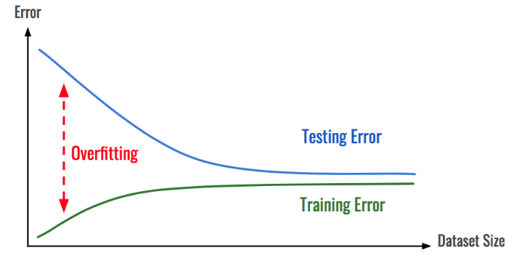
Why SVM instead of CNN/DNN?
Background
Problem Statement
Challenges and Techniques
Experimental Setup and Results
Conclusions
We validated different CNN architectures: DNN, MLP, VGG16
Sweeping hyperparameters: epochs, batch sizes, learning rates, etc.
CNN is vulnerable of overfitting, more suitable with large dataset
Best-Known Model of Convolutional Neural Network
Notes:
Many people may ask: “Why do you use Support Vector Machine” algorithm instead of CNN, DNN, or other deep learning techniques?
We have studied convolutional neural network modeling, or CNN, in early stages of our project.
However it does not show a better result, which is to say accuracy, than SVM classifier.
We’ve validated several CNN architectures, such as DNN, MLP, and the award-winning structure VGG16, sweeping several hyper-parameters.
However CNN is vulnerable of overfitting especially when the amount of data set is small. [CLICK]
Overfitting indicates that your model is not “generalized” enough to predict unseen data. [CLICK]

Slide 10
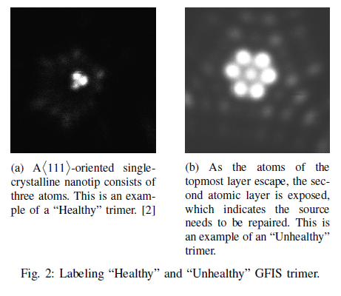
Data Preparation
Background
Problem Statement
Challenges and Techniques
Experimental Setup and Results
Conclusions
Labeling:
Label the data with classes:
“Healthy” or “Unhealthy”
Labeled by experts with domain knowledge
The label is also called
“response variable” in ML
Data Labeling
Notes:
Next, I will go through the data preparation techniques we used in this work. Data preparation is an important step in machine learning applications.
It not only makes prediction more accurate, but also reduces the computation cost of training and testing. In supervised learning classification problems, every data point is labeled with a class tag.
In our work it is “Healthy” and “Unhealthy” trimers. On the right-hand-side, image (A) shows an example of a “Healthy” trimer which consists of the first layer of atoms with a triangular shape, and image (B) is an example of a second layer atomic structure which could lead to an unacceptable imaging quality. [CLICK]

Slide 11
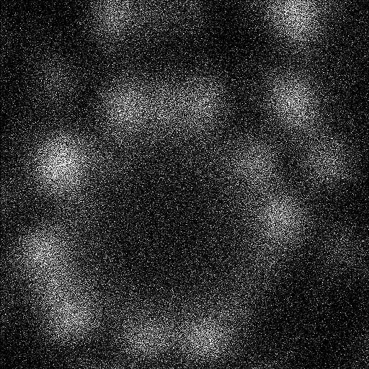
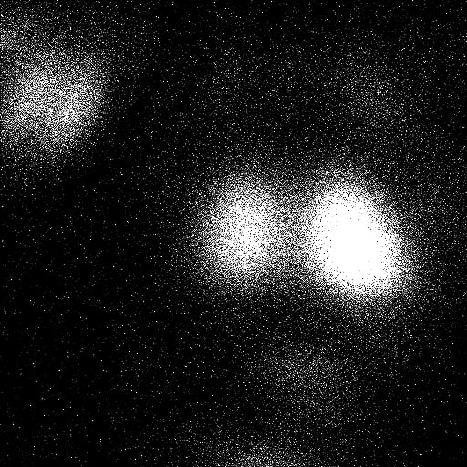
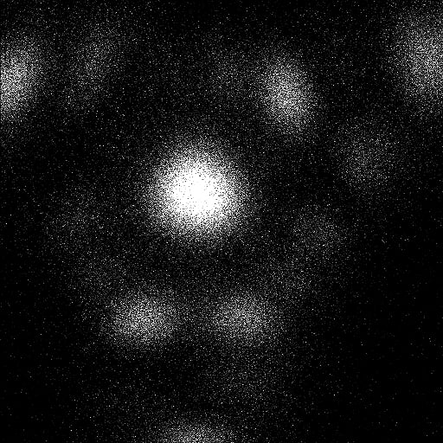
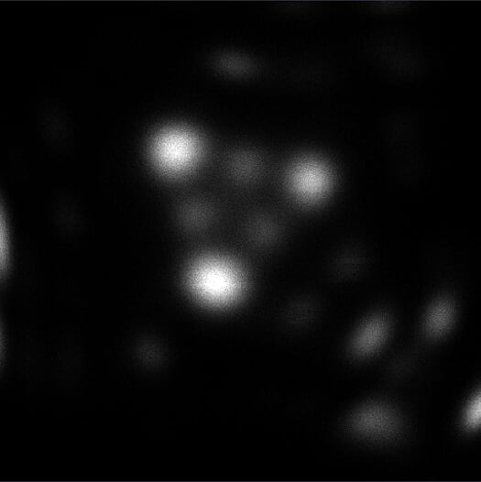
Reactive maintenance use case
Background
Problem Statement
Challenges and Techniques
Experimental Setup and Results
Conclusions
✘
✘
✔
Hollow
Dimer
✘
✘
Monomer
Next shelf
Trimer atoms have been etched away
Notes:
The trimer on the left with the green check is a good example of a “Healthy” trimer.
The images on the right are cases where the trimer atoms have been etched away, labeled as “Unhealthy” trimers in our work.
These Unhealthy configurations are what would be recognized in a REACTIVE maintenance use case.
[CLICK]

Slide 12
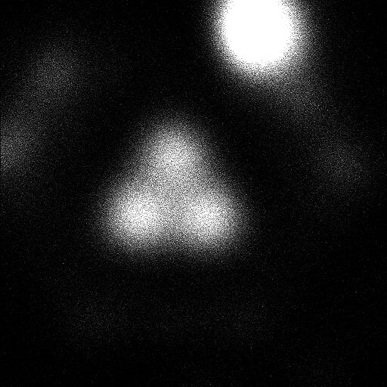
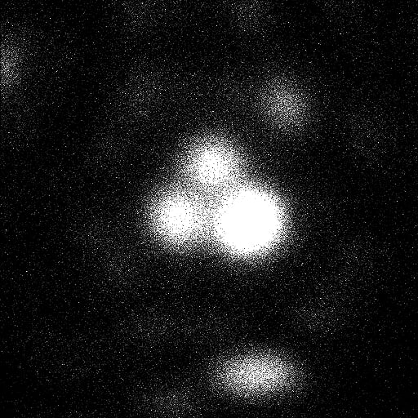
Predictive maintenance use case
Background
Problem Statement
Challenges and Techniques
Experimental Setup and Results
Conclusions
Trimer is present, but contaminant atom is creeping towards tip apex
Notes:
In a PREDICTIVE maintenance use case, shown here, we could observe that trimer is present, but a contaminant atom is creeping towards the apex of the tip. So, these images would also be labeled as “Unhealthy”. [CLICK]

Slide 13
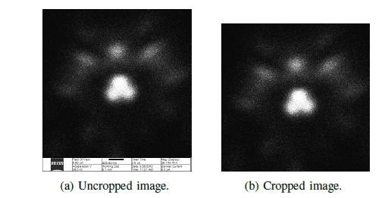
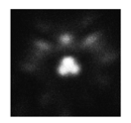
Image Pre-processing
Background
Problem Statement
Challenges and Techniques
Experimental Setup and Results
Conclusions
512 x 560
512 x 512
Unit: pixel²
Image Pre-processing:
Cropping –
Remove unnecessary dimensions (the parameter setup of machine)
Down-sampling –
Avoid “Curse of Dimensionality”,
Dimension reduction is applied
Cropping
512 x 512
256 x 256
Down-sampling
Notes:
In order to remove unnecessary information in the images, pre-processing steps are important.
We use cropping to reduce the dimensionality in the images, which also reduces the computation cost for our model. Also, down-sampling is a technique to avoid the “Curse of Dimensionality” phenomena which we will explain later.
We down-sample our image in half on both axes: the original data size is 512 by 512, and after this pre-processing it is 256 by 256.
This kind of technique is also called “feature extraction” in Machine Learning research. [CLICK]

Slide 14
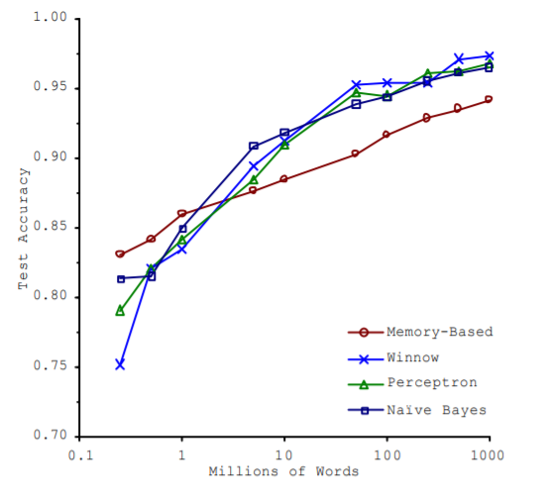
Data Augmentation
Background
Problem Statement
Challenges and Techniques
Experimental Setup and Results
Conclusions
Data Augmentation:
“It’s not who has the best algorithm that wins. It’s who has the most data.”
Why Data Augmentation?
Source: Banko and Brill, 2001
Notes:
Data augmentation is very important when you have a relatively small amount of data.
It is a common saying in Machine Learning that “It is not who has the best algorithm that wins, it is who has the most data.”
This figure on the right indicates that for different machine learning algorithms, when the amount of data is large, almost every model reaches the same accuracy. [CLICK]

Slide 15
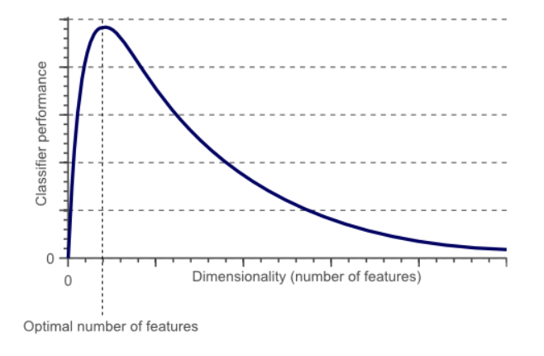
Curse of Dimensionality
Background
Problem Statement
Challenges and Techniques
Experimental Setup and Results
Conclusions
“The Curse of Dimensionality”
Hughes Phenomenon
As the number of features increases, the classifier’s performance increases as well until we reach the optimal number of features
Adding more features based on the same size as the training set will then degrade the classifier’s performance
Source: https://www.visiondummy.com/2014/04/curse-dimensionality-affect-classification/
Notes:
“The Curse of Dimensionality”, also called Hughes Phenomenon, is the phenomenon that as the number of features increases,
the classifier’s performance increases as well until we reach some optimal number of features.
Adding more features based on the same size of the training set will then degrade the classifier’s performance. [CLICK]

Slide 16
Cross-Validation K-Fold and Leave-One-Out
Background
Problem Statement
Challenges and Techniques
Experimental Setup and Results
Conclusions
K-Fold Cross-Validation (K-Fold CV)
In K-Folds Cross Validation data is split into k different subsets
We use (k-1) subsets to train our data and leave the last subset as test data
Averaging the model against each of the folds and then finalize our model, after that we test it against the test set
K-Fold Cross-Validation
Notes:
Cross-Validation is a common technique to validate the machine learning model performance.
K-fold cross-validation is the most common method used in different applications.
In K-Fold Cross Validation we split our data into K different subsets (or folds).
We then use (K-1) subsets to train our data and leave the last subset (or the last fold) as test data. We average the model’s performance against each of the folds and then finalize our model.
After that we test it against the test set. [CLICK]

Slide 17
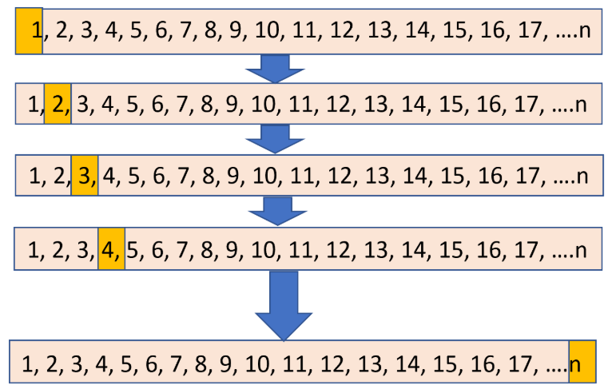
Leave-One-Out Cross-Validation (LOOCV)
Background
Problem Statement
Challenges and Techniques
Experimental Setup and Results
Conclusions
Leave-One-Out Cross-Validation is K-fold CV pushed to the extreme where K is equal to N (N is the number of data of the entire data set)
Model accuracy is increased compared to K-Fold CV since each data point is tested based on remaining (N-1) data points as training set
Leave-One-Out Cross-Validation
Notes:
Leave-One-Out cross-validation (LOOCV) is K-fold Cross-Validation pushed to the extreme where K is equal to N (the number of the entire amount of data points),
Model accuracy is increased compared to K-Fold Cross-Validation since each data point is used as test data that based on remaining (N-1) data points used as training set. [CLICK]

Slide 18
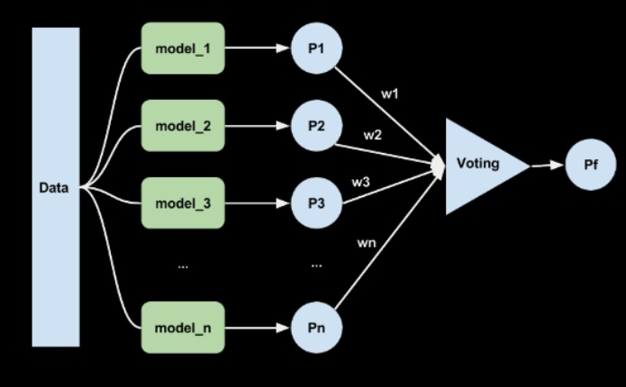
Ensemble Model
Background
Problem Statement
Challenges and Techniques
Experimental Setup and Results
Conclusions
Ensemble Model
Ensemble Model: Obtain decisions based on multiple models instead of single one
Models used to build ensemble model: Linear, RBF (Radial-Basis Function), Polynomial and Sigmoid
Source: https://www.slideshare.net/amitkaps/the-power-of-ensembles-in-machine-learning
Notes:
Beyond all these cross-validation methods, we also use ensemble model to validate if our model makes the best decision compared with others.
We use a “soft” voting classifier which votes according to the highest probability that multiple models conclude.
In our work we used different kernel functions (Linear, RBF, Polynomial and Sigmoid) of the SVM algorithm since it best fits our problem.
The result we get is similar to our original model which shows that our original model is making a precise prediction. [CLICK]

Slide 19
Outline
Background
Problem Statement
Challenges and Techniques
Experimental Setup and Results
Conclusions
Notes:
Now I am going to introduce our experimental setup and our results. [CLICK]

Slide 20
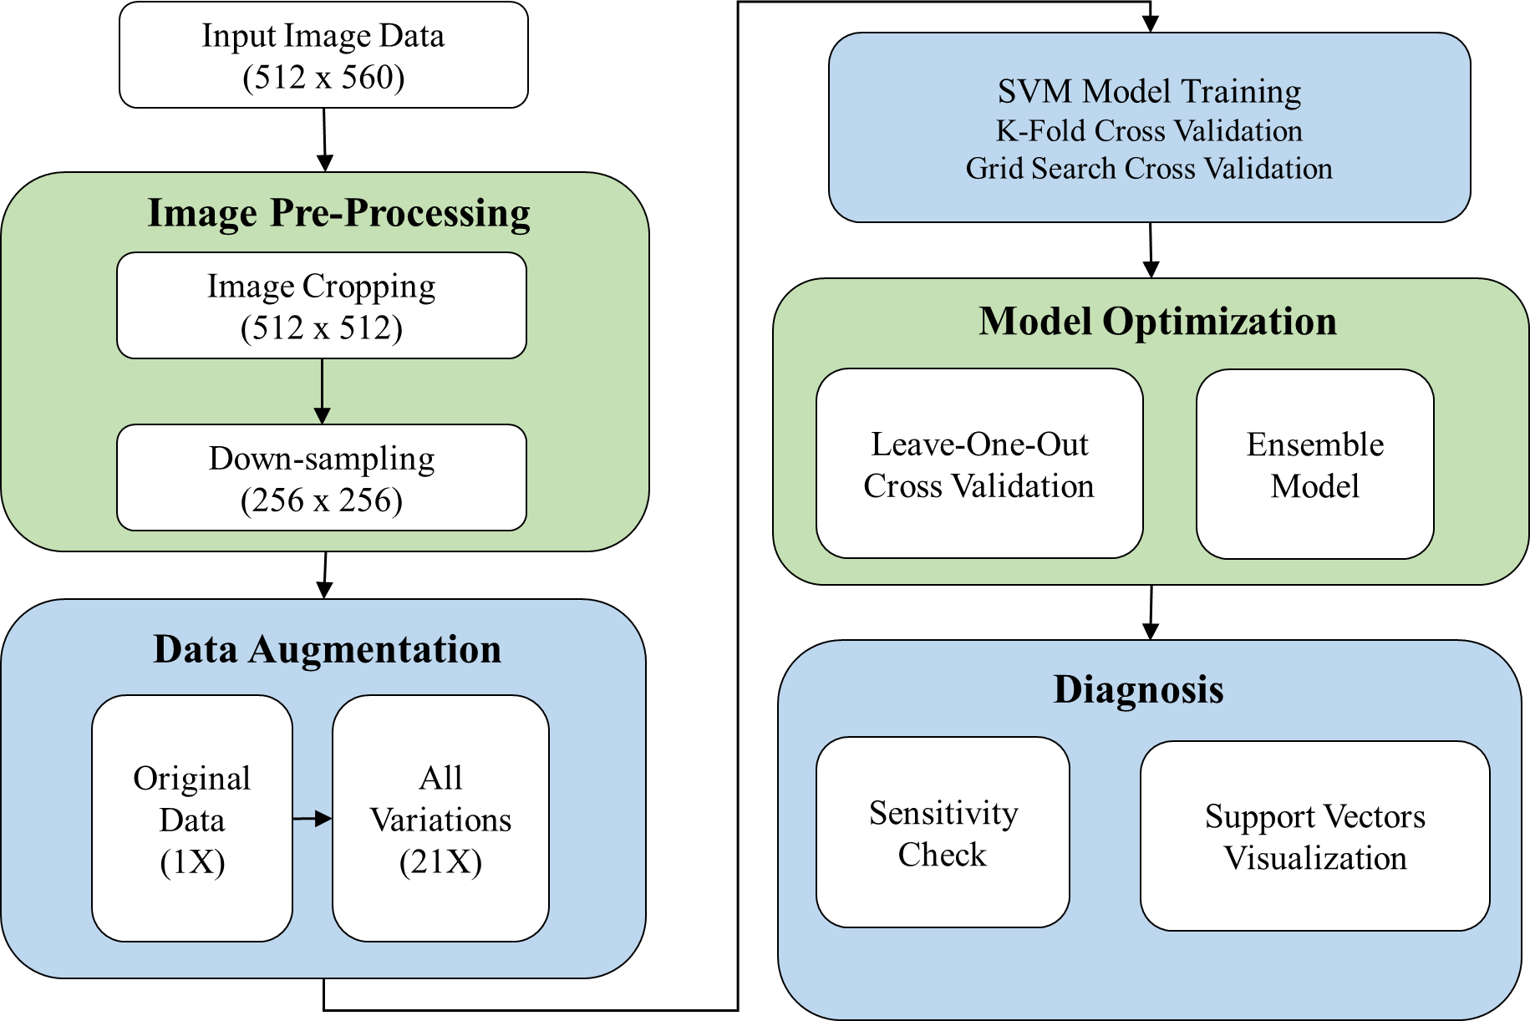
Background
Problem Statement
Challenges and Techniques
Experimental Setup and Results
Conclusions
Experimental Setup and Results
To ensure the robustness and generalization of our models, we implement image pre-processing, data augmentation, model optimization and diagnosis for our models
Notes:
The figure on the left-hand-side shows the flow chart of our experiments.
The input image data has original dimensions 512 by 560.
First, after cropping and down-sampling, the dimension of each image is now 256 by 256.
Second, we apply data augmentation, in order to avoid overfitting and curse of dimensionality, our data is expanded by 21 times of original data set.
Then we feed all data into our SVM model with different methodologies to make sure the robustness of our model.
Finally to enable instruction and analysis regarding this model, we do sensitivity check and list the number of support vectors to diagnose the result from data augmentation.
We also give instruction on how to extract data which would least cause incorrect prediction from the model. [CLICK]
*** Was it 512 x 560 or 512 x 512 ??? ***

Slide 21
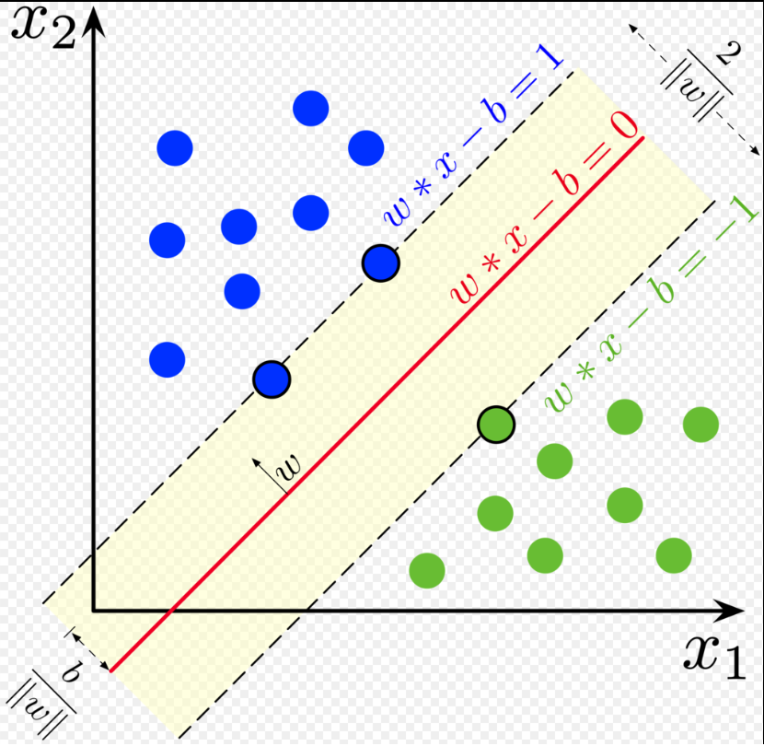
Support Vector Machine (SVM)
Background
Problem Statement
Challenges and Techniques
Experimental Setup and Results
Conclusions
Support Vector Machine (SVM)
“Unhealthy” Trimers
A Support Vector Machine (SVM) is a ML algorithm designed to solve binary classification problems with high dimensional covariates and small amount of data samples
“Healthy” Trimers
Notes:
The concept of a support vector machine is that it is a machine learning algorithm designed to solve binary classification problems with high dimensional covariates and small amount of data samples. [CLICK]
These properties of the SVM approach perfectly match our problem.
By maximizing the distance between the hyperplanes, the model could best predict two classes.
In our work these classes are the “Healthy” and “Unhealthy” trimer images. [CLICK]

Slide 22
Support Vector Machine (SVM)
Background
Problem Statement
Challenges and Techniques
Experimental Setup and Results
Conclusions
SVM determines an optimal hyperplane that separates the training data with maximal margin.
This matches our problem, which has comparatively small amount of data (726 images) with high dimensionality (256 x 256 pixel²).
Notes:
SVM determines an optimal hyperplane that separates the training data with maximal margin.
Again, this is well-matched to our problem, which has comparatively small amount of data with high dimensionality. [CLICK]

Slide 23
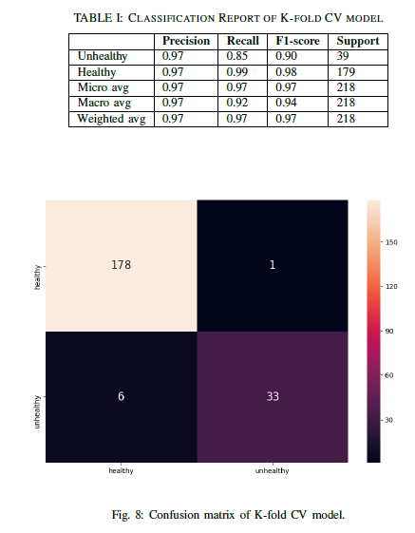
K-Fold CV Model Performance
Background
Problem Statement
Challenges and Techniques
Experimental Setup and Results
Conclusions
Confusion Matrix of K-Fold CV Model (K = 10)
Classification Report of K-Fold CV Model
Notes:
Here we show the model performance of K-Fold cross-validation. Confusion matrix on the left-hand-side and the classification report on the right-hand-side are common metrics for Machine Learning classification problems. In our notation, for the confusion matrix the x-axis is the predicted class and the y-axis is the actual class. In the classification report, the precision is measuring the ability of the classifier to not mislabel a negative sample as being positive.
The precision of both classes is higher than 97%.
This exceeds our original model performance goal of 90% precision when we first started the project. [CLICK]

Slide 24
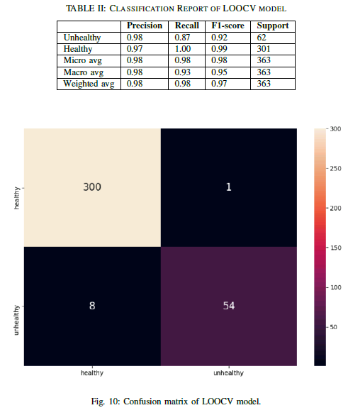
LOOCV Model Performance
Background
Problem Statement
Challenges and Techniques
Experimental Setup and Results
Conclusions
K-Fold CV
Confusion Matrix of LOOCV Model
Classification Report of LOOCV Model
Notes:
If we implement the leave-one-out cross-validation, the result indicates that there is a slight improvement compared with K-fold cross-validation.
This is expected since every point is tested based on the other (N-1) data points. However, the tradeoff is higher computation cost. [CLICK]

Slide 25
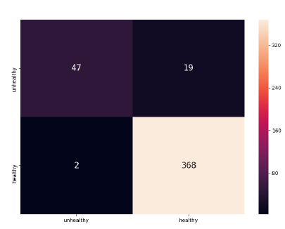
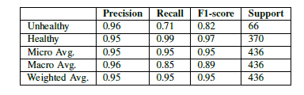
Ensemble Model Performance
Background
Problem Statement
Challenges and Techniques
Experimental Setup and Results
Conclusions
K-Fold CV
LOOCV
Confusion Matrix of Ensemble Model
Classification Report of Ensemble Model
Notes:
Here is the model performance of the ensemble model. The precision is around 95%, which is even lower than our original model. It means that our original model makes a better decision on each data point tested than the other models combined. [CLICK]

Slide 26
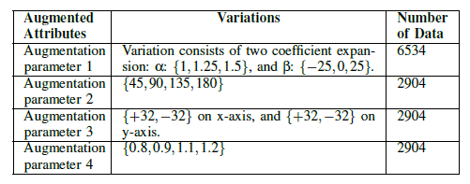
Background
Problem Statement
Challenges and Techniques
Experimental Setup and Results
Conclusions
Data Augmentation Setup
Train: Test ratio = 70% : 30%
Notes:
Originally, our model training encountered memory error after data augmentation was applied. However, we used “LIBLinear” solver to resolve this problem, so that we could feed all 15K data into our model without getting memory errors.
We did our data augmentation in four different attributes.
All numbers of data sorted by attributes are listed in the table shown here.
All of our dataset is split into train/test data with a fixed ratio of 70% to 30% [CLICK]
If train/test ratio is too high, it may lead to overfitting. On the other hand, if the ratio is too low, there is a tendency to underfit the model.[CLICK]

Slide 27
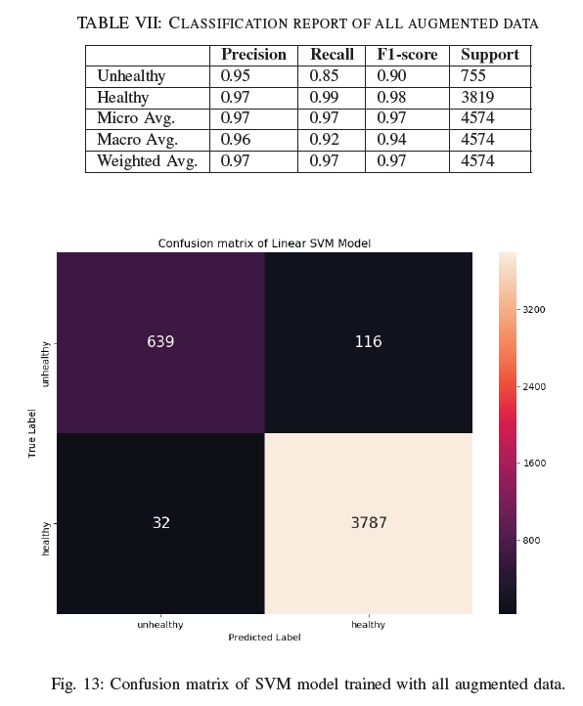
Data Augmentation Model Performance
Background
Problem Statement
Challenges and Techniques
Experimental Setup and Results
Conclusions
Confusion Matrix of Model
with Data Augmentation
Classification Report of Model
with Data Augmentation
Notes:
When we put all the augmented data into training.
We could still get a very high precision in both classes with at least 95% precision.
This shows our model is “GENERALIZED” enough to deal with unseen data. [CLICK]

Slide 28
Diagnosis - Sensitivity Check
Background
Problem Statement
Challenges and Techniques
Experimental Setup and Results
Conclusions
Diagnosis of Prediction Results
Notes:
In order to diagnose which attribute variation affects the judgment of our model most, we categorized falsely predicted data by their augmented attribute.
The sensitivities of these attributes were then ranked as: parameter 3, 2, 1, and 4. To keep these attributes as secret recipes in our experiments, we will not reveal which methodologies we are using.
The result indicates that we should avoid extracting data with attribute 3 varied in the data augmentation, so that the model will end up with a better prediction precision. [CLICK]

Slide 29
Outline
Background
Problem Statement
Challenges and Techniques
Experimental Setup and Results
Conclusions
Notes:
The final section of my talk is the conclusion which wraps up our research and gives some thoughts on future works. [CLICK]

Slide 30
Conclusions
Background
Problem Statement
Challenges and Techniques
Experimental Setup and Results
Conclusions
The first SVM image classifier for HIM GFIS trimer healthiness monitoring (over 95% precision for both classes)
Data augmentation is essential where a relatively small amount of data is available to assure the generalization of training models
In predictive maintenance applications where training data availability is limited, we have demonstrated that SVM approach shows better performance than CNN approach
Notes:
In this work, we have proposed the first machine-learning-based support vector machine image classifier for helium-neon ion beam microscope GFIS trimer healthiness monitoring.
We achieve high accuracy over 95% for both the healthy and unhealthy image classes.
For image based predictive maintenance, data acquisition time may limit the amount of data used for training, so we implement data augmentation to enhance the robustness of our model to deal with unseen data. And, based on our experiments, we found that SVM performs better than deep learning methodologies. [CLICK]

Slide 31
THANK YOU!
Advanced Process Control Conference
Majestic Ballroom A (Track A)
04:30PM~05:00PM Wed. Oct. 29th 2019
Notes:
Thanks very much to everyone for your attention. Any comments and questions are welcome. [CLICK]

