Slide 1
Toward an Open-Source Digital Flow: First Learnings from the OpenROAD Project
Tutu Ajayi, Vidya A. Chhabria, Mateus Fogaca, Soheil Hashemi, Abdelrahman Hosny, Andrew B. Kahng, Minsoo Kim, Jeongsup Lee, Uday Mallappa, Marina Neseem, Geraldo Pradipta, Sherief Reda, Mehdi Saligane, Sachin S. Sapatnekar, Carl Sechen, Mohamed Shalan, William Swartz, Lutong Wang, Zhehong Wang, Mingyu Woo and Bangqi Xu
Notes:
Good afternoon and thank you for the kind introduction. I am really honored to be among so many distinguished speakers in today’s program. Today I will introduce a project called OpenROAD in the IDEA program. OpenROAD aims for open-source, self-driving digital implementation.

Slide 2
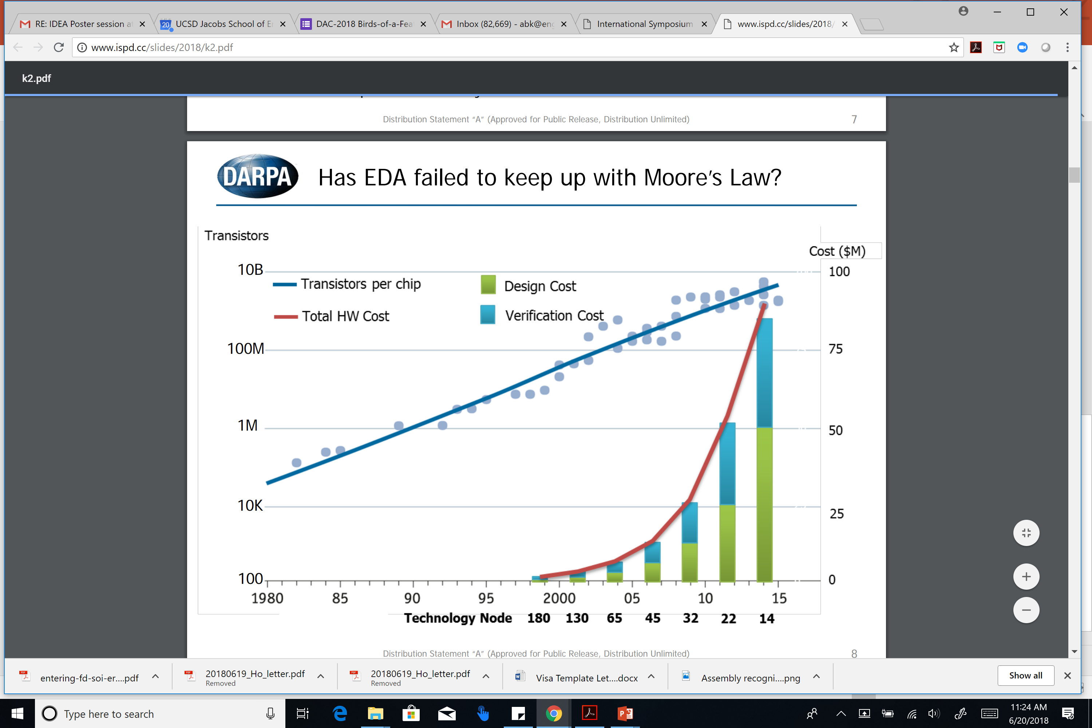
Design Crises: Cost, Expertise, Unpredictability
Motivation
OpenROAD
Open-source
Flow (RTL-GDS)
Analysis Tools
Design cost: not scaling! Design, process roadmaps not coupled
  [Figure: Andreas Olofsson, DARPA, ISPD-2018 keynote]
Notes:
When we talk about hardware today, we talk about the crises of hardware design: Cost, Expertise, Unpredictability
Design COST is engineers, licenses, schedule – AND RISK. This slide from Andreas a year ago tells us that wafer cost pretty much always ends up at a nickel or a dime per square millimeter in any process. But this curve at the right means that the cost of designing that square millimeter is out of control. This happens when nothing really ties design technology to Moore’s Law scaling itself.
{CLICK] Compounding this is non-scaling of QUALITY. With every new technology node, yes, you CAN print twice as many transistors in a square millimeter as before – which is AVAILABLE DENSITY … BUT, you CANNOT fit twice as many USEFUL transistors into a given area, going from node to node – and that’s REALIZABLE DENSITY. This DESIGN CAPABILITY GAP goes back well over a decade.

Slide 3
Design is Too Difficult !
Motivation
OpenROAD
Open-source
Flow (RTL-GDS)
Analysis Tools
Tools and flows have steadily increased in complexity
  Modern P&R tool: 10000+ commands/options
Hard to design with latest tools in latest technologies
  Even harder to predict quality, schedule
  Expert users required
  Increased cost and risk not good for industry!
Still have “CAD” mindset more than “DA” mindset
  Again: assumes expert users
How do we escape this “local minimum” ?
Notes:
Design itself is too difficult!
A modern P&R tool has more than 10K commands and options.
[CLICK] In latest nodes, tools introduce more complex procs to handle increasing design rule complexity. So outcomes are hard to predict, and expert users are needed. This brings cost and risk that are not good for the industry.
If you remember Makimoto’s wave: What swings the industry from a period of standardization back to a period of customization? Moore’s Law power and performance scaling, or improved design technology and design cost. But both of these drivers are stalled !
[Click] Still living in a computer-AIDED mindset, as opposed to a design AUTOMATION mindset – again assumes expert users.
[Click] So how do we escape this “local minimum”?

Slide 4
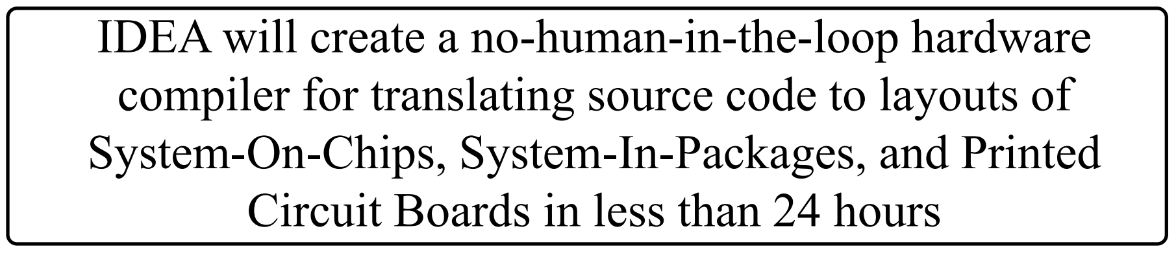
IDEA: No Human in the Loop, 24 hours
Motivation
OpenROAD
Open-source
Flow (RTL-GDS)
Analysis Tools
A. Olofsson, DARPA
ISPD-2018 keynote
Part of DARPA Electronics Resurgence Initiative
Traditional focus: ultimate quality
New focus = ultimate ease of use
No humans, 24-hour TAT = “equivalent scaling”
Overarching goal: designer access to silicon

Slide 5
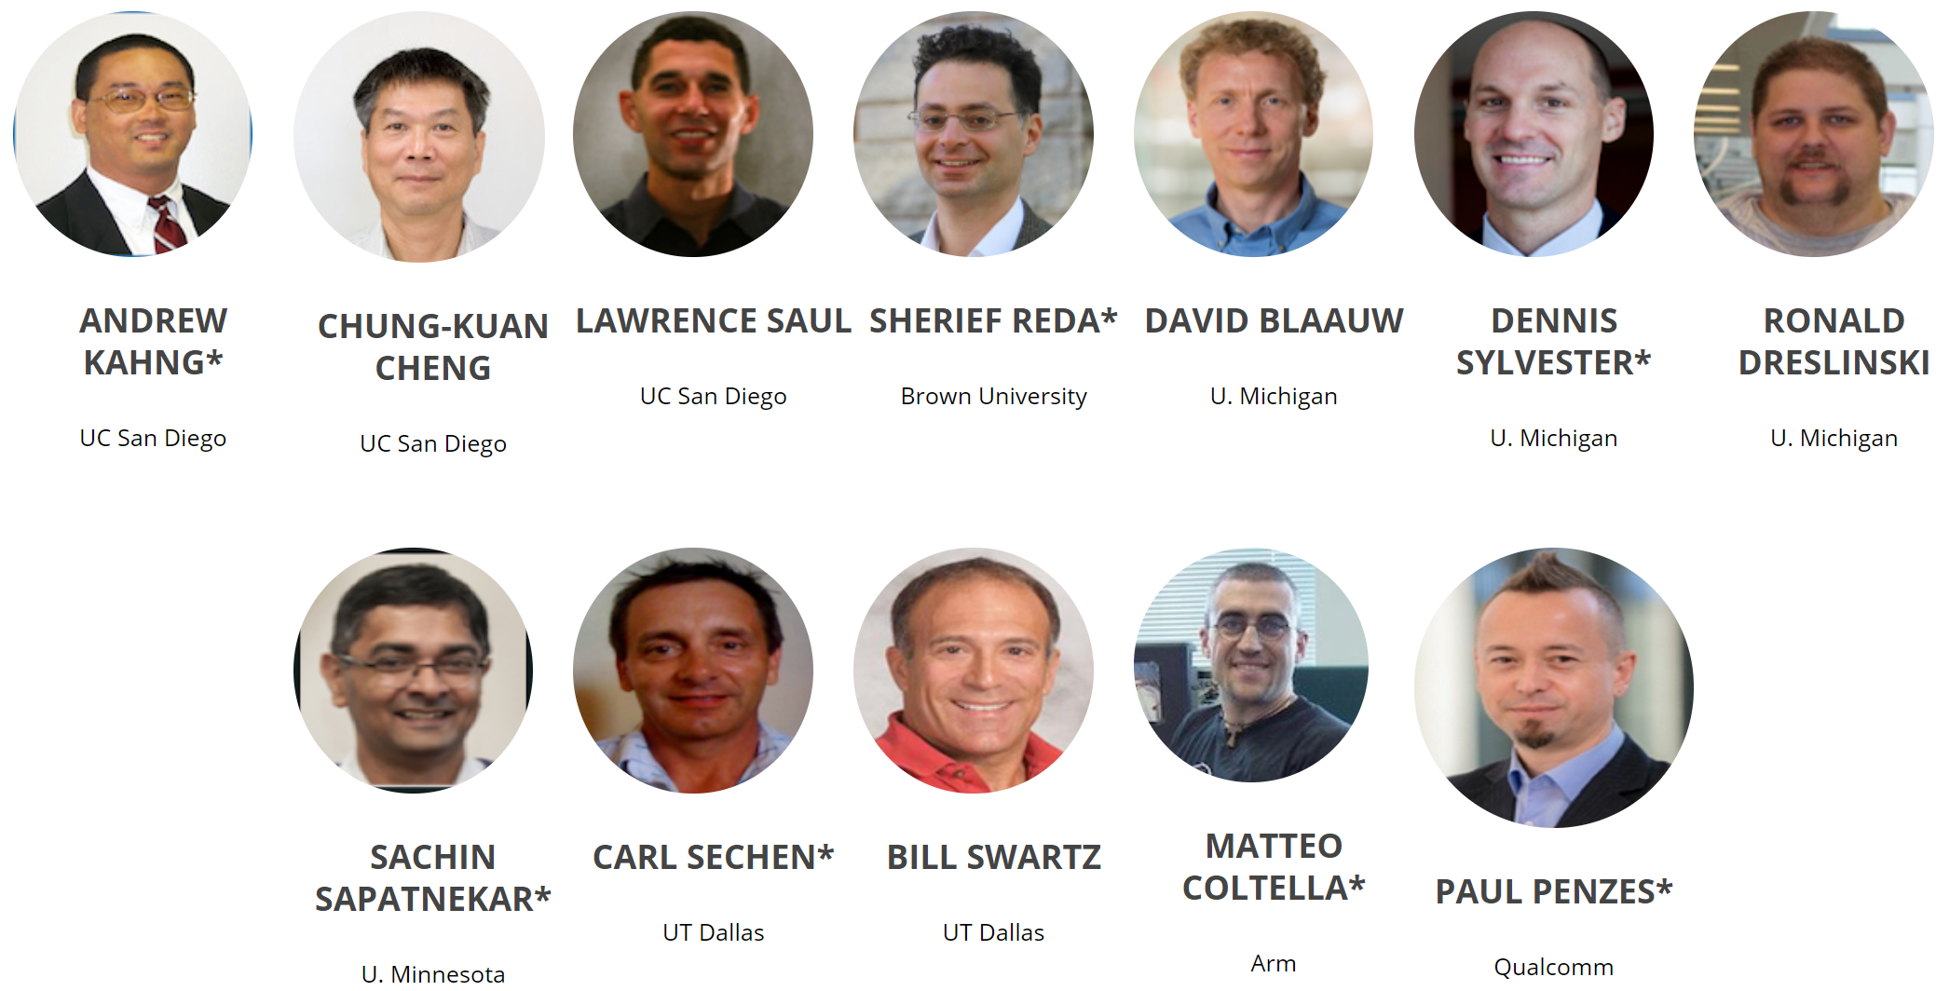
theopenroadproject.org
Motivation
OpenROAD
Open-source
Flow (RTL-GDS)
Analysis Tools
Notes:
Here are my co-PIs at the universities and the companies – many very well-known faces spanning from layout to analysis, plus SOC design and design methodology.

Slide 6
OpenROAD: A New Design Paradigm
Motivation
OpenROAD
Open-source
Flow (RTL-GDS)
Analysis Tools
24 hours, no humans – no PPA loss
Mindsets
  Achieve predictability from the user’s POV
  Use cloud/parallel to recover solution quality
  Focus on reducing time and effort = schedule, cost
Extreme partitioning
Parallel optimization
Machine Learning of tools, flows
Restricted layout
 Quality
 Schedule
 Cost
Design Complexity
Machine Learning is CENTRAL to this

Slide 7
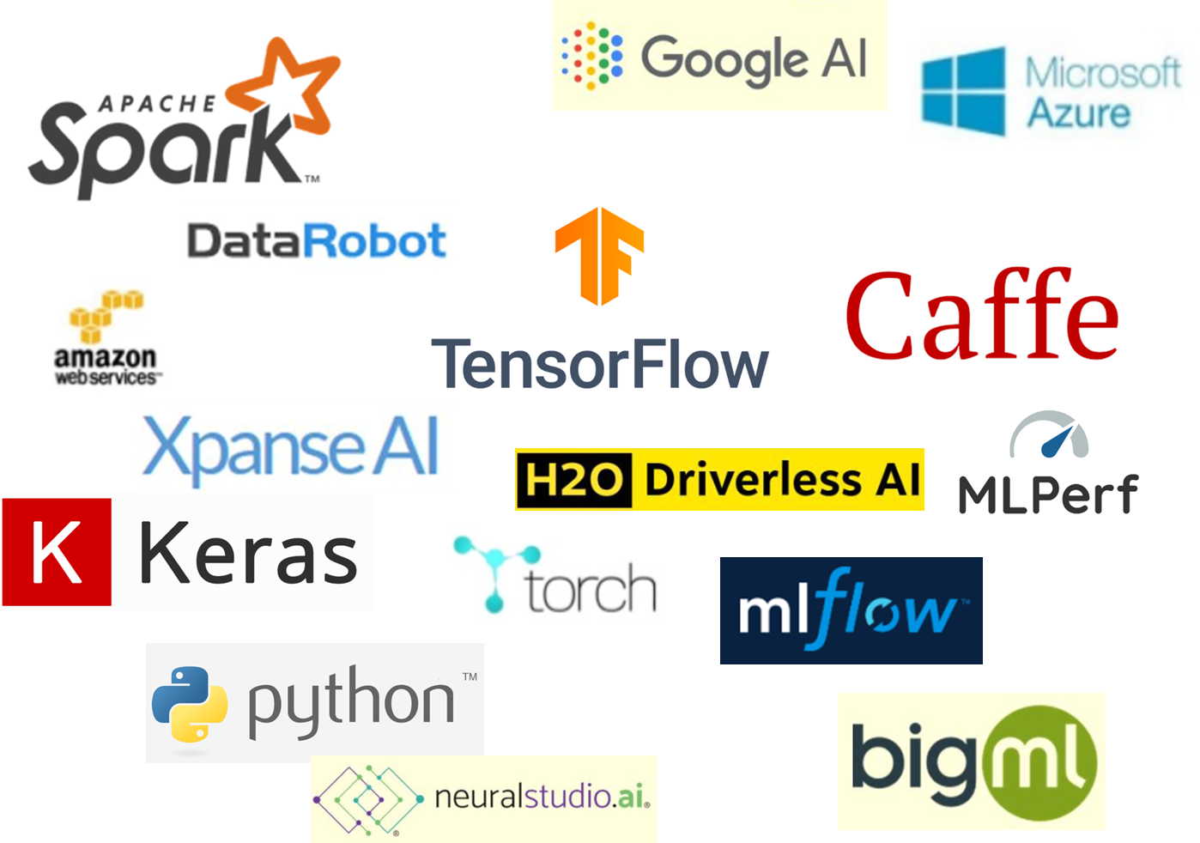

Open Source
Motivation
OpenROAD
Open-source
Flow (RTL-GDS)
Analysis Tools
Clarity, better science
  Leading edge becomes visible and well-defined
  Advances are verifiable: no more “irreproducible results” !
Avoid reinventing wheels
  Field advances more rapidly
Strong correlation with maturity, health of field
  Look at AI / ML, computer vision …
  Strategic advantages to researchers and companies alike
Do for EDA what Linux has done for software
  Follow on the heels of other open source hardware initiatives
Notes:
Clarity – research is principled and verifiable.
Don’t waste time! People are precious in our world – enough are going to Facebook without making research life unnecessarily tough or impossible!
As Andreas mentioned: mature fields do this, and flourish !

Slide 8
Also: “Paying It Forward”
Motivation
OpenROAD
Open-source
Flow (RTL-GDS)
Analysis Tools
EDA began with open source: SPICE, SUPREM, MAGIC, ESPRESSO, FASTCAP, MIS/SIS, …
Many open-source tools continue to be developed today
Tool | Provider | License | I/O Format
yosys | Clifford Wolf | ISC (BSD-2) | Industry
Parquet | UMich |  | Academic
NTUPlace 2.0 | NTU |  | Academic
NTHU GR | NTHU |  | Academic
Qrouter | Tim Edwards | GPL 2.0 | Industry
OpenTimer2.0 | UIUC | MIT | Industry
Rsyn | UFRGS | Apache 2.0 | Industry
We want to see critical mass, culture of FOSS in our domain
Notes:
I think of this as just paying it forward – the right thing to do for so many reasons.
So, OpenROAD is open-sourcing everything, by our contract and because we wanted to anyway.

Slide 9
Initial Target: RTL-to-GDS Layout Generation
Motivation
OpenROAD
Open-source
Flow (RTL-GDS)
Analysis Tools
Inputs: .v, .sdc, .lib, .lef
  .def, .spef in point tools
  config files required
  pre-characterizations required
Outputs: post-route .def, timing/power estimates
Alpha release: July 2019
V1.0 release: June 2020
design.v, design.sdc, design.lib, design.lef
LOGIC/ PHYSICAL SYNTHESIS
gate.v
gate.v, design.lib, design.lef,
.cfg files (IP, PDN)
FLOORPLAN / POWERPLAN
floorplan.def
design.lef, floorplan.def
STDCELL PLACEMENT
postPlace.def
gate.v, design.lef, postPlace.def,
tech characterization
PARASITIC EXTRACTION
STATIC TIMING ANALYSIS
CLOCK TREE SYNTHESIS
postCTS.v, postCTS.def
design.lef, postCTS.def
GLOBAL ROUTER
route.guide
postCTS.v, postCTS.def, route.guide
DETAILED ROUTER
postRoute.def
design.lef, postRoute.def
LAYOUT FINISHING
postLF.def
GDS
Notes:
Layout generation spans Logic Synthesis through Routing and then layout finishing.
[CLICK] OUR inputs are industry-standard formats - Verilog, constraints, timing/power libraries, physical library views. Additional config files and characterizations are also required.
[CLICK] Output is final routing, plus timing and power reporting.
[CLICK] Today we are about 15 months before v1 release.
We also work on die-package layout flow with Qualcomm, and Professor C-K Cheng at UCSD is leading board place-and-route development (two M.S. graduates of NTU are joining him in a few weeks).

Slide 10
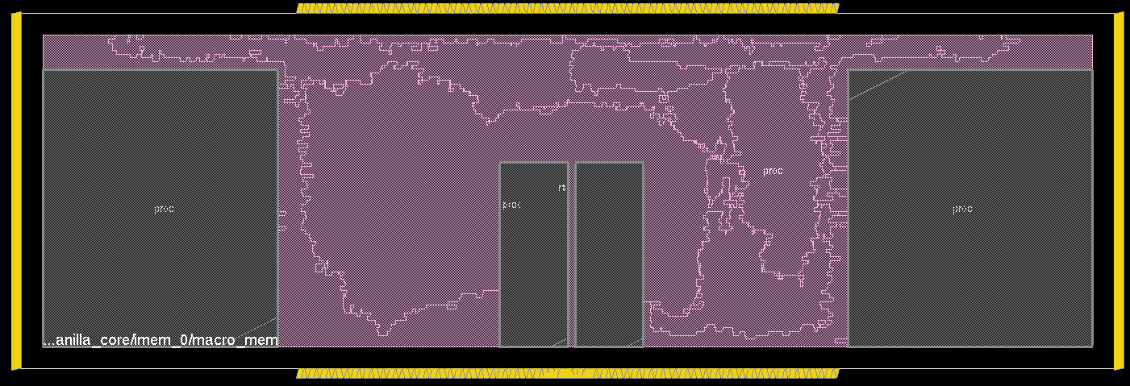
Testcases and libraries
Motivation
OpenROAD
Open-source
Flow (RTL-GDS)
Analysis Tools
Processor Designs
  Ariane – RISC-V based core from ETH
  Vanilla Bean – RISC-V based core from Michigan
  Black Parrot – Processor core from Washington
  Coyote – RISC-V based core from Michigan
  Sparc Core – Sparc based core from Princeton
  Cortex-A53 – Commercial core from Arm
Accelerator Designs
  aes
  gcd
  jpeg
  dynamic_node
Test Case Characteristics
  Number of cells: 200 – 250,000
  Total cell area: 1,000 – 1,301,194 um²
  Design Utilization: 19% - 65%
  Memory/Macros: 0 – 26
  Library: TSMC 65 nm LP
Vanilla Bean
Notes:
Let me start with a very important piece: where do we get calibrations and testcases, and who are our “internal AEs and product engineers”?
The team at Michigan acts as the pioneering customers – they provide feedback on what they are looking for to implement their designs, and what they see from the OpenROAD flow.
They assess QOR against what they’ve observed from previous tapeouts, and they also help prioritize features

Slide 11
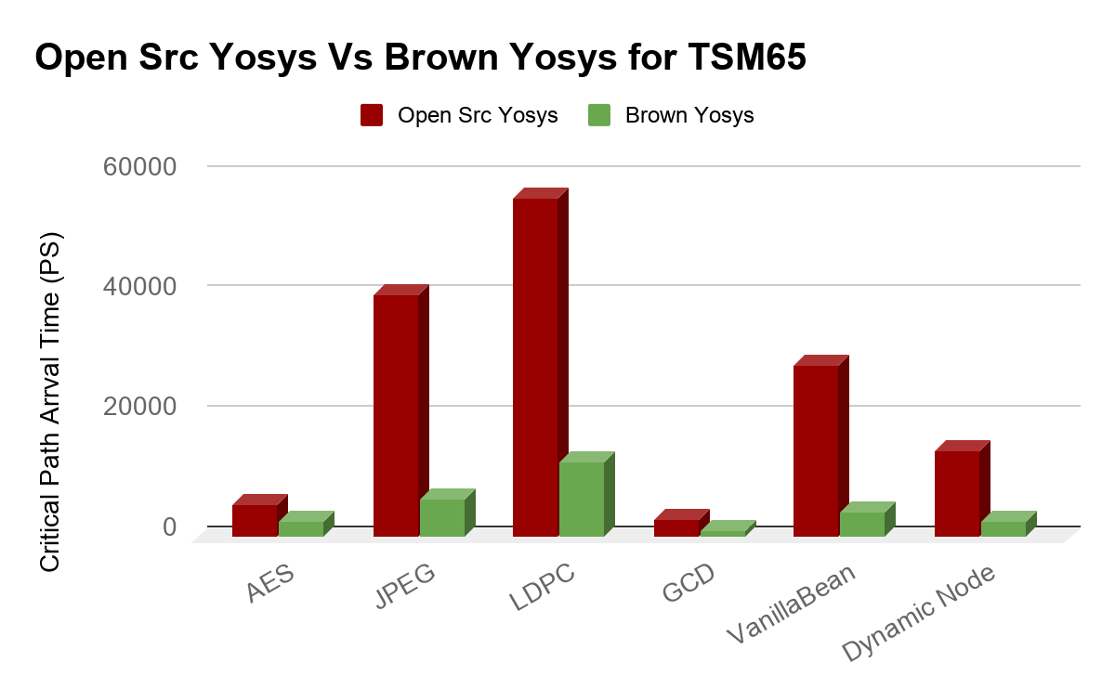
1. Logic and Physical Synthesis
Motivation
OpenROAD
Open-source
Flow (RTL-GDS)
Analysis Tools
Builds on open-source yosys-abc and adds large support for timing-driven synthesis: (1) physical synthesis, (2) SDC support, and (3) flow optimization
Physical synthesis (buffering, gate sizing, cloning, logic restructuring, etc)
.v
.def
.v, .lib, .sdc
Logic Synthesis
Floor Planning
Placement
.def, .spef
.def, .v
Physical synthesis (buffering
& sizing)
Legalization
STA
.spef

Slide 12
1. Logic and Physical Synthesis
Motivation
OpenROAD
Open-source
Flow (RTL-GDS)
Analysis Tools
SDC constraints support
Integrated an open source SDC Parser in Yosys/ABC
Add support for some SDC commands in ABC: create_clock, set_load, set_max_fanout, set_max_transition, etc.
Roadmap for SDC command implementation (e.g., set_driving_cell, set_input_delay, set_output_delay, set_min_delay,…)
Automated synthesis scripting
  Synthesis scripts have 10s-100s of commands crafted by experts
  Approach: Devised a reinforcement learning controller for synthesis.
  Results: ~14% improvement in area and meets timing constraints.

Slide 13
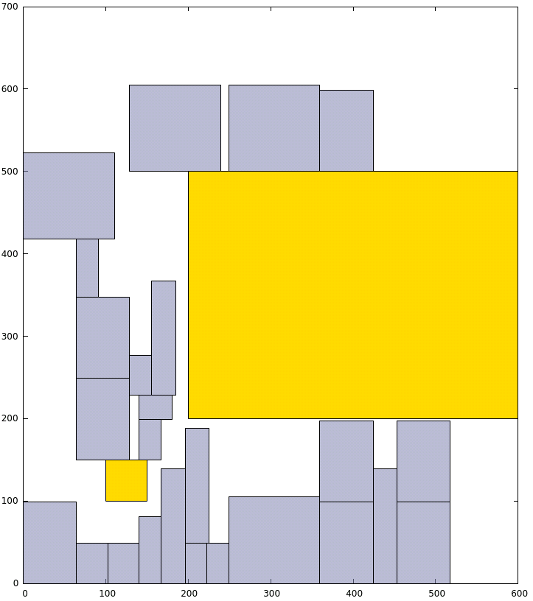
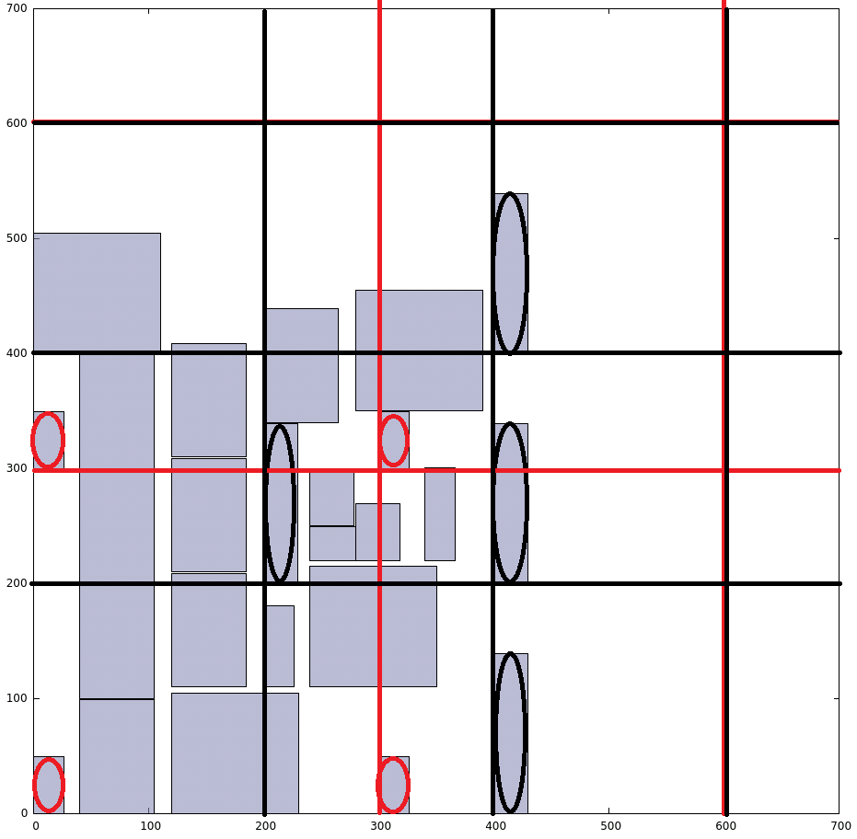
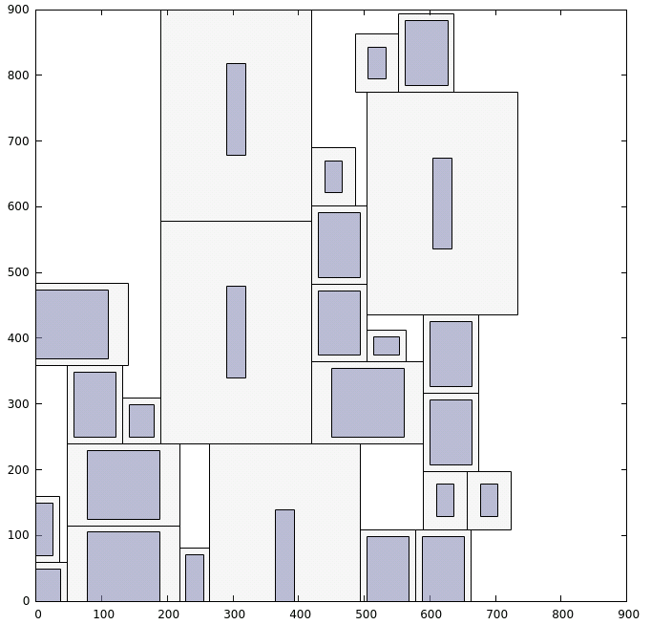
2. Floorplan / Powerplan
Motivation
OpenROAD
Open-source
Flow (RTL-GDS)
Analysis Tools
Macro packing evolved from UMichigan Parquet B*-tree-based simulated annealing
  Halos, channels, etc. rules captured in “config” files
PDN generation along with endcap, tapcell layout also part of tool
Verilog to DEF brings synthesis outputs
  Link: https://github.com/abk-openroad/OpenROAD-Utilities
.v from Logic Synth, IP, PDN.cfg, .pins
(+ .sdc, .lef, .lib)
Floorplan/PDN
Floorplan .def with PDN and placed macros
TCAD ‘03: Fixed-outline floorplanning: Enabling hierarchical design
Notes:
Now let me give a few snapshots of the implementation flow, from an internal demo that we had at the beginning of January.
For floorplanning and powerplanning, TritonFPlan has two major components, with methodology guidance from Qualcomm and Arm.
The first component is integer programming-based macro-packing, using rules embedded in config files. This understands netlist connectivity as well as channel, halo, grid-snapping and requirements.
The second component is Tcl-based Power Delivery Network (PDN) Generation, using a safe-by-construction methodology.
Today the field of use is rectangular floorplans, with macro count < 100. Students are working on correct-by-construction handling of endcaps and tapcells in 16 nanometer – and they are revisiting annealing-based macro packing, inspired by the published successes at NTU and Maxeda.

Slide 14
3. Placement
Motivation
OpenROAD
Open-source
Flow (RTL-GDS)
Analysis Tools
RePlAce features
  Timing-driven (OpenSTA timer integrated)
  Mixed-size (macros + cells)
  Electrostatics analogy in analytic placement
RePlAce used in:
  Physical synthesis
  Floorplanning
  Clock tree synthesis
  Traditional standard-cell placement
BSD-3 License
.def from FP/PDN (+ .v, .sdc, .lef, .lib)
Placement
Placed .def
https://github.com/abk-openroad/RePlAce
TCAD’18: RePlAce: Advancing Solution Quality and Routability Validation in Global Placement
Notes:
After Floorplanning comes Placement.
The UCSD RePlAce tool handles mixed-size placement and has simple timing-driven net weighting that integrates our open-source static timing engine. RePlAce uses the electrostatics analogy pioneered by Professor Cheng’s group at UCSD.
We use this engine in physical synthesis, floorplanning, post-CTS legalization, and traditional standard-cell placement.

Slide 15
3. Placement
Motivation
OpenROAD
Open-source
Flow (RTL-GDS)
Analysis Tools
Global routing during routability-driven global placement
Routability-driven loop
Notes:
After Floorplanning comes Placement.
The UCSD RePlAce tool handles mixed-size placement and has simple timing-driven net weighting that integrates our open-source static timing engine. RePlAce uses the electrostatics analogy pioneered by Professor Cheng’s group at UCSD.
We use this engine in physical synthesis, floorplanning, post-CTS legalization, and traditional standard-cell placement.

Slide 16
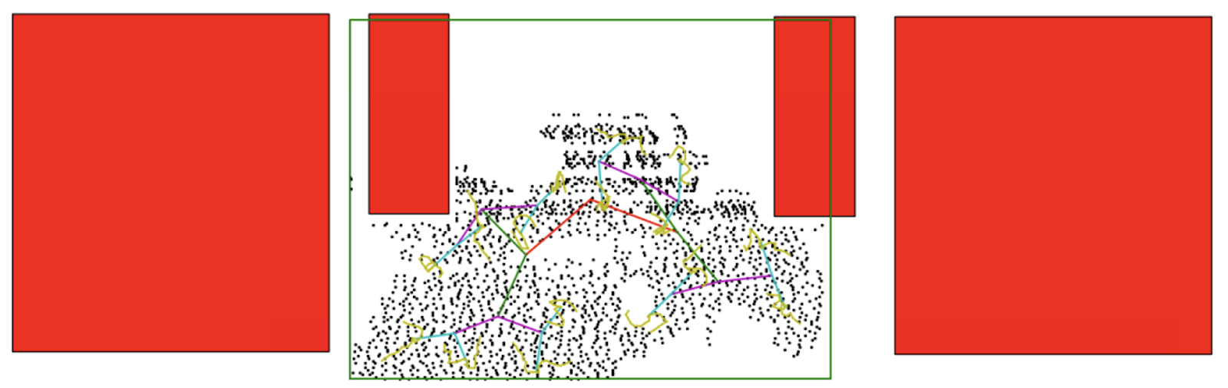
4. Clock Tree Synthesis
Motivation
OpenROAD
Open-source
Flow (RTL-GDS)
Analysis Tools
Placed .def
.cfg file, pre-char LUTs
(+ .sdc, .lef, .lib)
Evolved from GH-Tree [Han et al., TCAD18] Generalized H-Tree approach
All commercial tool dependencies in original implementation removed
One-time technology, library characterization uses OpenSTA
Sink clustering using capacitated k-means (ILP formulation removed)
Heuristic to handle segment length constraints and buffer placement
CTS
Post-CTS .v, .def (clock buffers legalized by RePlAce)
TCAD’18: Optimal Generalized H-Tree Topology and Buffering for High-Performance and Low-Power Clock Distribution
Clock tree for UM VanillaBean, 16FFC
Notes:
For those two Michigan examples, TritonCTS produces a topology with 174 clock buffers for VanillaBean in 11 seconds. For Coyote, TritonCTS process a topology with around 5000 clock buffers in 400 seconds.

Slide 17
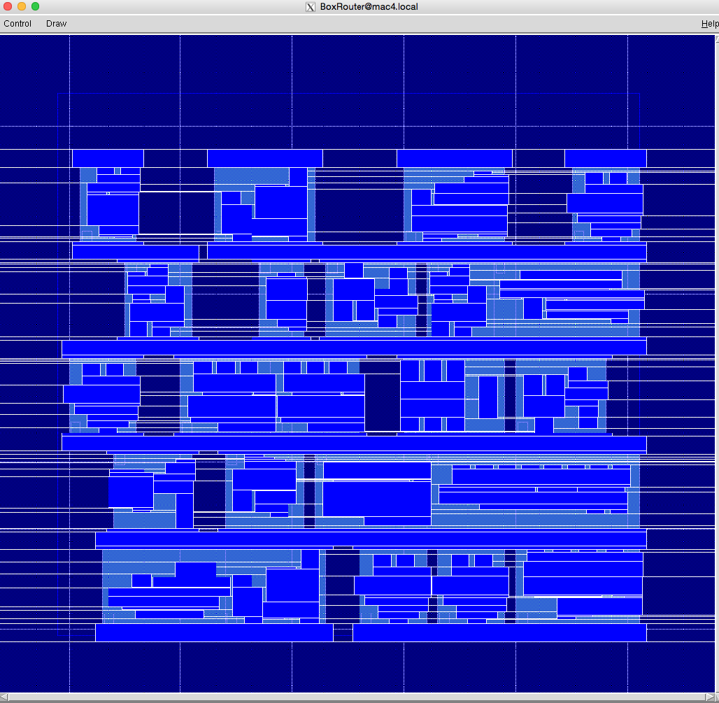
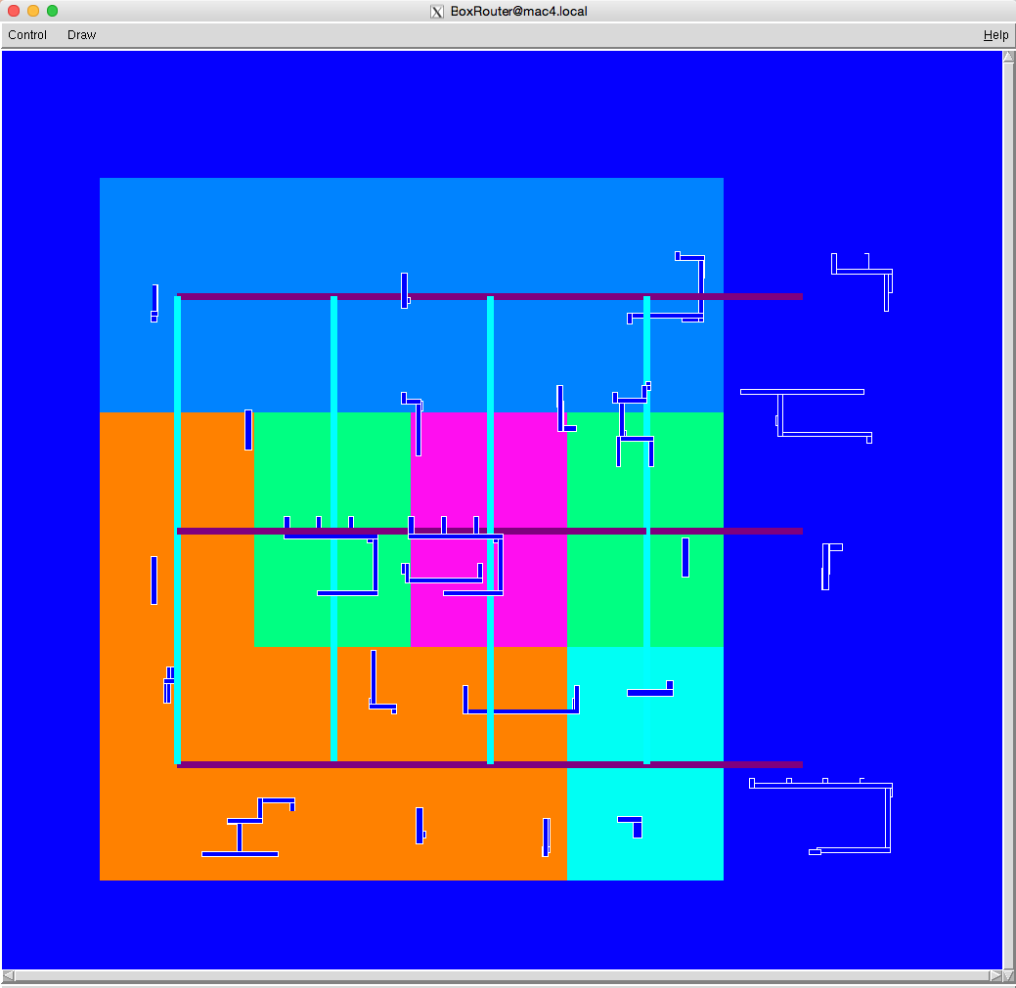
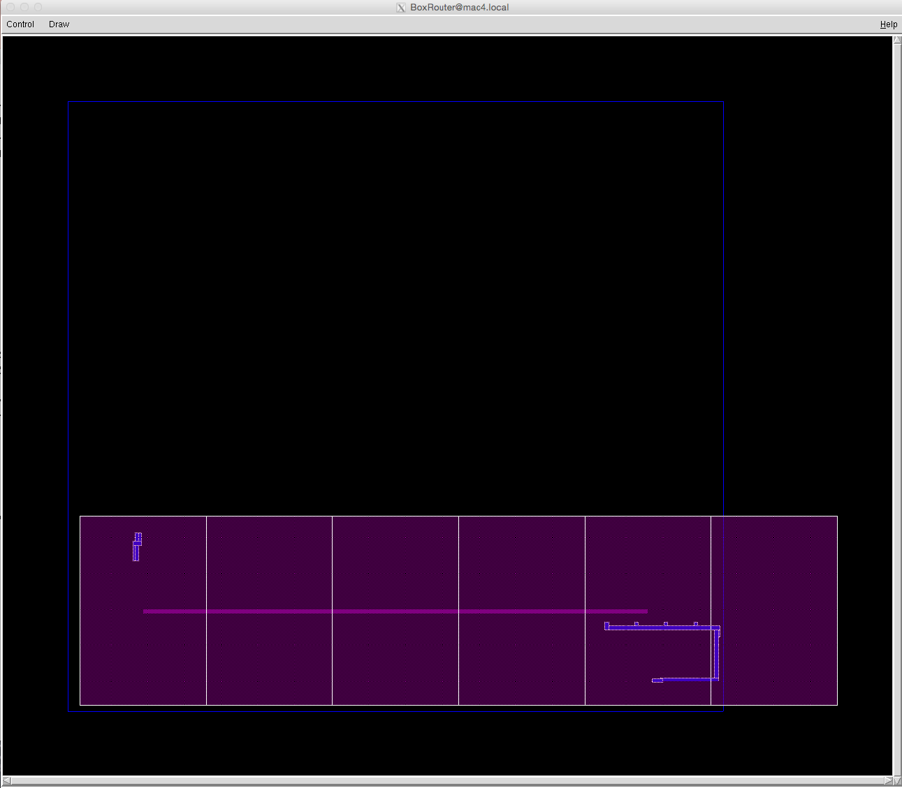
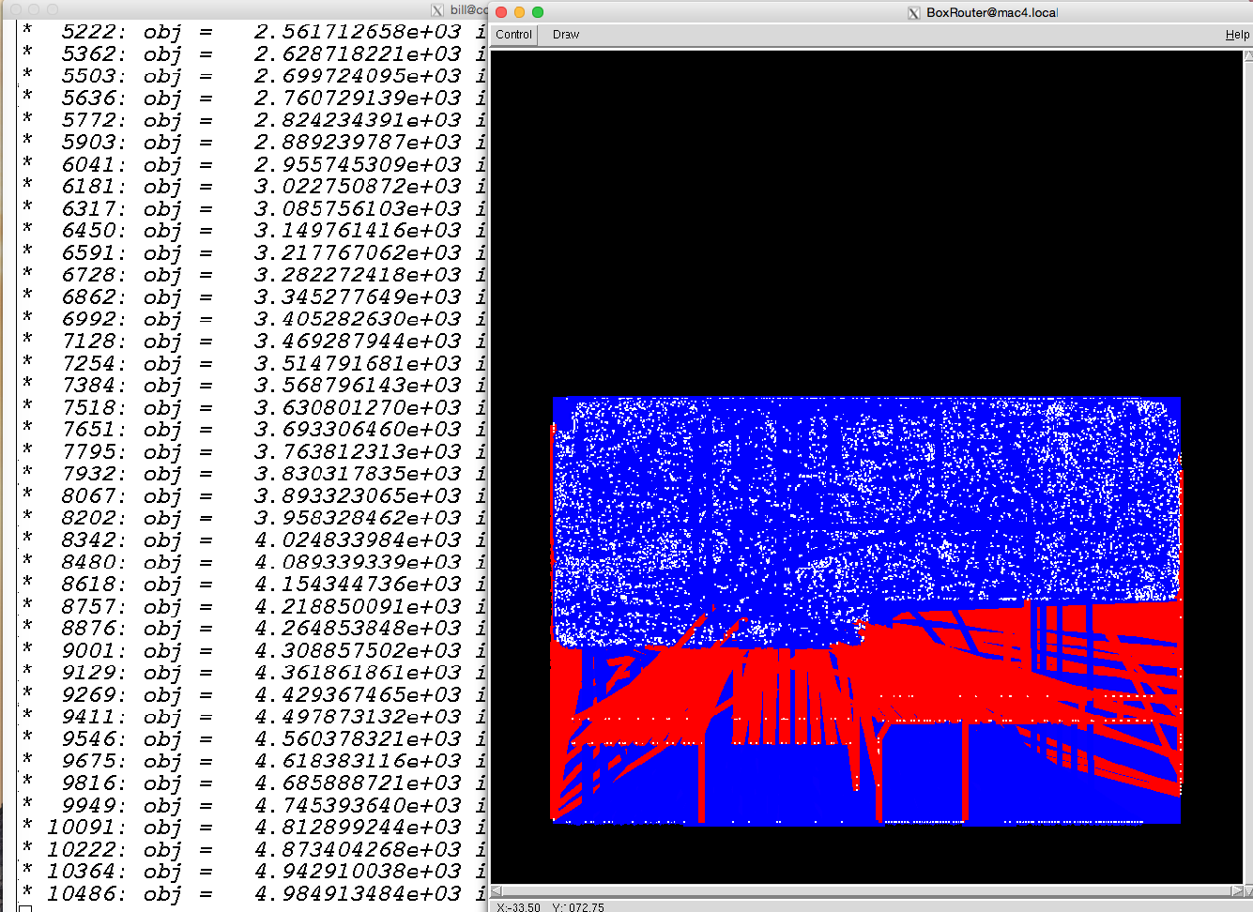
5. Global Routing
Motivation
OpenROAD
Open-source
Flow (RTL-GDS)
Analysis Tools
Adaption of BoxRouter 2.0 Cho et al. UT Austin
LP-based 3D Global Router (glpk)
GCELL model based
LEF/DEF input format
Detailed obstacle and pin support
Generates ISPD guide format
Placed .def
(+ .v, .sdc, .lef, .lib)
Global Routing
Observable Detailed Pin/Obstacle and GCELL Capacity Calculation
ISPD18 route guides
Built in Congestion Map Display
Tested on ISPD18, ISPD19 and tsmc65lp
Generation and Display of ISPD Route Guides
Routed .def
ICCAD’07: BoxRouter 2.0: Architecture and implementation of a hybrid and robust global router

Slide 18
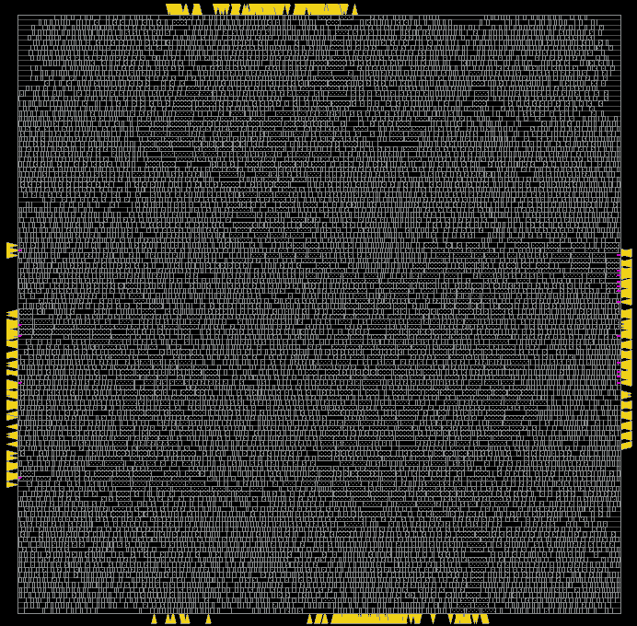
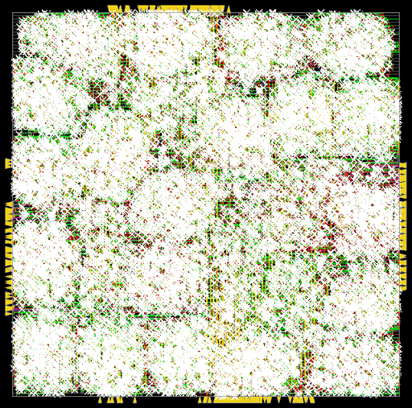
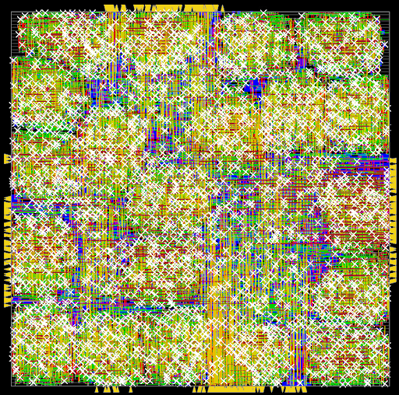
6. Detailed Routing
Motivation
OpenROAD
Open-source
Flow (RTL-GDS)
Analysis Tools
Evolved from ISPD18 Detailed Routing contest winner [Kahng et al., ICCAD18]
  Greedy approach (no ILP formulation) for track assignment
  LVS-clean initial detailed route at foundry nodes
  Violation removal accomplished with iterative search and repair (S&R)
Many foundational components added beyond “academic contest winner”
  DRC / quick DRC engines, pin access analysis, etc.
Example (~April 2019) with TSMC65 foundry node
  10K-instance design block with ~50% utilization
  Shown in figure: two S&R iterations reduce #violations from 50487 to 3487
Placed .def
+ ISPD18 route guides (+ .v, .sdc, .lef, .lib)
(Detailed) Routing
Routed .def
ICCAD’18: TritonRoute: An Initial Detailed Router for Advanced VLSI Technologies
Notes:
Routing is one of our toughest challenges. TritonRoute is a integer linear programing-based router. Currently, it starts with a global routing solution and performs track assignment considering major TSMC16 design rules.
In their ongoing effort, Lutong Wang and Bangqi Xu are working on local routing strategies and comprehending the remaining design rules in TSMC16.
They are also co-organizing with Mentor Graphics the ICCAD19 LEF/DEF Based Global Routing Contest.
This is part of our outreach to the community – in this case, there is an open-source bonus of up to 4X the default prize, available to each of the winning teams.

Slide 19
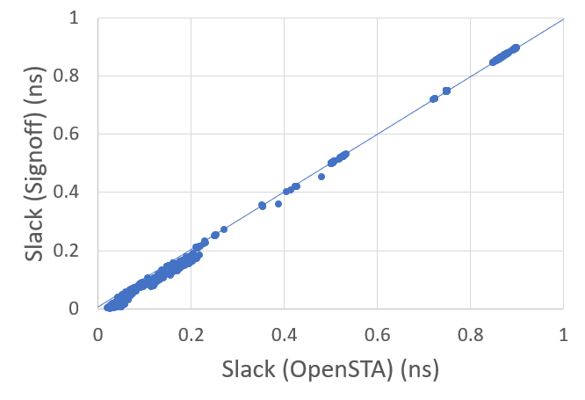
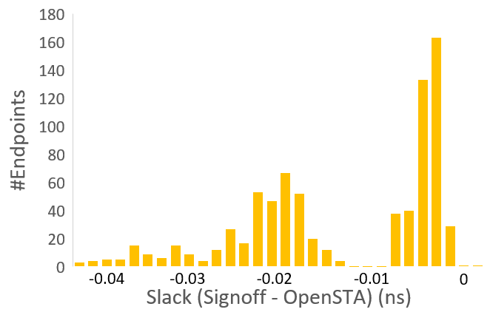
Analysis tools: 1. Static Timing Analysis
Motivation
OpenROAD
Open-source
Flow (RTL-GDS)
Analysis Tools
OpenSTA: open-sourced static timing analysis tool
  Developer: James Cherry (Parallax Software)
  Tested with ASAP7, GF14, TSMC16, ST28, etc.
  Integrated into several aspects of the tool
  GPLv3 license
aes_cipher_top (28nm, 12T, clkp=1000ps)
aes_cipher_top | WNS (ps) | TNS (ps) | #viol.
Signoff STA | -61 | -289 | 7
OpenSTA (arnoldi) | -57 | -314 | 9
https://github.com/abk-openroad/OpenSTA
Notes:
Our project’s OpenSTA release is an open-sourced version of the commercial Parallax timer. This is definitely one of OpenROAD’s highlights so far.
The developer, James Cherry, has added Arnoldi delay calculation, power reporting and other enhancements since the original release. This timer provides standard timing report styles and solid coverage of SDC constraint types.

Slide 20
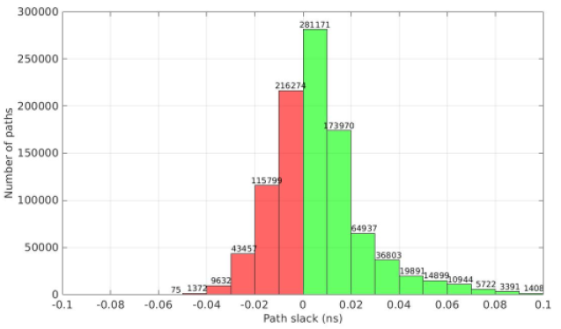
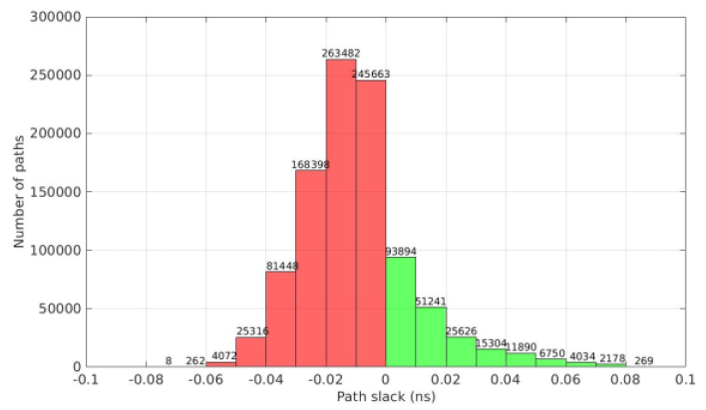
Analysis tools: 2. Parasitic Extraction
Motivation
OpenROAD
Open-source
Flow (RTL-GDS)
Analysis Tools
Results of comparing regression model SPEF with industry-tool SPEF on the AES design (CMP28 PDK)
Total R, C: Mean error = -3% (pessimistic)
Cell delay [all timing arcs] (CMP28): Mean error = -4% (pessimistic)
PEX is a callable function
Calling function
STA, FP, PL,
CTS, PSI
Design information
_{PDK}
_{Tech data}
_{Corners}
_{DEF format}
_{design.def}
Golden
PEX
INPUT
Path slack distribution
PEX model
Industrial tool
Regression Model
Number of paths
OUTPUT
_{SPEF format}
_{design.spef}
Path slack
Parasitic resistance/capacitance
Proprietary
Our
Model
Number of paths
Path slack

Slide 21
Conclusions
OpenROAD = digital layout, no-humans, 24-hours, open source
Open source (FOSS ecosystem, etc.) restores productivity and attractiveness of academic innovation
OpenRoad’s first year focus is developing the basic design flow using 65 nm
Second year will focus on database development, support of more advanced nodes, machine-learning driven optimizations, runtime improvements
Alpha release in late July 2019 (not available till then)
  https://github.com/The-OpenROAD-Project
  https://flow.theopenroadproject.org
Notes:
I say this with only the best of intentions for this field which has been so enjoyable for me for 30 years.

Slide 22
THANK YOU!
Open-Source Birds-of-a-Feather DAC meeting Wed 7pm N256
2nd WOSET co-located with ICCAD 2019
Notes:
To quote Andreas: Let’s get to work!
And on behalf of my OpenROAD teammates, thank you for your attention!

Slide 23
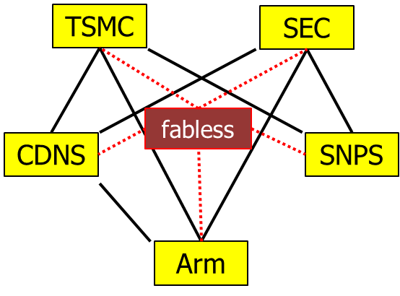
Why Open Source is Critical Now
Motivation
OpenROAD
Open-source
Flow (RTL-GDS)
Analysis Tools
Extreme consolidation: 2 fabs, 2 EDA companies, at most 3 standing in GPU, FPGA, Mobile SOC, …
Design technology is higher-value
Private-label EDA is inevitable
  One of few levers for differentiation
Foundry: protect IP leakage, roadmap better than current DTCO mechanisms
Fabless: protect key SOC methodology, design innovation that otherwise leaks to competitors
EDA: more useful research, in more usable forms
Academia: see previous slides (and, engage … or not)
Notes:
Personally, I feel that EVERYONE in this room should want to see OPEN-SOURCED EDA RESEARCH.
Why is this so critical?
Extreme consolidation.
Everyone fights intense wars with exactly the same weapons? (Fab processes, 3rd-party IPs, EDA tools…) → Everyone claims that “We will win because of our people and our culture” – WRONG.
Private-label EDA is inevitable, and this can REALLY benefit from open source glue and engines.
FOUNDRY:
FABLESS:
EDA: consumable, turnkey research results from academia
ACADEMIA: I’ve explained this, and from my past 20 years of open-sourcing, I do understand that people engage or not – it’s after all a personal thing. For my part, I believe it is the right path.

Slide 24
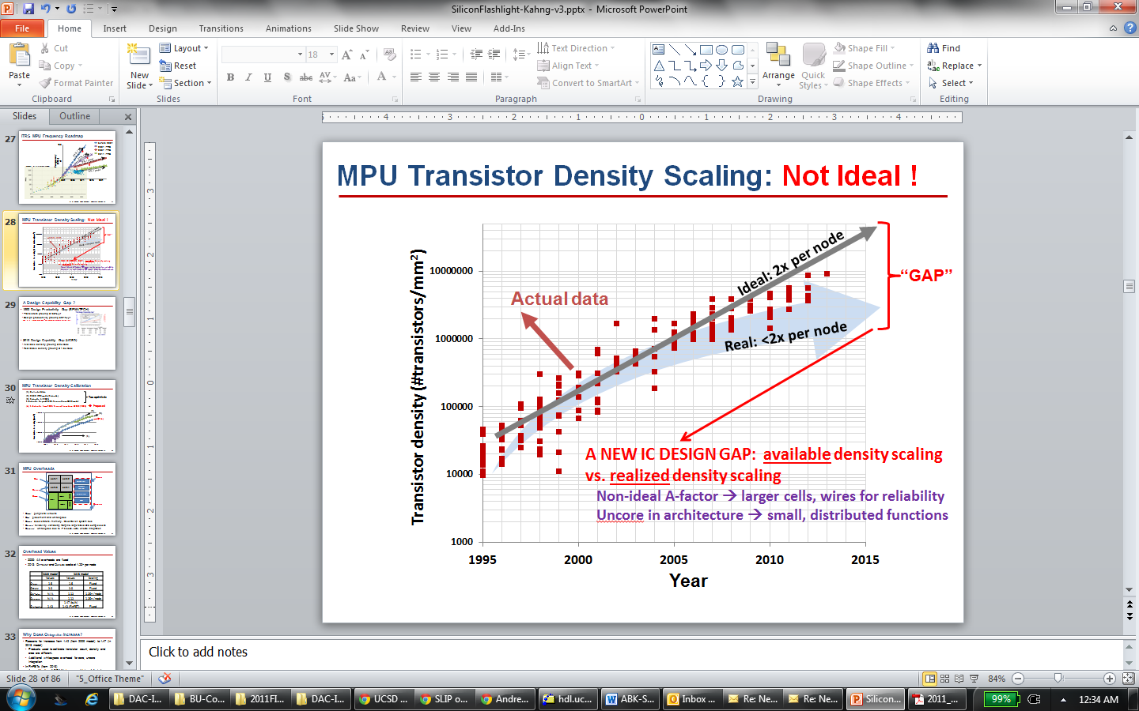
Design Crises: Cost, Expertise, Unpredictability
Motivation
OpenROAD
Open-source
Flow (RTL-GDS)
Analysis Tools
Design cost: not scaling
  Design, process roadmaps not coupled
Quality: also not scaling
  Available density: 2x/node
  Realizable density: 1.6x/node
  [Figure: Andreas Olofsson, DARPA, ISPD-2018 keynote]
  Figure: UCSD / 2013 ITRS
Notes:
When we talk about hardware today, we talk about the crises of hardware design: Cost, Expertise, Unpredictability
Design COST is engineers, licenses, schedule – AND RISK. This slide from Andreas a year ago tells us that wafer cost pretty much always ends up at a nickel or a dime per square millimeter in any process. But this curve at the right means that the cost of designing that square millimeter is out of control. This happens when nothing really ties design technology to Moore’s Law scaling itself.
{CLICK] Compounding this is non-scaling of QUALITY. With every new technology node, yes, you CAN print twice as many transistors in a square millimeter as before – which is AVAILABLE DENSITY … BUT, you CANNOT fit twice as many USEFUL transistors into a given area, going from node to node – and that’s REALIZABLE DENSITY. This DESIGN CAPABILITY GAP goes back well over a decade.

