Slide 1
“Unobserved Corner” Prediction: Reducing Timing Analysis Effort for Faster Design Convergence in Advanced-Node Design
Andrew B. Kahng^{+$}, Uday Mallappa$ and
Lawrence Saul⁺
UC San Diego $ECE & ⁺CSE Department
Notes:
Thank you for the introduction. My talk is on “Reducing Timing Analysis Effort for Faster Design Convergence in Advanced-Node IC Design, with our “Unobserved corner prediction”.

Slide 2
Outline
Introduction
Motivation
Modeling Methodology
Experiments
Conclusions
Notes:
In this presentation, I will first start with an introduction to static timing analysis and explain our motivation. Then, I will describe our modeling methodology.
I will then show the experimental results and conclude my talk

Slide 3
Introduction: Static Timing Analysis Today
Multi-corner multi-mode timing scenarios
Needed in every iteration of place, route and optimization
Expensive loops and overdesign in the flow
Substantial resources spent on timing analysis
Tool runtime, compute and license resource across multiple process, voltage and temperature (PVT) corners
All else being equal, design teams would like to always have accurate analyses at all signoff corners
Notes:
[Click] In advanced nodes, EDA tools and flows are confronted with many modes and many corners
[Click] To avoid expensive loops in the physical design flow, timing analysis is evaluated multiple times in a design cycle
and thus constitutes for a significant portion of design convergence time.
[Click] Substantial amount of compute, license and runtime resources are spent on timing analysis across multi-corner multi-modes
[Click] All else being equal, designers would like to analyze timing at all corners, for each iteration in the physical design flow

Slide 4
Motivation: Corner Explosion
Voltages: V1, V2, V3, V4 (operating modes)
4
×
FE corners: FF, FFG, FS, SF, TT, SSG, SS
6
×
BE corners: RC-worst, Cc-worst, RC-best
3
×
Temp corners: nominal, inversion, electro-migration
3
252 CORNERS → Costly
Notes:
Next few slides explain our motivation to solve the problem of corner prediction.
What is a timing corner? A timing corner is a specific timing model for a combination of Process, Voltage, Temperature and extraction conditions that a chip needs to analyzed at.
So, how many corners?
[Click] If we make a simple calculation in sub-16nm enablement, we have at least 4 voltages to support various operating modes such as
Nominal, svs, turbo and super turbo modes.
[Click] Also, timing analysis needs to be performed at few process corners such as listed here
[Click] In addition, there would be couple of parasitic extraction corners and
[Click] temperature values.
[Click] Any combination of these operating conditions is a valid corner.
[Click] This makes it about 250+ corners. This is a huge investment in runtime, resources, and licenses for every iteration that needs “update timing”

Slide 5
Motivation: Corner Reduction is not EASY
Lack of clear methodology to determine safe subset of corners
Safe conditions are
dependent on cell and wire delay contributions → path-specific
dependent on clock skew → endpoint-specific
Accuracy of existing methods in advanced nodes
Notes:
[Click] Can we reduce the number of corners and what does it take to do this ? The answer is “It is not easy”
[Click] There is no canonical methodology of determining the best subset of analyzed corners or safe corners that ensure timing correctness at other corners.
If such subset exists, we call such corner-subset as “safe conditions”
[Click] It turns out that the safe conditions are path-specific. Meaning the safe conditions are dependent on the cell/wire delay contributions.
Also, with clock-skew, these safe conditions are endpoint-specific as well.
[Click] Because the signoff corners are defined early in the design flow, with very little design specific timing information (e.g., timing paths, clock skew, etc.) and also lack of cell libraries.
,existing methods suffer from inaccuracies in advanced nodes.

Slide 6
Motivation: Runtime Vs. Overdesign
Runtime savings
(primary corners)
Seesaw Effect (runtime vs. overdesign)
Overdesign
Masks real violations
Add margins
Signoff with excessive margin wipes out potential gain from new technology
Notes:
[Click] Even though corner reduction is not easy, as shown in the top-left figure, designers practically can analyze timing at only a small number of corners during most of the design steps leading up to ﬁnal signoff. This potentially masks many real violations
[Click] To reduce the risk of masking real violations that are realized only in ﬁnal timing signoff runs, designers add ﬂat timing margins such as increase the target clock period.
This results in overdesigning and
[Click] As seen in the figure on the right (with performance on y-axis and technology scaling on x-axis), ROI for worst-case scenario is getting less.
With excessive margin, the potential benefit from moving to a new technology is wiped out.

Slide 7
Motivation: Previous Work
Subset-corner determination
Onaissi DAC11: Minimum set of dominant corners
Silva DATE07: Branch-and-bound methodology to identify a single corner
Onaissi TCAD08: “Cornerless” approach that uses a single run of STA
Learning-based methods for STA
TAU Workshop: STA accuracy and runtime
Stamoulis ICECS14: Regression techniques for analysis of transistor variability
Bian DAC17: Learning-based STA for on-chip variations
Kahng SLIP13: Learning-based approximation of interconnect delay and slew
Our work: Learning-based techniques for subset-corner determination and “unobserved” corner prediction
We need a “corner-prediction” methodology that is accurate and not runtime intensive
Notes:
[Click] Previous works include subset determination techniques and
[Click] learning-based techniques that predict STA outcomes for a given corner.
However, there is no clear methodology of determining the best subset of analyzed corners or safe corners that ensure timing correctness at other corners,
[Click] So, we need a corner reduction methodology that addresses the accuracy concerns in existing methods, avoids overdesign and non runtime intensive.
[Click] So, in our work, we use learning-based techniques to determine the best subset of corners that can help in reconstructing timing results at other corners.

Slide 8
Motivation: Corner Prediction as a learning problem
n columns
(N-n) columns
Columns represent corners
X_{train}
Y_{train}
R_{train}
X_{test}
Y_{test}
Many of the columns of this matrix are nearly linearly dependent
R_{test}
Rows represent path delays
Notes:
This slide motivates us to think of corner prediction as a learning problem.
[Click] If we view timing results as elements in a large matrix whose rows represent timing paths and whose columns represent corners.
We observe that many of the columns of this matrix are linearly dependent.
[Click] We can view the entire top portion of the matrix as the training data that is used to train our learning model.
We represent Xtrain and Ytrain to denote timing results for known corners and unknown corners
[Click] we use Xtest and Ytest to denote the matrix blocks of known and unknown corners.
A trained predictive model is used to infer the unknown elements in the bottom test matrix.

Slide 9
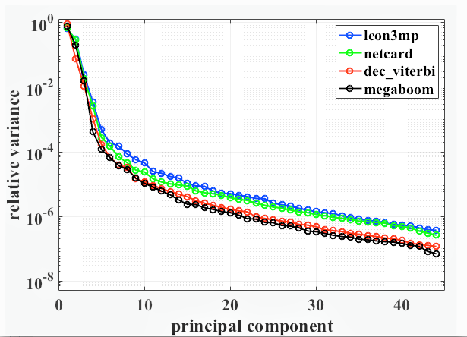
Motivation: Corner Prediction as a learning problem
Main support of the corner-distribution is concentrated in a low dimensional subspace
Notes:
Our overall approach is based on the premise that the path delay values at different analysis corners are strongly correlated. Intuitively, such correlations are a consequence of the underlying physics of devices, interconnects, and signal delay propagation along timing paths. Though it may be difﬁcult to model the detailed physics that produce these correlations, we can measure and exploit these correlations to predict large numbers of unknown path delay values from smaller numbers of known ones.
[Click] If we imagine the path delay values at different analysis corners as the coordinates of points in a high-dimensional space, this figure shows that the main support of these distributions is heavily concentrated in a much lower dimensional subspace

Slide 10
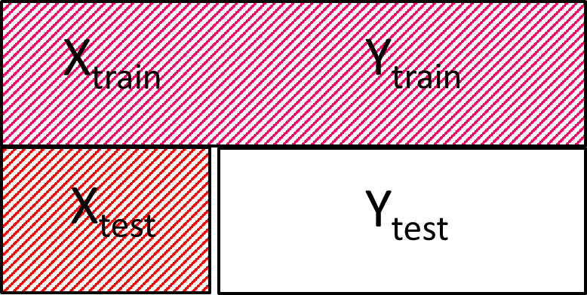
Modeling Methodology: Model Definition
Step 1: Subset Corner-Selection
Greedy Deletion to choose best “n” corners
Step 2: Model Training
Use $\left\{X_{train}\right\}\begin{matrix}n \\ 1\end{matrix}$ , $\left\{Y_{train}\right\}\begin{matrix}N \\ n\end{matrix}$ to train the model
$W\begin{matrix}∗ \\ \end{matrix}= \begin{matrix}argmin \\ W\end{matrix}\text{ || }\text{Y}\begin{matrix} \\ train\end{matrix} \text{ – } \text{X}\begin{matrix} \\ train\end{matrix}\text{ ∗ }\text{W} \text{||}\begin{matrix}2 \\ 2\end{matrix}$
Step 3: Model Inference
Use $\left\{X_{test}\right\}\begin{matrix}n \\ 1\end{matrix}$ to predict $\left\{Y_{test}\right\}\begin{matrix}N \\ n\end{matrix}$
$$Y\begin{matrix} \\ test\end{matrix}=\text{X}\begin{matrix} \\ test\end{matrix}\text{ ∗ }\text{W}\begin{matrix}∗ \\ \end{matrix}$$
Model Weights
Notes:
Our modeling is a three-phase procedure.
[Click] Let us refer to the same matrix again, from previous slides
[Click] The very first task is to find the best subset of corners that predict rest of the unobserved corners. We call this phase as subset collection.
To avoid exhaustive search, we use greedy backward elimination strategy to determine the subset. We start with a full set of corners, and greedily delete each corner that has little impact
with its deletion.
[Click] For the training phase, we require timing analysis at all corners, in order to learn this corner correlation.
Once the subset is determined, the training phase ﬁnds model parameters, minimizing the mean squared error of predictions of unobserved corners from known corners. This is a one-time training investment.
[Click] For model inference, we use the corresponding trained model parameters to predict timing at unobserved corners from observed corners, on any unseen test data.
This might surprise many of you, as we did not discuss anything about model features. The only feature is timing delay.
Or premise is that if a timing path has particular correlation across corners, any other path, with similar delay values across the known corners
Can be reconstructed to its high dimensional space just as its neighbor in the training dataset.

Slide 11
Modeling Methodology: Model Flow
Training
Testing
Real + Artificial circuits
(“N” analyzed corners) `
Unseen Real implementation
(“n” analyzed corners)
Greedy Deletion for subset-corners (n)
Model Training
(n, N-n, W*)
Model Training
(n, N-n, W*)
Model Results
(N-n predicted corners)
Outliers
Notes:
Our modeling flow has training and test phase.
[Click] As explained in the previous slide, training phase entails subset determination and model training.
[Click] The trained model is then used to infer timing results on any unseen design implementation from few known corners.
[Click] We also propose a model calibration step that aims to learn from outlier mispredictions, after every few iterations of model inference.

Slide 12
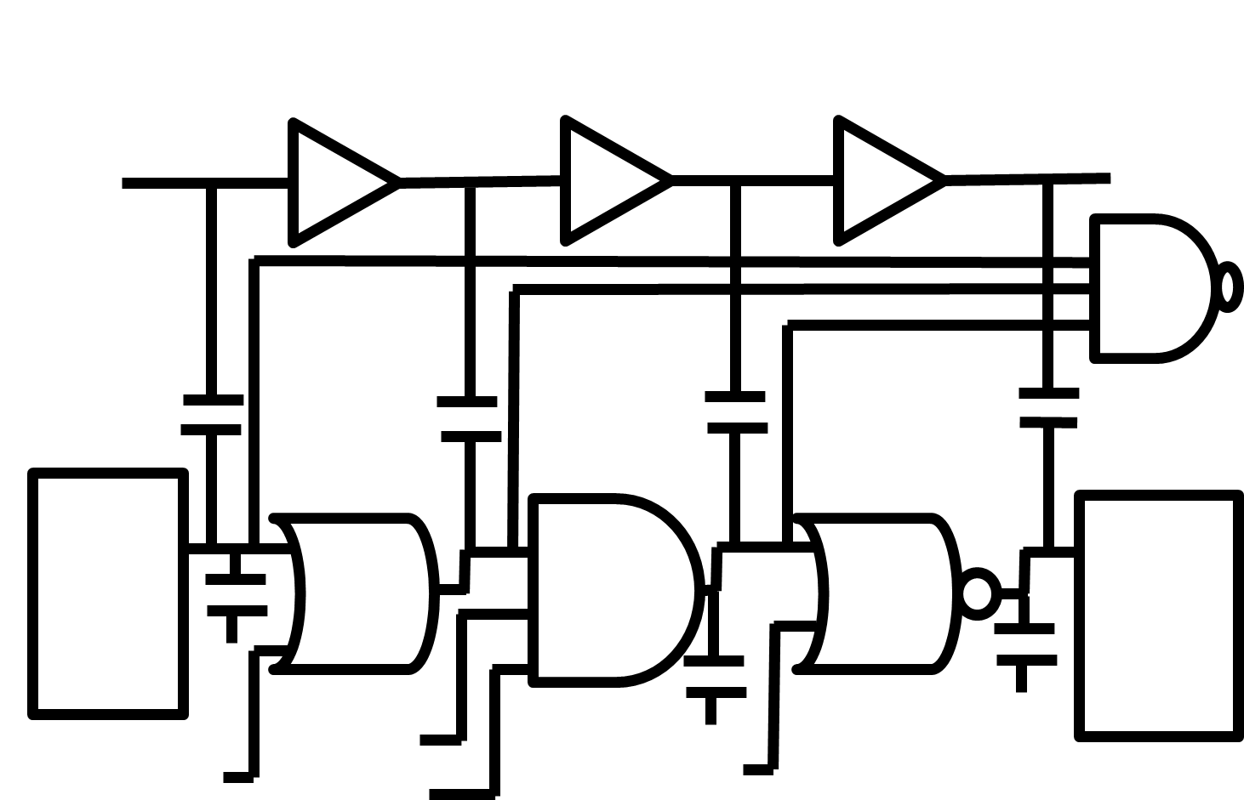
Modeling Methodology: Data Generation
Artificial circuits: Benefit during an initial, “bootstrap” training phase of modeling
Data generated by sweeping 11 circuit parameters
Matrix Generation Flow:
From the timing graph, obtain a matrix in which rows represent path delay values and columns represent corners
1 | 2 | 3 | 4 | 5 | 6 | … | N-2 | N-1 | N
… | … | 0.434 | 0.733 | 0.707 | 0.564 | 0.578 | 0.521 | … | …
… | … | 0.373 | 0.715 | 0.685 | 0.557 | 0.561 | 0.526 | … | …
… | … | 0.350 | 0.657 | 0.634 | 0.507 | 0.572 | 0.495 | … | …
… | … | … | … | … | … | … | … | … | …
Test matrix has “n” complete columns and “N-n” missing columns
Notes:
Now, I summarize my data generation flow.
[Click]: We evaluate the potential benefit of using artificial circuits during an initial bootstrap training phase of modeling.
These circuits are a collection of diverse timing paths, that aim to span a wide range of electrical and physical attributes of a timing path.
[Click]: Input to such a flow is a configuration file that contains 11 circuit variables such as number of stages in a timing path, cell types in the timing path, coupling effects,
A range of transition values at input of each cell, and a range of load at output load, for each cell output.
[Click]: The figure on the right illustrates one such artificial timing path
[Click]: Once we have design data for training, we convert the timing results into a equivalent matrix in which rows represent delay values of timing paths and columns represent corners.
[Click]: The table here shows one such example of a matrix that will be input to our model training.
[Click]: Equivalently, the test matrix is an incomplete matrix, with few columns completely filled and rest of the columns unobserved.
As discussed earlier, our objective is to predict these unknown columns of test matrix with little error

Slide 13
Experimental Setup
Testcases | #Instances
dec_viterbi, | 61K
netcard, | 303K
leon3mp, | 450K
megaboom, | 990K
prod1,2,3 (industry) | --------
Synthesis: Synopsys Design Compiler L-2016.03-SP4
P&R: Cadence Innovus Implementation System v16.2
STA: Synopsys PrimeTime
Python 2.7 and Scikit v0.20.3 libraries
Enablement: 28nm FDSOI, sub-16nm
Process (SS, TT, FF), Voltage (0.6 to 1.3 V in steps of 0.05), Temperature (-40C and 125C) and BEOL (RC-worst) corners
All experiments are performed with a single thread on a 2.6GHz Intel Xeon server
Notes:
[Click]: For all our experiments, we use Synopsys design compiler for synthesis, Cadence Innovus for Placement & Routing and Synopsys PrimeTime for STA.
[Click]: we implement our code in python and use Scikit libraries
[Click]: we use 28nm FDSOI and sub-16nm foundry enablements, for our model evaluations.
The space of analysis corners for our experiments is a set of combinations of Process, Voltage, Temperature and BEOL corners.
[Click]: Four public benchmark designs used for our model evaluation are listed in the table.
In addition, we also use three industrial designs in sub-14nm enablement, for which we have limited insight into.
[Click]: All experiments are performed with a single thread on a 2.6GHz Intel Xeon server

Slide 14
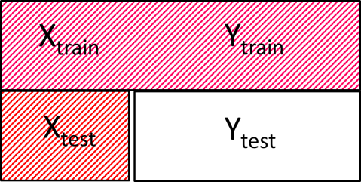
Reporting Metrics
$ε\begin{matrix}ij \\ rel\end{matrix}$ $=\frac{Absolute error of element in row i, column j of Y\begin{matrix} \\ test\end{matrix}}{Actual delay of element in row i, column j of Y\begin{matrix} \\ test\end{matrix}}$
Error Metric | Definition | Description
$$ε\begin{matrix} \\ mse\end{matrix}$$ | $\sqrt{\frac{\sum{\begin{matrix} \\ \\ ij\end{matrix} (ε\begin{matrix}ij \\ rel\end{matrix})\begin{matrix}2 \\ \end{matrix}}}{R\begin{matrix} \\ test\end{matrix}}}$ | Root of mean squared relative errors
$$ε\begin{matrix} \\ 99p\end{matrix}$$ | 99th percentile value of {$ε\begin{matrix}ij \\ rel\end{matrix}$} when sorted in ascending order | 99% datapoints have relative error value less than this value
$$ε\begin{matrix} \\ 99p99\end{matrix}$$ | 99.99th percentile value of {$ε\begin{matrix}ij \\ rel\end{matrix}$} when sorted in ascending order | 99.99% datapoints have relative error value less than this value
Notes:
In our model, objective function minimizes the square of absolute mispredictions. However, we understand from industry collaborators that relative delay prediction error is a valuable criterion.
Intuitively, a timing path with larger path delay value can afford larger misprediction, compared to a timing path with smaller path delay.
With this in mind, we report relative errors.
[Click]: Let us look at the matrix representation of our timing results.
[Click]: We use epsilon relative ij to represent relative error of an element in row i and column j of Ytest
[Click]: To quantify the model accuracy for the entire Ytest region of the matrix using a single value, we report three metrics, namely, mean, 99thpercentile and 99.99thpercentile values denoted by epsilon mse, epsilon 99p and epsilon 99p99
This table describes the definition of each metric.
To summarize, Mse is root mean squared error that signifies our mean accuracy metric.
To corroborate our model accuracy, we use 99p99 metric, which indicates that 99.99% of datapoints are bounded within this error value.
I would like to draw your attention to the colors of these three metrics. All our plots same color coding throughout.

Slide 15
Summary of Experiments
Data Path Delay Model
Post-routed data-path arrival time prediction
Artiﬁcial Testcases
Design-independent model
Clock Path Delay Model
Clock network synthesis and optimization
Corner Scalability
Increased number of corners
5,6. Technology Independence
Advanced (sub-16nm) foundry enablements
Notes:
In our experiments, we use in-house developed artificial circuits and real designs as described in the previous slide.
We perform five major experiments to demonstrate model usefulness.
[Click]: In experiment 1, the model is trained with datapoints from post-routed implementation of a real design and tested on an unseen post-routed implementation.
[Click]: In experiment 2, we assess the benefit of our artificial testcase generation methodology.
Our model is trained with artiﬁcial testcases and tested on unseen real designs. Thus, a onetime trained model using artiﬁcial circuits can predict timing analysis in unknown corners of any real design.
[Click]: The goal of experiment 3 is to demonstrate the usefulness of our model in predicting clock insertion delay at unknown corners using clock insertion delay at known corners. This ensures that the clock network is synthesized considering its delay values at all timing corners, without overdesigning the clock tree
[Click]: Fourth experiment extends our corner prediction to higher number of analysis corner. The goal is to check if increasing the total number of corners would demand for increased number of known corners, to attain a certain accuracy value.
[Click]: Last experiment seeks to conﬁrm the utility of our modeling in more advanced foundry enablements.

Slide 16
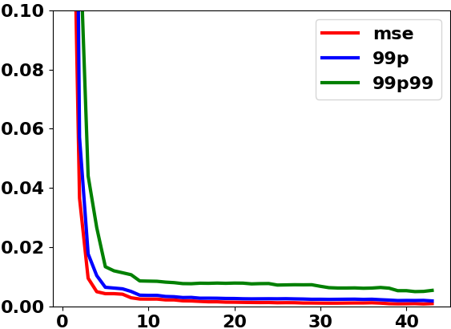
Results: Data Path Delay Model (Expt 1)
megaboom (990K instances, 350K FF)
Error
# Known Corners
Notes:
We report our results for all of previously mentioned real designs.
[Click]: Here, we show the results for our data path delay model, tested on megaboom design, with nearly 1M instances and 350K flipflops
[Click]: We plot error metrics on y-axis and
number of known corners, increasing from 1 to total analysis corners, on x-axis.
[Click]: These error metrics include relative mean squared error in red, 99 percentile metric in blue and 99p99 percentile metric in green.
Again, to recap, 99p99 metric indicates that 99.99% of datapoints are bounded within this error value.
In general, we expect that error metric decreases monotonically as more corners are included in the known set.
The plots clearly indicate that few known corners can accurately reconstruct high-dimensional timing delay values.
For example, in data path delay model, we see that model predictions are within 0.5% relative mean error, when
we use just “4” carefully chosen corners. In addition, 99p of the predictions are within 1% relative error.

Slide 17
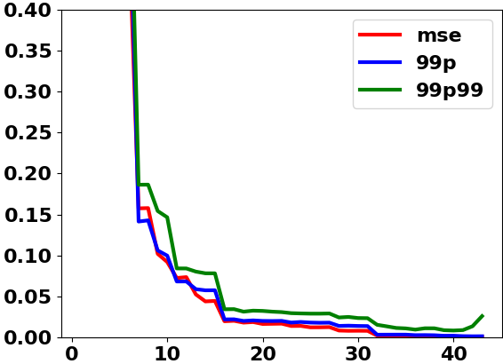
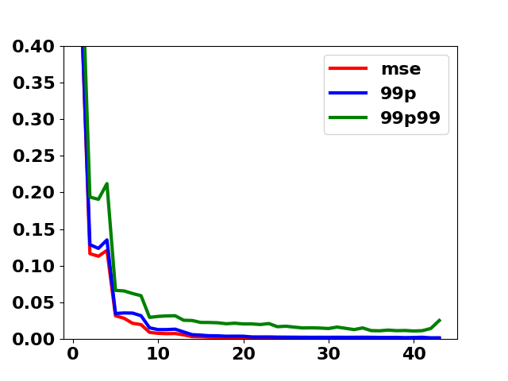
Results: Design-Independent Model (Expt 2)
megaboom (990K instances, 350K FF)
Trained using initial artificial testcases
Trained using richer artificial testcases
Error
10X improvement !!
# Known Corners
Notes:
[Click]: To demonstrate the use of our artificial circuits in training phase, we show the results of our predictive model on the megaboom example
[Click]:The plot on the left shows error metric with our original artificial circuit methodology. You can find the results of this experiment under experiment 2
[Click]: When we increase standard cell combinations in a timing path (from 36 cell types to 144 cell types for every third cell, when we traverse from launch to capture flop in the timing path)
Accuracy metrics improve by 10X. This can be seen on the plots in the right.
[Click]:As evident from the plot, accuracy improves with our latest artificial circuits.
The reason being, improvement of our artificial circuits methodology to span wider electrical and physical attributes of a timing path.
To elaborate, with a value of “n=9 achieves a mean relative error of 0.01% or rmse of less than 1% relative error.
Earlier, for n=9, this value was about 0.10 meaning 10% relative error.
This is a 10X improvement.

Slide 18
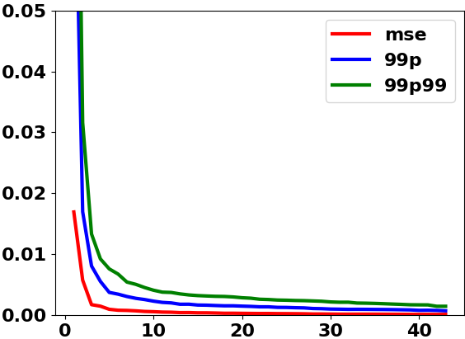
Results: Clock Path Delay Model (Expt 3)
megaboom (990K instances, 350K FF)
Error
# Known Corners
Notes:
Here, we show our results for our clock path delay model.
[Click]: The plot again is for the megaboom example.
The plots clearly indicate that few known corners can accurately reconstruct high-dimensional timing delay values, even for the clock path delay estimation

Slide 19
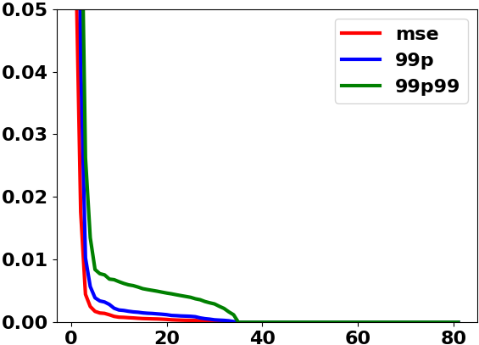
Results: Corner Scalability (Expt 4)
megaboom (990K instances, 350K FF)
Error
# Known Corners
Notes:
[Click]:Here, we show the results for Megaboom example when we increase the number of analyzed corners from 48 to 82
[Click]:Again, we see that the main support of these timing delay distributions is concentrated in a much smaller low-dimensional subspace.
These results suggest that a small number of known analysis corners can accurately predict timing analyses at unknown corners, even as number of corners grows large.

Slide 20
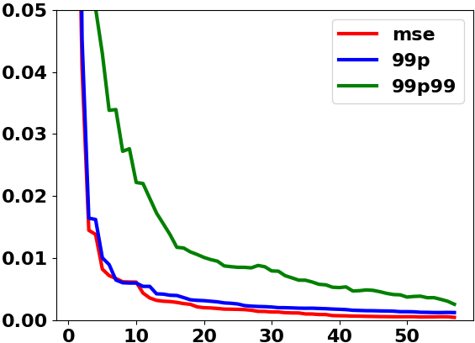
Results: Advanced Nodes (Expt 5)
megaboom (990K instances, 350K FF)
Error
# Known Corners
Notes:
[Click]: To demonstrate the use of our model in advance nodes, we evaluate our model in sub-16nm foundry enablements
[Click]: The plot shown here is for sub-16nm experiments
[Click] In addition to experiment 5, you can find results for experiment 6 in Fig 6 of our paper, where we show results in sub-14nm foundry enablement
[Click] Though the main support of these timing delay distributions are still concentrated in a low-dimensional subspace.
there is a scope for improvement.

Slide 21
Results: RMSE (Experiments 1 – 6)
Design | #Instances | Expt 1 (n = 4) | Expt 2 (n = 4) | Expt 3 (n = 4) | Expt 4 (n = 4) | Expt 5 (n = 4)
dec_viterbi | 61K | 0.003 | 0.016 | 0.0006 | 0.0036 | 0.002
netcard | 303K | 0.003 | 0.027 | 0.0008 | 0.0046 | 0.004
leon3mp | 450K | 0.004 | 0.024 | 0.0010 | 0.0047 | 0.003
megaboom | 990K | 0.005 | 0.044 | 0.0015 | 0.0025 | 0.013
Design | Expt 6 (n = 8)
prod1 | 0.0036
prod2 | 0.0018
prod3 | 0.0069
Notes:
[Click]:The table here summarizes our experimental results for various designs (both public benchmark and industry designs).
We tabulate relative mean squared error values for various designs. Other metrics can be found in the paper.
To recap, an error metric of 0.003 means that the mean relative error is 0.3% as compared to path delay value of timing path.
[Click]: As seen, in red, there is still a scope for improvement for artificial circuit-based experiments.
[Click]: We also show results for designs from our industry collaborator. Outliers in industrial designs can be attributed to lack of data, both in terms of rows and columns.

Slide 22
Outliers: Root-Cause Analysis
Data points that fail to be accurately reconstructed to their high-dimensional space
Rare path types with limited training examples
Isolated corners
Design methodology teams consider that effects of a few mispredictions are insigniﬁcant relative to
Design convergence beneﬁts from a predictive model
Analysis inaccuracies in current methods
Notes:
[Click]: In each of our experiments, we see a handful of data points that fail to be reconstructed to their high-dimensional space accurately, even with many known corners.
We understand that outliers are due to
existence of rare path types (e.g., memory as opposed to reg-to-reg) (limited rows)
existence of isolated corners (limited columns)
[Click]: While root-cause analysis and improvement of outlier predictions is an important direction for our future work,
Our industry collaborators feel that the effect of a few mispredictions is insigniﬁcant relative to
(i) the analysis improvement and design convergence beneﬁts from our predictive model, and
(ii) analysis inaccuracies that exist in current methods

Slide 23
Conclusion
We propose a learning-based model to predict STA results at unobserved corners, using a small subset of observed corners
With a 1M instance design in 16nm, our model uses 10 corners to predict timing results of 48 unobserved corners with $ε\begin{matrix} \\ mse\end{matrix}$ of 0.5% and $ε\begin{matrix} \\ 99p\end{matrix}$ of 0.6%
We propose clear design of experiments and explore various use cases of our model
We evaluate the potential benefit of our artificial circuits during initial “bootstrap” training phase of modeling
Our one time trained design-agnostic model is an important use case of our predictive model
Notes:
[Click]: In summary, we have shown that simple multivariate linear regression-based model can accurately predict a large set of unknown corners from a smaller set of known ones.
[Click]: For example, with a 1M instance example in 16nm enablement, we obtain a model based on 10 observed corners that
predicts timing results at the remaining 48 unobserved corners with less than 0.5% relative root mean squared error, and 99th
percentile relative prediction error less than 0.6%.
[Click]: We propose a clear design of experiments and explore various usecases of our learning model.
[Click]: With our in-house developed artificial circuits, we evaluate the benefit of these circuits during initial bootstrap training phase of modeling
[Click] Our design independent model using these artificial circuits is an important use case of our predictive model

Slide 24
Future Goals
With large data sets, explore statistical models that do not make strong assumptions of linearity
To handle outliers, it is possible to optimize more robust criteria in our statistical ﬁts
Improvement of our artificial circuit generation methodology
Extend this learning-based model for timing and leakage optimization
Notes:
[Click]: A number of ongoing and future works remain.
[Click]: With large data sets, it is possible to learn more ﬂexible statistical models that do not make strong assumptions of linearity.
[Click]: Also, to handle outliers, it is possible to optimize more robust criteria in our statistical ﬁts. So far these approaches have yielded incremental
beneﬁts, but it remains to ﬁnd the optimal combination of such strategies
[Click]: We are seeking to improve our artificial circuits that can span much wider space of real designs.
[Click]: To demonstrate the benefit from reducing overdesign with little impact to runtime, we are seeking to integrate our predictive models with an academic sizer and optimizer.

Slide 25
Thank You !
Uday Mallappa / UC San Diego
Notes:
We thank Dr. Tuck-Boon Chan and Dr. Jiajia Li for their valuable guidance, and we thank our lab’s funding sources.
Thank you for the attention and questions please !!!

