Slide 1
Detailed Placement for IR Drop Mitigation by Power Staple Insertion in Sub-10nm VLSI
Sun ik Heo†, Andrew B. Kahng‡, Minsoo Kim‡, Lutong Wang‡ and Chutong Yang‡ ‡UC San Diego, †Samsung Electronics Co., Ltd.
Notes:
Good afternoon. I am Minsoo Kim from UC San Diego.
The title of my presentation is Detailed Placement for IR Drop Mitigation by Power Staple Insertion in Sub-10nm VLSI.
This work is in collaboration with Samsung.

Slide 2
Outline
Motivation
Our Approach
Single-Row Optimization
Double-Row Optimization
Experiments
Conclusion
Notes:
In this presentation, I will first explain motivation of our work, and describe our dynamic programming-based algorithm for single-row and double-row detailed placement.
Then, I will show the experimental results and conclude my talk.

Slide 3
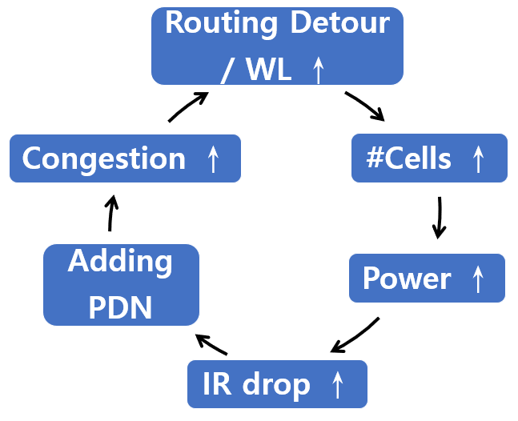
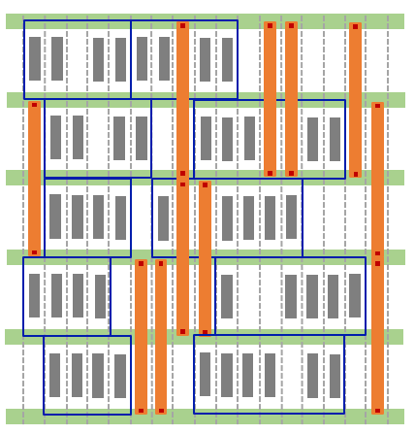
Motivation
Back-end-of-line (BEOL) resistance has increased dramatically in sub-10nm VLSI
Vicious cycle caused by high resistance
Power staples are short pieces of wires and vias that connect two or more adjacent (i.e., consecutive) VDD or VSS rails to mitigate IR drop
VDD
VSS
M2 rail
V1
VDD
M1
VSS
M1 pin/blockage
Cell boundary
VDD
Placement grid
VSS
Notes:
In advanced technologies, resistance of BEOL has increased dramatically, and [click] it causes a vicious cycle in VLSI design.
The added resistance increases wire delay and requires additional buffers to meet timing requirements.
This increases power consumption and leads to greater IR drop, requiring a denser PDN layout – which causes more congestion/wirelength, #cells again.
[click] Power staples are short pieces of wires and vias that connect two or more adjacent power rails to mitigate the IR drop. It can connect two rails in the same layer or different layers.
[click] This figure shows an example design with power staples. Metal 1 and via 1 are used for power staples and metal 2 is used to power rails in this work.

Slide 4
Challenges and Our Work
Two basic types of power staple insertion
Pre-placement: with fixed interval before placement
Better IR drop improvement but area/timing penalty
Post-placement: after fixed placement and routing
No additional penalty but poor IR drop improvement
Our work !
Contributions:
We propose a single-row and double (multi)-row dynamic programming-based approach to maximize a given objective function which comprehends the benefit from placing power staples
We propose a heuristic weighting function that balances the number of power staples for VDD and VSS
We perform extensive studies on the sensitivity and scalability of our algorithms with varying parameters, and show up to 13.2% IR drop reduction compared to a post-placement flow without our optimization
Notes:
[click] Currently, there are two types of power staple insertion strategies. [click] First, power staples are inserted before placement with fixed interval. It is called ‘pre-placement’. This has better IR drop improvement but more area and timing penalty. [click] Also, we can place power staples after routing, called post-placement. This does not have P&R overhead but has poor IR drop.
[click[ Our work uses the post-placement strategy.
[click] In this work, we propose a single-row and double (multi)-row dynamic programming-based approach to maximize # of power staples by placement perturbation.
[click] We also propose a heuristic weighting function that balances the number of power staples for VDD and VSS
[click] We study on sensitivity to various parameters of our algorithms and achieve up to 13.2% IR drop reduction compared to a post-placement flow without our optimization.

Slide 5
Outline
Motivation
Our Approach
Single-Row Optimization
Double-Row Optimization
Experiments
Conclusion
Notes:
Now I will first describe our dynamic programming-based detailed placement.

Slide 6
Single-Row Detailed Placement
Goal: perturb the placement to maximize power staple benefits to upper and lower rows while preserving the original cell ordering
Inputs: A legalized single-row placement and benefit table of power staples
Output: An optimized placement for power staples
Constraints: (i) No overlap between power staples and pins, (ii) no overlap between cells, (iii) displacement range
$$x_{3}=7$$
cell
$$x_{3}=6$$
Notation | Meaning
$$i$$ | Cell i, e.g., $c_{3}$
$$l$$ | Displacement, e.g., for $c_{3}$, $l=6−7=−1∈[−x_{Δ},x_{Δ}]$
$c_{1}$
$c_{2}$
$c_{3}$
$c_{4}$
$c_{1}$
$c_{2}$
$c_{3}$
$c_{4}$
0 1 2 3 4 5 6 7 8 9 10 11 12 13 14
(a) Initial row placement
(b) An example of final solution
Notes:
We first give the problem statement.
[click] The input are an initial, legalized single-row placement and benefit table of power staples. We perturb the placement to maximize power staple benefits. [click] The output is an optimized row placement, with maximized power staple benefits.
[click] There are three constraints in our formulation, the cell non-overlapping constraint, displacement range and reordering range. Also, no overlap between power staples and pins.
[Click] We show an example initial row placement and final solution to illustrate notations. According to the initial placement, we first index all the cells c1 to c4, from left to right, sequentially. For c3, it is initially placed at placement site 7, and in the final solution, it is placed at placement site 6. Thus, the displacement of cell c3 is -1. The displacement range is the maximum displacement constraint for each cell.

Slide 7
DP Objective Update
Updated cost if we place the next cell $i^{′}=i+1$
$d\left[i′\right]\left[j′\right]=\max\left(d\left[i\right]\left[j\right]+{benefit(}_{i j }^{i^{′}j^{′}})−α⋅disp,d\left[i^{′}\right]\left[j^{′}\right]\right)$
Current cost when $i$ cells are placed
Displacement cost
New staple locations after cell $i$ (on or before cell $i+1$)
$$x_{3}=7$$
$$x_{3}=6$$
$c_{1}$
$c_{2}$
$c_{3}$
$c_{4}$
$c_{1}$
$c_{2}$
$c_{3}$
$c_{4}$
$i^{′}=3$, $d\left[3\right]\left[−1\right]$
0 1 2 3 4 5 6 7 8 9 10 11 12 13 14
(a) Initial row placement
(b) An example of final solution
Notes:
This slide shows the details about objective update.
In the dynamic programming, we place one cells at a time, until all cells are placed.
d[i][j] indicates the current objective value when we have placed i cells, and the last cell has a displacement of j compared to its original location.
[click] From a known current cost solution d[i][j], we place the next cell i’=i+1, with a displacement of j’.
[click] The new objective is calculated from the old objective, [click] plus the added benefit from any power stapling opportunity caused by cell i+1, [click] minus a weighted displacement cost of cell i+1.
[click] From the same example as the previous slide, [click] i’ is 3, displacement j’ is -1, so DP objective values is d[3][-1].
For each new partial placement solution, it can be reached from multiple previous partial placement. DP objective is recurrently updated by picking the partial placement solution with the maximum benefit. In our flow, we perform sequential row-by-row optimization.

Slide 8
Benefit of Power Staples
Benefit: Whitespace for potential power staples
More spaces → more benefit !
VSS
Benefit = 4
VDD
Optimized
$$c_{i}$$
$$c_{i+1}$$
VSS
M2 rail
V1
M1
M1 pin/blockage
VDD
Cell boundary
Placement grid
Notes:
This slides show the benefit of power staples.
[click] In this optimization, the benefit means whitespace for potential inserted power staples.
[click] Thus, more spaces means more benefit.
[click] The benefit function calculates the potential power staples caused by the addition of cell i’. In this example, by placing cell i+1, four M1 tracks are made available for power staples, thus [click] the benefit is 4.

Slide 9
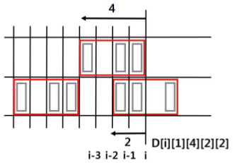
Double-Row Detailed Placement
Goal: perturb the placement to maximize power staple benefits to upper and lower rows without inter-row relocation while preserving the original cell ordering
Inputs: A legalized double-row placement and benefit table of power staples.
Output: An optimized placement for power staples.
Constraints: No overlap between power staples and pins, no overlap between cells and displacement range
DP array (different variables/dimensions from single-row DP)
D[i][s1][l1][s2][l2]
The cost of placing two rows up to placement site 𝒊
s1 (s2) indicates last placed cell $c_{s1} (c_{s2})$ in row 1 (2)
l1 (l2) indicates distance btw. left boundary of $c_{s1} (c_{s2})$ and site 𝑖
$$c_{s1}$$
$$c_{s2}$$
Notes:
This slide describes double-row detailed placement optimization.
[click] The problem statement is pretty much the same as single-row detailed placement except that we optimize two rows in a time. The benefit of double-row optimization is that we can align cells in both rows to maximize the potential power stapling site.
[click] For double-row detailed placement, the dp array is indexed by i, s1, l1, s2, l2.
Double-row dynamic programming algorithm makes progress site by site instead of cell by cell so that we could track the benefit of aligned power staples across two rows.
[ NOTE: l1 = 4, l2 = 2. There are s1 = 1 placed cells in the first row, and s2 = 2 placed cells in the second row. ]
[click] Similar to single-row optimization, a DP array item indicates the current objective value when we have up to site i. Here the last placed cell may have been placed on the left of site i, or crossing site i. s1 indicates the last placed cell Cs1 in row 1, [click] and l1 indicates the distance between the left boundary of Cs1 and site i. The objective update from d[i] to d[i+1] is done similarly to the single-row DP. The difference is here, we update with five dimensions, rather than two dimensions.

Slide 10
Double-Row Detailed Placement
Sequential, 2-row window optimization
Balance VDD/VSS staples
10VSS+1VDD
8VSS+6VDD
VDD
VDD
VSS
VSS
VDD
VDD
M2 rail
V1
M1
VSS
M1 pin/blockage
VSS
Cell boundary
Placement grid
VDD
VDD
VSS
VSS
Notes:
This slide shows the overall flow for double-row detailed placement. We sequentially optimize for every two-row window, without overlapping, like the example shown here [click]. Since the distance for different power rails is also two row heights, the optimization may prefer to generate one power staple more than the other. [click] In this example, the DP generates 10 VSSs but only one VDD.
We choose to balance the power staples for both VSS and VDD by reweighting the benefit table. [click] Here, we give a positive benefit even if we only have an empty track of one row height. In this way, we encourage the optimization of the next window to have more power staples across two windows so that the staples are balanced. In the figure on the right, we still use the same two-row window. [click] But this time, we have 8 VSS and 6 VDD staples.

Slide 11
Overall Flow
Input: post-route design
Detailed placement for power stapling insertion
Dynamic programming-based optimization
C++ code
Incr. routing and Vt swapping
To recover timing degradation by routing changes
Cadence Innovus
Power staple insertion
Cadence Innovus
Tcl code
IR drop Analysis
Vectorless dynamic analysis
Cadence Voltus
Post-P&R database
Detailed Placement for
Power staple insertion
Incremental routing
Timing Recovery
Vt swapping
with fixed cell location
Power staple insertion
IR drop analysis
Our flow
Notes:
This slide shows that the overall flow in this work.
[click] Input of our flow is post-P&R database.
[click] Given post-P&R database, dynamic programming-based optimization is performed.
[click] Also, we do incremental routing which followed by Vt swapping to recover timing degradation.
[click] We then insert power staples and [click] do IR drop analysis.

Slide 12
Outline
Motivation
Our Approach
Single-Row Optimization
Double-Row Optimization
Experiments
Conclusion
Notes:
Now, I will show experimental results.

Slide 13
Experimental Environment
Synthesis: Synopsys Design Compiler L-2016.03-SP4
P&R: Cadence Innovus Implementation System v16.2
IR drop analysis: Cadence Voltus IC power integrity solution
Vectorless dynamic IR drop
‘analyze_rail’ command used
We implement our heuristics in C++ with OpenAccess 2.2.43 to support LEF/DEF
7nm FinFET technology with 7.5T triple-Vt libraries from a leading technology consortium
Testcase: CORTEX M0, AES, MPEG, JPEG
Initial utilization : 0.60, 0.65, 0.70, 0.75
All experiments are performed with a single thread on a 2.6GHz Intel Xeon server
Design | #Insts | Clock period
CORTEX M0 | ~10K | 500ps
AES | ~12K | 500ps
MPEG | ~14K | 500ps
JPEG | ~54K | 500ps
Notes:
[click] In this experiment, we use DC, Innovus and Voltus for logic synthesis, P&R, IR drop analysis. [click] we implement our code in C++ with OpenAccess to support LEF and DEF.
[click] we also use 7nm FinFET technology with 7.5T triple Vt libraries. [click] we use three testcases from OpenCore and ARM CORTEX M0. The block size and target clock period are summarized in the table.
[click] All experiments are performed with a single thread on a 2.6GHz Intel Xeon server

Slide 14
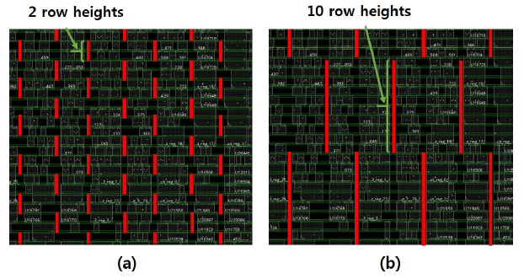
Study of Staple Length
The tradeoff between short and long staples
AES with pre-placed power staples at fixed intervals (20CPP) and perform IR drop analysis
2 to 10 row heights, with a step size of 2 row heights
Staple Length | Worst IR Drop (mV)
2 | 67.9
4 | 67.8
6 | 67.7
8 | 67.7
10 | 67.6
Small effects of staple length -> No benefit in our experiment
Notes:
This slide shows the study of benefit table. [click] We would like to see whether we would prefer fewer, but longer power staples, or more, but shorter power staples.
[click] We have tested power staple insertion with different length while the total length of power staples is the same. [click] We insert staples from power staples with 2 to 10 row heights.
[click] The snapshot shows how we test. [click] The table shows that the worst IR drop of testcase almost same.
[click] So we don’t consider the length of power staples in this work. Each power staple simply means a benefit of one in our experiments.

Slide 15
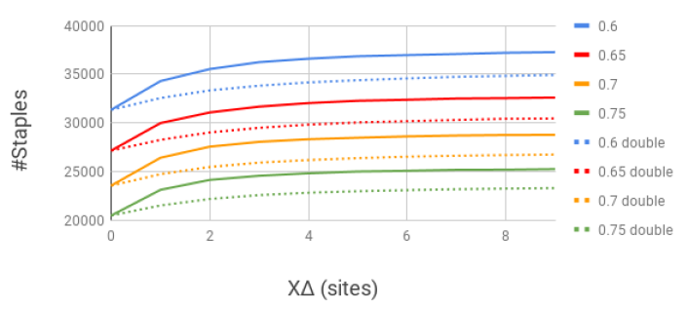
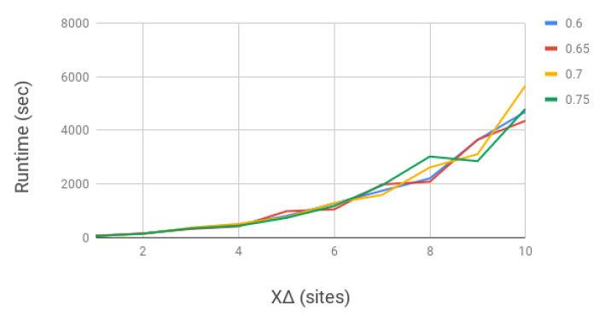
Study of Scalability/Sensitivity
Sensitivity to disp. range (𝑥Δ)
Utilizations: 0.60, 0.65, 0.70, 0.75
𝑥Δ > 5, there are diminishing returns in terms of #staples
𝑥Δ = 9 consumes 4X runtime compared to the run with 𝑥Δ = 5, but only minor increase in #staples
To balance the solution quality and runtime, we choose 𝑥𝛥 = 5 in all the experiments
Notes:
This slide shows the sensitivity and scalability to displacement ranges.
[click] We sweep displacement range from 0 to 10 placement sites using design with four different utilizations. [click] The left figure shows #staples vs. displacement range. More staples means better solution quality.
Across all utilizations, we see diminishing returns when x_delta is greater than 5.
The right figure shows runtime vs. displacement range. We see when x_delta is 9, it spends 4x runtime than when x_delta is 5, but we only achieve minor #staples increase.
[click] Thus, we choose x_delta=5 in all the experiments to balance runtime and solution quality.

Slide 16
Study of Weighting Factor
Sensitivity to displacement coefficients $α$
Total 𝑥Δ decreases sharply while #staples does not change much
We use $α$ = 0.01 in this experiment
Notes:
This slide shows the sensitivity to displacement coefficients.
The x-axis is the ALPHA parameter in both figures. In the left figure, the y-axis is #STAPLES.
In the right figure, the y-axis is total cell displacement in #sites.
[click] Across all utilizations, as long as we have the coefficients slightly greater than zero, we could minimize the total displacement (in the red circle) while maintaining good solution quality in terms of #staples.
A smaller total cell displacement is beneficial to minimize perturbation.
[click] Thus, we choose displacement coefficient alpha=0.01 in all the experiments.

Slide 17
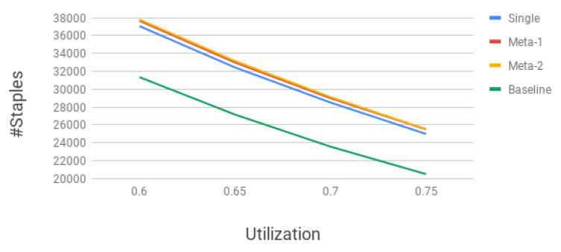
Study of Metaheuristics
We compare three strategies:
(i) single-row optimization (SR)
(ii) double-row optimization with overlap (Meta-1)
(iii) two-pass double-row optimization without overlap (Meta-2)
SR, Meta-1 and Meta-2 achieve 20.1%, 22.3% and 22.7% more inserted staples, respectively
*Baseline: no detailed placement optimization
Notes:
[click[ This slide shows the comparison among three strategies
The first strategy is just single-row optimization (SR);
The second is double-row optimization with overlap (Meta-1); For example, we optimize row 1 and row 2, then row 2 and row 3, then row 3 and row 4, sequentially.
The third is two-pass double-row optimization without overlap (Meta-2). For example, we optimize row 1 and row 2, then row 3 and row 4 in the first pass; and in the second pass, we shift the window by one row and optimize row2 and row 3, then row 4 and row 5.
[click] We compare to a baseline implementation, where no power stapling optimization is applied. SR, Meta-1 and Meta-2 respectively achieve 20.1%, 22.3% and 22.7% more inserted staples than the baseline solution.

Slide 18
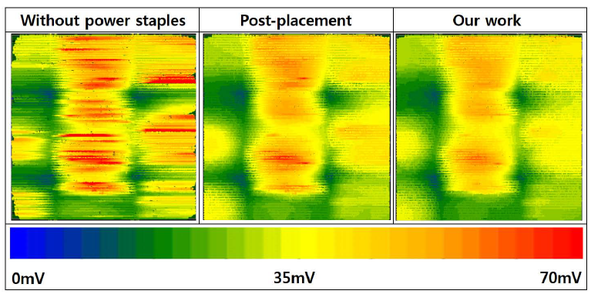
Experimental Results
Double-Row (Meta-2): up to 13.2% IR drop reduction
Design | Util | #Staples |  | IR drop (mV, Avg) |  | IR drop (mV, Worst) |  | WNS | Runtime
 |  | Init | Final (Δ%) | Init | Final (Δ%) | Init | Final (Δ%) | (ns) | (sec)
M0 | 60% | 29109 | 33423 (14.8%) | 29 | 28 (-3.4%) | 76 | 66 (-13.2%) | -0.009 | 2666
 | 65% | 25295 | 29254 (15.7%) | 28 | 28 (0.0%) | 58 | 60 (3.4%) | -0.016 | 2249.5
AES | 60% | 31355 | 37813 (20.6%) | 23 | 23 (0.0%) | 51 | 47 (-5.6%) | -0.001 | 2542.5
 | 65% | 27165 | 33164 (22.1%) | 22 | 22 (0.0%) | 54 | 51 (-5.6%) | -0.001 | 2127
MPEG | 60% | 75781 | 80951 (6.8%) | 24 | 24 (0.0%) | 64 | 60 (-6.3%) | 0.000 | 3700
 | 65% | 67836 | 72685 (7.1%) | 24 | 24 (0.0%) | 57 | 60 (5.3%) | 0.000 | 4088.5
JPEG | 60% | 217467 | 244333 (12.4%) | 28 | 27 (-3.6%) | 88 | 84 (-4.5%) | -0.001 | 16679
 | 65% | 193089 | 218483 (13.2%) | 26 | 27 (3.8%) | 79 | 76 (-3.8%) | 0.000 | 13869.5
*Baseline: no detailed placement optimization
Notes:
[click] The table here shows our experimental result with various design blocks using the benefit table and coefficient described from the previous slides. We use four design blocks, M0, AES, MPEG, JPEG.
[click] The number of staples increases by 6.8% to 22.1% after optimization. We also achieve up to 13.2% of IR drop.
[click] We have the runtime from 2666 second to 13869 second and we think we need to improve the runtime.
[click] The heatmap of AES shows that IR drop improvement by our optimization. Red means worst IR drop. We can see that our optimization effectively reduces total area of the worst IR region.
[We also note that runtimes are long, reflecting unoptimized implementation that pays heavily for getNext() function calls. Tuning of our code is an ongoing effort.]
[IR drop can increase after our optimization (e.g., the case of M0 with 0.65 utilization) This is because the design’s current map changes with placement perturbation and timing recovery steps, even though we add more power staples.]

Slide 19
Outline
Motivation
Our Approach
Single-Row Optimization
Double-Row Optimization
Experiments
Conclusion
Notes:
Now I will conclude my work.

Slide 20
Conclusion and Future Goals
We propose novel DP-based single- and double-row detailed placement optimizations for power staples
We perform extensive studies on the scalability of our algorithm, the sensitivity to weights, other runtime parameters, impact of the benefit table, as well as balance of VDD/VSS staples
We achieve up to 13.2% (10mV) reduction in IR drop with almost no WNS degradation
Ongoing / future works
Better exploration of the benefit table and metaheuristics
Understanding in greater detail the relationship between power staples and dynamic IR drop
Machine learning-based model to predict IR drop from power staple insertion
Runtime speedup techniques
Exploration of power mesh structures for testcases with different width, pitch and offset.
Study of DVD-aware detailed placement
Notes:
[click] In this work, we propose novel DP-based single- and double-row detailed placement optimizations for power staples.
[click] We study on scalability of our algorithms, the sensitivity to weights, other runtime parameters, impact of the benefit table, as well as balance of VDD/VSS staples.
[click] We achieve up to 13.2% (10mV) reduction in IR drop with almost no WNS degradation
[click] Our future work include better exploration of the benefit table and metaheuristics, understanding in greater detail the relationship between power staples and IR drop. Some machine learning models can be used to predict IR drop.
Also, it includes runtime speedup techniques, and exploration of power mesh structures for testcases with different width, pitch and offset, and study of DVD-aware detailed placement.

Slide 21
Thank You !
Notes:
Thank you for listening.

Slide 22
FAQ
Q1. In your experimental results, why do you have negative impacts (IR drop increase) by power staple insertion?
Answer: Since we have a timing recovery stage to recover timing degradation by routing changes, the result might have negative impacts on IR drop.
Q2: What are negative effects by power staple insertion?
Answer: Post-placement has no negative timing effect while pre-placement has huge timing degradation. However, adding power stapling after P&R might have EM issues.

