Slide 1
Finding Placement-Relevant Clusters With Fast Modularity-Based Clustering
Mateus Fogaça⁺, Andrew B. Kahng†, Ricardo Reis⁺* and Lutong Wang†
†UC San Diego VLSI CAD Laboratory ⁺PGMicro/*PPGC, INF, UFRGS
Notes:
Thanks for the introduction and good morning, everyone.
I’ll present my work entitled “Finding Placement-Relevant Clusters With Fast Modularity-Based Clustering”.
This work is the result of a cooperation between UCSD and UFRGS.

Slide 2
Outline
Introduction
Modularity clustering
Evaluation criterion
Experiments
“Blob placement”
Conclusion
Notes:
My presentation is divided into 5 items – First, I will show the motivations and contributions of our work.
Then I will present modularity clustering and our evaluation criterion.
Next, I will discuss our experimental setup and results.
Finally, I will introduce our prototype technique called “blob placement” and conclude my talk.

Slide 3
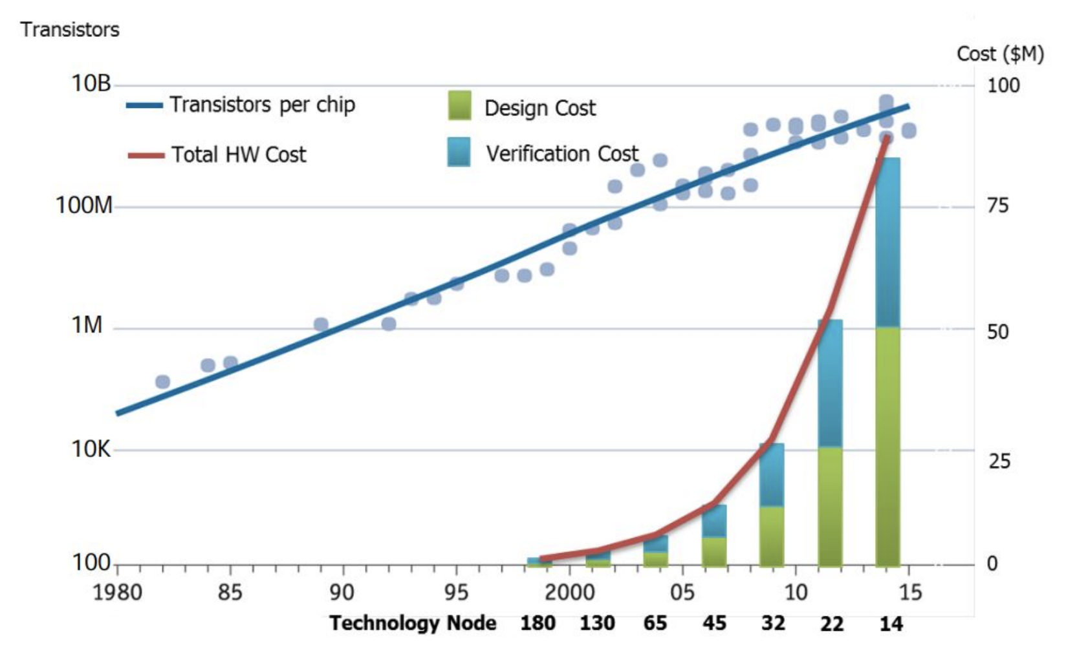
Motivation
Ever increase of cost of IC design cost
Engineers, licenses, servers, schedule, …
Importance of prediction tools to reduce flow iterations
DARPA’s IDEA program: “24-hour no-human-in-the-loop RTL-GDSII flow”
(Olofsson, 2018)
Notes:
The cost of IC design keeps increasing as companies have to afford a large number of teams of engineers, hundreds of EDA tool licenses, servers and tight design schedule.
This is depicted by this graphic on the right.
We can see number of transistors on a chip steadily increasing following the blue line.
On the other hand, the red curve shows the hardware cost growing exponentially, dictated by design and verification costs.
This raised the need for predictions tools, capable of reducing the number of iterations in the design flow and total design time.
As an example, DARPA recently launched a program which intents to enable a 24-hour no-human-in-the-loop RTL-DGS flow.
This flow will eventually use machine learning techniques, capable of predicting the outcomes of design stages and guide algorithms - to avoid failures, for example.
Now, let me show the scope of this work.

Slide 4
Problem statement
Given: (i) mapped netlist, (ii) information about the standard cell library
Find: clusters containing instances that are expected to remain close to each other along the stages of the implementation flow
Cluster: group of densely connected instances
Our work:
Employ modularity-based clustering to find logic gates that will remain together through the stages of the implementation flow
We propose new criterion to assess correlation between cluster and the instances placement
Perform experiments showing 20% better clustering quality compared to the traditional VLSI clustering tool hMetis
Demonstrate an prototype flow in which we can fast “blob placement” of clusters to assess early netlist and floorplan evaluation
Notes:
Our problem statement is --
Given a mapped netlist and information about the standard cell library, our goal is to find clusters containing instances expected to remain close to each other along the stages of the implementation flow.
And in this work we refer to clusters as group of densely connected instances.
[DOUBLE CLICK]
Our contribution are:
[CLICK]
Employ modularity-based clustering to find logic gates that will remain together through the stages of the implementation flow.
[CLICK]
We propose new criterion to assess correlation between cluster and the instances placement.
[CLICK]
Perform experiments showing 20% better clustering quality compared to the traditional VLSI clustering tool hMetis.
[CLICK]
Demonstrate an prototype flow in which we can perform fast “blob placement” of clusters to assess early netlist and floorplan evaluation.

Slide 5
Outline
Introduction
Modularity clustering
Evaluation criterion
Experiments
“Blob placement”
Conclusion
Notes:
So now let me present to you our clustering technique and evaluation criterion.

Slide 6
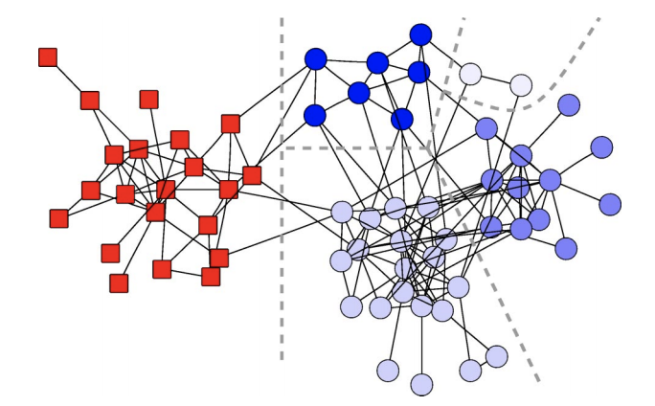
Modularity clustering
Modularity metric proposed by Newman and Girvan¹
Scalar number Q ranging from -1 to 1
Higher values means better clustering
Community detection
First time applied to VLSI
Fast and automatic behavior
Louvain algorithm²
700M edges in ~10min
¹Newman and Girvan, 2004
² https://sites.google.com/site/findcommunities
Q=0.54
Notes:
In this work we employ modularity-driven clustering techniques.
Modularity is a metric originally proposed by Newman and Girvan.
It is a scalar metric, commonly referred as Q, ranging from -1 to 1. Higher values mean a better clustering solution.
Modularity is well-stablished in community detection problems – such as those found in social media and bioinformatics.
We are applying modularity-driven clustering for the first time in the VLSI field.
Modularity-driven clustering have two desirable qualities: They are fast and automatic.
By automatic, we mean no need for user tuning – such as number of clusters and cluster sizes.
In this work, we apply Louvain algorithm, which is capable of finding clusters to networks with up to 700M edges in about 10 minutes
On the right we depict a clustered netlist. Each color represents a clusters. The total score of the clustering solution is 0.54.

Slide 7
Hypergraph to graph mapping
Louvain algorithm designed to work with graphs
Circuit hypergraph mapped into a graph → Clique model
Two weighting factors:
Net weights
Distance to I/Os
$$w_{h}=1/(w_{h,1}∗(w_{h,2}+1))$$
$$w_{h,1}=1/(p_{h}−1)$$
$$w_{h,2}=argmin(d\left(I\right), d\left(O\right))$$
Notes:
Our modularity-driven algorithm, Louvain, is designed to work with graphs. However netlists are hypergraphs.
In this work we map the netlist hypergraph to graphs using the clique model.
One important aspect of the hypergraph-to-graph mapping is how to weight the graph edges.
In our weight formula we have two factors: wh,1 and wh,2
wh,1 is related to the fanout of the nets. The traditional formula for cliques is 1/(ph-1), where is the number of pins in the net.
… But we will explore alternative net weighting schemes will be explore in our experiments.
The factor wh,2 is equal to the minimal topological depth of the net driver to the closes IO.
In the right we draw an circuit with 7 cells and 6 nets and the equivalent graph and weights using our approach.

Slide 8
Outline
Introduction
Modularity clustering
Evaluation criterion
Experiments
“Blob placement”
Conclusion
Notes:
Now, I’ll explain the criterion we propose for clustering evaluation.

Slide 9
Delaunay Triangulation (DT)
Correlation with placement
DT is the geometric dual of the Voronoi diagram of a pointset
May be used for visual debug
Edge lengths distribution can numerically hint the quality of the clustering
Black lines = DT
Red lines = Voronoi diagram
https://en.wikipedia.org/wiki/Delaunay_triangulation
Notes:
Unlike previous VLSI clustering works, we want to assess the correlation between our clusters and the actual placement.
I’ll present two criterion we propose to measure these correlation.
The first one is the Delaunay triangulation which can be defined as the dual of the Voronoi diagram of a pointset.
On the bottom, we depict a set of points in back.
The black edges represent the Delaunay triangulation.
The red points and edges represent the Voronoi diagram of the pointset.
The picture in the right shows the Delaunay triangulation of a clustering solution.
Each cluster is depicted with a different color.
In our case, the points are the centers of each instance.
With the Delaunay triangulation it is very easy to visualize clusters and detect outliers.

Slide 10
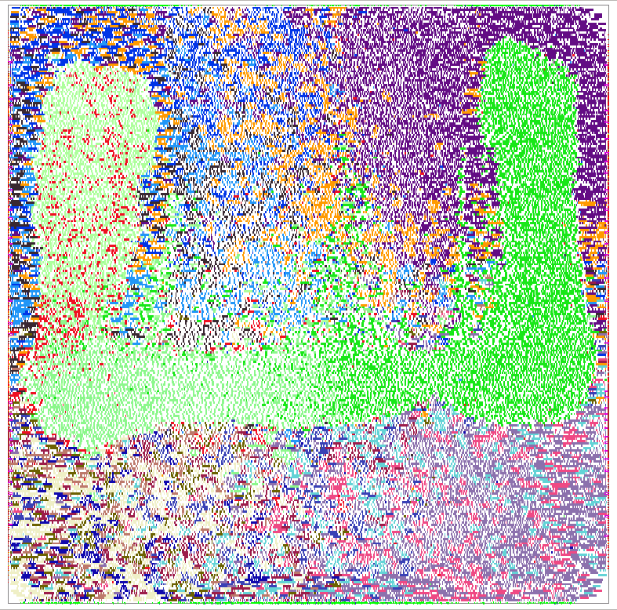
Davies-Bouldin index (DBi)
Originally proposed for evaluation of spatial clustering
Measure how well points are clustered in a cartesian space
Smaller values = better clustering
Avg. dist. of points to their cluster centroid
$$DB_{i}=\frac{1}{n} \sum_{i=1}^{n}{argmax_{i≠j}\left(\frac{σ_{i}+ σ_{j}}{l(p_{i}, p_{j})}\right)}$$
Distance between centroids of clusters
DBi = 12.60
DBi = 2.29
Notes:
The second evaluation criteria is the Davies-Bouldin index, we call DBi.
Originally, this metric was proposed to evaluate spatial clustering algorithms.
In practice, DBi is a function directly proportional to the distance from points to the center of their clusters and inversely proportional to the distance between clusters.
The smaller is the value of DBi, the better is the clustering solution.
[CLICK]
We show two clustering solutions for a same circuit.
In the picture, cells are colored according to their cluster.
Just by visualizing each picture, we can see that clusters on the second solution are more well-formed.
And that reflects in a DBi six times smaller.

Slide 11
Outline
Introduction
Modularity clustering
Evaluation criterion
Experiments
“Blob placement”
Conclusion
Notes:
Now I will present experimental setup and results.

Slide 12
Experimental setup
Implemented in Rsyn framework¹
Intel Xeon E5-2695 at 2.1 GHz with 256GB
Benchmarks synthesized with a traditional commercial flow
4 open design blocks²
14nm enablement
Benchmark | # Insts | # Nets | # I/0
jpeg_encoder | 42293 | 46402 | 49
ldpc | 43965 | 46741 | 4100
netcard | 251306 | 253145 | 333
leon3mp | 371549 | 370706 | 1849
¹ http://rsyn.design
² http://www.opencores.org
Notes:
Our experiments and evaluation criterion were implemented in Rsyn framework. Rsyn was also used for visualization.
Our experiments were performed using an Intel Xeon server.
We tested our metholodoly using 4 open design blocks, synthesized with a traditional commercial flow using a 14nm enablement.
This table presents the names and statistics of the testcases.
Testcases sizes range from 40k instances to 370k instances; 40K nets to 370K nets and 40 I/Os to 4K I/Os.
Next, we will discuss the three experiments conducted in this work.

Slide 13
Experiment 1
Compare edge-weighting models hypergraph-to-graph mapping
$$w_{h}=1/(w_{h,1}∗(w_{h,2}+1))$$
I/O proximity
Name | Net weight ($w_{h,2}$)
Lengauer90 | $$1/(p_{h}−1)$$
Huanhg95 | $$4/(p_{h}\left(p_{h}−1\right))$$
Tsay-Kuh91 | $$2/p_{h}$$
Frankle-Karp86 | $$2/p_{h}^{1.5}$$
$p_{h}$ = # of pin in the net
Notes:
Remember, the circuit netlist is a hypergraph and we map the hypergraph into a clique before applying Louvain.
Here, we present an example of a net with three terminals mapped into a 3-edge clique.
In our first experiment, we compare edge-weighting alternatives.
Our weighting scheme has two factors: First is I/O proximity weight, highlighted in purple, and second is the net weight, highlighted in red.
In this experiment, we explore 4 alternatives to net weights found in the literature and listed here.
Please refer to our paper for the rationale of each net weight.
We also test each net weight with the I/O proximity factor enabled and disabled.

Slide 14
Experiment 1
Evaluation metric: DBi
I/O proximity weights decreases DBi by 28% on average
Lengauer is the most promising alternative
Design | Lengauer90 |  | Huang95 |  | Tsay-Kuh91 |  | Frankle-Karp86
 | A | I/O | A | I/O | A | I/O | A | I/O
jpeg_encoder | 2.1 | 1.9 | 6.7 | 6.4 | 2.9 | 2.2 | 2.2 | 1.3
ldpc | 3.0 | 2.3 | 44.5 | 47.2 | 2.7 | 2.3 | 17.3 | 3.0
netcard | 4.6 | 2.0 | 11.1 | 2.3 | 1.9 | 2.7 | 8.3 | 3.7
leon3mp | 1.2 | 1.0 | 68.0 | 63.8 | 1.1 | 1.0 | 1.4 | 1.2
Avg | 2.7 | 1.8 | 32.6 | 29.9 | 2.1 | 2.1 | 7.3 | 2.3
Notes:
In this table, we present the results for each of the net weights.
The quality of our results in measured using the DBi metric.
Remember, smaller values of DBi represent better results.
Column A presents the results with I/O proximity weights disabled and column I/O presents the results with IO proximity weights enabled.
In our experiments, the use of I/O proximity weights improves the results by 28% on average.
[CLICK]
They also show Lengauer as the most promising net weighing alternative.
Therefore, the next experiments were conducted with Lengauer and I/O proximity weights.

Slide 15
Experiment 2
Compare Louvain with the traditional min-cut partitioning tool hMetis
hMetis is a multilevel partitioning tool
Number of clusters
Partitioning schemes: 2-way and k-way
Unbalancing factor (“ubal”): 10%, 20% and 40%
Clustering
Louvain
Compare w/
“ground-truth”
placement
Mapped
netlist
hMetis 2-way
(10%, 20%, 40%)
Clustering
solutions
hMetis k-way
(10%, 20%, 40%)
Notes:
In our second experiment, we compare Louvain with the traditional min-cut partitioning tool hMetis.
hMetis is a multilevel partitioning tool. Unlike Louvain, it requires user-tuning in the input parameters.
In this work, we explore three input parameters of hMetis: The target number of clusters; The partitioning scheme – That can be 2-way and k-way partioning; And the unbalancing factor among partitions. In this work we tested unbalancing factors of 10%, 20% and 40%.
The figure shows our experiment flow. We start with a mapped netlist. Then, we apply Louvain and hMetis using 2-way and k-way partitioning schemes. Each hMetis run is tested for three unbalancing factors, 10%, 20% and 40%.
Finally, we compared the clustering solutions with the ground-truth placement.

Slide 16
Experiment 2
hMetis presents a large gap of DBi based on user tuning
Louvain presents 20% better results on average
Design | Louvain |  | hMetis (2-way) |  |  |  | hMetis (k-way)
 | #clus | DBi | #clus | 10% | 20% | 40% | #clus | 10% | 20% | 40%
jpeg_ encoder | 52 | 1.94 | 64 | 2.39 | 1.71 | 2.81 | 52 | 2.18 | 1.51 | 2.17
ldpc | 18 | 2.29 | 16 | 9.27 | 4.36 | 12.94 | 18 | 7.84 | 12.6 | 35.86
netcard | 21 | 1.95 | 16 | 1.39 | 1.32 | 2.46 | 21 | 1.29 | 1.72 | 2.38
leon3mp | 30 | 1.04 | 32 | 2.61 | 1.47 | 3.51 | 30 | 2.33 | 1.55 | 3.80
Avg |  | 1.81 |  | 3.91 | 2.22 | 5.43 |  | 3.41 | 4.34 | 11.05
Notes:
Here we present the comparison with the “ground-truth” placement using DBi as quality metric.
For Louvain, we present the number of clusters obtained in each benchmark and their values of DBi.
For hMetis using 2-way partitioning, we present the results targeting number of clusters as the closest power-of-two from the number of clusters obtained in Louvain.
For hMetis using k-way partitioning, we target the same number of cluster as Louvain.
Louvain outperformes hMetis in ldpc and leonmp.
hMetis outperformes Louvain in jpeg_encoder and netcard.
[CLICK]
We also see that hMetis can present a large gap in DBi depending of the user parameter. The difference is about 2.5 times in the highlighted example.
[CLICK]
On average, Louvain presents results 20% better in terms of DBi, outperforming hMetis in our experiments.

Slide 17
Experiment 2
~12X faster
~6X faster
~4X faster
~4X faster
Notes:
We also compare the normalized runtime of Louvain and hMetis runs.
Louvain greatly outperforms hMetis in all benchmarks.
For ldpc, Louvain is 12X faster than hMetis.
And for the largest benchmarks, netcard and leon3mp, Louvain is 4X faster.
The fast nature of Louvain summed up with its “automatic behavior” makes Louvain an appealing alternative to traditional VLSI tools.

Slide 18
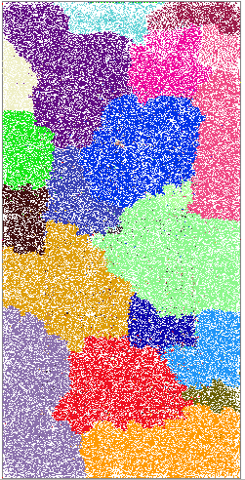
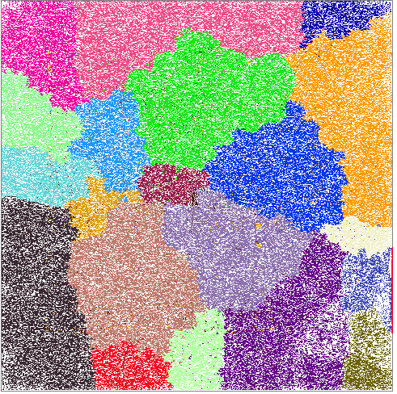
Experiment 3
Test the robustness of Louvain and hMetis
Compare results w/ floorplan 1:1 and 1:2
netcard
Notes:
In our third and last experiment, we compare the robustness of Louvain and hMetis w.r.t changes in the floorplan.
We compare the clustering results of Louvain and hMetis for the same design placed with floorplans 1:1 and 1:2. The total area and target desity are the same in both floorplans.
Here we show the visual results for netcard. The clusters sizes and appearances look the same for both aspect ratios.

Slide 19
Experiment 3
Increase in DBi when aspect ratio changes from 1:1 to 1:2
44% increase Louvain / 27% increase hMetis
Notes:
In this graphic we present the increase of DBi when changing from aspect ratio 1:1 to 1:2. Louvain is depicted in blue and hMetis is depicted in red.
The DBi metric is proportional to the total distance among clusters. This is why an increase of DBi is expected in 1:2 floorplans.
In this experiment, the increase of DBi values was of 44% for Louvain and 27% for hMetis.
From this, we may conclude that hMetis is more stable than Louvain.

Slide 20
Outline
Introduction
Modularity clustering
Evaluation criterion
Experiments
“Blob placement”
Conclusion
Notes:
Now I will present our prototype technique called “Blob placement” and its application.

Slide 21
“Blob placement”
Modularity-driven placement correlates well with placement
“Blob placement” = Placement of clusters
Fast evaluation of netlist and floorplan → Timing, congestion, density
Prototype flow:
clustering
Hierarchical
clustering
Mapped
netlist
Louvain
“Root blobs”
“Blob
placement” ¹
“leaf blobs”
Louvain
¹ https://github.com/abk-openroad/RePlAce
Notes:
So far, we saw how modularity-driven cluster has correlated well with placement and present far less runtime than traditional VLSI clustering tools.
We now present our prototype technique called “blob placement”.
In this technique, we perform the placement of clusters instead of the instances.
Our goal is to fast predict the actual placement and enable early floorplan and netlist evaluation.
In the bottom, I show how the flow works.
We start with a mapped netlist.
We perform clustering in this netlist. In this case we use Louvain algorithm to perform the clustering.
The clustering produces a set of clusters we call “root blobs”.
The, we break the “blobs” into smaller pieces applying clustering inside each blob individually.
Finally, we have a set of “leaf blobs” and we perform the placement of these blobs”
Blob placement was performed the academic placement tool RePlAce, that may be found public on GitHub
Let’s take a look into two examples…

Slide 22
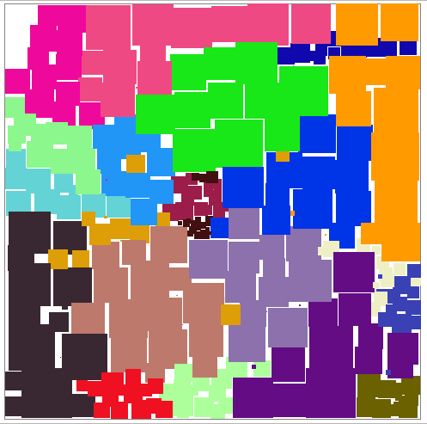
“Blob placement”
netcard
250K instances
21 clusters → “root blobs”
“Blob placement”
187 “leaf blobs”
Runtime = 143s
Notes:
The first example is netcard with a netlist composed of 250K instances.
The original placement can be seen in the left, with instances colored according to Louvain clusters.
Louvain finds 21 clusters for this circuit netlist.
If we apply our “blob placement” flow, the result is the picture on the right.
The total number of “leaf blobs” is 187 and can be placed in just 143 seconds.
We can see that our “blob placement” flow has an outcome very similar to the original placement

Slide 23
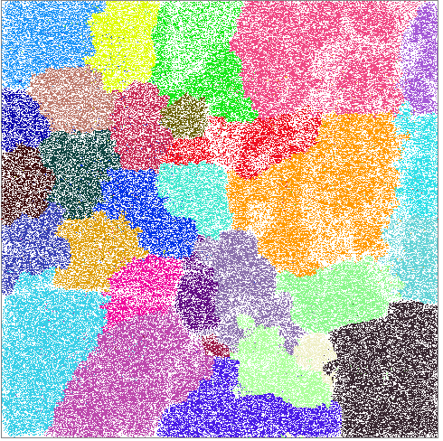
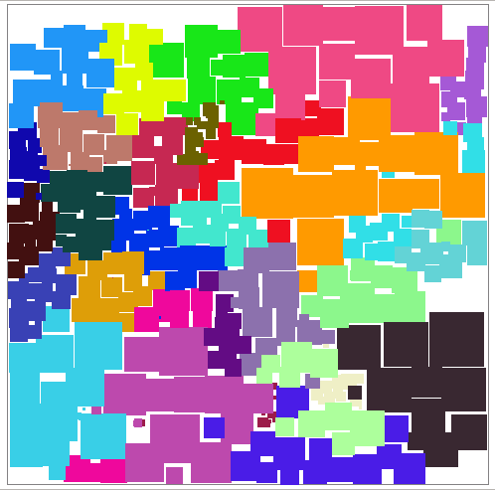
“Blob placement”
leon3mp
370K instances
30 clusters → “root blobs”
“Blob placement”
405 “leaf blobs”
Runtime = 200s
Notes:
Similarly, we present leon3mp, with 370K instances.
The original circuit is broken into 405 “leaf blobs” and again the “’blob placement” flow corelates very well with the original placement.
In summary, we believe our flow may be used to quickly predict the placement of designs with dozens of millions of instances.
This information may help designers to assess the quality of their floorplan and netlist.

Slide 24
Outline
Introduction
Modularity clustering
Evaluation criterion
Experiments
“Blob placement”
Conclusion
Notes:
I will now conclude my presentation.

Slide 25
Conclusions and Future Goals
Use of clustering for early feedback at floorplaning and RTL planning
Modularity-driven clustering 20% superior to traditional VLSI clustering methods
Louvain “Natural clusters”
No parameter tuning, no balancing constraints
4X faster than hMetis
Importance of hypergraph-to-graph mapping
Prototype “blob placement” flow
Ongoing / future works
Improved hypergraph-to-graph mapping using machine learning
Macro-block-ware clustering
Use of blob placement to help physically-aware synthesis
Notes:
In this work, we study netlist clustering in the context of enabling early feedback at floorplaning and RTL planning.
Our new criterion for clustering assesses whether netlist clusters “stay together” through the stages of the physical implementation flow.
We have performed experiments showing that Louvain performs 20% better than traditional VLSI clustering methods.
The key advantage of Louvain is the absence of user tuning - for instance, balancing constraints and number of clusters
Besides, Louvain performed 4X faster than hMetis in our experiments.
We also show the importance of the hypergraph-to-graph weighting alternatives
Finally, we showed that our clusters can be successfully used in our prototype “blob placement” technique.
[CLICK]
As future work we intent to improve hypergraph-to-graph mapping using machine learning.
We also want to make clustering sensitive to details of floorplan, such as the presence of macro blocks.
Finally, one challenge that remains is how to predict timing and congestion using the proposed blob placement to help physically-aware synthesis tools.

Slide 26
Thank you!
Notes:
This the end of my talk. Thanks for your attention!

